Slide 1
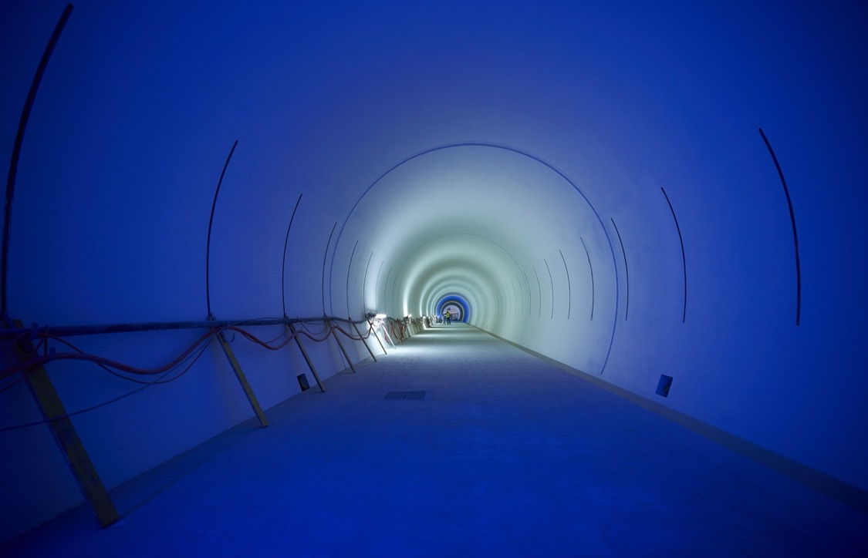
HL-LHC Upgrade Project
Joint KEK - CERN Committee, Dec 2023
O.Brüning, on Behalf of the HL-LHC Project

Slide 2
Outline
HL-LHC schedule
Status of key technologies towards the HL upgrade
  Civil engineering
  Final focusing magnets for lower beta*
  Superconducting Link
  Crab Cavity System
  D1
Inner Triplet String
Ongoing (and potential future) collaborations KEK – CERN
Conclusions

Slide 3
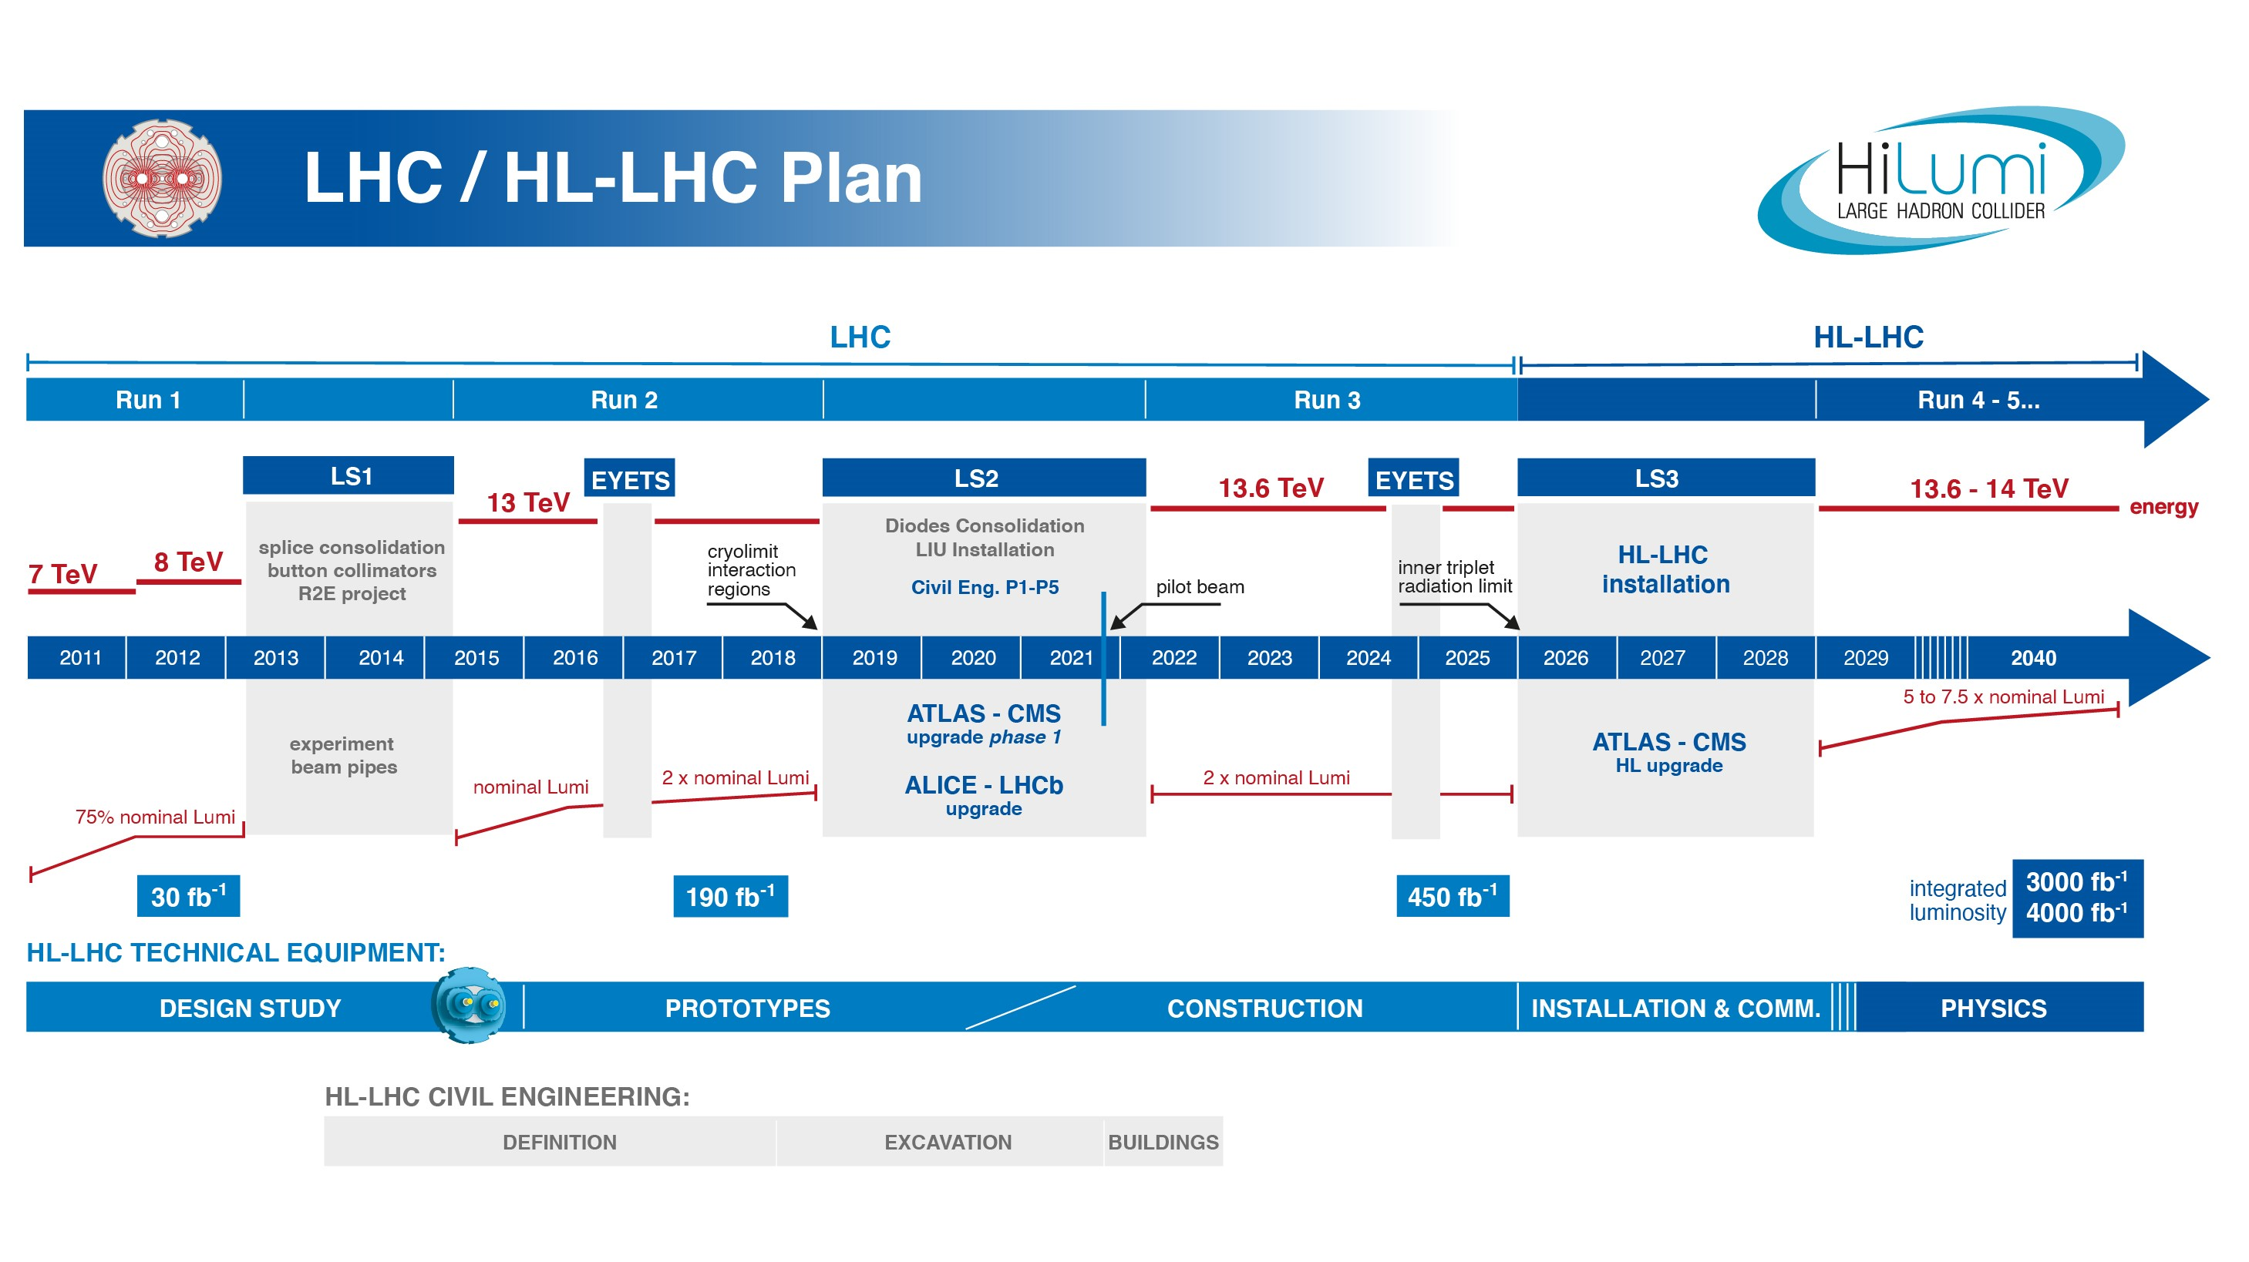
EU funded HiLumi
Design Study
Approval of
HL-LHC Project
We are here
HL-LHC Operation
Run3 operation
2 years until start of Long Shutdown 3
The project is ready for installation start in 2026! ➔ endorsed by 2023 C&SR

Slide 4
Goal of HL-LHC upgrade project
The main objective of the HL-LHC is to determine and build a hardware configuration and a set of beam parameters that will allow the LHC to reach the following targets:
Prepare machine for operation beyond 2025 and up to 2040
Devise beam parameters and operational scenarios for:
# enabling at total integrated luminosity of 3000 fb⁻¹
# implying an integrated luminosity of 250 fb⁻¹ per year,
# design oper. for μ ≤ 140 (➔ peak luminosity 5 x 10³⁴ cm⁻² s⁻¹)
-> A challenge as well for the experiments!
Operation with levelled luminosity!

Slide 5
New interaction region layout
New insertion and final focusing magnets
  Main quadrupole magnets MQXFA (Q1, Q3) from AUP and MQXFB (Q2) from CERN
  Superconducting separation and recombination dipoles, D1 from Japan and D2 from Italy
  Higher Order Corrector package (CP) and orbit correctors (MCBX) from Italy and Spain
ATLAS
CMS
LHC
ATLAS
CMS
HL-LHC

Slide 6






International Collaboration
Connection to LHC (UL)
Overall reduction of in-kind contributions from ca. 129 MCHF to 93.6MCHF with cancellation of Russian agreements
HEL & Dilution Kicker descoped from HL-LHC project
Currently pursuing additional contributions with Japan for QHPS and Crab-Cavity powering system - both are well advanced!
Service gallery (UR)
DFHM
DFHX
QHPS
SC Links
Q2a
Q1
TAXS
Q2b
Q3
CP
DFX
D1
DFM

Slide 7
The MS region with in-kind contributions
UA gallery
CC Powering System
Service cavern
(BBLR)
Q4
Crab cavities
D2
Collimators
TAXN

Slide 8
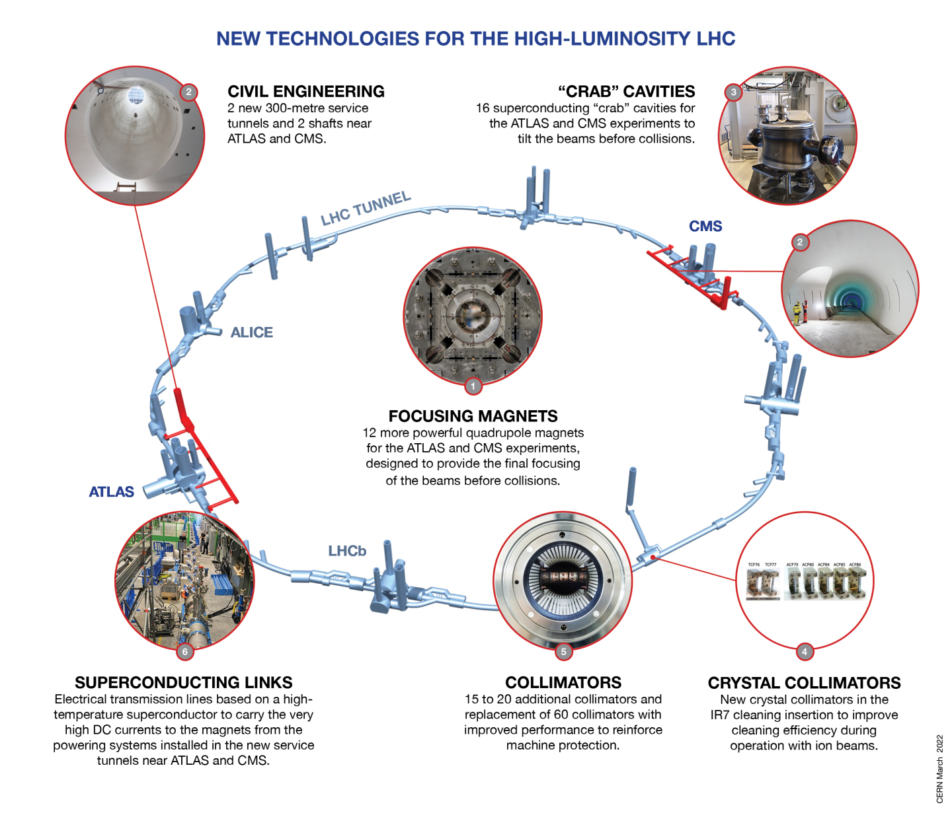
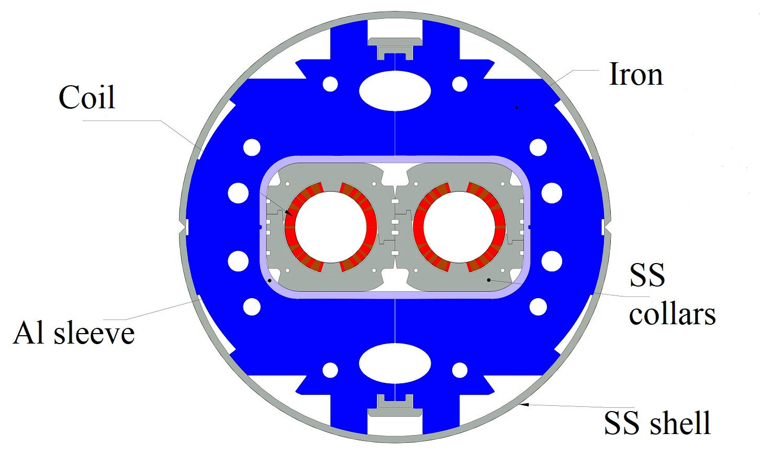
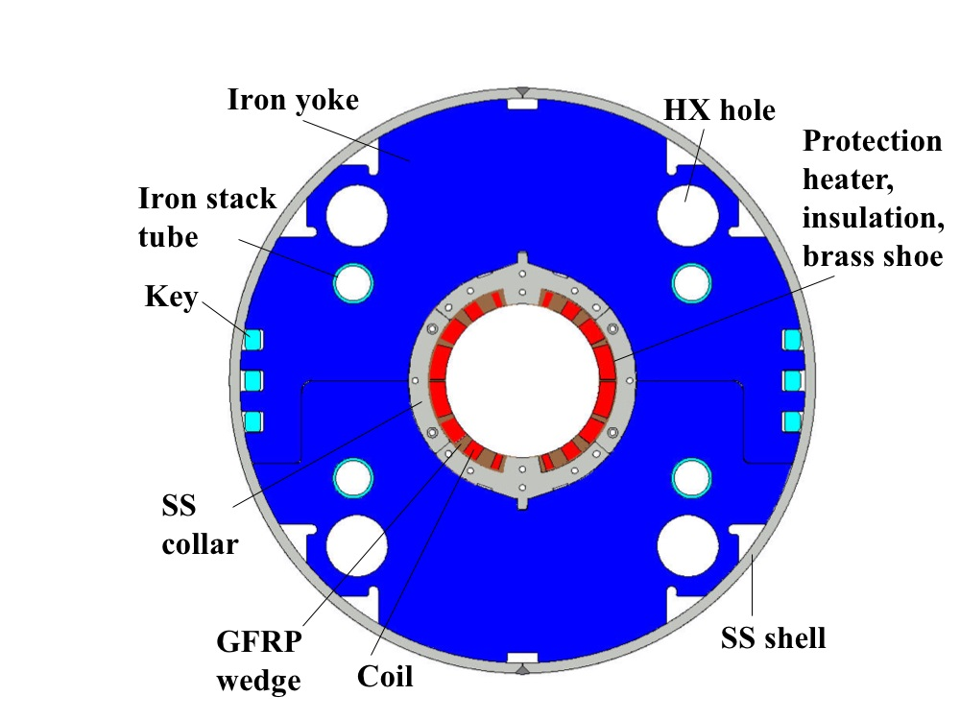
Technology
Landmarks
Series production in Industry well underway
Prototype and first series delivered to CERN
Separation / Recombination
dipole magnets: D1 & D2
Finished in 2023
Finished in 2023
Fully validated in 2023 and first magnets ready for installation
Complete Prototype System installed in SM18 and under testing
½ system already installed for Run3
Successfully deployed in 2023 Pb-Pb run
Prototype cryostated @ CERN

Slide 9
Outline
HL-LHC Schedule
Status of key technologies towards the HL upgrade
  Civil engineering
  Final focusing magnets for lower beta*
  Superconducting Link
  Crab Cavity System
  D1
Inner Triplet String
Ongoing (and potential future) collaborations KEK – CERN
Conclusions

Slide 10
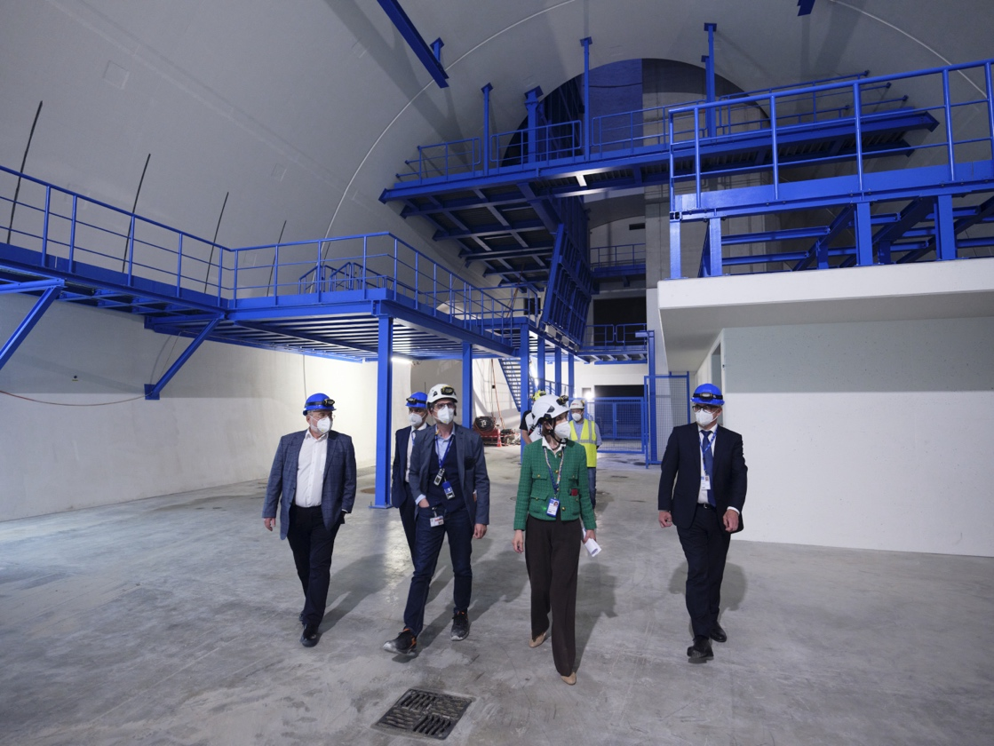
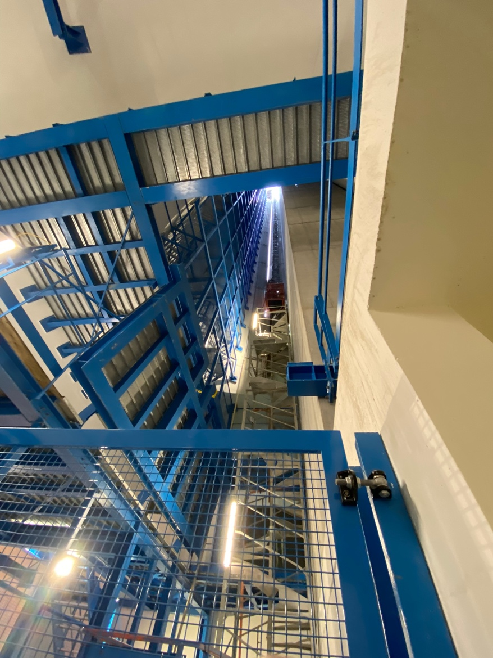
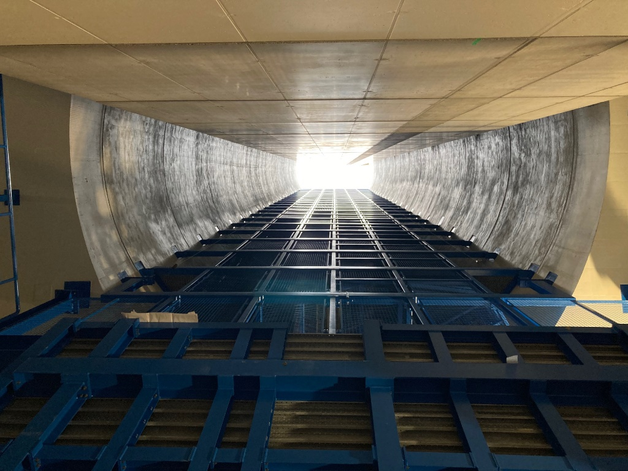
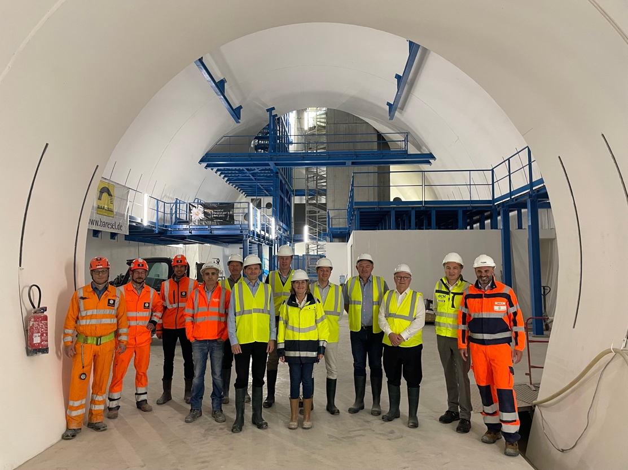
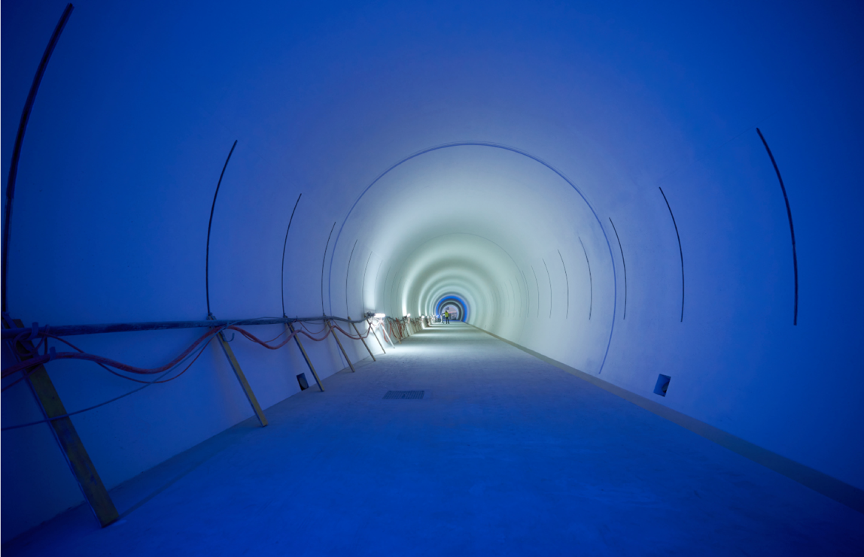
Ceremony for completion of CE on January 20th 2023
Notes:
To be updated with latest plans for Ceremony

Slide 11
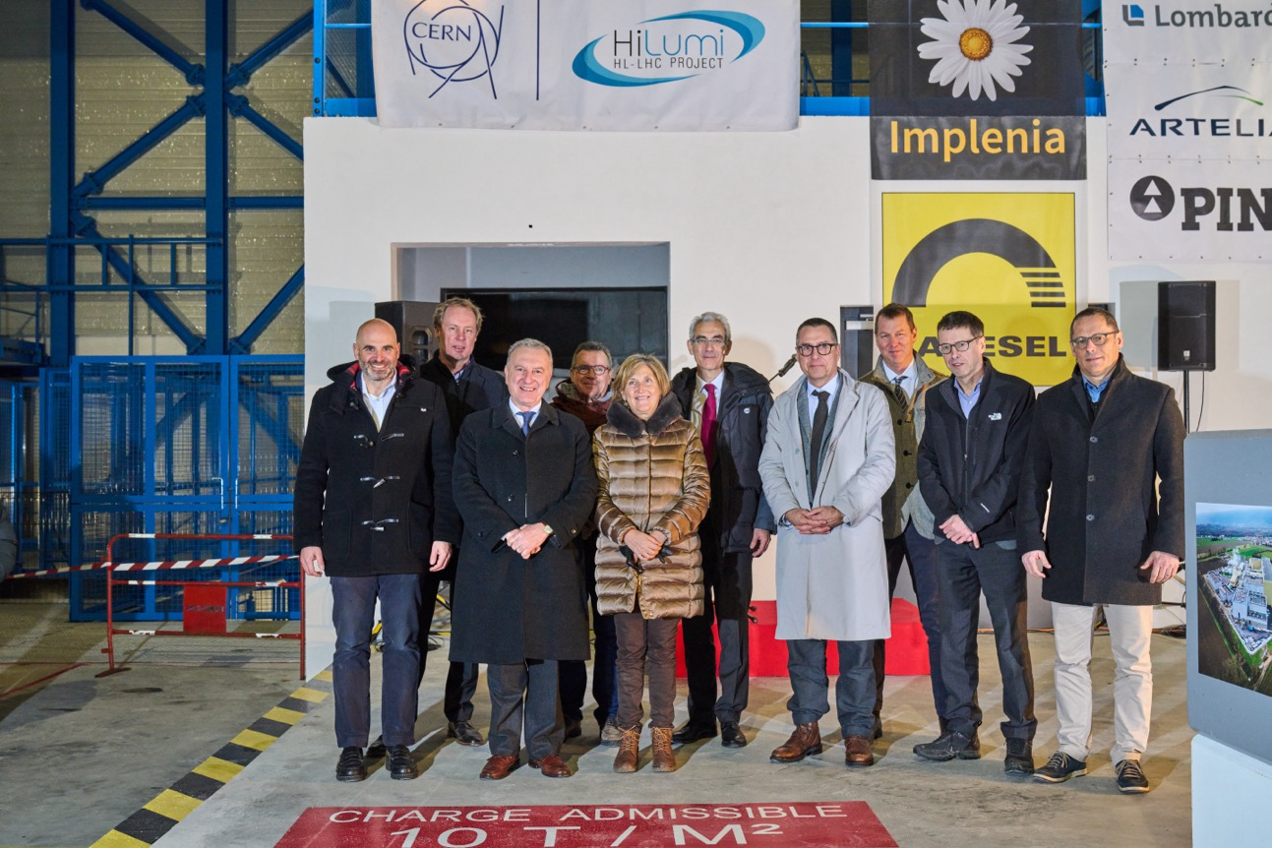
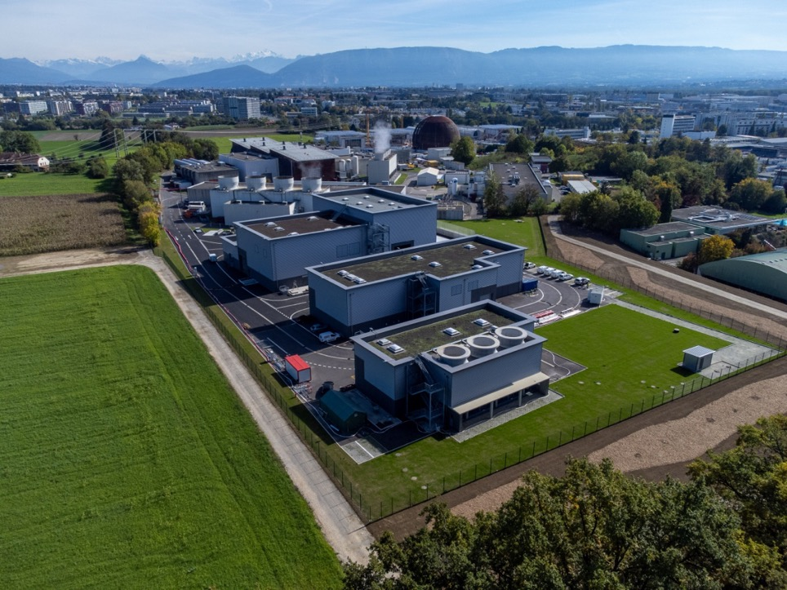
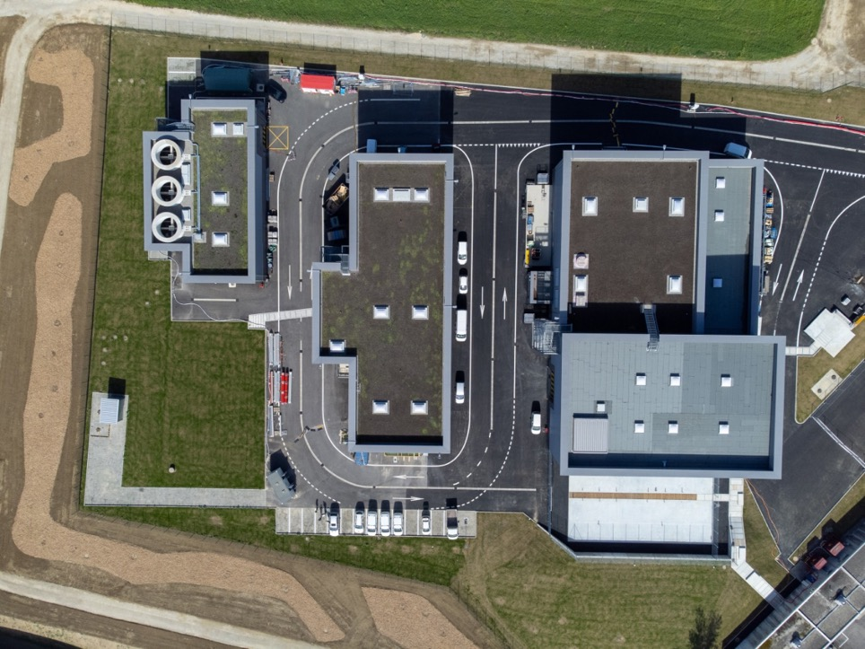
Completion of Surface buildings in 2023
Work Ended Spring 2023
SF17
SU17
SE17
SHM17
SD17
Example Point 1
20th January 2023
Celebration Ceremony: Point 5

Slide 12
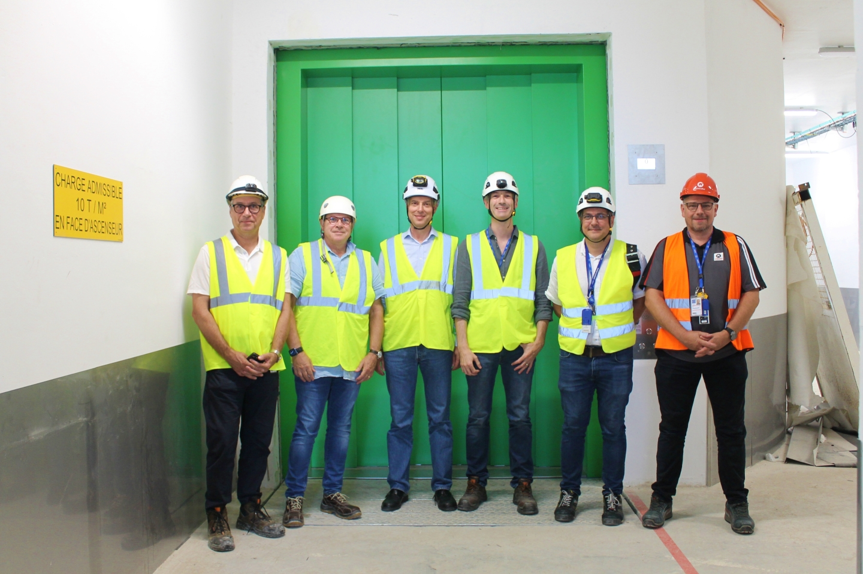
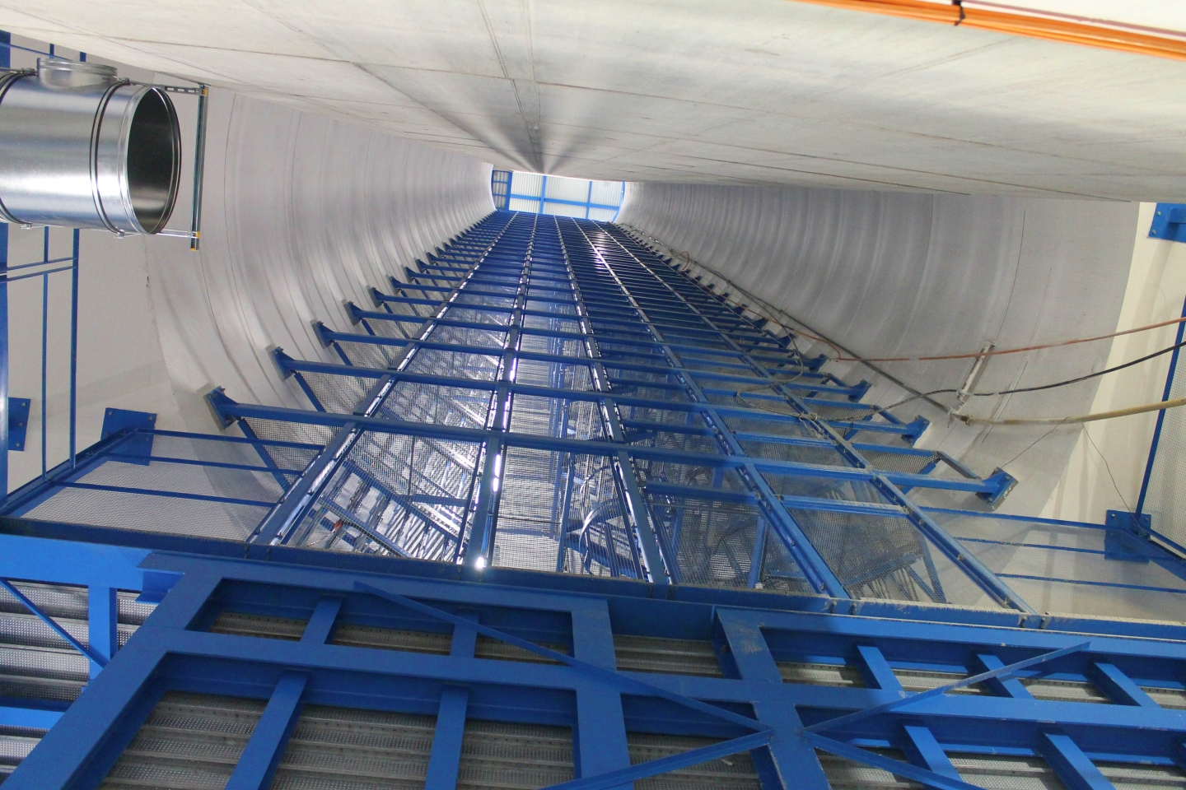
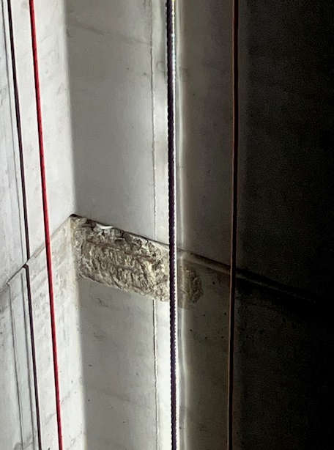
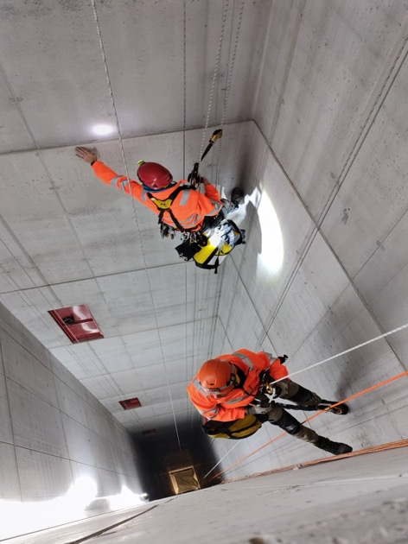
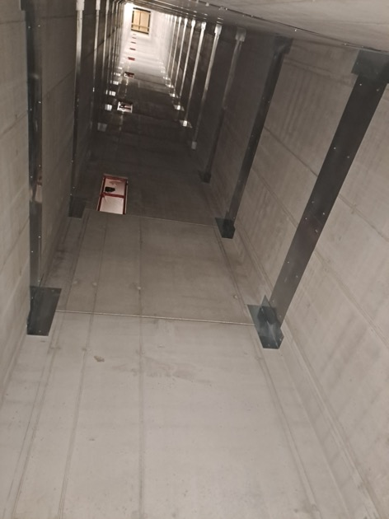

Lift Installation in Pt1 and Pt5
    PM17 issue resolved thanks to help of many CERN teams (EN-ACE, SCE, HSE WP17,…)
25/01/2023
concrete spalling
30/01-03/02/2023
Inspection
30/06/2023
Closure of NC
Impact on Schedule minimized by swapping start of Lift Installation from Pt1 to Pt5
But overall ca. 6 month lost for installation of technical infrastructure
Not critical ➔ Completion of Technical Infrastructure installation before start of LS3

Slide 13
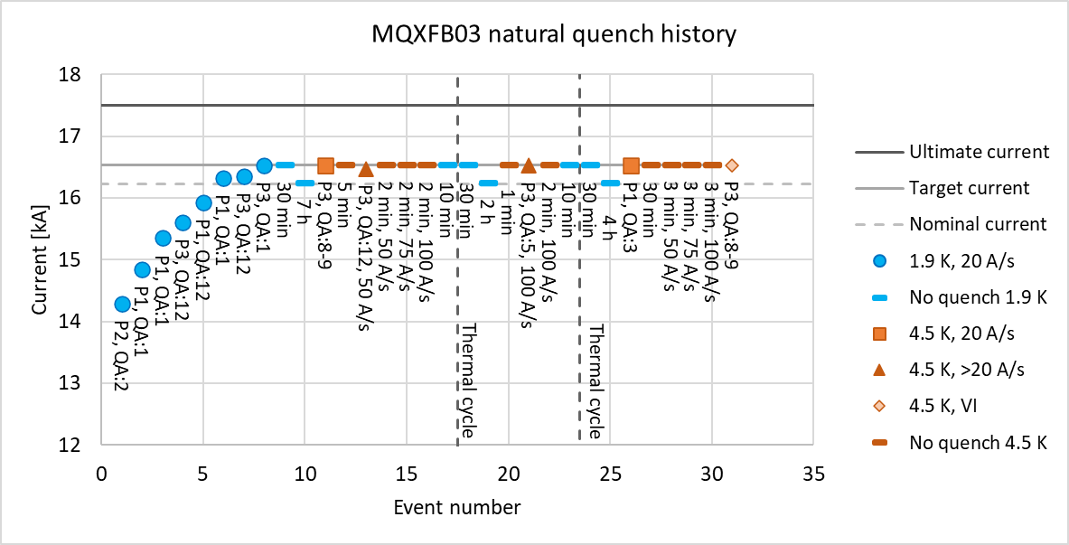
Status MQXFB – Q2 - Assemblies at CERN
Magnets produced ➔ None showing degradation!
3 [last 3] consecutive Magnets passed acceptance criterial!!!
MQXFBP1: test at CERN in 2020
  Failed to reach nominal current @ 1.9K But:
    Reached 6.4TeV equivalent without Quench; limitation only in one coil, all concepts validated @ 15.15kA
    ➔ Plan to exchange the limiting coil ➔ procedure test for 4+1 ➔ MQXFBMT4 July 2023 ✓
    MQXFBP2: test at CERN in 2021
        Limited at around nominal current and eventually reached nominal current at 1.9K at lower ramp rates
        ➔ review of assembly ➔ 3 Phase Improvement plan
        1) Stainless Steel prestress; 2) Assembly procedure of Cold-Mass; 3) Coil production
MQXFBP3: test at CERN in 2022 – Lower shell pre-stress ➔ 1) but after disassembling 01
  Nominal +300A @ 1.9K and 3 TC ✓
  Still limited at 4.5K ➔ but compatible with powering at ultimate current at 1.9K
MQXFB02 test at CERN in 2023 – 1) plus New Magnet Assembly procedure ➔ 1) & 2)
  nominal +300A @ 1.9K and 3 TC ✓ Still limited at 4.5K but compatible with ultimate at 1.9K!
MQXFB03 test at CERN in 2023 – New coil production ➔ 1) & 2) & 3)
  Nominal + 300A @ 1.9K and 4.5K and after TC! ➔ Full validation of magnet concept!
Decision to use P2 and P3 for the IT-String even though they are limited @ 4.5K
Re-cryostating of the cold-masses in final cryostat configuration
P2 already in final configuration in SM18 on the test bench!
Lost one coil during preparation for cold-test in final cryostat configuration
➔ Plan to exchange the damaged coil and keep 02 as a spare
First Magnet that will go into the machine!
13

Slide 14

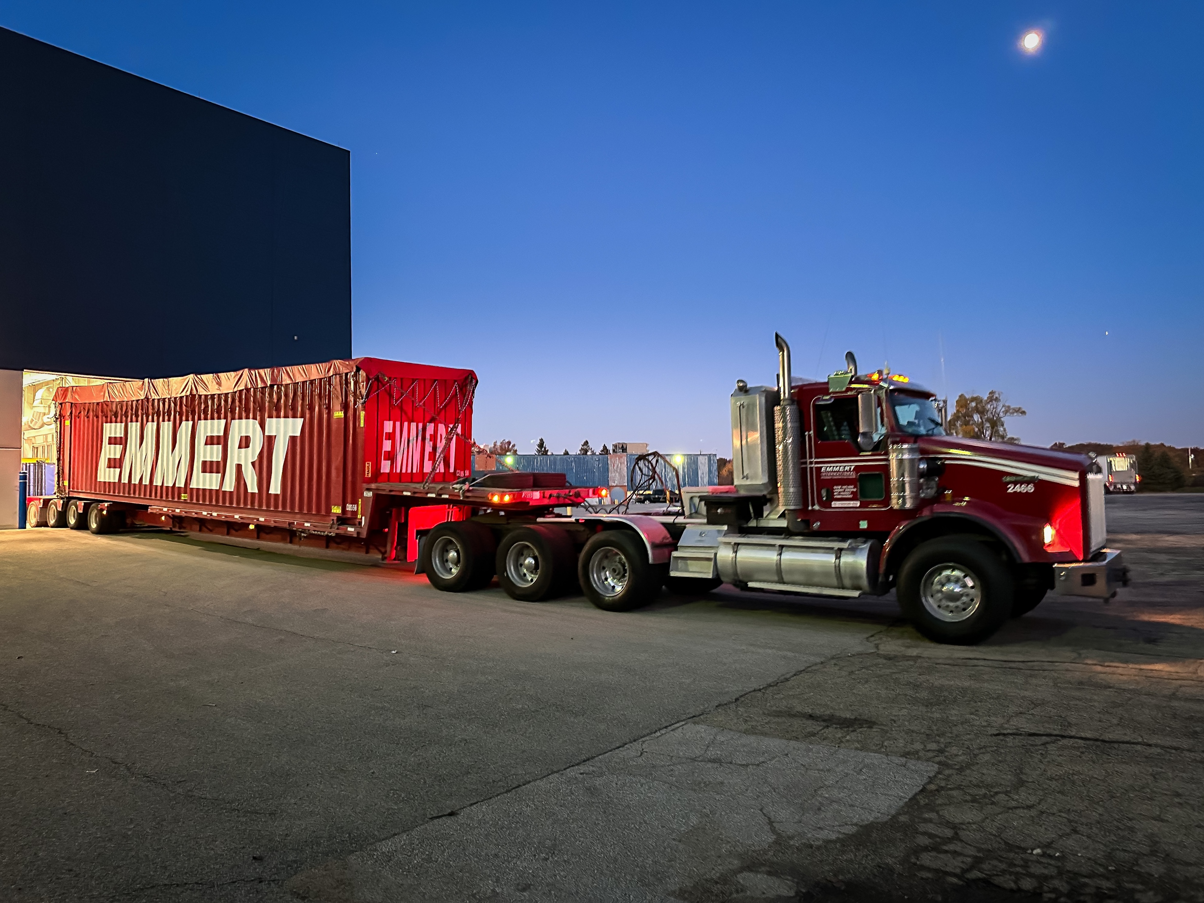
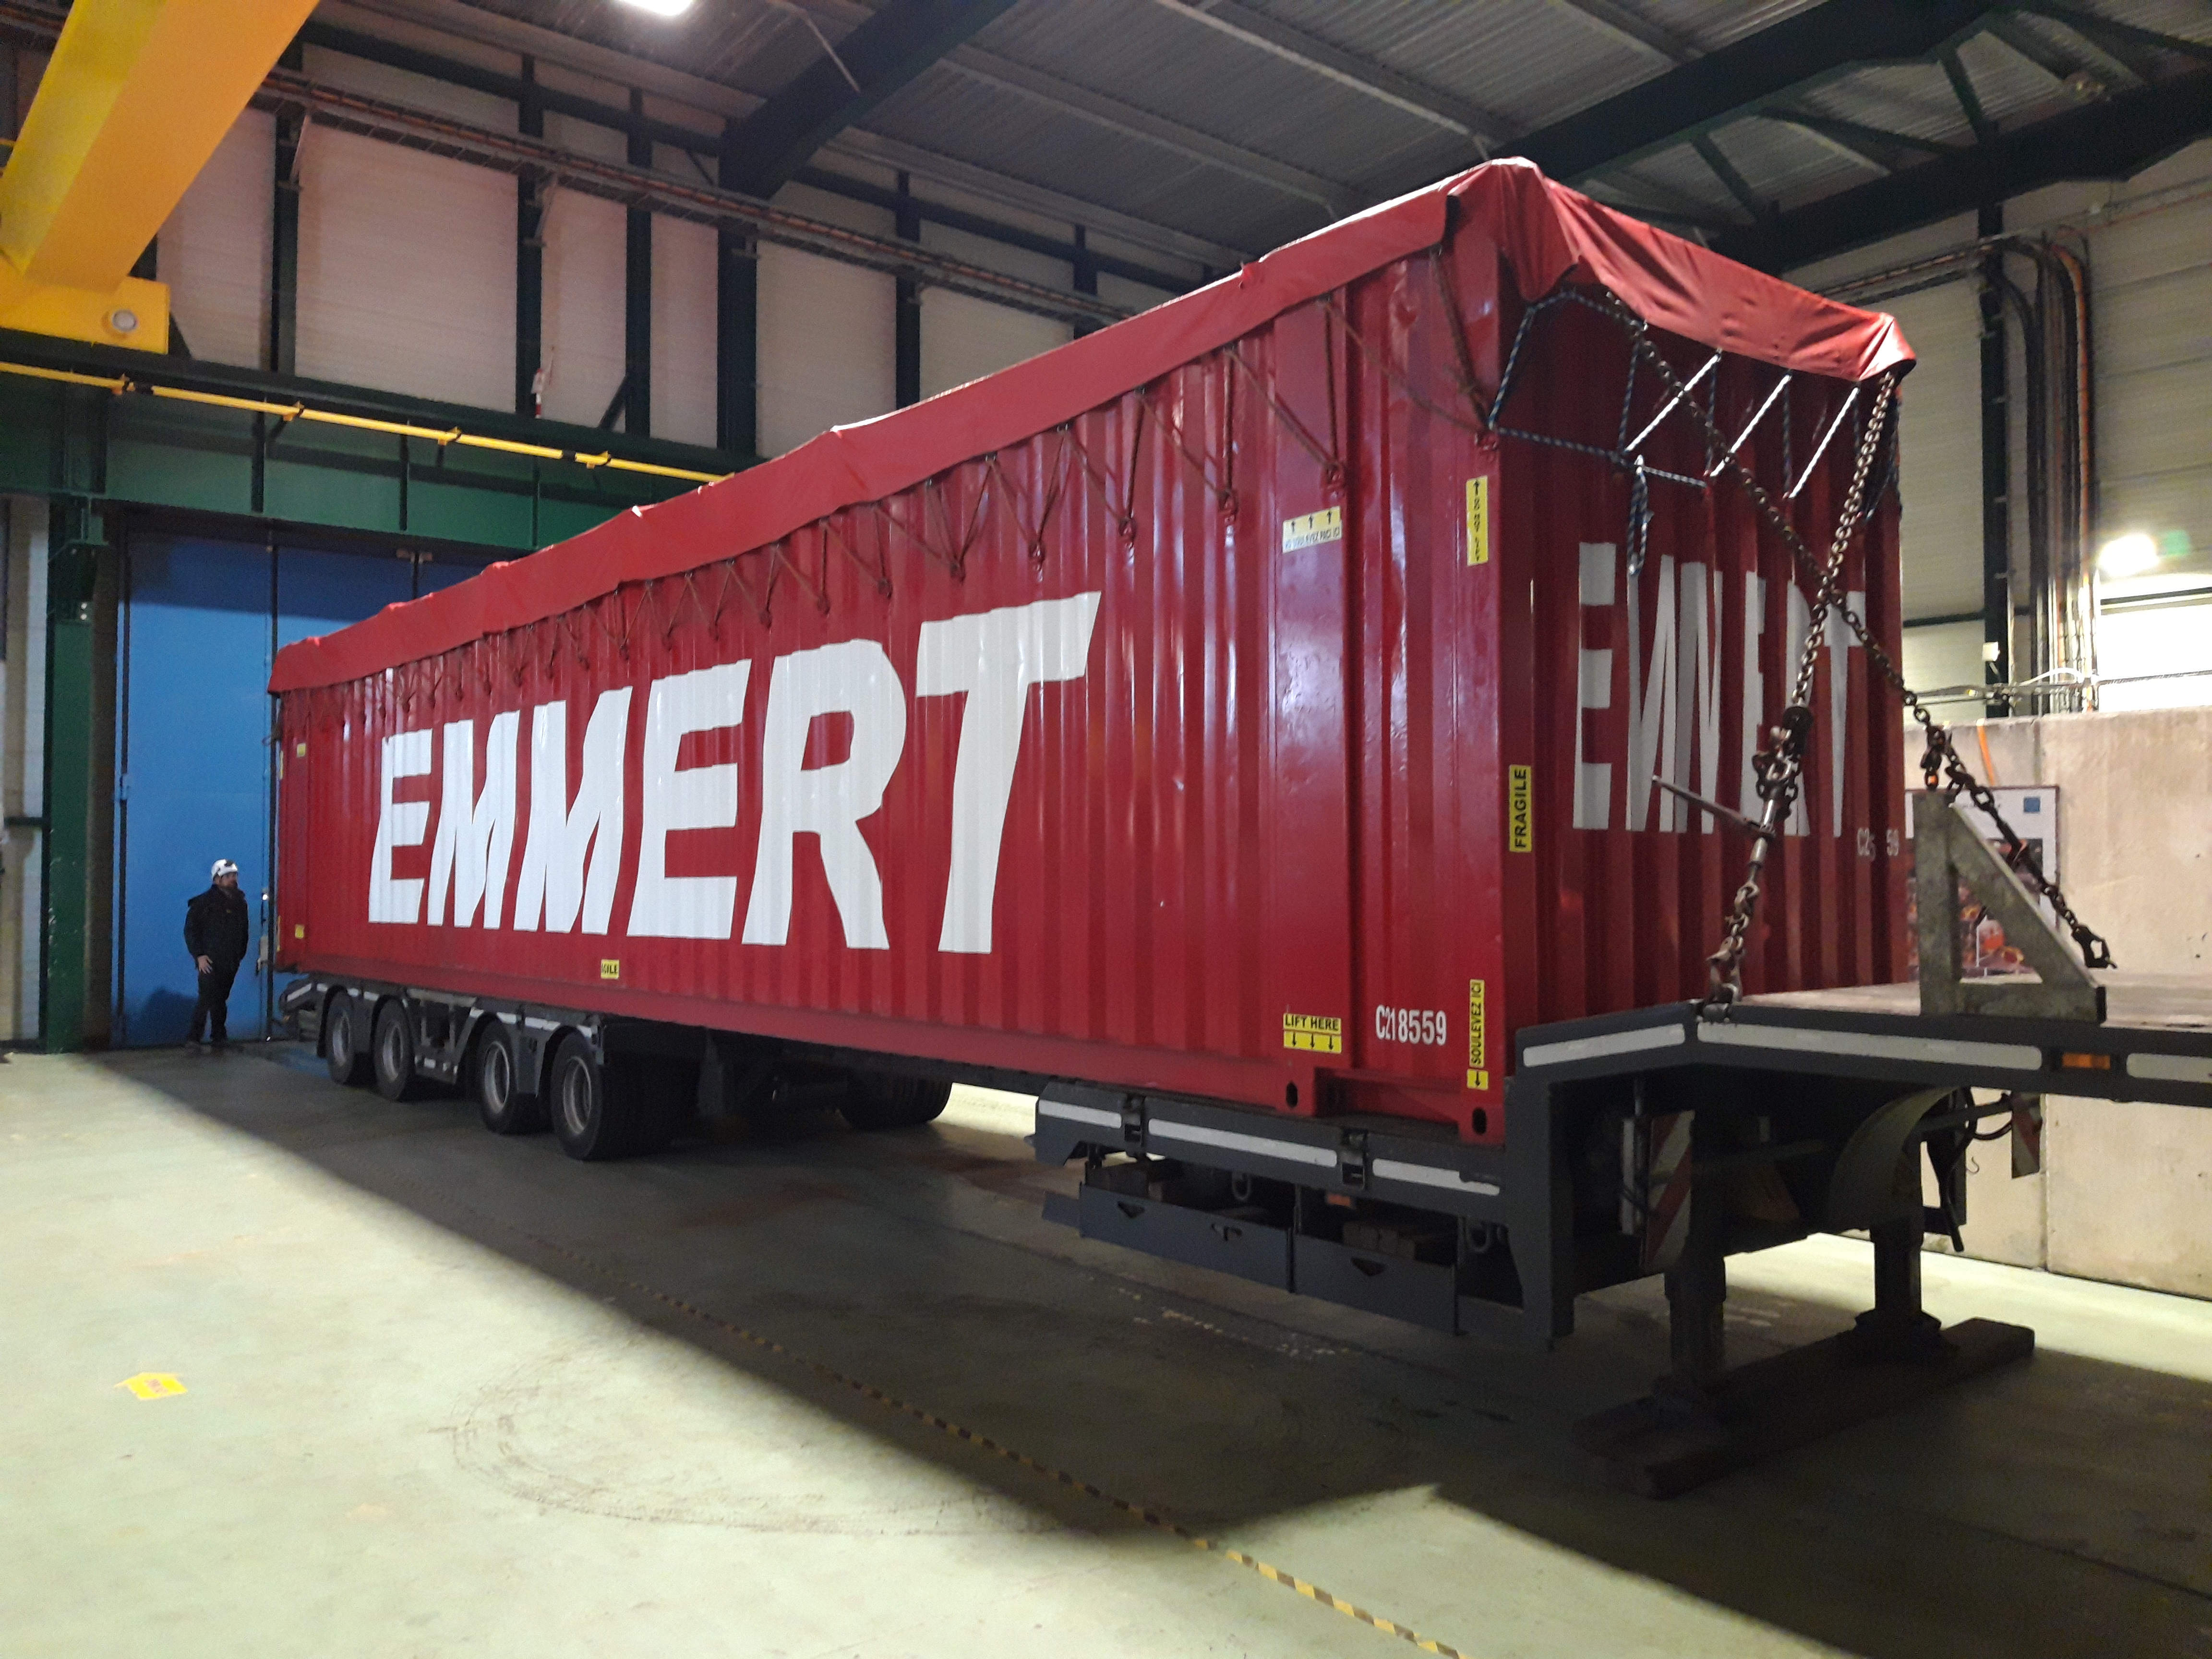

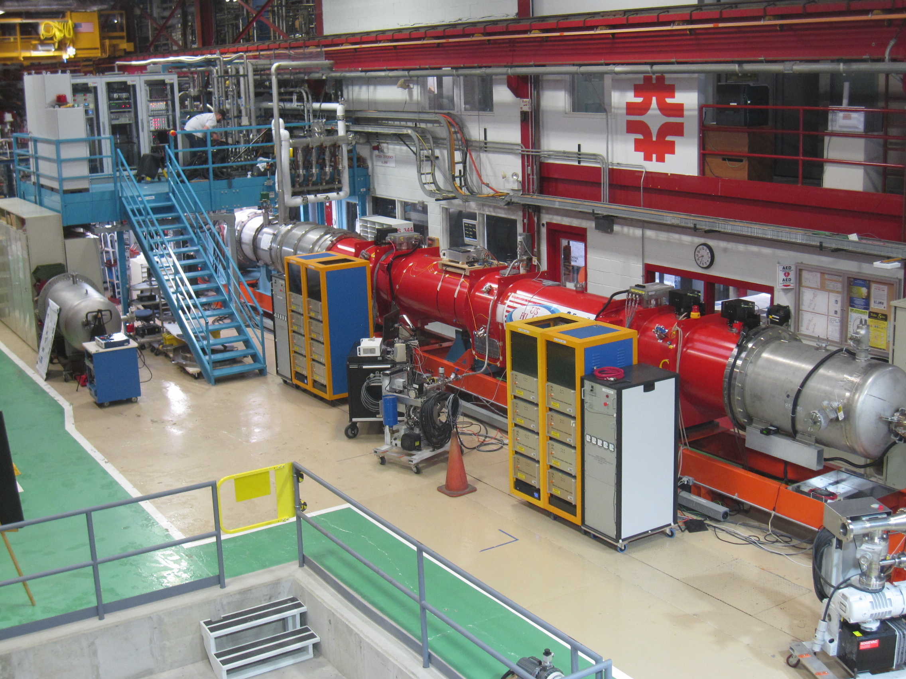
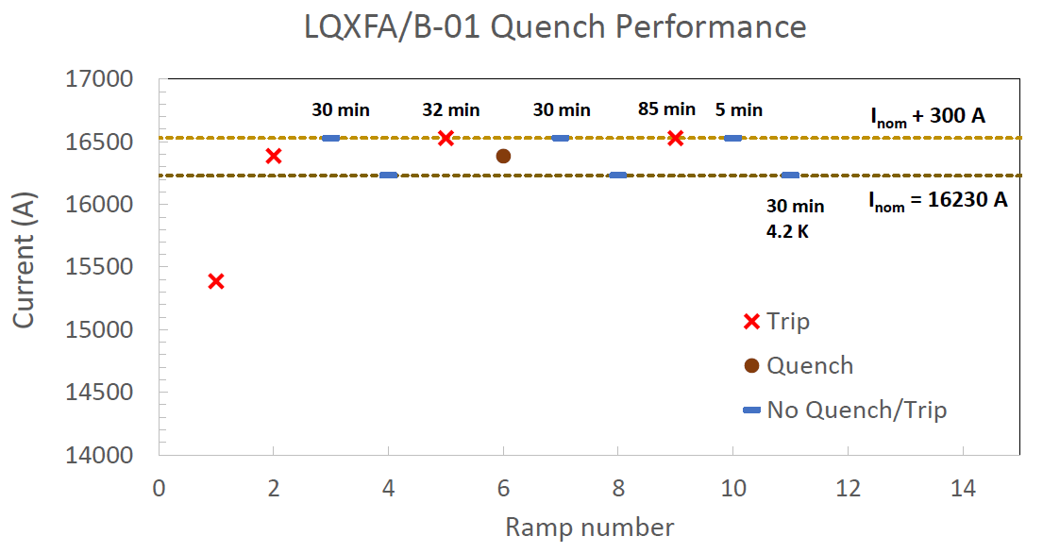

Status MQXFA – Q1 & Q3- Assemblies at AUP
STATUS
8 out of 20 magnets build, tested and validated!
From 15 that were produced – 3 during COVID ➔ all non-conformed being repaired ➔ 2 repaired validated
MQXFA08b & MQXFA14b repaired and validating coil replacement procedure and coil production planning
Endurance test on MQXFA05: 50 quenches, 5 TC ➔ magnet remains @ nominal! ✓
Unscheduled mechanical robustness test for MQXFA11 ➔ road accident ✓
Magnet passed acceptance criteria at vertical test station ✓
CA-01: First cold mass reaching nominal performance – no retraining after thermal cycle
Nonconformities but accepted in close collaboration with AUP to assure in-time delivery for IT-String
➔ Shipped in November ➔ Arrived @ CERN in December [acceptable for IT-String, not yet for machine]
Cabling completed: https://newscenter.lbl.gov/2023/08/30/cabling-for-lhc-upgrade-wraps-up/
Second Cold-Mass Assembly being prepared for testing at FNAL ➔ second out of 10 CMA
CA01 Arriving @ CERN November 28th 2023
CA01 Leaving FNAL October 30th 2023

Slide 15
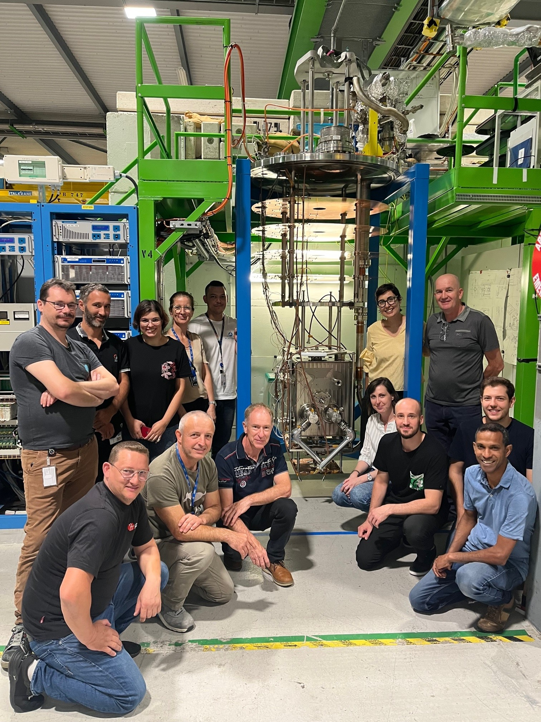
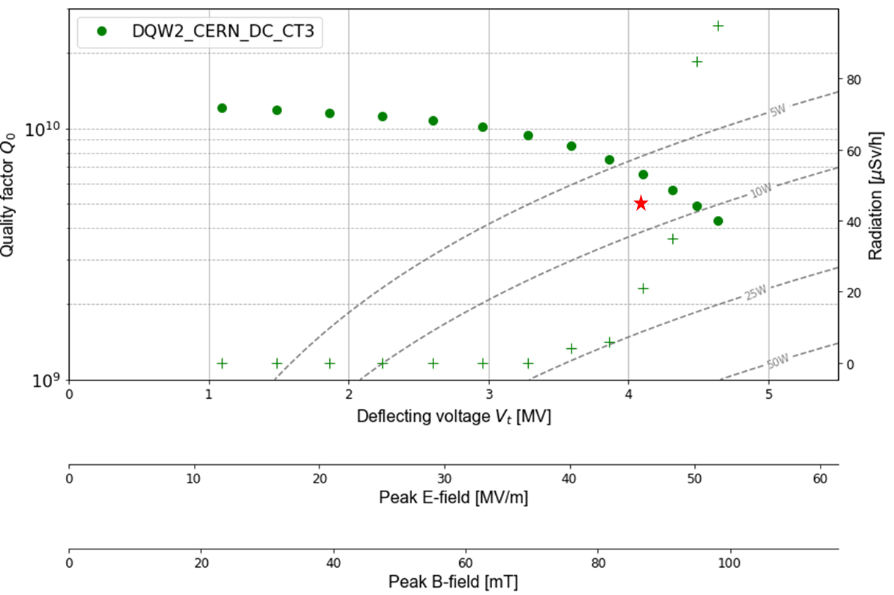
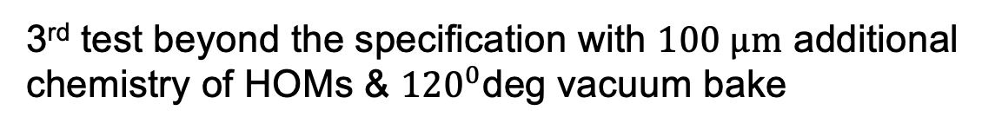
1st CERN-DQW Series, Qualified
3rd test beyond the specification with $100 μm$ additional chemistry of HOMs & ${120}^{0}$deg vacuum bake

Slide 16
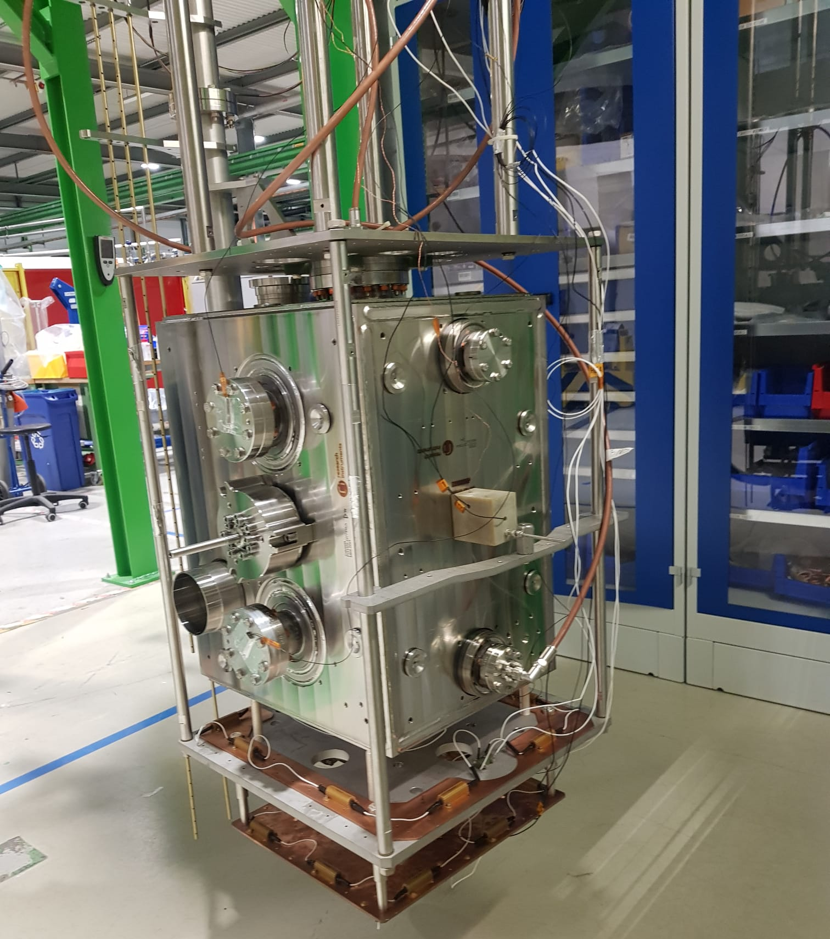
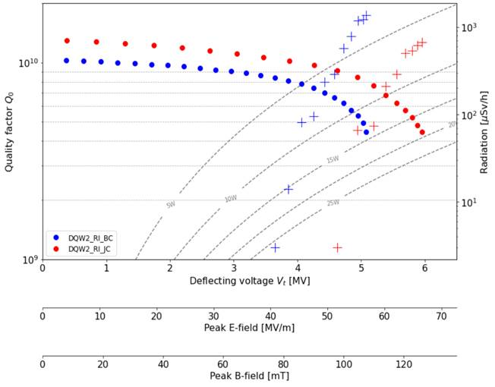
Industrial DQW Series (RI)
1st pre-series jacketed cavity with excellent results, metrology to be finalized before acceptance
2nd cavity in metrology and cold tests soon

Slide 17
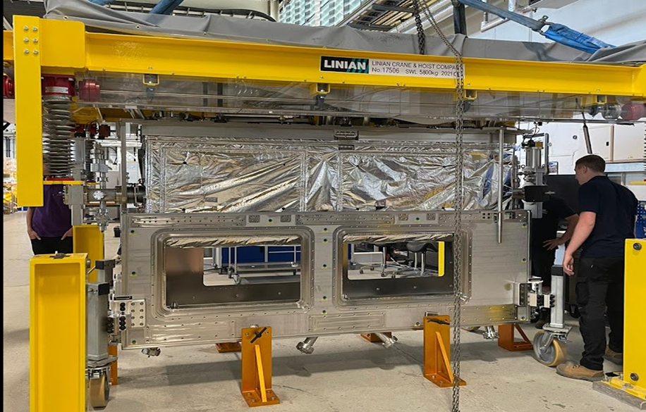
RFD Cold Mass Assembly – UK1 Collaboration
Lowering of Top plate to Cavity String successful !!
Since last PSM (July), important alignment issue between top plate and cavity string corrected with some non-conformities (not ideal but ok)
Delivered to CERN in time in October for installation deadline in the SPS Test-facility!
But unfortunately observed major Nonconformities following reception tests @ CERN
Electrical Short of coupler to ground / housing & vacuum leak
Will NOT be installed in the SPS in YETS 23 / 24
But important lessons learned for series production with UK and AUP / TRIUMF!!!!!!

Slide 18
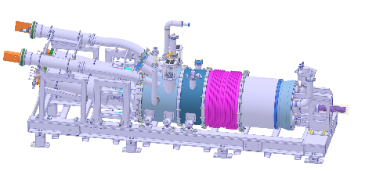
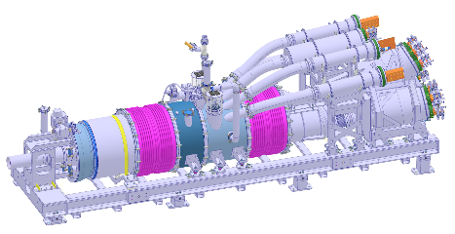
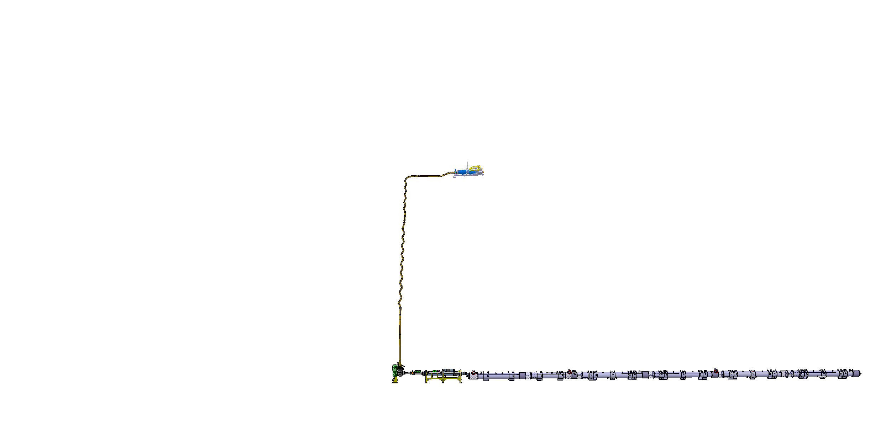
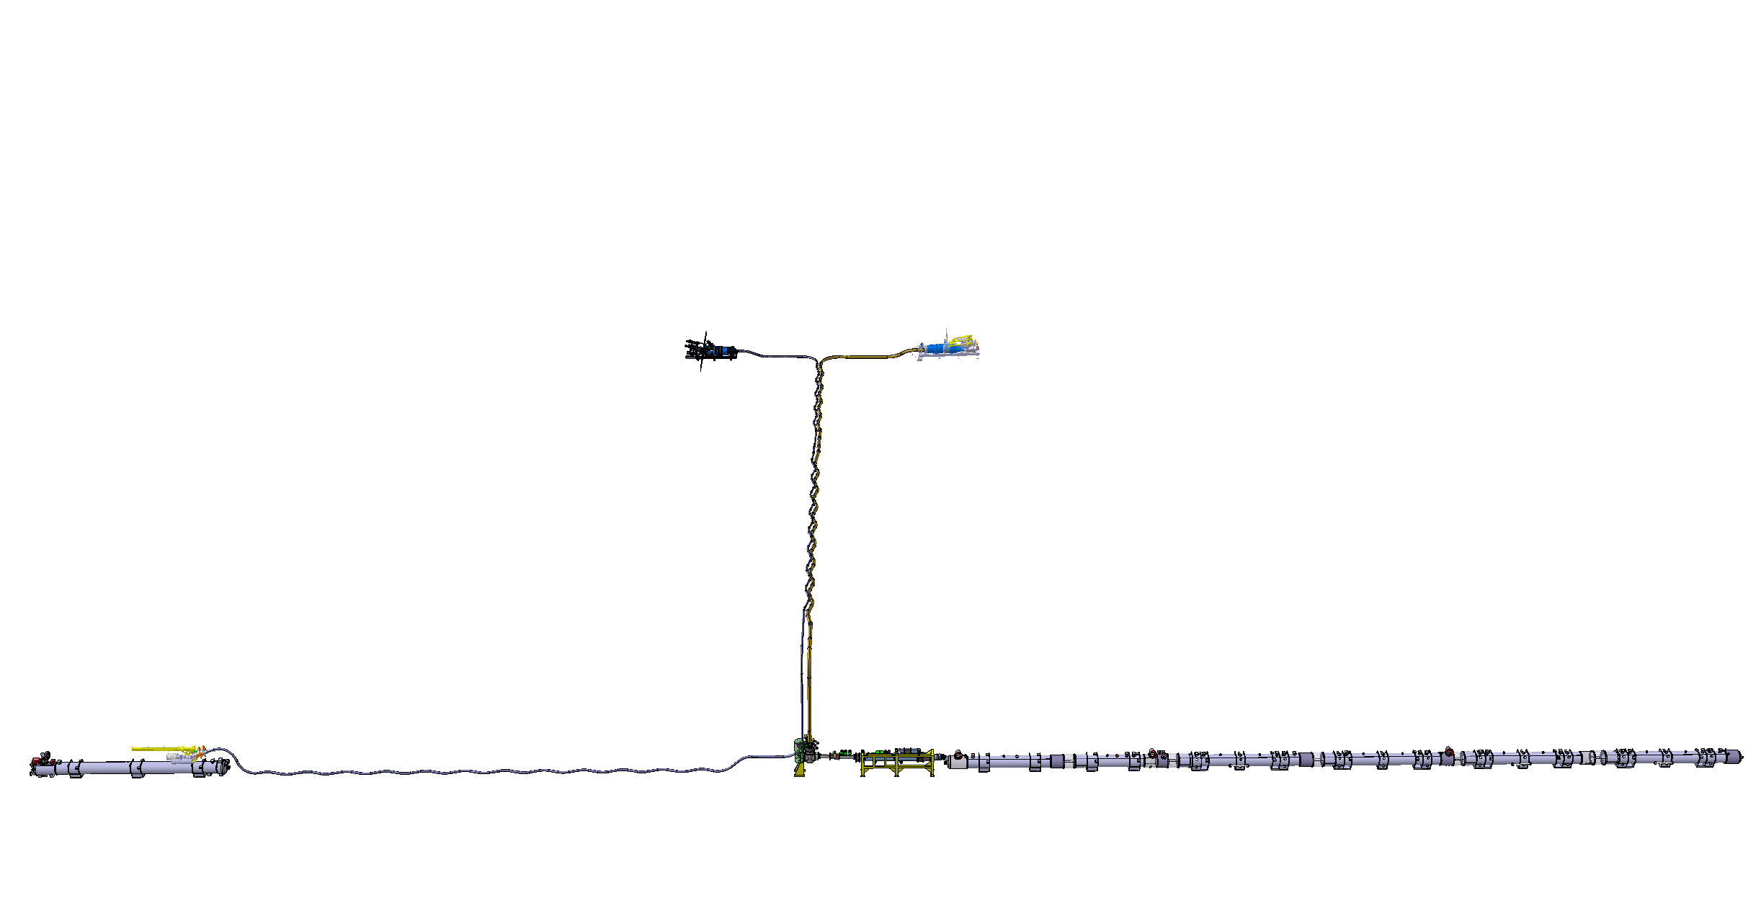
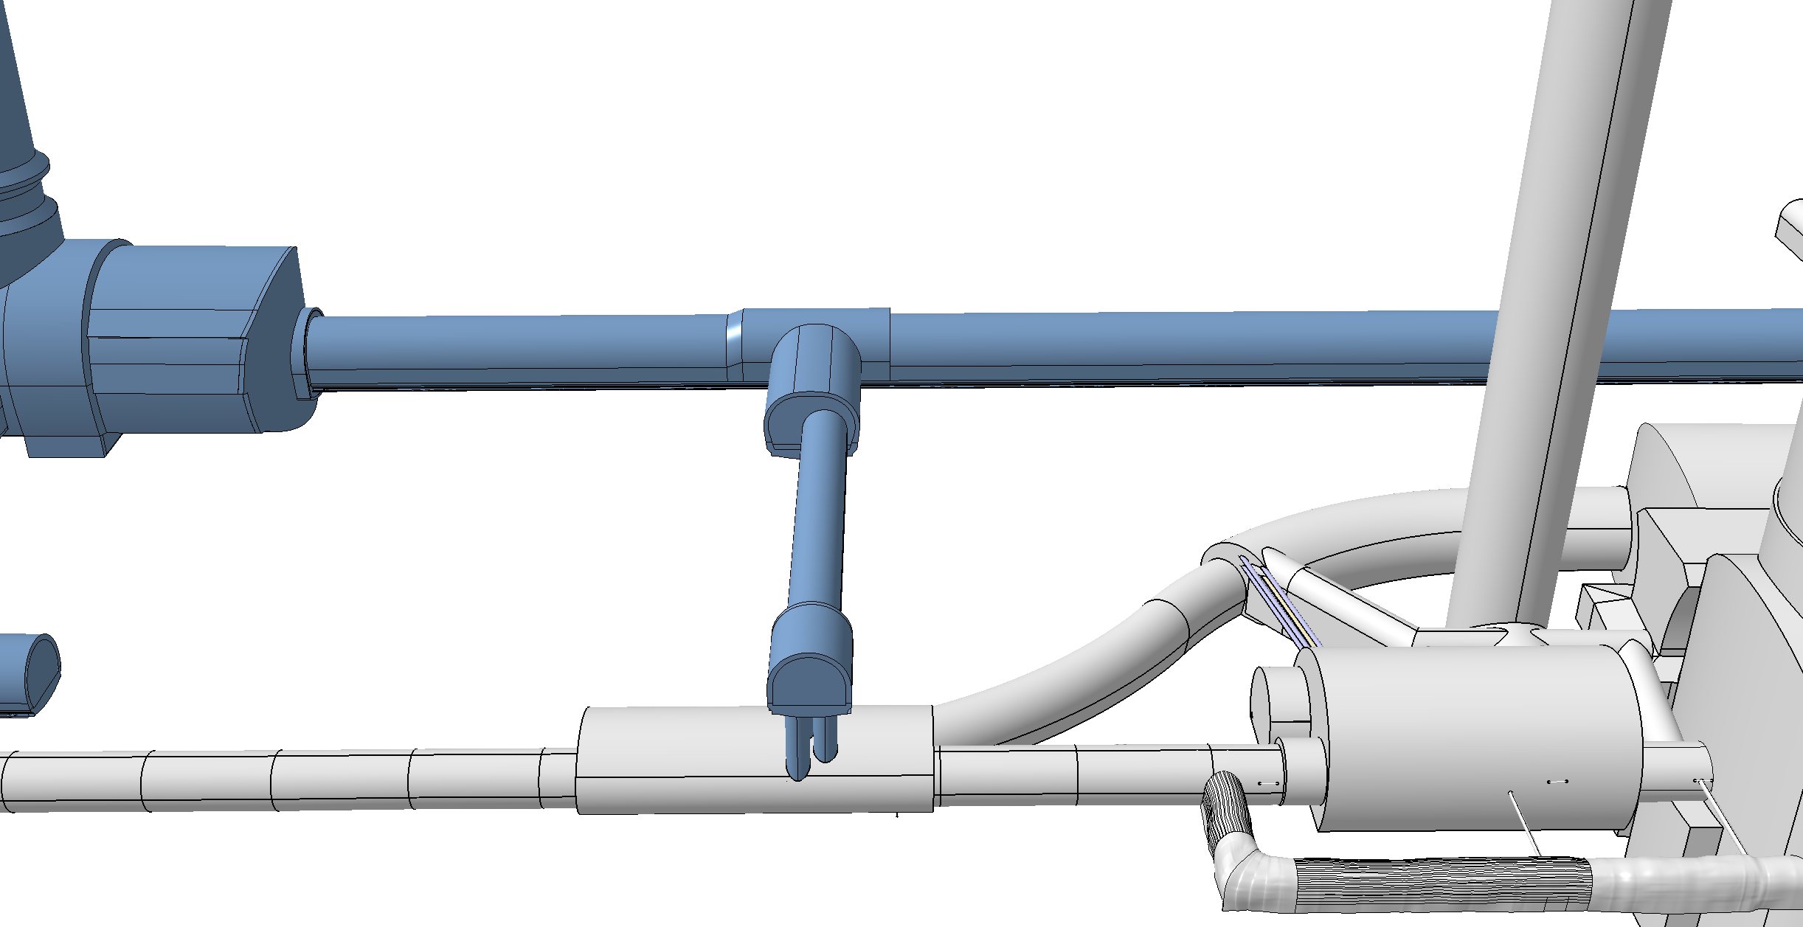
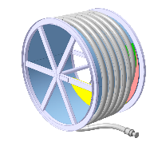
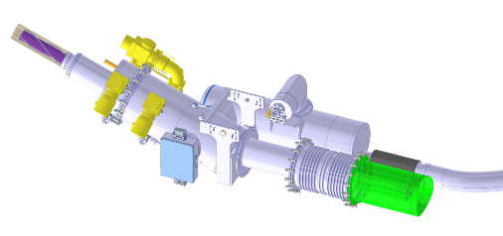
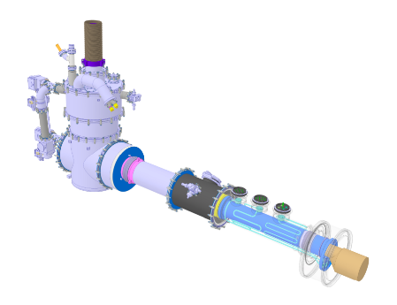
Cold Powering System
DFHM
DFHX
Power converters: (18, 0.6) kA
Power converters: (18, 7, 2) kA
DSHM
DSHX
140 m
89.5 m
Power converters: (60, 120, 200) A
D2
DCM
D1
CP
Q3
Q2B
Q2A
Q1
DFM
DFX

Slide 19
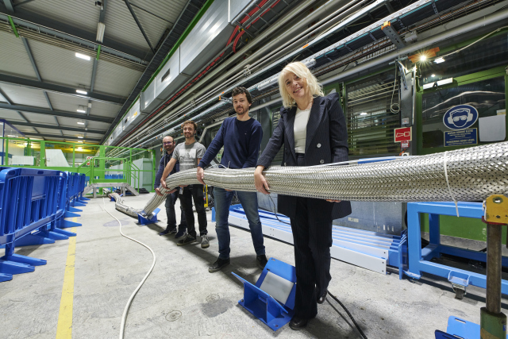
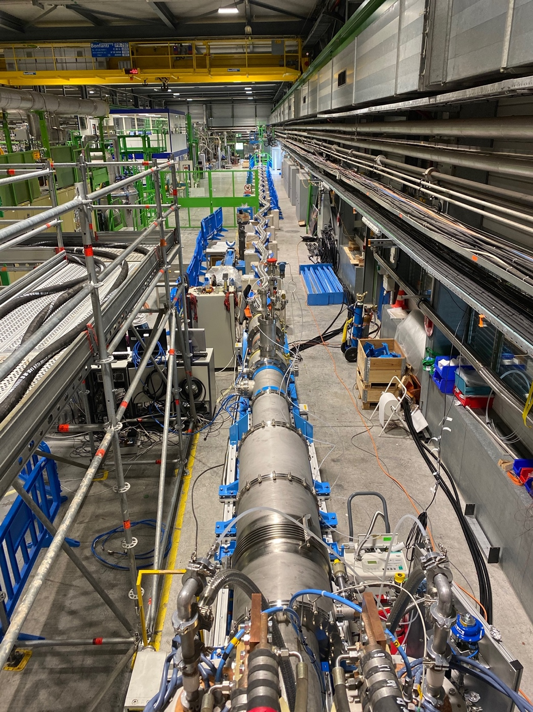
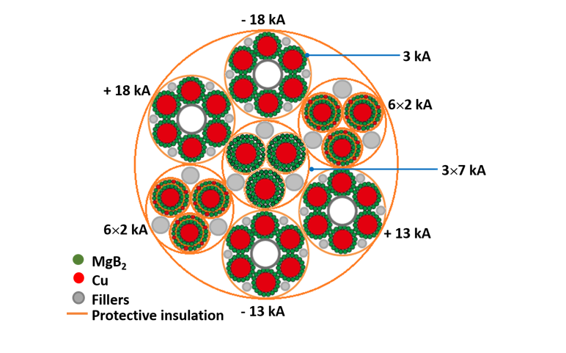
MgB₂ Superconductor and Superconducting link
Cable production complete !
Assembly of the first complete
system incl. flexible cryostats
is ongoing
Demo-3 in SM18
Successfully Demonstrated
Concept between 2020 / 22
with > 120kA @ 30K
19

Slide 20
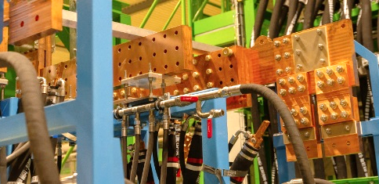
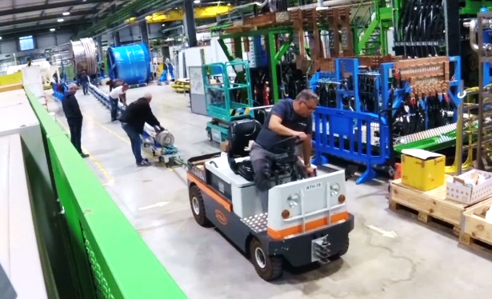
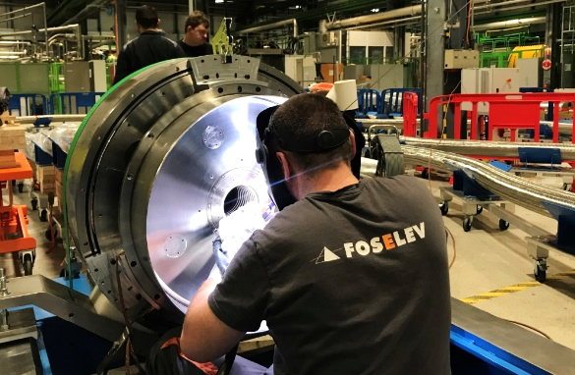
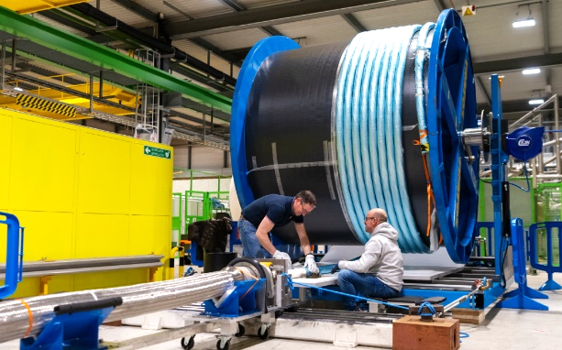
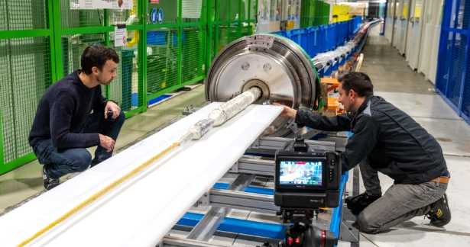
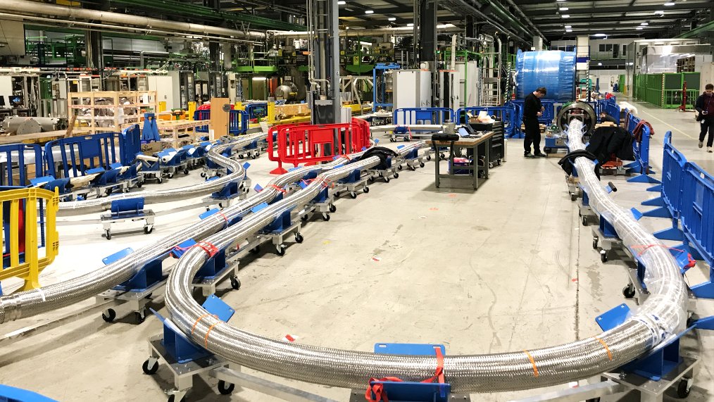
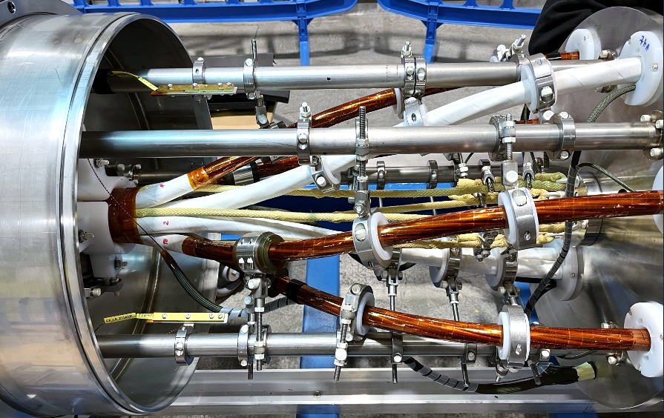
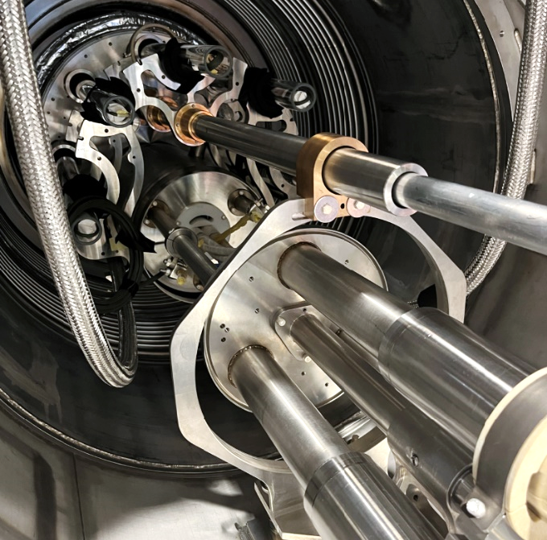
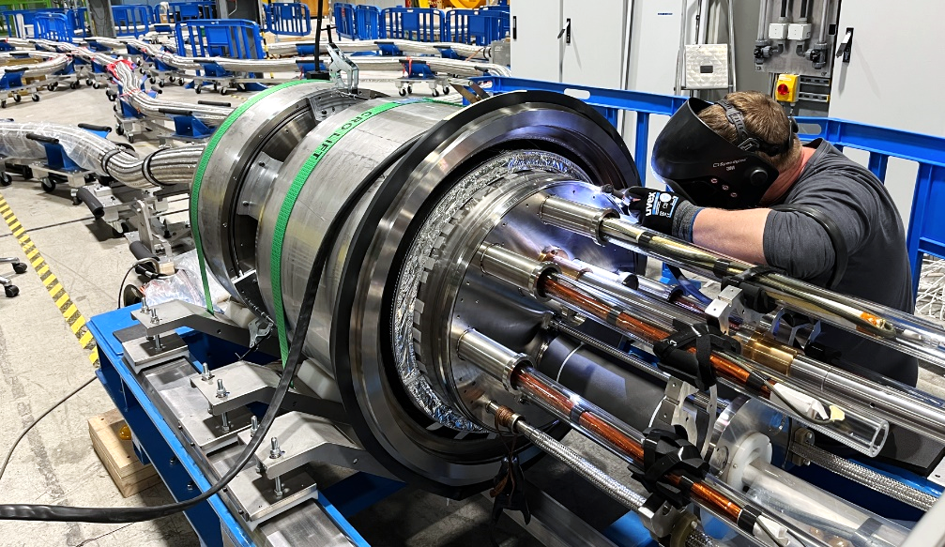
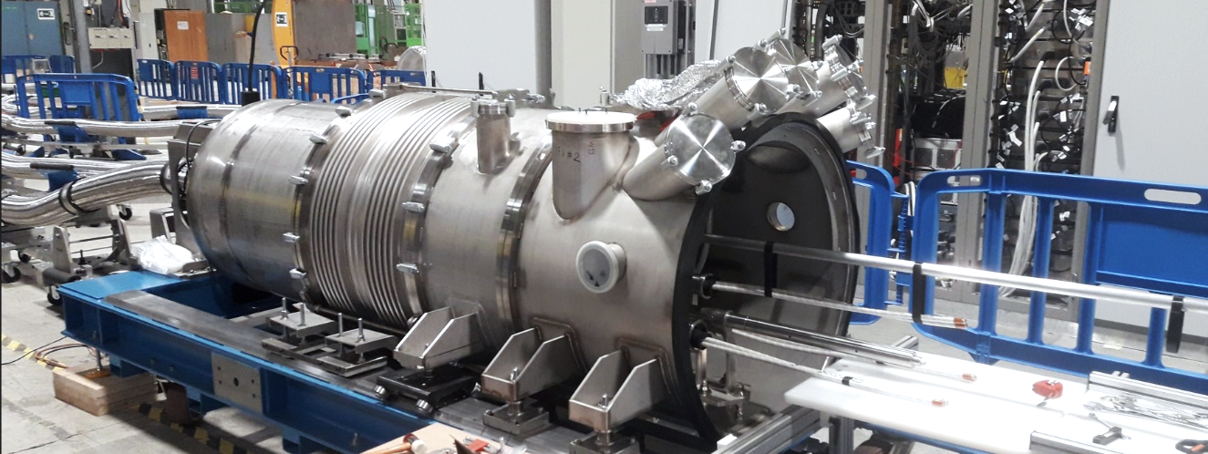

Complete System Test planned for End 2023 in SM18
SC-Link-DFHX assembly in pictures

Slide 21






Collaborations: D1
STATUS
D1 prototype completed cryostating – tested end 2023 at CERN
MBXF1 magnet reached performance requirements (first long magnet to ultimate)
MBXF5 magnet completed and tested @ KEK; upgraded test station at KEK
Half of the coils for the production completed
MBXFP1 in the cryostat
MBXF power tests (T. Nakamoto, M. Sugano, et al.)

Slide 22




HL-LHC IT STRING: P5L
P4
P5
P5
P3
P2
HL-LHC
P6
P5R
SPS
P7
P1
P5L
P8

Slide 23




HL-LHC testing facilities in SM18
Magnet Testbenches
IT Test Area
SRF Section
Cold-powering Test Area

Slide 24






IT String Status in pictures
PC and Energy Extraction racks installed on the metallic structure
Cryo Distribution
On top of the empty metallic structure
Under the metallic structure
Q4 2024
Q1’25
Q2-Q4 2025
Q1’26
Q2’26

Slide 25





THE IT-STRING INGREDIENTS ARE GETTING READY
Dates given in schedule change request, EDMS 2898265
  Q1: magnet cold mass being welded → Available in September 2024
  Q2a: MQXFBP3b completed → Available for Testbench Jan. → April 2024
  Q2b: MQXFBP2b completed → On SM18 Testbench → Available April 2024
  Q3: arrived at CERN December 2023 → Available July 2024
  CP cryostating Phase II ongoing → Available August 2024
  D1 cryostating completed → On SM18 Testbench → Available March 2024
D1
(in SMI2)
CP
CP
(SMI2)
Q2b
In SM18
Q2a
(in SMI2)
Q2b
(in SM18)
Q3
(in FNAL)
Notes:
To be updated by Ezio’s PSM presentation

Slide 26
Outline
HL-LHC design parameters and project planning
Status of key technologies towards the HL upgrade
  Civil engineering
  Final focusing magnets for lower beta*
  Superconducting Link
  Crab Cavity System
  D1
Inner Triplet String
Ongoing (and potential future) collaborations KEK – CERN
Conclusions

Slide 27
Other ongoing KEK collaborations/exchanges with HL
Separation/recombination dipole D1
  Prototype delivered and tested at CERN and re-assembled in its final cryostat configuration
  3 Series dipole magnets completed and validated at KEK – inclusive upgrade of the test station @ KEK
Beam Instrumentation
  Halo monitoring important for HL-era due to higher beam intensity and (likely) overpopulated tails
  Coronagraph prototype developed and installed in LHC, simulations show challenges to reach expected performance down to 5.5 sigma; Tests in the LHC Machine postponed to 2024
  Following LHC beam measurements, workshop planned by end 2024 to review results and explore eventual other options
Machine Protection
  First delivery of capacitors for QHPS received and being used for IT String units. Testing is ongoing
  New in-kind contribution of the full HL-LHC QHPS series to the HL-LHC project [630 units]
  Agreement being circulated for signature
Crab cavities
  Encouraging discussions towards potential additional in-kind contributions to HL project for IOTs and power transmission chain for CCs. CERN sent a contract proposal to KEK on the 2nd of November. Issue of invoicing to be agreed on
  MS being launched in parallel in-line with master schedule

Slide 28



Quench Heater Power Supplies (DQHDS)
All 60 units (52 + 8) for the IT String have been manufactured with capacitors provided by KEK.
Testing of the units is ongoing.
Ready for installation in the IT String.
Series production:
The units for the tunnel will be provided as in-kind contribution from Japan under the lead of KEK (in total 630 units).
Nichicon has introduced (small) modifications in the capacitor model (new base-plate, reduced variation of capacitance [4.7 mF +20% -5 %])
20 prototype capacitors have been delivered to CERN from KEK and have been successfully validated.

Slide 29




HPRF, Japan-CERN
The IOT technology at 400 MHz is the baseline for HL-LHC crab cavities
Recently, in kind from Japan to provide the HPRF system is in final stages of negotiations – outcome in Dec 2023. MoU addendum in draft
Circulators & Loads
RF Coaxial Lines
Schematic of one IP-side
WR2300 waveguides
IOT TH795 & TH1895 Trolley

Slide 30
References
Technical info: https://cernbox.cern.ch/s/IZ9HucUqBj7PE3u
Specification of the HPRF: https://edms.cern.ch/document/2874821/1.0
Addendum: KR5904/SY/HL-LHC ADD #5: https://edms.cern.ch/document/2975586

Slide 31
Conclusions
HL-LHC project has entered full series-production phase
Tunnel installation will start in 2 years from now, with IT String as very important intermediate validation milestone starting operation in Q4’24
Excellent and very pro-active collaboration with KEK, with promising discussions on further enlargement of the contributions within the HL-LHC project scope

Slide 32


Available beginning of 2024
Open Access Publication
https://doi.org/10.1142/13487
ISBN: 978-981-127-894-5
Repaired
MB Dipole
MQXFBP3
MQXFB02
D1
proto
CP
The project is on Track for installation
during LS3 starting in 2026

Slide 34
Outline
HL-LHC Schedule
Status of key technologies towards the HL upgrade
  Civil engineering
  Final focusing magnets for lower beta*
  Superconducting Link
  Crab Cavity System
  D1
Inner Triplet String
Ongoing (and potential future) collaborations KEK – CERN
Conclusions

Slide 35
Re-Organisation of the HL-LHC Project Office
Departure of Beniamino di Girolamo
➔ Appointment of Lars Jensen as new Collaboration Officer
Request after the Cost & Schedule Review 2022 to separate Budget and Schedule Office
➔ Reinforcement of the Schedule monitoring & control
➔ Redefinition of Project Office Mandates and names
➔ Dedicated Schedule Officer to be appointed by the end of the year
Internal Audit of the HL-LHC project by CERN audit team
➔ Revision and update of ALL HL-LHC related mandates
Migration of the Project Webpages to the New SharePoint platform
https://cern.sharepoint.com/sites/HL-LHC/WP1/SitePages/Collaborations.aspx -> new Collaborations office pages
https://cern.sharepoint.com/sites/HL-LHC/ -> new project Intranet
https://cern.sharepoint.com/sites/HL-LHC/CB/ -> new HLCB site
The HL-LHC Project is in the process of
Strengthening the liaison with the CERN central support team and
Safety Units for the
LS3 Organization

Slide 36

HL Project Management and Organsiation

Slide 37

HL-LHC technology landmarks
Series production in Industry well underway
Finished in 2023
Fully validated in 2023 and first magnets ready for installation
HL-LHC is an accelerator upgrade project with many challenging novelties covering a broad technology spectrum
Technology intensive project!
Finished in 2023
Successfully deployed in 2023 Pb-Pb run
Complete Prototype System installed in SM18 and under testing
½ system already installed for run3

Slide 38




QDS
UR55
Warm Diodes
CLIQ
PIC,BIS
CDBs
OC EE
Valve box
DFHX
D2 OC PCs
DFHM
US57
D2 PC
D1 PC
OC PCs
UW57
PC IT
PCs IT Trims
CDBs
DSHX
D2 OC EE
UL57
Cold box
DSHM
UA57
D1
CP
Q3
Q2B
Q2A
Q1
RF Powering
DFM
DCM
Cooling and Ventilation
DFX
UPR57
Cold Diodes
TAXN
D2
DQHDS
Crab
Cavities
Q4
Q5
Civil Engineering work completed by end of 2022!
Q6

Slide 39


General status and progress since CSR22 – 6 –
TASK 13.6 Upgrade of Synchrotron radiation (SR) monitors
  Streak Cameras and optical hutches have been descoped as SR source not appropriate to observe beam crabbing
  Development of Beam halo monitoring is on hold waiting for the tests of the Coronagraph prototype on Beam2 in LHC
    Not possible this year due to beam availability issues in 2023 – to be done in 2024
    This also puts the development of the second SR source on hold as it is foreseen to be used for Coronagraph.
      A new design of SR extraction tanks was built and installed in LHC (B1-5L4) to check impedance / heating problems. – nothing issue observed so far
    All those activities delayed by more than one year
    on critical path ! Risk Exercise (EDMS 2922920)
    Rediscuss specifications with WP2 & WP5
    Launched the studies of alternative solutions
      i.e. beam gas ionization and wire scanner
    Additional workforce planned
    i.e. post-doc in early 2024 and Ph.D in fall 2024
    Review/Workshop later in 2024

Slide 40
Conclusions
We report very good technical progress on many tasks with the successful validation of prototypes
Procurement and production of WP13 major items are well defined and followed-up closely.
Main risk is on overcost as we will be progressively moving into final tendering phase for most of the tasks
Beam halo monitoring is on critical path – current development on hold pending beam validation
  EVM not representing the correct situation yet – would need to restructure the WUs
  Put in place a plan to study alternative solutions
  Review / Workshop end of 2024 to monitor progress and propose solutions

