Slide 1


Status Report on D1 Magnets
Tatsushi NAKAMOTO, KEK
On behalf of CERN-KEK Collaboration for D1 Construction for HL-LHC
CERN-KEK Committee, 18th Meeting, Dec. 7, 2023

Slide 2
Acknowledgement
KEK (in particular)
M. Sugano, K. Suzuki, Y. Arimoto, R. Ueki, Y. Ikemoto, H. Kawamata,
N. Okada, R. Okada, H. Ohhata, A. Terashima, K. Tanaka, N. Ohuchi, T. Ogitsu.
Univ. of Tokyo
N. Kimura.
CERN (in particular)
E. Todesco, J. C. Perez (WPE), H. Prin, D. Duarte Ramos, C. Scheuerlein,
H. G. Gavela, A. Devred.
Hitachi
M. Yanagisawa, A. Yokogi, H. Togashi, T. Tahara, T. Chiba
Fusac Technologies
T. Ichihara.

Slide 3
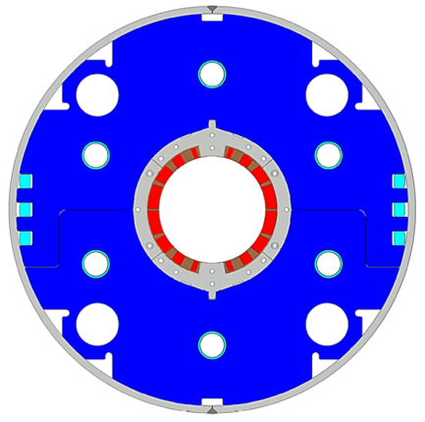
Japanese Contribution to HL-LHC: D1 magnets
Beam separation dipole (D1) by KEK
  Design study of D1 for HL-LHC within the framework of the CERN-KEK collaboration since 2011.
  150 mm single aperture, 35 Tm (5.6 T x 6.3 m), Nb-Ti technology.
  Development 2-m long model magnets (3 units) at KEK
Deliverables for HL-LHC
  1 full-scale prototype cold mass (LMBXFP)
  6 series cold masses (LMBXF1-6)
7 units x 7-m long cold masses

Slide 4
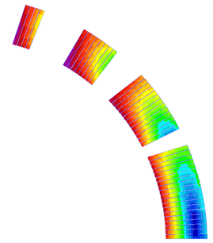
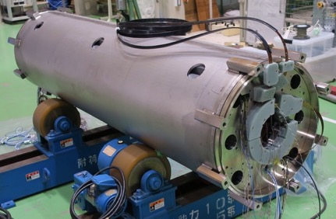
Design parameters
GFRP
wedge
Collar
 | prototype, series production (7m)
Coil aperture | 150 mm
Field integral | 35 T m
Field (3D) | Nominal: 5.60 T, Ultimate: 6.04 T
Peak field (3D) | Nominal: 6.58 T, Ultimate: 7.14 T
Current | Nominal : 12.11 kA, Ultimate 13.23 kA
Operating temperature | 1.9 K
Field quality | <10⁻⁴ w.r.t B₁ (R_{ref}=50 mm)
Load line ratio (3D) | Nominal: 76.5%, Ultimate: 83.1% at 1.9 K
Differential inductance | Nominal: 4.0 mH/m
Conductor | Nb-Ti: LHC-MB outer cable
Stored energy | Nominal: 340 kJ/m
Magnetic length | 6.26 m
Coil mech. length | 6.58 m
Magnet mech. length | 6.73 m
Heat load | 135 W (Magnet total) 2 mW/cm³ (Coil peak) > 25 MGy
Radiation dose
Shell
Nb-Ti/Cu coil
Yoke
QPH
Insulation
Brass shoe
4
8
12 ton
13
4 blocks
44 turns
19
Large-aperture single layer coil → Mechanical support of a coil is challenging
Three 2 m model magnets were developed at KEK.

Slide 5
D1 Prototype Cold Mass: MBXFP1

Slide 6
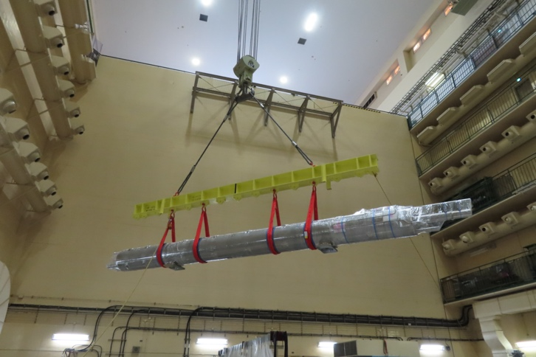
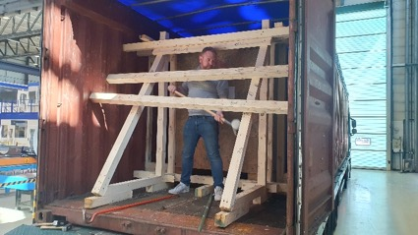
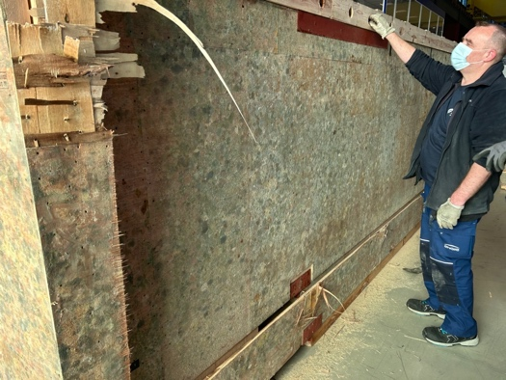
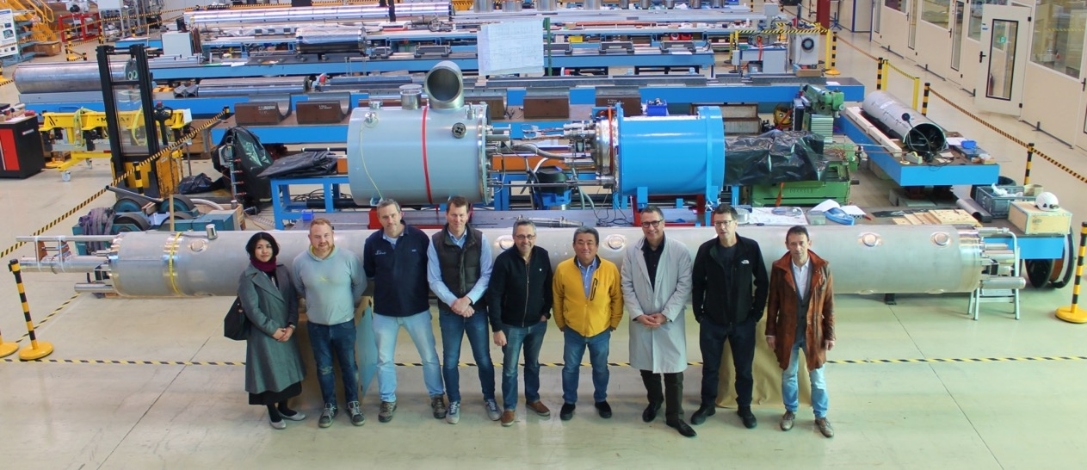
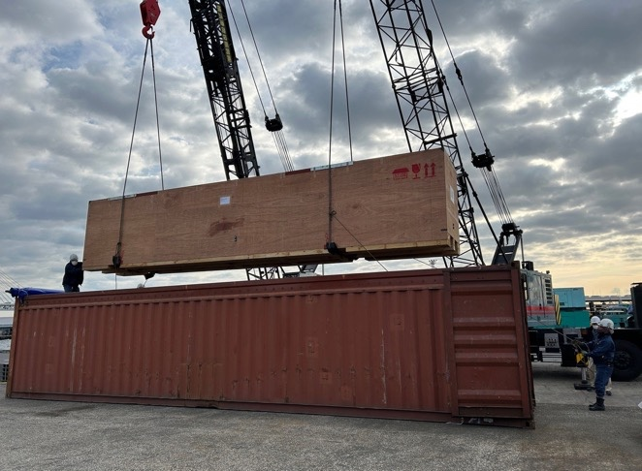
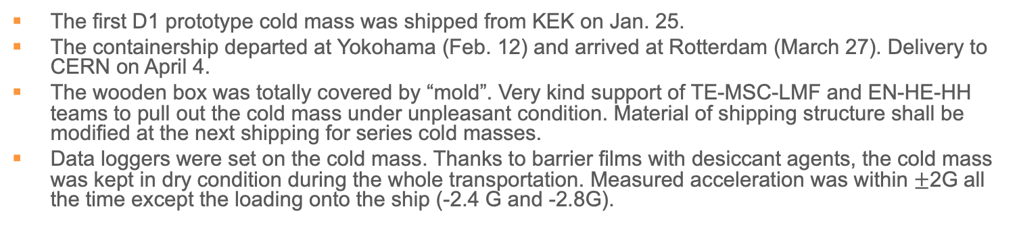
Delivery of MBXFP1 to CERN
The first D1 prototype cold mass was shipped from KEK on Jan. 25.
The containership departed at Yokohama (Feb. 12) and arrived at Rotterdam (March 27). Delivery to CERN on April 4.
The wooden box was totally covered by “mold”. Very kind support of TE-MSC-LMF and EN-HE-HH teams to pull out the cold mass under unpleasant condition. Material of shipping structure shall be modified at the next shipping for series cold masses.
Data loggers were set on the cold mass. Thanks to barrier films with desiccant agents, the cold mass was kept in dry condition during the whole transportation. Measured acceleration was within $±$2G all the time except the loading onto the ship (-2.4 G and -2.8G).

Slide 7
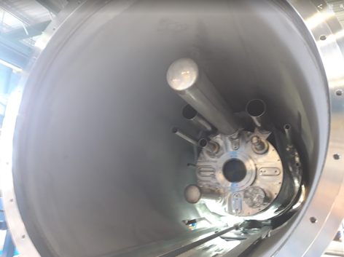
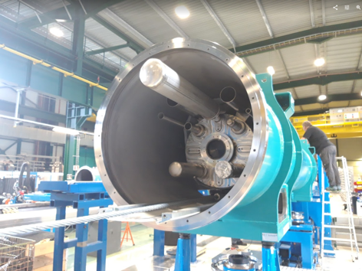
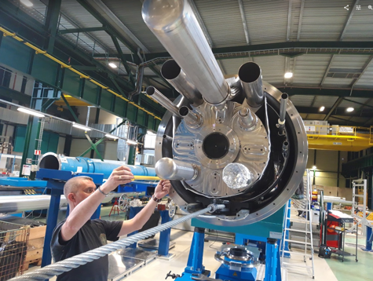
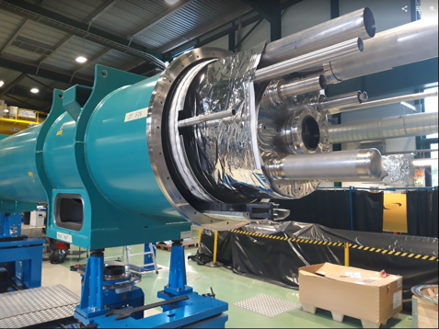
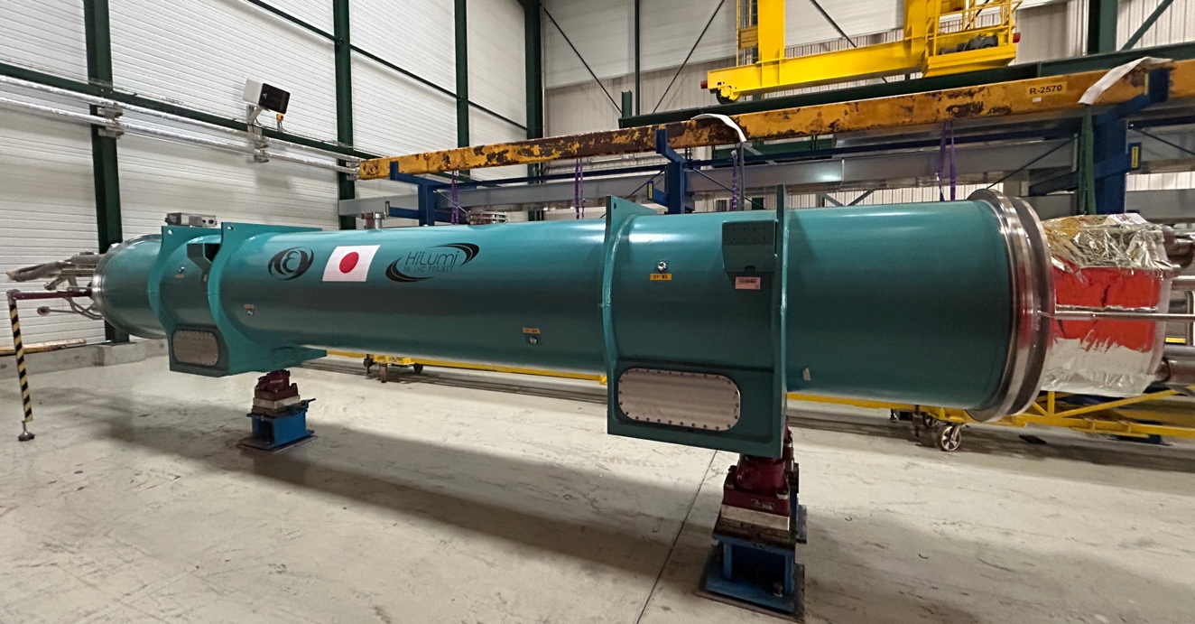
Cryostatting of MBXFP1 at CERN
Courtesy of Delio Duarte Ramos, Franco Julio Mangiarotti
Many thanks to H. Prin, D. Duarte Ramos for completing the cold mass and for cryostatting.
Cryostatting report at WP3 meeting can be found at https://indico.cern.ch/event/1296834/ .
Cooling of the magnet at SM18 was started in November and the powering test will be started soon.

Slide 8
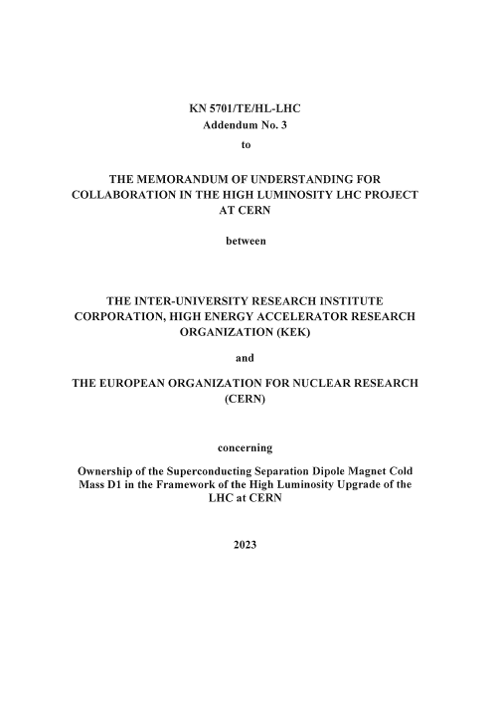
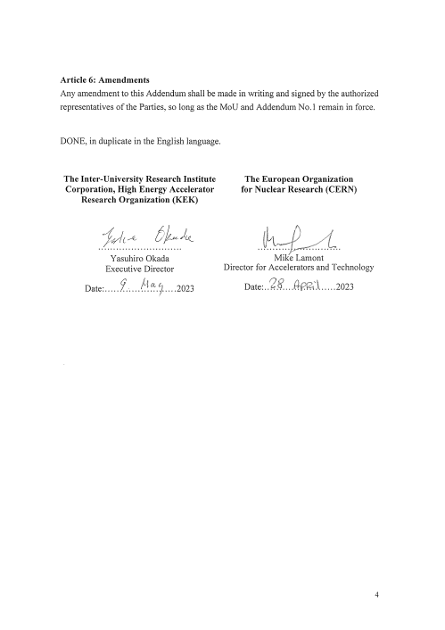
New MoU Addendum
Protocol of the ownership transfer of the D1 cold mass was NOT defined in the Addendum #1.
Discussion was triggered by the delivery of the D1 prototype and the Addendum #3 was finally issued in May 2023.

Slide 9
Status of the series D1 Cold Masses

Slide 10
Flow of D1 Cold Mass Production
Final assembly of cold mass
PV: Pressure Vessel
5 cap welding for prototype,
installation of tubes (BT, HXT)
final splice, instrumentation
end-cover & extremities welding
alignment & support welding
Magnet
1 coil winding
HITACHI
2 insulation, collaring
HITACHI
3 yoking
inspection incl. pressure test (@ 2.5 MPa)
4 shell & end-ring welding, end-plate, splice. Alignment target welding, cap welding for series, alignment meas.
KEK
SSW
Rotating coil
warm MFM
HP: readiness of shipping, documents.
CERN HP
vertical cold test
KEK
shipping to CERN
Training Quench
MFM at cold
CERN
SSW
Rotating coil
Cryostating
Horizontal cold test
warm MFM

Slide 11
Status of Series Magnet Production
MBXF5
  NC: the coil insulation damages were found after removal of the collaring-mandrel after yoking process. EDMS 2753776. (Report at the last meeting.)

Slide 12
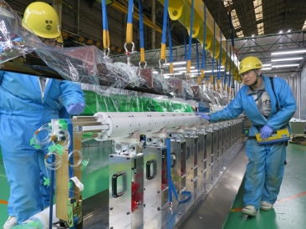
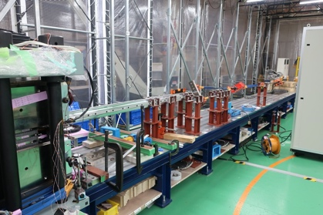
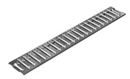
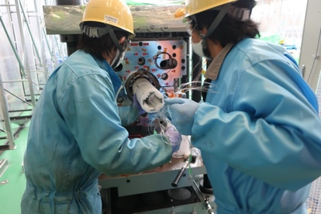
Major NC in Manufacturing of MBXF5
Recall
LT-1 and LB-1 coils for MBXF5 were completed.
  Estimated coil pre-stress: Good.
    LB-1: L120.7 (L) & 122.9 (R), LT-1: 121.7 (L) & 122.2 (R) (unit: MPa).
    EDMS 2724784
All components for the magnet were already fabricated.
Collaring and yoking processes were successfully done in June 2022.
NC: potential coil insulation damage was found after removal of the collaring-mandrel. EDMS 2753776.
  Investigation is underway.
Flat rollers
Spacers more than plan were removed from the RE side and the coil were exposed to the flat-rollers…

Slide 13
Repair of MBXF5 Coils
After repair of the damaged insulation
Electrical soundness of the repaired coils was validated by electrical test (coil resistance, inductance, impulse test at 1.3 kV).

Slide 14
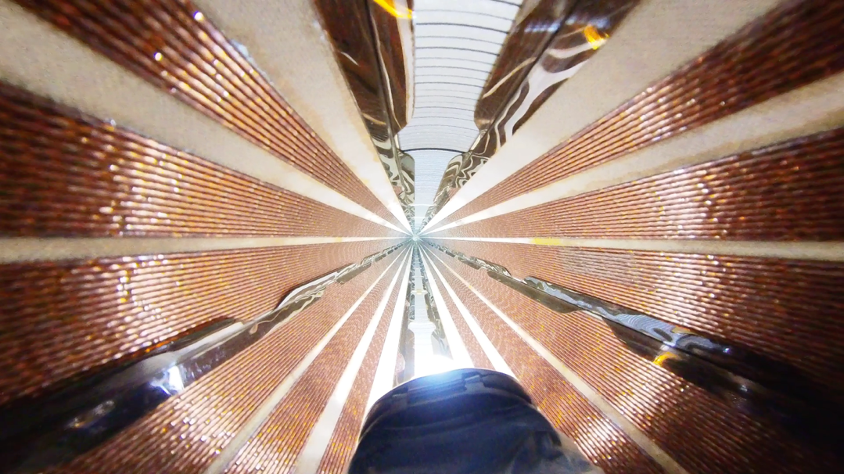
Status of Series Magnet Production
MBXF5
  NC: the coil insulation damages were found after removal of the collaring-mandrel after yoking process. EDMS 2753776. (Report at the last meeting.)
    The coils were successfully repaired and the NC was closed.
  The vertical cold test is being performed at KEK (Sep. 2023~).
MBXF1
  The vertical cold test was completed at April to June 2023.
  The final assembly of the cold mass is currently underway at Hitachi.
  Delivery to CERN is planned in June 2024 as the 1st series cold mass.
MBXF2
  The longitudinal shell welding was completed. The magnet will be delivered to KEK for the cold test in February 2024.
MBXF3
  Two coils were fabricated and the coil size measurement is ongoing.
MBXF5: Inside of coil bore after successful insulation repair.

Slide 15
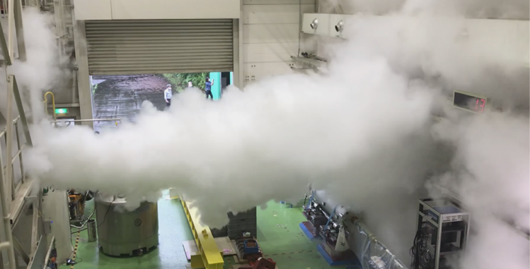
Remaining Issues in KEK Test Facility after MBXFP1 Powering Test
Recall
Training quench up to the ultimate current (13.2 kA) was NOT demonstrated in the powering test of MBXFP1 due to limitation of the test facility…
Target of Facility Upgrade
  Maximum voltage below 600 V at the ultimate current.
  Magnet dissipation energy below the safety limit of 1.5 MJ.
  Increase of helium gasbag capacity.
To satisfy these targets, new energy extraction using varistors and the additional helium gasbag were implemented before the cold test of MBXF1.

Slide 16
Test facility upgrades

Slide 17
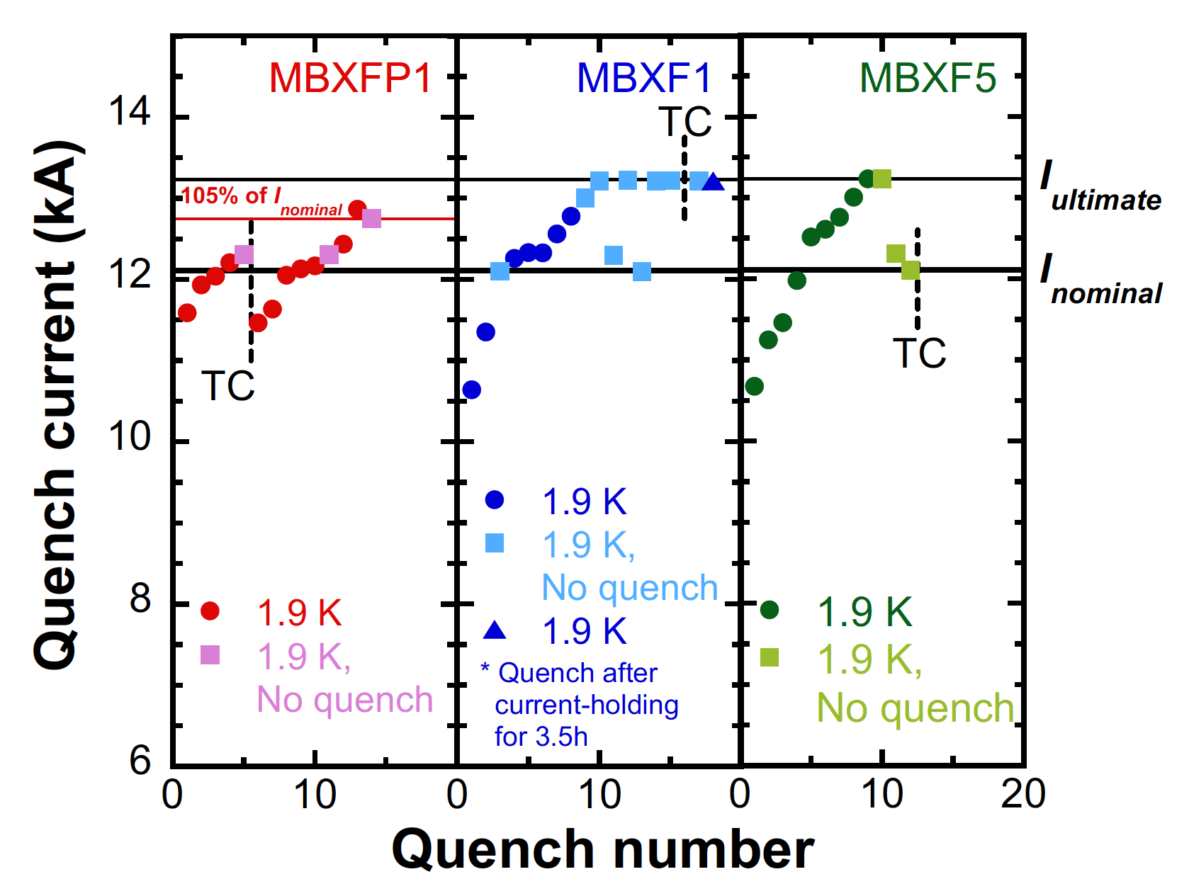
Training performance
 | MBXF1 |  | MBXF5
Test Cycle | Quench# | Iq (A) | Quench# | Iq (A)
1st TC | 1 | 10639 | 1 | 10673
 | 2 | 11353 | 2 | 11246
 | 3 | 12260 | 3 | 11461
 | 4 | 12331 | 4 | 11978
 | 5 | 12326 | 5 | 12514
 | 6 | 12559 | 6 | 12611
 | 7 | 12778 | 7 | 12778
 | NQ | 13214 | 8 | 13004
 |  |  | 9 | 13231
 |  |  | NQ | 13231
2nd TC | NQ | 13213 | TBD | TBD
MBXF1 and MBXF5 successfully reached the ultimate current (108% of the nominal current for HL-LHC). Thanks to the upgrade of the test facility.
Similar behavior of the training performance was observed.
No quench was needed for MBXF1 to reach the ultimate current after the full thermal cycle. Good training memory was confirmed.
The 2nd TC of MBXF5 is ongoing.
  In the meantime, the test has been postponed due to a technical issue of the warm-turbine of the refrigerator.

Slide 18
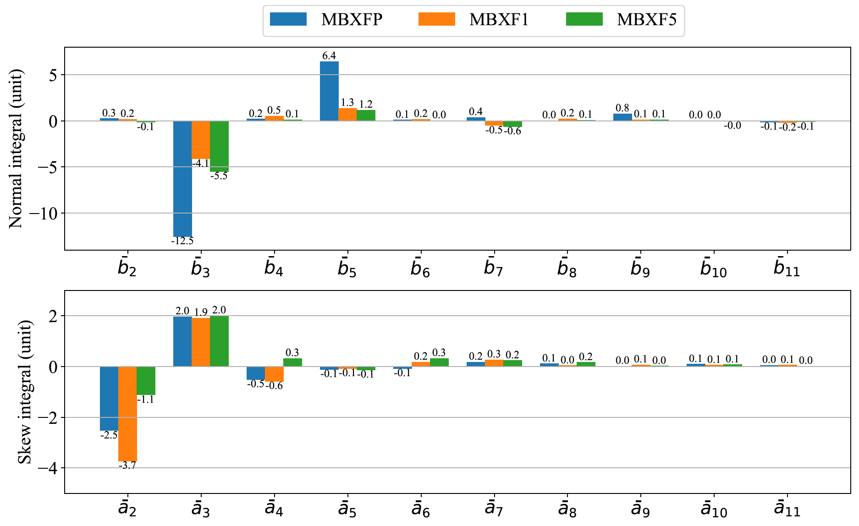
Field Quality: Integral
Prototype
Series
b₃ and b₅: fine tuning of coil cross section
Fine tuning of coil cross section to improve b₃ and b₅ was implemented for the series and the effectiveness was demonstrated.
The measured results were in good agreement with the calculation.
Good reproducibility was confirmed in the series magnets.

Slide 19
Summary
The D1 prototype cold mass was delivered to CERN in April 2023. Cold test at SM18 will be started TODAY (the 7th of Dec.).
A series production of the D1 has been progressing.
  MBXF5: NC of the insulation damage was closed. The 2nd TC of the cold test is underway at KEK.
  MBXF1: Following the successful cold test, the final assembly of the cold mass is ongoing.
  MBXF2 and 3: Magnet production is ongoing.
  MBXF6: A contract to fabricate the magnet parts will be awarded to Hitachi soon.
  MBXF4: Manufacturing will be started in JFY2024.
Powering test of the series magnets (MBXF1 and 5) at KEK
  2 series magnets successfully reached the ultimate current.
  Good training memory was demonstrated by MBXF1.
  Multipole coefficients have been within the tolerance. Good reproducibility was confirmed.

