Slide 1
CERN-KEK Collaborative Activities for
Linear Colliders
Steinar Stapnes – with information/slides from many others at KEK and CERN
Today:
Agreements and activities: ILC ITN, ATF (collaboration), CERN-KEK offices
Also: Klystron (completed), and continued X-band common work, ILC IDT mostly/fully replaced by ILC ITN agreement
Main new developments:
  ILC future planning and CERN’s role – agreement on ITN signed in July
  EAJADE started March 2023 (exchange programme with Japan (and Americas) for Higgs factories - ATF, SuperKEKb, sustainability studies, SCRF, etc

Slide 2
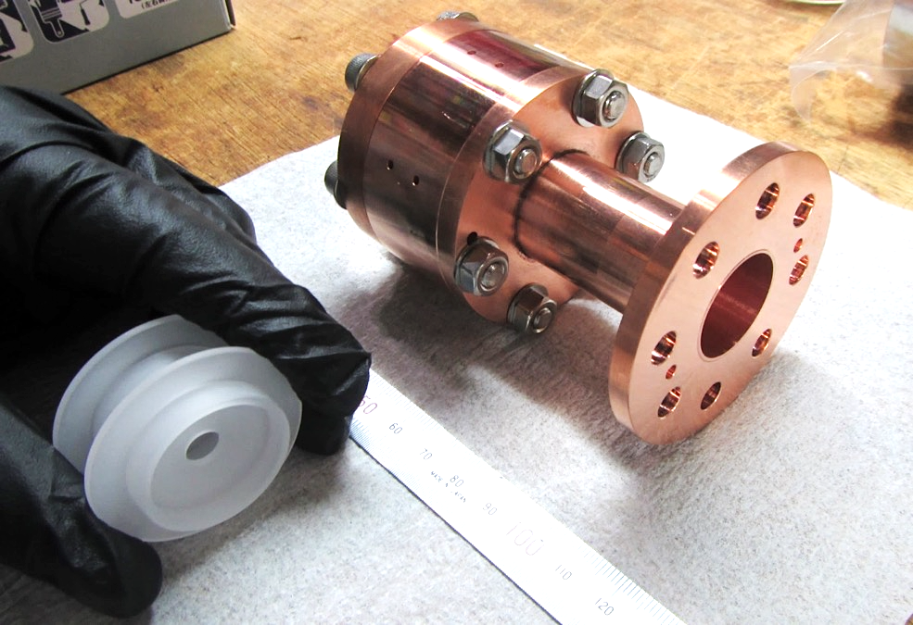
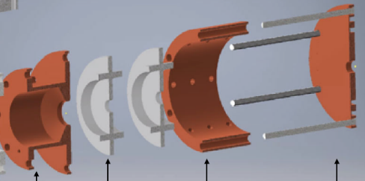
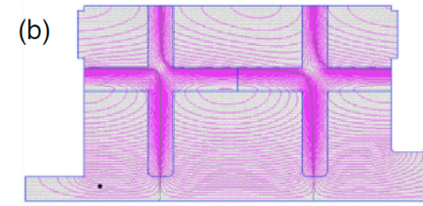
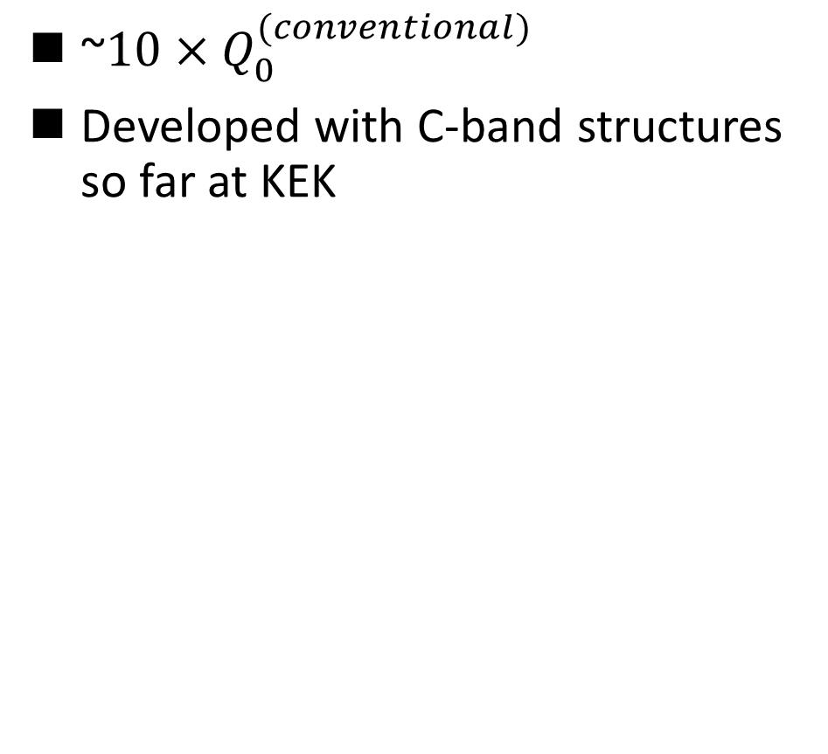
The 1st high-gradient test after the fire performed for
X-band Dielectric-Assist Accelerating (DAA) test cavity
~10 × $Q_{0}^{(conventional)}$
Developed with C-band structures so far at KEK
X-band (11.424 GHz)
These dielectric disks
installed in this metallic cavity
RF
E-field
Figures excerpted from
Shingo Mori, Mitsuhiro Yoshida, and Daisuke Satoh,
"Multipactor suppression in dielectric-assist accelerating structures via diamondlike carbon coatings",
Phys. Rev. Accel. Beams 24, 022001 – Published 12 February 2021

Slide 3
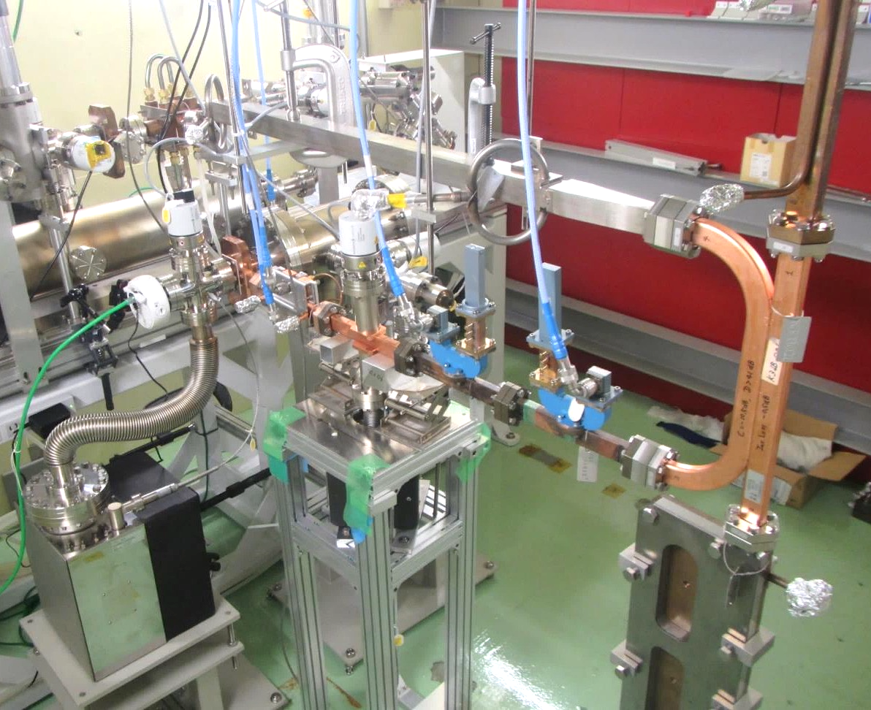
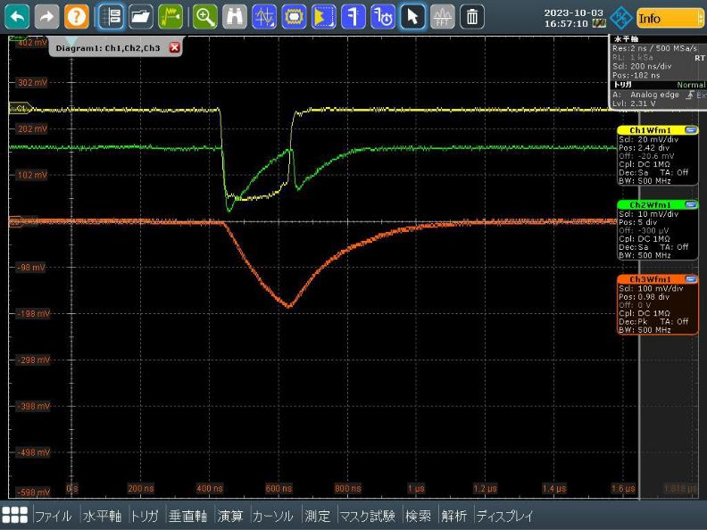
Setup for the X-band DAA test cavity in Nextef2/Shield-B
From the klystron
↓
With a reduced Q₀ for high-field testing on the dielectric material
  Fill time: ~200 ns
100%
DAA test cavity inside this vacuum chamber
↓Horizontal dummy load
We collected experimental data on the high-field performance.
↓Input
10dB coupler →
←Reflection
On-axis camera
10%
TM₀₁ mode launcher
(rect.TE₁₀→circ.TM₀₁)
↑Pickup
90%
200 ns
Vertical dummy load→

Slide 4
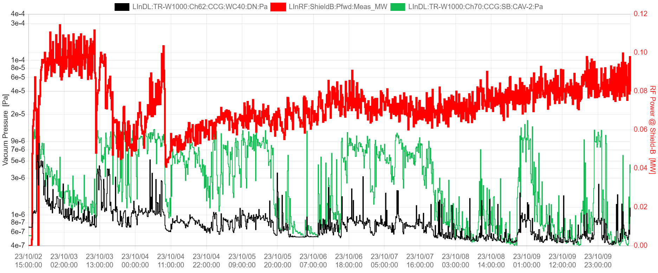
One week history of the 24-hour conditioning
2023-10-02 15:00 to 2023-10-10 9:00
with no interruption
11 h
Input RF power to the DAA cavity [MW] →
← Vacuum closest to the DAA cavity [Pa]
← Vacuum closest to the vertical dummy load [Pa]
100 kW →
100 ns →|
|→ 200 ns
150 ns
The RF power reached the goal of this test (~100 kW) with 200 ns pulse width.
The performance of the dielectric material against the high fields to be evaluated later
(Pulse width)

Slide 5
The ILC IDT organization – initiated at the ICFA meeting at SLAC February 2020
2020-21: The IDT – created by ICFA and hosted by KEK – was set up to move ILC towards construction. The worldwide structure of the WGs: https://linearcollider.org/team/
A set of key activities were identified in a Preparation Phase Programme.
2022-23: A subset of the technical activities of the full ILC preparation phase programme have been identified as critical (next slide). These are being addresses by a ~4 year programme called ITN – the ILC Technology Network. Moving forward with this work is being supported by the MEXT (ministry) providing crucial increased funding.
As of today: With funding from 1.4.2023 ITN is now starting. An agreement KEK and CERN and several European lab activities have been/are being set up. In the US the P5 process is ongoing, the hope is that ITN planning and interests can turn into important ITN involvements in due time.

Slide 6
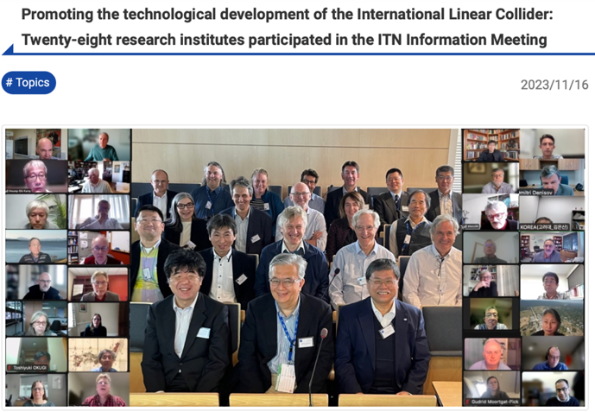
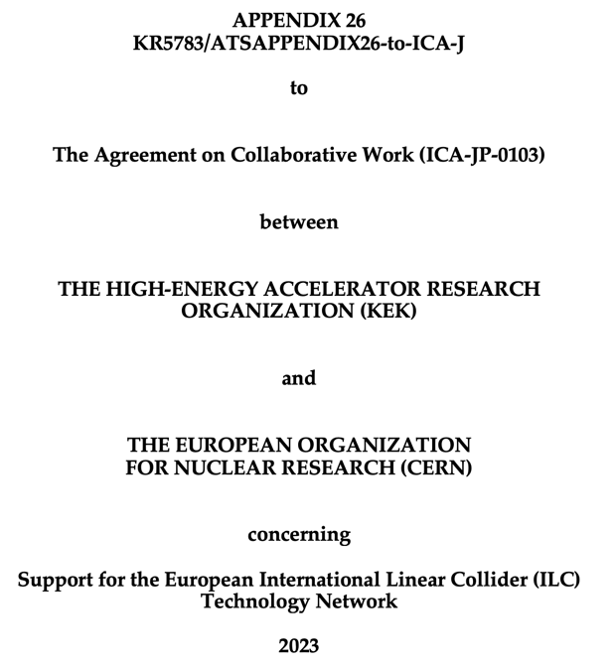
The ITN
WPP | 1 | Cavity production
WPP | 2 | CM design
WPP | 3 | Crab cavity
WPP | 4 | E- source
WPP | 6 | Undulator target
WPP | 7 | Undulator focusing
WPP | 8 | E-driven target
WPP | 9 | E-driven focusing
WPP | 10 | E-driven capture
WPP | 11 | Target replacement
WPP | 12 | DR System design
WPP | 14 | DR Injection/extraction
WPP | 15 | Final focus
WPP | 16 | Final doublet
WPP | 17 | Main dump
Building the ITN activities:
Planning in the IDT WG2 – significant interests and expertise already represented
Information meeting at CERN 16-17.10 jointly organized by KEK and the IDT
Interest matrix for the ITN work-packages, being consolidated
The next step: Further technical discussion to define deliverables, followed by agreement who among the laboratories will deliver what

Slide 7

Personnel with interest and skills in European labs/Univ., local infrastructure.
See left
Material funds as estimated (major/core part from KEK), in some cases complemented by local funding.
Agreement signed 7.7.2023, KEK contribution 2023-24 in progress (niobium and funds to CERN)
EAJADE, MC exchange project supporting Higgs factory personnel exchange to Japan and the US (LINK)
Started 1.3.2023
CERN LC, project office (within existing LC resources at CERN).
LC budget line in MTP until end 2028
The European ITN activities – 2023
European ITN studies are distributed over five main activity areas:
A1 with three SC RF related tasks
SRF: Cavities and Cryo Module (INFN, CEA, DESY, IJCLAB)
Crab-cavities (UK)
Main Linac elements: ML quads and cold BPMs (CIEMAT, IFIC)
A2 Sources
Positron source, pulsed magnet (Uni.H, DESY, CERN)
Wheel/target (the same and UK groups)
A3 Damping Ring including kickers
Low Emittance Ring lab(s) (UK)
A4 ATF activities for final focus and nanobeams
On-going/restarted (UK, DESY, IJCLAB, CERN, IFIC)
MDI (DESY, IJCLAB, Tel Aviv, UK groups)
A5 Implementation including Project Coordination
Dump, CE, Cryo – significant earlier efforts at CERN, follow up under discussion
Sustainability, Life Cycle Assessment (CERN, DESY, CEA, UK groups)
EAJADE started (EU funding) (DESY, UK, CEA, CNRS, IFIC, INFN, UHH, CERN)
Green: Being implemented
Yellow: Programme being defined with partners
Red: Programme in Europe less well defined

Slide 8
EAJADE
EAJADE (Europe–America–Japan Accelerator Development and Exchange programme) is a training, education and staff exchange network in the field of accelerator research for high-energy elementary particle physics (HEP).
The key technical challenges for the future Higgs factories are many but the most important addressed in EAJADE are, all with important training, skill development and knowledge exchange elements:
Luminosity performance, hardware and method developments related to this, being addressed in smaller beam facilities, prototypes and laboratory tests (addressed in work packages 1,2 and 3 covering method studies and hardware evaluations in beam tests, development and tests of radio-frequency (RF) systems and special devices that are critical for nanobeam creation, conservation and diagnostics).
Upgrading to higher energies and accelerating gradients (addressed in work packages 2 and 5 covering RF developments and plasma acceleration studies).
Power efficiency and sustainability, importantly connected to RF (addressed in work packages 2 and 4 covering RF efficiency improvements and power/energy reductions and recovery, and sustainable facilities in a wider perspective).
Best practices, international collaboration, exchange of ideas and collaborative studies across Higgs factory proposals, training related to prototyping and tests in facilities and laboratory setup (all work packages).
For all the on-going R&D activities, and for the Higgs factory studies and potential later implementation, training of future accelerator experts will be crucial. These projects are very long term and today it is important to train the future scientists and engineers who will implement them. The training, networking and interdisciplinary focus of EAJADE create an ideal and very international career development environment for these future experts and leaders in the field. Providing such an environment is therefore the overarching goal of EAJADE.
Specifically for CERN-Japan, can support many of the common activities we have talked about earlier, started March 2023
EAJADE (Europe–America–Japan Accelerator Development and Exchange programme) focused in Higgs Factories, with participation of major EU (CERN, INFN, CEA, DESY, CNRS, CSIC, UOXF), Japan (KEK, Tokyo Univ., Tohoku Univ.) USA (BNL, FNAL, SLAC, JLAB, LBNL, Cornell Univ.) and Canada (VISPA) labs.

Slide 9

EAJADE
WEB page: https://wsfa2023.huhep.org

Slide 10

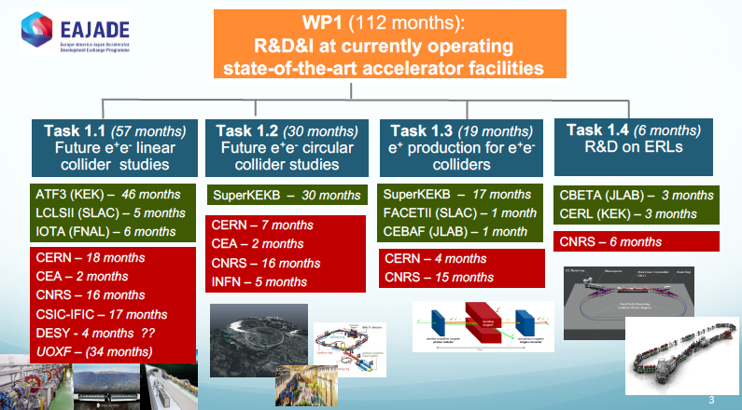
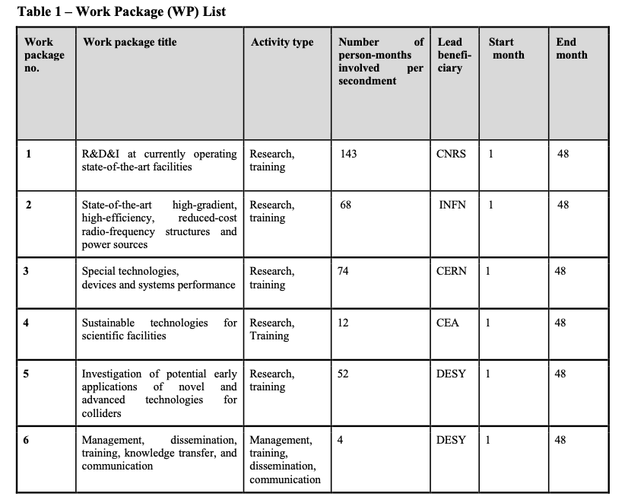
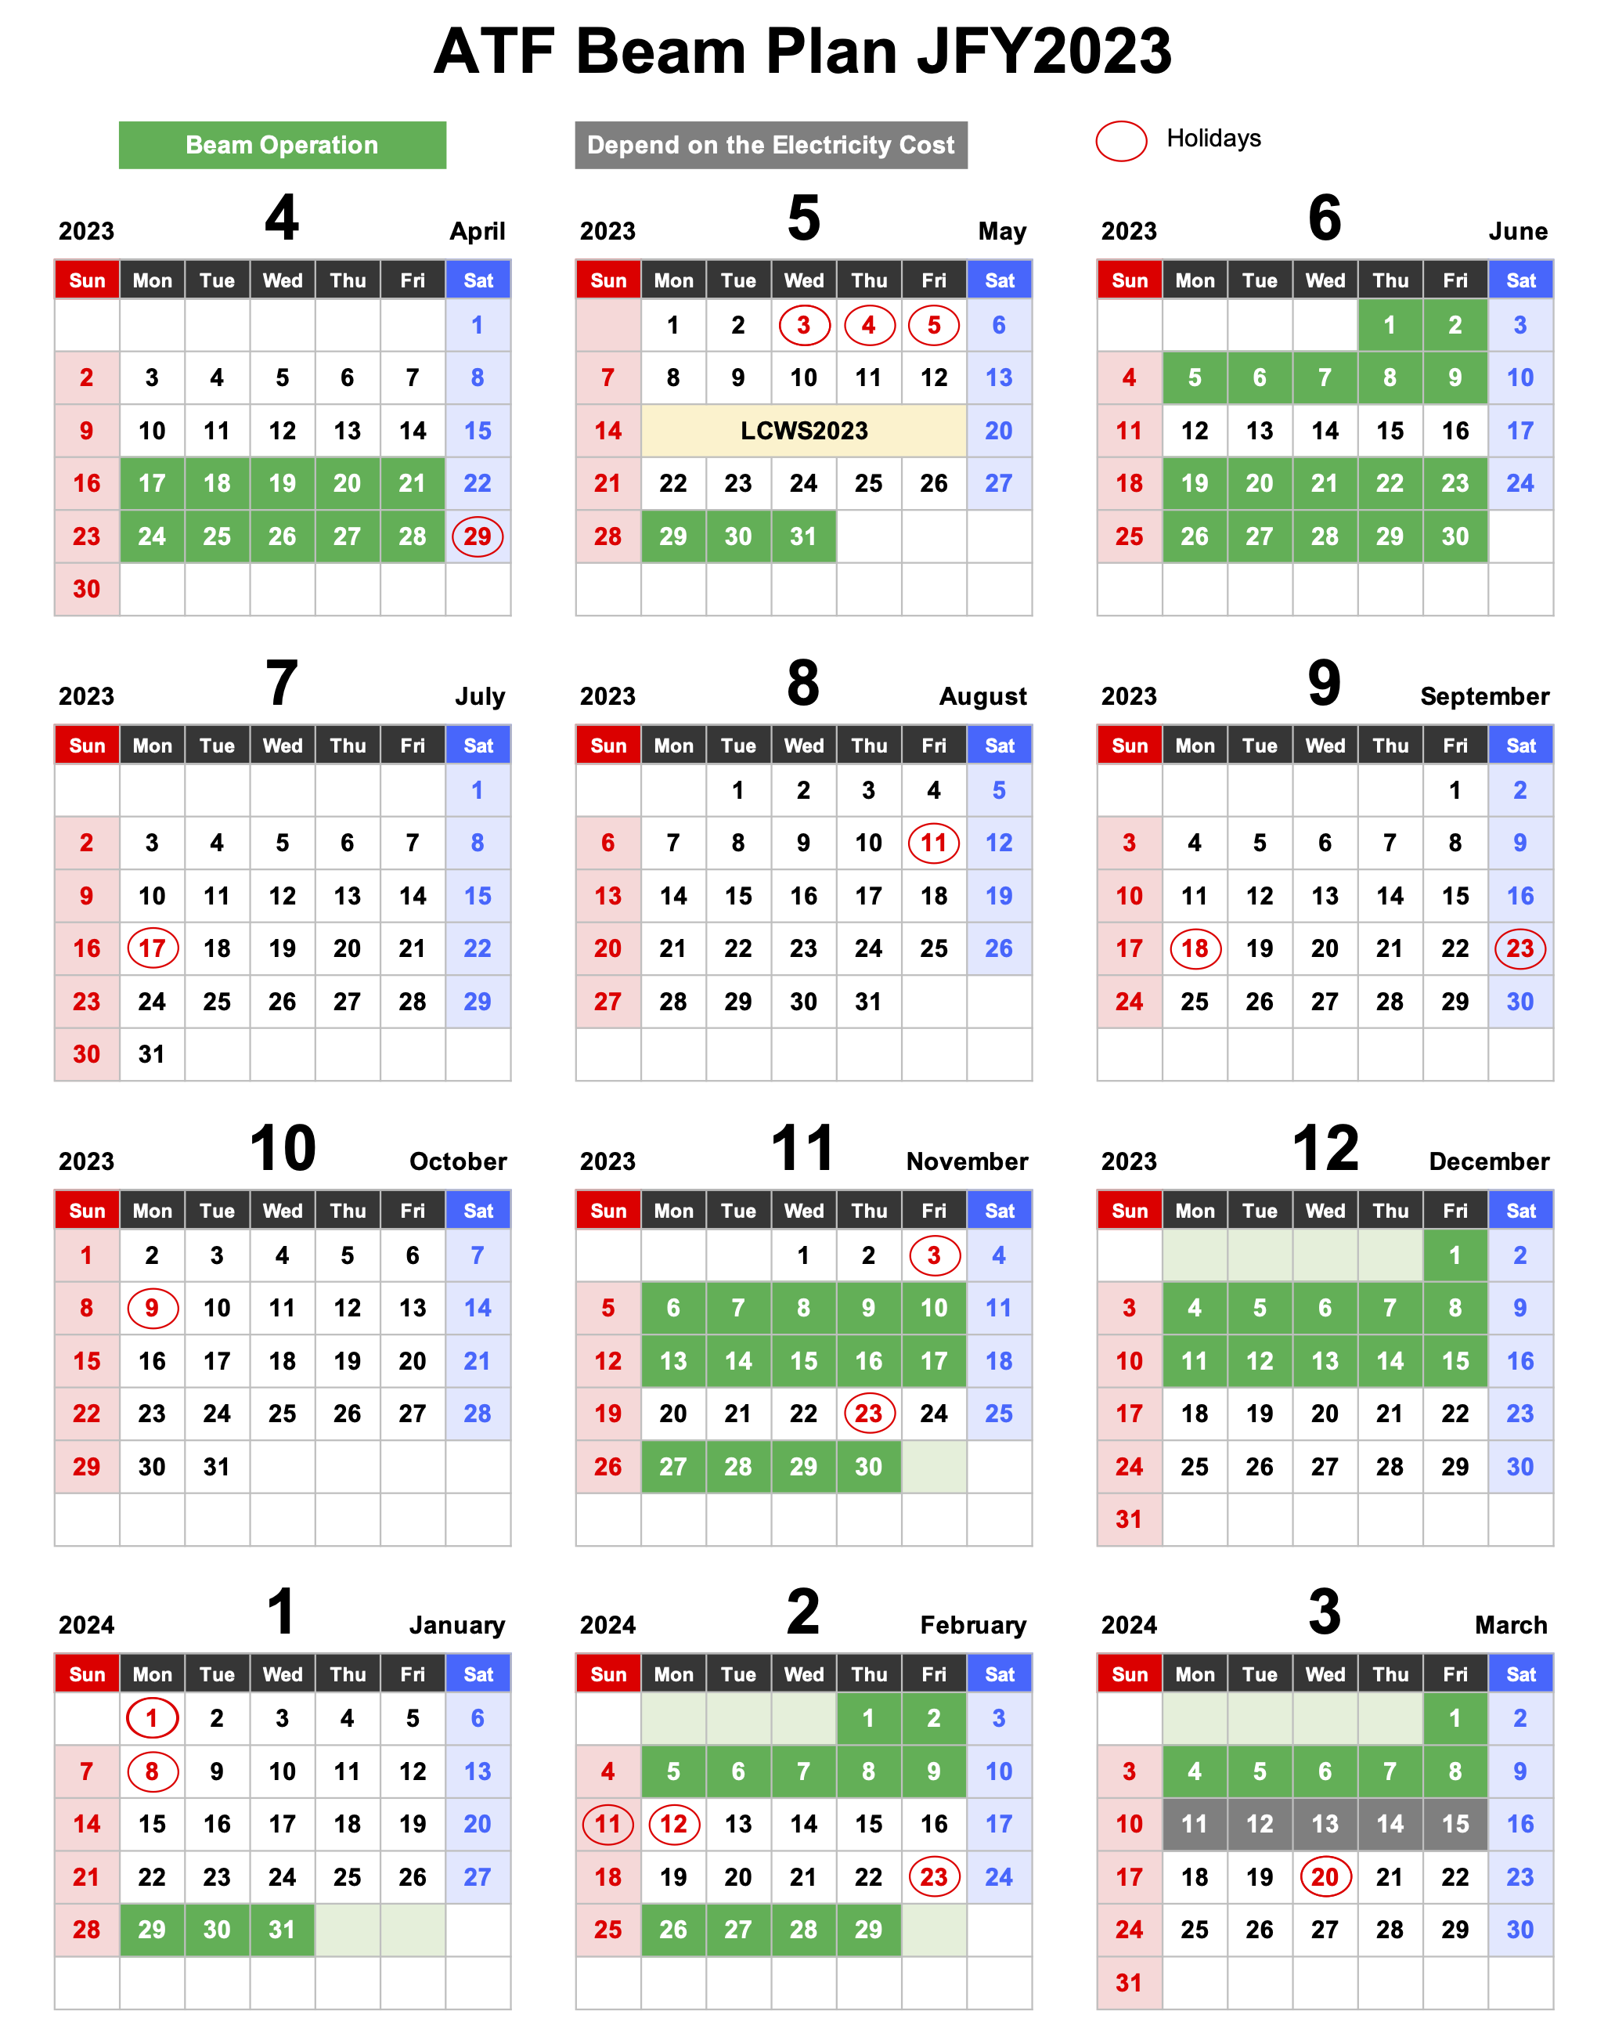
ATF3 in EAJADE project
EAJADE (Europe–America–Japan Accelerator Development and Exchange programme) focused in Higgs Factories, with participation of major EU (CERN, INFN, CEA, DESY, CNRS, CSIC, UOXF), Japan (KEK, Tokyo Univ., Tohoku Univ.) USA (BNL, FNAL, SLAC, JLAB, LBNL, Cornell Univ.) and Canada (VISPA) labs. (2023-2027)
Notes:
EAJADE (Europe–America–Japan Accelerator Development and Exchange programme) is a training, education and staff exchange network in the field of accelerator research for high-energy elementary particle physics (HEP).
The key technical challenges for the future Higgs factories are many but the most important addressed in EAJADE are, all with important training, skill development and knowledge exchange elements:
● Luminosity performance, hardware and method developments related to this, being addressed in smaller beam facilities, prototypes and laboratory tests (addressed in work packages 1,2 and 3 covering method studies and hardware evaluations in beam tests, development and tests of radio-frequency (RF) systems and special devices that are critical for nanobeam creation, conservation and diagnostics).
● Upgrading to higher energies and accelerating gradients (addressed in work packages 2 and 5 covering RF developments and plasma acceleration studies).
● Power efficiency and sustainability, importantly connected to RF (addressed in work packages 2 and 4 covering RF efficiency improvements and power/energy reductions and recovery, and sustainable facilities in a wider perspective).
● Best practices, international collaboration, exchange of ideas and collaborative studies across Higgs factory proposals, training related to prototyping and tests in facilities and laboratory setup (all work packages).
For all the on-going R&D activities, and for the Higgs factory studies and potential later implementation, training of future accelerator experts will be crucial. These projects are very long term and today it is important to train the future scientists and engineers who will implement them. The training, networking and interdisciplinary focus of EAJADE create an ideal and very international career development environment for these future experts and leaders in the field. Providing such an environment is therefore the overarching goal of EAJADE.

Slide 11
Concluding words and next steps
Interesting ongoing collaborative R&D with Japan and KEK with relevance for Linear Colliders (and Higgs factories in general), including ATF3 and EAJADE related exchanges of people.
ILC ITN moving ahead, financial and material support from KEK in the pipeline, initial work and further work-definition in Europe on-going
The existing and wider ITN activities are very well aligned with European accelerator R&D priorities (for Higgs-factories and the LDG roadmap), and builds on existing expertise, industrial capabilities and infrastructure – and a long history of technology developments for SC linacs and ILC in Europe, as well as common work between ILC and CLIC
Slides/plots and pictures from many colleagues in CLIC and ILC – many thanks

