Slide 1
TECHNICAL ACTIVITIES
ADO-PO / TC meeting JULY 2023
Joffrey Malaquin - JULY 6th 2023

Slide 2
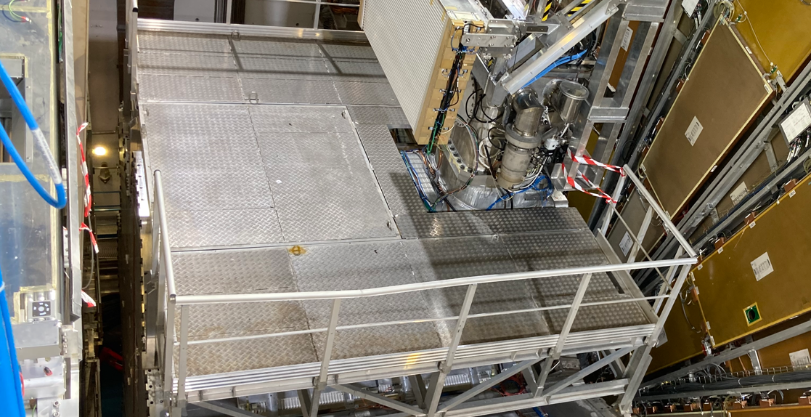
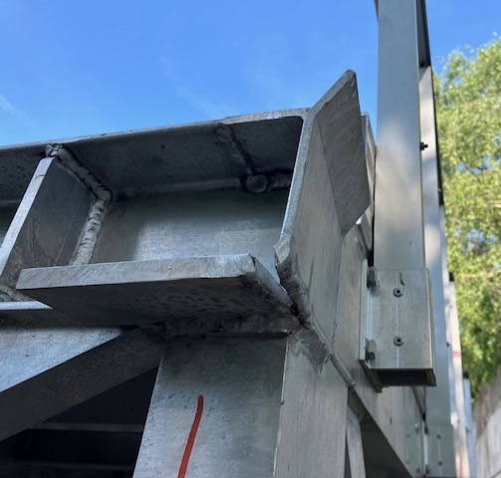
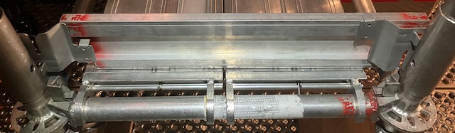
Getting ready for YETS 23-24
Opening / Closing operations
  Opening : from 30.10 to 20.12
  Closing : from 01.02 to 05.03
  Specifics : BW-C MDT/TGC1 separation for ≈ 3 weeks
Ongoing preparations
  ECT platforms guidings repair
  Hydraulic movement system maintenance
  Scaffoldings new self-locking toe boards (≈250)
  …

Slide 3
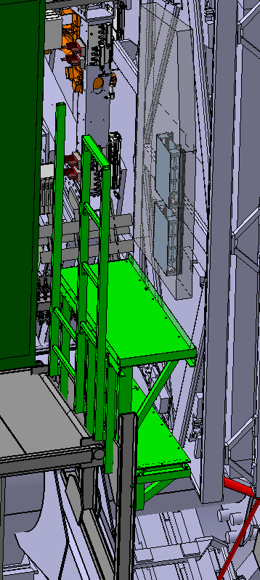
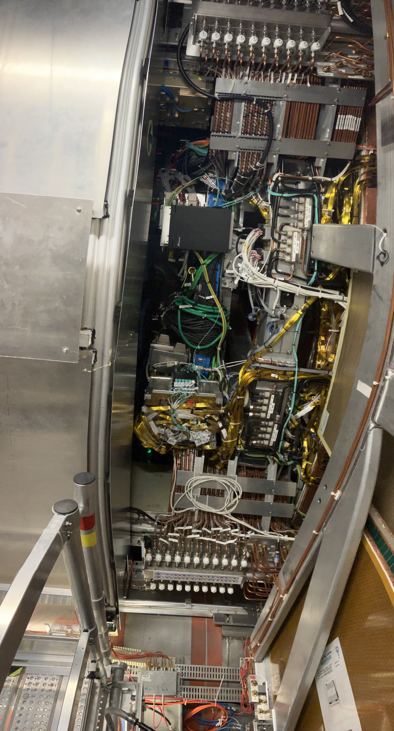
Getting ready for YETS 23-24
  Ongoing preparations
  …
  Procedures improvements
  4x new access platforms to NSW sectors 01-09 manufacturing
  BOL support prototype

Slide 4
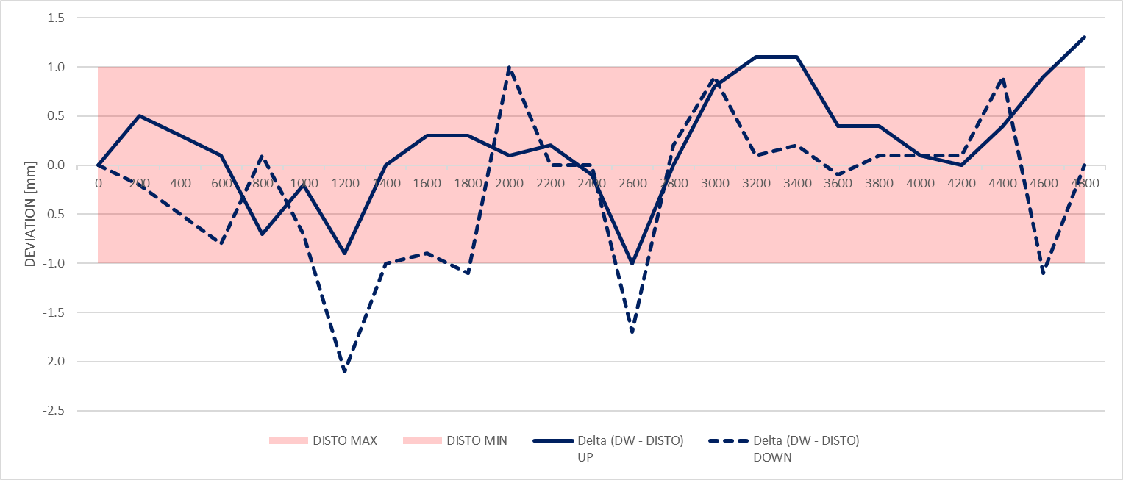
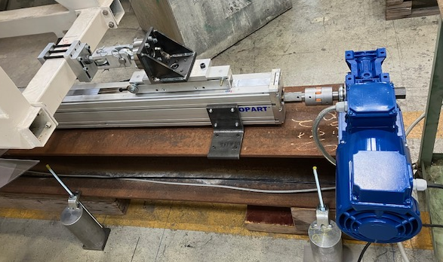
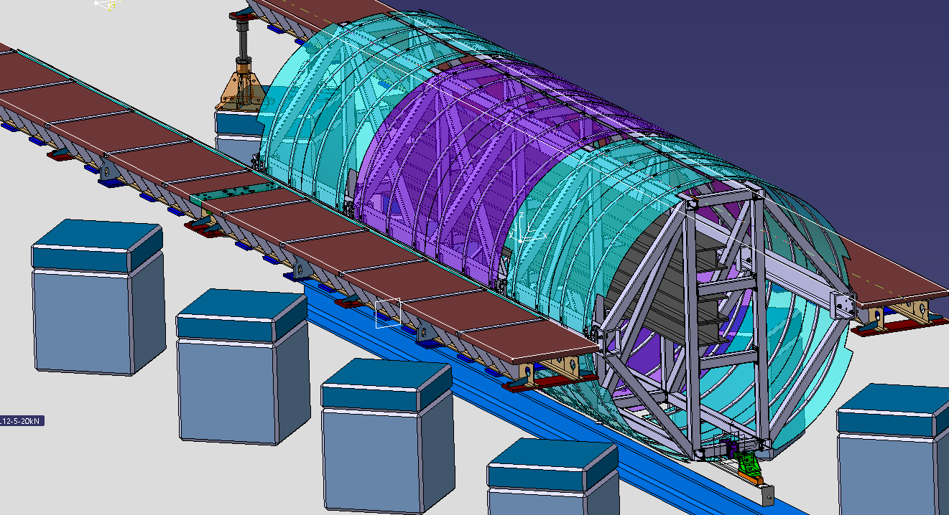
LS3 preparation
ITk lowering and insertion
Ongoing test campaign on ITk insertion mockup
  Components validation (actuator, sensors, frequency inverter…)
  Performance measurements (speed, force, acceleration…)
  Parameters investigation and choice
  Data acquisition software development
Test report to be reviewed at FDR (october 23)
Mockup setup will be upgraded with final toolings in years 2024-25
Force sensor
Reduction
Linear actuator
Motor

Slide 5
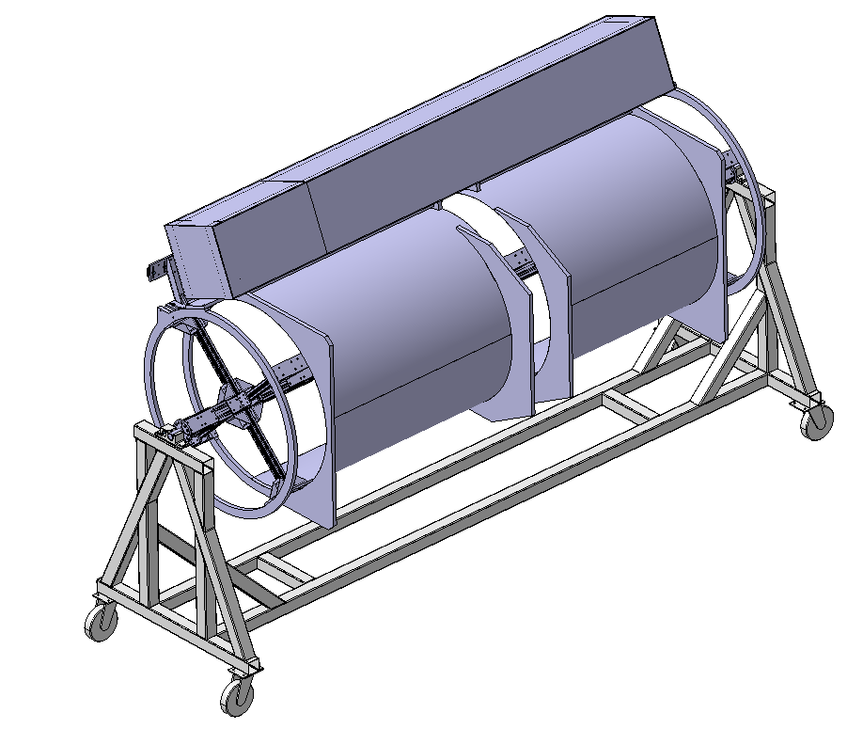
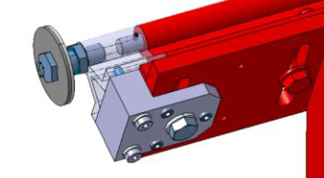
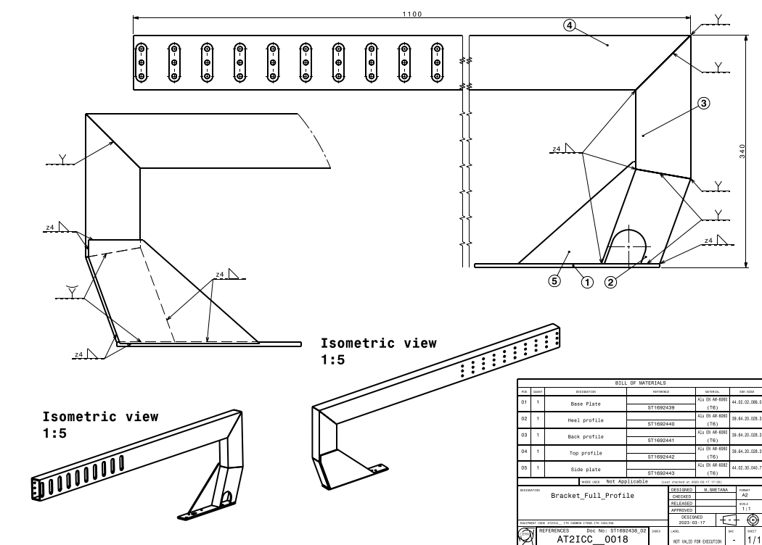
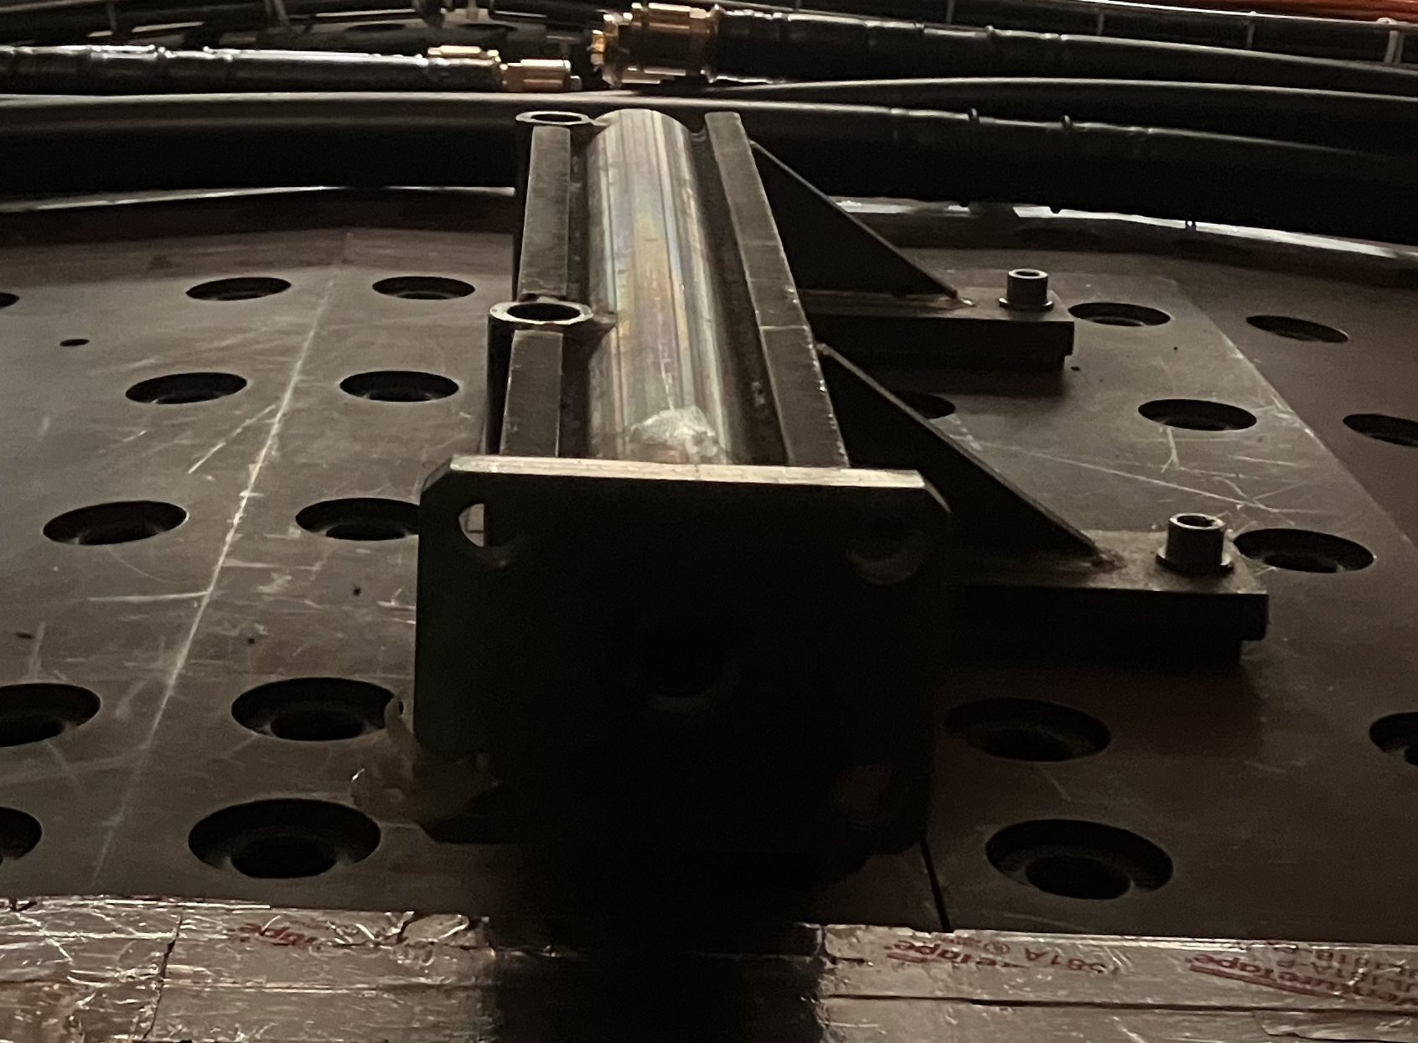
LS3 preparation
Muons
BIS BIL coil mockup for services routing
  Manufacturing and assembly of a scale 1:1 mockup of BT segment
  L = 4000 mm ; Ø 1100 mm
  Delivered to BB5 in June 2023
BIS movement actuator
BIS rails stoppers
BOL access platform
Services routing
PP2 Cooling bracket prototype
RS pins removal / modification

Slide 6
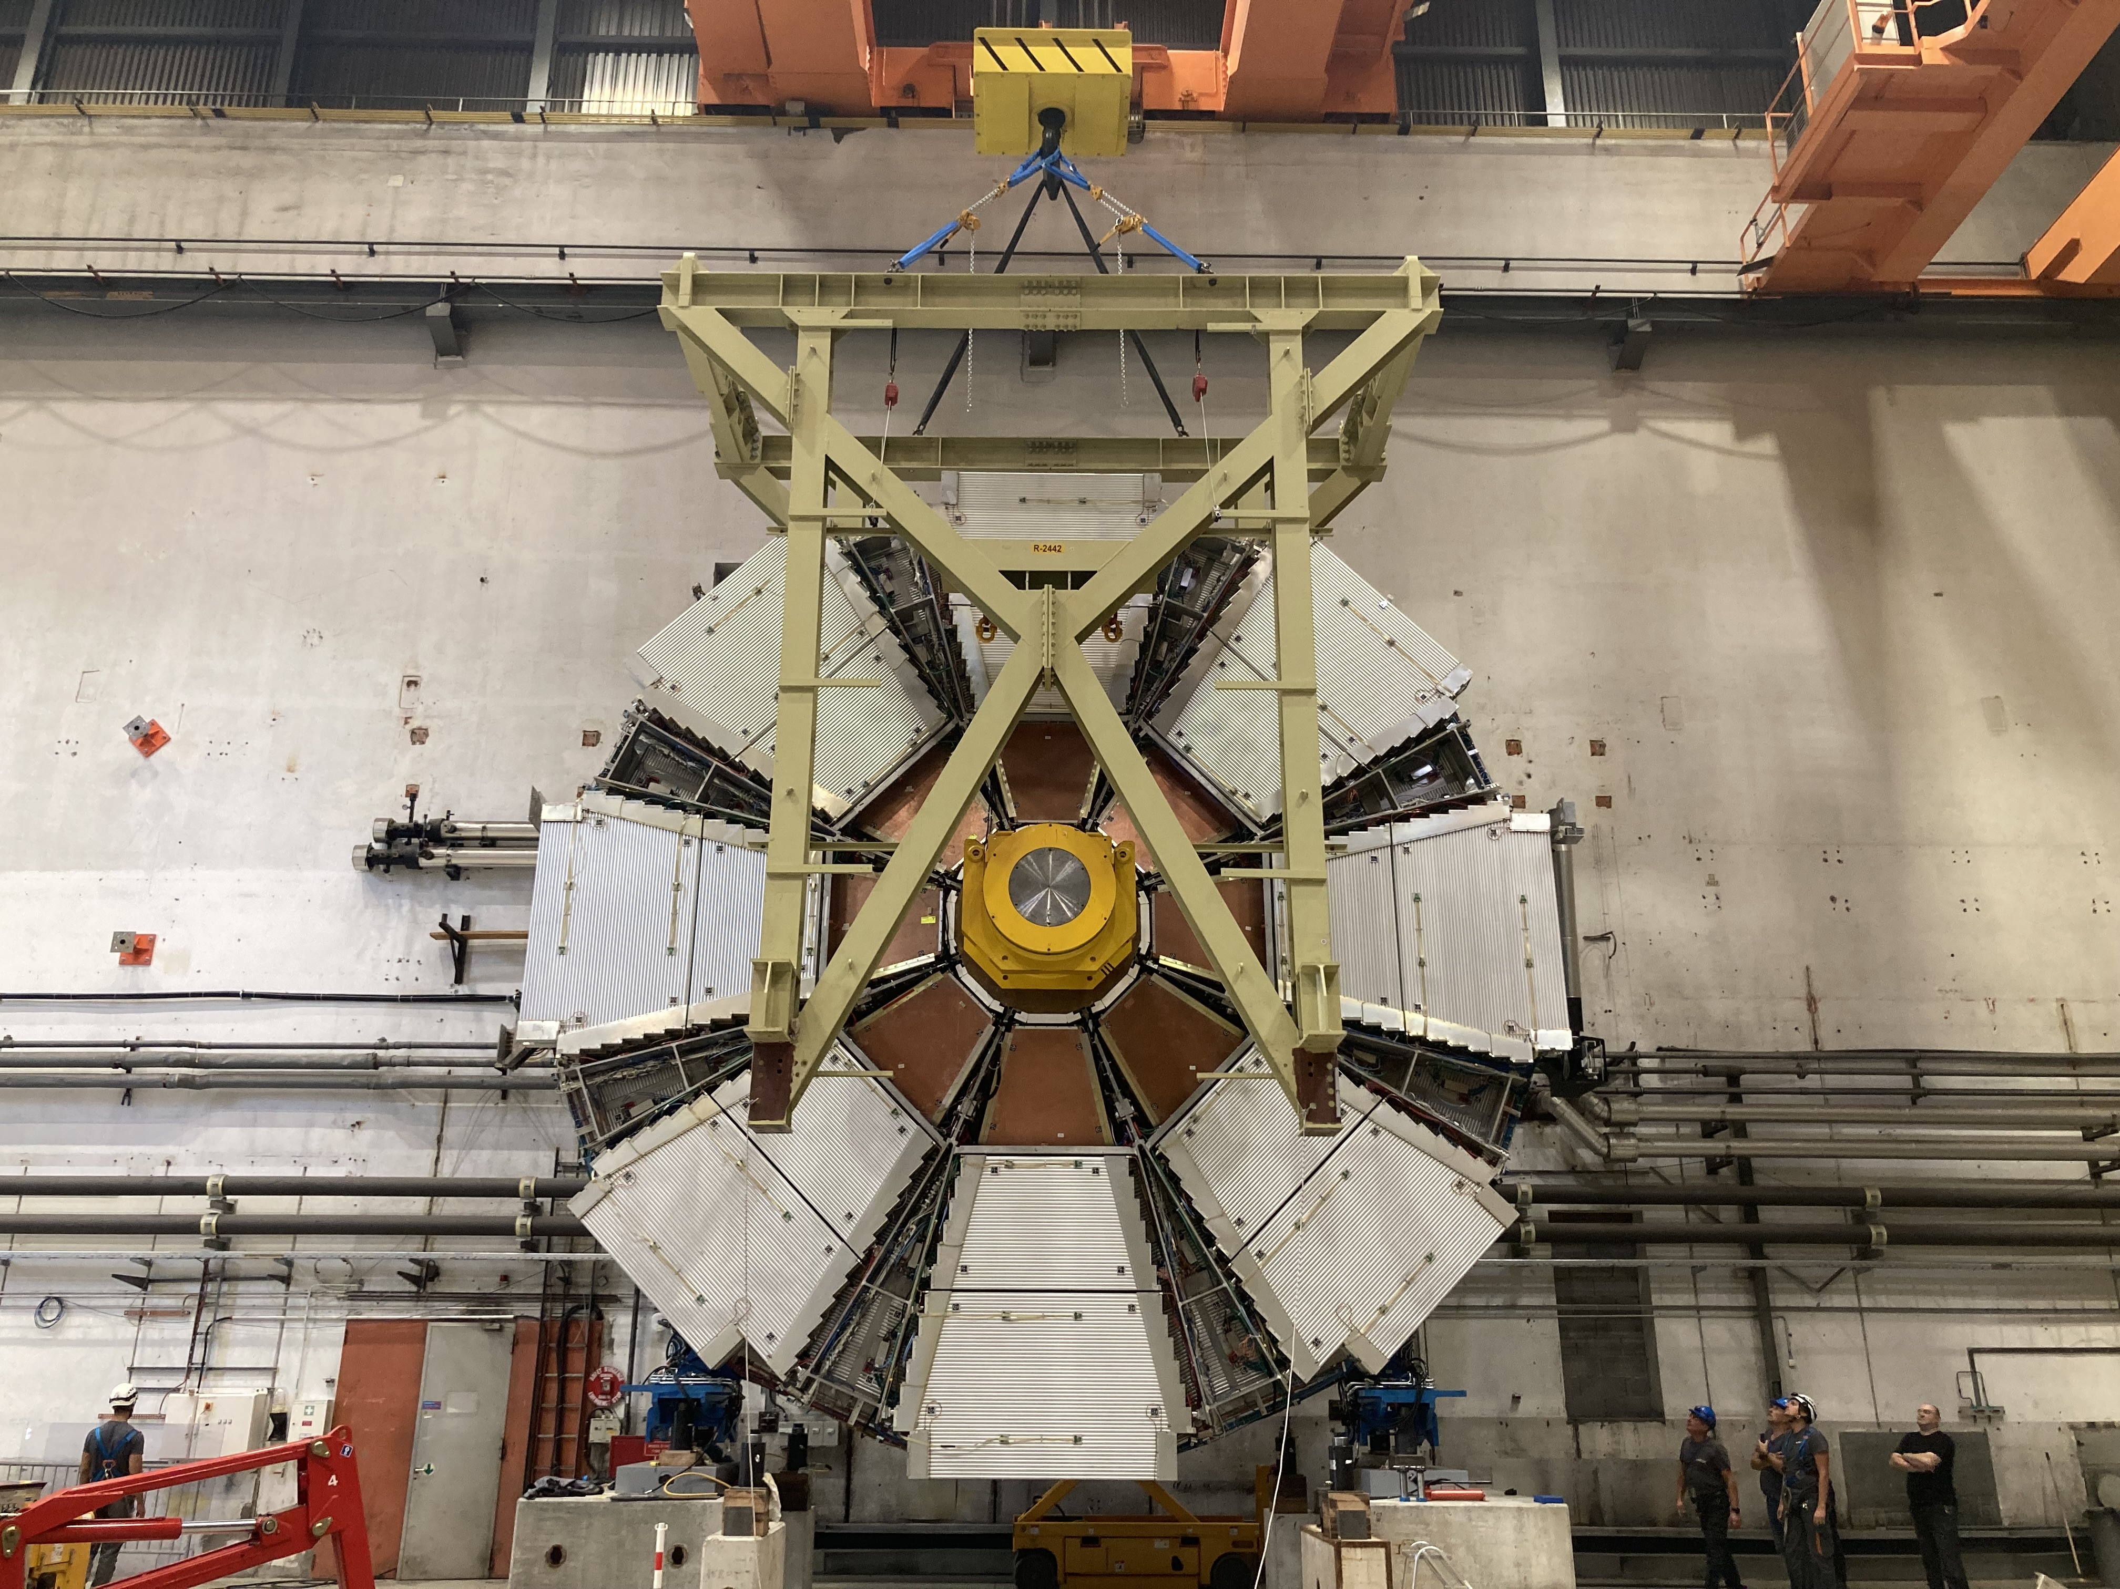
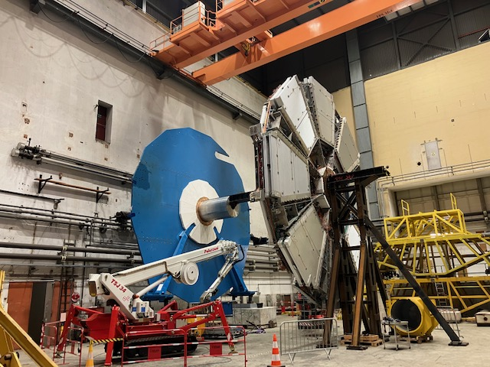
Other projects
JD-SW dismantling operations
    Started in sept 2022
    Currently removing CSC chambers
Support for b180 clean room preparation (HGTD)
Support for sniffers maintenance
Movement system Siemens PLC obsolescence
    Currently installed hardware not supported anymore
    Hardware components to be replaced : PLC, Communication cards
    Programs to be re-written

Slide 7
Technical support - Team
Operational Team
    Gevorg
    Jamie
    Cédric
    Christian
    Armen
    Louis
    Frederic
Supervision
  Joffrey Malaquin
+ design office
part time 50%
Thank you for you attention

