Slide 1
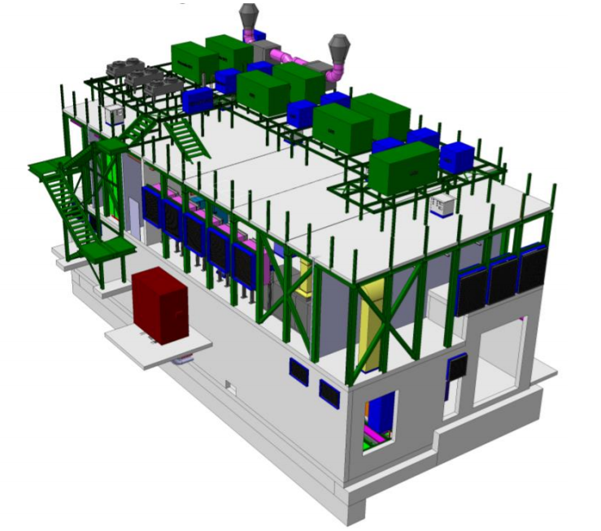


ADO-PO meeting:
Infrastructure
11/05/2023
Gerardo Velazquez Gutierrez (CERN)

Slide 2
Phase II infrastructure upgrade: Introduction & Overview
Major upgrades needed at the infrastructure level to cope with the Phase II detector requirements.
Phase II infrastructure upgrade (Hostlab project) is covered by Hostlab and ATLAS common fund, and it is monitored via Cost & Schedule reviews programmed each 15 months.
  The Work Package organization:
    WP6: New SXSN1 building + infrastructure + CO2 equipment
    WP7: Cooling and electrical upgrades for ATLAS facility.
      Both WP6 and WP7 are divided in sub WP.
Domain | Phase I | Phase II
Electricity | 3000 kVA | 8000 kVA
Cooling | 2800 kW | 6300 kW
Run 4 will require more than twice the power needed during Run 3!
-53^{O}C
Works happening in all ATLAS buildings at P1
Gerardo Velazquez Gutierrez (CERN)

Slide 3
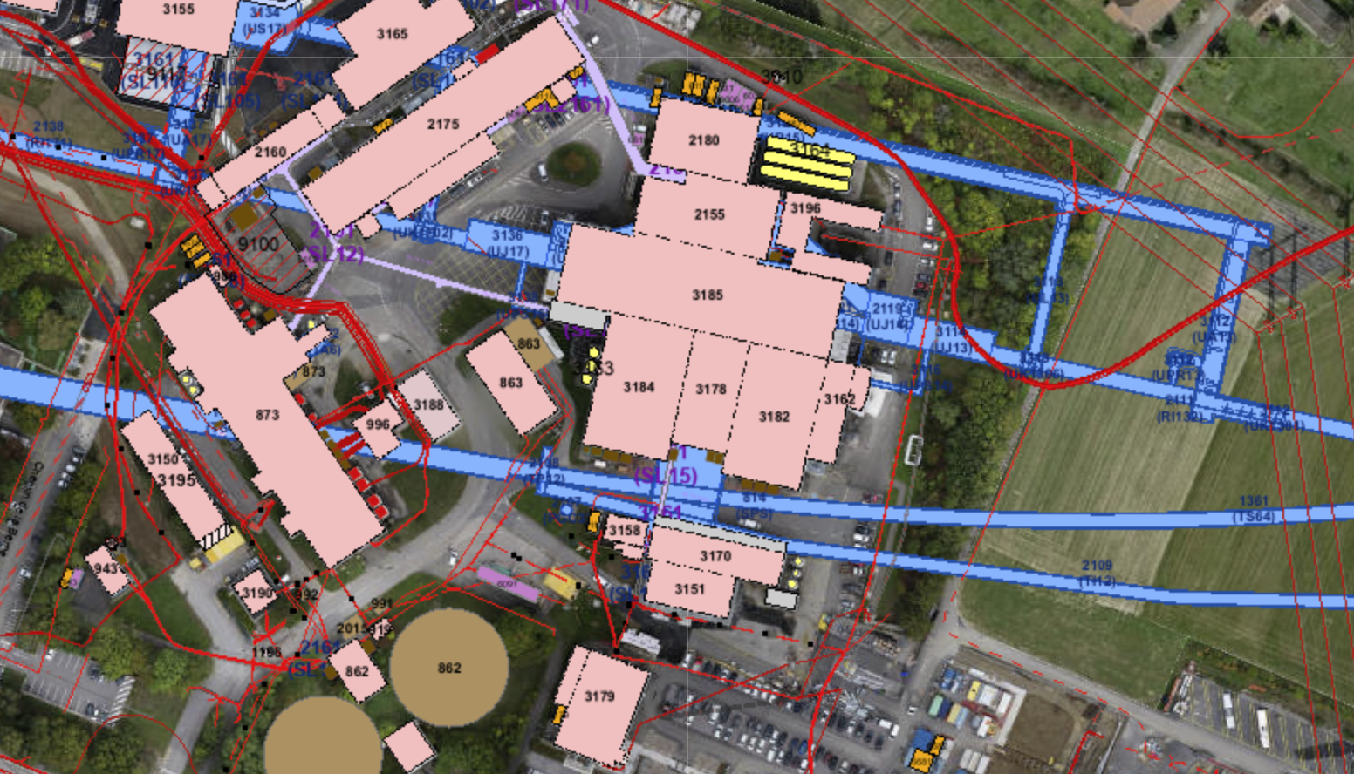
Phase II infrastructure upgrade: Introduction & Overview
WP7.1 and WP7.4 -> SU1 consolidation
WP7.6 -> TDAQ containers in Hi-Lumi area
WP7.2 and WP7.5 -> DAQ room in SDX1 consolidation
Control room
WP7.3 and WP7.7 -> USA15 rack room consolidation
WP7.8 -> UPS consolidation for detectors
WP6 -> New building and CO2 cooling
Gerardo Velazquez Gutierrez (CERN)

Slide 4
Phase II infrastructure upgrade: Introduction & Overview
YETS 22-23
2023 Run
YETS 23-24
2024 Run
EYETS 24-25
2025 Run
2026 (LS3)
2027 (LS3)
2028 (LS3)
SXSN1 building completion
SU1 cooling upgrade
SU1 cooling upgrade
ATLAS: R744 primary installation & commissioning
CO2 electrical supply
SU1 power upgrade
SU1 power upgrade
TDAQ upgrade - containers
CO2 completion
SXSN1 installation of EL/CV services
ATLAS/CMS: CO2 electrical supply
CO2 electrical supply
Main transfer line inst. in USA15
TDAQ containers: Start of CE
USA15 CV room HVAC upgrade
2PACL works
Preparations of USA15 CV room
DEMO inheritance CO2 cooling plant installation
Preparations of USA15 CV room
Partial 2PACL install. in USA15 CV room
2PACL early commissioning
TDAQ SDX1 upgrade
CO2 extraction installation
New ATCA area EL/CV upgrade
-53^{O}C
Main transfer line inst. in USA15
CO₂ related
EN-CV related
Big challenge
2PACL works
EN-EL related
SCE related
Planning:
On-going works on track! (subWP6 and subWP7 activities)
Activities being anticipated to flatten the workload in LS3, and to give more time for I&C to the detectors! (see next slide)
Continuously working on identifying activities that can be anticipated:
  Not straightforward as CERN group resources have to be also anticipated.
The USA15 rack room consolidation will be very challenging; many services involved, reduced space and a lot of requirements to fulfill!
Gerardo Velazquez Gutierrez (CERN)

Slide 5
Phase II infrastructure upgrade: Introduction & Overview
YETS 22-23
2023 Run
YETS 23-24
2024 Run
EYETS 24-25
2025 Run
2026 (LS3)
2027 (LS3)
2028 (LS3)
SXSN1 building completion
SU1 cooling upgrade
SU1 cooling upgrade
ATLAS: R744 primary installation & commissioning
CO2 electrical supply
SU1 power upgrade
SU1 power upgrade
TDAQ upgrade - containers
CO2 completion
SXSN1 installation of EL/CV services
ATLAS/CMS: CO2 electrical supply
CO2 electrical supply
Main transfer line inst. in USA15
TDAQ containers: Start of CE
USA15 CV room HVAC upgrade
2PACL works
Preparations of USA15 CV room
DEMO inheritance CO2 cooling plant installation
Preparations of USA15 CV room
Partial 2PACL install. in USA15 CV room
2PACL early commissioning
TDAQ SDX1 upgrade
CO2 extraction installation
New ATCA area EL/CV upgrade
-53^{O}C
Main transfer line inst. in USA15
CO₂ related
EN-CV related
Big challenge
2PACL works
EN-EL related
SCE related
Planning:
Significant workload on coordination and follow-up of the anticipated activities:
  EYETS/YETS period is always very busy due to the usual ATLAS maintenance activites (detectors & infrastructure)
  Anticipated works have to finish on time! By the cavern closure all must be finished…
  It has to be made sure that there cannot be any impact on the operation if projects run late.
Gerardo Velazquez Gutierrez (CERN)

Slide 6
WP6: the SXSN1 building and the CO2 cooling equipment
Gerardo Velazquez Gutierrez (CERN)

Slide 7
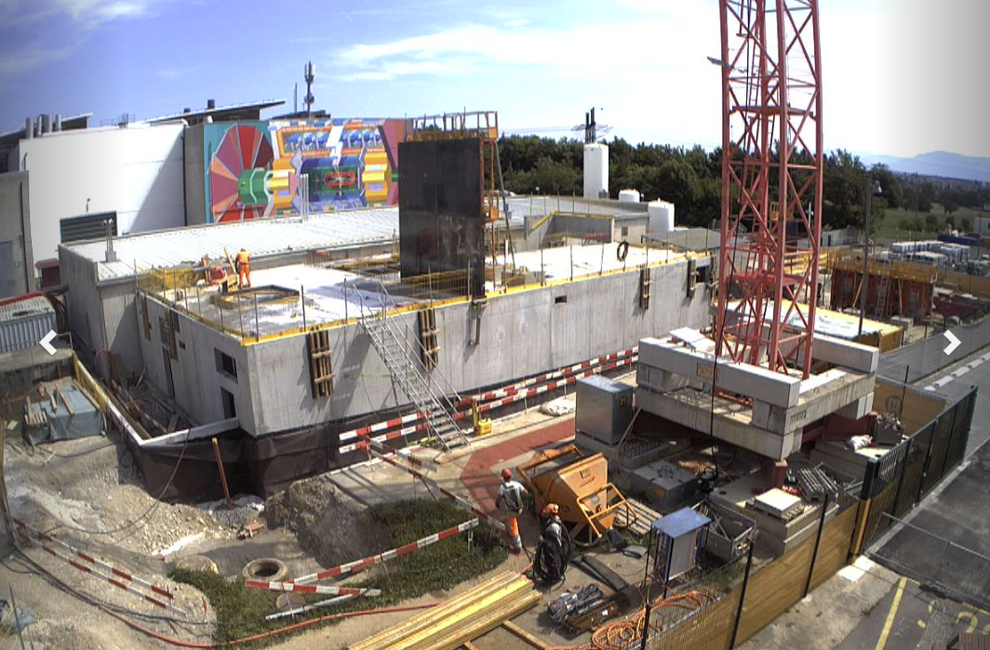
WP6: the SXSN1 building
A year ago – last PO/TC meeting
Gerardo Velazquez Gutierrez (CERN)

Slide 8
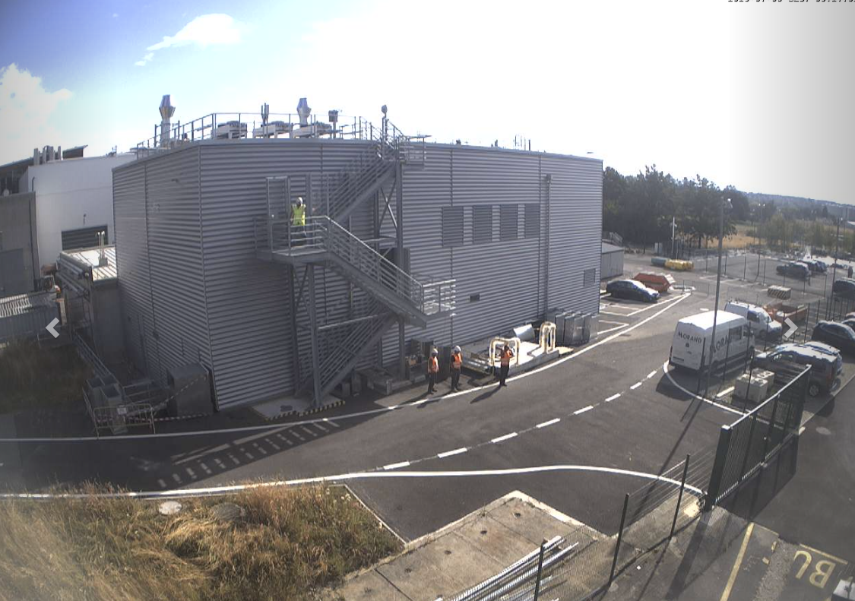
WP6: the SXSN1 building
Today
Gerardo Velazquez Gutierrez (CERN)

Slide 9
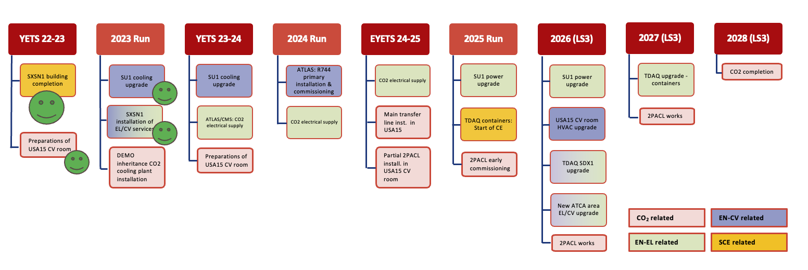
Phase II infrastructure upgrade : WP6 Status of the works
New SXSN1 building: Civil enginnering
  The works are completed.
  The buidling has already been handed-over to ATLAS according to plan.
  Cost to completion within the baseline.
New SXSN1 building: Infrastructure
  Ventilation completed on the ground floor, works continue on the first floor and the roof.
  General services – electricity completed and operational. Just missing the solar panels ☺.
  IT installation completed and operational.
  Fire detection (sniffers) completed. Detection points and cabling to the central being done this week.
  Access control completed.
  Complete Infrastructure ready by end of summer 23 -> Acceptance by HSE on going.
  Expenditures matching the Estimate to Completion.
Mezzanine for CO2 cabinets completed
The site will not be any longer category 1. The fences will be removed
Gerardo Velazquez Gutierrez (CERN)

Slide 10
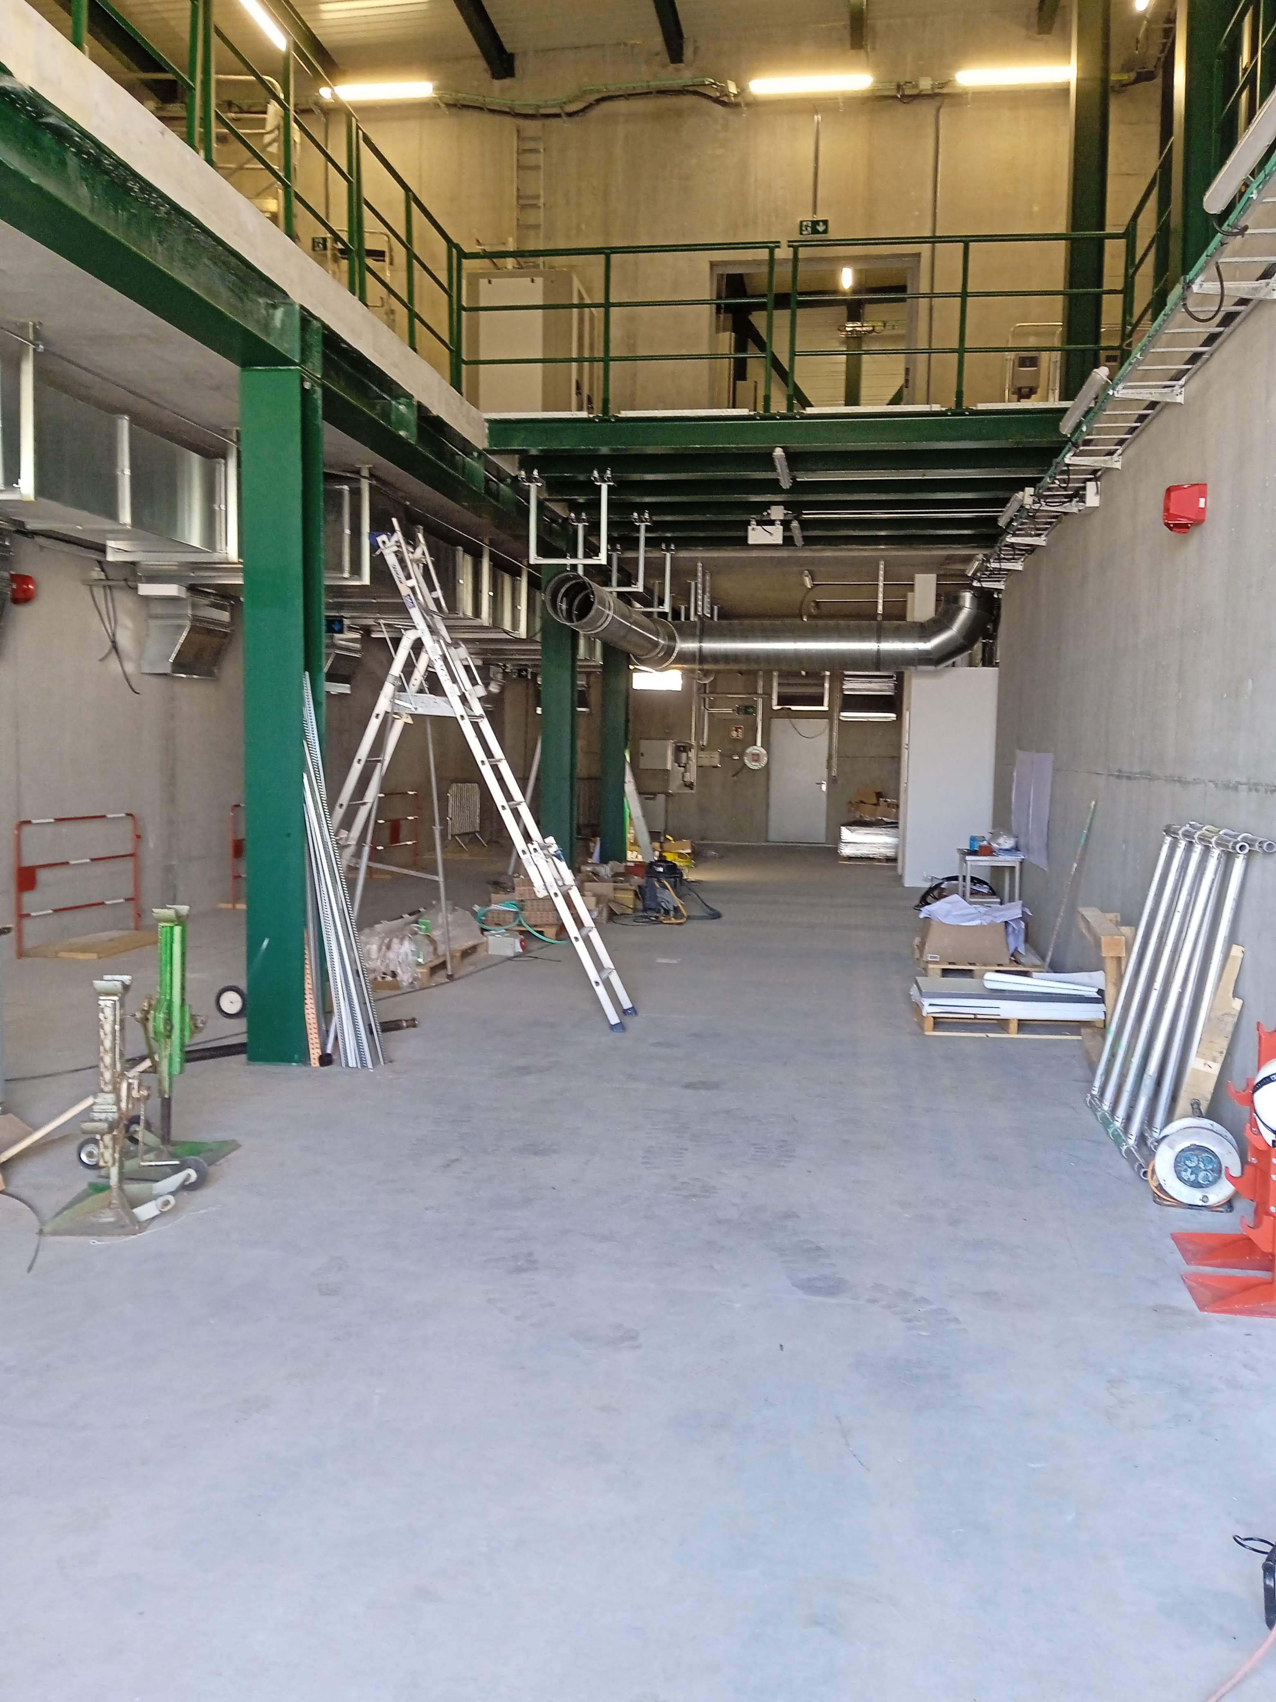
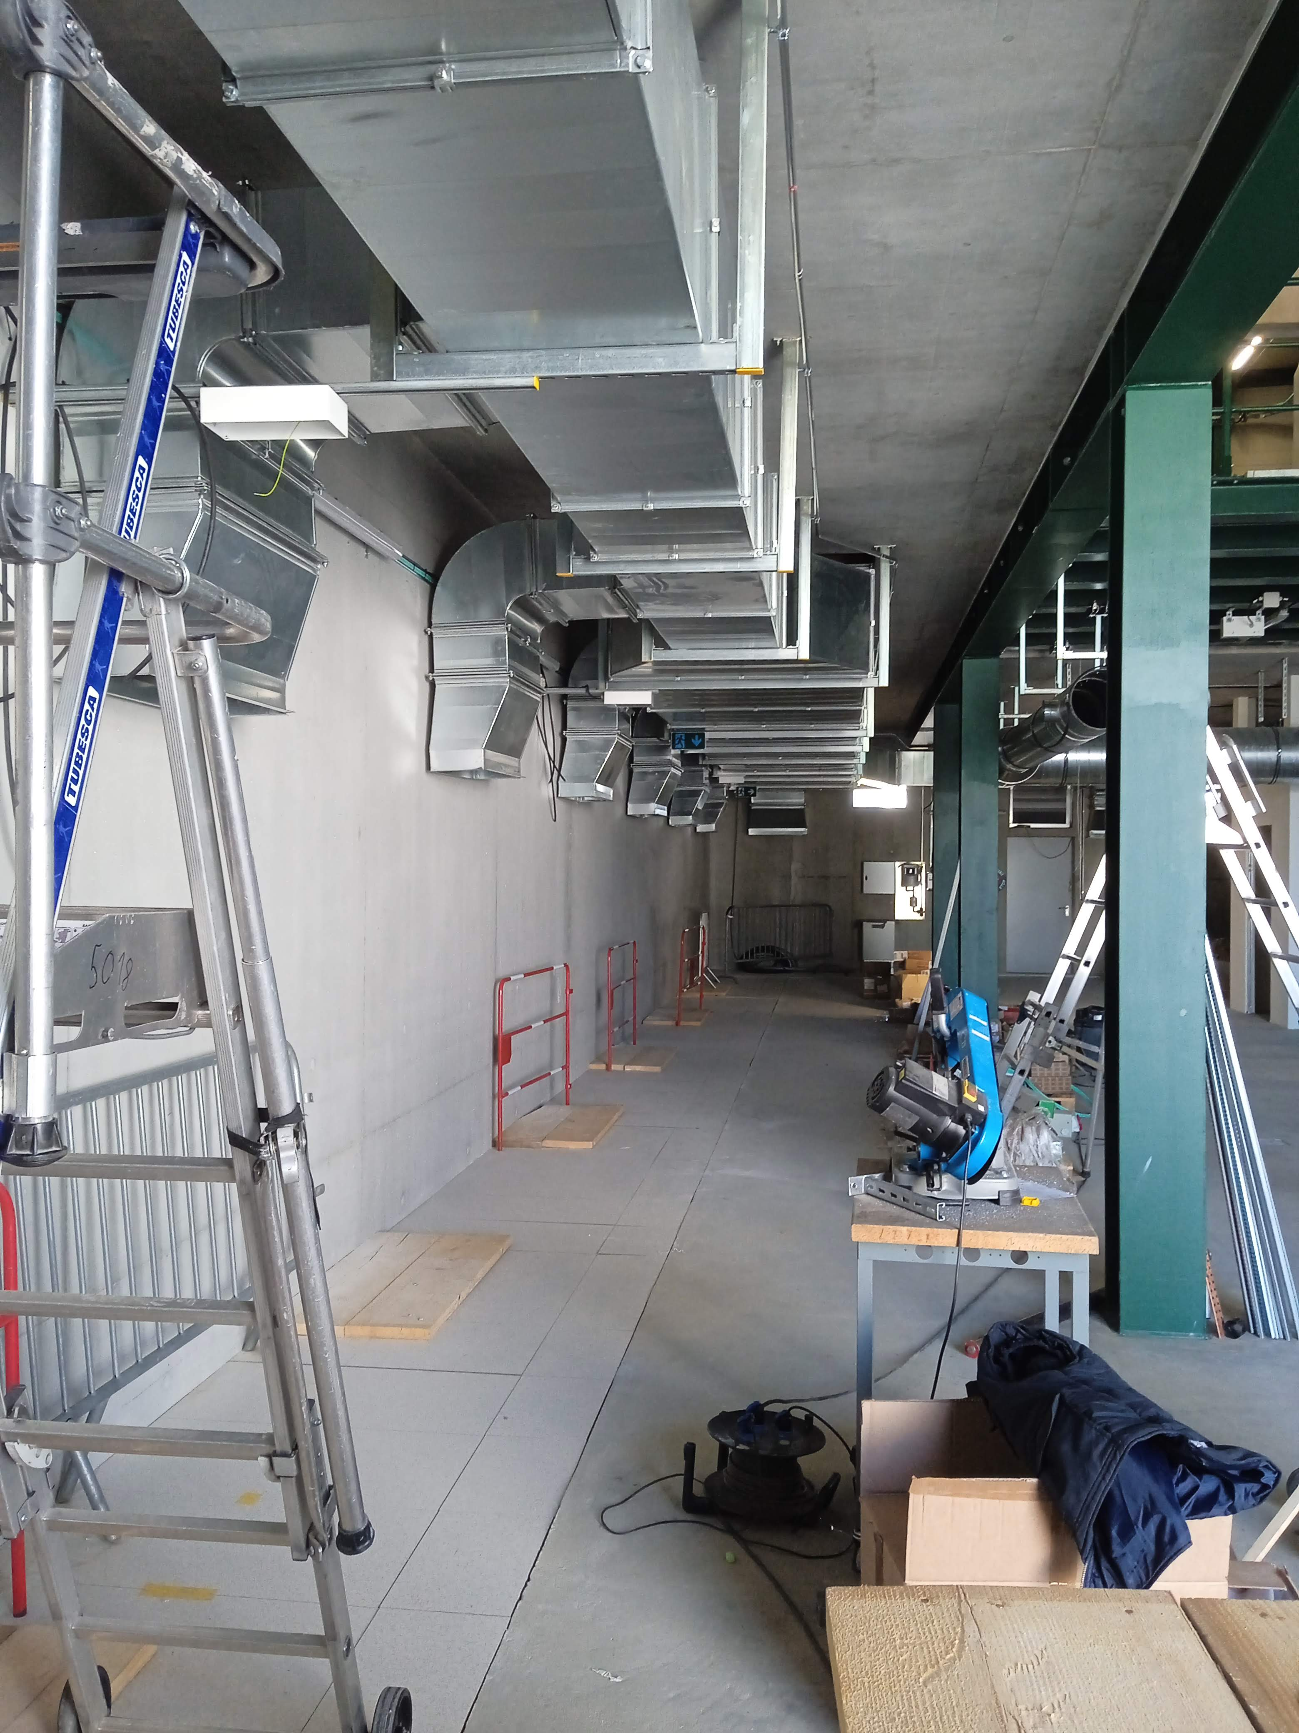
Phase II infrastructure upgrade : WP6 Status of the works
Ground floor works
Mezzanine for CO2 cabinets completed
Gerardo Velazquez Gutierrez (CERN)

Slide 11
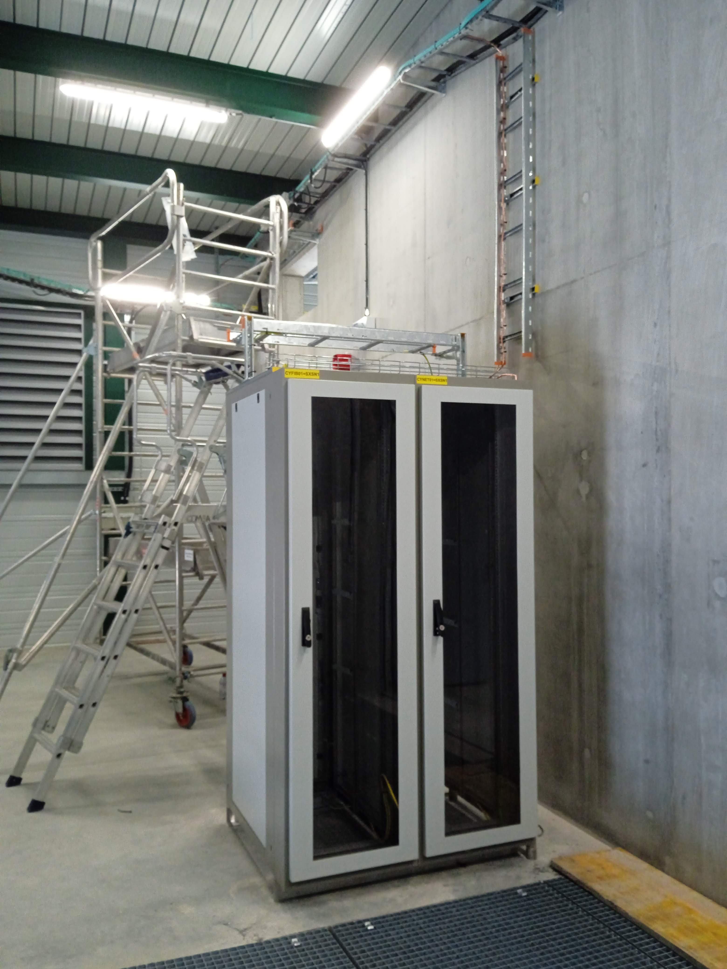
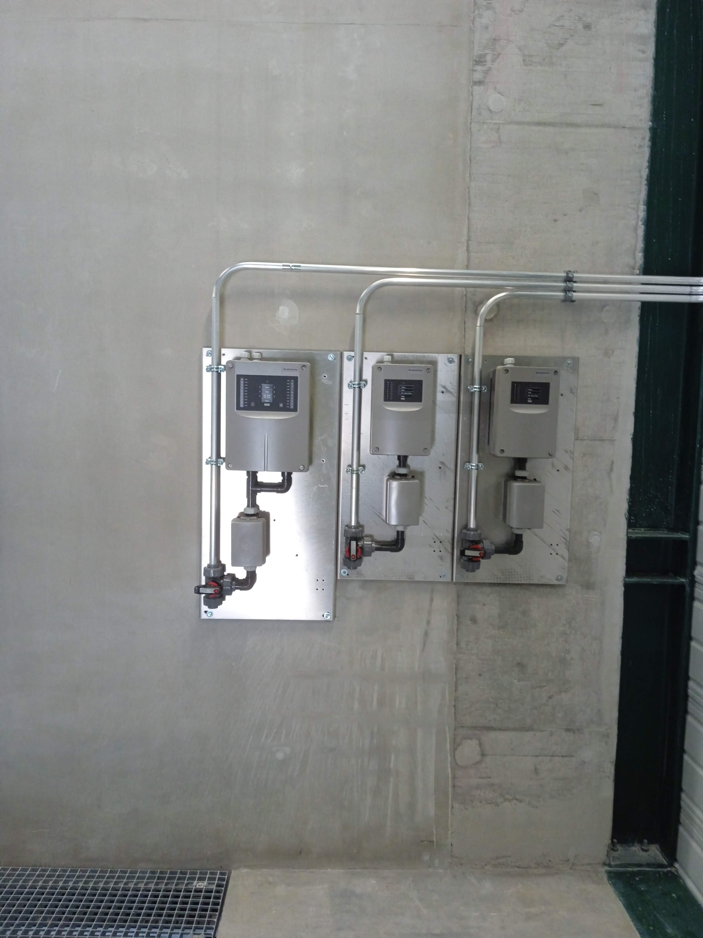
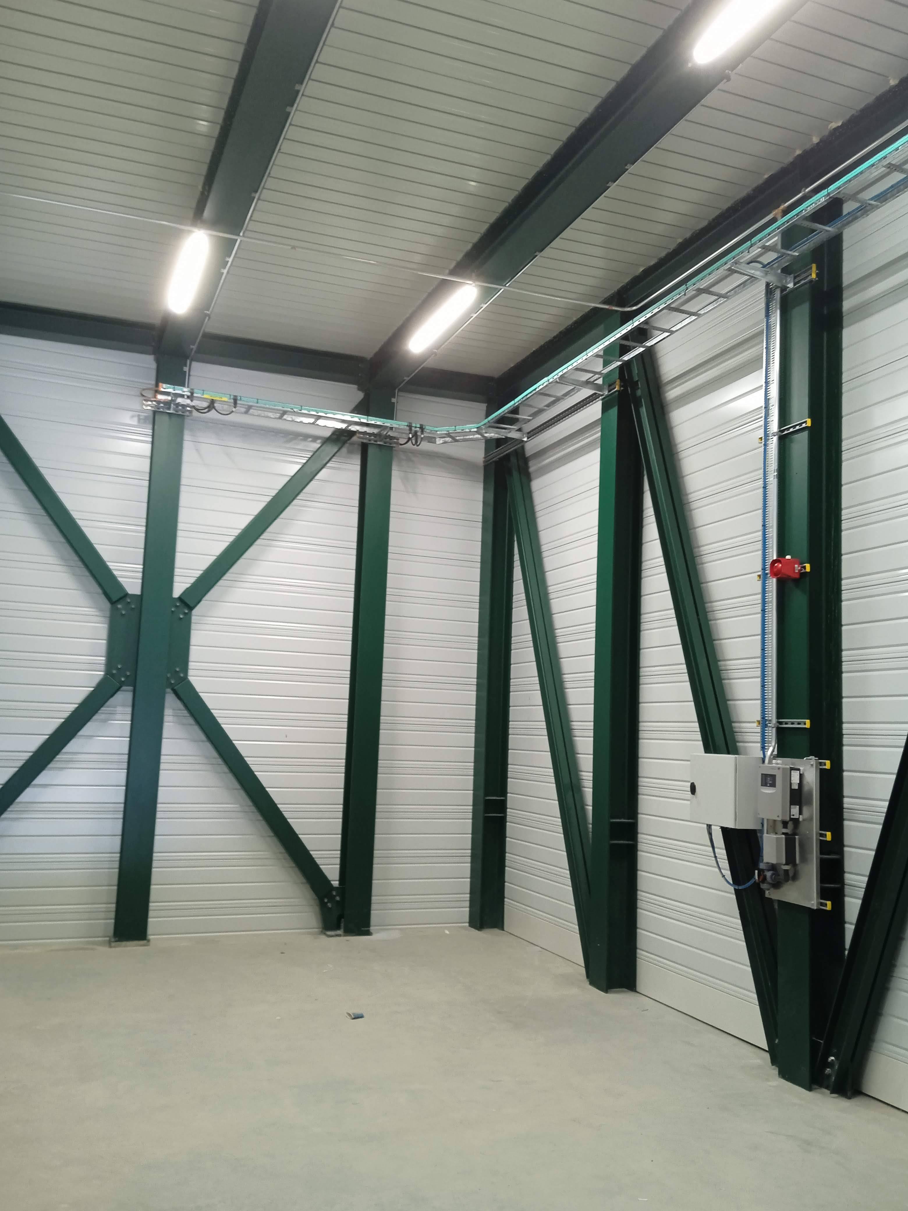
Phase II infrastructure upgrade : WP6 Status of the works
IT racks
Fire detection modules
Gerardo Velazquez Gutierrez (CERN)

Slide 12
WP7.1: the SU1 cooling station consolidation
Gerardo Velazquez Gutierrez (CERN)

Slide 13
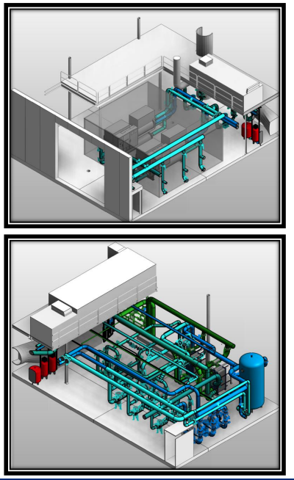
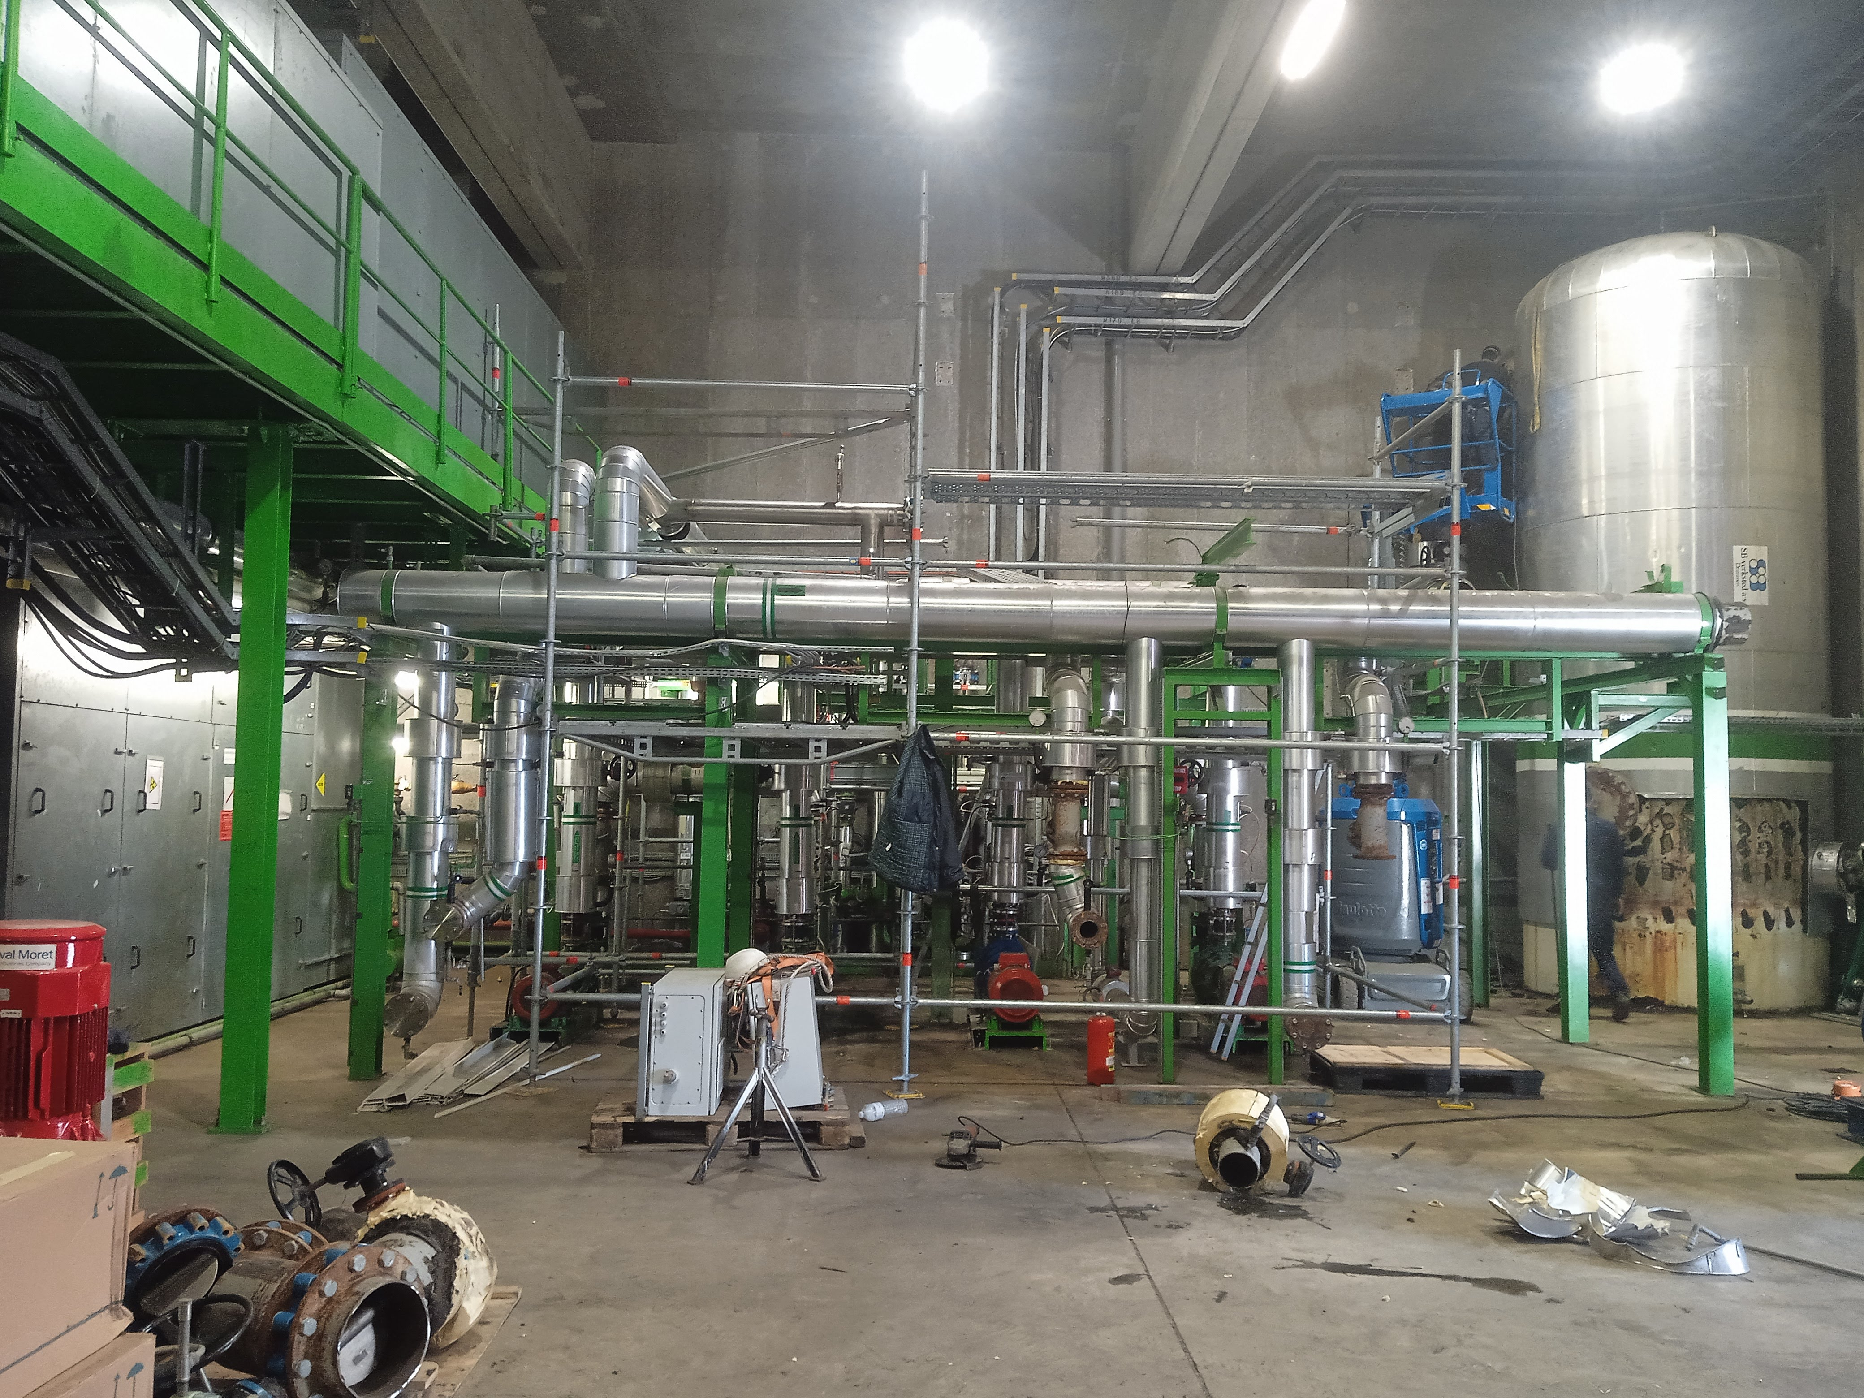
SU1 upgrade
  At the current situation:
    The cooling stations in building SUX1 (ATLAS):
      Produce and distribute the mixed water (14-20°C) to racks in SDX1 (770 kW cooling) and in USA15 (800 kW cooling)
      Produce and distribute water (6 -12°C) to HVAC systems, racks and processes in P1 surface buildings (SUX1/SGX1/SCX1/SH1/SR1/SU1) and underground caverns (US15/USA15);
    The pumping station in building SU1 distributes the chilled water from SUX1 to SR1 and SU1.
  The proposed upgrade to fulfil Phase II requirements
    The cooling station in building SUX1 (ATLAS):
      Will supply mixed water (14-20°C) to racks in SDX1 and in USA15 → 770 kW cooling capacity from SDX1 transferred to USA15
      Will supply chilled water (6 -12°C) to HVAC systems, racks and processes in P1 surface buildings (SUX1/SGX1/SCX1/SH1/SR1/SU1) and underground caverns (US15/USA15); 370 kW capacity to be transferred to USA15
    The new cooling station in building SU1 will supply:
      Raw water to SDX1
      Chilled water to US15/SR1/SU1
      Back-up chilled water during SF1 maintenance
Upgrade to gain the cooling capacity in USA15 and meet P1 chilled water needs
Courtesy F. Dragoni
Gerardo Velazquez Gutierrez (CERN)

Slide 14
SU1 upgrade
Beginning of YETS 22-23
Gerardo Velazquez Gutierrez (CERN)

Slide 15
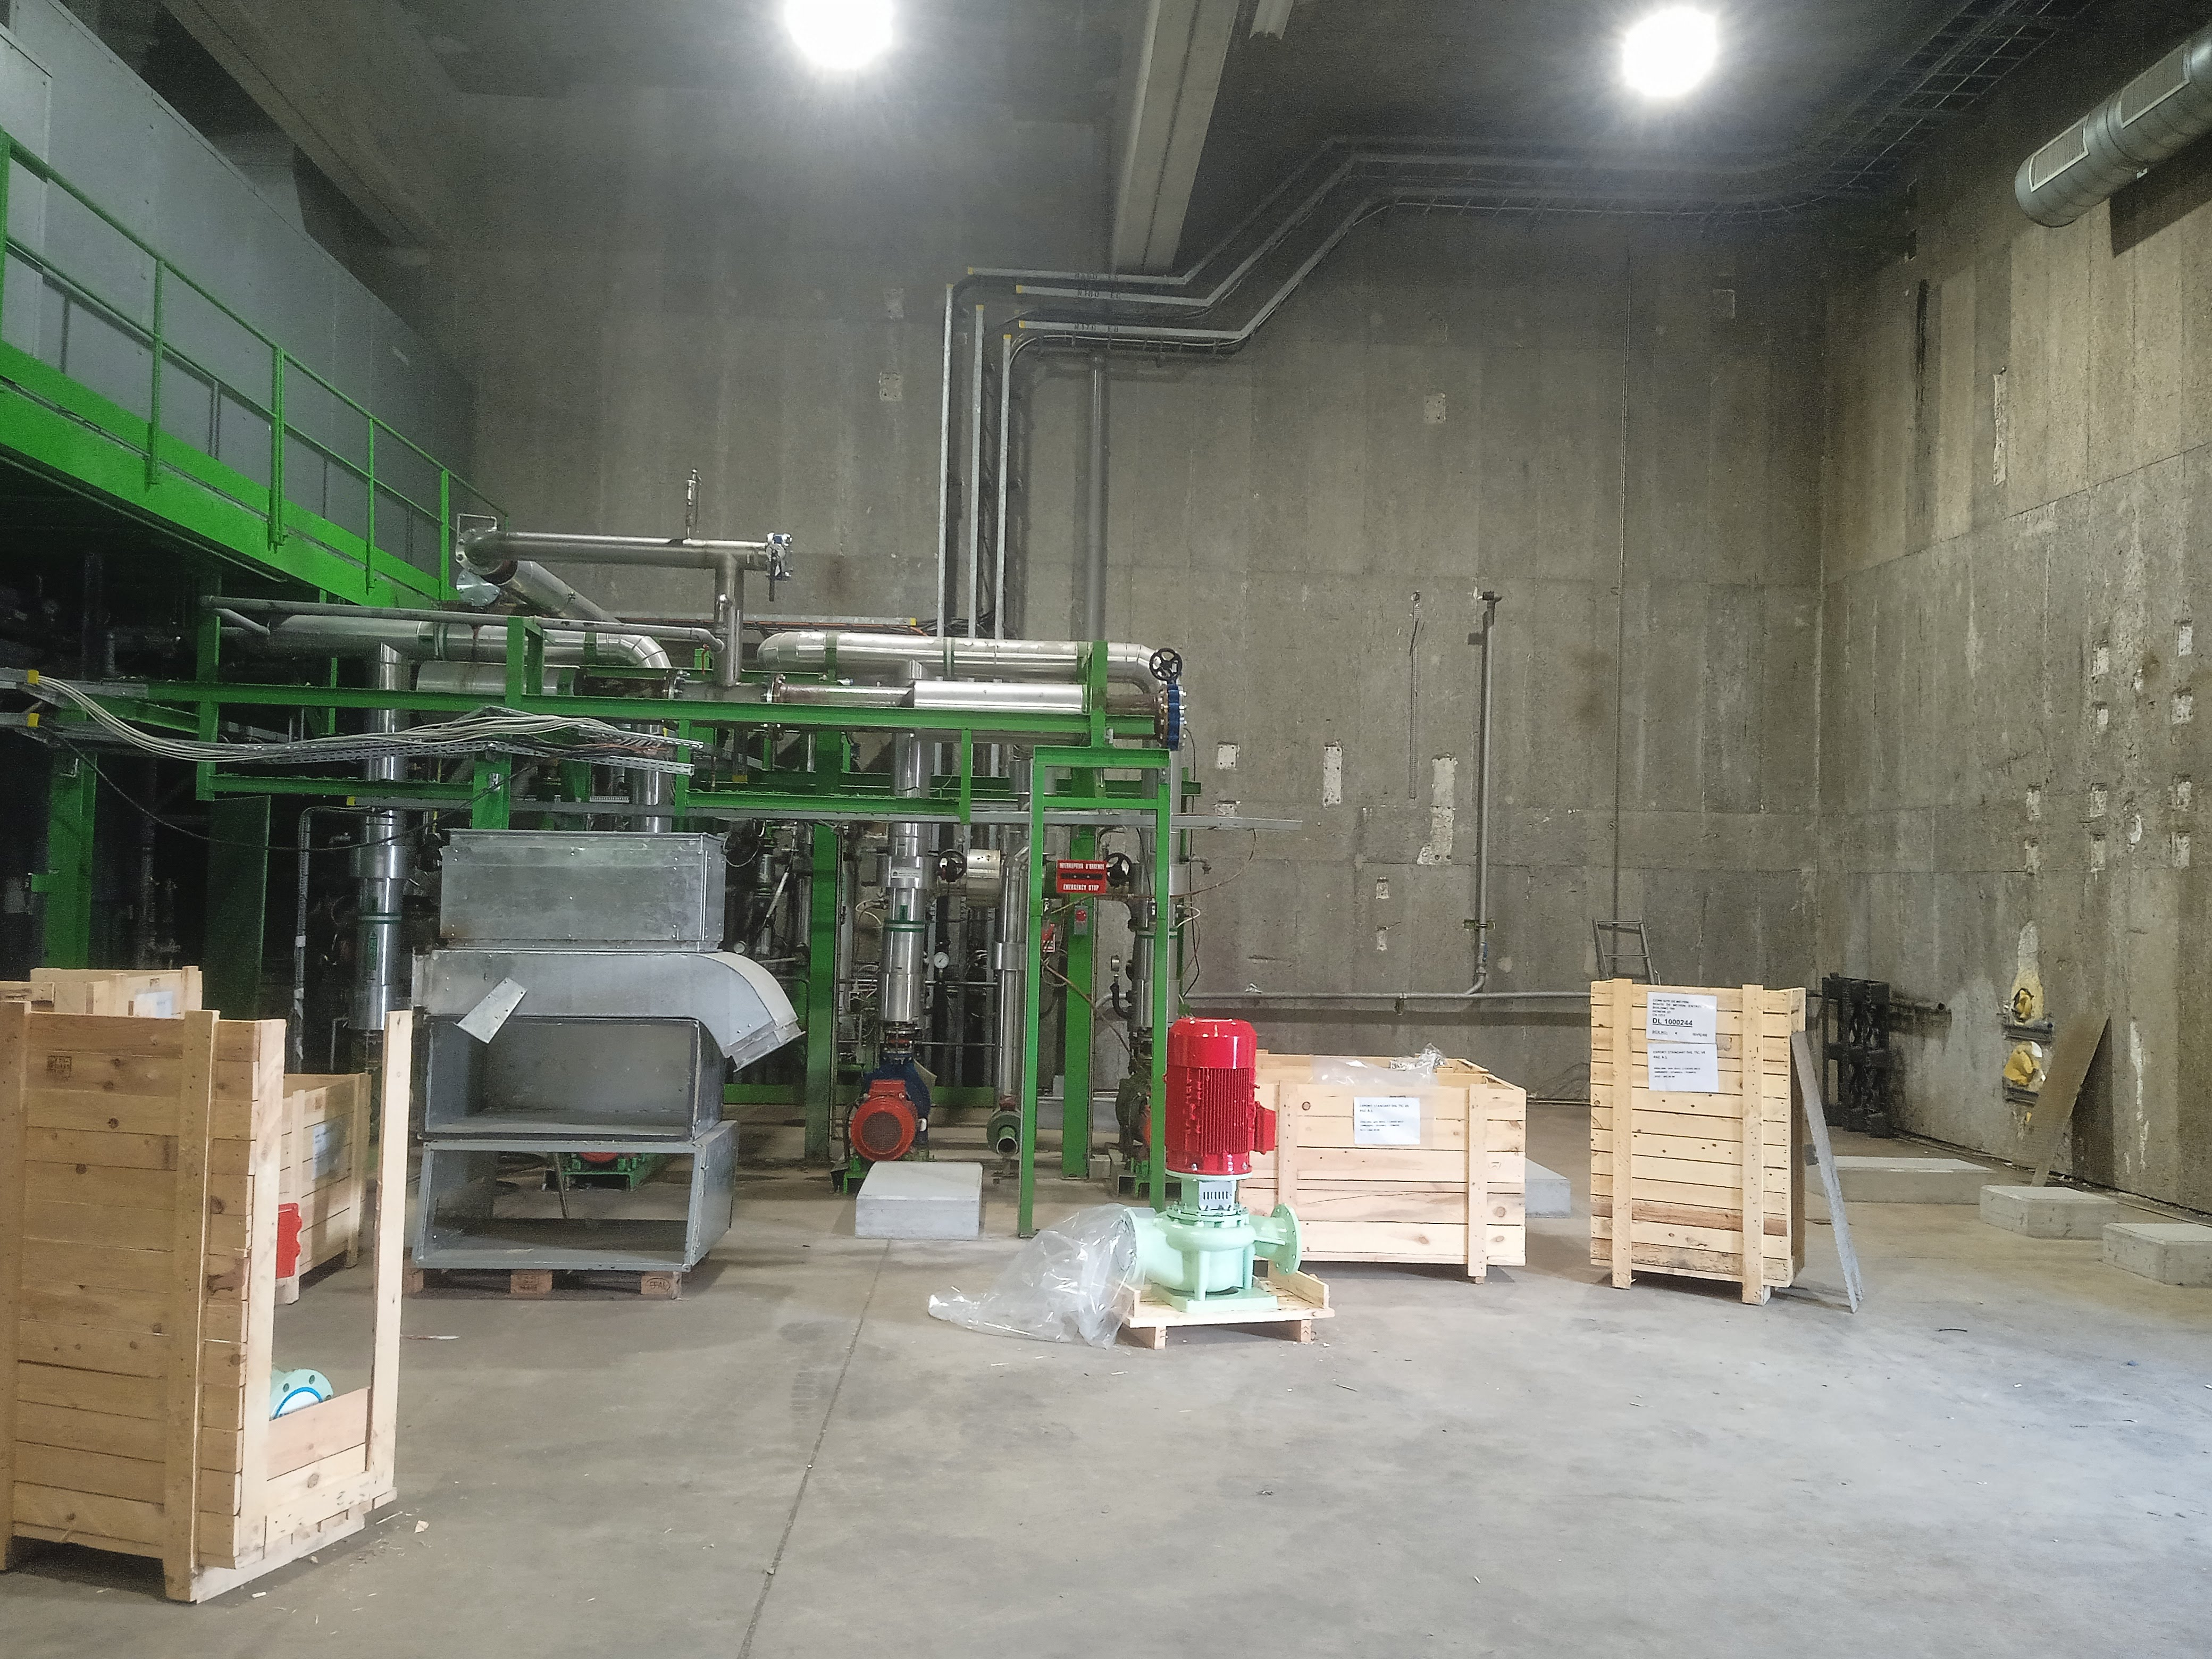
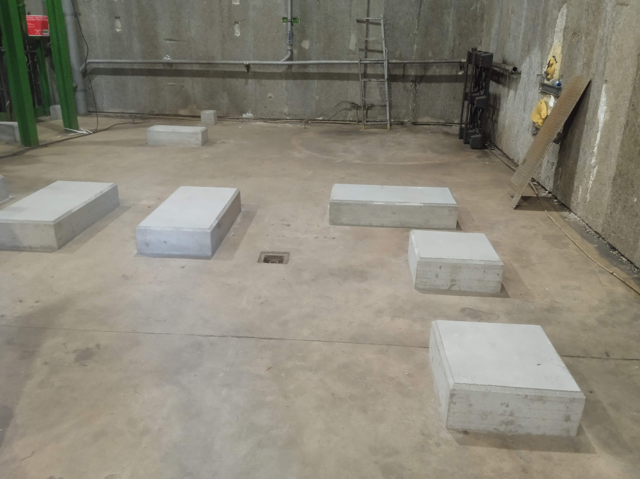
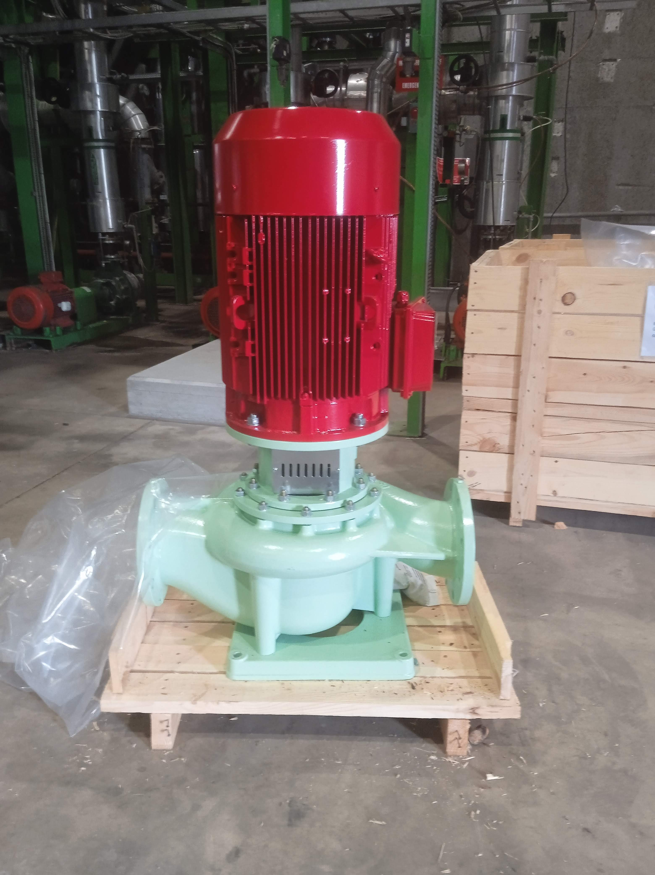
SU1 upgrade
Today
Gerardo Velazquez Gutierrez (CERN)

Slide 16
SU1 upgrade
  Project status:
    YETS22-23 works -> completed.
    Slabs for the pumps -> built.
    New room construction -> works will start after summer.
    YETS23-24 works -> scheduled.
Courtesy F. Dragoni
Gerardo Velazquez Gutierrez (CERN)

Slide 17
WP 7.3 and 7.7: the ATCA area consolidation
+ ATLAS TC for the full USA15 rack room
Gerardo Velazquez Gutierrez (CERN)

Slide 18
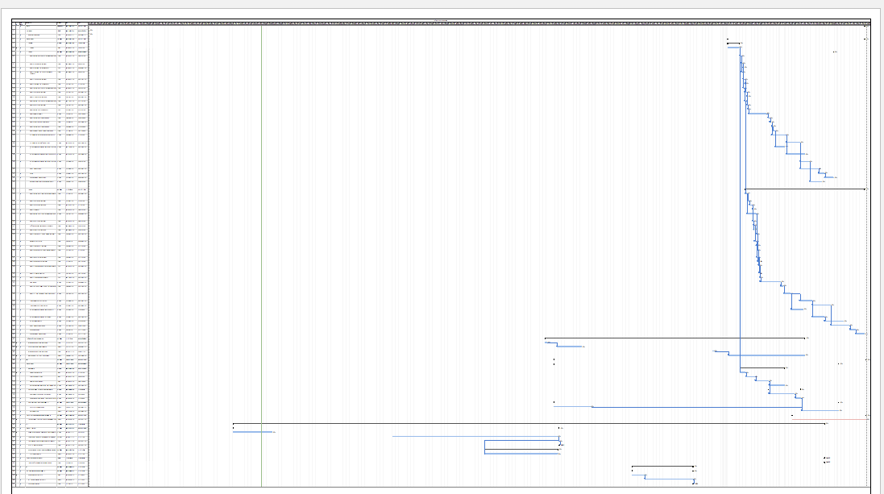
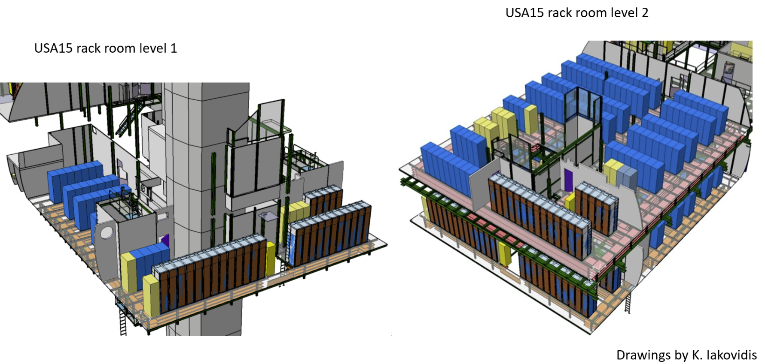
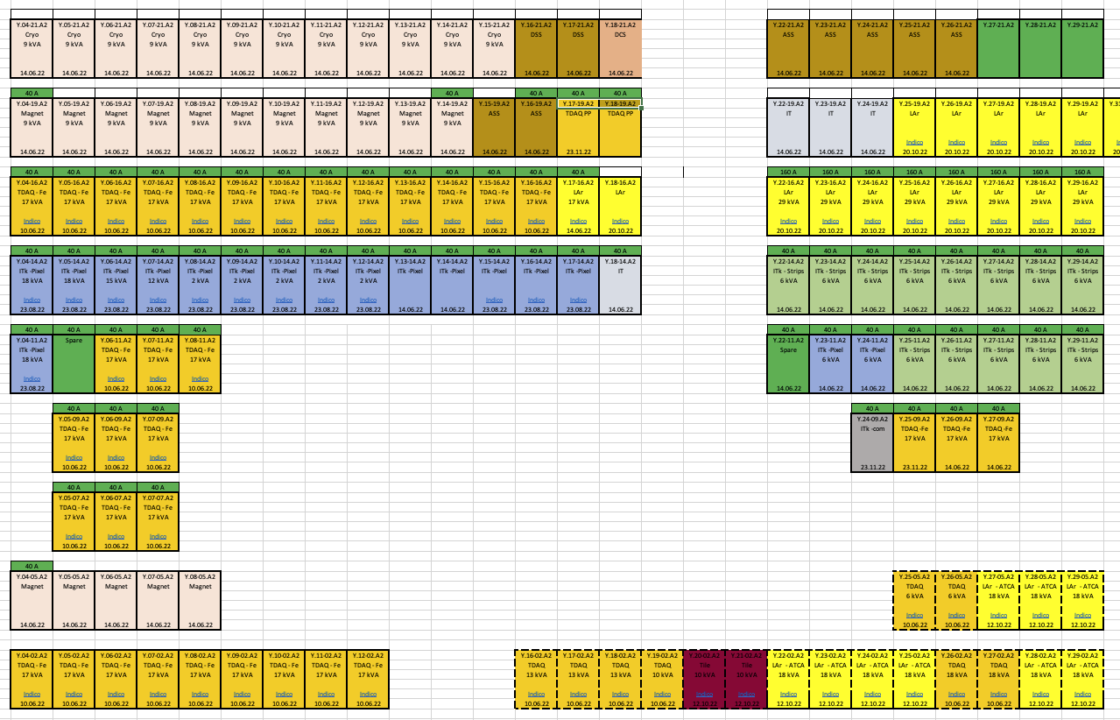
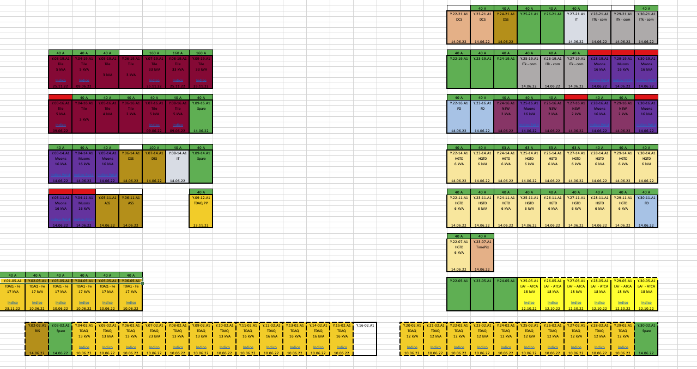
The USA15 rack room consolidation
SU1 works for cooling upgrade
Scope:
  49 “ normal” 52U racks to be replaced by 63U ones -> New ATCA area
  (around) 42 “normal” 52U racks to be replaced by server racks for TDAQ
  Additional cooling and electrical works in specific racks, as per subdetector needs, in USA15, US15 and UX15
  In addition:
    Electrical supply to the new racks (+1 MVA)
    Cooling to the new racks + pipe circuit modification in the USA15 false floor (+ 770 kW)
    New noise-mitigation walls
    Consolidation of the fire detection systems
Planning -> the goal is to accomplish the USA15 infrastructure consolidation + decabling in 2026
  Challenging but required to cope with the detector needs.
  First sequence of works already built -> optimizations on-going
  Accurate requirements are key for optimizing works that are already tight!
Gerardo Velazquez Gutierrez (CERN)

Slide 19
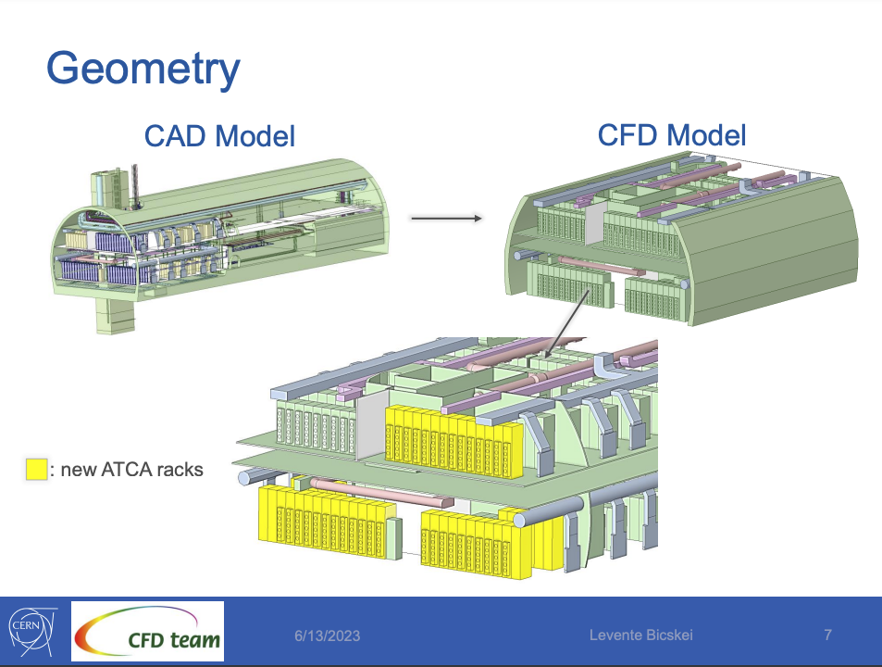
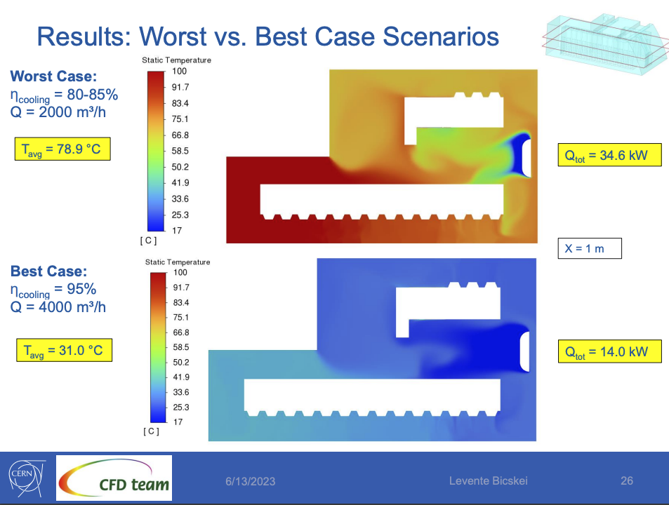
The USA15 rack room consolidation
SU1 works for cooling upgrade
Cooling:
  Studies performed.
  Some iterations on-going to discuss the details
Gerardo Velazquez Gutierrez (CERN)

Slide 20
The USA15 rack room consolidation
SU1 works for cooling upgrade
On-going work for 2023
  Validate the electrical solution.
  Start the tendering process for the racks and the cooling doors.
  Planning review and validation
Gerardo Velazquez Gutierrez (CERN)

Slide 21
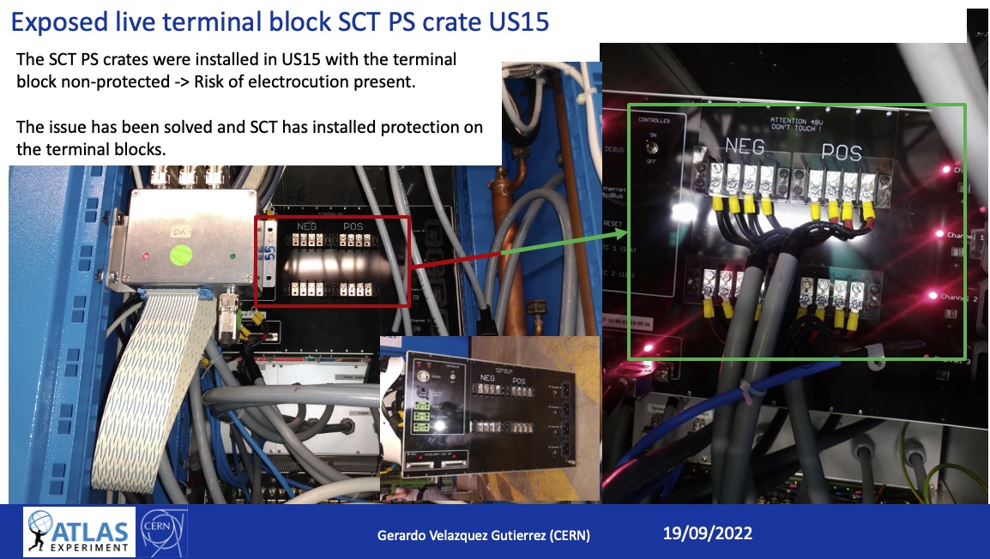
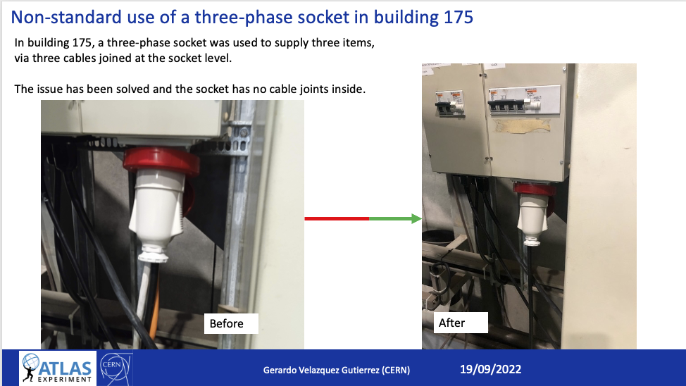
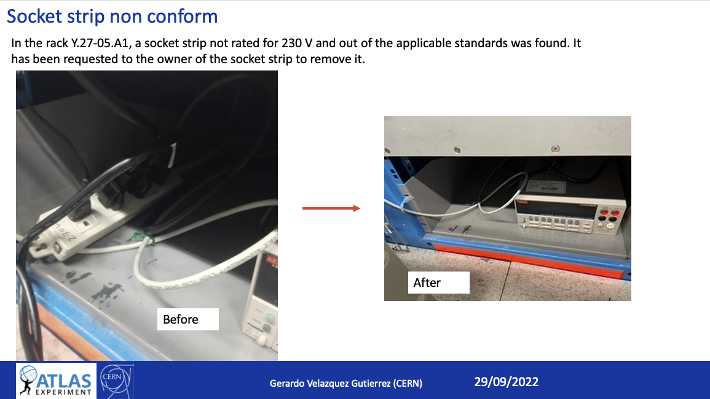
A word on the daily infrastructure works:
Effords being deployed on fixing electrical non-conformities.
Improvement on the time response to detector request to avoid the examples below.
Gerardo Velazquez Gutierrez (CERN)

Slide 22
Q&A?
Gerardo Velazquez Gutierrez (CERN)

