Slide 1
ADO-PO/TC meeting
Ludo

Slide 2

Some short considerations
First and foremost I would like to thank everyone working in TCn for the incredible work done in all these years
Several big challenges have been overcome due to the individual skills of you all but also (and more importantly) due to the team work in TCn.
I am very happy to see that between the different activities in TCn there is very good communications and collaboration.
  Safety, Project Office, Operations, Shut down activities, preparation for PhaseII and Service design/deployment etc.

Slide 3
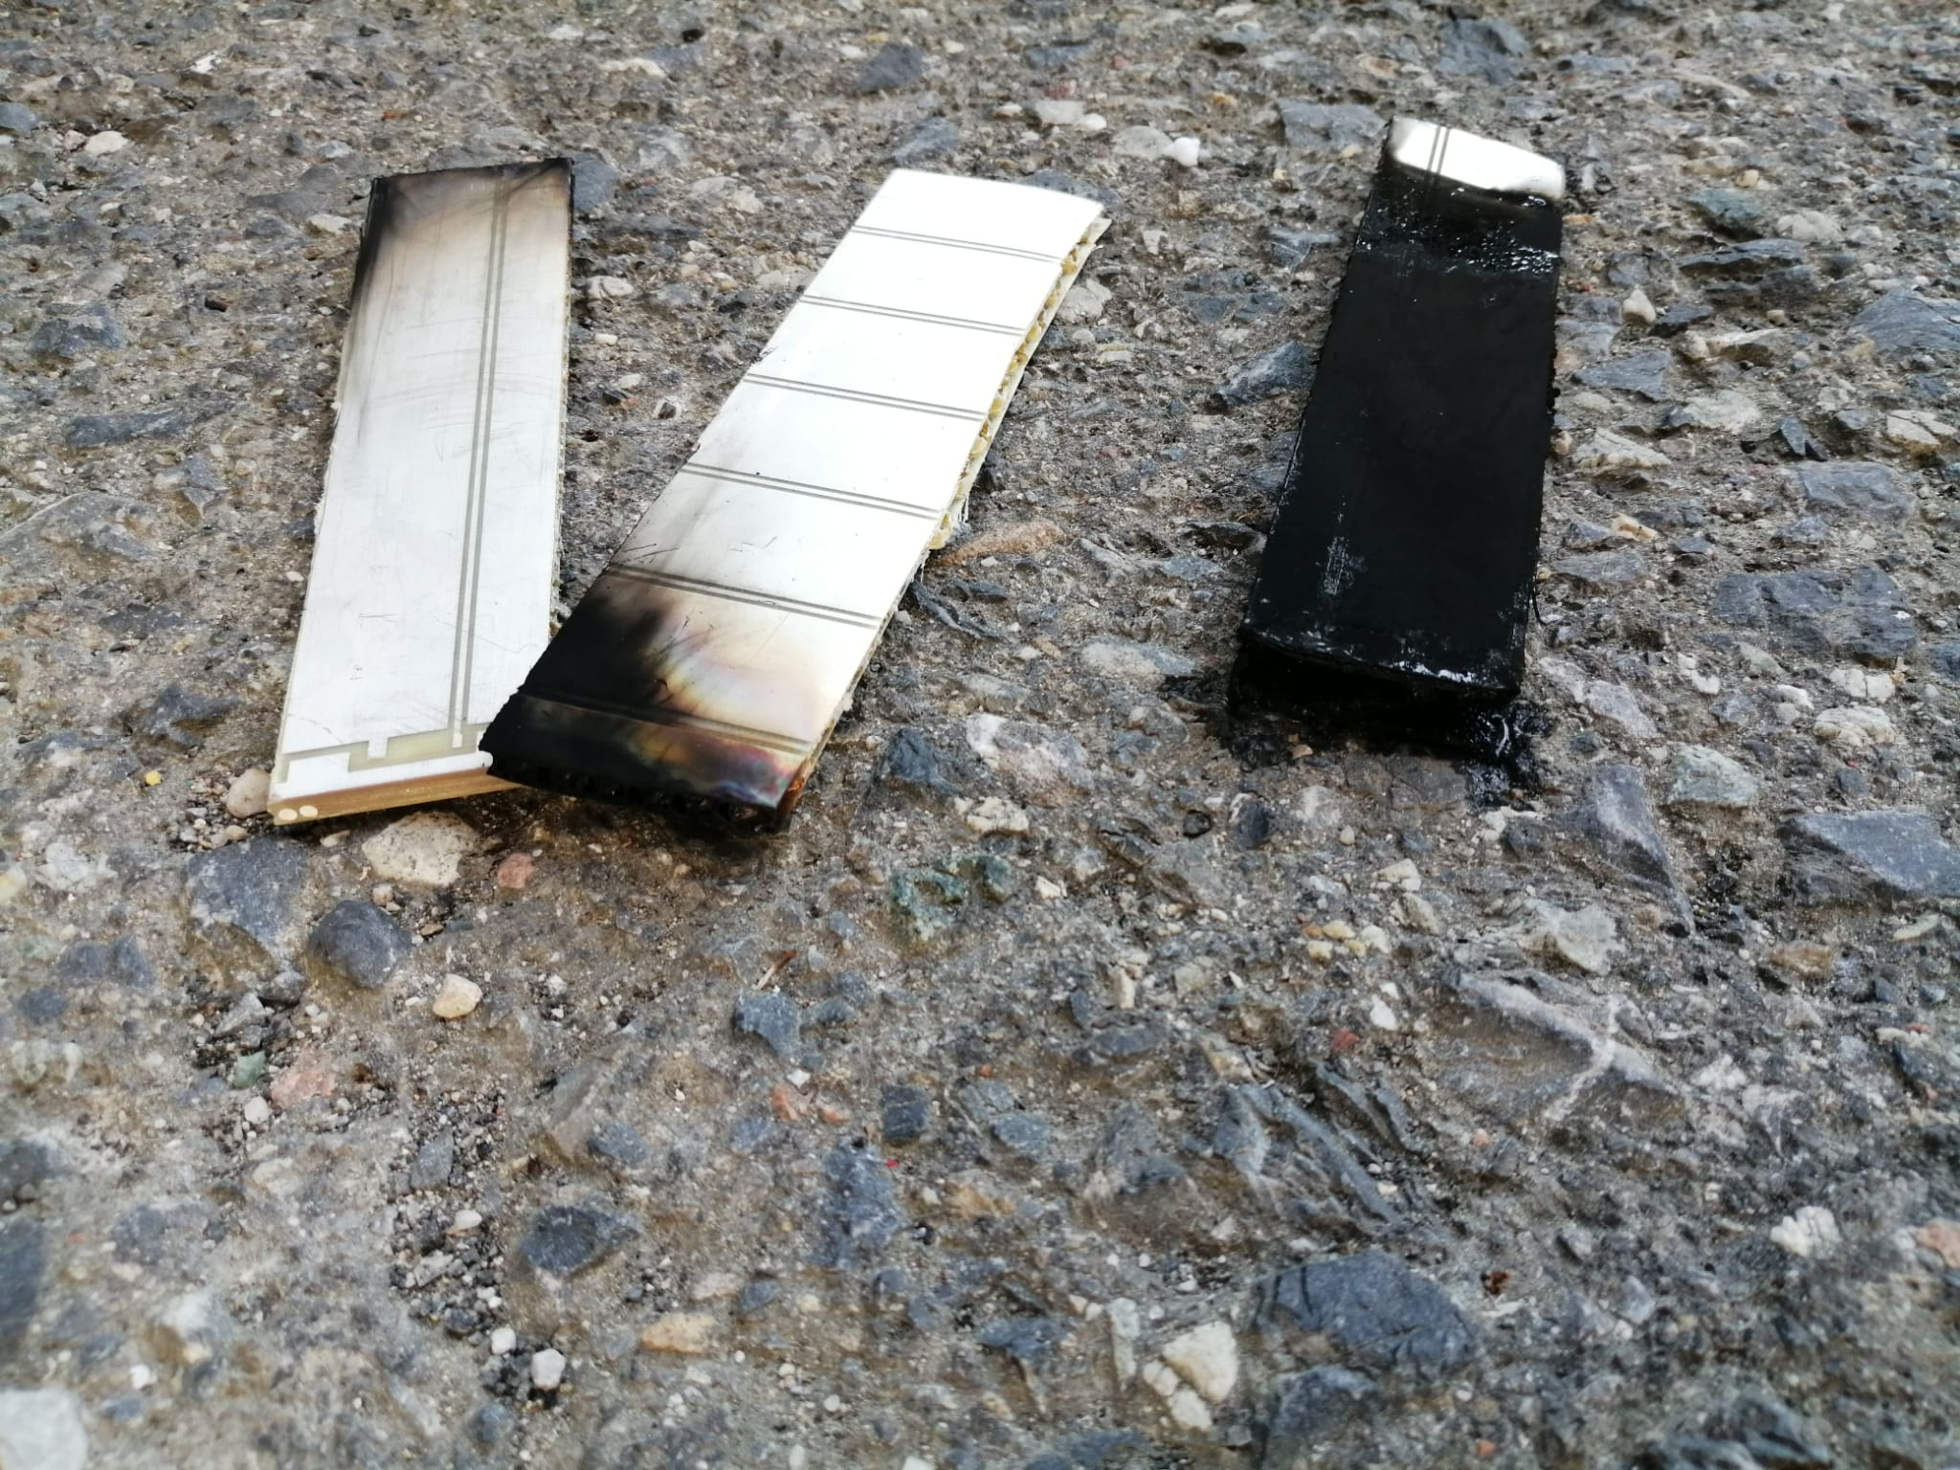
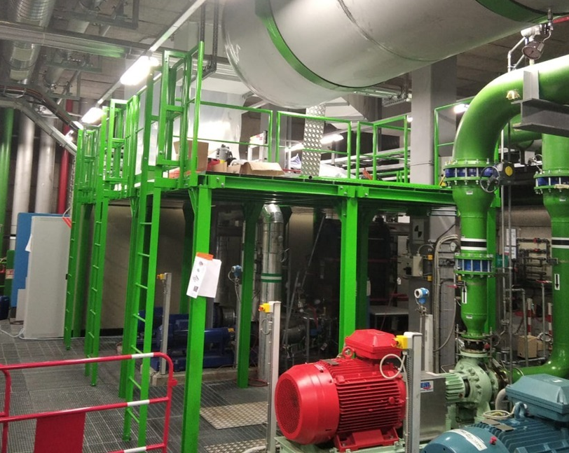
ATLAS and TCn Accomplishments
Very few examples where I am very proud of the results you have achieved
  Shut Down activities:
    Opening and closing of the detector is very well mastered (since many years) and reaction to problems is fast and flexible (eg: opening and closing the ECC in the 2022 closing)
    We were ALWAYS in time in closing the detector when requested by LHC
  Safety: follow up of the safety rules for the material used in Phase II
    Several fire tests performed on sample of material to be used in Phase II and very good collaboration with the systems
  Project Office:
    Huge work on the early deployment of infrastructure/services for Phase II
      CO2 mezzanine in CV room, CO2 pipes etc.
    Impressive work of Project office on the muon installation

Slide 4
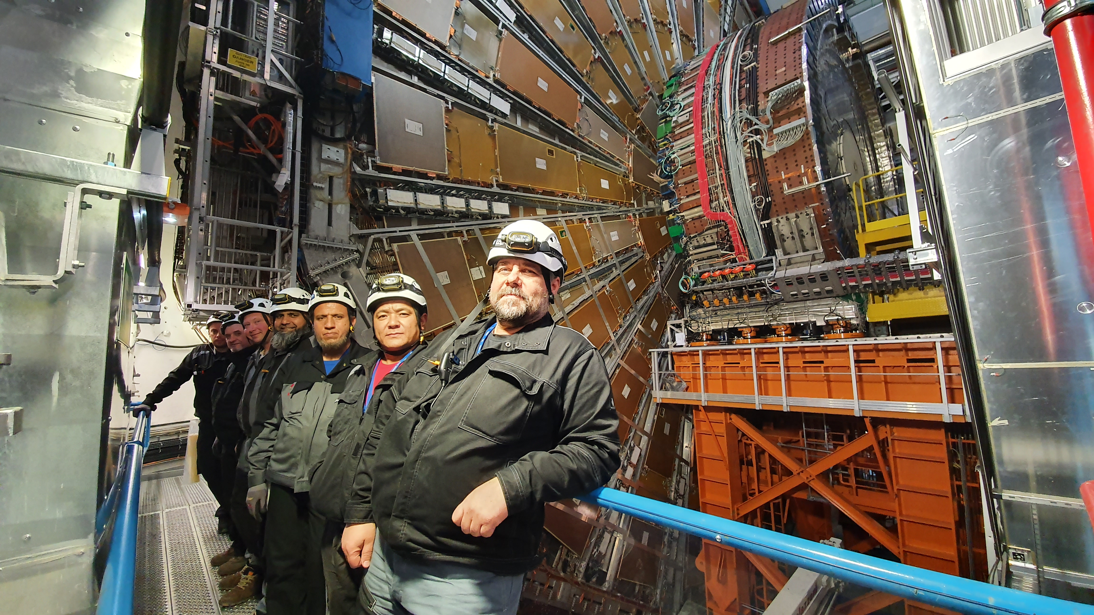
ATLAS and TCn Accomplishments
Very few examples where I am very proud of the results you have achieved
  Operations:
    Great follow up of all the big and small accidents
    Continuous development of the expert system and new development of the Water detection system
  Preparation of Phase II big infrastructure (Host Lab projects)
    One for all … the new CO2 Building completed ~ in time and in budget !
  Service Design/Deployment:
    Great Flexibility during YETS and LS to accommodate last minute requests
    Huge work to plan the Decabling/cabling activities in LS3

Slide 5
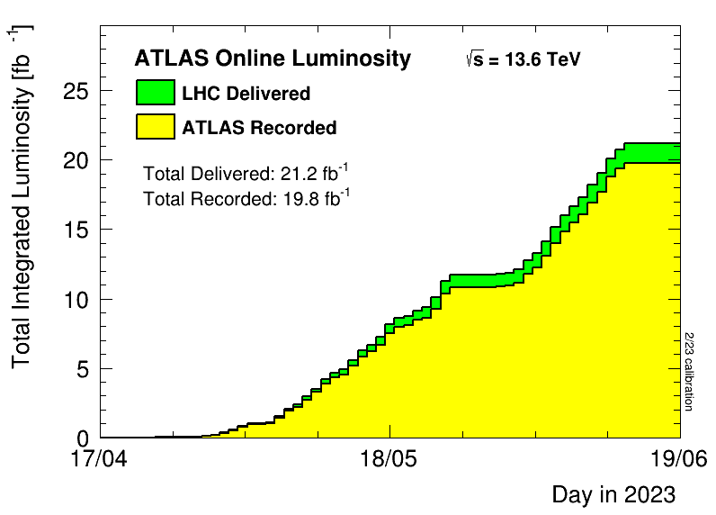
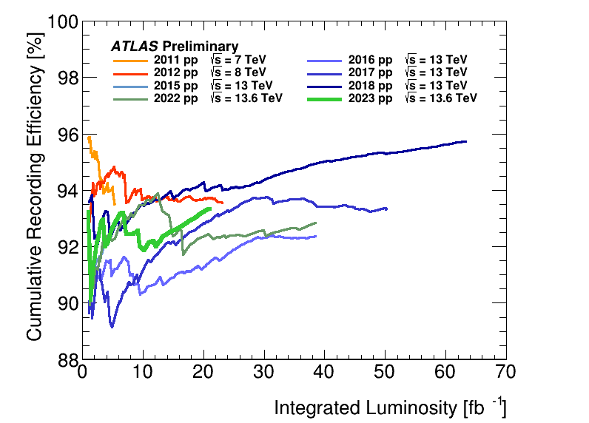
Priorities: both ATLAS and TCn
Operation:
  Continue to improve the data taking/quality efficiency and collect a very large sample of pp and HI data in Run 3
    This data will be the food for physicists for this decade!
    TCn involvement through OPM and Safety
  Finalise the commissioning of Phase I items
    Mostly on the Systems (+ direct involvement of TC)
  Reduce impact on Global warming emissions
    RPC and TRT leaks
      Involvement of TC in support of leak search both for RPC and TRT

Slide 6
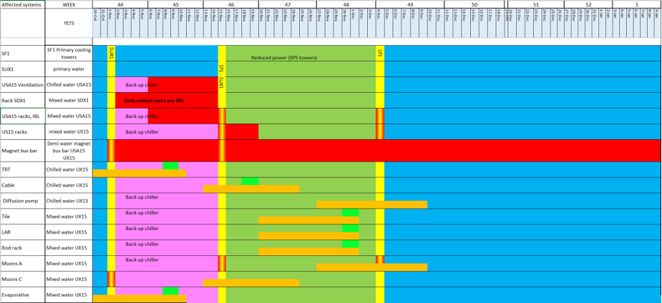
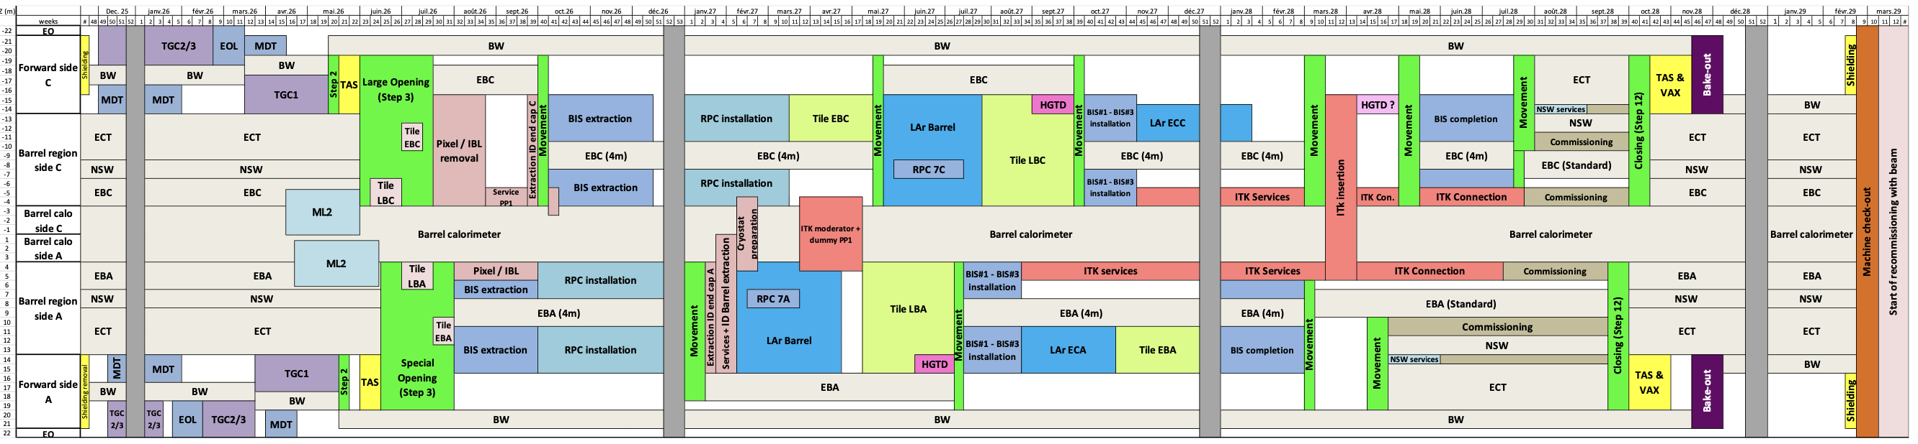
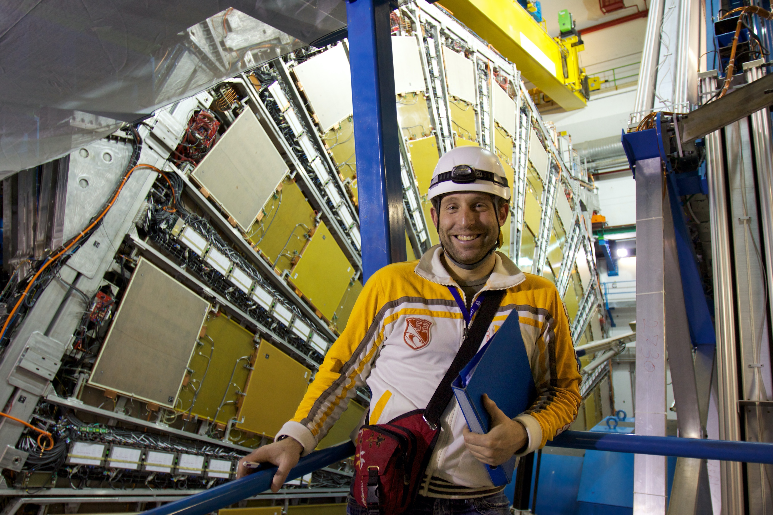
Priorities: both ATLAS and TCn
Preparation of YETS:
  Schedule disruptive maintenance early in YETS to minimise impact on systems
  Usual support to system in preparing access and any other requests
Phase II preparation:
  Continue to front load activities for Phase II as much as possible, to decrease the pressure on TC and Support groups during LS3
  Identify the needs for person power and find institutes or other sources to provide the needed effort
  Prepare a very solid LS3 schedule for the installation of all the Phase II upgrades and related infrastructure
  Pay particular care to the safety aspects for all Phase II activities
    Fire protection
    Toxic gas protection (eg CO2)
    RP protection
    Work environment
Matrix Reloaded

Slide 7
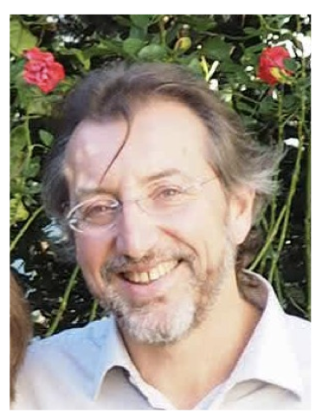
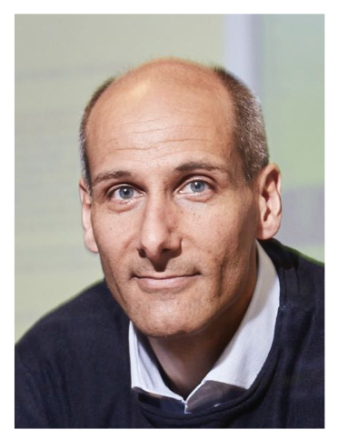
Priorities: specific to TC
Ensure a very smooth transition to the next TC:
  From March ‘24 Martin will take over

Slide 8
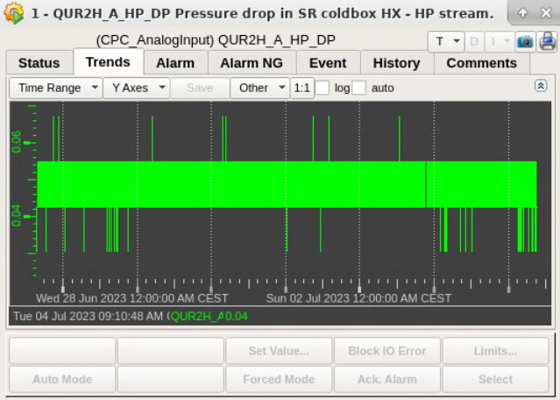
Short term point of attention
General one…
The ATLAS detector and infrastructures is almost 20 year old…
  We see sign of ageing (not only in the people) ….
Specific ones…
  Several accidents on cooling systems: Pollution due to a misplaced cartridge in the Muon cooling plant, Defective actuator in ID evaporative cooling plant
    Both of them promptly addressed, but with potential big impact
  Shield refrigerator Clogging:
    Quite scaring situation at the start of beam operation, great response of CRYO group
      Now situation is stable but Cross fingers
  LAr ECC diffusion pump heater break down
    Very scaring situation, again great response of CRYO group

Slide 9
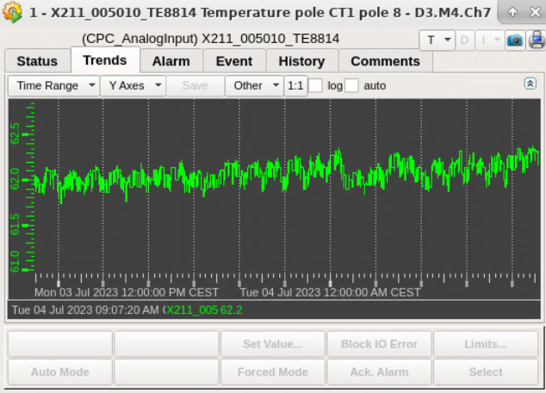
Short Term point of attention
Toroid Fast Dump:
  One more cycle to the toroid
    limited lifetime for the magnet.. We need to limit as much as possible cycles
  After rump up the breakers showed much larger temperature (one contact over 100 C)
    Temperature problem mitigated adding Fans
    The underlying problems remains there…
    Temperature slightly increasing…

Slide 10
Conclusions
A BIG THANKS s to all of you for your dedication and your great skills and great team work!
On a personal level I am really happy to work with you and share this very interesting (and tiring) times with you all!

