Slide 1
Ferrite heating: Preliminary analysis
SPS BWS Task Force – Giannis Papazoglou & Federico Carra – CERN-EN-MME
2023-06-02
EDMS: 2897472

Slide 2
Overview
Preliminary analysis for the Ferrite heating:
  ANSYS calculations using simplified model
  Analytical calculations

Slide 3
Preliminary model

Slide 4
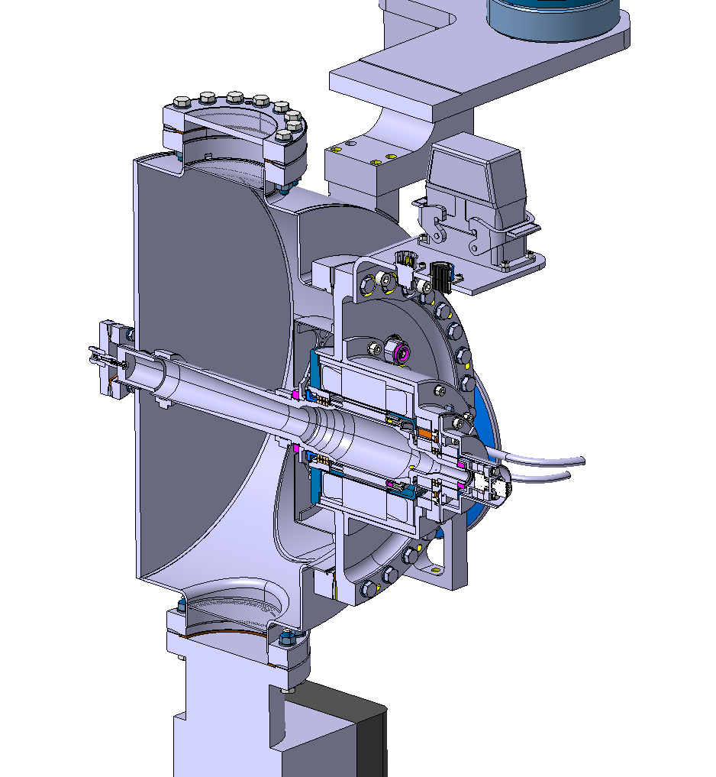
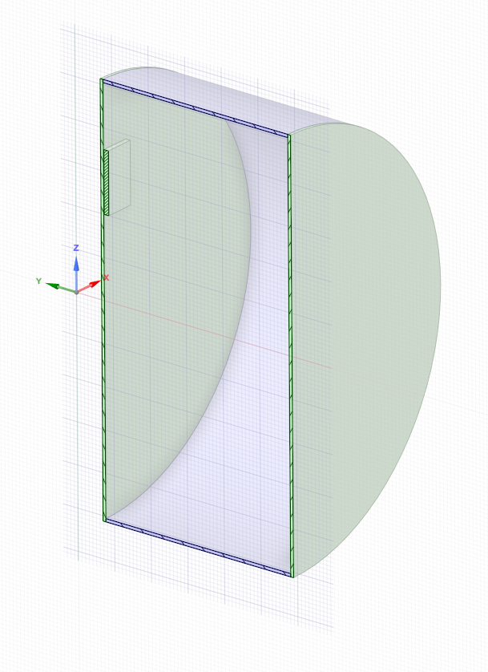
Design
Ferrite Block
Simplified Design

Slide 5
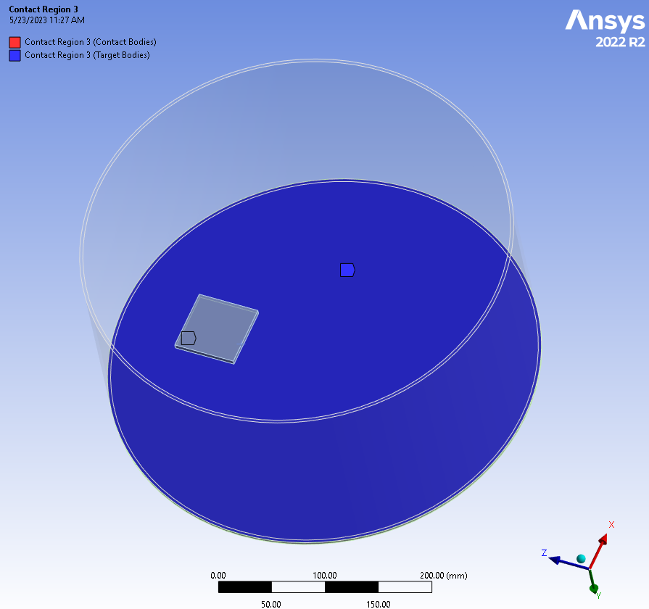
Boundaries
Thermal conductance between ferrite and = 6.2 e-2 W/(m^2*K)
Convection around the chamber to 22C ambient = 7 W/(m^2K)
Emissivity Ferrite = 0.8
Emissivity tank = 0.35

Slide 6
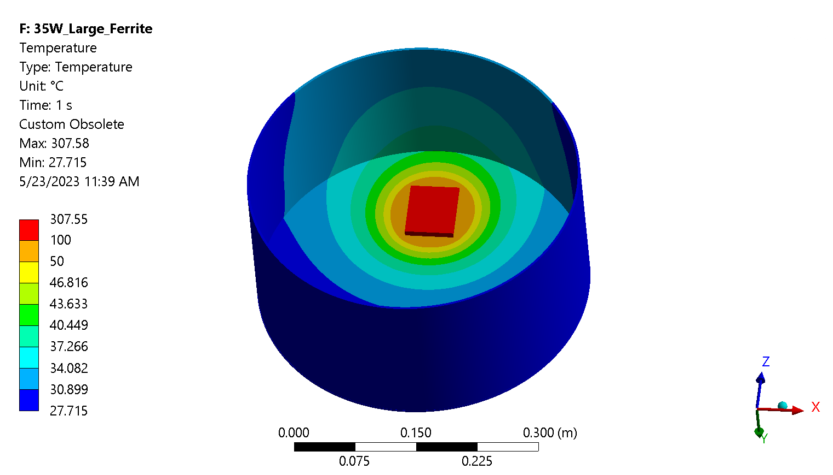
Results 35 W
Analytical: 380C

Slide 7
Analytical Calculations

Slide 8
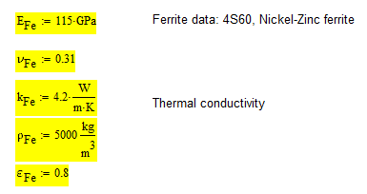
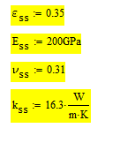
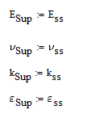
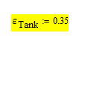
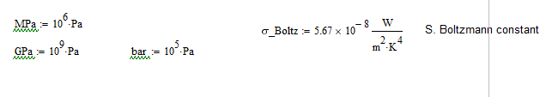
Housekeeping

Slide 9
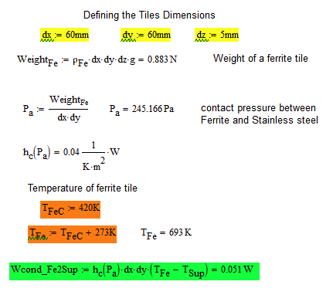
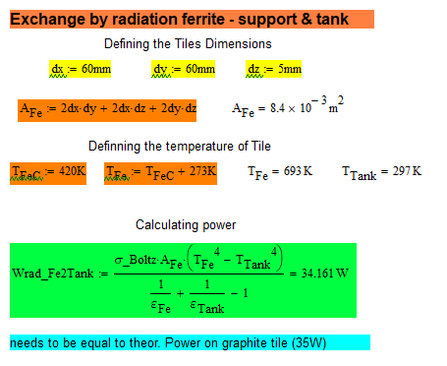
Small Tile 35W
Conduction
Radiation
T_FeC = 420 degC
T_FeC = 420 degC
Conduction/Radiation = 0.1 %

Slide 10
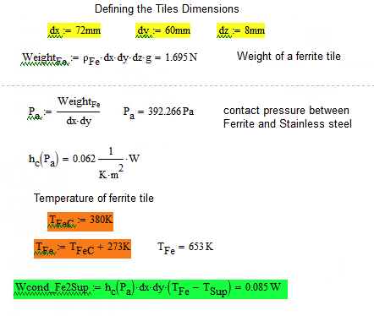
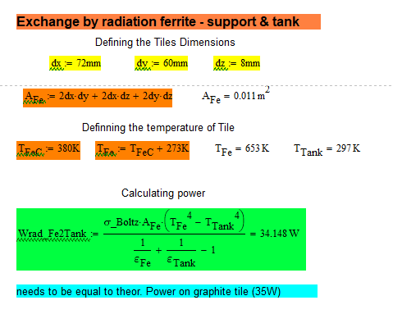
Large Tile 35W
Conduction
Radiation
T_FeC = 380 degC
T_FeC = 380 degC
Conduction/Radiation = 0.25 %

Slide 11
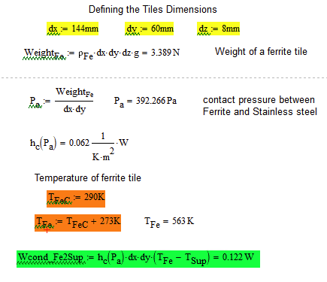
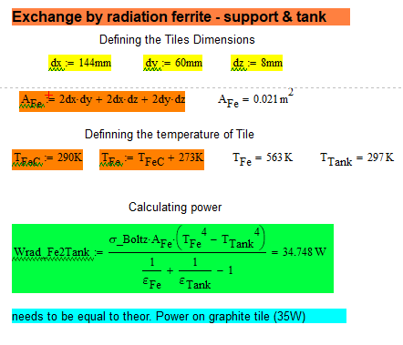
2 Large Tiles 35W
Conduction
Radiation
T_FeC = 290 degC
T_FeC = 290 degC
Conduction/Radiation = 0.35 %

Slide 12
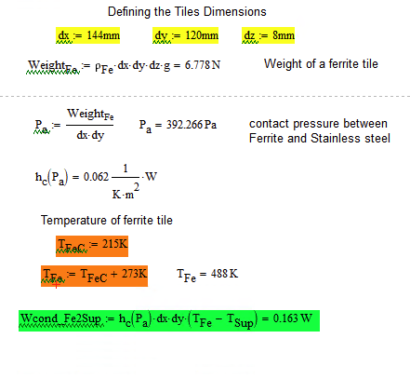
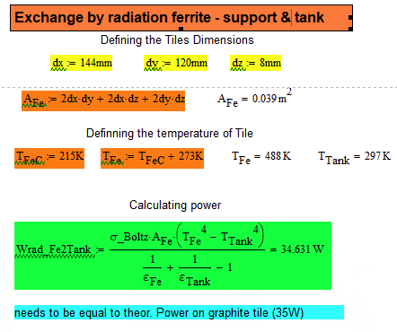
4 Large Tiles 35W
Conduction
Radiation
T_FeC = 215 degC
T_FeC = 215 degC
Conduction/Radiation = 0.5 %

Slide 13
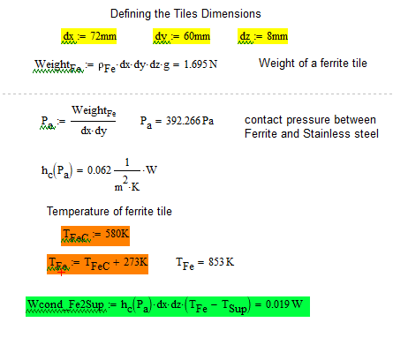
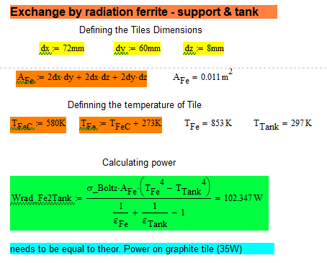
Large Tile 100W
Conduction
Radiation
T_FeC = 580 degC
T_FeC = 580 degC

Slide 14
Other considerations
Currie Point of Fe ~ 375 C → Need to stay below that to avoid saturation
Outgassing → can be an issue in high temperatures
Overall: Suggested to stay below 250 C
For a total power around 30-40 W we could spread it in 4 tiles without active cooling.
In the case of 100 W → difficult to work without active cooling

