Slide 1
TS1 preparation

Slide 2
Preparation of two spare WS: on going, ready at the end of next week
Preparation of compensatory measures depending on input from impedance colleagues
Modification of BA4 layout, one vertical WS will become horizontal WS(ECR in preparation, will be submitted soon)

Slide 3
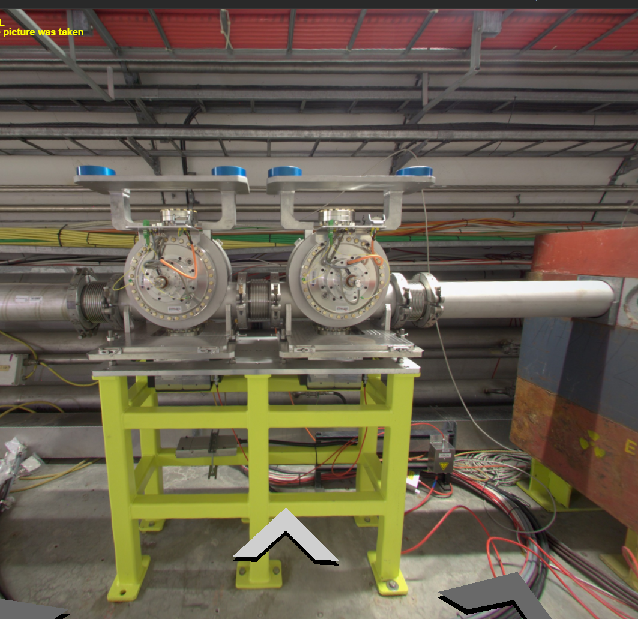
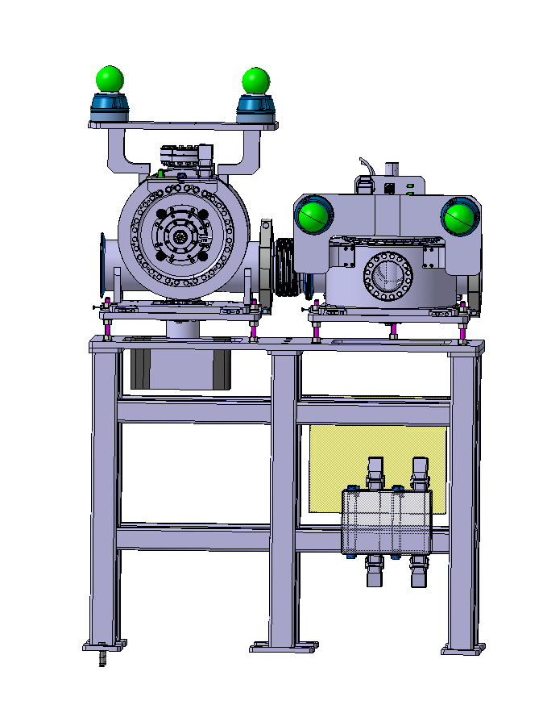
BA4 proposed configuration:
1 vertical WS and 1 horizontal WS
BA4 actual configuration: 2 vertical WS

