Slide 1
SPS Wire Scanner Measurements
Christine Vollinger, Michela Neroni, Michael Sullivan for the Impedance Working Group

Slide 2
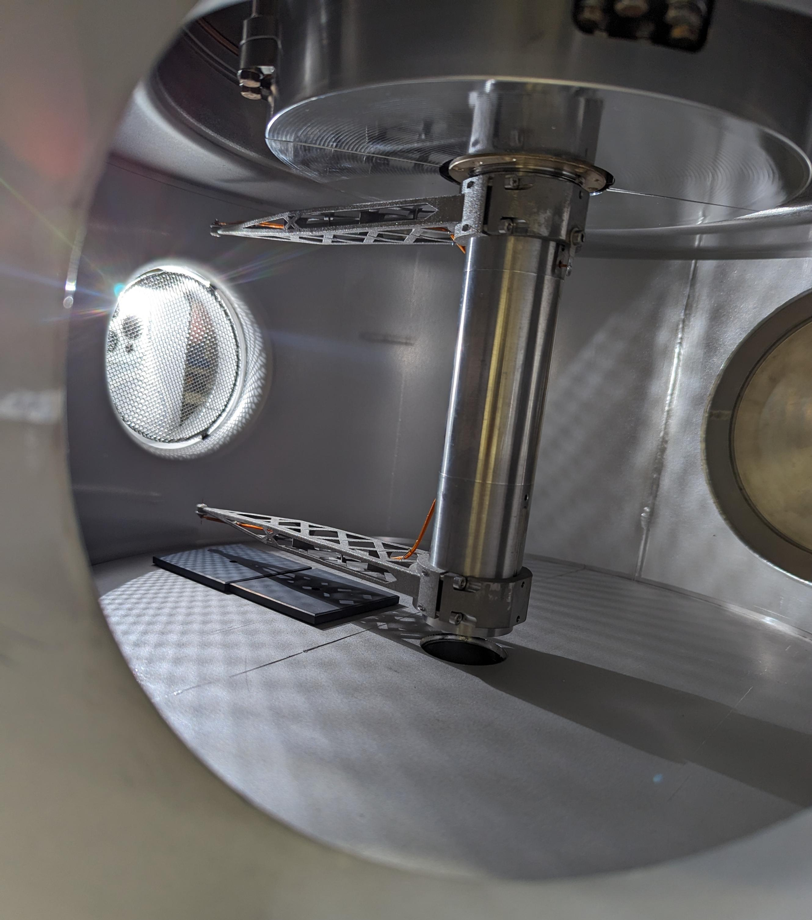
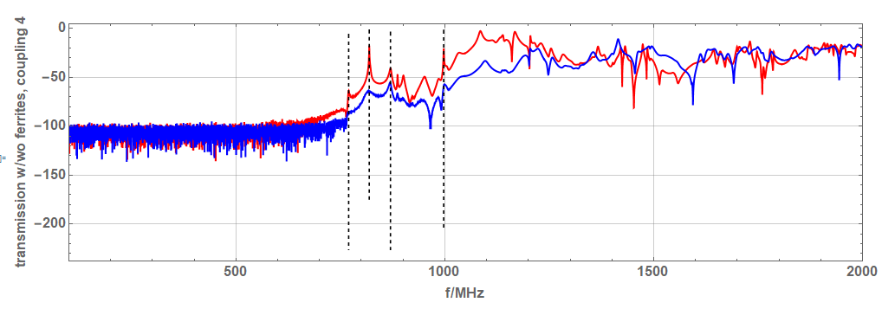

Measurements (probe-probe on axis)
998 MHz
818 MHz
769 MHz
869 MHz

Slide 3
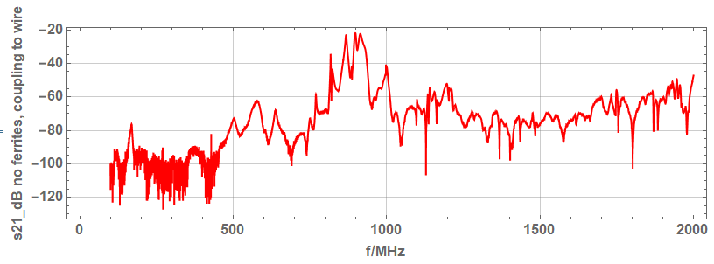
Measurements (probe to wire)
166 MHz mode

