Slide 1
SPS Wire Scanner Impedance studies
Michael Sullivan

Slide 2
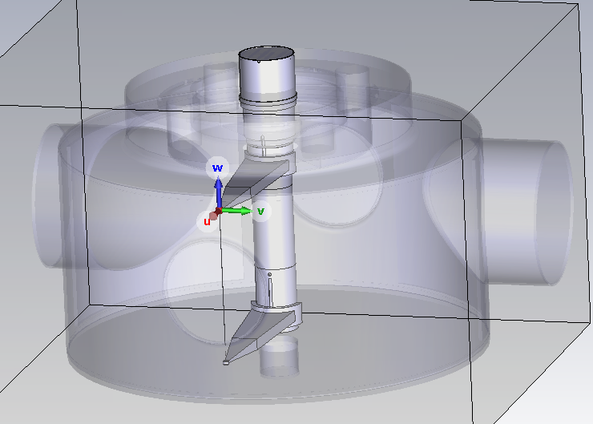
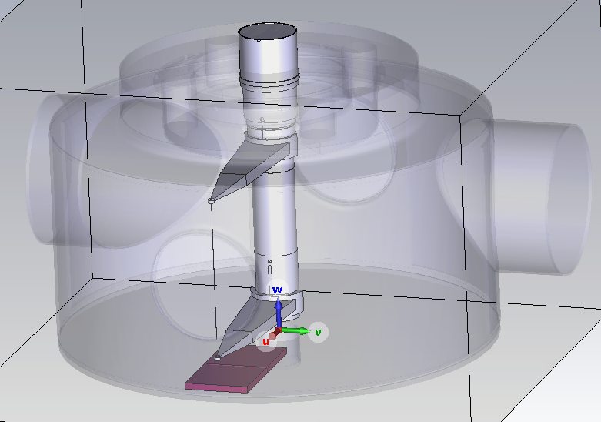
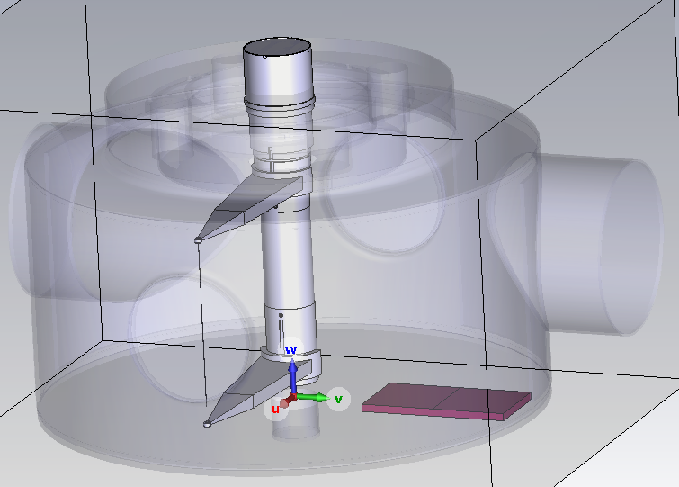
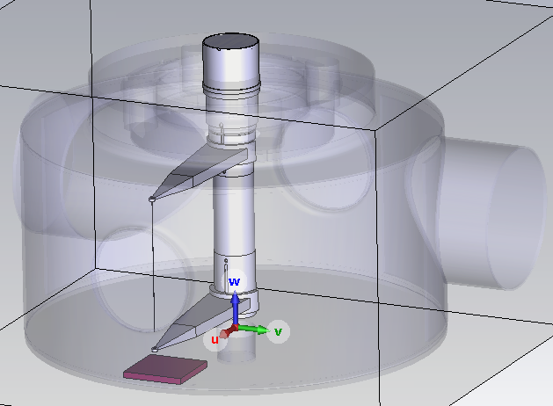
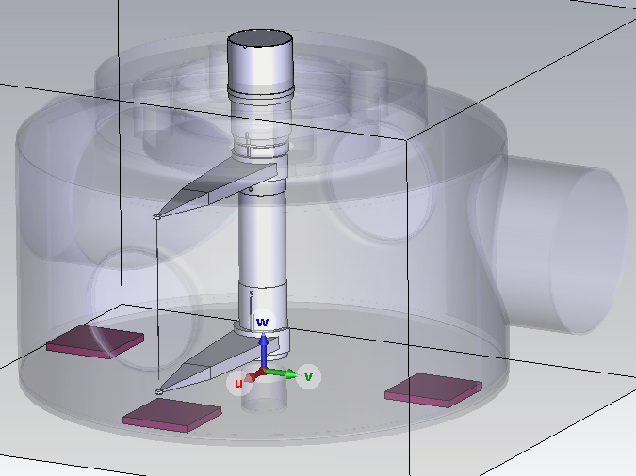
Mitigation Options – TT2111R Ferrites
Current 2023 Model
2 Tiles (0°)
2 Tiles (-90°)
1 Tile (0°)
3 Tiles (-90°, 0°, 90°)

Slide 3
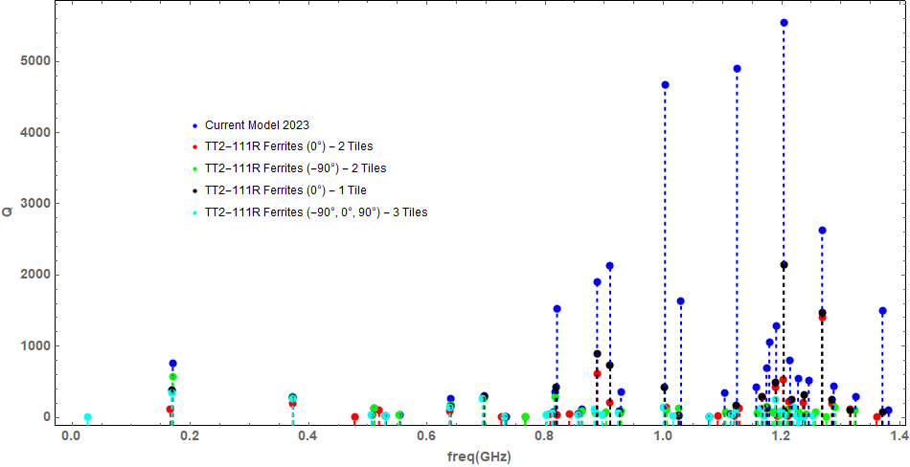
Mitigation Options – TT2111R Ferrites

Slide 4
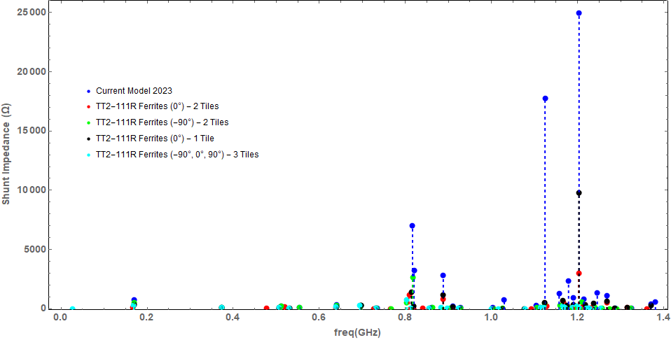
Mitigation Options – TT2111R Ferrites

Slide 5
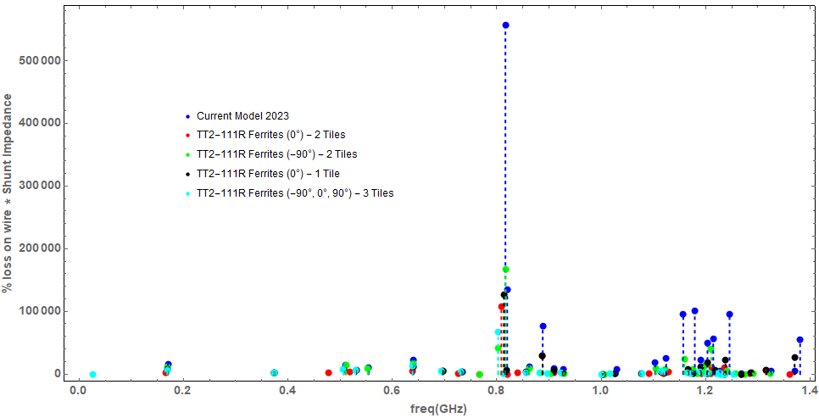
Mitigation Options – TT2111R Ferrites

Slide 6
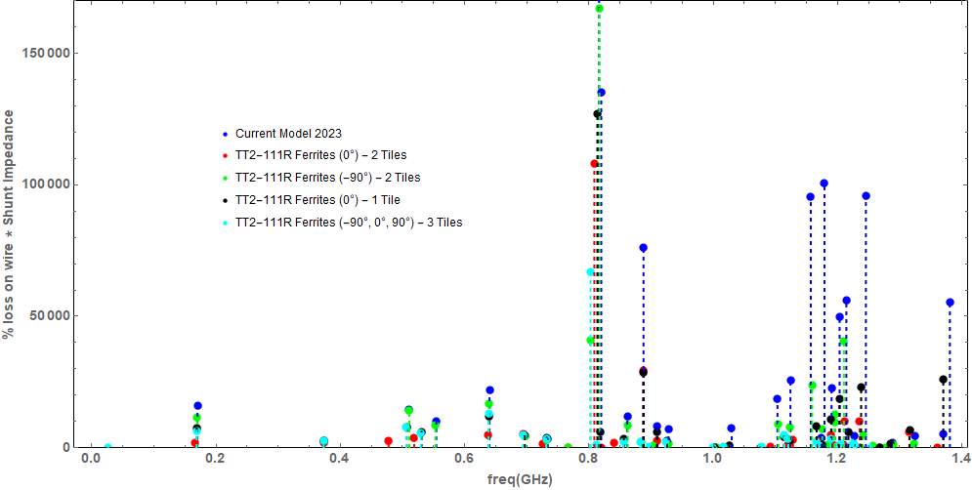
Mitigation Options – TT2111R Ferrites

Slide 7
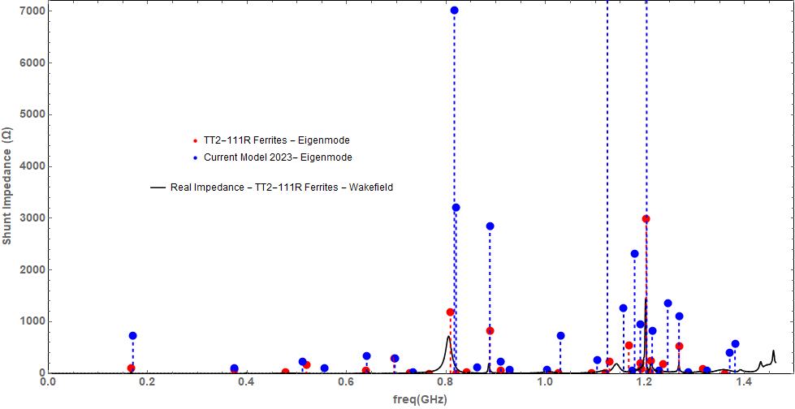
Mitigation Options – TT2111R Ferrites

Slide 8
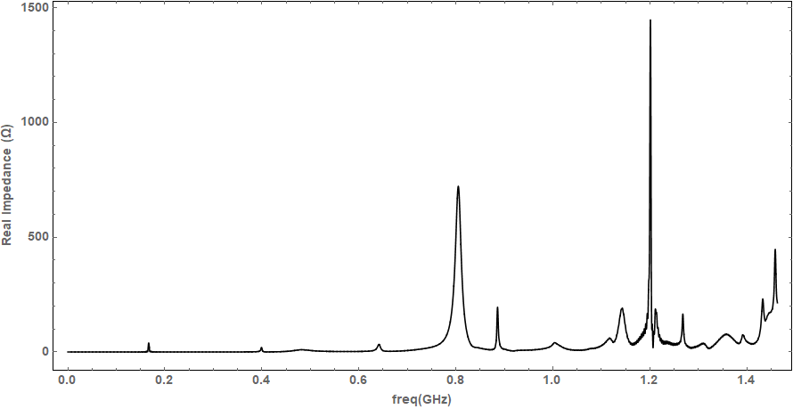
Mitigation Options – TT2111R Ferrites

Slide 9
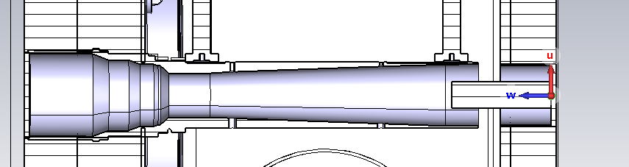
Mitigation Options – Feedthrough insert
Example of a feedthrough insert that could be used.
CST simulations for this have been done but the data has not yet been analysed.
It is to be seen whether the shape of the insert could be optimised to mitigate problematic modes.
Could possibly be used in situation where ferrites are not possible.

