Slide 1
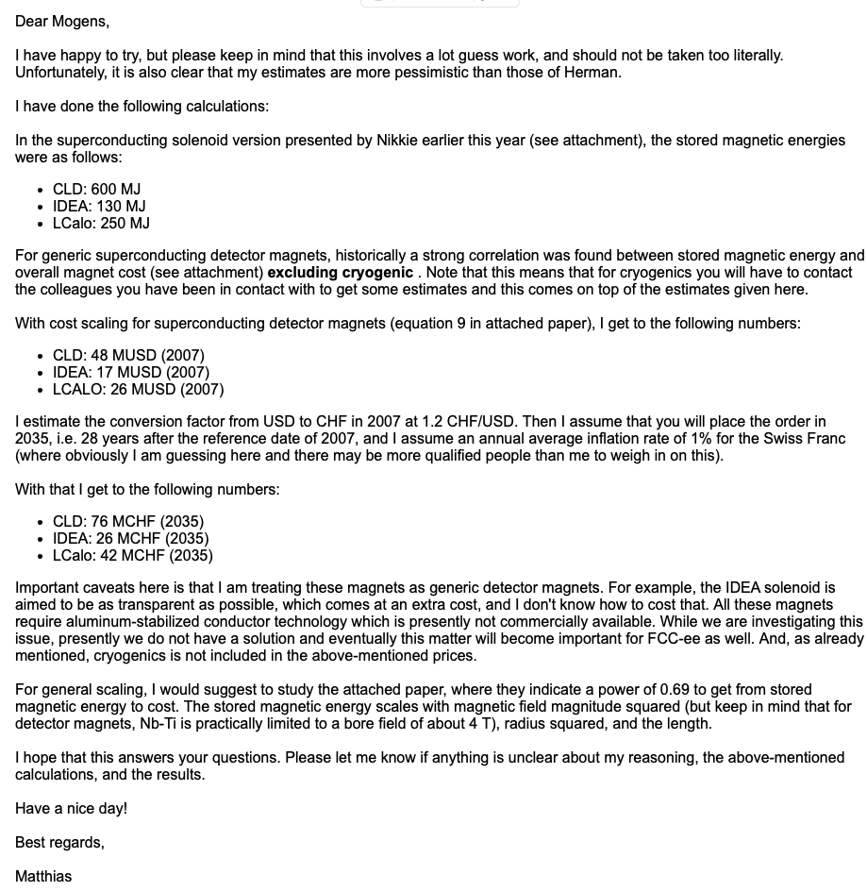
Solenoid
2nd Costing Meeting,
May 16th
CLD note: 50 MCHF

Slide 2

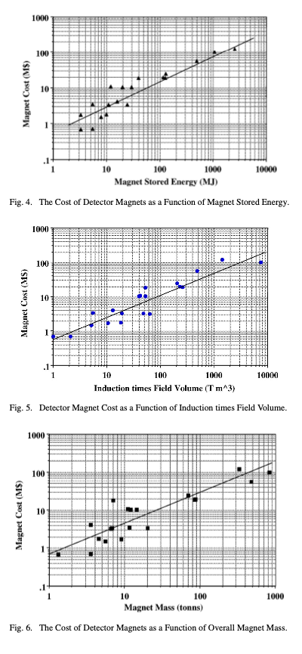
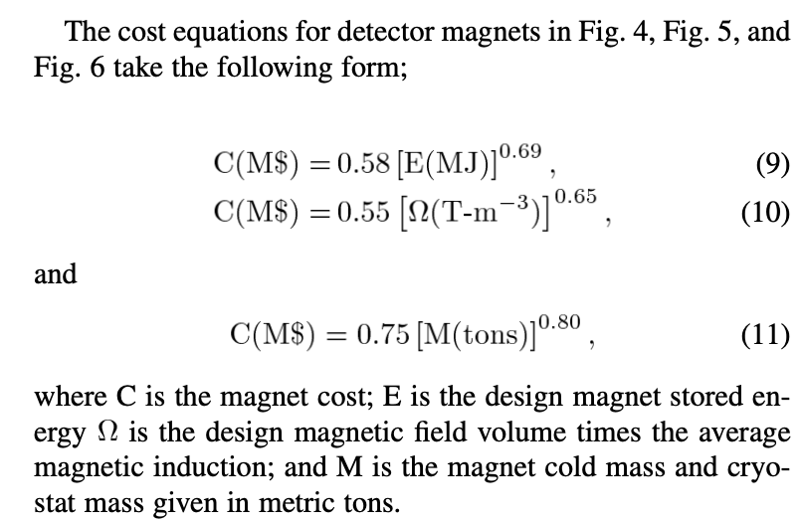

Slide 3
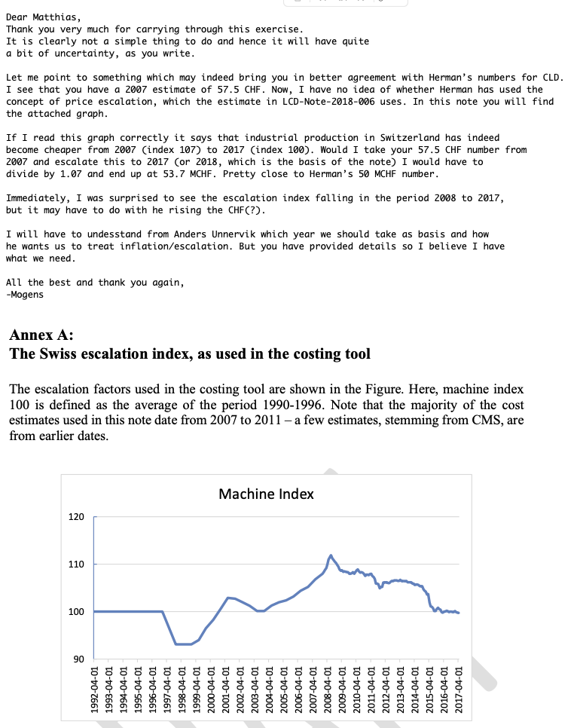
Price escalation,
Inflation,
Reference year?

Slide 4
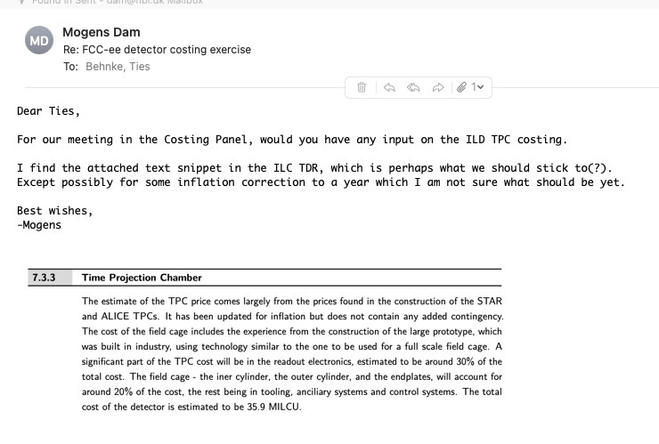
TPC

