Slide 1
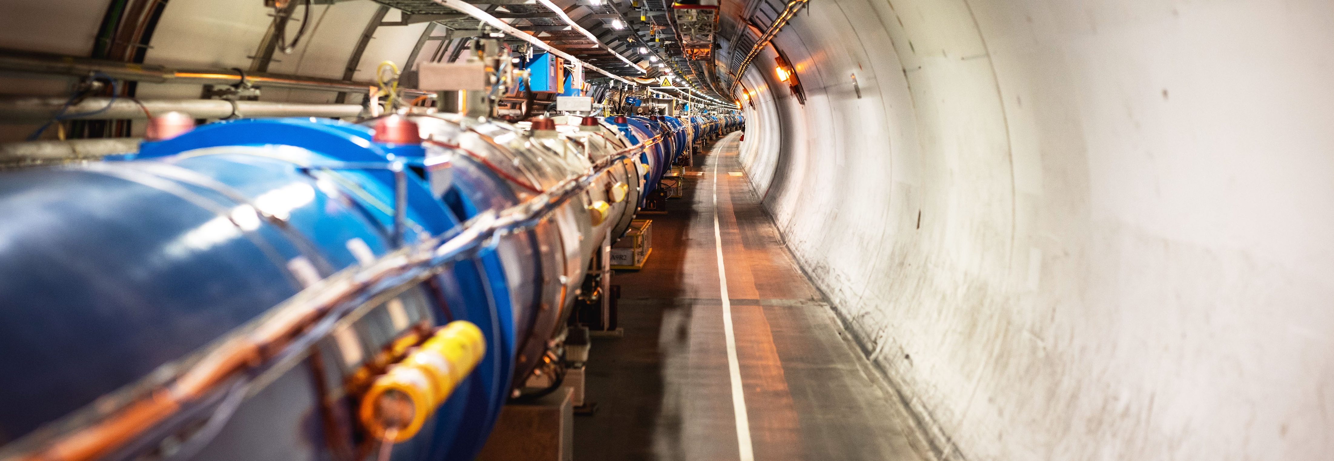
REPORT FROM CERN INTERNATIONAL RELATIONS
Joint CERN-Croatia Committee
23 June 2023

Slide 2

Science for peace
CERN was founded in 1954 with 12 European Member States
CERN’s annual budget
is 1200 MCHF (equivalent
to a medium-sized European university)
23 Member States
Austria – Belgium – Bulgaria – Czech Republic
Denmark – Finland – France – Germany – Greece Hungary – Israel – Italy – Netherlands – Norway
Poland – Portugal – Romania – Serbia – Slovakia Spain – Sweden – Switzerland – United Kingdom
As of 31 December 2022
Employees:
2658 staff, 900 fellows
Associates:
11 860 users, 1516 others
3 Associate Member States
in the pre-stage to membership
Cyprus – Estonia – Slovenia
7 Associate Member States
Croatia – India – Latvia – Lithuania – Pakistan
Türkiye – Ukraine
6 Observers
Japan – Russia (suspended) – USA
European Union – JINR (suspended) – UNESCO
Around 50 Cooperation Agreements
with non-Member States and Territories
Albania – Algeria – Argentina – Armenia – Australia – Azerbaijan – Bangladesh – Belarus – Bolivia
Bosnia and Herzegovina – Brazil – Canada – Chile – Colombia – Costa Rica – Ecuador – Egypt – Georgia – Honduras
Iceland – Iran – Jordan – Kazakhstan – Lebanon – Malta – Mexico – Mongolia – Montenegro – Morocco – Nepal
New Zealand – North Macedonia – Palestine – Paraguay – People's Republic of China – Peru – Philippines – Qatar
Republic of Korea – Saudi Arabia – Sri Lanka – South Africa – Thailand – Tunisia – United Arab Emirates – Vietnam
Notes:
The speaker can highlight CERN’s second mission as stated when it was established: to foster peaceful collaborations between nations that had recently been at war.
Additional information (OPTIONAL)
More than 40% of CERN’s budget is returned to industry through materials, utilities and services

Slide 3
A laboratory for people around the world
Distribution of all CERN Users by the country of their home institutes as of 31 December 2022
Geographical & cultural diversity
Users of 110 nationalities
19.4% women
Member States 7147
Austria 85 – Belgium 129 – Bulgaria 43 – Czech Republic 244 Denmark 49 – Finland 90 – France 844 – Germany 1225 Greece 119 – Hungary 73 – Israel 64 – Italy 1527
Netherlands 169 – Norway 79 – Poland 305 – Portugal 100 Romania 109 – Serbia 33 – Slovakia 70 – Spain 383
Sweden 103 – Switzerland 406 – United Kingdom 898
Associate Member States
in the pre-stage to membership 69
Cyprus 15 – Estonia 30 – Slovenia 24
Associate Member States 382
Croatia 38 – India 132 – Latvia 16 – Lithuania 14 – Pakistan 35
Türkiye 122 – Ukraine 25
Observers 2991
Japan 216 – Russia (suspended) 873 – United States of America 1902
Non-Member States and Territories 1271
Algeria 2 – Argentina 13 – Armenia 8 – Australia 21 – Azerbaijan 2 – Bahrain 4 – Belarus 18 – Brazil 122
Canada 199 – Chile 34 – Colombia 21 – Costa Rica 2 – Cuba 3 – Ecuador 4 – Egypt 20 – Georgia 32
Hong Kong 15 – Iceland 3 – Indonesia 5 – Iran 11 – Ireland 5 – Jordan 5 – Kuwait 4 – Lebanon 13 – Madagascar 1
Malaysia 4 – Malta 1 – Mexico 49 – Montenegro 4 – Morocco 19 – New Zealand 5 – Nigeria 1 – Oman 1
Palestine 1 – People’s Republic of China 333 – Peru 2 – Philippines 1 – Republic of Korea 147 – Singapore 2 South Africa 52 – Sri Lanka 10 – Taiwan 45 – Thailand 17 – Tunisia 2 – United Arab Emirates 7 – Viet Nam 1
Notes:
THIS SLIDE WILL INCLUDE THE NUMBER OF MEMBERS OF PERSONNEL OF THE VISITORS’ COUNTRY OF ORIGIN

Slide 4
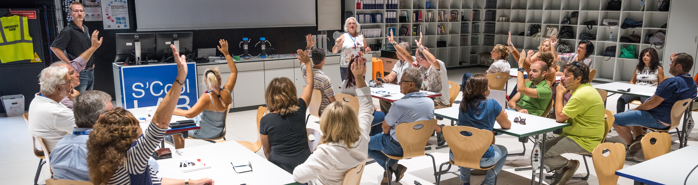
CERN’s training, education and outreach programmes
300 Undergraduate students in
Summer programmes
>3000 registered PhD students.
>1000 Fellows, Technical and Doctoral Students in research and applied physics, engineering and computing.
13 304 teachers since 1998 and 2000 participants in the webinar since 2020.
Numbers for Croatia
4 summer students during 2019
113 teachers in Teacher Programmes since 1998
1 teams in BL4S competition since 2014
28 students participating in S’Cool LAB
since 2015
539 visitors in 2019
151 000 visitors on guided tours of CERN in 2019, from 95 countries.
CERN engages with citizens
across the globe:
on-site and travelling exhibitions
in 15 countries, > 1 million visitors
Science Gateway will open in 2023, expanding CERN’s outreach reach and impact, locally and globally.
Notes:
THE NUMBERS ON THIS SLIDE NEED REGULAR UPDATING
CERN schools: High Energy Physics; Computing; Accelerator

Slide 5
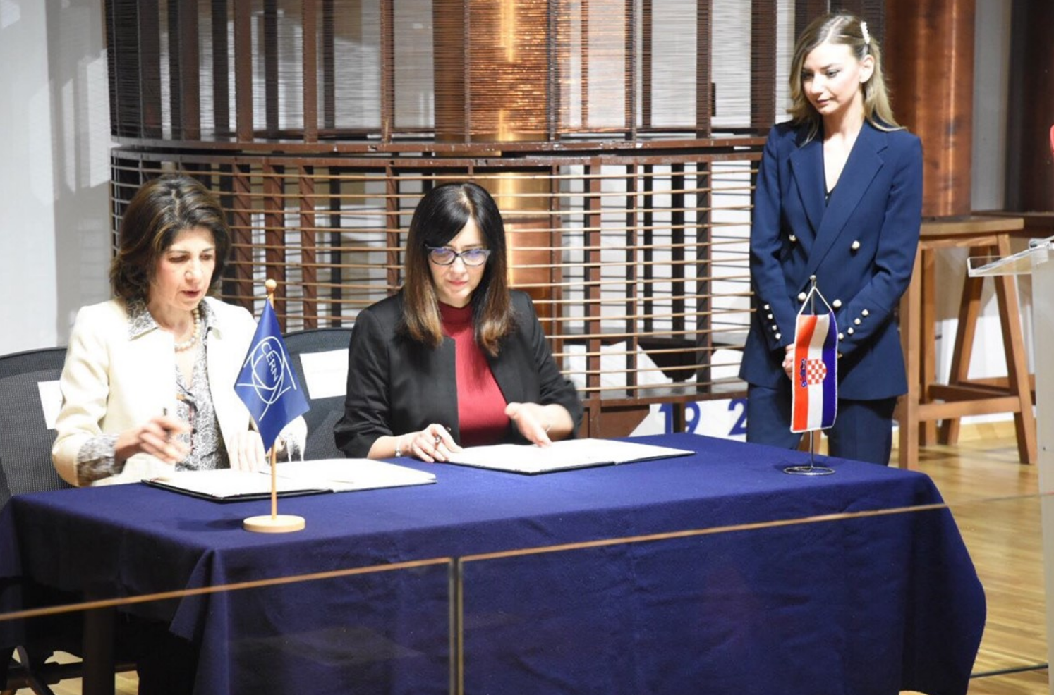
Croatia and CERN
International Cooperation Agreement signed in 1991, on further development of scientific and technical cooperation in high energy physics.
Prior to 1994, Croatian physicists were mainly involved in the SPS heavy-ion programme with the NA49 experiment, and in the preparation of the ALICE experiment at the LHC.
Contribution to ALICE and CMS detector construction at the LHC with involvement of Croatian industry.
Following application in 2014, Associate Member State since October 2019.
28 February 2019; Fabiola Gianotti, CERN Director-General, and Blaženka Divjak,
Minister of Science and Education of the Republic of Croatia, signed the Agreement
admitting Croatia as an Associate Member State of CERN.
Notes:
This is the first slide of the country-specific section.
(THIS SECTION TYPICALLY HAS 3/4 SLIDES)

Slide 6
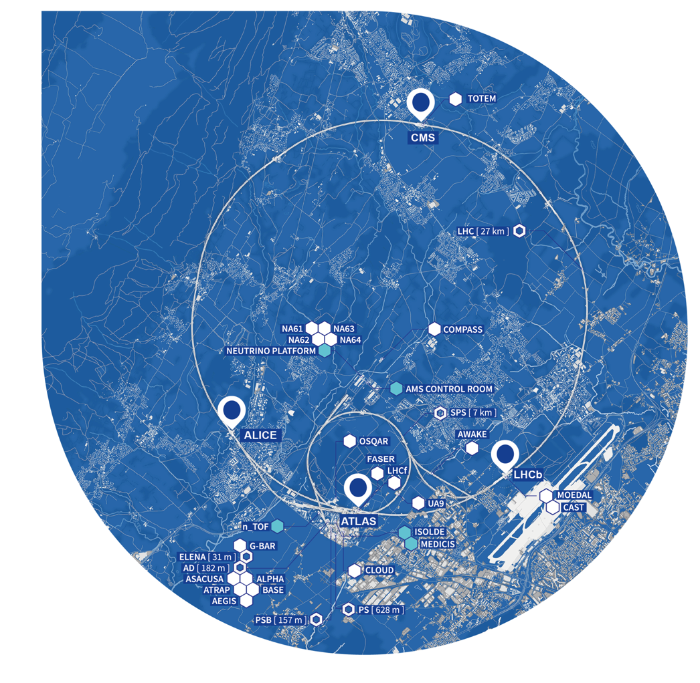
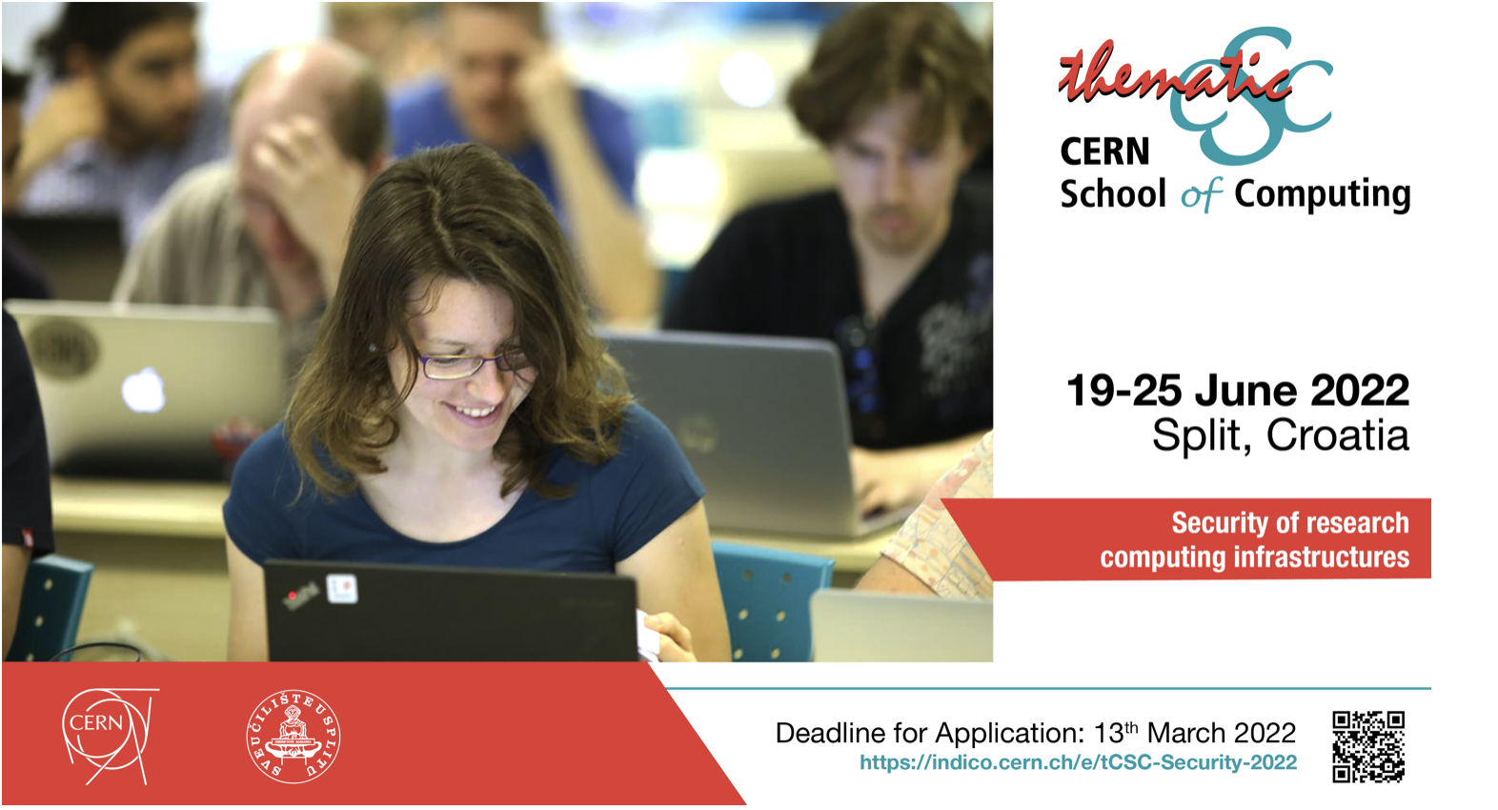
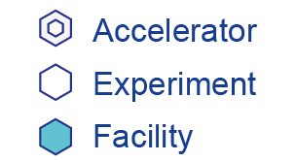
Croatia is involved across a wide range of experiments at CERN
LHC EXPERIMENTS:
ALICE 2 Institutes, 9 members
CMS 3 institutes, 32 members
International Conference of High Energy Physics every 2 years in Croatia
9 different CERN Schools of Computing organized in Croatia (in collaboration with
the University of Split) since 2007
FIXED TARGET EXPERIMENTS
NA61
N_TOF
Neutrino Platform
2 institutes, 9 members
ISOLDE
1 institute, 3 members

Slide 7

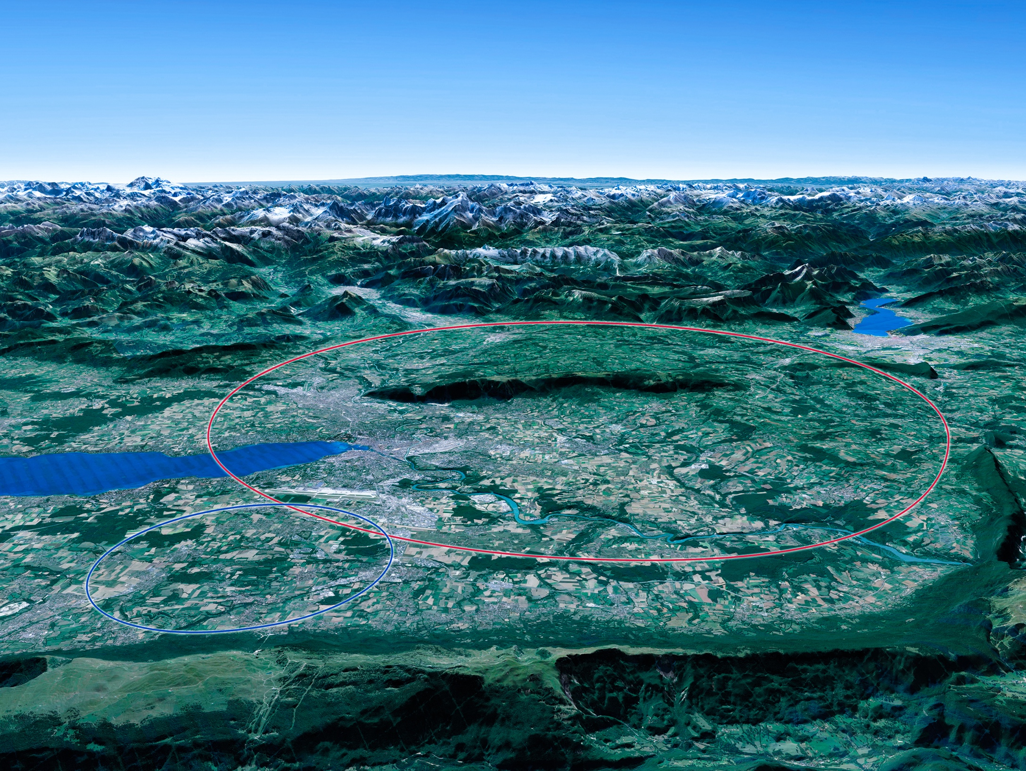

Scientific Priorities for the Future
Implementation of the recommendations
of the 2020 Update of the European Strategy
for Particle Physics:
• Fully exploit the HL-LHC.
• Build a Higgs factory to further understand this unique particle.
• Investigate the technical and financial feasibility of a future energy-frontier 100 km collider at CERN.
• Ramp up relevant R&D.
• Continue supporting other projects around
the world.
LHC
Notes:
For information, the ESPPU recommendations in more detail:
Full exploitation of the HL-LHC
An electron-positron Higgs factory is the highest priority after the LHC
Ramp up R&D efforts for advanced accelerator technologies
Support long-baseline neutrino projects in Japan and US
Investigation of feasibility of a future 100 TeV hadron collider at CERN
THIS IS THE LAST SLIDE IN THE “RESEARCH” SECTION

Slide 8

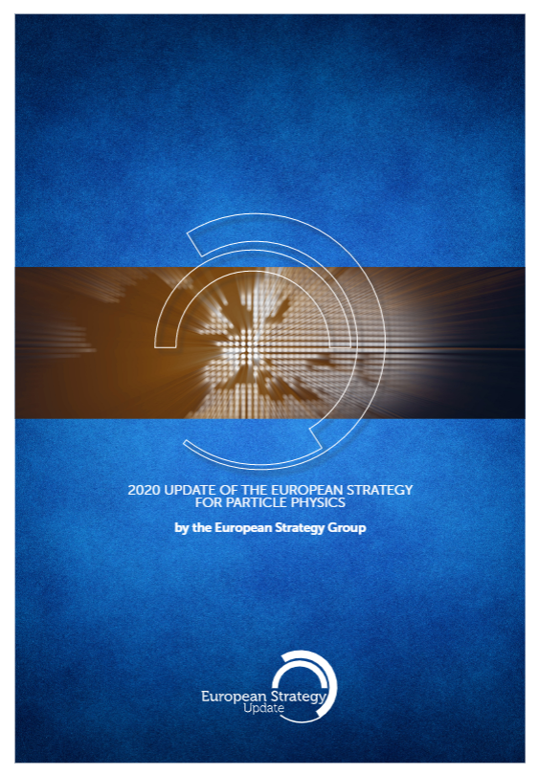
FCC Feasibility Study
FCC Feasibility Study (FS) will address a recommendation of the 2020 update of the European Strategy for Particle Physics (ESPP):
“Europe, together with its international partners, should investigate the technical and financial feasibility of a future hadron collider at CERN with a centre-of-mass energy of at least 100 TeV and with an electron-positron Higgs and electroweak factory as a possible first stage.
Such a feasibility study of the colliders and related infrastructure should be established as a global endeavour and be completed on the timescale of the next Strategy update.”
Complete Feasibility Study Report by end 2025

Slide 9


Status of FCC Global Collaboration
Increasing international collaboration as a prerequisite for success:
→links with science, research & development and high-tech industry will be essential to further advance and prepare the implementation of FCC
150
Institutes
32
Companies
34
Countries
EC
H2020
FCC Feasibility Study: Aim is to increase further the collaboration, on all aspects,
in particular, on Accelerator and Particle/Experiments/Detectors (PED).

Slide 10

FCC Global Collaboration Working Group
From ESPP 2020: “Such a feasibility study of the colliders and related infrastructure should be established as a global endeavour….”
→ FCC Global Collaboration Working Group active since spring 2021
Engage with institutes/countries/regions with mature communities, and the potential to contribute substantially to the Organization’s long-term scientific objectives, to facilitate participation in FCC FS.
Work with national laboratories, institutes, universities and industry in MS, AMS, Observer States and NMS to:
  Encourage an expanded membership and explore opportunities for future prospective participants.
  Explore opportunities for future prospective participants in defining areas of collaboration.
  Prepare the foundations for research and contributions by industry.
  Liaise with national contact persons and forums.

Slide 11


FCC Engagement Meetings
Overview
  Recently-launched extended forums with interested countries to discuss collaboration with FCC.
  Topics:
    Introduction to FCC Feasibility Study.
    Presentation of FCC physics, experiment, detector, accelerator and global collaboration.
    Presentations from the country scientific community.
Meetings
  Mexico (mini meeting on accelerator)
    June 2021
  Republic of Korea
    September 2021
  Pakistan
    September 2021
  Portugal
    November 2021
  Estonia
    March 2022
  Greece
    January 2023, June 2023
Much interest expressed by participating countries and the FCC looks forward to stronger / deeper involvement in the follow-up.

Slide 12
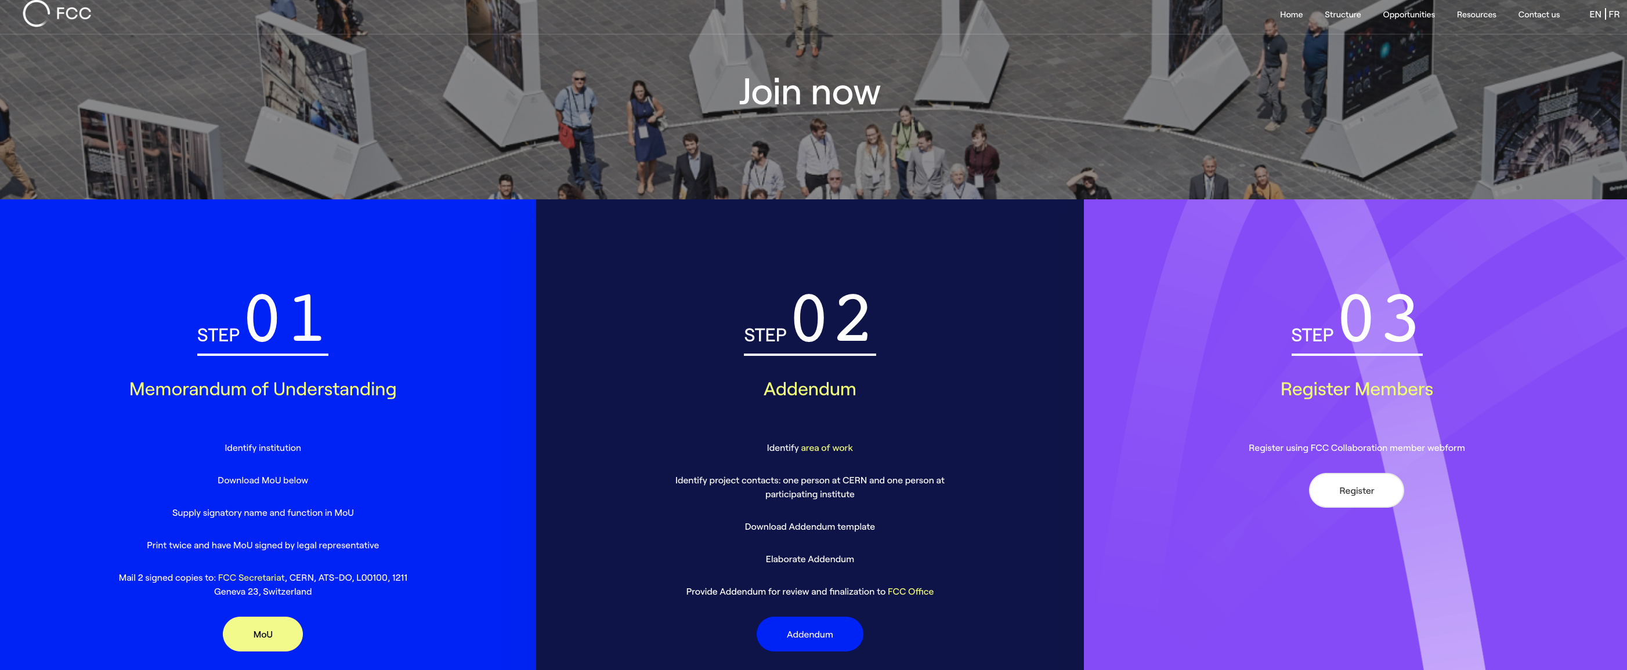
FCC Feasibility Study Collaboration Membership
Participation in FCC through MoU and Addenda.
The FCC MoU for the first phase of the study is being updated to cover the Feasibility Study.
The current participating institutes who wish to take part in the Feasibility Study can continue to participate on the basis of the previously signed MoU until the updated MoU is signed.
https://fccis.web.cern.ch/join-now

