Slide 1





CERN-Croatia Liaison Committee meeting
CERN, 23rd June 2023

Slide 2





Croatian institutions active at CERN
Smaller experiments
n_TOF
NA61
CAST
ISOLDE
25 CERN users

Slide 3
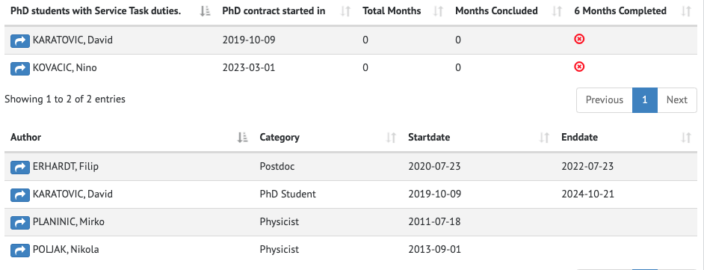

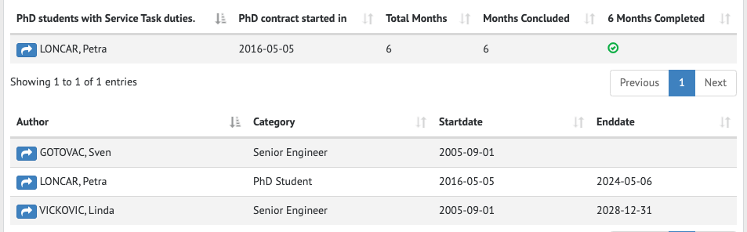
ALICE – experiment – two groups
Zagreb
TPC – upgrade
project + data analysis
4 active members – two senior physicists and two graduate students
Spin-off
Split
2 senior engineers and 1 grad student
Direct observation of the dead-cone effect in quantum chromodynamics, May 19 2022 | NATURE 605 (7910) , pp.440-+
Unveiling the strong interaction among hadrons at the LHC, Dec 10 2020 | NATURE 588 (7837) , pp.232-+,

Slide 4
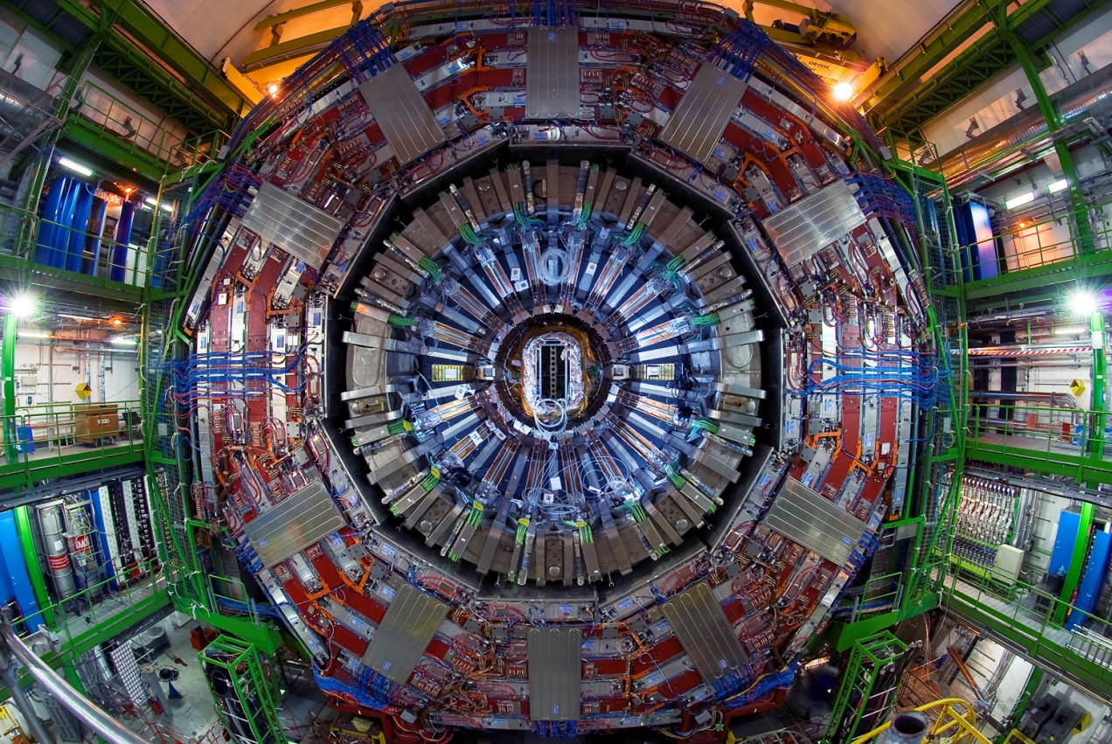
Participation in the CMS Experiment
Split University Group (FESB+PMF)
5 scientists (1 on leave for public service)
2 PhD students
8 engineers
5 completed theses since LHC start
Current activities (last 5 years)
Physics analysis:
  Split: Higgs (golden HZZ channel, self and anomalous H couplings), VBS
  RBI: BSM Searches, Higgs to bb (VH, double and triple Higgs)
Detector activities:
  Split: ECAL Software
  RBI: Pixel Offline+Online
Upgrade Activities (Phase 2)
  RBI: Pixel detector upgrade (module production and testing, irradiation tests)
  Split: HGCAL: L1 trigger - development and design of advanced electronics algorithms (ASIC and FPGA). Machine learning in real time for (EM) shower classification
RBI group (Zagreb)
6 scientists
1 PhD students
7 completed theses since LHC start
Some highlights
Transfer of knowledge, technology and capacity building (Physics <-> Electronics Engineering) at Split-FESB for HGCAL
Convenership roles in physics analyses (HZZ, stop) and detector responsibilities (e.g. Pixel sw)
Leading authors in several physics papers

Slide 5
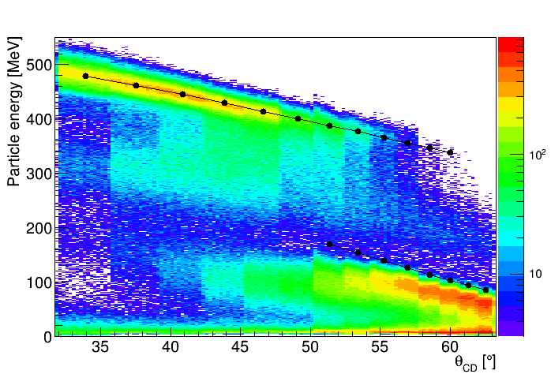
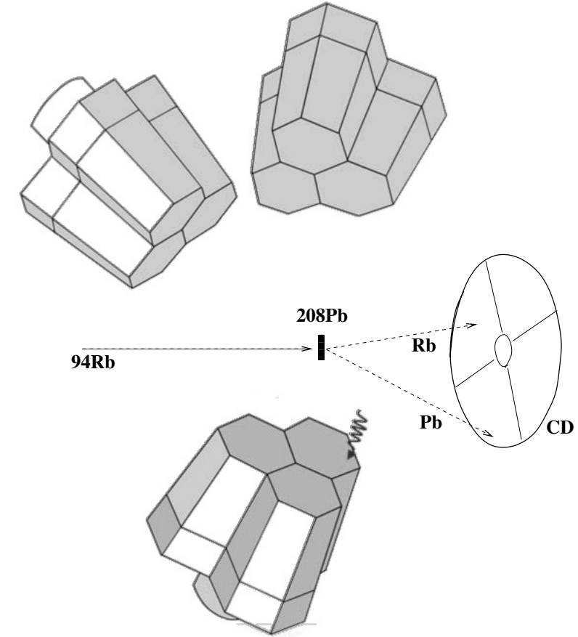
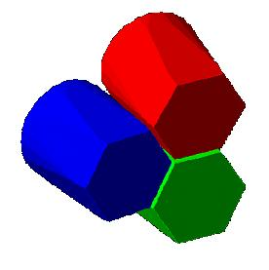
Participation in experiments @ ISOLDE
PROJECT IS572 – Multi Nucleon Transfer Experiment @ MINIBALL
spoke(s)person: S. Szilner, Ruder Boskovic Institute, Zagreb, J.J. Valiente Dobon, LNL – INFN, Padova, Italy
First MNT experiment with RIB.
Beam Intensity required 1.5 10⁷pps
First Exp. @ HIEISOLDE with all cavities used (6.15 MeV/u)
Rb-like
Pb-like
MrSc: M. Bortolami, Study heavy elements with exotic beams at ISOLDE - CERN,Universita degli Studi di Padova, Dipartimento di Fisica e Astronimia Galileo Galilei, Padova, (supervisor; J.J. Valiente Dobon), 2018
MrSc: M. Crnac, Faculty of Science, Zagreb (supervisor: S. Szilner), 2019
PhD: P. Colovic, Study of transfer reaction properties with stable and unstable heavy ion beams, Faculty of Science, Zagreb (supervisor: S. Szilner), 2020 P. Colovic, S. Szilner et al., Population of lead isotopes in binary reactions using a 94Rb radioactive beam, Physical Review C 102 (2020) 054609

Slide 6
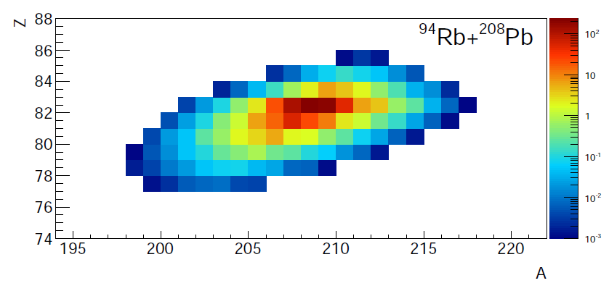
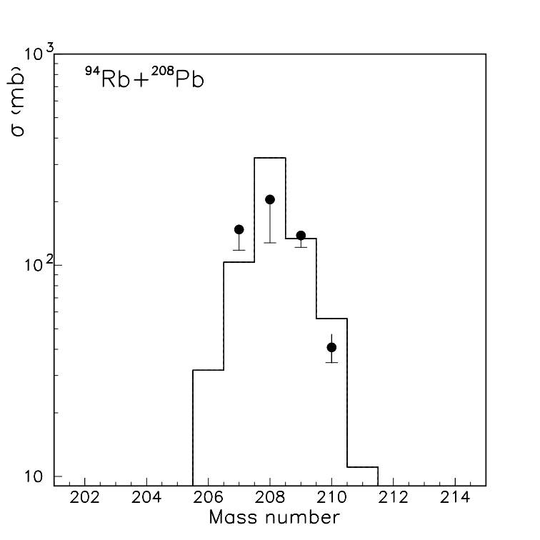
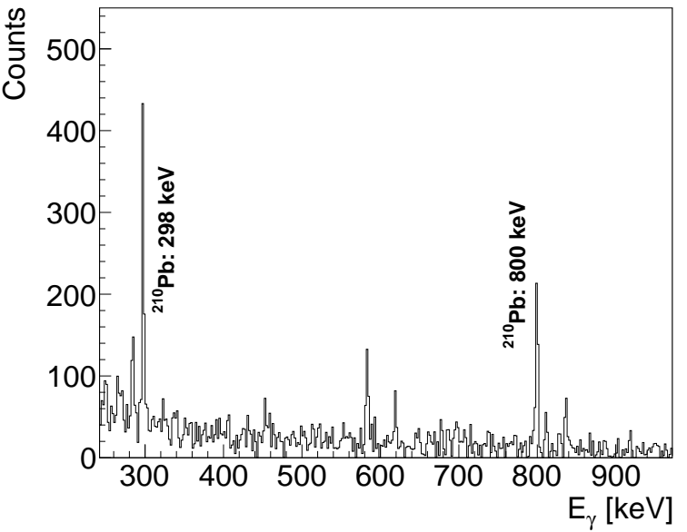
→ multinucleon transfer reactions with neutron-rich unstable beams of ISOLDE – CERN are suitable reaction mechanism to produce the neutron-rich heavy nuclei with the cross section high enough to study their structure properties, which in turn will help us to understand better the origin of elemnets in our Universe
Conferences and workshops:
11-th Scientific Meeting of the Croatian Physical Society (2018): invited presentation (S. Szilner); poster (P. Colovic)
La Rábida International Scientific Meeting on Nuclear Physics (2019): poster (P. Colovic)
Nuclear Structure and Dynamics (2019) Venezia, invited presentation (S. Szilner); poster (P. Colovic) “The best poster award”

Slide 7

Participation in the n_TOF Collaboration
n_TOF (neutron time of flight) collaboration
Members from the Faculty of Science,
University of Zagreb, since 2012:
Damir Bosnar (group leader)
Petar Žugec (PhD & postdoc at n_TOF)
*In 2017 we proposed a measurement:
P. Žugec et al., Measurement of the energy-dierential cross section of the 12C(n, p) and 12C(n, d) reactions, CERN-INTC-2017-081 / INTC-P-522
which was accepted and successfully performed.
It requires a plethora of new methods, having resulted in a publication of 3 technical papers, in preparation for a main publication on the data analysis (to be completed):
P. Žugec et al., Study of a data analysis method for the angle resolving silicon telescope, Journal of Instrumentation 15 (2020) P02011
P. Žugec et al., A synchronization method for the multi-channel silicon telescope, Nuclear Instruments and Methods in Physics Research A 983 (2020) 164606
P. Žugec et al., Machine learning based event classification for the energy-differential measurement of the natC(n,p) and natC(n,d) reactions, Nuclear Instruments and Methods in Physics Research A 1033 (2022) 166686
Activites in the last 5 years:
an energy-differential measurement of the natC(n,p) and natC(n,d) reactions*
in-group support (witin n_TOF) with the signal analysis procedures, simulations of experimental setups for different measurements, various numerical analyses
working on introducing machine learning techniques at n_TOF

Slide 8
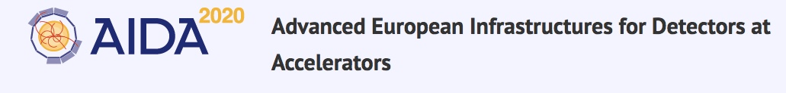

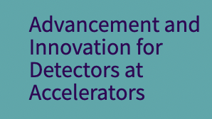
Participation in CERN R&D Projects
CERN RD50
Radiation hard semiconductor devices for very high luminosity colliders
CERN RD53
Developing the tools and designs needed to produce the next generation of pixel readout chips needed by ATLAS and CMS at the HL-LHC Radiation
CERN RD51
Development of Micro-Pattern Gas Detectors Technologies
RBI joined RD50 in 2016
RBI interest: future silicon detectors
RD53 expressed interest in radiation hardness tests at RBI Co60 source
PMF ZG joined RD53
Development of gaseous detectors for precise time measurement (20ps)
RBI participates in AIDA2020 and AIDAinnova as Transnational Access Facility

Slide 9
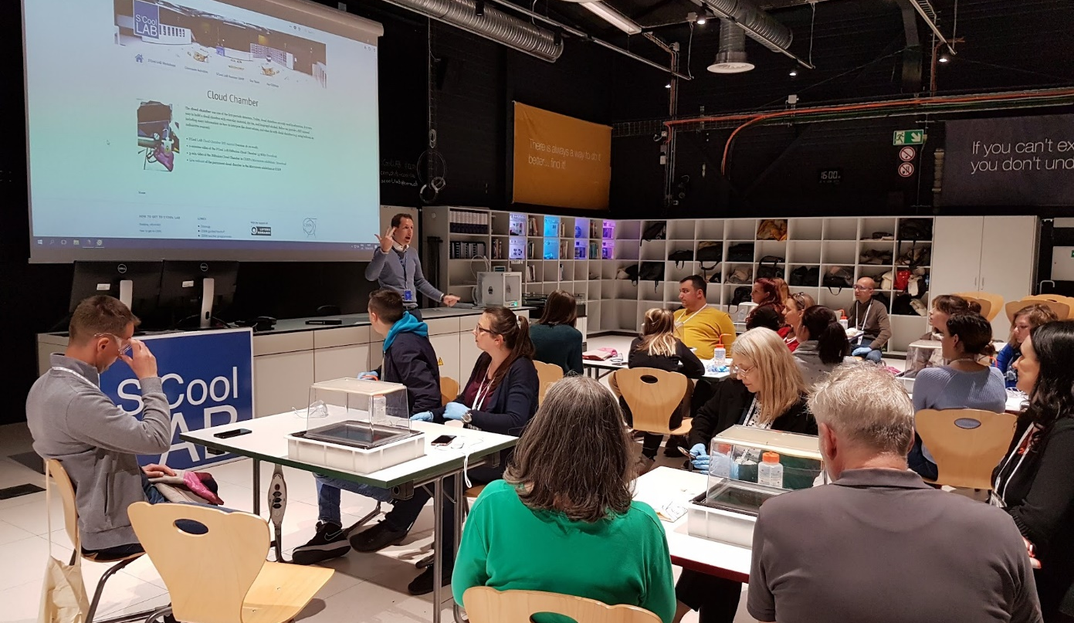
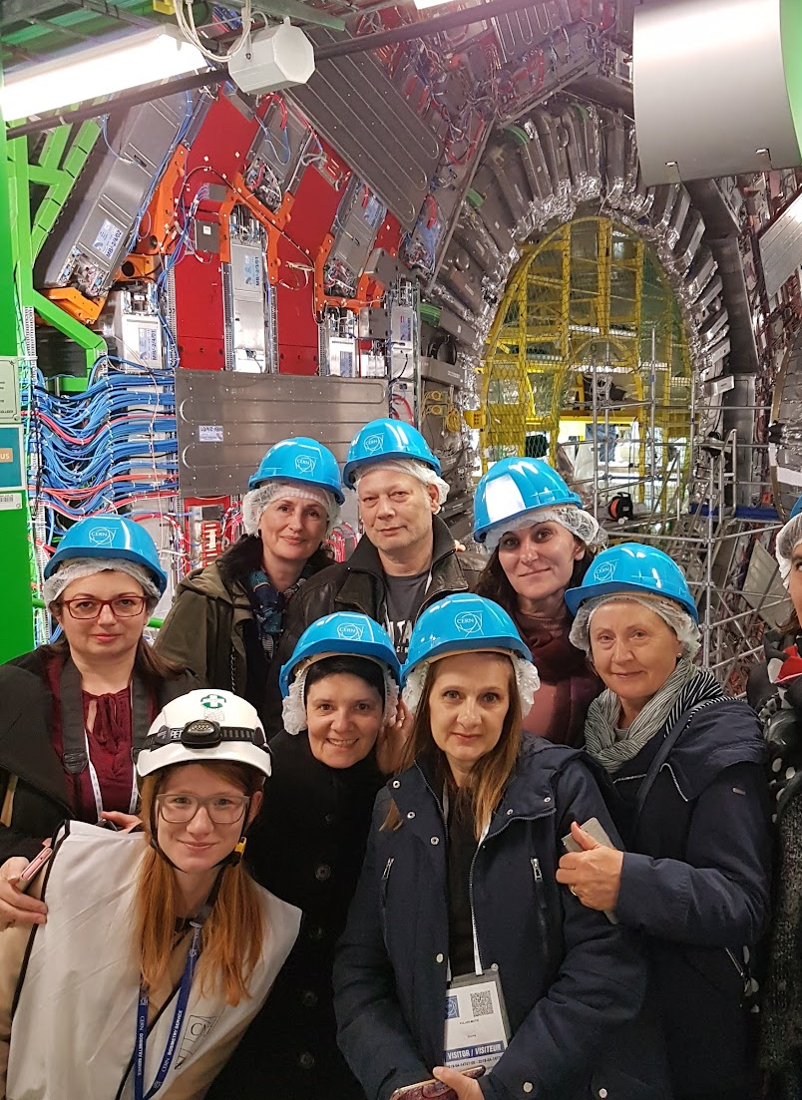
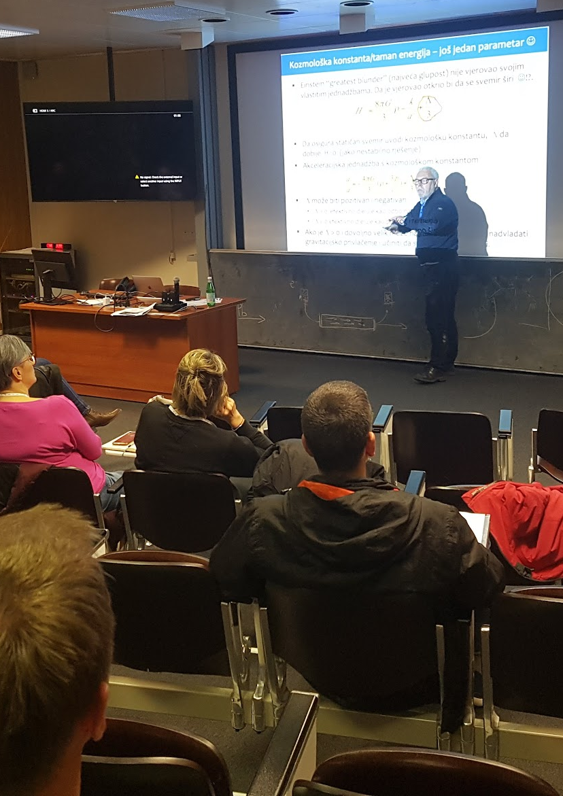
Croatian Teachers Program
Running since 2015:
  5 programs
  ~180 teachers in total
Enthusiastic feedback from participants
Thanks to the support of our ministry and the awesome Teachers Program team @ CERN!

Slide 10
Wrapping it up:
Our strengths, weaknesses, our future
Our strengths
Actively contributing to world-class science at CERN
Large network of international connections, used to competitive international environment
Successfully training young researchers to make an impact
Successful in securing national and international resources in challenging conditions
Our weaknesses and challenges
Not contributing enough to hardware
  Hard within typical Croatian grant possibilities
  Options through ESFRI funding?
Not reaping all the technology benefits we could
  Too few contacts with industry
Too few students
  Only partly due to funding
  Important brain drain challenge
Our path for the future
Keep and improve our scientific contribution
Increase (or bring back) our contribution to hardware and technology

