Slide 1


Croatia-CERN Liaison Committee meeting
23.6.2023.
Hrvoje Meštrić, PhD
Director-General
Directorate for Science and Technology
Ministry of Science and Education of the Republic of Croatia

Slide 2
Croatia – Strategic framework
National Development Strategy 2030.
  strategic goal "Competitive and innovative economy" - Development of science and technology
National Recovery and Resilience Plan (COMPONENT 3.2: BOOSTING RESEARCH AND INNOVATION CAPACITY):
  Reform and strengthening of the research and development capacities of the public research sector

Slide 3
The main goal of the (NRRP) component
Improving the system of institutional funding for universities and scientific institutes to motivate scientific productivity, efficiency and knowledge transfer through direct investment and increased scientific research funding.
Increased investment in research infrastructure and organisational capacities of universities and scientific institutes.
Introducing a new enabling framework for the advancement and career development of researchers.
Introducing a more efficient institutional and programming framework for research and development funding schemes.

Slide 4
Legislative framework
Law on Higher Education and Scientific Activity
Croatian Science Foundation Law
Law on Quality Assurance in Higher Education and Science

Slide 5
National Strategic documents
Smart Specialization Strategy
Action Plan for Mobility
National guidelines for Technology Transfer
RI Roadmap

Slide 6
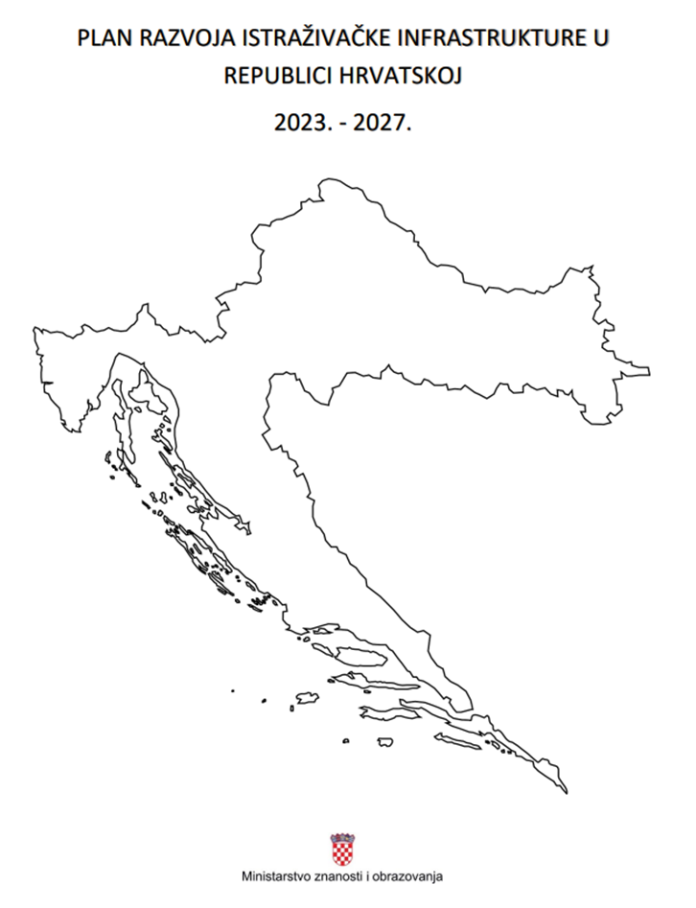
Research Infrastructure Roadmap of the Republic of Croatia
Croatia published its Research Infrastructure
Roadmap 2023 – 2027
It provides an overview of:
The existing research infrastructure in Croatia,
ERIC and similar infrastructure that we participate
in and
International research organizations that we have
been participating in.
It provides monitoring criteria and basic criteria for the
selection and financing of future research infrastructures.

Slide 7
Vision of the development of RI in Croatia
The development of RI will be planned in such a way as to enable their long-term sustainability and the greatest possible contribution to the national R&I system.
Research infrastructures will promote open access and collaboration with other stakeholders.
Planning, monitoring and evaluation mechanisms will be implemented to ensure quality planning and management of research infrastructures.
Croatia will use national and international research infrastructures in internationally competitive research and will strengthen the international cooperation.

Slide 8


Croatia and CERN

Slide 9
Brief history
The application by Croatia for Associate Membership - 19 February 2014 and updated on 6 December 2017;
The examination of Croatia’s application by the fact-finding Task Force
The Council decision dated 27 September 2018 to authorise the Director-General to submit to Croatia a draft Agreement for the granting of the status of Associate Member
The letter dated 17 October 2018 by the Director-General
20 November 2018 - communicating Croatia’s endorsment of the provisions of the draft Agreement
The Resolution by the Council - 13 December
Agreement concerning the granting of the status of the Associate Member at CERN – 28 February 2019

Slide 10
Participation to CERN experiments
Ruđer Bošković Institute
Faculty of Science, University of Zagreb
Faculty of Electrical Engineering, Mechanical Engineering and Naval Architecture, Split
Faculty of Science, University of Split
CAST
RD50
ALICE
CMS
CNGS1
ISOLDE
NA61
NP06
RE17
nTOF collaboration

Slide 11
Croatian companies – capacities
Companies in the CERN supplier Database:
  PICOLOGIC
  HELIOZ TECHNOLOGIES
  EKOFIMA
  INETEC
  DALSTROJ
  NOMAGO MOBILITY DOO
  HLADNI VAL DOO
  INTERKOR PLUS
  SPIROFLEX
Further possibilities for the Croatian companies?
Industrial vs. Human return and Croatian possibilities?

Slide 12
What are the benefits for Croatia?
Contracts with the Croatian economy
Competitive international projects
Use of technology developed at CERN and incorporation into own products
The possibility of a longer stay of students at CERN
Sending physics teachers on long summer stays at CERN
CERN fellow positions
Scientific papers
Lectures

Slide 13
National support in relation to CERN
travel expenses for the Croatian scientists
  for work within the CERN experiments
visits of physics teachers to CERN
  with the aim of raising awareness of the possibilities and activities of CERN
  access to top education and research projects for Croatian scientists and increased mobility of scientists

Slide 14
National novalties related to CERN
Expert group regarding the cooperation with the CERN –revised in January 2023
The purpose of the group is to establish a system related to the cooperation of the Croatian scientific and business community with CERN, with the aim of more efficient use and further development of research infrastructures at the national level.

Slide 15
New members of the National Expert Group
New members in the CERN Committees
New Industrial Liaison officer

Slide 16
Plans and ideas
Organization of the Info day in Croatia?
Organization of the company visits?
Organization of the research institutions visits?
Plan for the Technical Visit in 2024?

Slide 17
Thank you!
Contact details:
phone: +385 (1) 4594 341
Donje Svetice 38, 10000 Zagreb
https://mzo.gov.hr

