Slide 1
Procurement Overview
for Croatia(Associate Member State)

Slide 2
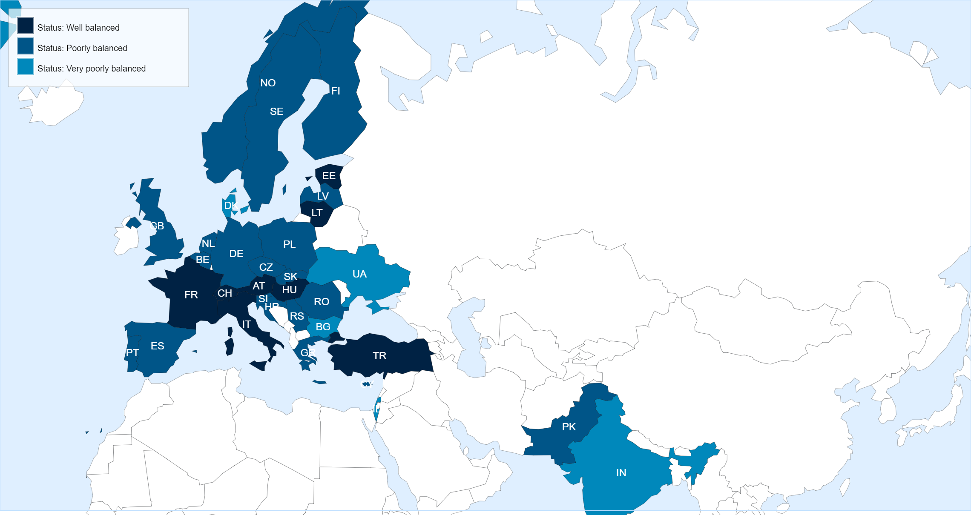
Status of Member States (For Supply contracts from 01.03.2023 until end of February 2024)
Key Figures for Croatia
* Data not available in the DWH yet.
No. of suppliers registered on eProcurement
14
No. of contracts active in 2022
4
No. of contracts awarded in 2022
–
No. of firms contacted for MS dispatched in 2022
3
No. of firms contacted for IT dispatched in 2022
0
No. of firms contacted for PE dispatched in 2022
1

Slide 3
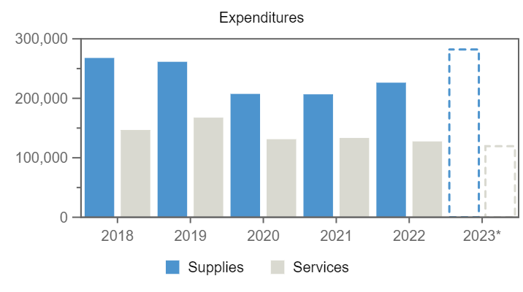
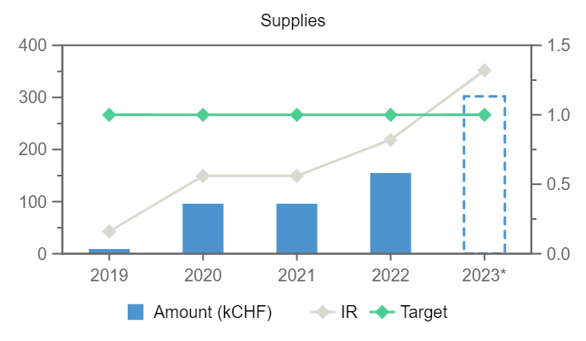
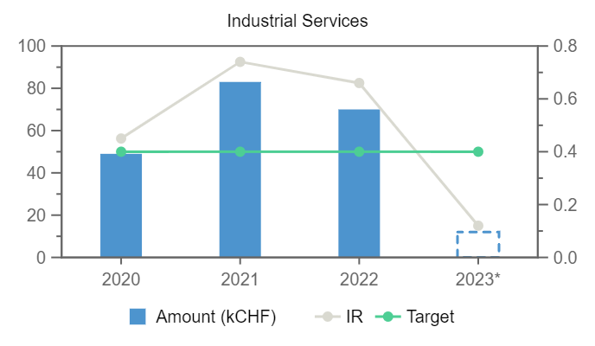
Expenditures (Croatia, kCHF)
Year
Supplies
Services
2019
9
–
2020
96
49
2021
96
83
2022
155
70
2023*
302
12
Annual contributions and industrial returns for Croatia
Contributions (kCHF)
Expenditures (All countries totals, kCHF)
Expenditures (Croatia, kCHF)
Year
Country Contribution
All Countries
%
Year
Supplies
Services
Year
Remaining
Procurement**
Personnel
2019
250
1 171 420
0.02
2018
267 860
146 760
2019
158
9
83
2020
1 000
1 196 893
0.08
2019
261 375
167 528
2020
390
148
462
2021
1 000
1 199 321
0.08
2020
207 407
131 216
2021
316
182
502
2022
1 000
1 205 987
0.08
2021
206 717
133 358
2022
-89
225
864
2023
1 000
1 230 382
0.08
2022
226 311
127 469
2023*
- 194
316
879
2023*
282 188
119 453
Industrial Return
Annual Industrial Return
Supplies
Services
Year
Ratio
Target
Ratio
Target
2019
0.16
1
–
0.4
2020
0.56
1
0.45
0.4
2021
0.56
1
0.74
0.4
2022
0.82
1
0.66
0.4
2023*
1.32
1
0.12
0.4
*Provisional figure based on commitments

Slide 4
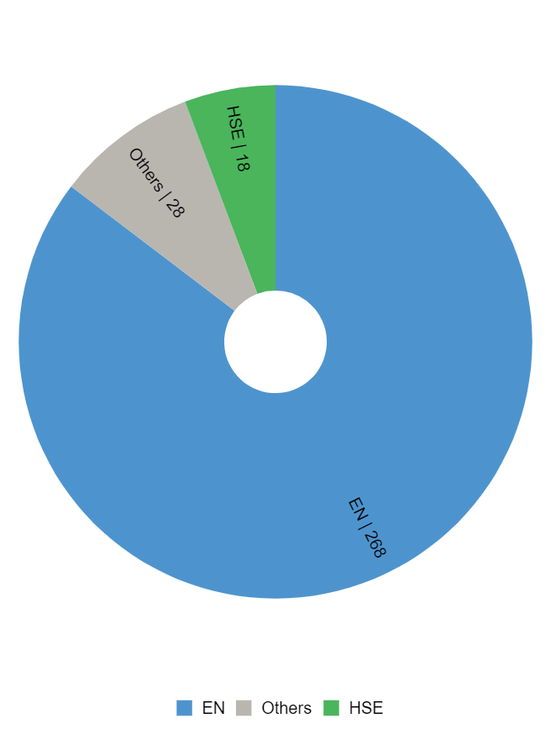
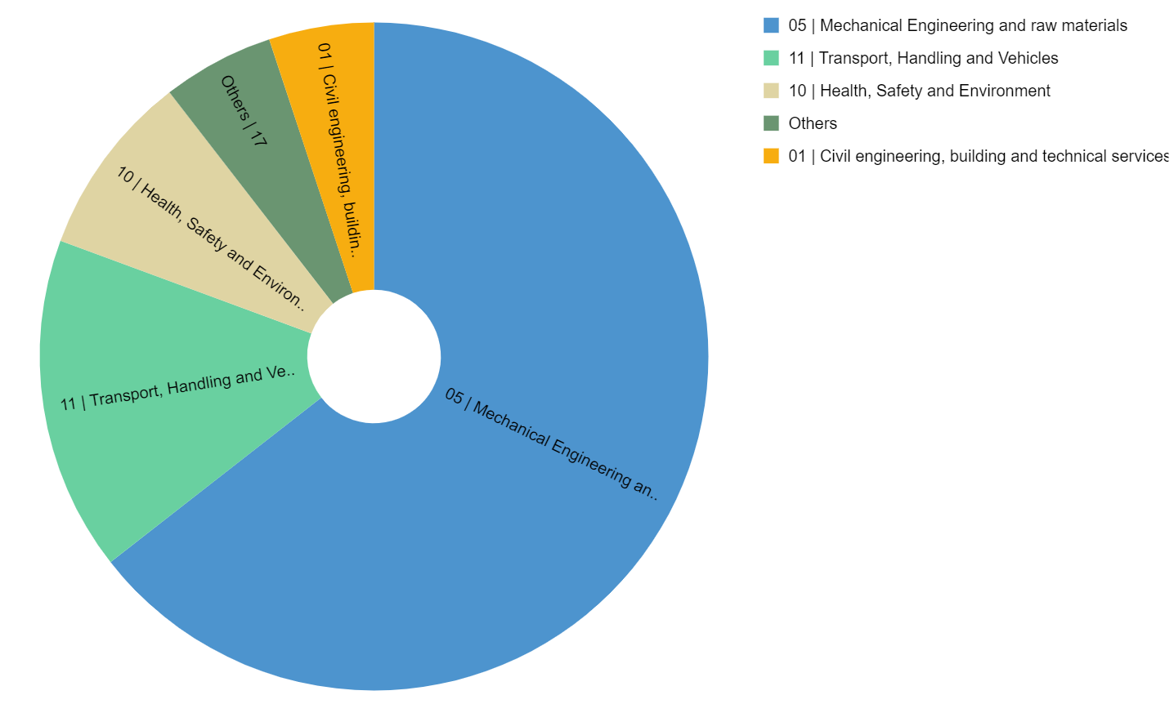
Expenditure by department and procurement codes for Croatia
Expenditure by Department (kCHF)
Expenditure by (Activity|Procurement) Code (kCHF)

Slide 5
Top Suppliers in Croatia
By Country of Supplier
By Country of Origin
Supplier Name
Town
No. Orders
CERN Budget (CHF)
Teams Budget (CHF)
Supplier Name
Supplier Country
No. Orders
% HR
CERN (CHF)
Teams (CHF)
DALSTROJ
Split
1
181 061
–
DALSTROJ
HR
1
100
181 061
–
RUDER BOSKOVIC INSTITUTE
Zagreb
8
28 522
9 155
ASCENSEURS SCHINDLER
CH
2
8
51 200
–
MEDITERRANEAN INSTITUTE FOR LIFE SCIENCES MEDILS
Split
2
–
27 920
RUDER BOSKOVIC INSTITUTE
HR
8
100
28 522
9 155
MEDITERRANEAN INSTITUTE FOR LIFE SCIENCES MEDILS
HR
2
100
–
27 920
SPIROFLEX
Ruscica
3
15 812
–
EKOFIMA
Slavonski Brod
6
11 962
–
SPIROFLEX
HR
3
100
15 812
–
EKOFIMA
HR
6
100
11 962
–
PICOLOGIC
Zagreb
1
2 710
–
TESI SRL
IT
26
–
11 771
–
ELECTROTEL
RO
1
4
6 368
–
RAM POWER SRL
IT
1
8
4 694
–
PICOLOGIC
HR
1
100
2 710
–

Slide 6
List of contract/orders with the highest turnover in 2023 for Croatia
Contract/Order
Description
Supplier
Amount (CHF)
CA9468758
J3081061 DFHX SERIES FRAMES
DALSTROJ
181 061
B1455
REPLACEMENT OF LHC LIFTS
ASCENSEURS SCHINDLER
51 200
S245
METALLIC STRUCTURE
TESI SRL
11 771
CA1002986
R5P2 IRRADIATION CAMPAIGN LOW DOSE RATE
RUDER BOSKOVIC INSTITUTE
9 909
CA1002798
IT-CS ANTENNAS CABLE IRRADIATION
RUDER BOSKOVIC INSTITUTE
8 355
CA1001742
J3082956 WP12-ID239 HL-VM HILUMI BELLOWS
SPIROFLEX
8 006
CA1001741
J3082920 WP12-ID239- VACUUM MOD. BELLOWS
SPIROFLEX
6 663
B1518
SIRIUS ASSEMBLING/CABLING
ELECTROTEL
6 368
CA1004424
IRRADIATION H1 MATERIALS - HL-LHC
RUDER BOSKOVIC INSTITUTE
4 948
B1677
COOLING PLANTS CONTRACT
RAM POWER SRL
4 694

Slide 7
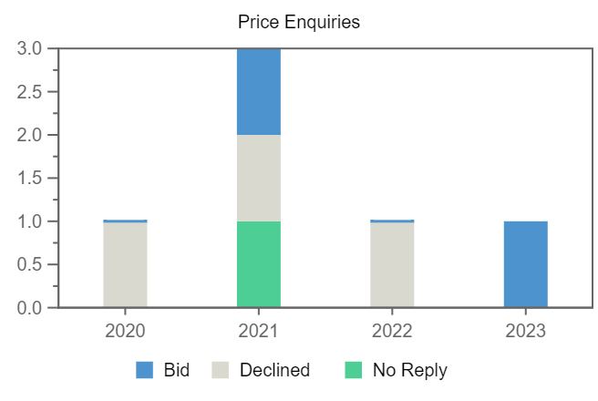
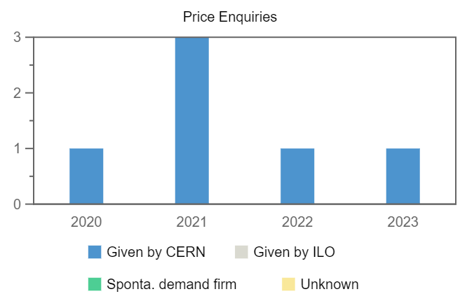
Price Enquiries above 50k CHF for Croatia
Number of firms contacted
Origin of firms contacted
Year
Firms Contacted
RANK (1)
RANK (2)
RANK (3)
2020
1
–
–
–
2021
3
–
–
1
2022
1
–
–
–
2023
1
–
–
–

Slide 8
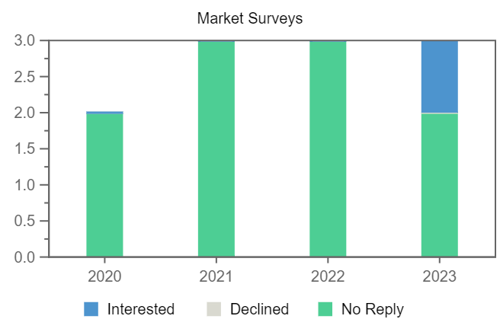
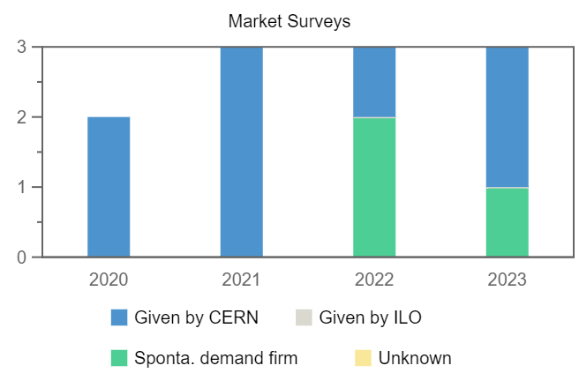
Market Surveys for Croatia
Number of firms contacted
Origin of firms contacted
Year
Firms Contacted
Interested
Declined
No Reply
Selected
2020
2
–
–
2
–
2021
3
–
–
3
–
2022
3
–
–
3
–
2023
3
1
–
2
–

