Slide 1
LAr Purification Studies and a Novel Recirculation System
Konstantinos Mavrokoridis
k.mavrokoridis@liverpool.ac.uk
GLA2011, Jyvaskyla, Finland
09.06.11

Slide 2
Talk Outline
Why argon purity matters
Effects of various contaminations on gas argon scintillation light
Purification chemicals - How do they work?
Summary of a set of experiments performed to determine the efficiency of the purification chemicals
The 40L LAr Liverpool Cell
– Construction
– A novel recirculation pump and LAr purification
– Effects of O₂ contamination on LAr scintillation light
K. Mavrokoridis LAr R&D Liverpool 09.06.11 01/21

Slide 3
Why Purity Matters
The ionised electrons produced in a liquid argon detector such as the ArDM must be able to drift over a distance longer than a metre, without substantial capture by electronegative impurities ( i.e O₂,H₂O,CO₂,N₂)
Typically better than 1 ppb purity is required
Purest argon gas in the market (N6 cylinder) contains 1 ppm impurities
Therefore purification cartridges and recirculation systems have to be employed
K. Mavrokoridis LAr R&D Liverpool 09.06.11 02/21

Slide 4
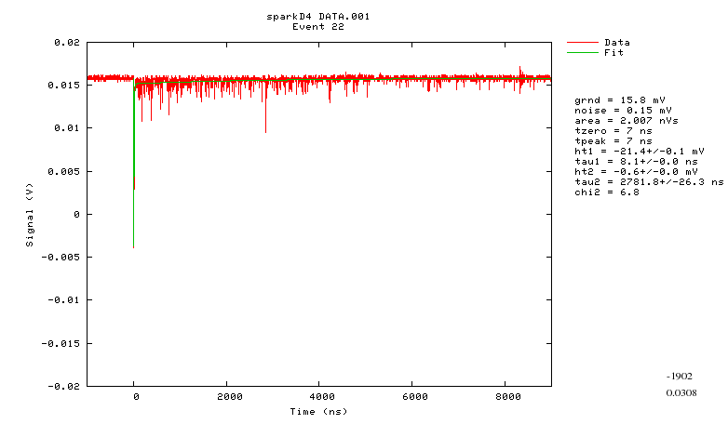
Argon Gas Scintillation
T2
T1
Scintillation light from argon has two distinct decay times - a slow component, T2 (triplet), and a fast component, T1 (singlet). The slow component, T2, can be used as a measure of Argon purity. The purest gas argon has a T2 of about 3200 ns (J. W. Keto et al, PRL, 1974).
K. Mavrokoridis LAr R&D Liverpool 09.06.11 03/21

Slide 5
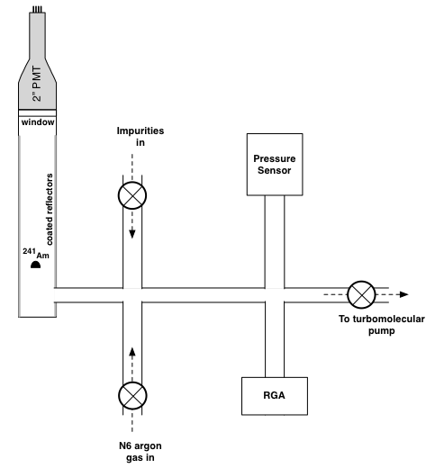
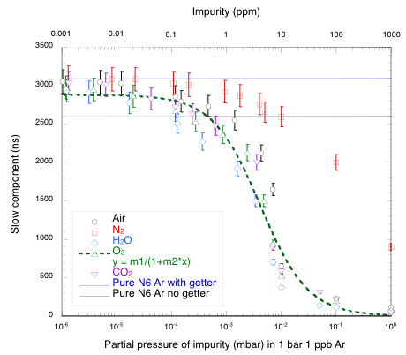
Effect of various impurities on GAr scintillation light
--H₂O was found to be very marginally the worst impurity followed by CO₂ and O₂.
--N₂ was found to be the most benign impurity within argon gas.
--Birks law type function fit
y=m1/(1+m2*x); m1=2878ns, m2=0.24
K. Mavrokoridis, PhD Thesis
Correlation of the slow component decay time to partial pressure of impurities within 1 bar ppb argon gas
K. Mavrokoridis LAr R&D Liverpool 09.06.11 04/21

Slide 6
The Argon Purification Chemicals (a)
Molecular Sieves
Size/Steric Exclusion
Thermodynamic Selectivity
Molecules small enough to pass through the pores are adsorbed while larger molecules are not
A measure of preferential absorption of certain molecules over others when all molecules can enter the pores.
Molecular sieves can be graded to capture molecules with sizes between 3 Å and 10 Å
Is achievable because the adsorption of a particular gas is favourable over another on the accessible cationic sites within the crystal.
Molecular sieves can be used to purify argon based on the size/steric exclusion and thermodynamic selectivity properties
K. Mavrokoridis LAr R&D Liverpool 09.06.11 05/21

Slide 7
The Argon Purification Chemicals (b)
Copper
Copper reacts strongly with oxygen forming copper oxide.
2Cu + O₂ → 2CuO
Phosphorous pentoxide
P₄O₁₀ reacts exothermically very strongly with water producing orthophosphoric acid.
P₄O₁₀ + 6H₂O → 4H₃PO₄
Hazardous upon skin contact and inhalation
K. Mavrokoridis LAr R&D Liverpool 09.06.11 06/21

Slide 8
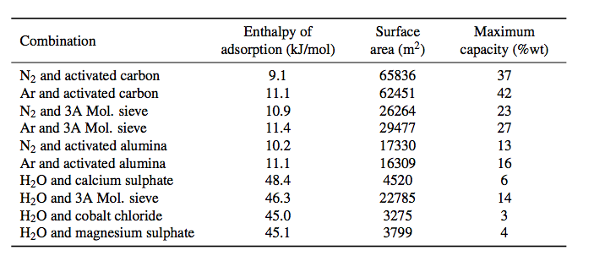
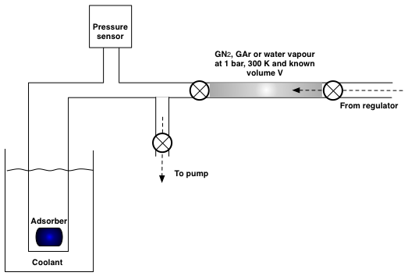
Adsorption of H₂O, N₂, Ar
Measurements of the enthalpy of adsorption, total capacity, and effective surface area of interaction, for argon gas, nitrogen gas and water vapour on a range of molecular sieves and anhydrous complexes were performed.
The BET (Brunauer, Emmett, Teller) isotherm describes adsorption and provides a route to measuring both the average enthalpy of adsorption and the effective surface area of the adsorber (e.g. activated charcoal)
Adsorption results for the BET isothermal experiment
K. Mavrokoridis LAr R&D Liverpool 09.06.11 07/21

Slide 9
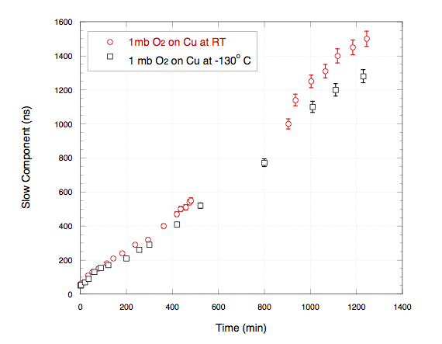
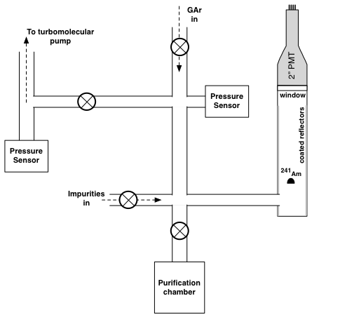
Efficiency of Cu and P₄O₁₀ at removing O₂ and H₂O
Efficiency of copper at room temperature and -130 ^{O}C at removing 1 mbar O₂ partial pressure impurity in 1 bar N6 argon gas
K. Mavrokoridis LAr R&D Liverpool 09.06.11 08/21

Slide 10
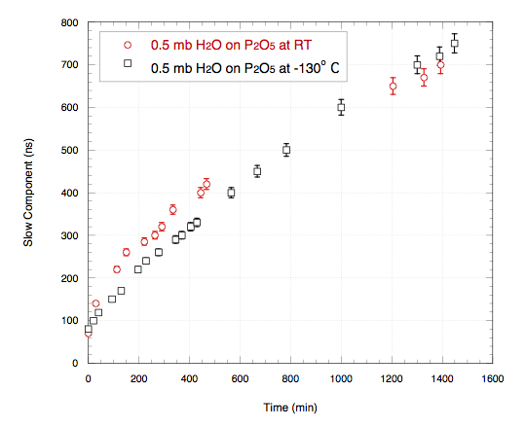
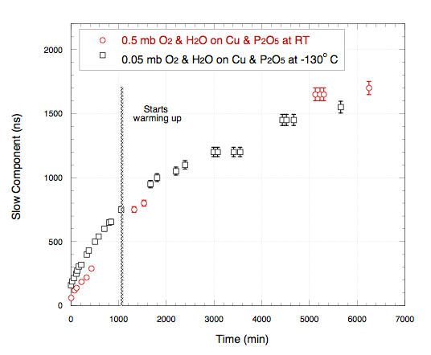
Efficiency of Cu and P₄O₁₀ at removing O₂ and H₂O
P₄O₁₀ at RT and -130 ºC removing 0.5 mbar H₂O partial pressure impurity in 1bar N6 argon gas
Cu and P₄O₁₀ mixture at RT and -130 ºC removing 0.5 mbar and 0.05 mbar respectively O₂/H₂O partial pressure impurity in 1bar N6 argon gas
Within 30 hours the slow component decay time increased from 70 to 1650ns corresponding to ~3 ppm O₂ equivalent impurity
K. Mavrokoridis LAr R&D Liverpool 09.06.11 09/21

Slide 11
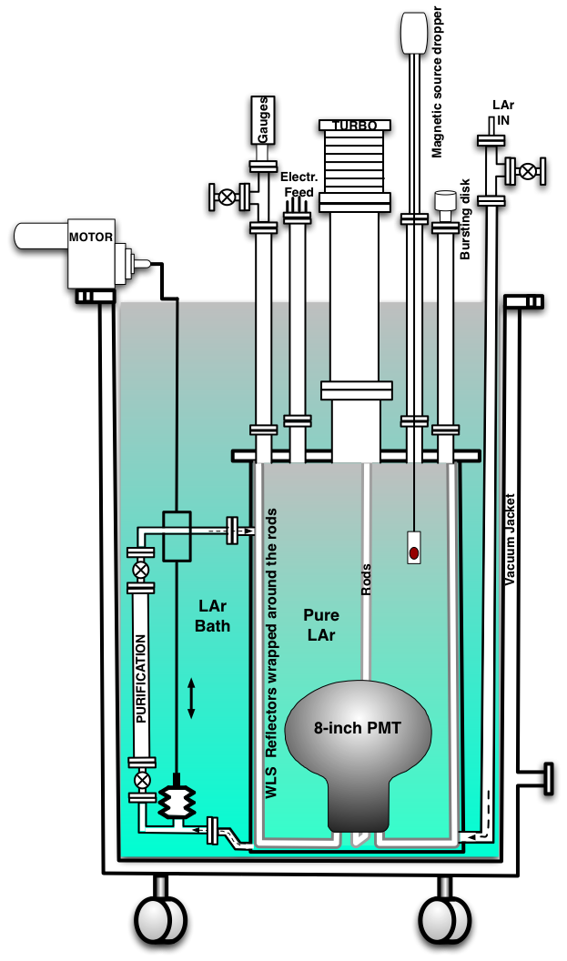
The Liverpool LAr Cell -Schematic
250 L LAr bath
40 L LAr target
Bellow pump powered by an external geared motor
Heat load loses ~115 W
Boiling rate ~12 l/min
Loosing about 20 L in 24h-assumming 10cm thick polyethylene lid
K. Mavrokoridis LAr R&D Liverpool 09.06.11 10/21

Slide 12
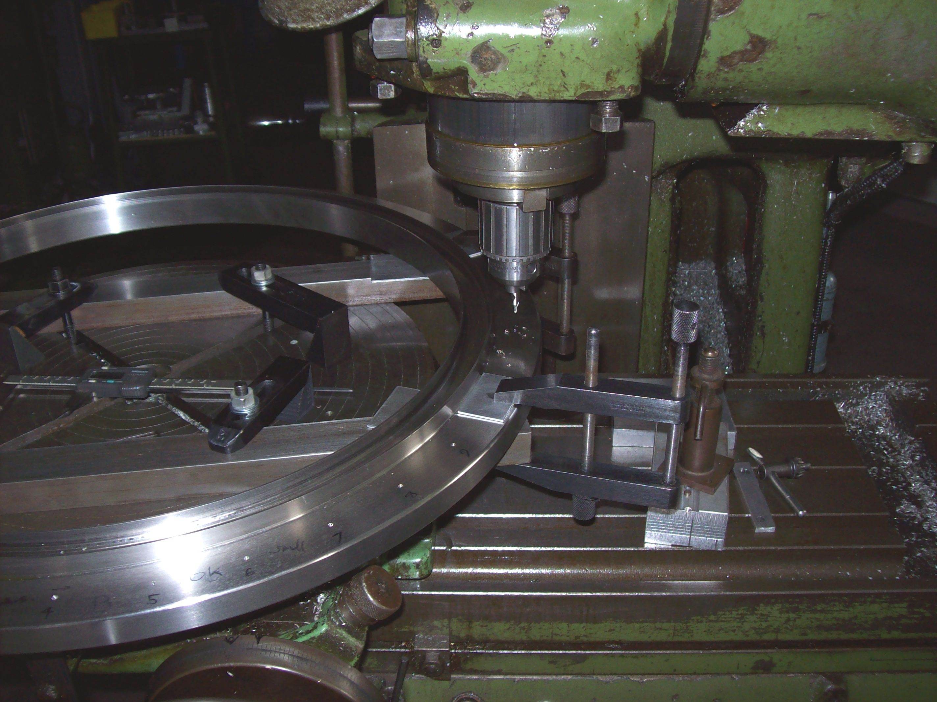
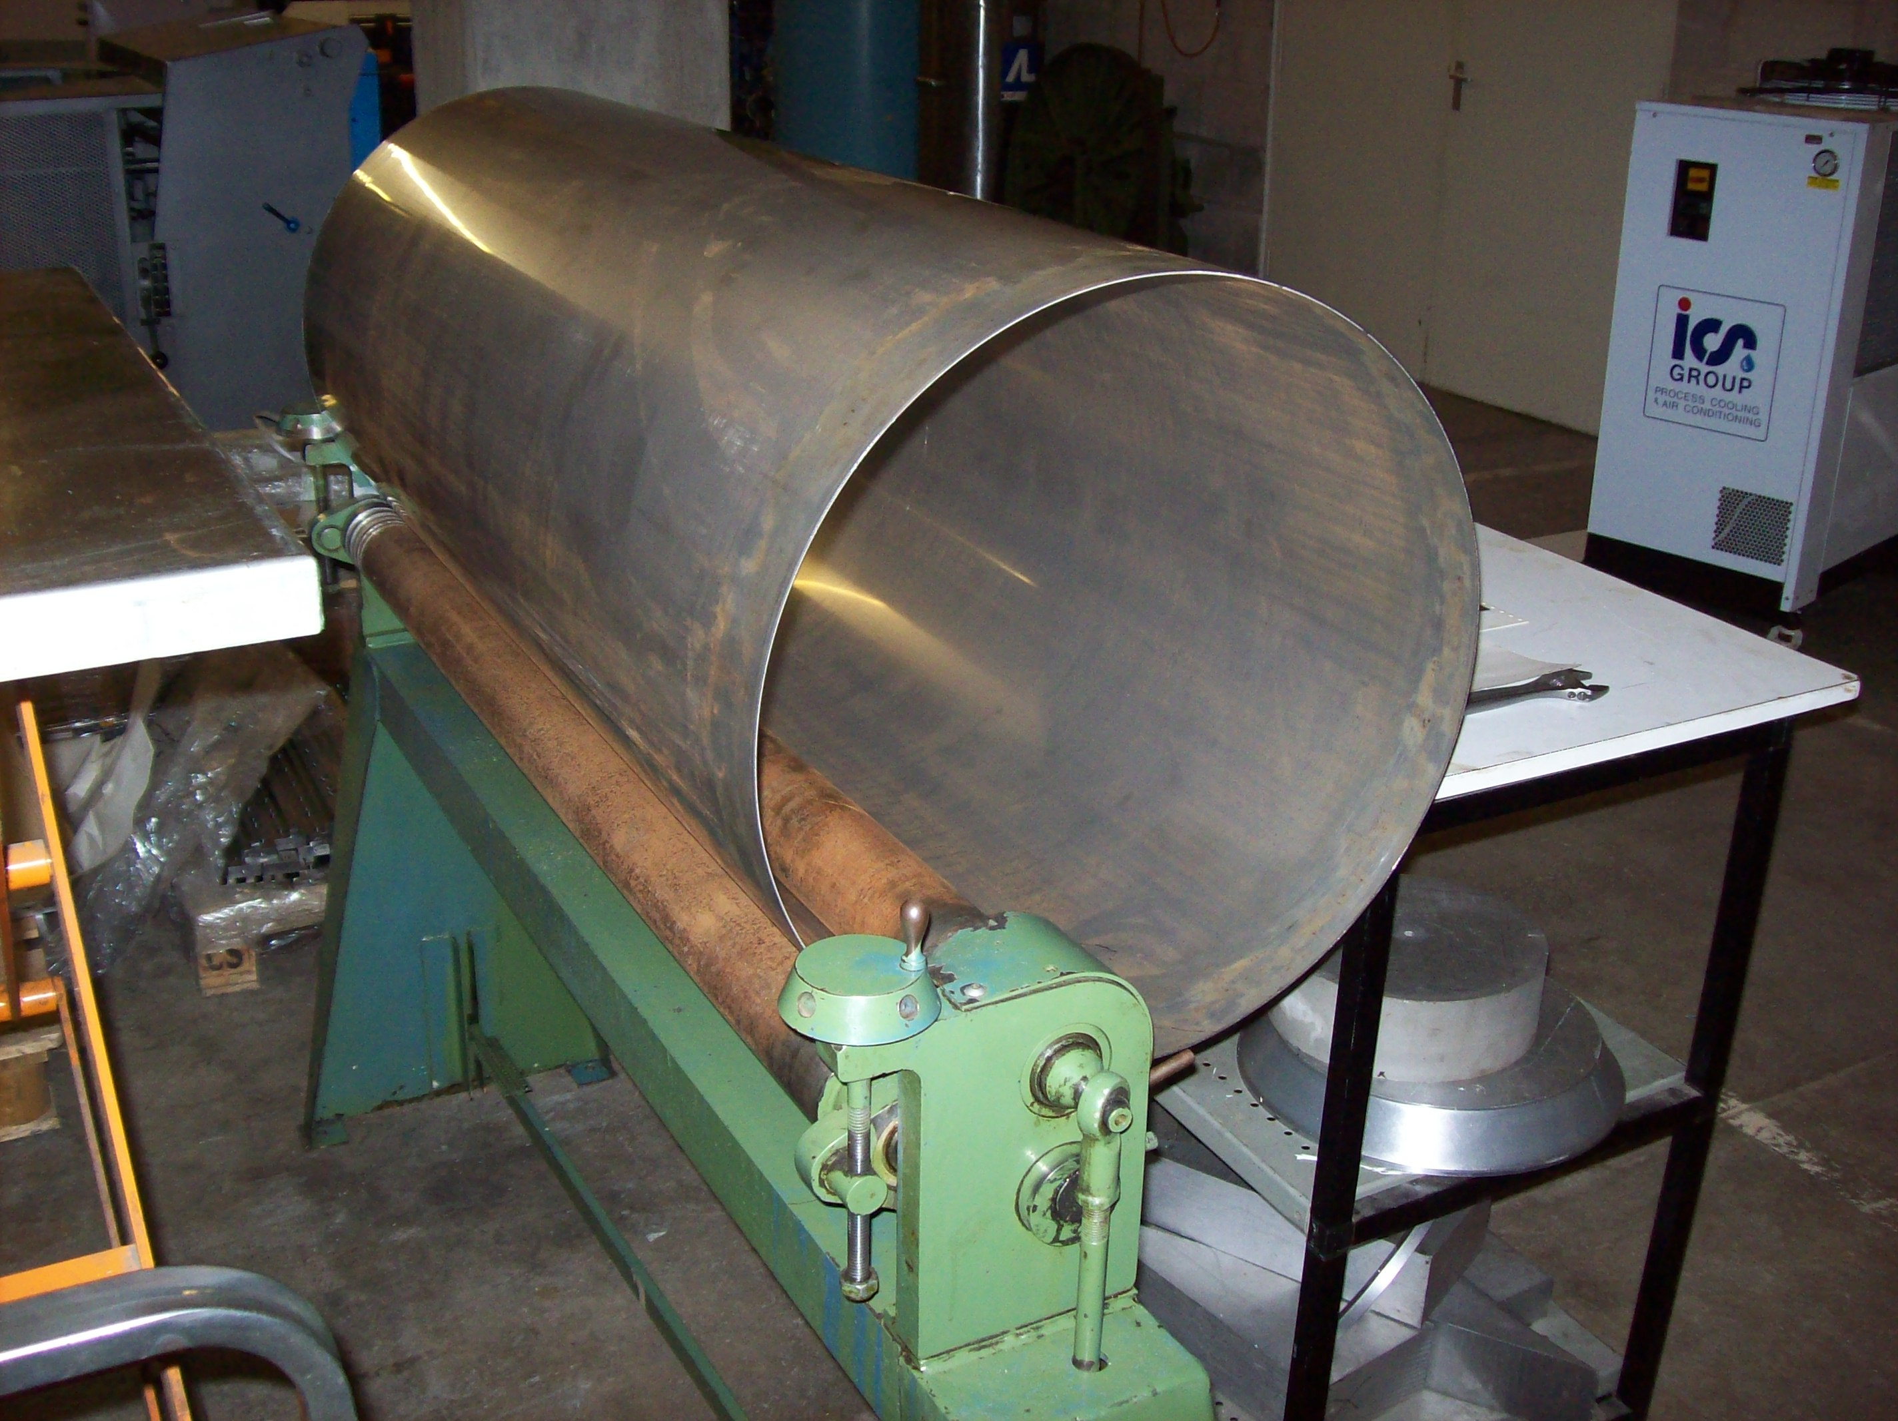
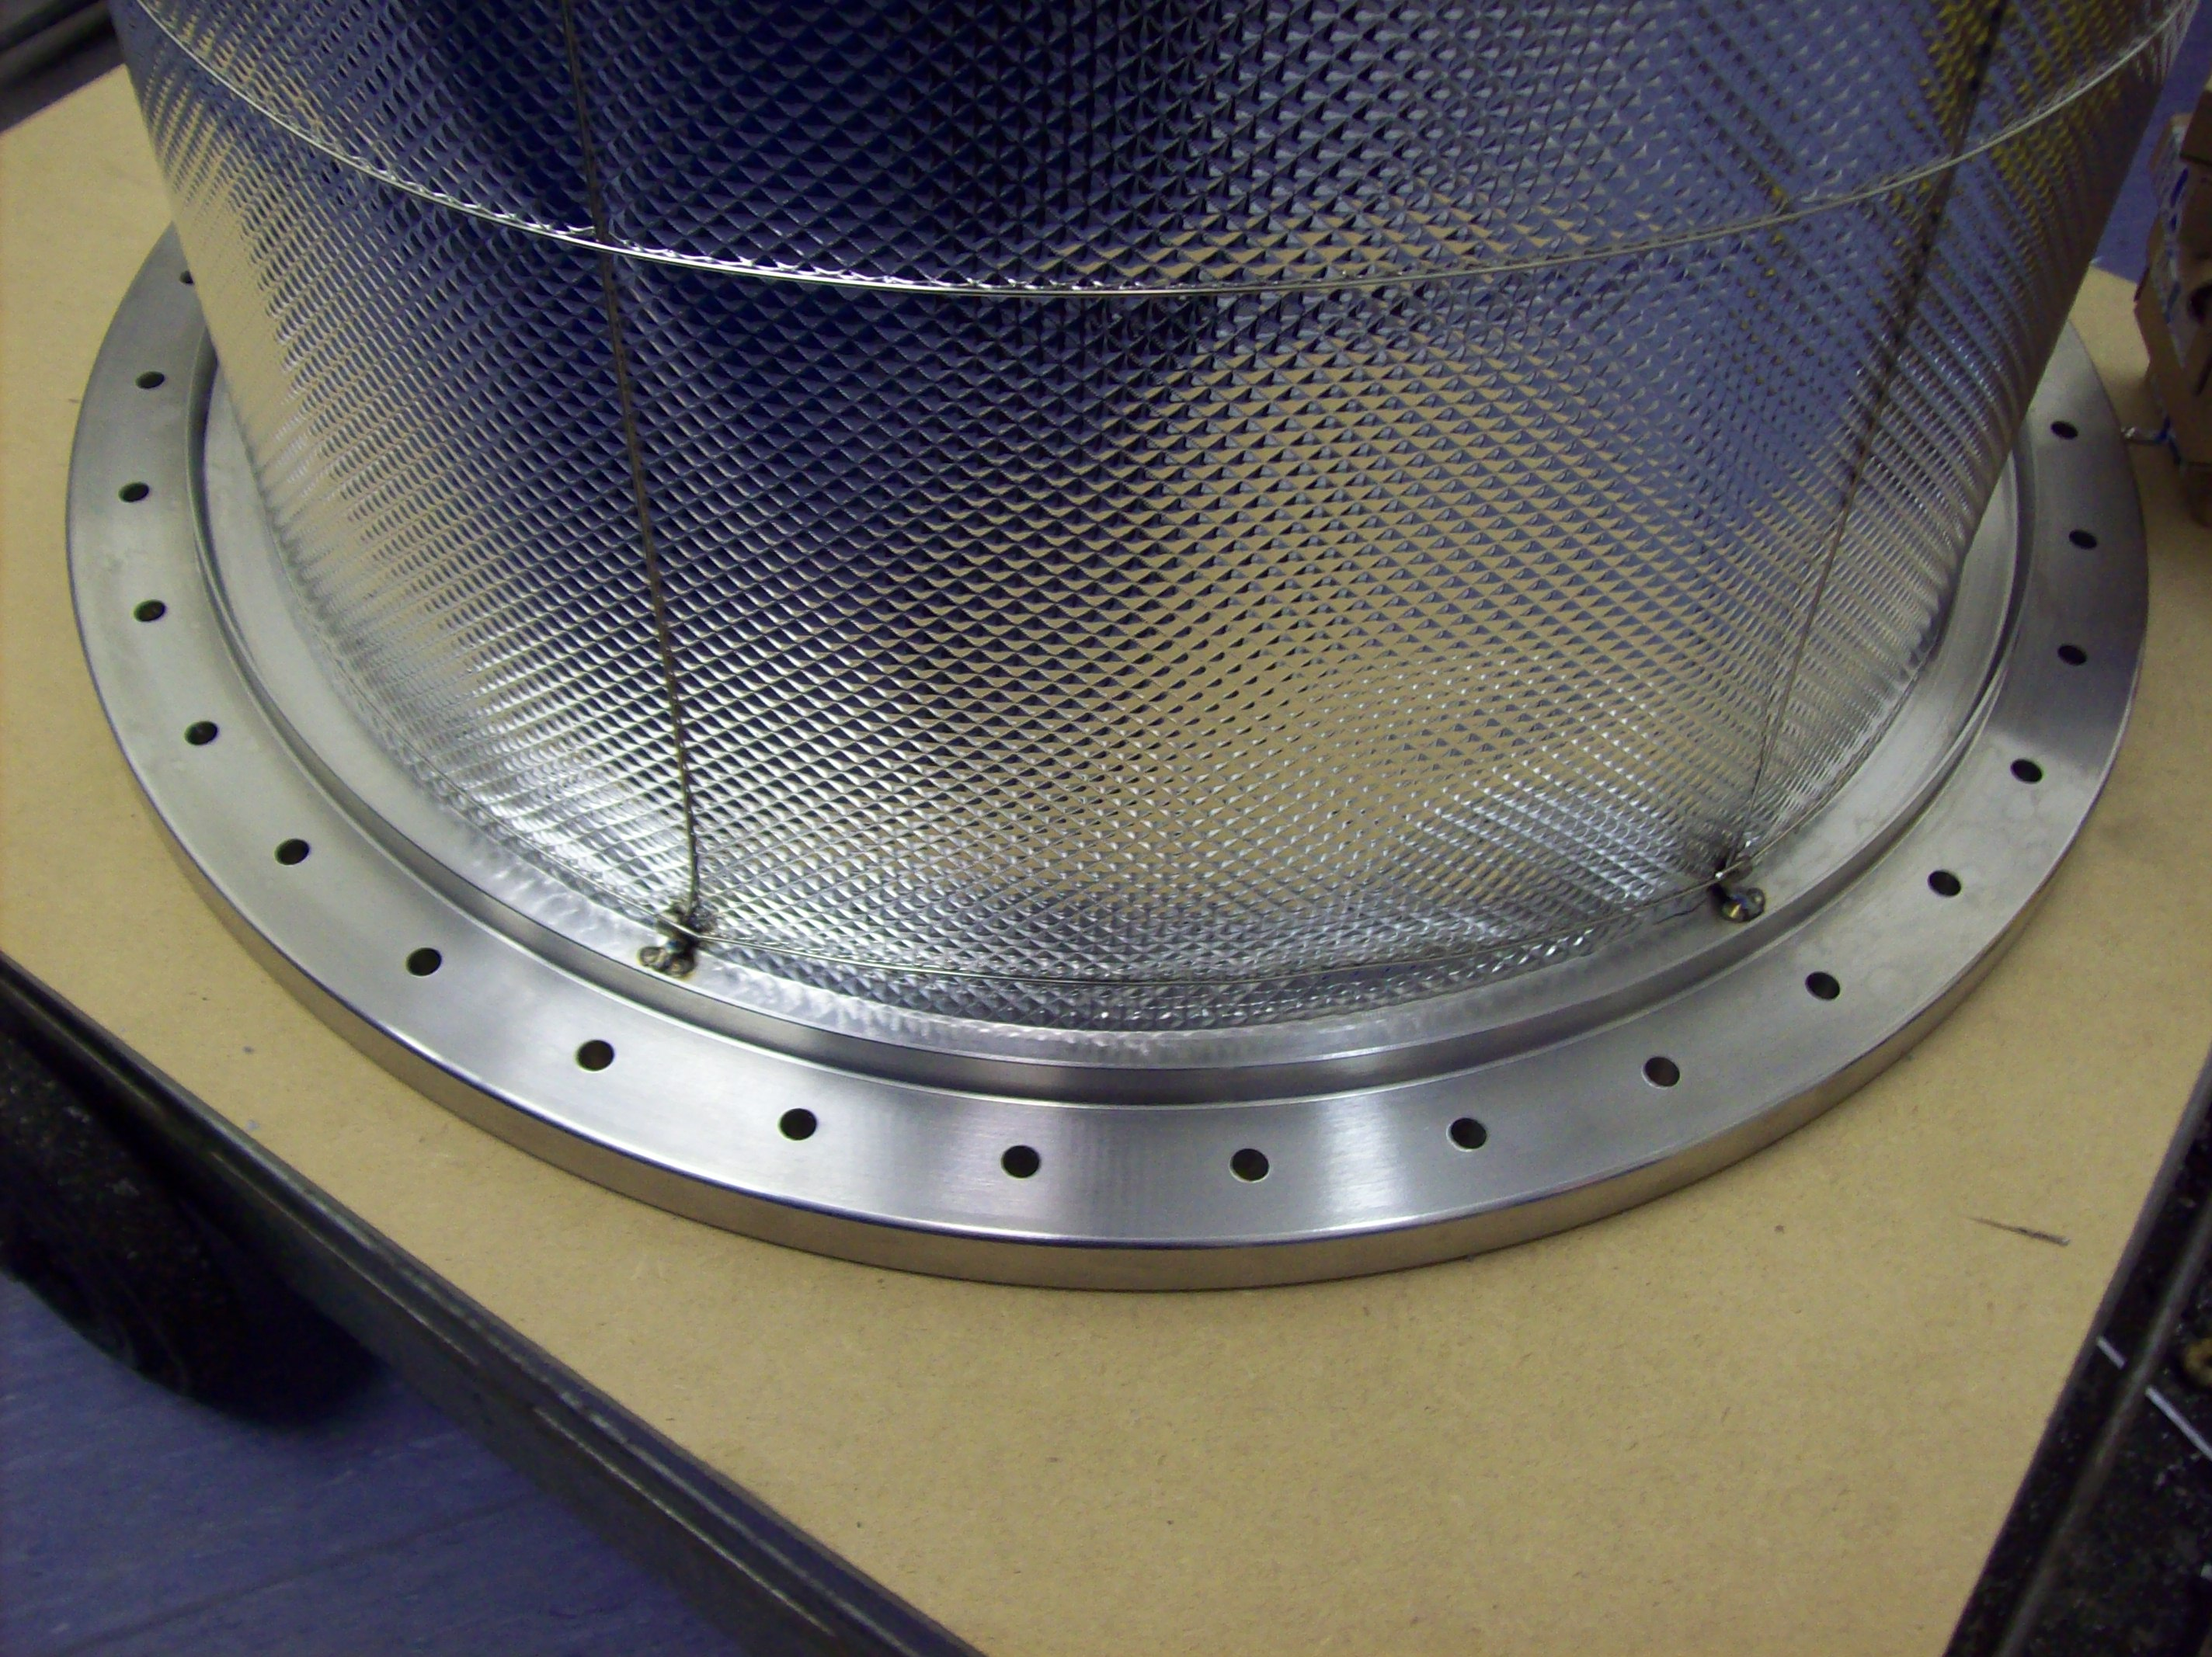
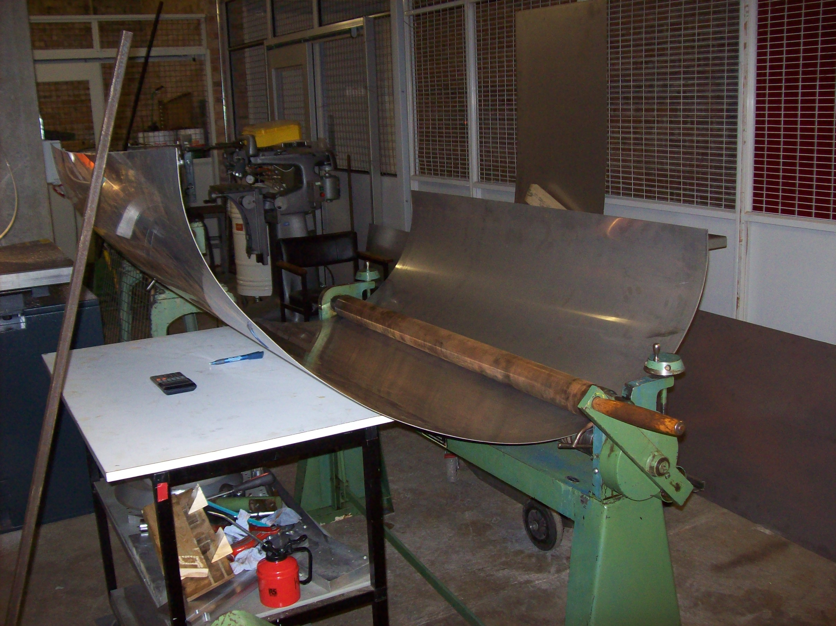
Construction of the Liverpool LAr Cell
Left: Rolling the stainless steel sheet
Right: Machining the top flange
Construction by Kevin McCormick
K. Mavrokoridis LAr R&D Liverpool 09.06.11 11/21

Slide 13
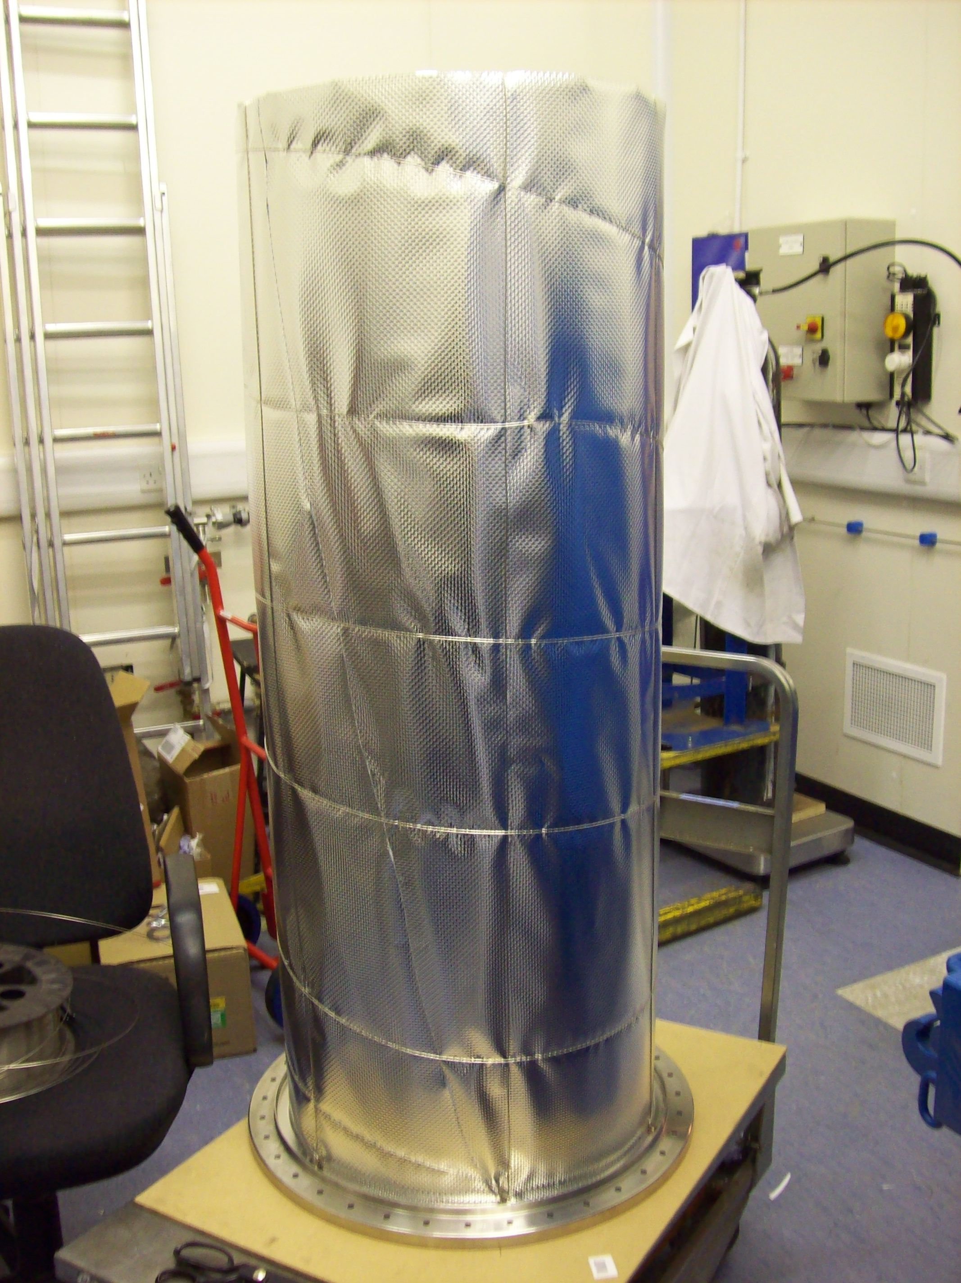
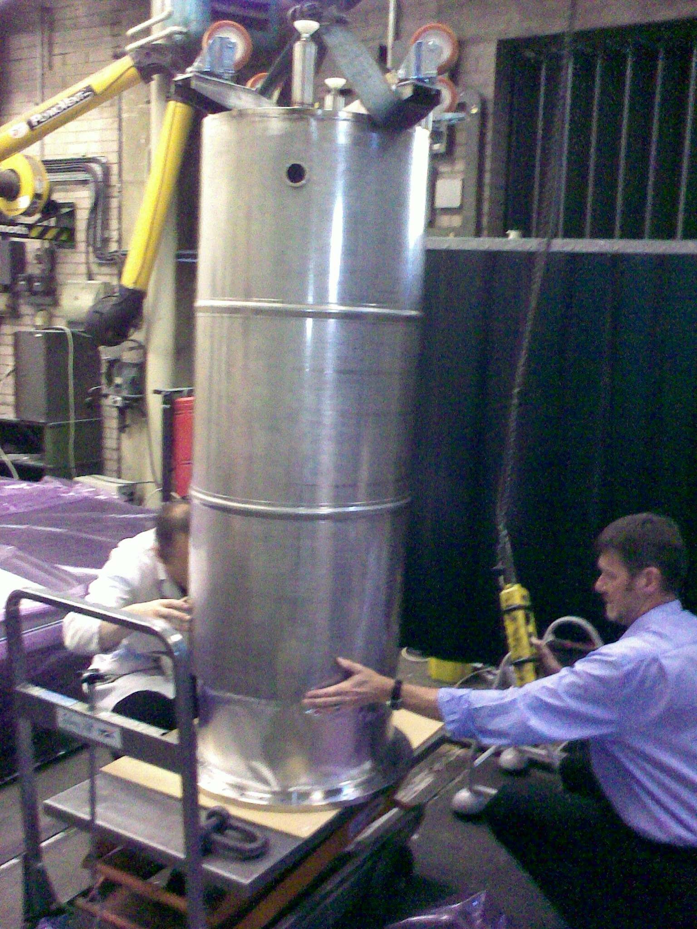
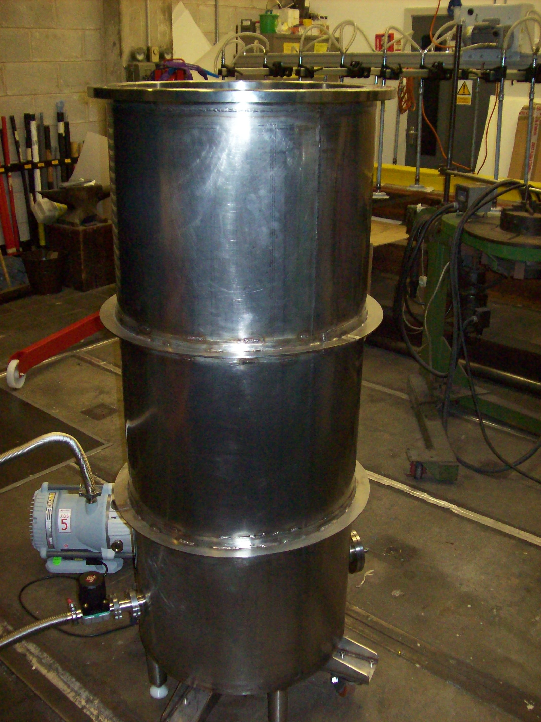
The Liverpool LAr Cell -Construction
Wrapped with Mylar reflector to minimize radiation losses
All the welding performed using argon gas to avoid oxidation and achieve UHV
K. Mavrokoridis LAr R&D Liverpool 09.06.11 12/21

Slide 14
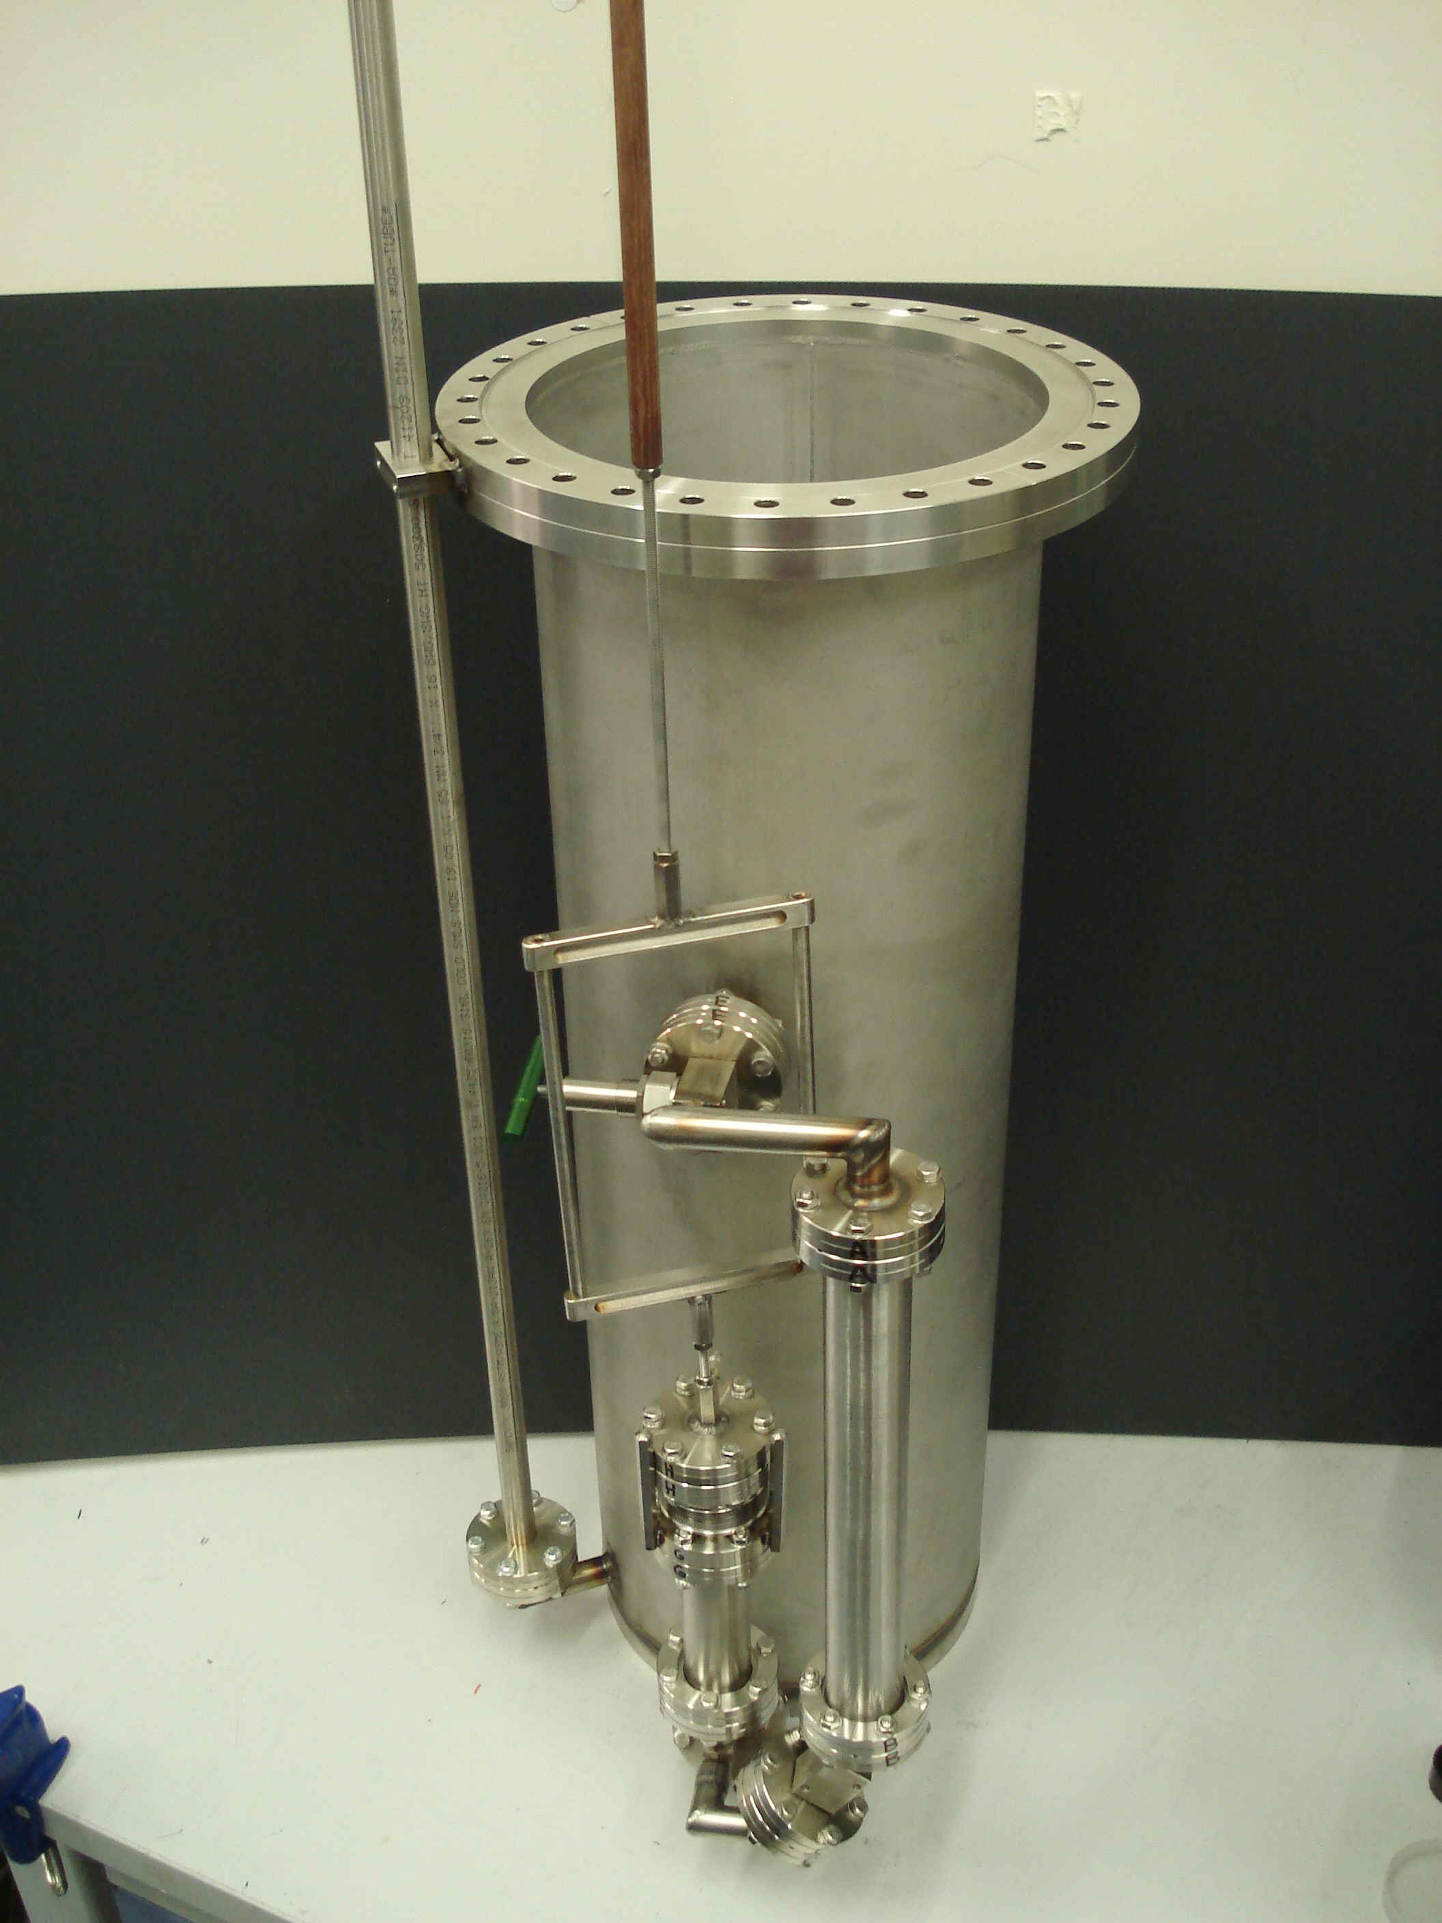
The 40 L Target Vessel and Recirculation System
Development of a novel one way recirculation system using metal balls and a bellow
Scalable design
Purification Cartridge
Metal bellow
LAr feedthrough
K. Mavrokoridis LAr R&D Liverpool 09.06.11 13/21

Slide 15
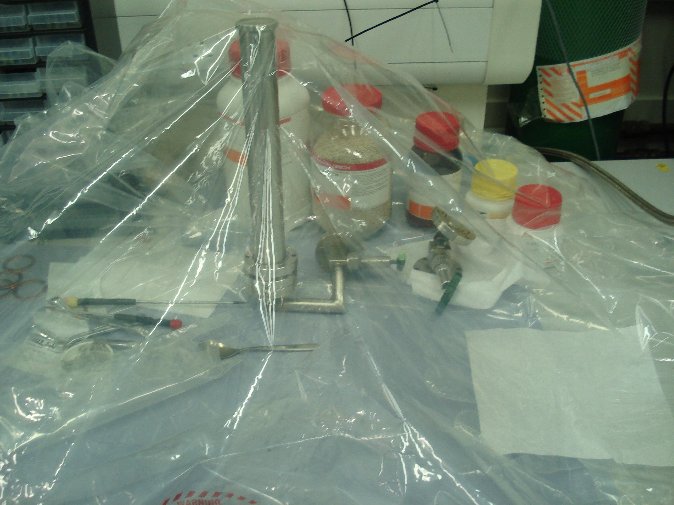
The Liverpool LAr Cell– The Purification Cartridge
3A,4A,13X Molecular
Sieves for removing,
N₂,H₂O,CO₂
Copper for removing
O₂ (2Cu+O₂→ 2CuO)
Filling the purification cartridge within an argon bag in order to avoid reaction with air molecules
K. Mavrokoridis LAr R&D Liverpool 09.06.11 14/21

Slide 16
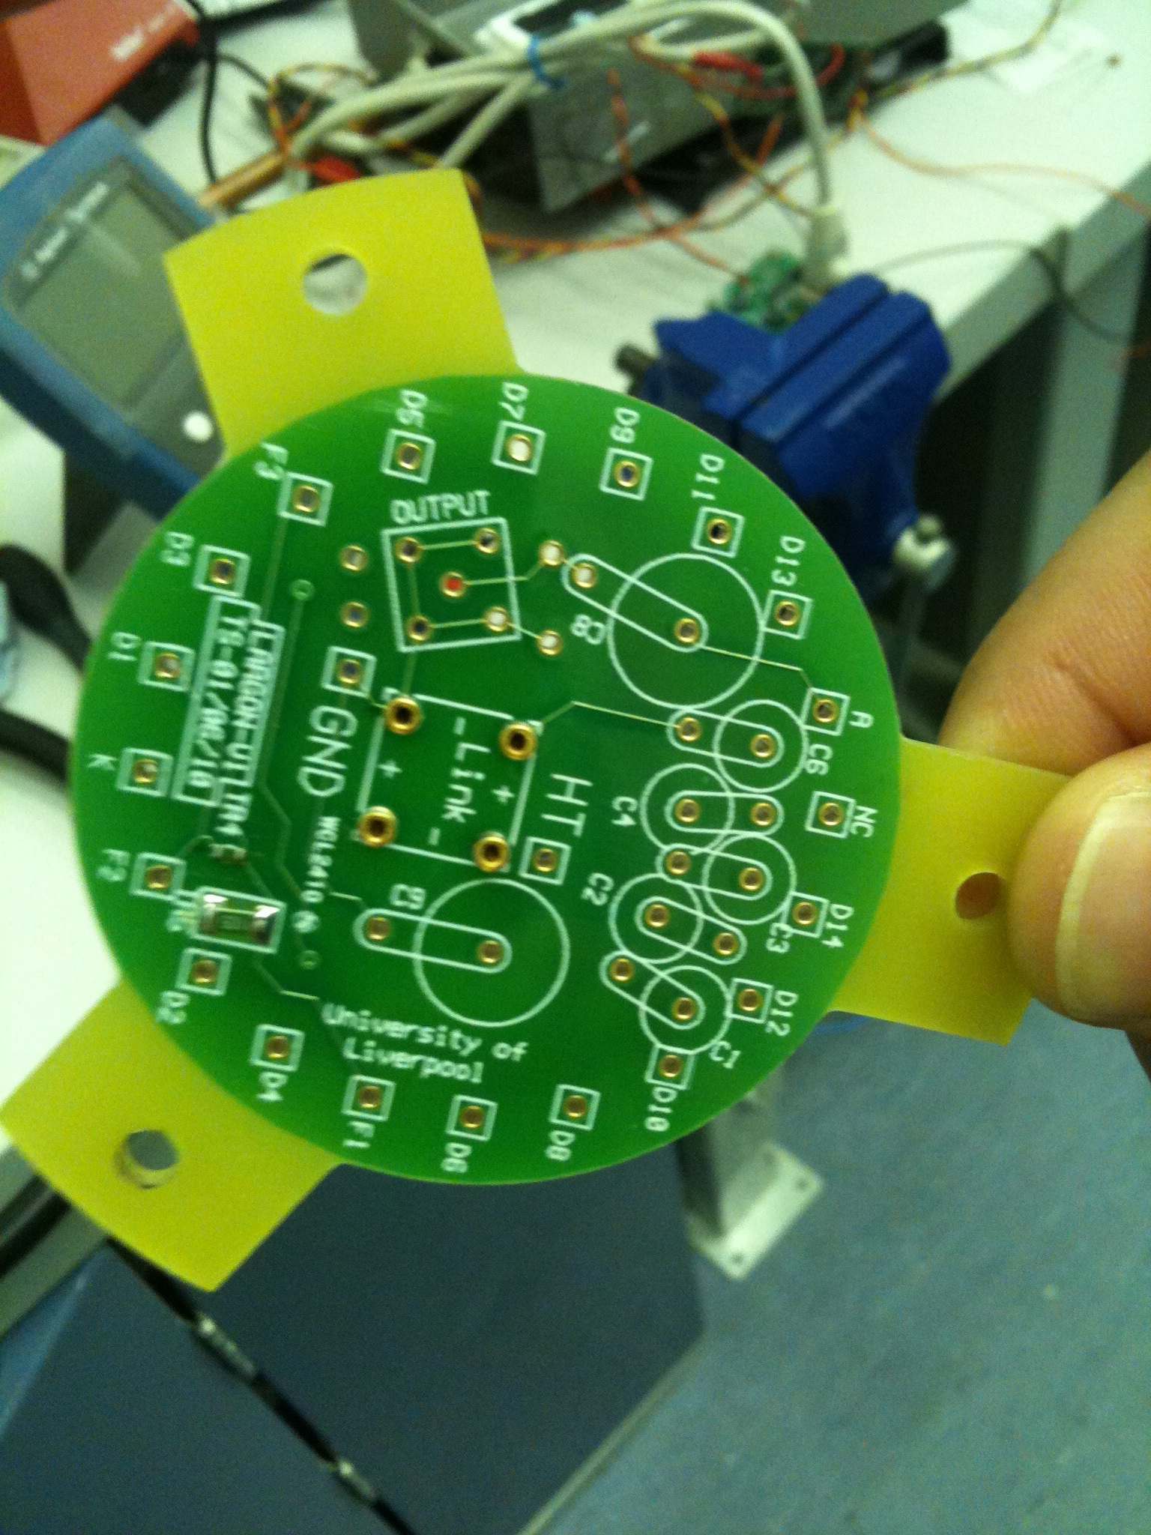
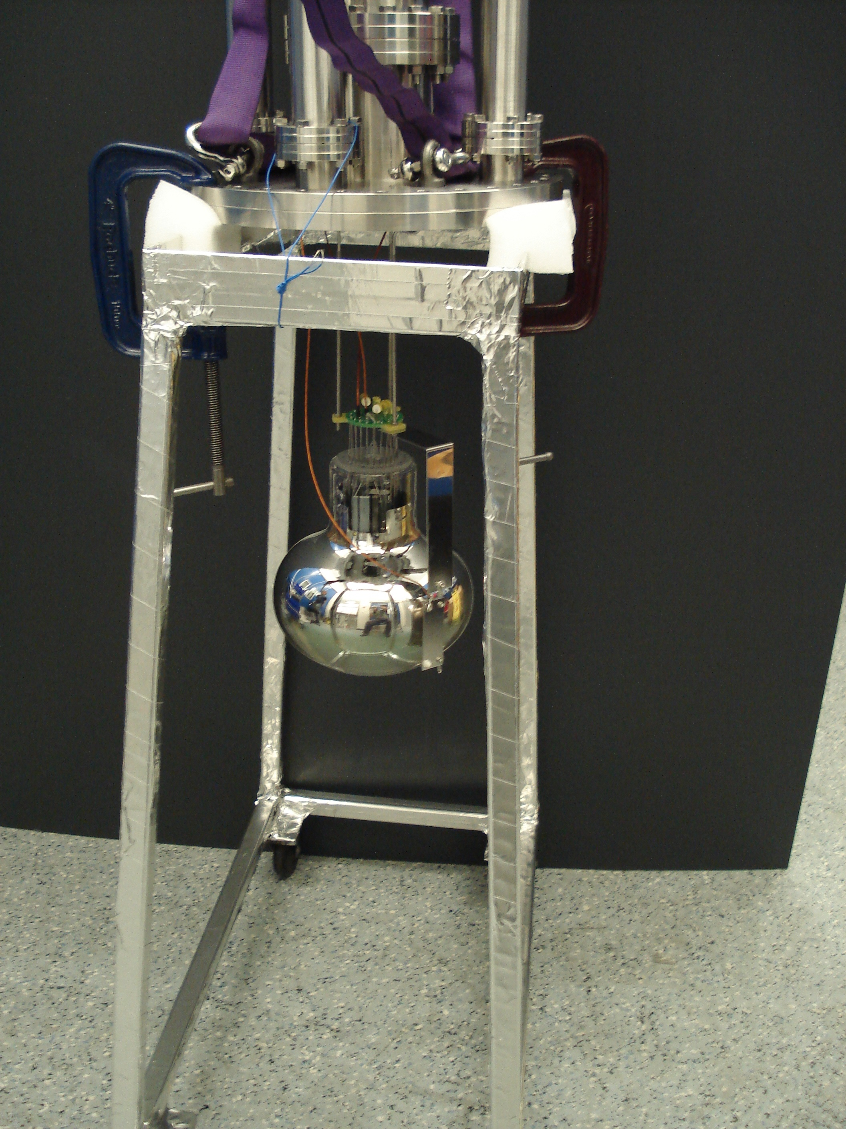
The Liverpool LAr Cell – Light Readout
Development of cryogenic voltage divider
Cryogenic 8-inch Hamamatsu R5912-02MOD PMT (~2500 GBP)
Capacitor LAr level meter
K. Mavrokoridis LAr R&D Liverpool 09.06.11 15/21

Slide 17
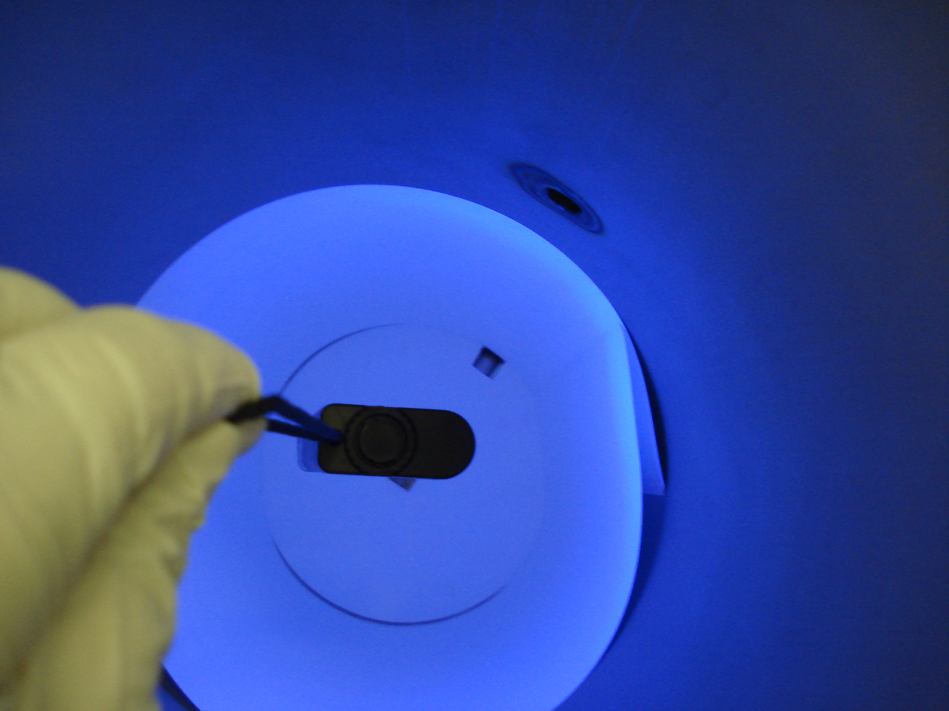
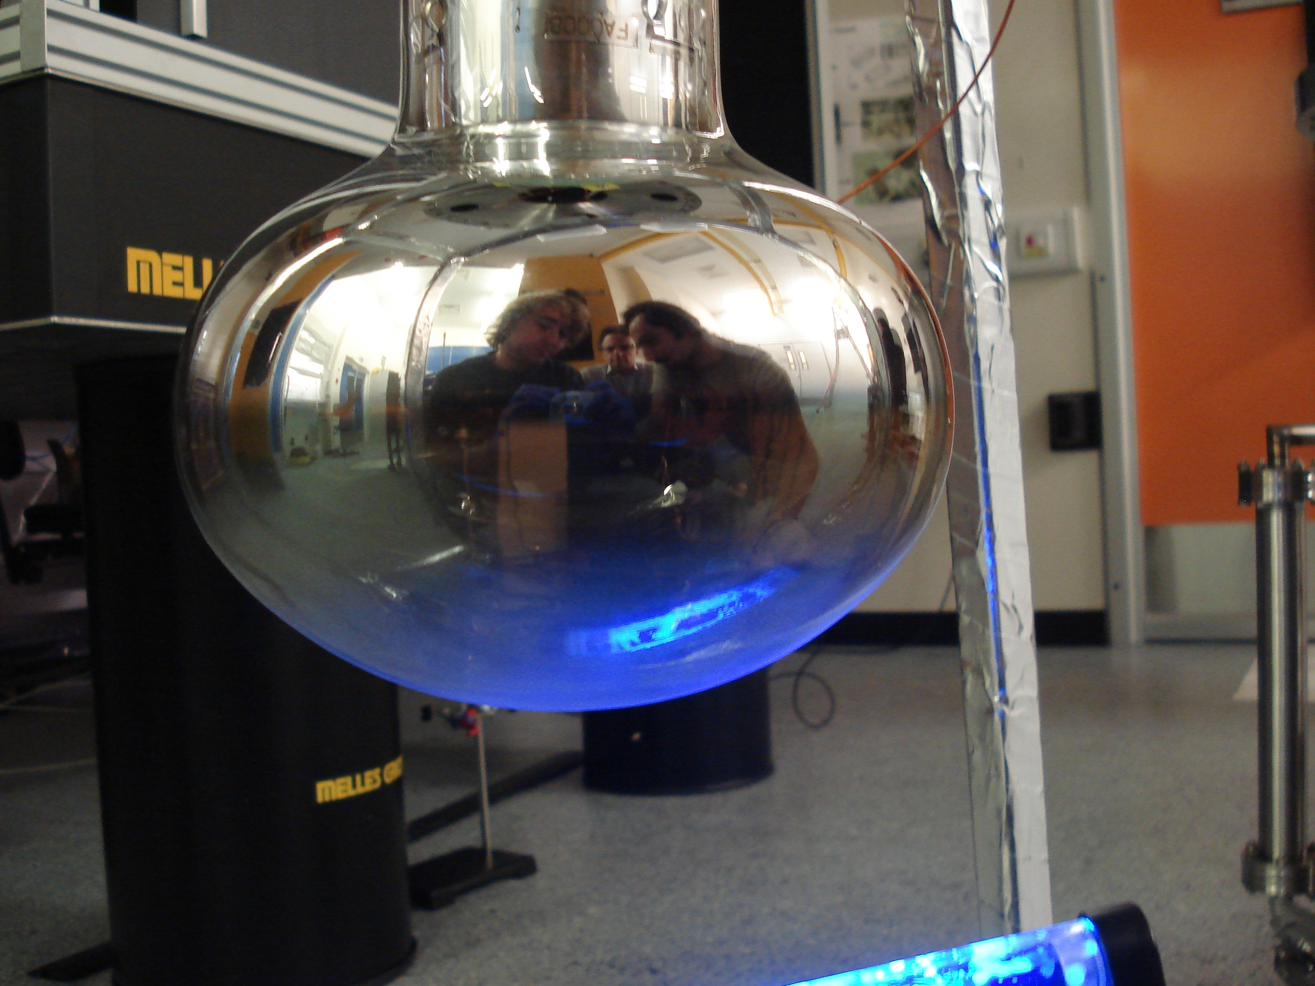
The Liverpool LAr Cell – The WLS Coated Reflectors
TPB coated PMT under a UV lamp
TPB coated 3M foil under a UV lamp
Shifts 128 nm → 430 nm
K. Mavrokoridis LAr R&D Liverpool 09.06.11 16/21

Slide 18
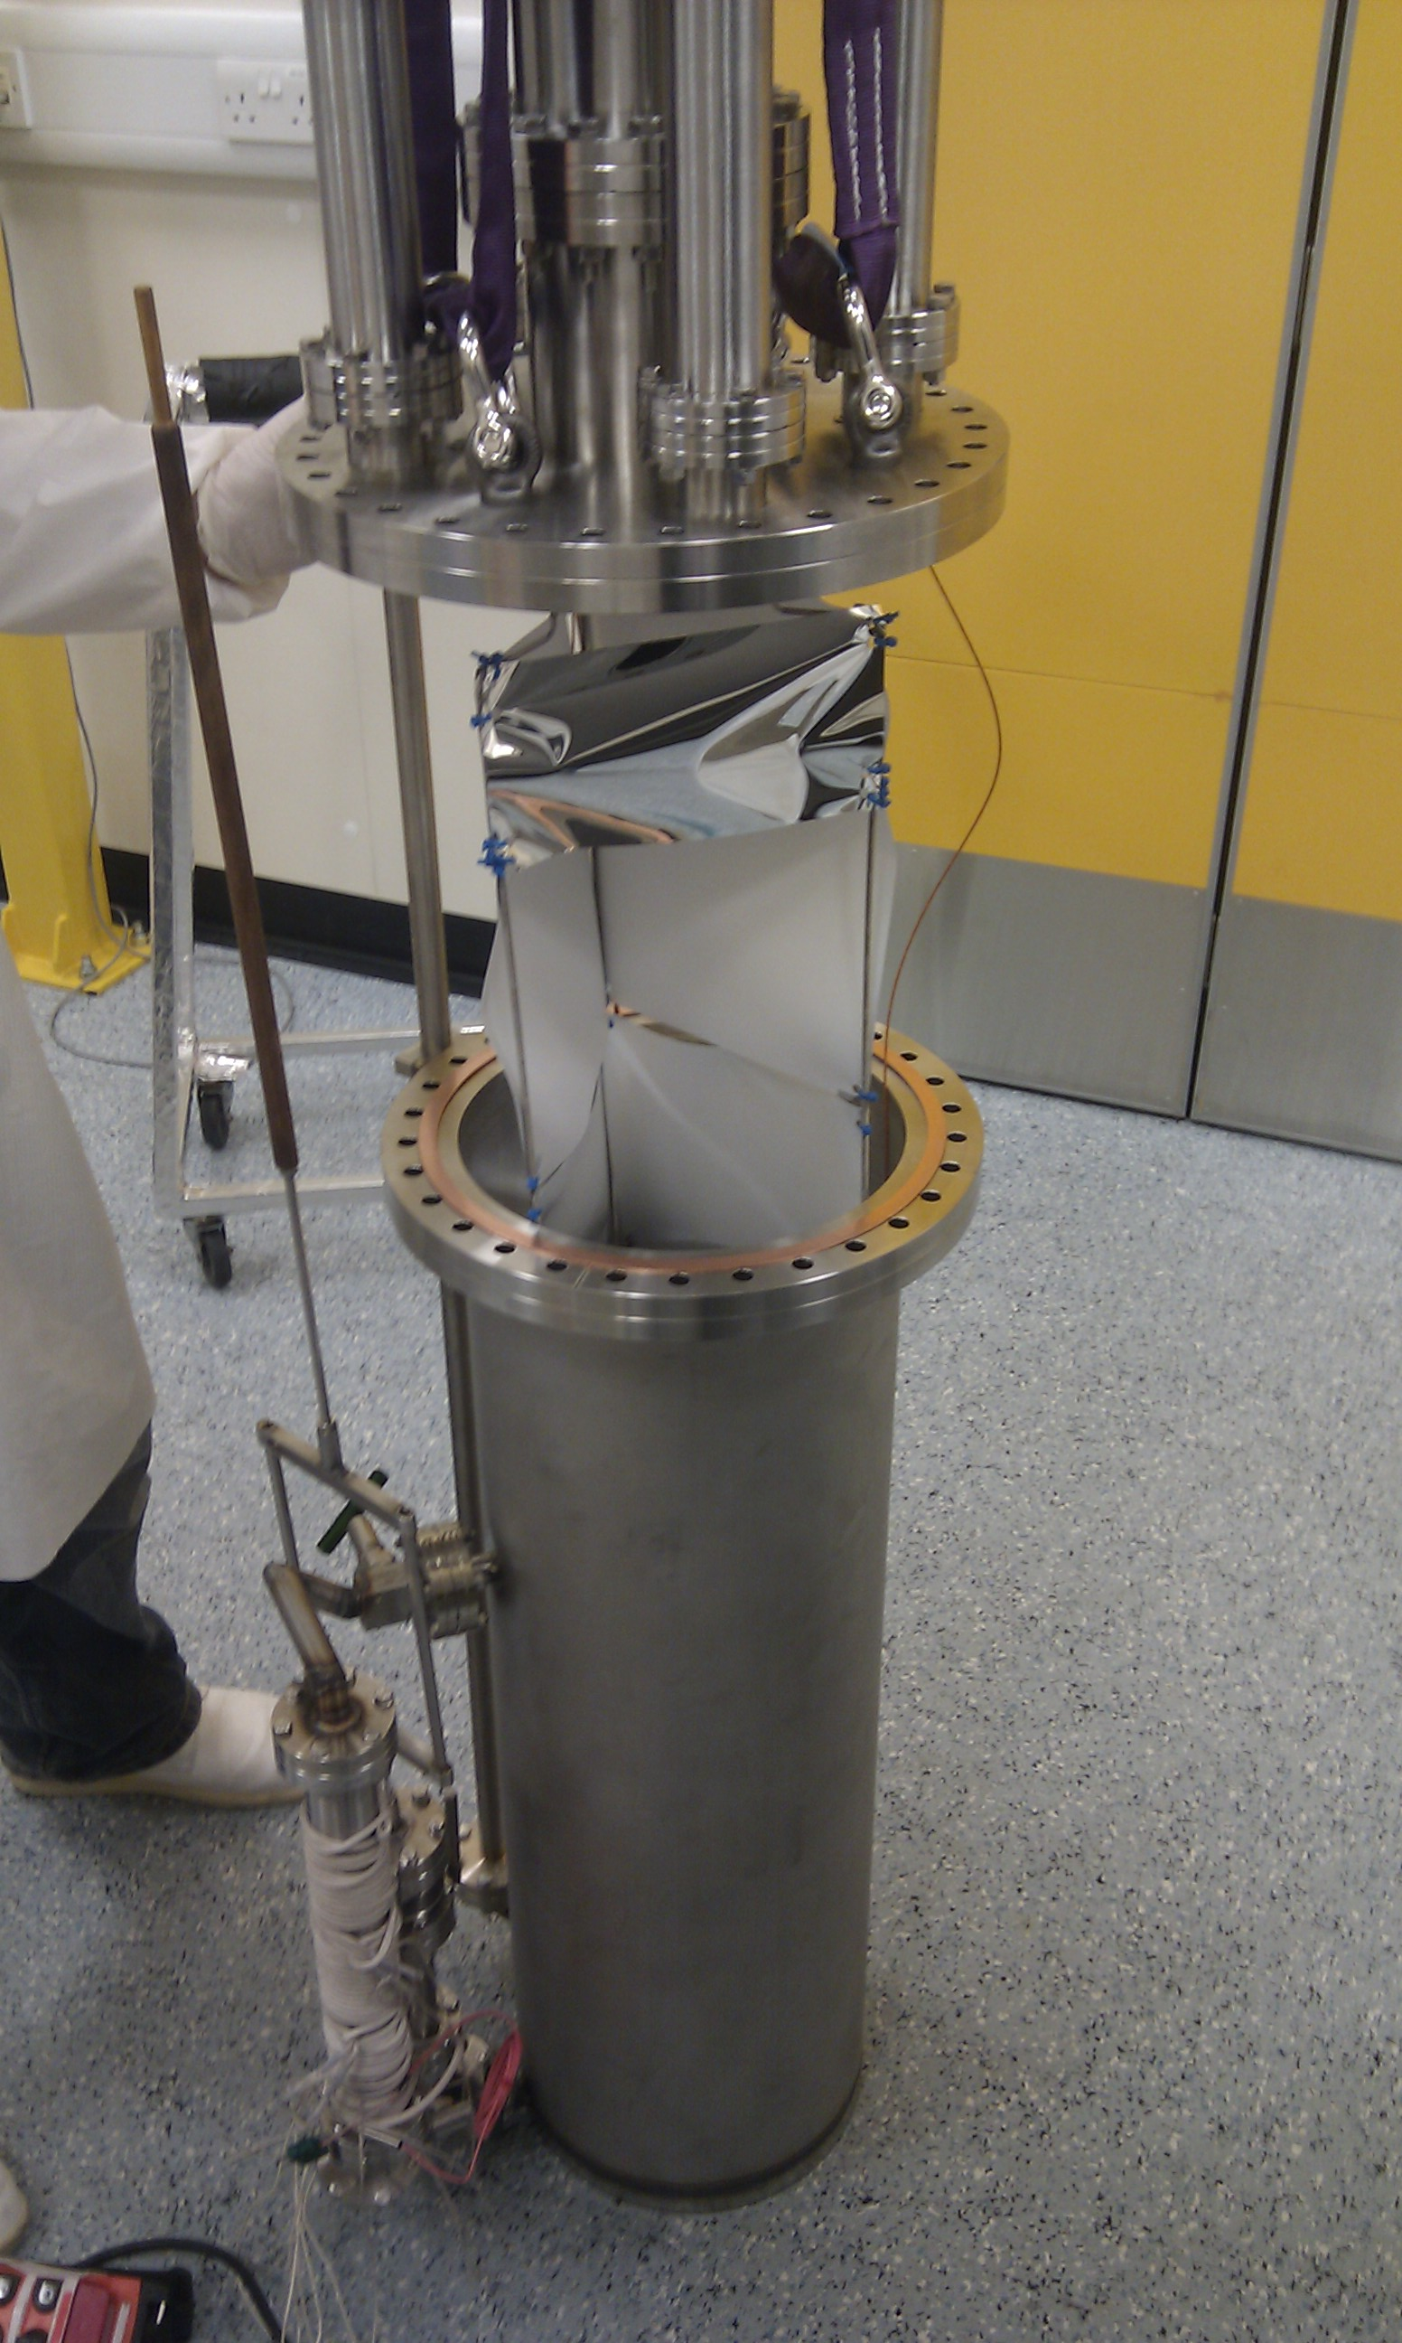
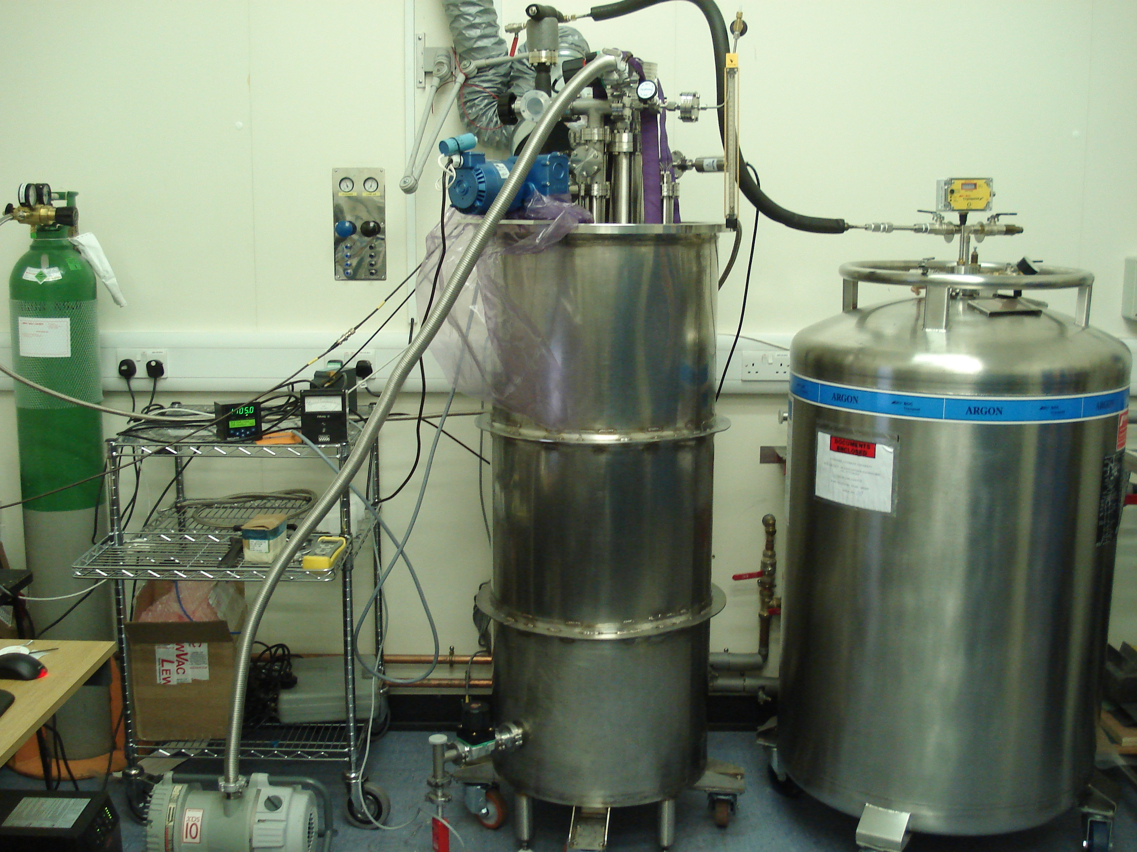
The Liverpool LAr Cell- Assembled
Closing the detector
K. Mavrokoridis LAr R&D Liverpool 09.06.11 17/21

Slide 19
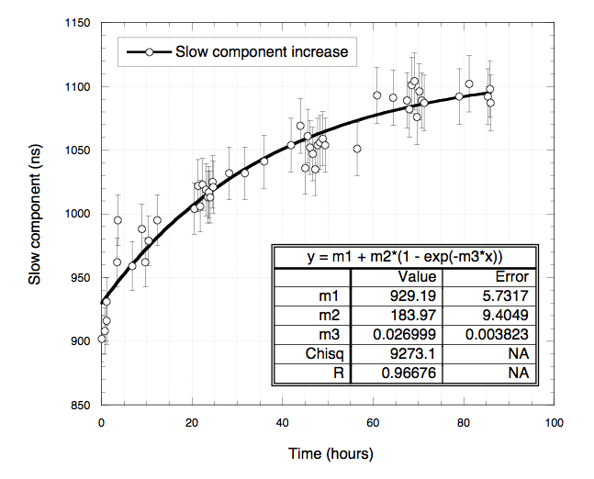
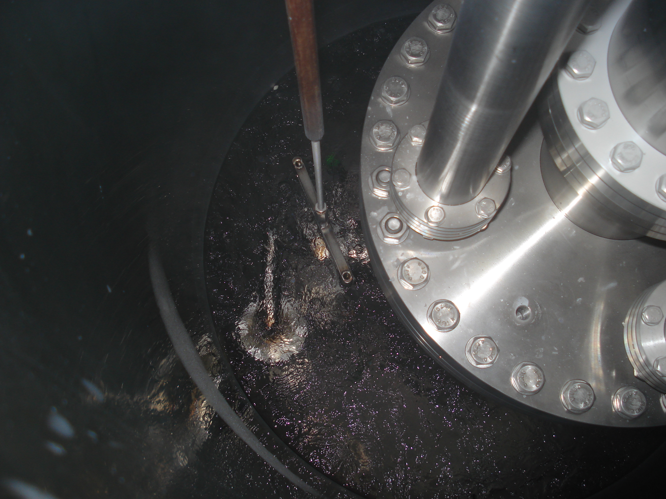
LAr Recirculation and Purification Test
Within 4 days continuous re-circulation at rate of 27 litres/hour, the slow component decay time was increased by 200 ns reaching ∼1100 ns
K. Mavrokoridis LAr R&D Liverpool 09.06.11 18/21

Slide 20
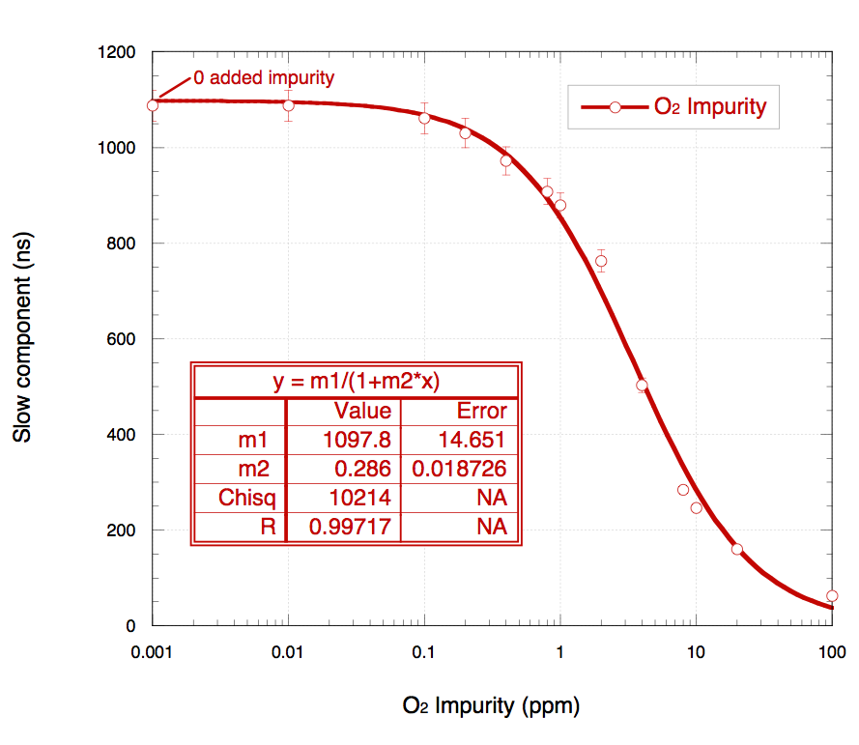
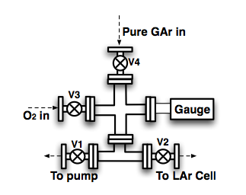
Effect of 0.01 ppm to 100 ppm O₂ impurity on LAr scintillation light
Data collected using an Am-241 alpha source
Birks law type function fit
y=m1/(1+m2*x); m1=1097ns, m2=0.28
Correlation of the LAr slow component decay time with part per million O₂ impurity
K. Mavrokoridis LAr R&D Liverpool 09.06.11 19/21

Slide 21
Summary & Conclusions
Effect of various impurities on the GAr scintillation –correlation of slow component decay time to ppm equivalent impurity level
Purification Chemicals -How they work
-Molecular Sieves, Cu and P₄O₁₀
Efficiency of the chemicals at removing O₂ , H₂O and N₂ found to be high
The Liverpool LAr Cell:
--Construction of a novel cryogenic recirculation pump,
--Successful operation of the pump with a recirculation rate of 27L/hour over four days
--Successful purification of LAr over 4 days recirculation -slow component of LAr increased by 200 ns reaching ~1100 ns
--Slow component decay time of LAr scintillation light was correlated to ppm O₂ equivalent contamination
K. Mavrokoridis LAr R&D Liverpool 09.06.11 20/21

Slide 22
Thank You
K. Mavrokoridis LAr R&D Liverpool 09.06.11 21/21

