Slide 1
Status of LBNE LAr and LAr1 at FNAL
Bruce Baller - Fermilab

Slide 2
Outline
LBNE LAr detector (LAr40) overview
  Facility tour
  Detector configuration
  Membrane cryostat
  Cost scaling
Issues and Prototypes
LAr1 – Engineering Prototype conception

Slide 3
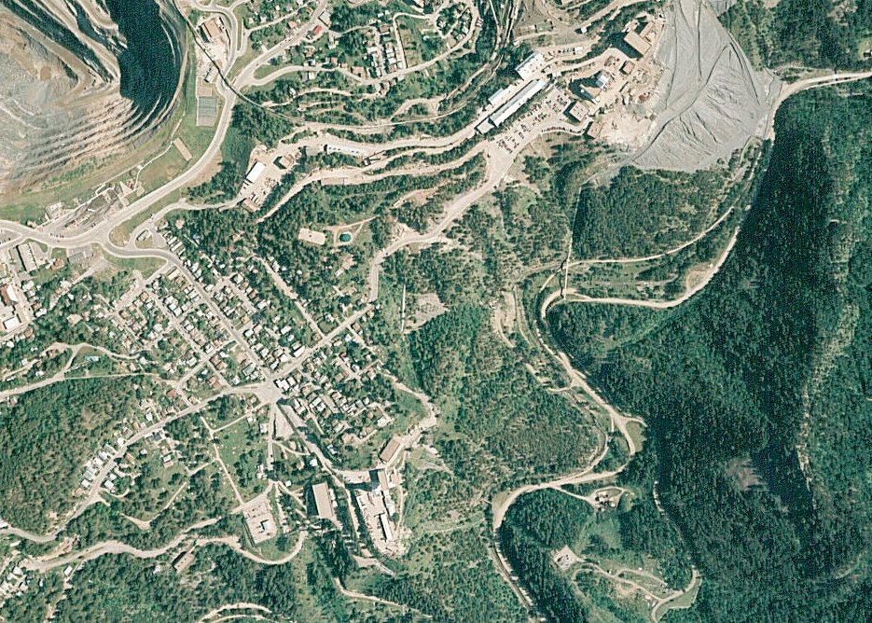
SITE PLAN
Access Ramp
Access Portal
Utility Shaft Access Portal, Cryogenics Building
Cavern
Existing 800 Level
Ross Shaft
Existing 300 Level

Slide 4
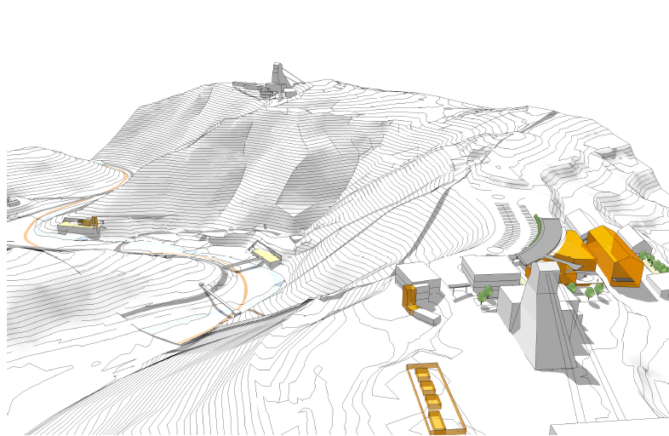
Facility Overview
Ross Headframe
Kirk Drift (existing)
At 300 level
South Portal (new)
Cryogenics building
300’ elevation
North Portal (new)
Access to cavern
Kirk Road

Slide 5
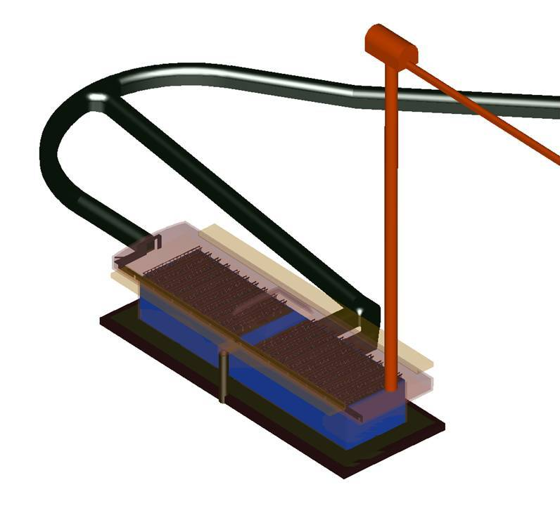
Decline Tunnel
4.5m x 5.5m
Air supply
Ventilation/cryo
Air exhaust
2ndry egress
Mucking drift
+ Cryostat construction
+ sump pump
+ lower level veto access
Module 1
130m
Module 2
33m

Slide 6
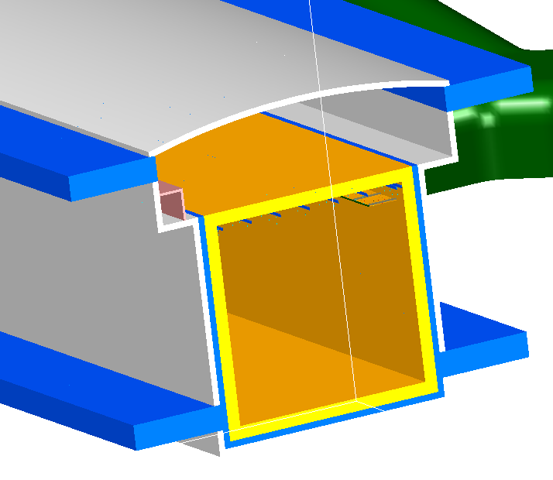
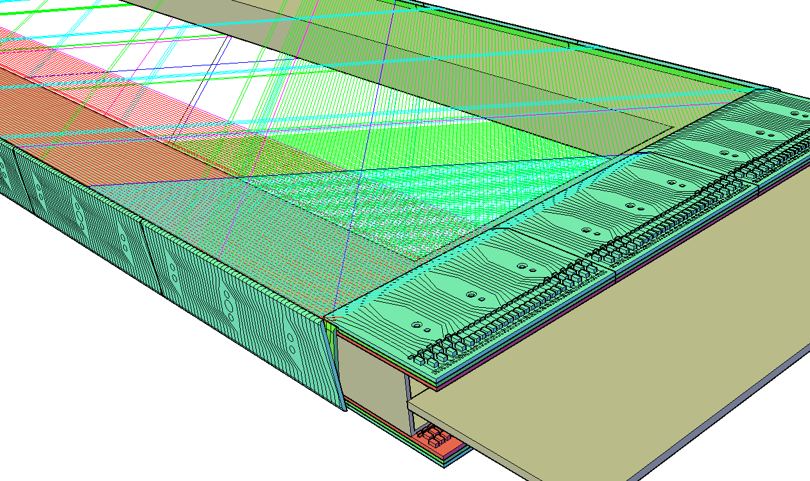
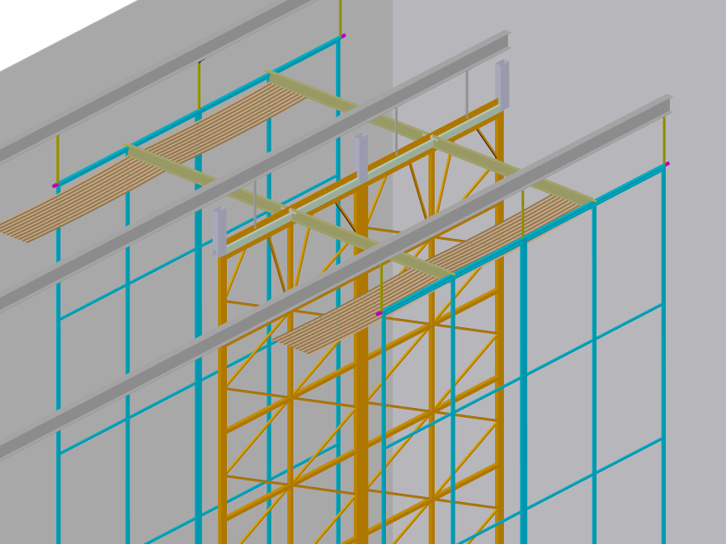
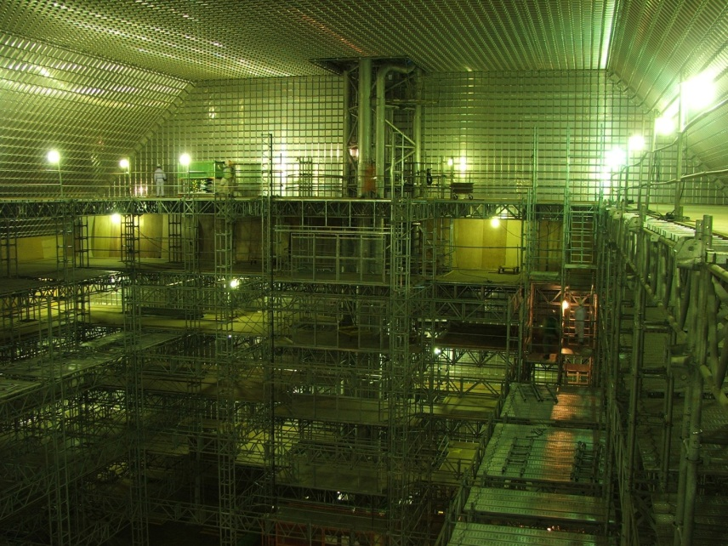
CR Veto
CR Veto
2.5m
Membrane Cryostat
Mounting Rails
7m
CR Veto
Anode
Plane
Assembly
No Crane
Field Cage
Cathode
Plane
Assembly

Slide 7
Reference Design - Key Parameters
Detector module configuration
  2 high x 3 wide x 18 long = 108 Anode Plane Assemblies (APA)
    5mm wire spacing
    Four wire planes: Grid, Induction 1, Induction 2, Collection
    3 readout channels/APA
      2462 readout wires x 4x redundancy / 3840 MUX
    3.67m drift
  16.4 kt fiducial mass, 19.4 kt active mass, 25 kt total mass
  Cooling required – 40 kW nominal, 57 kW max
Two detector modules in one cavern – 32.9 kton ~ 200 kton Water Cherenkov detector equivalent

Slide 8
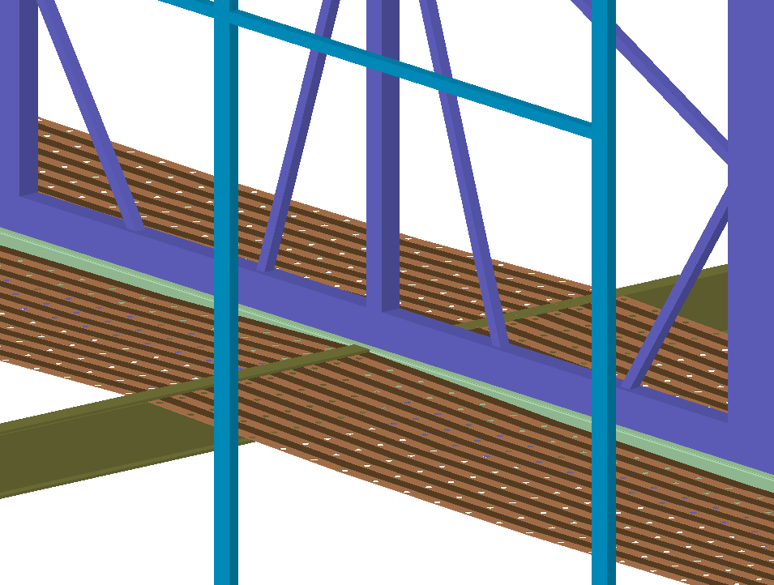
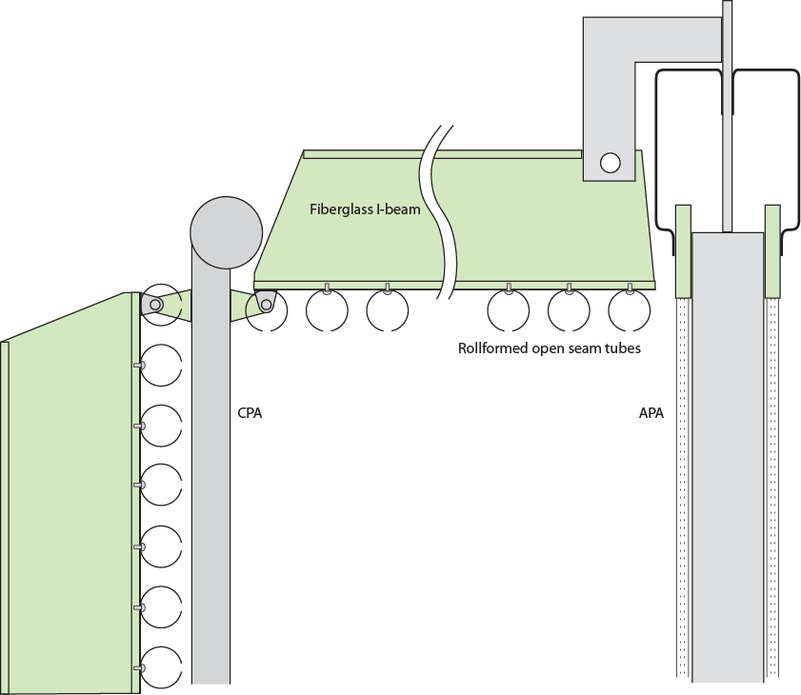
Field Cage Concepts
Field cage panels (2.5mx3.67m) pre-assembled on to the CPA
Each panel has its own resistor divider
Light weight, flexible printed circuit material (30,000 sqft.)
Supported by pultruded fiberglass beams between APA and CPA
Perforated to allow LAr convection flow

Slide 9
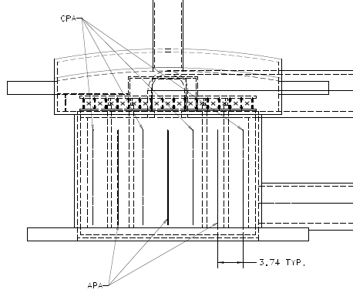
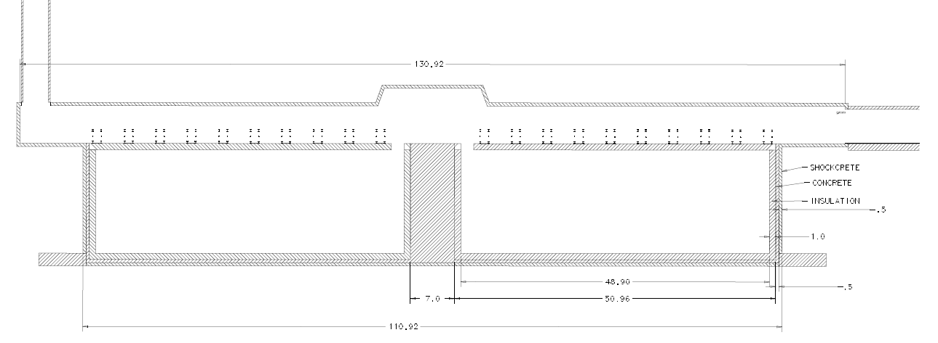
Emergency egress
Ventilation/cryo
Air exhaust
Installation hatch
Cryo piping
18 x 2 drift cells

Slide 10
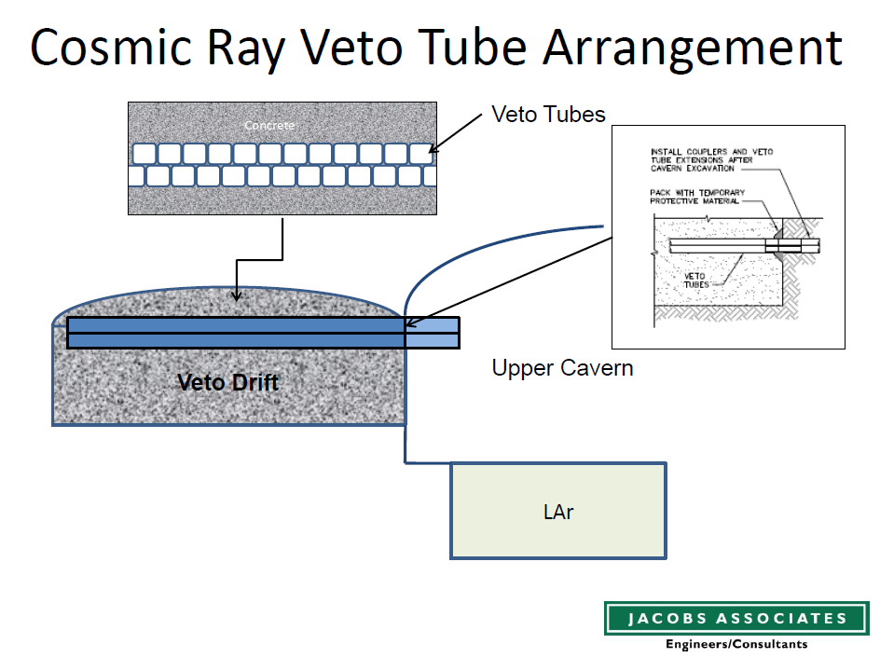
4” square
tubing
Stuff veto tube holes with your favorite high efficiency detector
Example: loop of WLS fiber inside a flexible light reflective bag containing liquid scintillator

Slide 11
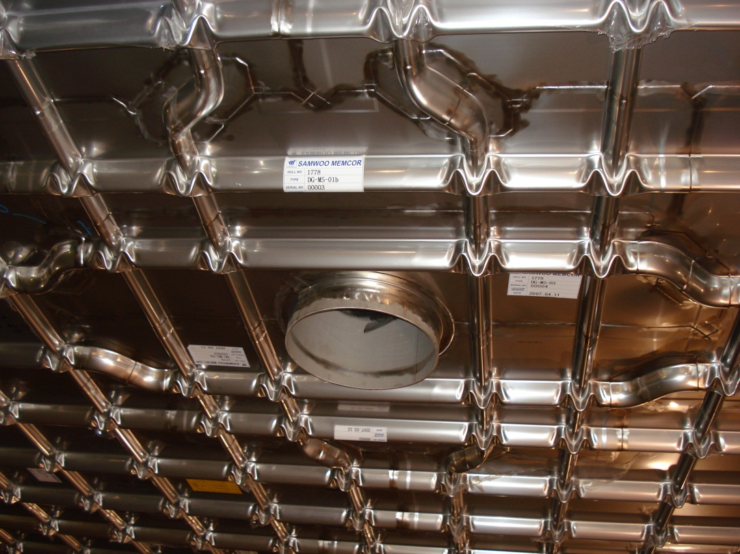
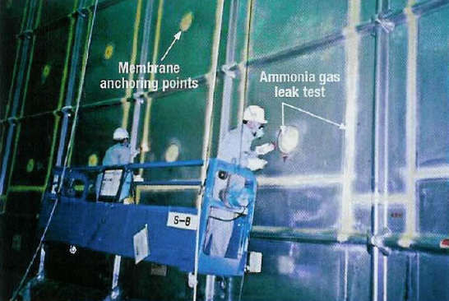
Cryostat
GTT membrane roof penetrations
IHI membrane leak checking

Slide 12
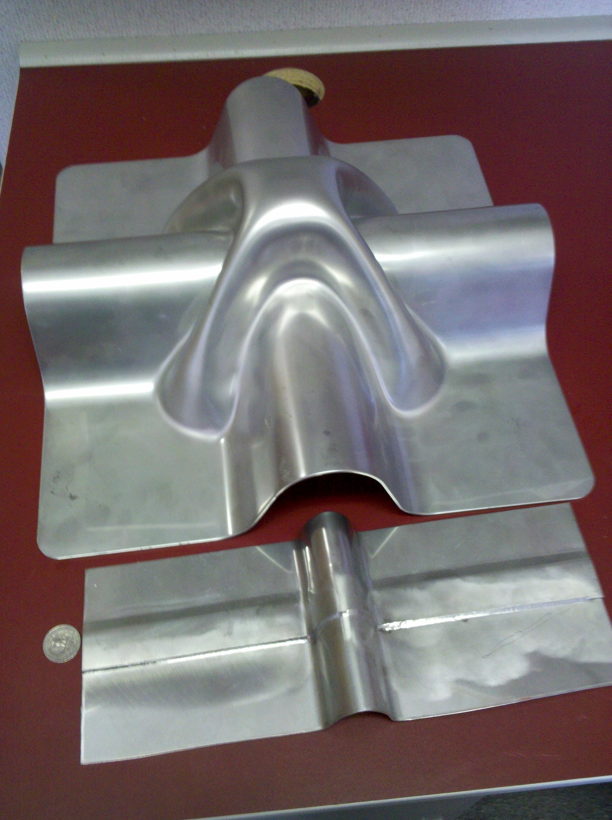
Ishikawajima-Harima Heavy Industries (IHI)
3m x 8m panels
2mm 304 SS
Gas Transport & Technigaz (GTT)
1m x 3m panels
1.2mm 304 SS

Slide 13
Membrane Cryostat
Benefits
Concerns
Full containment system
Long record in LNG industry in more severe service
~standard industrial design
“Cryostat in a kit” construction model
High fiducial mass fraction
Long weld length on thin sheets
Rock interactions
  Freezing
    Heat the concrete liner
  Elastic rebound
    mm - cm movements possible in first few months after excavation
  Creep
    Not suitable for use in rock with large creep

Slide 14
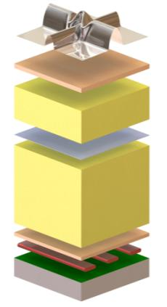
Detector Module Cooling Requirement
Total ~ 40 kW
  Insulation - 28 kW
    1m foam - 5.4 kW/m2
  LAr Pumps - n x 6 kW
  Electronics – 5 kW
    Front end – 10 mW/chan
    Digital – 5 mW/chan
LN refrigerators designed for 60 kW cooling
  Heat output 140 kW
LAr40 = 2 detector modules
Detector volume
Purge, vacuum, LAr
❶ Stainless steel primary membrane
❷ Plywood board
❸ Reinforced polyurethane foam
❹ Secondary barrier
❺ Reinforced polyurethane foam
❻ Plywood board
❼ Bearing mastic
❽ Concrete covered with moisture barrier
❶
Insulation space #1
Purge, test gas, vacuum
❷
❸
❹
Insulation space #2
Purge, test gas, vacuum
❺
Concrete bathtub
Ufer ground, heating
❻
❼
❽

Slide 15
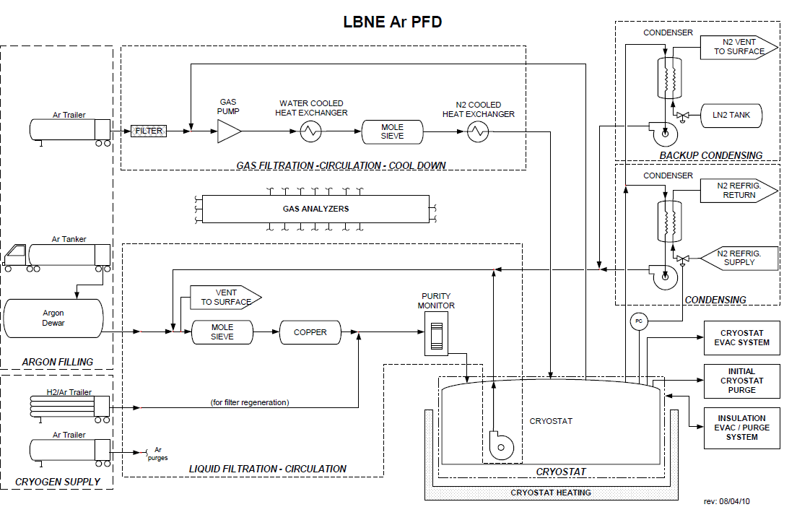
LAr Process Piping
4 x 34 m³/hr

Slide 16
LN Refrigeration System
2 operating + 1 spare

Slide 17
Detector and Associated Conventional Facilities Cost Scaling
All $’s are Total Project Cost including direct cost, indirect cost, 40% contingency, 20% escalation
Split into
  Fixed cost (design, tooling, project management prototypes, etc)
  Incremental cost that scales with the appropriate design parameter (e.g. volume of rock/LAr, surface area of cryostat pit, length of the cavern, number of readout channels)
Wire spacing
  Construction cost: $7.1M (Electronics, cabling, F/T) + $2.8M (wire winding labor) → $15.30/channel
Anode Plane Assembly - $118k (5mm wire spacing)
Cryostat - $9.3k/m²
Two detectors in one cavern
  Excavate one long pit for two detectors + 5m concrete septum
    $598/m³ for pit excavation & shotcrete
    $500/m³ for highbay excavation only
    $700/m² for highbay roof support & shotcrete

Slide 18
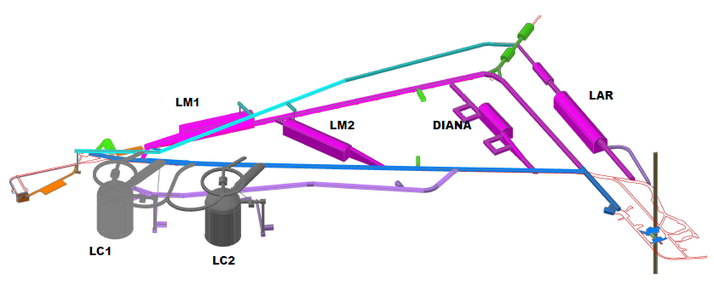
LAr40 at 4850 Level
Concept utilizing existing access and ventilation shafts
Cost?

Slide 19
Issues & Prototyping Plan
Achieving argon purity without vacuum pumping
  Liquid Argon Purity Demonstrator (LAPD)
Achieving argon purity in a membrane cryostat
  3m x 3m wall panel
    Could one evacuate a membrane cryostat if it is found necessary?
    Testing completed - yes
  LAPD → 33 ton prototype (purity monitors)
    Reviewing proposals for cryostat design and material procurement
      Selected IHI
    Construct in summer 2012
Engineering and integration prototype – LAr1
  Organized as a sub-project (Project Manager, Deputy, schedule, etc)
  Internal cost and schedule review in July

Slide 20
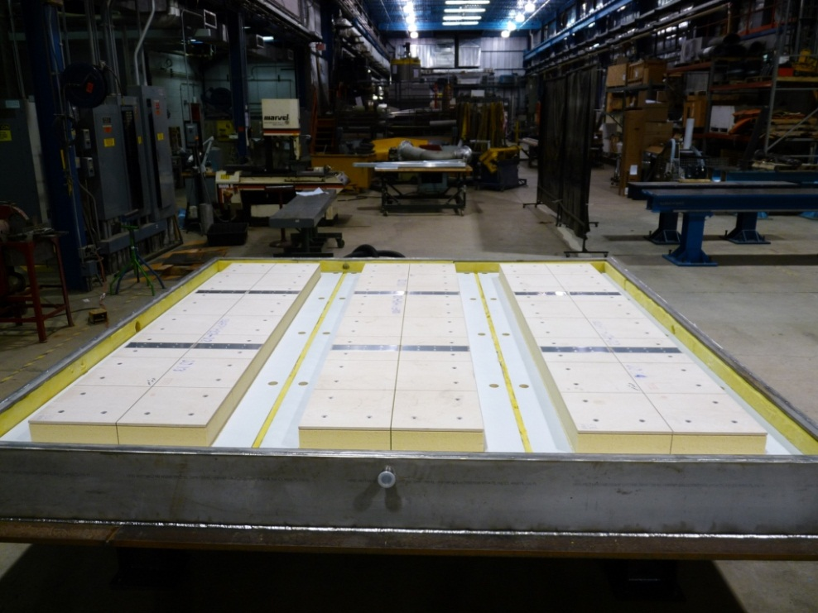
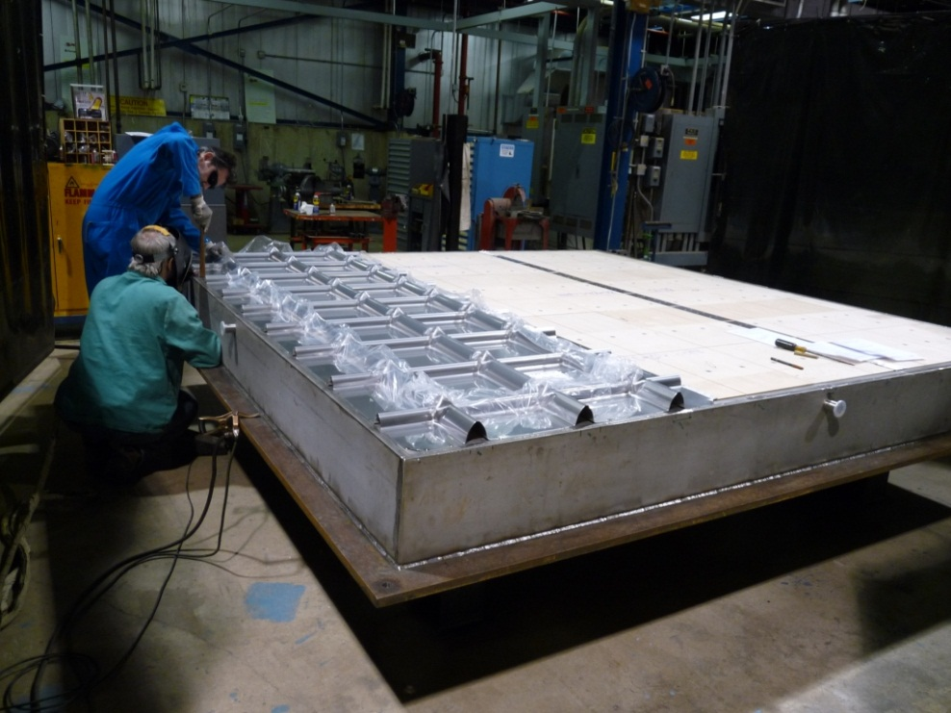
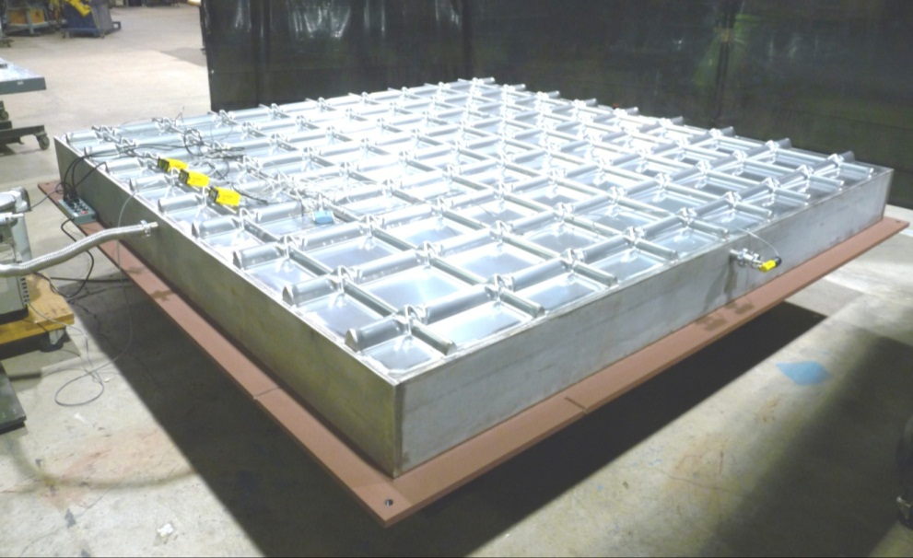
3m x 3m Wall Mock-up
A helium leak detector is connected to the insulation space. After 10 days of evacuation, the pressure was 0.60 Torr. Wall section was bagged and helium sprayed inside to give a global leak test for the membrane. There was no response to helium. Picture taken March 23, 2011
Vacuum pumping of membrane cryostat is feasible

Slide 21
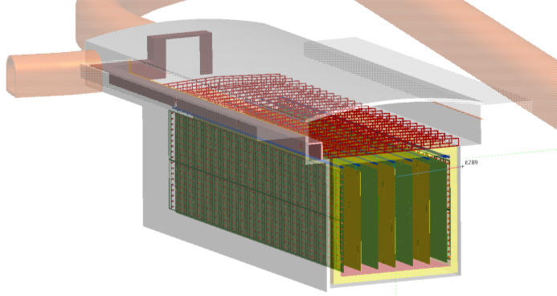
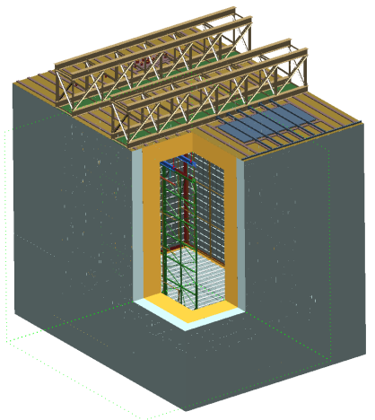
LAr1 Liquid Argon Engineering Prototype Objectives
The Engineering Prototype includes the major features of the LAr40 detector
Establish a credible basis for scaling to a 20 kton LAr TPC module
Test the membrane cryostat design for high purity liquid argon service
(Surface area ratio 1:11 , Argon mass ratio 1:30 with the 20 kton cryostat, same gas ullage height)
Test the mechanical structure of the APA including wire tension stability
Test argon purity and drift length
Test full readout chain including cold electronics
Test Integration features such as
  TPC supports and installation
  Signal/power feedthough, HV system/feedthrough/connection
  Grounding scheme and common mode noise control
Gain practical knowledge in membrane cryostat construction methods
More complete list contained in LAr1 proposal by Russ Rucinski docdb #3452

Slide 22
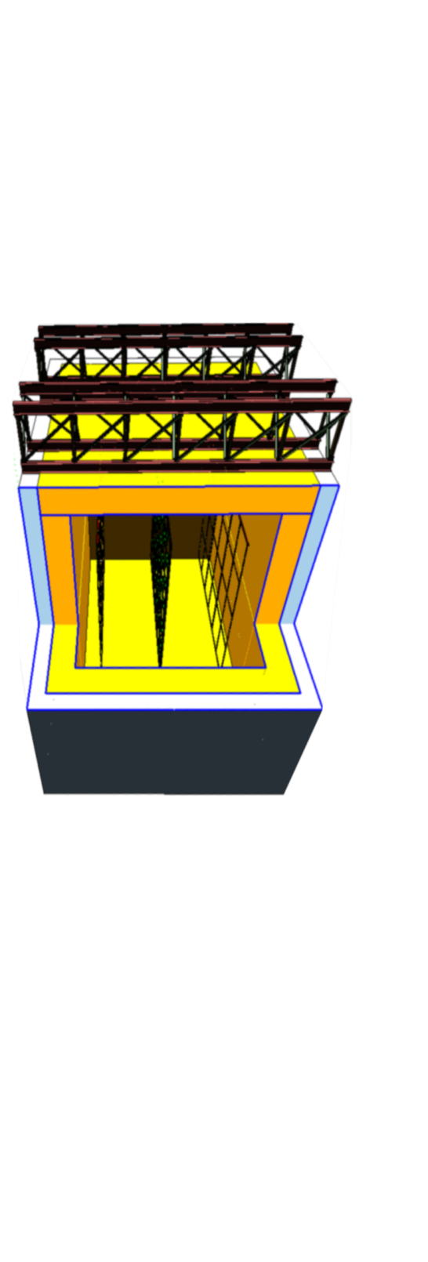
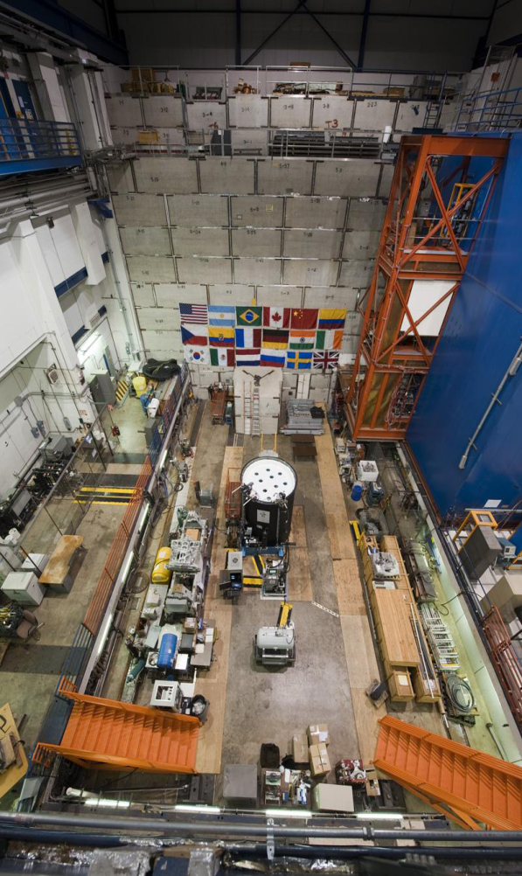
Major Schedule and Cost Savings from Reusing Established and Operating Infrastructure at DZero
No new building
Cryostat concrete enclosure and steel roof construction is not affected by weather
Existing liquid argon and nitrogen cryogenic systems for D0 Calorimeter
Oxygen Deficiency Hazard (ODH) safety systems with argon spill management
50 ton and 10 ton building cranes
Machining and welding shops
FIRUS, High Sensitivity Smoke Detection (HSSD), Fire safety systems
Emergency backup power diesel generator

Slide 23
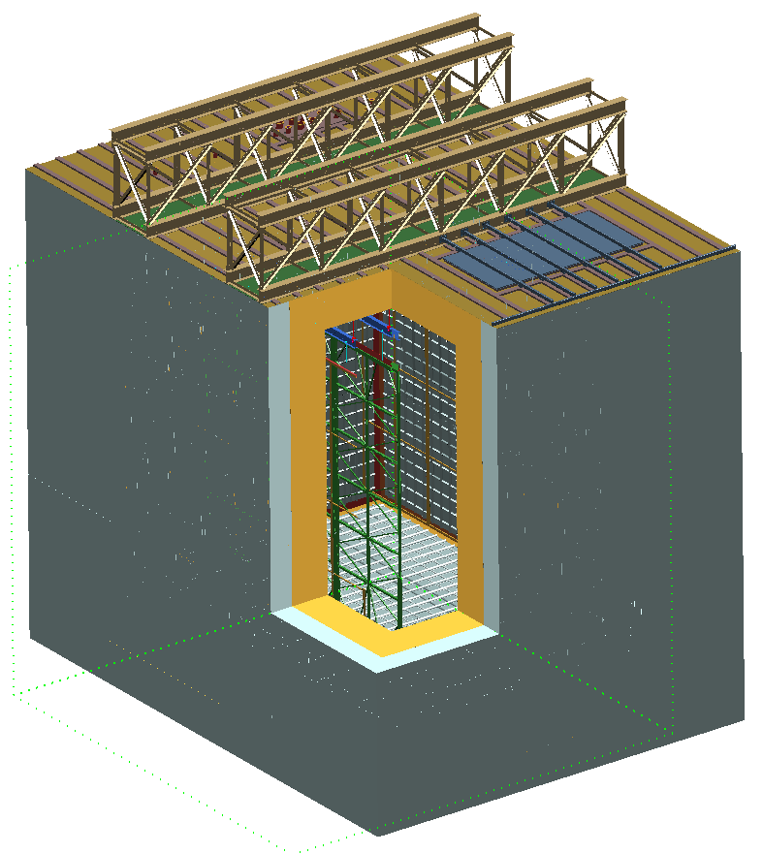
LAr1 Cryostat Enclosure
Reinforced steel plate for top of outer shell
Guard rails on cryostat top not shown
Access hatch braced with beams
Trusses at same 5 m ctr-ctr spacing as LAr40 provide same cable/rack arrangement as a zone of LAr40
1m thick foam insulation
Reinforced concrete for bottom and sides of outer shell
Total mass = 1.1 kt
Active = 500 ton
Fiducial = 380 ton
CAD model by Steve Hentschel

Slide 24
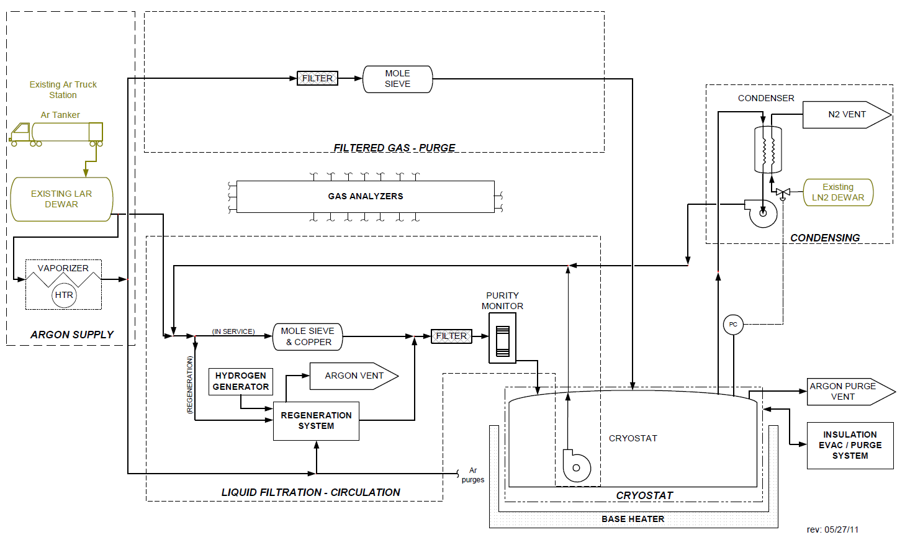
LAr1 Cryogenic System Process Flow Diagram
From Mark Adamowski

Slide 25
LAr 1 Preliminary Cost and Schedule
Labor without contingency, escalation
~ 4 M$
M&S without indirects, contingency, escalation
~ 10 M$
Critical Path Activities of a Technically Driven Schedule
Calendar years
2011 | 2012 |  |  |  | 2013 |  |  |  | 2014
Q4 | Q1 | Q2 | Q3 | Q4 | Q1 | Q2 | Q3 | Q4 | Q1
Design cryostat concrete enclosure
RFP for cryostat enclosure
Order concrete enclosure
Construct cryostat concrete enclosure
Design cryostat by membrane company
RFP for cryostat materials
Procure membrane materials
Install membrane in cryostat enclosure
33.5t prototype tests successful
Setup and load TPC in cryostat
Purge and fill cryostat
Design Cryogenic System
Procure cryogenic systems components
Cryogenic system installation

Slide 26
Conclusions
Conceptual design developed for a 34 kton LAr TPC for LBNE
  Detector meets the scientific goals of LBNE (ref B. Svoboda talk)
  Detector sited at shallow depth (210 m) with a cosmic ray veto system to enable proton decay physics
Conceptual design for a LAr1 engineering prototype for LBNE
  Different goals than LAr1 detector for short baseline physics
    Goals are not incompatible – timescales might be
  Prototype structured as a ~independent project

Slide 27
TPB coated light guide
PMT

