Slide 1
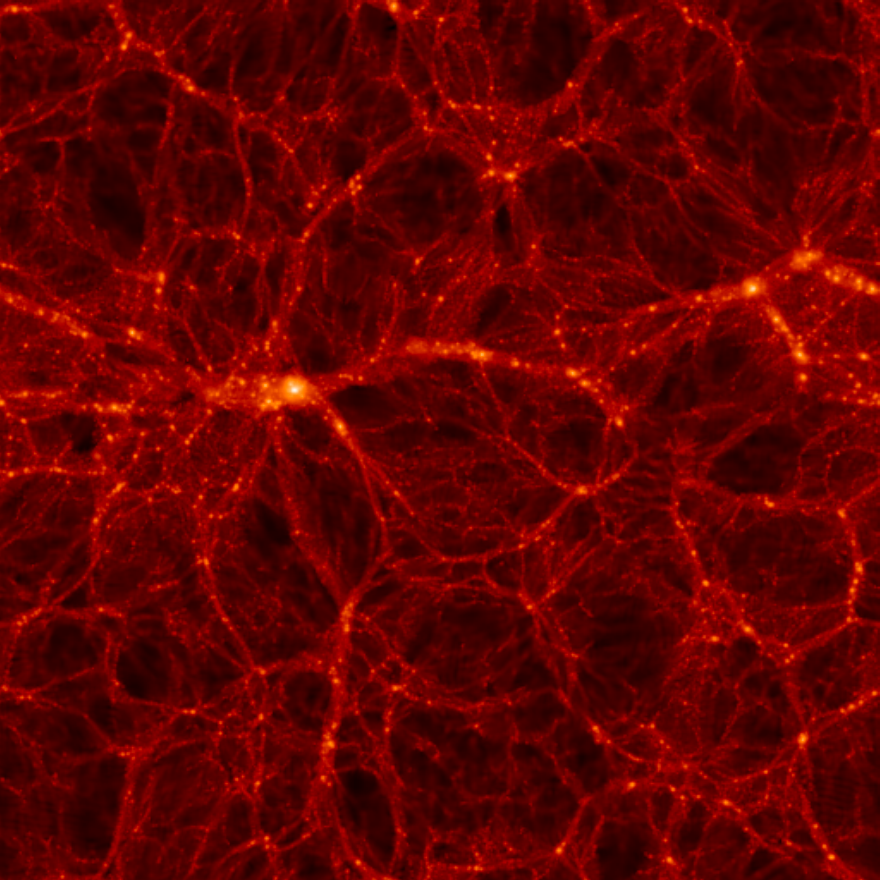
ASTROPHYSICAL NEUTRINOS
ν_{e} ν_{μ}
ν_{τ}
STEEN HANNESTAD, Aarhus University
GLA2011, JYVÄSKYLÄ

Slide 2
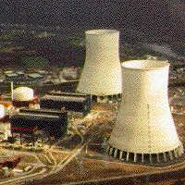
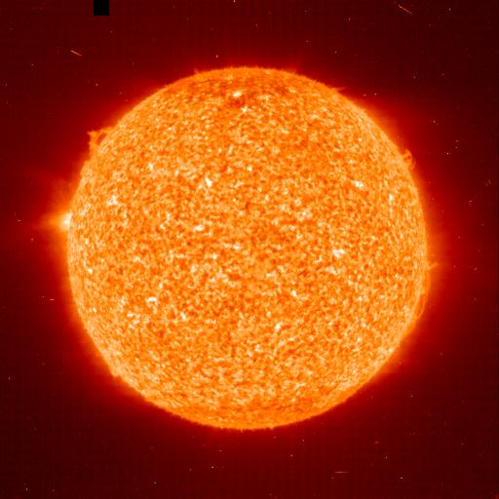


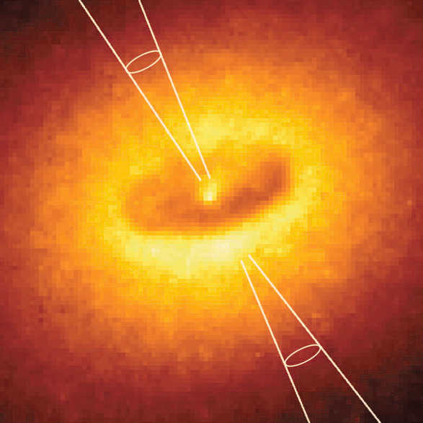
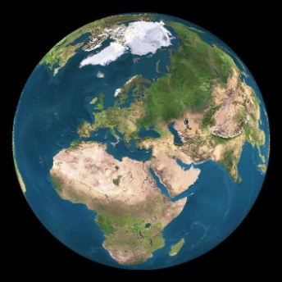
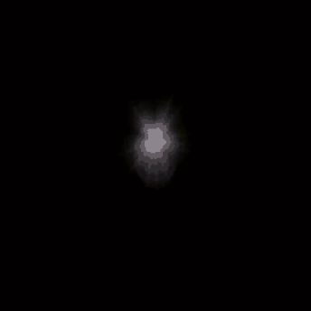
Where do Neutrinos Appear in Nature?
Nuclear Reactors
✓
Sun
✓
Supernovae
(Stellar Collapse)
Particle Accelerators
✓
SN 1987A ✓
Earth Atmosphere
(Cosmic Rays)
✓
Astrophysical
Accelerators Soon ?
Earth Crust
(Natural
Radioactivity)
✓
Cosmic Big Bang
(Today 330 ν/cm³)
Indirect Evidence

Slide 3
Fermion Mass Spectrum
Q = −1/3
d
s
b
Q = +2/3
u
c
t
Charged Leptons
e
μ
τ
All flavors
Neutrinos
ν₃
1
10
100
1
10
100
1
10
100
1
10
100
1
10
100
1
meV
eV
keV
MeV
GeV
TeV

Slide 4
FLAVOUR STATES
PROPAGATION STATES
MIXING MATRIX (UNITARY)

Slide 5
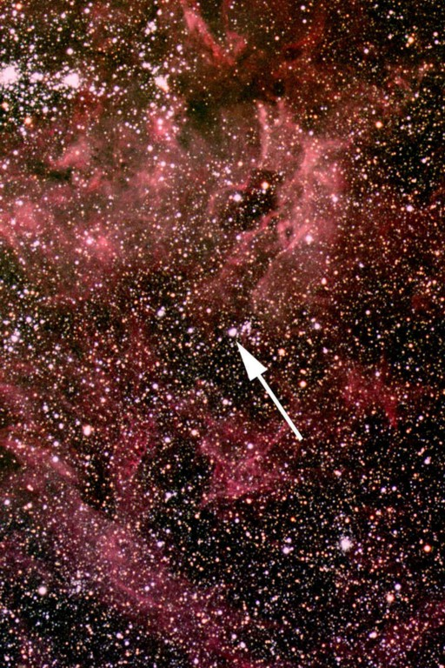
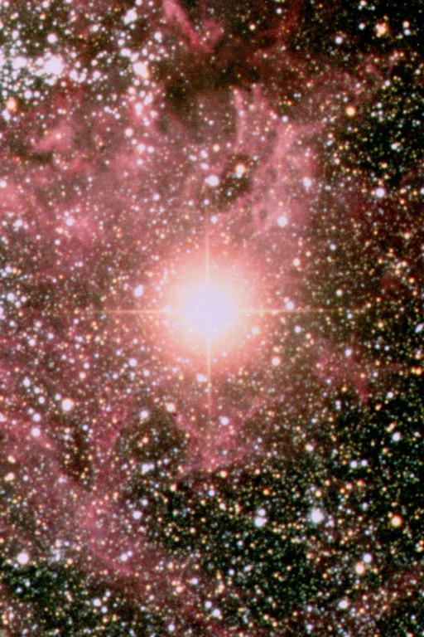
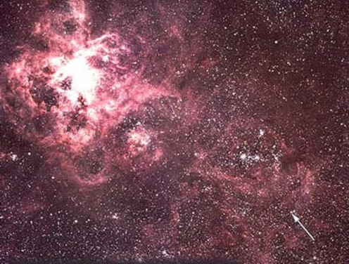
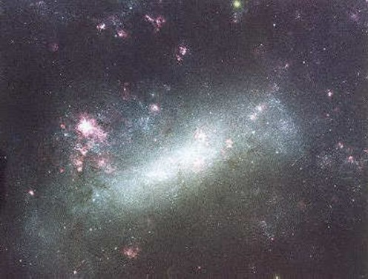
Sanduleak -69 202
Sanduleak −69 202
Supernova 1987A
23 February 1987
Tarantula Nebula
Large Magellanic Cloud
Distance 50 kpc
(160.000 light years)

Slide 6
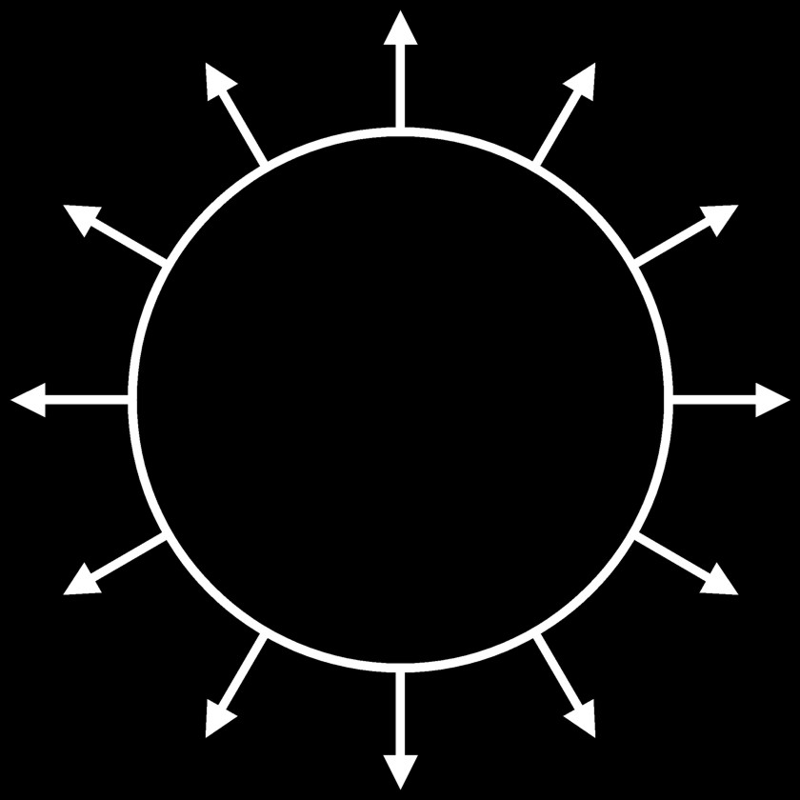

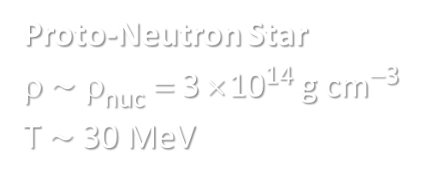

Stellar Collapse and Supernova Explosion
Newborn Neutron Star
Collapse (implosion)
Explosion
$\sim$ 50 km
Proto-Neutron Star
ρ $\sim$ ρ_{nuc} = 3 × 10¹⁴ g cm⁻³
T $\sim$ 30 MeV

Slide 7

Stellar Collapse and Supernova Explosion
Newborn Neutron Star
$\sim$ 50 km
Neutrino
cooling by
diffusion
Proto-Neutron Star
ρ $\sim$ ρ_{nuc} = 3 × 10¹⁴ g cm⁻³
T $\sim$ 30 MeV

Slide 8
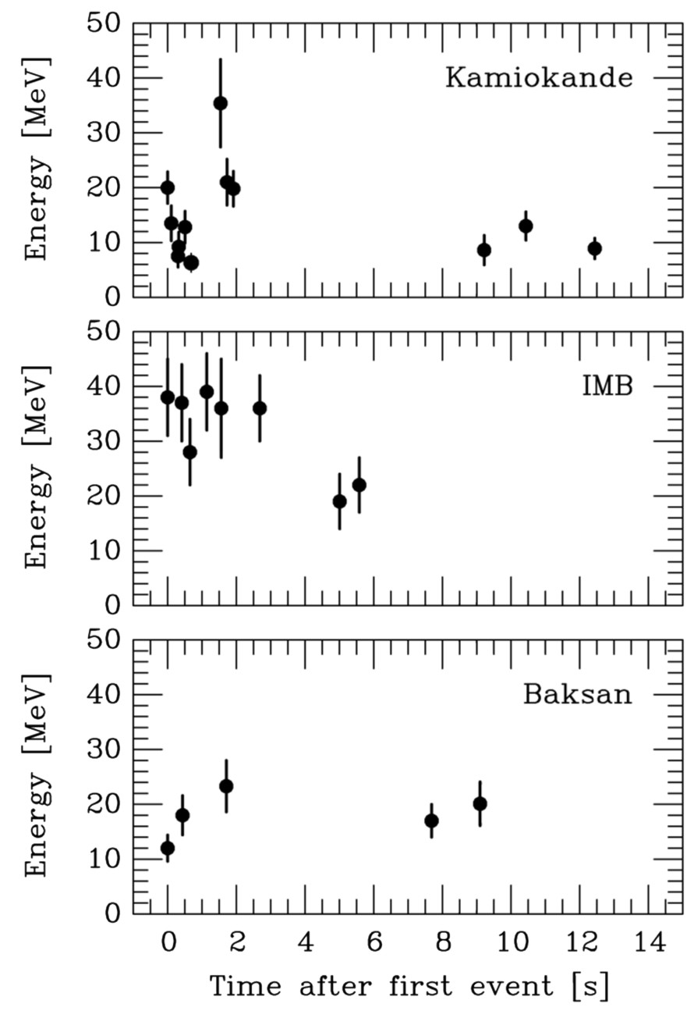
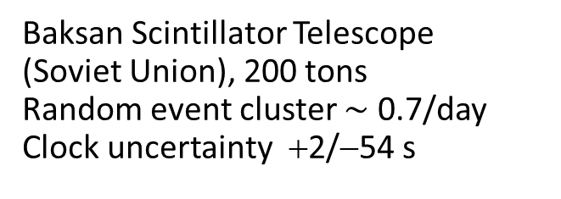
Neutrino Signal of Supernova 1987A
Kamiokande-II (Japan)
Water Cherenkov detector
2140 tons
Clock uncertainty ±1 min
Irvine-Michigan-Brookhaven (US)
Water Cherenkov detector
6800 tons
Clock uncertainty ±50 ms
Within clock uncertainties,
all signals are contemporaneous

Slide 9
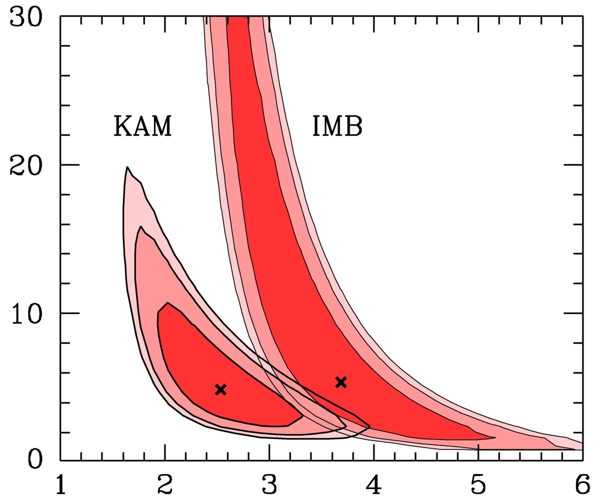

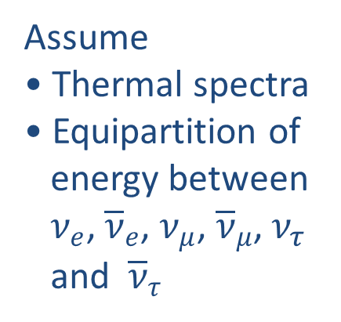
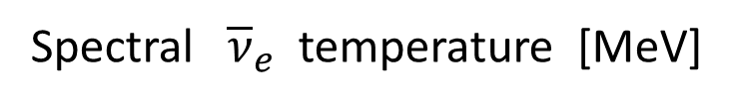
Interpreting SN 1987A Neutrinos
Assume
• Thermal spectra
• Equipartition of
energy between
$ν_{e}$, ${\overline{ν}}_{e}$, $ν_{μ}$, ${\overline{ν}}_{μ}$, $ν_{τ}$
and ${\overline{ν}}_{τ}$
Contours at CL
68.3%, 90% and 95.4%
Recent long-term
simulations
(Basel, Garching)
Jegerlehner,
Neubig & Raffelt,
PRD 54 (1996) 1194
Spectral ${\overline{ν}}_{e}$ temperature [MeV]

Slide 10
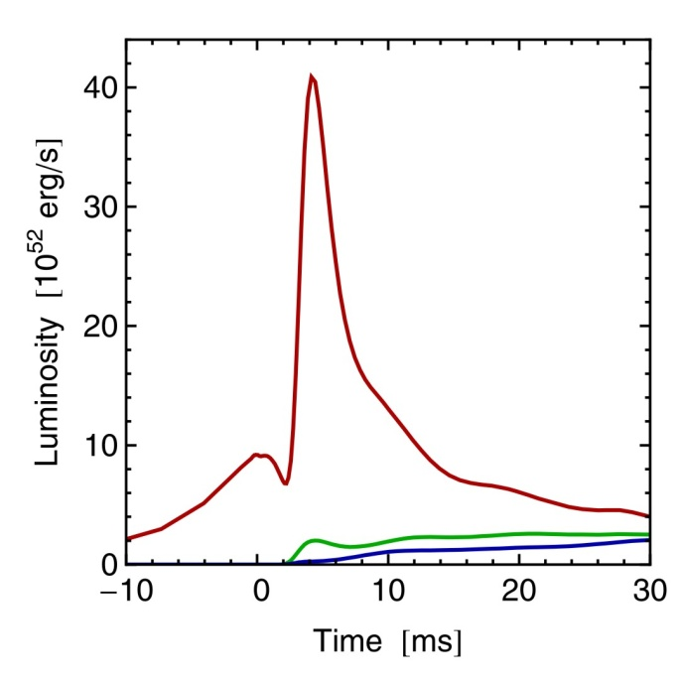
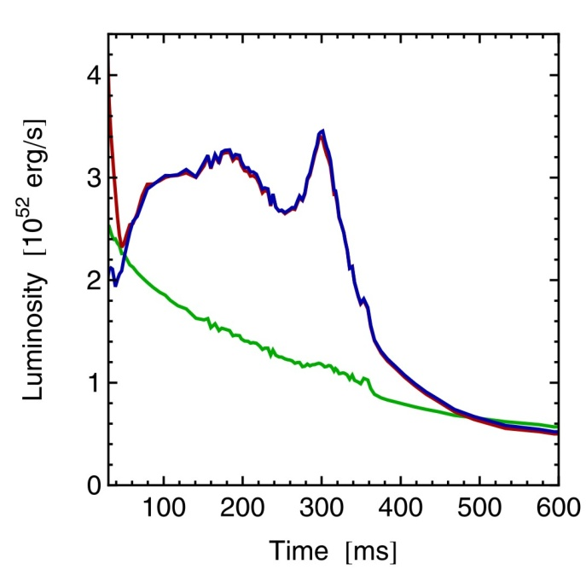
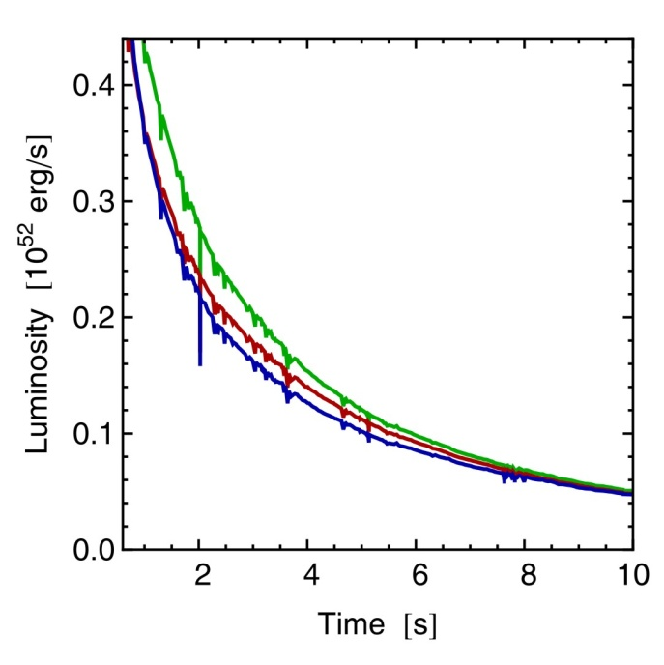
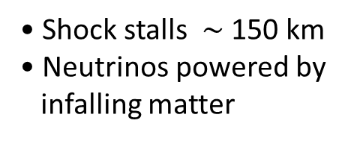
Three Phases of Neutrino Emission
Prompt ν_{e} burst
Accretion
Cooling
Shock breakout
De-leptonization of
outer core layers
Shock stalls $\sim$ 150 km
Neutrinos powered by
infalling matter
Cooling on neutrino
diffusion time scale
Spherically symmetric model (10.8 M⊙) with Boltzmann neutrino transport
Explosion manually triggered by enhanced CC interaction rate
Fischer et al. (Basel group), A&A 517:A80, 2010 [arxiv:0908.1871]

Slide 11
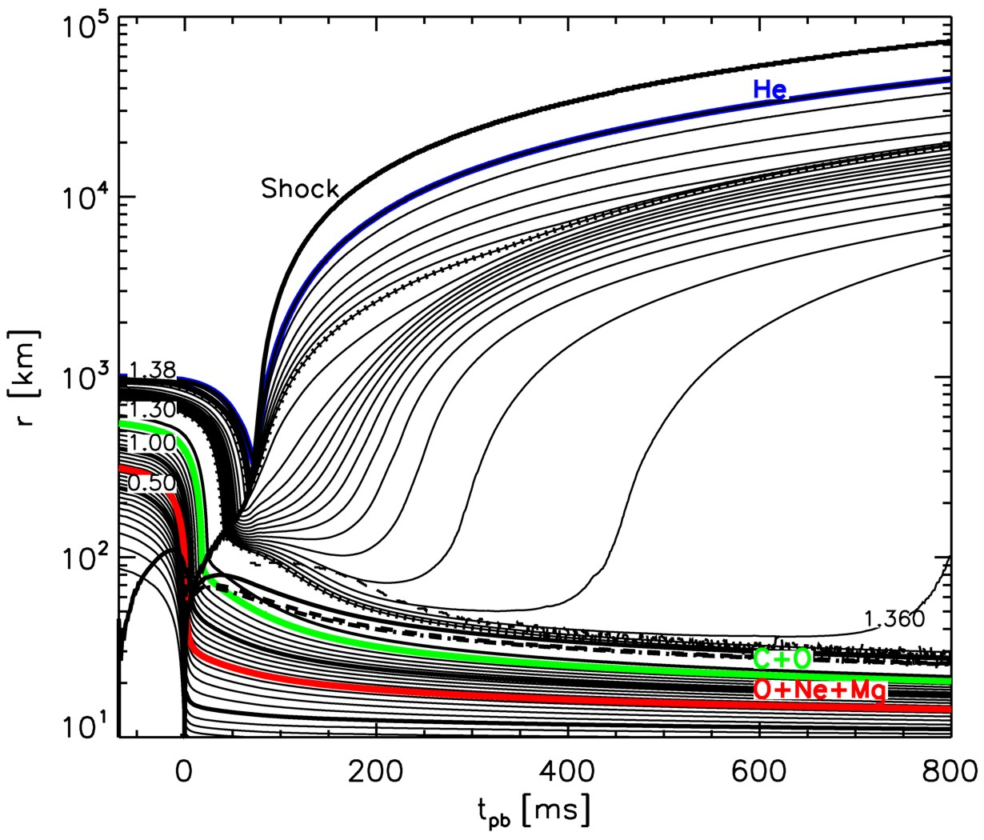
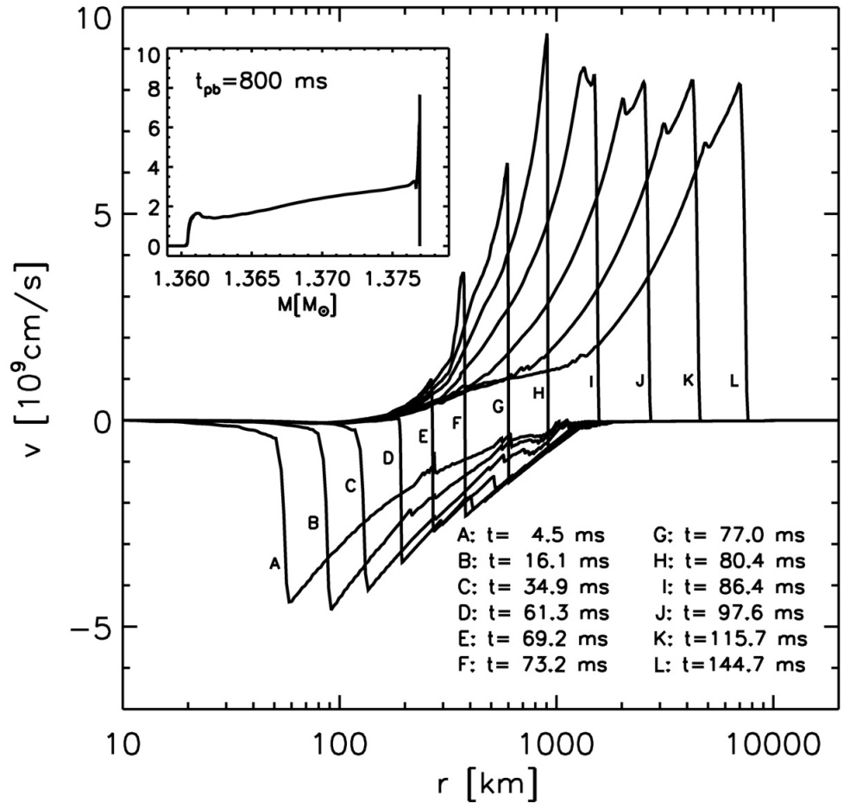
Exploding Models (8–10 Solar Masses) with O-Ne-Mg-Cores
Kitaura, Janka & Hillebrandt: “Explosions of O-Ne-Mg cores, the Crab supernova,
and subluminous type II-P supernovae”, astro-ph/0512065

Slide 12
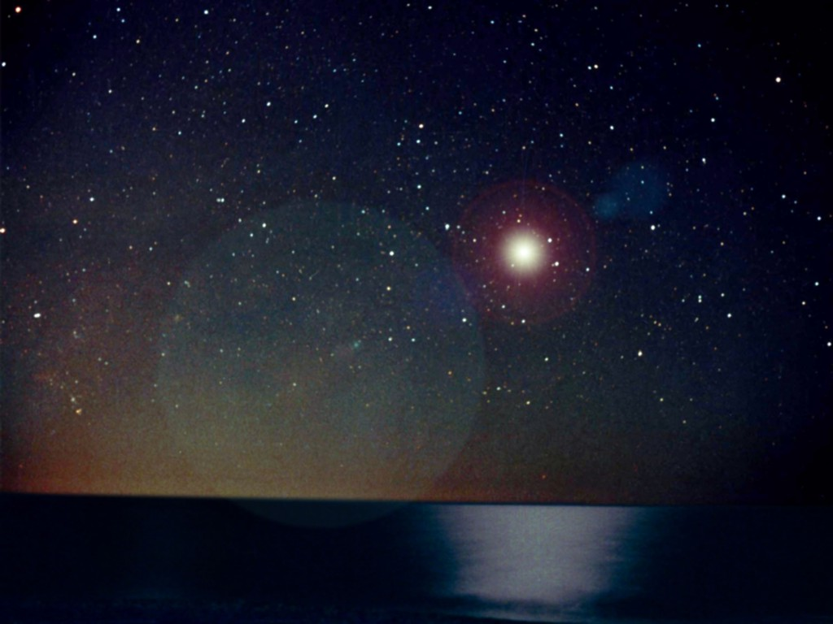
Flavor Oscillations
Neutrinos from Next Nearby SN

Slide 13
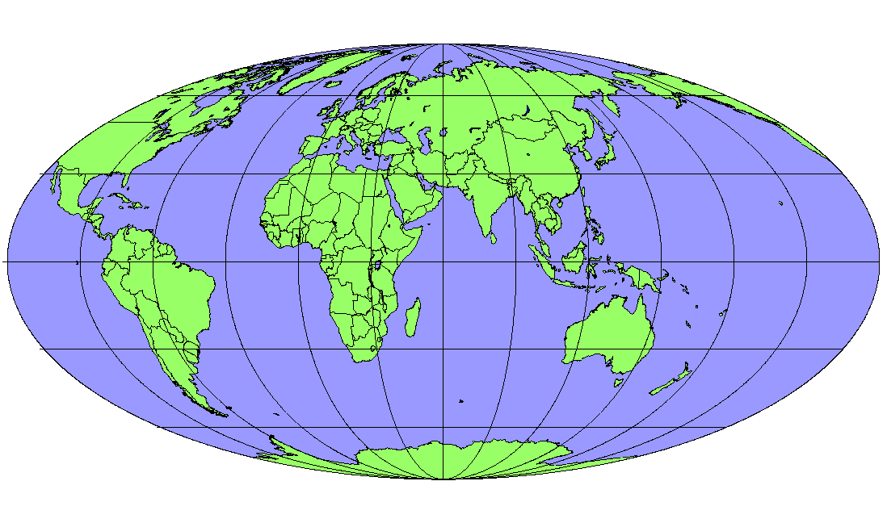
Operational Detectors for Supernova Neutrinos
MiniBooNE
(200)
LVD (400)
Borexino (100)
Baksan
(100)
Super-Kamiokande (10⁴)
KamLAND (400)
In brackets events
for a “fiducial SN”
at distance 10 kpc
IceCube (10⁶)

Slide 14
Flavor Oscillations
Supernova Rate

Slide 15
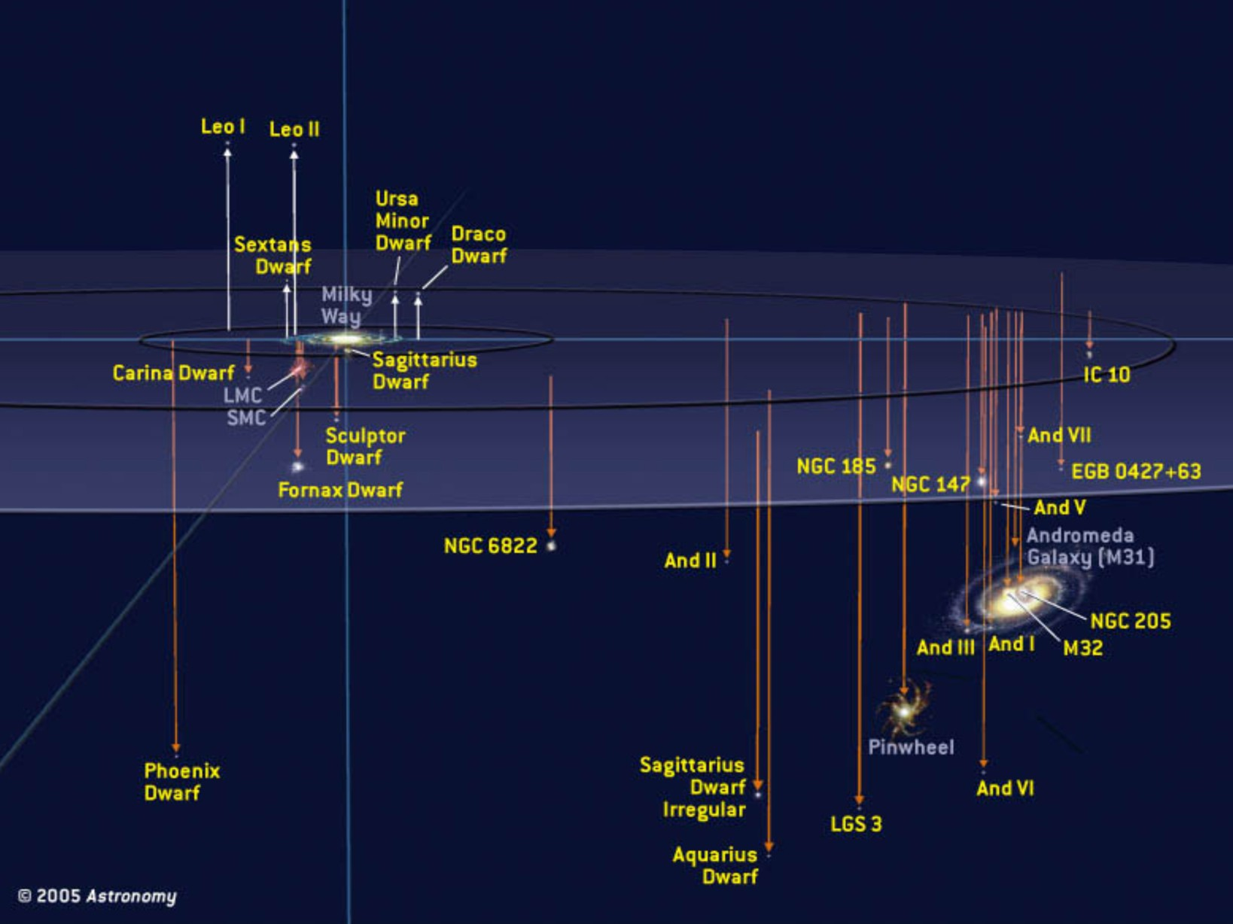
Local Group of Galaxies
With megatonne class (30 x SK)
60 events from Andromeda
Current best neutrino detectors
sensitive out to few 100 kpc

Slide 16
Core-Collapse SN Rate in the Milky Way
SN statistics in
external galaxies
van den Bergh & McClure
(1994)
Cappellaro & Turatto (2000)
Gamma rays from
²⁶Al (Milky Way)
Diehl et al. (2006)
Historical galactic
SNe (all types)
Strom (1994)
Tammann et al. (1994)
No galactic
neutrino burst
90 % CL (30 years)
Alekseev et al. (1993)
Core-collapse SNe per century
0
1
2
3
4
5
6
7
8
9
10
References: van den Bergh & McClure, ApJ 425 (1994) 205. Cappellaro & Turatto,
astro-ph/0012455. Diehl et al., Nature 439 (2006) 45. Strom, Astron. Astrophys. 288 (1994) L1.
Tammann et al., ApJ 92 (1994) 487. Alekseev et al., JETP 77 (1993) 339 and my update.

Slide 17
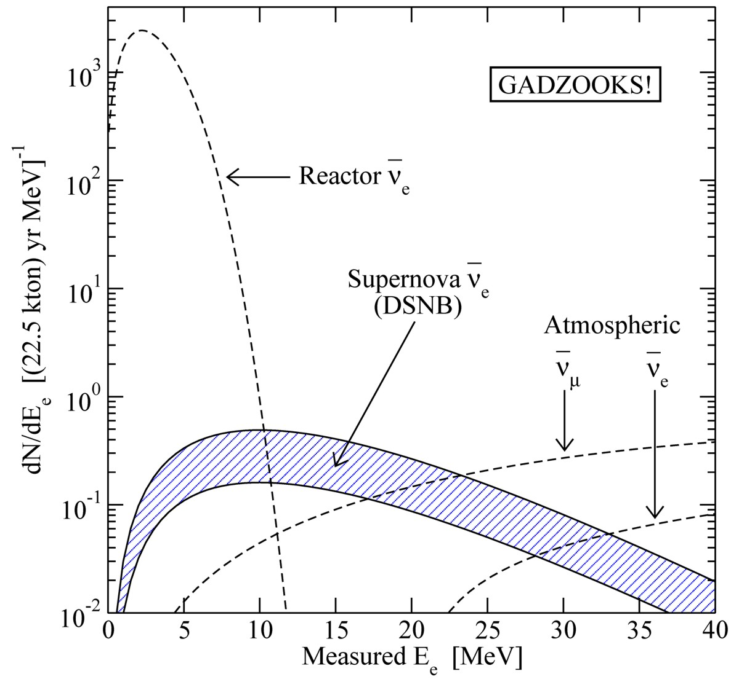
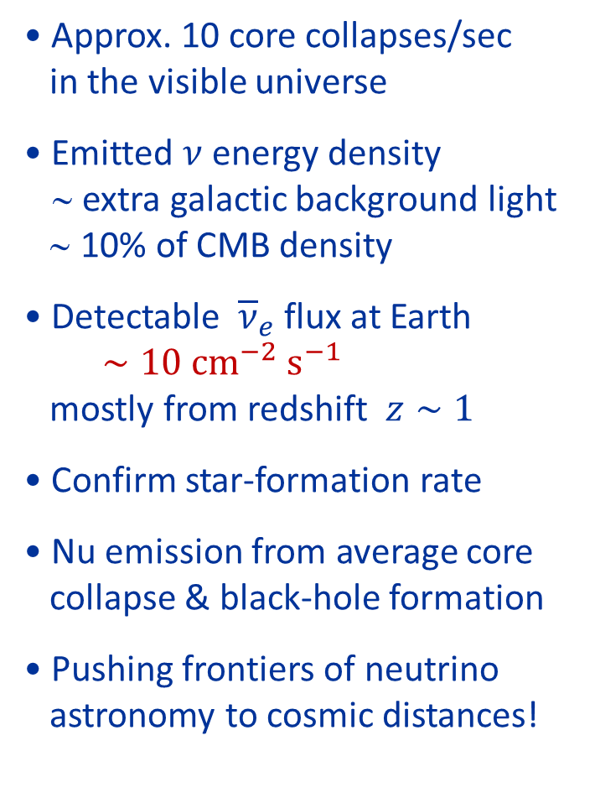
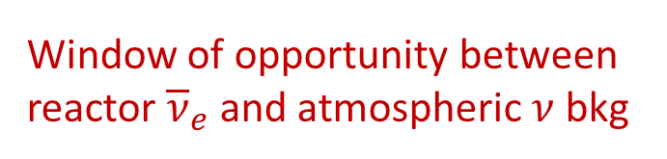
Diffuse Supernova Neutrino Background (DSNB)
• Approx. 10 core collapses/sec
in the visible universe
• Emitted $ν$ energy density
∼ extra galactic background light
∼ 10% of CMB density
• Detectable ${\overline{ν}}_{e}$ flux at Earth
$∼10 {\text{cm}}^{−2} {\text{s}}^{−1}$
mostly from redshift $z∼1$
• Confirm star-formation rate
• Nu emission from average core
collapse & black-hole formation
• Pushing frontiers of neutrino
astronomy to cosmic distances!
Beacom & Vagins,
PRL 93:171101,2004
Window of opportunity between
reactor ${\overline{ν}}_{e}$and atmospheric $ν$ bkg

Slide 18

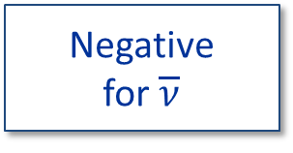
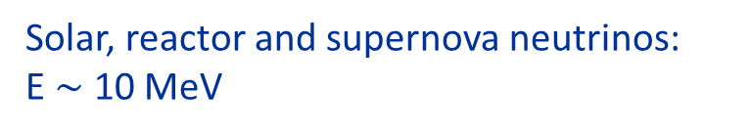
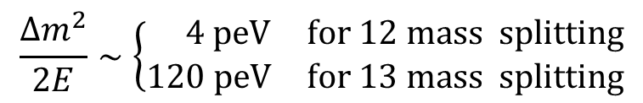
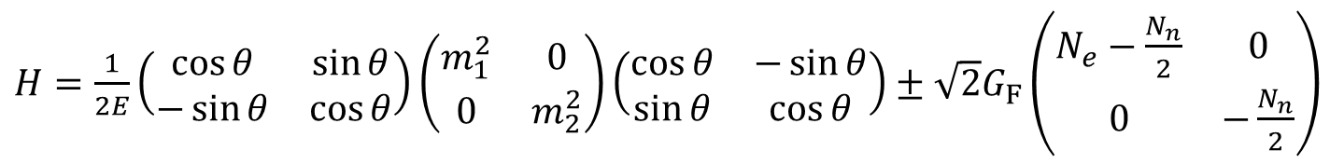
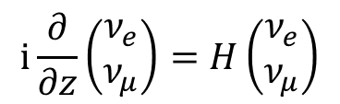
Neutrino Oscillations in Matter
2-flavor neutrino evolution as an effective 2-level problem
$$\text{i}\frac{∂}{∂z}\left(\begin{matrix}ν_{e} \\ ν_{μ}\end{matrix}\right)=H\left(\begin{matrix}ν_{e} \\ ν_{μ}\end{matrix}\right)$$
Negative
for $\overline{ν}$
With a 2×2 Hamiltonian matrix
$H=\frac{1}{2E}\left(\begin{matrix}\cos{θ} & \sin{θ} \\ −\sin{θ} & \cos{θ}\end{matrix}\right)\left(\begin{matrix}m_{1}^{2} & 0 \\ 0 & m_{2}^{2}\end{matrix}\right)\left(\begin{matrix}\cos{θ} & −\sin{θ} \\ \sin{θ} & \cos{θ}\end{matrix}\right)±\sqrt{2}G_{F}\left(\begin{matrix}N_{e}−\frac{N_{n}}{2} & 0 \\ 0 & −\frac{N_{n}}{2}\end{matrix}\right)$
Mass-squared matrix, rotated by
mixing angle θ relative to interaction
basis, drives oscillations
Weak potential difference
$ΔV_{weak}=\sqrt{2}G_{F}N_{e}∼0.2 \text{peV}$
for normal Earth matter, but
large effect in SN core
(nuclear density 3×10¹⁴ g/cm³)
$$ΔV_{weak}∼10 \text{eV}$$
$$\frac{Δm^{2}}{2E}∼\left\{\begin{matrix} 4 \text{p}\text{eV} & \text{for}\text{ 12 }\text{mass} \text{splitting} \\ 120 \text{peV} & \text{for}\text{ 13 }\text{mass} \text{splitting}\end{matrix}\right.$$
Solar, reactor and supernova neutrinos:
E $∼$ 10 MeV

Slide 19
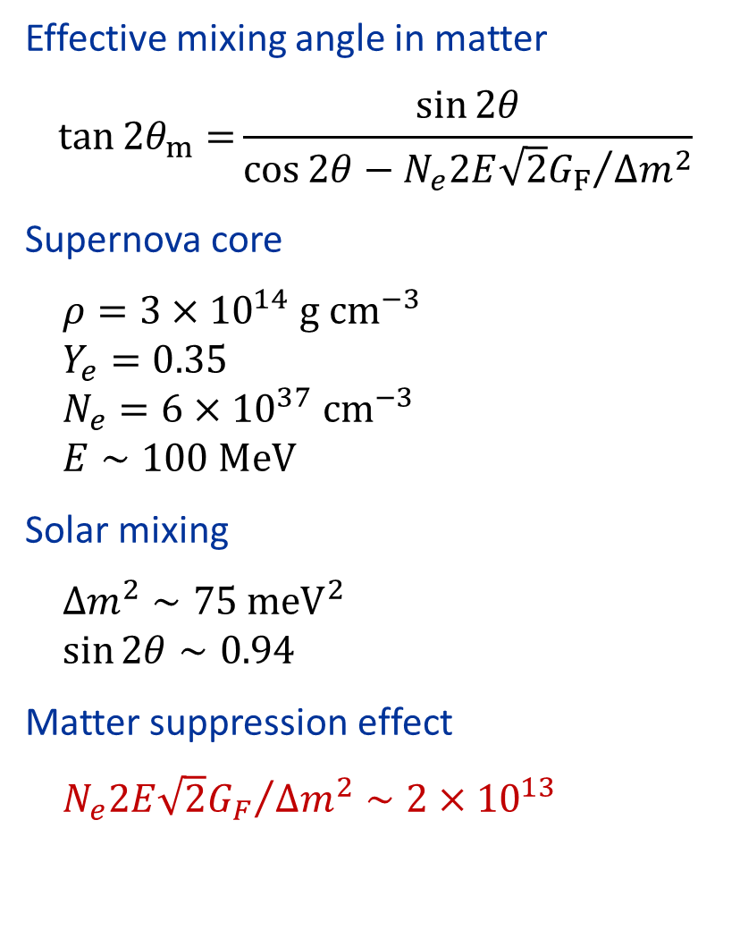

Suppression of Oscillations in Supernova Core
• Inside a SN core,
flavors are “de-mixed”
• Very small oscillation
amplitude
• Trapped e-lepton
number can only
escape by diffusion

Slide 20
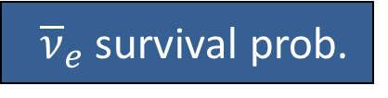




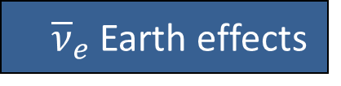
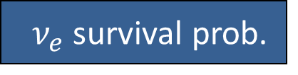



Signature of Flavor Oscillations
1-3-mixing scenarios
A
B
C
Mass ordering
Normal (NH)
Inverted (IH)
Any (NH/IH)
$\sin^{2}{θ_{13}}$
$≳{10}^{−3}$
$$≲{10}^{−5}$$
MSW conversion
adiabatic
non-adiabatic
$ν_{e}$ survival prob.
0
$$\sin^{2}{θ_{12}}≈0.3$$
$$\sin^{2}{θ_{12}}≈0.3$$
${\overline{ν}}_{e}$ survival prob.
$$\cos^{2}{θ_{12}}≈0.7$$
0
$$\cos^{2}{θ_{12}}≈0.7$$
${\overline{ν}}_{e}$Earth effects
Yes
No
Yes
May distinguish mass ordering
Assuming collective effects are not important during accretion phase
(Chakraborty et al., arXiv:1105.1130v1)

Slide 21
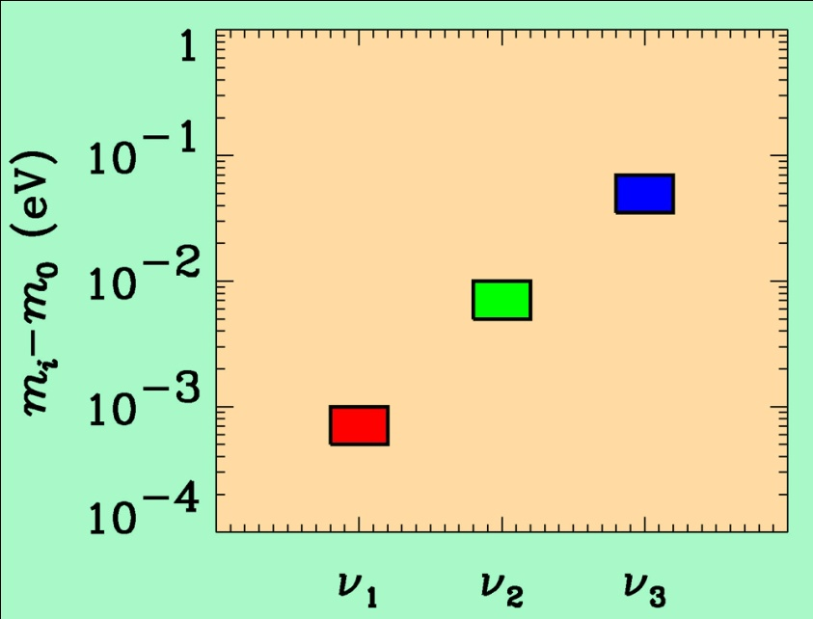
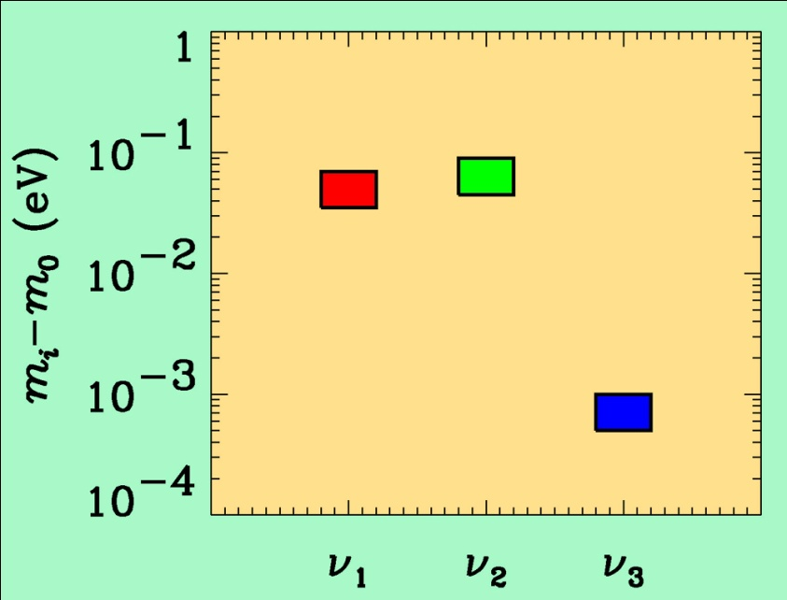
If neutrino masses are hierarchical then oscillation experiments
do not give information on the absolute value of neutrino masses
ATMO. ν
K2K
MINOS
SOLAR ν
KAMLAND
Normal hierarchy
Inverted hierarchy
If neutrino masses are degenerate
no information can be gained from such experiments.
Experiments which rely on either the kinematics of neutrino mass
or the spin-flip in neutrinoless double beta decay are the most
efficient for measuring m₀

Slide 22
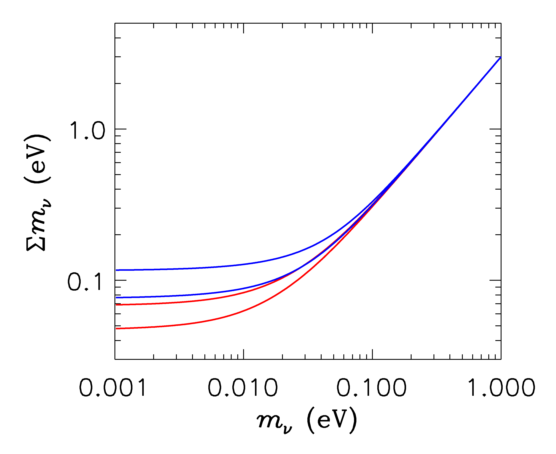
HIERARCHICAL
DEGENERATE
INVERTED
NORMAL
LIGHTEST

Slide 23
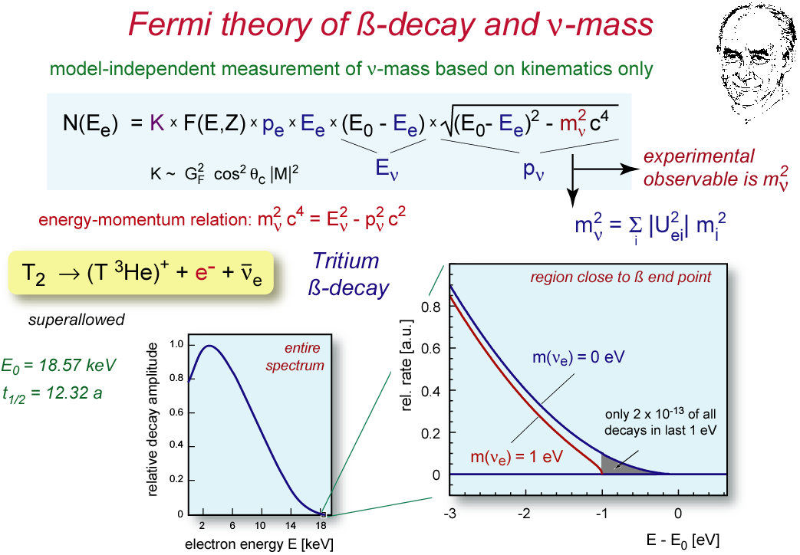
ß-decay and neutrino mass
model independent neutrino mass from ß-decay kinematics
only assumption: relativistic energy-momentum relation
experimental observable is m_{ν}²
T₂:
E₀ = 18.6 keV
T_{1/2} = 12.3 y

Slide 24
Tritium decay endpoint measurements have provided limits
on the electron neutrino mass
Mainz experiment, final analysis (Kraus et al.)
This translates into a limit on the sum of the three mass
eigenstates

Slide 25
NEUTRINO MASS AND ENERGY DENSITY
FROM COSMOLOGY
NEUTRINOS AFFECT STRUCTURE FORMATION
BECAUSE THEY ARE A SOURCE OF DARK MATTER
(n ~ 100 cm⁻³)
FROM
HOWEVER, eV NEUTRINOS ARE DIFFERENT FROM CDM
BECAUSE THEY FREE STREAM
SCALES SMALLER THAN d_{FS} DAMPED AWAY, LEADS TO
SUPPRESSION OF POWER ON SMALL SCALES

Slide 26
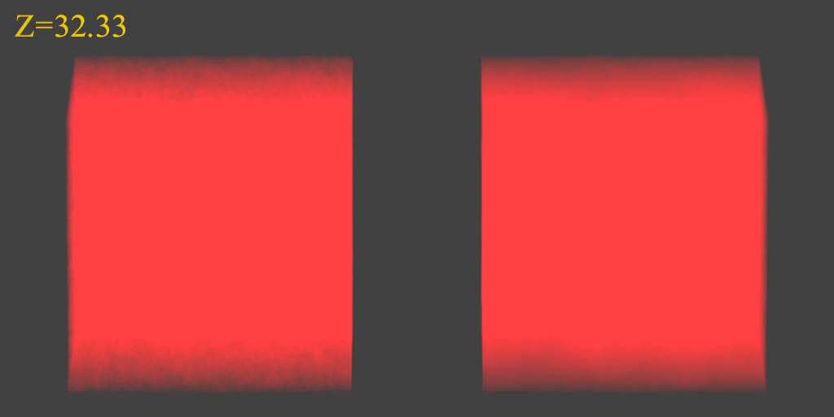
N-BODY SIMULATIONS OF ΛCDM WITH AND WITHOUT
NEUTRINO MASS (768 Mpc³) – GADGET 2
256
Mpc
Haugboelle & STH, Aarhus University

Slide 27
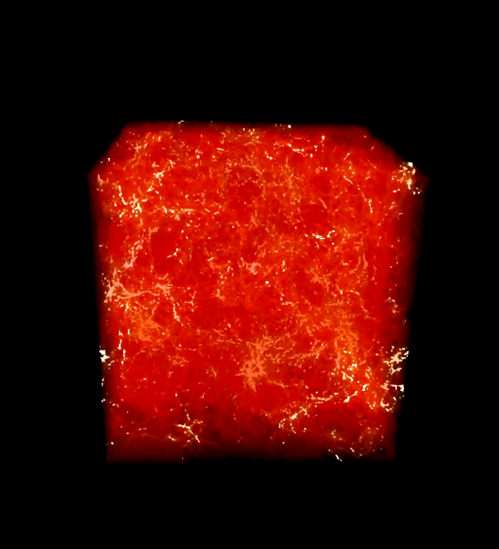
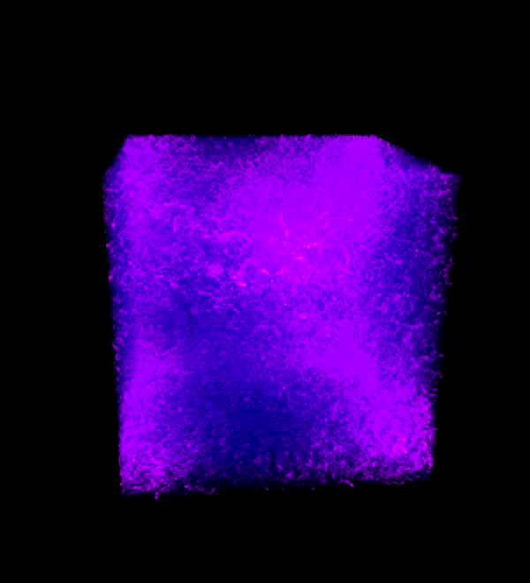
SIMULATION WITH
DARK MATTER
NEUTRINOS
STH, HAUGBØLLE, RIIS & SCHULTZ (IN PREPARATION)

Slide 28
AVAILABLE COSMOLOGICAL DATA

Slide 29
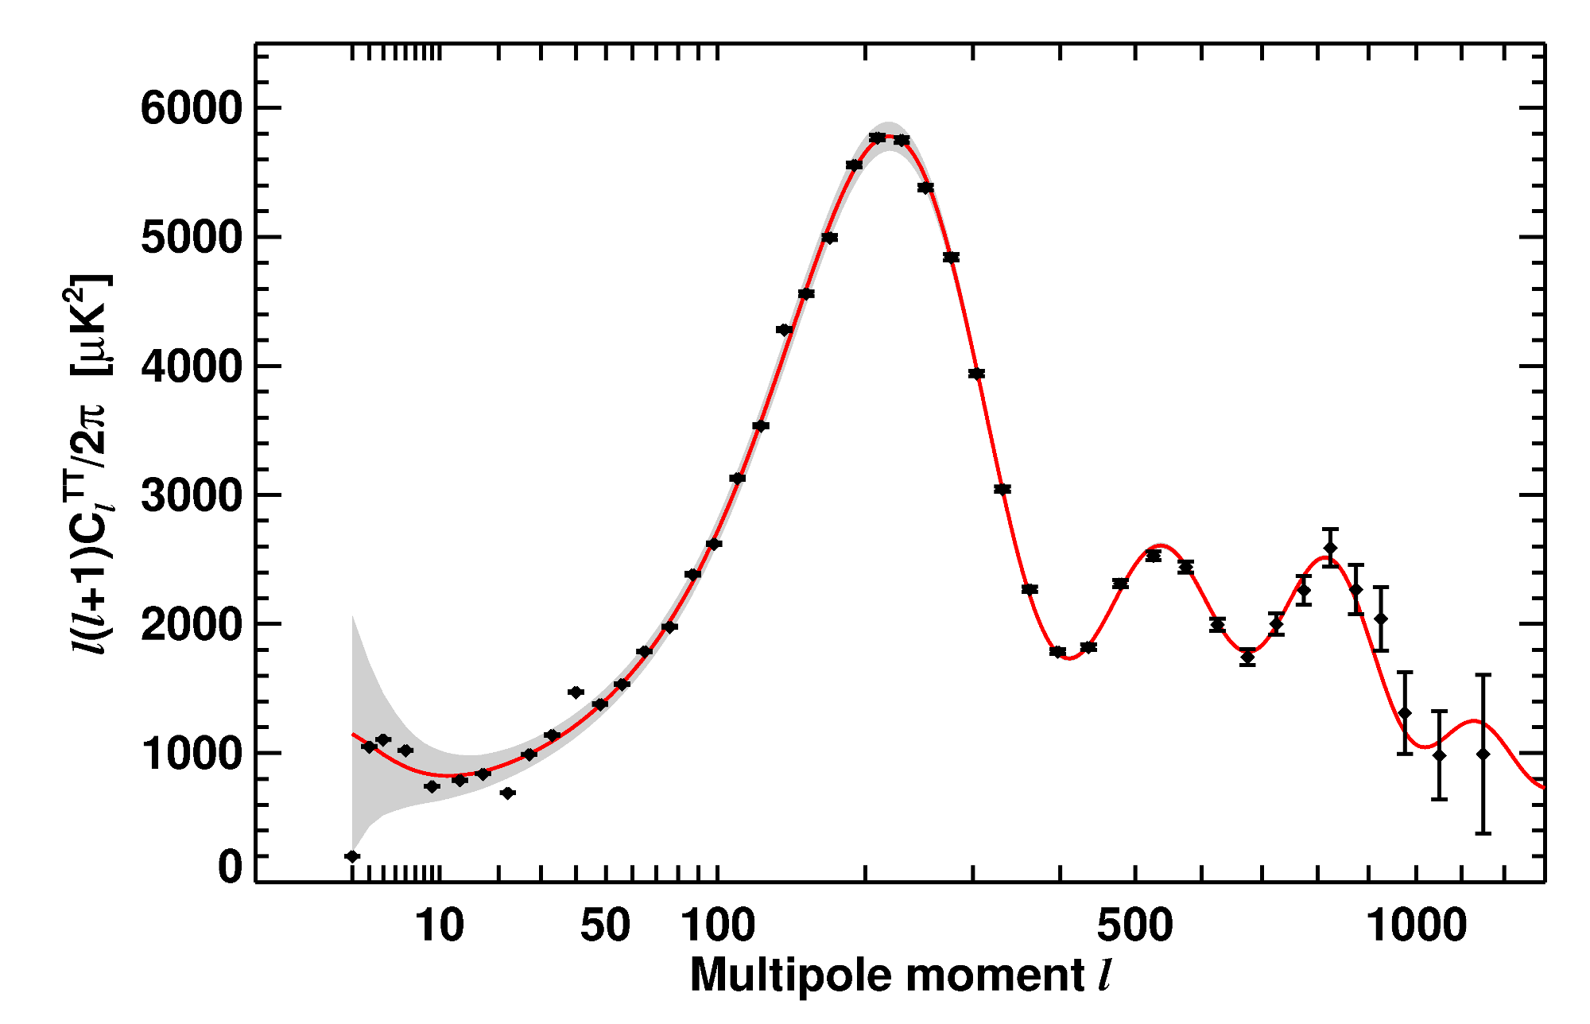
WMAP-7 TEMPERATURE POWER SPECTRUM
LARSON ET AL, ARXIV 1001.4635

Slide 30
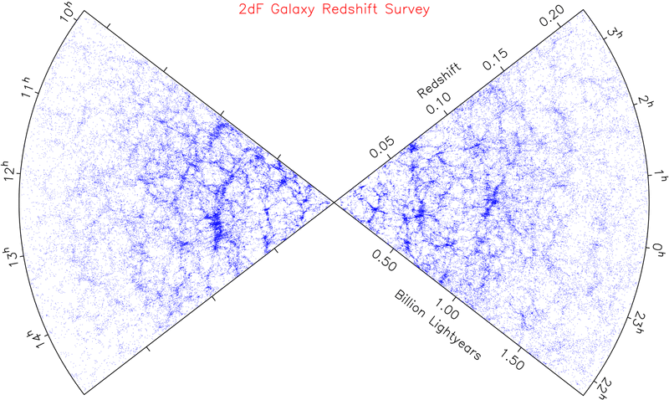
LARGE SCALE STRUCTURE SURVEYS - 2dF AND SDSS

Slide 31
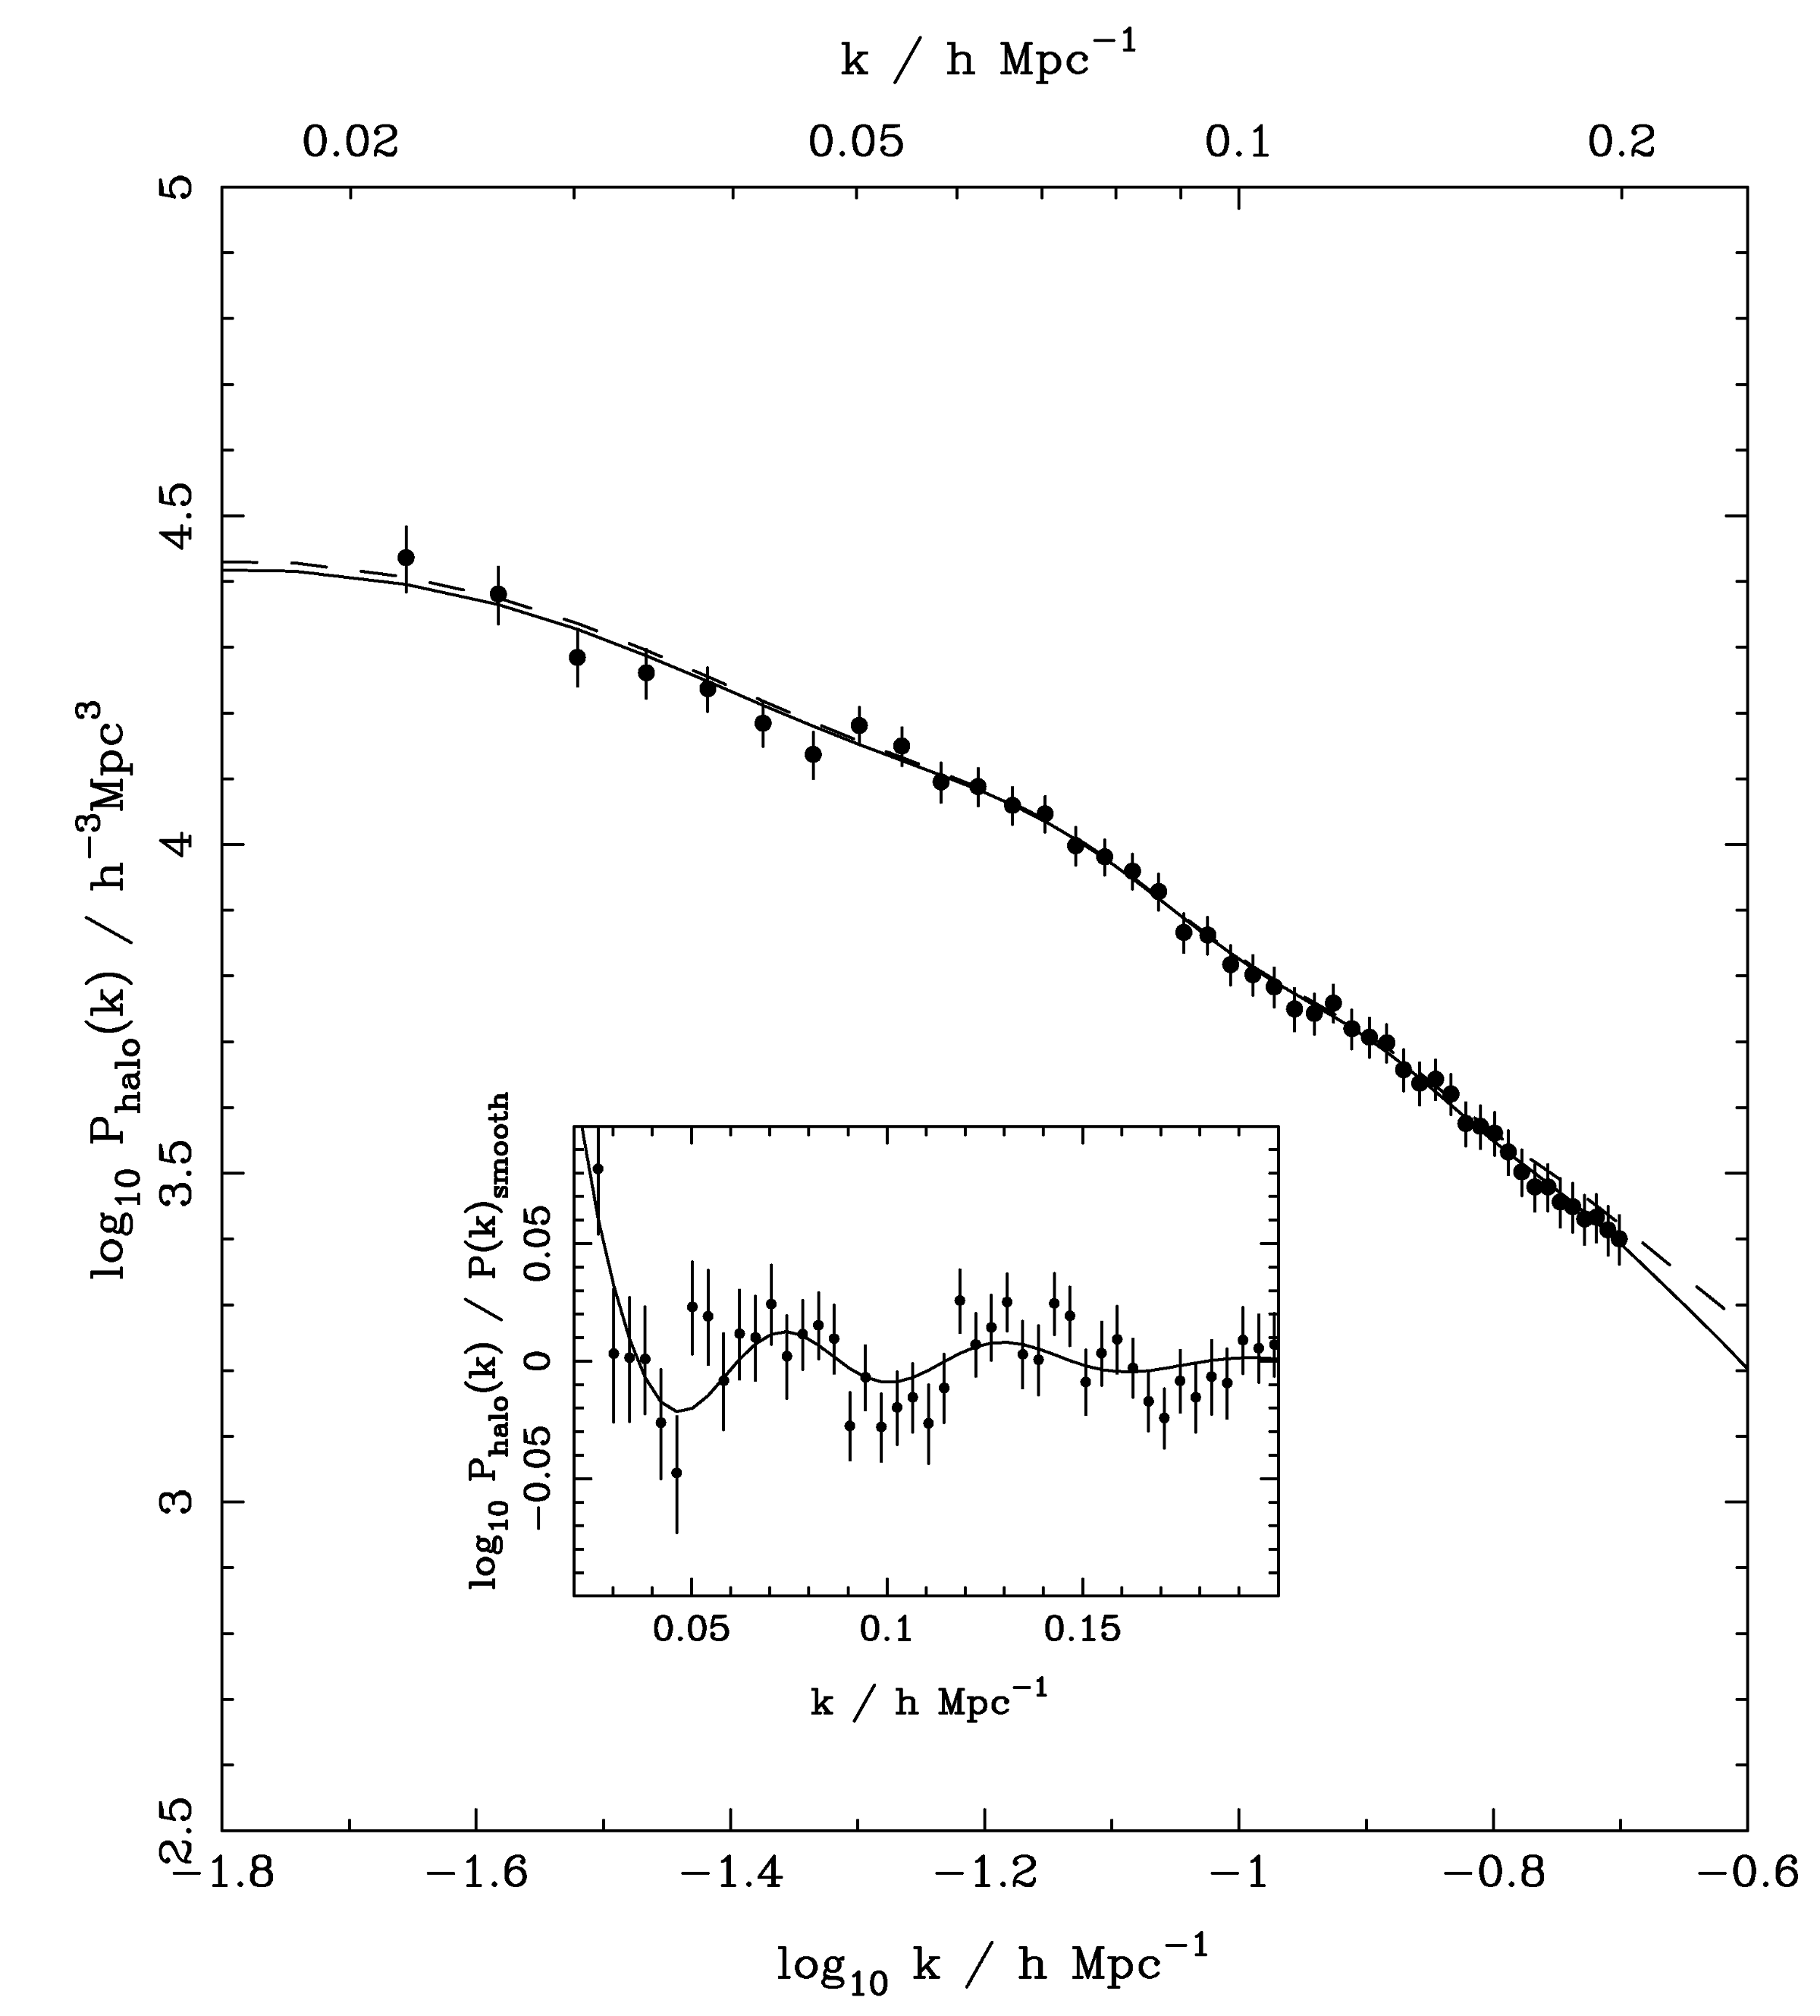
SDSS DR-7
LRG SPECTRUM
(Reid et al ’09)

Slide 32
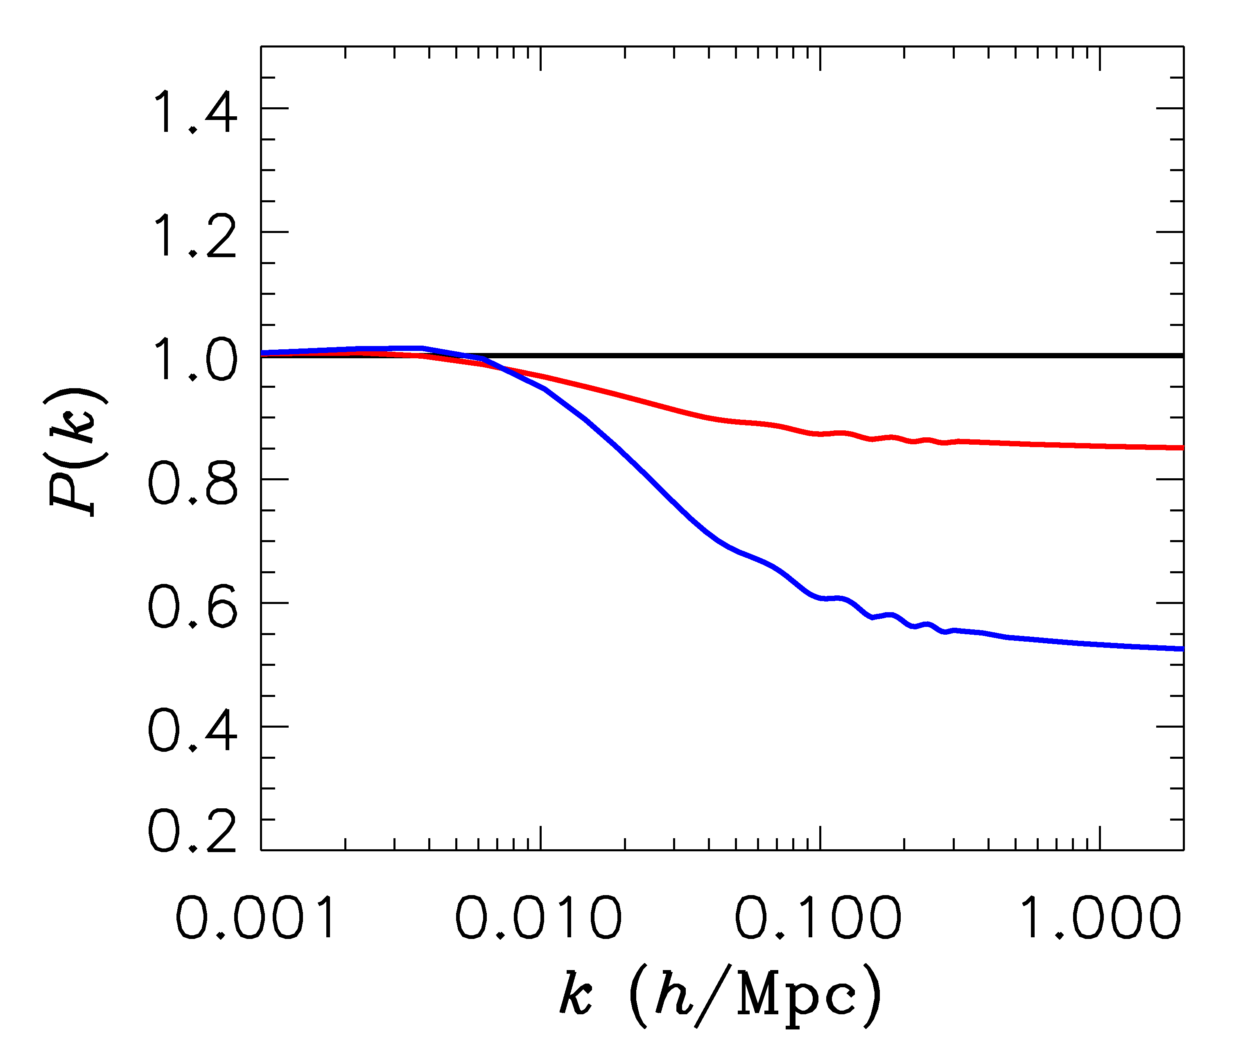
FINITE NEUTRINO MASSES SUPPRESS THE MATTER POWER
SPECTRUM ON SCALES SMALLER THAN THE FREE-STREAMING
LENGTH
Sm = 0 eV
P(k)/P(k,m_{ν}=0)
Sm = 0.3 eV
Sm = 1 eV

Slide 33
NOW, WHAT ABOUT NEUTRINO
PHYSICS?

Slide 34
WHAT IS THE PRESENT BOUND ON THE NEUTRINO MASS?
DEPENDS ON DATA SETS USED AND ALLOWED PARAMETERS
THERE ARE MANY ANALYSES IN THE LITERATURE
USING THE MINIMAL COSMOLOGICAL
MODEL
STH, MIRIZZI, RAFFELT, WONG (arxiv:1004:0695)
HAMANN, STH, LESGOURGUES, RAMPF & WONG (arxiv:1003.3999)
JUST ONE EXAMPLE

Slide 35


THE NEUTRINO MASS FROM COSMOLOGY PLOT
More data
+Ly-alpha
~ 0.2 eV
0.2-0.3 eV
0.2-0.3 eV
+ SNI-a
+WL
~ 0.5 eV
0.5-0.6 eV
0.5-0.6 eV
+ SDSS
0.6 eV
~ 1 eV
1-2 eV
CMB only
1.1 eV
~ 2 eV
2.? eV
??? eV
Minimal
ΛCDM
+N_{ν}
+w+……
Larger model
space

Slide 36

Gonzalez-Garcia et al., arxiv:1006.3795

Slide 37
WHAT IS N_{ν}?
A MEASURE OF THE ENERGY DENSITY IN NON-INTERACTING
RADIATION IN THE EARLY UNIVERSE
THE STANDARD MODEL PREDICTION IS
Mangano et al., hep-ph/0506164
BUT ADDITIONAL LIGHT PARTICLES (STERILE NEUTRINOS,
AXIONS, MAJORONS,…..) COULD MAKE IT HIGHER

Slide 38

TIME EVOLUTION OF
THE 95% BOUND ON
N_{ν}
Pre-WMAP
WMAP-1
WMAP-3
WMAP-5
WMAP-7
ESTIMATED PLANCK
SENSITIVITY

Slide 39
A STERILE NEUTRINO IS PERHAPS THE MOST OBVIOUS CANDIDATE
FOR AN EXPLANATION OF THE EXTRA ENERGY DENSITY
Hamann, STH, Raffelt, Tamborra, Wong, arxiv:1006.5276 (PRL)
ASSUMING A NUMBER OF ADDITIONAL STERILE STATES OF
APPROXIMATELY EQUAL MASS, TWO QUALITATIVELY DIFFERENT
HIERARCHIES EMERGE
ν_{s}
ν_{A}
ν_{A}
ν_{s}
3+N
N+3

Slide 40
WHAT IS IN STORE FOR THE FUTURE?
BETTER CMB TEMPERATURE AND POLARIZATION
MEASUREMENTS (PLANCK)
LARGE SCALE STRUCTURE SURVEYS AT HIGH
REDSHIFT
MEASUREMENTS OF WEAK GRAVITATIONAL LENSING
ON LARGE SCALES

Slide 41




WEAK LENSING – A POWERFUL PROBE FOR THE FUTURE
Distortion of background images by foreground matter
Unlensed Lensed

Slide 42

EUCLID
ESA M-CLASS MISSION
2020-25

Slide 43

STH, TU & WONG 2006

