Slide 1
Near and far future at J-PARC neutrino beam
(30min incl. discussion)
110607
GLA11
Jyvaskyla
Finland
Takashi Kobayashi
KEK

Slide 2
Contents
Introduction
  J-PARC & T2K
Achievements
Earthquake damages and recovery plan
Future upgrade plan
  Physics program
  J-PARC upgrade
  Detector options
  R&D status
Summary

Slide 3
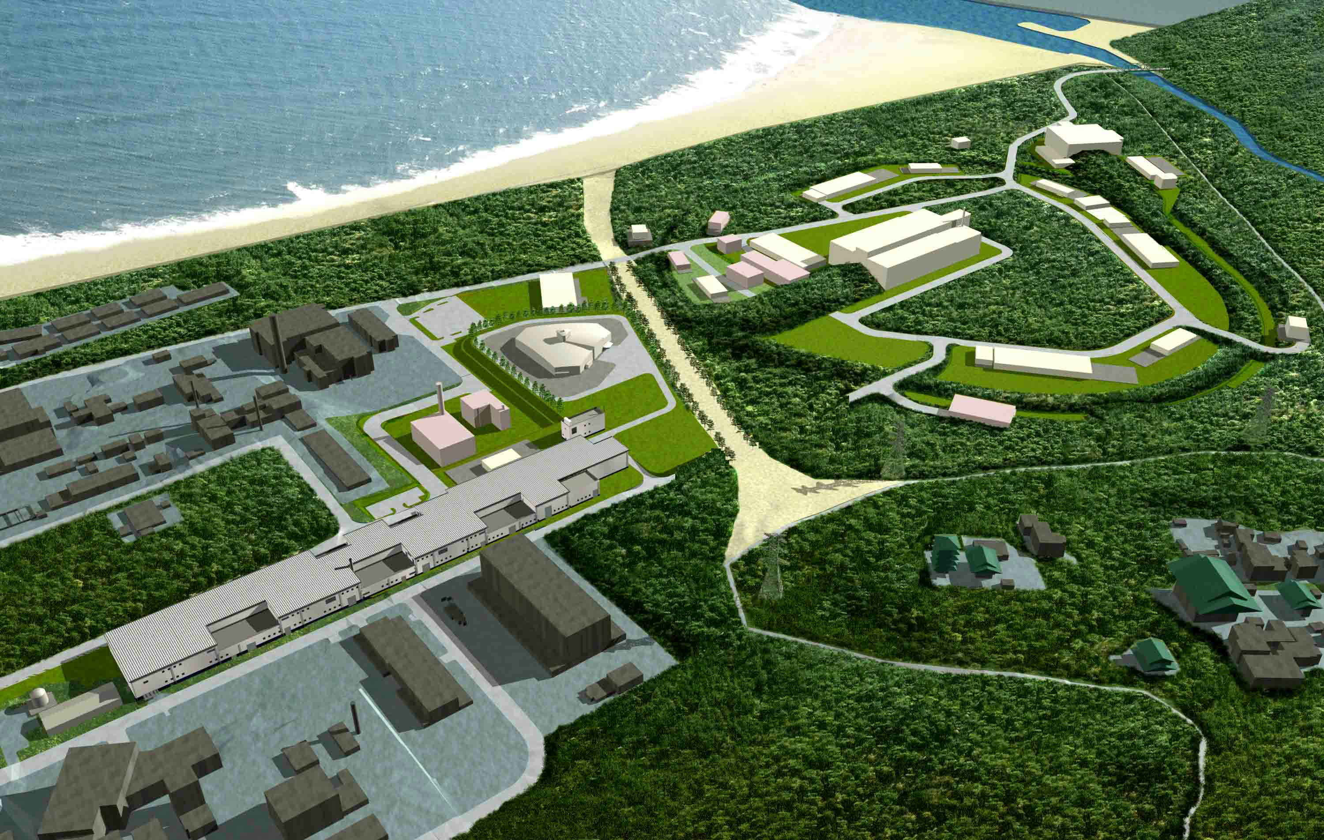
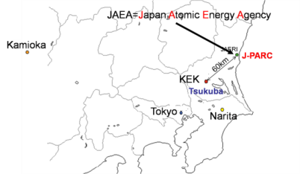
J-PARC
Japan Proton Accelerator Research Complex
Joint Project between KEK and JAEA
Slow Extracted Beam Facility
Materials and Life Science
Experimental Facility
Hadron Beam Facility
Neutrino to Kamiokande
Main Ring
(30 GeV, 0.3 Hz,
0.75 MW→ 1.66 MW)
Linac
180→400 MeV
Rapid Cycling Synchrotron
(3GeV, 25 Hz, 1MW)
Construction: JFY01~08 (Neutrino: JFY04~08)

Slide 4
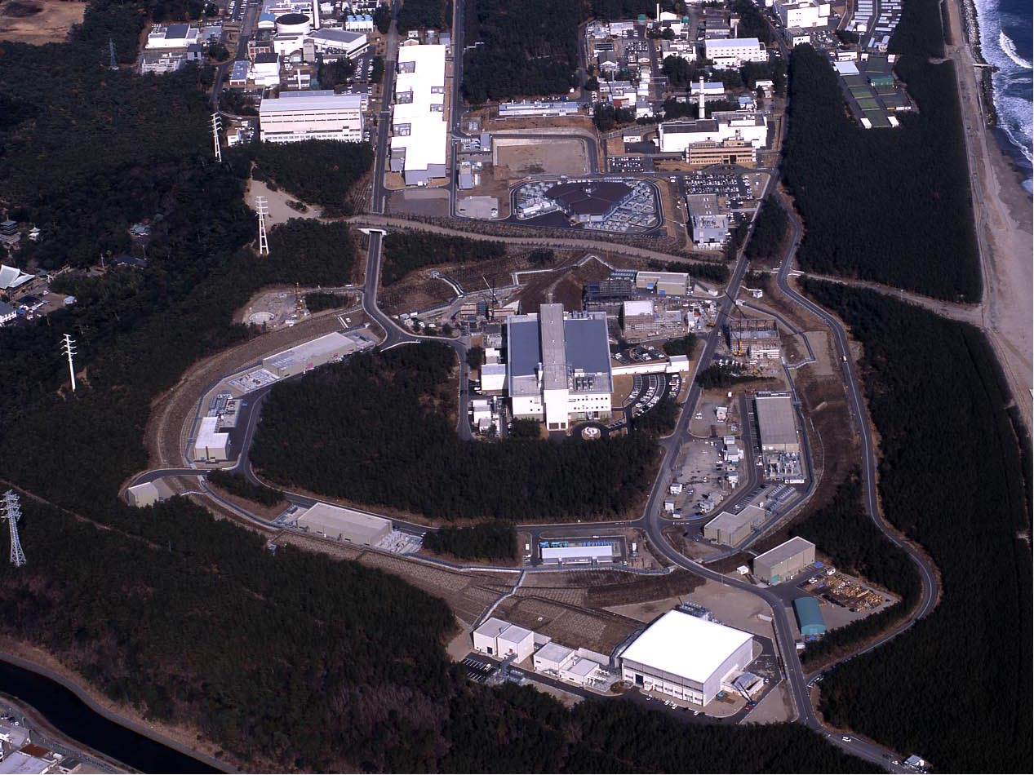
Construction
JFY2001~2008
J-PARC Facility
(KEK/JAEA）
Linac
South to North
3 GeV Synchrotron
Neutrino Beams (to Kamioka)
Design Intensity
750kW
Main ring
CY2007 Beams
JFY2008 Beams
JFY2009 Beams
Bird’s eye photo in January of 2008
Notes:
以上、加速器の現状を述べましたが、それでは，この施設を用いてどんな研究を展開するのかという話題に移りたいと思います。
この写真はさっきの写真とよく似ておりますが、実験室がよく見えるように、逆方向の南から北方向を眺めたものです。
本年度末には、物質生命科学実験施設とハドロン実験施設において実験が始まります。そして、来年度早々には、ニュートリノビームを神岡の方に送ることにしております。
実験室としては３つありますので、それぞれでどんな科学が展開されるのかをザッと眺めたいと思います。

Slide 5
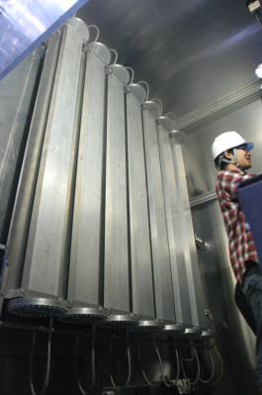
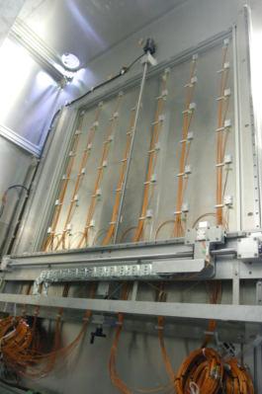
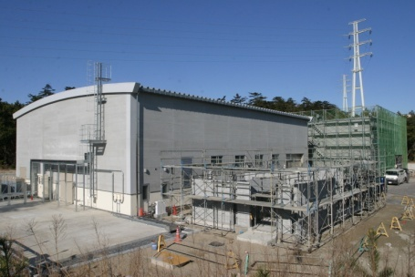
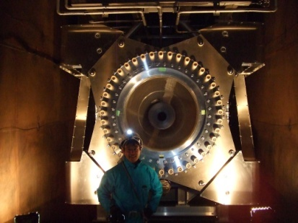
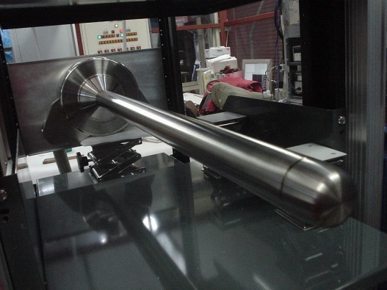
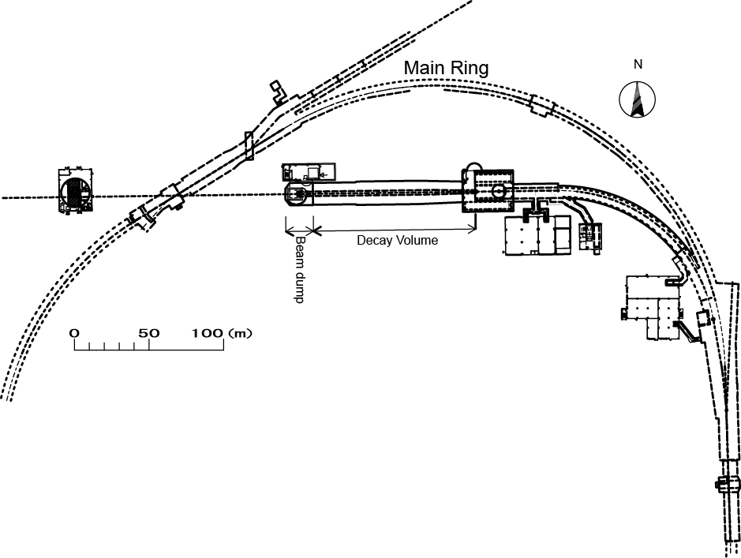
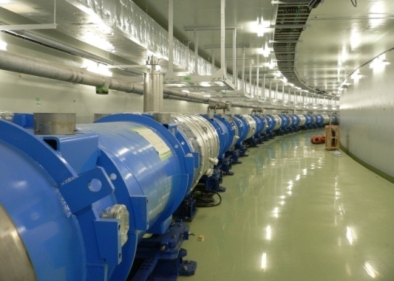
Neutrino facility at J-PARC
Muon monitors
Helium gas cooled
Graphite Target
Neutrino monitor bld.
Electromagnetic horn
First >1MW tolerable superbeam facility in the world
First application of off-axis beam
Major components
  Superconducting combined function magnets
  Graphite target (26mmφx90cm, Helium gas cooling)
  3 horns @ 250kA
  110m of decay volume
  Graphite beam dump
Primary beamline (superconducting)
5

Slide 6
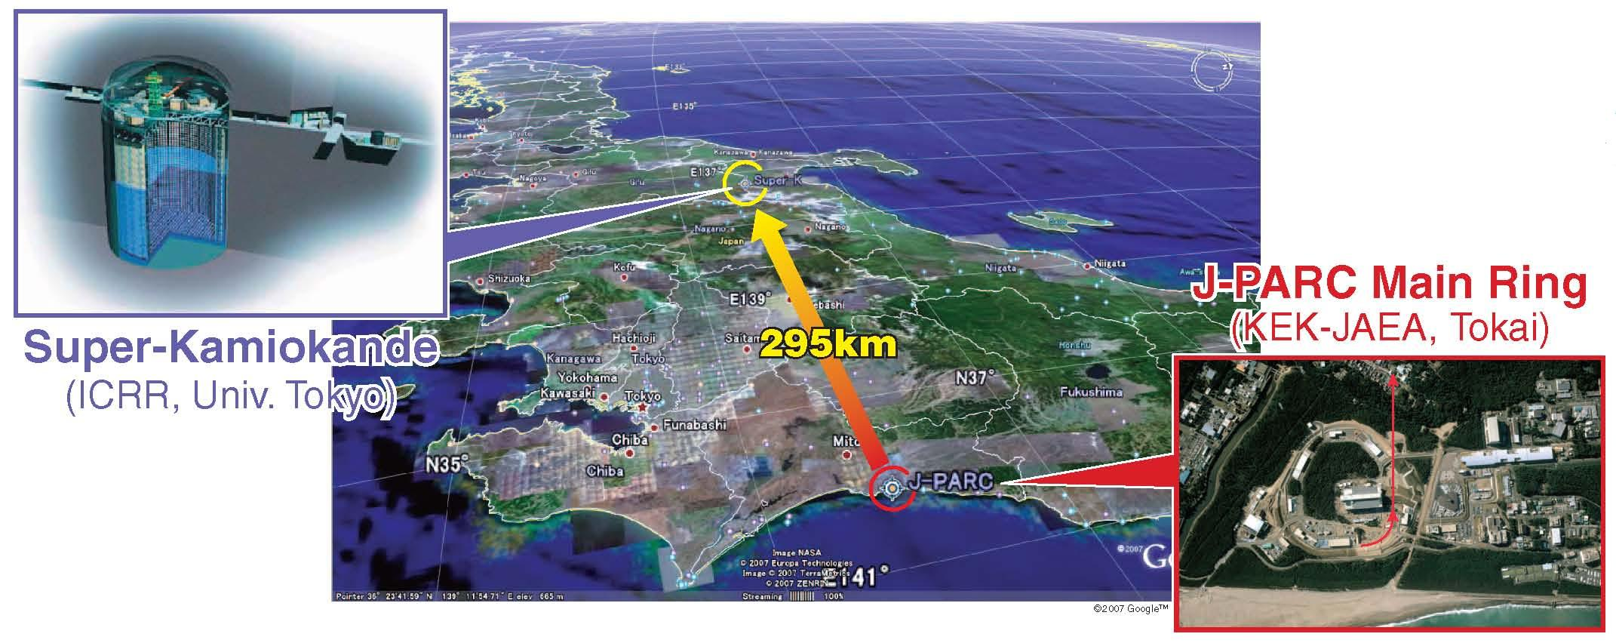
Tokai-to-Kamioka (T2K) experiment
The 1st experiment w/ J-PARC ν facility
High intensity ν_{μ} beam from J-PARC MR to Super-Kamiokande @ 295km
Discovery of νe appearance → Determine θ₁₃
  Last unknown mixing angle
  Open possibility to explore CPV in lepton sector
Precise meas. of ν_{μ} disappearance → θ₂₃, Δm₂₃²
  Really maximum mixing? Any symmetry? Anything unexpected?

Slide 7
Contents
Introduction
  J-PARC & T2K
Achievements
Earthquake damages and recovery plan
Future upgrade plan
  Physics program
  J-PARC upgrade
  Detector options
  R&D status
Summary

Slide 8
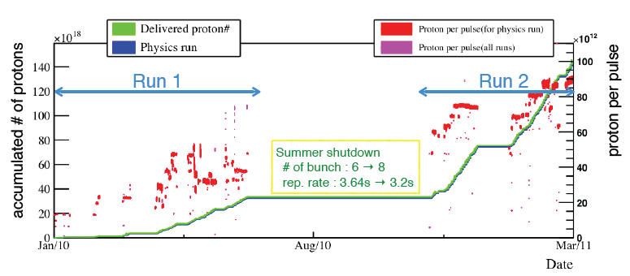
Status of T2K
145kW
Started physics data taking in Jan. 2010
Beam power has been increasing, reached 145 kW stable operation (~0.9x10¹⁴ p/pulse)
  # of bunches: 8→ 6 w/ new FX kickers
  Rep. rate : 3.64s → 3.02s
1.43x10²⁰ p accumulated until Mar.11, 2011

Slide 9
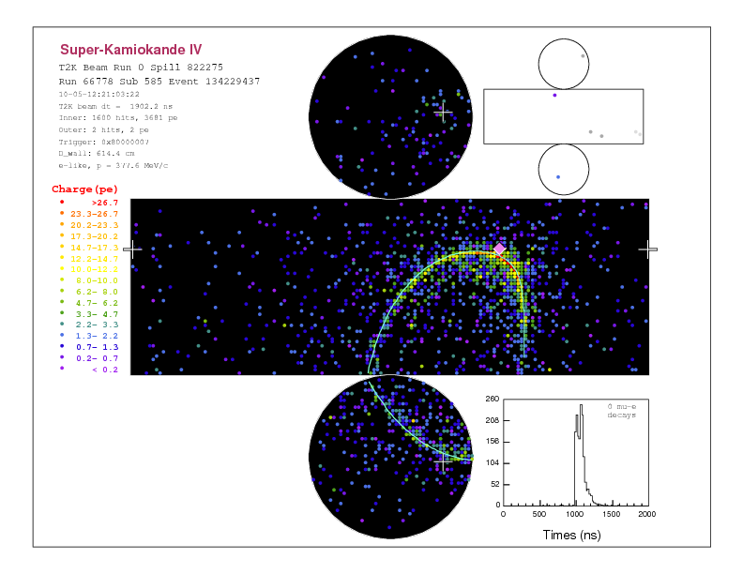
T2K First physics results
Based on data before Summer 2010 (0.32x10²⁰pot)
Nue appearance search results
  # of sig. cand. : 1
  # of exp’ed BG: 0.30±0.07
  Upper bound on mixing angle θ₁₃ is given
We have 4.5 times more data → Results in this summer

Slide 10
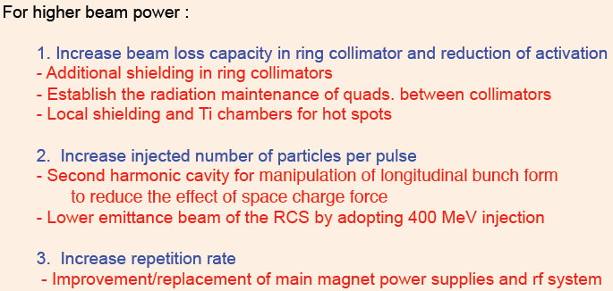
Present Power limitation in accelerator
Beam loss
  Need to control beam loss to keep radio-activation level of components
  Injection part/timing is biggest source
    Requiremets <~200W loss (450W capacity of collimator + some safety factor)
Present bottle neck
  Injection kicker magets in MR
    Dirty pulse shape produces beam loss
    Will be replaced during this shutdown

Slide 11
Higher power for neutrino facility
Beamline is designed for
  750kW@50GeV with >3 safety margin (can run 1.7MW w/o major upgrade)
  >~3MW for parts which can never be replaced
We have ran 145kW max, and ~70kWx10⁷s integ.
We have not suffered from O(100kW) operation on heat load or thermal shock stress
Rather, we have been facing issues on radio-activation
  Target and horns are activated at 1Sv/h level
    Remote maintenance in hot cell is needed AS PLANNED
    Remote maintenance rehearsal done last summer, first real replacement will be made this summer
  Radio-activated air
    Regulation: ⁴¹Ar<0.5mBq/cc in every exhaust stacks
    Limiting beam power upto ~200kW now
    Hermeticity and Air cond configuration will be improved
  Tritium in He vessel
    <5mBq/cc for exhaust and <20mBq/cc for working environment
    Right after operation, O(1000mBq/cc) → ~300mBq/cc by several ventilations
  Radio-activated water
    Used for cooling of Horn, He vessel, DV, beam dump
    Regulation:³H<60Bq/cc and ⁷Be<30Bq/cc if disposed to ocean
    → O(50) dilution and 20 times disposal works required
  All can be handled, but when we go >1MW, additional facility to handle radiation issues might be necessary

Slide 12
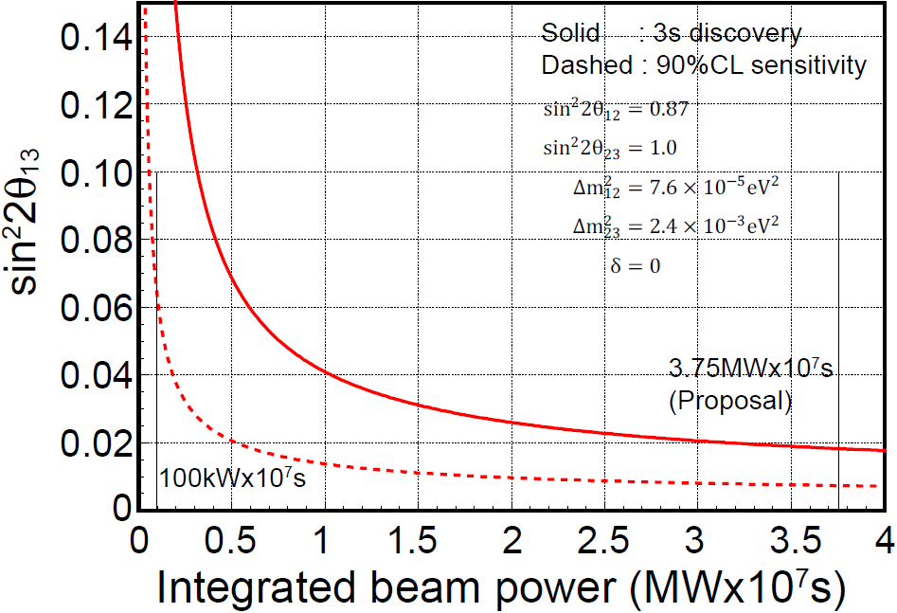
T2K goal: Discovery of ν_{e} appearance
Approved：3750(750ｘ5) [kWx10⁷s]
(~8x10²¹POT)
3σ discov. > sin²2θ₁₃=0.018
Turning point
  ~1000 [kWx10⁷s]
Curr. Upper bound
3σ
10⁷s=2800hr
=116days
90%CL
~1MWx10⁷s

Slide 13
Contents
Introduction
  J-PARC & T2K
Achievements
Earthquake damages and recovery plan
Future upgrade plan
  Physics program
  J-PARC upgrade
  Detector options
  R&D status
Summary

Slide 14
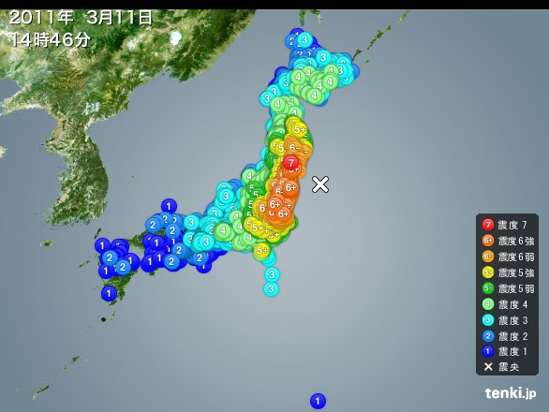
Earthquake on Mar. 11th
Happened at 14:46 on Mar. 11th
  Magnitude 9.0 in Richter scale
  Seismic intensity 6+ at Tokai
  No Tsunami reached to J-PARC
  All of electric power was stopped
  Maintenance day=Acc. not operated
Damages
  Lots of subsidence happened here&there
    LINAC tunnel sunk ~4cm at maximum, tunnel is bent
    RCS elec-power facility ground sink damaged the facility
    Big water leak into MR tunnel by big cracks ➔ mostly fixed
    1~2m drop of surrounding ground of neutrino facility
  No fatal damages found on accelerator & beamline components
Recovery work is accelerating
  Mar-Apr: Inspection
  Apr- : Ope test/recovery

Slide 15
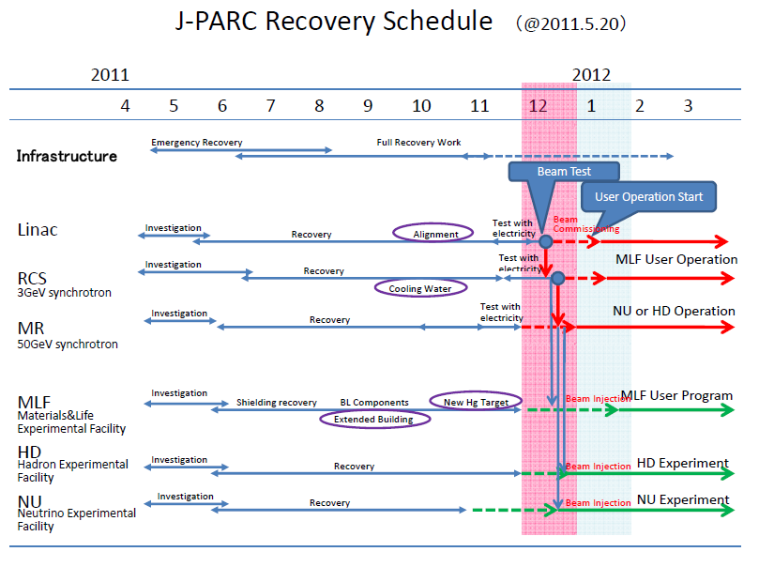
We will resume the beam within 2011
Will make every efforts to make it earlier
Will run beam >2 “cycle” ~ 2month in JFY2011 (until Mar. 2011)

Slide 16
Contents
Introduction
  J-PARC & T2K
Achievements
Earthquake damages and recovery plan
Future plan
Summary

Slide 17
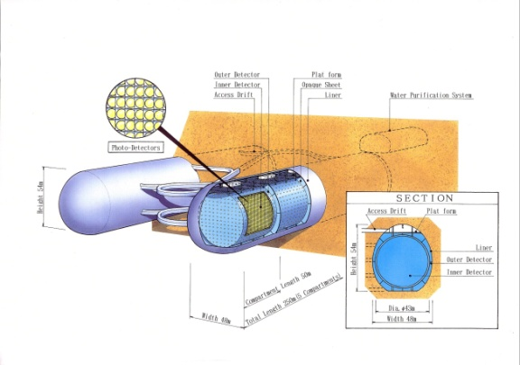
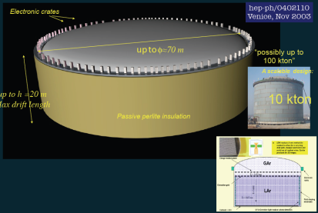
Quest for the Origin of Matter Dominated Universe
One of the Main Subject of the KEK Roadmap
Discovery of
the ν_{e} Appearance
T2K
(2009~)
Discovery of
Lepton CP Violation
Proton Decay
Neutrino
Intensity Improvement
Establish
Huge Detector
Technology
Huge Detector R&D
Construction of
Huge Detector
v
Water Cherenkov
Liquid Ar TPC
Notes:
17

Slide 18
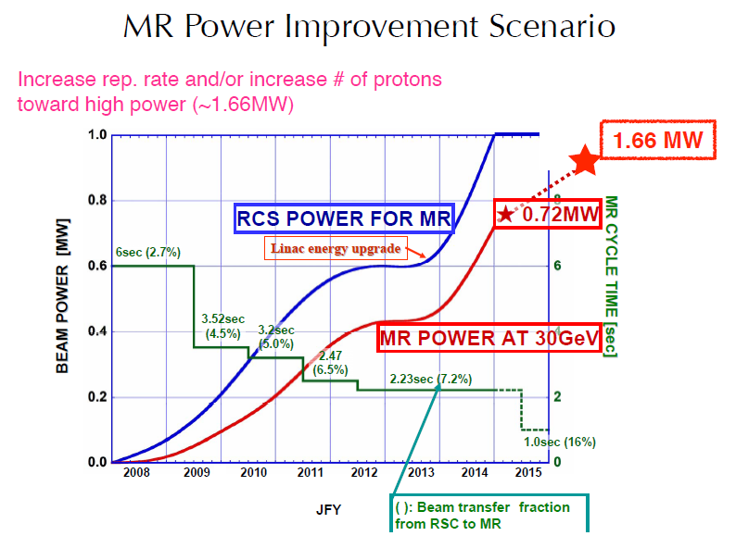
Studies and R&D on Power supply, RF configuration, etc are being made

Slide 19
MR Power Improvement Scenario toward MW-class power frontier machine
― KEK Roadmap ―
 | Day1 (up to Mar.2011) | Next Step | KEK Roadmap
Power(MW) | 0.145 | 0.45 | >1.66
Energy(GeV) | 30 | 30 | 30
Rep Cycle(sec) | 3.04 | 2.2 | 1.92～0.5
No. of Bunch | 8 | 8 | 8
Particle/Bunch | 1.2×10¹³ | 2.5×10¹³ | 4.1～8.3×10¹³
Particle/Ring | 9.2×10¹³ | 2.0×10¹⁴ | 3.3～6.7×10¹⁴
LINAC(MeV) | 181 | 181 | 400
RCS | h=2 | h=2 | h=2 or 1
Achieved !
Combination of High rep. cycle and High beam density

Slide 20
For higher power
Maximize # of protons/bucket
  Controlling beam loss is critical
Maximize rep rate
  Increase accelerating RF power to shorten the acceleration time
  Magnet power supply system for fast and good control while ramping
Maximize running time to increase integrated power
Present and near future FX cycle (trial in March)
  160msec 4 RCS cycle injection
  1.9 sec →1.43 Acceleration
  0.13sec →0 Flat top
  1.04 sec →1.0 Ramp down
  3.2 sec → 2.6 sec : 135kW → 166kW
    3.02s achived
Main Ring

Slide 21
Reducing cycle time
Short term project (this summer)
  Install 2 more RF cavities to shorten cycle time (6 →8)
  Continue reducing ramp/fall time with present P.S. (cycle time ~2.2 sec)
  2nd RF cavity for more protons/bunch
Long term project
High gradient cavity – crystalized FineMet in magnetic field
  FT3L-based cavities are a potential solution for getting the RF voltage
  Other cooling (Fluorinert, air) should be investigated as a back-up solution.
  More RF cavities (effect on accelerator lattice to be investigated)
New MR power supply
  Reducing the number of magnets per power supply to reduce the inductive load
  Design with IGBT technology, and use a capacitor-based energy storage scheme to eliminate line flicker and filter the ripple
Need further developments and funding to realize

Slide 22
“Available” technologies for huge detector
Good at low E (<1GeV) narrow band beam
Good at Wideband beam
Liq Ar TPC
Aim O(100kton)
Electronic “bubble chamber”
  Can track every charged particle
  Down to very low energy
Neutrino energy reconstruction by eg. total energy
  No need to assume process type
  Capable upto high energy
Good PID w/ dE/dx, pi0 rejection
Water Cherenkov
Aim O(1000kton)
Energy reconstruction assuming Ccqe
  Effective < 1GeV
Good PID (μ/e) at low energy
Cherenkov threshold

Slide 23
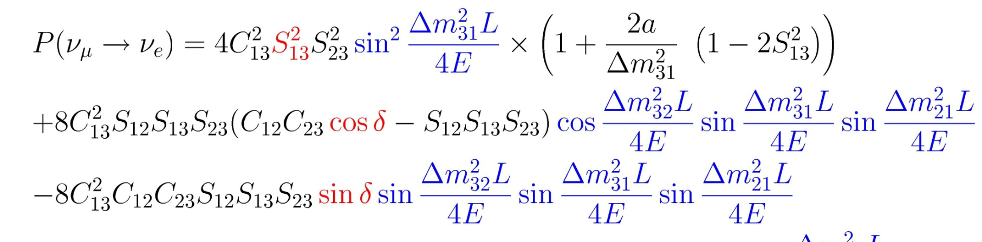
θ₁₃ & lepton CP violation
Leading
CP-odd
+ other terms..
δ→−δ, a→-a for
Matter eff.:
CP dependent term
(where sinθ₁₂~0.5, sinθ₂₃~0.7, sinθ₁₃<0.2)
Effect of CP Phase δ appear as
  ν_{e} Appearance Energy Spectrum Shape
  *Peak position and height for 1st, 2nd maximum and minimum
  *Sensitive to all the non-vanishing δ including 180°
  *Could investigate CP phase with ν run only
  Difference between ν_{e} and ν_{e} Behavior
    Sensitive to any mechanism to make asymmetry
    Separation from possible sources of non-CPV asymmetry needed
23

Slide 24
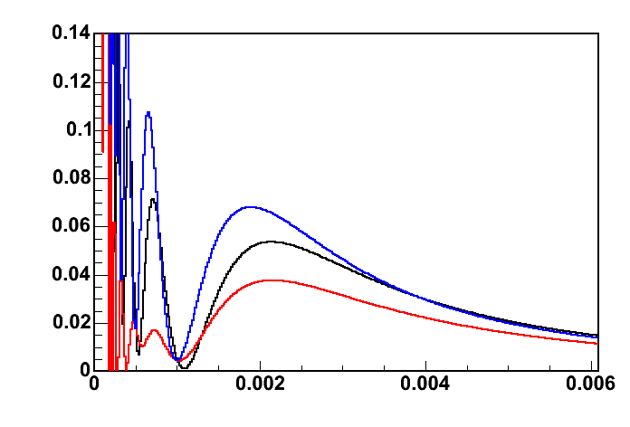
Optimization of Angle and Baseline
Off-axis angle
  On-Axis: Wide Energy Coverage,
  ○Energy Spectrum Measurement
  ×Control of π⁰ Background
  Off-Axis: Narrow Energy Coverage,
  ○Control of π⁰ Background
  ×Energy Spectrum Measurement
  → Counting Experiment
Baseline
  Long:
  ○ 2nd Osc. Max. at Measurable Energy
  × Less Statistics
  ? Large Matter Effect
  Short:
  ○ High Statistics
  × 2nd Osc.Max.Too Low Energy to Measure
  ? Less Matter Effect
OA0°
ν_{μ} flux
OA2°
OA2.5°
OA3°
ν_{μ} → ν_{e} oscillation probability
δ_{CP}=0
δ_{CP}=90
Oscillation probability
δ_{CP}=270
Δm₃₁² = 2.5x10⁻³ eV²
sin²2θ₁₃ = 0.1
No matter effects
(E/L)

Slide 25
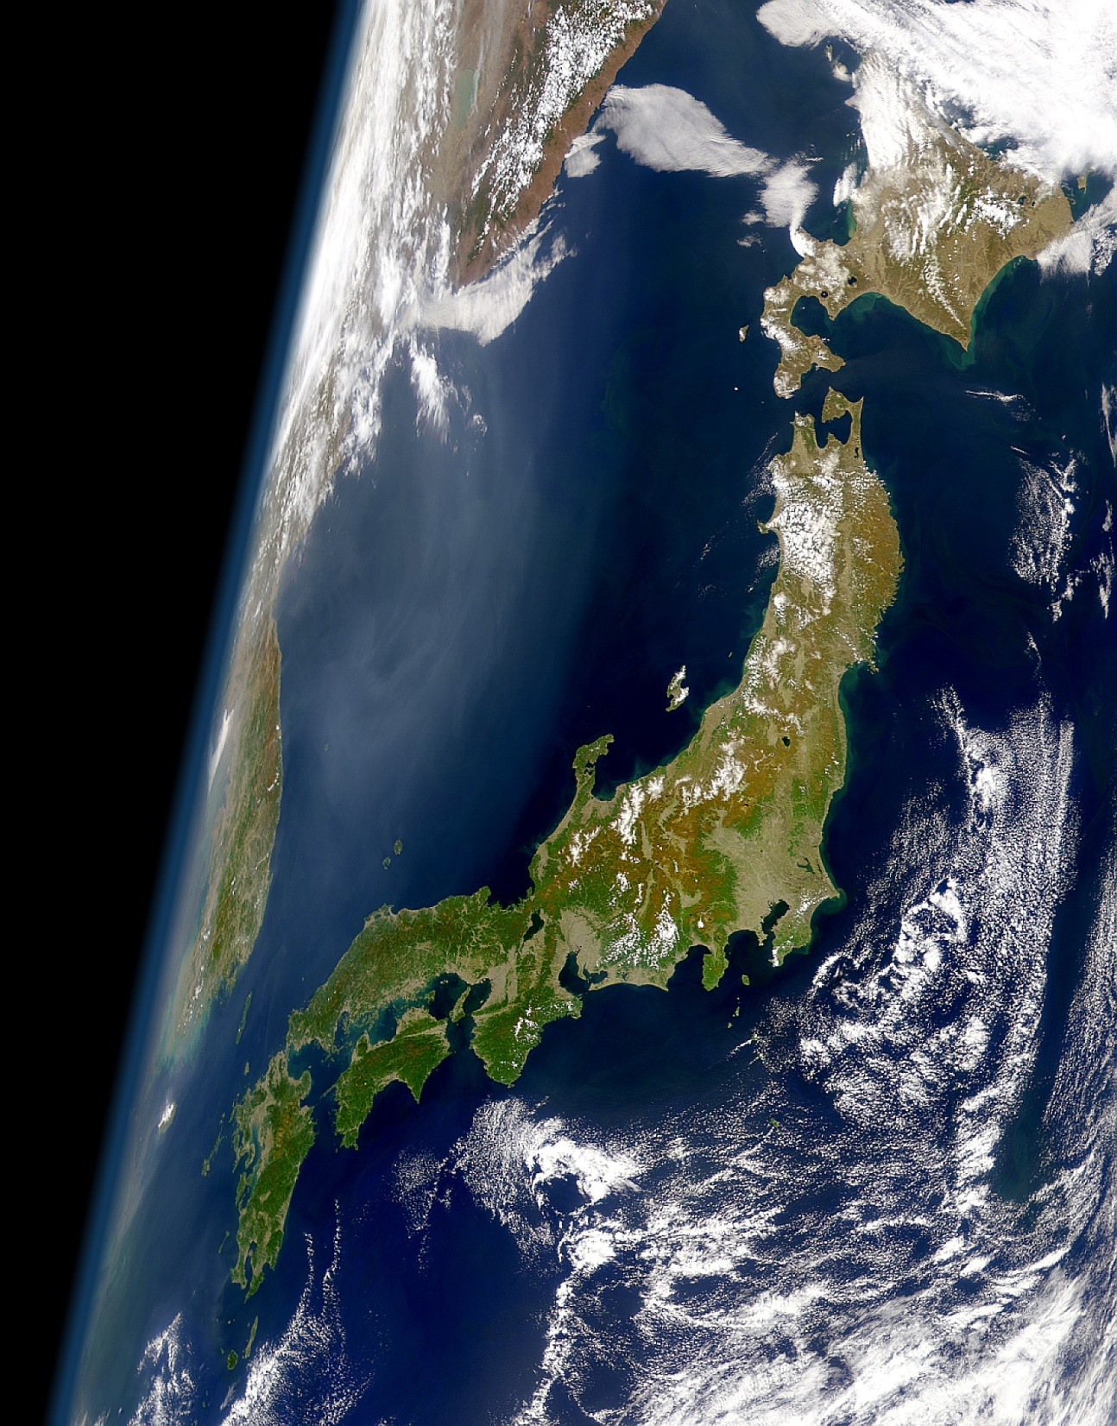
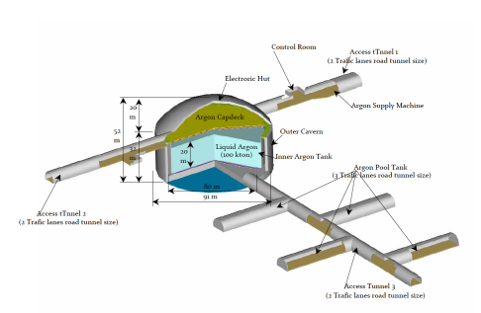

Scenarios from J-PARC
Kamioka L=295km OA=2.5deg
Okinoshima L=658km OA=0.78deg
Almost On-Axis
P32 proposal (Lar TPC R&D)
Recommended by J-PARC PAC
(Jan 2010), arXiv:0804.2111

Slide 26
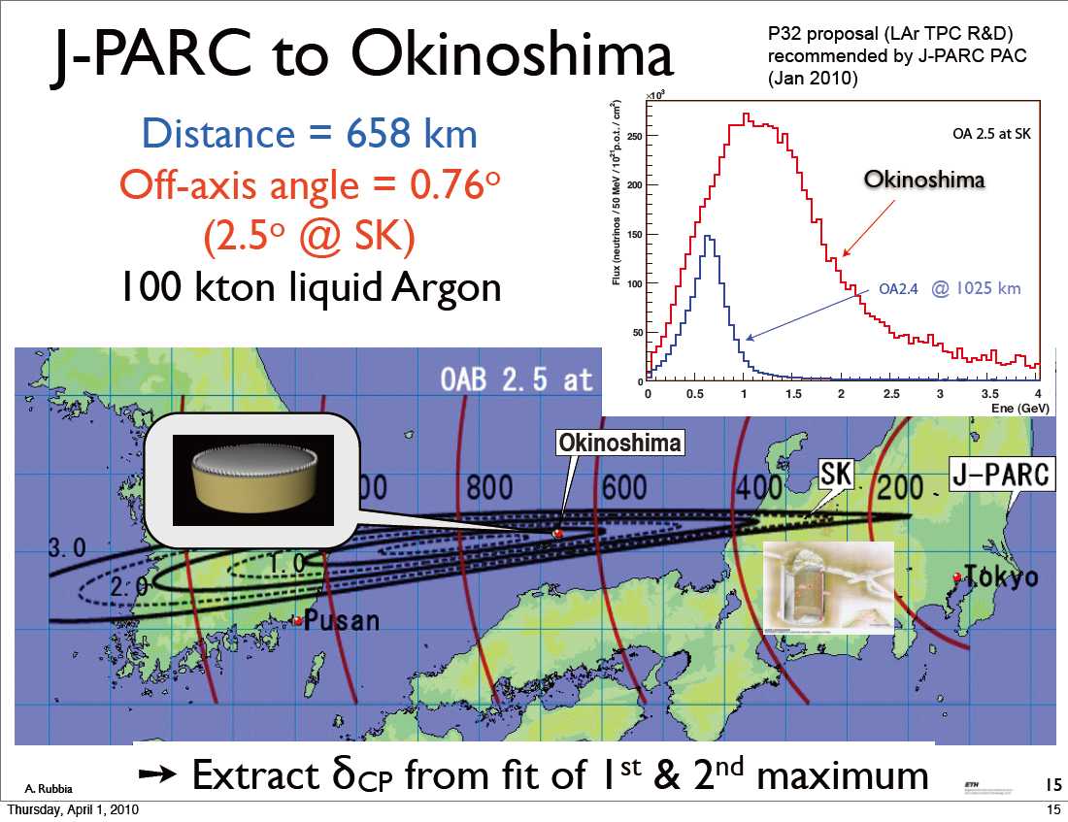
J-PARC to Okinoshima
Scenario 1
P32 proposal (Lar TPC R&D)
Recommended by J-PARC PAC
(Jan 2010), arXiv:0804.2111

Slide 27
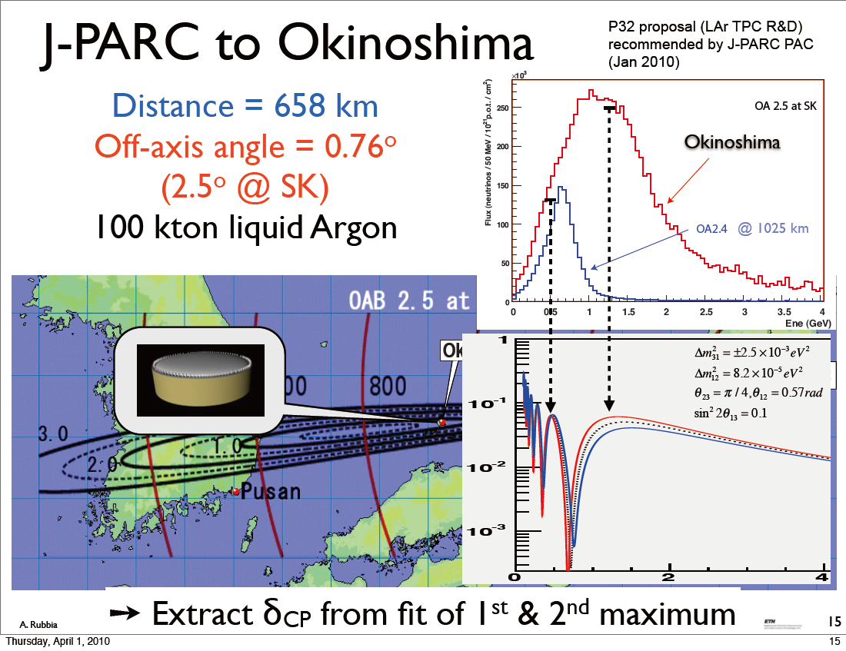
J-PARC to Okinoshima
Scenario 1
P32 proposal (Lar TPC R&D)
Recommended by J-PARC PAC
(Jan 2010), arXiv:0804.2111
KEK’s primary option

Slide 28
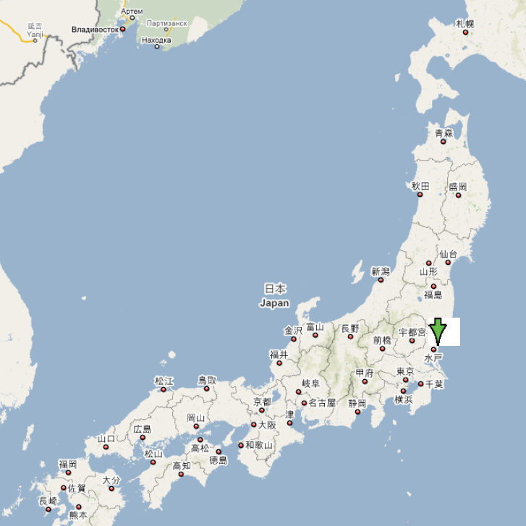
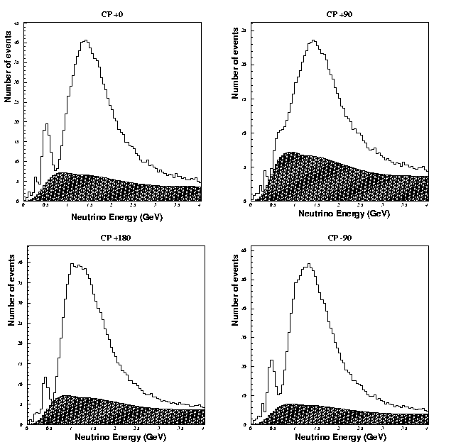
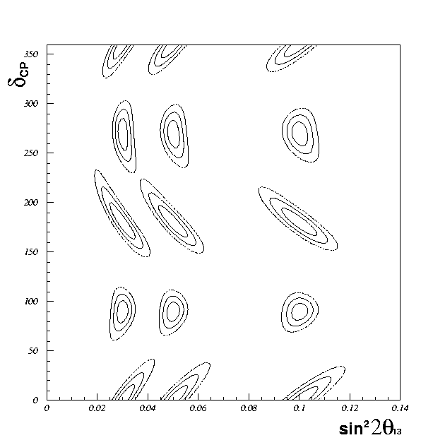
Scenario 1
ν_{e}Spectrum
sin²2θ₁₃=0.03,Normal Hierarchy
Cover 1st and 2nd Maximum
Neutrino Run Only 5Years×1.66MW
100kt Liq. Ar TPC
  -Good Energy Resolution
  -Good e/π^{０}discrimination
Keeping Reasonable Statistics
δ=0°
δ=90°
δ=180°
δ=270°
CP Measurement Potential
Okinoshima
Beam ν_{e}
Background
3σ
658km
0.8deg. Off-axis
NP08, arXiv:0804.2111

Slide 29
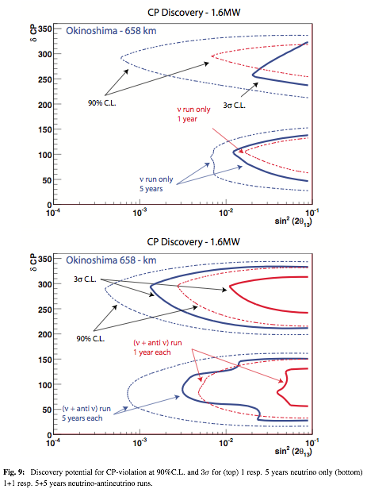
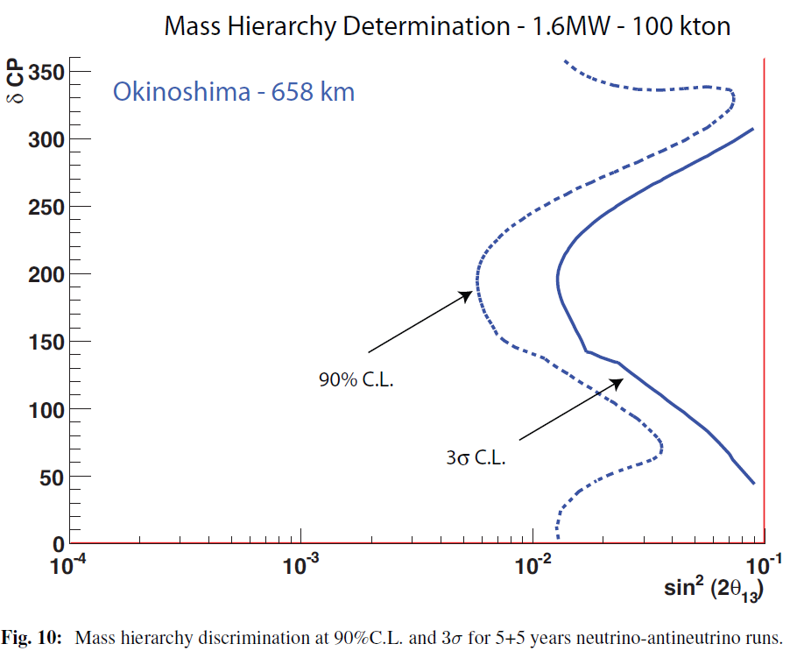
J-PARC to Okinoshima: Sensitivities
Scenario 1
CP Violation
Hierarchy
ν run only
ν run and ν run

Slide 30
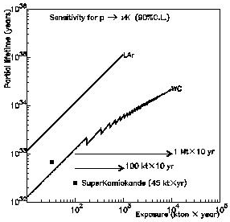
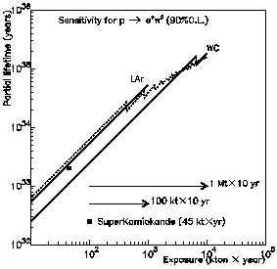
100kt LiqAr also for Proton decay search!
ν ＋ K＋ mode: LAr（100kt×10years）＝～7×WC（500kt×10yeas）
e ＋ π⁰ mode: LAr（100kt×10years）＝～1/2×WC（500kt×10years）
10³⁶
SUSY GUT prediction
ｐ → ν ＋Ｋ＋ (90%CL)
10³⁶
Life time (years)
Life time (years)
10³⁵
SUSY GUT prediction
10³⁵
Liquid Argon TPC
１００ｋｔ×１０年
Water Cherenkov
５００ｋｔ×１０years
10³⁴
10³⁴
Super-K limit
Liquid Argon TPC
１００ｋｔ×１０years
Water Cherenkov
５００ｋｔ×１０年
Super-K limit
10³³
10³³
ｐ → ｅ＋π^{０} (90%CL)
100
1000
10000
(kt×year)
100
1000
10000
(kt×year)

Slide 31
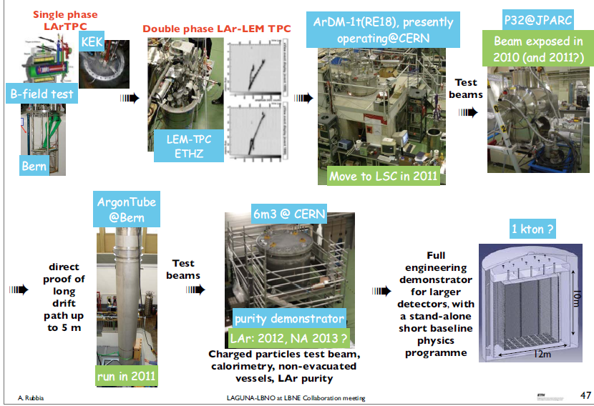
R&D steps toward 100kt Lar detector

Slide 32
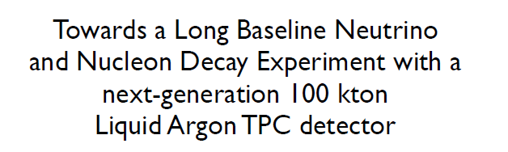
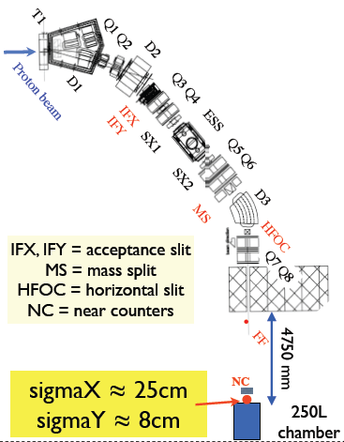
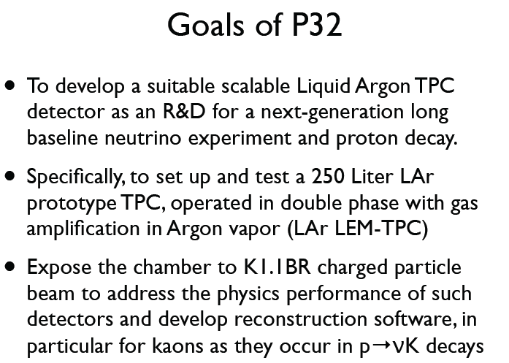
R&D effort toward large LAr TPC: T32 experiment
K1.1 Line
ETHZ, KEK, Iwate, Waseda (36members)

Slide 33
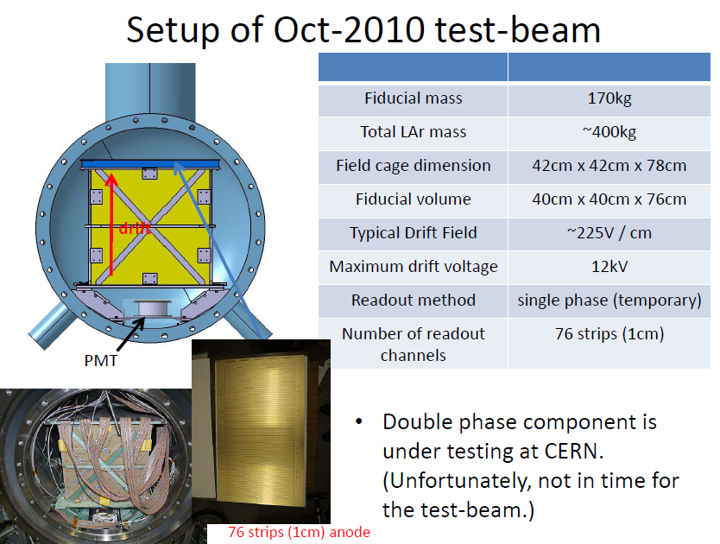
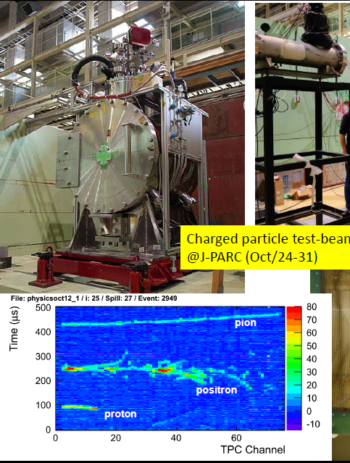
T32 test beam at J-PARC
First beam data taken in Oct/Nov, 2010
Results will be presented in PAC (Jul.2011)
Possible beam 2011(?)
See Maruyama’s talk

Slide 34
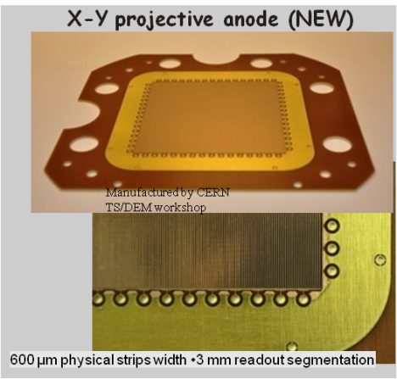
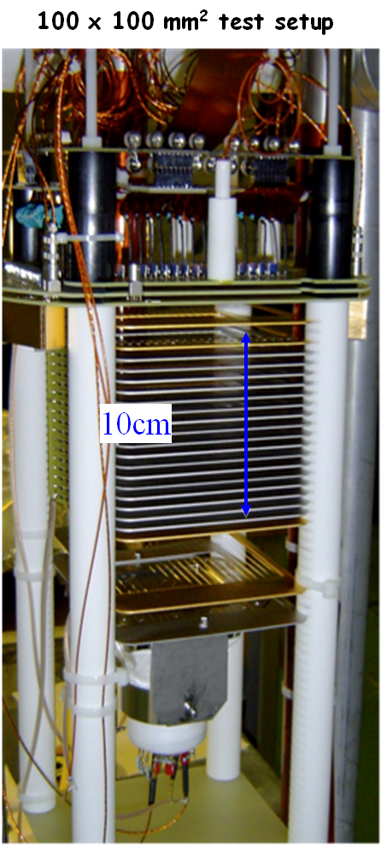
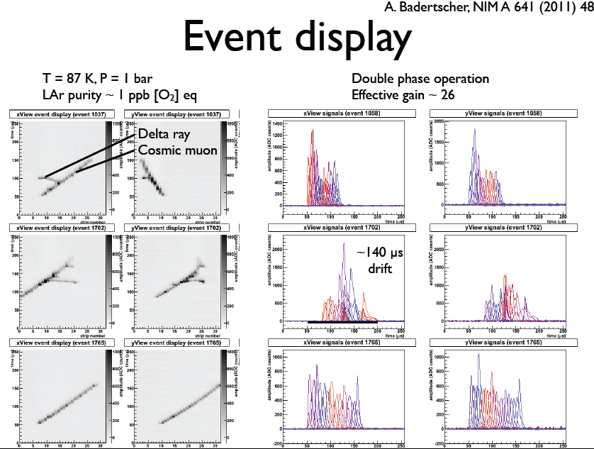
LAr LEM-TPC 3L R&D by ETHZ
Development of 2d double phase readout
See F. Resnati’s talk

Slide 35
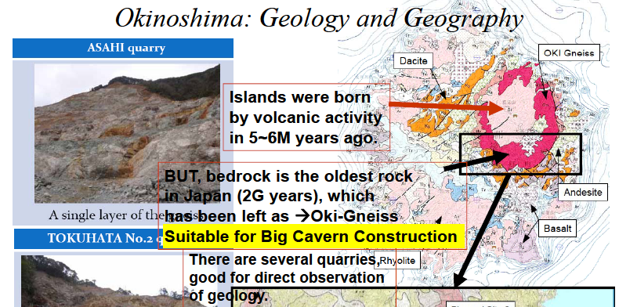
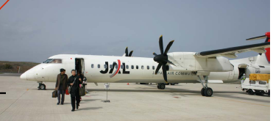
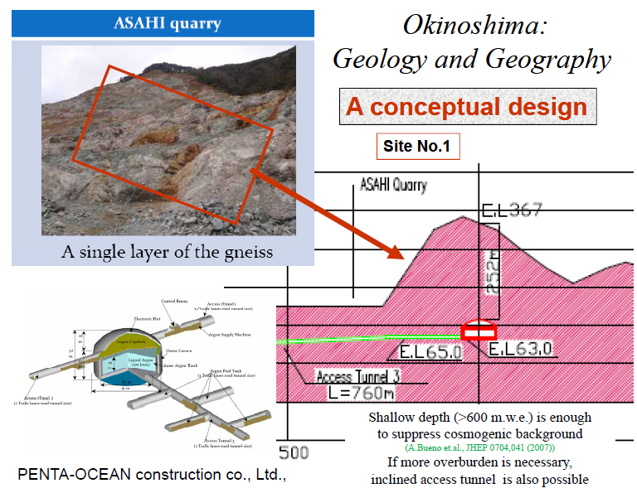
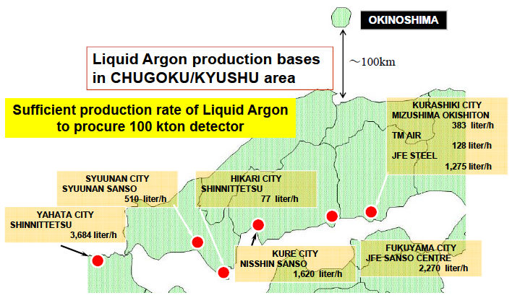
J-PARC-Okinoshima feasibility studies
(Some examples)
Site visit
Potential LiqAr supply
See Yoshioka’s talk

Slide 36
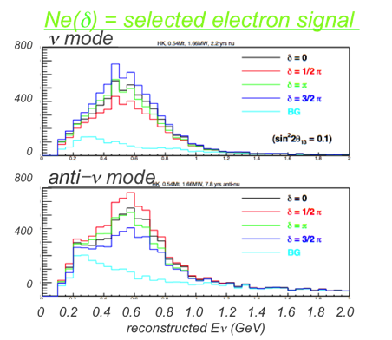
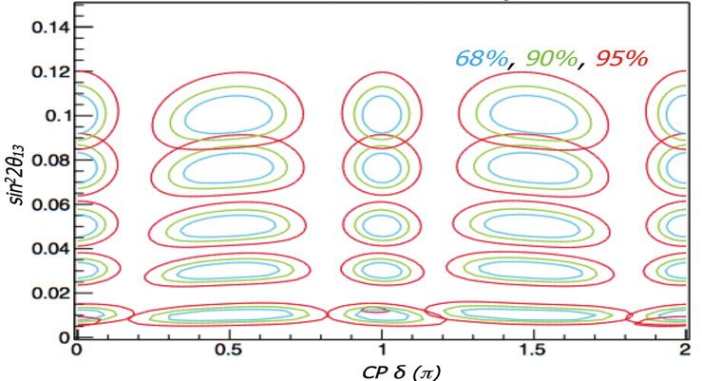
J-PARC-HyperK @ Kamioka
discovery of (θ₂₃, Δm²₂₃) → (θ₁₂, Δm²₁₂) → θ₁₃ in a few year
remaining param. will be δ_{CP}, mass-hierarchy,
θ₂₃-octant
leptonic CPV w/ JPARC ν
resolve θ₂₃ octant
w/ atmospheric ν
mass hierarchy determination w/ atmospheric ν
sin²θ₂₃=0.6
sin²θ₂₃=0.5
sin²θ₂₃=0.4
3σ
5 yrs of 1.66 MW JPARC ν data.
5% syst. errors are assumed.
4 yrs exposure of atm. ν data.
Super-K syst. errors are assumed.

Slide 37
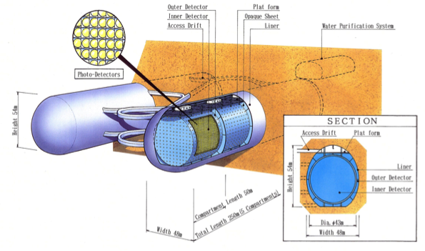
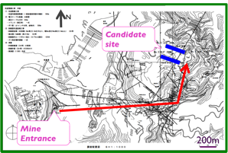



Hyper-K Base-Design
1Mton total volume, twin cavity
0.54Mton fiducial volume
Inner (D43m x L250m) x 2
Outer Detector >2m
Photo coverage 20% (1/2 x SK)
20” PMT w/ cover
Base-design to be optimized
Geological survey of the site is going on
Qualitative studies on physics potential
FEM analysis
(Factor of safety)

Slide 38
Summary
Aim to realize an experiment to discover CPV in neutrino and Proton decay with
  Upgraded J-PARC 0.75MW ➔ 1.66MW (➔??MW)
  Huge, high sensitivity detector
Possible options
  100kton LiqAr @ Okinoshima: CPV (,hierarchy)
    KEK pursue this option
  ~Mton Hyper-K @ Kamioka: CPV
Intensive studies and R&D on going
  Physics potential
  Detector
    LiqAr (ETHZ/KEK/Waseda/Iwate)
    Water Cherenkov: Photo detector, site study, etc
Within few years when T2K acquire ~1MW.10⁷s, hope (need) to decide next direction

Slide 39
Spare

Slide 40
Critical path toward high power operation
Space charge
Beam power is limited by beam loss
  RCS, RCS-MR injection, and MR
At what intensity, does the space charge effect become non-linear
  MR Beam break-up (?) instabilities observed in MR at 1.5e13 ppb (design is 4 e13 ppb). Behavior similar to other high intensity accelerators driven by broadband impedance and/or electron cloud.
  2nd harmonic RF will be installed summer >1.7e13 ppb test in fall
Long term project
Need work on more systematic studies on the nature of collective instabilities and impedance sources including possible electron cloud effects.
Possibility of RCS h=1 operation and injection to MR
LINAC 400MeV Operation (avoid severe space charge effect at RCS injection) → Construction of necessary component has been funded and construction started

Slide 41
Item to be Modified from DAY1 toward High Intensity
No. of Bunch in MR(6→8)
  Fast Rise Time Extraction Kicker Magnet
Increase Repetition Rate (3.5Sec→1.92Sec)
  RF and Magnet Power Supply Improvement
RCS h=1 Operation (longer beam bunch to decrease space charge effect)
  RF Improvement
LINAC 400MeV Operation (avoid severe space charge effect at RCS injection)
h=2: 2 bunches×4cycle injection to MR
h=1:Single bunch with doubled no. of proton×8cycle injection

Slide 42


Steps towards proposal of 100 kton Giant Liquid Argon TPC
arXiv:hep-ph/0402110
ETHZ, Iwate, KEK, Waseda,
Additional improvement of detector technology beyond ICARUS T600
  long drift distance to reduce readout channel
    Signal amplification, Better purity, HV supply for drift system
    3L@CERN, 10L@KEK, ArDM@CERN
  Acceptable purity with No-evacuation
    6m3@CERN
Performance evaluation (detection efficiency, background suppression, etc.)
  250L@KEK for J-PARC test beam (T32):
    First cosmic track observed! Beam in Oct/Nov 2010
  etc
Final prototyping
  Level of 1 kt prototype
Full engineering design and cost estimation

Slide 43
Accelerator Based Neutrino Project in Japan
 | K2K | T2K | 3rd Generation Exp. (KEK Roadmap)
High Power Proton Synchrotron | KEK PS 12GeV 0.005MW Existing | J-PARC MR 30GeV up to 0.75MW Brand New | J-PARC MR 30GeV 1.66MW Technically Feasible Upgrade
Neutrino Beamline | K2K Neutrino Beamline Brand New | J-PARC Neutrino Beamline Brand New | J-PARC Neutrino Beamline Existing
Far Detector | Super Kamiokande Existing at KAMIOKA | Super Kamiokande Existing at KAMIOKA | Brand New -Detector Technology ? -Place ? (Angle and BaseLine)
1st Priority Physics Case | Neutrino Oscillation ν_{μ} Disappearance | Neutrino Oscillation ν_{μ}→ν_{e} | Lepton Sector CP Violation + Proton Decay Search
Able to concentrate on Far Detector issue toward the 3rd Generation Experiment after T2K startup

Slide 44
Additional requirement for far detector optimization
Proton Decay Discovery Performance
Realization of the huge detector
  Test of the key components
  Experimentally prove the detector performance
    if necessary, good prototyping
    (able to predict Huge Detector Performance well)
    is important
    Test with the beam is important
KEK started R&D for Huge Liq. Ar TPC with ETH Zurich

Slide 45

Discovery of nucleon decay
High quality tracking information, high energy resolution, low particle energy detection energy threshold
→ Background free measurement for several decay modes
Possible to explore 10³⁴-10³⁵ years life time within 10 years for several decay mode
65 cm
Shallow depth(>600 m.w.e.) is enough to suppress cosmogenic background
Main background is atmospheric neutrino
Never miss p→νK⁺, p→e⁺K⁰, n→e⁺K–, ...etc.
Surely detect high multiplicity final states mode (e.g. p→µπK, ...)
e+
53 cm
µ+
K+
p=425 MeV

Slide 46
Scenario 1
Neutrino event rate and experimental sensitivity
Events in 100 kton, 658 km, 5 years @ 1.66 MW
No Osc. | ν_{μ} CC | ν_{e} CC | ν_{μ} CC | ν_{e} CC
5 years | 82000 | 750 | 1460 | 35
δ_{cp (deg)} | 0 | 90 | 180 | 270
sin²2θ₁₃=0.1 | 2867 | 2062 | 2659 | 3464
sin²2θ₁₃=0.05 | 1489 | 1119 | 1342 | 1908
sin²2θ₁₃=0.03 | 942 | 506 | 829 | 1266
  ＊ ×10 larger total events than T2K
  ＊ High detection efficiency, excellent background suppression,
  high precision electron neutrino energy spectrum measurement
    CP discovery exceeds 3σ for sin²2θ13>0.02
    measure θ13 with δsin²2θ13≈±0.01 and test CP at better than 90%CL if sin²2θ13>0.01
    sin²2θ13<0.001 @ 90%CL (if no signal is found) one order better than T2K

Slide 47

J-PARC to
Okinoshima
Mass hierarchy
investigation

Slide 48
J-PARC to Okinoshima

Slide 49

Scenario 2
Cover 1st Maximum Only
2.2Years Neutrino+7.8Years anti-Neutrino Run 1.66MW
540kt Water Cherenkov Detector
295km
2.5deg. Off-axis
<Eν>~0.6GeV
Kamioka
Tokai
δ=0
sin²2θ₁₃=0.03,Normal Hierarchy
δ=π/2
CP sensitivity
signal+BG
ν_{μ}
νμ+νμ+νe+νe BG
sin²2θ₁₃
3σ
νμ+νμ BG
Eν^{rec}
Eν^{rec}
deg.
3σ
ν_{μ}
Fraction of δ
sin²2θ₁₃
Eν^{rec}
Eν^{rec}
K.Kaneyuki @NP08

Slide 50




Scenario 3
Cover 2nd Maximum @ Korea
Cover 1st Maximum @ Kamioka
5Years ν+5Years ν Run 1.66MW
270kt Water Cherenkov Detector each
@ Korea, Kamioka
295km
2.5deg. Off-axis
1000km
1deg. Off-axis
F.Dufour@NP08
(study is initiated by M.Ishitsuka et. al. hep-ph/0504026)

Slide 51
Comparison of Each Scenario
 | Scenario 1 Okinoshima | Scenario 2 Kamioka | Scenario 3 Kamioka Korea
Baseline(km) | 660 | 295 | 295 & 1000
Off-Axis Angle(°) | 0.8(almost on-axis) | 2.5 | 2.5 1
Method | ν_{e}Spectrum Shape | Ratio between ν_{e} ν_{e} | Ratio between 1st 2ndMax Ratio between ν_{e} ν_{e}
Beam | 5Years ν_{μ,} then Decide Next | 2.2 Years ν_{μ,} 7.8 Years ν_{μ,} | 5 Years ν_{μ,} 5 Years ν_{μ,}
Detector Tech. | Liq. Ar TPC | Water Cherenkov | Water Cherenkov
Detector Mass (kt) | 100 | 2×270 | 270+270
Study is continuing to seek for optimum choice

Slide 52




Okinoshima: Geology and Geography
Islands were born
by volcanic activity
in 5~6M years ago.
BUT, bedrock is the oldest rock
in Japan (2G years), which
has been left as →Oki-Gneiss
Suitable for Big Cavern Construction
There are several quarries,
good for direct observation
of geology.
PENTA-OCEAN construction co., Ltd.,

Slide 53


Okinoshima:
Geology and Geography
A conceptual design
Site No.1
Shallow depth (>600 m.w.e.) is enough
to suppress cosmogenic background
(A.Bueno et.al., JHEP 0704,041 (2007))
If more overburden is necessary,
inclined access tunnel is also possible
PENTA-OCEAN construction co., Ltd.,

Slide 54


100 kton Giant Liquid Argon TPC
Preliminary design (used for cost estimate)
Excavation volume:
2.8×10⁵ m³
462m long
Tunnel 1
Four tunnels
for Ar pool,
150m each
827m long
Tunnel 2
≈70 m
Drift length
h =20 m
arXiv:hep-ph/0402110
PENTA-OCEAN construction co., Ltd.,
760m

Slide 55



SAIGOU
Large electric power station
enough for our facility
Okinoshima:
Infrastructure
OMOSU port (local)
・Coastal fishery base
・Landing place of daily commodities
Candidate site
SAIGOU port (Main)
・Base of the remote island route that links Oki Islands to the mainland
・Coastal fishery base
Oki airport, two regular flights
Oki – Osaka, Oki - Izumo

Slide 56

Okinoshima:
Liquid Argon supply
Most efficient way is to use presently available ferry liner
OKINOSHIMA
Liquid Argon production bases
in CHUGOKU/KYUSHU area
～100km
Sufficient production rate of Liquid Argon
to procure 100 kton detector
KURASHIKI CITY
MIZUSHIMA OKISHITON
383 liter/h
TM AIR
128 liter/h
JFE STEEL
1,275 liter/h
SYUUNAN CITY
SYUUNAN SANSO
510 liter/h
HIKARI CITY
SHINNITTETSU
77 liter/h
YAHATA CITY
SHINNITTETSU
3,684 liter/h
KURE CITY
NISSHIN SANSO
1,620 liter/h
FUKUYAMA CITY
JFE SANSO CENTRE
2,270 liter/h

Slide 57







The new LAr LEM-TPC
LAr LEM TPC = Double phase TPC with gain in GAr vapor
Motivated by the very long drift path needed in giant detectors and DM applications (keV detection)
hep-ph/0402110, arXiv:0811.3384, NIM A617(2010)188, J.Phys.Conf.Ser.171:012020,2009, arXiv:1001.0076
segmented anode
amplification stage
GAr
Continuous waveform recording
→ image
3 kV/cm
1 kV/cm
ionization
extraction grids
Cosmic tracks in 3 lt prototype (G≈6):
LAr
scintillation
cathode
PMT
dE/dx
x-t
y-t

Slide 58


Liquid Argon TPC Lab.@KEK
Hydrosorb
LAr
Turbo Pump
Oxysorb
10L@KEK
GAr
Recirculation
pump
250L@KEK
Test
Chamber
Scroll Pump
LAr Open Bath

Slide 59




1st Liq. Ar TPC Signal with Cosmic Ray in Japan
Anode
Grid
Trigger Counter set up
HV setting
  Cathode -2500 V
  Grid -1000 V
  Cathode-anode; 5cm
Oscilloscope waveform
  Ch1 is the fastest signal
  Drift time ~20 μs
Field
shaper
Cathode
Anode: 4ch×2.2cm×9cm
1
2
3
4
Anode
Trigger 1
3x0.5x30 cm
Grid
Trigger 2
Cathode

Slide 60



6m3 @ CERN
A. Curioni et al., GLA2010 workshop
R&D towards non evacuated vessels on large vessel
Purity measured with direct scintillation light measurement !
First test purging - satisfactory!
Piston effect seen
Reached 3ppm O2 contamination via flushing
Gas recirculation under construction
ETHZ-Liverpool 6m3 @ CERN

Slide 61


An example of performance evaluation
with clear objective: 250L@KEK
P32 proposal (Lar TPC R&D)
Recommended by J-PARC PAC
(Jan 2010)
Measurements with
well defined charged particle test beam
To benchmark performance of detector
To develop realistic simulation/reconstruction software
K1.1BR
Beamline
Experimental Facility
Cryogenic vessel with beam window (originally for MEG liquid Xe calorimeter test module)
Ultra-Vacuum established
Cryocooler and liquid Argon filling under investigation
Liquid Argon purification system under procurement
Exposure to low-momentum separated K beam @J-PARC
Parameters for 250L@KEK
Fiducial mass | 170 kg
Total Liquid Argon mass | ～400 kg
Field cage dimensions | 42×42×78 cm³
Fiducial volume | 40×40×76 cm³
Drift field | 1 kV/cm
Max. drift voltage | 40 kV
Readout method | Double phase, Two view anode LEM-TPC
Readout segmentation | Two 40 ×38 cm² LEM-TPC
Readout pitch | 3mm in x & y
Number of readout channels | 288 per LEM-TPC 576 in total
LEM-TPC effective gain | ～25
  p → ν K(340MeV/c K⁺ )

Slide 62




340 MeV/c K⁺ (p→Kν) in 250L@KEK
First beam exposure
in October 2010
>90% of slow kaons stop in detector
with range ≈10cm (others decay in-flight)
Many soft decay products are contained
dE/dx analysis can be performed for particle ID
Total energy deposit
in 250L@KEK
dE/dx likelihood
µ/π
K

Slide 63


250L@KEK: Cryogenics
GM Cryocooler
LN₂ Coil
Inner volume
Cold Head
Heat input of 250L cryostat: ~ 30W
GM Cryocooler (~150W)
  For normal operation
LN₂ heat exchange coil (~500W)
  Additional cooling equipment for pre-cooling, filling, and recirculation for purification
Successful filling of the vessel
  ~ 3 hours for pre-cooling
  7 hours for 100L filling
  ~ 50L/hour (in case the vessel is cold enough)
Stably kept ~1 week with cryocooler
Precooling
~3hour
~ 10L/hour
for first 20L
~ 50L/hour

Slide 64




Very high drift “high” voltage...
S. Horikawa et al., GLA2010 workshop
ArDM-1t measurements
ArDM-1t measurements
Extraction grids + anode
Field cage + reflector
Greinacher circuit
Discharging rod
Cathode
ArDM-1t detector

