Slide 1
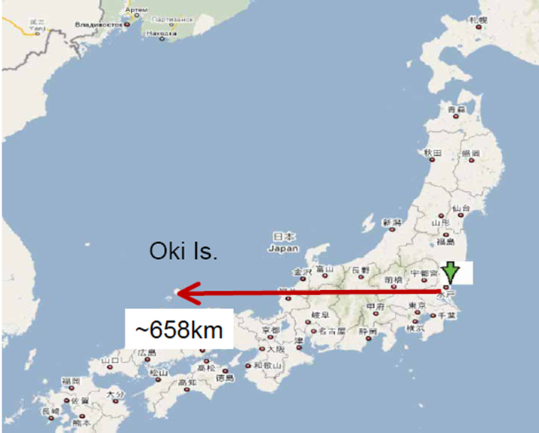
Okinoshima site study
GLA2011, June 9, Jyväskylä, Finland
Kiyokazu Kawakami^{a)}, Takuya Hasegawa^{b)}, Osamu Hirabayashi^{a)}, Tokiyoshi Kaneta^{a)}, Takasumi Maruyama ^{B)}, Koichiro Nishikawa^{b)}, Tetsunori Oshimo^{a)} , André Rubbia ^{C)}, Masashi Tanaka^{b)}, Masakazu Yoshioka^{b)}
^{A)} Penta-ocean Construction Co., Ltd
^{B)} High Energy Accelerator Research Organization (KEK)
^{C)} ETH Zurich (ETHZ), Institute For Particle Physics
How Japanese islands and Okinoshima were born
Location
Geology and geography
Conceptual design of the cavern
Procurement and transportation of 100k-ton liq. Ar
Summary

Slide 2
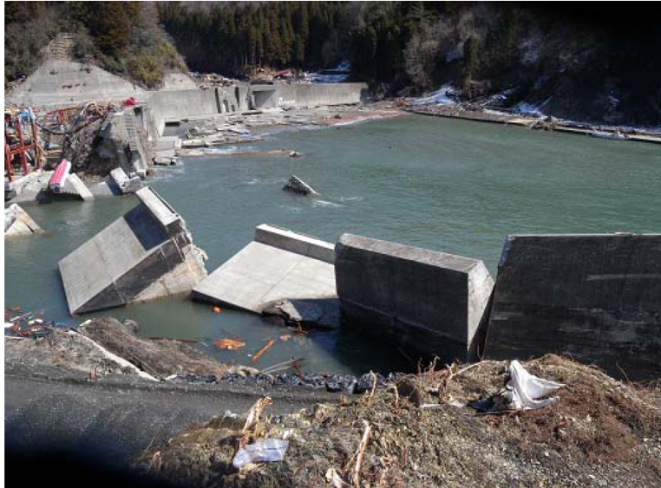
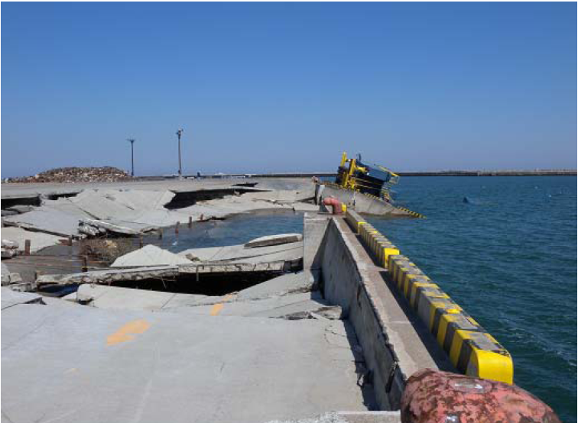
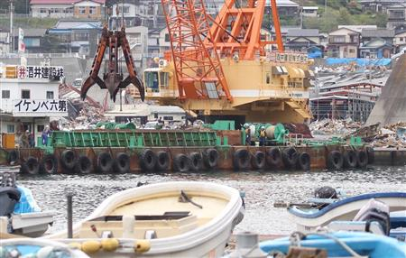
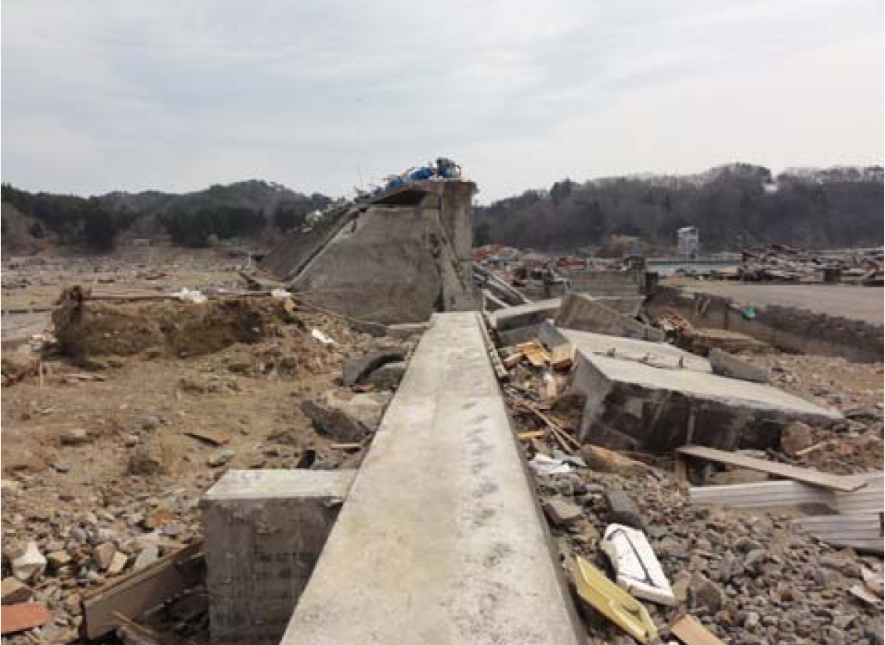
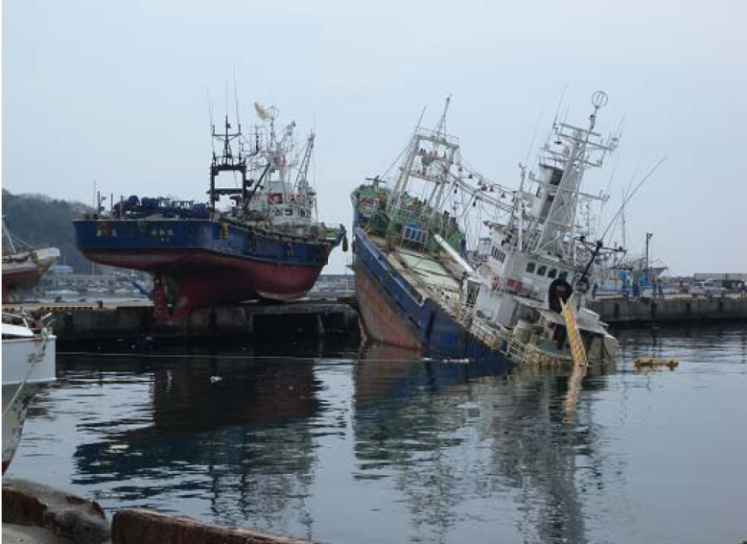
Damaged harbor by mega-quake and tsunami.
Disaster-relief work by marine construction companies
Key persons of civil engineering
K. Kawakami, O. Hirabayashi and T. Kaneta, members of Penta-Ocean construction co., Ltd
They could not attend this workshop, since their main business is marine construction.

Slide 3
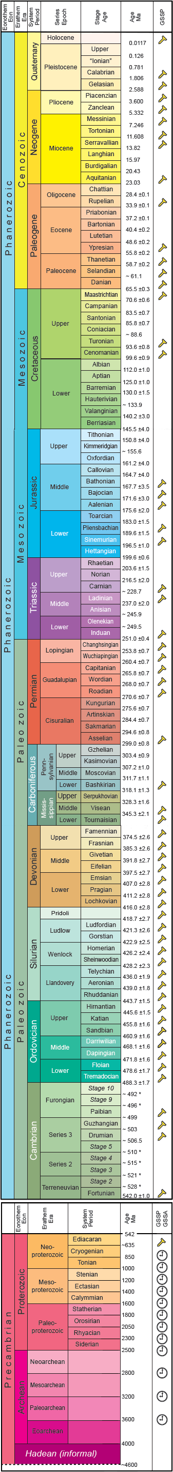
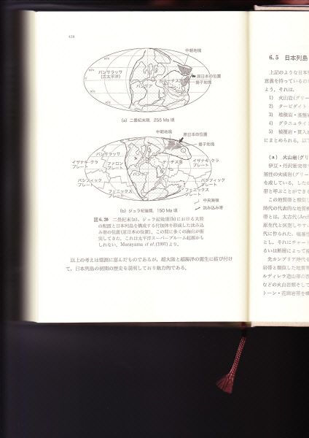
How Japanese islands and Okinoshima
were born? == 1st STEP ==
●
150Ma
255Ma
●
In 255 Ma (end of the Permian), the basis of Japanese islands were
created at around the equator at the edge of the supercontinent Gondwana,
They were born from the deep sea as accretionary prism.
This is the original basis of Okinoshima islands.
Then drifted to the northward,
In 150 Ma (end of the Jurassic), they were located at the present latitude.

Slide 4
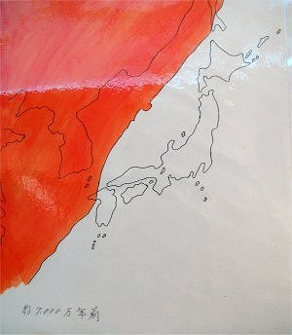
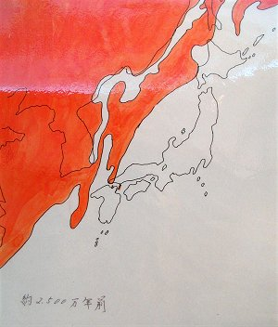
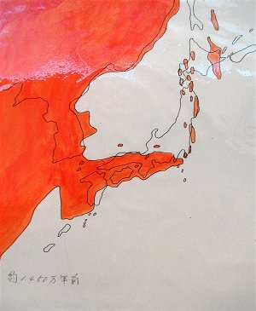
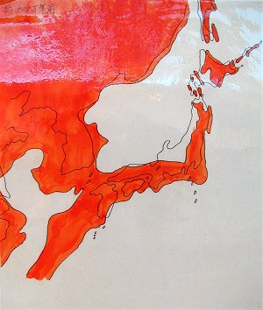
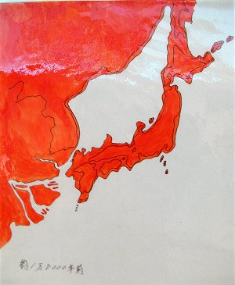
http://www.avis.ne.jp/~ammonite/nihon.htm
70 Ma (Cretaceous~Paleocene)
25 Ma (Oligocene)
14 Ma (Pleistocene)
== 2nd STEP ==
Japanese islands were
splitting off from the Asian
continent since 25 million
years ago.
50,000 years ago, Homo
Sapience were getting at
Japan and created culture.
18,000 years ago, present
shape were almost created.
Still most active place in the world
from plate tectonics point of view
5 Ma
18000 years ago

Slide 5
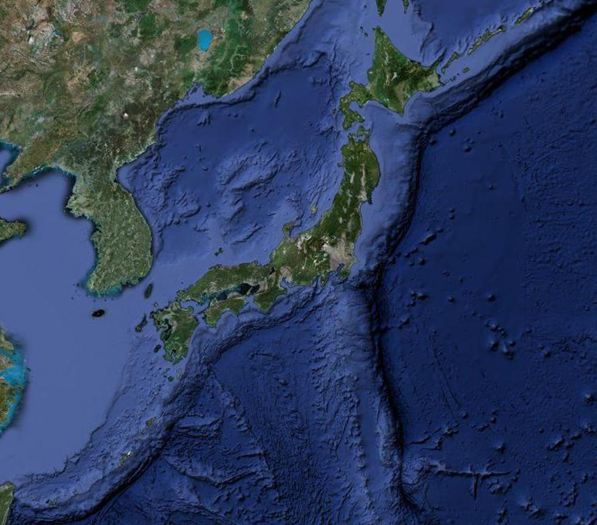
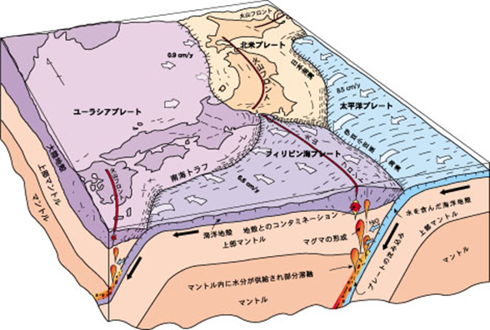
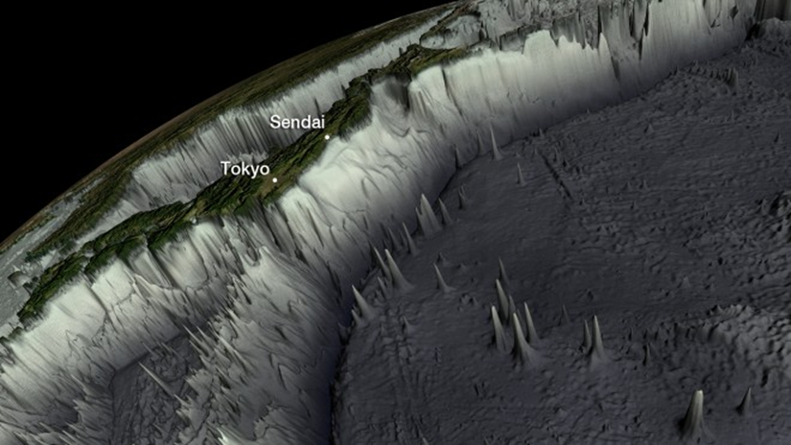
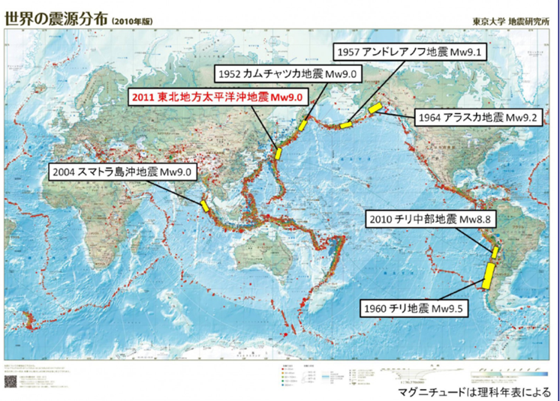
2. Location of Okinoshima
Distribution of mega-earthquake of M-9 class

Slide 6
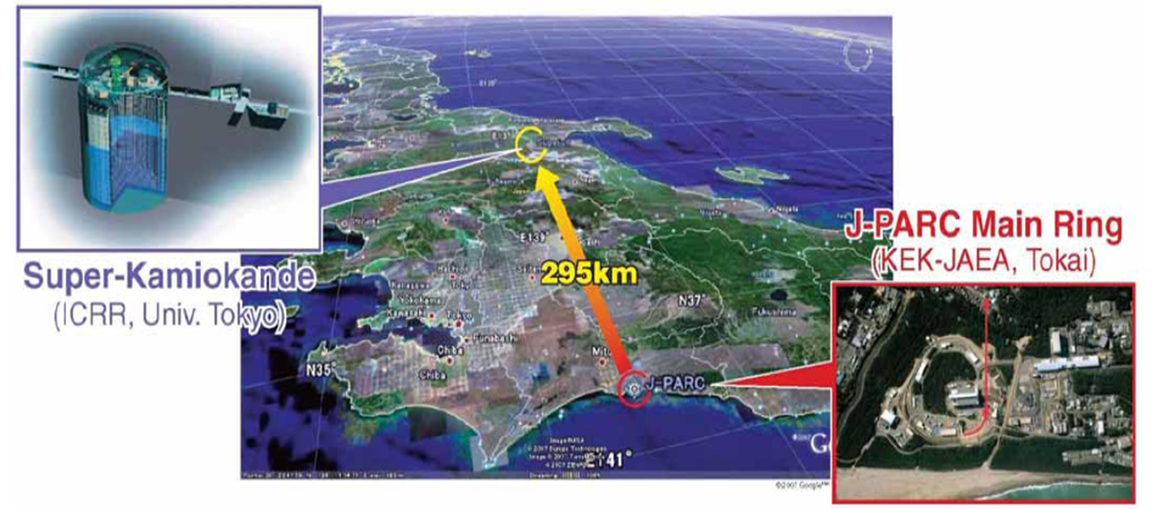
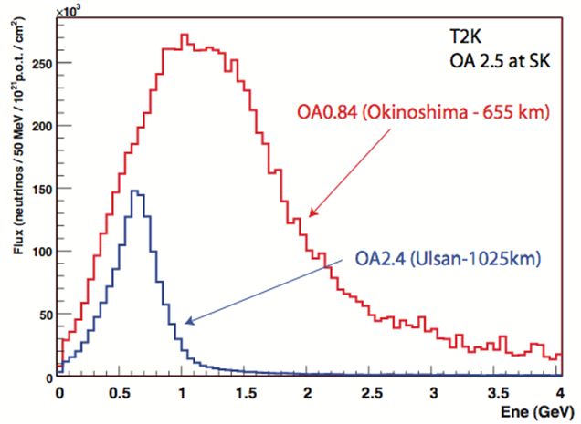
Angle of elevation: 0.76 degree
  Good coverage of 1st and 2nd oscillation peaks
  Ideal for Liq. Ar TPC

Slide 7

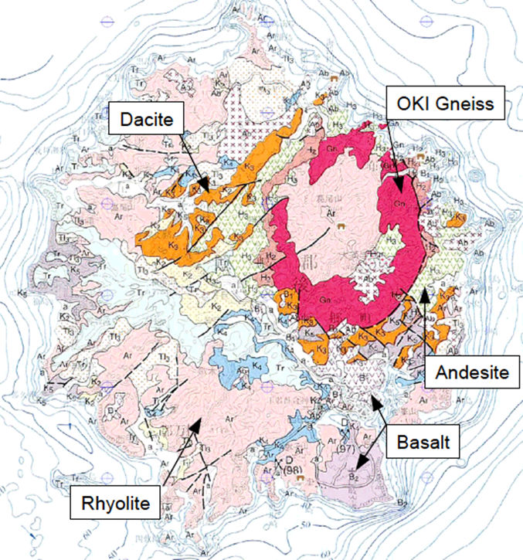
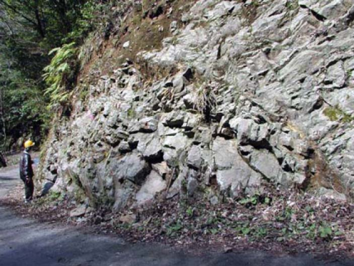
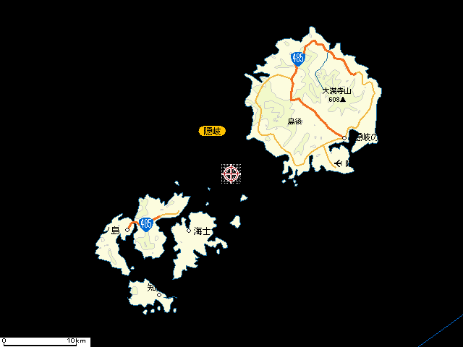
3. Geology and geography
In 5 Ma, Okinoshima-islans were born by volcanic activities
and consisting of igneous and very old metamorphic rocks.
Metamorphic event of Oki-gneiss was in 250 Ma at the equator position.
Oki-gneiss contains a small amount of very old zircon (3000 Ma !!), which is one of the
evidences that islands have been a part of Asian continent.

Slide 8
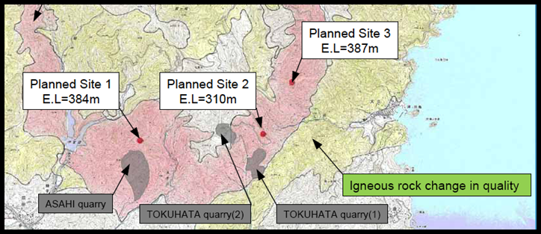
Necessary conditions for the large-scale
underground cavern construction and
for keeping long-term operation safety.
The site should be in the bedrock of
healthy OKI-gneiss.
Keep enough distance from the
dislocation and active faults.
Keep enough distance from the
stratum boundary with the igneous
rock, in order to avoid to be changed
in quality of the gneiss by the crackle
of the igneous rock.

Slide 9
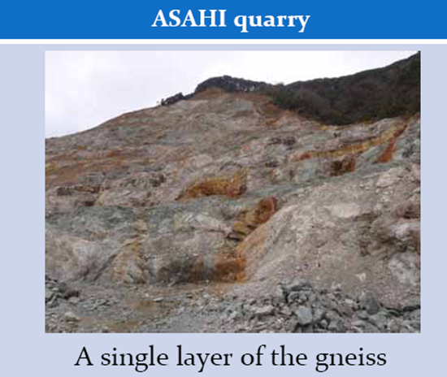
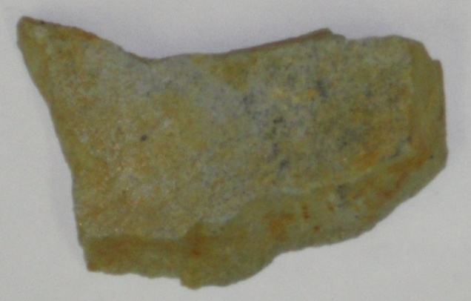
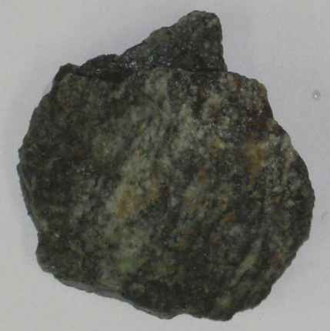
Specific Gravity | 26.9kN/m³
Axial Strength | 79.2Mpa
The bedrock situation | Form of lump
Very good conditions for excavation
with New Austrian Tunneling Method
using blasting.
Cracks are very few
We can make inclined access tunnels
when more earth covering is required

Slide 10
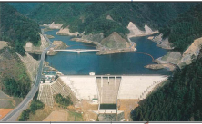
Permeability at OKI-gneiss can be estimated from Chyoshi Dam
(agriculture, drinking water) located near the site.
20≦Lu
5≦Lu＜10
1≦Lu＜2
Lu＜1
Lugeon coefficient (Lu) is less then 1 (×10⁻⁷m/sec)
Lu is small enough to avoid the water-inflow from the dam to the cavern.

Slide 11
Necessary Geological Investigation in future
Method |  | Items identified for investigation
Geophysical prospecting | Seismic prospecting | Elastic wave velocity of ground. Position, scale and velocity of slow velocity zone
 | Electrical prospecting | Specific resistance of ground and cross-sectional distribution of specific resistance
Boring Investigation (vertical and lateral) |  | Stratification and distribution of sand and rock. Position, scale, properties, continuity of fault, fractured zone, and soft layer. Type of rock, weathering and alteration, properties of fracture and joint. Possibility of groundwater, pressure and amount of water-inflow
Borehole test, logging | Standard penetration | Examination of stability around portal, and places where overburden is small. To grasp depth of rock and bearing layer.
 | Borehole load test | Deformation coefficient , elastic coefficient , etc
Laboratory test |  | Physical and mechanical characteristics of constituting rock : unit weight , elastic wave velocity , compressive strength , etc. Mineral characteristics of constituting rock : clay mineral content , slaking characteristic , etc. Physical and mechanical characteristics of constituting soil : Particle size distribution , water content , compressive strength , consistency , etc.

Slide 12

4. Conceptual design of the facility
GLACIER: Main Liquid Argon Cavern
Three access tunnels
Four Argon pool tanks
Liq. Ar tank will
be isolated from
the cavern wall

Slide 13
Rock bolt
  Floor L=6m
  Wall L=4m
  Dome L=6m
Cable bolt
  Wall L=8m
  Dome L=15m
Shot-crete (t=160mm=80+80mm) with steel fiber

Slide 14
Deformation analysis result using FLAC3D code
Sequential analysis
(every 2m)
250m
A sequential analysis
(2m digging and install support)
170m
Input properties of ground
Unit weight (γ) kN/m³ | Elastic coefficient (E)MPa | Poisson ratio | Cohesive strength (ｃ)MPa | Friction angle (φ)°
24.3 | 7,900 | 0.3 | 20 | 36
250m
Analysis model for FLAC3D

Slide 15
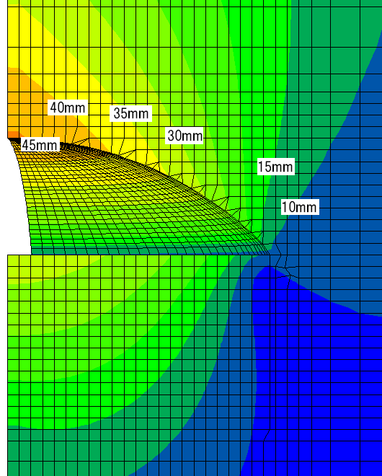
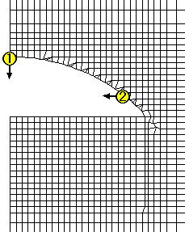
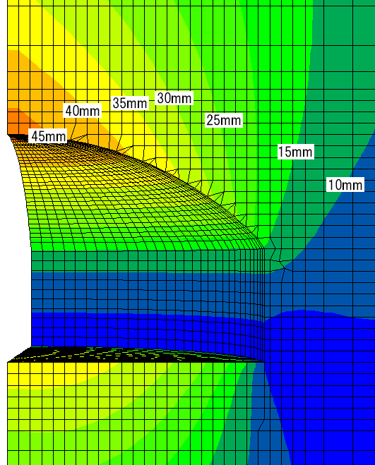
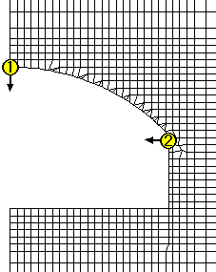
Result (1)
Distribution of the displacement ① settlement, ② horizontal displacement
Time of the digging to 20m
Time of the digging to 30m
① 45.4mm
② 3.5 mm
① 46.6mm
② 0.7 mm
Time of the digging to 40m
Time of the digging to final stage
① 47.0mm
② 1.4 mm
① 47.2mm
② 2.7 mm

Slide 16
Result (2)
Shear strain distribution
Time of the digging to 20m
Time of the digging to 30m
Time of the digging to 40m
Time of the digging to final stage

Slide 17
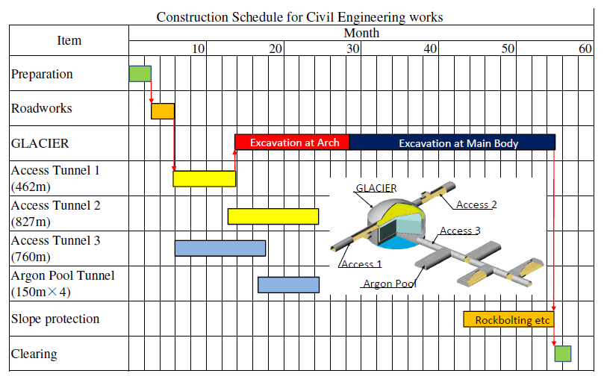
Construction Schedule
Start Liq. Ar storage

Slide 18
Preliminary cost study
Item | Cost (M €) | Comments
GLACIER | 40.8 | H=52m, Φ=91m, Dome type cavern
Access Tunnel 1 | 6.7 | 462m long
Access Tunnel 2 | 9.0 | 827m long
Access Tunnel 3 | 9.3 | 760m long
Argon Pool Tunnels | 6.4 | 50m long×4
Slope Protection | 4.0
Road Works | 2.9 | Improvement
Temporary Works | 5.9
On-site Expenses | 21.7
Head-office Expenses | 7.7
Total | 114.4
1 € = 116 Yen

Slide 19
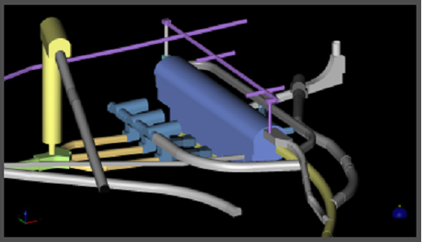
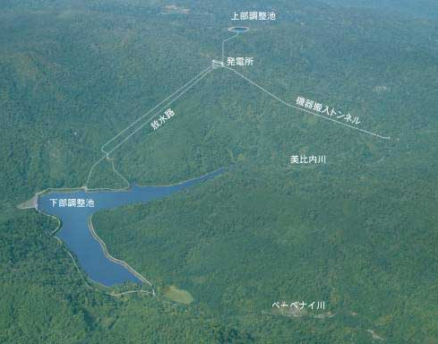
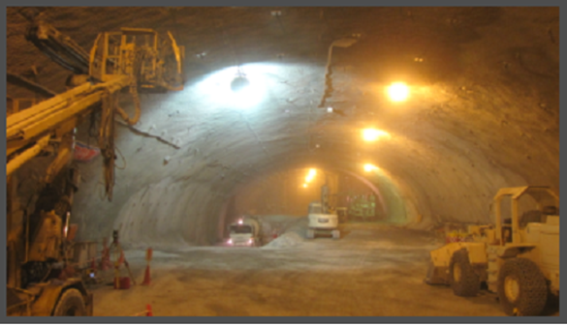
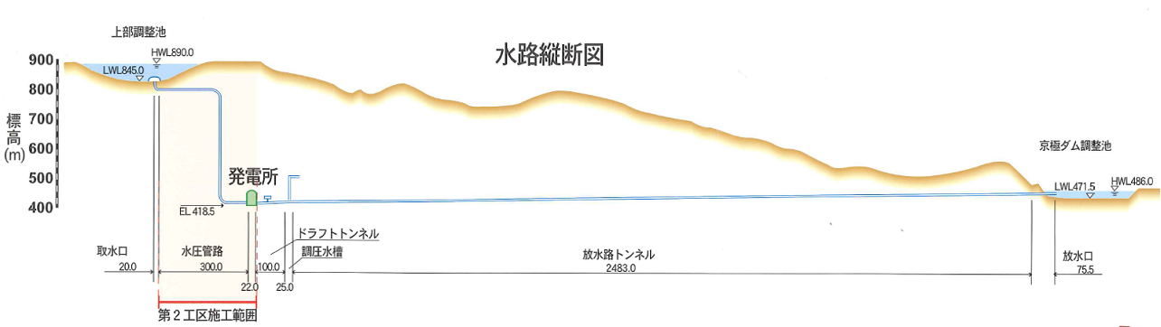
An example of of large-scale cavern construction in Japan
for pumped-up hydroelectric power plant station (in Hokkaido)
(Courtesy of K. Ryoke and M. Nago, Taisei Corporation)
3D

Slide 20
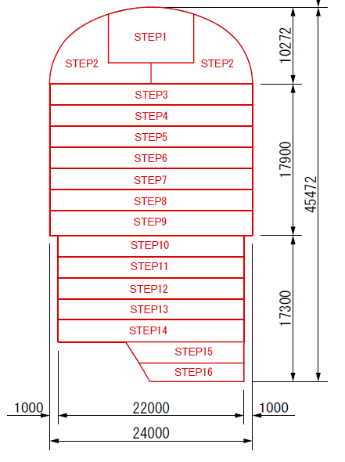

Cavern excavation procedure
STEP1 Top excavation
STEP2 Arch-part excavation
STEP3～ bench-part excavation
K. Ryoke and M. Nago, Taisei Corporation
□□□□□□□作業所
Notes:
発電所本体の掘削は，
１６のステップに分けて行います。
★→先ず頂設導坑の掘削を行い
★→次にアーチ部切拡げを行い，
★→順次下方に向ってベンチ掘削を行っていきます。

Slide 21
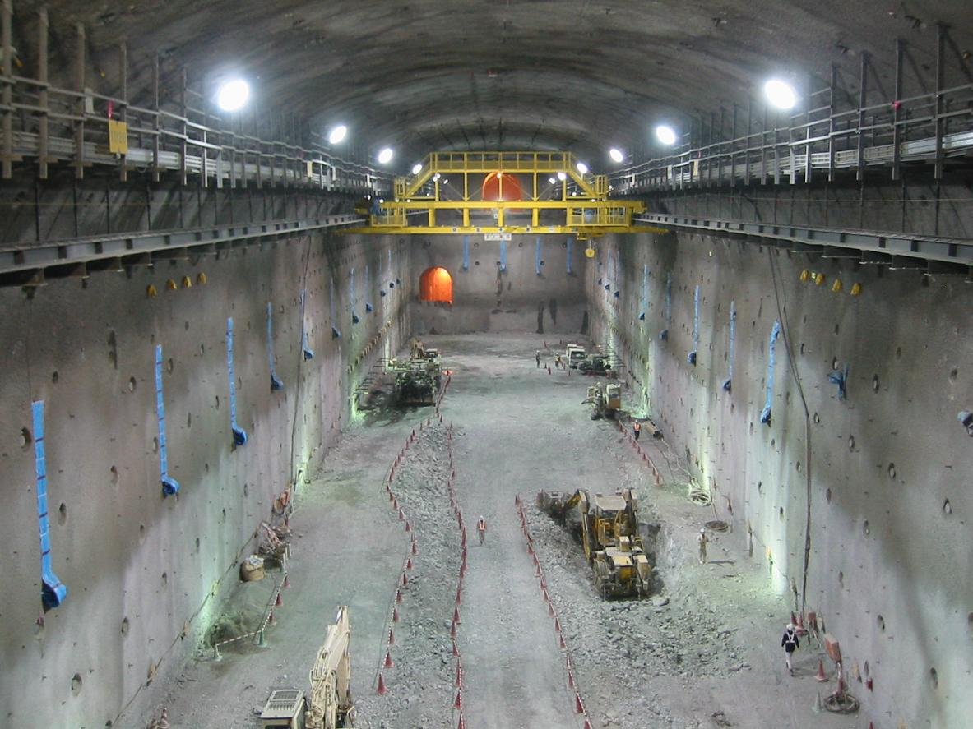
アーチ部
1段ベンチ
２段ベンチ
3段ベンチ
４段ベンチ
5段ベンチ
K. Ryoke and M. Nago, Taisei Corporation
□□□□□□□作業所
Notes:
こちらが，これから皆さんがご見学される地下発本体の工事現場の写真です。
この写真は，アーチ切拡げ完了時に撮影したものです。
現在は・・・

Slide 22
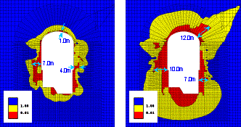
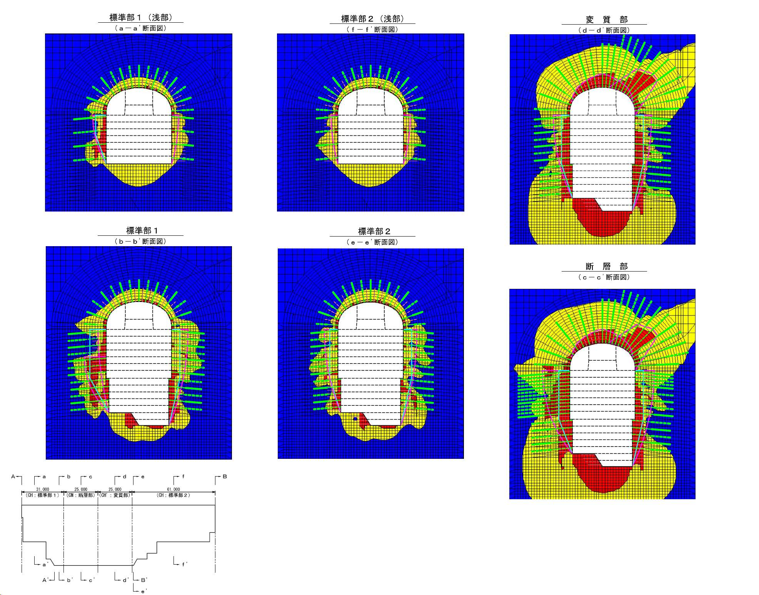
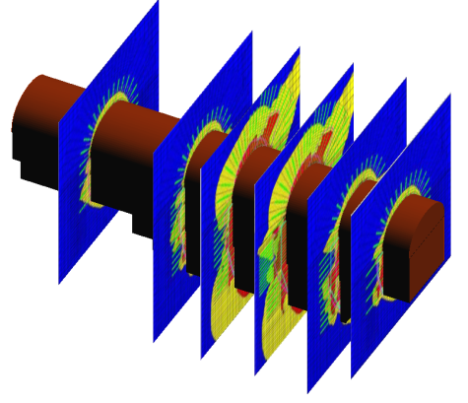
Design and forecast analysis based on not only preliminary survey but also new (real time) information through real excavation works
Standard position
Faulting position
Identify falling rock
標準部１
Estimate necessary anchor
Distribution of loose area
Estimate axial force increment
due to displacement
Design of necessary anchor
Estimate displacement
after anchor setting
断層部
Decision of anchor spec.
Type of anchor bolt, length,
Pattern, etc.
Analyze cavern stability
Decide the spec. of rock bolt
K. Ryoke and M. Nago, Taisei Corporation
□□□□□□□作業所
Notes:
まず、事前調査から得られた情報を基に設計を行います。
京極地下発電所では、支保構造として、
PSアンカー、ロックボルト、吹付けコンクリート
を採用しています。
設計手順としましては、
まず、事前調査で得られた物性値と地質モデルを基に、予測解析を行います。
予測解析で得られたゆるみ域を対象として、
アンカーの導入力を決定します。
ゆるみ領域は岩盤の塑性領域です．
次に、アンカーを考慮した解析モデルを用いて、
再度予測解析を行い、
アンカー設置後の変位に伴う軸力増分を求めます。
これらの導入力と増加軸力を合わせて、設計アンカー力とし、
アンカーの仕様を決定します。
このとき、アンカーの自由長としては、ゆるみ域の外に設定し、
定着長としてはアンカー仕様に相応する長さとします。
アンカーの仕様が決定すると、アンカー間のゆるみ岩塊を対象として、
ロックボルトの仕様を決定します。

Slide 23
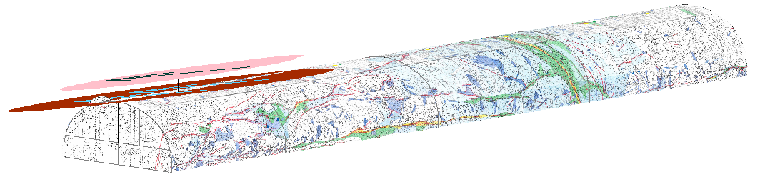
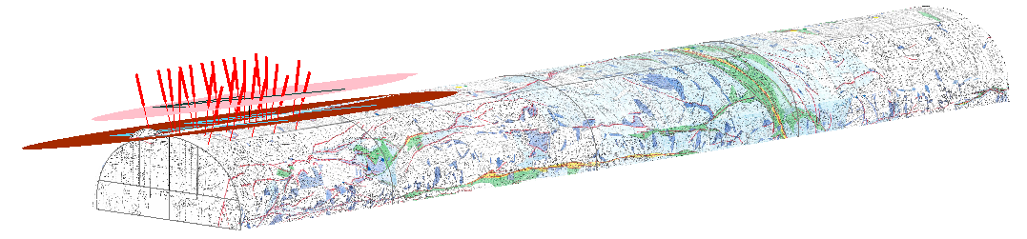
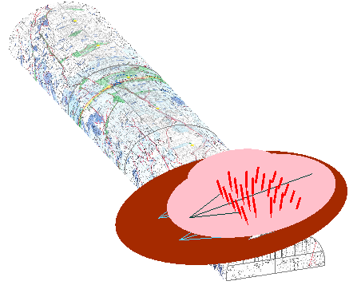
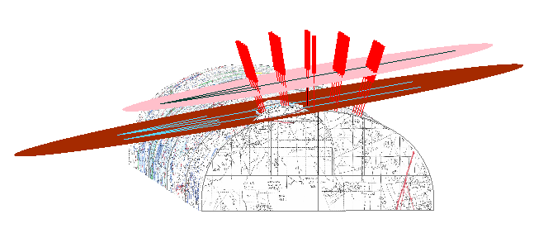
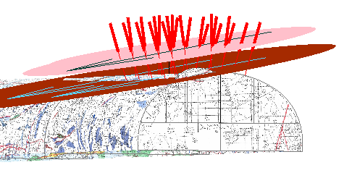

Decision of the optimum action when the problem: real time analysis and discussions are carried out
Planning
Verification
Instructions
K. Ryoke and M. Nago, Taisei Corporation

Slide 24
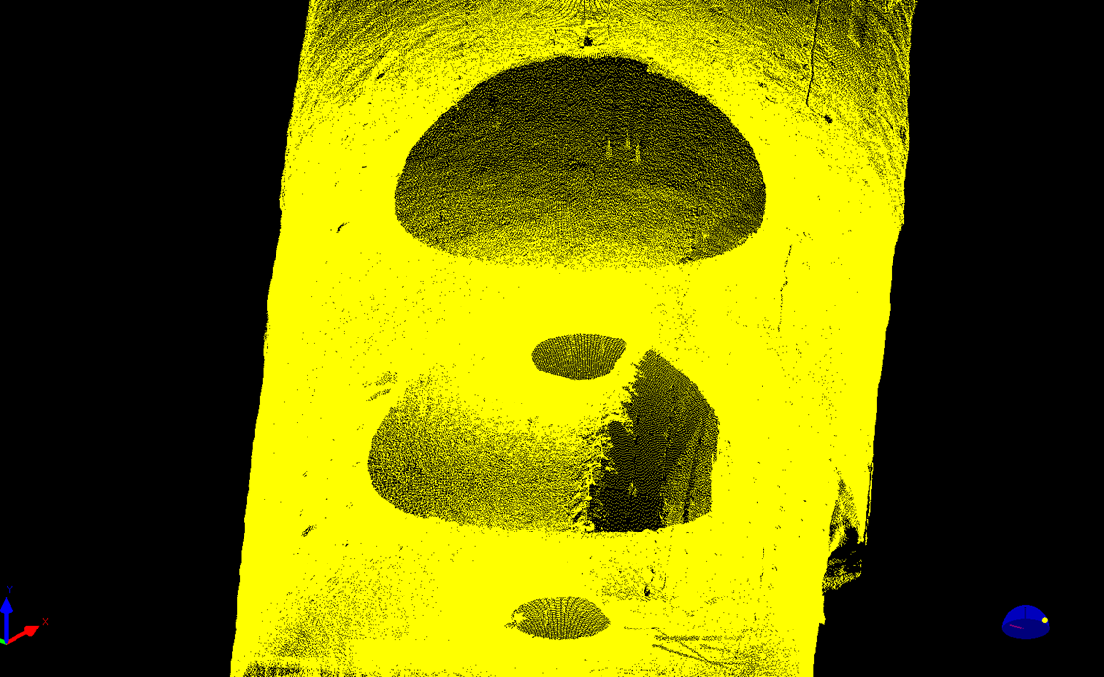
3D laser scan method can be used for the real time
monitoring of cavern deformation during excavation.
Cavern wall itself is the reflector of laser light.
No special optical reflector is required.
Personal computer-based analysis
Very simple and effective
K. Ryoke and M. Nago, Taisei Corporation

Slide 25
5. Procurement of 100k-ton Liq. Ar (in 5 years)
We have studied following 3 cases, and gotten a final solution
Construct an on-site production plant
Use an LNG carrier
Use regular commercial ferry transport
On-site plant
  The cost for the initial construction would be very expensive.
  Enough electricity for its operation would not be available
  in Okinoshima.
Courtesy of Osaka Gas
Co. Ltd. (S. Yoshioka, H. Terai)

Slide 26
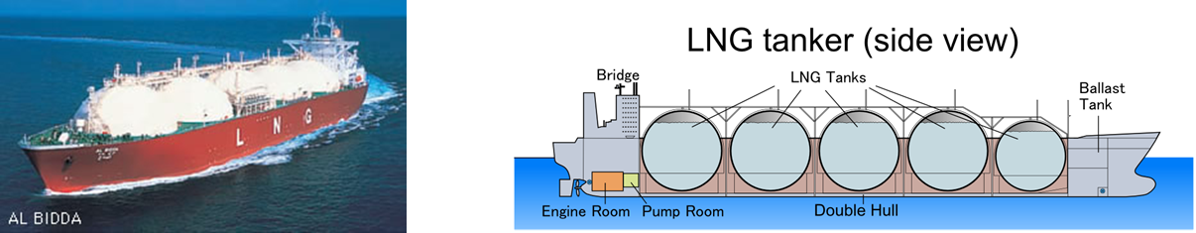
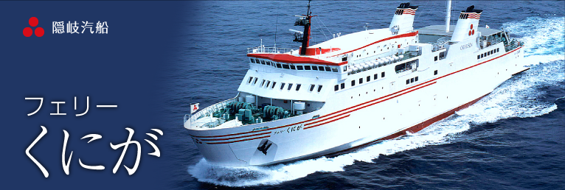
2. Use an LNG carrier
  We would have to solve the technical and legal problems
  in converting an LNG carrier to Liq. Ar.
  The cost of hiring such a ship for 5 years would be expensive.
3. Use regular commercial ferry transport
  Currently they are not legally allowed to carry tanker trucks.
Courtesy of Osaka Gas
Co. Ltd. (S. Yoshioka, H. Terai)

Slide 27
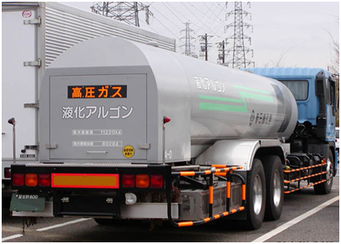

Final solution
  Buy Liq. Ar from several large-scale manufacturing plants having large production capacities. Many such plants are located in Japan and we would contract to buy 10~15 % of their annual production capacity.
  Hire 4 tanker trucks dedicated for the Liq. Ar ground transportation, both in Honshu and Okinoshima for 5 years.
  Hire 1 barge dedicated for the marine transportation between Honshu and Okinoshima for 5 years.
Courtesy of Osaka Gas
Co. Ltd. (S. Yoshioka, H. Terai)

Slide 28

Item | Cost (M €)
Hire 1 Barge | 4.18
Hire 4 tanker tracks | 4.14
Running cost of tracks | 5.09
Buy 100k-ton Liq. Ar | 65.48
Total cost | 78.90
1 € = 116 Yen
preliminary
Courtesy of Osaka Gas
Co. Ltd. (S. Yoshioka, H. Terai)

Slide 29
Summary
Location
  Good coverage of 1st and 2nd oscillation peaks
  Ideal for Liq. Ar TPC
Geology
  Nice Oki-gneiss for large-scale cavern excavation
Geography and Infrastructures
  Enough earth covering
  Good approach (public road, harbor, air-port, etc.)
Civil engineering
  5 years
  114.4 M €
  No essential technical problem
Procurement of 100 k ton Liquid Argon
  5 years
  78.9 M €
  No essential technical problem
Future tasks
(Engineering)
Liq. Ar vessel and
its system
More detailed
cavern design
Geological survey

