Slide 1
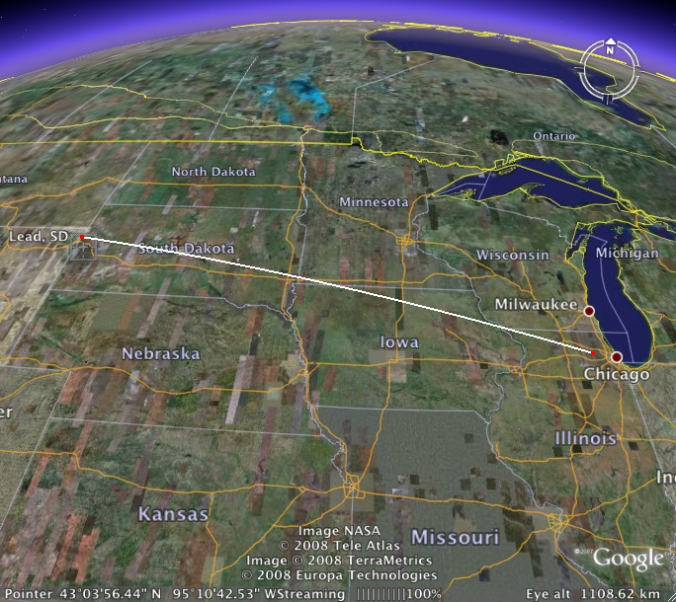
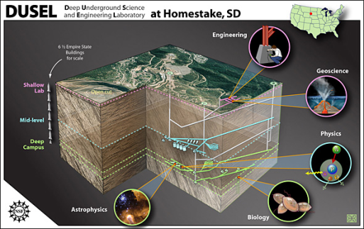
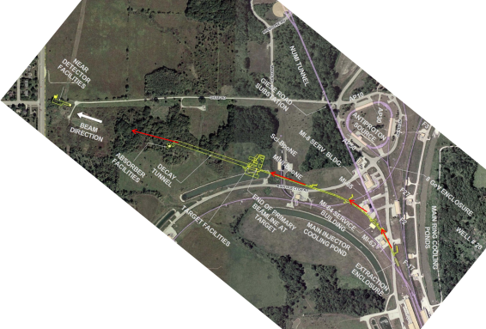


Status of LBNE
Robert Svoboda
GLA2011, Jyväskylä, Finland

Slide 2
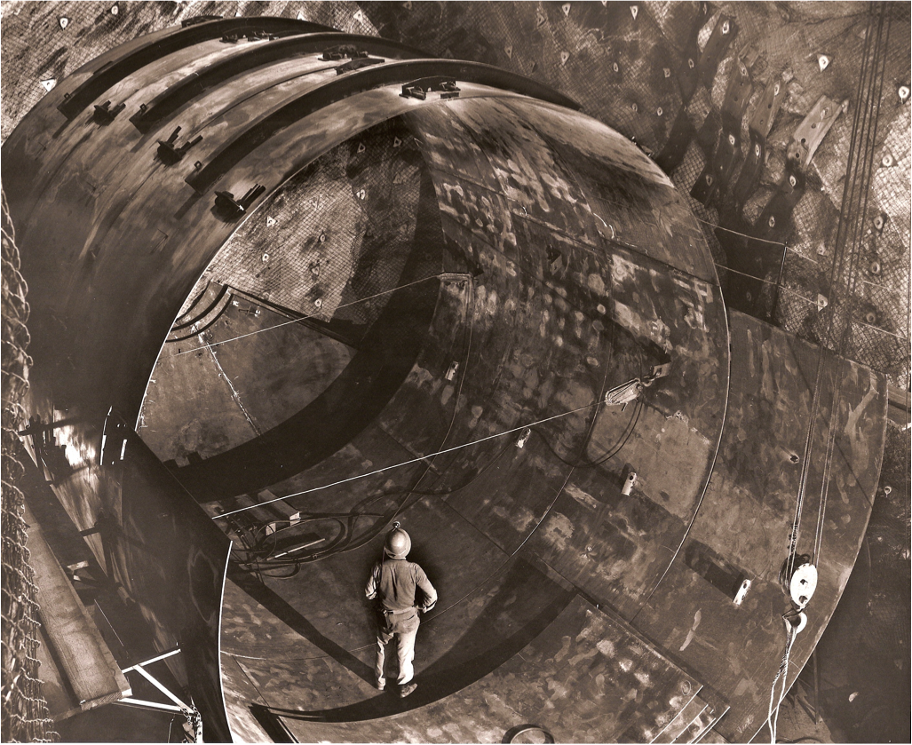
Overview
Far Site
Far Detector
Beam and Near Detector
Summary

Slide 3
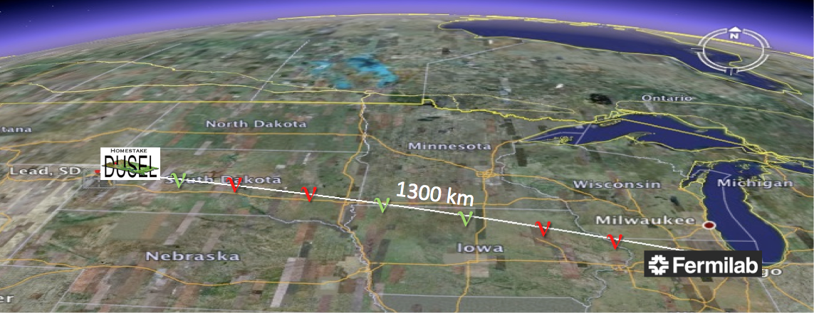
Beam: 700 kW, 60-120 GeV, 5 years ν + 5 years ν
on-axis, wide band, upgradable to 2.3 MW
Baseline: 1300 km FNAL to Homestake
Far Site: Underground location to facilitate broad program
Near Site: on current Fermilab property
Configurations: several options under study for beam,
near, and far detectors

Slide 4
OVERVIEW: Two Far Detector Options
200 kT water Cherenkov
34 kT liquid argon
Two 17 kT fiducial LAr detectors
To be located at a new drive-in
site at 800 foot level. (one detector
shown here)
One 200 kT fiducial WC detector
Located at the 4850 foot level

Slide 5
Long-Baseline Neutrino Experiment Collaboration
IPMU/Tokyo: M. Vagins
Irvine: G. Carminati, W. Kropp, M. Smy, H. Sobel
Kansas State: T. Bolton, G. Horton-Smith
LBL: R. Kadel, B. Fujikawa, D. Taylor
Livermore: A. Bernstein, R. Bionta, S. Dazeley, S. Ouedraogo
London-UCL: J. Thomas
Los Alamos: S. Elliott, A. Friedland, V. Gehman, G. Garvey, T. Haines, D. Lee, W. Louis, C. Mauger, G. Mills, A. Norrick, Z. Pavlovic, G. Sinnis, W. Sondheim, R. Van de Water, H. White
Louisiana State: W. Coleman, T. Kutter, W. Metcalf, M. Tzanov
Maryland: E. Blaufuss, R. Hellauer, T. Straszheim, G. Sullivan
Michigan State: E. Arrieta-Diaz, C. Bromberg, D. Edmunds, J. Huston, B. Page
Minnesota: M. Marshak, W. Miller
MIT: W. Barletta, J. Conrad, T. Katori, R. Lanza, L. Winslow
NGA: S. Malys, S. Usman
New Mexico: B. Becker, J. Mathews
Notre Dame: J. Losecco
Oxford: G. Barr, J. DeJong, A. Weber
Pennsylvania: J. Klein, K. Lande, A. Mann, M. Newcomer, S. Seibert, R. vanBerg
Pittsburgh: D. Naples, V. Paolone
Princeton: Q. He, K. McDonald
Rensselaer: D. Kaminski, J. Napolitano, S. Salon, P. Stoler
Rochester: R. Bradford, K. McFarland
SDMST: X. Bai, R. Corey
SMU: T. Liu, J. Ye
South Carolina: H. Duyang, S. Mishra, R. Petti, C. Rosenfeld
South Dakota State: B. Bleakley, K. McTaggert
Syracuse: M. Artuso, S. Blusk, T. Skwarnicki, M. Soderberg, S. Stone
Texas: S. Kopp, K. Lang, R. Mehdiyev
Tufts: H. Gallagher, T. Kafka, W. Mann, J. Schnepps
UCLA: K. Arisaka, D. Cline, K. Lee, Y. Meng, F. Sergiampietri, H. Wang
Virginia Tech: E. Guarnaccia, J. Link, D. Mohapatra, R. Raghavan
Washington: H. Berns, S. Enomoto, J. Kaspar, N. Tolich, H.K. Tseung
Wisconsin: B. Balantekin, F. Feyzi, K. Heeger, A. Karle, R. Maruyama, D. Webber, C. Wendt
Yale: E. Church, B. Fleming, R. Guenette, K. Partyka, J. Spitz, A. Szelc
Alabama: J. Goon, I Stancu
Argonne: M. D’Agostino, G. Drake. Z. Djurcic, M. Goodman, X. Huang, V. Guarino, J. Paley, R. Talaga, M. Wetstein
Boston: E. Hazen, E. Kearns, S. Linden, J. Stone
Brookhaven: M. Bishai, R. Brown, H. Chen, M. Diwan, J. Dolph, G. Geronimo, R. Gill, R. Hackenberg, R. Hahn, S. Hans, D. Jaffe, S. Junnarkar, J.S. Kettell, F. Lanni, L. Littenberg, J. Ling, D. Makowiecki, W. Marciano, W. Morse, Z. Parsa, C. Pearson, V. Radeka, S. Rescia, T. Russo, N. Samios,R. Sharma, N. Simos, J. Sondericker, J. Stewart, H. Tanaka, C. Thorn, B. Viren, Z. Wang, S. White, L. Whitehead, M. Yeh, B. Yu
Caltech: R. McKeown, X. Qian, C. Zhang
Cambridge: A. Blake, M. Thomson
Catania/INFN: V. Bellini, G. Garilli, R. Potenza, M. Trovato
Chicago: E. Blucher
Colorado: S. Coleman, R. Johnson, A. Marino, M. Tzanov, E. Zimmerman
Colorado State: M. Bass, B. Berger, J. Brack, N. Buchanan, J. Harton, V. Kravtsov, W. Toki, D. Warner, R. Wilson
Columbia: R. Carr, L. Camillieri, C.Y. Chi, G. Karagiorgi, C. Mariani, M. Shaevitz, W. Sippach, W. Willis
Crookston: D. Demuth
Dakota State: B. Szcerbinska
Davis: M. Bergevin, R. Breedon, J. Felde, P. Gupta, M. Tripanthi, R. Svoboda
Drexel: C. Lane, J. Maricic, R. Milincic, K. Zbiri
Duke: T. Akiri, J. Fowler, K. Scholberg, C. Walter, R. Wendell
Duluth: R. Gran, A. Habig
Fermilab: D. Allspach, M. Andrews, B. Baller, E. Berman, D. Boehnlein, M. Campbell, A. Chen, S. Childress, B. DeMaat, A. Drozhdin, T. Dykhuis, C. Escobar, A. Hahn, S. Hays, A. Heavey, J. Howell, P. Huhr, J. Hylen, C. James, M. Johnson, J. Johnstone, T. Junk, B. Kayser, G. Koizumi, T. Lackowski, P. Lucas, B. Lundberg, T. Lundin, P. Mantsch, E. McCluskey, N. Mokhov, C. Moore, J. Morfin, B. Norris, V. Papadimitriou, R. Plunkett, C. Polly, S. Pordes, O. Prokofiev, J. Raaf, G. Rameika, B. Rebel, D. Reitzner, K. Riesselmann, R. Rucinski, R. Schmidt, D. Schmitz, P. Shanahan, M. Stancari, J. Strait, S. Striganov, K. Vaziri, G. Velev, G. Zeller, R. Zwaska
Hawaii: S. Dye, J. Kumar, J. Learned, S. Matsuno, S. Pakvasa, M. Rosen, G. Varner
Indian Universities: V. Singh (BHU); B. Choudhary, S. Mandal (DU); B. Bhuyan [IIT(G)]; V. Bhatnagar, A. Kumar, S. Sahijpal(PU)
Indiana: W. Fox, C. Johnson, M. Messier, S. Mufson, J. Musser, R. Tayloe, J. Urheim
Iowa State: M. Sanchez
22 April 2011
~300 physicists and engineers, 55 institutions

Slide 6
This Talk
Will present present state of design of the experiment. Nothing is yet completely fixed, but options have been narrowed down and work is ongoing to evaluate cost and schedule.
You will be shown the current plans assuming that the U.S. NSF does not participate. NSF had been asked to pay ~10% of LBNE construction costs and operate DUSEL. Now the U.S. Dept of Energy (DOE) is planning to bear the full construction cost and be responsible for facility operations. This is assumed in all slides.
A decision was made by DOE to, at least initially, continue evaluation for only the Homestake site. A formal review was held at SLAC in March under a "blue ribbon" panel commissioned by the Director of the Office of Science (all science, not just HEP). All slides and schedules assume usage of the Homestake site.

Slide 7
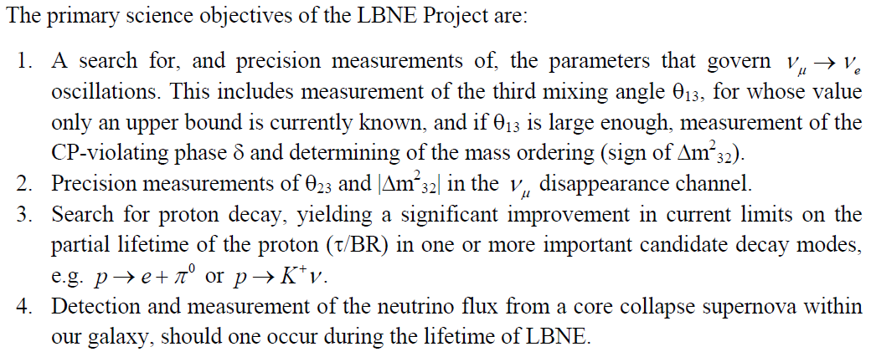
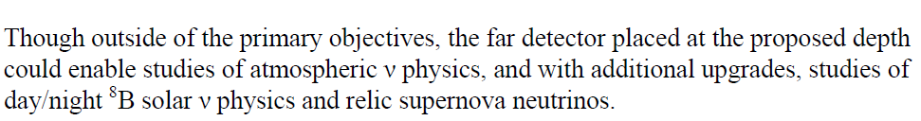
Physics Research Goals of LBNE

Slide 8
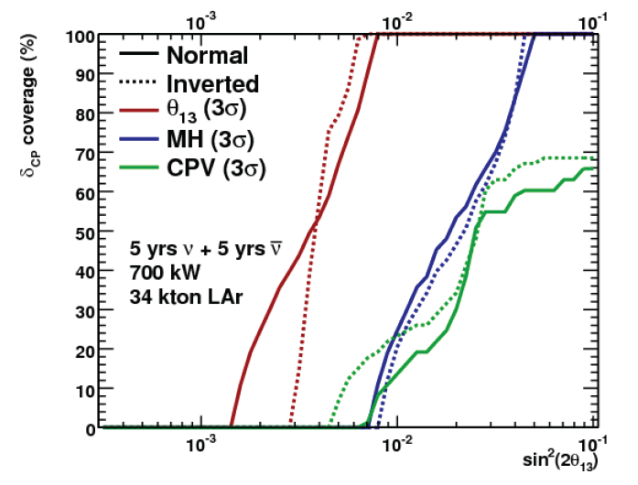
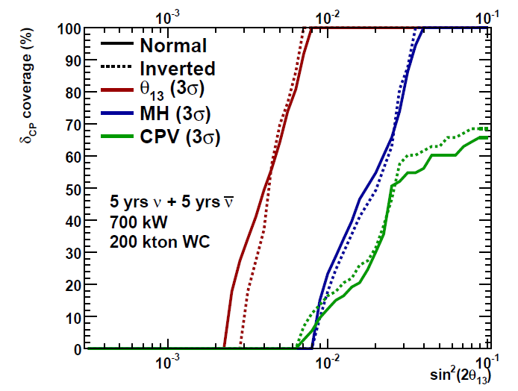
Physics with the Neutrino Beam
34 kt LAr TPC
200 kt WCD
For beam physics: 200 kt WCD ≈ 34 kt LAr ≈ 100 kt WCD + 17 kt LAr
  Ongoing work to tune efficiency and signal/background may affect this equivalence
  Will alternate WCD/LAr plots in this talk
  5+5 years turns out to be near optimal in shallow minimum
Quantitative & qualitative performance differences for some non-beam physics

Slide 9
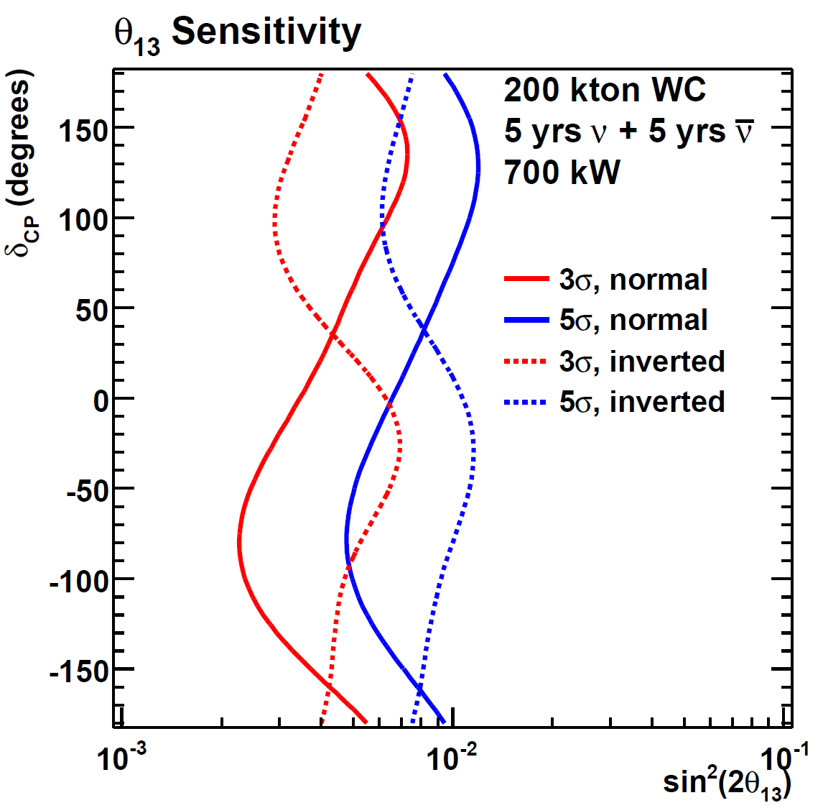
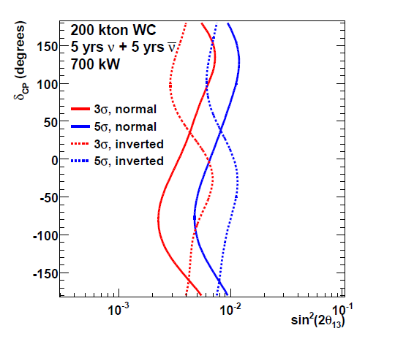
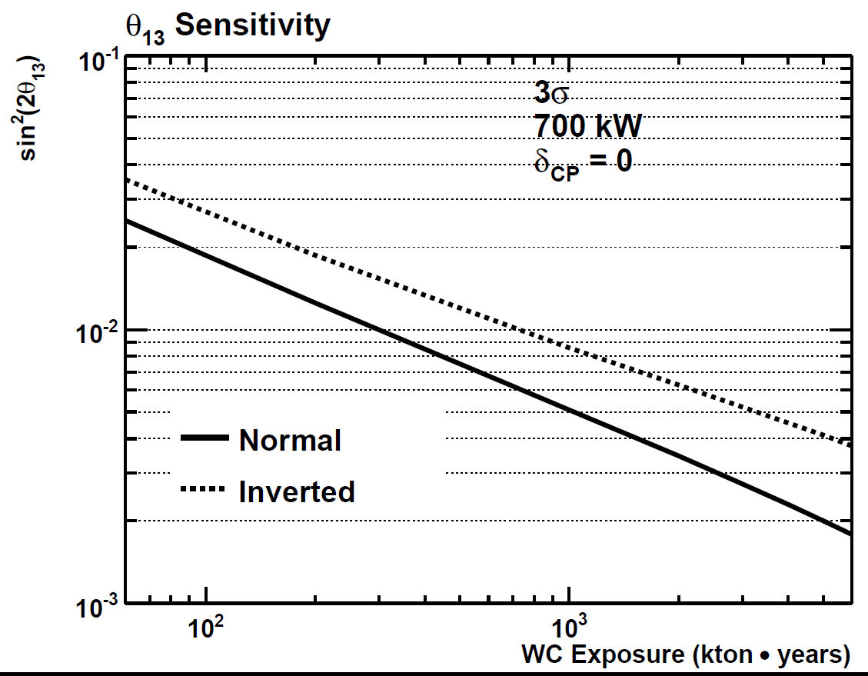
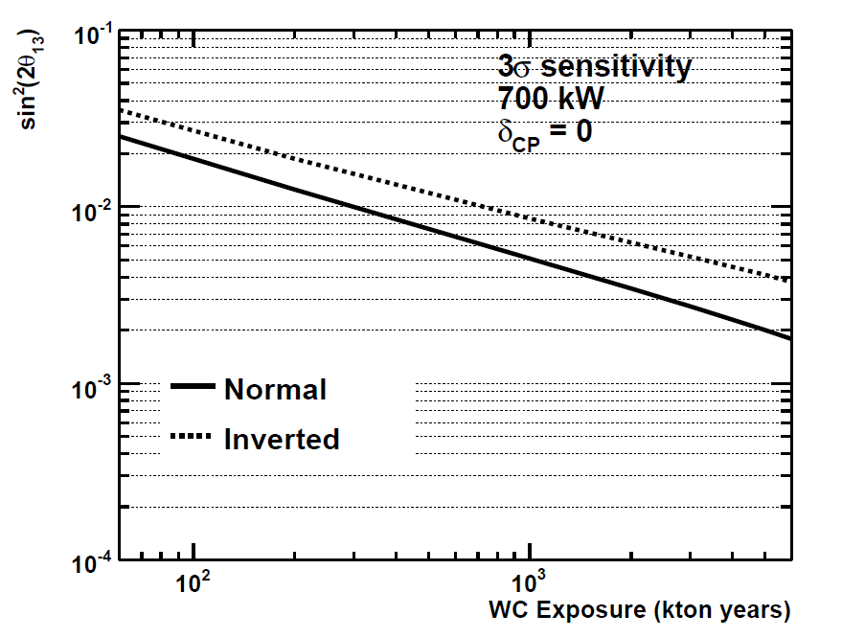
sin²2θ₁₃≠0 Sensitivity
~Daya Bay/T2K/NOvA (EuroNu2009)
Note: 3σ
200 kt x 5+5 yrs
Project X
sin²2θ₁₃ 3-σ sensitivity: 0.002--0.008 (~0.001--0.004 with 2 MW beam)
While not designed as a primarily θ₁₃ experiment, sensitivity is still very good, especially with Project X

Slide 10
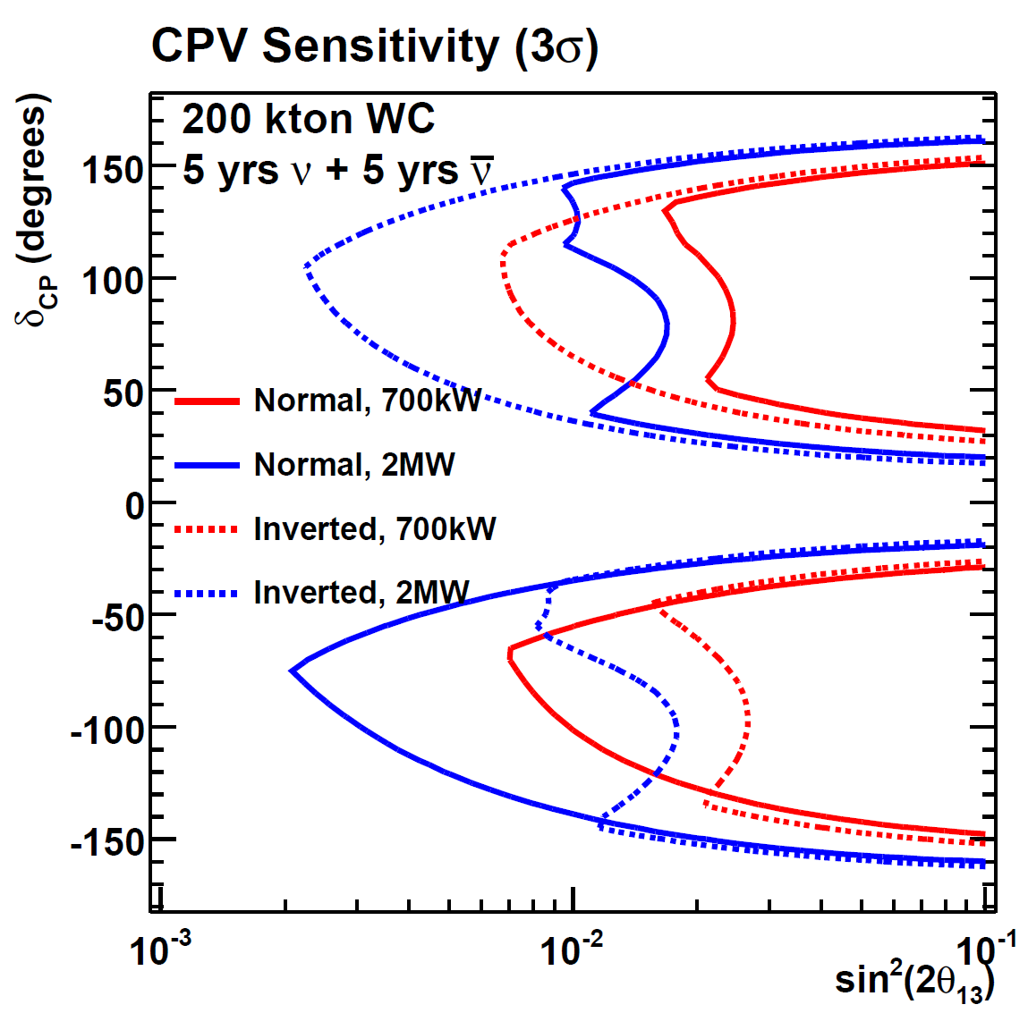
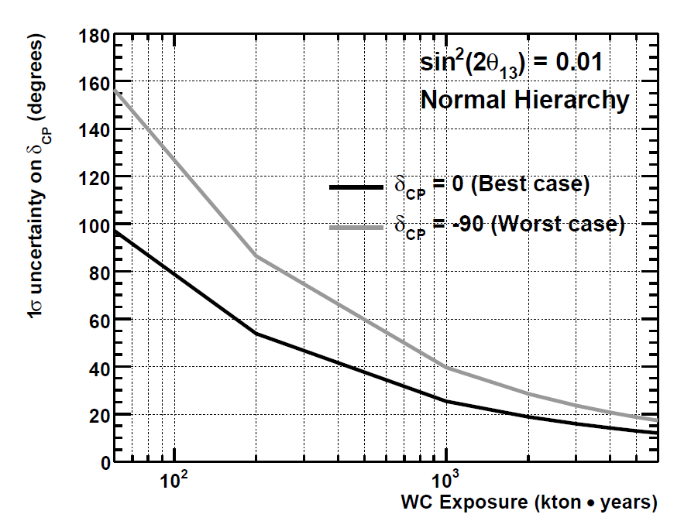
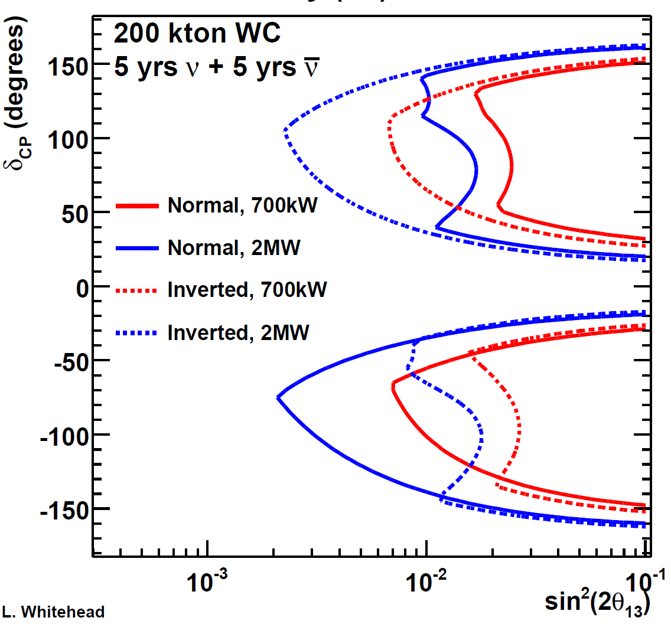
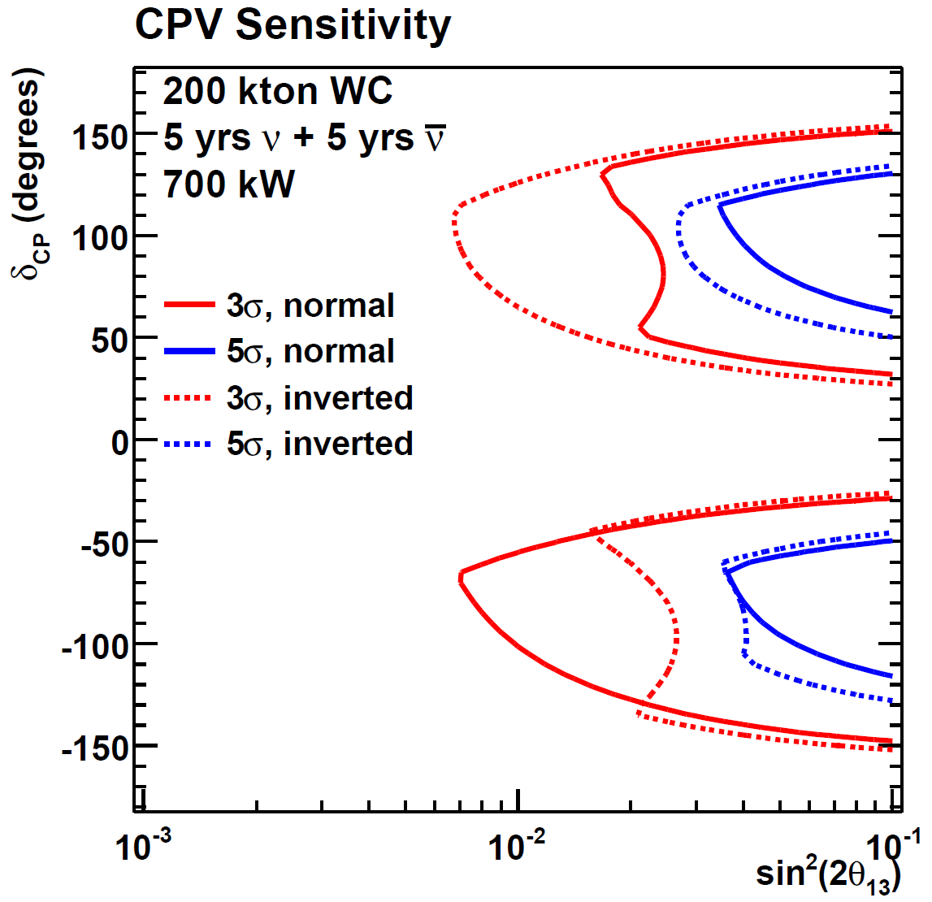
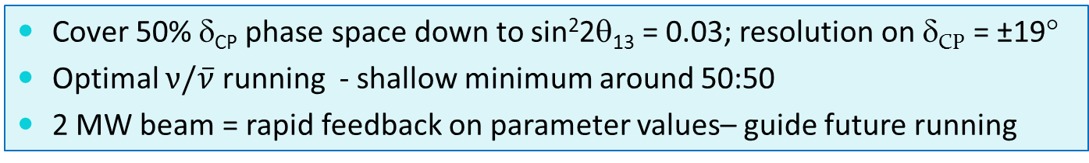
CP Sensitivity
3σ exclusion of CP conserving δ_{CP}=0° or 180°
1σ resolution on δ_{CP} measurement
50%
200 kt x 5+5 yrs
2 MW
700 kW
Project X
Cover 50% δ_{CP} phase space down to sin²2θ₁₃ = 0.03; resolution on δ_{CP} = ±19°
Optimal $ν/\overline{ν}$ running - shallow minimum around 50:50
2 MW beam = rapid feedback on parameter values– guide future running

Slide 11
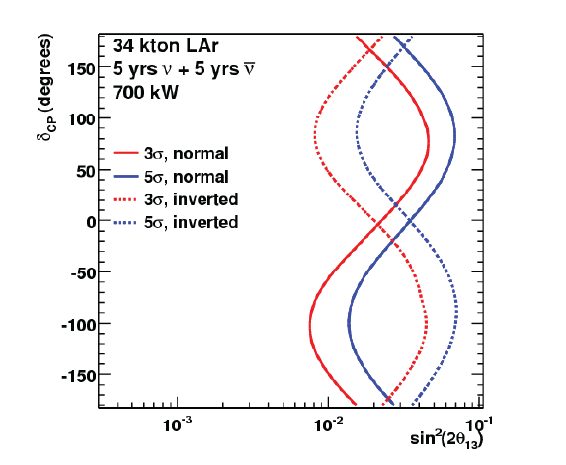
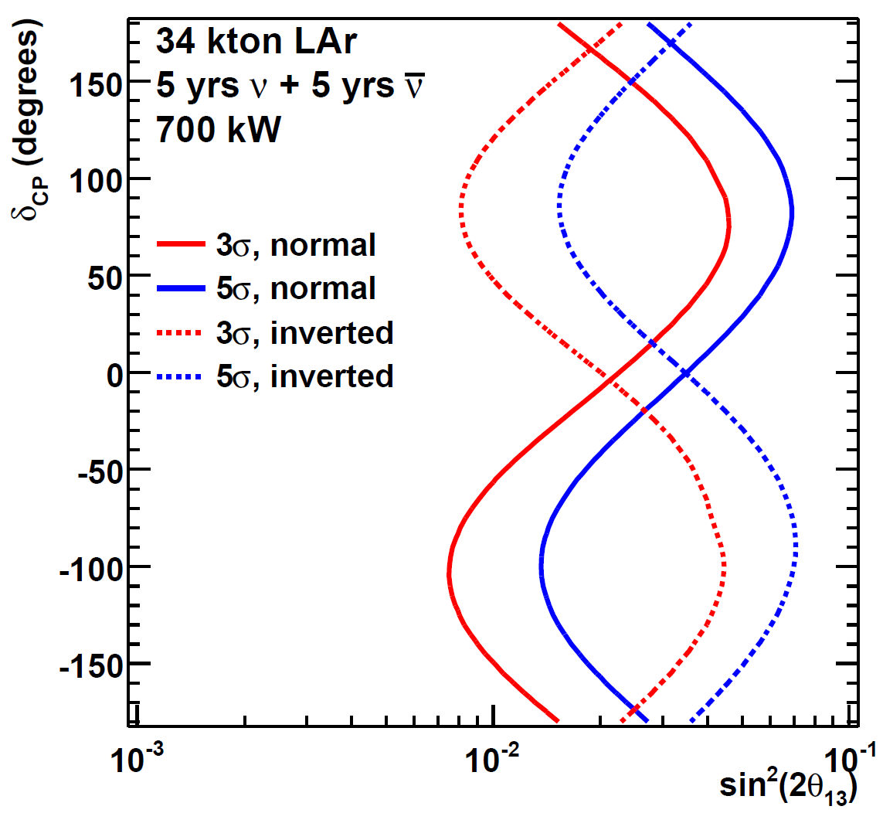
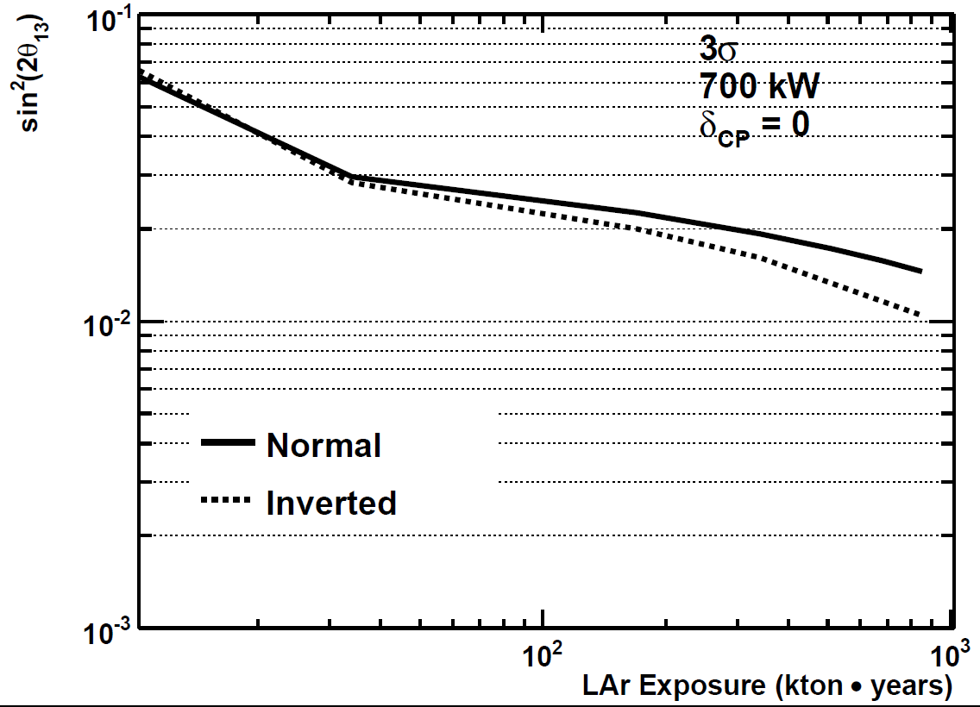
MH Sensitivity
3σ/5σ exclusion of MH hypothesis
3σ exclusion of MH hypothesis
34 kt x 5+5 yrs
Project X
340 kt-y LAr exposure can resolve MH at 3σ for all δ_{CP} down to sin²2θ₁₃= 0.04
Shorter baselines (NOvA, T2K) challenged by inherent degeneracies between CP-violating asymmetries and matter effects.

Slide 12
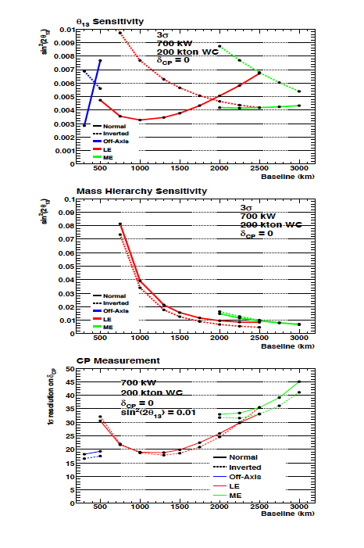
Homestake is at a good distance
A 1300 km baseline:
Large matter effects
Higher energy at oscillation peak with enhanced cross section compare to MINOS
Interplay between θ₁₃, mass hierarchy, and CPV is complex
Lower flux due to 1/r² is important
FNAL-Homestake distance makes three important measurements possible with a single experimental configuration.
(Beam retuned at each distance)

Slide 13
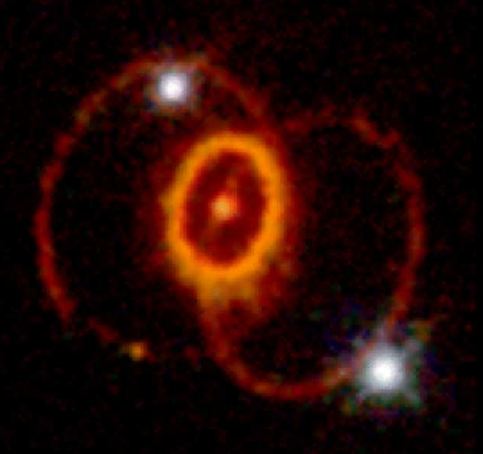
Supernova Neutrinos
When a star's core collapses ~99% of the gravitational binding energy of the proto-neutron star goes into ν's
SN at galactic core (10 kpc)
⇒ tens of thousands of interactions
in tens of seconds
Large detectors can discriminate between core collapse models
Sanduleak -69º 202 → SN 1987A
"You don't have to be lucky, you just have to be patient."

Slide 14
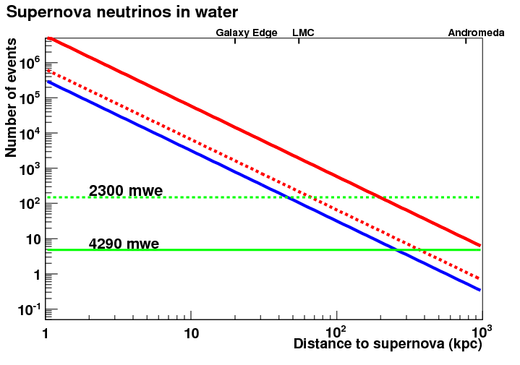
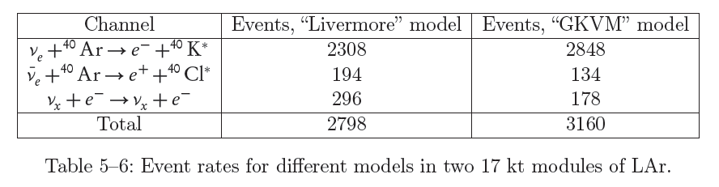
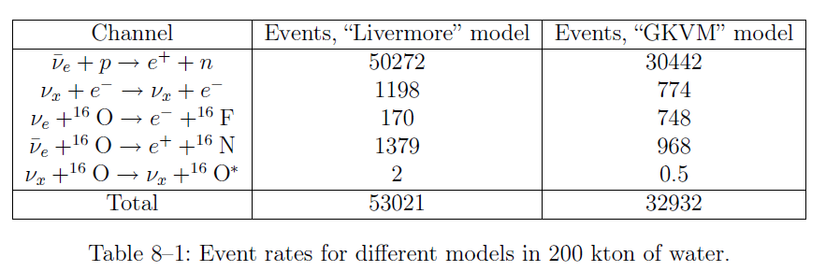
SN Rates and Reach
/30s
Significant difference in model
event rate prediction - but still large
LAr
WC
3-σ Mass Hierarchy sensitivity
700 mwe
200 kt WC
SK
34 kt LAr
cosmic muons/30s
Larger detector mass -> further reach
Could potentially resolve Mass Hierarchy to 3-σ out to Galaxy Edge (both LAr & WC) if "spectral swap" features observed
In a hybrid WCD+Lar: Good spectral information of νe from LAr will help resolve flavor content of the primarily νe-bar in WCD

Slide 15
Reactor ν (ν_{e})
Constant SN rate (Totani et al., 1996)
Totani et al., 1997
Hartmann, Woosley, 1997
Malaney, 1997
Kaplinghat et al., 2000
Ando et al., 2005
Lunardini, 2006
Fukugita, Kawasaki, 2003(dashed)
Solar ⁸B (ν_{e})
Solar hep (ν_{e})
SRN predictions
(ν_{e} fluxes)
Differences due to core collapse models and assumed
SN rate and luminosity
Large WC detector or LS detectors are best.
HEP solar neutrinos limits LAr
sensitivity (ν_{e}) – plus need for large size.
Conclusion: LAr detector too small to justify added costs of deep site for this physics
Atmospheric ν_{e}

Slide 16
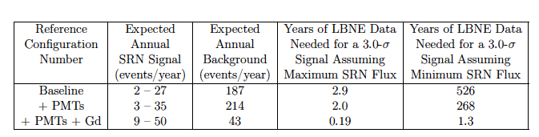
Published SK limit on diffuse SN flux compared with several models
The Homestake muon rate an order of magnitude smaller than Kamioka,
so expect 15.5 MeV threshold instead of 19.3 MeV. This enhances signal by 40% in addition to just detector mass scaling.
Due to geomagnetic latitude, atmospheric neutrino rate per kton is 50% higher at
Homestake as compared to Kamioka. This enhances background by 50%.
Notes:
16

Slide 17
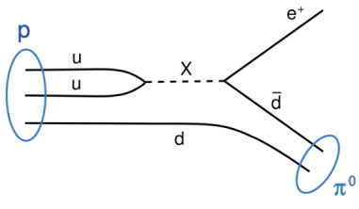
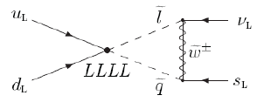
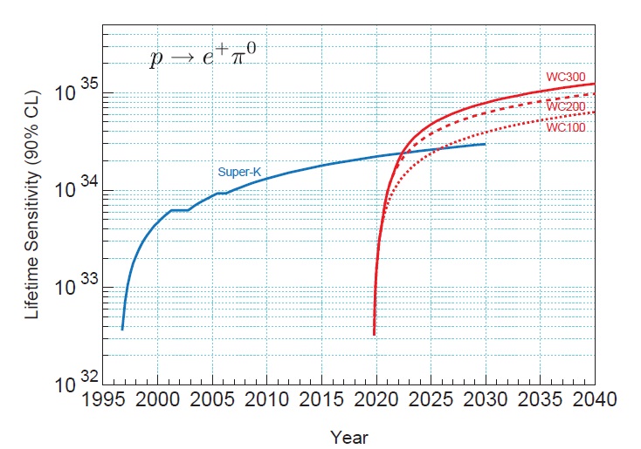
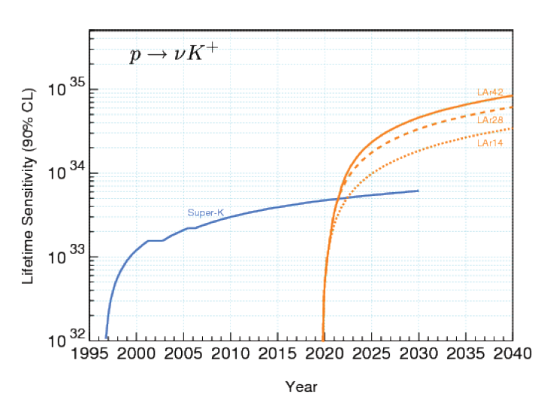

Proton Decay
WCD
LAr
e⁺π⁰: WC200 reach ~10³⁵ in 20 years -- 7.5x SK current; 5x SK ultimate
νK⁺: LAr34 reach ~7x10³⁴ in 20 years -- 23x SK current; 10x SK ultimate
Detector mass is the main issue, backgrounds also come into play

Slide 18
The Far Site

Slide 19
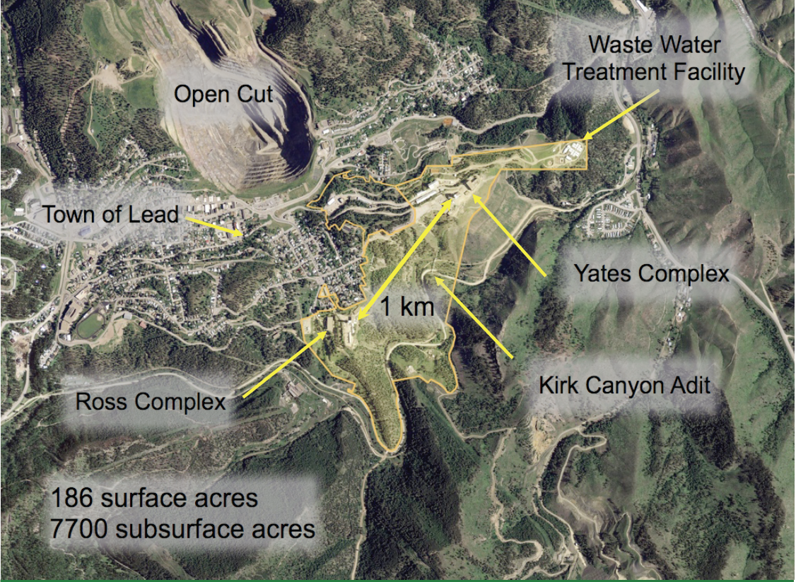
Homestake Site:
Surface Facility

Slide 20
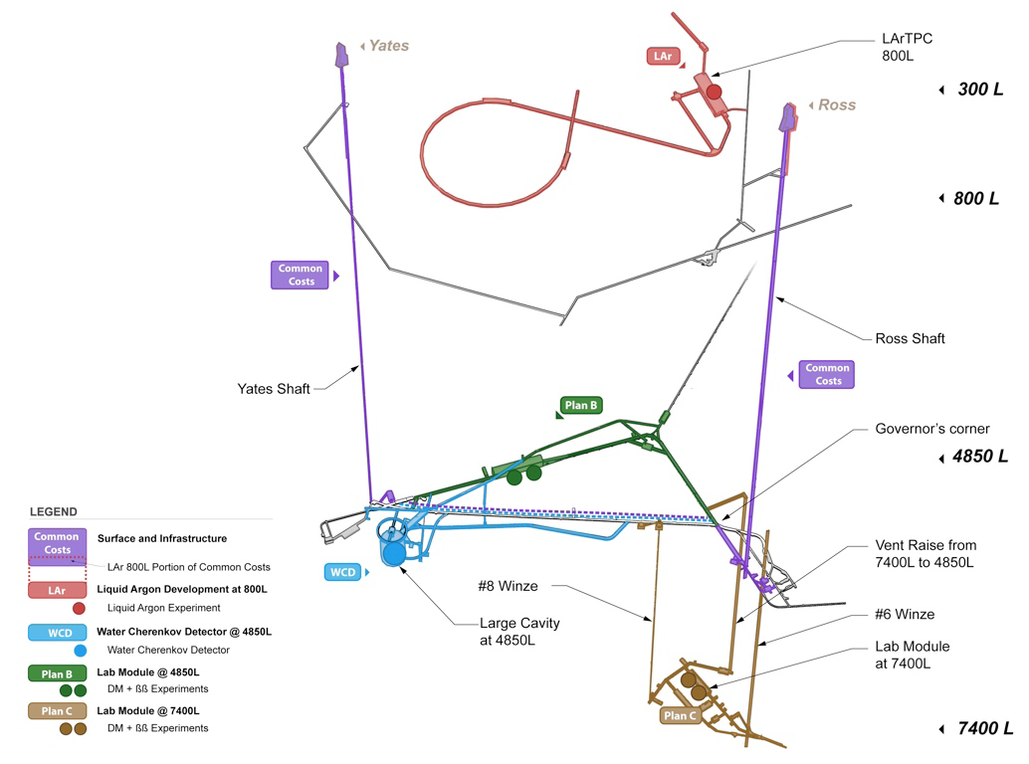
OVERVIEW: Underground Lab Basic Layout
4850 campus at 4200 mwe
Davis Lab (existing)
Large Cavity Site
General lab module
800 campus at 700 mwe
LAr detector lab
7400 campus at 6400 mwe
Deep Lab module

Slide 21
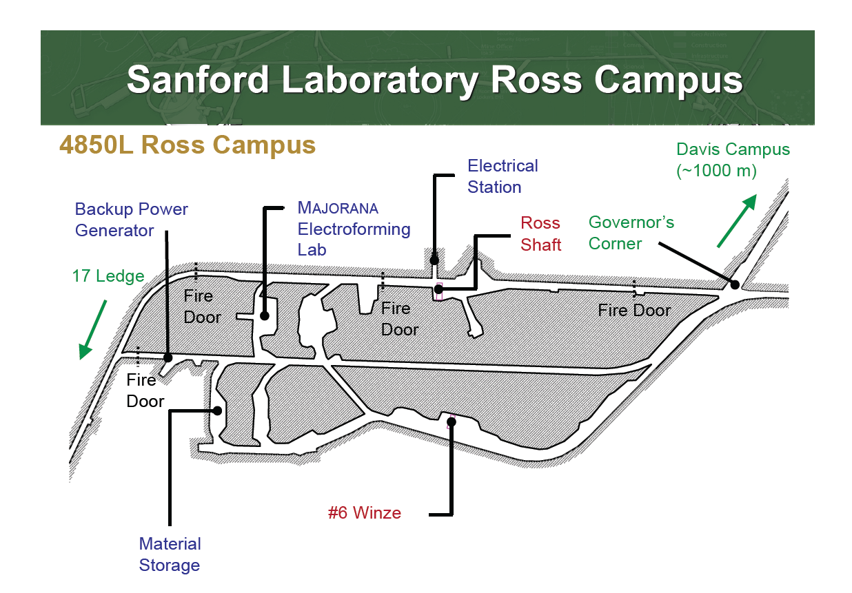
Part of existing Laboratory built
with South Dakota funds

Slide 22
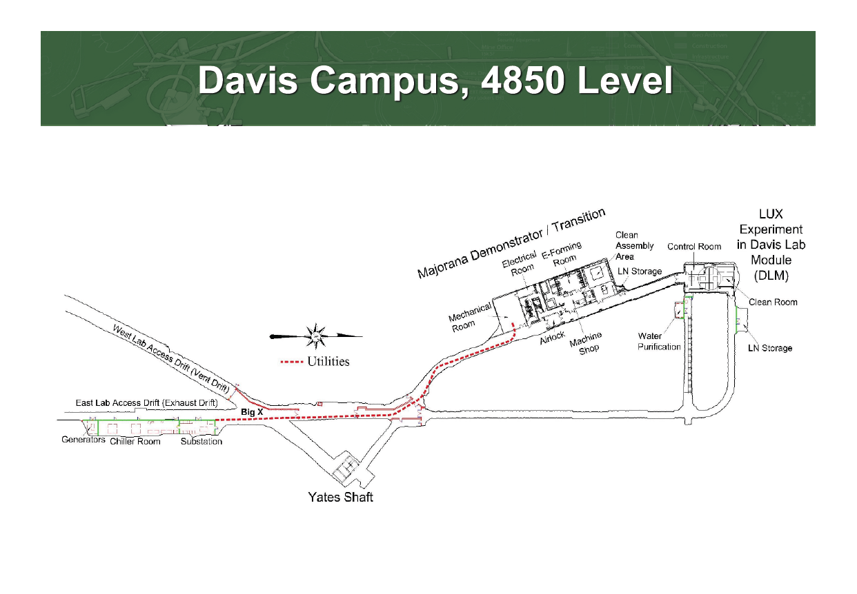

Slide 23
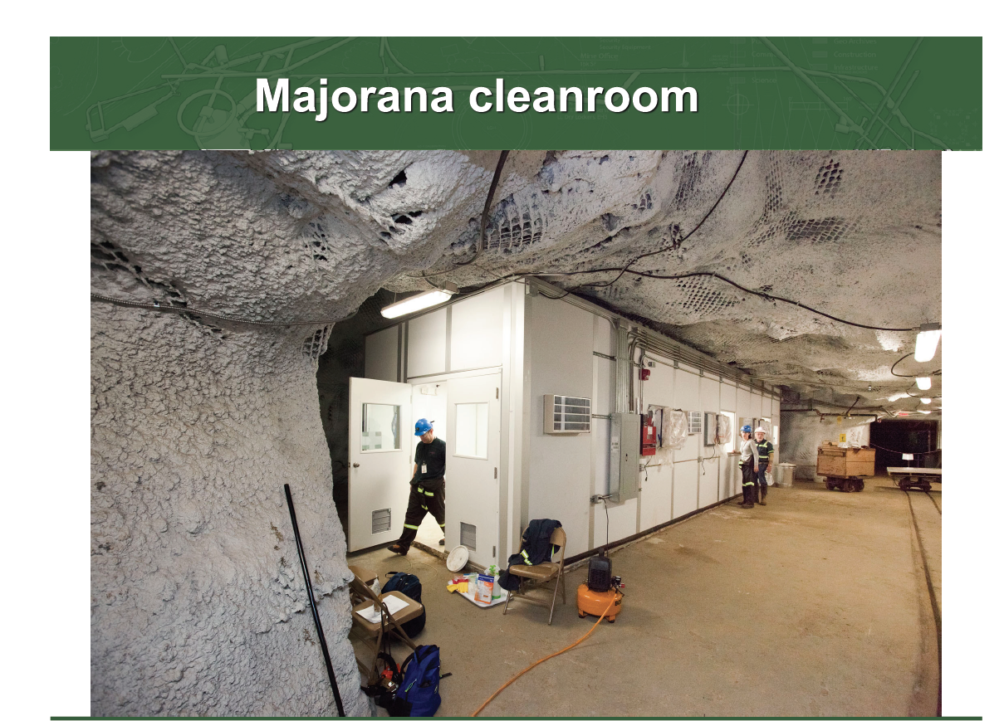

Slide 24
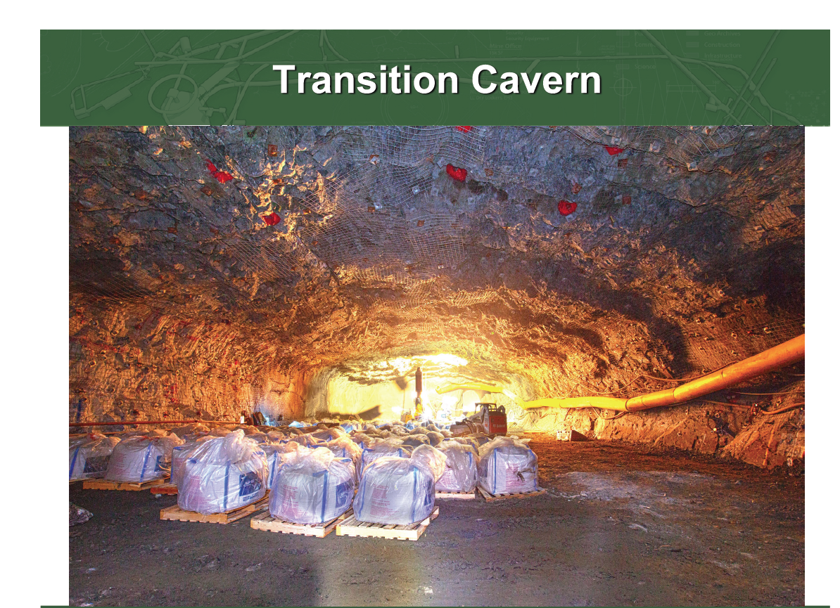

Slide 25
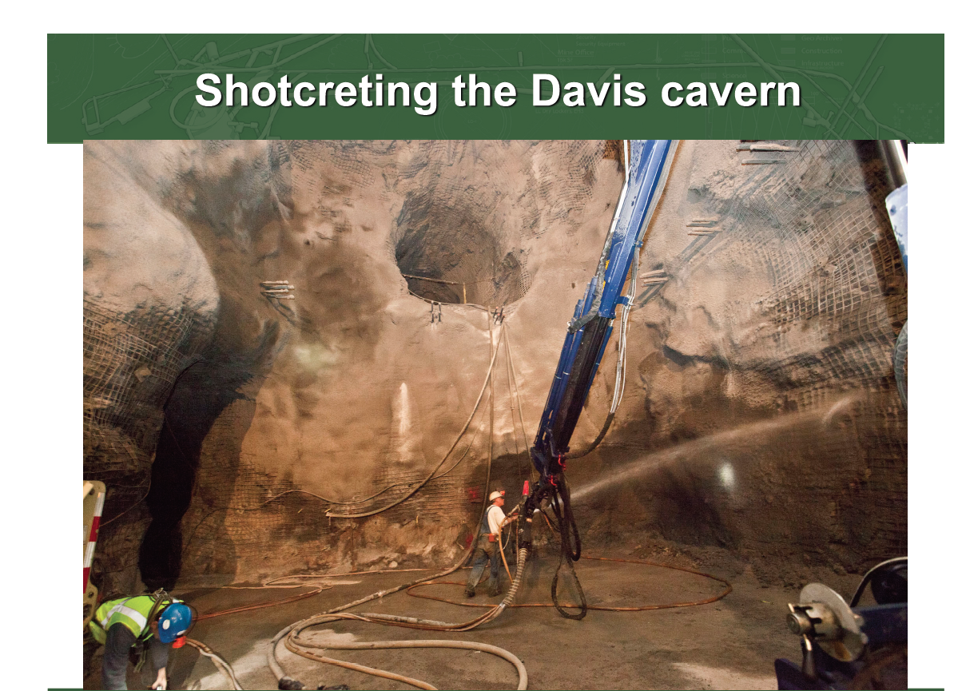

Slide 26
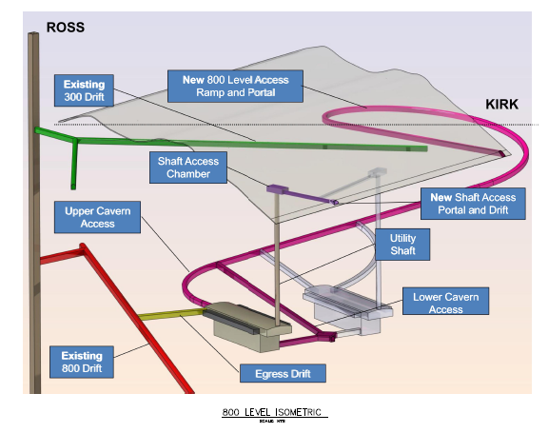
LAr 800 level lab at Homestake
      24-34kt cavern at 800 level
      Space on surface for cyrogenics system
      Drive-in access for experiment installation
      Experimental utilities: power, ventilation for cryogenic safety
      Why 800 level?
      SN detection, atmospheric neutrinos detection improved
      Critical for proton decay

Slide 27
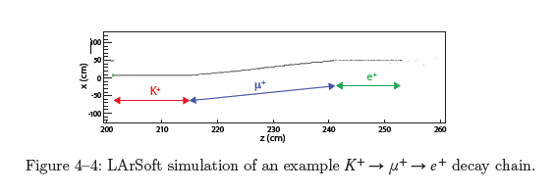
Depth Requirements for Proton Decay: Liquid Argon
A unique feature of LAr detectors are their ability to reconstruct the K⁺ decay from the SUSY-motivated decay mode pgνK⁺. This would allow sensitivity to this mode five times that of Super-Kamiokande over a 10 year run.
The most significant background expected is from CR muons that make a Kº_{L} that enters the detector from the outside and then charge exchanges into a K⁺.

Slide 28
Requirement for Muon veto
Without a muon veto, a fiducial volume cut of 5-7 meters from the wall is predicted to be necessary
With an effective veto this can be significantly reduced.
At 800 feet, a muon veto is planned that would retain roughly 80% of the FV.
Conclusion: with a sufficiently well-designed muon veto, 800 feet should be sufficient. This is currently the driving factor in the depth requirement.
Muon veto
K⁺
Kº_{L}
detector
μ

Slide 29
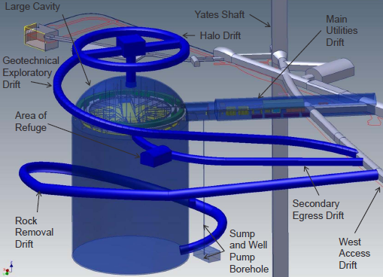
WCD Conventional Facilities (CF) at Homestake
WCD CF based on requirements of experiment
      150kt-200kt cavern at 4850 level
      Space on surface for water fill system, underground for water recirculation system
      Experimental utilities: power, water for tank, drainage of leak & native water from the tank, drainage for tank maintenance
4850 level location driven by potential for low energy neutrino
measurements now and in future upgrades. Cosmological SN
neutrinos, solar neutrinos, geoneutrinos.

Slide 30
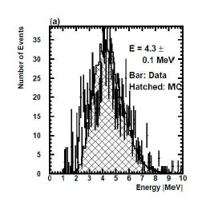
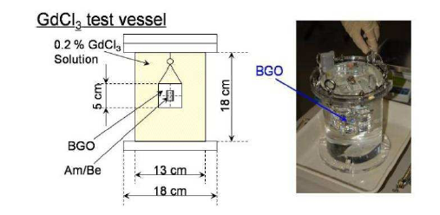
Addition of Gadolinium
Tests with Super-Kamiokande have shown that neutron tagging via gadolinium
in the water is feasible.
Case Study document details the increased light collection needed for LBNE.
Roughly a factor of two is desirable to achieve good efficiency

Slide 31
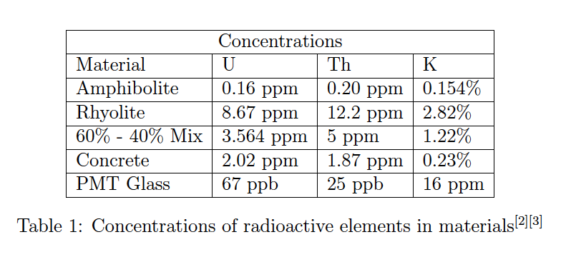
Low Energy Physics: Radiopurity
For the WC detector option, extensive hit-level studies have been done
of the effects of radiopurity on detector energy threshold performance.

Slide 32
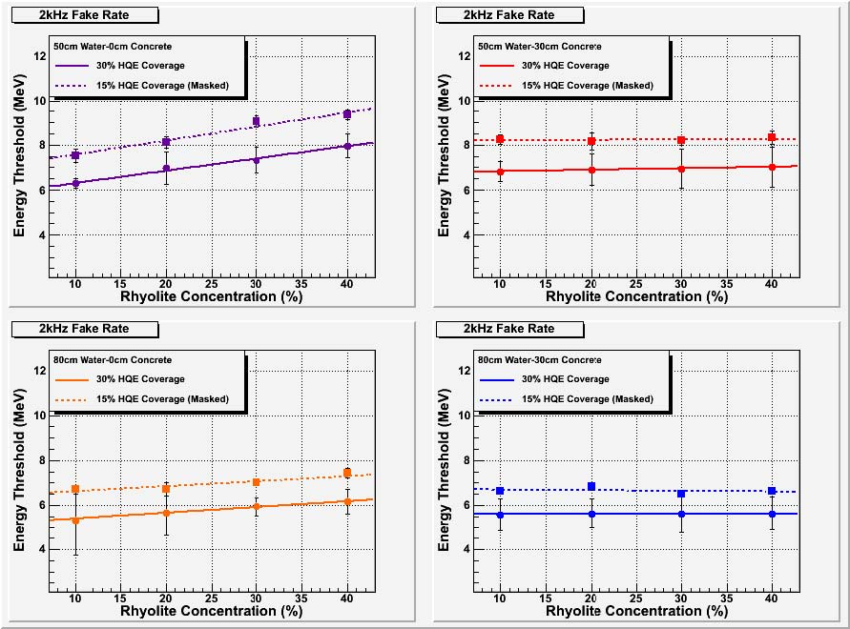
Threshold independent of rock with 80 cm buffer. Nominal threshold with design coverage is ~6.7 MeV. No concrete liner BETTER since Homestale rock has quite good radiopurity compared to typical concrete.
With
concrete
liner
Design PMT coverage
Without
concrete
liner

Slide 33
The Far Detectors

Slide 34
Detector Mass Requirements
The 200 kT mass selected for a WC detector is driven by the statistics necessary to address the physics goals in a ten year run, for sin²2θ₁₃ in the range of current experimental sensitivity.
If sin²2θ₁₃ is outside this range, LBNE has enough sensitivity to make the most sensitive search for this parameter.
The smaller 34 kT mass for LAr is based on the ability to use non-QECC events to look for ν_{μ}gν_{e} oscillations due to event ID and NC rejection.

Slide 35
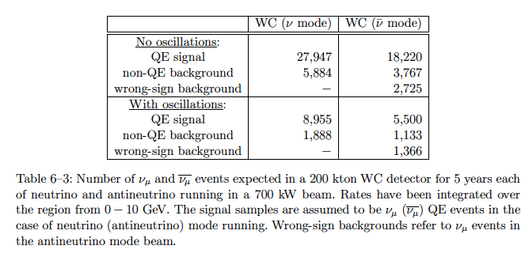
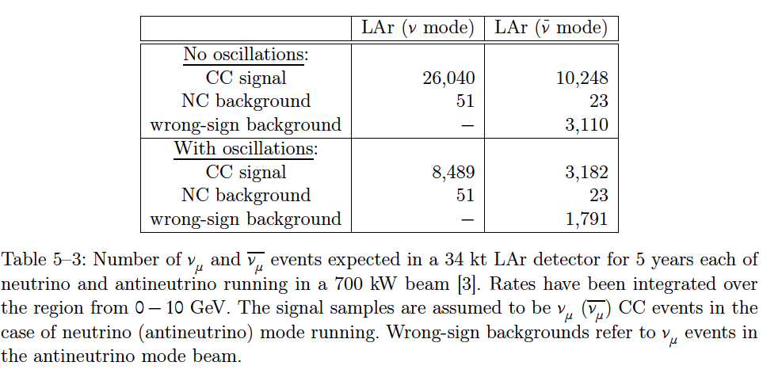
Event rates for numu and numubar events in LAr (bottom) and WC (top).
These tables indicate why
sensitivities are similar in this mode. The wrong-sign background in LAr is compensated by the reduced background from non-QE/NC

Slide 36
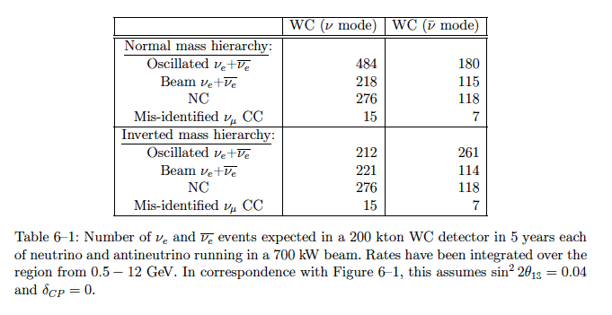
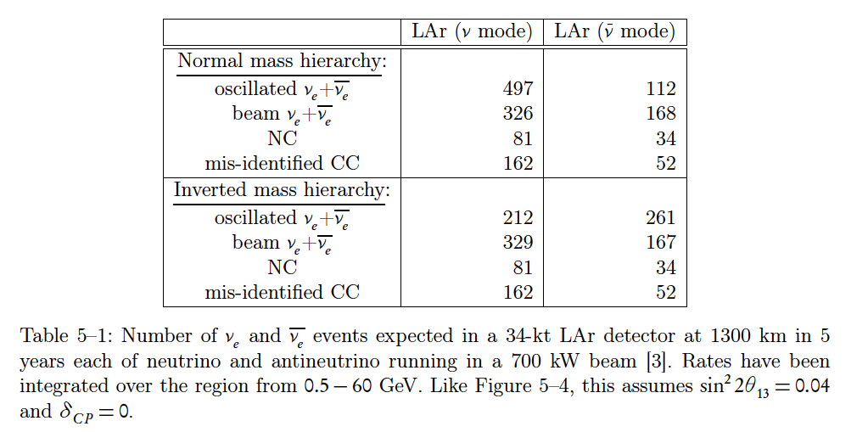
Event rates for nue and nuebar events in LAr (bottom) and WC (top).
Note the difference in the background components for
the two detector types.
A measurement with two different detector types would be complimentary – the systematic uncertainties in the background are quite different.

Slide 37
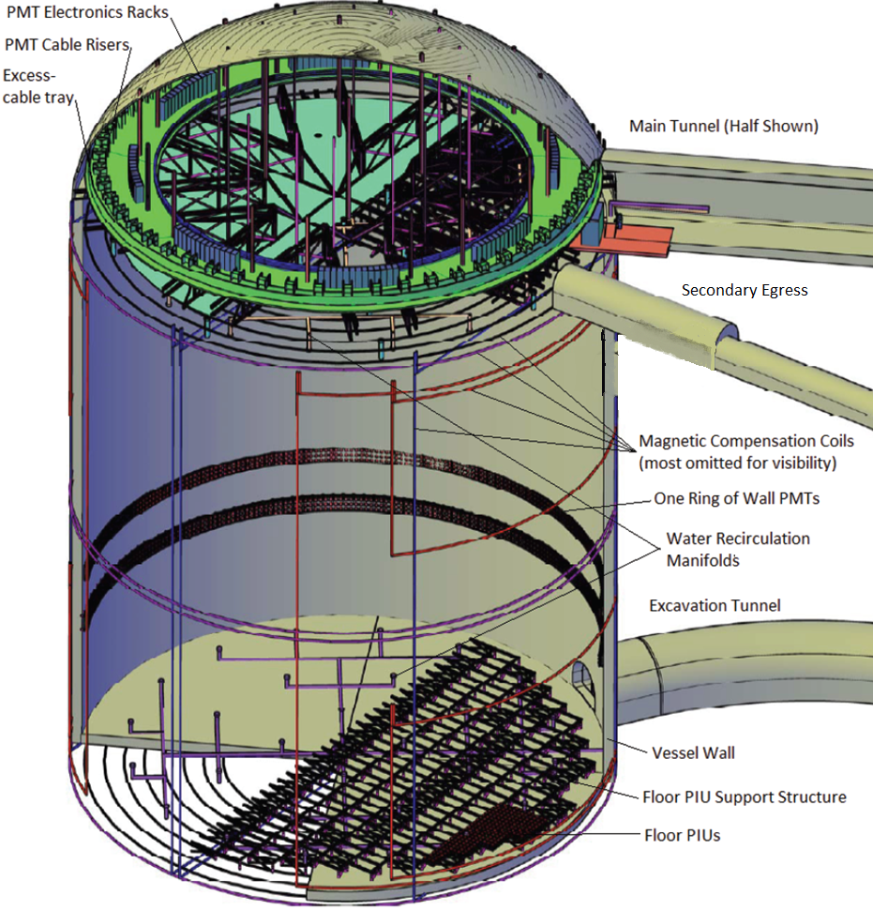
Water Cherenkov Detector Overview
Main Detector Components
Large Cavern
Water Vessel
Ultra-pure water system
PMTs with Electronics
2 sizes under consideration:
150 kt or 200 kt fiducial mass (7-9 x SuperK)
PMT + light collectors give photon detection efficiency equivalent to SuperK II

Slide 38


Water Containment
Text
Drainage mat covered with shotcrete
Polymer membrane
on shotcrete protects the ultra-pure water and stops leakage
Alternate design:
Polymer membrane against 14” poured concrete vessel.

Slide 39


Water Cherenkov Detector Deck
Spans the 65m diameter cavern, suspended from the dome.
Provides a light-tight, air-tight barrier for the detector.
Balcony (8 m wide) provides space to mount electronics.
Gondola under balcony for access to detector wall

Slide 40

Phototube System
23,000 (29,000) 12” HQE PMTs in 150 kt (200 kt) detector
  Will be catalogue item this year
  Competing 11” tube also available this year
Light collectors will be used
  Winston cones or scintillator plates
  40% increase in light assumed
  Both can achieve >50%
HQE PMTs + light collectors give photon detection efficiency equivalent to SuperK II.

Slide 41



Ultra-Pure Water System
125 gal/min fill system
takes industrial water
filters and removes minerals
Removes gasses, U/Th and sterilizes
4.5 to 6 months to fill
700-1200 gal/min recirculation system
Filters and sterilizes the water
Removes U/Th and gasses
Removes heat

Slide 42

Liquid Argon TPC Overview
Alternating Cathode and Anode Plane Assemblies
(CPA, APA).
Foam-insulated cryostat inside concrete containment vessel (membrane cryostat)
Veto system to tag cosmic rays passing through the adjacent rock.
Photon detectors provide t=0 for non-beam physics.
Two detectors, 12-17 kt each, in a common cavern at the 800 level.
At this meeting:
Cold Electronics: Veljko Radeka
Light Guides: Ben Jones
LBNE LAr detector and 1kT prototype: Bruce Baller

Slide 43


Current TPC Design
Modular APA design: 3 views on a
2.5 m x 7 m frame, mounted 2 high in cryostat
3 or 5 mm wire pitch
3.75 m or 2.5 m drift cell
7 m
2.5 m

Slide 44
LAr Prototyping Program
LBNE LAr development builds on world-wide R&D program
LBNE-specific prototyping program includes:
3 x 3 m² membrane cryostat wall panel – testing in progress
3 x 3 x 3 m³ membrane cryostat prototype
- Understand cryostat technology
- Verify purity in this cryostat
- Preliminary design complete; operational in 2012
kton-scale full engineering prototype
- Full engineering prototype of complete detector system
- Leverage DZero infrastructure to minimize construction cost
and time, and operating cost.
- Early planning stage; schedule depends on funding, but could
be operational in 2014.
This meeting: See Talk by Brian Rebel on LAPD and Bruce Baller's talk on the 1kT prototype.

Slide 45

LAr Detector Size
Active volume of each detector:
20-22.5 m wide (depending on drift length)
14 m high
33-55 m long (depending on fiducial mass)
Two detectors end-to-end in common cavern

Slide 46
The Beam and Near Detectors

Slide 47

Beam Reference Design

Slide 48


OVERVIEW: Four options for the neutrino beam
Two possible extraction points from the Main Injector: MI-10 and MI-60
Cost, risk, site conditions,
interference, space for
decay pipe
Beamline above or below grade

Slide 49


CF at Fermilab
Initial designs laid out like NuMI beam and ND facilities, but with ND isolated from Absorber
Slide here with layout/profile
NuMI/MINOS
LBNE

Slide 50

Most Cost Effective: MI-10, Shallow
Under evaluation:
Integration with other uses for MI-10
Radiation issues with target above grade
Stability of beam and target support structure
No known insurmountable problems, but further study required to prove feasibility.

Slide 51

Most Conservative: MI-60, deep
Conceptually like the successful NuMI design
Longer primary proton beamline
Significant excavation deep underground
=> Substantially higher cost

Slide 52


Slide 53


Slide 54


Near Neutrino Detector Options: LAr Far Detector
Neutrino Beam
Neutrino Beam
TPC Tracker
0.4 T dipole
Small TPC (13 tons)
Instrumented dipole yoke and downstream EM and hadron calorimeters
LAr Membrane Tracker
0.4 T dipole (central field)
Larger TPC (350 tons)
Full containment of hadrons and EM showers
Mimics far detector.

Slide 55


Near Neutrino Detector Options: H₂O Far Detector
Neutrino
Beam
Neutrino
Beam
Scintillator Tracker
0.4 T dipole
MINERvA(-like) scintillator strips – totally active.
Embedded H₂O and D₂O targets
Instrumented dipole yoke and downstream EM calorimeter.
Straw Tube Tracker
0.4 T dipole
Low-density straw tube tracker (based on NOMAD design)
Embedded H₂O and D₂O targets
Instrumented dipole yoke and downstream EM calorimeter.

Slide 56
Where to now?
?

Slide 57
We are promised a clear decision by DOE as to what extent (if any) they will use the Homestake site – not only for LBNE but for all the "underground" science experiments – very soon. Report of the review committee will be public next week. This decision needs to be made in time for FY13 budget request, this summer.
A decision on which technology to pursue (water or liquid argon) will be made as soon as possible – delayed due to NSF and DUSEL uncertainty. Collaboration would like to pursue both – but probably too expensive without significant international participation.
Next Science Collaboration meeting July 13-15 at Fermilab. "Observers" welcome, as are new collaborators!

Slide 58
Backup Slides

Slide 59


Baseline and beam options for LAr show that 1300 km is still a near optimal distance.
Note: possible shorter baseline experiments may
not be able to determine mass ordering, especially off-axis.

Slide 60


Access to New Physics
Non-Standard Interactions
Long-Range Flavor Interactions
unoscillated
ν_{μ}
red curves
= oscillated with new physics
Improve NSI bounds ~x2 in e−μ, ~x10 in μ−τ
Long range interaction sensitivity better than precision tests of gravity

Slide 61


CP Sensitivity – Target Mass
Normal Hierarchy
Similar results for LAr: 17 kt, 25 kt, 34 kt
Adding mass an effective way to improve sensitivity – adding later is difficult
More mass helps all non-beam physics

Slide 62





$ν_{μ}$/${\overline{ν}}_{μ}$Disappearance
sin²2θ₂₃
$$ν_{μ}$$
Project X
200 kt x 5 yrs
sin²2θ₂₃ to ~0.6% and Δm₃₁² to ~0.8% precision in 5-year ν run
  “Competitive” to NOνA full run
Clear multiple oscillation pattern due to very long baseline
Resolve θ₂₃ octant degeneracy for angles < 40° if sin²2θ₁₃ > 0.075
(WCD slightly better)
  NOvA cannot due to sin²2θ₂₃ and δ_{CP} correlations (would combine w/ Daya Bay)

Slide 63

Expected Backgrounds for p g e⁺π⁰
Calculated: 2.1 +/- 0.9 ev/Mton/yr
Measured*
in LE beam: 1.63 (+0.42/-0.33 stat) (+0.45/-0.51 syst.) ev/Mton/yr
Super-Kamiokande currently has NO candidates at 0.141 Mton-yr
A 0.2 Mton detector would have ~4 background events after 10 years.
Can this be improved?
Higher resolution and improved
detector capabilities have improved
backgrounds in the past.
*PRL 102:141801 (2009)

Slide 64

SRN results of SK-I and SK-II
90% CL limit of SRN
Total
background
Atmospheric ν_{μ} → invisible μ → decay e
Atmospheric ν_{e}

Slide 65

Si
Hit level simulations show
that at 12% coverage detection
of Gd capture is marginal. Includes
effects of gammas from glass, rock,
and radon, plus dark noise.
Coverage background@70% efficiency
12% 15%
24% 1.5%
Coverage efficiency@ 5% mid-ID
12% 55%
24% 77%
Driver is reduction of background
from “stealth” muons by tagging
actual IBDK events.

Slide 66


NOνA
NH
Note: Figure caption says “2-sigma”
http://www-nova.fnal.gov/plots_and_figures/plots_and_figures.html#020_Theta13_Mass_Hierarchy_CP_phase

Slide 67

From Bueno, et al arXiv:hep-ph/0701101v1

Slide 68

Threshold estimates
Taking into account PMT coverage, dark noise, gammas from the rock and PMT glass
and radon in the water, simulations were done for the threshold achievable
for a given “fake rate” of background events

Slide 69


