Slide 1

WArP
The WArP Experiment
Claudio Montanari
I.N.F.N. - Pavia - Italy

Slide 2
WArP Collaboration
P. Benetti, F. Boffelli, E.Calligarich, M.Cambiaghi, C. Montanari, A.Menegolli, G.L.Raselli, M.Roncadelli, M.Rossella, A. Zani
INFN and Department of Physics at University of Pavia (Italy)
F. Carbonara, A.G. Cocco, N. Deniskina, G. Fiorillo, F. Perfetto
INFN and Department of Physics at University of Napoli (Italy)
M. Antonello, N. Canci, F.Cavanna, F. Di Pompeo, C. Rubbia*, A.M. Szelc, E. Segreto, C. Vignoli
Laboratori Nazionali del Gran Sasso, INFN and L’Aquila University (Italy)
F. Calaprice, C.Galbiati, B. Loer
Princeton University (USA)
B. Baibussinov, S. Centro, M.B. Ceolin, G. Meng, F. Pietropaolo, S. Ventura
INFN and Department of Physics at University of Padova (Italy)

Slide 3
The WArP Programme
The WARP experiment is intended to search for WIMP recoils in LAr with 140 kg fiducial volume and a detection threshold of < 20 KeV_{ion}.
A unique feature of this experiment is that the active volume is tightly surrounded by a ≈ 8 ton, 4 π active anticoincidence, also of LAr, in order to veto not only β and γ, but especially, entering and exiting neutrons with a recoil detection threshold as low as ≈ 20 keV.
The detector is designed to host up to 1 ton active inner volume with no changes in the active anticoincidence shield.
The WArP technology has been established during several years of R&D, started in 1992 in CERN and prosecuted during the last decade in few INFN Labs (LNGS, Napoli, Pavia and Padova).
The 100 liters detector was put in operation at the beginning of May, 2009. It was run for about 3 months with no drift field: Electronics and DAQ setting up; tests on light yield. The run was then stopped due to problems on the high voltage system for the drift field.
A second run was then performed in 2010 after repairs and upgrades. Also in this case the run was stopped due to problems on the HV system most likely consequent to the previous failure.
The detector design has been completely reviewed between the end of 2010 and the beginning of 2011. Some modifications have been implemented.
The 100 liters has been filled with ultra-purified LAr at the beginning of June 2011 and is presently coming back to operation.

Slide 4
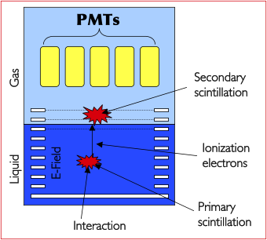
WIMP Detection in WArP
Three simultaneous criteria to discriminate potential WIMP recoils from backgrounds:
  Simultaneous detection of prompt scintillation and drift time-delayed ionisation in Liquid Argon:
    pulse height ratio strongly dependent from columnar recombination of ionizing tracks.
    3D reconstruction of event position.
  Pulse shape discrimination of primary scintillation:
    wide separation in rise times between fast (≈ 10 ns) and slow (≈ 1.6 µs) components of the emitted UV light.
  Precise 3D reconstruction of event position:
    Precise definition of fiducial volume; additional rejection of multiple neutron recoils and gamma background
Double Phase Argon Chamber
Only detector with triple discrimination technology.
Largest discrimination of γ/β-induced backgrounds.

Slide 5
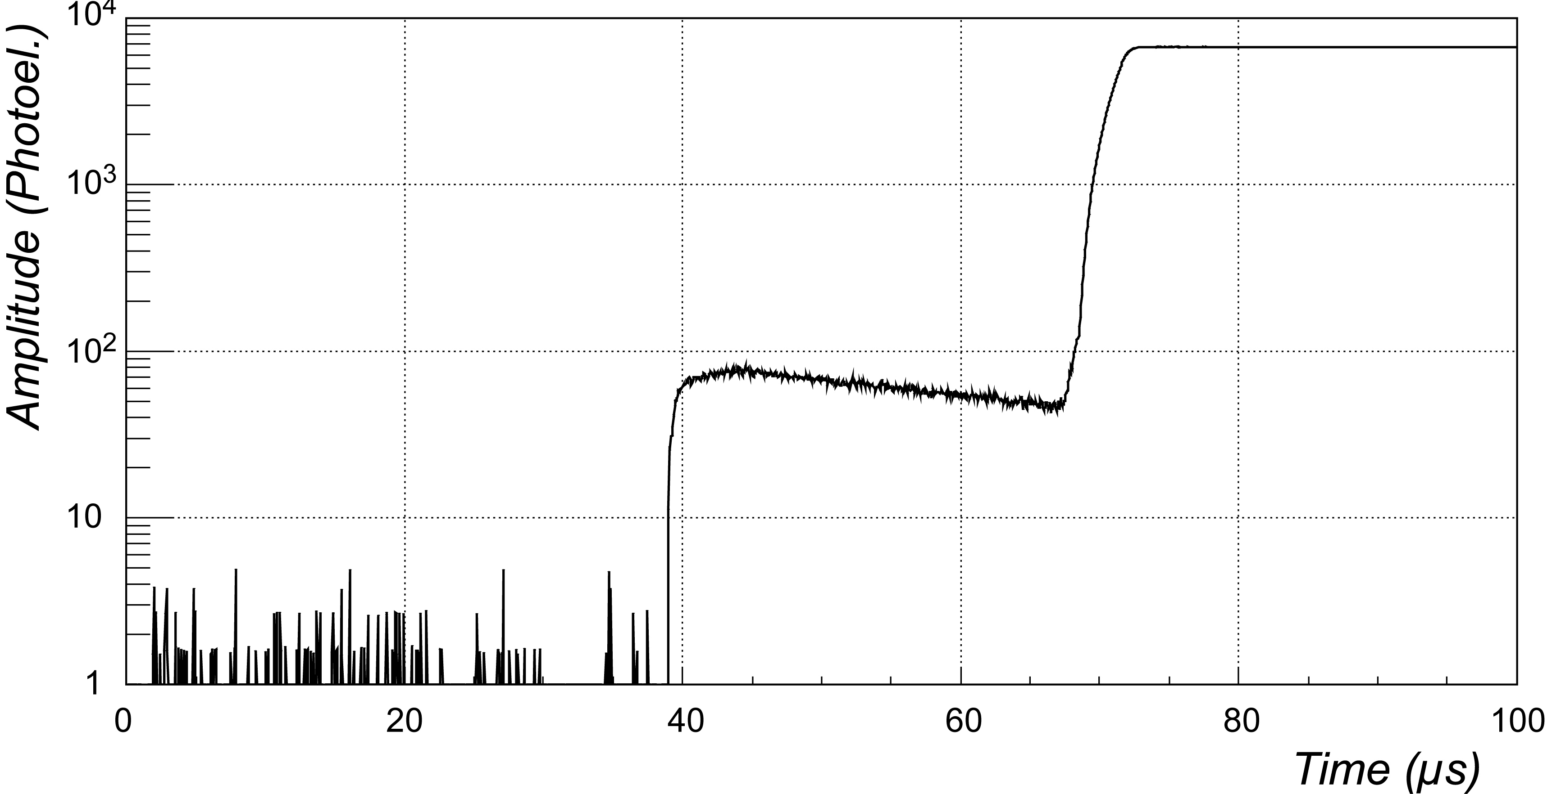
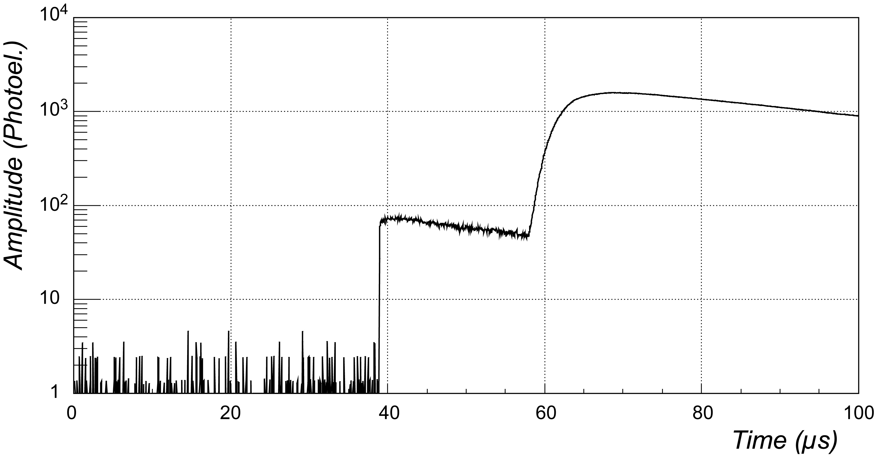
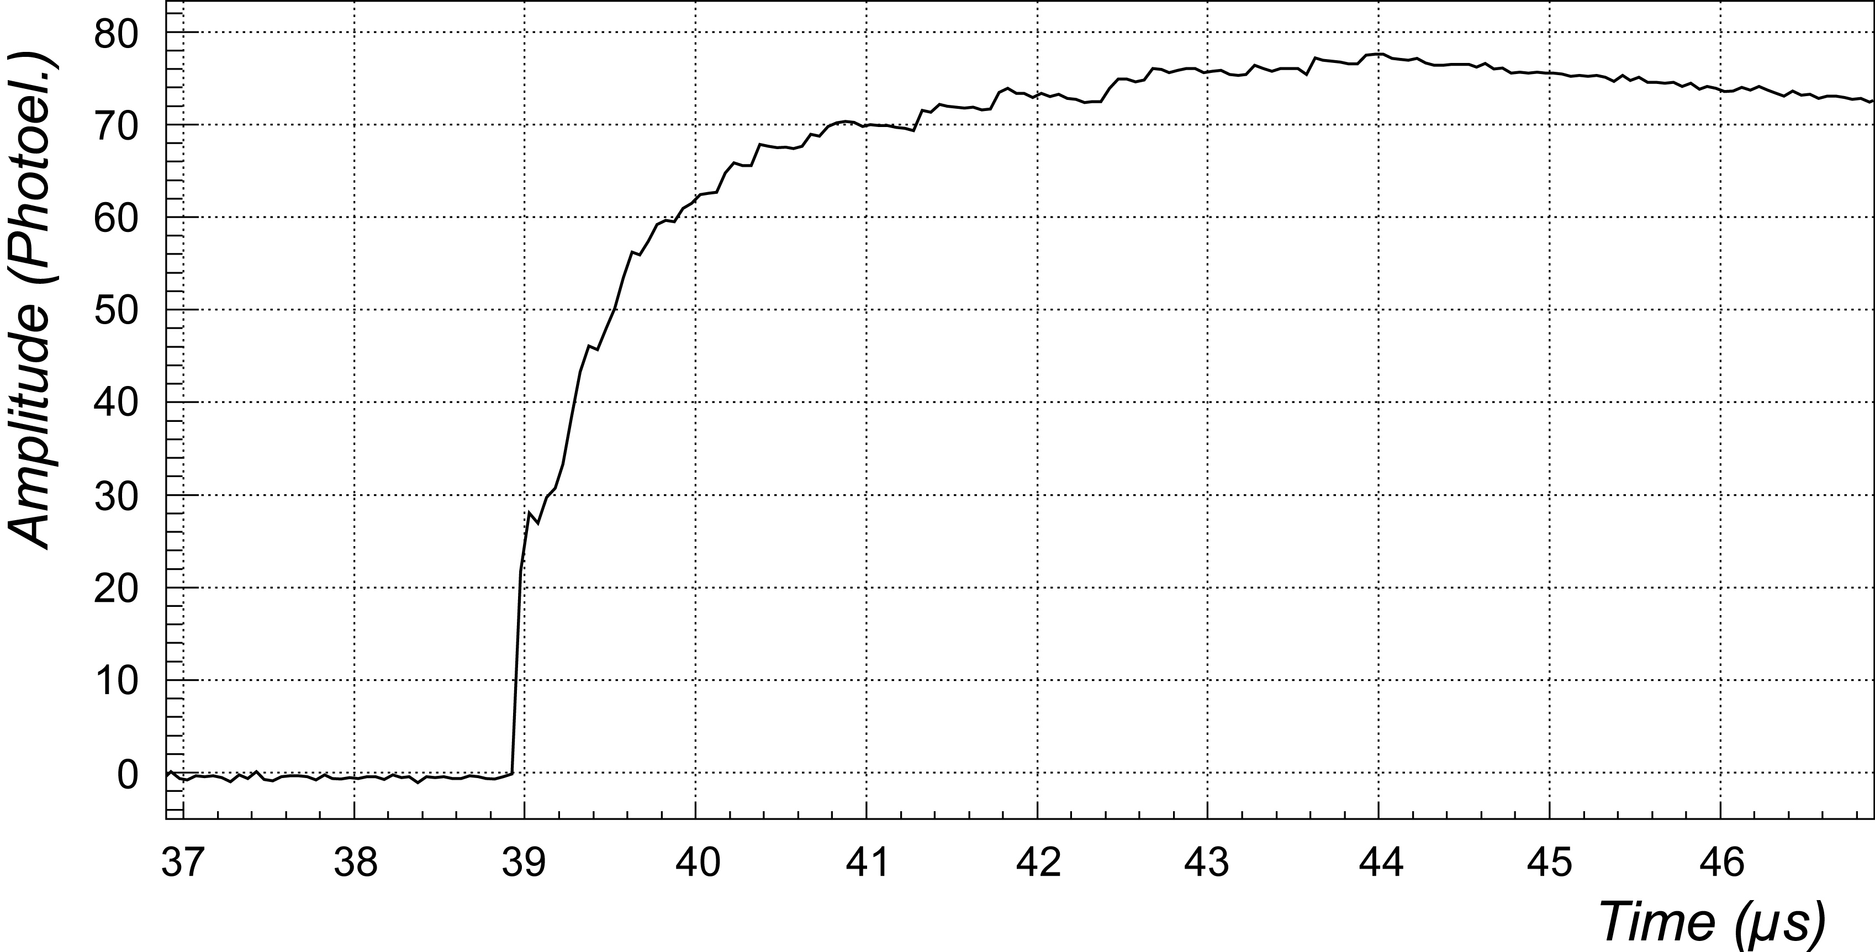
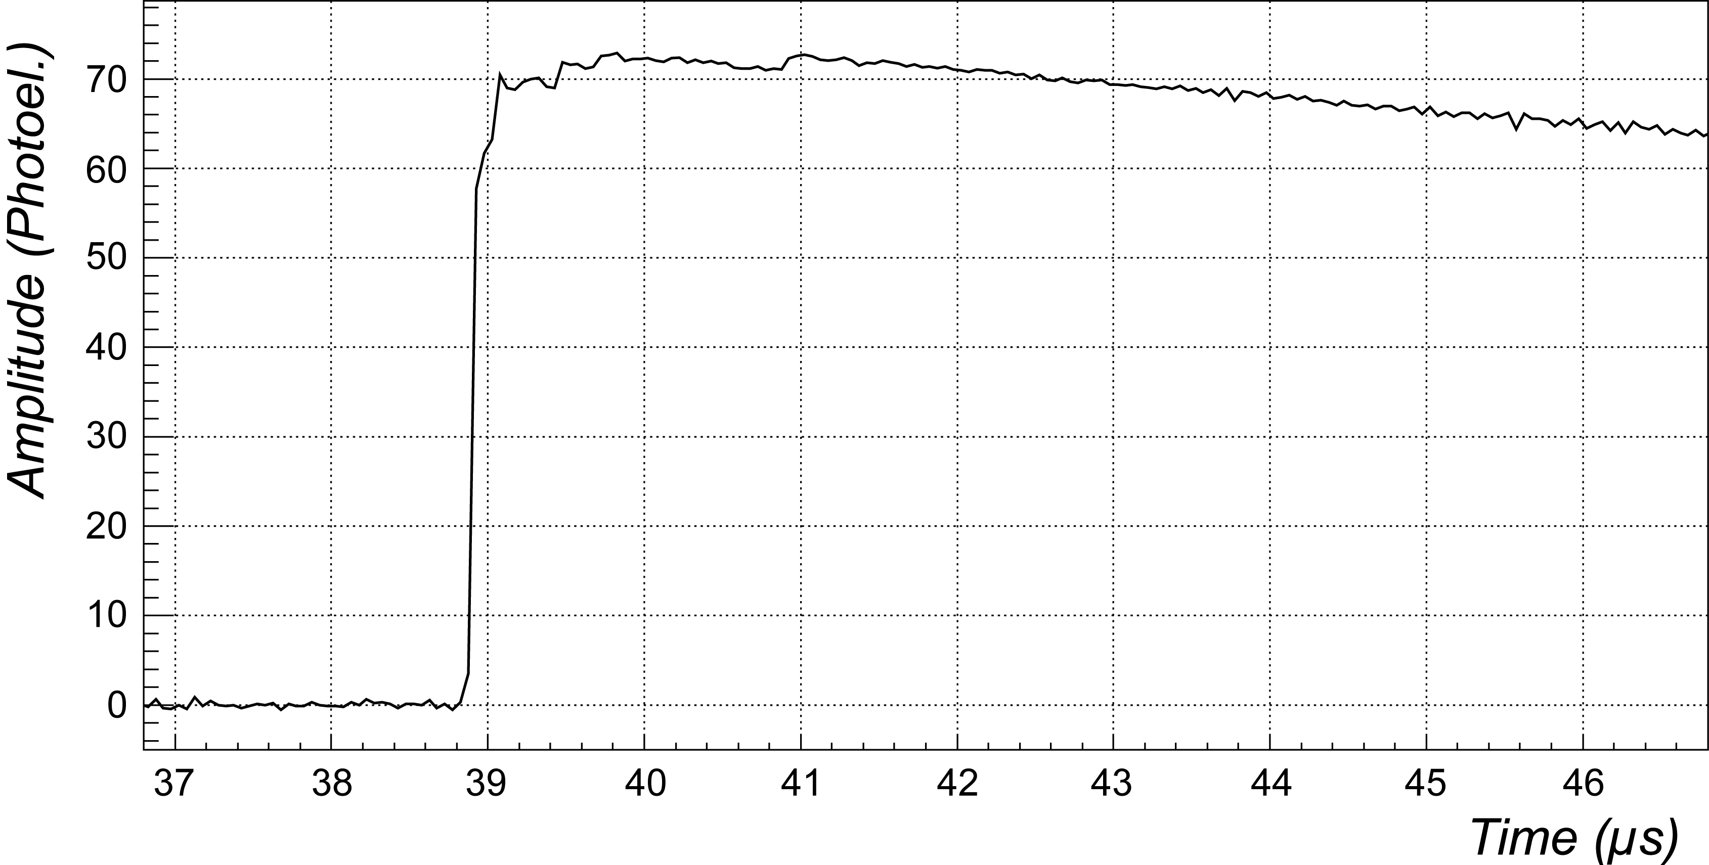
Discrimination Technique
  S1 = primary (prompt) scintillation signal
  S2 = secondary (delayed) scintillation signal (proportional to ionization)
Minimum ionising particles: high S2/S1 ratio (~100) + slow S1 signal.
α particles and nuclear recoils (R-like events): low (<30) S2/S1 + fast S1.
(A)
Electron
S2
(B)
Argon recoil
S2
S1
S1
Drift time
S1
S1

Slide 6
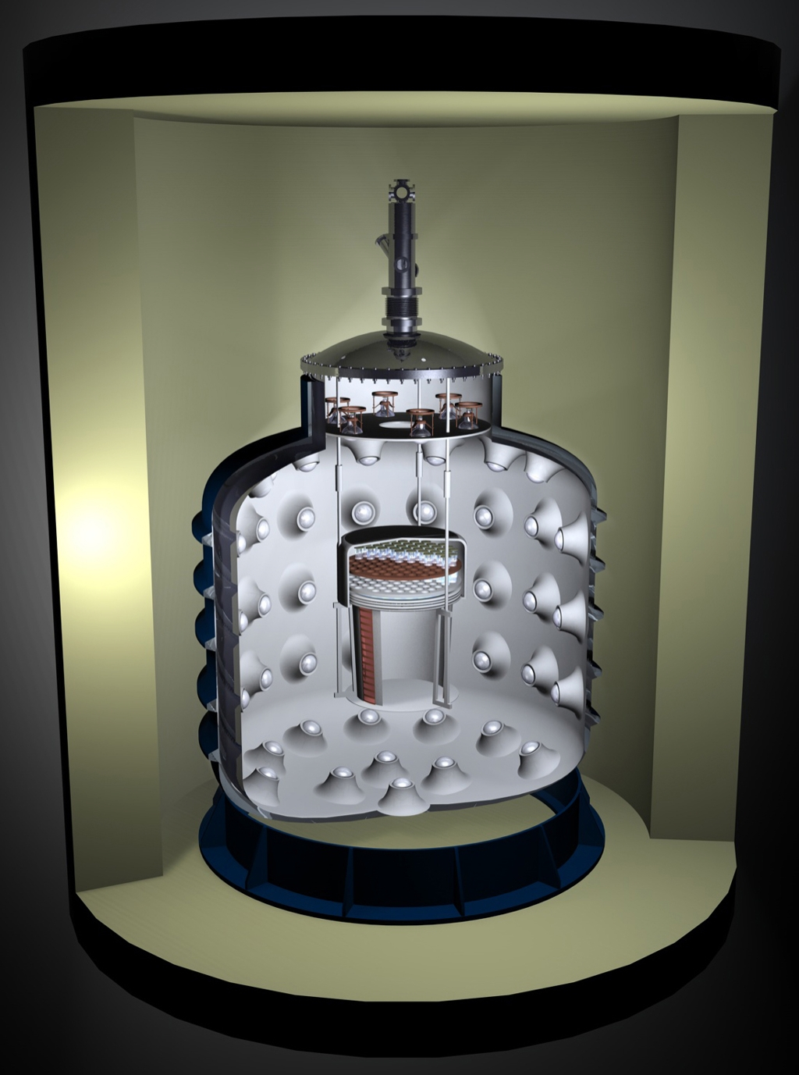
The 100 liters detector
Sensitive volume = 100 liters (140 kg).
  3-D event localization by means of:
    Drift time recording (vertical axis);
    Centroid of PM’s secondary signal amplitudes (horizontal plane).
4π active VETO system:
  tags and measures the neutron-induced background with an ID-factor ≈ 99.99 %;
Construction accomplished between mid 2004 and November 2008.
Detector commissioning:
  Technical runs (2): December 2008 to August 2009, February 2010 to June 2010
  Present run: started on March 2011, after repairs and upgrades.
Designed also to host a 1 ton detector.
Active Veto
(6000 liters Lar)
100 liters Chamber
Passive neutron and gamma shield
Notes:
6

Slide 7
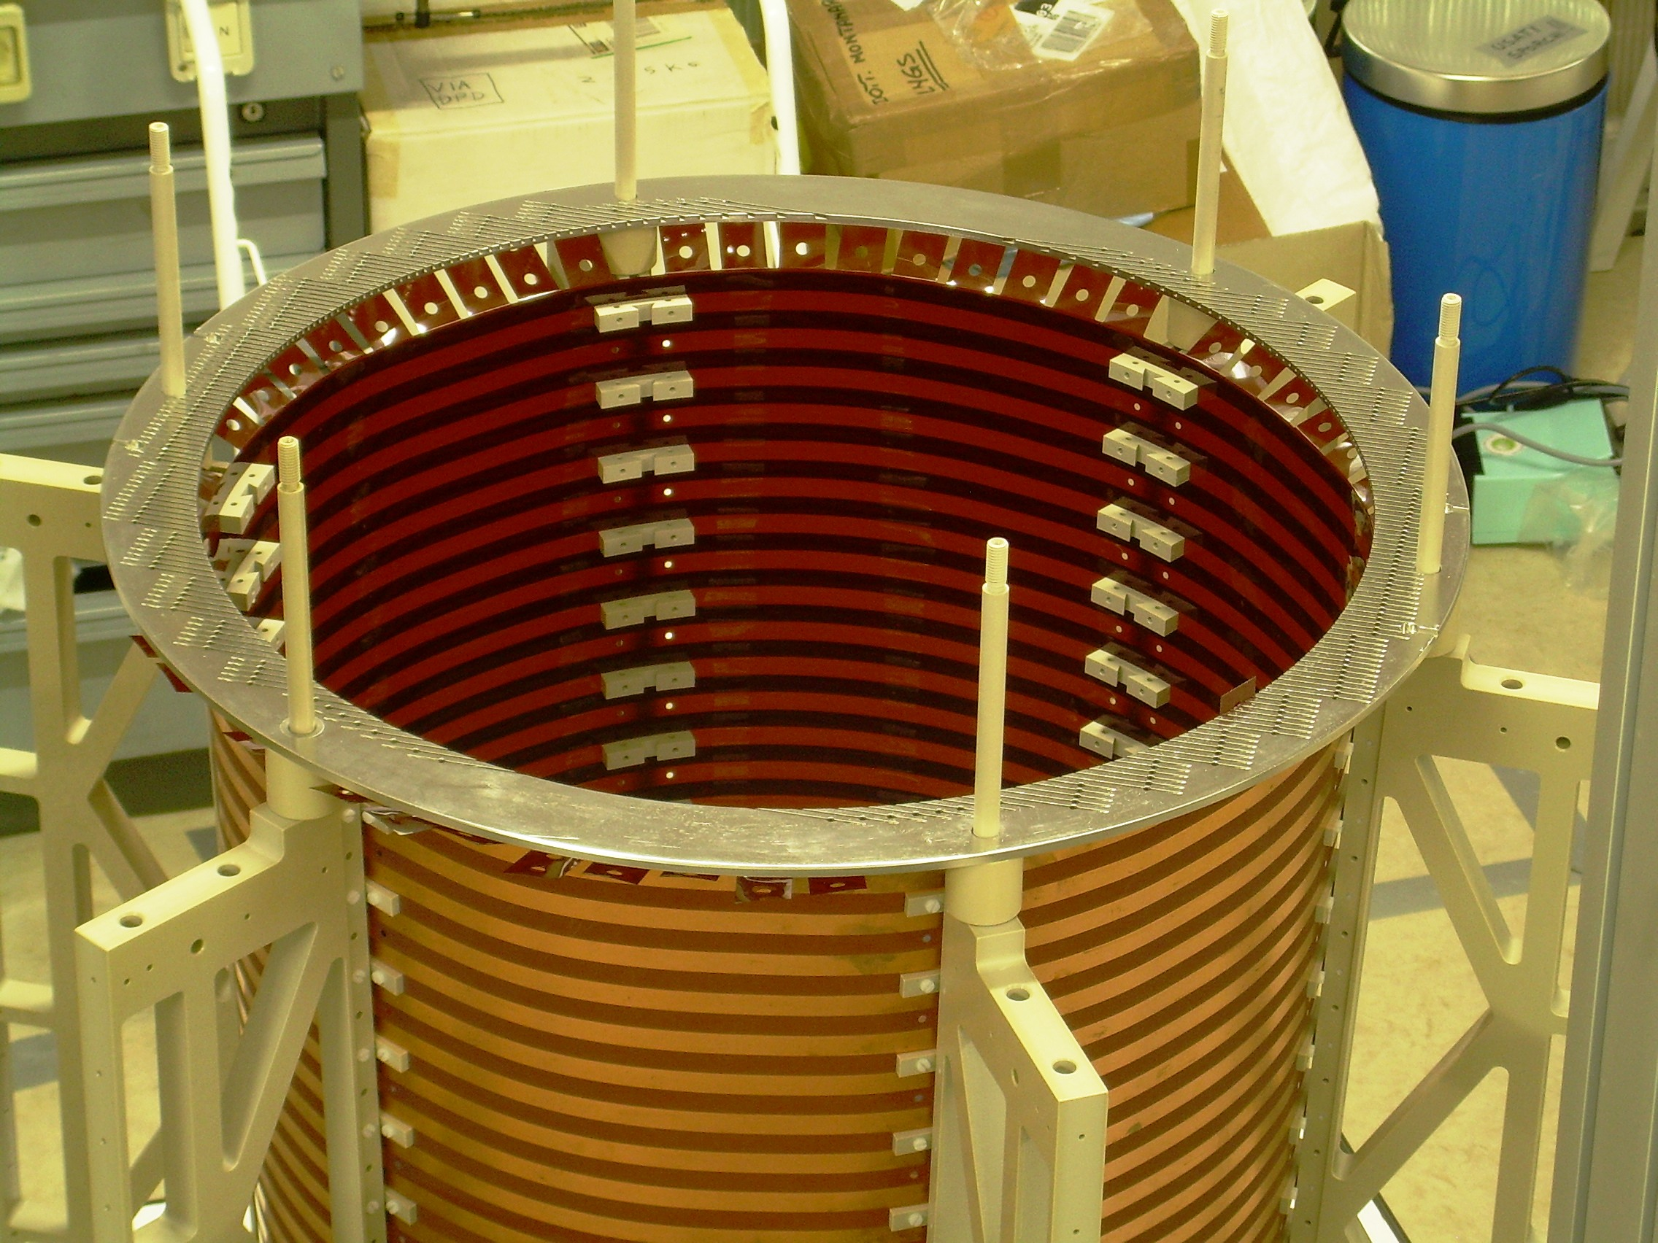
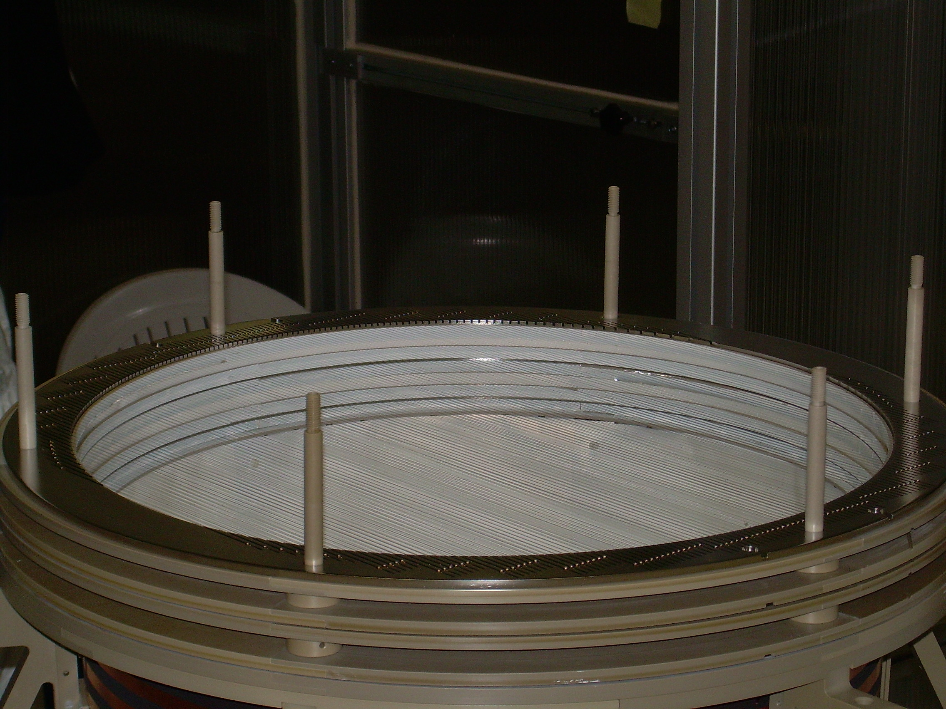
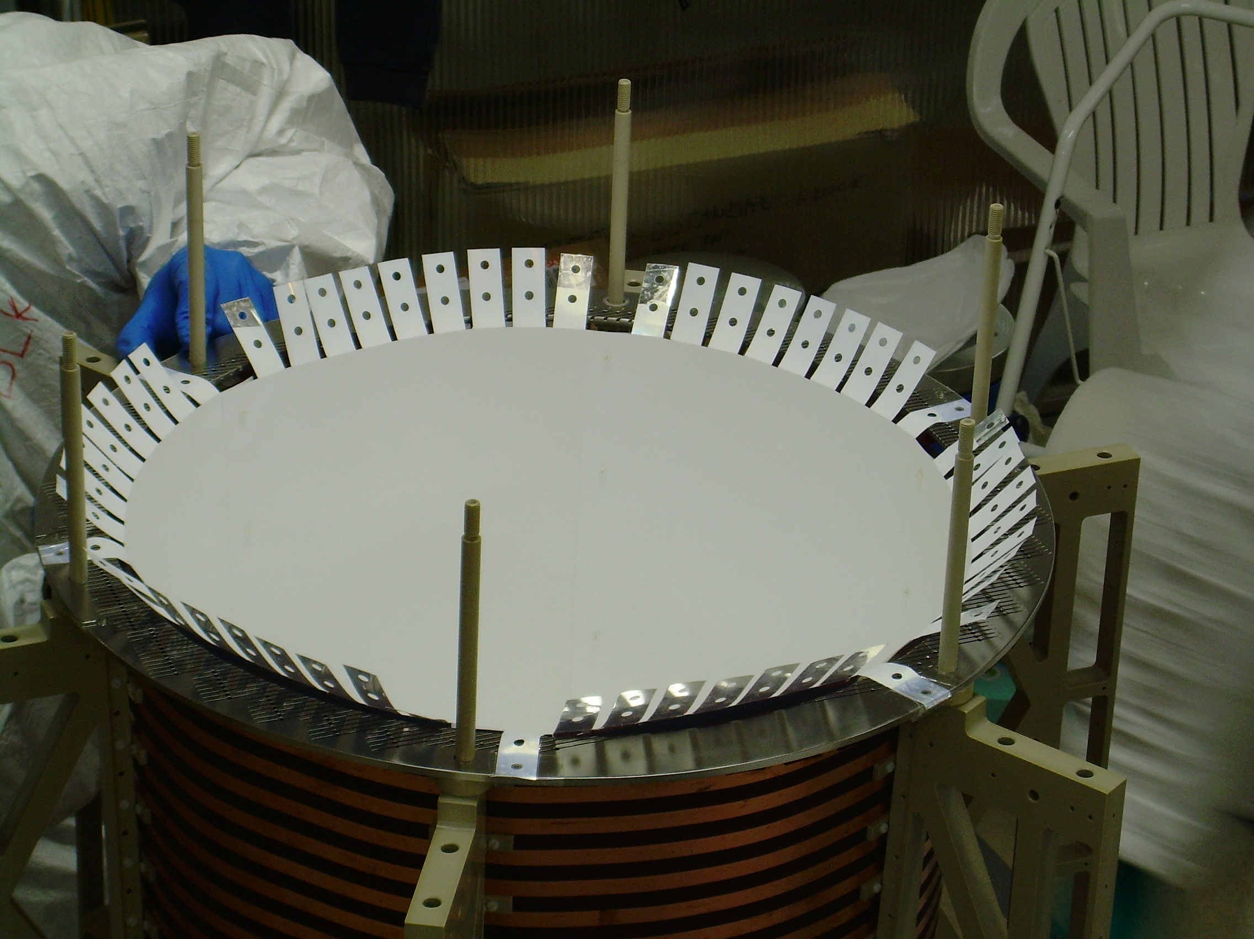
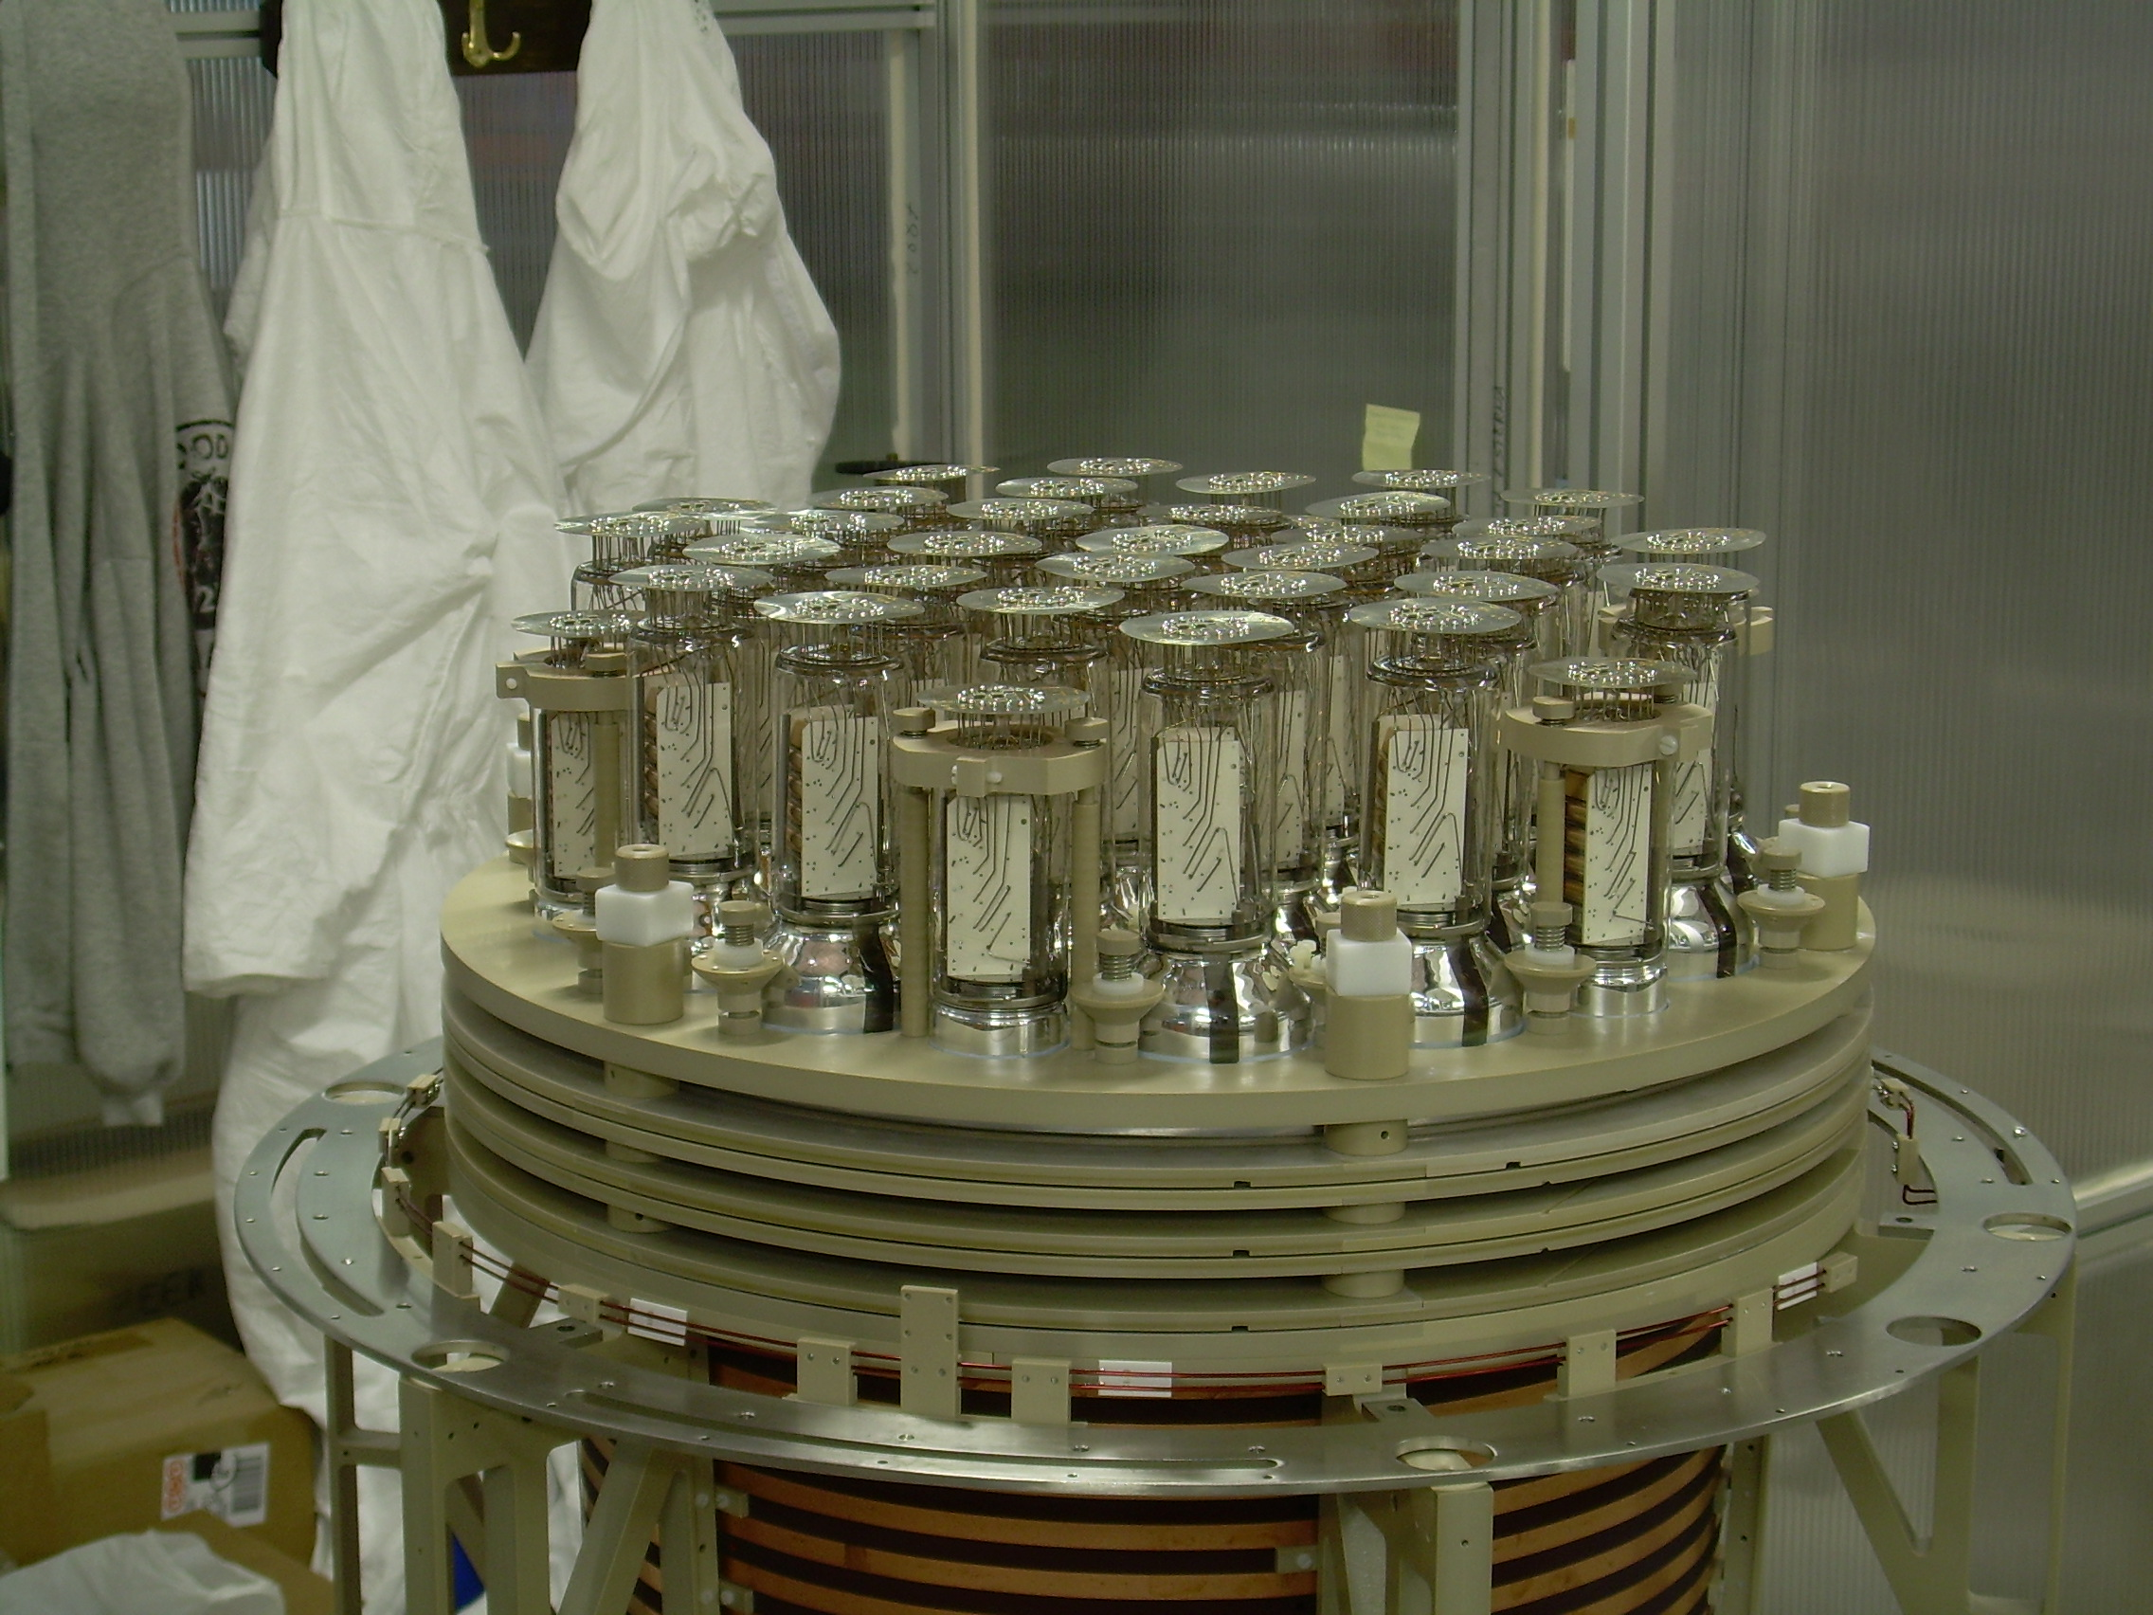
Inner Detector Assembly (Jun, 2008)
Race Tracks
Grids
Reflector +
Wavelength Shifter
Phototubes

Slide 8
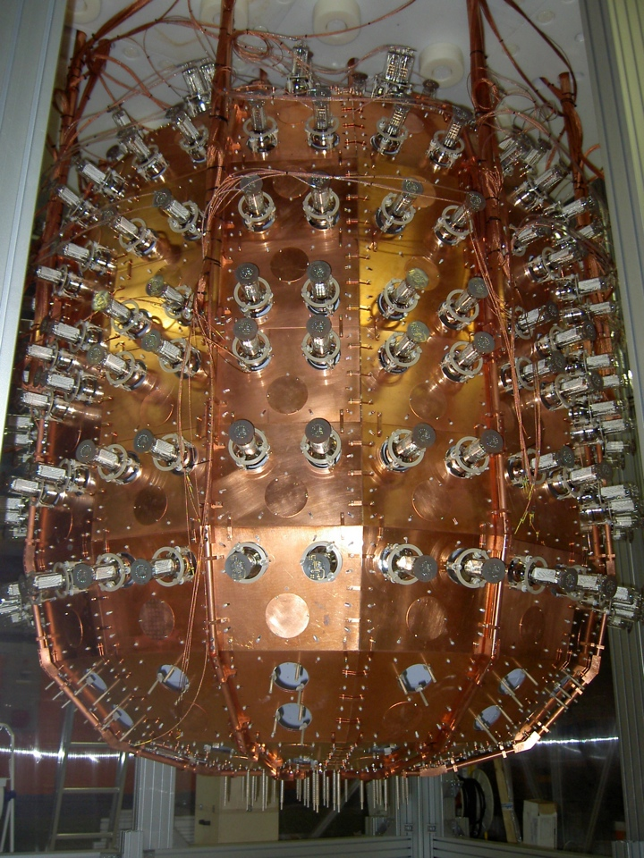
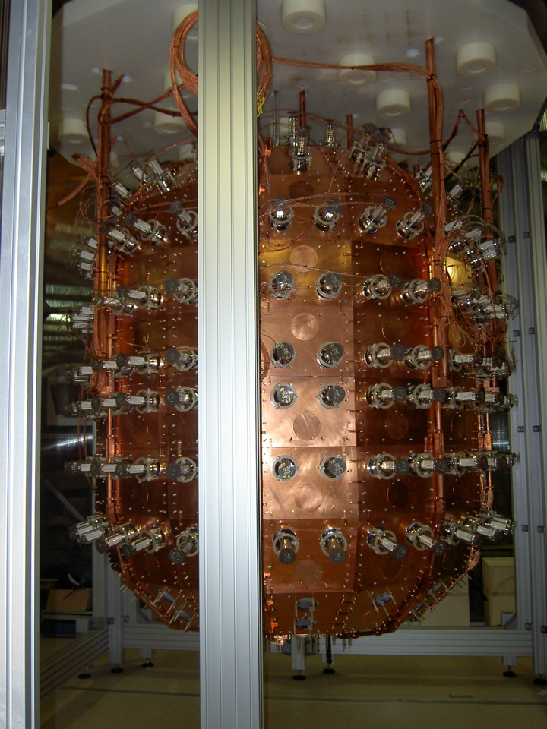
Active Shield Assembly
(Nov., 2008)
8

Slide 9
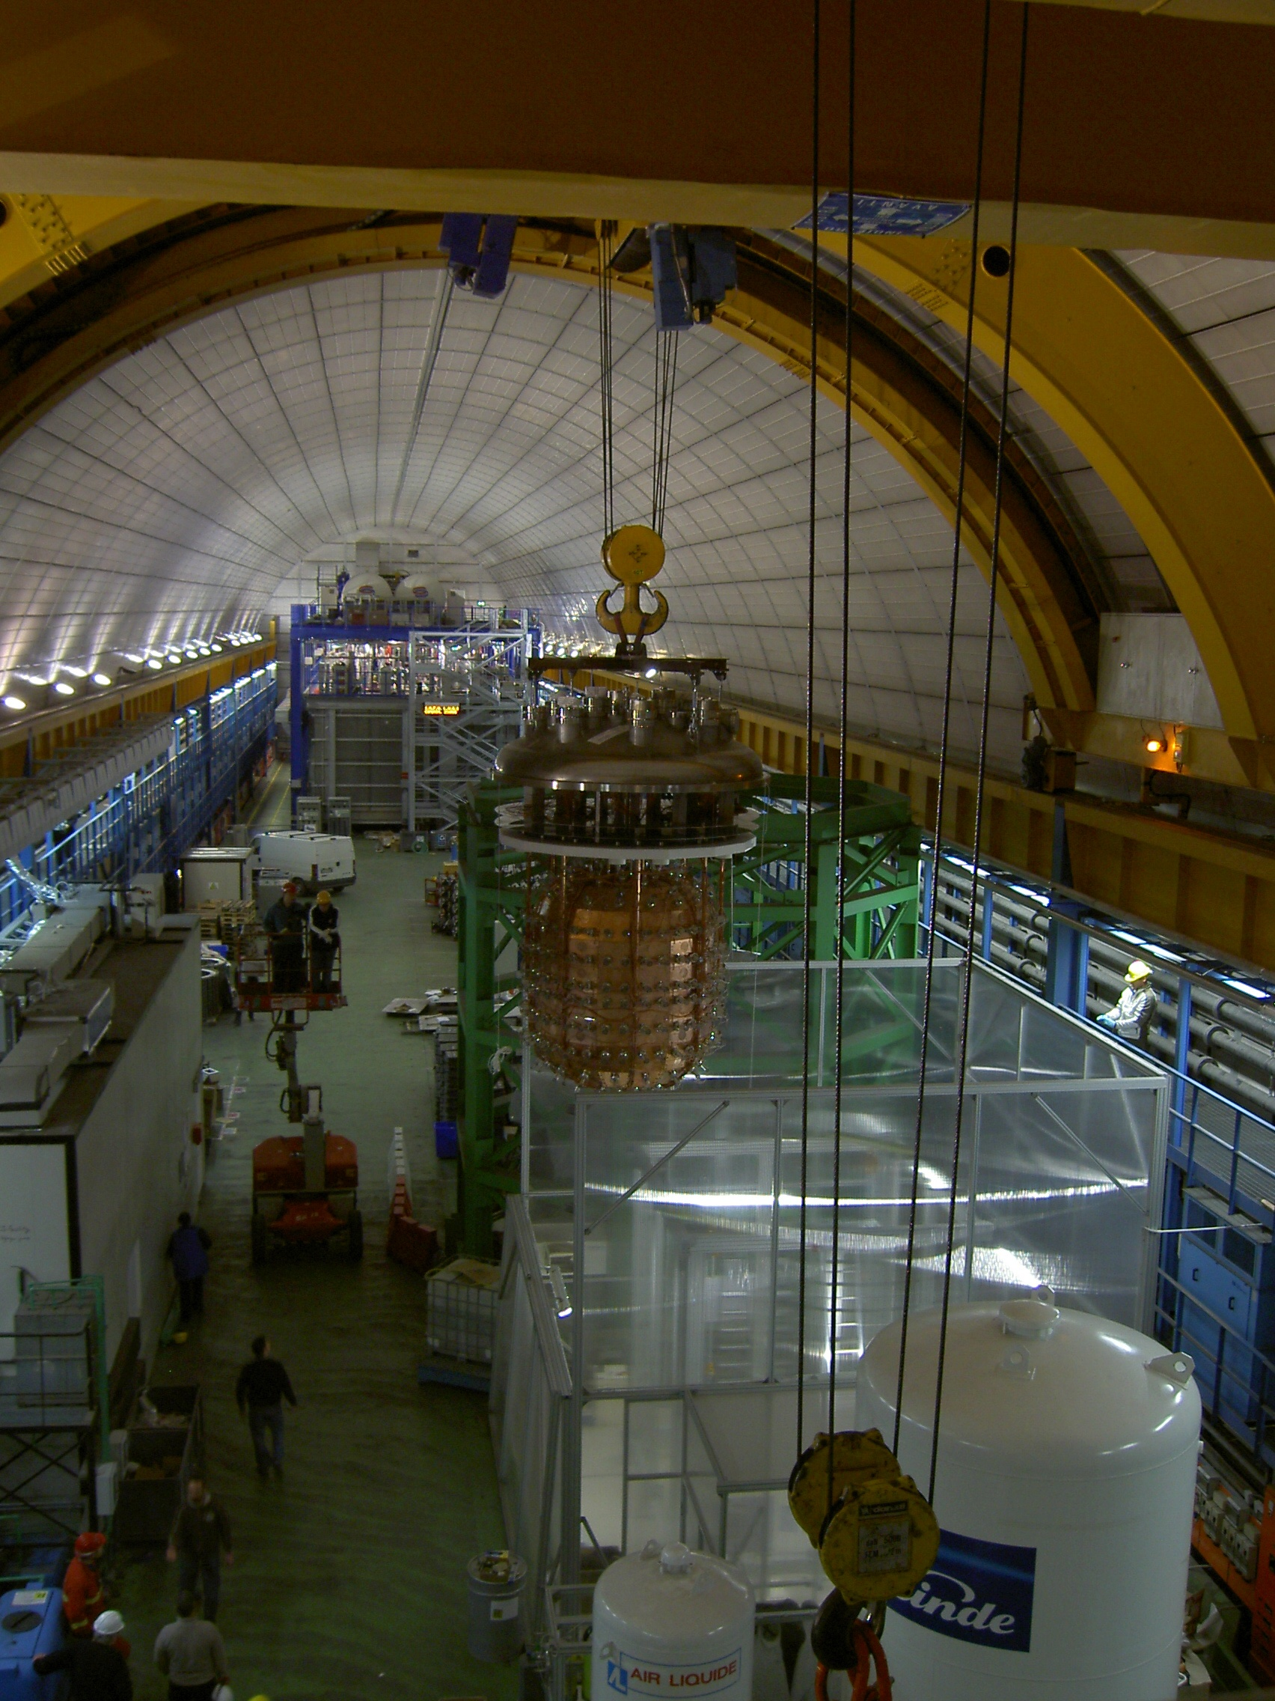
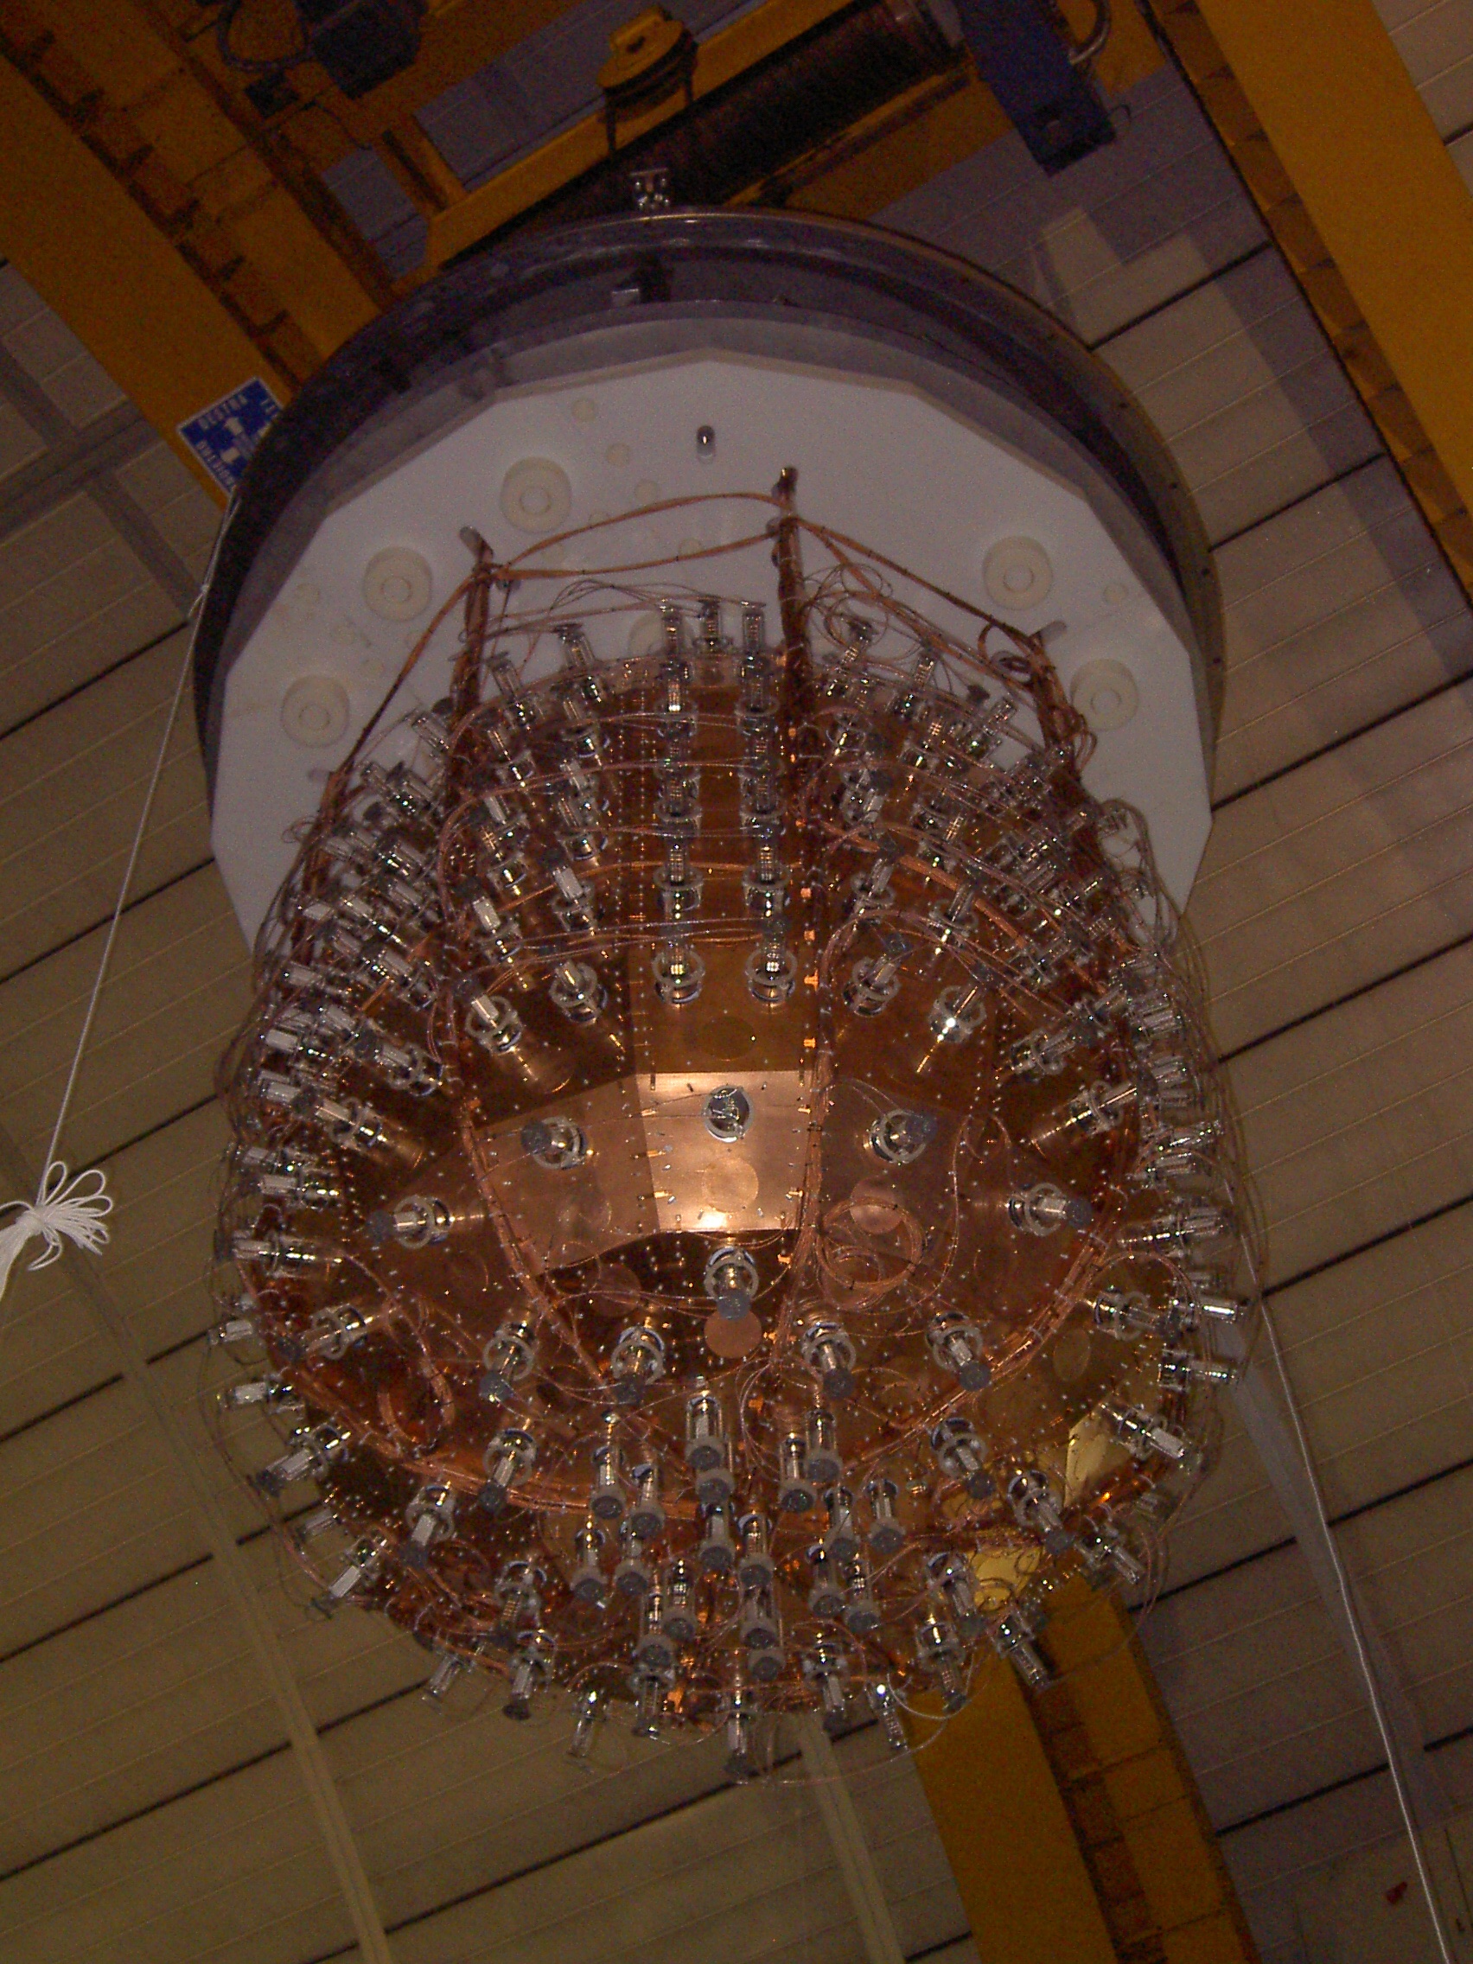
Installation in the main cryostat (December 17th 2008)
9

Slide 10
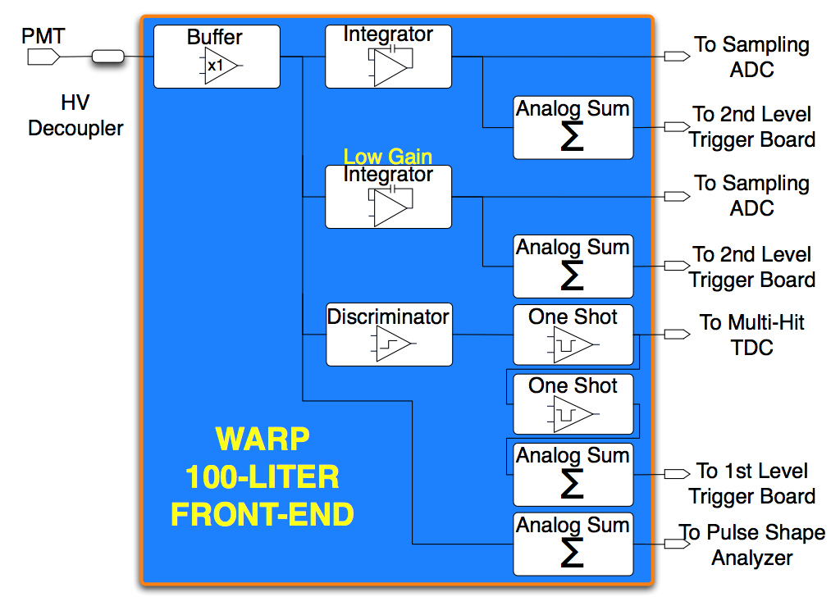
R/O Electronics
INNER DETECTOR
ACTIVE SHIELD
Based on high level commercial solution from Aquiris.
Online data reduction and pre-processing with high speed FPGA
Easily scalable
Front-end custom made from CAEN.
DAQ and logic based on commercial components.
GTP
PM
PM
PM
PM
PM
PM
PM
PM
PM
PM
PM
PM
cPCI
ac240
ac240
ac240
ac240
cPCI
ac240
ac240
FE PC1
80 MB/s @ 300 Hz 1/10 zero skipping
FE PC5
Tot. Thrgh
~80 MB/s
~400M B/s
EBM
10x20 GE switch
100 MB/s
EB PC1
EB PC2
EB PC N
FC switch
~400 MB/s
SAN
SAN
Notes:
10

Slide 11
WArP-100 First Technical Run
During the first technical run (December 2008 – August 2009) several functionalities of the detector and the cryogenic plant have been verified:
  DAQ and performance of the inner detector with no drift field;
  Functionality and performance of the cryogenic plant (consumption rates, functionality of the Gas recirculation system);
  LAr purity check by measurement of the scintillation light slow component.
The first technical run was stopped after the breakdown of the HV feedthrough for the drift field.

Slide 12
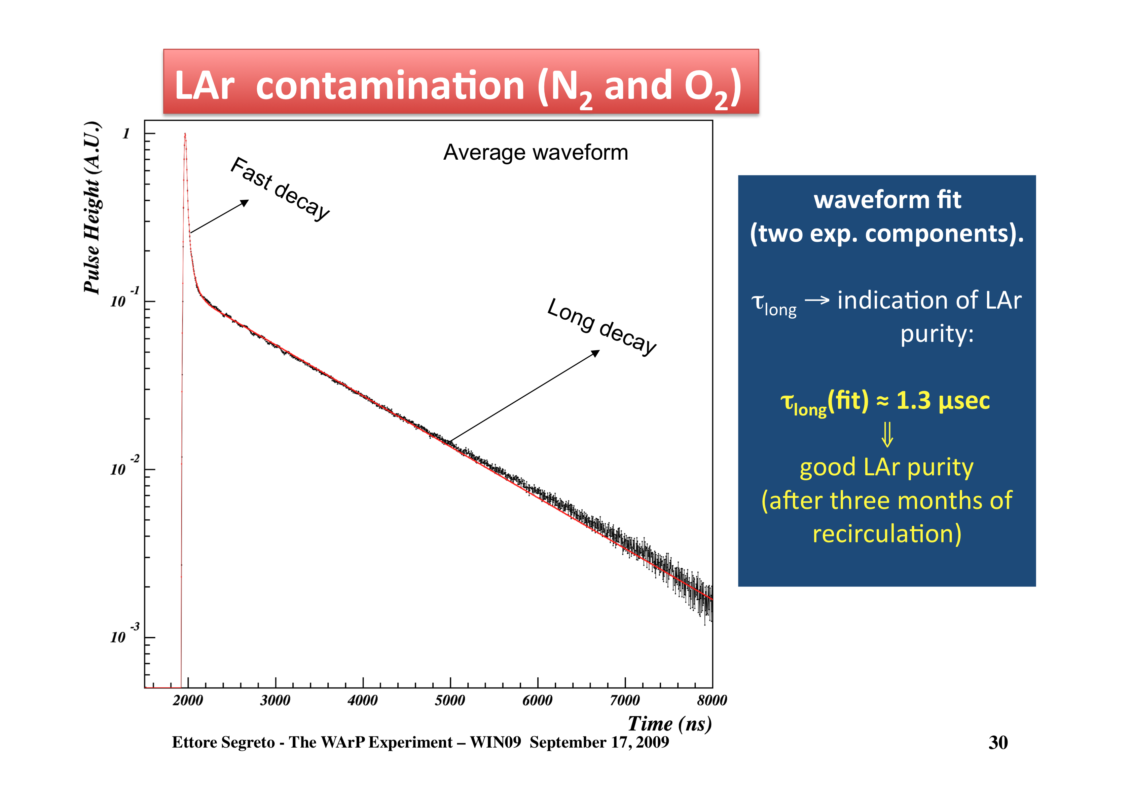

Slide 13
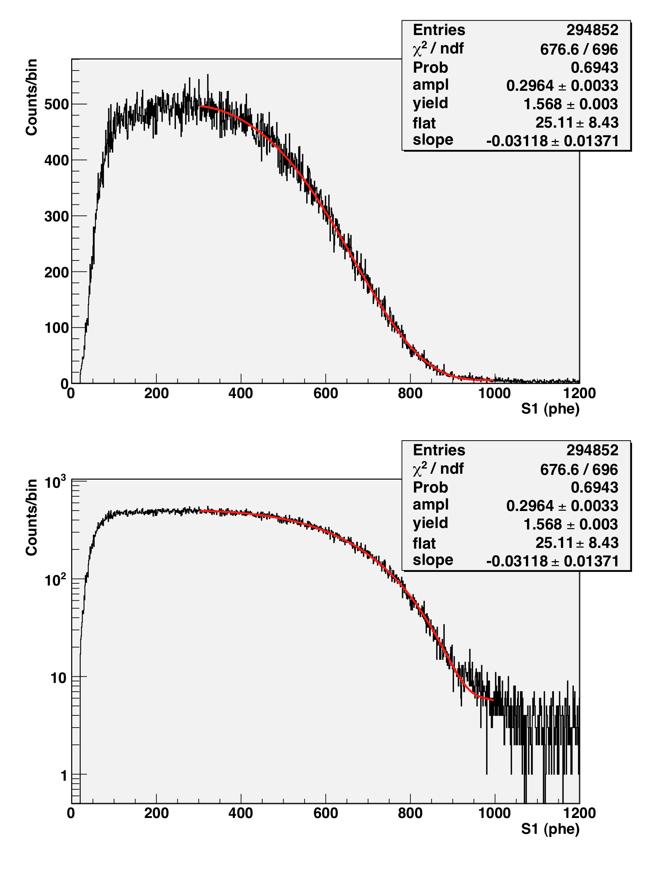
Light yield measurement from 39Ar decay
Measured Light yield
From 39Ar beta decay
Spectrum ~ 1.6 ph.el. / keV

Slide 14
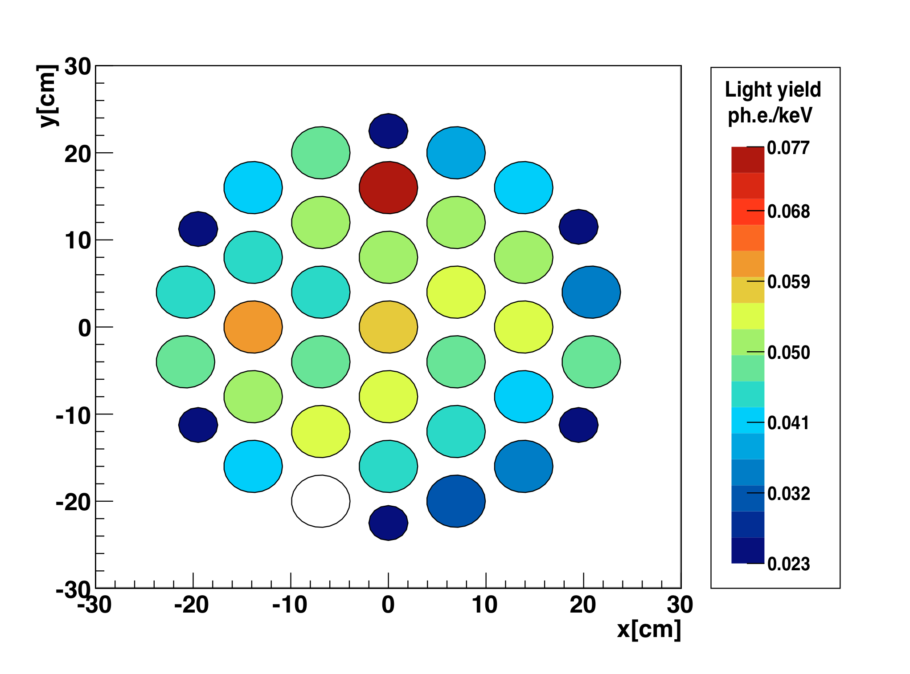
Light Collection Uniformity
Best PMT (QE > 30%)
Poor light collection
uniformity(also when
corrected for
the PMTs QE).
No evidence of
geometrical issues.
Low gain PMT (not used)

Slide 15
WArP-100 Second Technical Run
The second technical run started on February 2010, after the replacement of the HV feedthrough and cable with a completely revised version and after the replacement of the inner detector waveshifting/reflecting surfaces.
The detector filling with ultra-purified LAr was completed on March 16, 2010. As for the previous run the detector functionalities at null drift field have been studied and found in agreement both with those of the previous run and with the expectations based on results obtained in our labs.
The drift field was turned on at the beginning of May, 2010. After about two days of operation the current in the HV circuit suddenly interrupted. As verified after the detector opening, the failure was due to the breaking of few ceramic resistors, most likely damaged by the HV discharge occurred in the 2009 run.
The run was then interrupted around the mid of June 2010, after additional few weeks of operation to test the performance of the active shield and the cryogenic plant.
In summary:
with the exception of the new, different failure of the HV system, the detector performances recorded in the 2010 run were in agreement with expectation (based on the results from the 2009 run) and considered as suitable for a physics run.

Slide 16
Preparation for the 2011 run
After the agreement of the INFN Commissione II, last January 31st, following the interaction with an International Committee that completely revised the experiment design and performance (November 2010 – January 2011), we started the operations for the 100 liters re-activation:
  A new HV distribution system for the drift field, with high redundancy, have been implemented and extensively tested;
  Optical shields on the Veto phototubes have been installed and all the phototubes have been checked at room temperature;
  Modifications of the Veto readout electronics and relative tests have been completed;
  The gas recirculation system has been modified to reduce the running costs;
  New filters for both the liquid and the gas recirculation systems have been installed;
  Other activities in preparation of the new run were also carried on (installation of the Argon pre-filters, update of the DAQ software, development and maintenance of the analysis software);
  The detector cooling started on May 25, 2011, filling with ultra-purified LAr ended June 1st, 2011.
Activities with the 2.3 liters prototype, to study the new high quantum efficiency phototubes performances are also being carried on in parallel.

Slide 17
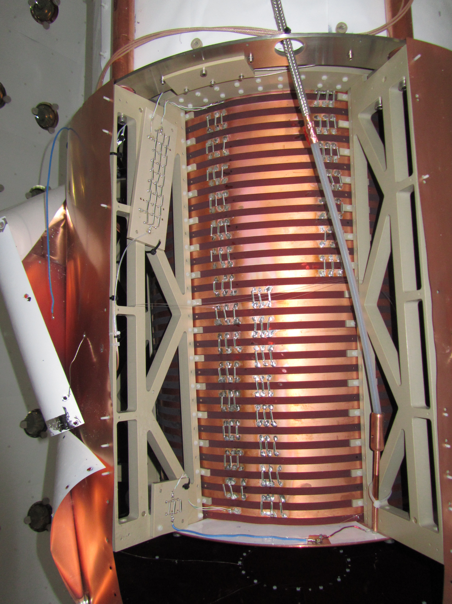
The new HV Distribution Chain
To First Grid (in liquid)
To Ground (or Low Voltage Output)
Race Tracks
-HV (from Cathode)
Divider chain from the cathode to the first grid (in liquid) and then to ground (or to low voltage), made by three resistors in parallel.
(≈ 48.5 MΩ) resistance painted on ceramic substrate.

Slide 18
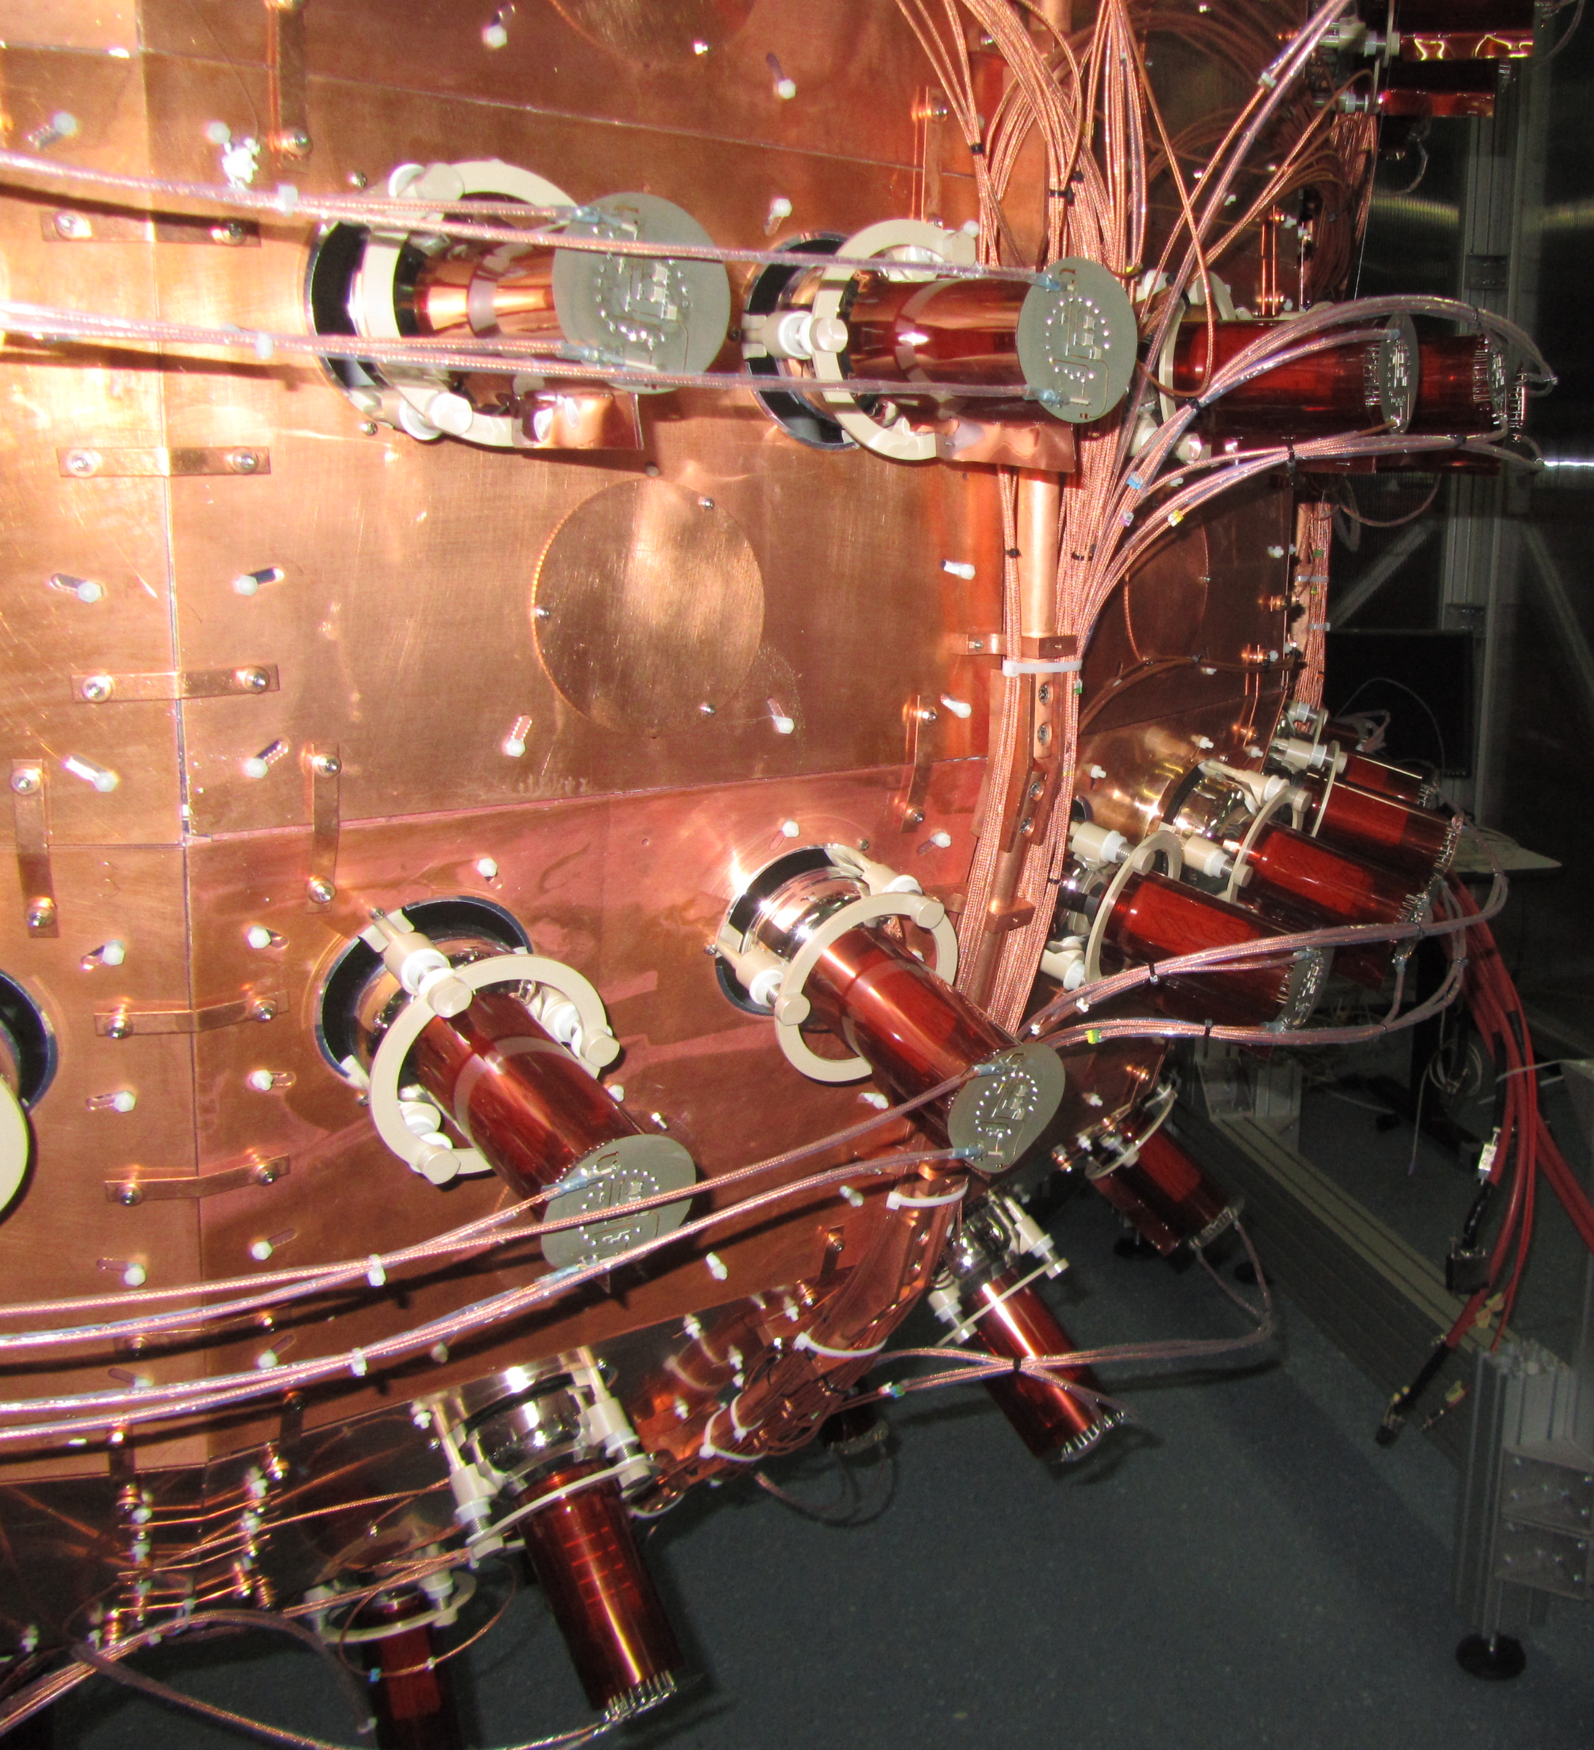
Optical shields
Two superposed Kapton foils (each with 125 µm thickness) wrapped around the cylindrical part of the 3” PMTs body.
Solution tested in liquid Argon for mechanical stability with a spare PMT.

Slide 19
WARP Veto Electronics
Standard configuration
  Multiplexing charge pre-amplifiers CAEN N914
    Standard RC shaping time 100 μs
  100 MHz, 14 bits digitizers CAEN V1724
Modifications Proposed by WARP Collaboration and Agreed with Battiston Review Committee
  Modification of RC shaping time
    100 μs → 5 μs
  Modification of sensitivity
    0.8 mV/pC → 4.2 mV/pC
  Test with WARP-2.3L prototype to check
  Ability to correctly measure single photoelectrons
  Ability to correctly reproduce spectra recorded in presence of radioactive source

Slide 20
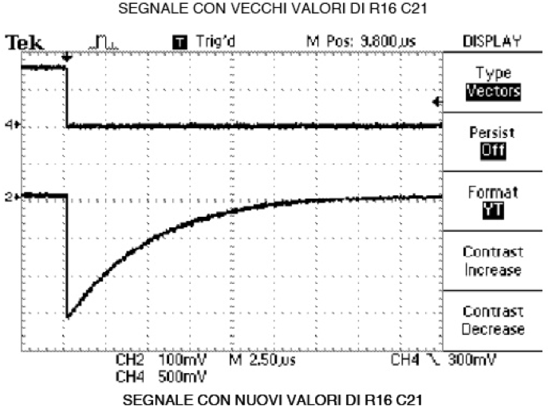
Modification of Boards
Shown difference in shaping time
All boards modified as of February 2011

Slide 21
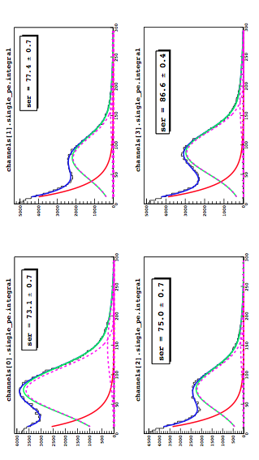
Single photoelectron Determination

Slide 22
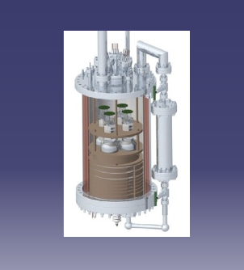
R&D WORK (PARALLEL Activity):
An extensive set of tests characterized the WArP activity at LNGS all over the last 10 months.
The scaling-up in detector mass and complexity without loss of detector performance is in general not a trivial task.
An experimental test has been performed with a detector about four times the size of the one used with the first test of the Hamamatsu PMT (LY=7 phel/keV - 0.5 lt - single PMT – single phase), to check the scaling-up capability of the implemented technology.
The detector composed by the WArP 2.3 lt prototype chamber equipped for this test with 4 HQE Hamamatsu PMTs (Mod. R11065).
The boundary surfaces (lateral and bottom) of the 2.3 lt active volume lined with a TPB coated VIKUITI ESR reflector layer, freshly produced at LNGS with standard vacuum evaporation techniques.
PMTs are left “naked” (no wavelength shifter)
The 4 PMT anode signals directly digitized by two Acqiris Boards (Mod. U 1080 A, 2-chs. each with 8-bit dynamic range and 1GS/s) at 1 ns sampling time over 15 μs time interval;
Main goals of the test (Jan-Mar.,’11):
LY and gain stability in time on long term running period.
Test of the VETO electronics in experimental conditions by replacing the 4
PMTs ACQIRIS read-out electronics with the first modified CAEN N914 board.
Test of a new fast digitizer board (CAEN V1751) and comparison with the
present ACQIRIS board
neutron-source run for Pulse Shape Discrimination study at improved LY
conditions.
The detector geometry of the 2.3 lt is a scaled-down version of the WArP-100 detector (100 lt of active volume, 37 PMTs, 12% of photo-cathodic coverage); therefore the results from the 2.3 lt test can be assumed to be somehow predictive of the LY from the WArP-100 Inner Detector, when operated under equivalent conditions.

Slide 23
Data Analysis and Results (I)
Detector exposed to ²⁴¹Am, ¹³³Ba, ⁵⁷Co and ¹³⁷Cs sources;
Number of phel obtained by the sum of the phel detected by each PMT (calibration via SER spectrum)
²⁴¹Am source – bkg subt.
The Light Yield determined with other sources is less accurate but fully agree with ²⁴¹Am value.
The detector geometry is a scaled-down version of the WArP -100 detector (100 lt of active volume, 37 PMTs, ∼ 12% of photo-cathode coverage);
LY = 6.35 phel/KeV ± 5%
The light yield from this detector test can be assumed as predictive of the LY from the WArP 100 Inner Detector, when operated under equivalent conditions.

Slide 24
Data Analysis and Results (II)
LY stable within 2%;
One PMT has a systematic lower light yield -> not yet understood (PMTs have almost the same Quantum Efficiency);
With four PMTs working in the same way -> LY ≃ 6.6 phel/keV
Light Yield stability
Slope of the slow scintillation component: 1130 ns (1300 ns for clean Argon). This reduces the light yield of about 10%.
Direct measurement with mass spectrometer showed the presence of ~ 1 ppm of N₂ (not captured by our filters);
In case of clean Argon the LY would have been in the range of 7 phel/KeV.

Slide 25
WArP Main Extrapolation Data
Electrons total light yield @ no field |  | 1.7(pessimistic) |  | phe / keVe
Electrons (20-60 keV) reduction @ 1 kV / cm |  | 0.67
Electrons total light yield @ 1 kV / cm |  | 1.14 |  | phe / keVe
Electron energy | 30 | 40 | 50 | 60 | keV
Fast component fraction (electrons) | 0.35 | 0.32 | 0.30 | 0.29
Fast component for electrons @ 1 kV / cm | 0.40 | 0.37 | 0.35 | 0.34 | phe/keVe
Slow component for electrons @ 1 kV / cm | 0.74 | 0.77 | 0.79 | 0.80 | phe/keVe
Lindhard factor @ no field | 0.25 | 0.25 | 0.25 | 0.25
Recoils total yield (any field) | 0.425 | 0.425 | 0.425 | 0.425 | phe/keVi
Fast component for recoils | 0.32 | 0.32 | 0.32 | 0.32 | phe/keVi
Slow component for recoils | 0.11 | 0.11 | 0.11 | 0.11 | phe/keVi
Energy scan
Recoil energy | 30 | 40 | 50 | 60 | keV
Fast component for recoils | 9.6 | 12.7 | 15.9 | 19.1 | phe
Fast component for electrons (identical) | 9.6 | 12.7 | 15.9 | 19.1 | phe
Slow component for recoils | 3.2 | 4.25 | 5.3 | 6.4 | phe
Slow component for electrons | 17.8 | 26.9 | 36.4 | 45.8 | phe
Electrons energy | 28.5 | 38.0 | 47-5 | 57.0 | keV
Rate above threshold @ σ(p) = 10^-42 cm^2 | 0.058 | 0.042 | 0.031 | 0.021 | ev/kg/day
Rate for 100 kg WArP @σ(p) = 10^-44 cm^2 | 21.2 | 15.4 | 11.3 | 7.5 | ev/year
Rate of 39Ar in 100 kg WArP @ 20keVe < E < 40keVe |  | 1.1 E 08 |  |  | ev/year
Rate for 1 ton WArP @σ(p) = 10^-45 cm^2 | 21.2 | 15.4 | 11.3 | 7.5 | ev/year
Rate of 39Ar in 1 ton WArP @ 20keVe < E < 40keVe |  | 1.1 E 09 |  |  | ev/year
Rate for 10 ton WArP @σ(p) = 10^-44 cm^2 | 21.2 | 15.4 | 11.3 | 7.5 | ev/year
Rate of 39Ar in 10 ton WArP @ 20keVe < E < 40keVe |  | 1.1 E 10 |  |  | ev/year

Slide 26
WArP-100 Possible Upgrade
Within the WArP R&D activities a new generation of high Quantum Efficiency PMTs, working at LAr temperature, from Hamamatsu, have been extensively tested.
Results obtained in the 2.3 liters prototype have shown very good performance yielding a light collection exceeding 6 phel/keV, with a photocathode coverage similar to the one of the 100 liters inner detector and working in single phase mode, in several consecutive runs.
A set of 40 of this new generation PMTs could be used as a replacement for those presently installed in the 100 liters inner detector. The possibility to roughly double the photocathode coverage by placing an array of phototubes at the bottom of the double phase camber is also being considered.
This upgrade could take place at the end of the present 100 liters run, and should bring the light yield in the range of 5 photoelectrons/keV or better.
This will allow to significantly lower the detector threshold and to increase the rejection power for betas and gammas by several orders of magnitude.
Notes:
26

Slide 27
Conclusions
In 2009 and 2010 the 100 liters detector has undergone two technical runs that lasted about three months. Both runs have been terminated due to the failure of the HV system for the drift field. The second failure was most likely an consequence of the first one that was not detected when the detector was opened the first time.
With the exception of the failure of the HV system, the detector performances recorded in the two runs were in agreement with expectations from the results of our prototypes and considered as suitable for a physics run.
The WArP design was examined by an International Review Committee between November 2010 and January 2011. Following some recommendations from the Committee, the WArP programme restarted at the beginning of 2011.
After some modifications and repairs (HV distribution system, PMTs optical shielding, GAr recirculation transfer lines, active shield electronics), the 100 liters detector started the re-commissiong phase.
A new filling of the detector with ultra-purified LAr was completed on June 1st, 2011.
The detector is presently coming back to operation.
A new technical run is expected for the next three months.
Extension of the run and possible future upgrades will be discussed after the results of the technical run.
Notes:
27

