Slide 1
Concepts
&
Resources
Cath Noble
Digital Accessibility Workshop
26 June 2023

Slide 2
Digital accessibility – broad brushstrokes
What is:
  Impairment | Accessibility | Assistive technology
Experience impairment:
  Visual
  Motor
  Cognitive
Constructing a “POUR” website
(Starter guide to...) Design tips, tools, evaluation

Slide 3
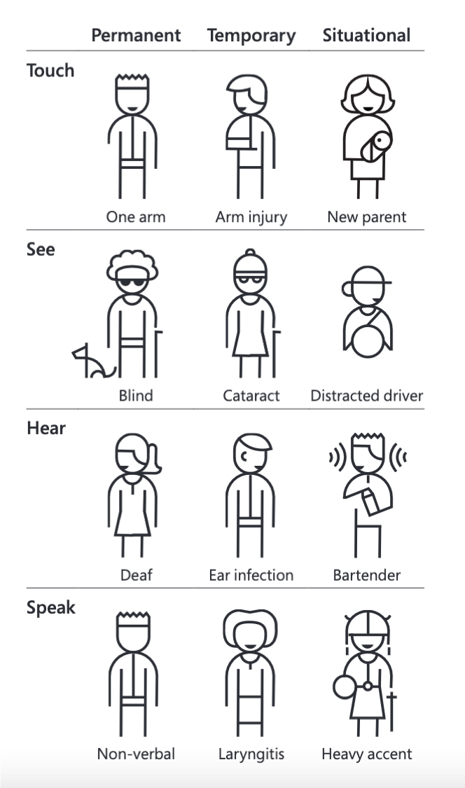
What is Impairment?
Impairment can manifest in many different ways.
  Visual | Auditory | Motor | Cognitive
  Permanent | Temporary | Situational
  Wide range of severities – mild to extreme
~ 1.3 billion people have a disability or impairment worldwide.
  16% of world’s population, 1 in 6.
Impairments happen to EVERYONE
Image from https://inclusive.microsoft.design/tools-and-activities/Inclusive101Guidebook.pdf
Notes:
Disability/impairment not always total paraplegic or totally blind

Slide 4
What is Digital Accessibility
Web Accessibility Initiative (WAI) definition underpinning the
Web Content Accessibility Guidelines (WCAG)
  “Web accessibility means that websites, tools, and technologies are designed and developed so that people with disabilities can use them.
  More specifically, people can; perceive, understand, navigate, […] interact with the Web, [and] contribute to the Web”
Lower the digital barriers that hinder access to your content.

Slide 5
What is assistive technology?
Alternative methods to interact with websites
Helps impaired users depending on what is needed.
  Screen-readers
  Keyboard navigation
  Input devices - Mouth-wands, eye-tracking software, voice recognition
  Functions - Slow/sticky keys (eg. difficulties maintaining pressure on keyboard)
  Live captioning and transcripts
Look at your Accessibility settings on your device!
Only helpful if website has been designed and developed to take these technologies into account
Notes:
BEYOND visually-expressed + mouse-control
Designing for ourselves….

Slide 6
Showcasing: The screen-reader
Software which allows people who are blind or visually impaired to use their computer.
  Convert digital text into synthesized speech.
  User can hear content and navigate with the keyboard.
  Skim/scan text, keyboard tabs from link-to-link.
  Describes images if “alternative” text has been included
Requires:
  Page structured logically, uses titles and headers (<h1>,<h2>…) to navigate
  Images described with “alt” text
  All page functionality to be accessible via keyboard
Notes:
Page structured logically… don’t have to listen to every last banner and side-bar before reaching body content

Slide 7
Experience impairment

Slide 8
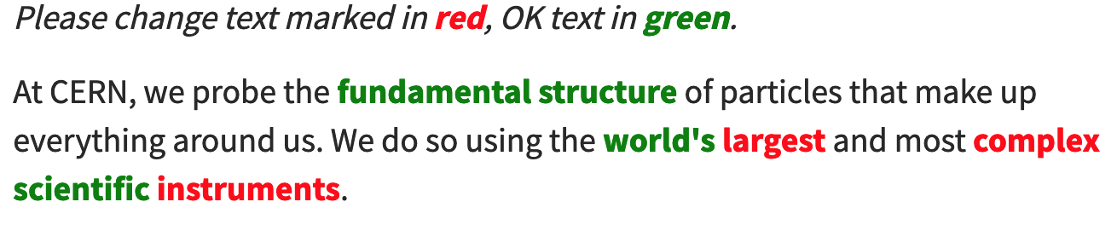
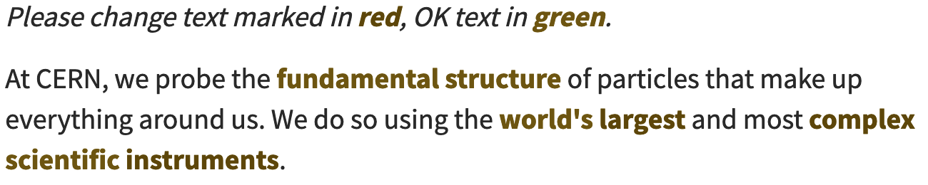
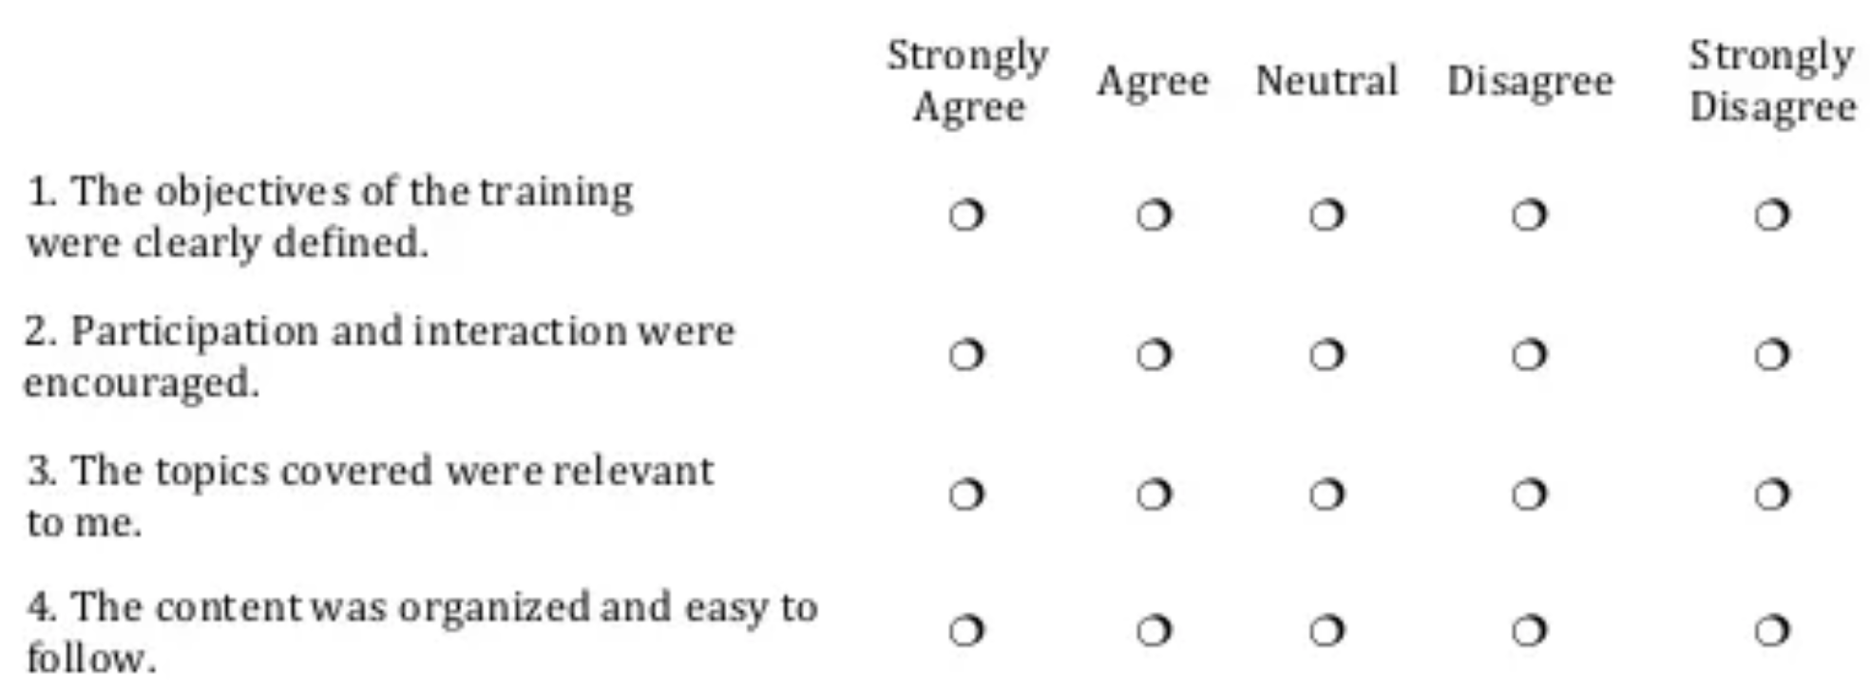
Experience: Visual
Red/green colourblind simulation
Images of text
Actual text: can be resized without losing clarity
Helen
Text embedded in image: distorts and pixelates when resized
Lose context on magnification
Notes:
CERN website banners, embedding ppt slides as images into webpages

Slide 9
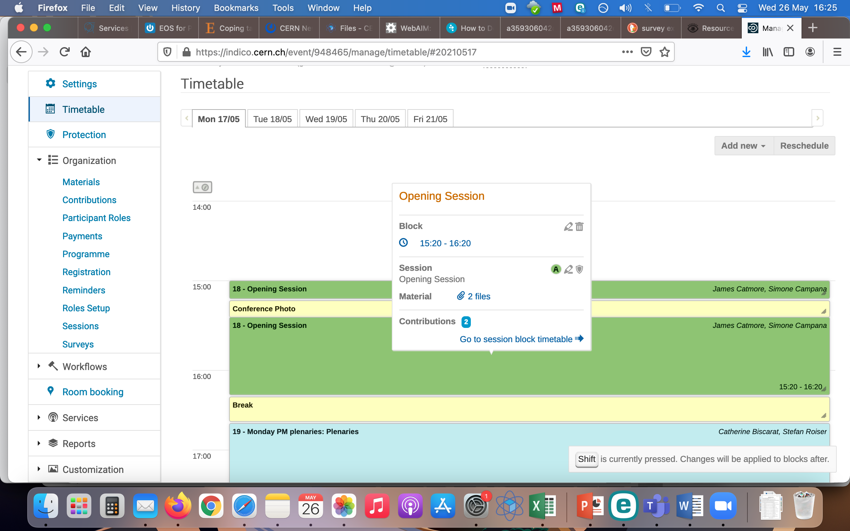
Experience: motor control
Experience it yourself
  Try 5 minutes using your non-dominant hand for everything:
  cleaning your teeth | computer mouse in non-dominant hand | NO mouse at all, use keyboard only…
Itsy bitsy teeny weeny icons
  Target area and spacing
  Easy to click the wrong one
  Icon placement – error risk
User cannot use a mouse or pad: on keyboard navigation only
  Inaccessible widgets (mouse-only target!)
  Tab control: Lengthy navigation… or not be able to navigate at all
Notes:
What that means for time, frustration, exclusion

Slide 10
Experience: Cognitive
Phisiycsts adn eneneigrs at CERN seu eth wodlr's laegrst and most coplmex scftnieiic inumnestrts ot study eth basic cotueinntsts of matter – funaemtndal pacelirts. Suabotmic parictles rae made to colilde tohtgeer at close ot het speed fo lihgt. The prceoss gives us clues about woh the paltirces inraetct, dna prvoides inhsigts into eht fumntdneaal laws fo nartue. eW want to adnvace het boairundes of human kndolewge by delving into het smalelst buldiing blcoks fo oru unievrse.
Dyslexia
  Complex words
  Fonts
Epilepsy, migraines, attention disorders
  Autoplay on videos, unstoppable!
  Sliding image banners
  White on Black text ~ flickering/scrolling
I love CERN
Physicists and engineers at CERN use the world's largest and most complex scientific instruments to study the basic constituents of matter – fundamental particles. Subatomic particles are made to collide together at close to the speed of light. The process gives us clues about how the particles interact, and provides insights into the fundamental laws of nature. We want to advance the boundaries of human knowledge by delving into the smallest building blocks of our universe.

Slide 11
Constructing a ”POUR” website

Slide 12
Constructing a POUR interface
Understand the rationale (the ‘why’) then you can be more effective in applying the ‘what’ and the ‘how’
The principles: https://webaim.org/articles/pour/
P Perceivable
O Operable
U Understandable
R Robust
Notes:
Not just memorise list of guidelines

Slide 13
P is for …. Perceivable
If you can’t perceive it, it’s inaccessible.
Visual
  Readable text, view images
  Meaning not conveyed by colour alone
  Colour contrast and background images not interfering with message
Audio
  Screen-reader friendly – navigable, scannable…
  Captions on audio-heavy content
  Audio not obscured by background sounds
Notes:
DON”T DESIGN FOR YOURSELF! (or if you do, for you in 30 years)

Slide 14
O is for… Operable
Input methods
  Keyboard-accessible, voice responsive etc
Interaction methods
  Find/skip content, navigate menus, sidebar content
User Control Over Timing
  Timeouts (eg. banking), multi-media controls
Error Recovery
  Can back out of hitting (eg) wrong link

Slide 15
U is for… Understandable
Language should be clear and as simple as possible
  Audience
  Non-native speakers
Document/website language MUST be identified!
  Screen-readers pronounce text according to <lang> language attribute
  If text written in (eg) English is read with the pronunciation rules of another (eg. language attribute set to <html lang=“fr”>), results are incomprehensible.
  EN/CZ audio example at https://webaim.org/techniques/language/
Notes:
Language/non-native. Topic matter. CERN English.

Slide 16
R is for… Robust
Don’t make up your own standards, internationally-agreed ones already exist…
  https://www.w3.org/WAI/standards-guidelines/
  https://webaim.org/articles/ (for explanations)
Functionality : Current and Future Technologies
  Is your website/interface compatible with assistive technologies?
  Developers: robust clean code, future-proof where possible ;-)
Notes:
Reduce hacks

Slide 17
(Starter guide to...) Design tips, tools, evaluation

Slide 18
Example solutions: auditory
Create high-quality audio wherever humanly possible.
Include (live) captions and transcripts
  Not perfect but already very helpful
  Live captions grant time and clues to figure out what’s being said.
  (automated) Transcripts = access all content after event
Easy to switch on and costs you nothing; radical improvement for those that need it
  Eg. Turn on live captioning in Zoom as a default!!!
Notes:
Also useful when audio quality is bad ☺
No need to make it harder than it already is. And it helps everyone, nothing more frustrating that listening to bad audio, hey…
vCHEP with a speaker with heavy accent and the live captions really struggled

Slide 19
Example solutions: visual
Colour perception
  Use accessible colour palettes, including for data visualisation
  Use texture/shape as well as colour to convey meaning
    not changes marked in red alone
    but changes marked in red and underlined
Feed the screen-reader
  Include “ALT” text (a descriptive snippet) for screen-reader to describe pictures
  No more “Click here”/”Read more” labels - use labels that make sense, based on destination rather than action (see Webaim for link text advice)
Notes:
Click here: red flag that website designed on desktop using a mouse – other methods likely not considered

Slide 20
Example solutions: motor control
Mouse/tap methods
Icons: bigger target areas
  Min 44px x 44px ¹
Icon placement
  Consider error-forcing placements.
  Space them well if you do….
I accept the terms & conditions
I accept the terms & conditions
1 WCAG recommendation at https://www.w3.org/TR/WCAG21/#target-size

Slide 21
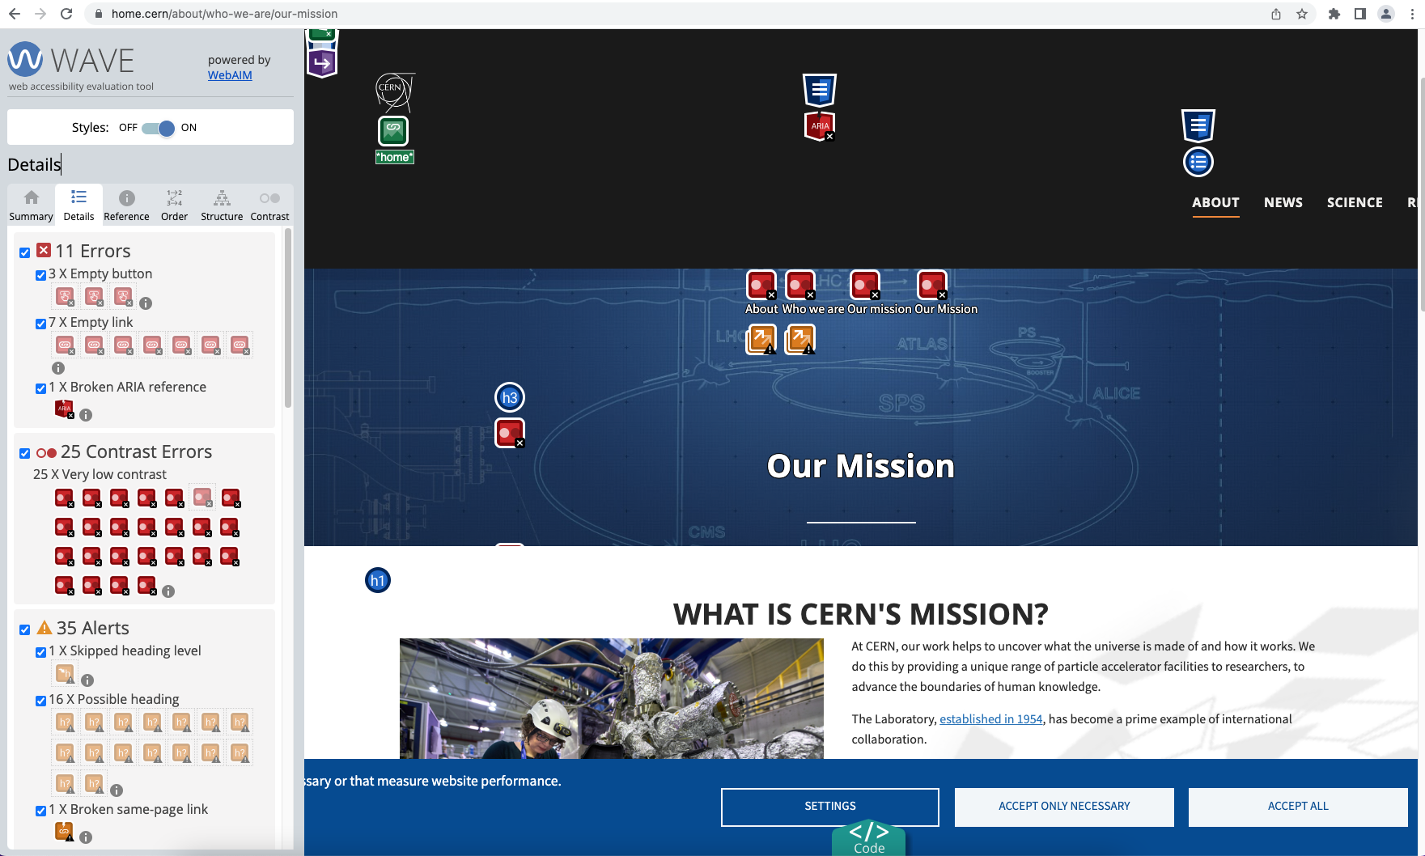
WAVE – automatic accessibility evaluation
https://wave.webaim.org/
Web interface version
Browser extensions
  Firefox, Edge, Chrome
  Works behind SSO

Slide 22
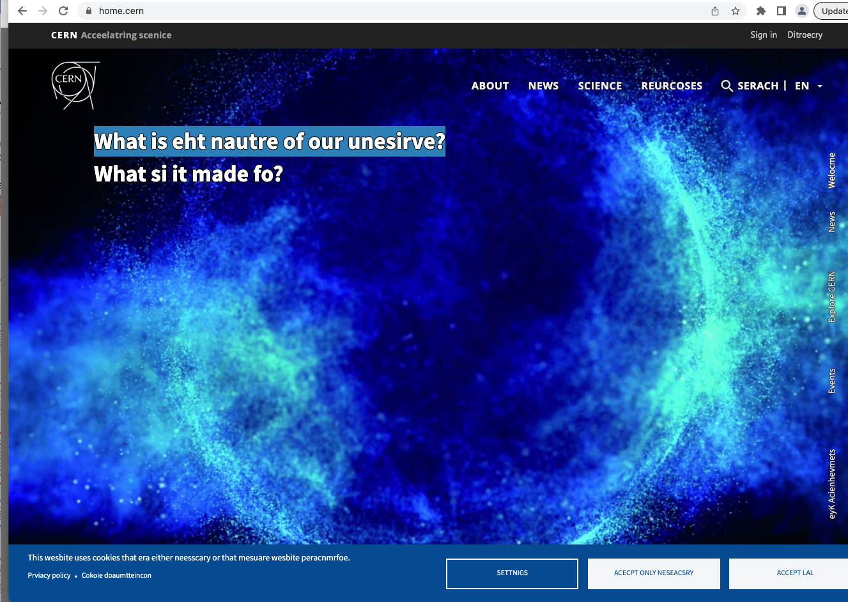
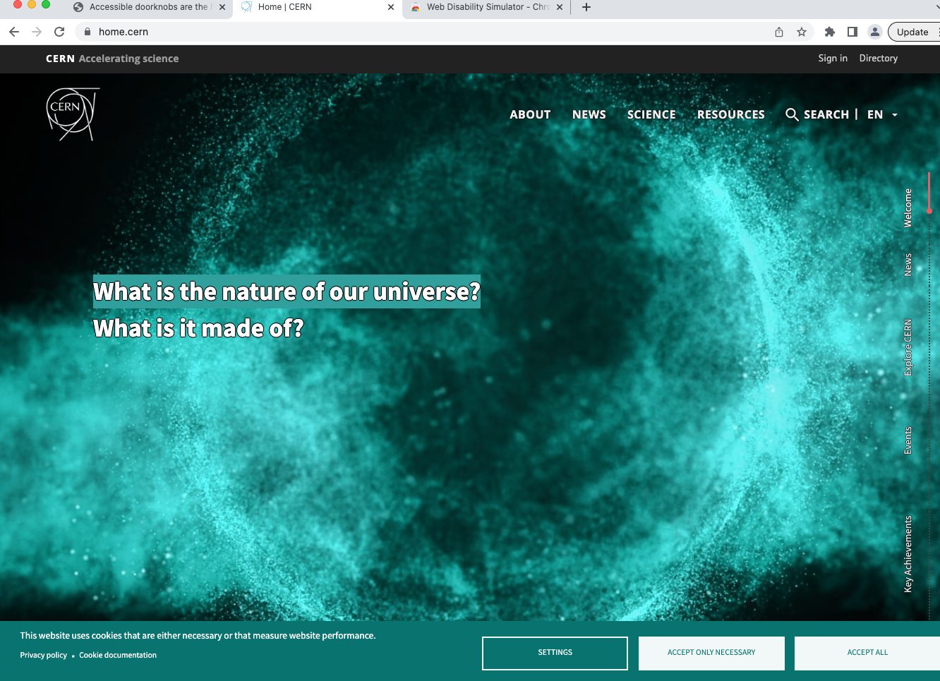
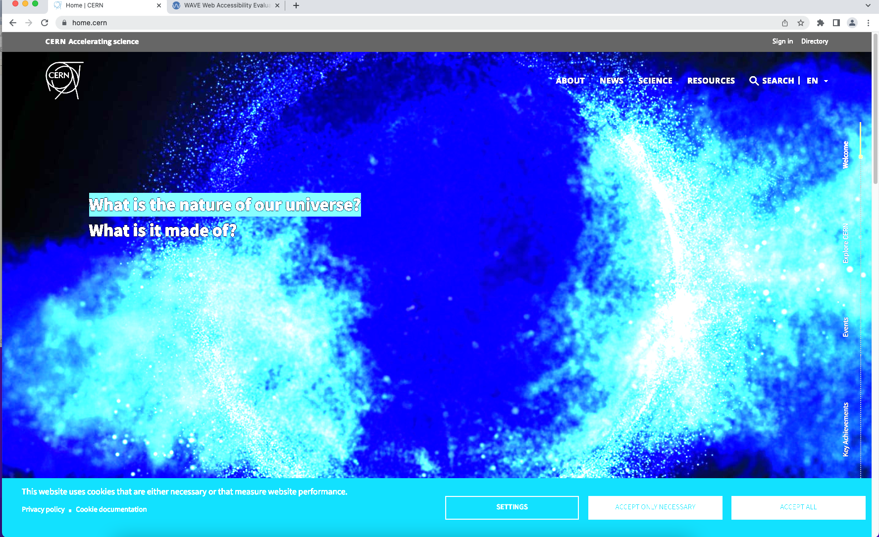
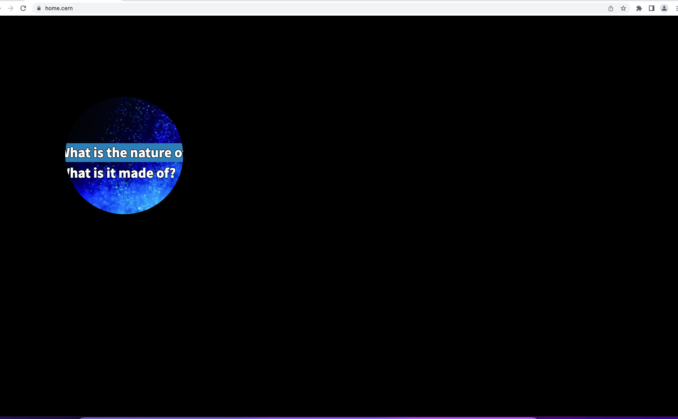
Web Disability Simulator
Web Disability Simulator: Chrome browser extension
Simulates how people with disabilities see the web.
Pointers to promote your understanding + techniques for text/design choices

Slide 23
Accessibility Mindset - conclusion
Invisible to you does not mean invisible to others.
Educate yourself to understand the impact of your design choices.
Do what you can. A little tweak can go a long way for those that need it.
Start now!
Notes:
Don’t wait until it’s compulsory. You’re going to have to implement it sooner or later…

Slide 24
Annex 1: Articles and tips
WebAim: articles, resources, tools…
  https://webaim.org/
  https://webaim.org/articles/userperspective/
WAI:
  https://www.w3.org/WAI/tutorials/
Specifics
  Avoid using ‘Click Here” – appropriate labelling for links (focus on destination, not on the action)
    https://www.lamar.edu/web-communication/resources/avoid-using-click-here.html
  Designing for red/green colourblindess
    https://visualisingdata.com/2019/08/five-ways-to-design-for-red-green-colour-blindness/
WebAIM Million: 2023 report on the accessibility of the top 1,000,000 home pages
  https://webaim.org/projects/million/
Including an Accessibility Statement
  WAI’s “Developing an Accessibility Statement”
  https://www.w3.org/WAI/planning/statements/

Slide 25
Annex 2: Tools (for starters)
WAVE: Automated evaluation to highlight and resolve issues
  https://wave.webaim.org/
Firefox: (right click/Inspect Accessibility… or via menu/More Tools…)
WebAIM resources: Checklists, tools
  https://webaim.org/resources/
Web Disability Simulator (Chrome browser extension)
  https://chrome.google.com/webstore/detail/web-disability-simulator/olioanlbgbpmdlgjnnampnnlohigkjla
Accessible Colour palette generator
  https://venngage.com/tools/accessible-color-palette-generator

