Slide 1
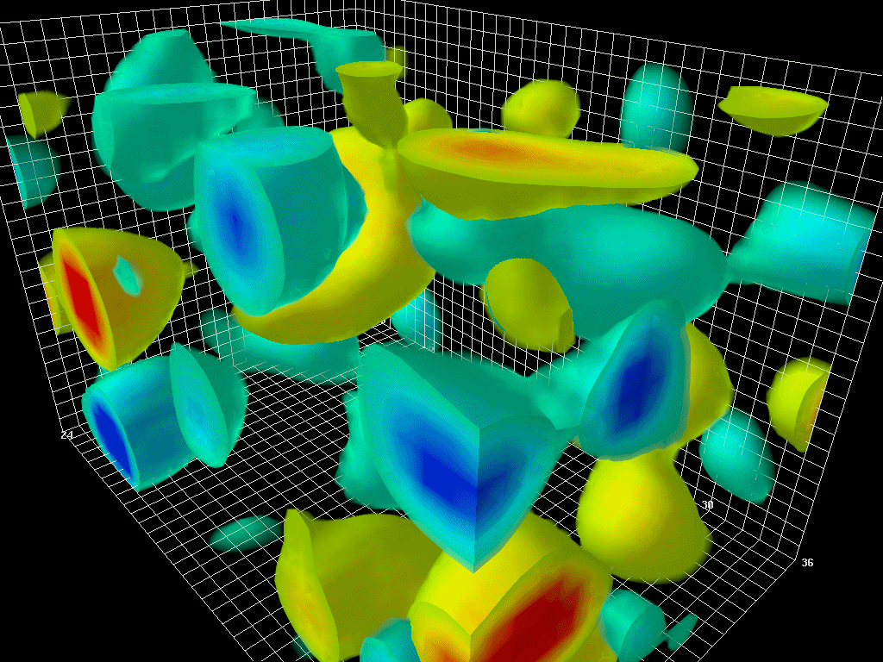
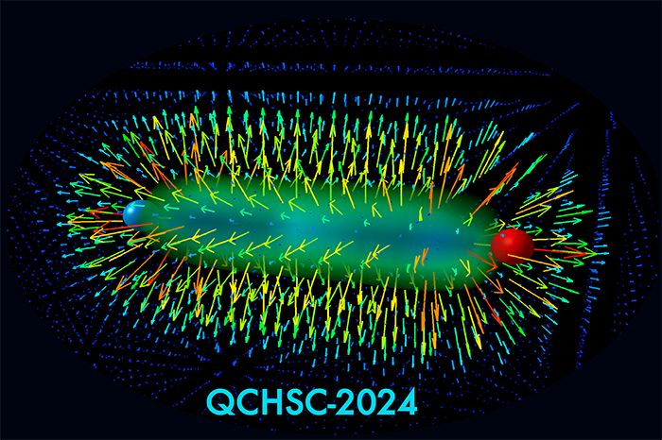



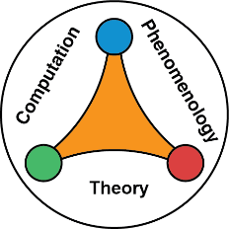


The QCD confining string and the world-sheet axion
18th – 24th of August 2024
Andreas Athenodorou
The Cyprus Institute
0000-0003-4600-4245
In collaboration with Pedro Bicudo, Sergei Dubovksy, Conghuan Luo, Alireiza Sharifian and Michael Teper

Slide 2
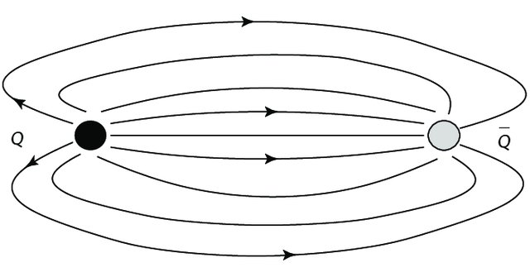



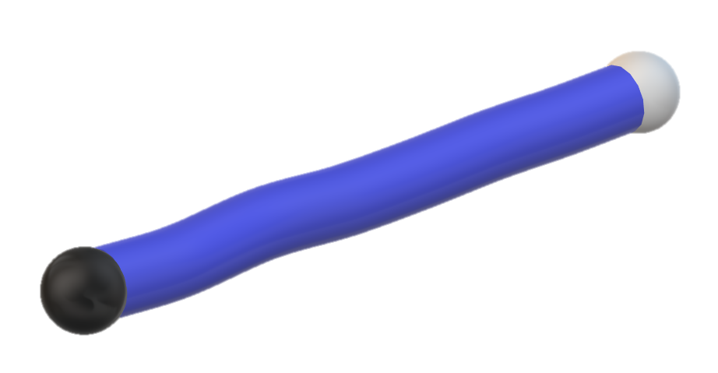
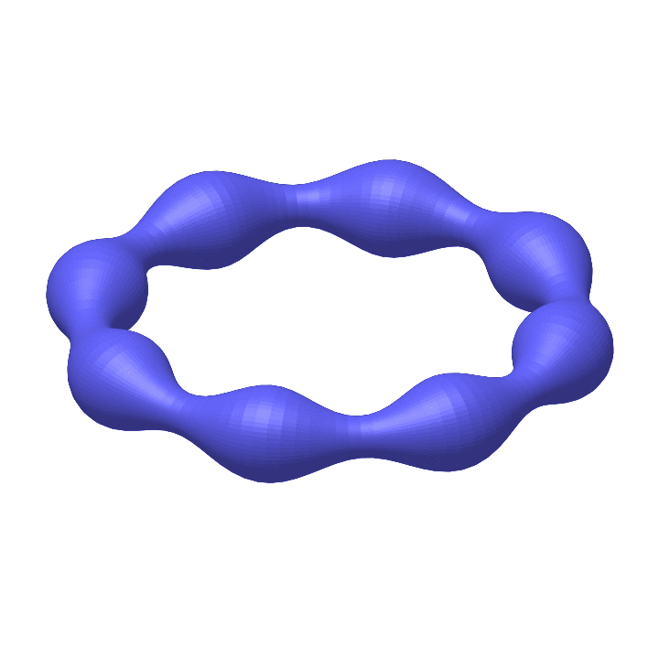
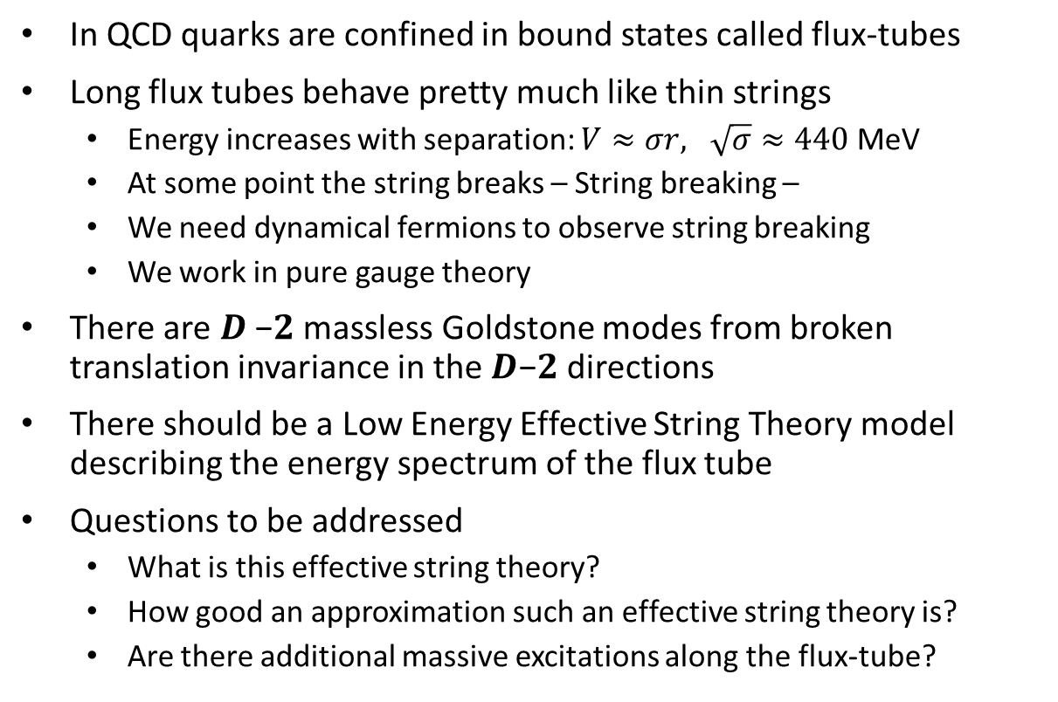
Are flux tubes strings?
In QCD quarks are confined in bound states called flux-tubes
Long flux tubes behave pretty much like thin strings
  Energy increases with separation: $V≈σr, \sqrt{σ}≈440$ MeV
  At some point the string breaks – String breaking –
  We need dynamical fermions to observe string breaking
  We work in pure gauge theory
There are 𝑫 −𝟐 massless Goldstone modes from broken translation invariance in the 𝑫−𝟐 directions
There should be a Low Energy Effective String Theory model describing the energy spectrum of the flux tube
Questions to be addressed
  What is this effective string theory?
  How good an approximation such an effective string theory is?
  Are there additional massive excitations along the flux-tube?
Notes:
Insert older articles

Slide 3
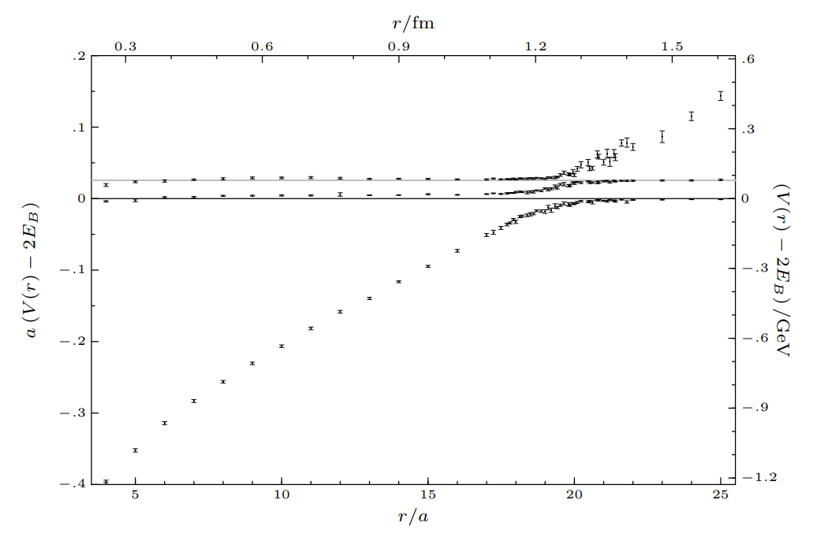
Are flux tubes strings?
J. Bulava et al, Phys.Lett.B 793 (2019), 493-498
In QCD quarks are confined in bound states called flux-tubes
Long flux tubes behave pretty much like thin strings
  Energy increases with separation: $V≈σr, \sqrt{σ}≈440$ MeV
  At some point the string breaks – String breaking –
  We need dynamical fermions to observe string breaking
  We work in pure gauge theory
There are 𝑫 −𝟐 massless Goldstone modes from broken translation invariance in the 𝑫−𝟐 directions
There should be a Low Energy Effective String Theory model describing the energy spectrum of the flux tube
Questions to be addressed
  What is this effective string theory?
  How good an approximation such an effective string theory is?
  Are there additional massive excitations along the flux-tube?
Notes:
Insert older articles

Slide 4
Are flux tubes strings?
In QCD quarks are confined in bound states called flux-tubes
Long flux tubes behave pretty much like thin strings
  Energy increases with separation: $V≈σr, \sqrt{σ}≈440$ MeV
  At some point the string breaks – String breaking –
  We need dynamical fermions to observe string breaking
  We work in pure gauge theory
There are 𝑫 −𝟐 massless Goldstone modes from broken translation invariance in the 𝑫−𝟐 directions
There should be a Low Energy Effective String Theory model describing the energy spectrum of the flux tube
Questions to be addressed
  What is this effective string theory?
  How good an approximation such an effective string theory is?
  Are there additional massive excitations along the flux-tube?
QCD
Notes:
Insert older articles

Slide 5
Are flux tubes strings?
In QCD quarks are confined in bound states called flux-tubes
Long flux tubes behave pretty much like thin strings
  Energy increases with separation: $V≈σr, \sqrt{σ}≈440$ MeV
  At some point the string breaks – String breaking –
  We need dynamical fermions to observe string breaking
  We work in pure gauge theory
There are 𝑫 −𝟐 massless Goldstone modes from broken translation invariance in the 𝑫−𝟐 directions
There should be a Low Energy Effective String Theory model describing the energy spectrum of the flux tube
Questions to be addressed
  What is this effective string theory?
  How good an approximation such an effective string theory is?
  Are there additional massive excitations along the flux-tube?
SU(3)
Notes:
Insert older articles

Slide 6
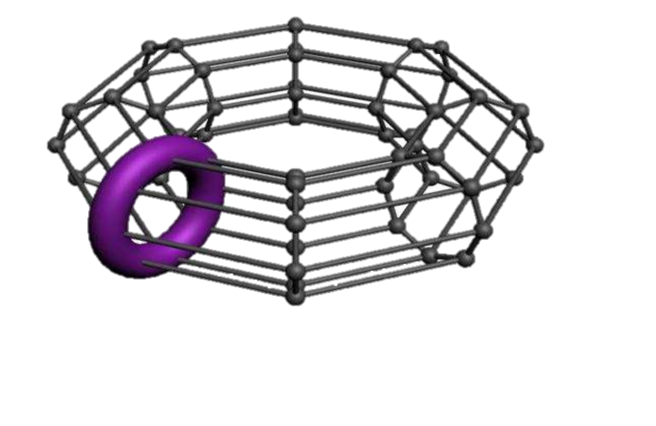
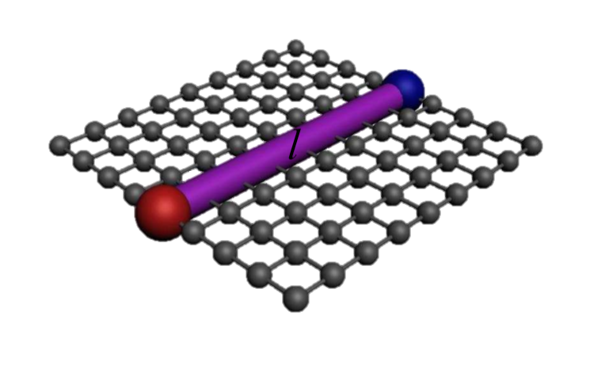


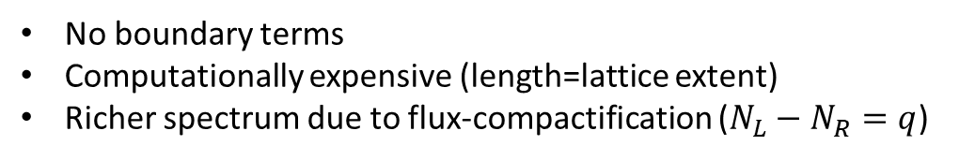


How to investigate
Strategy:
  Is there a theoretical description in agreement with Lattice data for the flux-tube?
  Is there a group of lattice data in striking disagreement with the theory?
  What does this disagreement teach about the theory? Can the theory be extended?
Two flux-tube set ups:
Closed Flux-Tube (Torelon)
Open Flux-Tube
$$\overline{q}$$
Periodic boundaries
Compactification
$$R$$
$$R$$
$$q$$
[Teper, Barak, AA]
[Caselle, Bicudo, Brandt, Kuti, AA]
No boundary terms
Computationally expensive (length=lattice extent)
Richer spectrum due to flux-compactification ($N_{L}−N_{R}=q$)
One needs to deal with the boundary terms
Computationally not so expensive

Slide 7
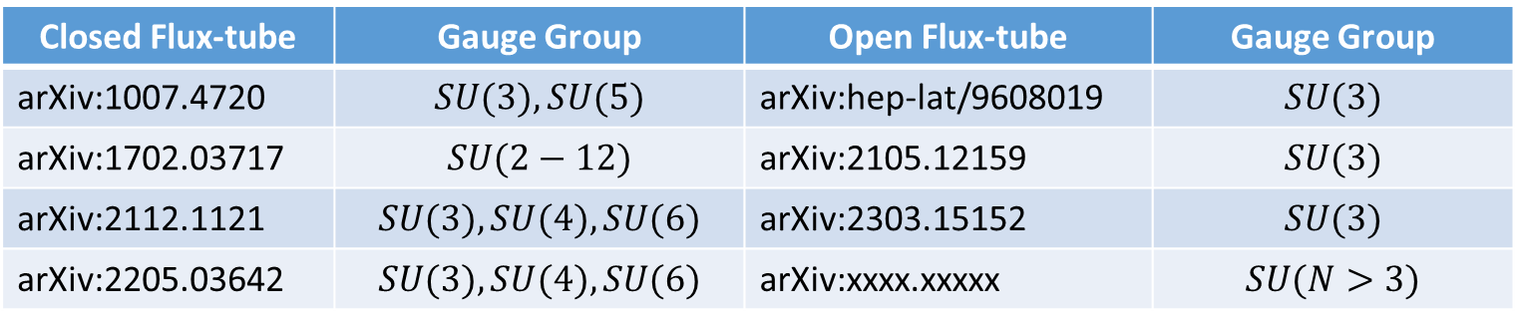
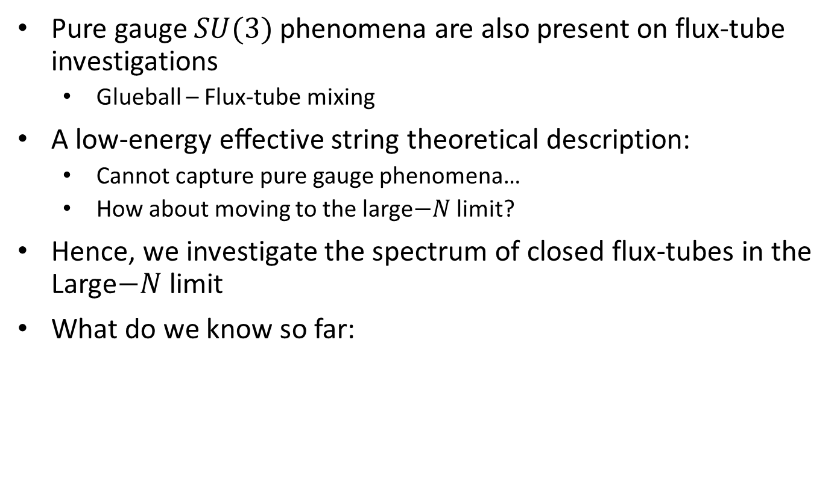
Climbing the Large−𝑁 steep
Pure gauge $SU(3)$ phenomena are also present on flux-tube investigations
  Glueball – Flux-tube mixing
A low-energy eﬀective string theoretical description:
  Cannot capture pure gauge phenomena…
  How about moving to the large$−N$ limit?
Hence, we investigate the spectrum of closed flux-tubes in the Large$−N$ limit
What do we know so far:
Closed Flux-tube | Gauge Group | Open Flux-tube | Gauge Group
arXiv:1007.4720 | $$SU(3), SU(5)$$ | arXiv:hep-lat/9608019 | $$SU(3)$$
arXiv:1702.03717 | $$SU(2−12)$$ | arXiv:2105.12159 | $$SU(3)$$
arXiv:2112.1121 | $$SU(3), SU(4), SU(6)$$ | arXiv:2303.15152 | $$SU(3)$$
arXiv:2205.03642 | $$SU(3), SU(4), SU(6)$$ | arXiv:xxxx.xxxxx | $$SU(N>3)$$

Slide 8
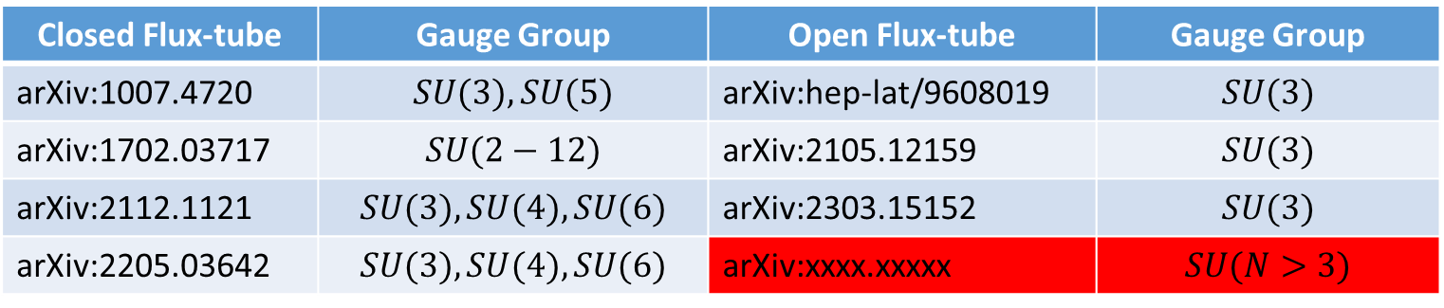
Climbing the Large−𝑁 steep
Pure gauge $SU(3)$ phenomena are also present on flux-tube investigations
  Glueball – Flux-tube mixing
A low-energy eﬀective string theoretical description:
  Cannot capture pure gauge phenomena…
  How about moving to the large$−N$ limit?
Hence, we investigate the spectrum of closed flux-tubes in the Large$−N$ limit
What do we know so far:
Closed Flux-tube | Gauge Group | Open Flux-tube | Gauge Group
arXiv:1007.4720 | $$SU(3), SU(5)$$ | arXiv:hep-lat/9608019 | $$SU(3)$$
arXiv:1702.03717 | $$SU(2−12)$$ | arXiv:2105.12159 | $$SU(3)$$
arXiv:2112.1121 | $$SU(3), SU(4), SU(6)$$ | arXiv:2303.15152 | $$SU(3)$$
arXiv:2205.03642 | $$SU(3), SU(4), SU(6)$$ | arXiv:xxxx.xxxxx | $$SU(N>3)$$

Slide 9




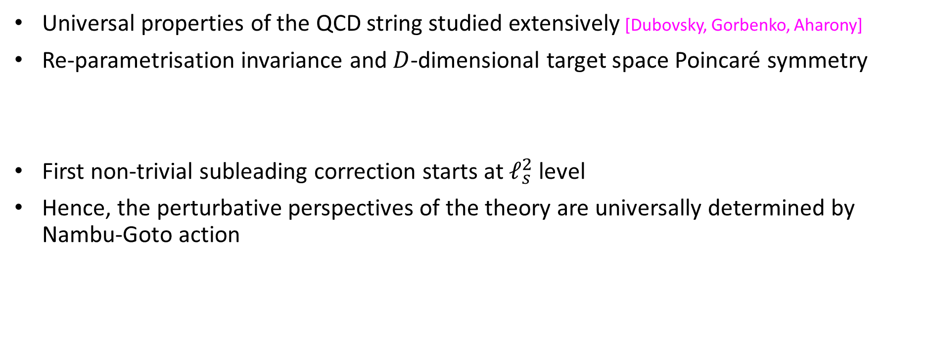
The effective string theory of long strings
Universal properties of the QCD string studied extensively [Dubovsky, Gorbenko, Aharony]
Re-parametrisation invariance and $D$-dimensional target space Poincaré symmetry
First non-trivial subleading correction starts at $ℓ_{s}^{2}$ level
Hence, the perturbative perspectives of the theory are universally determined by Nambu-Goto action
,
Notes:
h is the induced metric of the world sheet, R is the scalar curvature tensor constructed out of this metric, K is the extrinsic curvature tensor. R vanishes because it is a total derivative, K^2 vanishes on shell and R and KK terms are cancelled due to Gauss-Codazzi equation

Slide 10
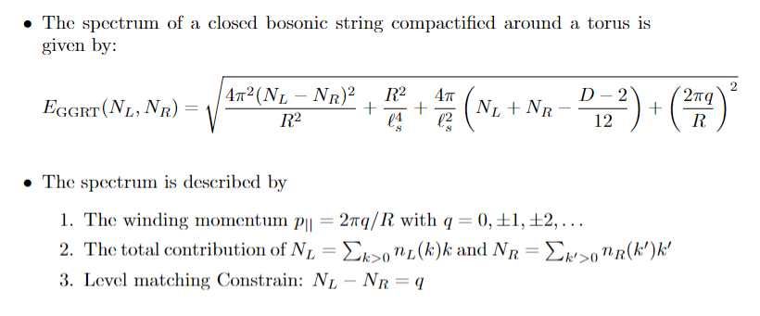
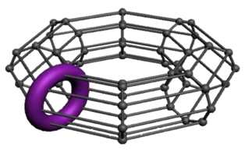

The Goddard-Goldstone-Rebbi-Thorn spectrum for closed string
We quantize the Closed bosonic string (Nambu-Goto)
$$R$$
Notes:
Stays

Slide 11
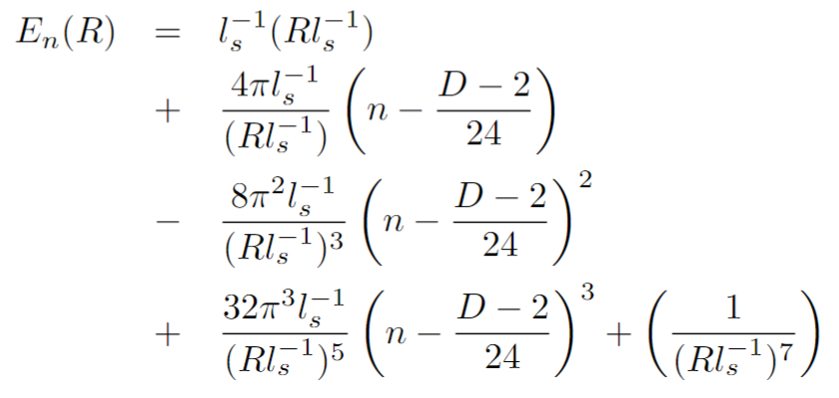
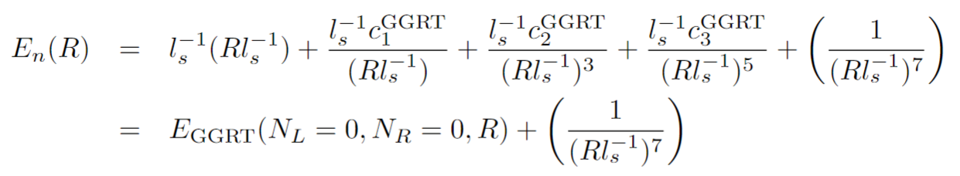
The closed string expansion in $1/R𝓁_{s}^{−1}$
Topic received contributions since the early 80s
[M. Lüscher ’81, J. Polchinski & A. Strominger ‘90, M. Lüscher & P. Weisz ’04, O. Aharony et al ’07 – 11, S. Dubovsky et al ’12 – 19]
Relation to the GGRT spectrum:
Linear Confinement
Lüscher 1980, Polchinski&Strominger 1991
Lüscher&Weisz 2004, Drummond 2004
Aharony&Karzbrun 2009
Notes:
Hence, the GGRT spectrum can be thought of as a particular resummation of tree level terms in the ℓs/R expansion

Slide 12
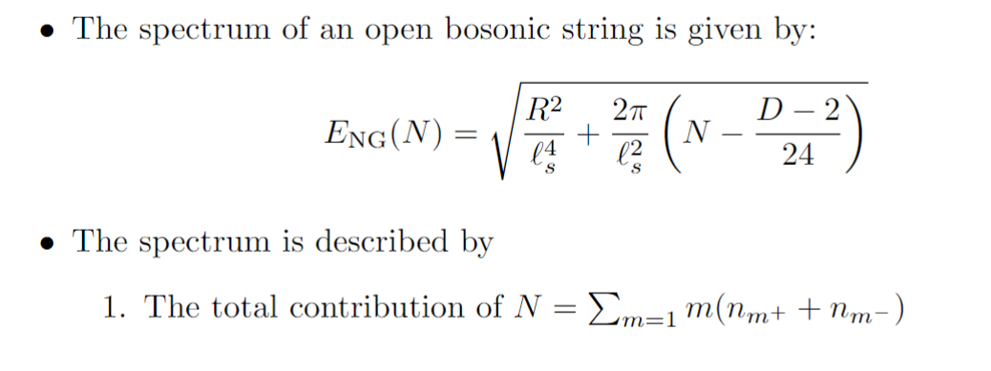

The Nambu-Goto spectrum for open strings
Quantize the Open bosonic string (Nambu-Goto)
[Arvis ‘83]
$$R$$
Notes:
h is the induced metric of the world sheet, R is the scalar curvature tensor constructed out of this metric, K is the extrinsic curvature tensor. R vanishes because it is a total derivative, K^2 vanishes on shell and R and KK terms are cancelled due to Gauss-Codazzi equation

Slide 13
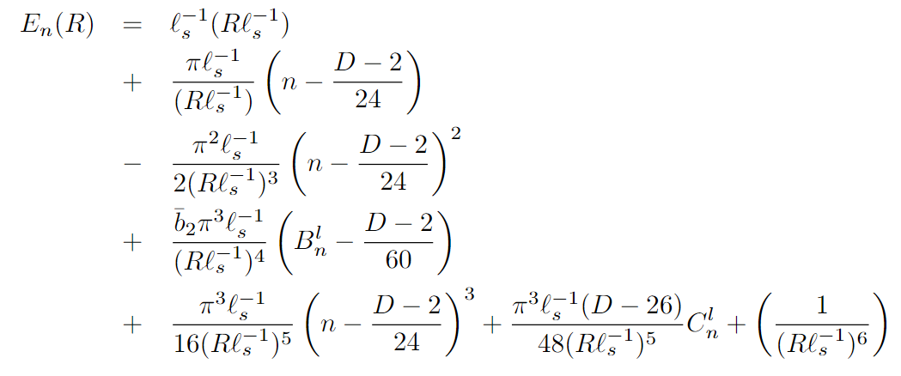
The open string expansion in $1/R𝓁_{s}^{−1}$
Topic received contributions since the early 80s
[M. Lüscher ’81, J. Polchinski & A. Strominger ‘90, M. Lüscher & P. Weisz ’04, O. Aharony et al ’07 – 11, S. Dubovsky et al ’12 – 19]
Relation to the NG spectrum:
Linear Confinement
Lüscher 1980, Polchinski&Strominger 1991
Lüscher&Weisz 2004, Drummond 2004
Aharony et al 2010, 2012
Aharony et al 2009, 2010
Notes:
Hence, the GGRT spectrum can be thought of as a particular resummation of tree level terms in the ℓs/R expansion

Slide 14
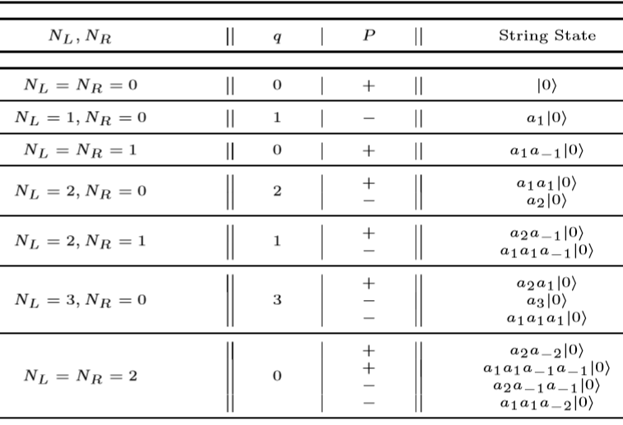
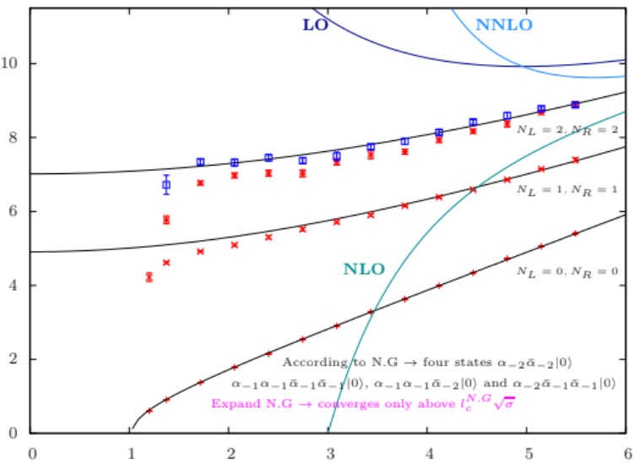

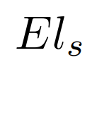
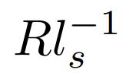
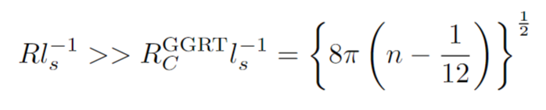
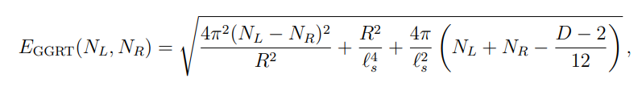


The expansion in $1/R𝓁_{s}^{−1}$ - the $D=2+1$ closed flux tube case
S. Dubovsky et al.
Phys. Rev. Lett., 111(6):062006, 2013.
$$pℓ_{s}$$
Expand
$$ℓ_{s}/R$$
Expansion valid for
In $D=2+1$ only string like states have been observed so far
$D=3+1$ case is more complex and interesting to look for such states
Notes:
Stays

Slide 15

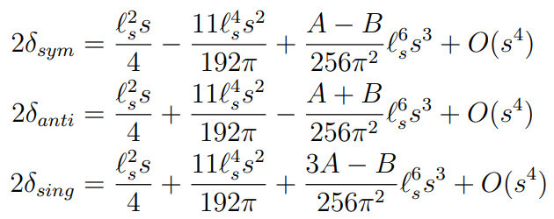

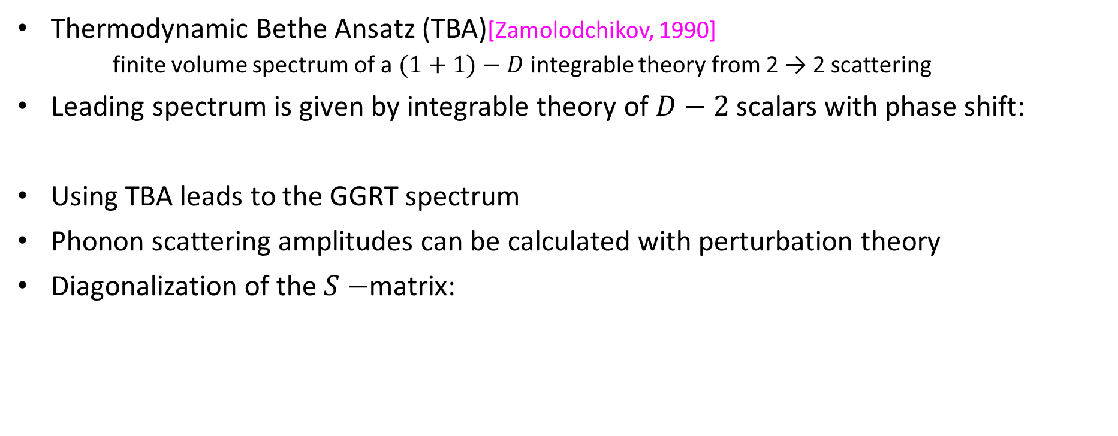


Closed flux tube spectrum from world-sheet scattering
Thermodynamic Bethe Ansatz (ΤΒΑ)[Zamolodchikov, 1990]
  finite volume spectrum of a $(1+1)−D$integrable theory from 2 → 2 scattering
Leading spectrum is given by integrable theory of $D−2$ scalars with phase shift:
Using TBA leads to the GGRT spectrum
Phonon scattering amplitudes can be calculated with perturbation theory
Diagonalization of the $S−$matrix:
$$2^{±}$$
$$0^{−}$$
$$0^{+}$$
Notes:
The tree level scattering of phonons is integrable and and is characterized by the following phase shift

Slide 16
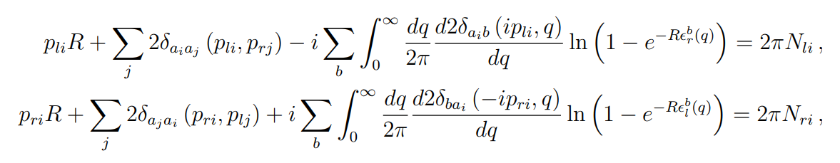

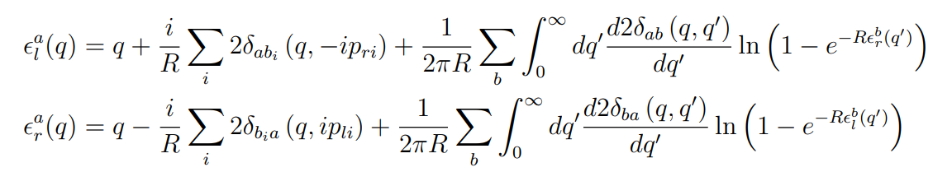
Closed flux tube spectrum from world-sheet scattering
TBA formulates with the generalized quantization condition around the circle:
The pseudo-energies satisfy:
The energy of a state is written as
+ Approximations
ΑΒΑ
Notes:
Stays

Slide 17
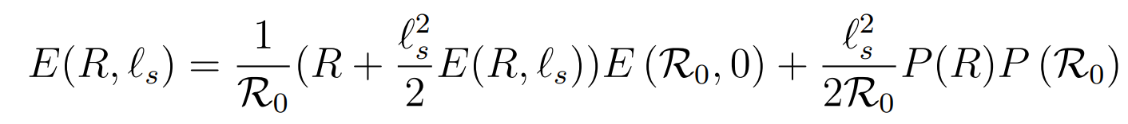

Closed flux tube spectrum from world-sheet scattering
$Τ\overline{Τ}$ simplifies TBA because the undressed theory is free in the leading order
We neglect all the winding corrections in the undressed spectrum
Momentum Quantization Condition becomes the Asymptotic Bethe Ansatz (ABA)
We can investigate the spectrum of phonons – massive excitations using ABA + $Τ\overline{Τ}$ deformations. [Chen, Conkey, Dubovsky, Hernández-Chifflet 2018]
Recipe
  Start with a world-sheet theory of free phonons (phonons can interact at subleading order in low energy limit) and massive particles.
  Compute the finite volume spectrum of this theory using ABA.
  Deform the theory by $Τ\overline{Τ}$ operator to the string scale, which will automatically incorporate the axion-interaction at leading order.
Notes:
Stays

Slide 18
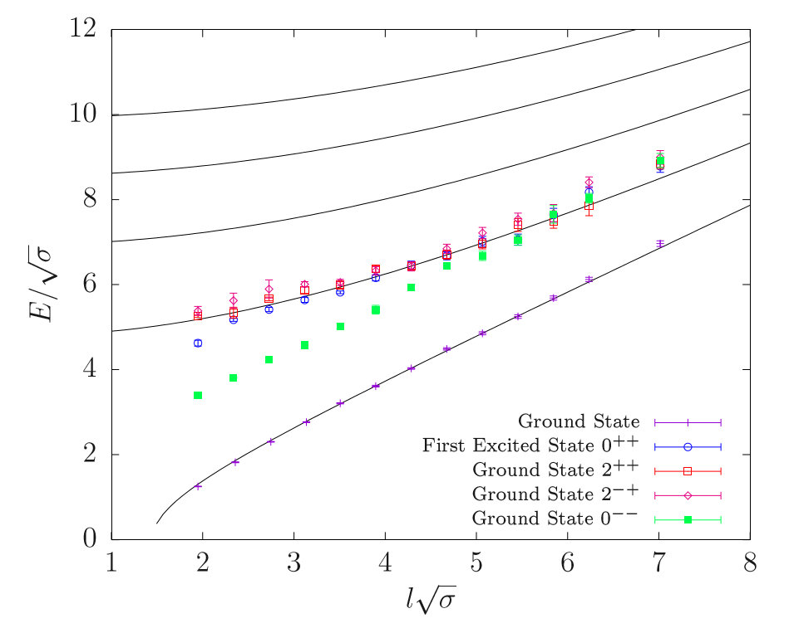
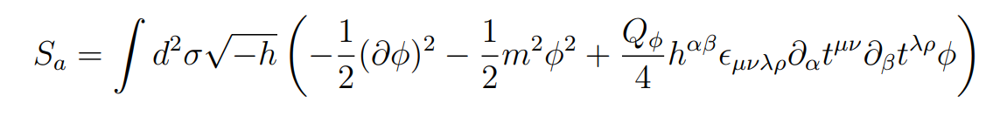
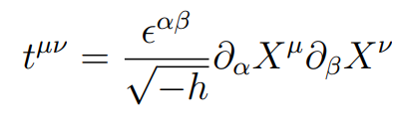









The Axionic String Ansatz (ASA)
Lattice calculations demonstrate that there is one massive resonance
We add a massive resonance [Dubovsky et al 2013]
is a pseudoscalar – the world-sheet axion
From Monte-Carlo data of $4D SU(3)$Yang-Mills:
Integrable coupling:
Can we describe all states in $D=3+1$with the worldsheet fields only?
$$N_{L}=N_{R}=3$$
$$N_{L}=N_{R}=2$$
$$N_{L}=N_{R}=1$$
$$N_{L}=N_{R}=0$$
$$∆E\sim const.$$
Notes:
Stays

Slide 19
The Axionic String Ansatz (ASA)
Lattice calculations demonstrate that there is one massive resonance
We add a massive resonance [Dubovsky et al 2013]
is a pseudoscalar – the world-sheet axion
From Monte-Carlo data of $4D SU(3)$Yang-Mills:
Integrable coupling:
Can we describe all states in $D=3+1$with the worldsheet fields only?
Notes:
Stays

Slide 20
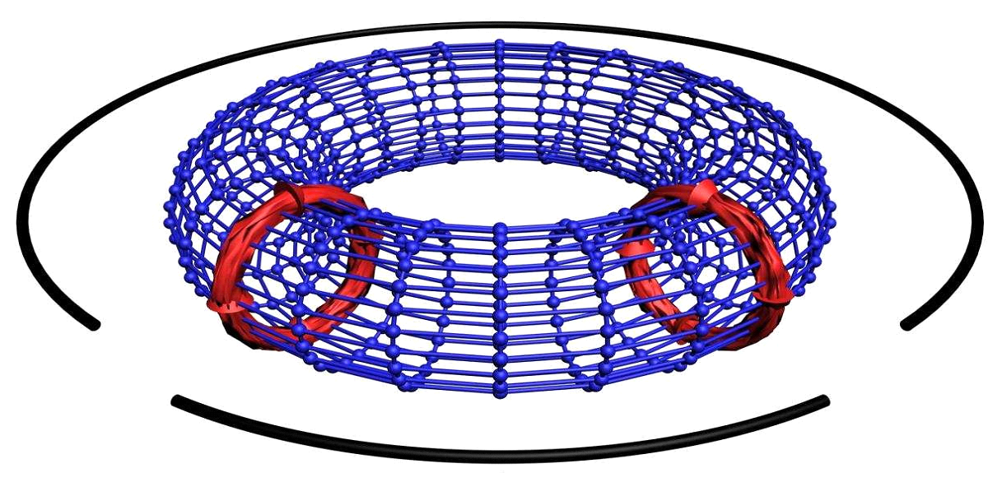
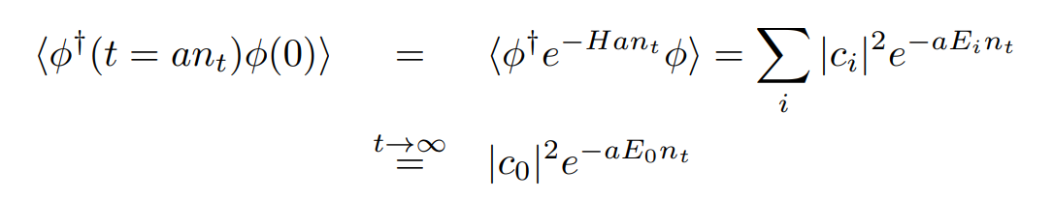

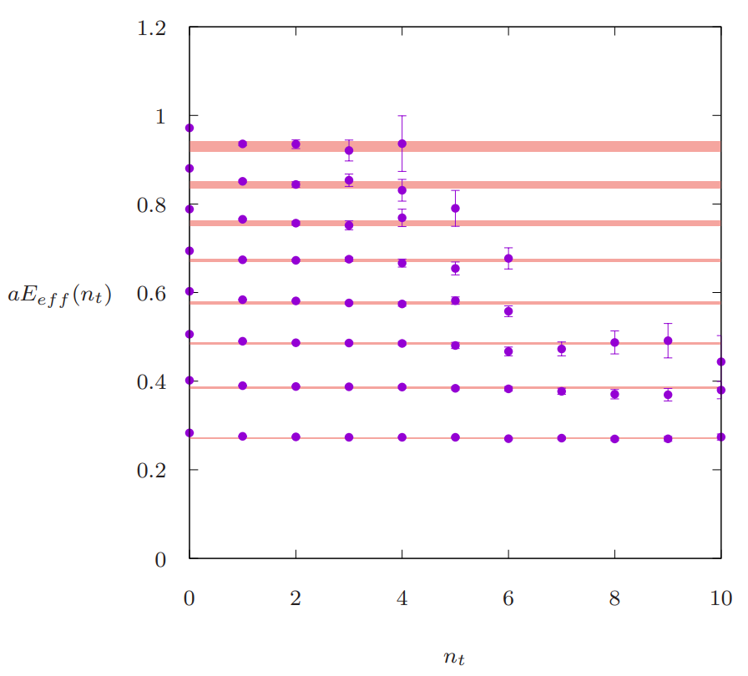

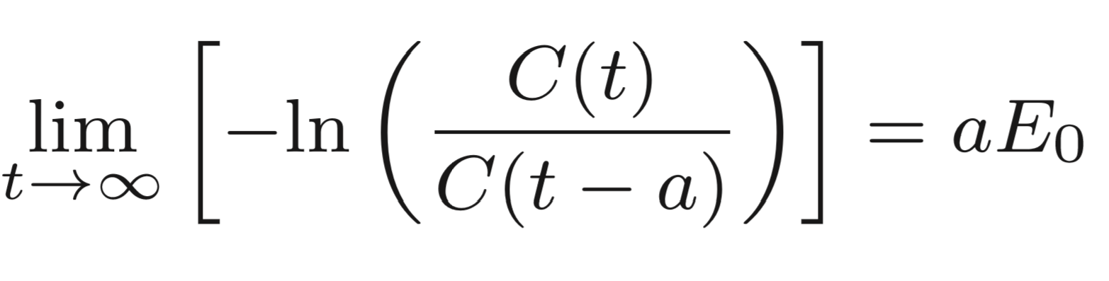


Extracting the spectrum of close flux tubes
The spectrum is extracted using torelon correlation functions
Using the effective mass
For excitation spectrum we use the GEVP
[Presentation by Francesco Giacomo Knechtli]
$$T−t$$
$$t$$
Provides the ground state
Example of effective masses
Notes:
Stays

Slide 21
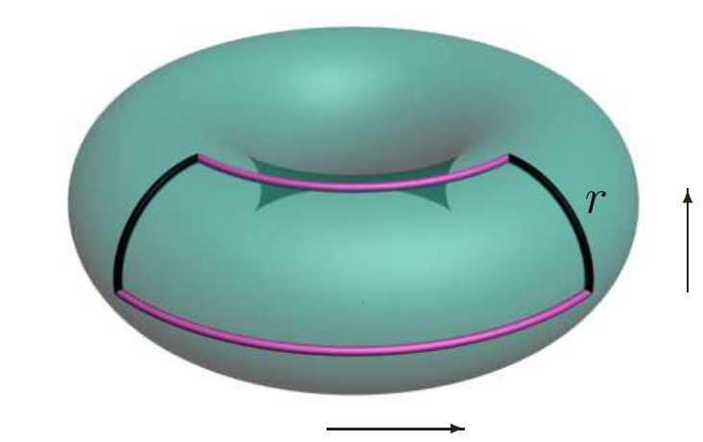
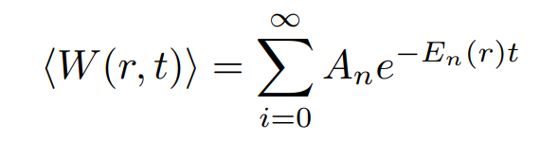
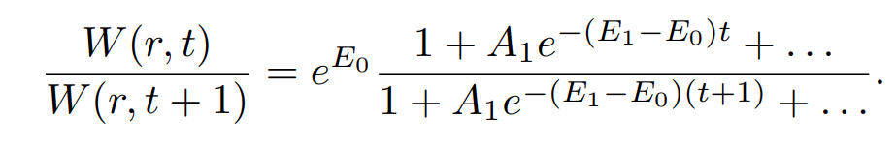
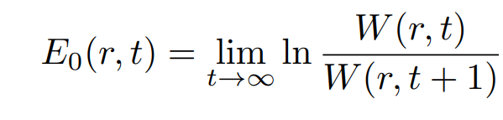



Extracting the spectrum of open flux tubes
The spectrum is extracted using Wilson loops $W(r,t)$
We use the effective energy:
For excitation spectrum we use once again the GEVP
$$W(r,t)$$
Space
$$t$$
Time
Notes:
Stays

Slide 22
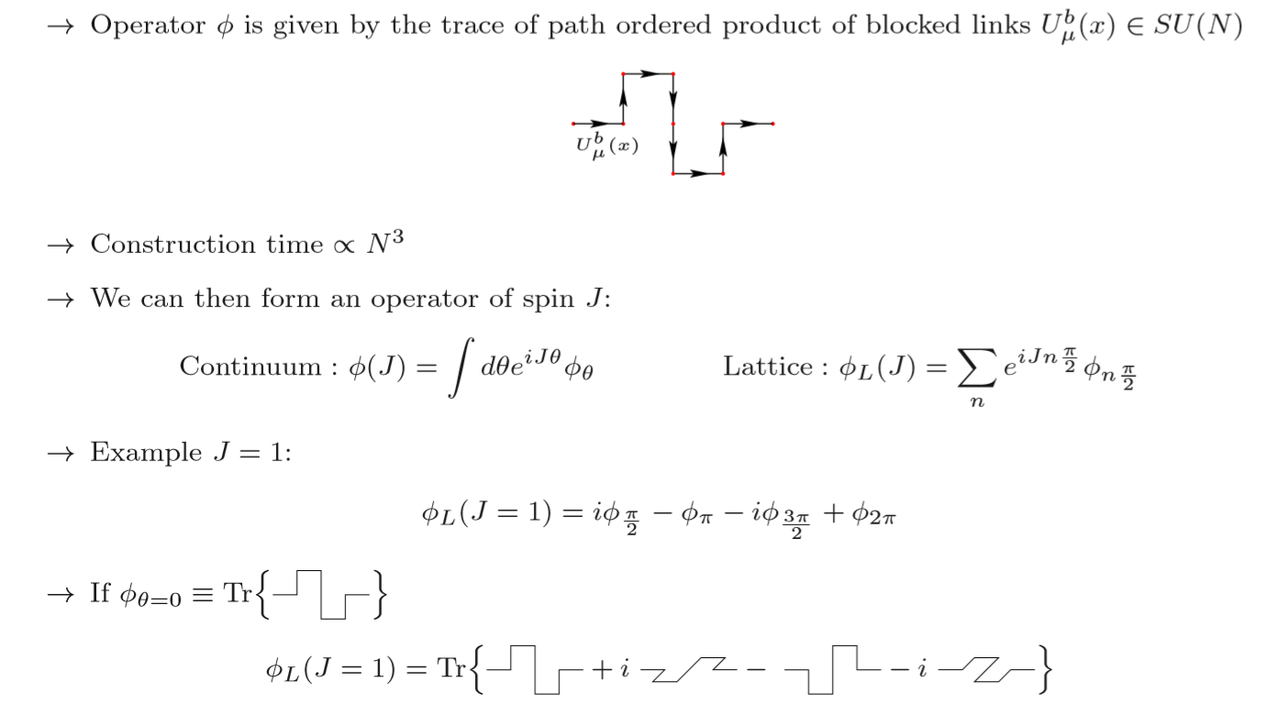
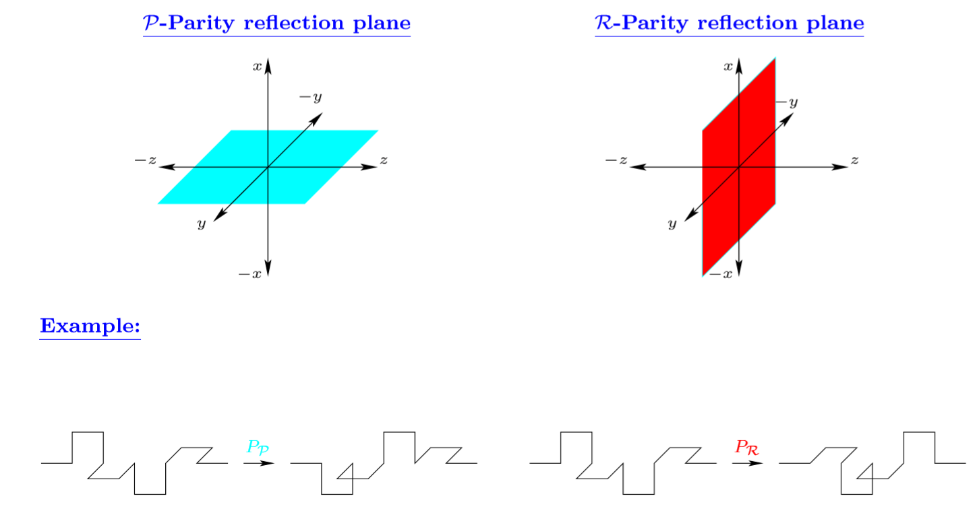

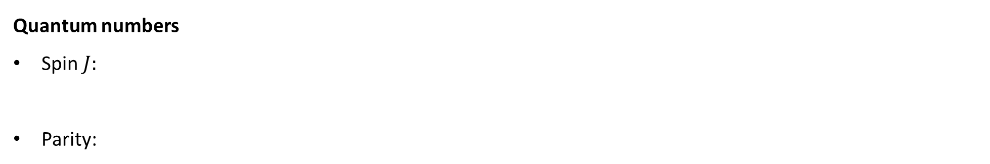
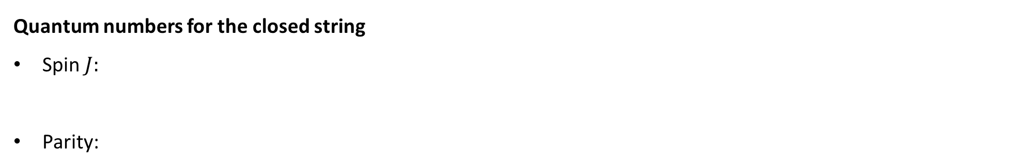


The Quantum Numbers of closed flux tubes
Quantum numbers for the closed string
Spin $J:$
Parity:
Example
Example
We build operators described by the quantum numbers of $J$, ,
We use a large basis of operators with transverse deformations:
Notes:
Stays

Slide 23




The Quantum Numbers of open flux tubes
Quantum numbers for the open flux tube
Spin $Λ$: Projection of angular momentum $J$ onto the charge axis $J∙\hat{R}$
Parity and Charge Conjugation : , with eigenvalues $g(u)≡1(−1)$
For $Λ=0$ we have one more quantum number
We project onto the irreducible representations
$Σ_{g}^{+}$, $Σ_{g}^{−}$, $Σ_{u}^{+}$ and $Σ_{u}^{−}$, where $Σ→Λ=0$
$Π_{g}$ and $Π_{u}$, where $Π→Λ=1$
$Δ_{g}$ and $Δ_{u}$, where $Δ→Λ=2$
Notes:
Stays

Slide 24











Closed flux tube results: The absolute ground state $N_{L}=N_{R}=0$
$$SU\left(3\right), β=6.0625$$
$$SU\left(5\right), β=17.63$$
$$SU\left(6\right), β=25.55$$
$$SU\left(3\right), β=6.338$$
$$SU\left(5\right), β=18.375$$
Notes:
Stays

Slide 25


Closed flux tube results: the GGRT state with $N_{L}=N_{R}=1$
Results for $SU\left(3\right)$ and $β=6.0625$
$$N_{L}=N_{R}=3$$
$$N_{L}=N_{R}=2$$
$$N_{L}=N_{R}=1$$
$$N_{L}=N_{R}=0$$
$$∆E\sim const.$$
Notes:
Stays

Slide 26






Closed flux tube results: the GGRT state with $N_{L}=N_{R}=1$
Results for all the ensembles
$$N_{L}=N_{R}=2$$
$$N_{L}=N_{R}=1$$
$$N_{L}=N_{R}=0$$
$$SU\left(3\right), β=6.0625$$
$$SU\left(5\right), β=17.63$$
$$SU\left(6\right), β=25.55$$
$$SU\left(3\right), β=6.338$$
$$SU\left(5\right), β=18.375$$
Notes:
Stays

Slide 27


Closed flux tube results: the GGRT state with $N_{L}=N_{R}=1$
Results for all the ensembles
$$0^{− −}$$
$$N_{L}=N_{R}=2$$
$$N_{L}=N_{R}=1$$
$$SU\left(3\right), β=6.0625$$
$$SU\left(5\right), β=17.63$$
$$SU\left(6\right), β=25.55$$
$$SU\left(3\right), β=6.338$$
$$SU\left(5\right), β=18.375$$
Notes:
Stays

Slide 28



Closed flux tube results: the GGRT state with $N_{L}=N_{R}=1$
Results for $SU\left(3\right)$ and $β=6.0625$
$$N_{L}=N_{R}=2$$
$$\sim 1.85$$
$$N_{L}=N_{R}=1$$
$$SU\left(3\right), β=6.0625$$
$$SU\left(5\right), β=17.63$$
$$SU\left(6\right), β=25.55$$
$$SU\left(3\right), β=6.338$$
$$SU\left(5\right), β=18.375$$
Notes:
Stays

Slide 29









Closed flux tube results: the GGRT state with $N_{L}=N_{R}=1$
Results for $SU\left(3\right)$ and $β=6.338$
$$2^{++}$$
Using $T\overline{T}$ deformation and ABA
GGRT
$$2^{−+}$$
$$0^{++}$$
$$0^{−−}$$
Notes:
Stays

Slide 30



The Axionic States
Operator that creates a massive excitation with momentum
Notes:
Stays

Slide 31







Closed flux tube results: the $0^{−−}$state and the axion
Results for $SU\left(3\right)$ and $β=6.338$
Results for $SU\left(3\right)$ and $β=6.0625$
ABA + $T\overline{T}$
$$N_{L}=N_{R}=2$$
$$N_{L}=N_{R}=1$$
TBA with no high orders in $s$
TBA with higher orders
Notes:
Stays

Slide 32






Closed flux tube results: the $0^{++}$states and the axion
Results for all the ensembles
$$N_{L}=N_{R}=3$$
$$N_{L}=N_{R}=2$$
$$N_{L}=N_{R}=1$$
$$N_{L}=N_{R}=0$$
$$SU\left(3\right), β=6.0625$$
$$SU\left(5\right), β=17.63$$
$$SU\left(6\right), β=25.55$$
$$SU\left(3\right), β=6.338$$
$$SU\left(5\right), β=18.375$$

Slide 33



Closed flux tube results: the $0^{++}$states and the axion
Results for all the ensembles
$$N_{L}=N_{R}=3$$
$$N_{L}=N_{R}=2$$
$$N_{L}=N_{R}=1$$
$$SU\left(3\right), β=6.0625$$
$$SU\left(5\right), β=17.63$$
$$SU\left(6\right), β=25.55$$
$$SU\left(3\right), β=6.338$$
$$SU\left(5\right), β=18.375$$

Slide 34




Closed flux tube results: the $0^{++}$states and the axion
Results for $SU\left(3\right)$ and $β=6.338$
$$N_{L}=N_{R}=2$$
$$N_{L}=N_{R}=1$$
ABA + $T\overline{T}$
ABA
Notes:
Stays

Slide 35






Closed flux tube results: $J=1, q=1$ ground, $1^{st}$ and $2^{nd}$
Results for $SU\left(3\right)$ and $β=6.338$
$$N_{L}=2, N_{R}=1$$
$$N_{L}=1, N_{R}=0$$
Notes:
Stays

Slide 36





Closed flux tube results: $0^{−}, q=1$ ground and first excitations
Results for $SU\left(3\right)$ and $β=6.338$
TBA
$$N_{L}=2, N_{R}=1$$
$$N_{L}=1, N_{R}=0$$
From $0^{−−}$first excited state $a_{3}$ and $a_{4}$
Notes:
Stays

Slide 37




Open flux tube results: $Σ_{g}^{+}$ representation in SU(6)

Slide 38

Open flux tube results: $Σ_{g}^{−}$ representation in SU(6)

Slide 39


Open flux tube results: $Σ_{g}^{−}$ representation in SU(6)

Slide 40

Open flux tube results: $Σ_{u}^{+}$ representation in SU(6)

Slide 41


Open flux tube results: $Σ_{u}^{−}$ representation in SU(6)

Slide 42

Open flux tube results: $Σ_{u}^{−}$ representation in SU(6)
1.656(2) from closed string

Slide 43

Outlook
We have obtained the spectrum of closed flux-tubes in 4D SU(N) Gauge Theories
  The interaction involving axions can be approximated by $T\overline{T}$ deformation
  We observe two towers of states – (phonon) + (axions + phonon) states
We have obtained the spectrum of open flux-tubes in 4D $SU(N)$ Gauge Theories
  The spectrum involves an axion with the same mass as that for the closed flux-tube
  There is need for an Effective String Theory for Open Flux Tubes
  TBA analysis for the Open Flux tube is needed
Spectrum of closed flux tube supports that it can be described by worldsheet fields only

Slide 44





Thanks for your attention!!!
Thanks Derek Leinweber for the amazing visualizations

