Slide 1
Open access at CERN
Anne Gentil-Beccot CERN SIS-OS
June, 14th 2023

Slide 2
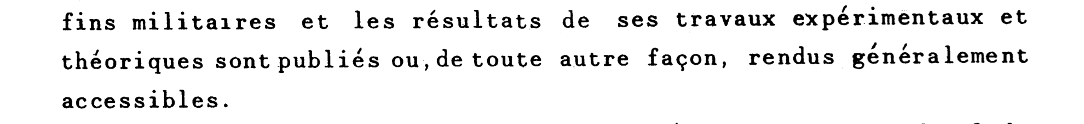
Open Access at CERN, a long history…
CERN convention, signed in 1953
“preprint” culture in the discipline
  arXiv
  Institutional repository, CDS

Slide 3
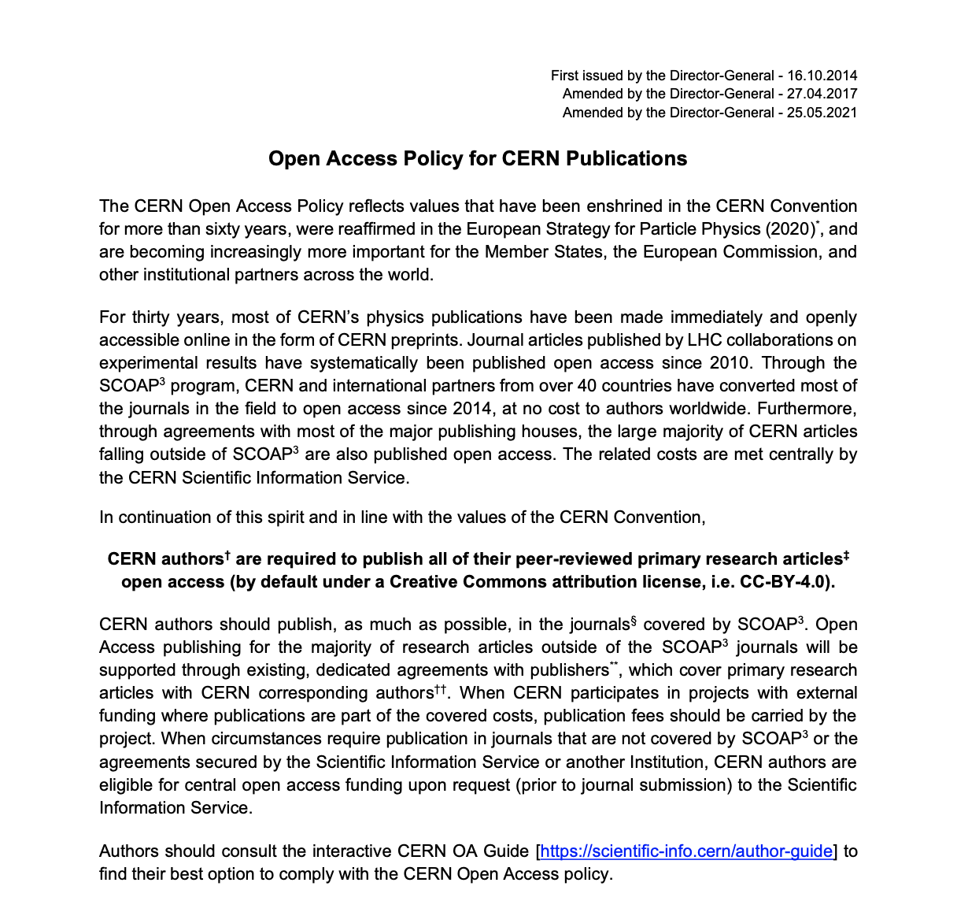
The CERN OA Policy

Slide 4




The Open Access mechanisms available at CERN
Sponsoring Consortium for Open Access Publishing in Particle Physics
CERN supports other OA models transparent for the author
SCOAP³
Collective
models
CERN has negotiated Open access agreements with 10 publishers (more than 4000 journals)
For other articles the fees can be centrally covered under certain conditions
OA agreements
Individual APC

Slide 5






SCOAP³
Sponsoring Consortium for Open Access Publishing in Particle Physics
  https://scoap3.org
11 HEP journals fully or completely converted to Open Access
All the articles are automatically published Open Access, under CC-BY license
Full OA Journals:
European physical Journal C
JHEP
Nuclear physics B
Physics Letters B
Partial OA Journals (HEP):
Acta Physica polonica B
AHEP
Chinese physics C
Physical review C
Physical review D
Physical review letters
PTEP

Slide 6


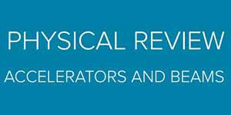
Other collective models
CERN supports collective agreements with publishers to cover OA for all articles.
Transparent for the author
All the articles are automatically published Open Access

Slide 7





Open access agreements with publishers
Article submitted by CERN corresponding authors and collaborations*
The publisher captures the article as being part of the agreement
CERN SIS validates eligibility
*
*

Slide 8


Agreements with gold open access publishers
CERN has agreements with full Open Access publishers.
  MDPI
  Frontiers
Discounts for CERN affiliated authors
Centrally covered by CERN SIS, upon verification of the eligibility

Slide 9



Articles submitted to journals outside existing agreements
CERN SIS informed at early stage
CERN agreement
No
high APC
Centrally covered by SIS
Other institution agreement

Slide 10
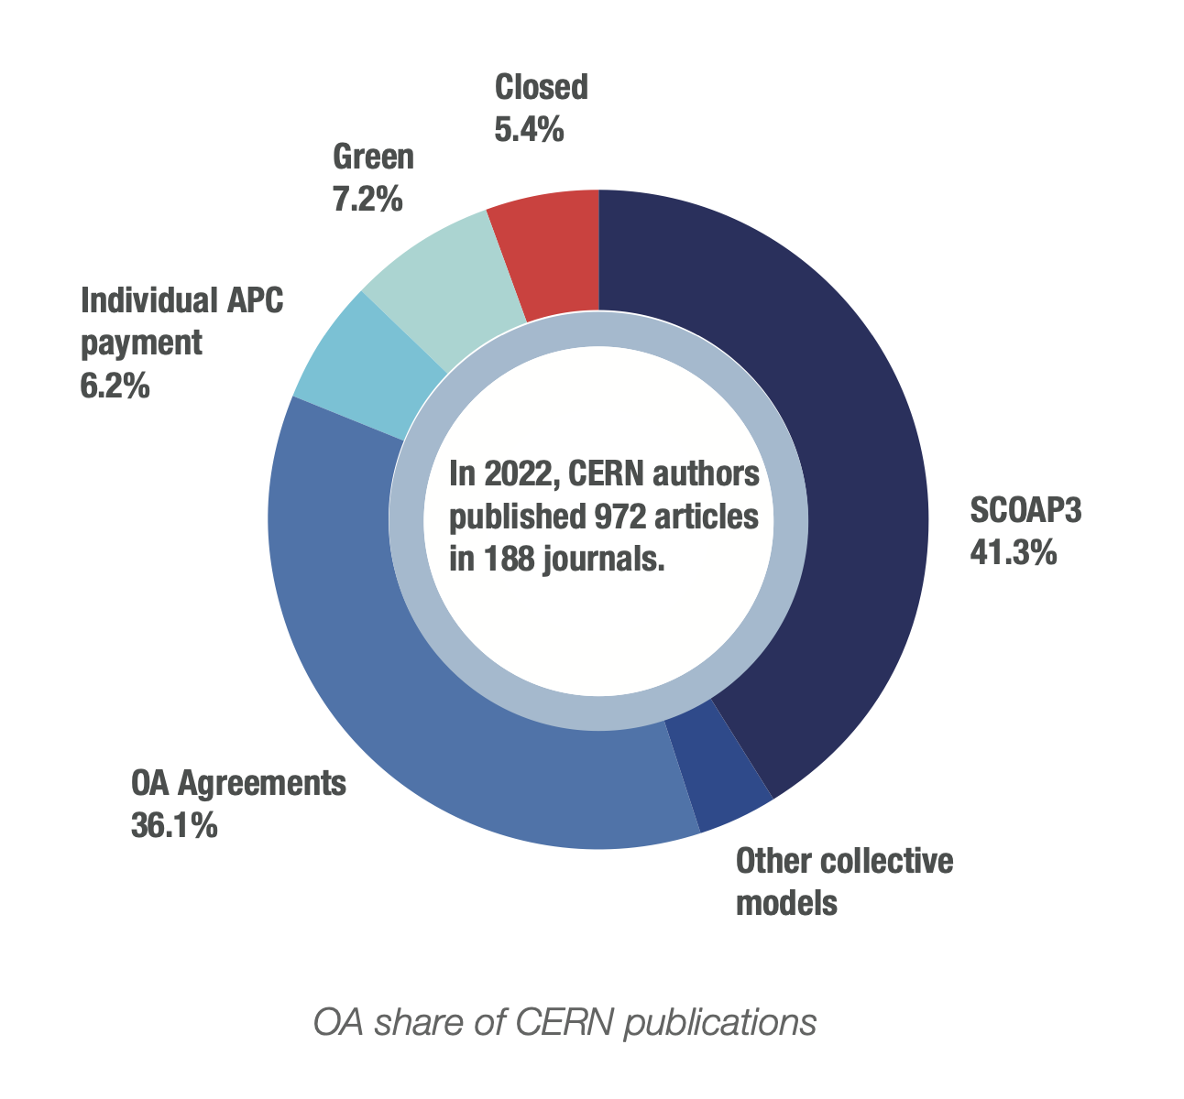
Open Access at CERN in 2022

Slide 11
Open Access to monographs
CERN supports CERN authors in publishing monographs in Open Access
  >10 monographs already published in OA
During pilot phase, SCOAP3 for books is converting some 100 titles in OA, all titles available on the OAPEN platform.
Next phase of SCOAP3 for Books (in preparation) will publish frontlist titles in Open Access

Slide 12
OA to monographs, a usage explosion!
x326

Slide 13
Communication strategy regarding OA
“traditional” channels:
  Website: https://cern.ch/open-access
  Support line (email and mattermost)
  Articles in internal bulletin
Author guide: guidance provided to authors at the journal level
Focused communication:
  Newcomers at CERN, “onboarding” sessions
  Presentations to author groups
  Discuss with publishers to improve communication provided to authors
Next steps:
  Training materials

Slide 14
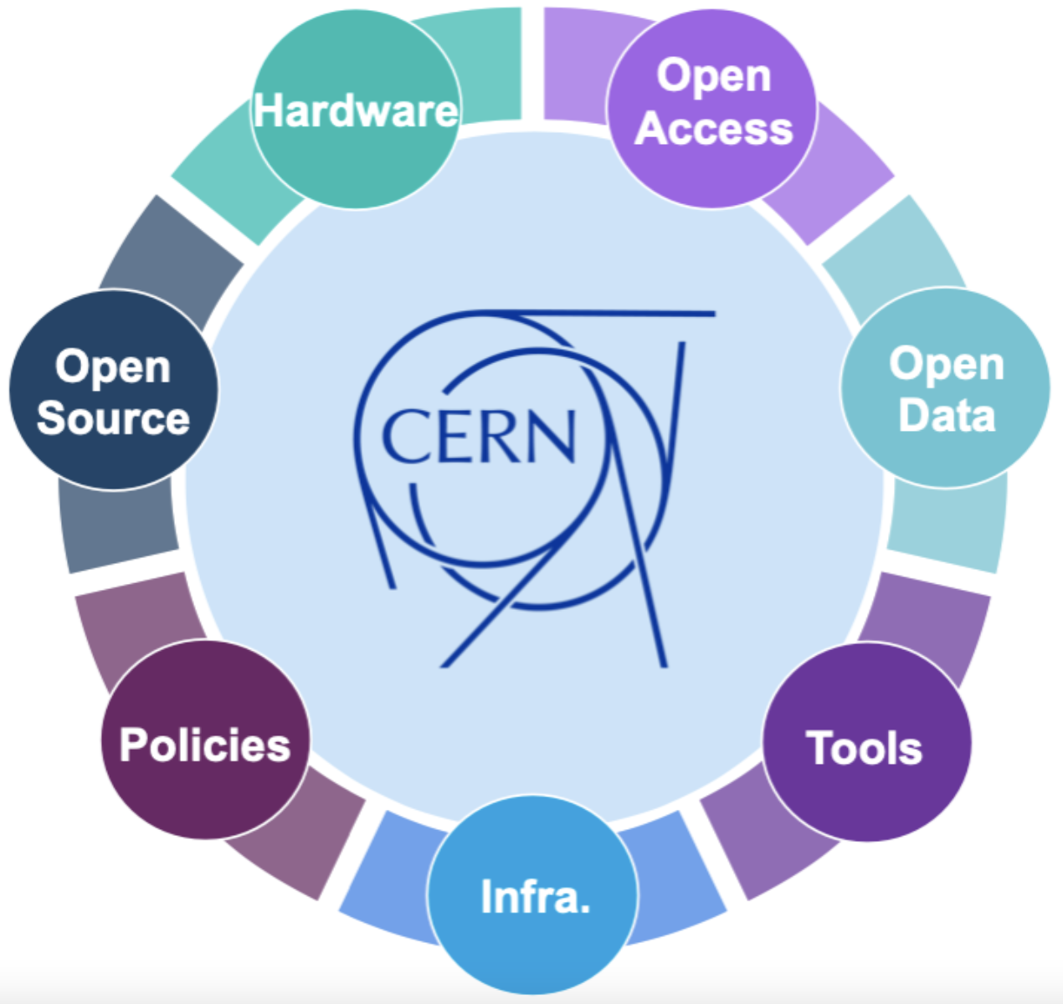
Going further towards Open Science
CERN open data policy for LHC experiments:
  http://dx.doi.org/10.17181/CERN.QXNK.8L2G
CERN open science policy (October 2022):
  http://dx.doi.org/10.17181/CERN.RTIF.Z8BO
14

Slide 15
Thank you!
Anne.Gentil-Beccot@cern.ch

