Slide 1
Open Science at CERN
Alexander Kohls, Group Leader CERN Scientific Information Service
14. June 2023

Slide 2

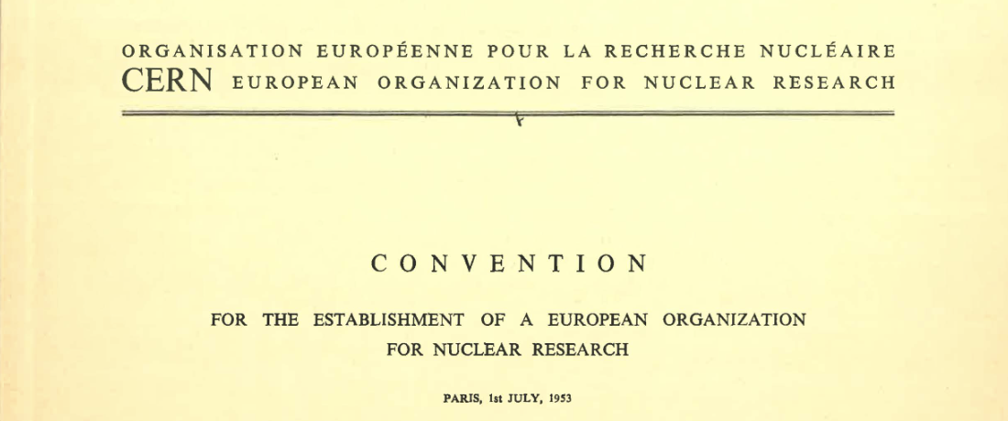
“…and the results of its experimental and theoretical work shall be published or otherwise made generally available”
CERN Founding Convention (1953)
Illustration by Stephanie van de Sandt

Slide 3
What is Open Science?
The UNESCO definition
Open science is defined as an inclusive construct that combines
various movements and practices aiming
to make multilingual scientific knowledge openly available, accessible and reusable for everyone,
to increase scientific collaborations and sharing of information for the benefits of science and society, and
to open the processes of scientific knowledge creation, evaluation and communication to societal actors beyond the traditional scientific community.
[…] it builds on the following key pillars: open scientific knowledge, open science infrastructures, science communication, open engagement of societal actors and open dialogue with other knowledge systems.
https://unesdoc.unesco.org/ark:/48223/pf0000379949.locale=en

Slide 4
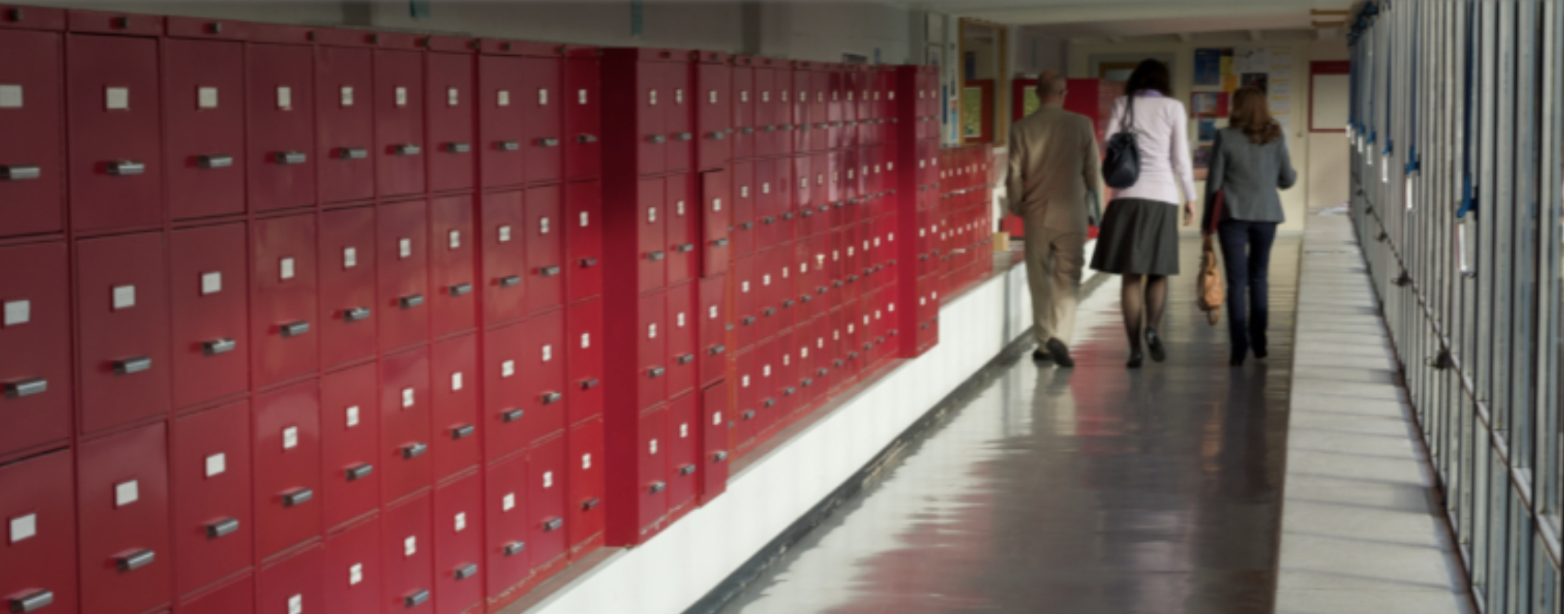
High-Energy Physics has always had an open preprint culture

Slide 5
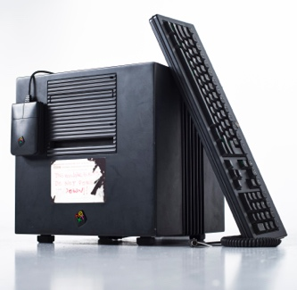




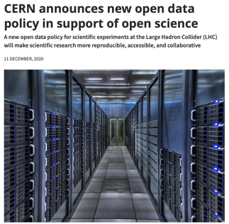


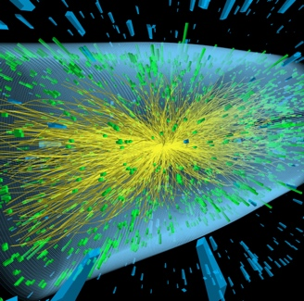

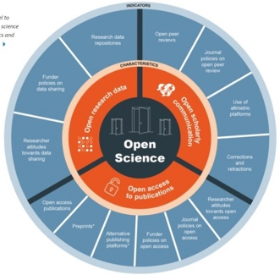

CERN – on the path to universal open science
With the addition of APS SCOAP3 covers 90% of the journal literature in HEP and acts as role model for other OA transitions
CERN LHC Open Data Policy defines uniform mechanisms to release LHC experimental data + associated analysis artefacts (software, workflows, notes, etc.)
Creation of the WWW lays the foundation of digital scholarly publishing
arXiv introduces global digital pre-print sharing which becomes the norm in particle physics
INSPIRE systematically links HEPData sets
with their respective publications
CERN announces Open Access policy and launches SCOAP3 as primary mechanism to achieve 100% OA
1989
1991
2011
2014
2018
2020
2022
CERN publishes v1.0
of its Open Hardware License, soon becoming a standard for open souce hardware
First partial LHC data released via CERN Open Data Portal incl. visualization tools for education
CERN develops suite of tools to support reuse and reproducability of open data
CERN issued an institutional Open Science Policy

Slide 6








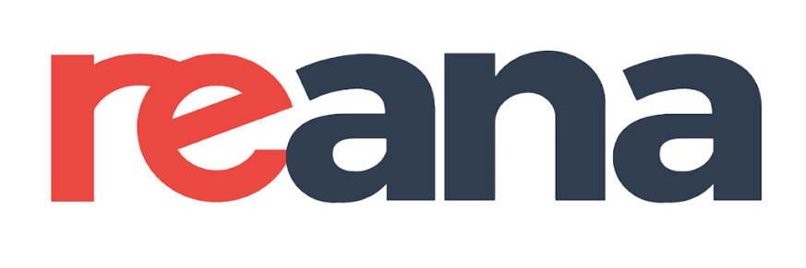

Open Science at CERN
Hardware
Data
Software
Tools
Policies
Access
Open Access (2014)
LHC Open Data (2020)
Open Science (2022)
Infrastr.

Slide 7

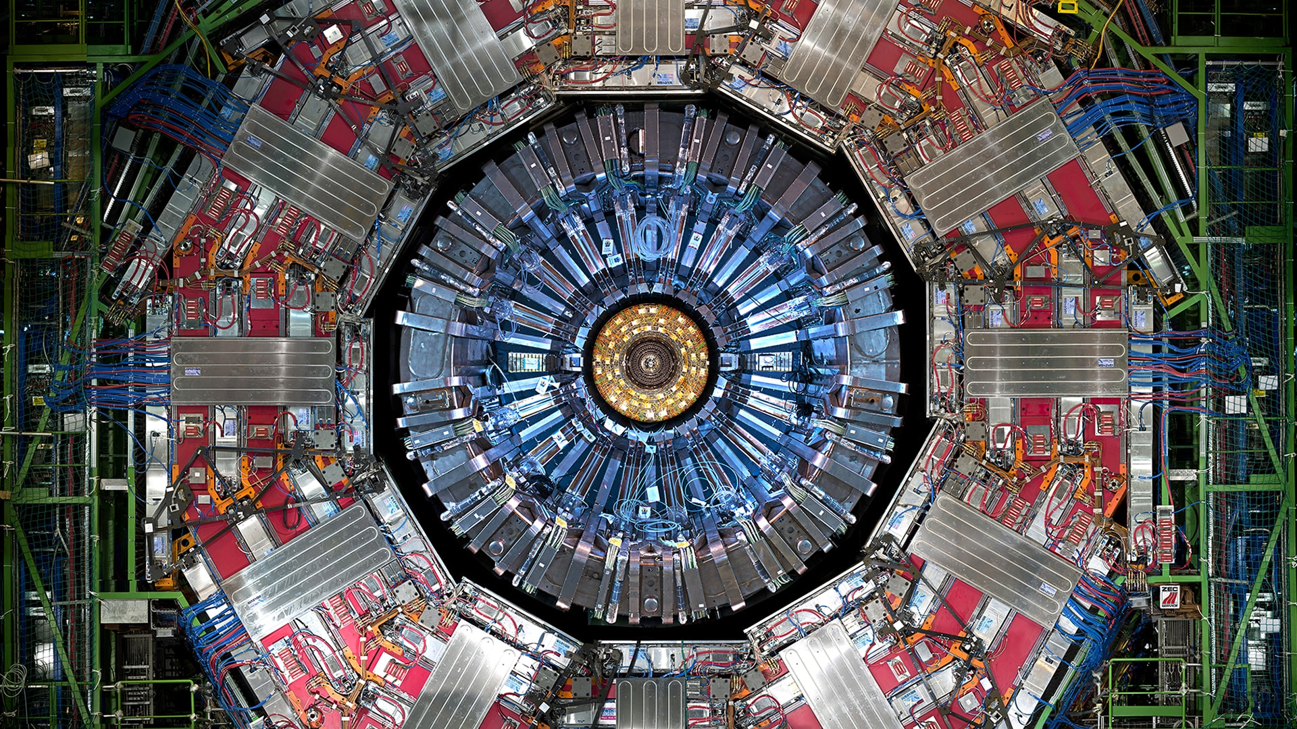
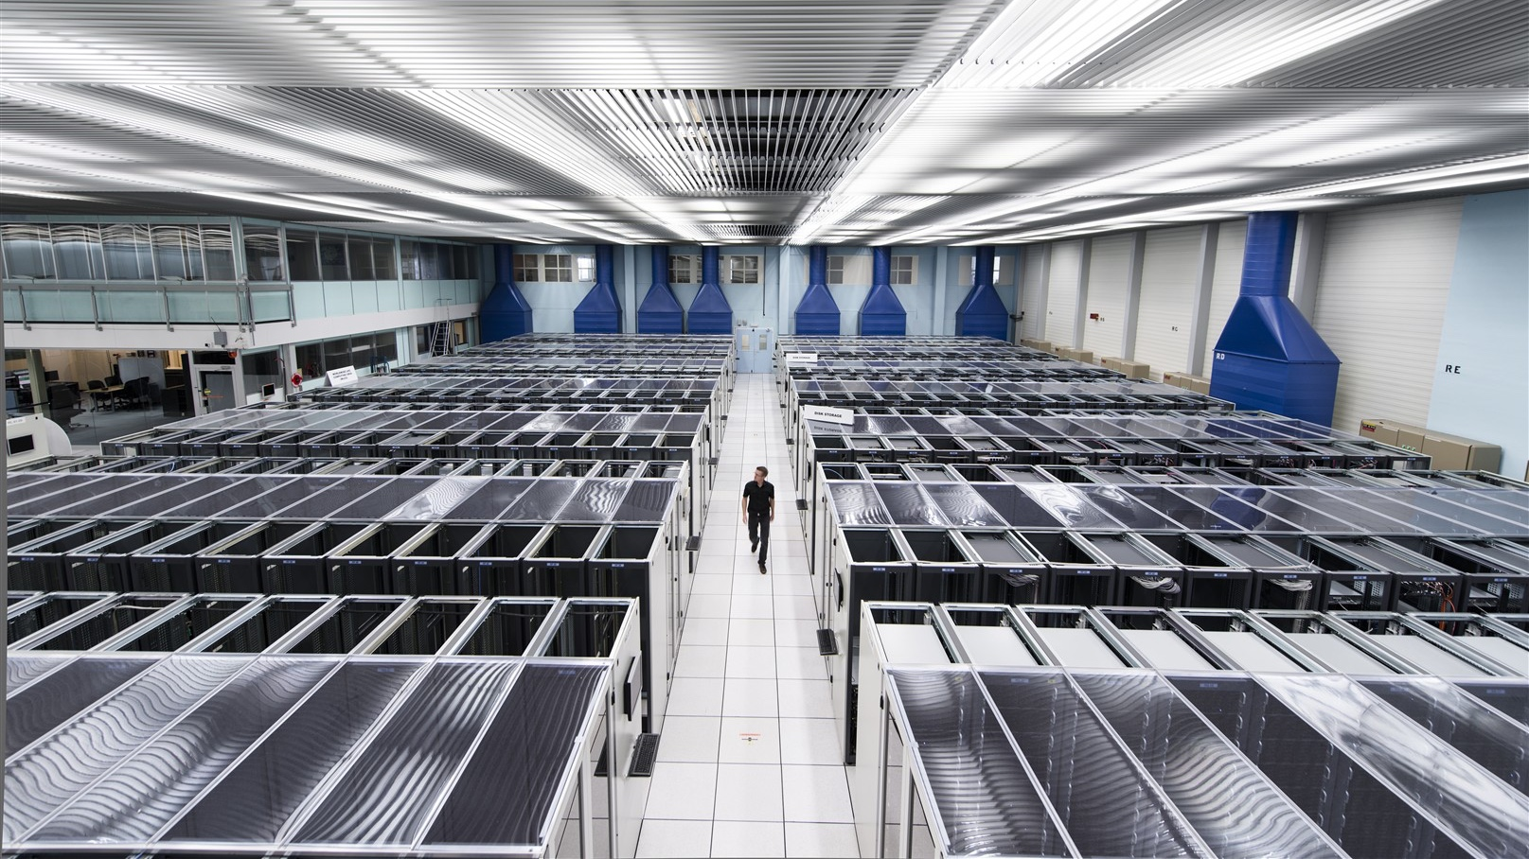
CERN stores more than 100 PB of data per year
Data collection
Data storage
  1 PB/sec of collision data impossible to store
  Trigger systems at each of 4 main detectors:
    Level 1: almost real-time (< 2.5 microseconds)
    reduction to 100’000 events/second
    Level 2: within 200 microseconds further
    reduction to 1’000 events/second for storage
  90 PB/year from LHC
  + 25 PB from other experiments
  CERN data center has 411 PB on tapes + 365 PB on disks (including duplicates)
  EOS (CERN’s proprietary storage system) hosts now more than 5bn files and served 2.5 exabyte of data (in 2020)
  High latency of tapes problematic for open data services (1-3 minutes or even more)

Slide 8
Different level of CERN experimental data
Data
Level 1 data made public at the time of underlying publication
Data may include for instance simplified or full binned likelihoods
Plots and Tables of Published Results
(data tables from >1’500 LHC publications)
1
Dedicated subsets of data selected and formatted to provide rich samples
Made available and accessible in formats suitable for educational
Not intended nor adequate for the publication of scientific results.
Outreach and Education Datasets
(24 datasets containing > 1.7m events)
2
Calibrated reconstructed data useful for algorithmic, performance and physics studies
Data accompanied by provenance metadata, appropriate simulated data samples, software, reproducible example analysis workflows, and documentation.
Reconstructed Data
(ca. 70 PB for LHC Run 2 and Run 3)
3
Raw Data
(some 600 PB)
4
Not released due to the complexity of the data, metadata, methods and software
Practically impossible to use due to extensive computing resources

Slide 9
Expanded LHC data sharing practices
Data
CERN Open Data Policy (2020)
To make scientific research more reproducible, accessible, and collaborative.
Endorsed by all four LHC experimental collaborations; to be expanded to others.
Level 1 and level 2 releases already common practice.
New OD Policy commits to publicly releasing level 3 scientific data.
Data will start to be gradually released five years after collection.
(Open) Data Levels
Provision of additional documentation
1
Systematically released through HEP Data.
Data formats for analysis in outreach
2
Released in simplified, portable and self-contained formats through CERN Open Data.
Reconstructed data and simulations
3
Will be gradually shared along with the analysis software to allow full scientific analysis.
Basic raw level data
4
Needs detailed understanding of the (data- taking) experimental conditions – not shared.

Slide 10
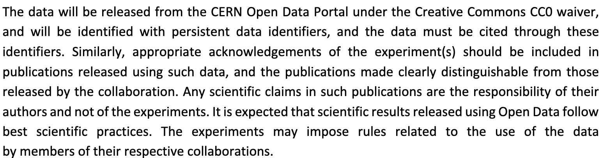
CERN Open Data Policy: License
Data
https://cds.cern.ch/record/2745133/files/CERN-OPEN-2020-013.pdf

Slide 11



CERN and its partners created a suite of tools for sharing and linking research data
Data
  CERN Open Data Portal allows HEP experiments to share their data (collisions, simulations, related software, etc.)
  Already contains > 2PB of data
  Zenodo is a multi-disciplinary open research repository commissioned by the EC through OpenAIRE
  Hosts 80% of the world’s software DOIs
  HEPData is the primary repository for tables and datasets related to ca. 10’000 publications
  Operated by Durham University in collaboration with CERN

Slide 12

Open is not enough!
“The solutions adopted by the high-energy physics community to foster reproducible research are examples of best practices that could be embraced more widely. This first experience suggests that reproducibility requires going beyond openness.”
Chen, X., Dallmeier-Tiessen, S., Dasler, R. et al. Open is not enough. Nature Phys 15, 113–119 (2019) https://doi.org/10.1038/s41567-018-0342-2

Slide 13


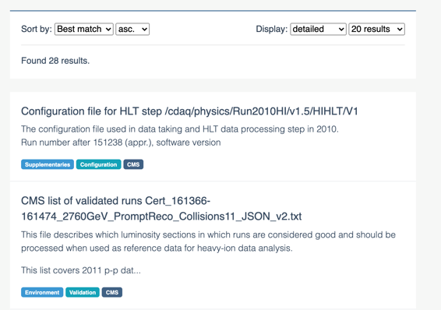
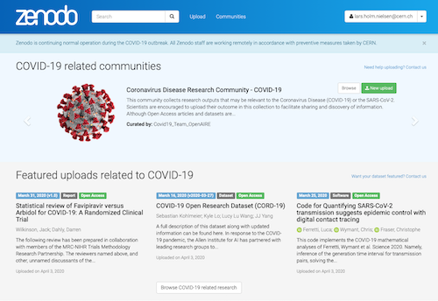
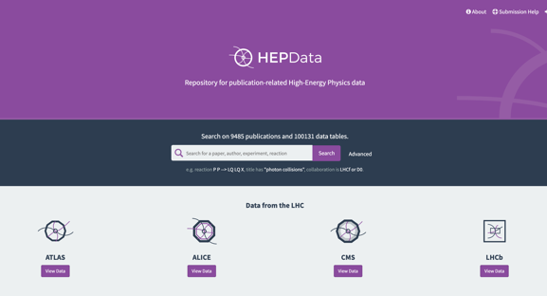
Three pillars of successful Open Data
Preservation & Long-term Access
Data
Publish & Share
Reproducibility
Archive and publication platforms
Reproducible research data analysis platforms
Digital Repositories
Notes:
Layout and colors review

Slide 14

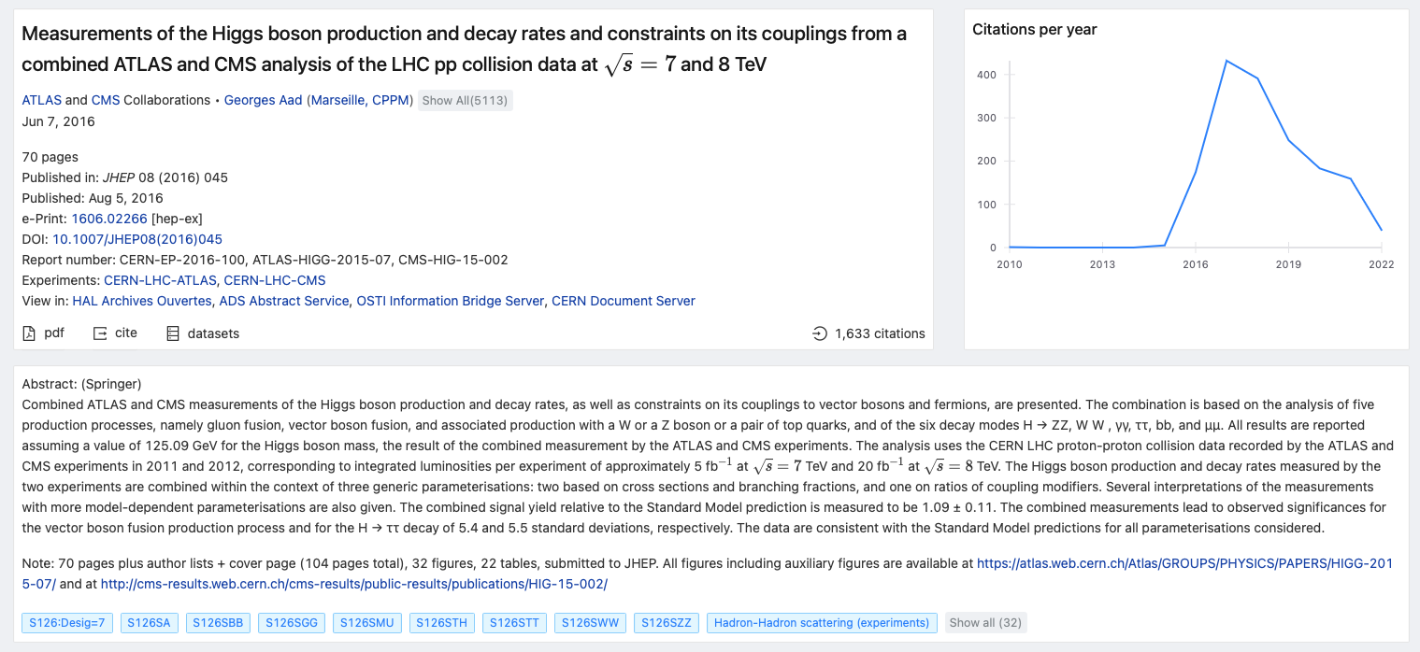
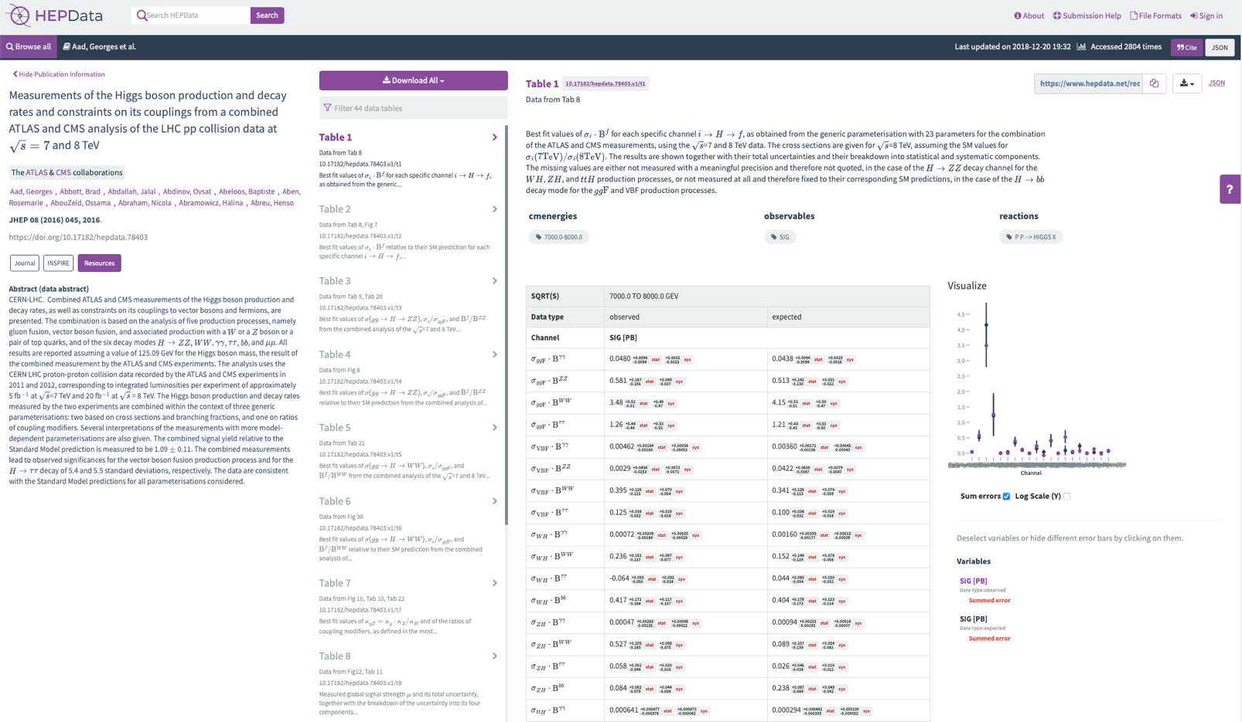

Encourage and acknowledge FAIR data sharing
Data
INSPIRE includes links to respective HEPData records
Soon it will also link to other datasets and software…
…and will count their citations
Persistent identifiers are the key!
https://doi.org/10.5281/zenodo.4028383

Slide 15
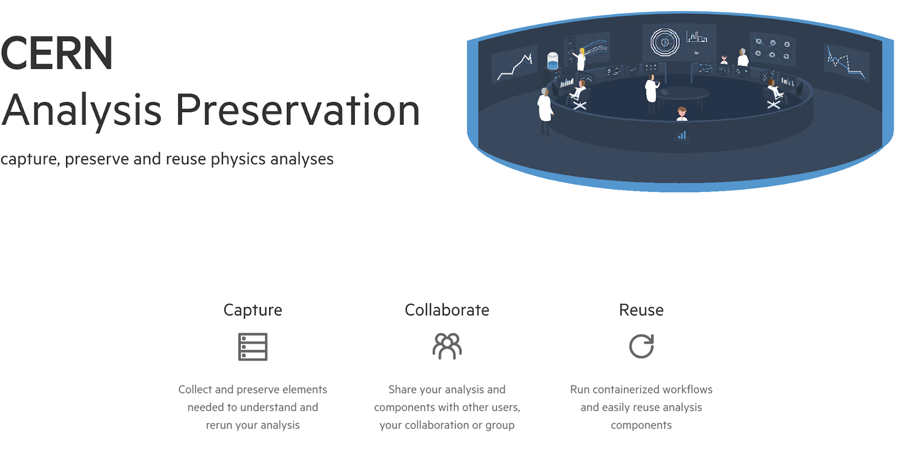
Three pillars of successful Open Data
Preservation & Long-term Access
Data
Publish & Share
Reproducibility
Archive and publication platforms
Reproducible research data analysis platforms
Digital Repositories

Slide 16
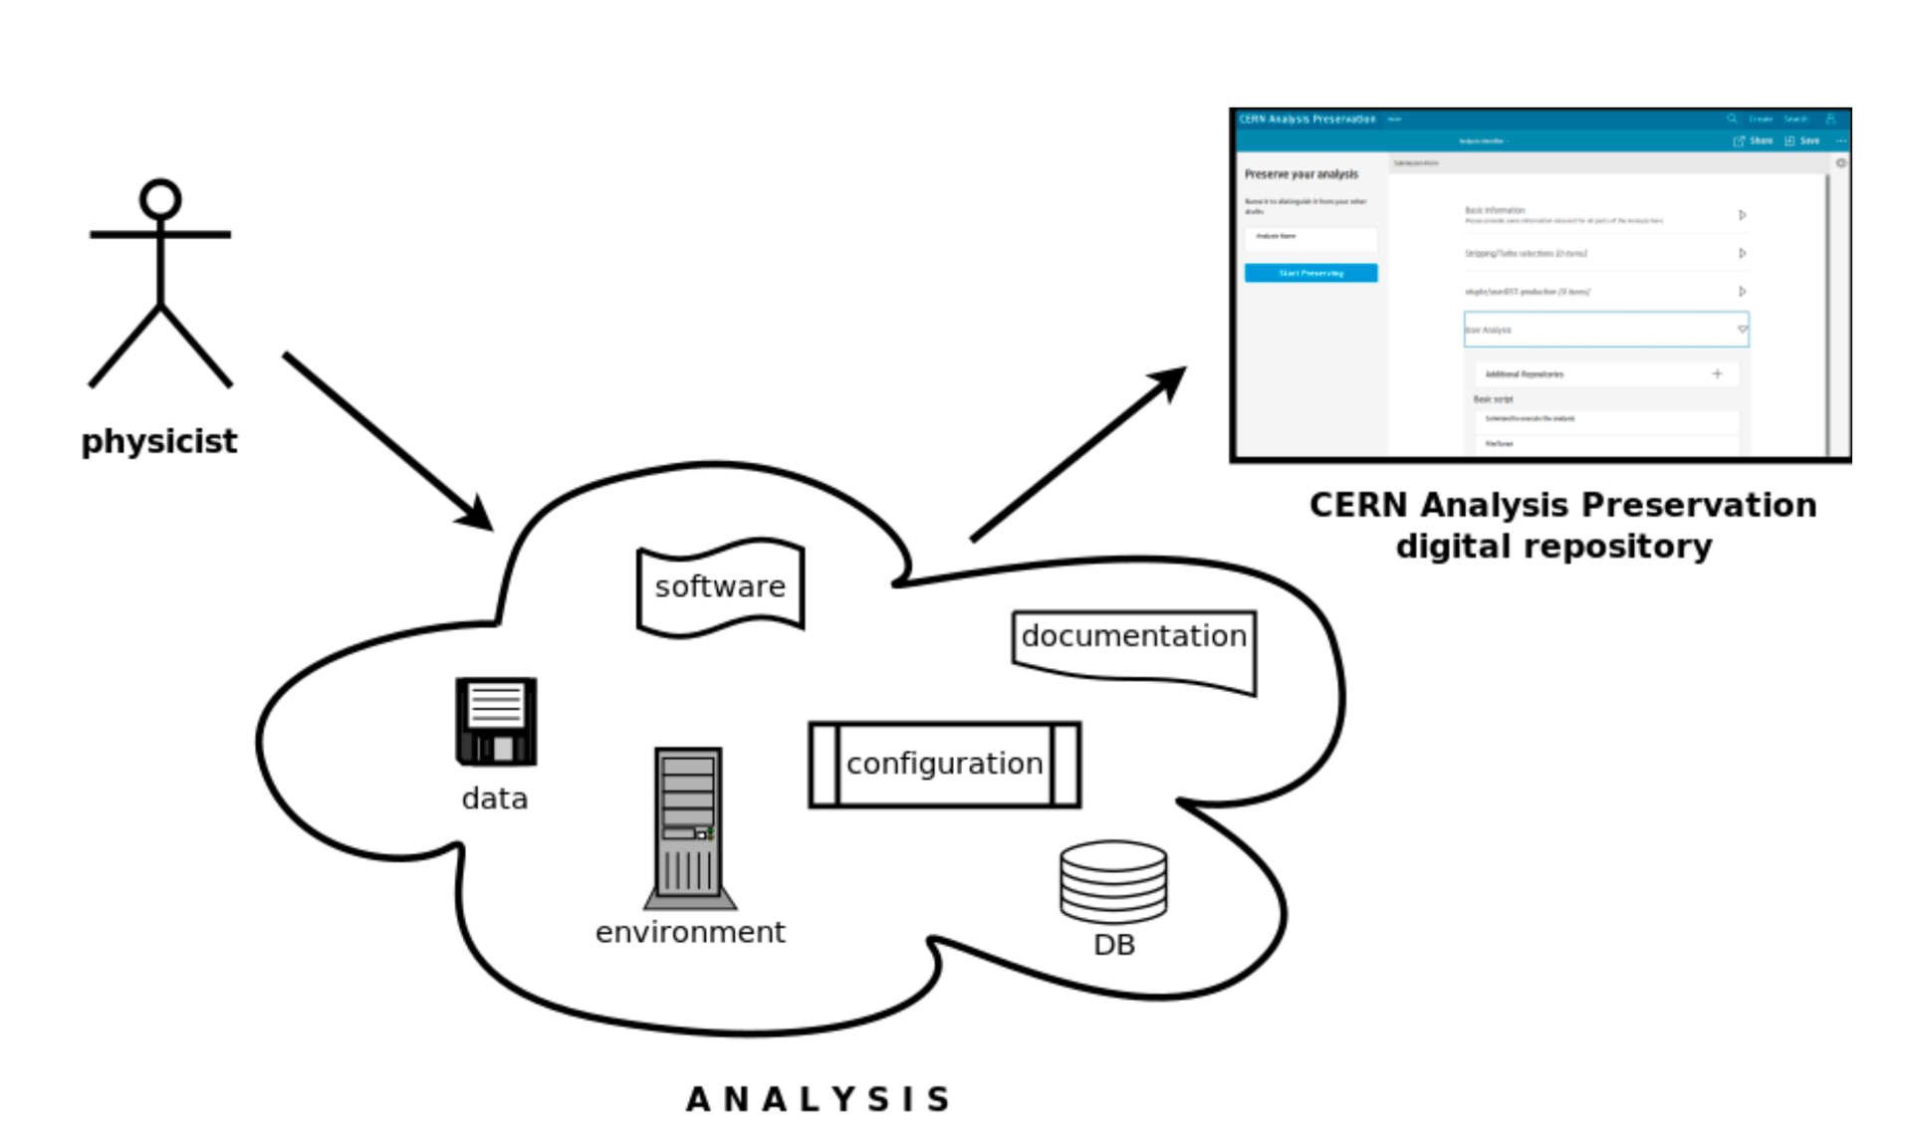
FAIR as the basis for open
Tools
While Open Data is crucial, the integrity of research results is the
foundation: preservation of outputs throughout the entire research process
needed in order to ensure…
long-term accessibility
quality assurance
(re)usability
Solution: CERN Analysis Preservation

Slide 17
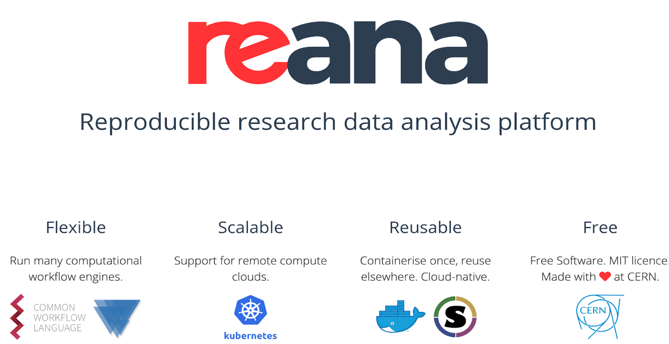
Three pillars of successful Open Data
Preservation & Long-term Access
Data
Publish & Share
Reproducibility
Archive and publication platforms
Reproducible research data analysis platforms
Digital Repositories

Slide 18
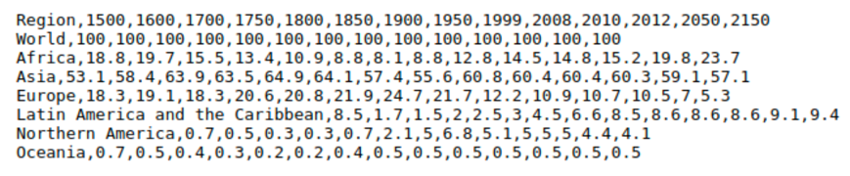
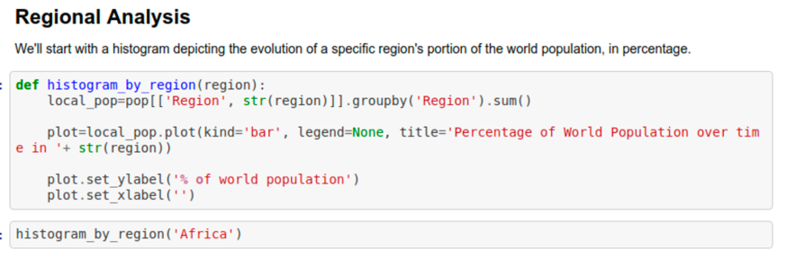
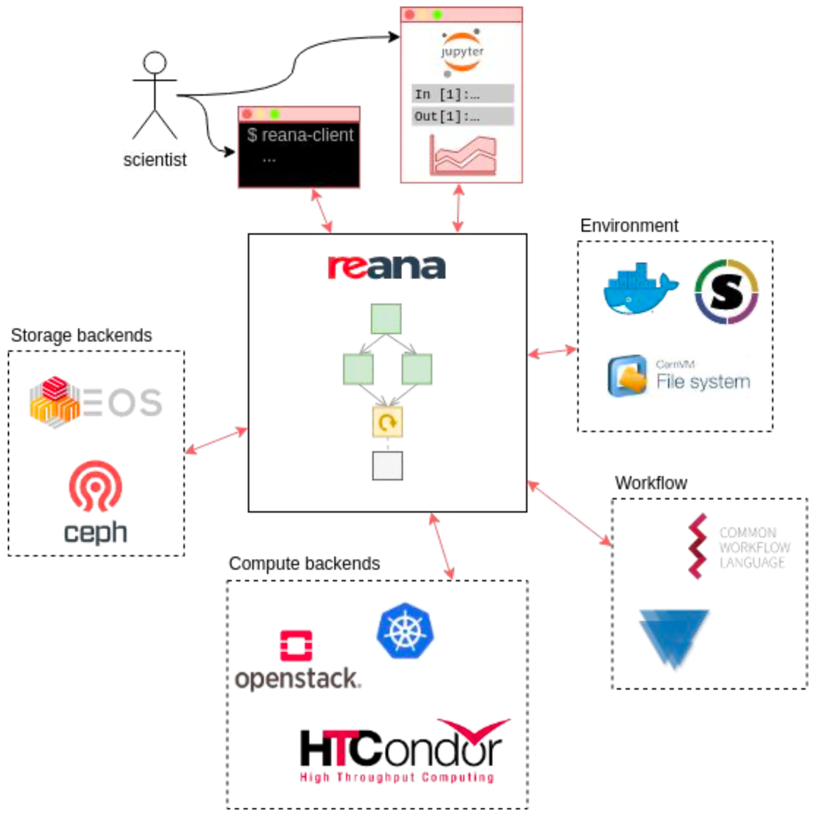
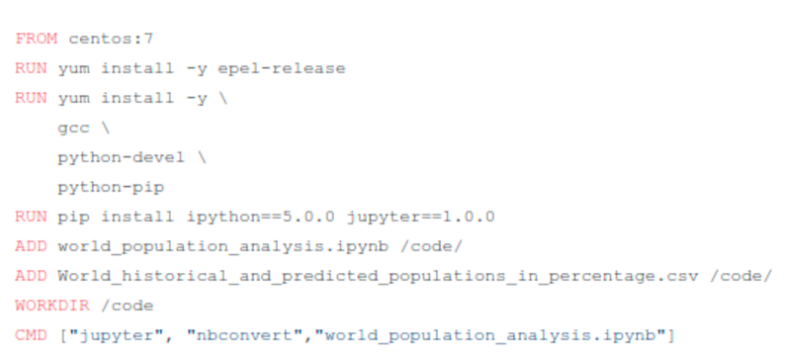
REANA
Tools
REANA architecture:
Four ingredients for reproducibility:
1 input: CSV file
2 code: Jupyter notebook
3 environment: CentOS7, IP5
4 workflow: papermill ...
  Cloud-native, free application
  Flexible and scalable
    Storage backends
    Compute backends
  Input data
    Input files
    Input parameters
  Analysis code
    Software frameworks
    User code
  Compute environment
    Operating system
    Database calls
  Analysis workflow
    Single command
    Complex workflows
    Container technologies
    Workflow engines
♻
https://github.com/reanahub/reana-demo-worldpopulation
http://reana.io

Slide 19
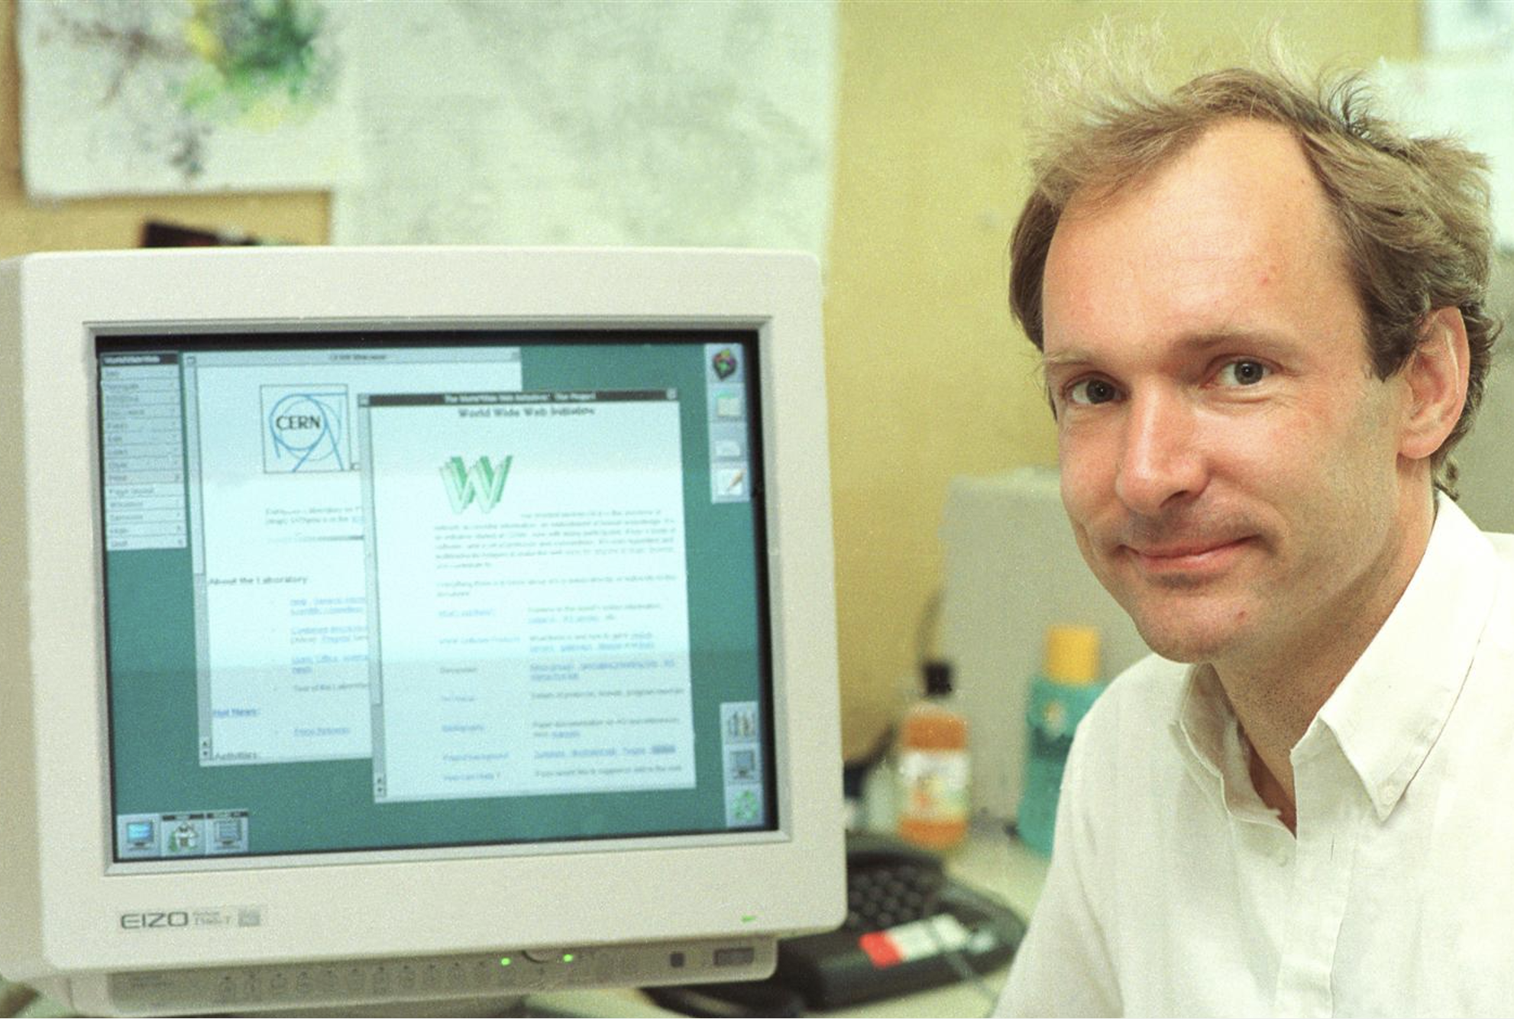
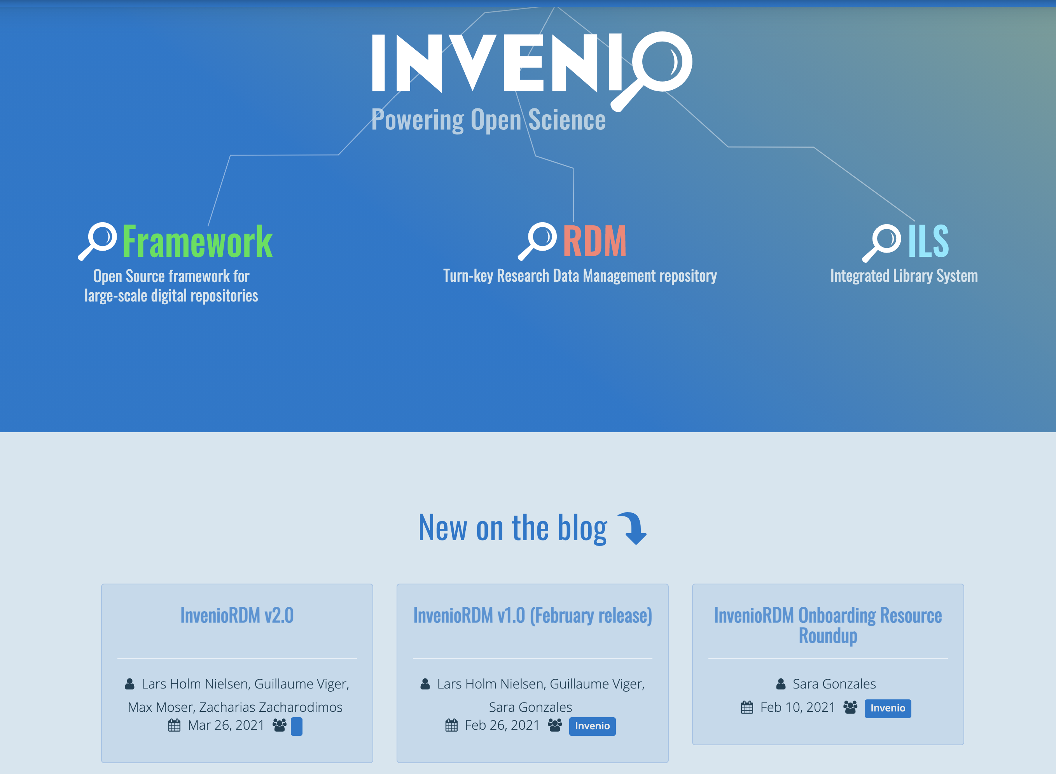
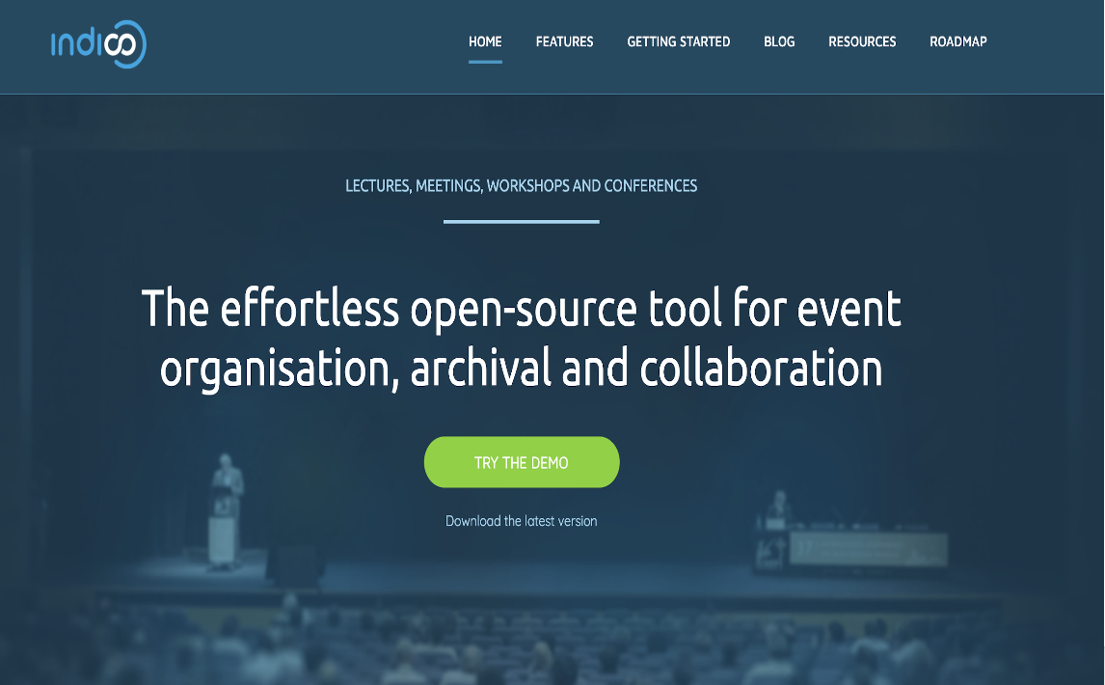
Our Open-Source Philosophy
Source
“Recipients of technology should have access to all its building blocks, such as software code,
schematics for electronics and mechanical designs, in order to study it, modify it and redistribute it to others”
CERN Tradition of developing software and placing it in the public domain
The www was created by Tim Berners-Lee at CERN
Invenio is an open-source digital repository package
Indico is an open-source online conferencing tool

Slide 20
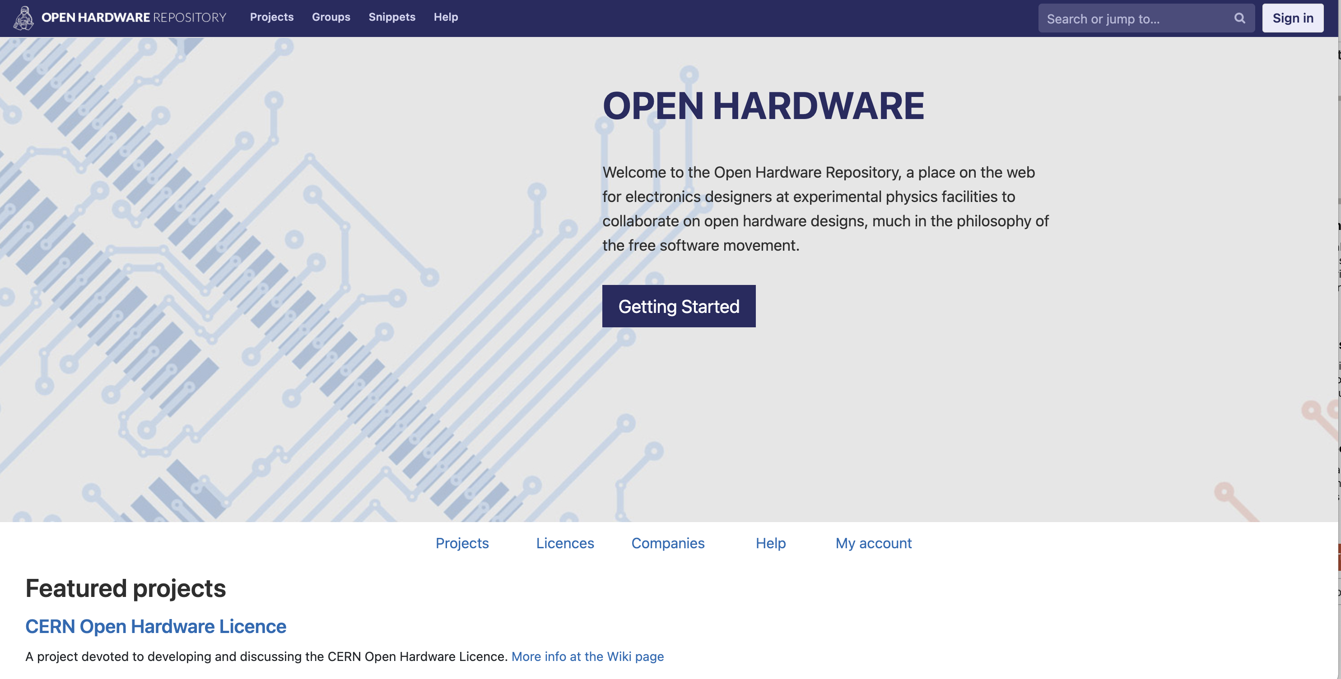
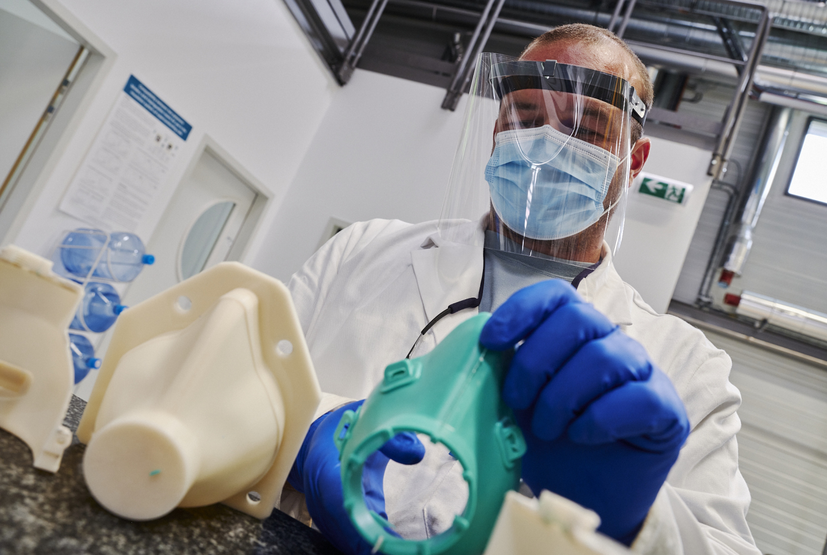
Open Hardware
Hardware
Developed the Open Hardware Repository
Created the CERN Open Hardware Licence
  Anyone should be able to see the source – the design documentation in the case of hardware – study it, modify it and share it
  Source’ includes schematic diagrams, designs, circuit or circuit-board layouts, mechanical drawings, flow charts and descriptive texts, as well as other explanatory material.
OHWR.org
A silicon mask produced using 3D printed molds designed and made at CERN (Image: CERN)

Slide 21
Open Source at CERN
OSPO
Producer CERN regularly creates or updates numerous open-source products, such
as analysis or experiment software (e.g. root), general software projects
(e.g. Indico) or hardware design (e.g. 3D-printed face mask)
Contributor CERN extensively contributes to a wide range of worldwide open-source
initiatives
Consumer More than 70% of open-source software used at CERN is based on
external projects*; most CERN services rely on components such as
Python, Kubernetes and the Linux Kernel
Governance Creation of the CERN Open Hardware licenses, CERN being member of
driver major infrastructure projects governing bodies (e.g. Ceph foundation)
* See IT 2022 report: https://codimd.web.cern.ch/tbVJZyW7SVC1hsggmrAu6A

Slide 22
The OSPO Mandate
OSPO
Drive Open Source practices:
  Promote CERN as a contributor
  Assert CERN as a user
  Enable Open Source due diligence
Provide support for the entire CERN community
Be an entry point to CERN’s expertise
Organise events, communication, support and training
Act as interface for external partners
Internally
Externally

Slide 23
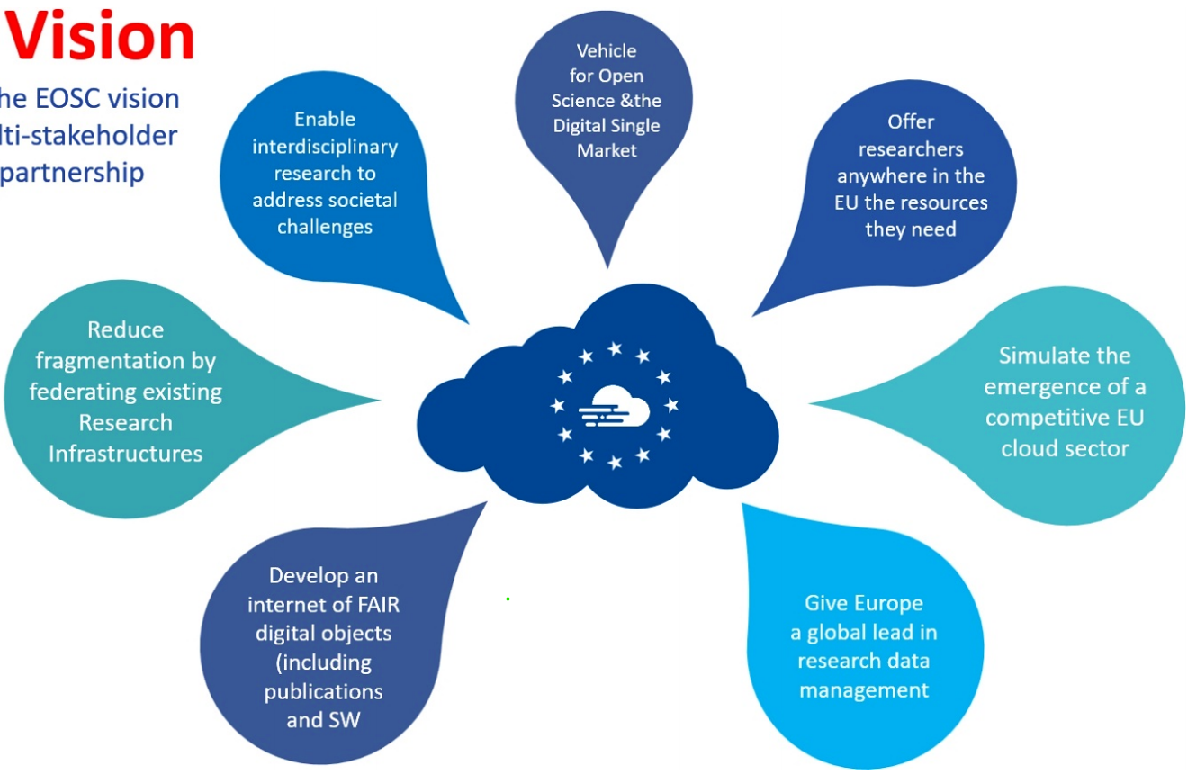
CERN in-kind contributions to European Open Science Cloud
Infra.
  Data culture - promote digital repository certification and data preservation across the research community
  Thematic areas - implement FAIR data principles in the particle physics domain
  Research data repositories – continue to support Zenodo as a trusted repository open to the world
  Service deployment - federate public e-infrastructures and commercial service providers to establish a hybrid cloud platform supporting open research
  Governance model - share the experience of more than a decade of operating a global data infrastructure

Slide 24
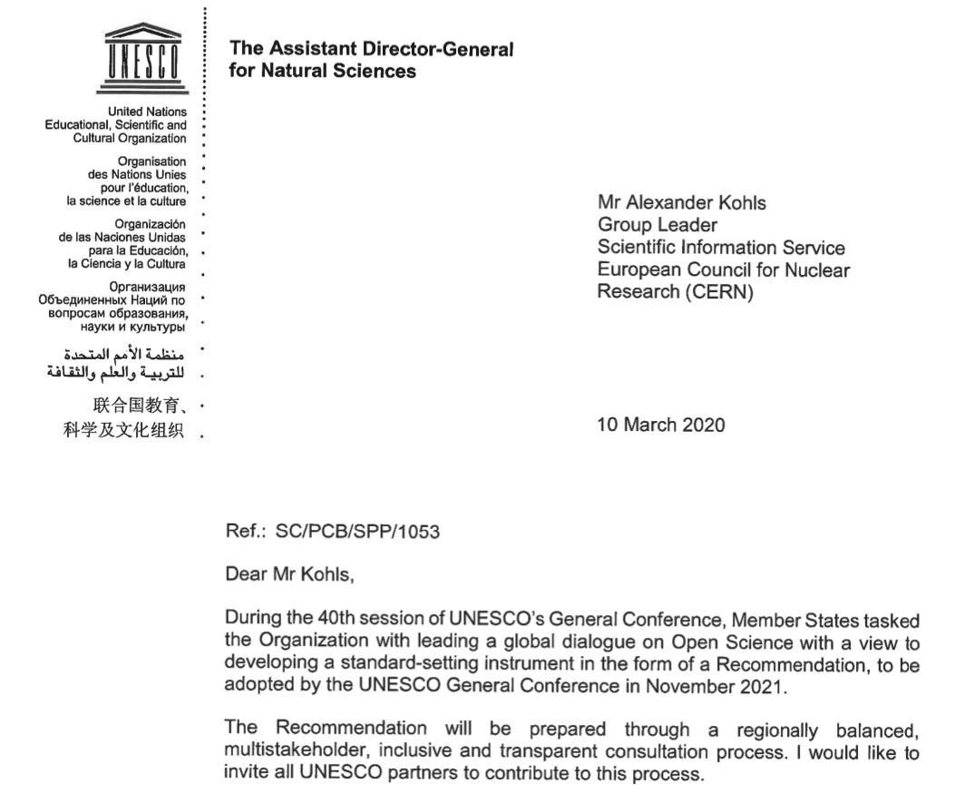
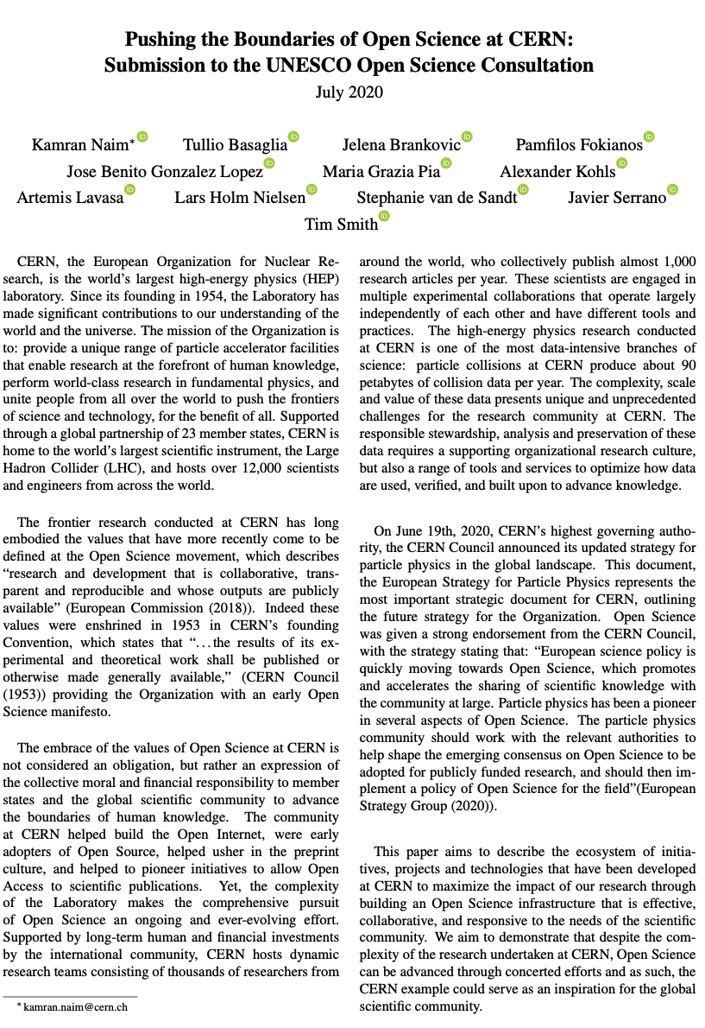

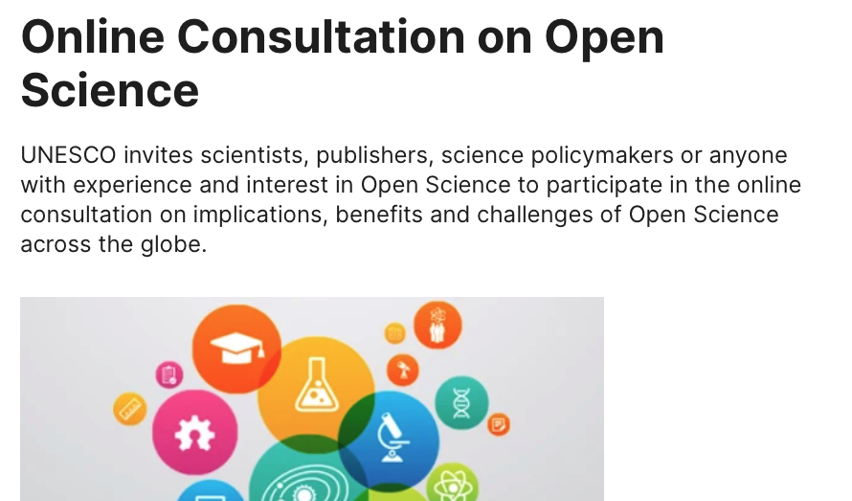

UNESCO Recommendations on Open Science created the momentum
https://doi.org/10.17181/CERN.1SYT.9RGJ
CERN is proud to have joined
UNESCO on the journey towards
Recommendations on Open Science

Slide 25

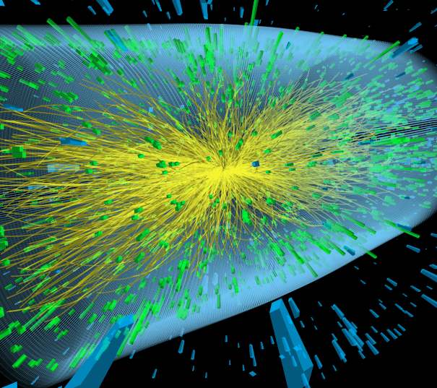

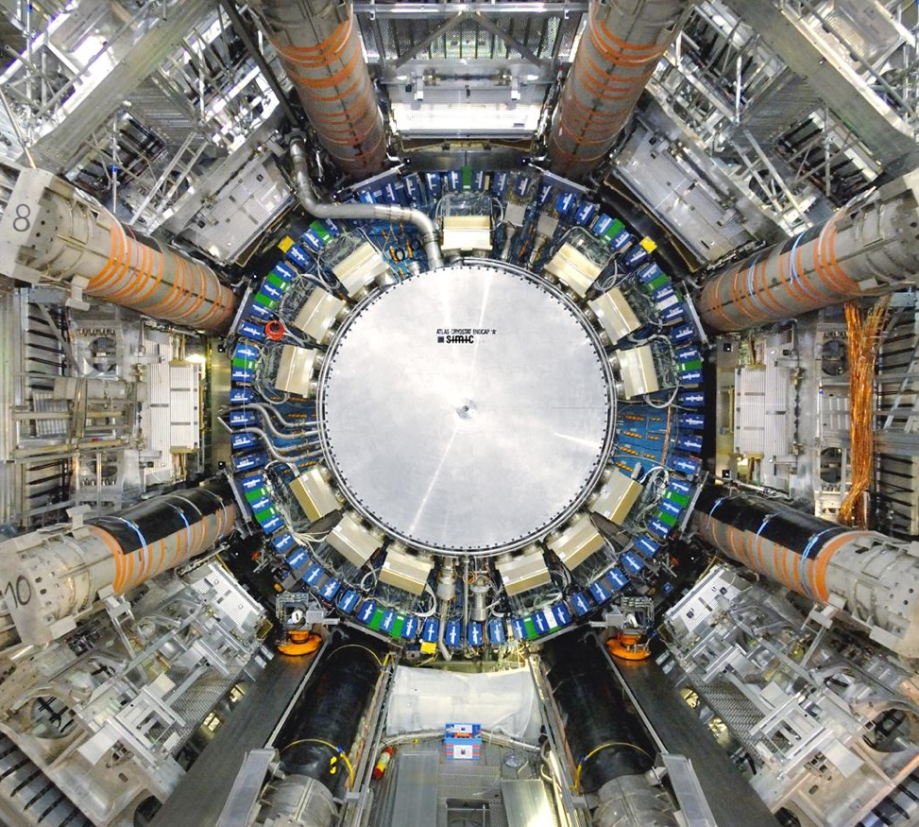
Policy framework for Open Science at CERN
CERN Open Access Policy (2014)
LHC Open Data Policy (2020)
CERN Open Science Policy (2022)
Funder Open Science Policies
  Hardware
  Software
  Access
  Data
All CERN research articles published OA (CC-BY)
Central fund available
Different routes (SCOAP³, Read
& Publish, APC payment)
4 LHC collaborations will release all level 3 data (+ level 1 and 2)
Gradual release will start ~5 years after collection
Other experiments to follow
Open…
Reusability & reproducibility
Research Assessment
Education & Outreach
Funding agencies supporting experimental collaborations have specific open data requirements
CERN will establish central support office for compliance

Slide 26
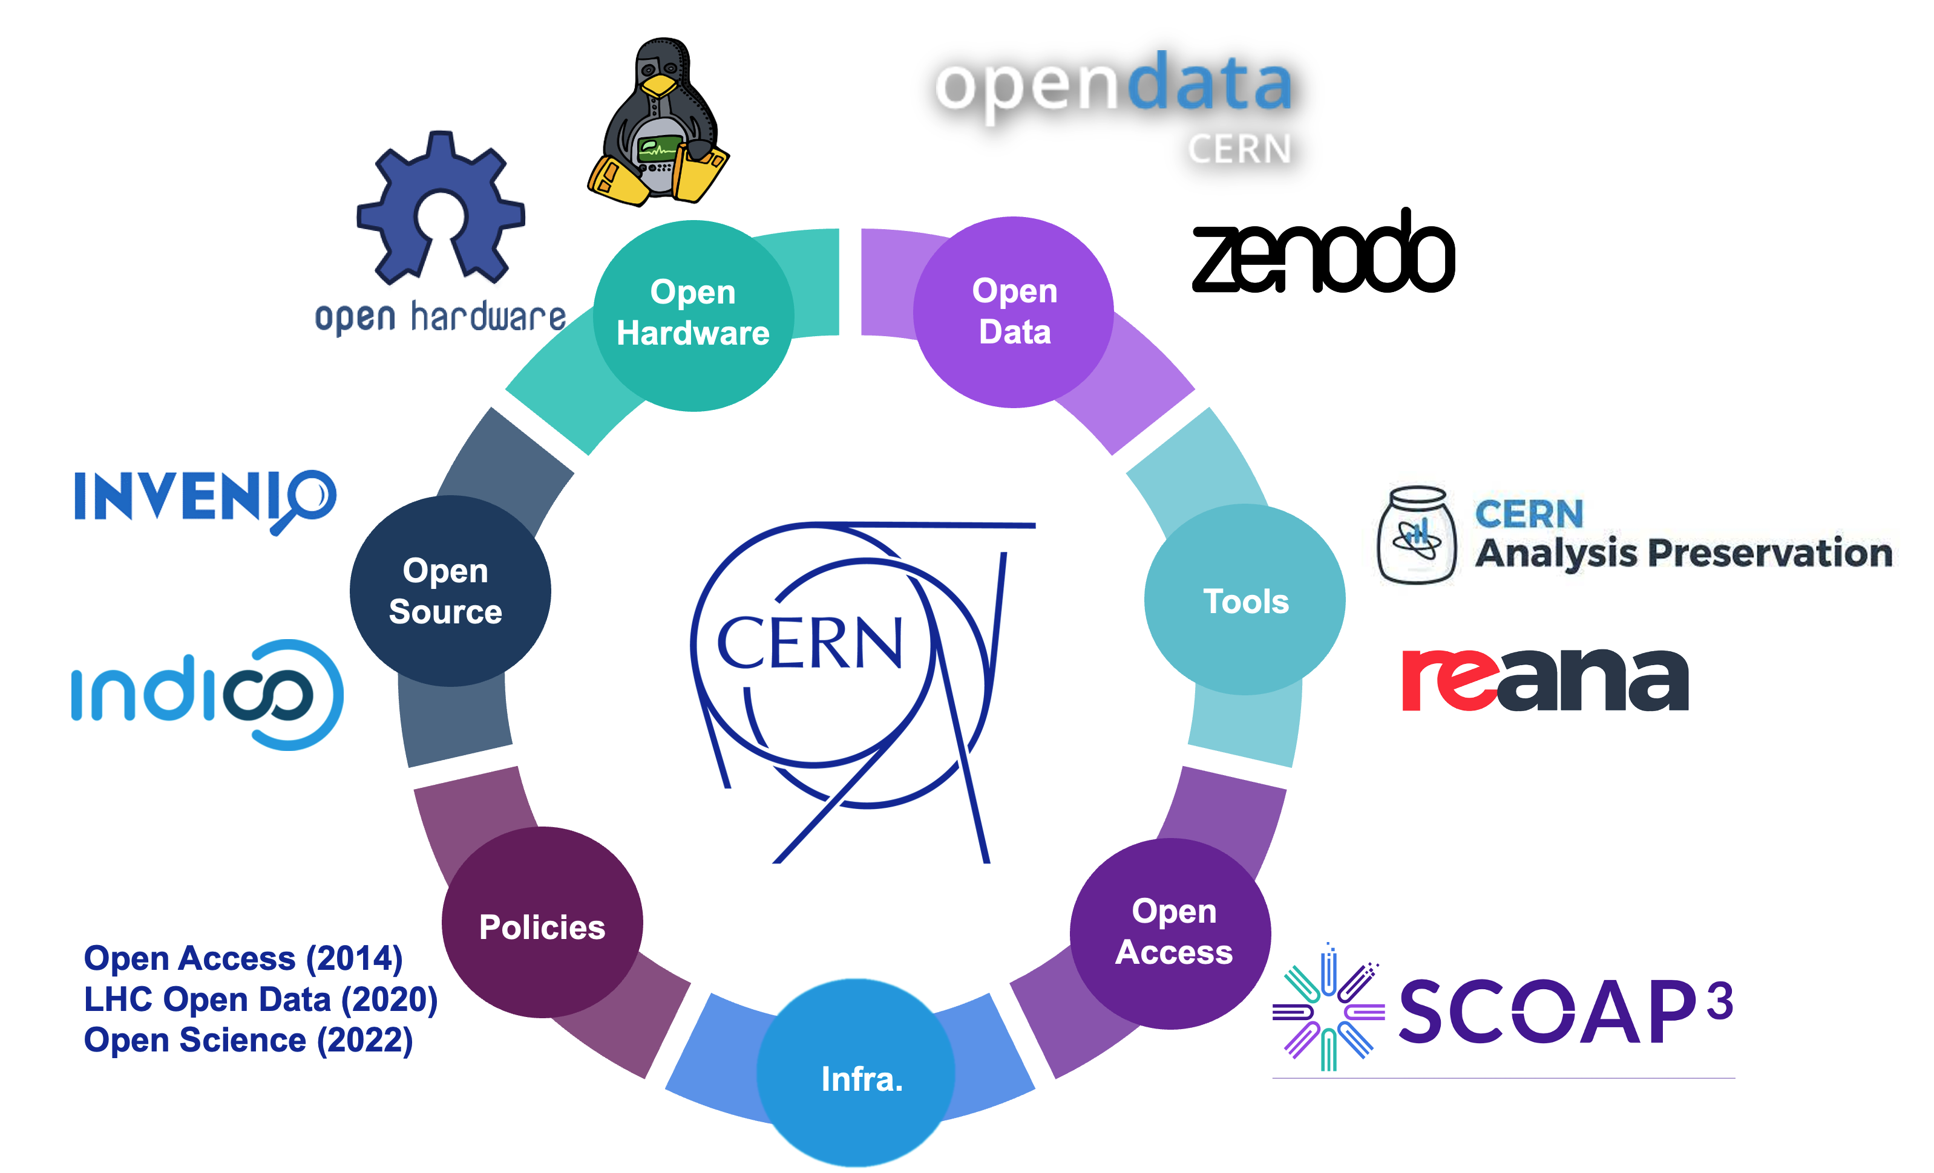


Developing the CERN Open Science Policy
Decentralised institutional efforts &
grassroots movements
Policy frameworks & best practices
+

Slide 27
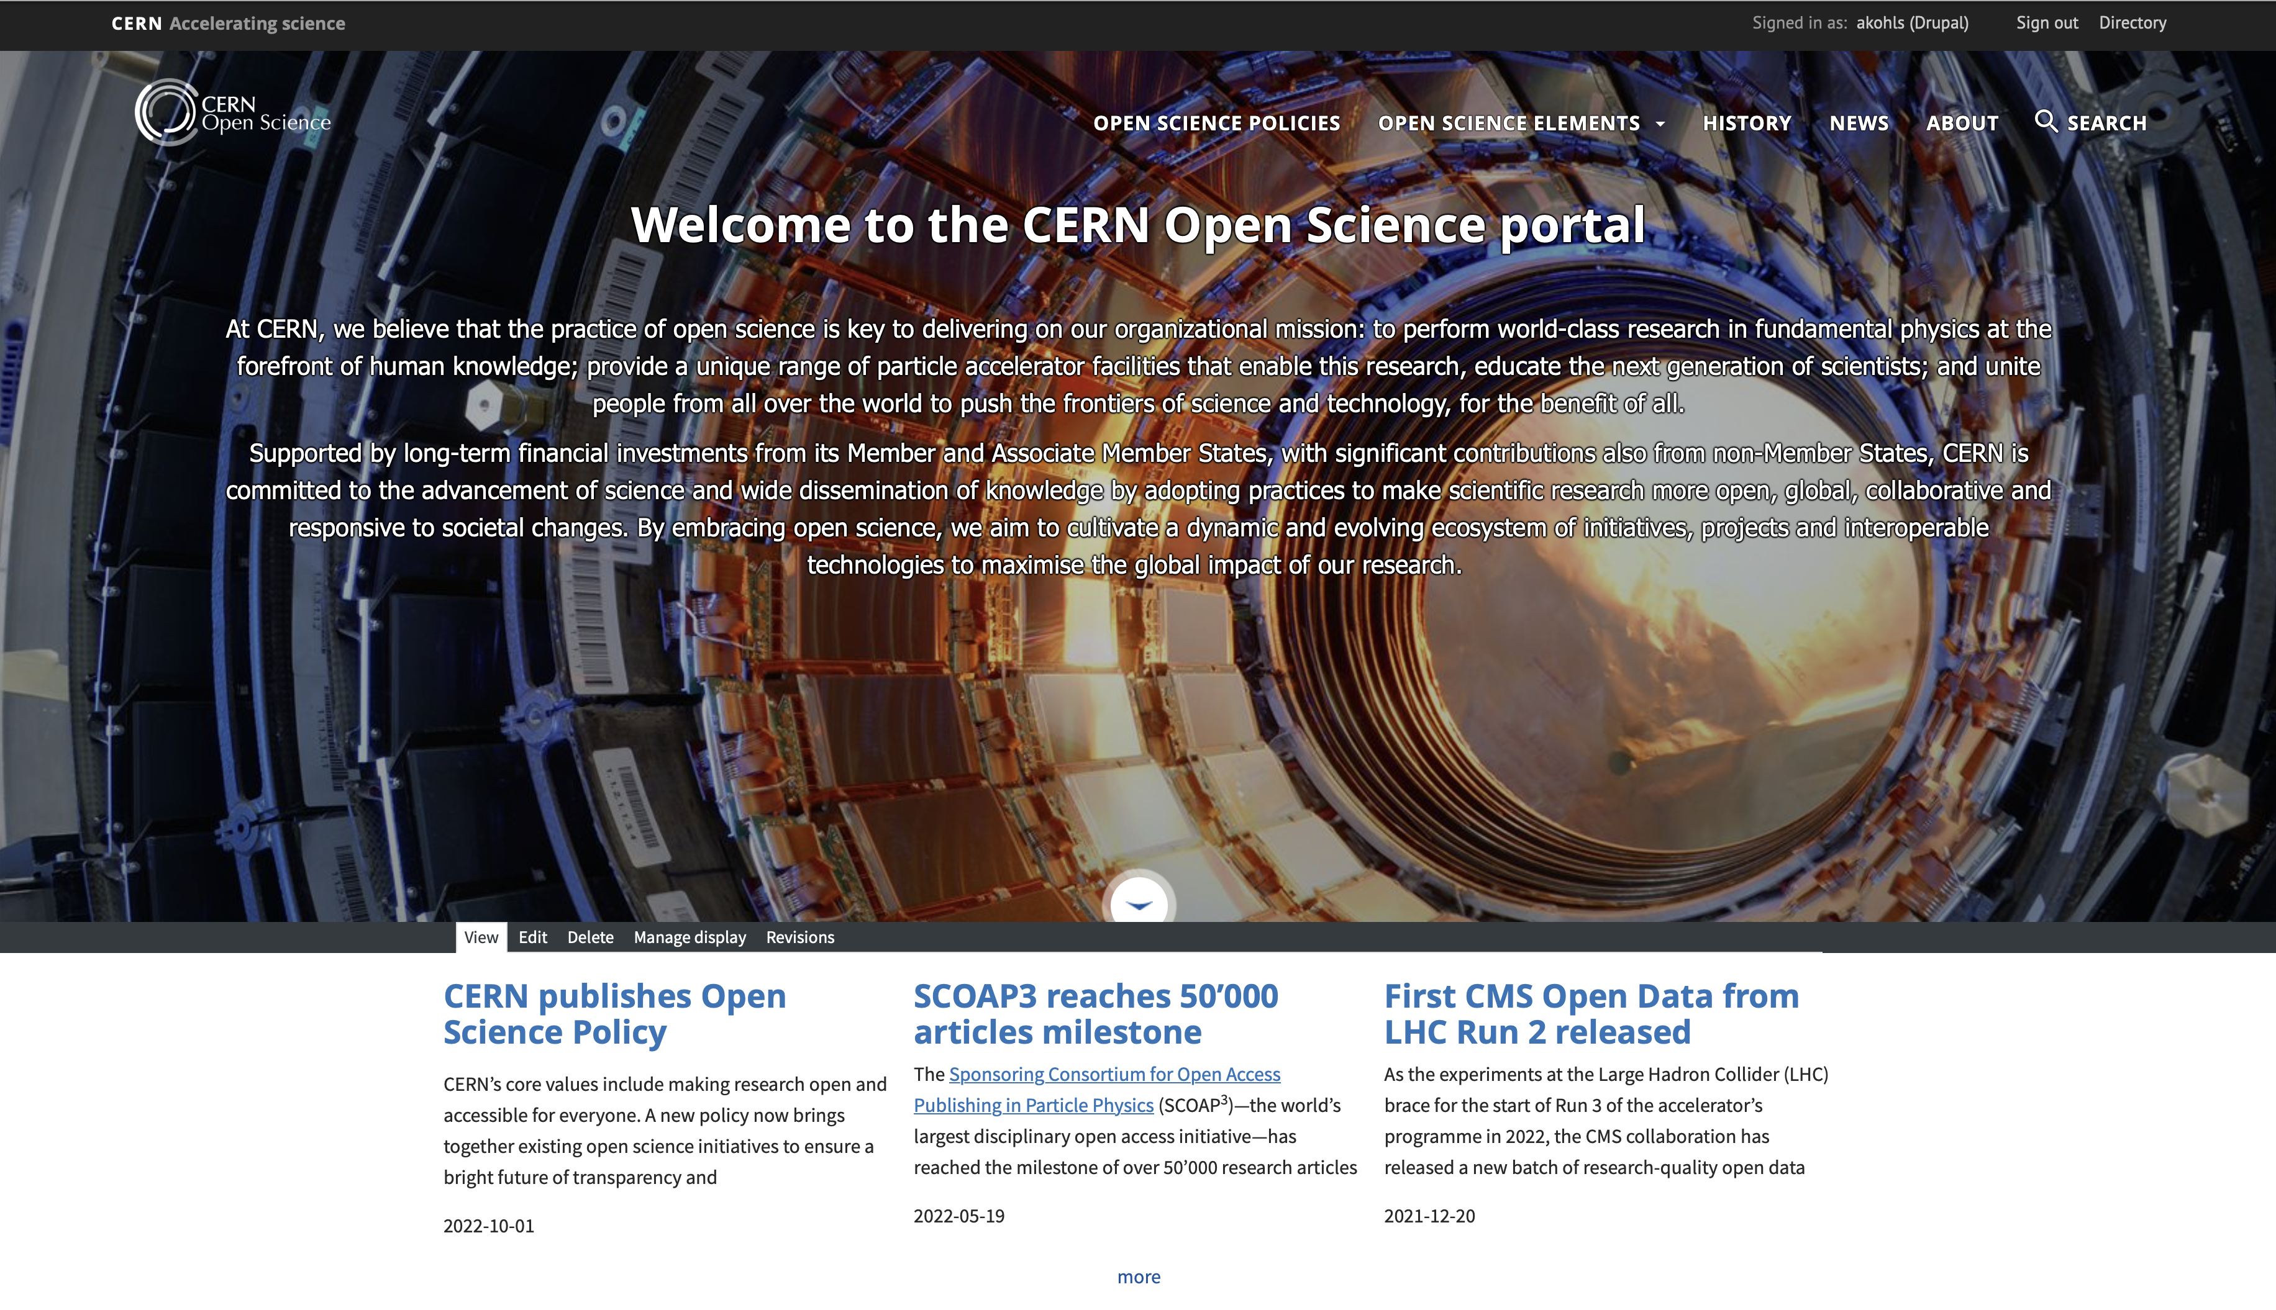
CERN Open Science Policy
Captures current practice and states progressive vision across multiple
Open Science domains:
Policy is governed and implemented by the community
Policy text (V1.0, Oct 2022) and more details available
on the CERN OS website: https://openscience.cern
Open Access to Publications | Research Integrity, Reuse & Reproducibility
Open Research Data | Infrastructure for Open Science
Open Software | Research Assessment & Evaluation
Open Hardware | Education, Training & Outreach
 | Citizen Science

Slide 28
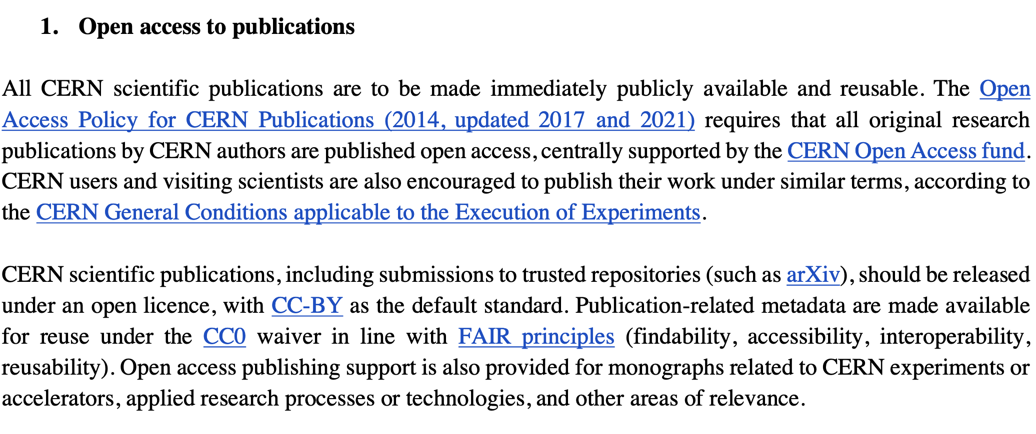
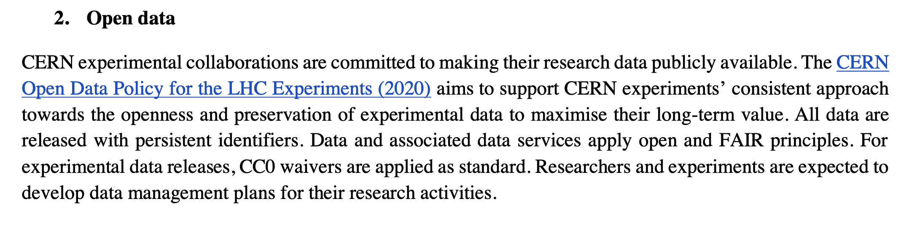
CERN Open Science Policy
Examples of policy statements
https://cds.cern.ch/record/2835057

Slide 29
Open Science Policy
Implementation Plan
Policy accompanied by implementation document outlining roles, responsibilities, mechanisms & resources
Includes actionable measures to support the policy’s implementation across the organization and in the experiments@CERN
Implementation led by Communities of Practice across the various OS activities
Each chapter with editors/shepherds of the OSWG, but everyone within the WG could contribute to the development of each part
Identifies/surfaces both existing and required resources for policy implementation
To be published openly
https://cds.cern.ch/record/2856044/files/CERN-OPEN-2023-007.pdf

Slide 30
CERN OS Governance Framework
Directorate
Open Science Steering Board
Responsible for OS strategy & policy
Consists of department/experiment reps
OS Practitioners Forum (OSPF)
Open forum for CERN-wide exchange
Meets at least 2x per year
OS Office
Open Data WG
CoARA Implementation WG
SIPB
… WG
… Interest Group
OSPO
Ensures OS implementation
Provides input to annual OS Report

Slide 31
Thank you!
Contact: alexander.kohls@cern.ch https://openscience.cern

