Slide 1
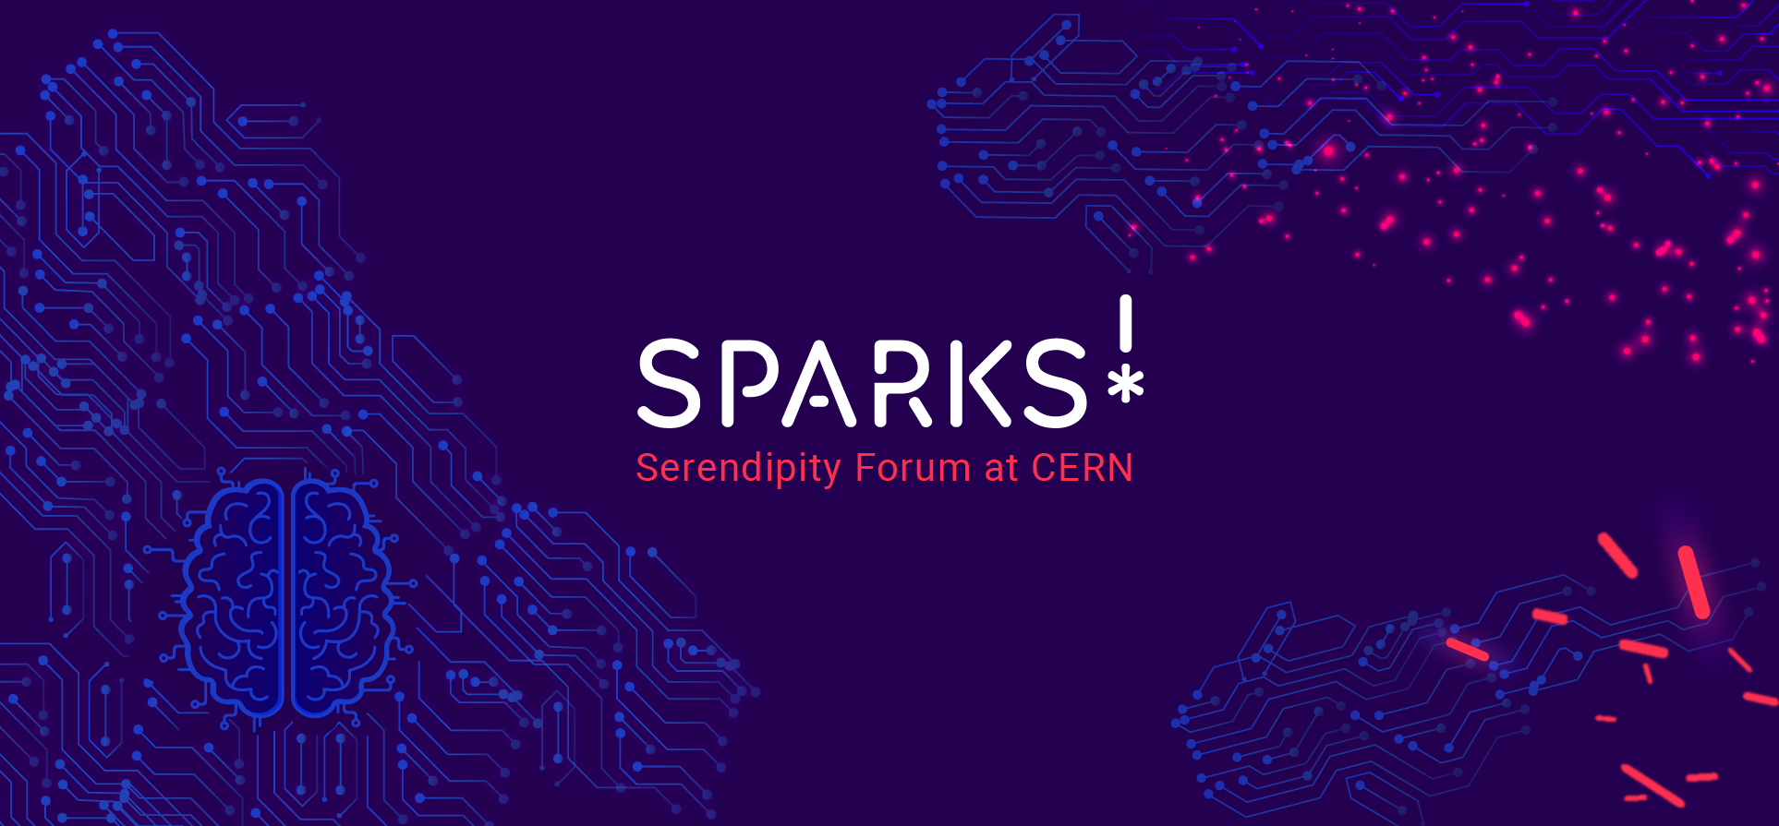

Slide 2
Agenda meeting 24 May 2023
Format and dates confirmed
Development phases
Curate speakers for launch 16 November
Topics
Co-conveners for each topic
Updates from previous editions
Next

Slide 3
1. Sparks! Dates and Formats
2023
16 Nov - Launch - Sparks 3rd edition - Future Quantum at SGW - 2-3 talks + performance
2024
March 7 - Sparks Talks - 8 talks with Q&A + performance at SGW
March 8 - Sparks Forum - Plenary at the Globe and breakout sessions at IdeaSquare with a wrap-up session for the public at SGW

Slide 4
2. Project timeline
Phase I – Conception and initiation (12 months prior event)
Consult committee and hierarchy about theme
Contact potential internal stakeholders, co-curators
Keep Partnerships and Fundraising updated with project decisions
Phase II – Definition and planning (9 months prior event)
Refine theme and define topics with committee and/or co-curators
Identify co-conveners and other external stakeholders
Reflect on global format date, location, format for launch, order of Forum and Talks, etc
Define full edition budget and liaise with PUF according to their requests
Define prospective dates with Logistics
Evaluate and adjust timeline
Produce first content for brochures, allow time for copy editing
Phase III – Launch or execution (five non-holiday months before the event)
Curation in collaboration committee
Graphic design brief of edition
First contact with internal teams, define briefs
Plan website development for the edition
Decide and plan ticketing for the public event
Organise travel and accommodation
Start comms across platforms

Slide 5
3. Launch
Launch - 16 November 2023
Talk 01 - Quantum 101 - Carlo Rovelli or Manjit Kumar or Katie Mack who is running a video series on the topic
Talk 02 - Quantum at CERN - ?
Talk 03 - Potential impact for society - Jason Palmer (economist) or Reeke Heijman-te Paske (Quantum Delta NL) or Scott Aaronson
Performance (David Quayola piano / Suwenchi dance, Libby Heaney gaming)/ Quantum sound music
Alberto had also organized a quantum gaming session which may be interesting to repeat.

Slide 6
4.Theme and topics
Theme: Future Quantum
1 - Questioning reality - How will the second quantum revolution change our understanding of reality?
2 - Opening Quantum - How do we ensure knowledge sharing in the domain for both researchers and users? (How do we ensure both researchers and users have a good grasp of the knowledge necessary to make good decisions; and that the knowledge is shared in an open way?)
3- Changing the game - The first true quantum computer might bestow geopolitical advantage. What frameworks need to be put into place to avoid global supremacy?
4 - Sensing Quantum - Quantum sensors have the potential to reduce the costs of high-tech apparatus, especially linked to health. Who has access to tech? How do we ensure the new tools will be used towards democratisation rather than risk increasing the societal divide?
5- Quantum disruption - With Quantum computing, small groups might be able to produce more interesting results than larger groups. How will quantum computing shake up existing structures in research (small vs. large groups), industry, geopolitics (think a small country with first quantum supremacy)?

Slide 7
5. Co-conveners
Instead of having participants be selected by us, we will aim to have a couple of organisations co-convening each topic. At least one topic should have the involvement of one person from the CERN community
2 institutions per topic
10 names proposed by each - passed through committee
CERN invites 5
Attention to diversity and openness to format

Slide 8
6.Follow up previous events
How to follow up the interest from first and second forum editions? First edition we have the papers, but how about second edition?
Yellow Report 2nd edition: Writer working on it
MLST: Follow-up Markus’ message - What is next?
Frontiers: Drafts of 5 first articles, considering if Fabiola will sign the collection
Proposals to follow-up:
Gender in tech for health research
Ethics in AI by Anja Kaspersen

Slide 9
7. Next
Inviting co-conveners: template
Future meetings:
https://newdle.cern.ch/newdle/FTKBqxwj
July: Tues, 4pm or Wed 26, 4 pm
August: Fri 25, 5pm or Tues 29, 4pm
Sept: Tues 26, 3 or 4 pm or Thur 28, 3pm
Oct: Thur 26, 3pm or Mon 30, 4pm

Slide 10
8. Follow-up group!
Participants:
Meg - Digital Health and Rights and how this affect young adults - Warwick
Sonia - Health and ai diagnostics through nano-medicine - associate professor and a company
Els - Intellectual properties for health technologies to all
Shirin - Gendro - gender biases across research/ supporting the human immonome project for AI
Topics:
Digital health, gender access biases, rights
Digital Data - obtain, cleaning, access
Design the data you are trying to collect - Design principles that will address the challenges
Theme - End-to-End Equality in data for health (feminist approach)
Format:
Bring in private sector, civil society, funding agencies
Event / white paper /

Slide 11
Enrica’s input
Carlo Rovelli gets my vote if we can get him.
The others I do not know them, but they sound very interesting.
Alberto had also organized a quantum gaming session which may be interesting to repeat.

Slide 12
Maurizio’s input
I would avoid Rovelli. And not for his position on the war in Ukraine. Just for what he says when he talks about physics.
Katie is an astrophysicist. I don’t see it fitting.
A good speaker for a general talk could be Manjit Kumar, who wrote a great book on the subject
I think Scott Aaronson has a podcast on that, but he already gave two CERN talks, so maybe we should look for someone else
If you want some historical perspective with some CERN content related to John Bell, I would go for Reinhold Bertlmann, who worked with John Bell back then and kept working on QT.
You mean QTI or something else/more? There is an unexplored (so far) connection there between entanglement and some of the experimental techniques used, for instance, with Na62 and LHCb
I would just be less assertive. For instance "The first true quantum computer will bestow geopolitical advantage”. Will it? Not sure about it at all.

Slide 13
6. KPIs
Target audiences | Sparks events | Comments | KPIs
Potential new donors | Public event | The bigger the show the better
Local decision-makers, including Host-States | Public event and panel | Needs French
Local media | Public event and panel | Needs French
University-level students | Podcast, public event | Specially if we involve universities in the forum
HEP community (depending on topic ) | Podcast, and panel | Specially if theme is something like “energy”
CERN community | Podcast, public event and panel | Current audience of Sparks
“Interested” local communities (in science/CERN) | Podcast, public event and panel | Current audience of Sparks

