Slide 1
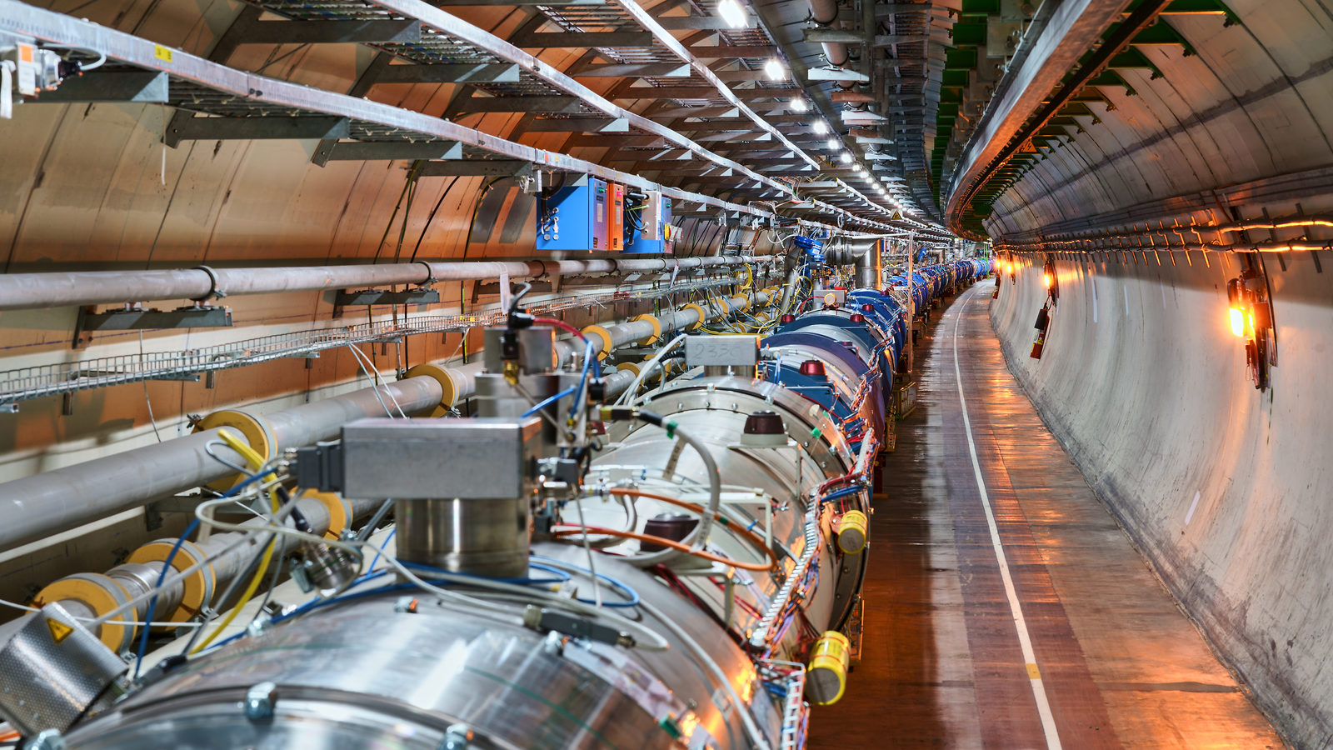
LHC Run 3 – Status and Outlook

Slide 2
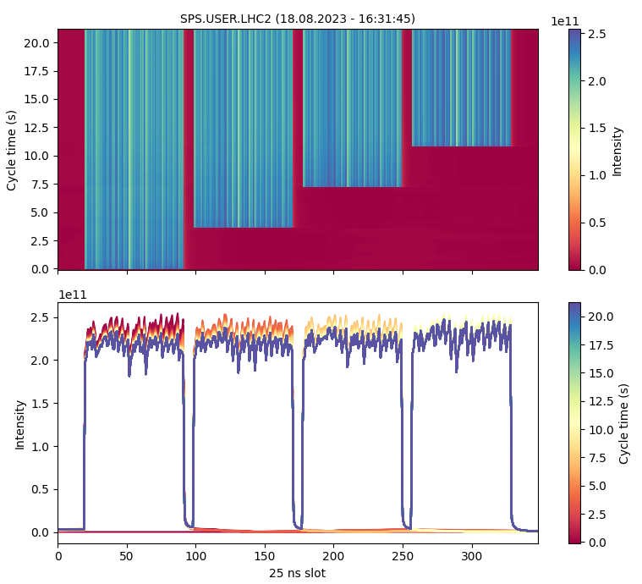
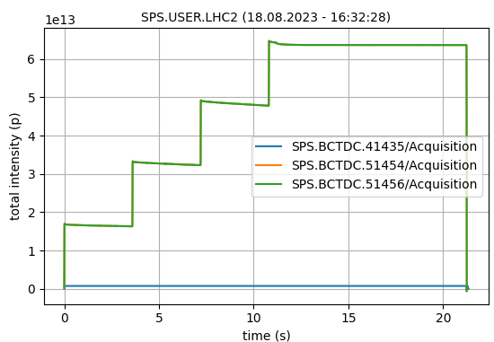
Achieved SPS LIU intensity target
Intensity reach demonstrated on 13.06.23, 18.08.23:
4x72 with 2.2e11 p/b at flat top
  Excellent transmission (~95% without scraping)

Slide 3
LIU beams - Summary & outlook
year | Intensity at SPS FT [p/b] | # of bunches | Batch spacing [ns] | Transverse emittance (mm) | Bunch length [ns] | Beam type
2023 | 2.2e11 | 4 x 72 | 200 | 1.9 | 1.6 | Standard
2023 | 2.15e11 | 4 x 56 | 200 | 2.05 | 1.6 | 8b4e
2023 | 1.8e11 | 56 + 5 x 36 | 200 | 1.6 | 1.6 | hybrid
Demonstrate reproducibly LIU target intensity (2.3e11 p/b) at SPS flat top
  Prove and/or improve robustness of new WS design
Improve 8b4e brightness and explore reach beyond 2.3e11 p/b, while continuing BCMS characterization
Beam quality: Study in detail and minimize tails in transverse beam profiles across chain

Slide 4
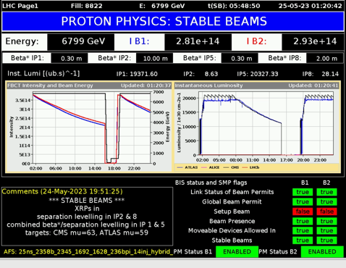
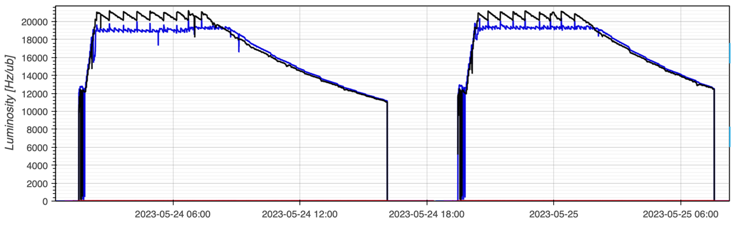
Some excellent physics performance
New record: Integrated luminosity of 1.2 fb⁻¹ in 24h!
Peak levelling just above 2.0 x 10³⁴ cm⁻²s⁻¹
Pileup targets ATLAS/CMS = 63 / 59
  Thanks to combined separation β* levelling and separation levelling we can deliver different pile up to ATLAS and CMS
Max energy per beam at start of stable beams: 409 MJ
1.59 x 10¹¹ p/b (Injected: 1.61)
24th to 25th of May 2023

Slide 5
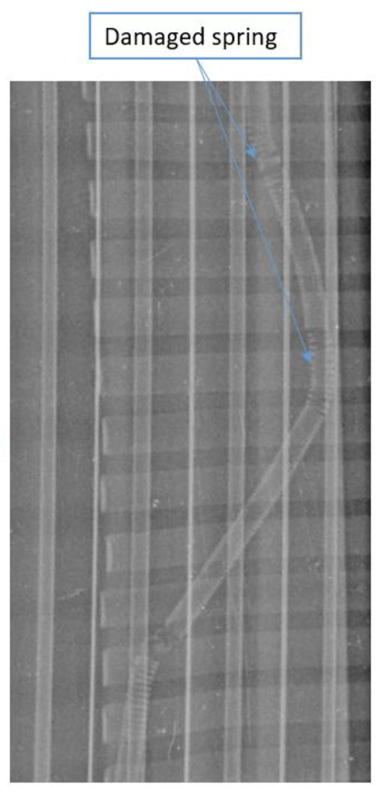
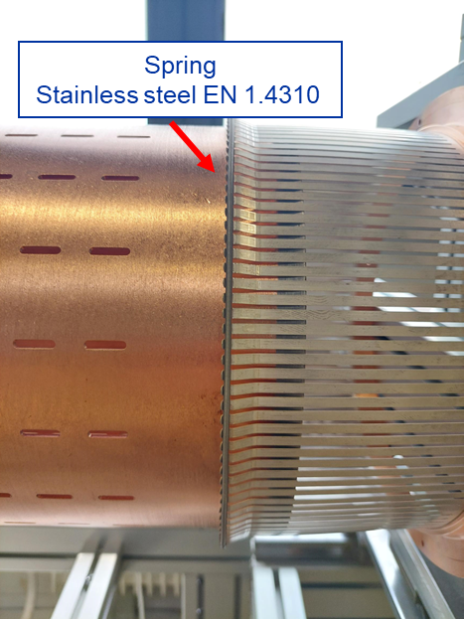
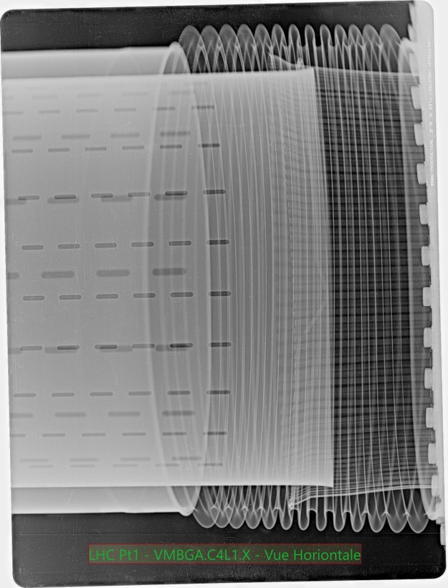
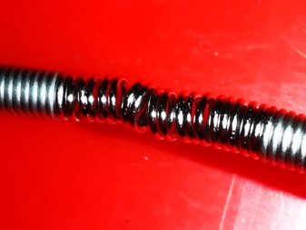
Vacuum Module R1 – May – 5 days lost
Clear sign of the spring heating
How it should look
Spring disengaged with RF fingers not touching
Possibly intensity driven hold at 1.6e11 ppb

Slide 6
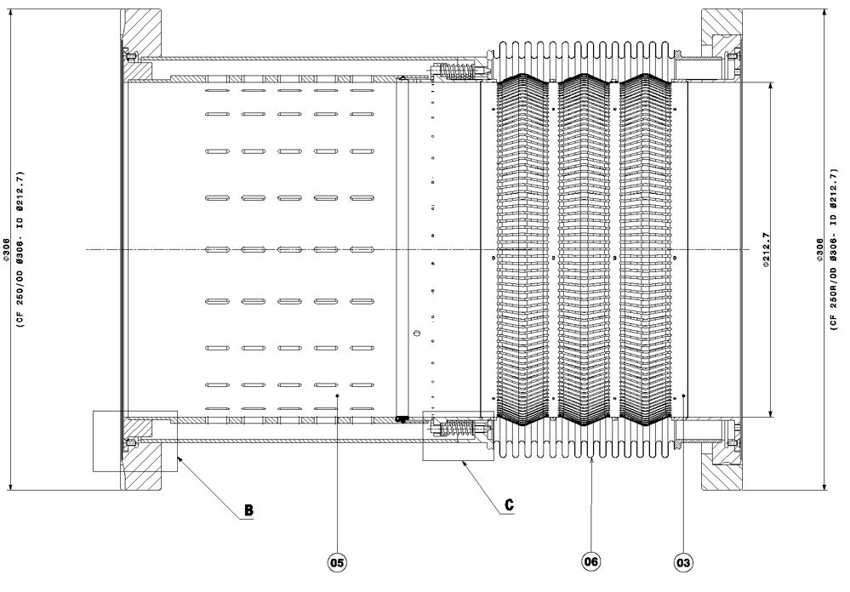
Warm module exchange foreseen
The new DRF warm module design does not contain any sliding RF fingers or a spring to guarantee electrical continuity.
65 warm modules of ID212.7 with two beams circulating inside are installed in the LHC.
Replacement program foreseen – 28 modules in YETS 23/24, the rest in YETS 24/25.

Slide 7
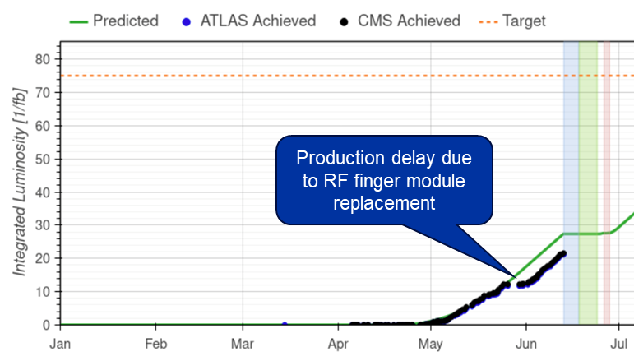
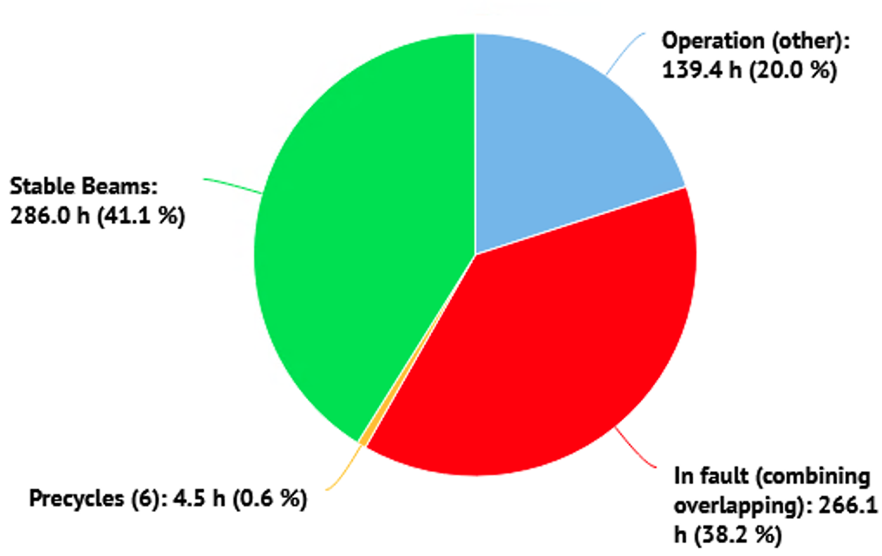
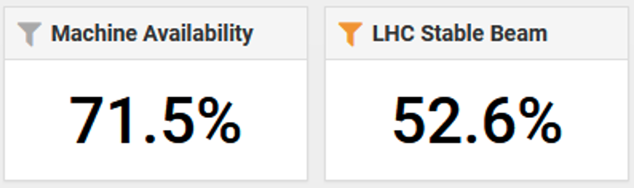
Overall LHC Performance…
May 2023
In June 2023

Slide 8
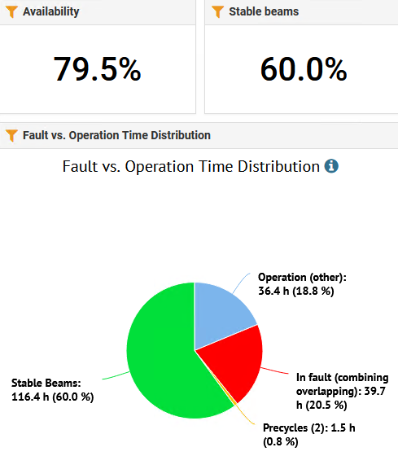
… up to July
However…

Slide 9
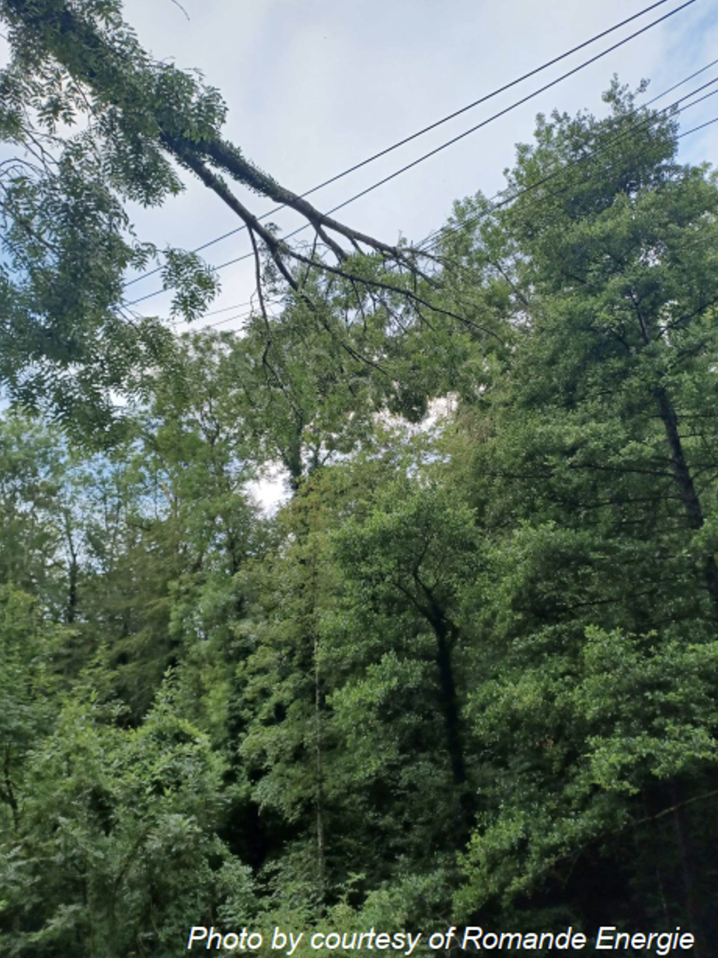
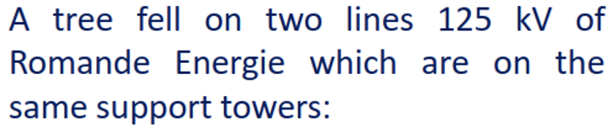
17th July 2023 01:00:17
Beams dumped at 01:00:17 by RF fault
370 ms later several magnets quenched:
  RQ7/9/10.R4
  RQ10.R8
  RQX.L8
The heat wave generated by RQX.L8 quench tripped the IP8 cold compressor
Notes:
the fact that some magnets quench after major electrical perturbations is a known + recurrent fact, as unfortunately some of the longer quench detection cables pick up on the perturbations and exceed the detection thresholds. Undesirable but nothing particularly special with this event…

Slide 10
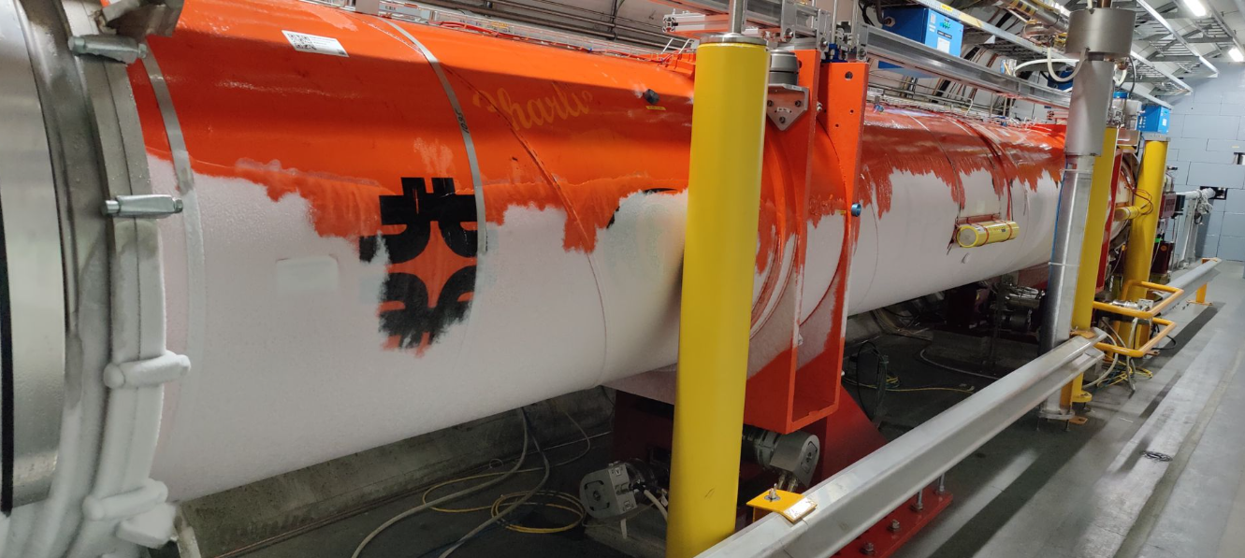
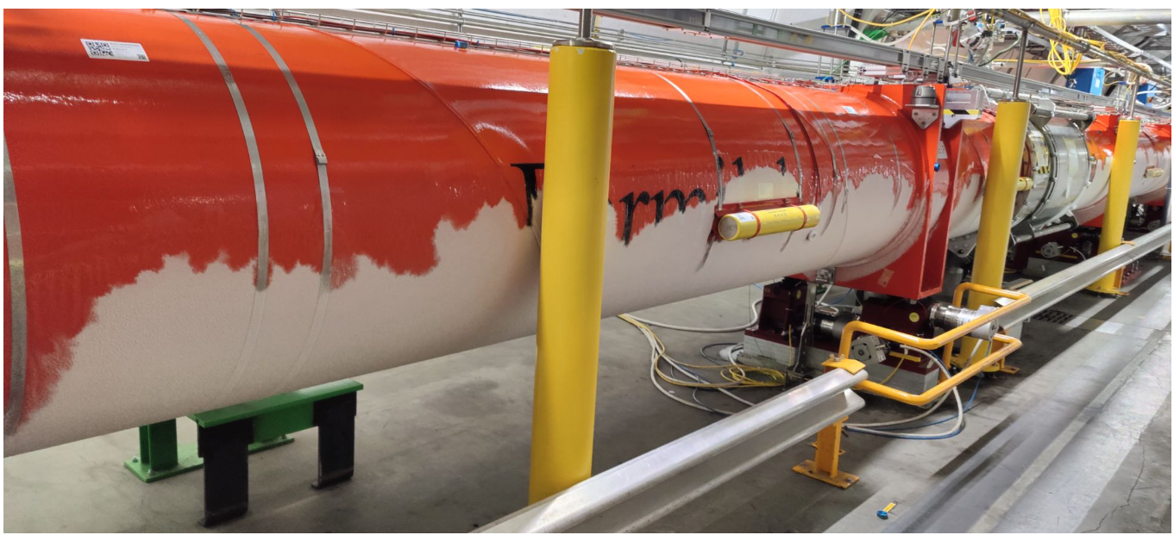
Electrical glitch and consequence
Q1
30 s after the quench, a significant leak appeared in the vacuum vessels of IT.L8 assembly.
8 hours after the quench, the pressure in the vacuum vessels is at 1 bar and the average temperature of the cold masses is 150 K
Q3

Slide 11
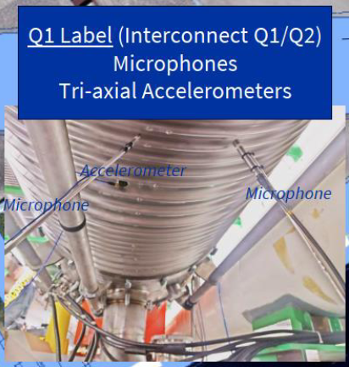
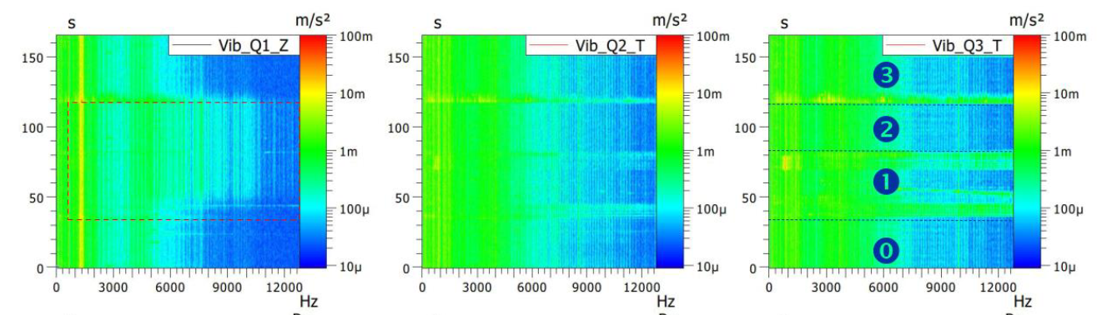
Leak location
Confirmed to be in the cold masses volume, the helium leak had to be localised over the 40m of the triplet assembly.
Microphones and accelerometers were installed below the interconnection bellows.
With the pressurisation of the cold masses, accelerometers in Q1-Q2 interconnection measured significant vibration, indicating a possible position of the leak
Courtesy EN-MME
Q1-Q2
Q2-Q3
Q3-DFBX

Slide 12
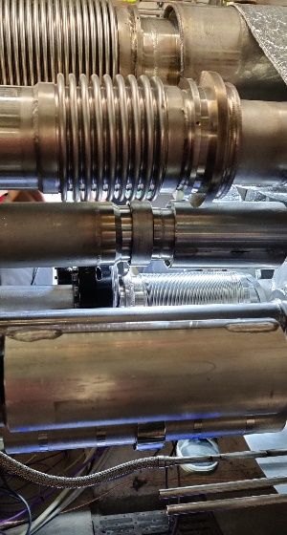
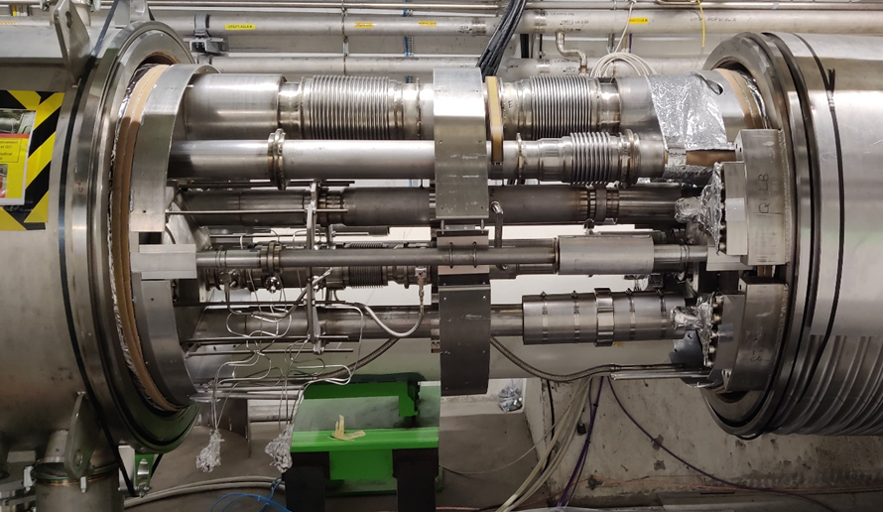
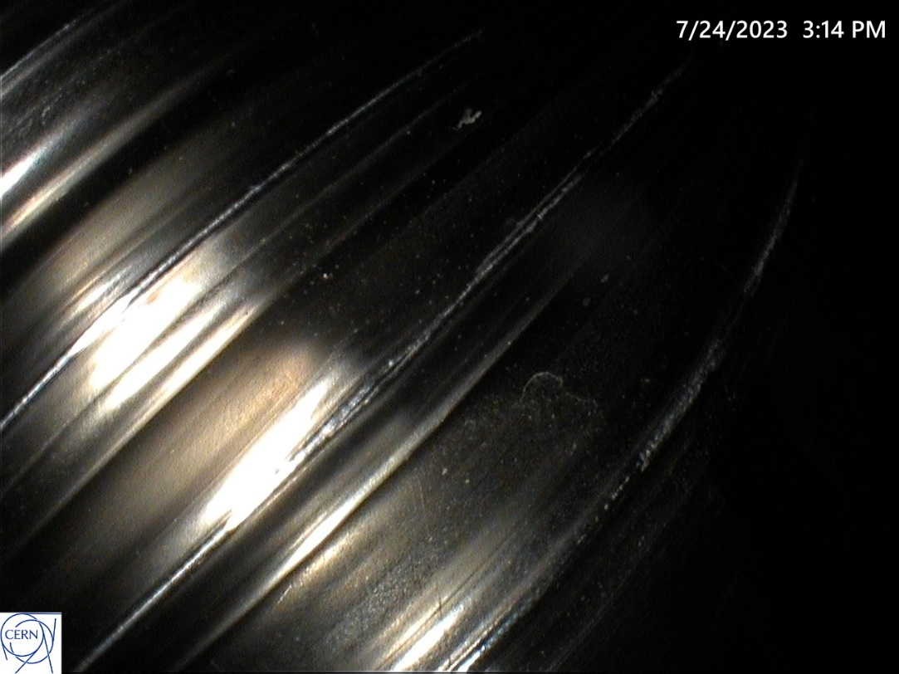
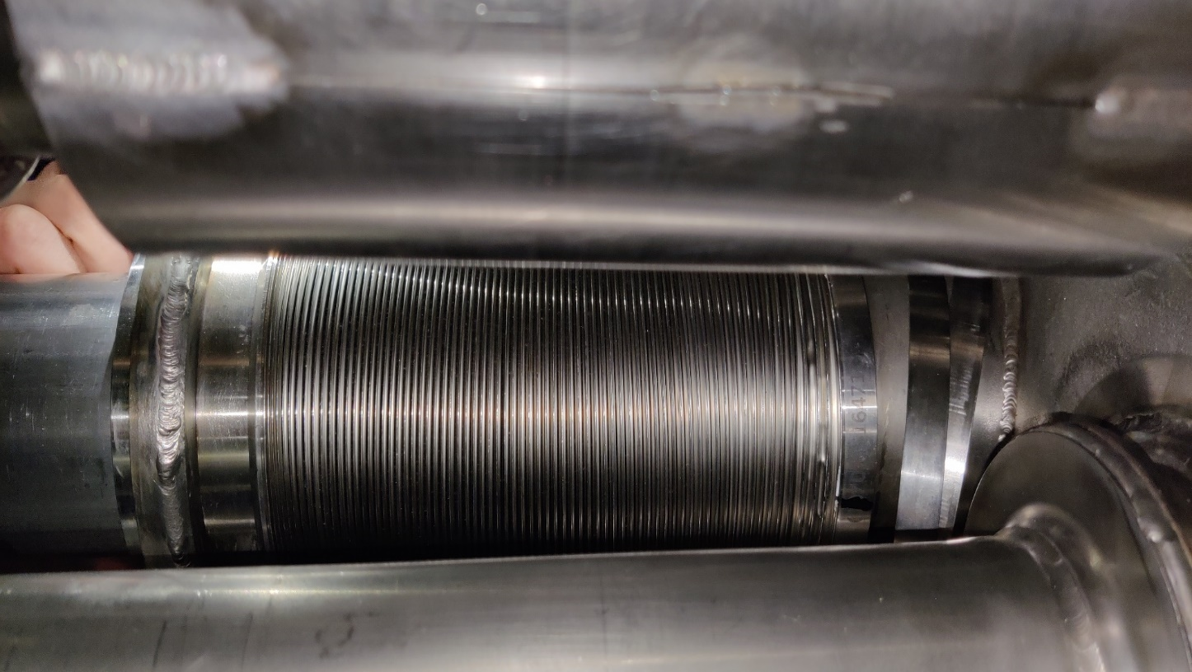
24th July, start of countdown
Cryogenics gives 10 day window for intervention - longer will mean warming up sector 78
Complete warm-up of the IT magnets
Electrical lock out
Depressurisation of all cryogenics lines
Injection of dry air in the interconnections
  → Green light to open the IC
Q2
Q1
Edge welded bellow of the M2 Line
(instrumentation line)
1.6mm
20cm

Slide 13
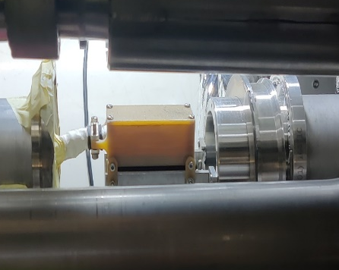
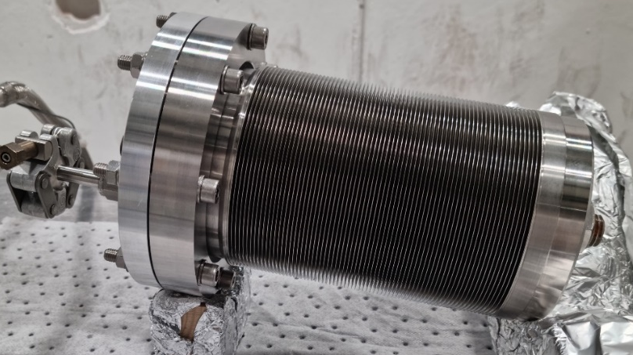
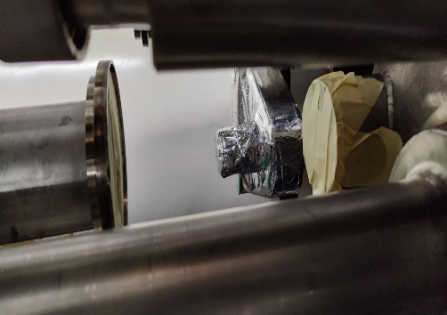
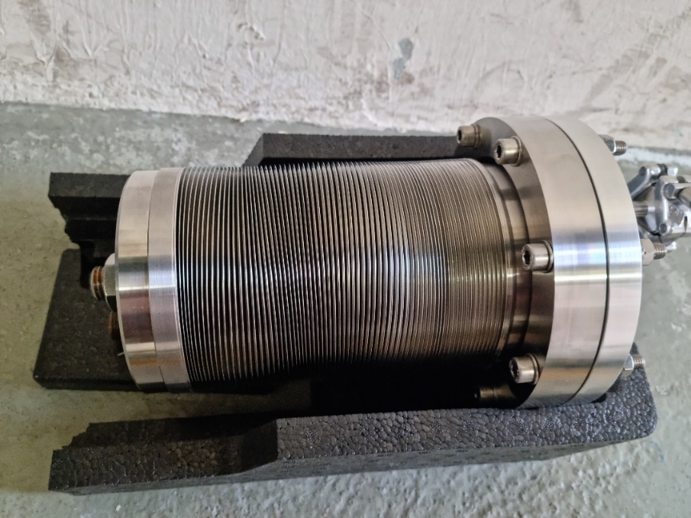
Bellow removal
Tuesday 25th
In IT.L8, the M2 bellow is removed.
In the lab, 2 spare bellows are pressure tested.
Leak test ⇨ pressure cycle to 20 barg ⇨ leak test
Instrumentation onnection box
before pressure test
after pressure test

Slide 14
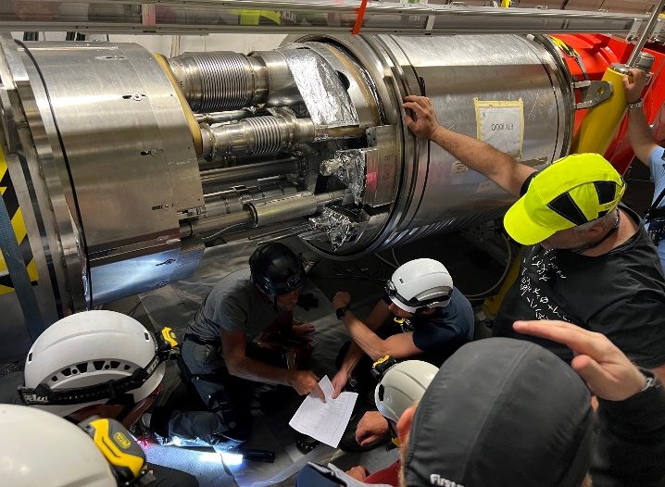
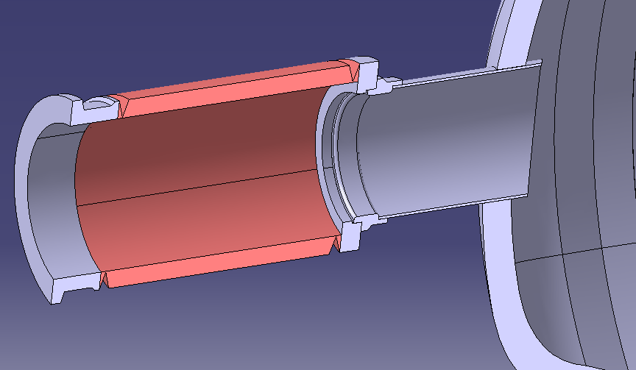
Spare bellows welding
Wednesday 26th & Thursday 27th
The M2 bellows is an integral component of the as-delivered Q1 cold mass. In-situ replacement of the bellows requires a new strategy of welding at the interconnection.
#1
#3
#2
Additional intermediate Ring (316LN)

Slide 15
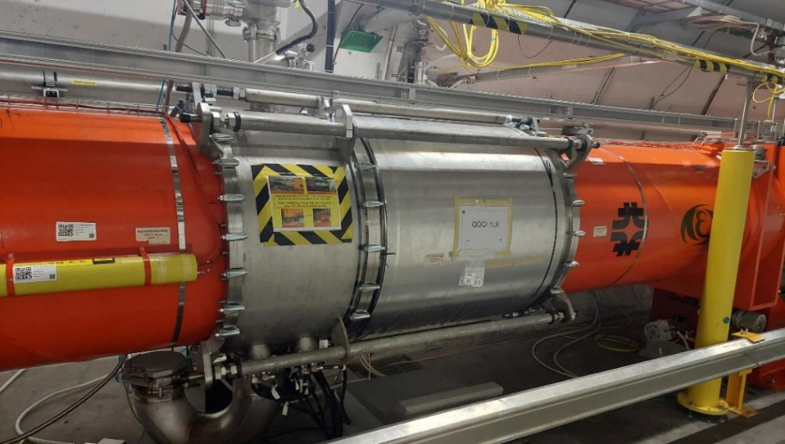
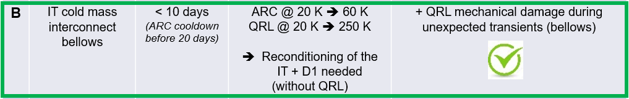
End of countdown
On Friday 28th, the Q1-Q2 interconnection is closed
Start of Insulation vacuum pumping & tightness checks
Start of cold mass purging
In total :
IT magnet warm-up : 1 week
Leak repair : 1 week
Cool-down and reconditioning : 3.5 weeks
ElQA and Powering : 0.5 weeks
1½ months without beam in the LHC

Slide 16

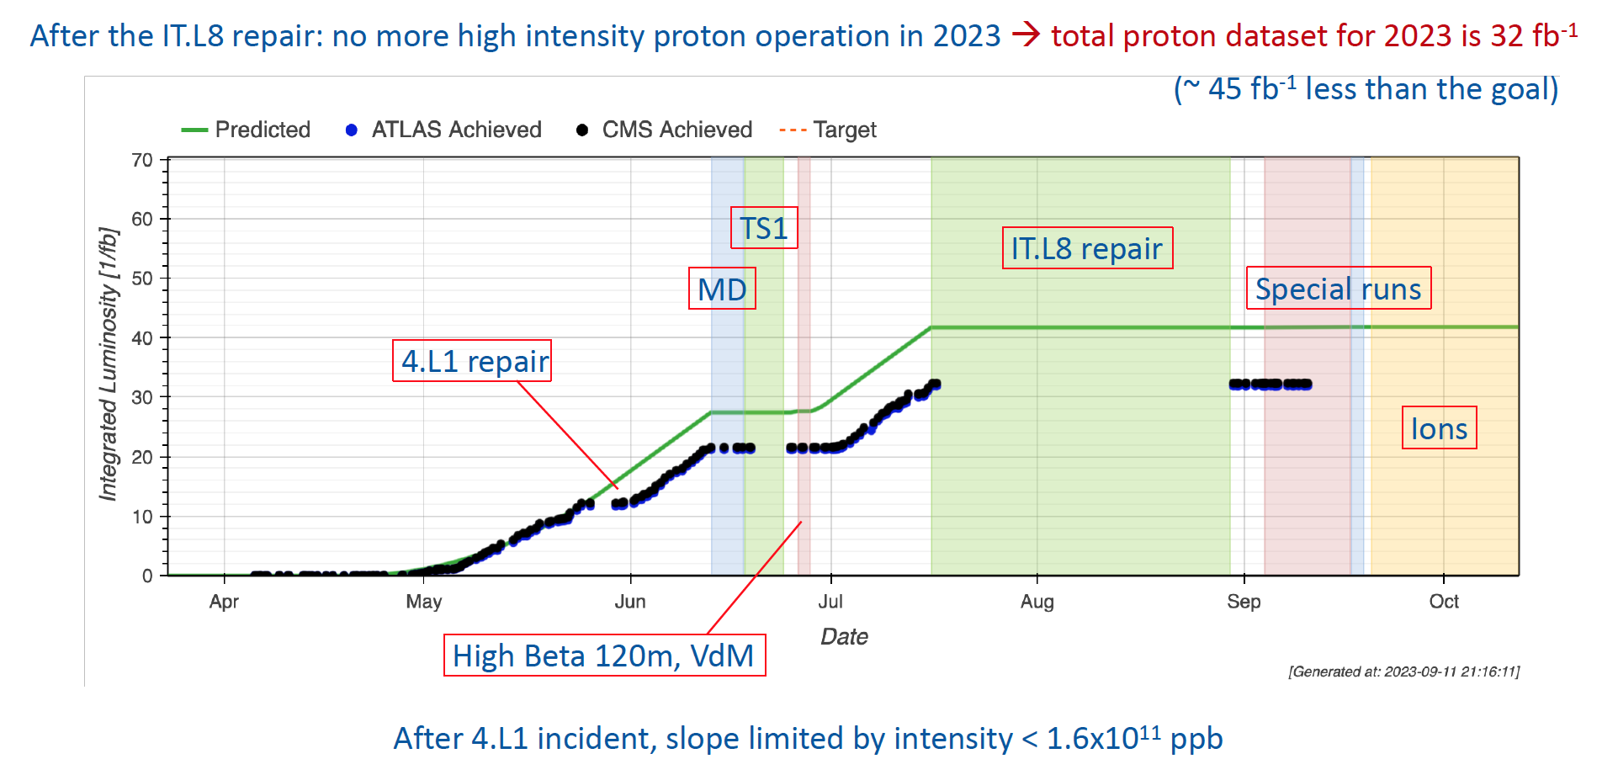
Proton luminosity 2023

Slide 17
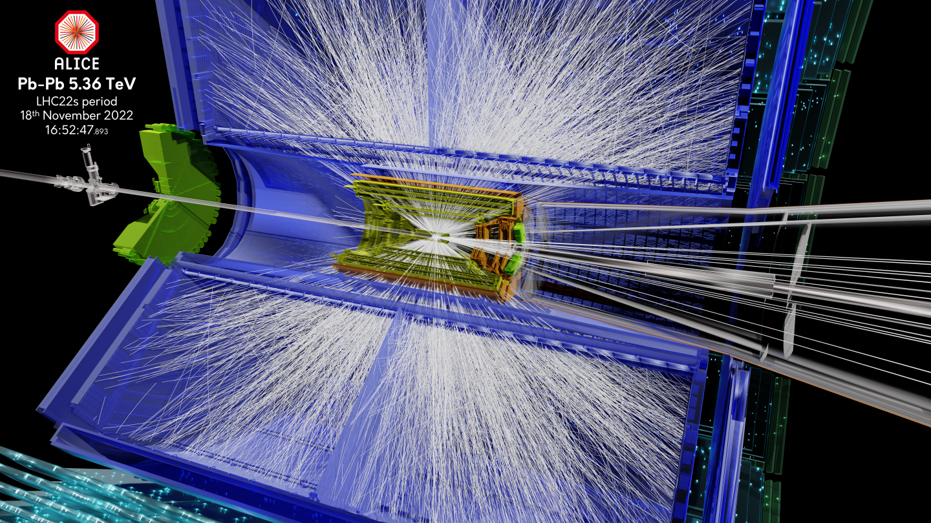
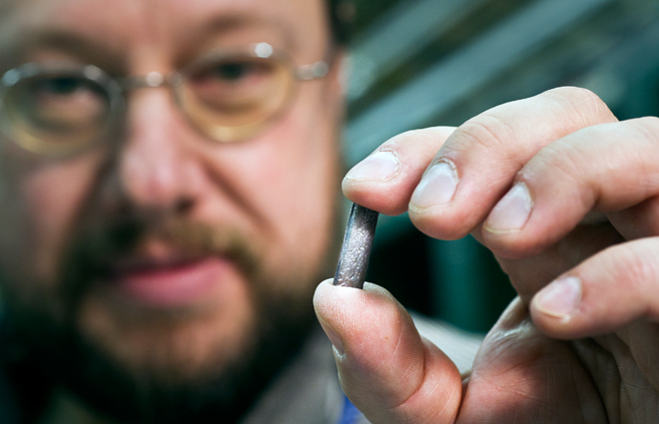
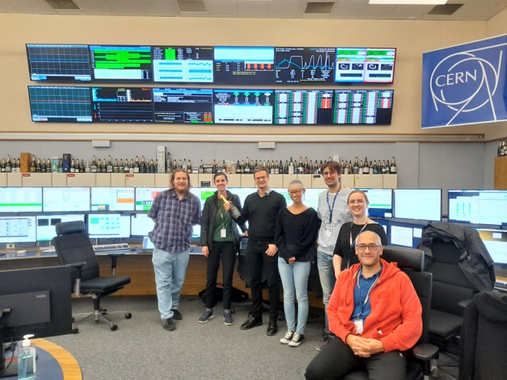


Slide 18
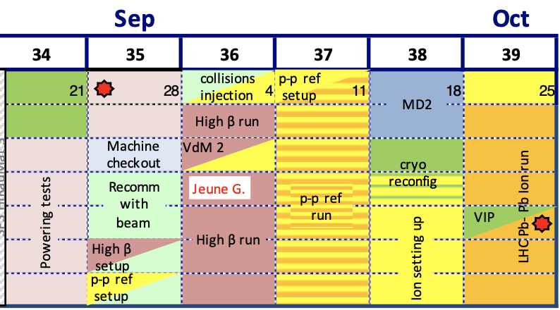
Change of plan
Decided to focus on special runs and ions in the remaining time
However…

Slide 19
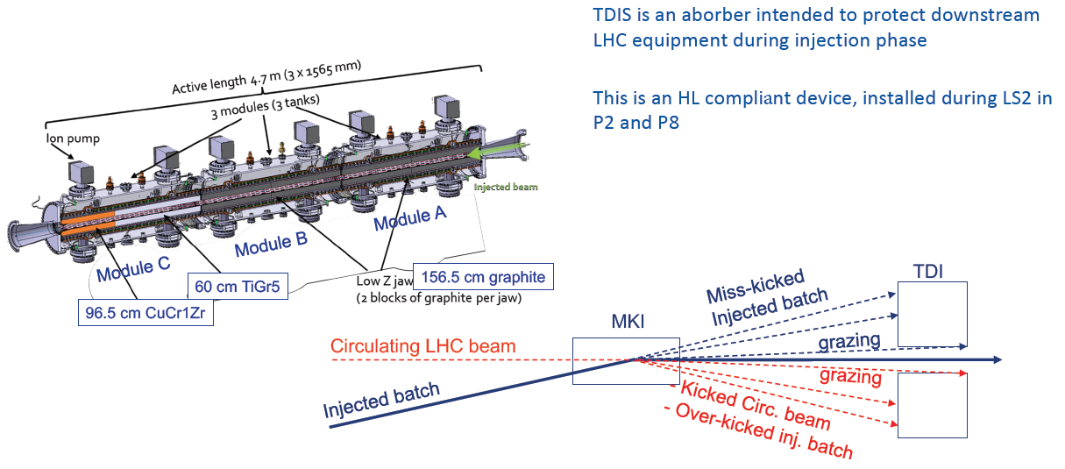
TDIS – Injection Projection Devices

Slide 20
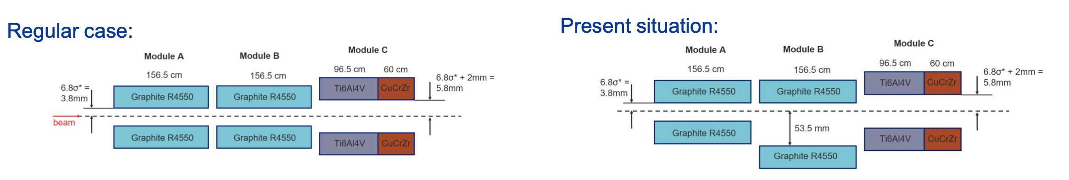
TDIS-IP8
A vacuum leak developed on IP8-TDIS, starting on 1st September
Leak at the level of module B, bottom jaw, downstream bellow
Leak varnished and jaw blocked in open position: degraded injection setup:
➔ slightly reduced number of bunches for ppref run (impact on filing scheme)
➔ NO intensity limitation for ION run
However…

Slide 21
TDIS-IP8
An additional leak developed on the IP8-TDIS, starting on 8th September
Investigation revealed a leak at the level of module A, bottom jaw, upstream bellow
Leak was varnished and jaw blocked in open position

Slide 22
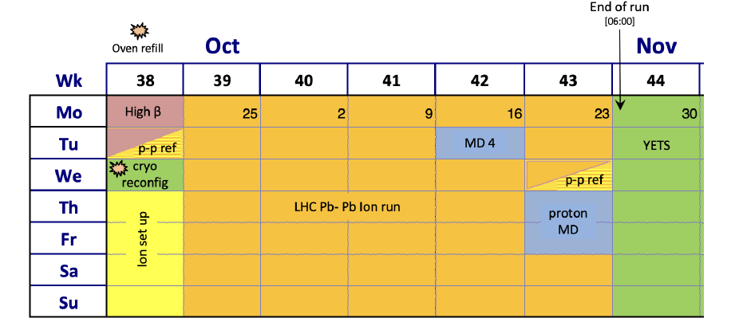
Another schedule update…
With 2 jaws blocked out, TDIS-IP8 OK for ion runs but not for full pp reference run

Slide 23
Run 3 Schedule
Reduced operation in 2023 but total for 2024/2025 remains unchanged
Optimised the running time to adapt to energy costs to bring significant savings without impacting overall physics time beyond that introduced with 2022 & 2023 measures
2023
31 weeks
2024
2025
33 weeks
36 weeks
YETS 22-23
17 weeks
YETS 23-24
19 weeks
EYETS 24-25
19 weeks
LS3
Baseline start of LS3 is 17 November 2025
Total pp goal for Run 3 was 300 fb-1, revised to ~260 fb-1

Slide 24
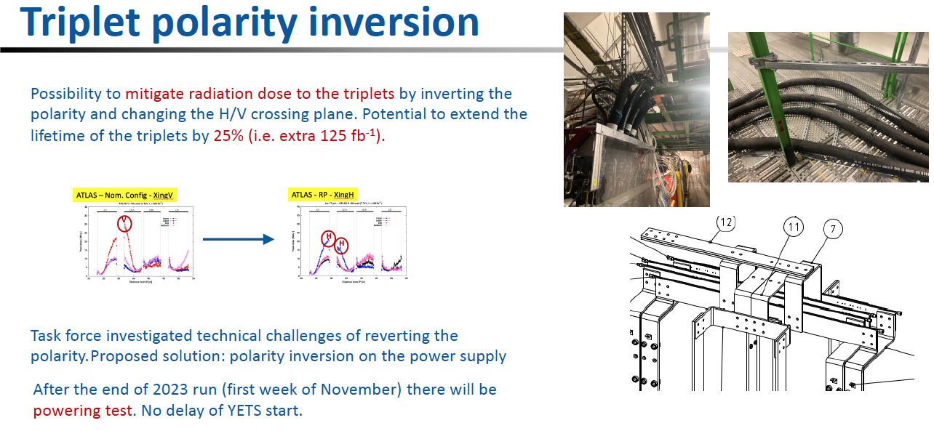
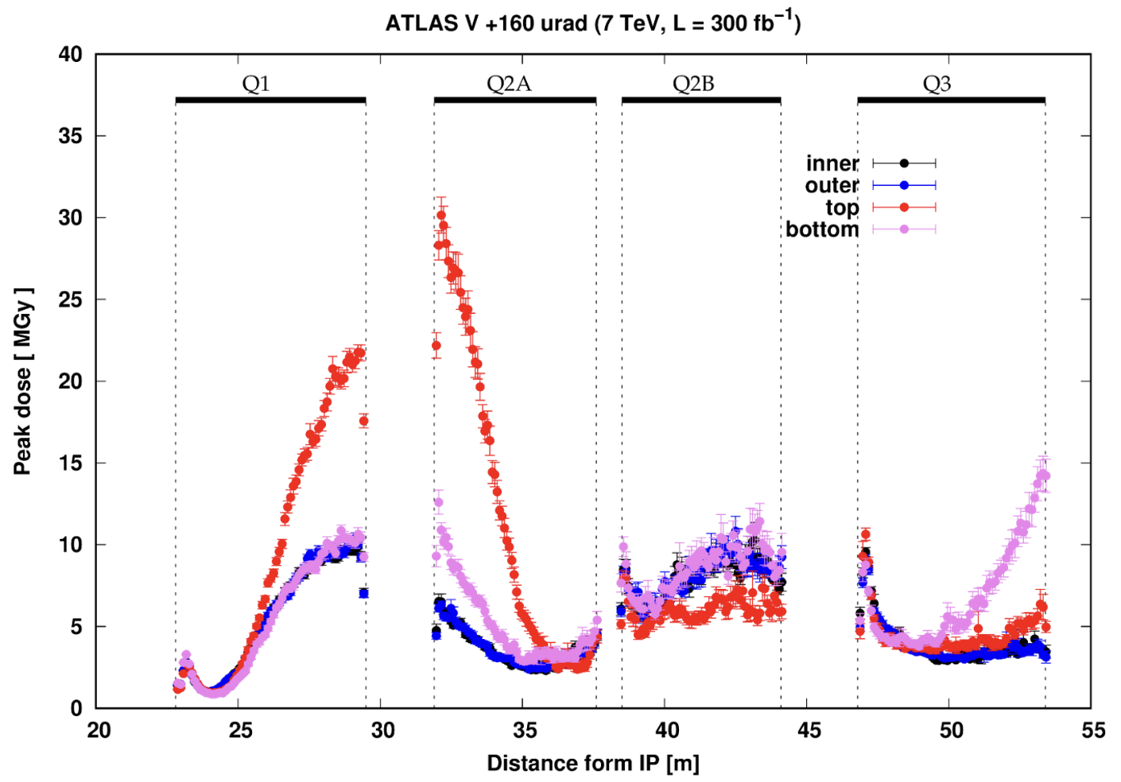
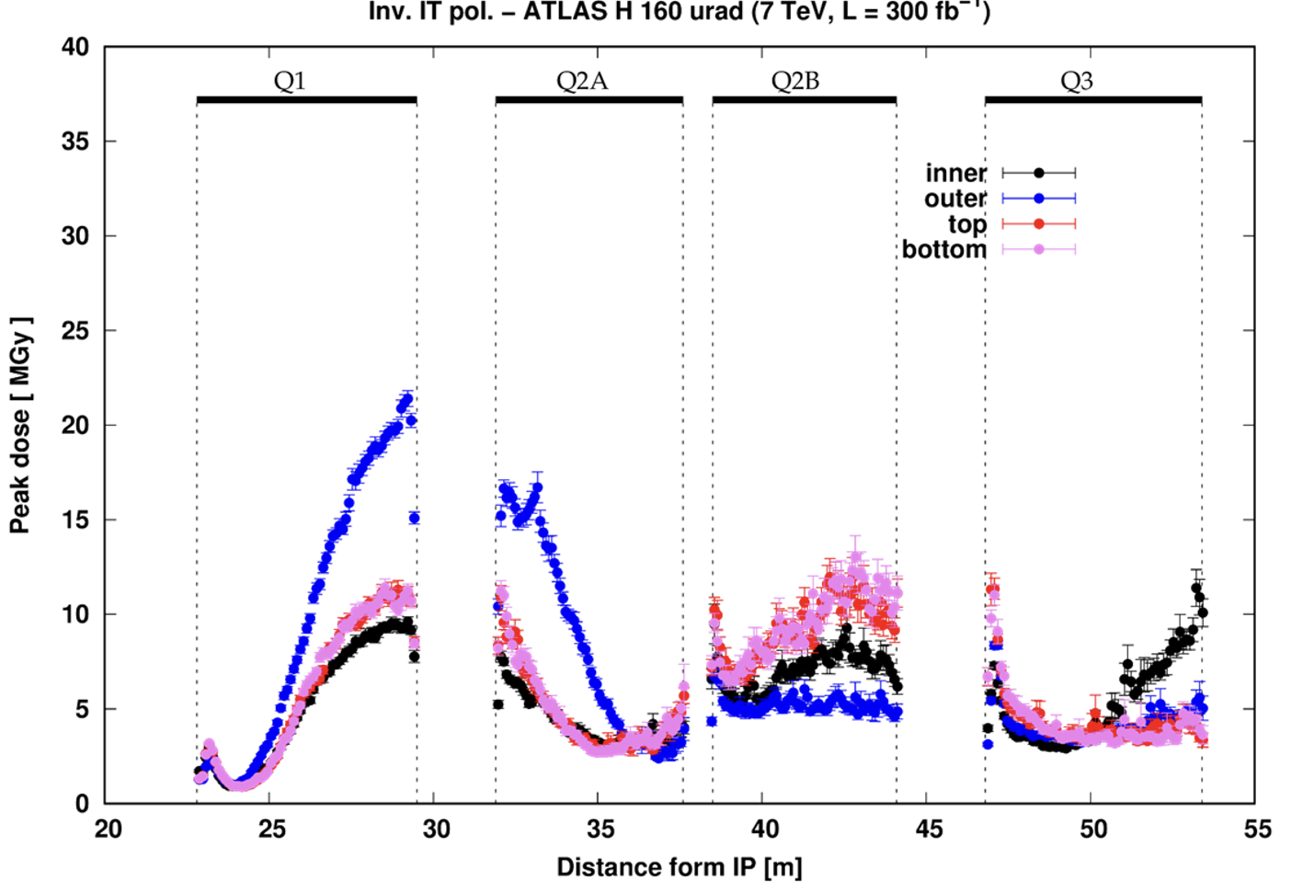

Slide 25
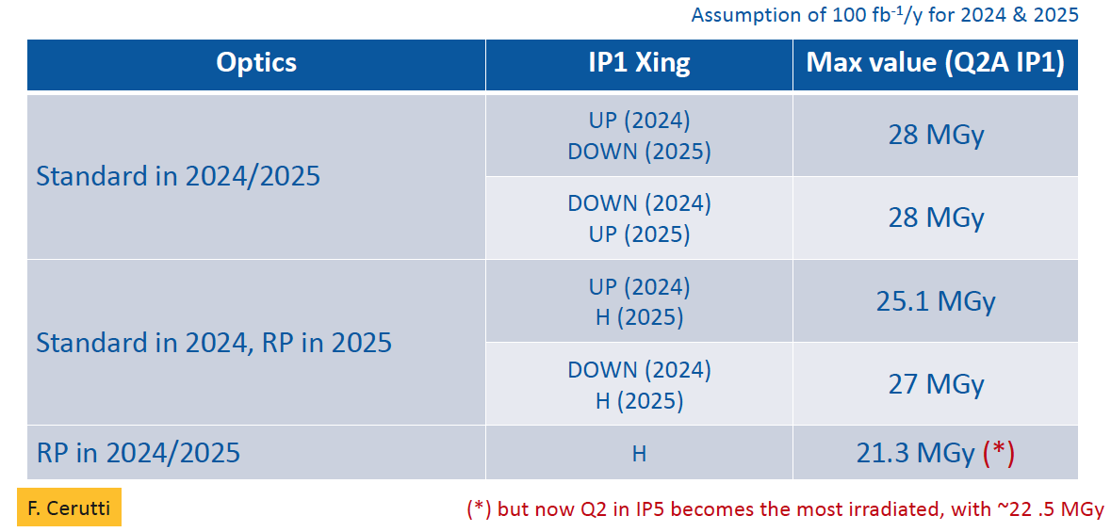
Triplet Polarity Inversion (latest)

Slide 26
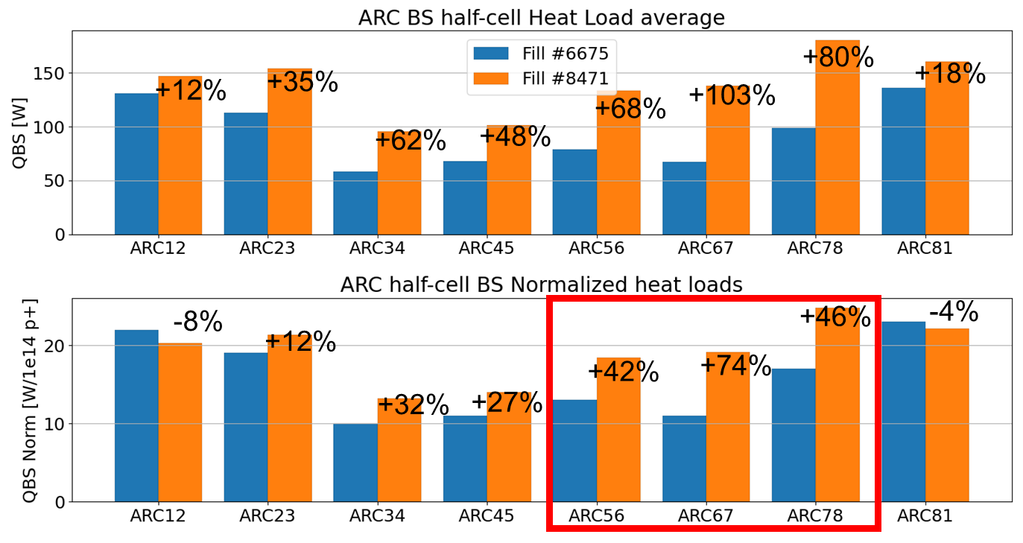
Electron Cloud Heat Load
Sector 7-8 emerged degraded from LS2, determining the heat load limitation of the LHC
LS1
  Provoked significant degradation of heat loads in S12 & S23 & S78 & S81
LS2
  Provoked significant degradation of heat loads in S56 & S67 & S78
Thanks to the hybrid filling scheme (mixture of 8b4e and 36 bunch trains), the heat load is under control for Run 3

Slide 27
Beam screen heat load – longer term
Problem
    Non-uniform heat load along the LHC arcs
    Important scatter within arcs, cells, magnets.
    Degradation during Long Shutdowns
Origins*
    Presence of CuO layer – Max SEY > e- cloud threshold
    Low carbon concentration – limited surface graphitization (required for scrubbing)
Objectives
    Remove CuO and/or increase surface carbon concentration on selected Beam Screen (BS)
    BS surface passivation (robustness against re-oxidation)
*Cf. Valentine Petit’s PhD thesis: https://cds.cern.ch/record/2721533

Slide 28
Beam-Screen Treatment Project phases
Proposal for a New Project aiming to reduce the LHC's heat load by in-situ Beam-Screen Treatment (BST) presented at last week’s LMC
Phase 1 – Process selection / optimization (2 technological choices) (up to Q2-2024)
Phase 2 – Mock-up demonstration / Personnel training (Q2-2024 → Q1-2026)
Phase 3 – Implementation in the machine (Q2-2026 → Q2-2028) – LS3
Guillaume Rosaz

Slide 29
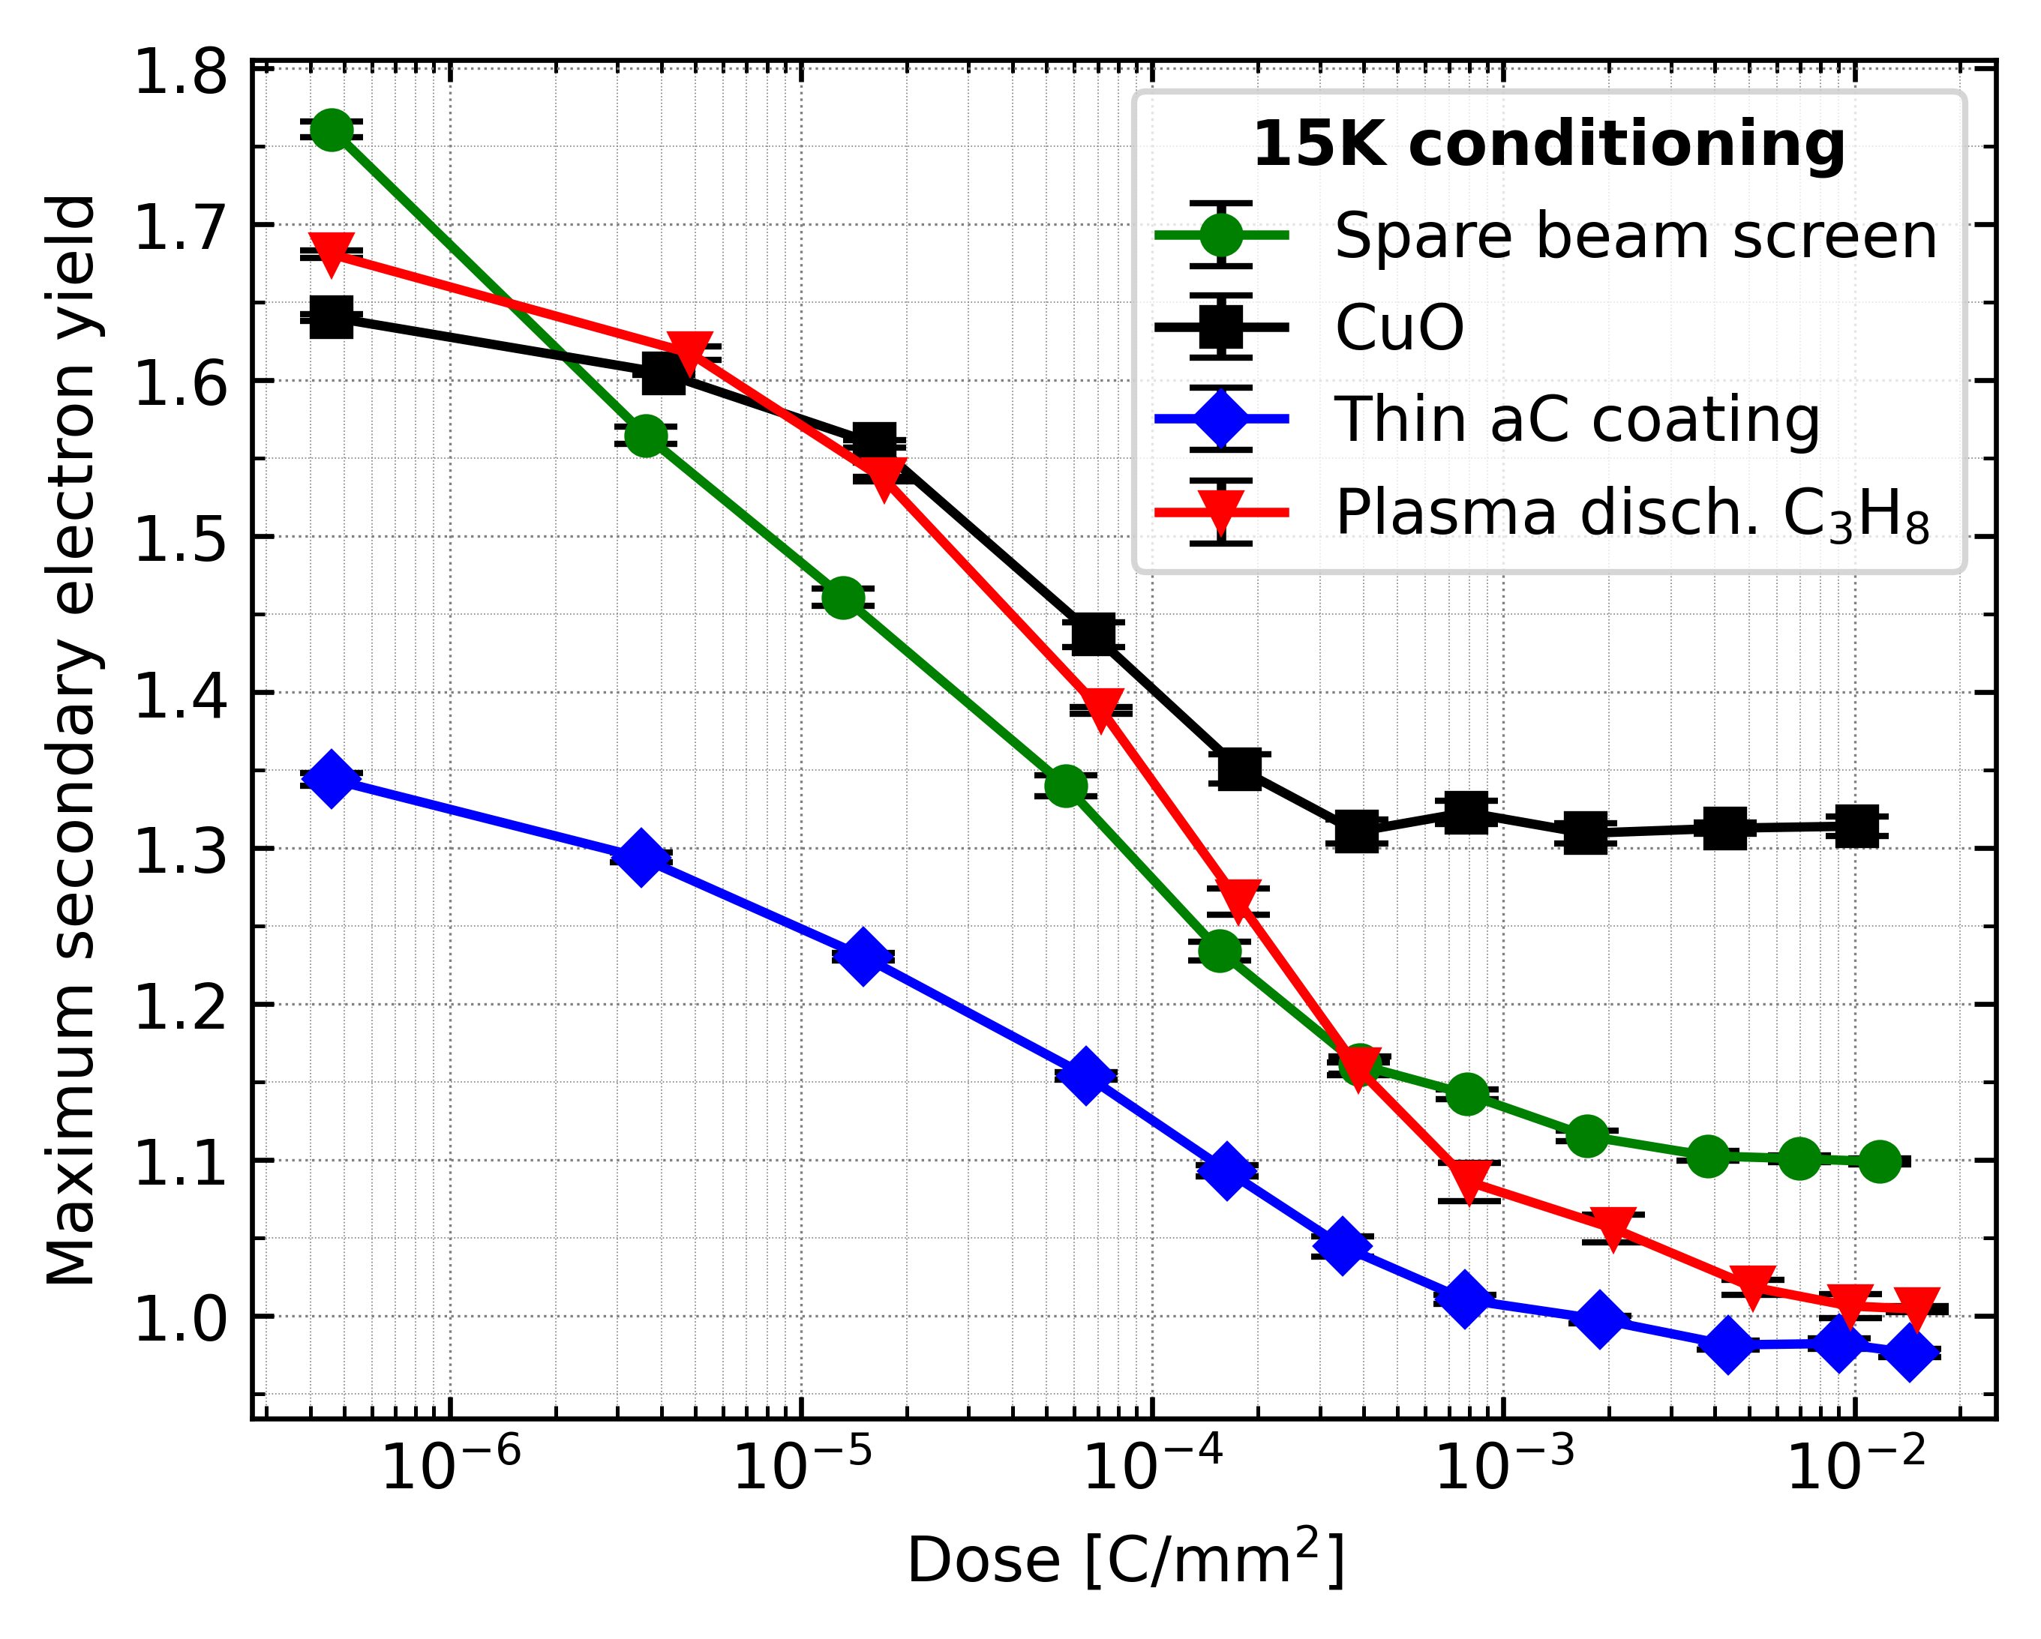
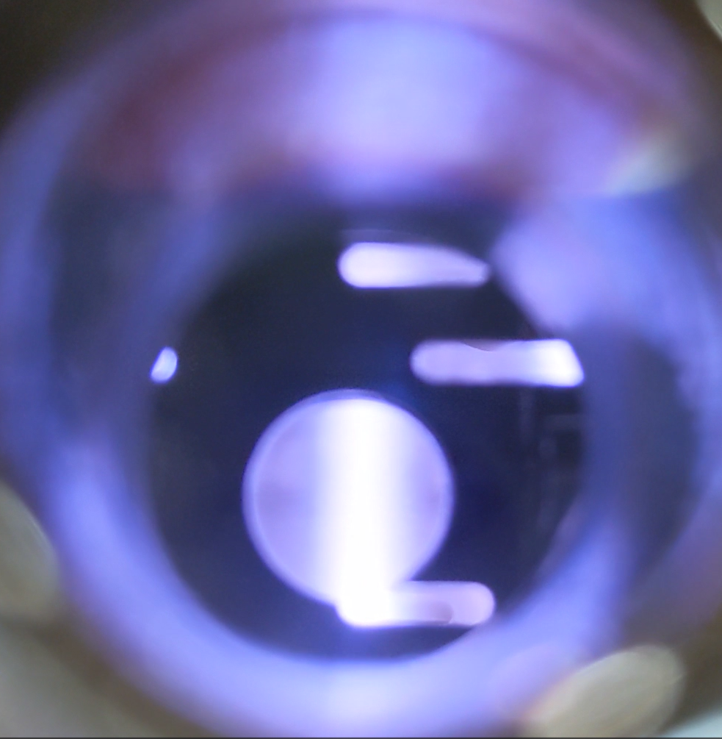
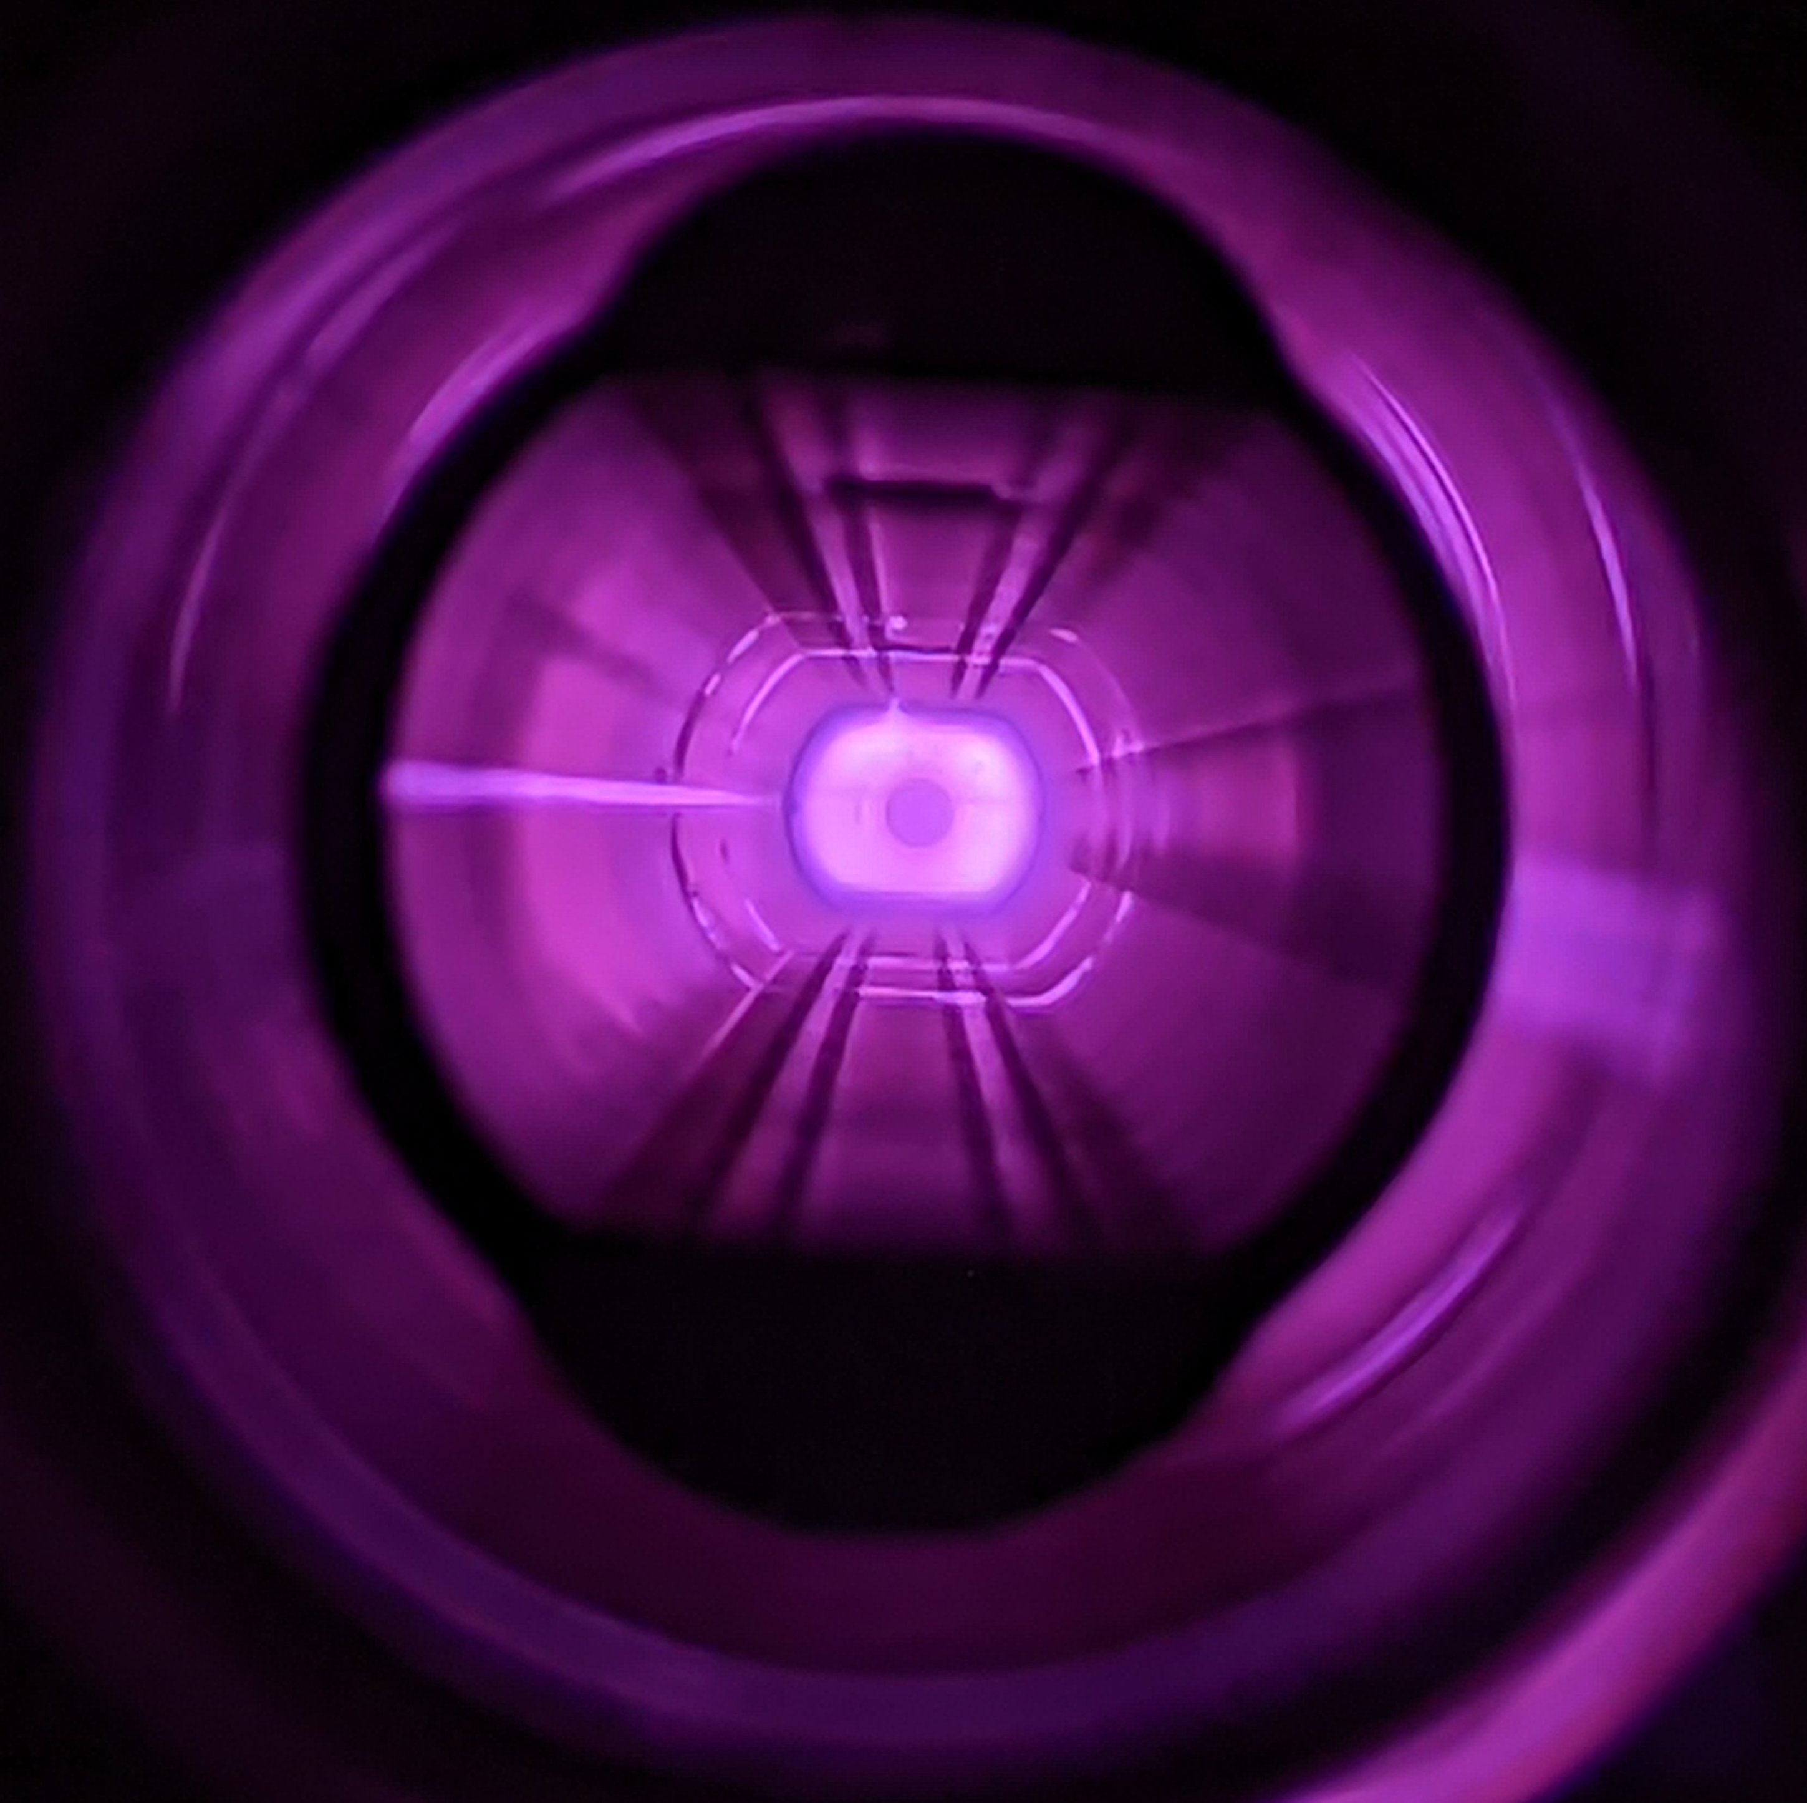
Phase 1 - Activities
Thin a-C coating vs Plasma discharge in C_{x}H_{y}
Samples qualification
  SEY quantification on samples
  Photo-Electron Yield quantification on samples
  Ageing (multiple 15K conditioning + Air exposure cycles)
  Adhesion
  Electron Stimulated Desorption
PVD discharge
PE-CVD discharge
V. Petit

Slide 30
Summary remarks
LIU targets achieved in injectors!
LHC in Run 3 has demonstrated
    Excellent luminosity performance – both peak and integrated
    Good availability over sustained periods of time
    Impressive flexibility and sophisticated operational and system level control
However, 2023 has been a difficult year with poor availability
    Pushing performance in an aging machine? Non-conformities? Might worry that it’s systematic…
Reactivity has been fantastic as always, IT.L8 widely seen as a remarkable collaborative recovery
Triplet longevity and electron cloud remain key issues going forward…
THANKS!

