Slide 1



Status of US AUP Contribution
Giorgio Apollinari – FNAL
HL-LHC AUP Project Manager
13th HL-LHC Collaboration Meeting
Vancouver, Canada - September 2023

Slide 2
Outline
Introduction
Project Overview
Overview of AUP Status
Summary

Slide 3
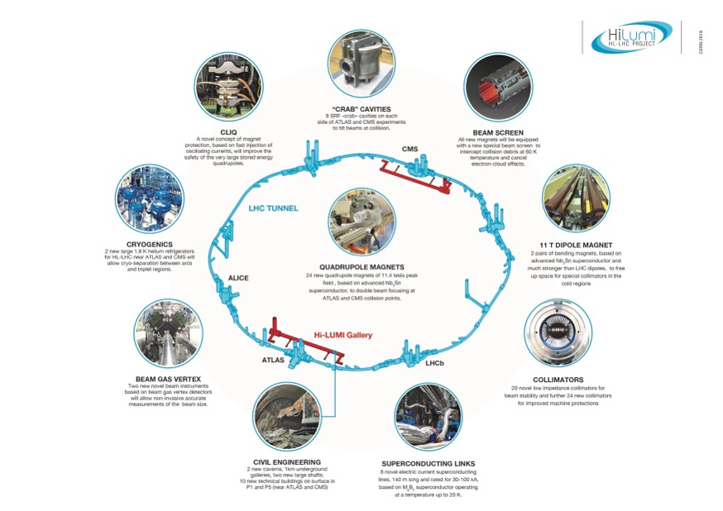

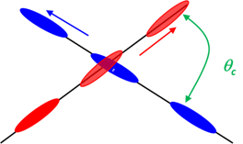
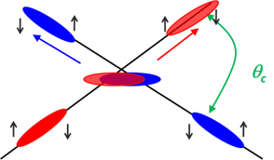
US Contribution to HL-LHC
HL-LHC AUP
Quad
Magnets
Beam size
Crab
Cavities
From HL-LHC Project Leader
O. Bruning - CERN
HL-LHC: from 300 fb⁻¹ to 3000/4000 fb⁻¹
LARP (DOE supported R&D Program) established the necessary technology for the HL-LHC Focusing Magnets and Crab Cavities
DOE baselined HL-LHC AUP Project in 2019 (FNAL, BNL, LBNL with contributions from ANL, SLAC, JLAB, ODU & FSU)
DOE re-baseline AUP in 2023 to absorb COVID impacts on Cost and Schedule
Notes:
Overall goal

Slide 4


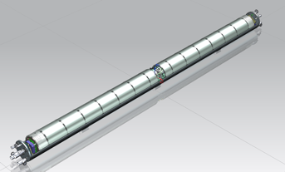
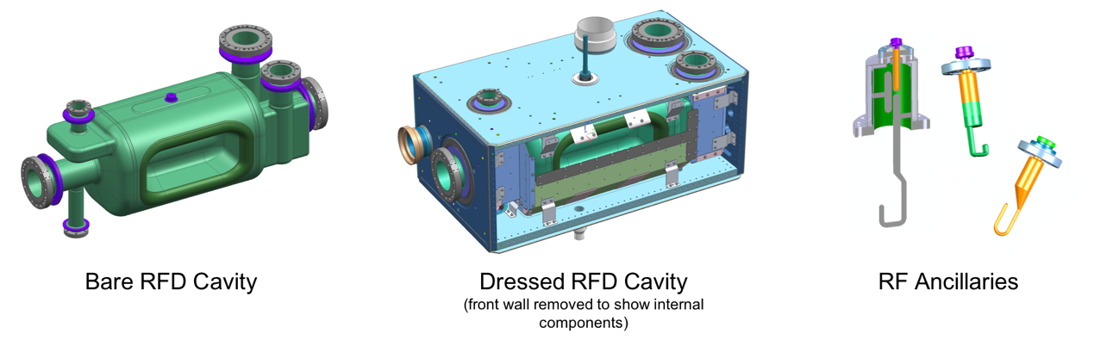
HL-LHC AUP Deliverable Scope
Technical Details
Q1/Q3 Cryoassembly
(10 CryoAssemblies with 20 Magnets)
Dressed RFD Cavity
(10 Dressed Cavities & Ancillaries)
MQXFA
Magnet
302.2
Cold Mass
Assembly
302.4
Cryo-Assembly
302.3
High Order Mode
Antennas

Slide 5
AUP Q1/Q3 and RFD Cavities KPPs
Parameters | Threshold Performance | Objective Performance
Inner Triplet Focusing Quadrupoles (Q1 and Q3) | a) 6 Q1/Q3 Cryoassemblies are accepted by CERN after testing at HL-LHC agreed upon Acceptance Criteria for the Cryoassembly. The Cryoassemblies will be assembled from Cold Masses built by HL-LHC AUP and Cryostat kits provided by CERN. b) 3 Q1/Q3 Cold Masses built with magnets tested vertically at HL-LHC agreed-upon Acceptance Criteria c) Complete coils and remaining components for 1 additional Q1/Q3 Cold Mass | 4 additional Q1/Q3 Cryoassemblies are accepted by CERN after testing at HL-LHC agreed-upon Acceptance Criteria for the Cryoassembly. The Cryoassembly will be assembled from Cold Masses built by HL-LHC AUP and Cryostat kits provided by CERN
SRF Crab Cavities | a) 8 Radio Frequency Dipoles (RFDs) Dressed cavities for the HL-LHC Crab Cavity System are accepted by CERN after being tested at HL-LHC nominal temperature, nominal frequency, and ultimate cavity voltage. Dressed cavities include HOM couplers, pick-ups, He Vessel and magnetic shields. b) Procurement of components for 2 additional RFD Dressed Cavities | 2 additional Radio Frequency Dipoles (RFDs) Dressed cavities for the HL-LHC Crab Cavity System are accepted by CERN after being tested at HL-LHC nominal temperature, nominal frequency, and ultimate cavity voltage. Dressed cavities include HOM couplers, pick-ups, He Vessel and magnetic shields.
10 Q1/Q3 Cryoassemblies
(8 Operations + 2 Hot Spares)
10 RFD Dressed Cavities
(8 Operations + 2 Hot Spares)
HL-LHC AUP Project includes Objective KPPs

Slide 6

Progress since last CM on Magnets
G. Ambrosio in Plenary +
6 AUP Talks in WP3
LBNL Cable Factory ~completed Production
  2 more cables recently added to absorb Coils yield impact
FNAL and BNL Factories at end of Production (~2-3 coils left)
MQXFA11 assembled and tested
  Successfully passed BNL Vertical Test
MQXFA08b (COVID impact) had coil replaced
  Successfully passed BNL Vertical Test
  First demonstration of Coil replacement in long (4.2m) production magnet
MQXFA13 assembled and tested
  Failed BNL Vertical Test on ramp-rates NC, probably due to insufficient azimuthal pre-load on Magnet ends
  Plan to replace limiting coil.
MQXFA14b assembled and tested
  MQXFA14 failed on QH Hipot during Fabrication. Coil Replaced. Also benefited from lesson learned in MQXFA13 with increase in pre-stress
  Fastest training to date among AUP magnets.
MQXFA15, MQXFA16 and MQXFA17 in various states of completion
  MQXFA07b to be tested next in Nov. ‘23, after BNL cryo system maintenance

Slide 7
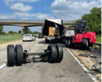
Magnets Assembly & Test History
MQXFA03 | VTS Tested OK
MQXFA04 | VTS Tested OK
MQXFA05 | VTS Tested OK
MQXFA06 | VTS Tested OK
MQXFA07 | VTS COVID Limitations, coil replaced | MQXFA07b | TBT₁
MQXFA08 | VTS COVID Limitations, coil replaced | MQXFA08b | VTS Tested OK
MQXFA09 | Assembly NCR (2 coils affected by folded Kapton) | Cannibalized | 2 coils rejected 2 coils used in 14b and 5, structure used in 11
MQXFA10 | VTS Tested OK
MQXFA11 | VTS Tested OK
MQXFA12 | Assembly NCR (Hipot fail) coils to be replaced | MQXFA12b | TBT₄
MQXFA13 | VTS Limitations (end prestress), coil replaced | MQXFA13b | TBT₃
MQXFA14 | Assembly NCR (QH hipot fail), coil replaced | MQXFA14b | VTS Tested OK
MQXFA15 | TBT₂
LQXFA/B-01
LQXFA/B-02
LQXFA/B-03
LQXFA/B-04

Slide 8
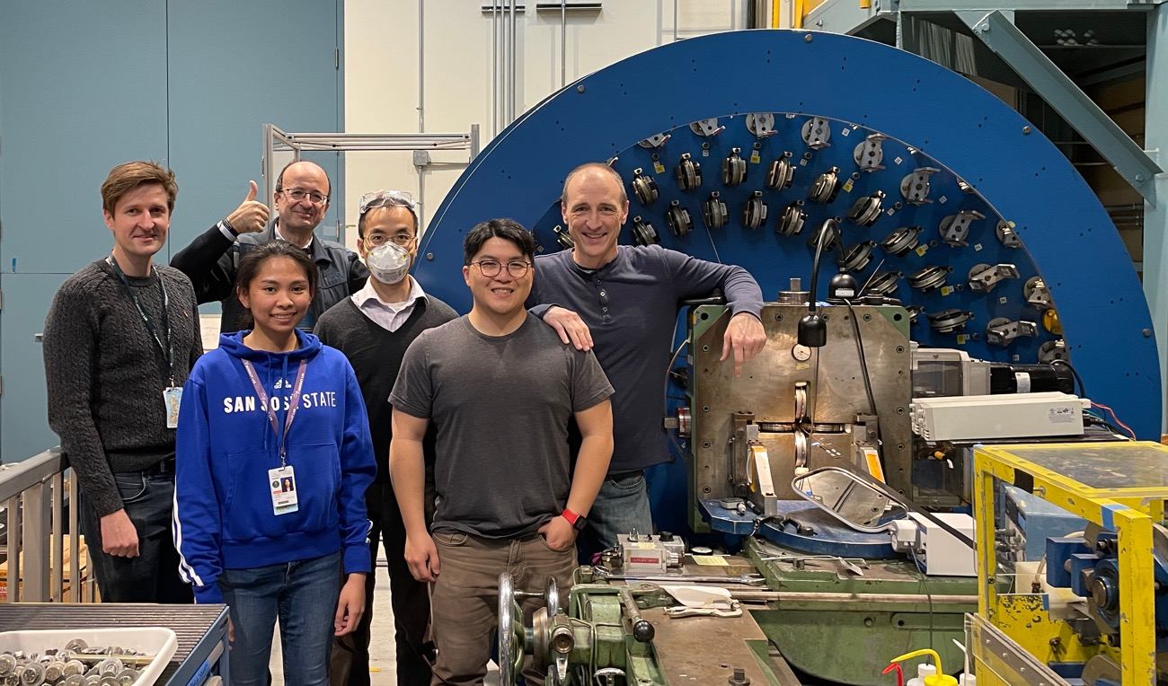
Celebrations for Last Cable Completed @ LBNL
https://newscenter.lbl.gov/2023/08/30/cabling-for-lhc-upgrade-wraps-up/

Slide 9
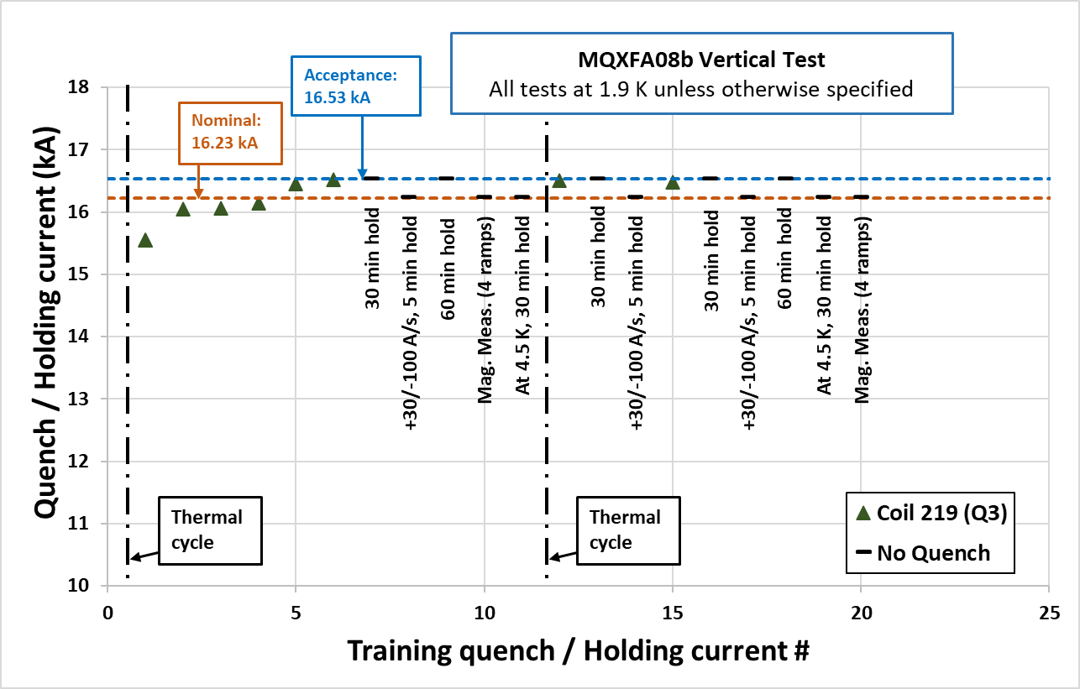
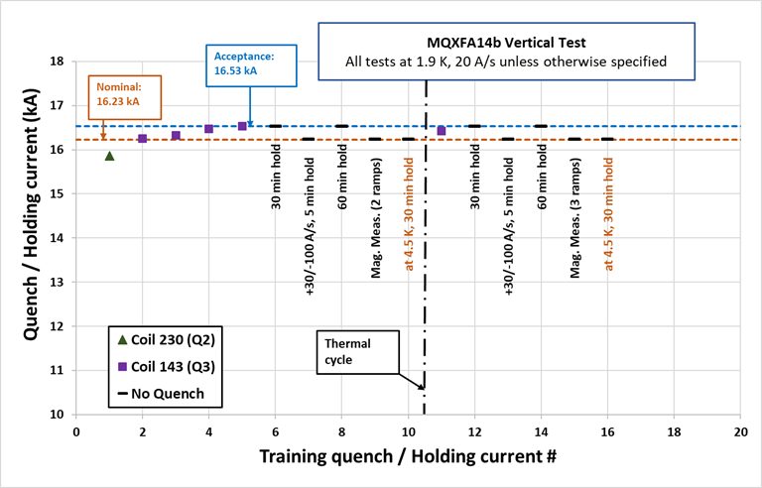
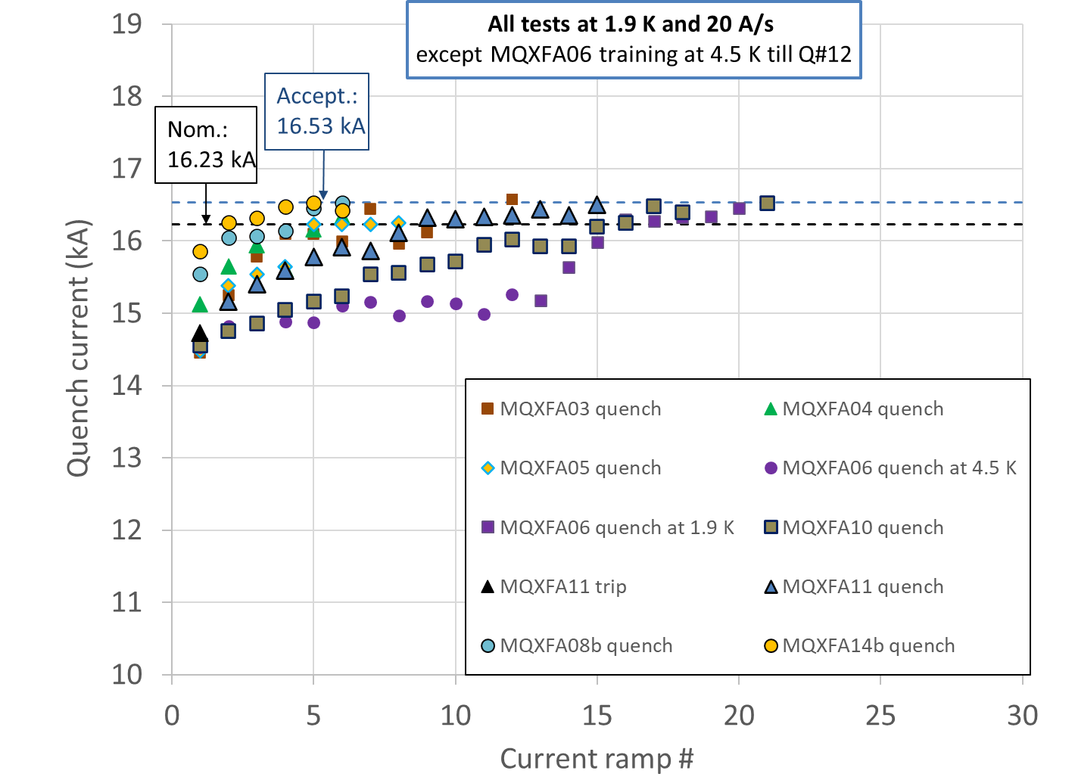

MQXFA08b and MQXFA14b
Approximately 60% MQXFA Magnets Produced
40% MQXFAs Magnets (8/20) Accepted for CM/CA
8 MQXFAs

Slide 10
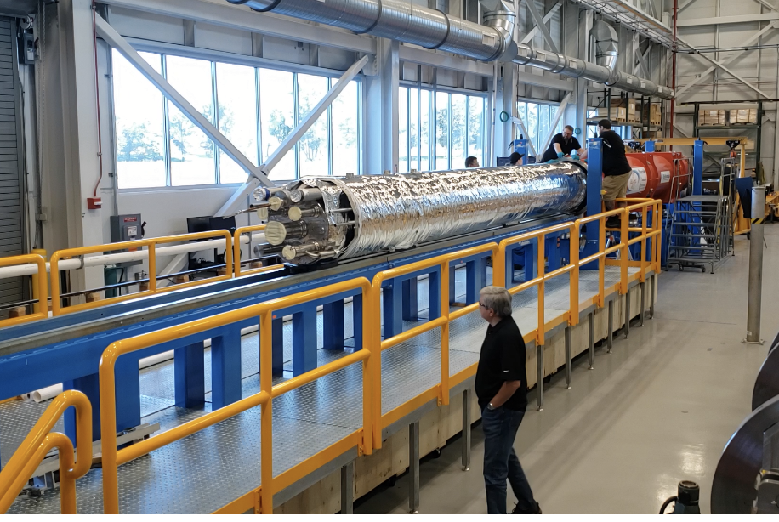
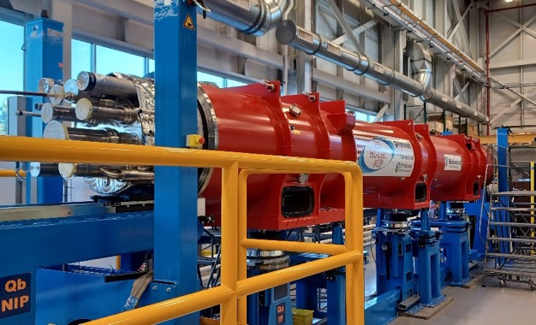
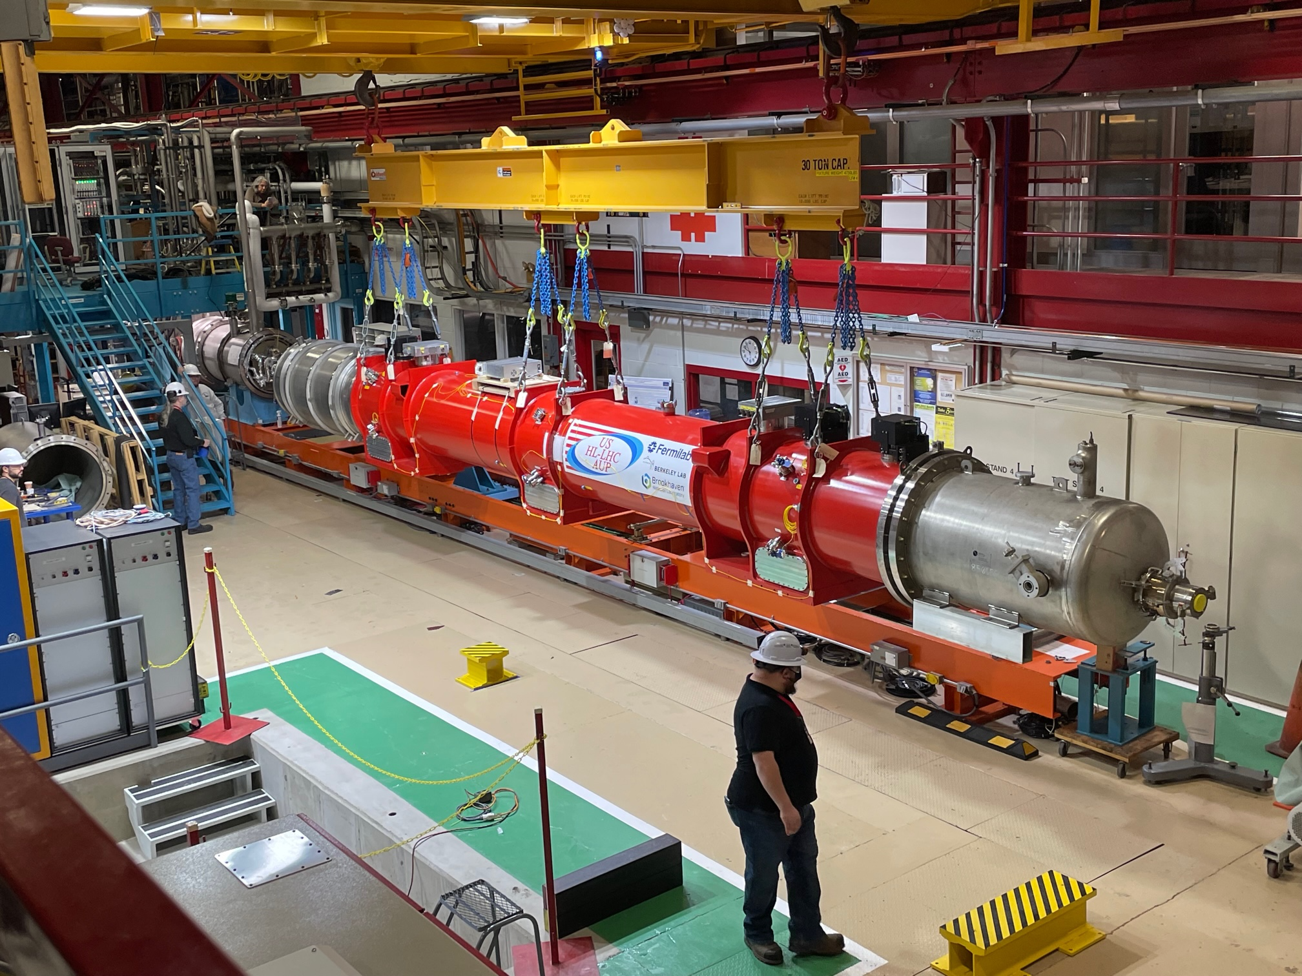
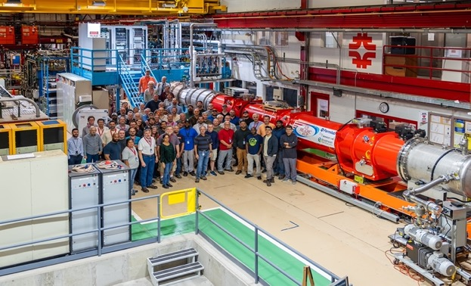
LQXFA/B-01 Progress & Achievements
Insertion in Cryostat (shown at Uppsala)
Installation in FNAL TS4 (Jan-Feb ‘23)
Test Completion/Warm-up Start (Aug. ‘23)

Slide 11
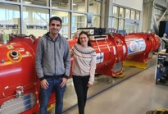
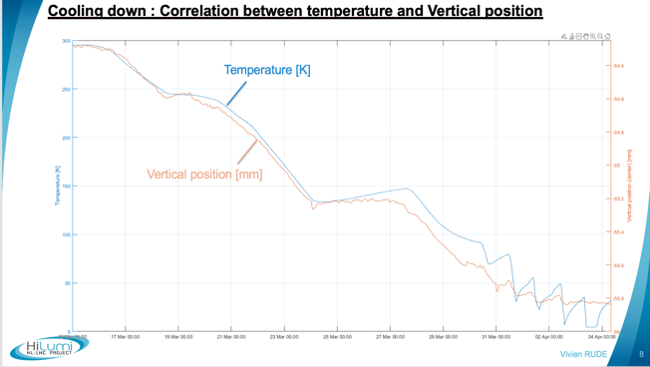
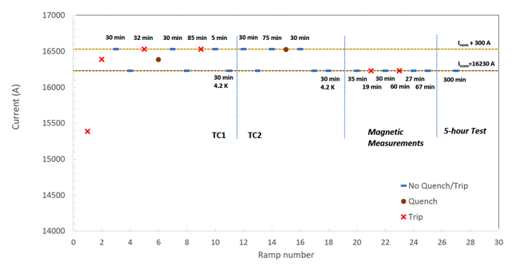
LQXFA/B-01 Progress & Achievements (cont.)
Validated Cold Mass design
  Magnet alignment, quench performance, pressure test, etc.
Validated Cryostat Design and FSI (CERN)
  1.9K, 80K, heat loss, etc.
Re-validated Magnet performance
  Nominal and Acceptance, 1.9K and 4.2K, 5h test, ramp rates, field measurements, etc.
from V. Rude, 5/10/2023
from G. Chlachidze, 9/8/2023

Slide 12
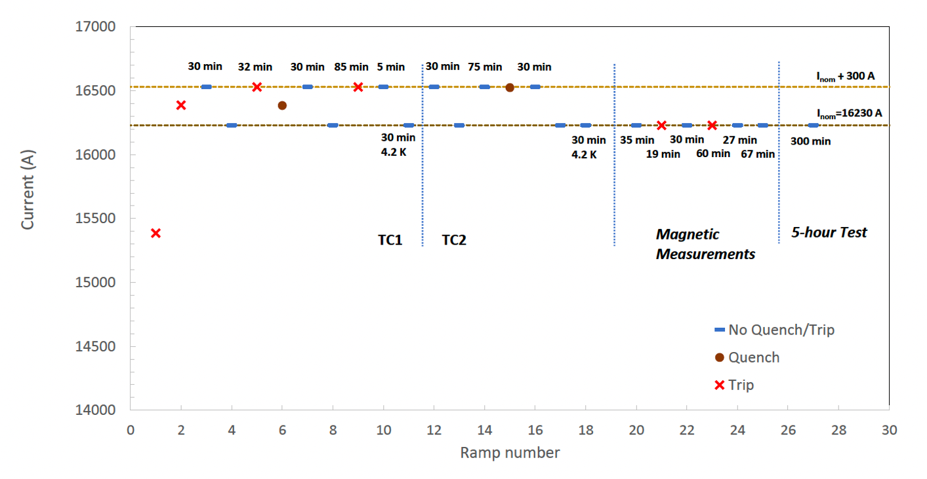
LQXFA/B-01 Horizontal Test

Slide 13
LQXFA/B-01 Path to Acceptance by CERN
2 major type of NCRs in LQXFA01
  Welded by ASME Code in Jan. 2022
    No formal and timely (i.e. before weld execution) approval by CERN for WPS/PQR according to “Safety Agreement”
    For LQXFA/B-01 used the same welding rod, WPS/PQR and volumetric inspection eventually approved by CERN in April 2023.
  2 missing QH in one of the magnets (2 out of 16)
    Lack of redundancy in QP if installed in the tunnel
Mutual suggestion for Acceptance of LQXFA/B-01 + 1 additional vertically tested MQXFA Magnet (+ misc.) for potential swap of magnet at CERN at a later date if necessary.
  Important for US to be a reliable partner to support the CERN String Test schedule. In addition, timely experience on Integration and Shipments to CERN is critical.
  Letter from AUP PO to HiLumi Leader with response starting the clock.

Slide 14
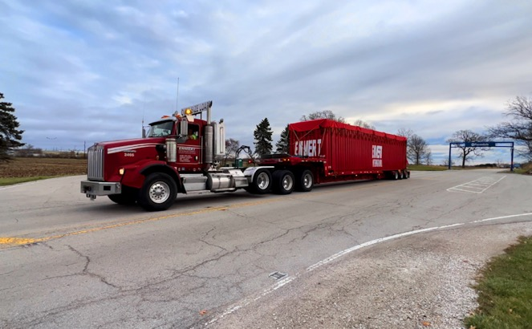
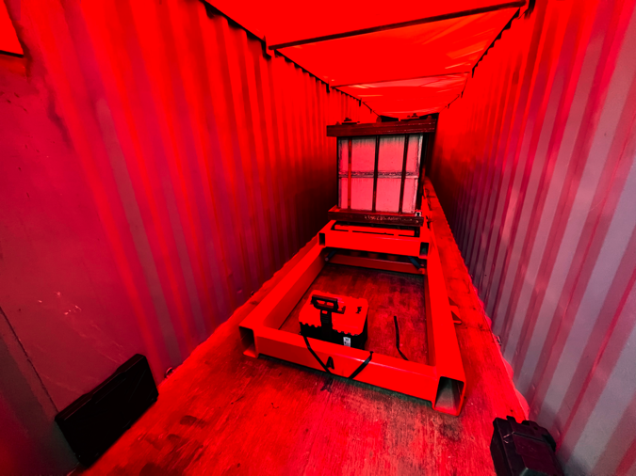
Q1/Q3 Transportation Readiness Review
LQXFA/B-01 Delivery to CERN
Review of testing results from local road testing and full-scale dummy load test shipment to CERN
  Included discussion of previously-reviewed shipping matters for a thorough examination of the transportation process.
Results show the transportation frame performed nominally, attenuating expected shipping loads to acceptable levels.
With one minor process recommendation, the committee endorsed proceeding with the first Q1/Q3 shipment.
Ship for LQXFA/B-01 reserved for Nov. 5th 2023 anticipating LQXFA/B-01 convergence on acceptance path by late September
Dummy Load Test Shipment Leaving FNAL – 11 November 2022
Dummy Load Test Shipment at CERN – 14 December 2022

Slide 15
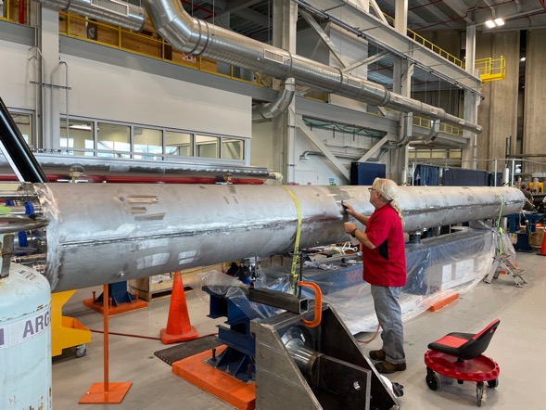
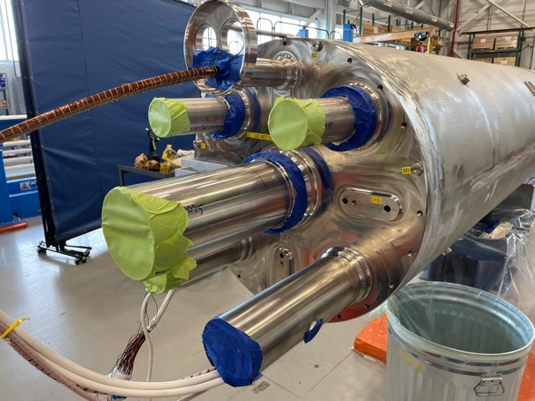
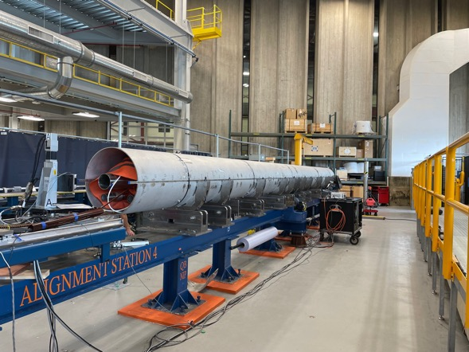
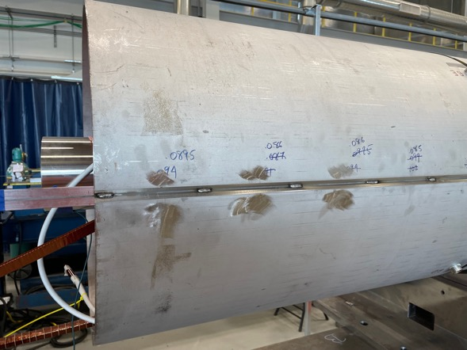
CM02 and CM03
CM02 ready for PAUT (Sep. ‘23)
CM02 End Plate (Sep. ‘23)
CM03 ready for Long. Welds (Sep. ‘23)
CM03 Tack Welds (Sep. ‘23)

Slide 16
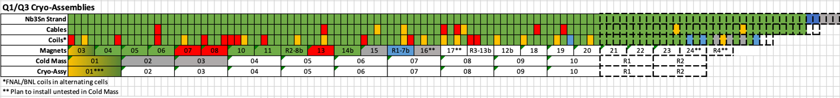
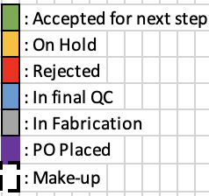
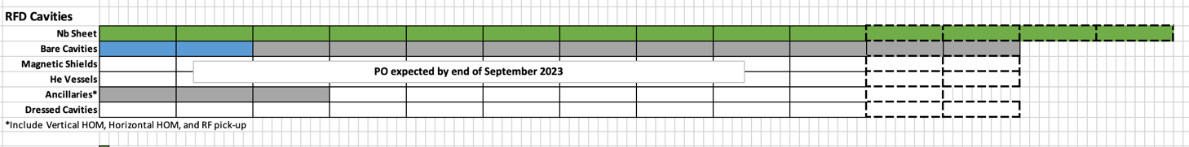
Production Dashboard
from R. Carcagno
“Basic” deliverables
80 coils, 20 magnets, etc.
Technical Production Details in WPs presentations

Slide 17
Progress since last CM on RFD Crab Cavities
L. Ristori in Plenary +
3 AUP Talks in WP4
Demonstrated RFD HOMs at JLAB
Completed receipt of all Nb Raw Material at ZANON
2 Pre-series at ZANON in final phases
  Unable to polish a small damage on beampipe flange. Will need complex re-machining process with estimated delay of 1-2 months.
Documentation under control
Placed order for 10 Series Cavities, production at peak with majority of components formed.
1st Prototype Cavities at ZANON for He Vessel installation
  2nd Prototype at FNAL (for validation of ZANON processing) might require additional HPR.
Cracked ceramic window at CERN in leak test preparation
Order for He Vessels expected to be placed by the end of September ‘23

Slide 18
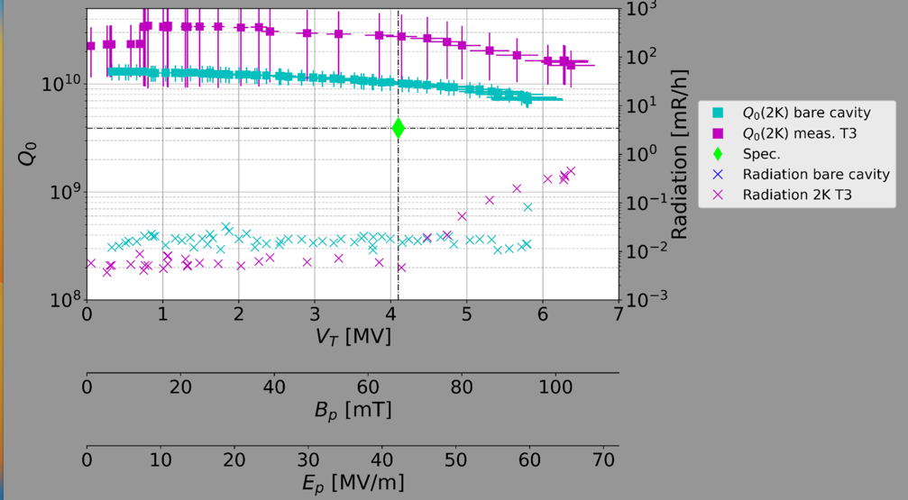
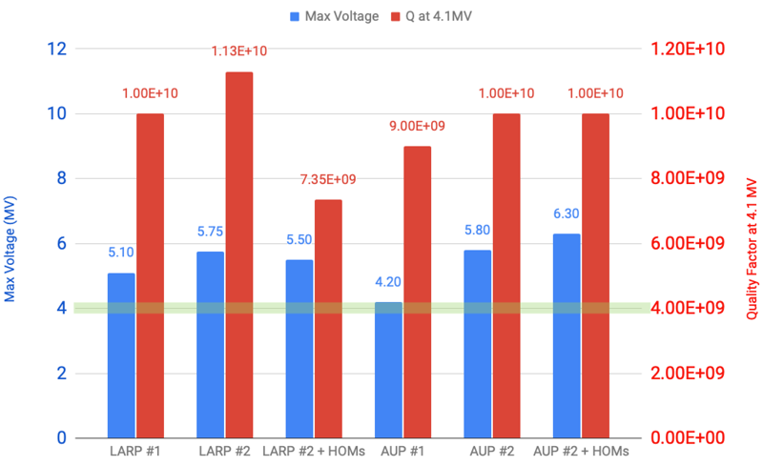
NRFD002+HOMs 3rd Test Summary
14th – 18th Aug. ‘23

Slide 19
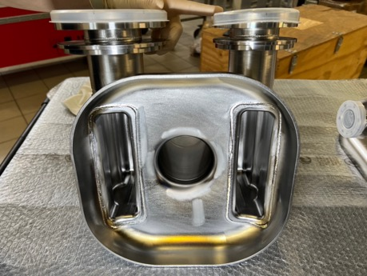
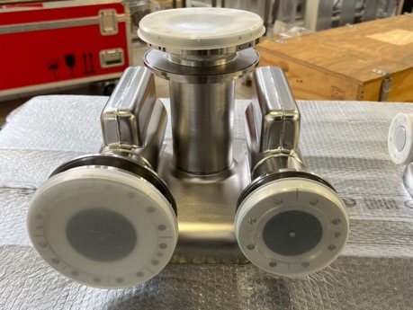
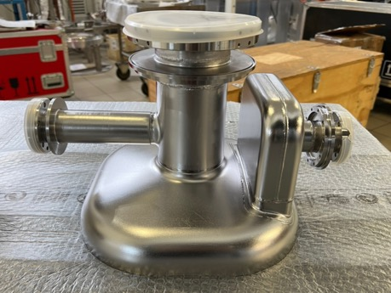
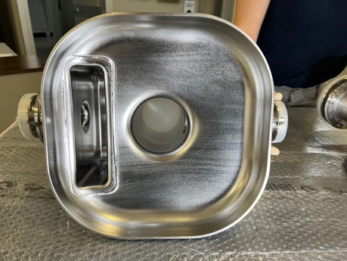
Pre-Series RFD Cavities
NRFD01: Reshaping and trim-tuning completed successfully, needs re-machining prior to EBW.
NRFD02: Reshaping complete, undergoing trim-tuning.

Slide 20
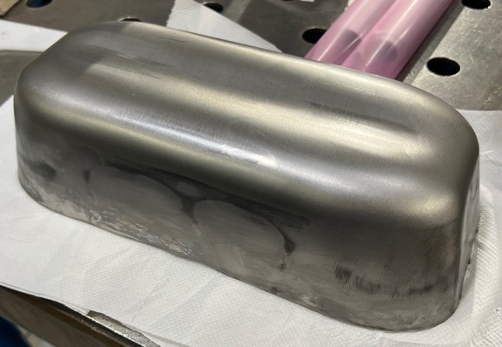
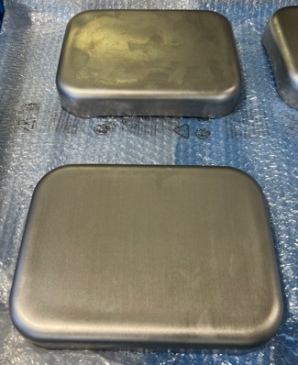
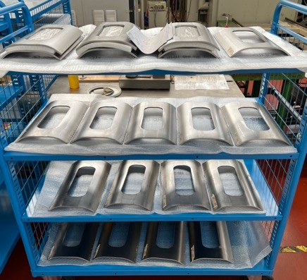
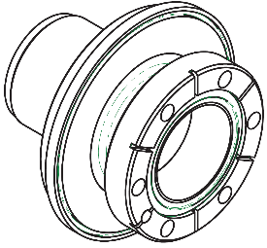
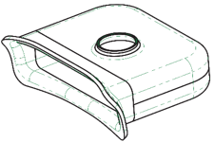
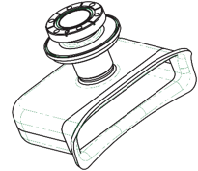
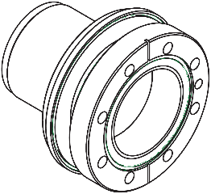
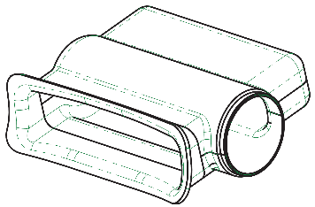
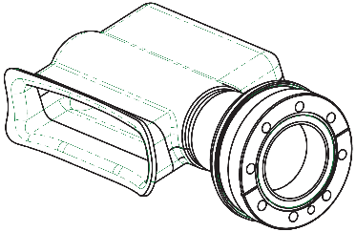
Series RFD Cavities
Series RFD Bare Cavity @ ZRI
  Processing procedures approved by CERN
ZRI QCP/ MIP global advancement: 11% completed

Slide 21
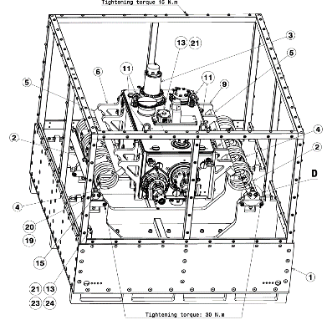
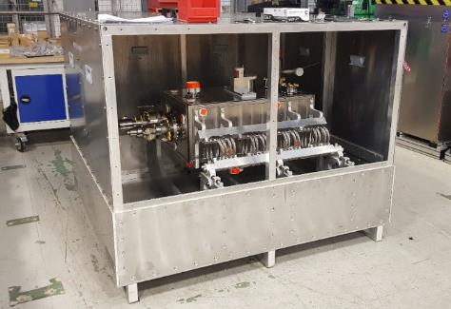
RFD Pre-series QA: EDMS Status
Manufacturing Drawings RFD Bare Cavities | EDMS 2080712 | Released
Test Plan PQR | EDMS 2479595 | Released
Welding Book | EDMS 2397280 | Released
Manufacturing and Inspection Plan | EDMS 2069490 | Released
Cleaning & Etching Procedure | EDMS 2069492 | Released
Identification, Marking and Traceability Procedure | EDMS 2069496 | Released
Procedure of Radiographic Examination of Welds | EDMS 2069497 | Released
Leak Test Procedure | EDMS 2080831 | Released
Dimensional Control Procedure | EDMS 2080834 | Released
Visual Testing | EDMS 2100569 | Released
Grinding Procedure | EDMS 2630567 | Released
RF measurements & Trimming | EDMS 2080833 | Released
Packing Procedure | EDMS 2642947 | Ongoing review (ZRI)
  Pre-Series Production Procedures fully approved by CERN

Slide 22
Rebaseline Process
DOE has acknowledged that the impact of unexpected events such as COVID and Abnormal Cost/Escalations due to geopolitical events are placing AUP in jeopardy of not completing its KPPs and has allowed AUP to “apply for rebaseline” in late 2022
A “Rebaseline Process” was initiated with funding agency (DOE) with the following goals:
  Maintain Objective Deliverables to CERN as approved in 2019 (10 Q1/Q3 CA, 10 Dressed RFD Cavities)
  Modify TPC and CD-4 dates:
    2019 Baseline TPC_{CD2}= $242.7M CD4_{CD2}= Mar. ‘28
    2023 Re-Baseline TPC_{Reb}= $266.0M CD4_{Reb}= Dec. ’29
  Rebaseline Reviews and Approval:
    DOE Review in Dec. 13th-15th ’22 (thanks to Oliver for help !)
    ESAAB approval in February 2023.

Slide 23
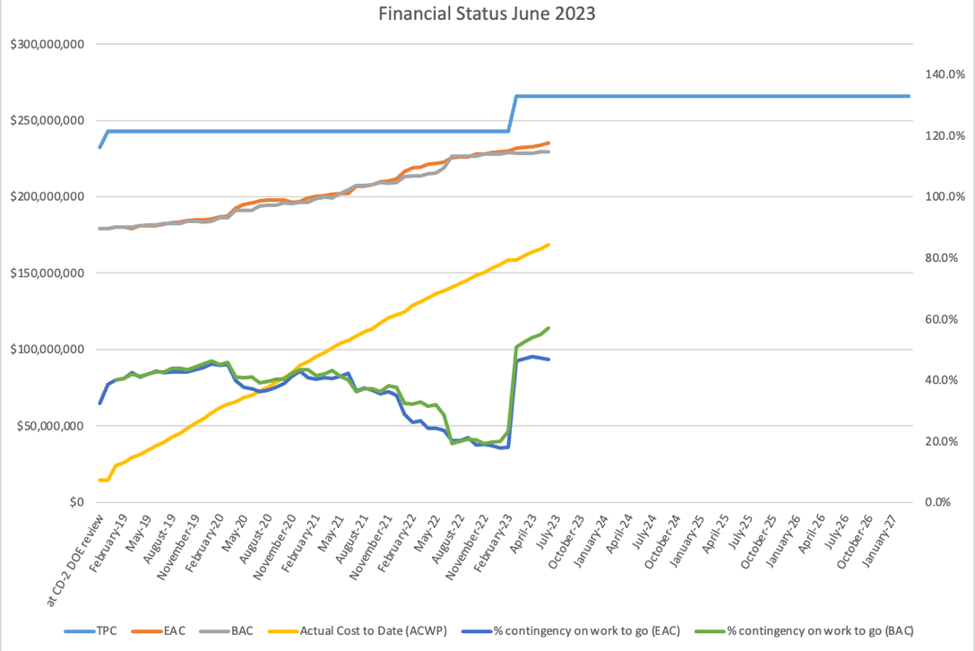
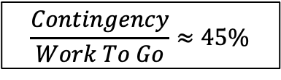
Financial Situation (Past)
DOE has disbursed $266M to the US-AUP (fully funded)
CPI_{Jun ‘23}=1.00
SPI_{Jun ’23}=0.99
Contingency
Work To Go
Estimate at Completion
$$\frac{Contingency}{Work To Go}≈45\%$$
Actual Cost
AUP is in the “last leg of the race” (~3/4 complete)

Slide 24
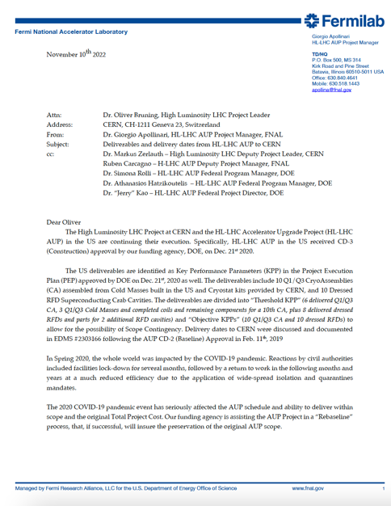
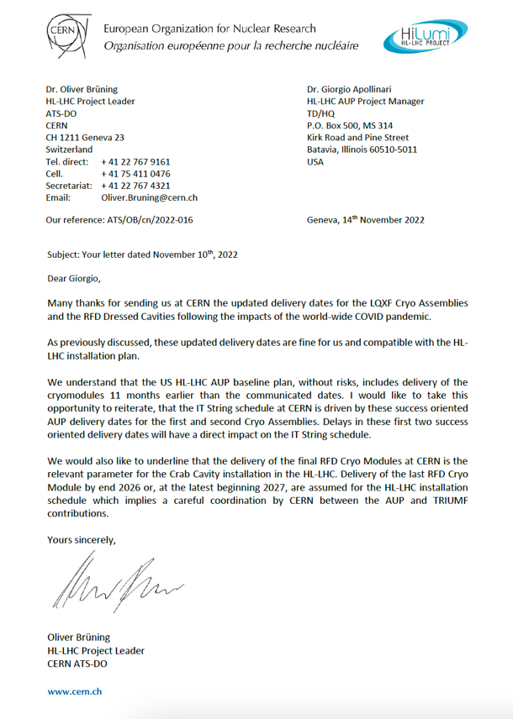
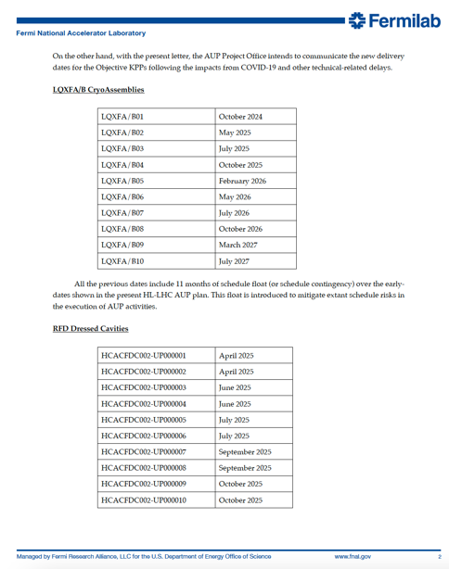
Delivery Dates to CERN
Delivery dates agreed with CERN

Slide 25
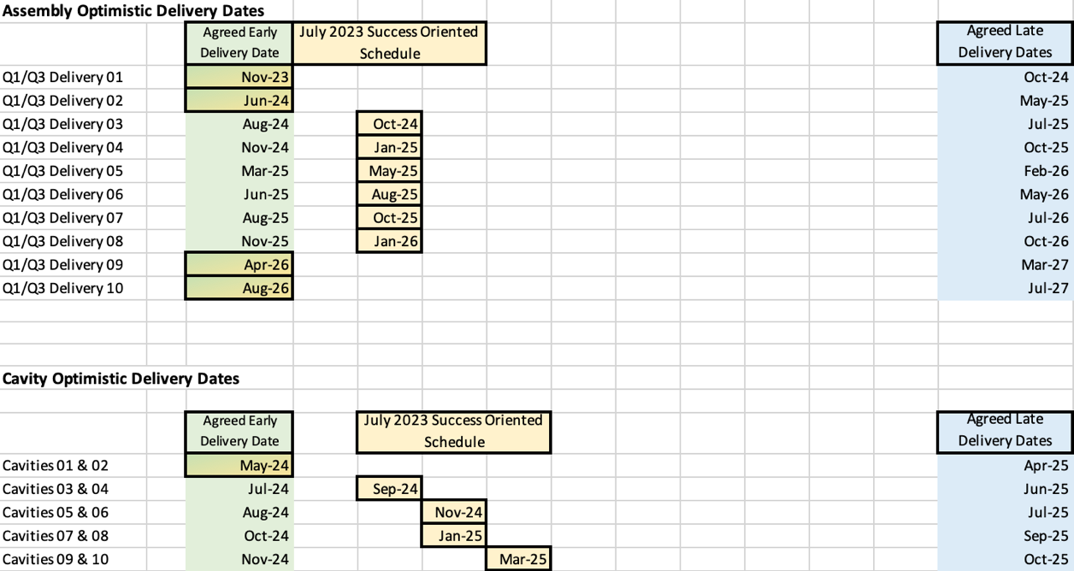

Delivery Dates to CERN
1 cell = 1 month
Success Oriented Schedule provided to CERN WPs as input for upcoming C&S Review

Slide 26
Conclusions
AUP is ~3/4 complete
Steady progress on MQXFA Construction
  8 magnets passed vertical test, one more ready for test now.
LQXFA/B-01 Horizontal Test successfully completed, cryomodule soon to be on its way to CERN.
RFD Crab Cavities series order placed.
  Pre-production cavities in final assembly completion.
  Order for He Vessel soon to be placed
Succesfull approval of AUP Rebaseline due to COVID/Abnormal Escalation impact with ~10% increase in funding

