Slide 1





Status of interaction region magnets (WP3) with focus on MQXFB
E. Todesco, S. Izquierdo Bermudez, D. Duarte Ramos,
G. Ambrosio, S. Feher, T. Nakamoto, Q. Xu, F. Toral, S. Farinon, M. Statera
A. Foussat, J.-C. Perez, E. Gautheron, A. Devred, et al,
13th HL-LHC Collaboration Meeting, 25 September 2023

Slide 2
List of contributors (from East to West)
KEK: T. Nakamoto, M. Sugano, K. Suzuki, N. Kimura et al.
IHEP: Q. Xu, Y. Wang, D. Ni, W. Wu, L. Li, Q. Peng, et al.
INFN-LASA: M. Statera, M. Sorbi, M. Prioli, S. Mariotto, et al.
INFN-Genova: S. Farinon, B. Caiffi, A. Bersani, R. Cereseto, et al.
CERN: S. Izquierdo Bermudez, E. Gautheron, G. Kirby, A. Foussat, J. Carlos Perez, F. Rodriguez Mateos, N. Lusa, E. Ravaioli, M. Bednarek, P. Quassolo, F. Mangiarotti, M. Bajko, A. Devred, G .Willering, S. Ferradas Troitino, H. Prin, A Milanese, R. Principe, A. Ballarino, B. Bordini, J. Fleiter, F. Savary, D. Duarte Ramos, Y. Leclercq, M. Struik, L. Fiscarelli, S. Russenschuck, C. Petrone, P. Fessia, S. Riebe, H. Garcia Gavela, G. Vandoni, L. Quain Solis, A. Dallocchio, D. Perini, P. Moyret, S. Sgobba, A. Moros, M. Crouvizier, M. Guinchard and its team, et al.
CIEMAT: F. Toral, C. Martins Jardim, J. Garcia Matos, et al.
AUP: G. Ambrosio, S. Feher, R. Carcagno, G. Apollinari, B. Ahia, P. Joshi, K. Amm, M. Yu, A. Nobrega, J. Schmalzle, M. Anarella, A Vouris, G. Chlachidze, S. Stoynev, R. Bossert, M. Baldini, P. Ferracin, D. Cheng, S. Prestemon, G. L. Sabbi, L. Cooley, V. Lombardo et al.,

Slide 3
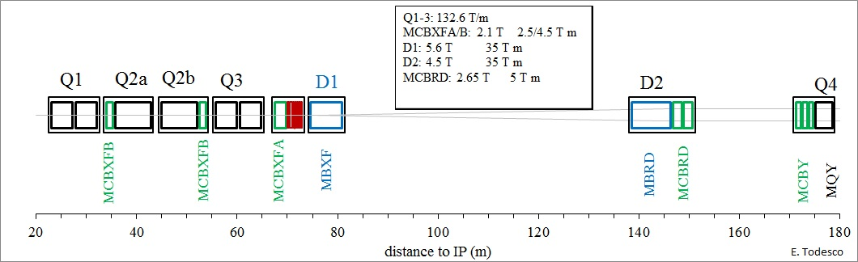
Interaction region magnets
MQXF: Nb₃Sn quadrupole (24 magnets to install)
D1: Nb-Ti separation dipole (4 magnets to install)
D2: Nb-Ti recombination dipole (4 magnets to install)
MCBXFA/B: Nb-Ti nested correctors (12 magnets to install)
MCBRD: Nb-Ti CCT correctors (8 magnets to install)
High order correctors: Nb-Ti superferric correctors (36 magnets to install)

Slide 4
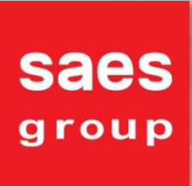
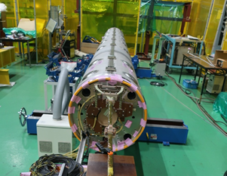
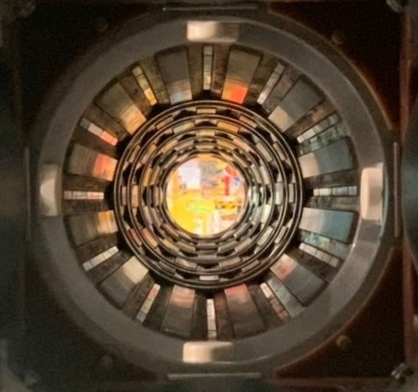
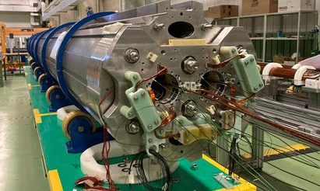


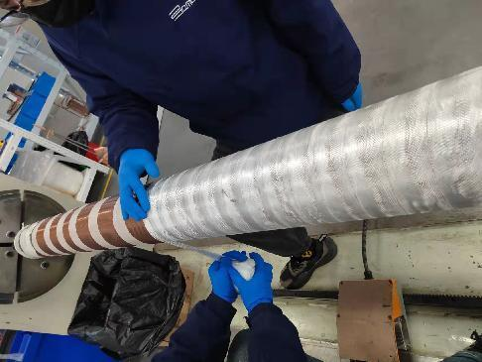
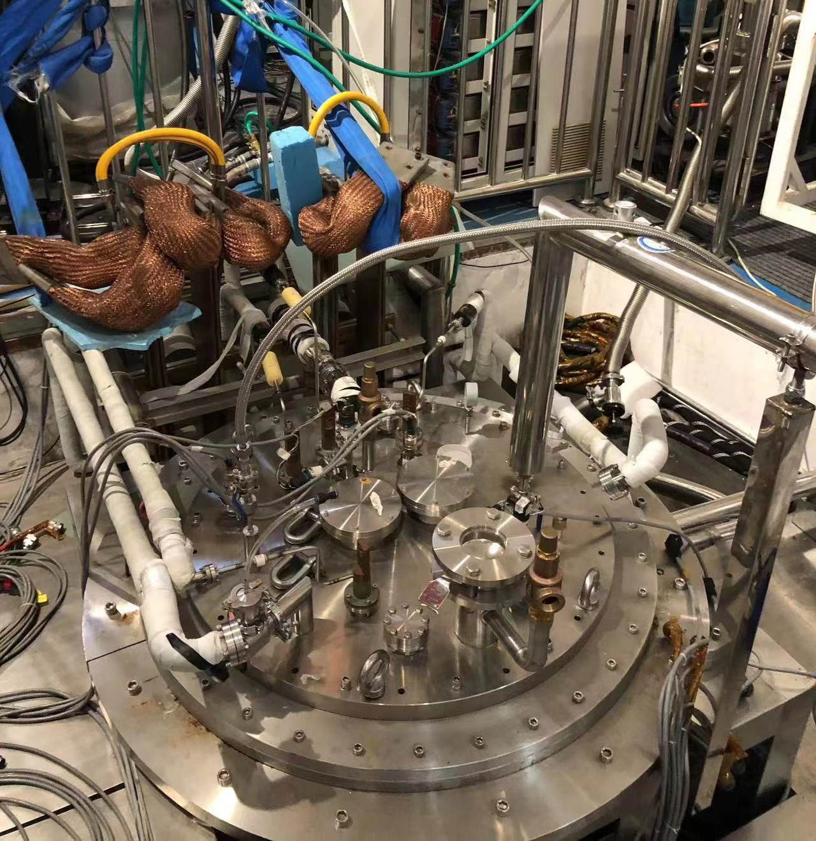
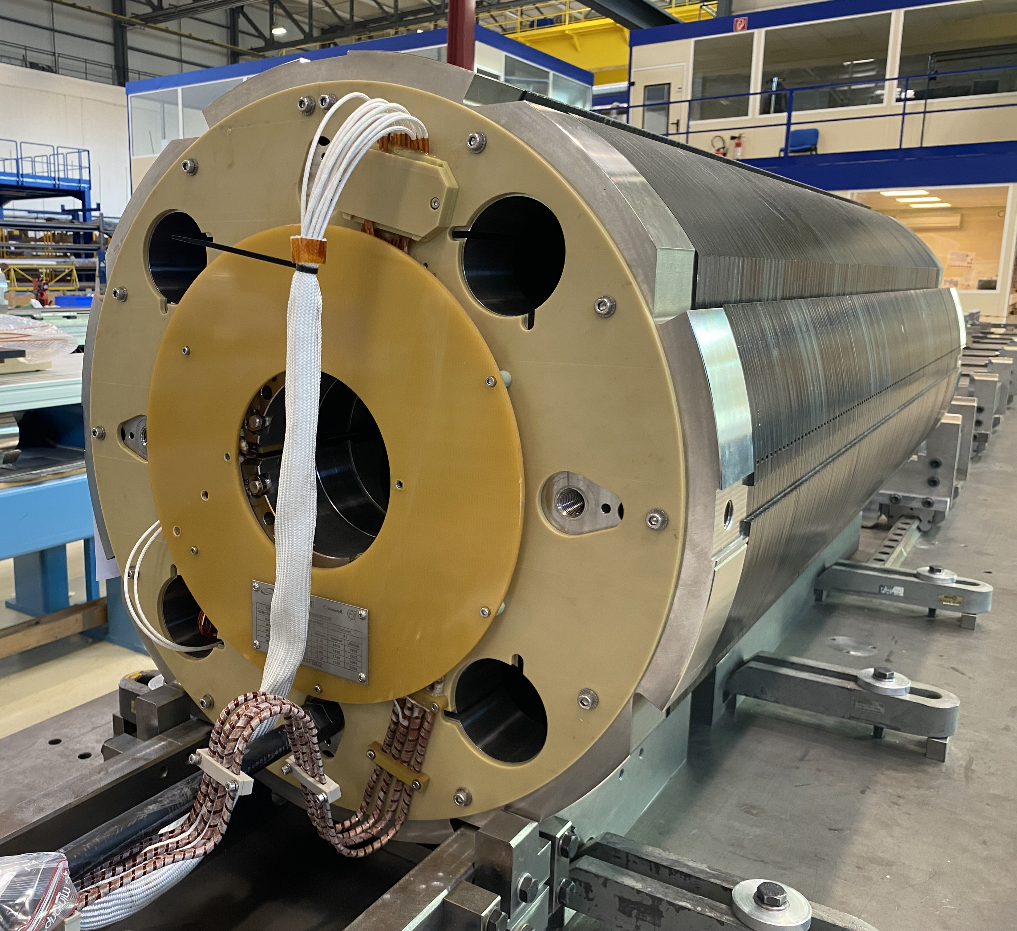




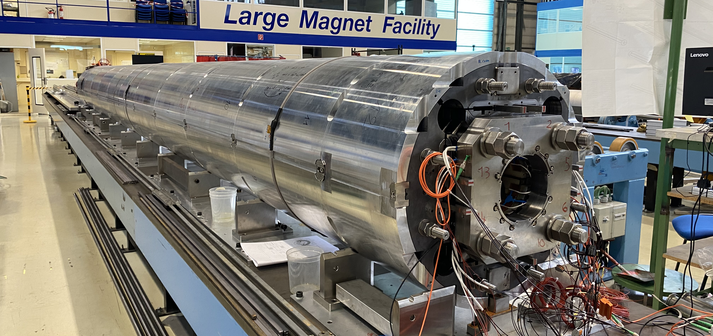
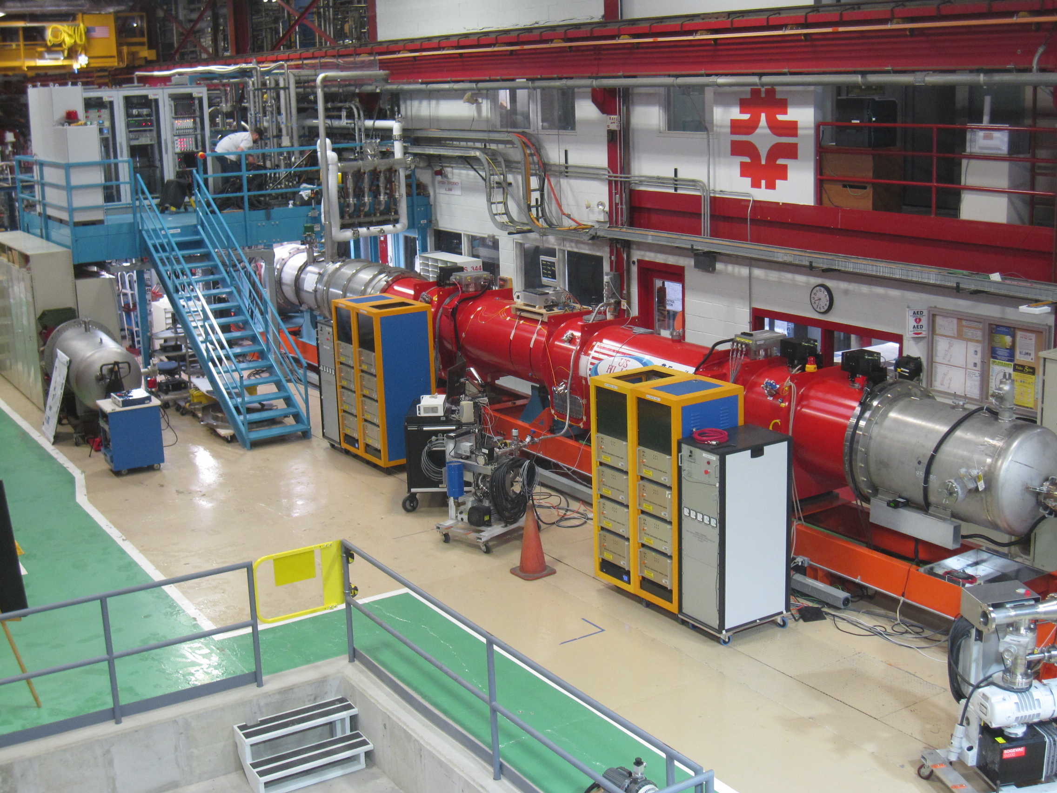




High order correctors
[M. Statera, E. Gautheron et al.
D1
[T. Nakamoto, J. C. Perez et al.]
D2
[S. Farinon, A. Foussat, et al.]
Nested correctors
[F. Toral, J. C. Perez et al.]
CCT correctors [Q. Xu, A. Foussat et al.]
Q2 [S. Izquierdo Bermudez et al.]
Q1/Q3 [G. Ambrosio, S. Feher, S. Izquierdo Bermudez et al.]

Slide 5
Contents
Summary of Nb-Ti magnets
Summary of MQXFA
Status of MQXFB

Slide 6
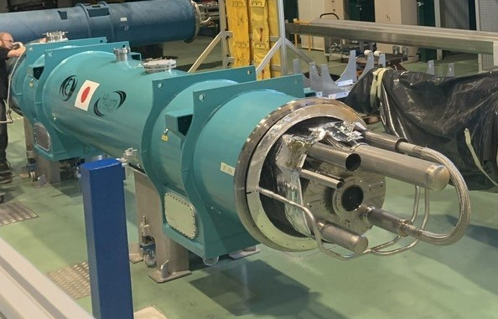
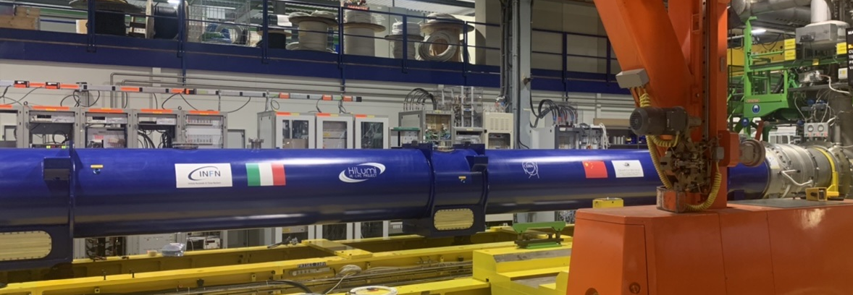
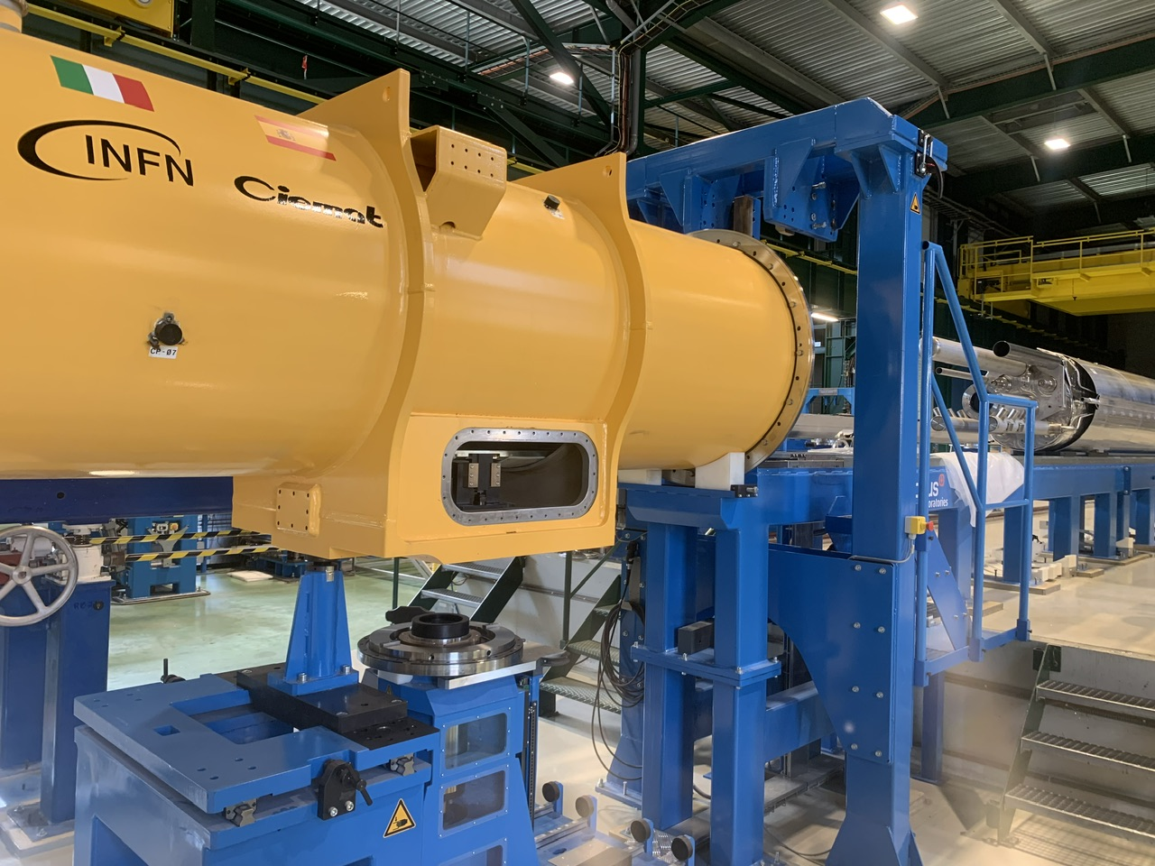
Nb-Ti magnets
D1 (See talk by T. Nakamoto):
  Prototype and first series magnet reached requirements (vertical test)
  1st cryo-assembly completed, test in October 2023 at CERN
D2 (See talk by A. Pampaloni):
  D2 prototype reached requirements – test completed
  1st series magnet expected at CERN in October 2023
D2 correctors (see talk by E. Todesco):
  The performance of the first two magnets (MCBRD01/02) is close to requirements, MCBRD03 reached performance at 4.5 K in IMP, MCBRD04 reached performance at 4.5 K in IMP, thermal cycle pending
Nested correctors (see talk by F. Toral):
  Three (out of 12) short nested series magnets produced and qualified for installation
  Prototype long magnet also qualified for installation
High order correctors: production completed, all magnets tested and accepted
  1st cold mass production completed at CERN, cryo-stating ongoing
  Assembly of the second cold mass started
MBXFP1 in the cryostat
D2 prototype in the test bench
Corrector package in the cyostating bench

Slide 7
Contents
Summary of Nb-Ti magnets
Summary of MQXFA
Status of MQXFB

Slide 8

MQXFA program (see G. Apollinari and G. Ambrosio)
132.6 T/m at 7 TeV, corresponding to 11.3 T peak field
MQXFA10: >7 TeV, 11.6 T
MQXFAP1: >7 TeV, 11.6 T, but electrical short
MQXFA11: >7 TeV, 11.6 T
MQXFAP2: ~6 TeV, ~10 T, broken structure
MQXFA8b: >7 TeV, 11.6 T
MQXFA03: >7 TeV, 11.6 T
MQXFA13 : ~7 TeV, 11.3 T
MQXFA04: >7 TeV, 11.6 T
MQXFA14b: >7 TeV, 11.6 T
T₀: aperture and cable selection
MQXFA05: >7 TeV, 11.6 T
MQXFA7b: November
MQXFA06: >7 TeV, 11.6 T
MQXFA15b: January
DOE approval
MQXFA07: ~6.5 TeV, 10.7 T
Red: conform
Black: non conform
Grey: coming soon
T₀+4
MQXFA08: <6 TeV
2013
…
2017
2018
2019
2020
2021
2022
2023
2024
2025
13 magnet tested, 8 conform, 3 non-conform, 12 more new magnets to test (7b, 12b, 13b,15-23)

Slide 9
MQXFA Test Results
MQXFA03-06, A10, A11, A08b and 14b reached performance and met all requirements
  Operation at nominal current plus 300 A at 1.9 K, nominal current at 4.5 K
  Good memory, i.e. no retraining after thermal cycle
MQXFA07 and MQXFA08 showed performance limitations with reverse behavior
MQXFA13 showed long training and erratic behavior close to nominal current, the weak coil will be replaced
I_{nom}
A03
A04
A05
A06
A07
A08
A08b
A10
A11
A13
A14
Powering test of MQXFA magnets (B. Ahia, S. Feher, G. Ambrosio et al.)

Slide 10
Removing performance limitations
MQXFA08 limiting coil was replaced, and the magnet reached performance requirements
  First long magnet with coil replacement
  Same procedure will be applied to MQXFA07 and to MQXFA13
Only ramps at 20 A/s
Empty markers indicate current reached without quench
Power test of MQXFA08 (J. Muratore, A. Yahia, S. Feher, G. Ambrosio et al.)

Slide 11
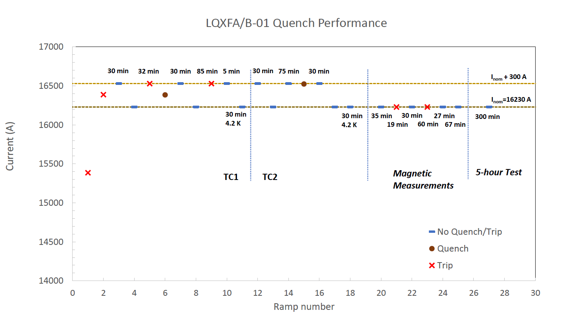
MQXFA program
First cold mass reaching performance – no retraining after thermal cycle
Update
Quench performance of LQXFA01 (G. Ambrosio, S. Feher, et al.)

Slide 12
Contents
Summary of Nb-Ti magnets
Summary of MQXFA
Status of MQXFB

Slide 13
A summary of MQXF program
132.6 T/m at 7 TeV, corresponding to 11.3 T peak field
MQXFBP1: ~6.5 TeV, ~10.5 T
MQXFBP2: ~6.9 TeV, ~11.2 T
MQXFBP3: >7 TeV, 11.6 T
MQXFB02: >7 TeV, 11.6 T
T₀: aperture and cable selection
MQXFB03: test ongoing
MQXFB04: April
Red: conform
Black: non conform
Grey: coming soon
T₀+7
2013
…
2017
2018
2019
2020
2021
2022
2023
2024
2025
7 to 9 more magnets to test

Slide 14
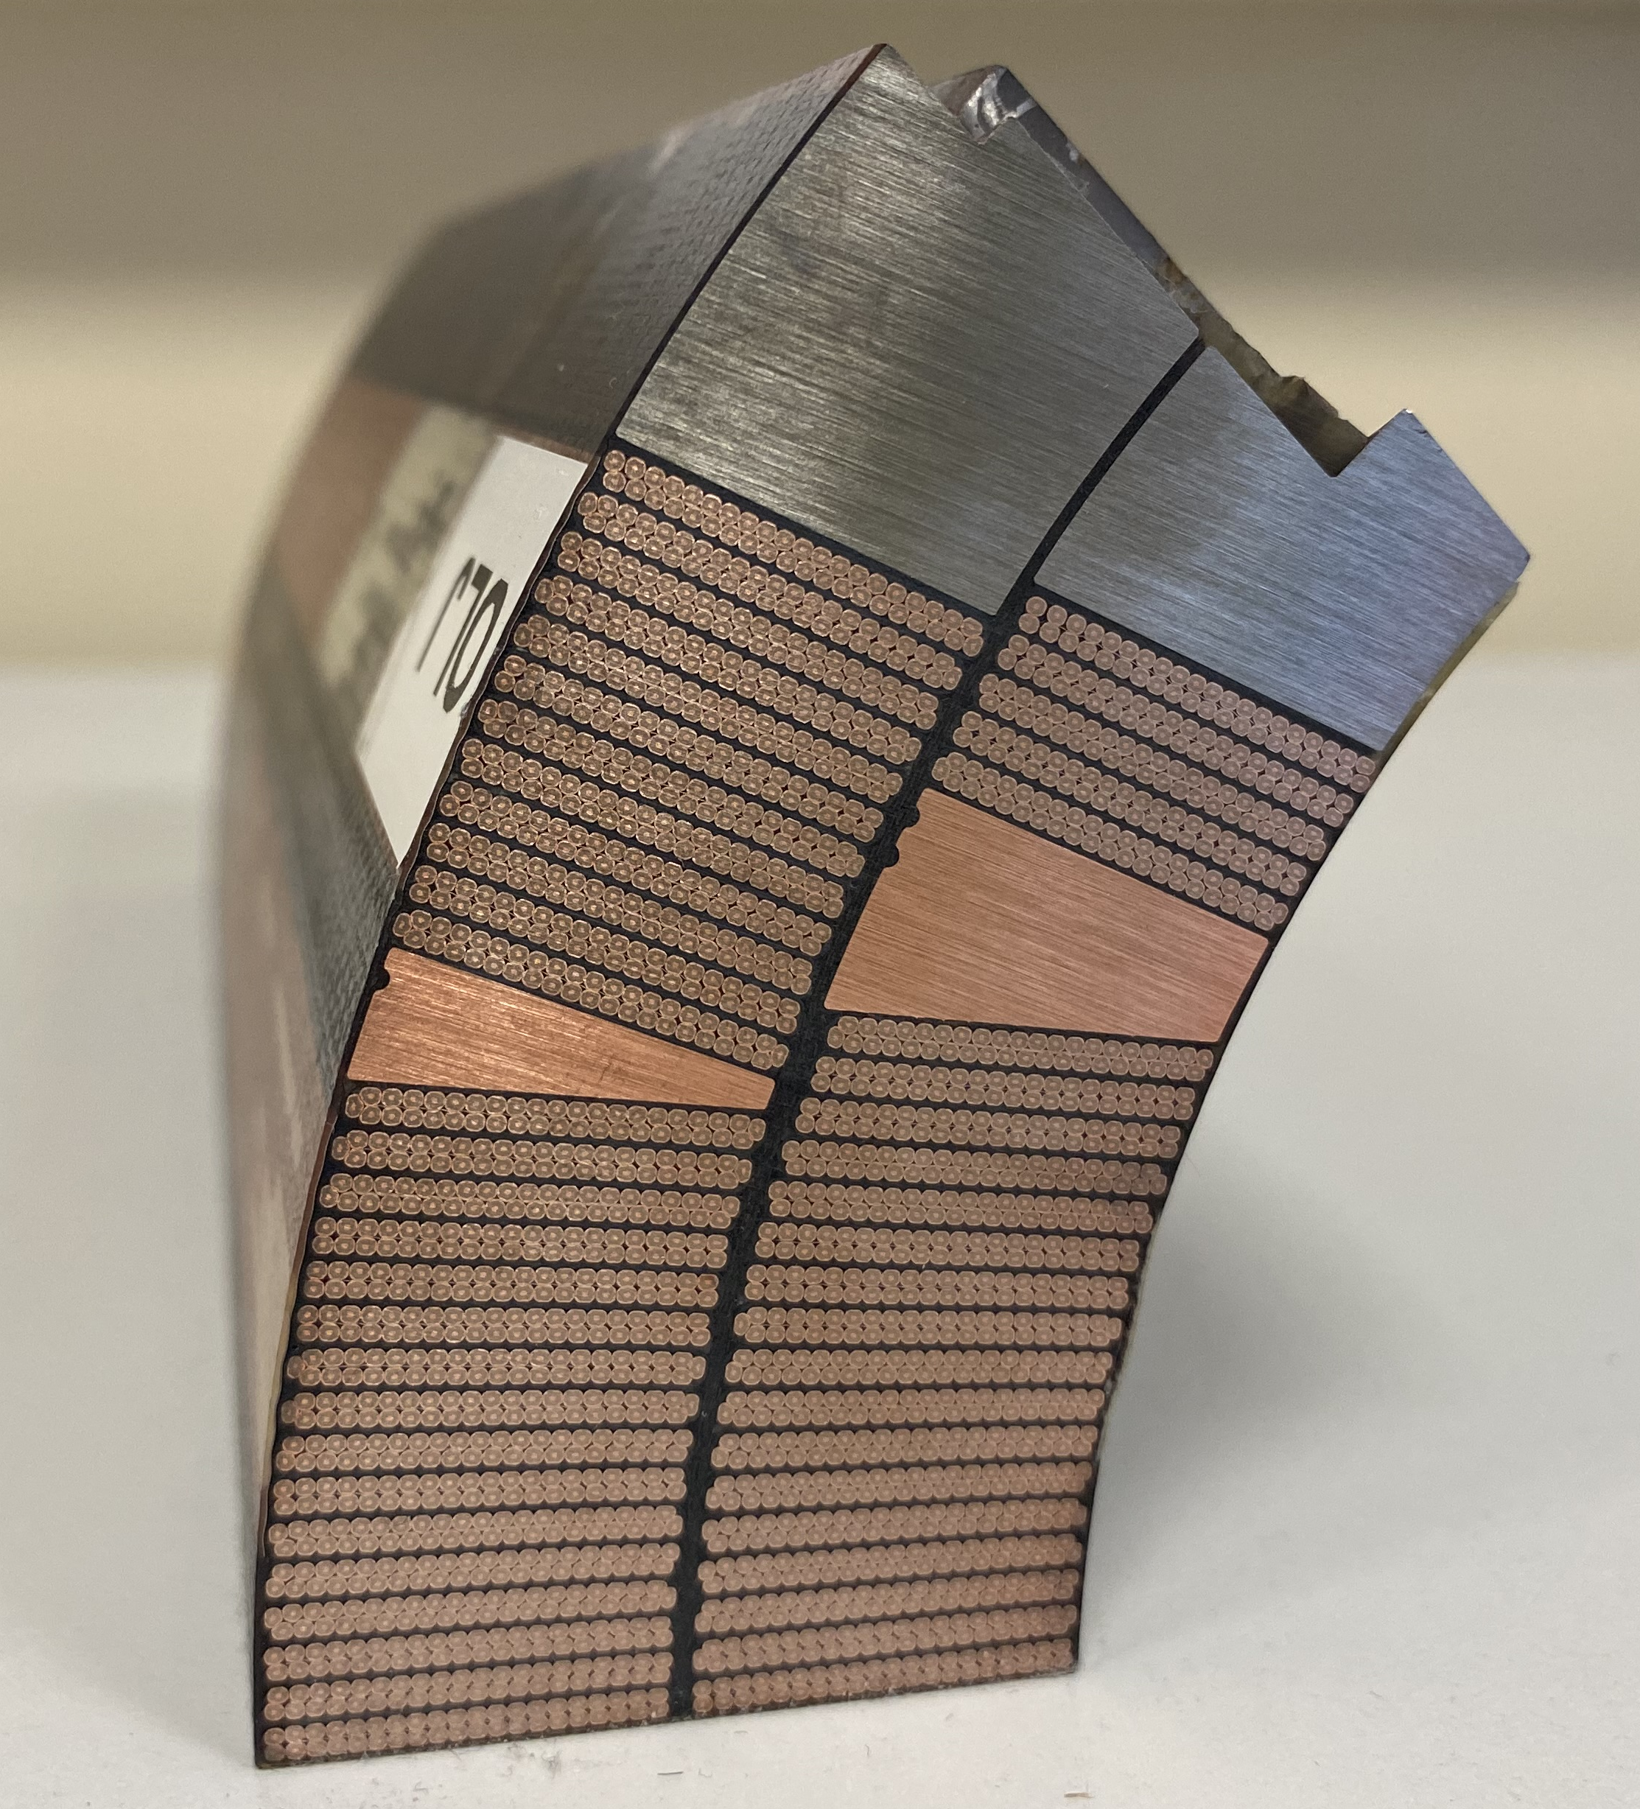
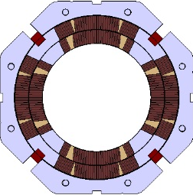
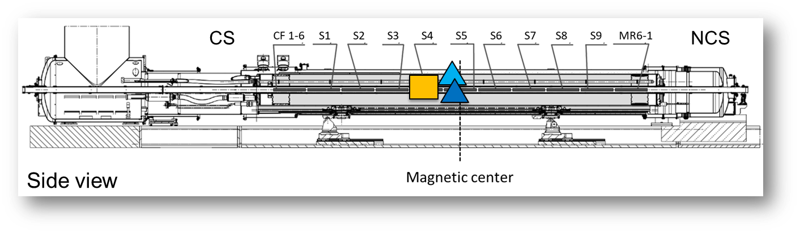
MQXFBP1&BP2 Prototypes Performance
F
MQXFBP1 and BP2 were limited below nominal current at 1.9 K (~15 and ~16 kA respectively).
4.5 K behaviour compatible with magnet on the critical surface (70% of the short sample limit in MQXFBP1, 73 % in MQXFBP2).
No retraining after thermal cycle and magnet performance did not degrade with temperature cycles, quenches and current cycles.
In all the cases, the quench location was on the inner layer pole turns near the mechanical center of the magnet.
Power circuit modification (the so-called trimmed powering) to evaluate the performance of non-limiting coils → other two coils also limited with similar mechanism (straight part), at 16.5-17 kA – no quenches in the heads, and no degradation with thermal cycle
MQXFBP1
MQXFBP2
P2
P1
(7.5 TeV)
(7.5 TeV)
(7 TeV)
(7 TeV)
CS view
Pole turn inner layer
P3
P4
F. J. Mangiarotti et al., "Power Test of the First Two HL-LHC Insertion Quadrupole Magnets Built at CERN," in IEEE Transactions on Applied Superconductivity, vol. 32, no. 6, pp. 1-5, Sept. 2022, Art no. 4003305, doi: 10.1109/TASC.2022.3157574.

Slide 15
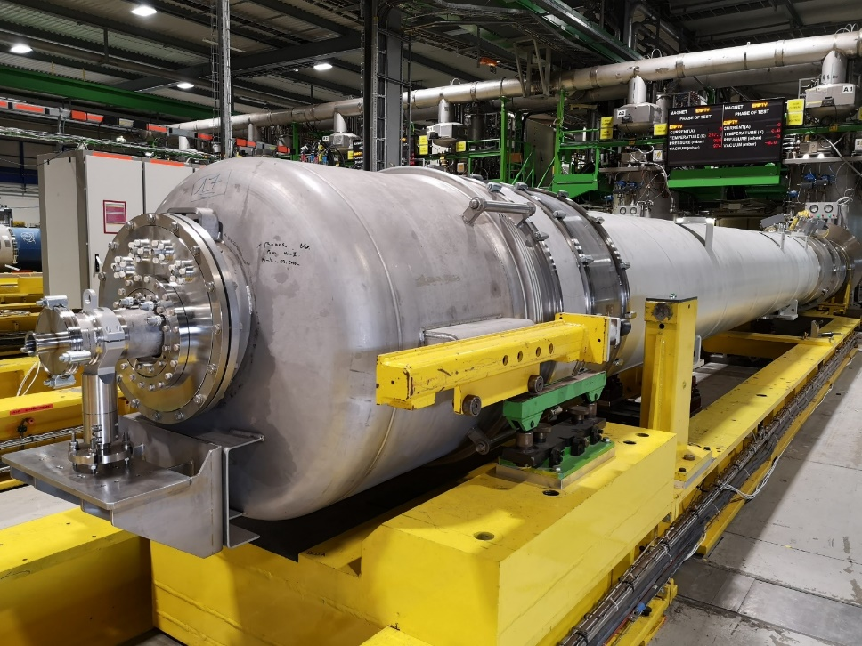
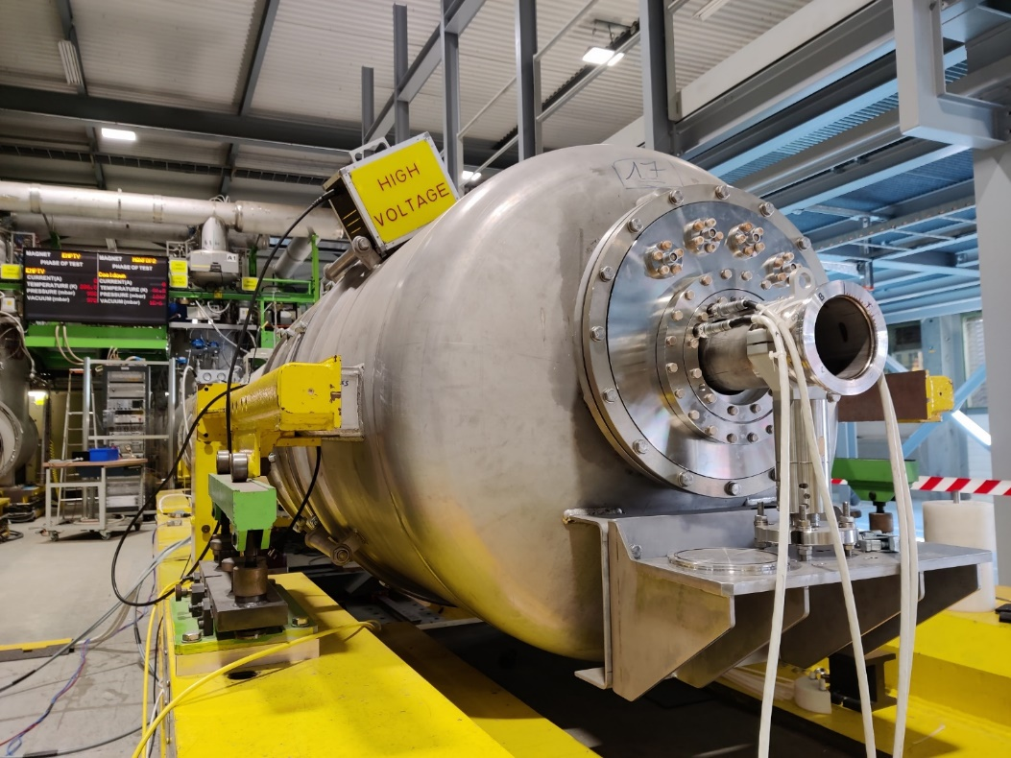
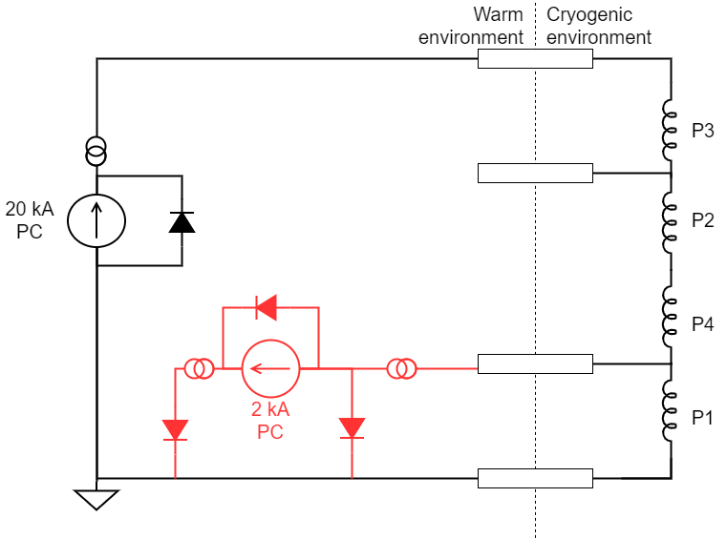
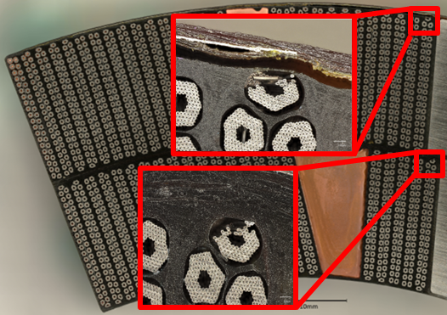
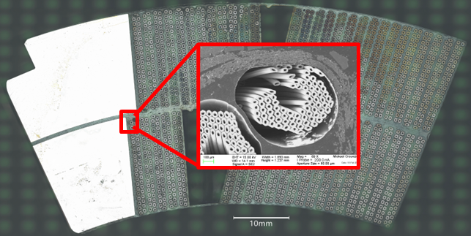


Overview on main findings and strategy definition
In Spring 2021, we stopped the production to identify and address possible root causes for the performance limitation:
Cold mass assembly
Magnet assembly
Coil manufacturing
It may also be a combination of two of the three, or all of them
Limiting performance BP1
Very similar phenomenology in BP2 → systematic problem?
3 out of the 4 coils in BP2 show same type of limitation
Very localized defect in the limiting coil of BP1
Similar defect in a virgin coil (never assembled in a magnet)
2020 |  |  |  | 2021 |  |  |  | 2022 |  |  |  | 2023
Q1 | Q2 | Q3 | Q4 | Q1 | Q2 | Q3 | Q4 | Q1 | Q2 | Q3 | Q4 | Q1 | Q2 | Q3 | Q4
 |  |  |  |  | Identify and |  |  | Cold mass: BP3
 |  |  |  |  | assess potential |  |  |  | Magnet assembly: B02
 |  |  |  |  | root causes |  |  |  |  | Coil fabrication: B03
Test ongoing
BP3
coils
B02
coils
BP3
cold mass
BP2
coils
BP3
magnet

Slide 16
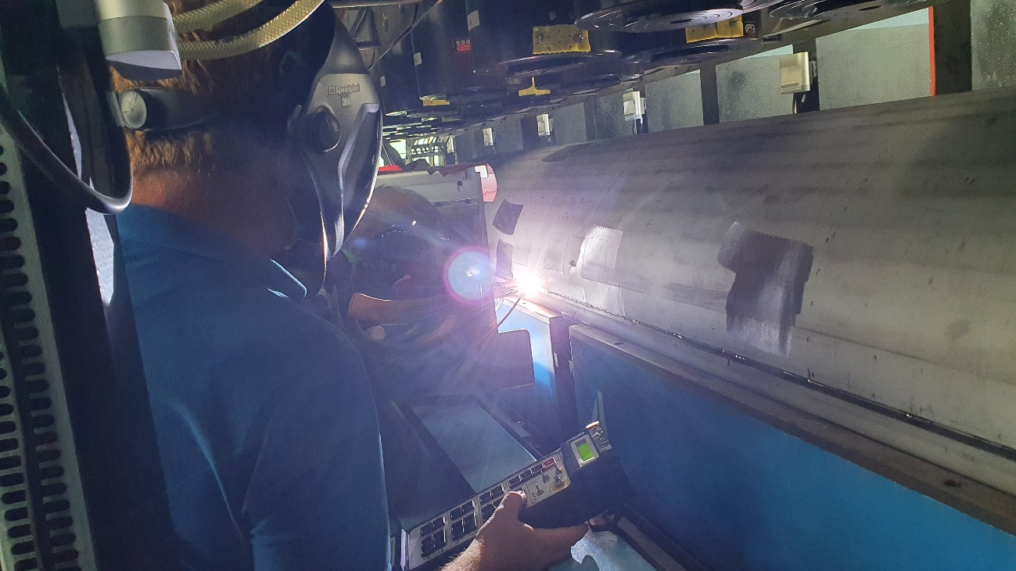
MQXFBP3: Cold mass assembly
Optimized welding procedure, to decouple the stainless steel vessel and and magnet
MQXFBP3 reached the target current at 1.9 K (I_{nom} + 300 A) after one quench
At 4.5 K, we see the same type of limitation observed in MQXFBP1 and MQXFBP2 but at higher levels.
  Quench level extrapolation for MQXFBP3 at 1.9 K: above ultimate current with a temperature margin at nominal current of 2 K (0.35 K needed for operation¹).
No re-training after thermal cycle. Magnet performance does not change with thermal and current cycling
RRP reference
strand performance
7.5 TeV
7 TeV
80 % I_{ss}
73 % I_{ss}
70 % I_{ss}
MQXFBP3 T_{margin} at I_{nom} ≈ 2 K
Borges de Sousa et al, “Numerical Assessment of the Inhomogeneous Temperature Field and the Quality of Heat Extraction of Nb₃Sn Impregnated Magnets for the High Luminosity Upgrade of the LHC “

Slide 17
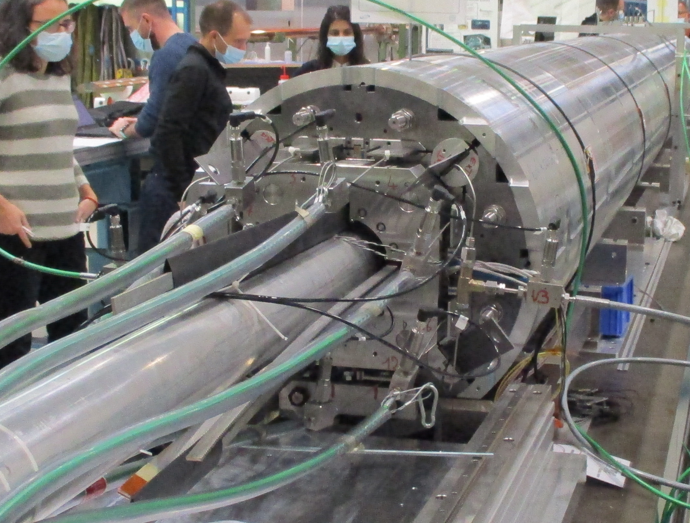
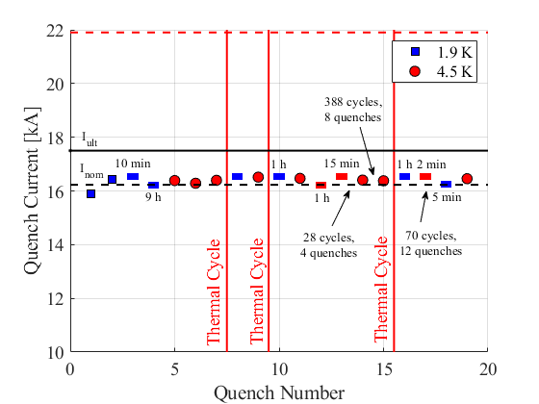
MQXFB02: Magnet Assembly
Optimized procedure of bladder and key loading, to eliminate the overshoot of coil azimuthal stress during loading
MQXFB02 reached the target current at 1.9 K (I_{nom} + 300 A) after two quenches.
At 4.5 K, we see the same type of limitation observed in MQXFBP1&P2&P3 but above nominal current
  Quench level extrapolation for MQXFB02 at 1.9 K: above ultimate current with a temperature margin at nominal current of 2.8 K (0.35 K temperature margin needed for operation).
No retraining after thermal cycle. Endurance test show no degradation after 3 thermal cycles, ≈ 50 quenches and 500 current cycles.
RRP reference
strand performance
80 % I_{ss}
82% I_{ss}
73 % I_{ss}
70 % I_{ss}
MQXFB02 T_{margin} at I_{nom} ≈ 2.8 K
Only ramps at 20 A/s

Slide 18
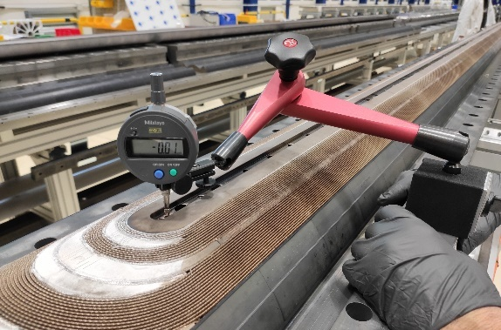
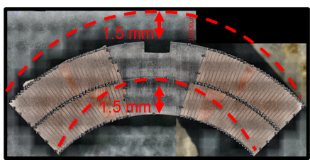
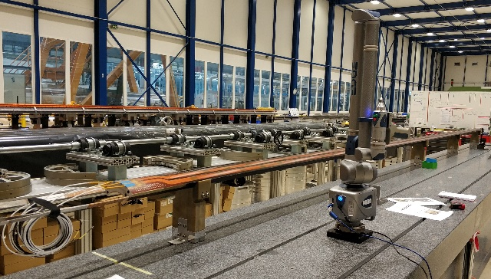
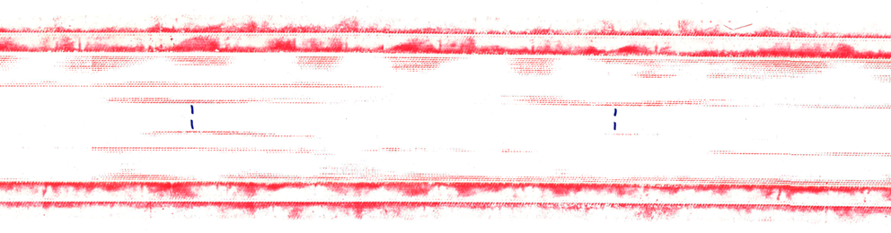
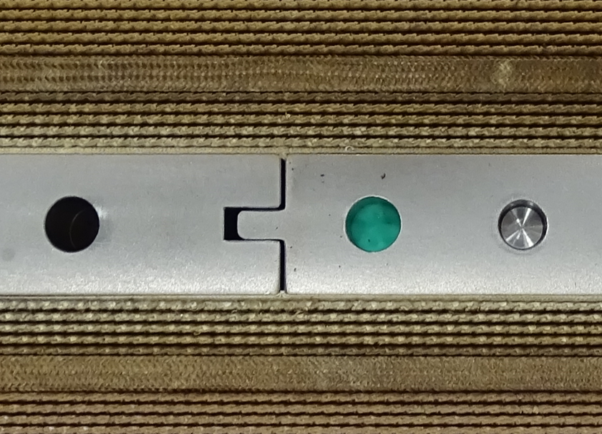
MQXFB03: Coil fabrication
After reaction, a vertical deflection of the outer layer pole with respect to the base plate of 1-2 mm is typically observed after the opening of the reaction fixture.
After impregnation, the coil is azimuthally bigger in the middle (≈ 0.1 mm per mid-plane).
Pole to pole transitions, where collapsed filaments are found in destructive inspections, have been identified as stress concentration region during the closure of the impregnation fixture
Vertical pole deflection (reacted coils)
Azimuthal coil arc excess (impregnated coils)
Pressure sensitive film imprints (2.5 – 10 MPa)of the inner coil radius during the closure of the impregnation fixture
Ti pole
(400 mm length)
mp
Inner radius
Pole (400 mm length)
mp
Pole to pole transition

Slide 19
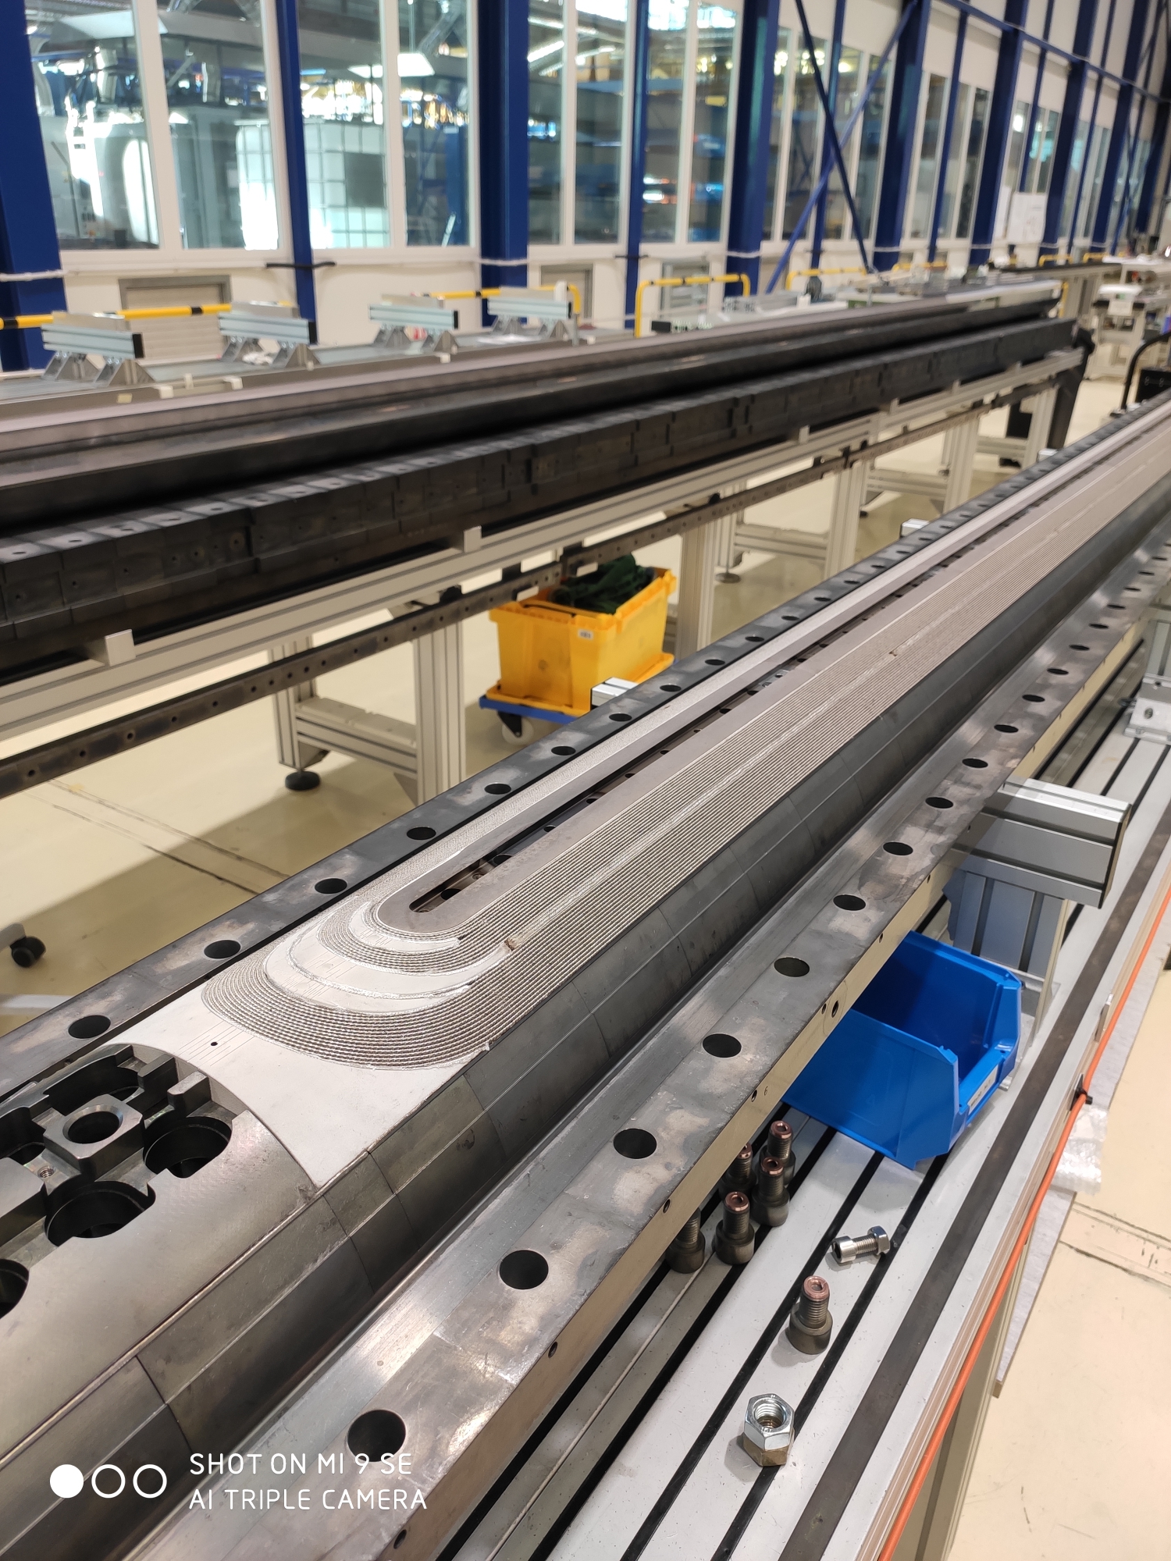
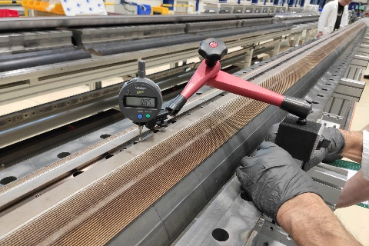

New generation coils
  Modifications aimed at reducing the friction between coil and reaction mold
    Pole gap increase
    Partial compensation of the curing cavity
    Removal of the ceramic binder from the outer layer of the coil
New generation coil measurables point to a coil which is more ‘relaxed’ after RHT
  No coil ‘hump’ after reaction
  No bigger coil azimuthal size towards the middle after impregnation
  More homogeneous torque required to close the impregnation fixture
More details on Wednesday in the parallel session

Slide 20
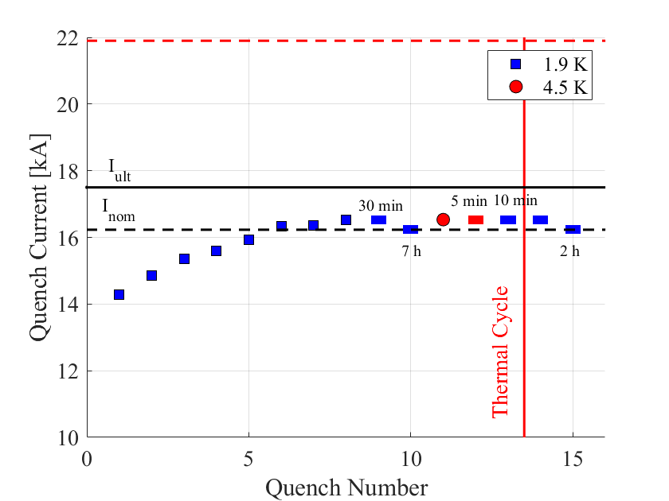
MQXFB03 Test Results
MQXFB03 reached the target current at 1.9 K (I_{nom} + 300 A) after eight quenches. It operated during 1 hour at target current and 7 hours at I_{nom}
Stable operation at 4.5 K at target current (I_{nom} + 300 A), no sign of conductor limitation as observed in previous magnets
  The magnet reaches target current at 4.5 K at 100 A/s (nominal 20 A/s), a good indication that we still have margin.
Good memory after thermal cycle (test still ongoing)
Training of MQXFB03
Ramp rate dependency at 4.5 K
no quench
Only ramps at 20 A/s

Slide 21
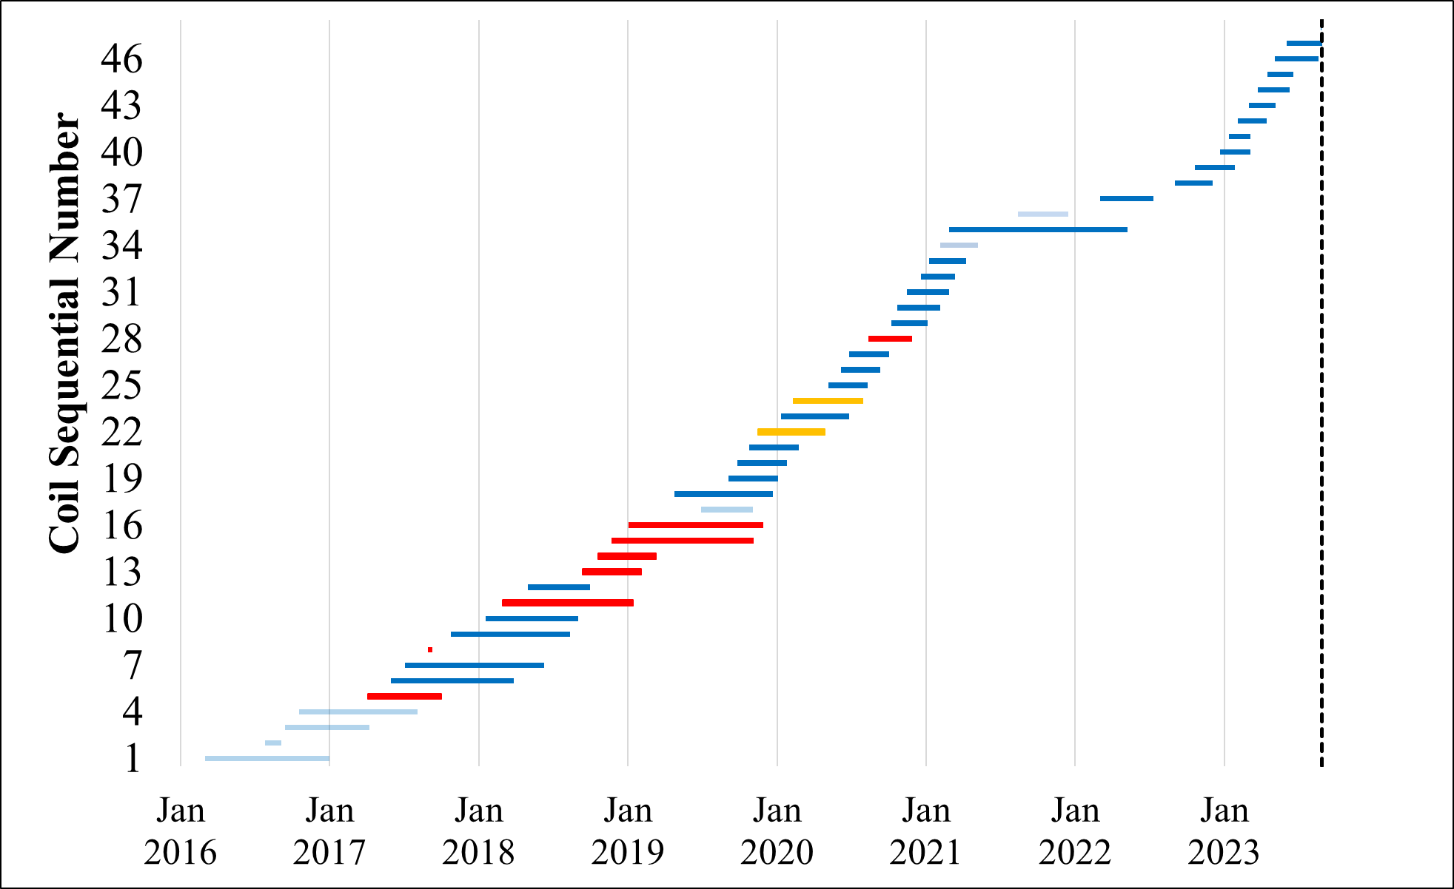
MQXFB – Next steps
Coil fabrication:
  10 ‘new generation’ coils have been completed
  Coil fabrication ongoing, with a pace of ≈ 1 coil/month
Magnet assembly
  Assembly of MQXFB04, with 4 new generation coils ongoing. Test expected in Spring 2024.
New generation coils
Cold mass and cryo-assembly
  MQXFBP2b and MQXFBP3b have been assembled in Q2 cold mass configuration, BP2b is ready to be tested in SM18 (and then, the string). Cryostating of BP3b almost copleted.
  MQXFB02b Q2-type cold mass completed, but disassembly needed due to an electrical non-conformity
  From MQXFB04, the plan is to go directly to Q2 cold mass
Next critical steps:
  Demonstrate reproducibility of the performance with MQXFB04
  First test of a Q2 final cryo-assembly

Slide 22
Conclusions
Cold mass manufacturing procedures successfully applied to all types of magnets
MQXFA
  Successful test of the first cold mass in horizontal position – major milestone
  Coil replacement validated in MQXFA08b
  AUP completed cable and (almost) coil production. 8 magnets (out of 11 (+2) magnets tested) are accepted (reached I_{nom} + 300 A at 1.9 K, I_{nom} at 4.5 K, > 2.6 K temperature margin (0.35 K needed)).
MQXFB
  Three MQXFB magnets reached HL-LHC requirements (MQXFBP3, MQXFB02 and MQXFB03).
  Endurance test in MQXFB02 show no degradation after 3 thermal cycles, ≈ 50 quenches and 500 current cycles.
  MQXFB03, produced using new generation coils, does not show performance limitation: first 7.2 m length magnets with no signs of conductor degradation!
  Next critical step: demonstrate reproducibility of the performance with MQXFB04

Slide 23
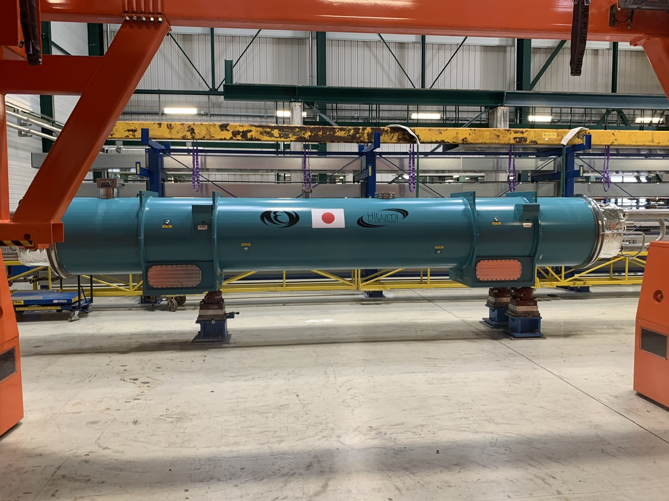
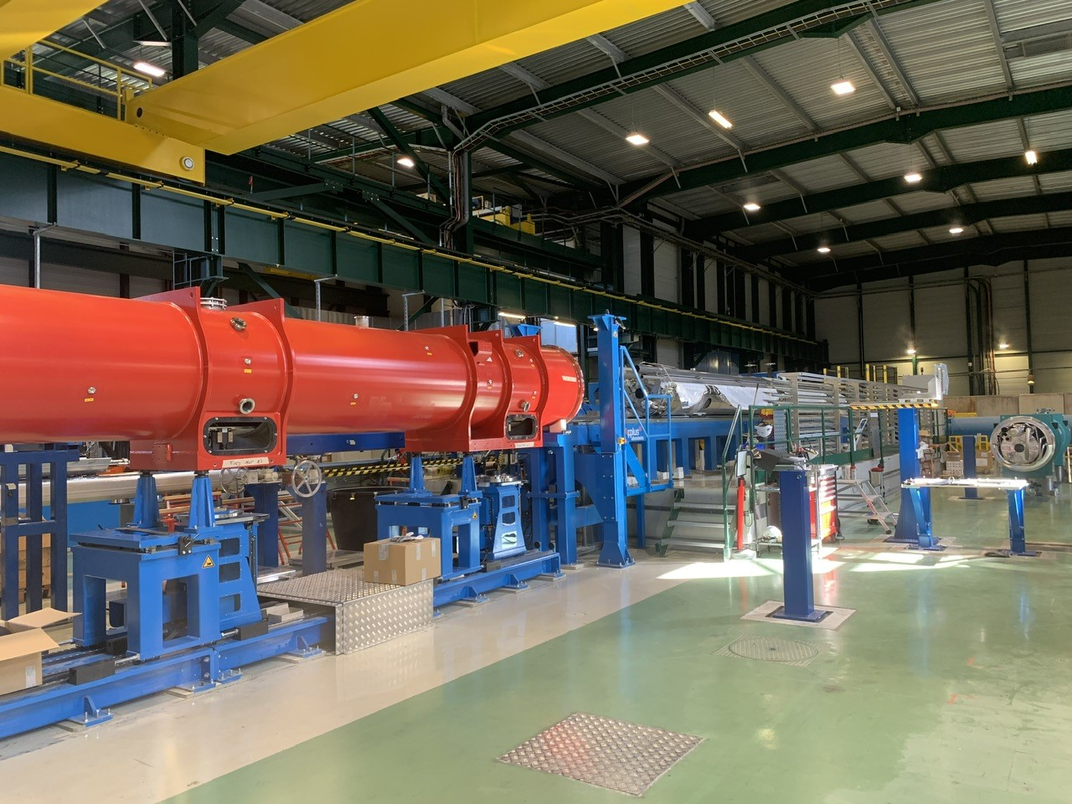
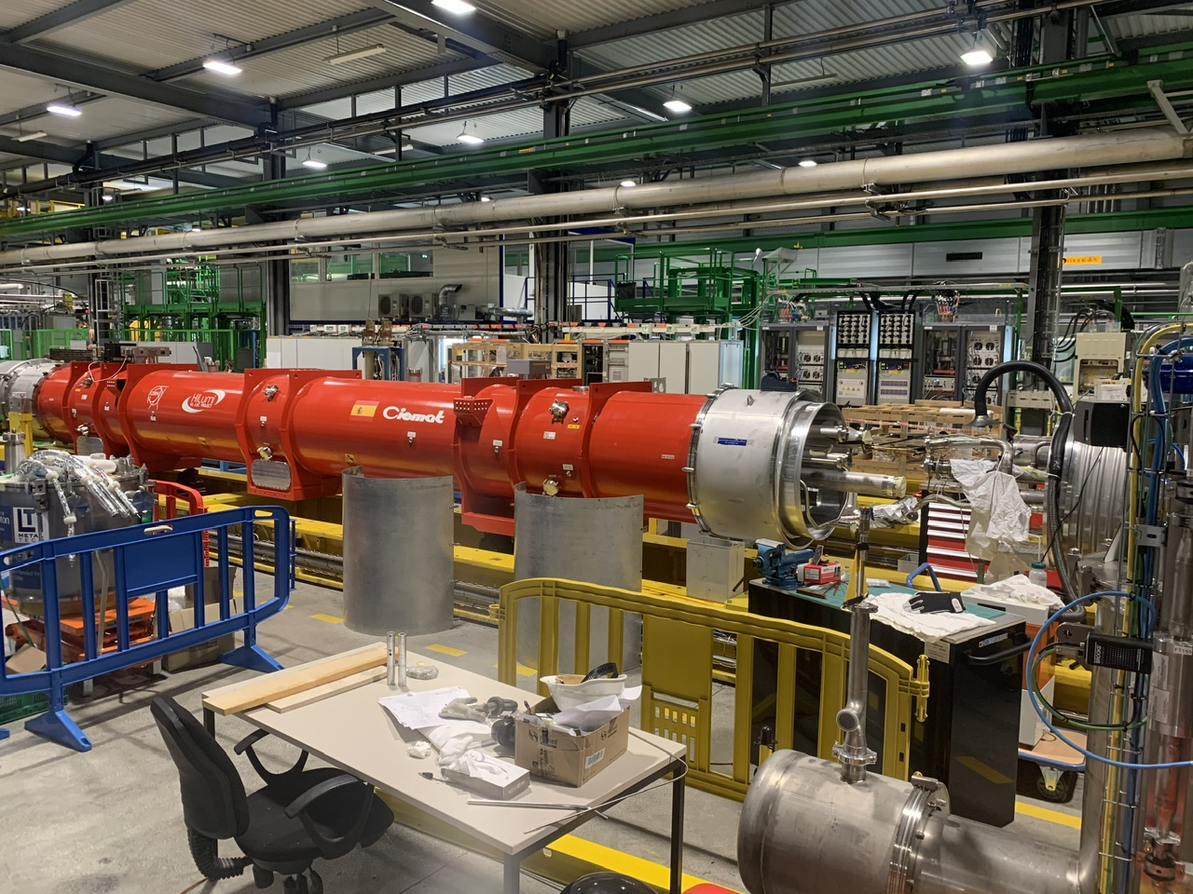
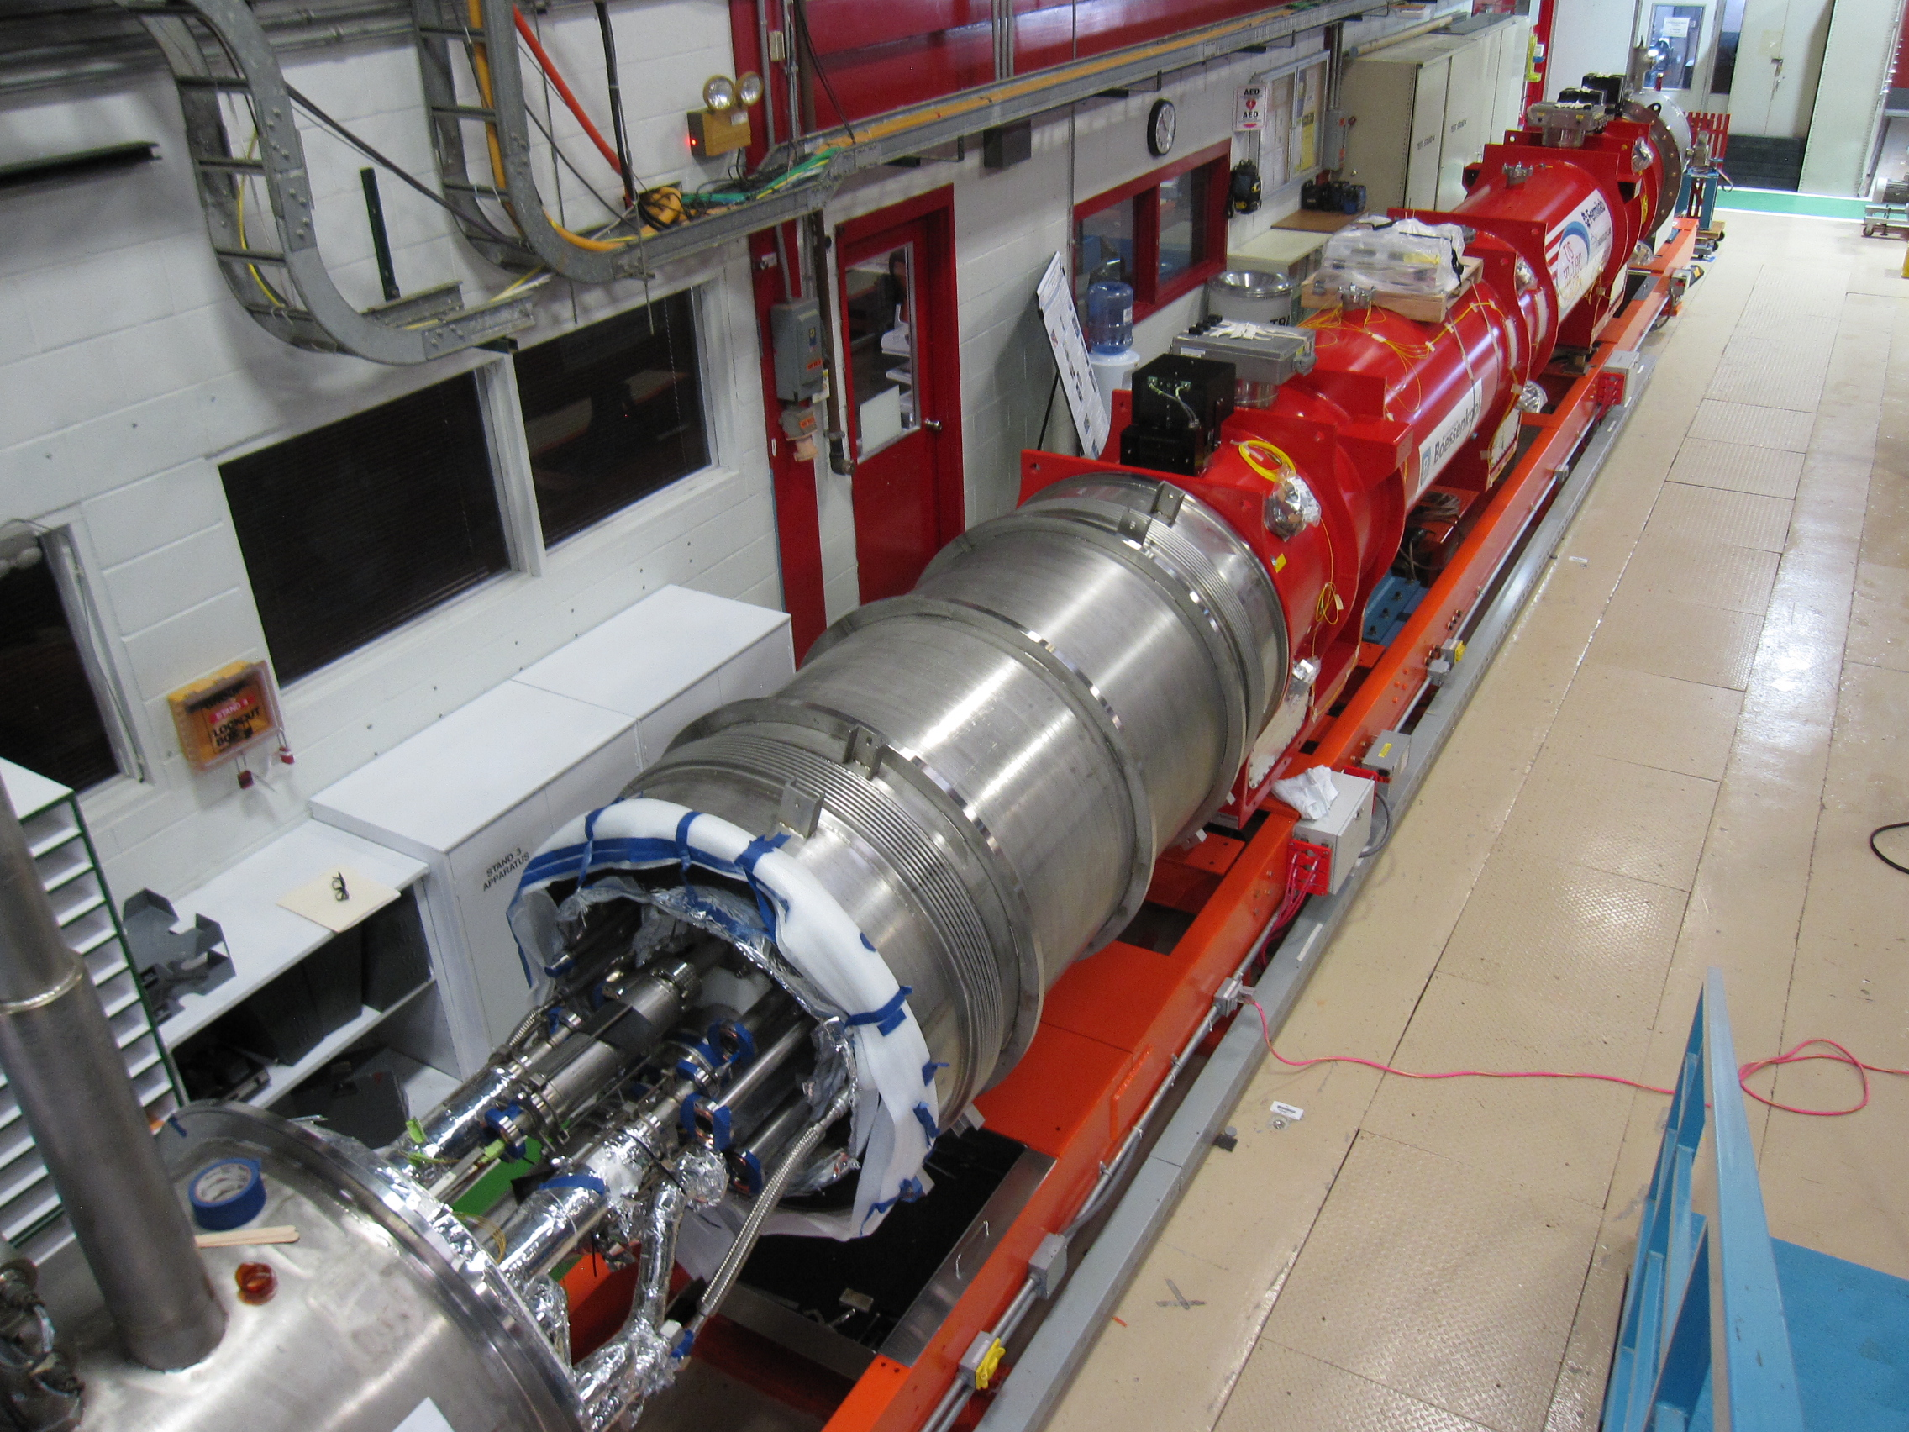
The string is taking the right colors!
Q2a
(in SMI2)
CP
(SMI2)
D1
(now in SMA18)
Q2b
(in SM18)
Q3
(in FNAL)

Slide 24
Thanks

Slide 25
Additional slides

Slide 26

Readiness for the string
D1
(now in SMA18)
Readiness dates for the string:
  Q1: magnet cold mass being welded → Available in September 2024
  Q2a: MQXFBP3b completed – H test in January → Available April 2024
  Q2b: MQXFBP2b completed – H test in October → Available April 2024
  Q3: magnet test being completed → Available in July 2024
  CP cryostating phaseII ongoing → Available August 2024
  D1 cryostating completed → Available March 2024
CP
CP
(SMI2)
Q2a
(in SMI2)
Q2b
(in SM18)
Q3
(in FNAL)

Slide 27
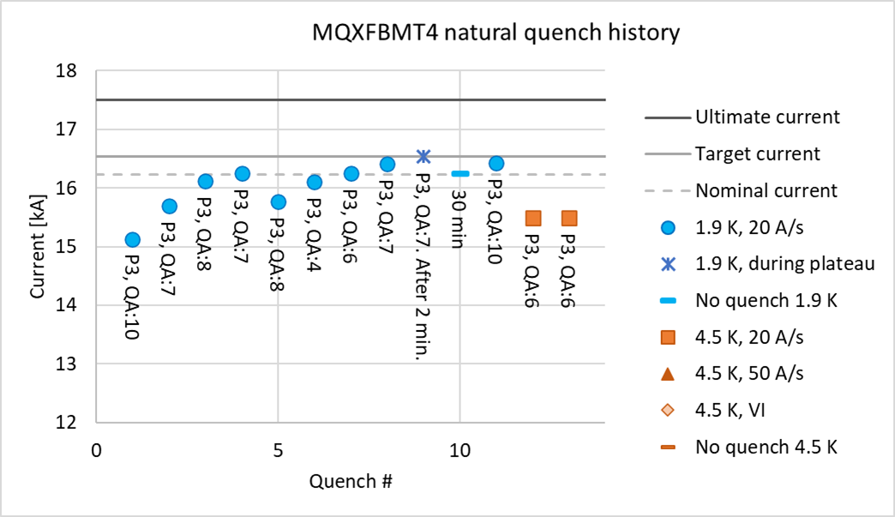
Plan B: MQXFBMT4
A coil produced with minor modifications with respect to MQXFB02 (CR127) was assembled with the 3 non-limiting coils of MQXFBP1.
Objectives:
  Improve our understanding on the phenomenology for conductor limitation, in case MQXFB03 coils do not reach performance and we need to go back to the ‘old’ coil fabrication process
  Practice coil replacement
Results:
  Longer training than previous magnets, always the new coil (CR127) is the quenching coil
  Performance limitation at 15.5 kA at 4.5 K in CR127

Slide 28
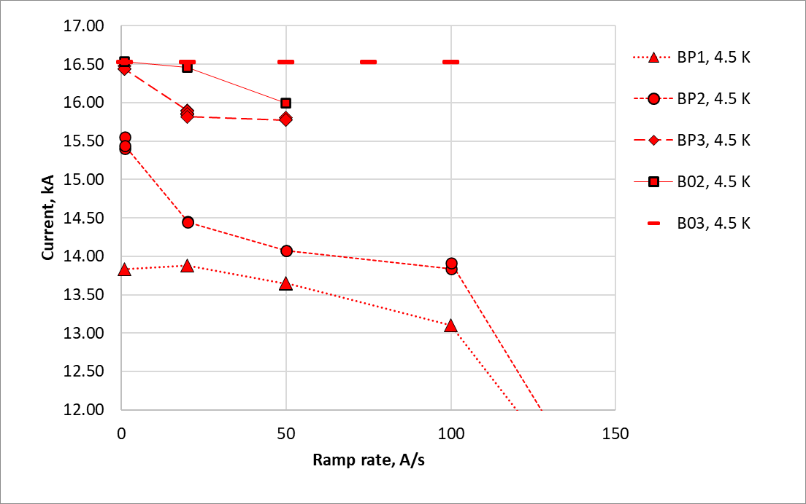
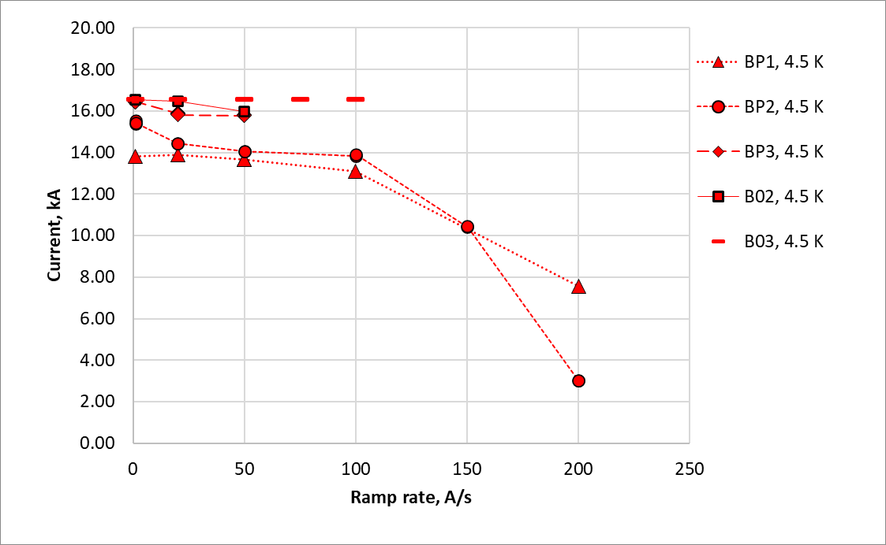
Ramp rate dependency MQXFB magnets
MQXFB03 is able to reach target current at 4.5 K at 100 A/s
no quench
no quench
Pole turn quench
Mid-plane block quench

Slide 29
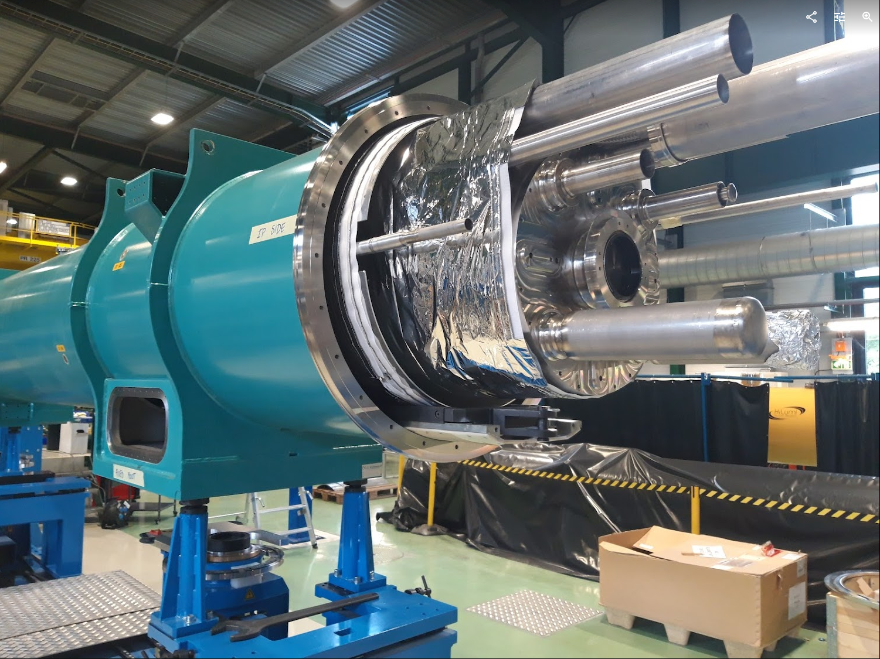
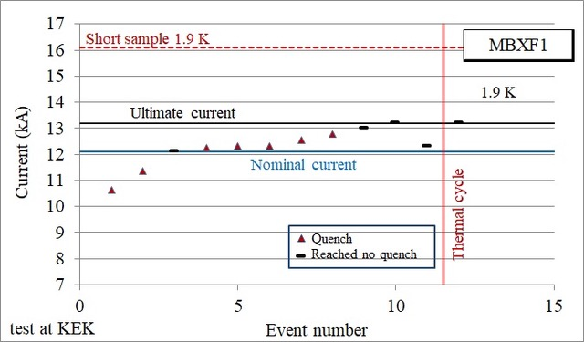
D1 (see T. Nakamoto talk)
MBXFP1 (prototype) in the cryostat, ready to be connected to the test bench
  After cold test, ~15 weeks of work (phase 2 cryo-stating for delivery to the string)
MBXF1 (first series) reached requirements (vertical test)
MBXF5 (second series) tests in October
MBXF2 magnet assembly on-going
Half of the coils are completed
MBXFP1 in the cryostat
Powering test of first series magnet MBXF1
(T. Nakamoto, M. Sugano, K. Suzuki, J. C. Perez, et al)

Slide 30
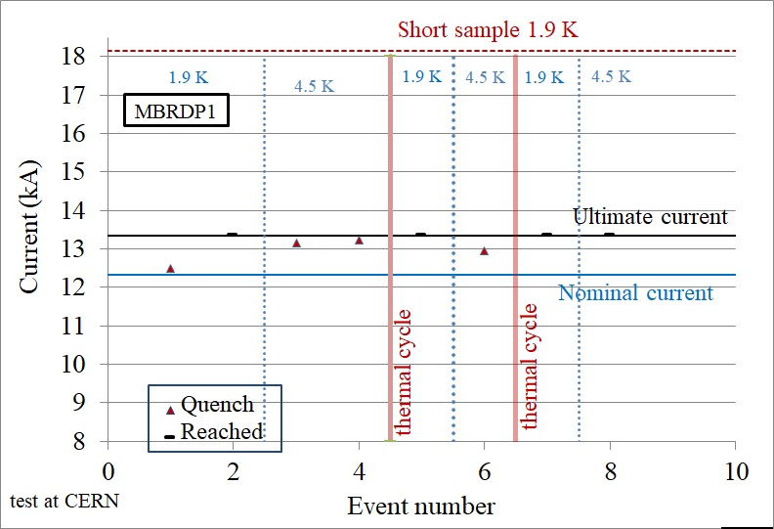
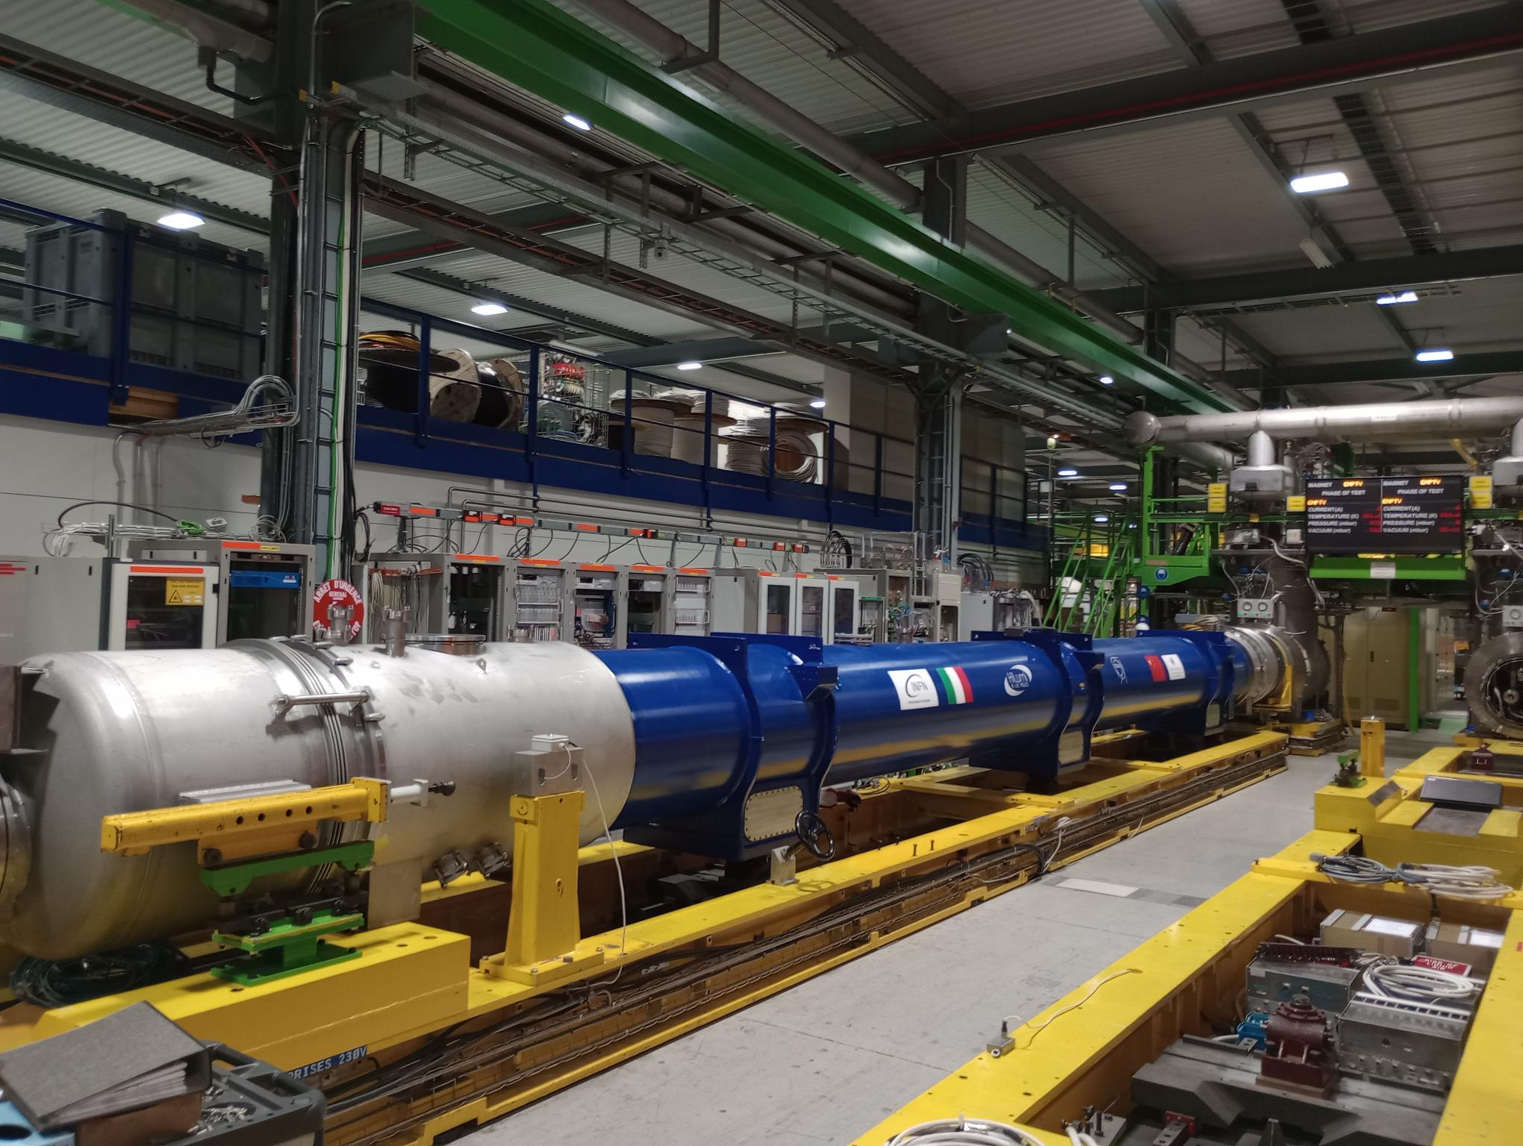
D2 (see A. Pampaloni talk)
D2 prototype (fully made in ASG) reached requirements
Manufacturing of the first series magnets close to completion, expected at CERN in October 2023
  RT magnetic measurements show that the iteration on field quality was successful
Half of the series coils are completed, collaring of the second series magnet on-going
D2 cold mass on the test bench in SM18 (S. Farinon, B. Caiffi, A. Bersani, A. Foussat, et al)

Slide 31
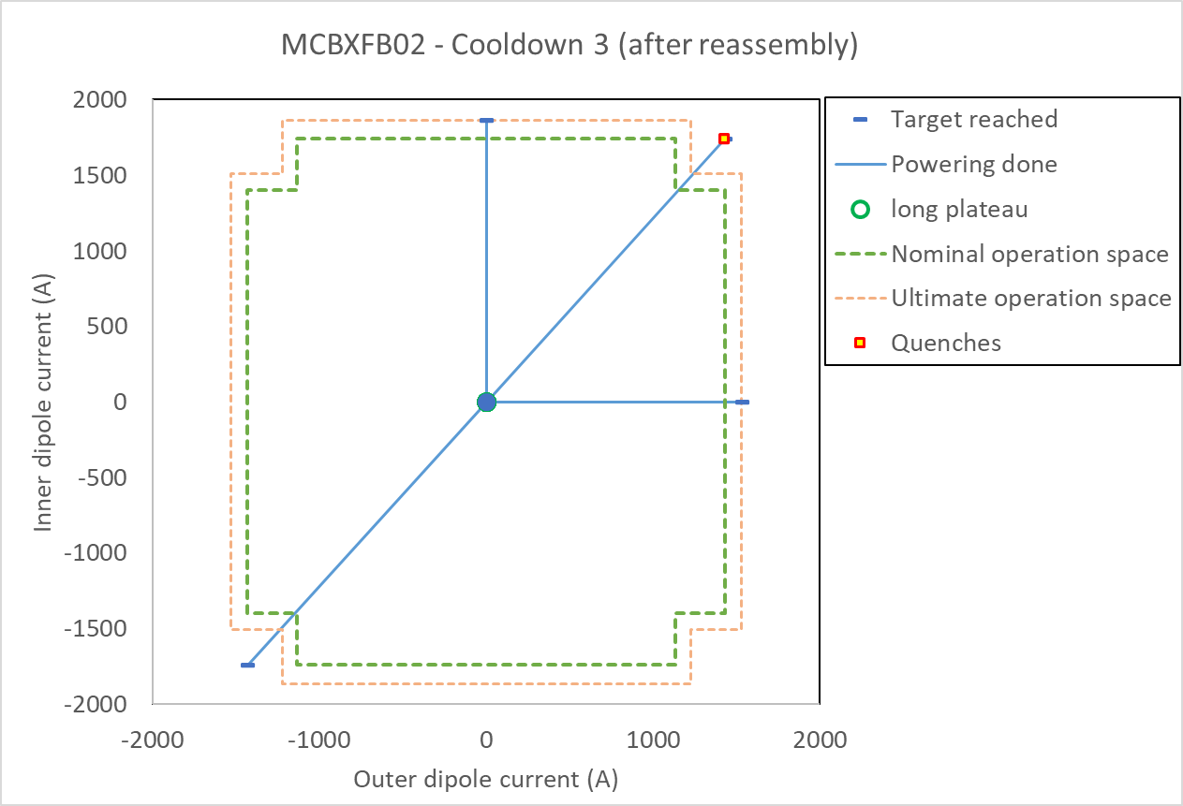
Nested correctors (see F. Toral talk)
The performance limitation seen on the retraining after change of torque in prototype MCBXFBP1 and MCBXFBP2 (short nested correctors) was overcome after a design iteration executed on MCBXFB01
Three (out of 12) short nested series magnets produced and qualified for installation
  From MCBXFB02, magnets fully manufactured in Elytt
  Endurance test of MQXFB02 showed no degradation of the performance after 2000 cycles
Prototype long magnet also qualified for installation
Test results of MCBXFB02
(G. Willering, F. Toral, J. C. Perez, C. Martins, et al)

Slide 32

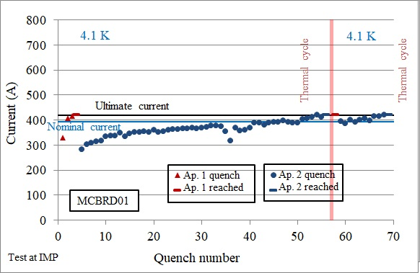
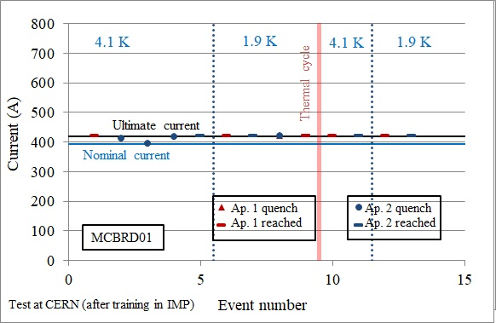
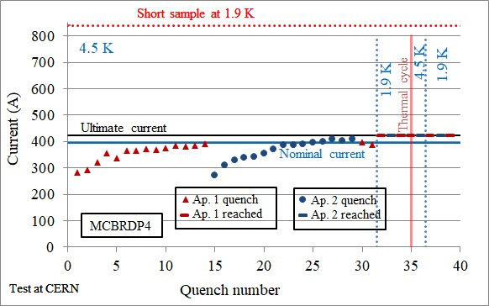
D2 correctors (see Q. Xu talk)
Issue of very long training at 4.5 K observed in initial production at BAMA has been solved (iteration on impregnation procedures, and size of the channel gap)
MCBRD01 and 02 reached performance at 4.5 K in IMP (nonconformity in retraining and HV test) (quarantine, non-conformed procedures, performance close to requirement)
MCBRD03 reached performance at 4.5 K in IMP, good memory after thermal cycle
MCBRD04 being tested IMP
At CERN:
  3 prototype magnets have been completed and are conformed (MCBRDP2-3-4).
  2 magnets being built with components from IHEP (MCBRD11/12)
Training of MCBRD01 (PE: Q. Xu, test: W. Wu, G. Willering et al)
Training of MCBRDP4
(WPE: A. Foussat, G. Kirby, test: G. Willering et al)

Slide 33
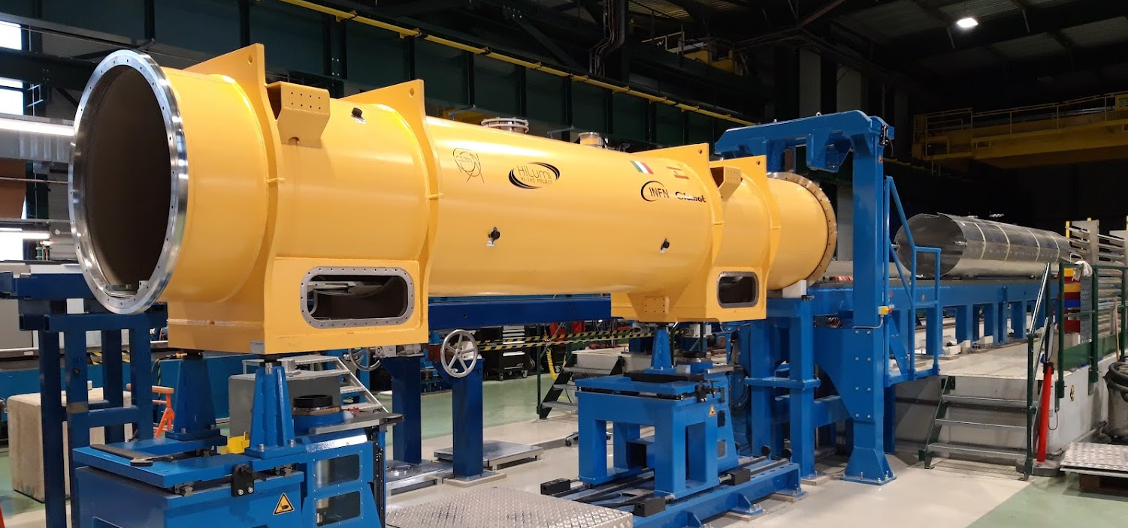
High order correctors
Production completed in SAES-RIAL vacuum (54 magnets)
  All magnets delivered and accepted M. Statera, et al., IEEE TAS 32 (2022)
  First corrector package cold mass completed, and being cryostated
(M. Statera, E. Gautheron, H. Prin, D. Duarte et al)

