Slide 1
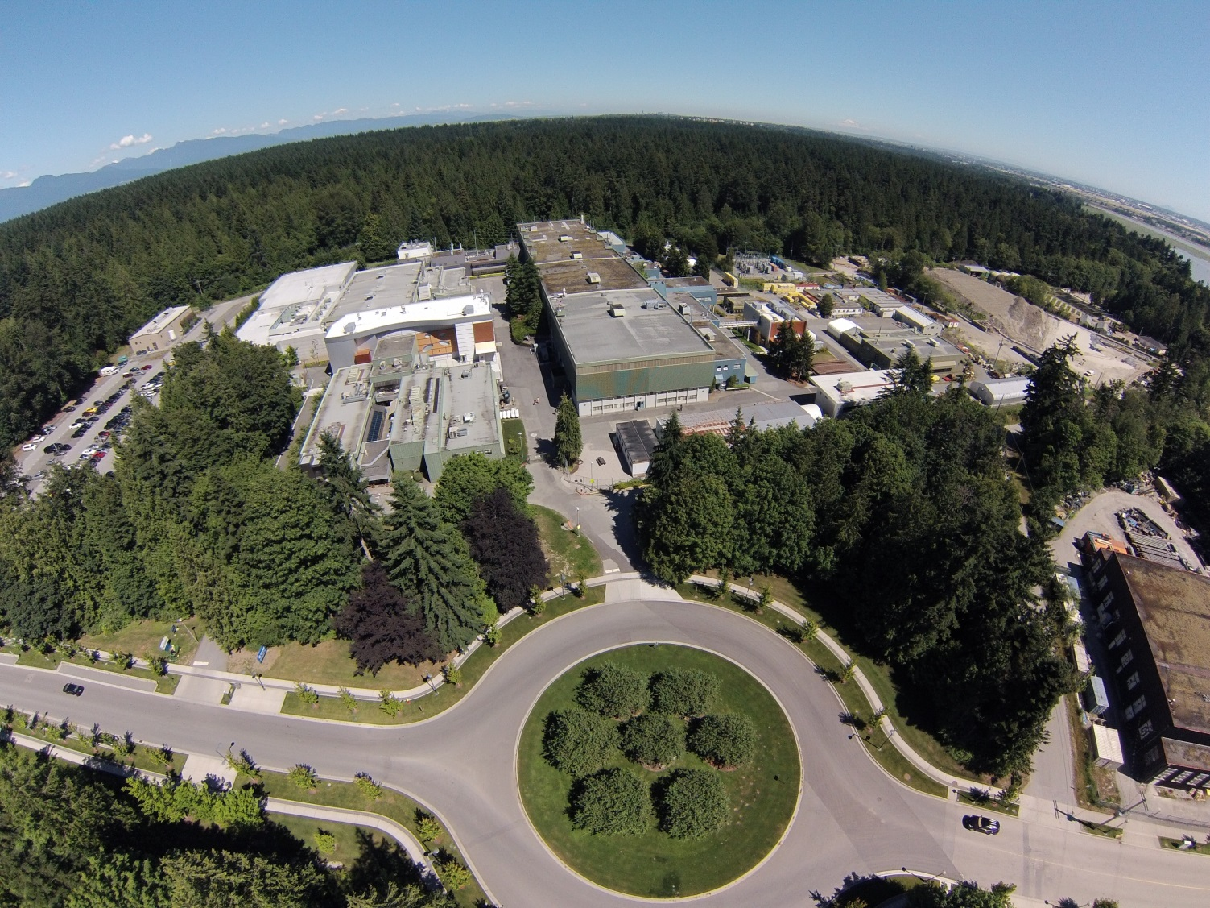
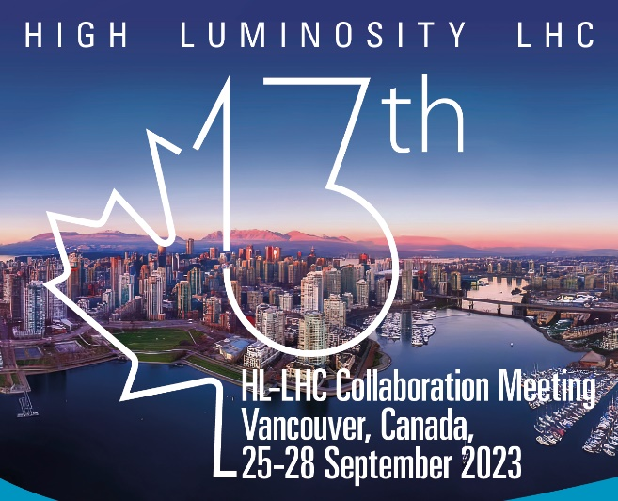

Overview of TRIUMF
HL-LHC collaboration meeting
Oliver Kester
Director, Accelerator Division TRIUMF
Monday, September 25, 2023
Notes:
I would like to start with acknowledging the unceded and traditional territories of the Musqueam, Squamish and Tsleil-Waututh Nations, on which the SFU Morris J. Wosk Centre for Dialogue building is located.

Slide 2
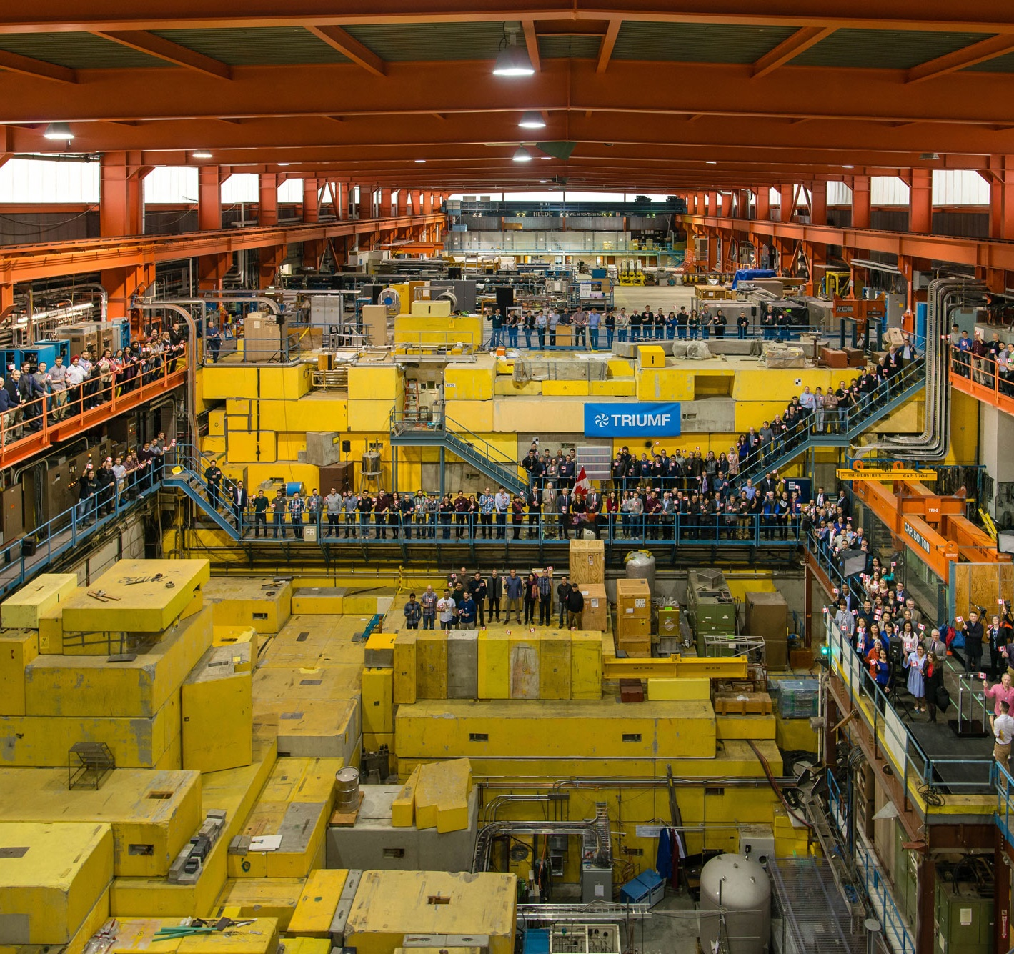
Welcome to B.C.!
Home of TRIUMF
TRIUMF is Canada’s particle accelerator centre. We are a world-class hub of research, education, and innovation that is home to ~600 staff and students
Founded in 1968 by the University of British Columbia, Simon Fraser University, and the University of Victoria, TRIUMF is a cornerstone of BC’s innovation ecosystem, driving impact locally, nationally, and around the world
2

Slide 3
TRIUMF is located on the traditional, ancestral, and unceded territory of the Musqueam people, who for millennia have passed on their culture, history, and traditions from one generation to the next on this site.
TRIUMF’s home has always
been a seat of learning.

Slide 4

Discovery, accelerated.
Our multidisciplinary community uses TRIUMF’s world-class accelerator infrastructure to drive leading-edge research that delivers impact in science, medicine, and industry, helping position Canada as a global leader
Member Universities:
University of Alberta
University of British Columbia
University of Calgary
Carleton University
University of Guelph
University of Manitoba
McGill University
McMaster University
Université de Montréal
University of Northern
British Columbia
Queen's University
University of Regina
Saint Mary's University
Université de Sherbrooke
Simon Fraser University
University of Toronto
University of Victoria
University of Waterloo
Western University
University of Winnipeg
York University

Slide 5



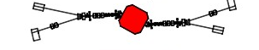
TRIUMF accelerator complex
ISAC-II
High energy
Primary beam driver (1974):
500 MeV Cyclotron, 300 μA, H⁻
Produces rare isotopes, neutrons and muons
Isotope Separator and Accelerator facility – ISAC (1996)
ISAC-I: Normal conducting-linac
  0.15-1.8 MeV/u (2000)
ISAC-II: Superconducting-linac
  1.5-16.5 MeV/u (2006)
Advanced Rare Isotope Laboratory – ARIEL (in progress)
Superconducting electron linac
30 MeV, 10 mA, cw (2019)
4 (+1) Cyclotrons for medical isotope production – TR30 and TR13 designed by TRIUMF
ARIEL
ISAC-I
Low and
medium
energy
Isotope Cyclotrons
elinac
500 MeV Cyclotron and BL1A
IAMI

Slide 6
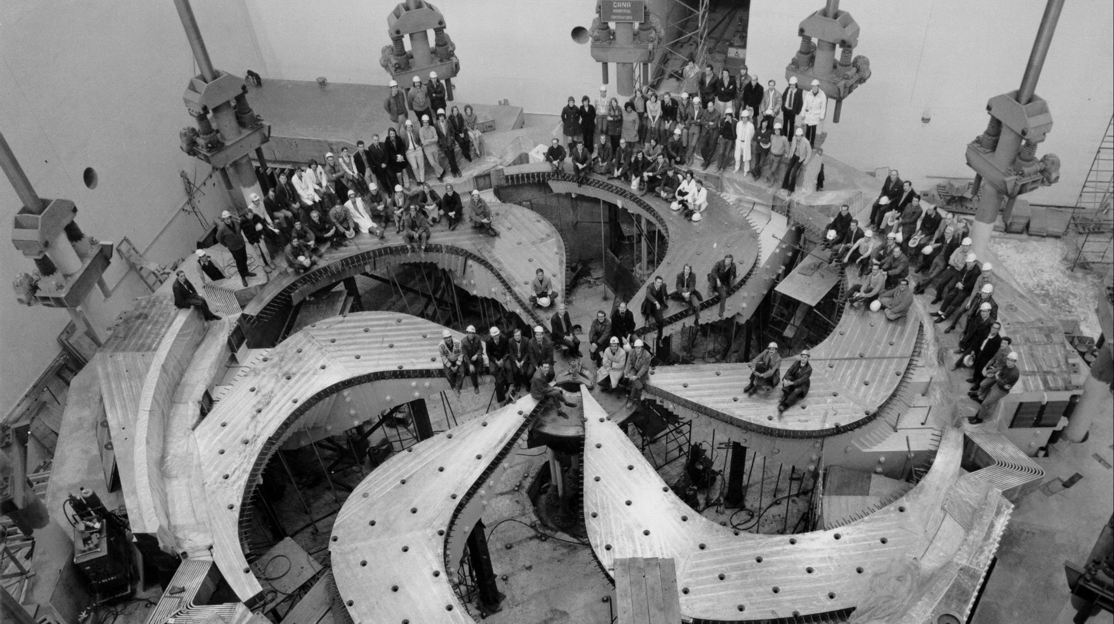
Constructed in the early 70th of last century
Largest normal conducting Cyclotron in the world: D = 18 m
Magnet weight: 4000 t, Coil current: 18500 A
H- cyclotron (multiple extraction at different energies)
5500 hours of beam delivery per year

Slide 7
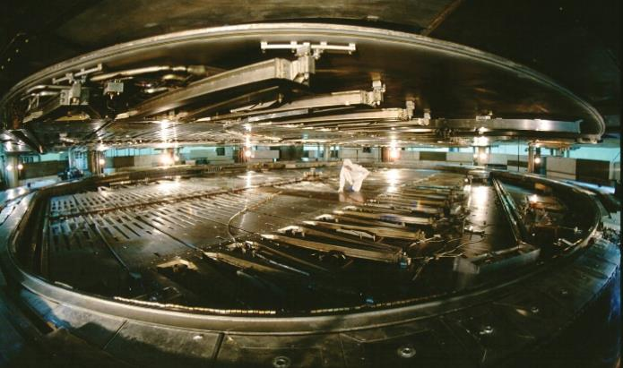
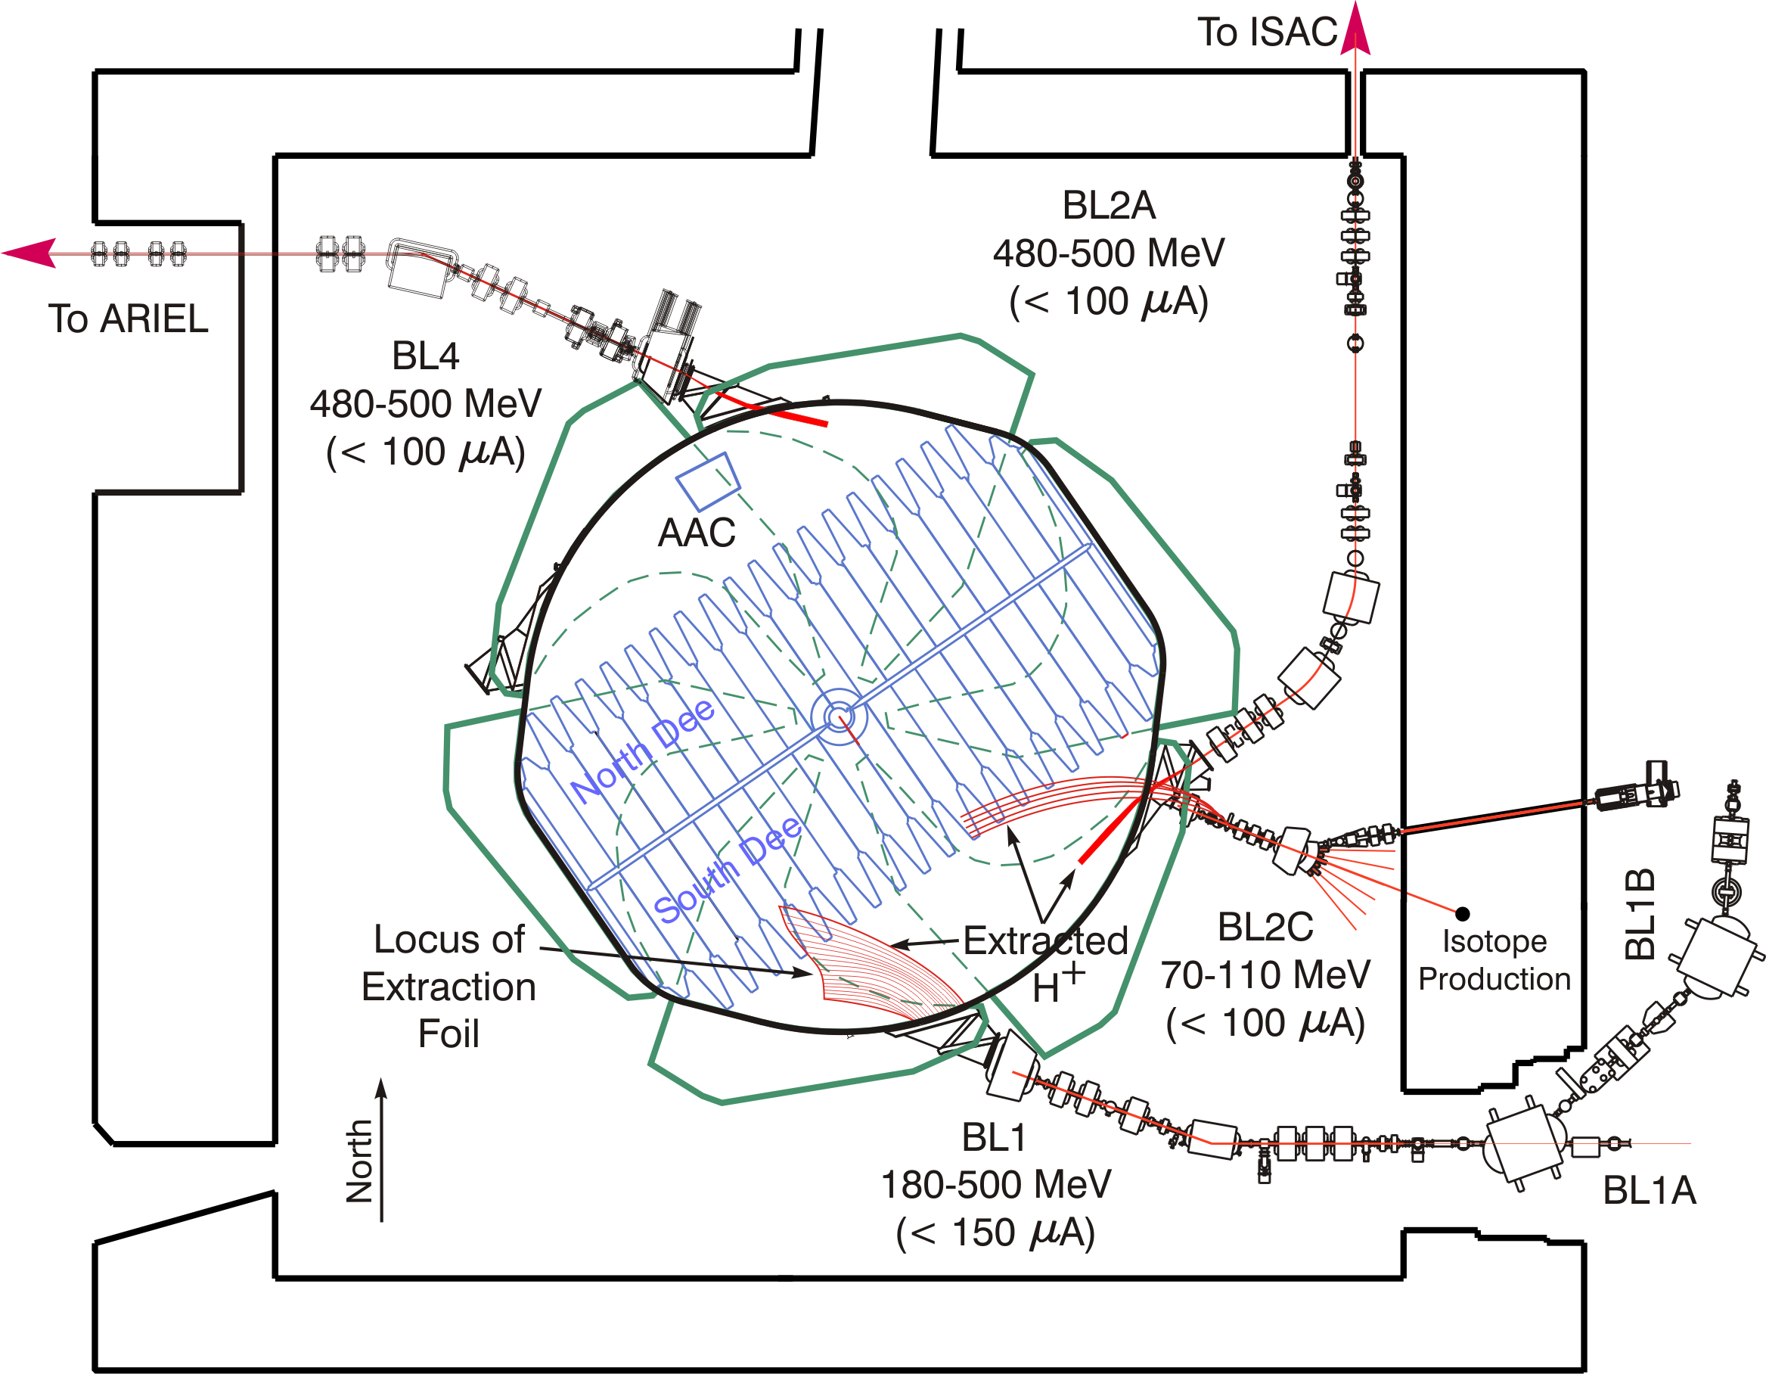
The TRIUMF 500MeV Cyclotron
H⁻ extraction
  Multiple high-power beams by stripping extraction
    Variable energy – simultaneous beam delivery – presently 3 beams extracted
H- Ion
Carbon Foil
⊗B
p
H⁻ extraction
v

Slide 8
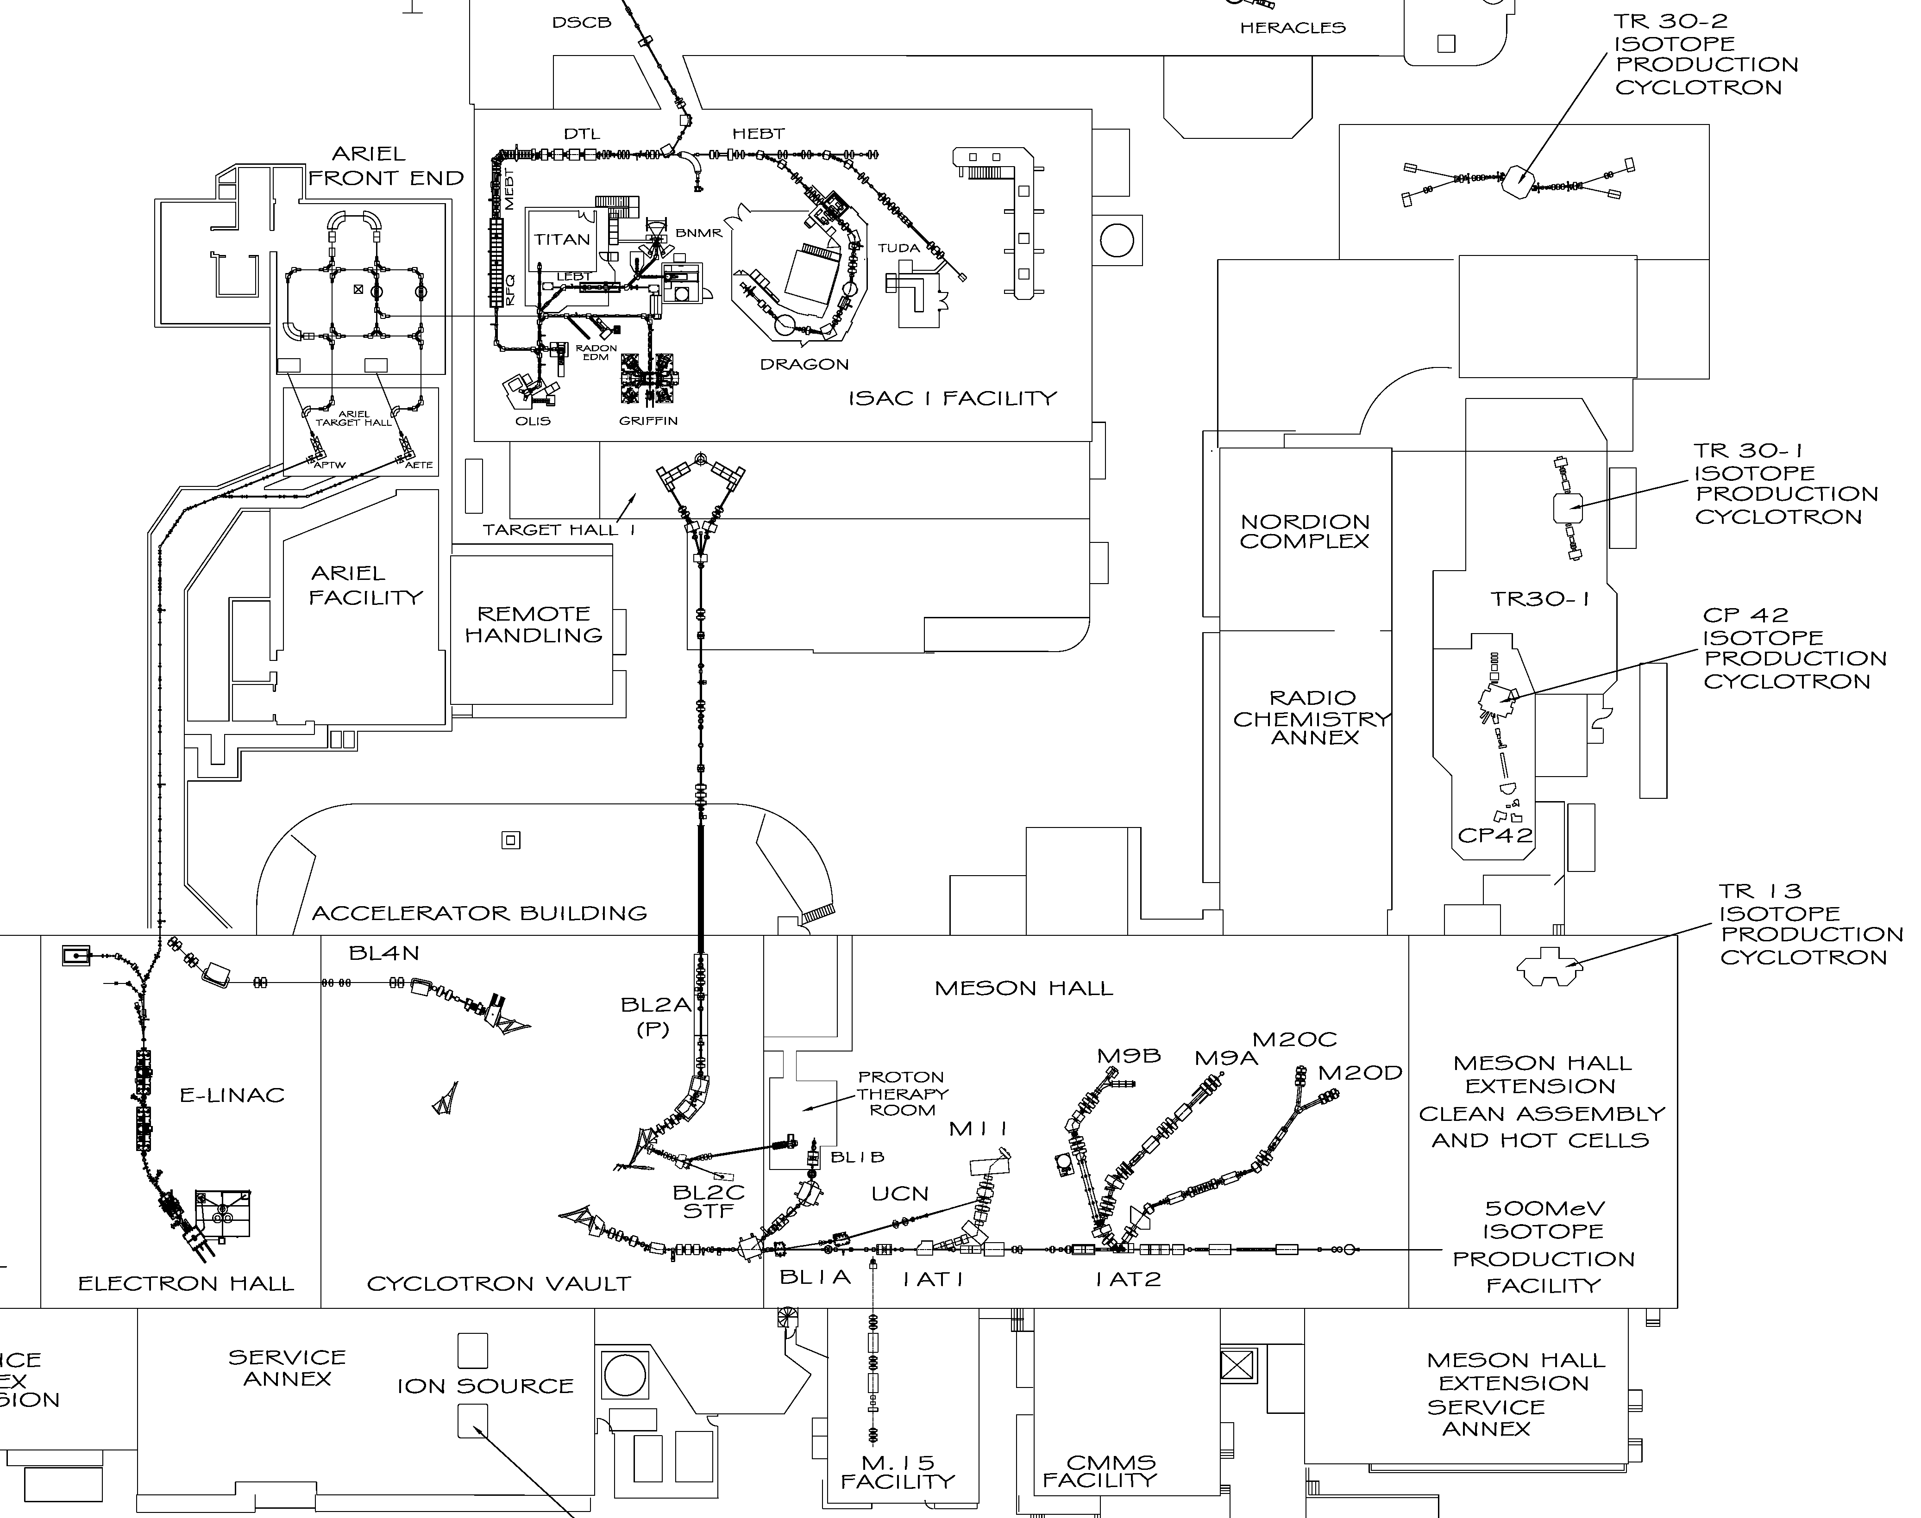

Overview of applications driven by the
520 MeV Cyclotron
The 520 MeV cyclotron provides beam for medical isotope production (Nuclear Imaging & research on particle radiation therapy).
Irradiation capabilities with protons and neutrons.
Proton beams are delivered to
  the Solid Targetstation Facility (STF)
  for Sr production [⁸⁵Rb(p,4n)⁸²Sr]
  Isotope Production Facility (IPF)
  Proton Irradiation Facility (PIF)
  Neutron Irradiation Facility (NIF)
  And in the future to the ARIEL Proton Target Station West (APTW) with the symbiotic medical target in the beam dump.
ARIEL symbiotic target
STF
PIF/NIF
IPF

Slide 9
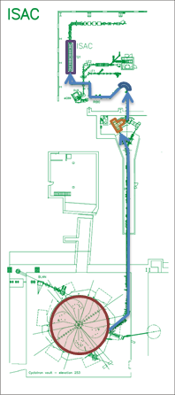
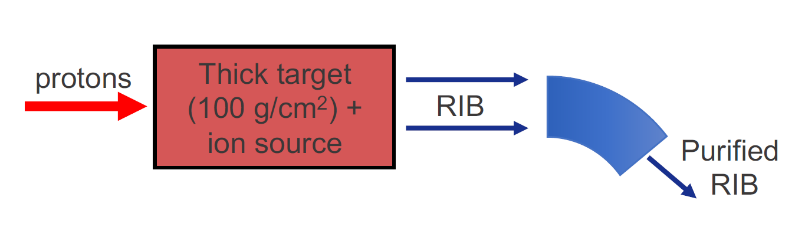
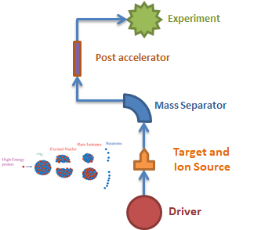
Isotope Separator Accelerator facility - ISAC at TRIUMF
Isotope Separation On-line (ISOL) facility for rare isotope beam (RIB) production
High power proton beam (50 kW)
Extracted ions are mass
separated and either post-accelerated or delivered to low energy experiments directly.
Experiment

Slide 10
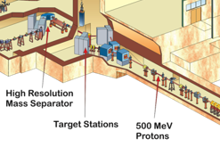
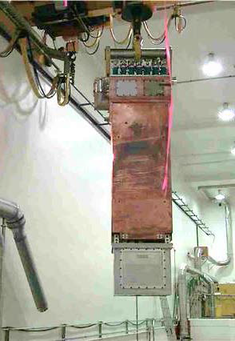
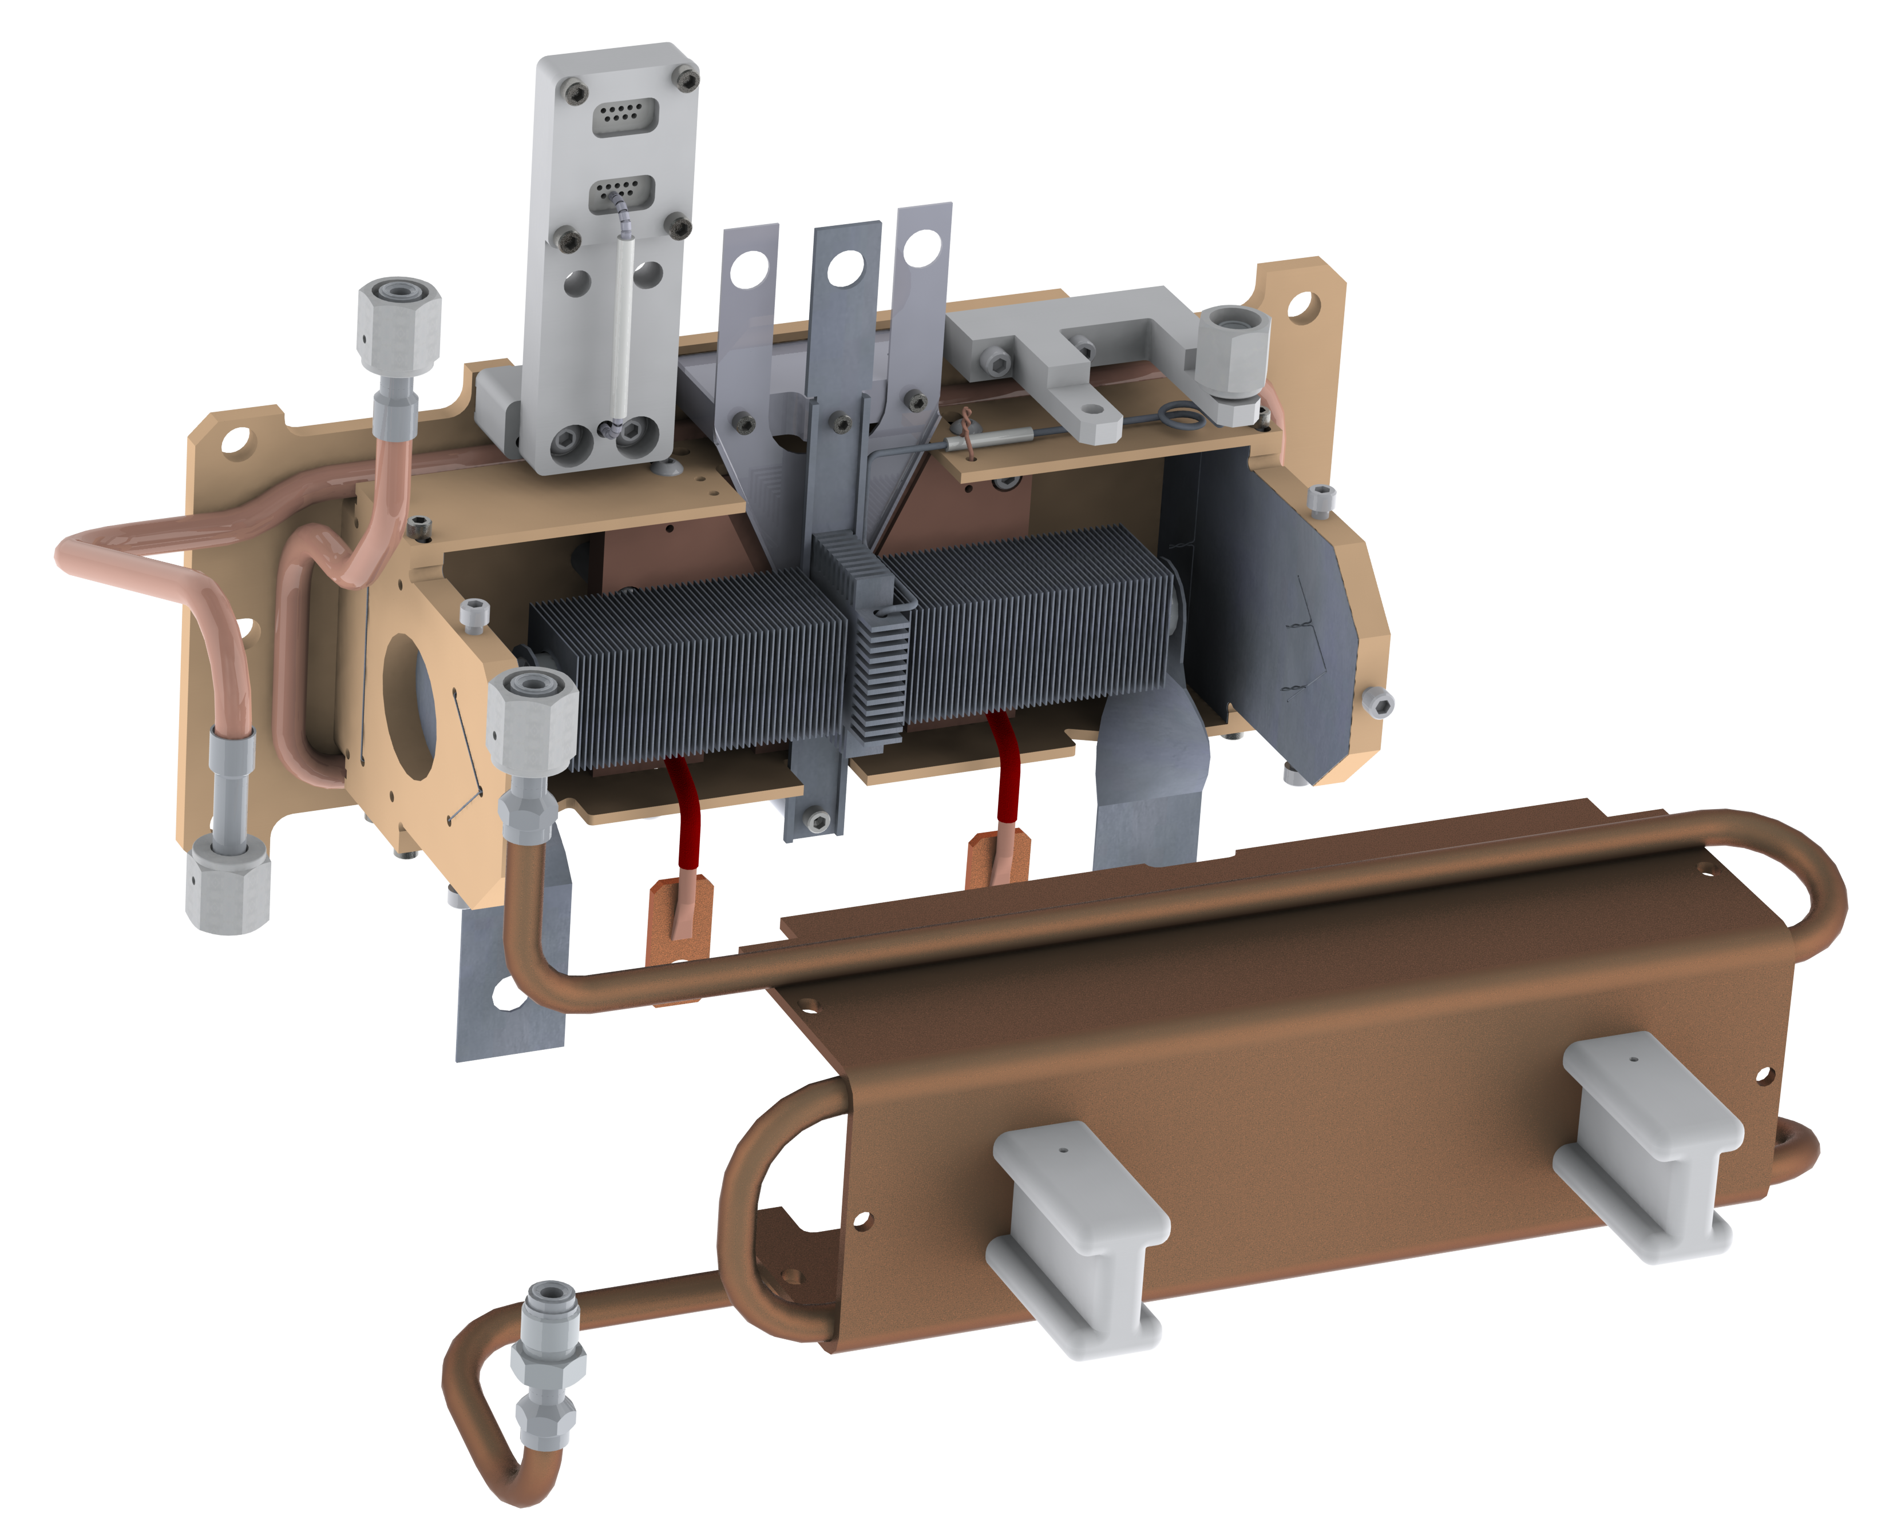
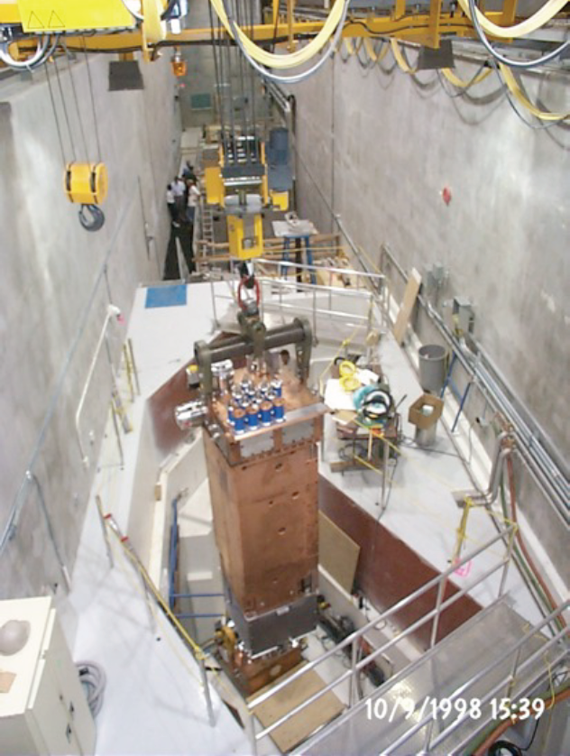
ISAC – World’s Highest Power ISOL Target Systems
Target assembly mounted in the Target Module containment box
The target containment box is mounted on the bottom end of the target module.
The target module is moved to/from target stations via remote handling crane – target exchange is done in a hot cell
Target station
Shielding
500 MeV
protons
Containment Box
Target module
Target assembly

Slide 11
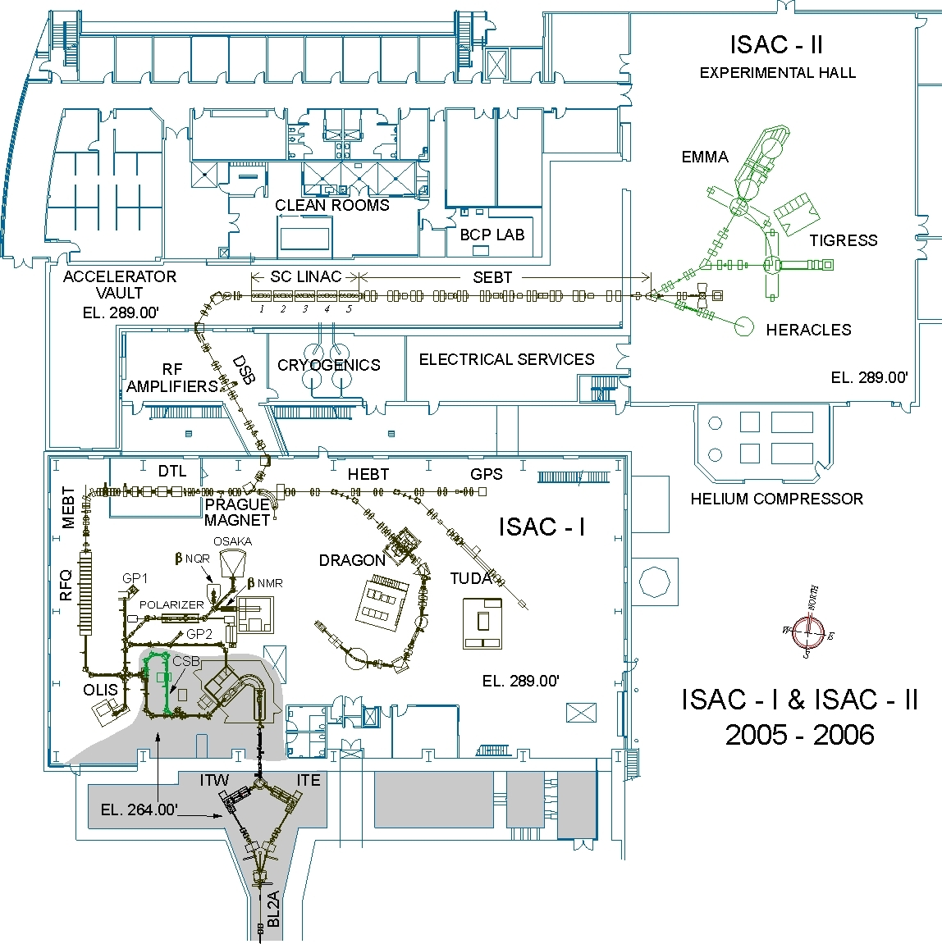
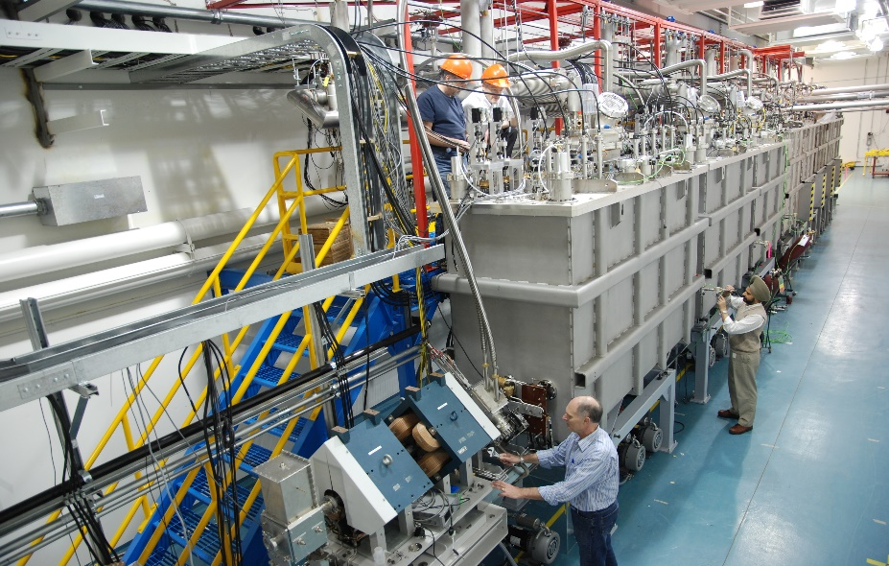
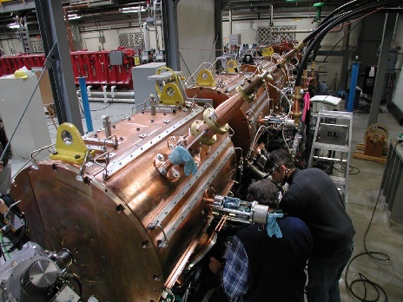
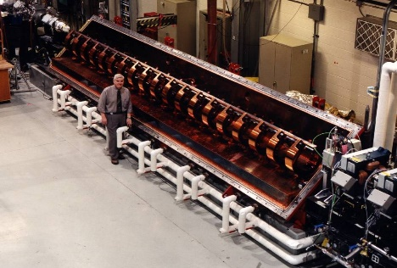
RIB-Post Accelerators
SCRF Lab
SC-Linac
DTL
6
7
8
RFQ
Refrigerator
World leading flexibility and performance:
Fully variable energy from 0.15 MeV/u to 16.5 MeV/u
Designed and built in house
ECR charge breeder
Mass Separator
Targets

Slide 12
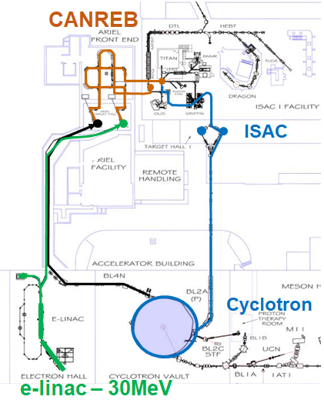
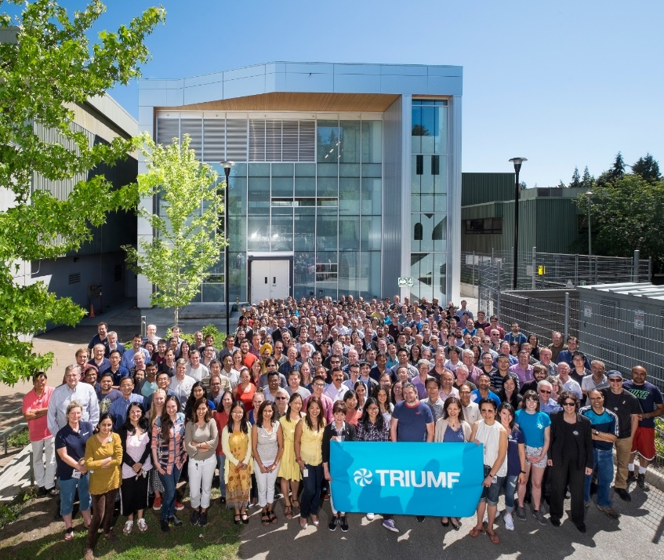
ARIEL: ISAC×3
ARIEL is the world’s most powerful isotope separation online complex.
It will triple ISAC's present rare isotope capabilities by adding
  a 50kW proton target station
  a 100kW electron target station
  Unique beam preparation and transport system (CANadian Rare isotope facility with Electron
  Beam ion source - CANREB)
ARIEL is the only rare isotope
facility that will provide three RIB beams simultaneously to experiments.
ARIEL completion is planned for 2027

Slide 13
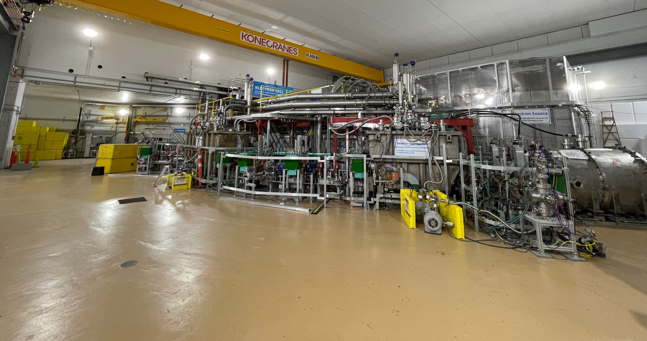
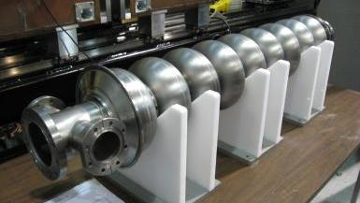
ARIEL – superconducting electron-Linac
10 kW beam dump
cryo-module 2
e⁻gun
Elliptical cavities, 1.3 GHz
9 cell, TESLA type
11 MV/m demonstrated
cryo-module 1
E-gun delivers max. 10 mA at 300 keV beam
The injector cryomodule (1) accelerates to 5-10 MeV
The accelerator cryomodule (2) is equipped with two cavities and reaches max. 30 MeV.

Slide 14
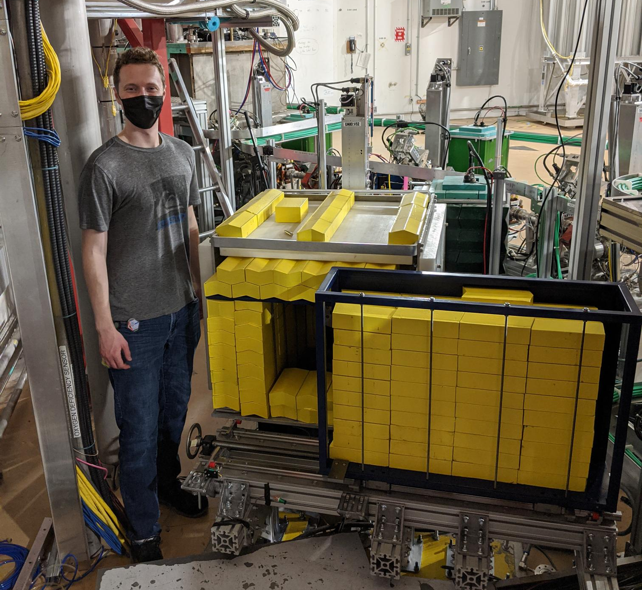
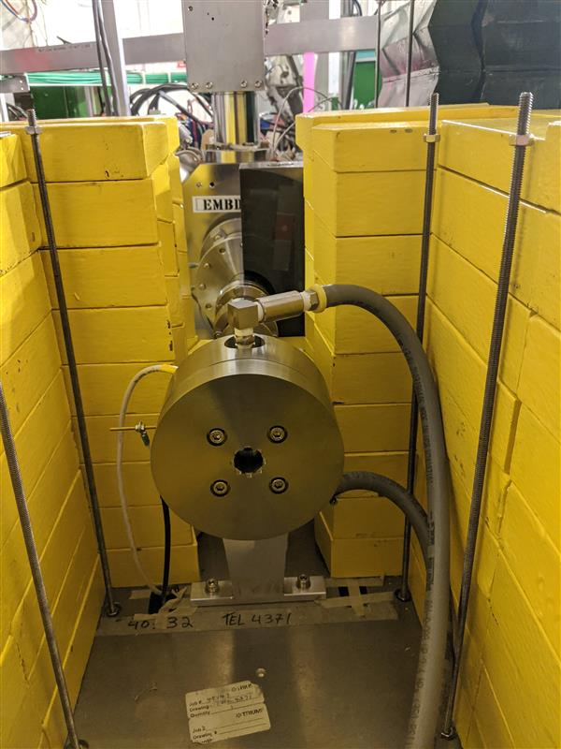
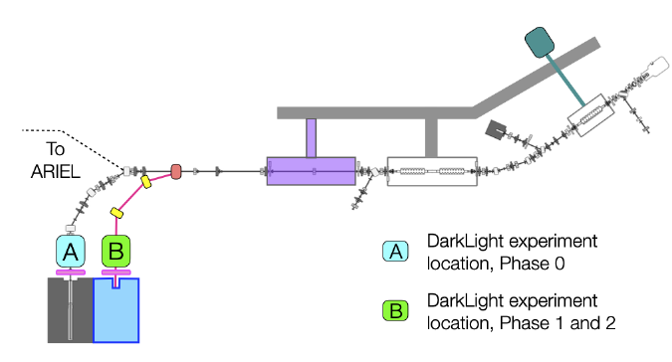
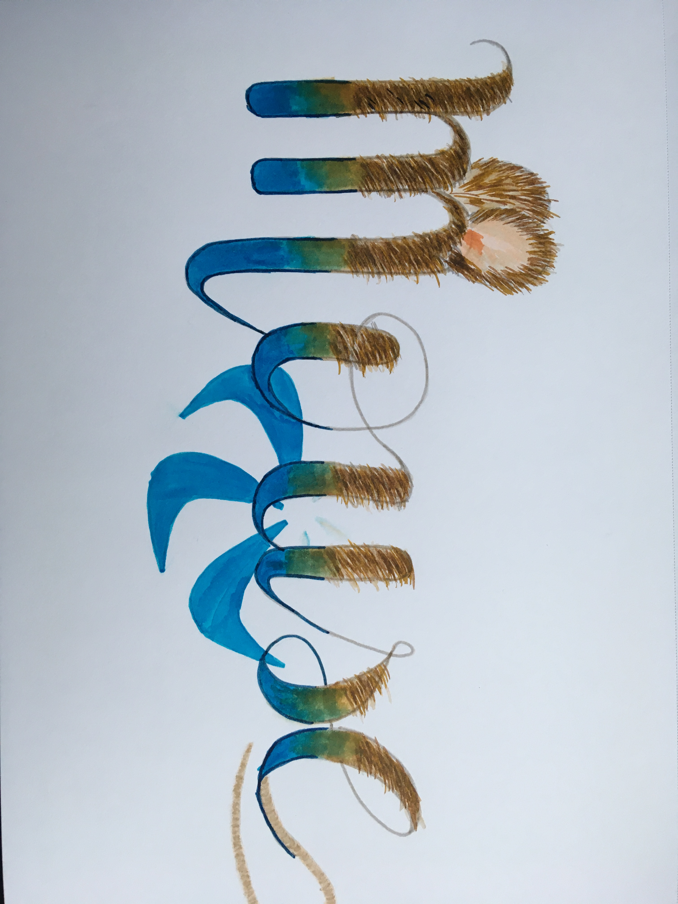
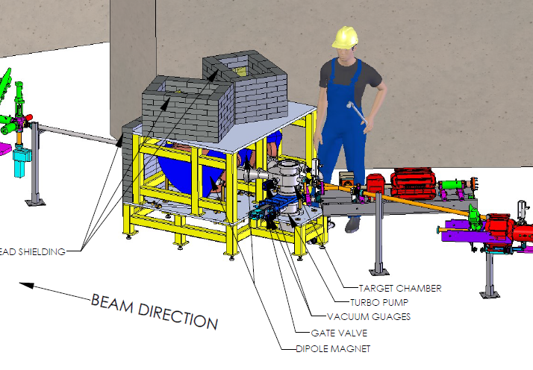
Early science supported by the ARIEL e-linac (active)
FLASH radiotherapy
involves the ultra-fast delivery of radiation treatment at dose rates several orders of magnitude greater than those currently in routine clinical practice.
It is enabled by the new ARIEL convertor technology:
Studies comparing response to identical dose deposited at FLASH and conventional rates in mouse, fruit fly and DNA completed
FLASH does rates about 100 Gy/s, conventional 0.1 Gy/s
Future activities are planned
Dark matter search – DARK LIGHT experiment looking for a 5th force (dark photons) in electron scattering
at the ARIEL e-linac
Experiment gets additional motivation from recent results from the muon g-2 experiment at Fermilab.

Slide 15
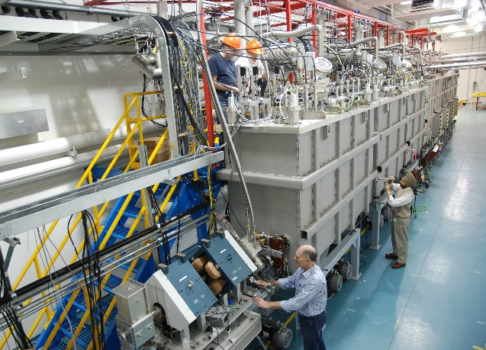
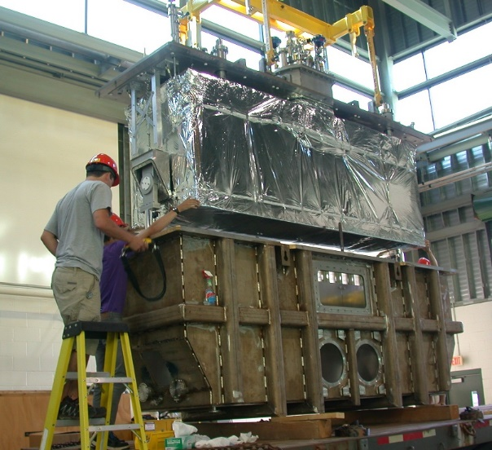
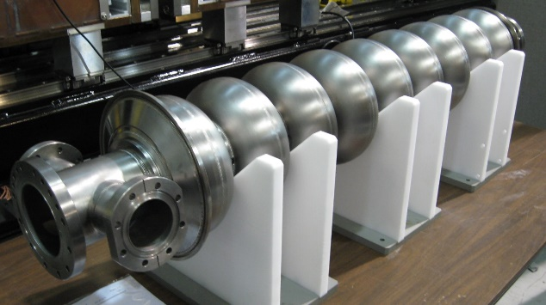
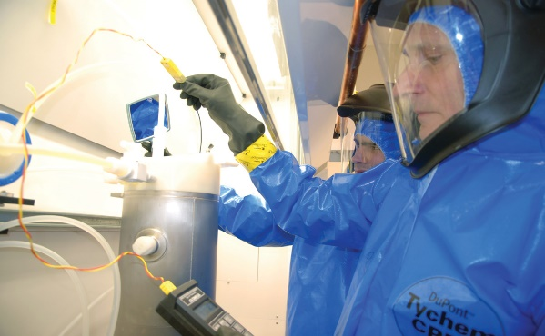
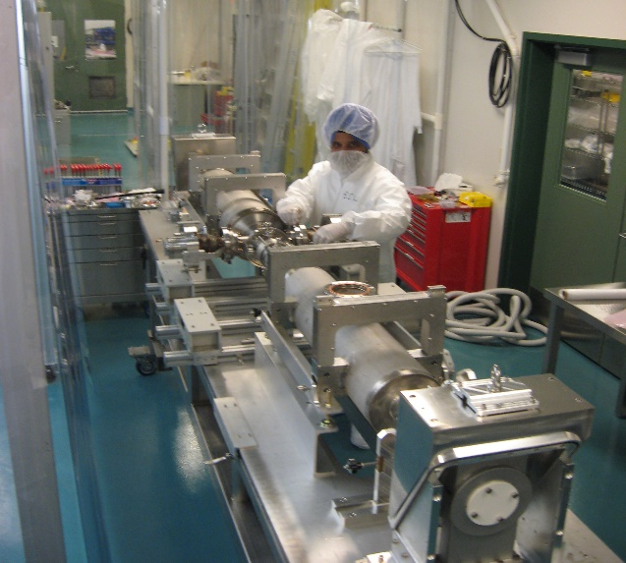
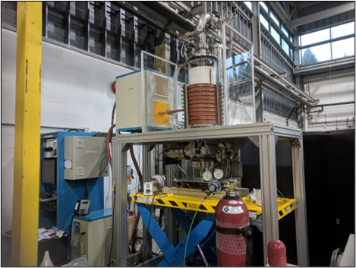
TRIUMF SRF Infrastructure (I)
TRIUMF hosts two SRF linacs (ISAC-II heavy ion linac and the ARIEL electron linac) and SRF supporting infrastructure.
Activities range from student R&D on test resonators to work for others (prototyping cavities and components) and to full cryomodule assemblies
For student training and R&D we have added
  UHV RF induction oven
  Coaxial test resonators for fundamental studies
  New high parallel field spectrometer for beta-NMR

Slide 16
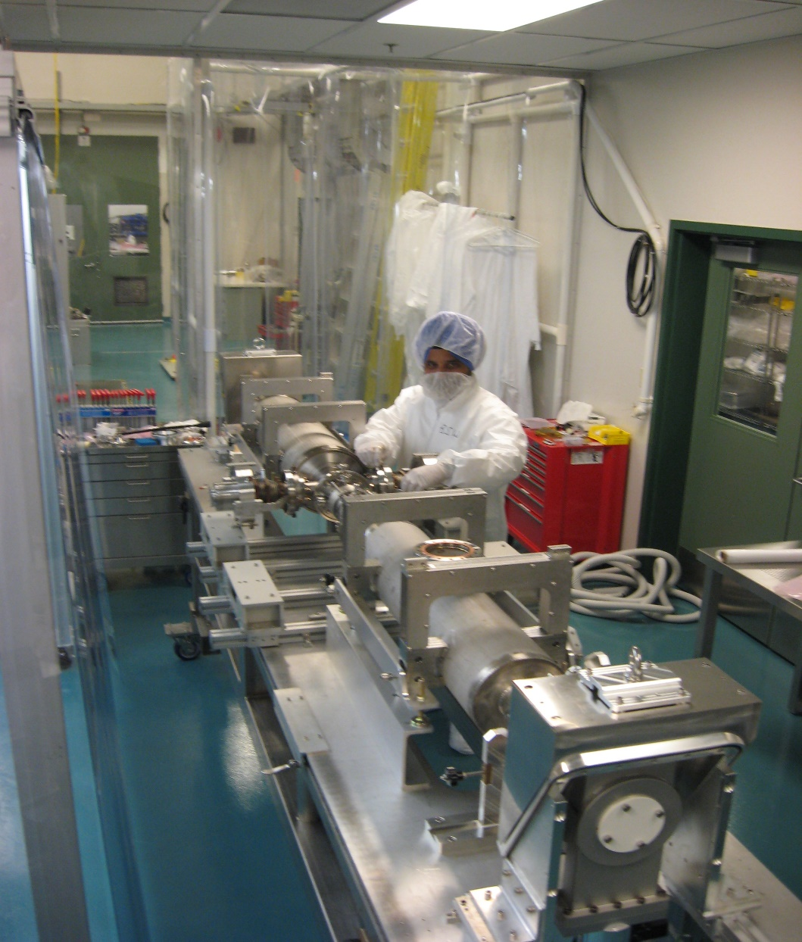
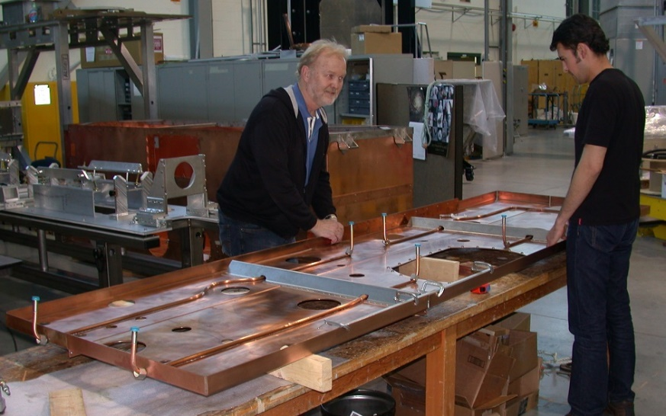
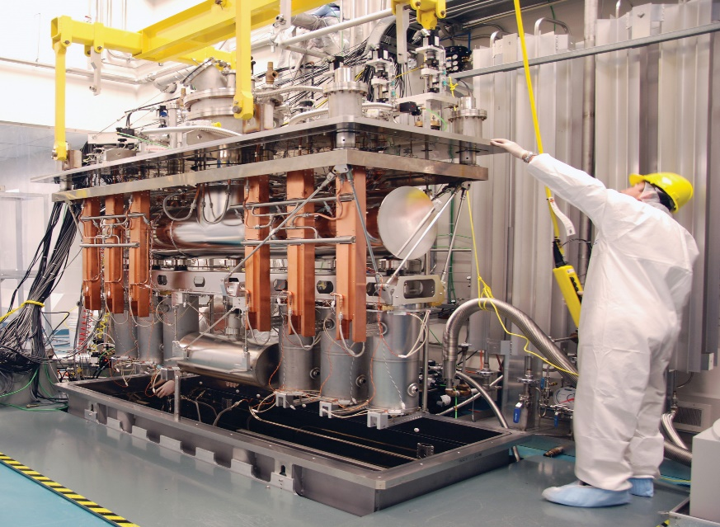
TRIUMF SRF Infrastructure (II)
42m
TRIUMF SRF test and assembly areas
  500m² of floor space, overhead crane comprising:
  US cleaning tanks, HPWR area, cryogenics on tap, cryomodule assembly area (clean room for hermetic string assembly), chemical etching lab (BCP), rf testing
  Minor upgrades of clean room performed to meet the HL-LHC requirements.
  Cryomodule test capability in ISAC-II
    LHe – 100ltr/h in falling level, 200W at 4K, 40W at 2K
    LN2 at 1.5 Bar
    Shielded pit, LLRF, controls
  Issues with space for the HL-LHC project (larger CM assembly space in adjacent hall) →New clean room for ISAC-II ordered!
ISAC-II SCRF Area
RF Controls Lab
Boot Area
RF Measurments
Water Rinse/Clean Area
17m
Boot-up
RF Meas
Preparation Area
SCRF Test Clean Area
Clean Assembly Area
Chemical Lab
Test Pit

Slide 17
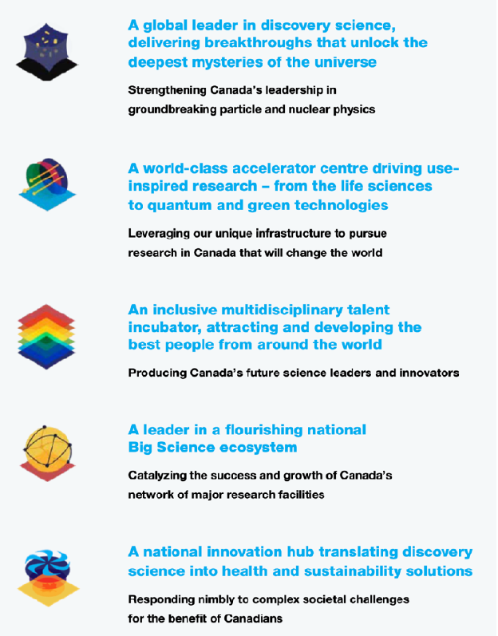

  TRIUMF released the 20-year vision September 2022 as a response to an international peer review.
  The product of an 18 months process engaging a broad research and stakeholder community leading to five core themes.
  The Visions lays out a long-term direction for the laboratory built
  around five pillars defining how
  the community sees the
  laboratory’s future.

Slide 18




Thank you
Merci
www.triumf.ca
Follow us @TRIUMFLab

