Slide 1



MQXFA Status
Giorgio Ambrosio,
with contributions from the whole MQXFA team

Slide 2
Acknowledgement
US HL-LHC Accelerator Upgrade Project (AUP)
  BNL: K. Amm, M. Anerella, A. Ben Yahia, H. Hocker, P. Joshi, F. Kurian, J. Muratore, J. Schmalzle, P. Wanderer
  FNAL: G. Ambrosio, G. Apollinari, M. Baldini, J. Blowers, R. Bossert, R. Carcagno, G. Chlachidze, J. DiMarco, S. Feher, S. Krave, V. Lombardo, C. Narug, A. Nobrega, V. Marinozzi, C. Orozco, T. Page, S. Stoynev, T. Strauss, M. Turenne, D. Turrioni, A. Vouris, M. Yu
  LBNL: D. Cheng, P. Ferracin, L. Garcia Fajardo, E. Lee, M. Marchevsky, M. Naus, I. Pong, S. Prestemon, K. Ray, G. Sabbi, G. Vallone, X. Wang
  NHMFL: L. Cooley, J. Levitan, J. Lu, R. Walsh
CERN: HL-LHC Project
  G. Arnau Izquierdo, A. Ballarino, M. Bajko, C. Barth, N. Bourcey, B. Bulat, M. Cruovizier, A. Devred, H. Felice, S. Ferradas Troitino, L. Fiscarelli, J. Fleiter, M. Guinchard, O. Housiaux, S. Izquierdo Bermudez, N. Lusa, F. Mangiarotti, A. Milanese, A. Moros, P. Moyret, C. Petrone, J.C. Perez, H. Prin, R. Principe, E. Ravaioli, T. Sahner, S. Sgobba, P. Tavares Coutinho Borges De Sousa, E. Todesco, J. Ferradas Troitino, R. Van Weelderen, G. Willering

Slide 3
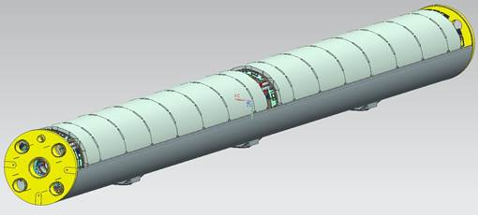
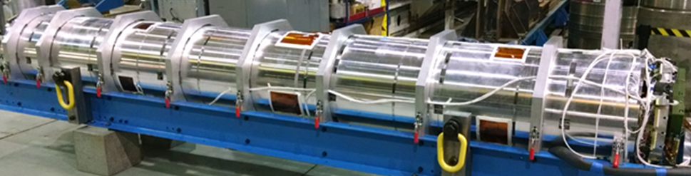

MQXFA (AUP 302.2) Deliverables
20 Magnets
  16 magnets for 8 Q1/Q3 to be installed in LHC tunnel
  4 magnets for 2 Q1/Q3 commissioning spares
  (assuming: 4 re-assemblies = post test re-work)
  (assuming: 1 damaged during handling or shipment)
Magnet
(MQXFA)
Cold Mass
(LMQXFA)
Cryo-assembly
(LQXFA)

Slide 4
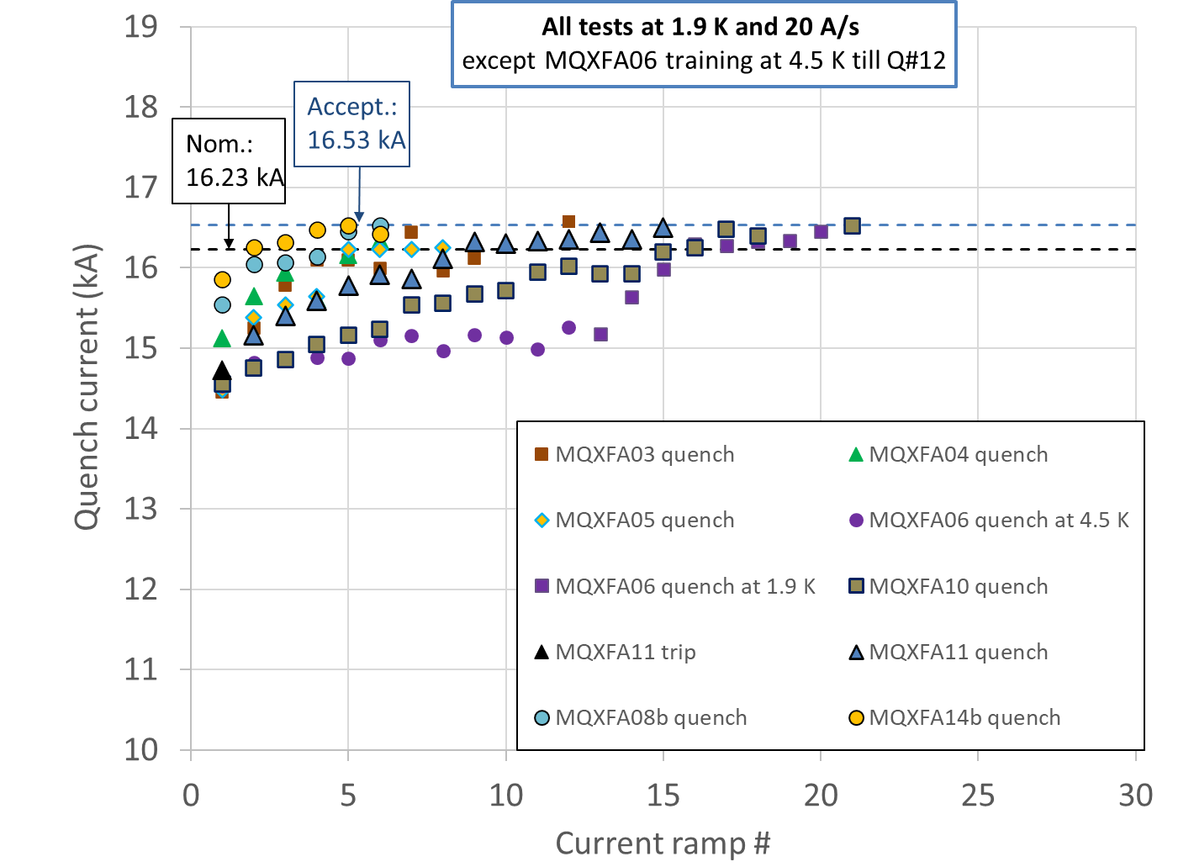

The Big Picture
MQXFA magnets
Tested: 11
Met Requirements: 8
Did not meet requir.: 3
Waiting for test: 1
Being assembled: 2
MQXFA at BNL after shipment from LBNL

Slide 5
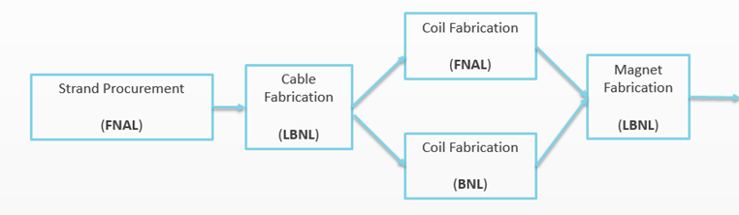
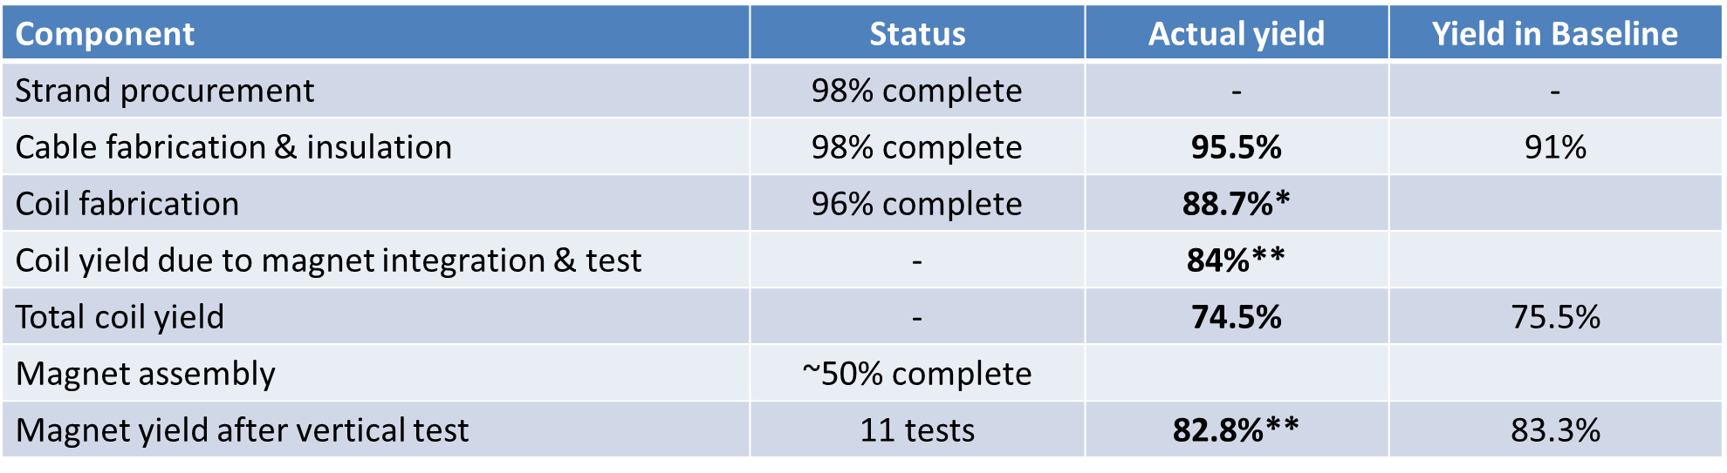
Status Summary
BL Yield: 75.5%
Coil Parts (FNAL)
BL Magnet
Yield: 83.3%
BL Yield: 91%
BL Yield: 75.5%
*,** see backup slides for notes

Slide 6
Conductor Procurement & QC
Conductor delivery:
  ~98% conductor received (out of 260 km, including LARP proc.)
  Last shipment (40 km) expected in October 2023
  Some spools that were reworked received extra lubricant, and impacted cable stability (see next slide)
Strand verification 98% complete
Cable qualification 100%
Witness Sample tests ~94%

Slide 7
Cable Fabrication & Insulation
Cable Fabrication & Insulation Status:
  Fabricated: 111 (+ 4 from LARP)
  To be fabricated: 2
Cable yield:
  Yield is 95.5% (4 rejected, 2 on-hold), vs. 91% assumed in Baseline
    Some cables (5) were on-hold because of strand lubrication issue causing cable mechanical instability
      Coil fabrication teams (at FNAL and BNL) were able to fix all popped strands in 3 cables and fabricate 3 coils

Slide 8

Coil Fabrication at FNAL & BNL
Coil fabrication is 96% complete (out of 106 coils)
¹Assuming to use some coils on hold
More details on Thursday in
MQXFA fabrication status and schedule

Slide 9
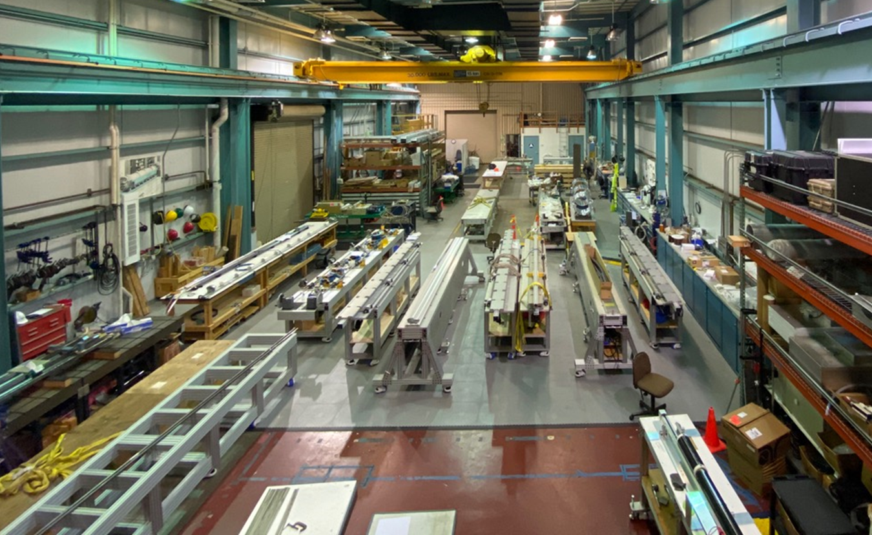
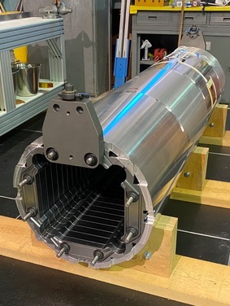
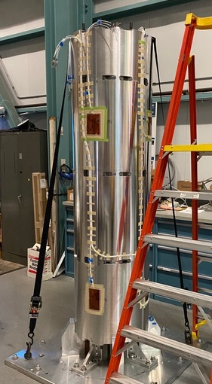
MQXFA Structure Proc. & Magnet Assembly
Procurement of main parts is complete
Two assembly lines at LBNL are fully operational
  staggered mode
15 magnets have been assembled
  11 tested (8 successful, 2 reworked, 1 to be reworked)
  2 disassembled for NCRs
  1 preload adjustment based on lessons learned from MQXFA13
  1 ready for test (MQXFA07b)
Assemblies of MQXFA16 and MQXFA17 are in progress.
More details on Thursday in MQXFA, magnet assembly and preload by Dan Cheng
Two MQXFA assembly lines at LBNL
MQXFA shell-yoke assembly in process

Slide 10
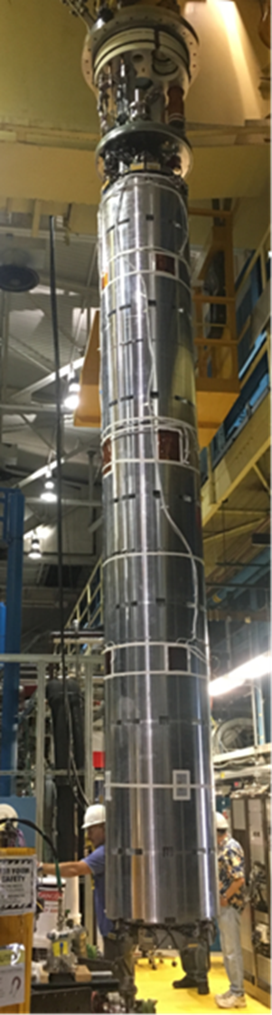
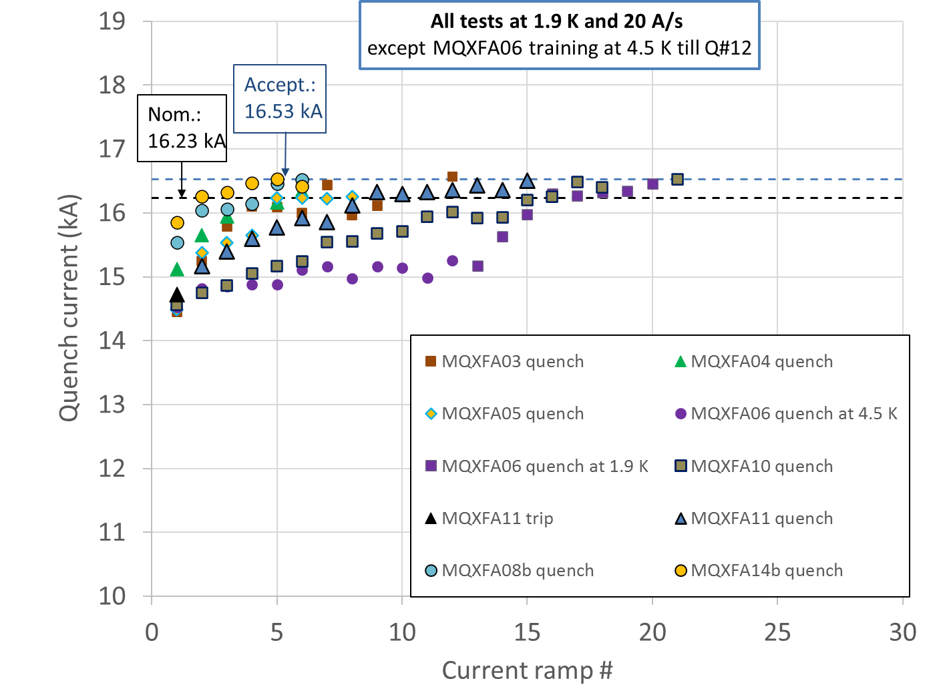
MQXFA Vertical Test (by 302.4)
8 magnets met requirements out of 11 tests
More details on Wednesday in Test Production testing summary of the MQXFA magnets by Anis Ben Yahia; and in Field quality and integrated gradient in MQXFA magnets and LQXFA/B01 by Joe Di Marco.
MQXFA magnet being moved to vertical test station at BNL

Slide 11
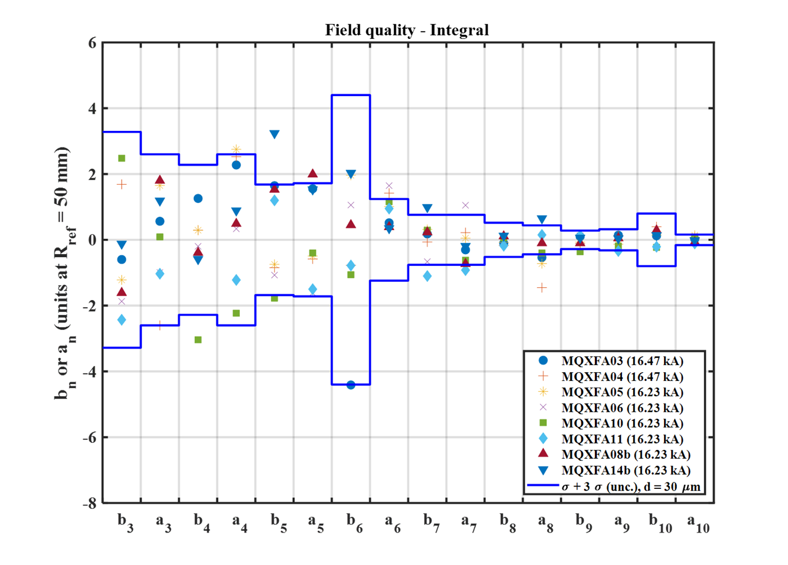
MQXFAs Integral Harmonics at Nominal Curr.
b6 correction introduced in one coil on MQXFA04 and all subsequent coils:
125 um shift toward midplane
Magnetic shims used to correct low order harmonics
Before b6 correction in cross-section
More details on Wednesday in Field quality and integrated gradient in MQXFA magnets and LQXFA/B01 by Joe Di Marco.

Slide 12
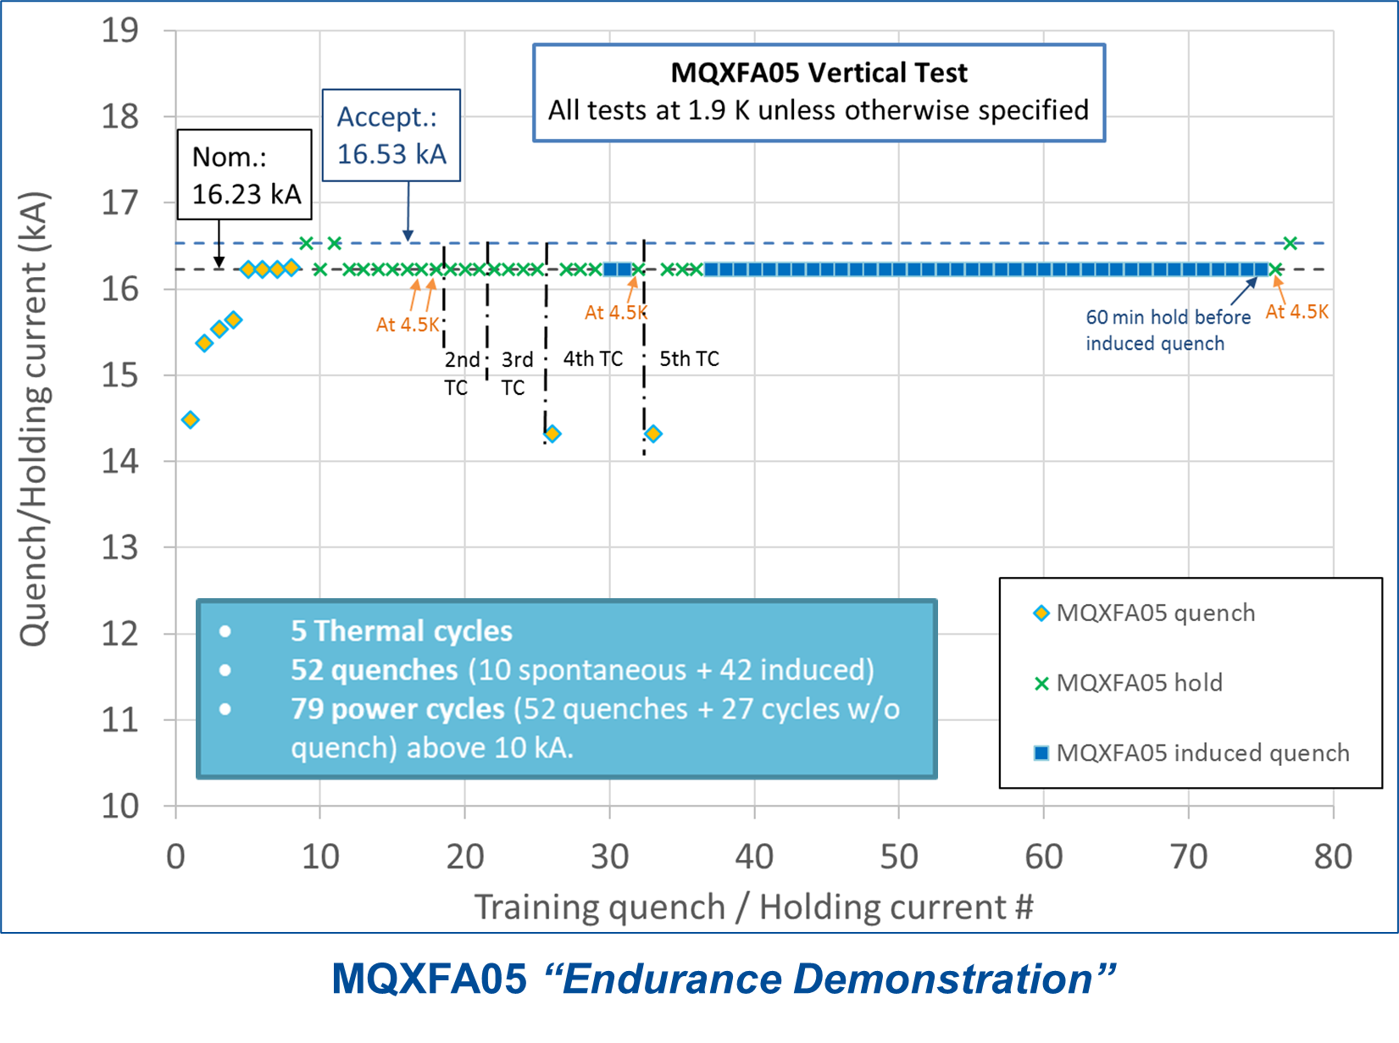
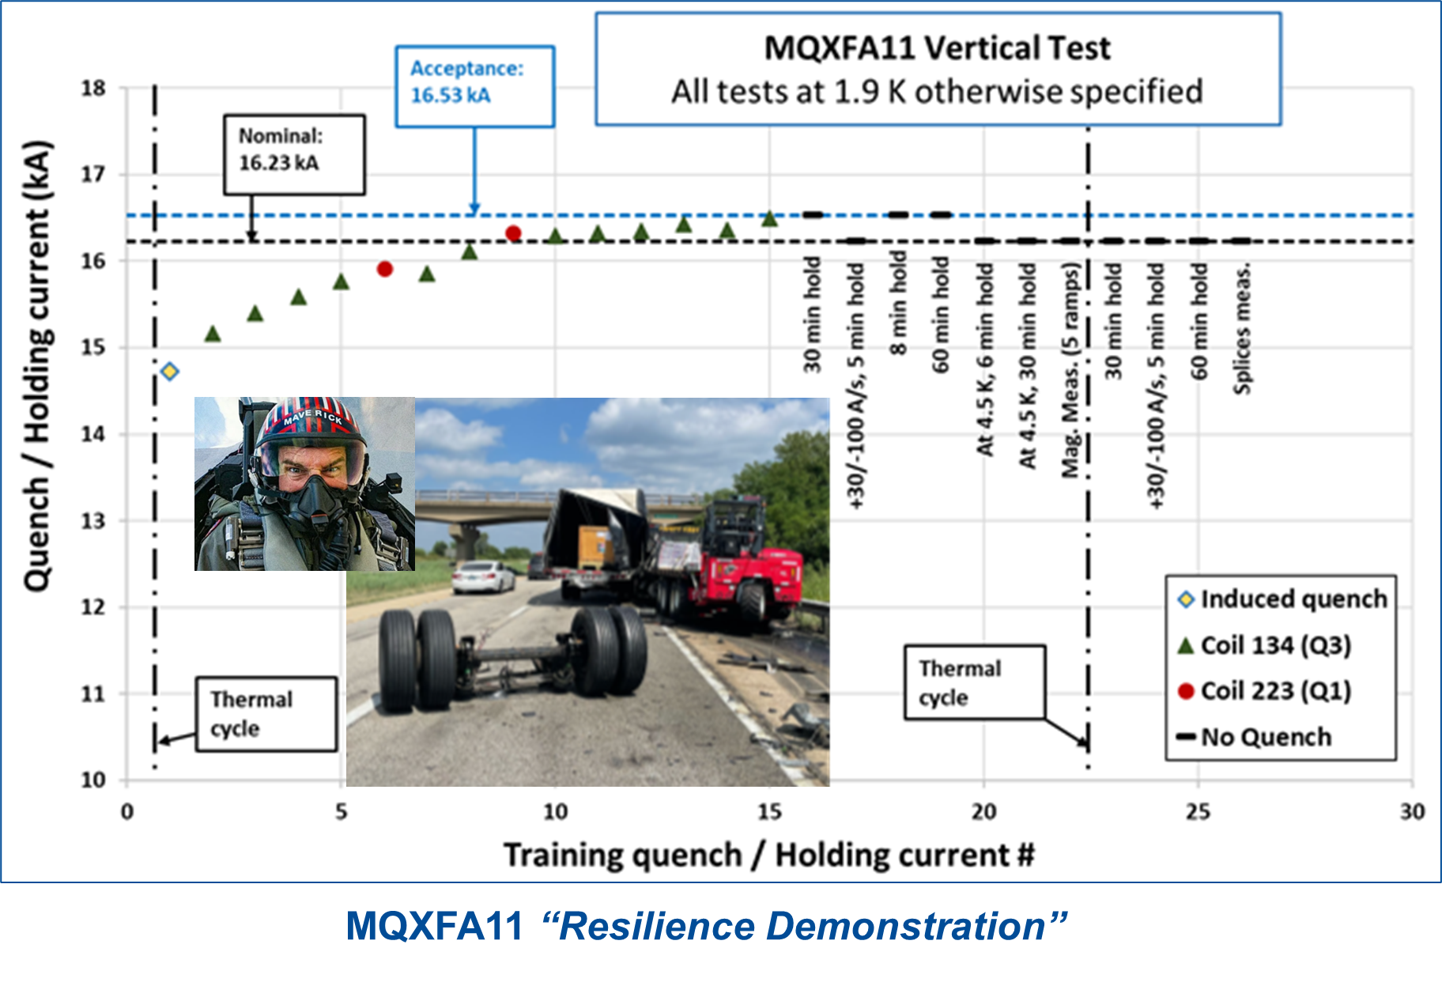
“Endurance” & “Resilience” Demonstrations
More details on Wednesday in Test Production testing summary of the MQXFA magnets by Anis Ben Yahia.

Slide 13
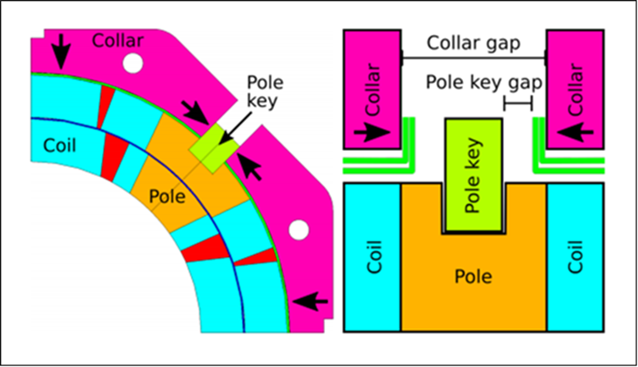
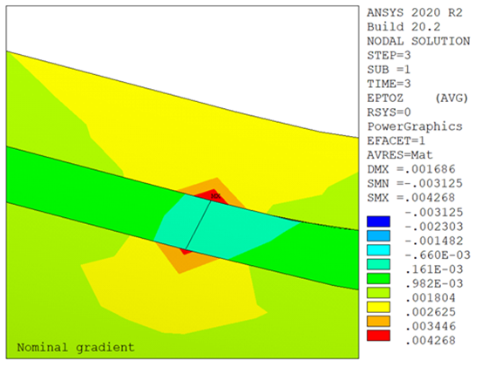
Lessons Learned from MQXFA07/08 NCR
MQXFA07 and MQXFA08 non-conformity analyses are complete (AUP doc-4293 & 4776; EDMS# 2777612)
  “Smoking gun” (broken Nb₃Sn filaments) was found through metallographic analysis by CERN team
Lessons learned:
  Asymmetry during assembly may be looked-in by prestress
  2D asymmetry may cause poor preload in the ends
  COVID restrictions contributed to these issues
All causes have been addressed for future magnets
Closed pole key gap in a coil may lead to poor longitudinal preload in the ends of that coil at edge to end-spacer transition

Slide 14
Lessons Learned from MQXFA13 NCR
MQXFA13 investigation is in progress
  metallographic analysis to be performed at CERN
Main suspect: Small arc-length in the ends of all coils caused low pre-load and high strain in the ends.
  Limiting coil had smallest arc-length of all tested coil
Preventive actions:
  Increased the maximum allowable stress during preload: from 110 to 120 MPa
  Target for minimum loading key size based on coil dimensions
More details on Thursday in MQXFA, magnet assembly and preload by Dan Cheng

Slide 15
Plans and Schedule
Plans for magnet assembly:
  MQXFA07b is at BNL for test
  MQXFA15 preload adjustment in a couple of weeks after MQXFA16 is complete
  MQXFA16 & MQXFA17 have high priority for test in CA05
  MQXFA13b and MQXFA12b after them
  MQXFA09 was retired
    2 coils and structure reused in other magnets
Working Schedule
  August update:

Slide 16
Conclusions
The fabrication of MQXFA magnets by US-AUP is at peak production rate.
  Strand procurement, Cable fabrication, Coil fabrication are almost complete
  Magnet assembly is close to 50% complete
Cable yield is higher than starting assumption, whereas coil yield is lower. Baseline was changed accordingly.
Three magnets out of eleven did not meet requirements during vertical test. Lessons were learned and changes implemented.
Last magnet to be completed around beginning of 2025

Slide 17
Back up Slides

Slide 18
Status Summary
*The actual yield includes the sum of the probabilities of using coils on hold (i.e. 2 coils with 50% probability of being used = 1 coil approved for use).
**MQXFA07 and MQXFA08 coils and magnets were fabricated under Covid restrictions. AUP project was re-baselined assuming that 66% of MQXFA07 and MQXFA08 limited performances were due to the impact of Covid restrictions. These issues assumed to be Covid impact were not included in the actual yield.

Slide 19
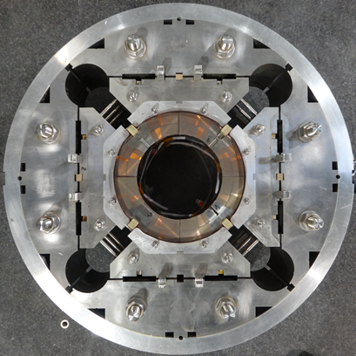
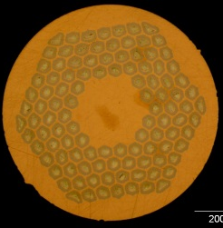
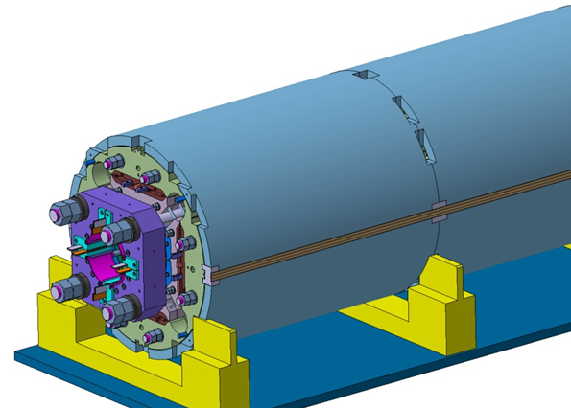
MQXFA/B Design
Parameter | Unit | MQXFA/B
Coil aperture | mm | 150
Magnetic length | m | 4.2/7.15
N. of layers |  | 2
N. of turns Inner-Outer layer |  | 22-28
Operation temperature | K | 1.9
Nominal gradient | T/m | 132.2
Nominal current | kA | 16.23
Peak field at nom. current | T | 11.3
Stored energy at nom. curr. | MJ/m | 1.15
Diff. inductance | mH/m | 8.26
Strand diameter | mm | 0.85
Strand number |  | 40
Cable width | mm | 18.15
Cable mid thickness | mm | 1.525
Keystone angle |  | 0.4
Nb₃Sn Conductor
RRP 108/127
P. Ferracin et al., “Development of MQXF, the Nb₃Sn Low-β Quadrupole for the HiLumi LHC ” IEEE Trans App. Supercond. Vol. 26, no. 4, 4000207
G. Ambrosio et al., “First Test Results of the 150 mm Aperture IR Quadrupole Models for the High Luminosity LHC” NAPAC16, FERMILAB-CONF-16-440-TD

Slide 20
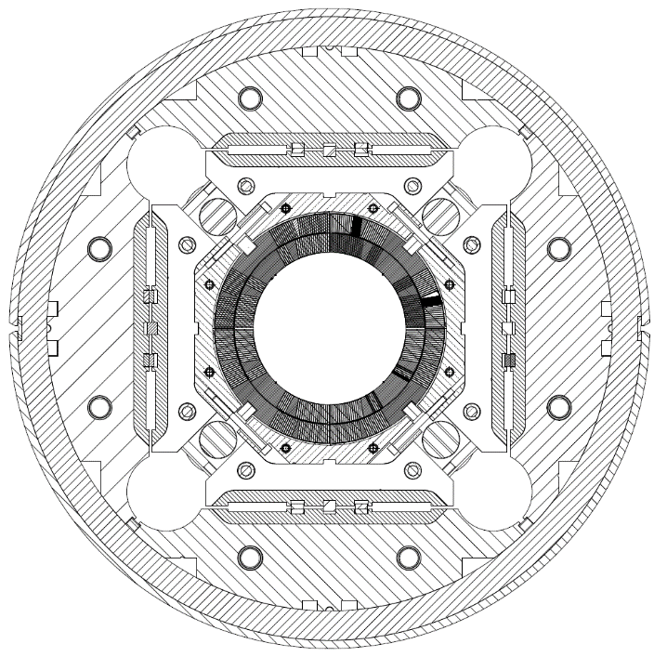
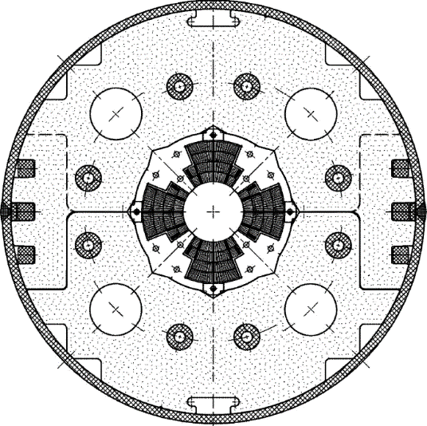
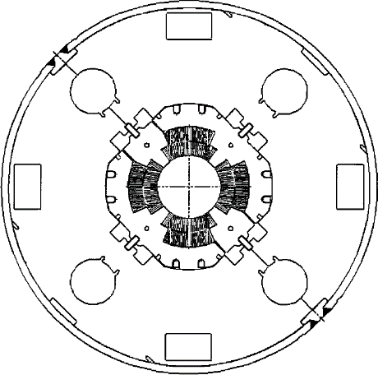
Low-β quadrupole magnets from LHC to HL-LHC
Cold mass OD from 490/420 to 630 mm
More than double the aperture: from 70 to 150 mm
~4 times the e.m. forces in straight section
~6 times the e.m. forces in the ends
State of the art quadrupoles at the time of LHC construction
MQXF
MQXA
MQXB
Same scale for all 3 plots

