Slide 1


Status of D1
Tatsushi NAKAMOTO, KEK
On behalf of CERN-KEK Collaboration for D1 Construction for HL-LHC
13th HL-LHC Collaboration Meeting, Vancouver, Canada, Sept. 25, 2023

Slide 2
Acknowledgement
KEK (in particular)
M. Sugano, K. Suzuki, Y. Arimoto, R. Ueki, Y. Ikemoto, H. Kawamata,
N. Okada, R. Okada, H. Ohhata, A. Terashima, K. Tanaka, N. Ohuchi, T. Ogitsu.
Univ. of Tokyo
N. Kimura.
CERN (in particular)
E. Todesco, J. C. Perez (WPE), H. Prin, D. Duarte Ramos, C. Scheuerlein,
H. G. Gavela, A. Devred.
Hitachi
M. Yanagisawa, A. Yokogi, H. Togashi, T. Tahara, T. Chiba
Fusac Technologies
T. Ichihara.

Slide 3
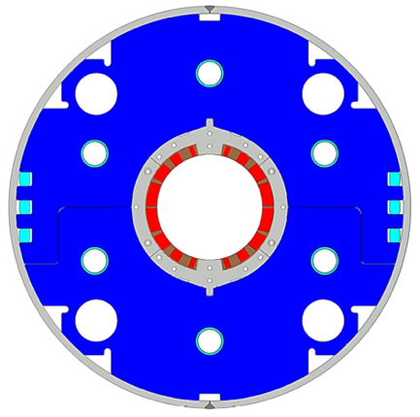
Japanese Contribution to HL-LHC: D1 magnets
Beam separation dipole (D1) by KEK
  Design study of D1 for HL-LHC within the framework of the CERN-KEK collaboration since 2011.
  150 mm single aperture, 35 Tm (5.6 T x 6.3 m), Nb-Ti technology.
  Development 2-m long model magnets (3 units) at KEK
Deliverables for HL-LHC
  1 full-scale prototype cold mass (LMBXFP)
  6 series cold masses (LMBXF1-6)
7 units x 7-m long cold masses

Slide 4
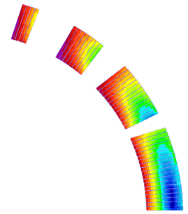
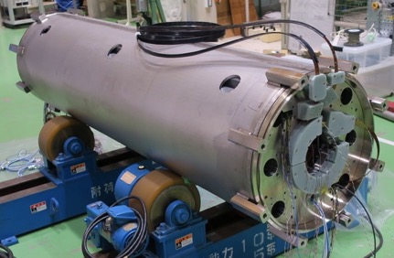
Design parameters
GFRP
wedge
Collar
 | prototype, series production (7m)
Coil aperture | 150 mm
Field integral | 35 T m
Field (3D) | Nominal: 5.60 T, Ultimate: 6.04 T
Peak field (3D) | Nominal: 6.58 T, Ultimate: 7.14 T
Current | Nominal : 12.11 kA, Ultimate 13.23 kA
Operating temperature | 1.9 K
Field quality | <10⁻⁴ w.r.t B₁ (R_{ref}=50 mm)
Load line ratio (3D) | Nominal: 76.5%, Ultimate: 83.1% at 1.9 K
Differential inductance | Nominal: 4.0 mH/m
Conductor | Nb-Ti: LHC-MB outer cable
Stored energy | Nominal: 340 kJ/m
Magnetic length | 6.26 m
Coil mech. length | 6.58 m
Magnet mech. length | 6.73 m
Heat load | 135 W (Magnet total) 2 mW/cm³ (Coil peak) > 25 MGy
Radiation dose
Shell
Nb-Ti/Cu coil
Yoke
QPH
Insulation
Brass shoe
4
8
12 ton
13
4 blocks
44 turns
19
Large-aperture single layer coil → Mechanical support of a coil is challenging
Three 2 m model magnets were developed at KEK.

Slide 5
D1 Prototype Cold Mass: MBXFP1

Slide 6
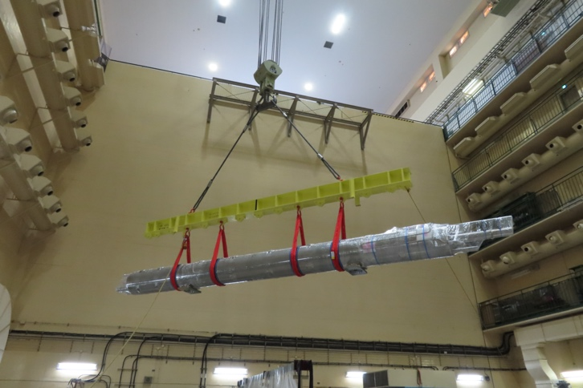
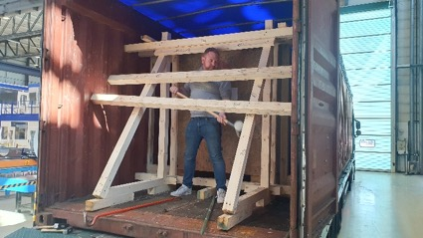
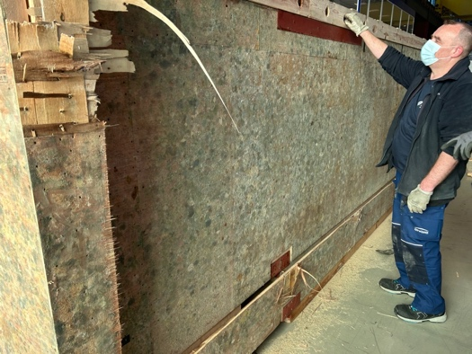
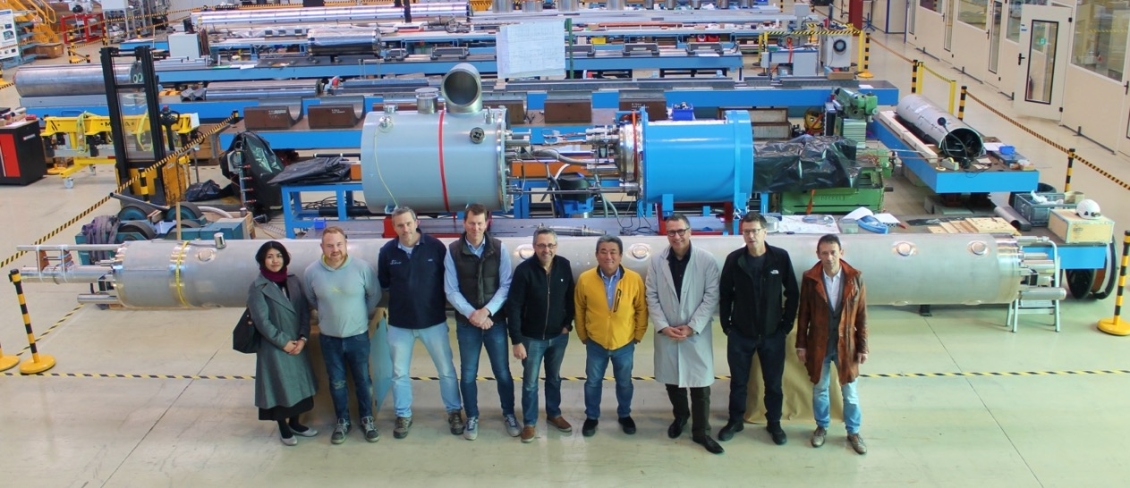
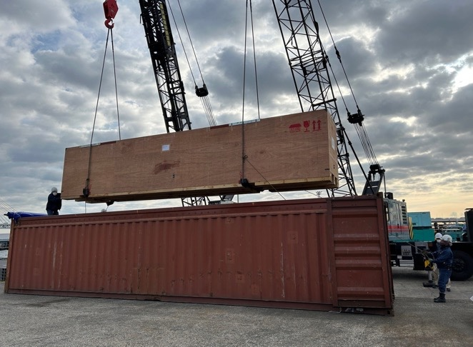
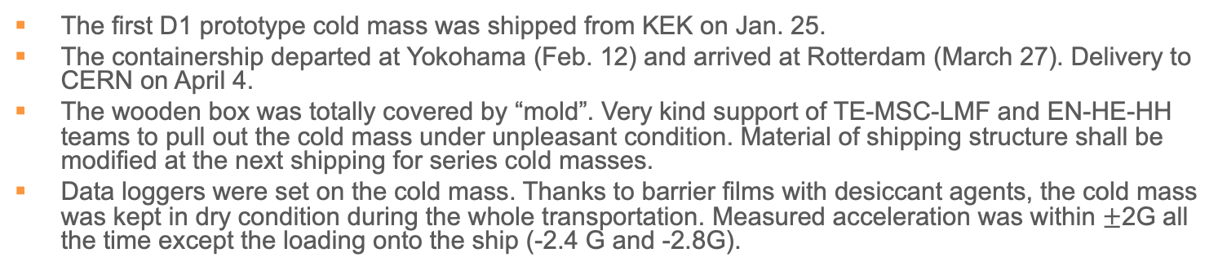
Delivery of MBXFP1 to CERN
The first D1 prototype cold mass was shipped from KEK on Jan. 25.
The containership departed at Yokohama (Feb. 12) and arrived at Rotterdam (March 27). Delivery to CERN on April 4.
The wooden box was totally covered by “mold”. Very kind support of TE-MSC-LMF and EN-HE-HH teams to pull out the cold mass under unpleasant condition. Material of shipping structure shall be modified at the next shipping for series cold masses.
Data loggers were set on the cold mass. Thanks to barrier films with desiccant agents, the cold mass was kept in dry condition during the whole transportation. Measured acceleration was within $±$2G all the time except the loading onto the ship (-2.4 G and -2.8G).

Slide 7
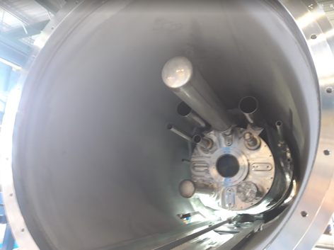
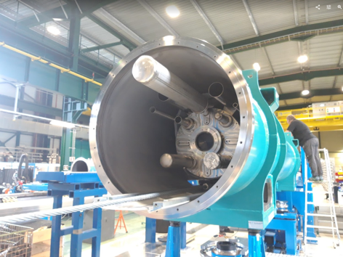
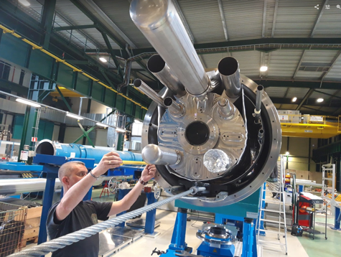
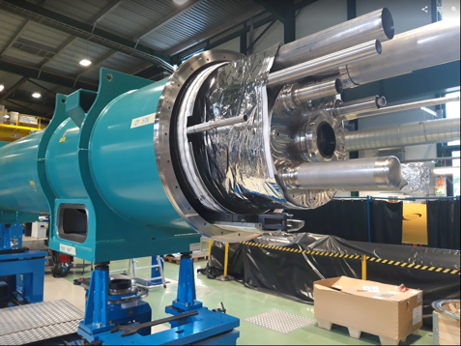
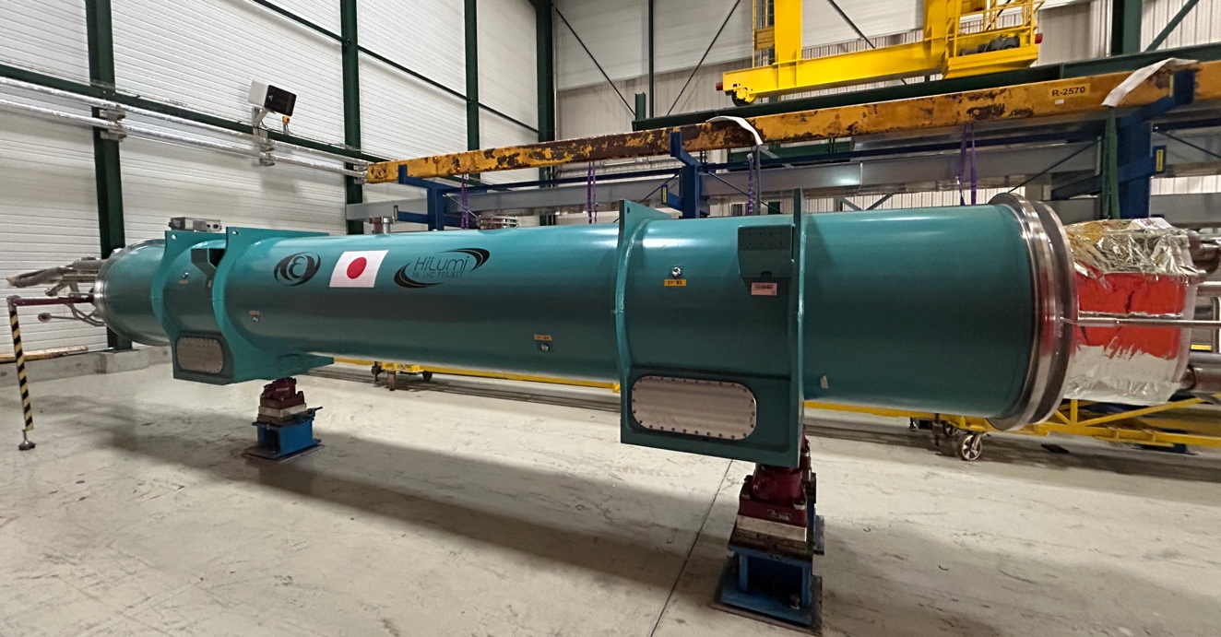
Cryostatting of MBXFP1 at CERN
Courtesy of Delio Duarte Ramos, Franco Julio Mangiarotti
Many thanks to Herve and Delio for completing the cold mass and for cryostatting.
Cryostatting report at WP3 meeting by Delio can be found at https://indico.cern.ch/event/1296834/
Dimensions are mostly good and accepted. One deviation is detected between end cover and cold mass shell. Root cause will be investigated by CERN and KEK.
Cold test at SM18 will be performed soon.

Slide 8
First series magnet: MBXF5
(in order of coil winding)

Slide 9
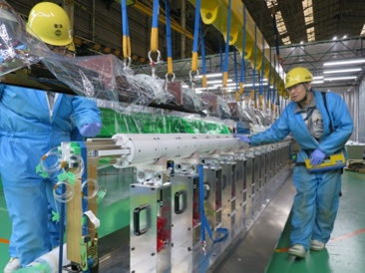
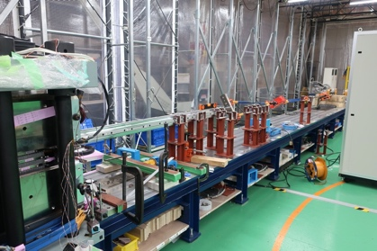
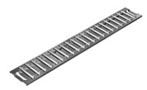
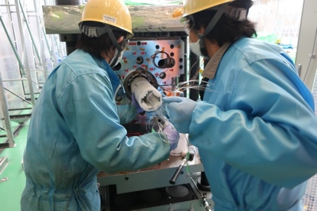
Major NC in Manufacturing of MBXF5
Recall
LT-1 and LB-1 coils for MBXF5 were completed.
  Estimated coil pre-stress: Good.
    LB-1: L120.7 (L) & 122.9 (R), LT-1: 121.7 (L) & 122.2 (R) (unit: MPa).
    EDMS 2724784
All components for the magnet were already fabricated.
Collaring and yoking processes were successfully done in June 2022.
NC: potential coil insulation damage was found after removal of the collaring-mandrel. EDMS 2753776.
  Investigation is underway.
Flat rollers
Spacers more than plan were removed from the RE side and the coil were exposed to the flat-rollers…

Slide 10
Actions for NC
Investigation of insulation damage on the MBXF5 coil inner surface.
Root cause analysis and redesign of the collaring mandrel for MBXF1 assembly.
Assembly of MBXF1 magnet with modified collaring mandrel.
Disassembly of MBXF5 magnet.
  Detailed investigation of the insulation damage.
  Proposal of coil repair.
MBXF5 coil repair and validation
Resume of MBXF5 magnet assembly
Technical meeting on Aug. 25, 2022 (EDMS 2773481)
LHC-MBXFC-QN-0004 v.0.1 (EDMS 2753776 v.0.1)
Technical meeting on Nov. 15, 2022 (EDMS 2799279)
LHC-MBXFC-QN-0004 v.1.0 (EDMS 2753776 v.1.0)

Slide 11
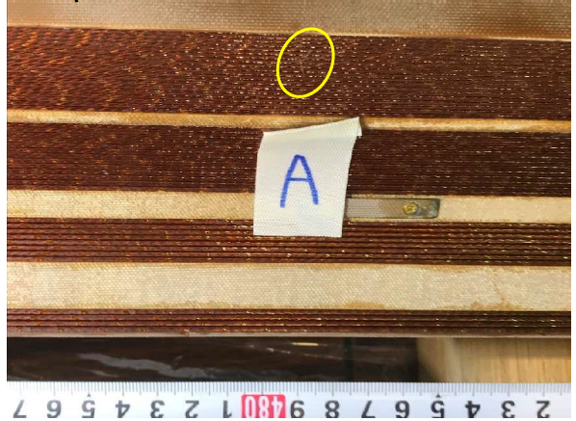
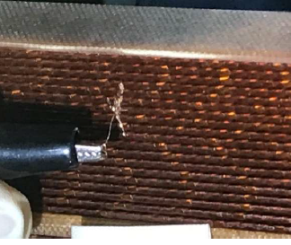
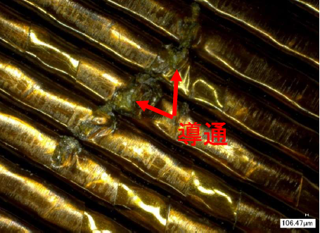
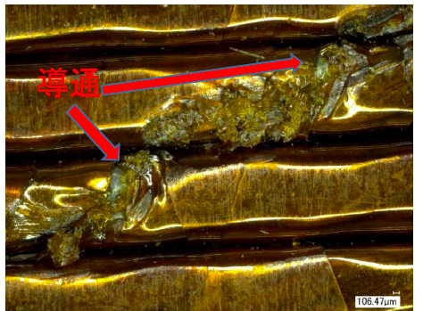
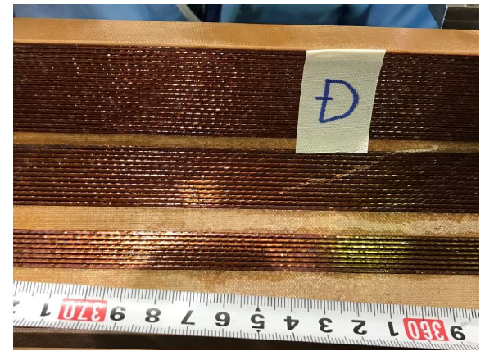
Microscopic Investigation after MBXF5 Disassembly
conductive
conductive
September 2022.
9 damaged locations identified.
No damage on the SC strand

Slide 12
Repair of MBXF5 Coils
After repair of the damaged insulation
Electrical soundness of the repaired coils was validated by electrical test (coil resistance, inductance, impulse test at 1.3 kV).

Slide 13
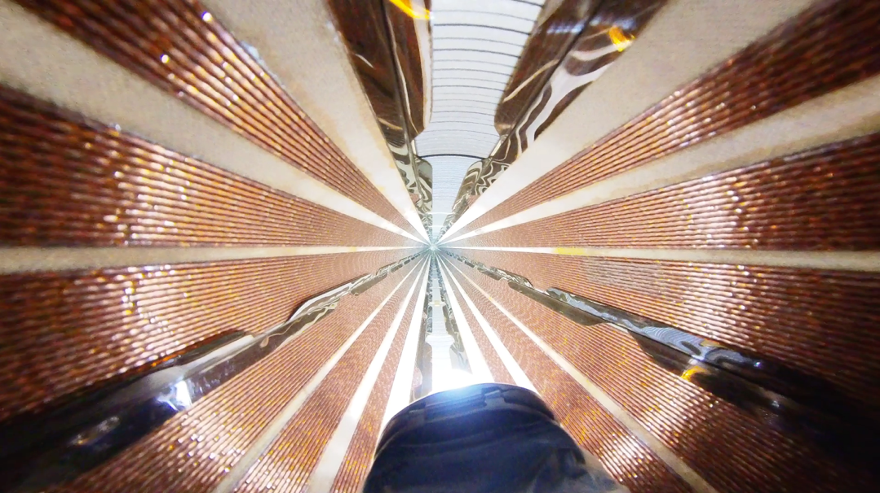
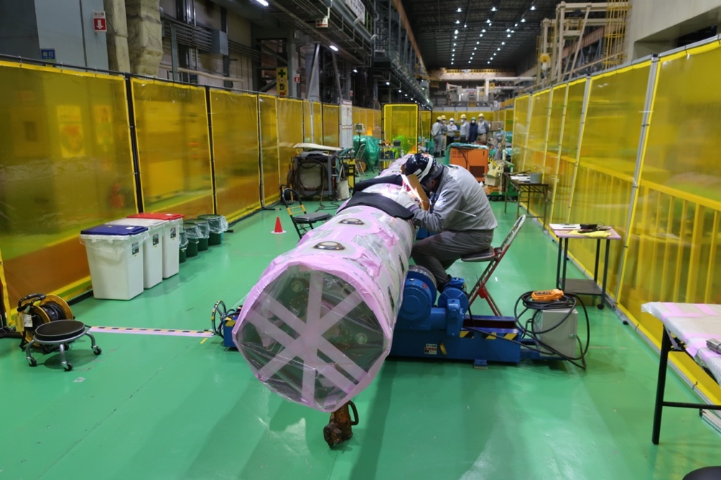
Present status MBXF5
NC was closed in Feb. 2023 and the magnet assembly was resumed.
Visual inspection of coil surface after yoking: OK.
Manufacturing of MBXF5 was completed in June 2023.
MBXF5 is currently situated in the vertical cryostat at KEK for powering test. But cooling has been suspended due to malfunction of a revolution indicator of the cold turbine.

Slide 14
Second series magnet: MBXF1
(in order of coil winding)

Slide 15
Status of MBXF1
Coil winding of MBXF1 started in June 2022 following MBXF5 manufacturing.
Due to a major NC of MBXF5, MBXF1 magnet was completed in February 2023 while MBXF5 was repaired.
Powering test started in April 2023 at KEK’s test facility where some upgrades were implemented for enabling the training quench up to the ultimate current (13.2 kA).
Test results were satisfactory as shown in the next slides.
MBXF1 will be the first series cold mass to be completed around early 2024.

Slide 16
Test facility upgrades

Slide 17
Training performance
Full scale magnets
Quench current of MBXF1
 | Quench # | Run ID | Iq (A)
1st TC | 1 | 69 | 10639
 | 2 | 71 | 11353
 | – | 73 | 12099
 | 3 | 75 | 12260
 | 4 | 77 | 12331
 | 5 | 79 | 12326
 | 6 | 80 | 12559
 | 7 | 82 | 12778
 | – | 86 | 13214
2nd TC | – | 508 | 13213
Temperature: 1.9 K
Ramp rate: 12 A/s or 30 A/s
Quench detection: 0.1 V, 10 msec
Quench protection: QPH and varistor
Quench start location: quench antenna
I_{nominal}
The training quenches started at a lower current with respect to the prototype.
After 2 quenches, the magnet current reached the nominal current.
The ultimate current was attained after 7 quenches.
After thermal cycle, the magnet reached the ultimate current without quench, showing perfect training memory.
I_{ultimate}
I_{ultimate}

Slide 18
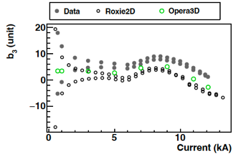
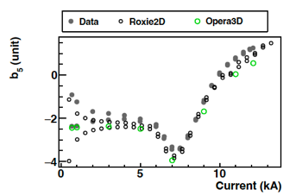
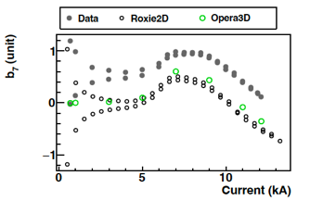
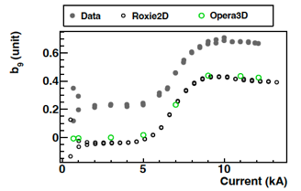
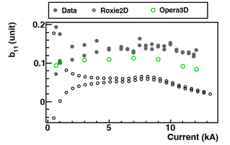
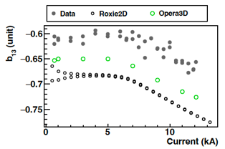
Field Quality: DC loop at the Z center
- MBXF1 -
Measured b₃ differs from the calculation by < 4 unit at I_{nominal} (12.11 kA).
For other allowed multipoles, measurement agrees with the calculation within 0.5 unit.

Slide 19
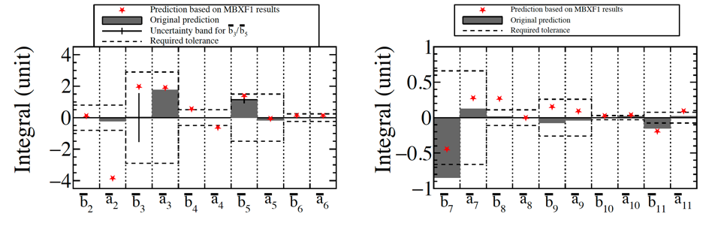
Predicted FQ (Integral) in the LHC cryostat
- MBXF1 -
Note: difference of ferromagnetic environment between KEK test stand and LHC cryostat.
From the obtained field quality in the KEK cryostat, we estimated the actual field quality predicted in the LHC cryostat.
  Requirements will be fulfilled in most of the harmonics.
MFM of the D1 prototype cold mass at SM18 will be crucial to confirm the effect of the LHC cryostat on FQ.

Slide 20
Summary
MBXFP1: Delivered to CERN in April 2023. Horizontal cold test in October is planned.
MBXF5: After a major NC with coil insulation damages, the magnet was successfully recovered and completed in June 2023. The cold powering test has been suspended due to the trouble of the test facility.
MBXF1: The test result of the cold powering test looks good. The final cold mass assembly at Hitachi is underway. Delivery to CERN as the first series cold mass is anticipated in May 2024.
MBXF2: Coil winding was already started in February 2023 and magnet assembly (yoking) is underway.
MBXF3: Coil winding will be started in October 2023.
MBXF4: Coil winding is planned in 2024.
MBXF6: The deliverables in JFY2023 will be the whole parts needed for the coil winding and the magnet assembly, but NOT including the actual manufacturing work at Hitachi. The coil winding is foreseen in April/May 2024.

