Slide 1
Status of D2 in INFN-Genova
A. Pampaloni
S. Farinon, A. Bersani, B. Caiffi, R. Cereseto, F. Levi, D. Novelli - INFN Genova
E. Todesco, A. Foussat, L. Fiscarelli, M. Guinchard, G. Ninet, G. Willering - CERN
13th HL-LHC Collaboration Meeting, Vancouver (Canada), 25 - 28 September 2023

Slide 2
Outline
CERN/INFN agreements
D2 magnet layout
Prototype test results:
  Training
  Protection scheme effectiveness
  Magnetic measurements
  Mechanical measurements
From prototype to series:
  Change of cross-section
Status of the series magnets
Overall schedule

Slide 3
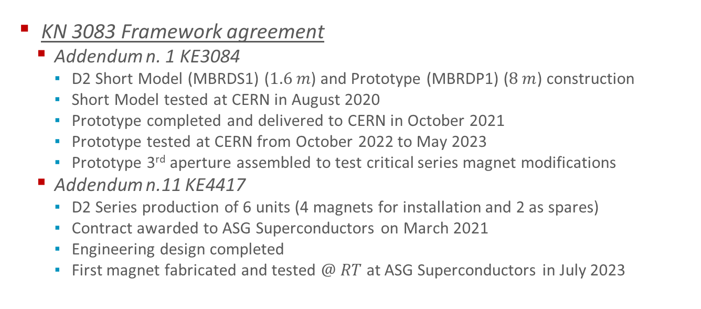
CERN/INFN Agreements for D2
KN 3083 Framework agreement
  Addendum n. 1 KE3084
    D2 Short Model (MBRDS1) ($1.6 m$) and Prototype (MBRDP1) ($8 m$) construction
    Short Model tested at CERN in August 2020
    Prototype completed and delivered to CERN in October 2021
    Prototype tested at CERN from October 2022 to May 2023
    Prototype 3rd aperture assembled to test critical series magnet modifications
  Addendum n.11 KE4417
    D2 Series production of 6 units (4 magnets for installation and 2 as spares)
    Contract awarded to ASG Superconductors on March 2021
    Engineering design completed
    First magnet fabricated and tested $@ RT$ at ASG Superconductors in July 2023

Slide 4
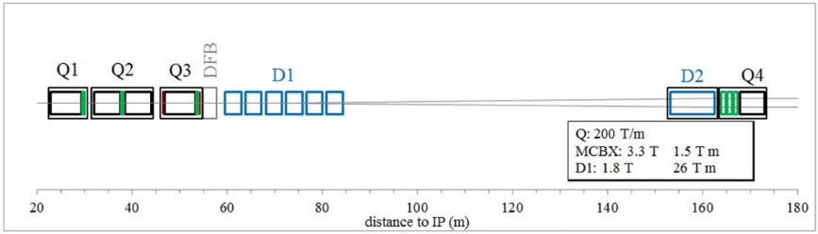
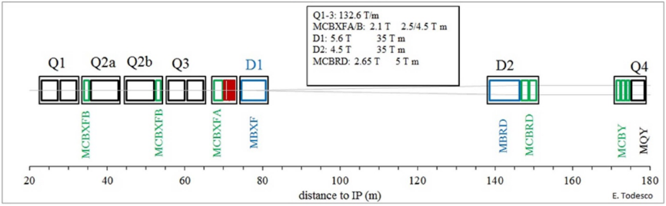
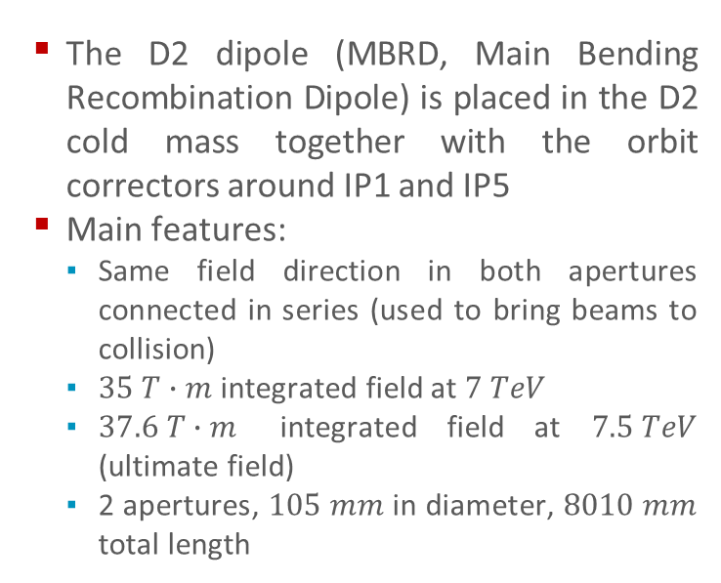
D2 Layout and Function
  The D2 dipole (MBRD, Main Bending Recombination Dipole) is placed in the D2 cold mass together with the orbit correctors around IP1 and IP5
  Main features:
    Same field direction in both apertures connected in series (used to bring beams to collision)
    $35 T∙m$ integrated field at $7 TeV$
    $37.6 T∙m$ integrated field at $7.5 TeV$ (ultimate field)
    2 apertures, $105 mm$ in diameter, $8010 mm$ total length
  LHC
  HL-LHC
# magnets | # apertures | # coils
4 series | 8 | 16
2 spares | 4 | 8
Total = 6 | Total = 12 | Total = 24

Slide 5
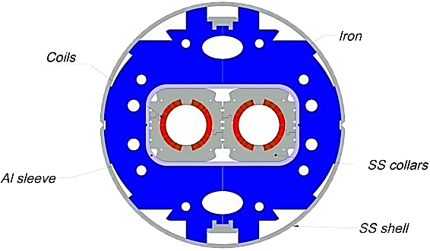
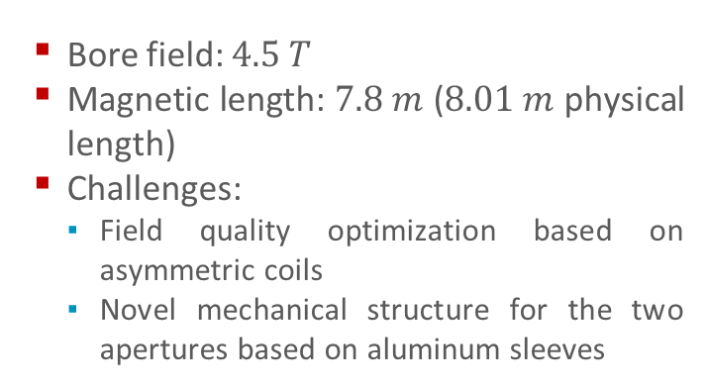
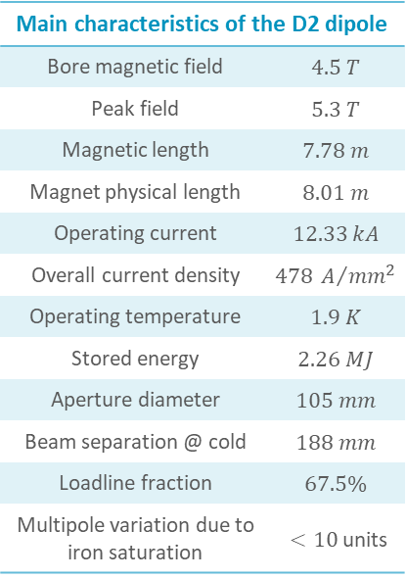
D2 Cross Section
  Bore field: $4.5 T$
  Magnetic length: $7.8 m$ ($8.01 m$ physical length)
  Challenges:
    Field quality optimization based on asymmetric coils
    Novel mechanical structure for the two apertures based on aluminum sleeves
Main characteristics of the D2 dipole
Bore magnetic field | $$4.5 T$$
Peak field | $$5.3 T$$
Magnetic length | $$7.78 m$$
Magnet physical length | $$8.01 m$$
Operating current | $$12.33 kA$$
Overall current density | $$478 A/{mm^{2}}$$
Operating temperature | $$1.9 K$$
Stored energy | $$2.26 MJ$$
Aperture diameter | $$105 mm$$
Beam separation @ cold | $$188 mm$$
Loadline fraction | $$67.5\%$$
Multipole variation due to iron saturation | $<10$ units

Slide 6
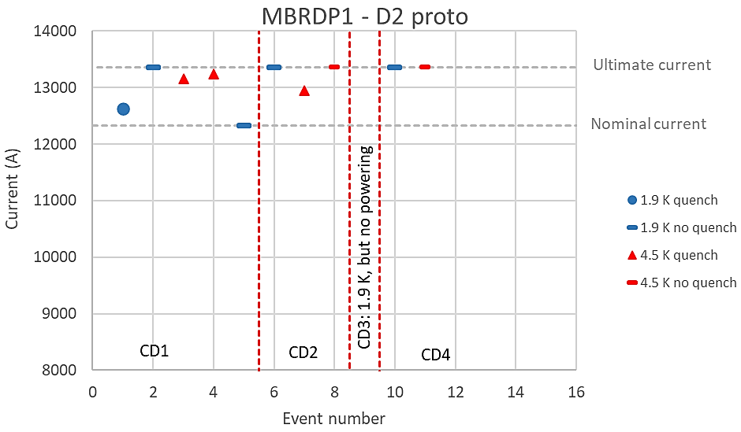
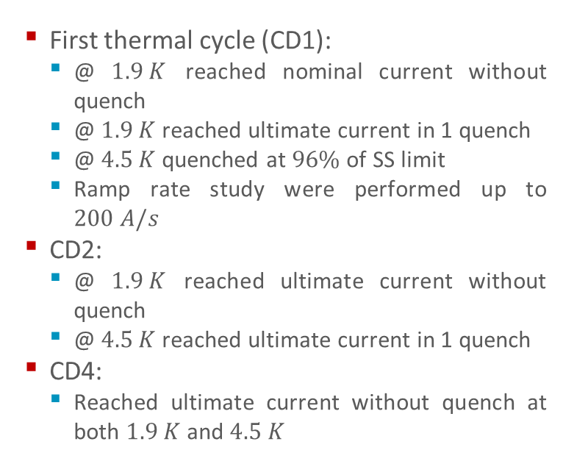
Prototype Test Results: Training
  First thermal cycle (CD1):
    @ $1.9 K$ reached nominal current without quench
    @ $1.9 K$ reached ultimate current in 1 quench
    @ $4.5 K$ quenched at $96\%$ of SS limit
    Ramp rate study were performed up to $200 A/s$
  CD2:
    @ $1.9 K$ reached ultimate current without quench
    @ $4.5 K$ reached ultimate current in 1 quench
  CD4:
    Reached ultimate current without quench at both $1.9 K$ and $4.5 K$
  Courtesy of G. Willering

Slide 7
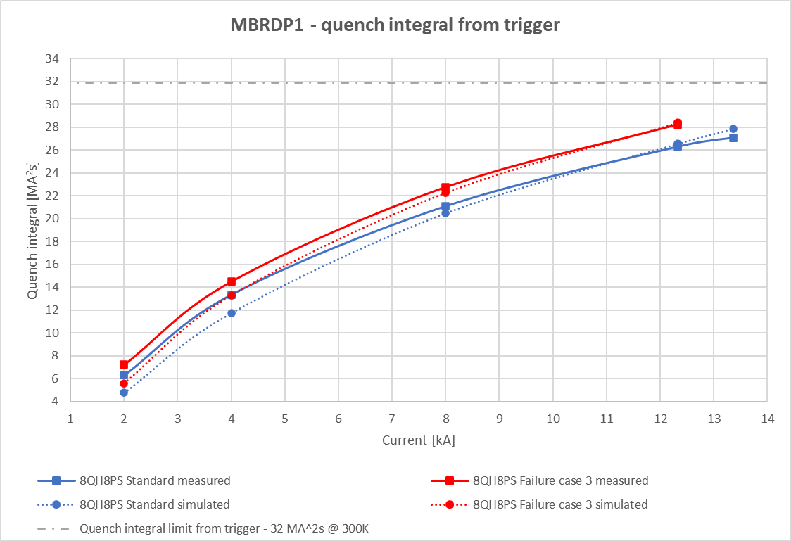
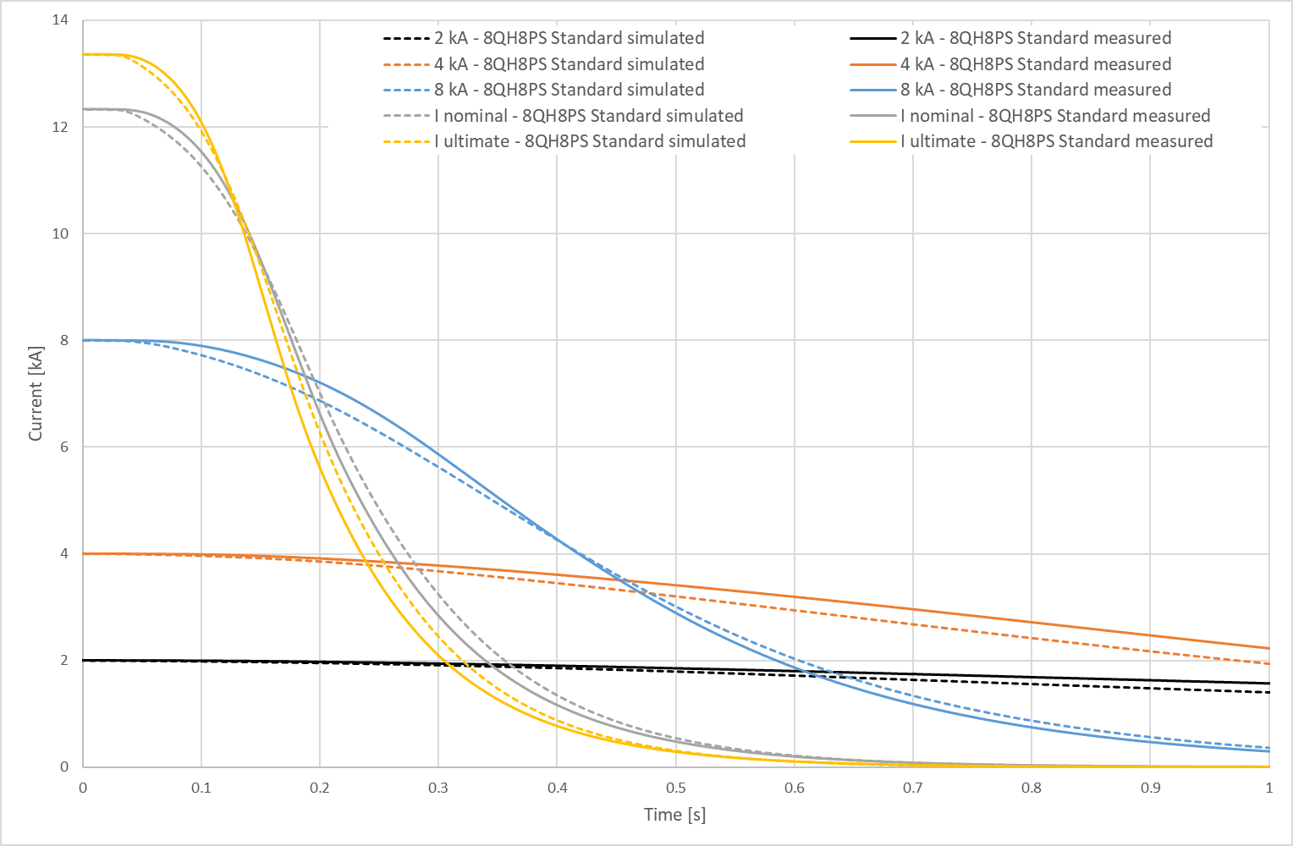
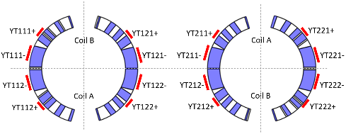
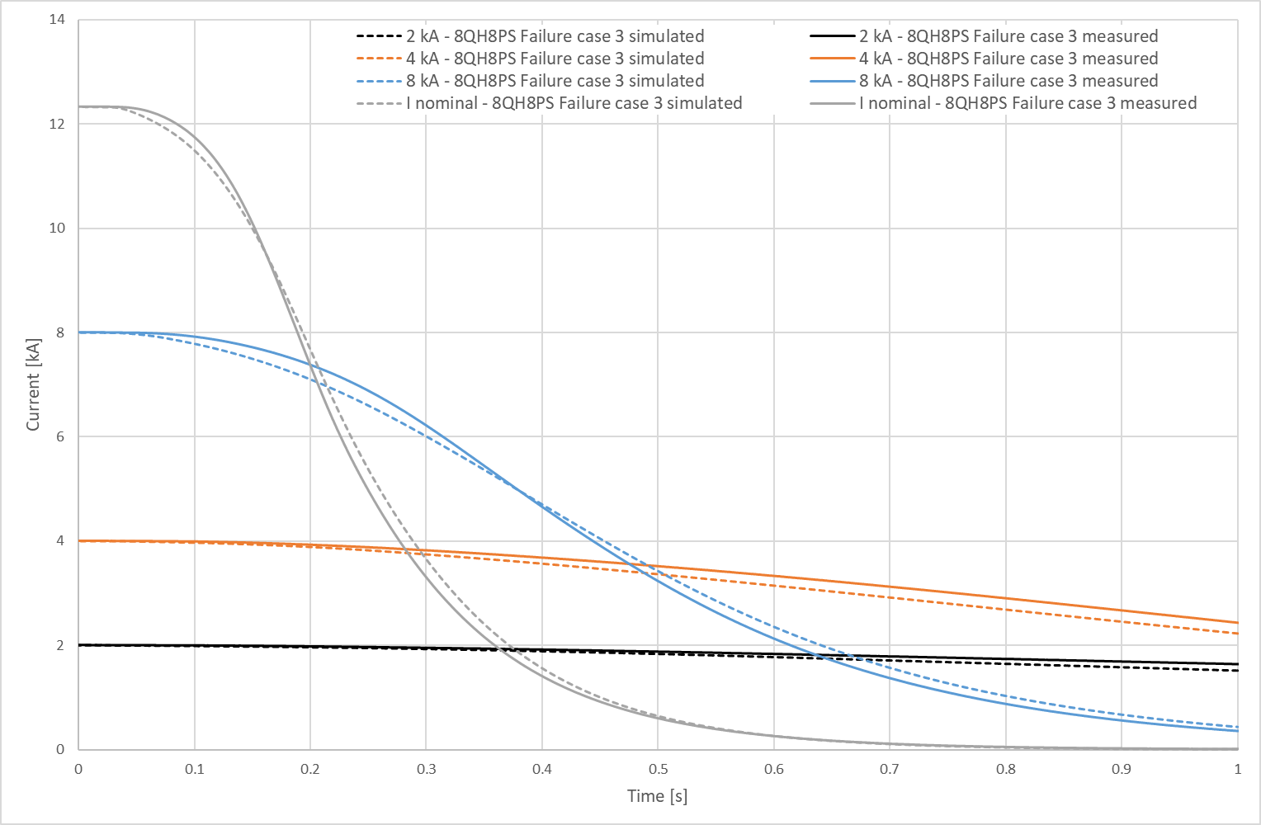
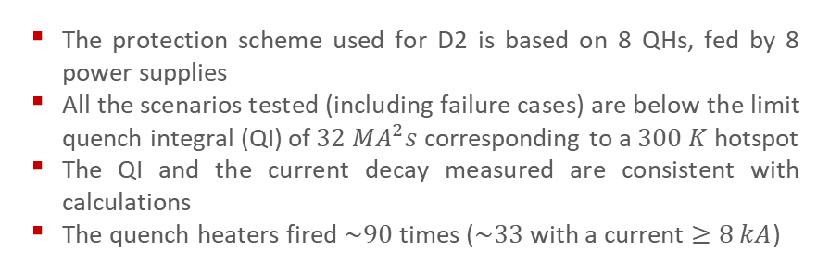
Prototype Test Results: Protection Scheme Effectiveness
  The QI is given from the trigger; in a real quench one should add the time from quench start to trigger (e.g., for the quench at $1.9 K$ at $12.63 kA$ this was $23 ms$ or $3.7 MA^{2}s$).
  The protection scheme used for D2 is based on 8 QHs, fed by 8 power supplies
  All the scenarios tested (including failure cases) are below the limit quench integral (QI) of $32 MA^{2}s$ corresponding to a $300 K$ hotspot
  The QI and the current decay measured are consistent with calculations
  The quench heaters fired $\sim 90$ times ($\sim 33$ with a current $≥8 kA$)
  Courtesy of G. Willering

Slide 8
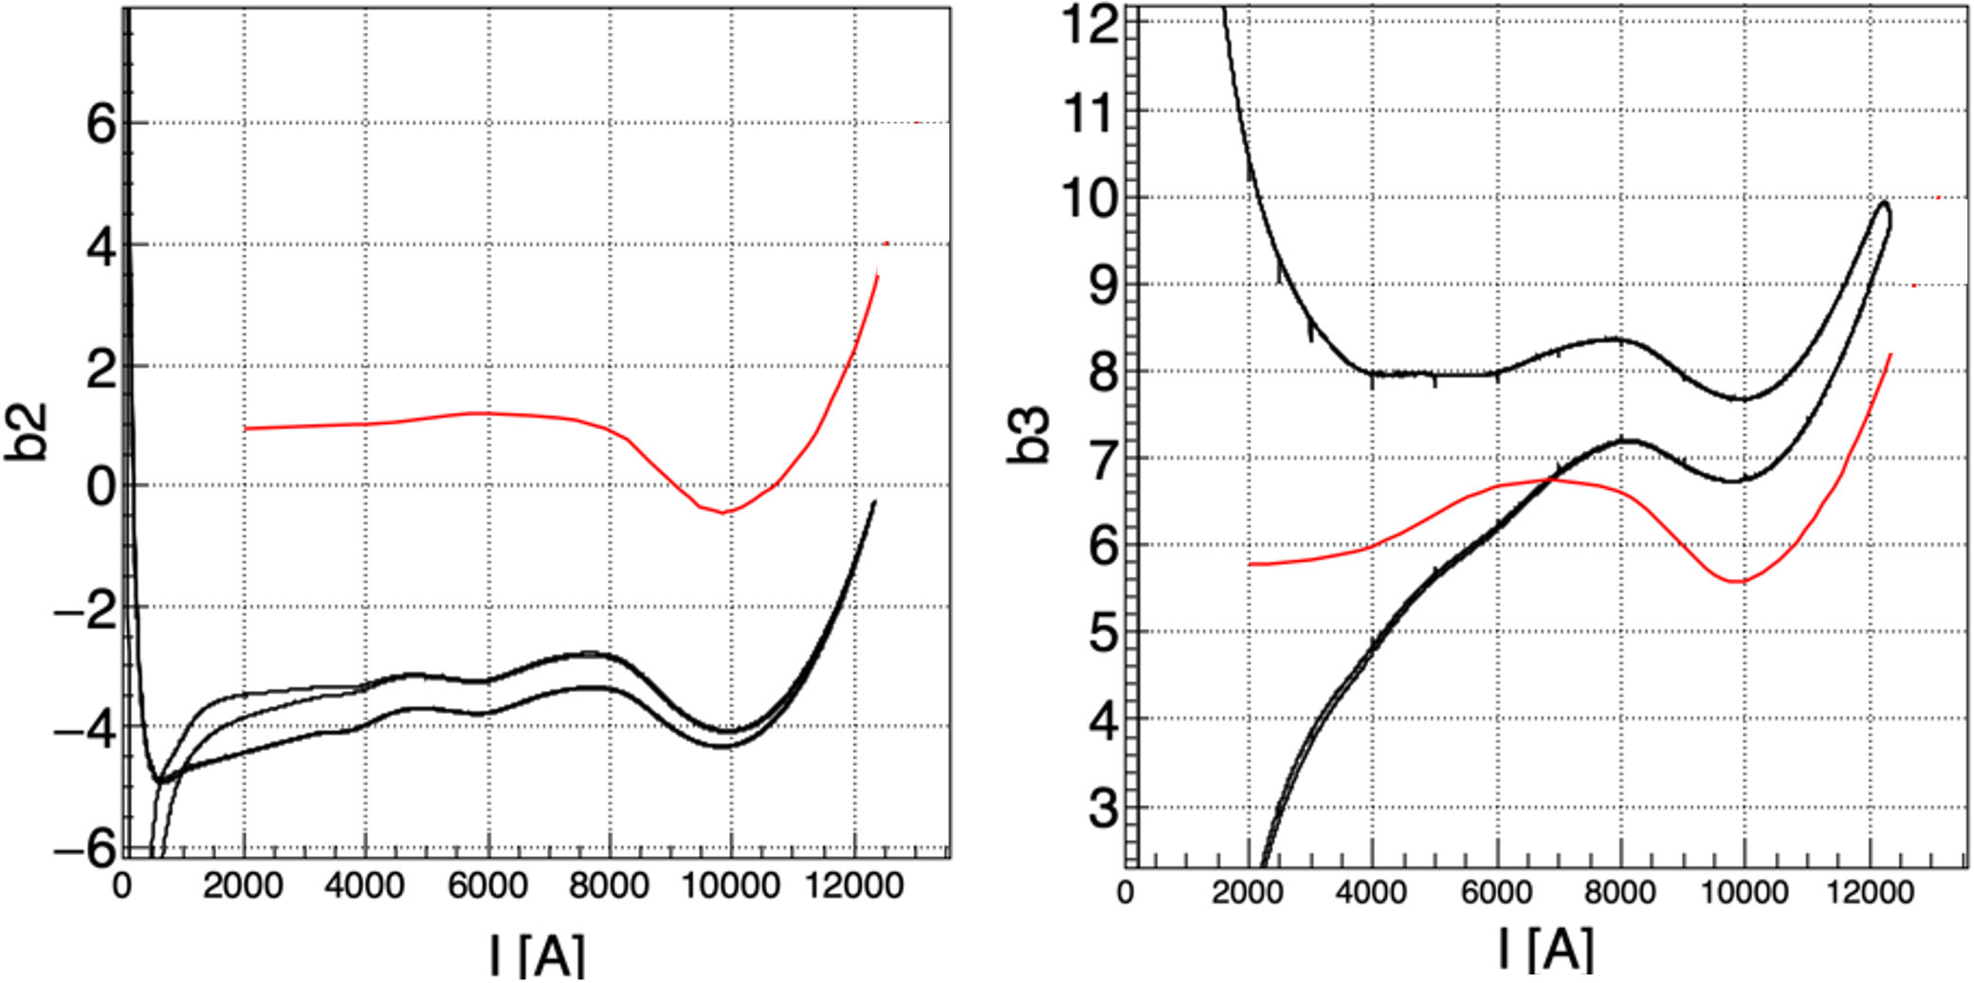
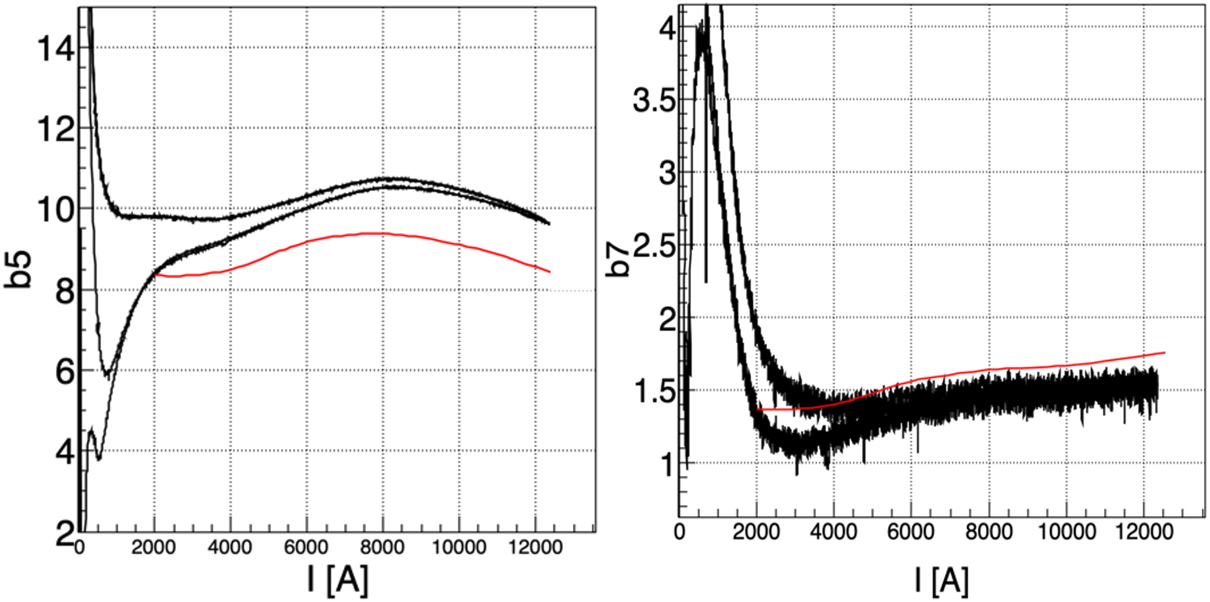
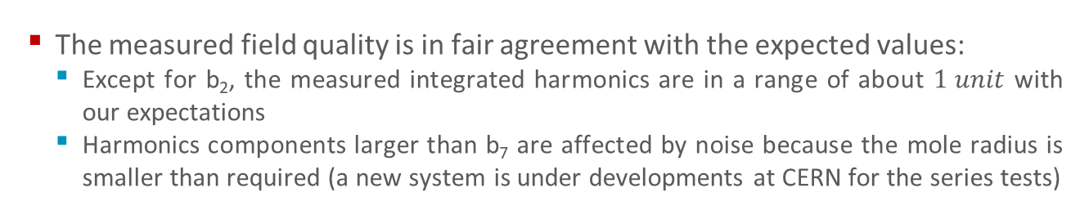
Prototype Test Results: Magnetic Measurements
  The measured field quality is in fair agreement with the expected values:
    Except for b₂, the measured integrated harmonics are in a range of about $1 unit$ with our expectations
    Harmonics components larger than b₇ are affected by noise because the mole radius is smaller than required (a new system is under developments at CERN for the series tests)
  Courtesy of L. Fiscarelli

Slide 9
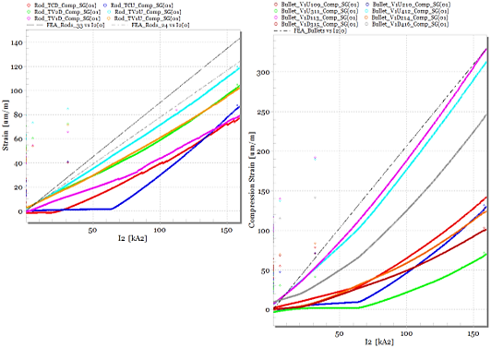
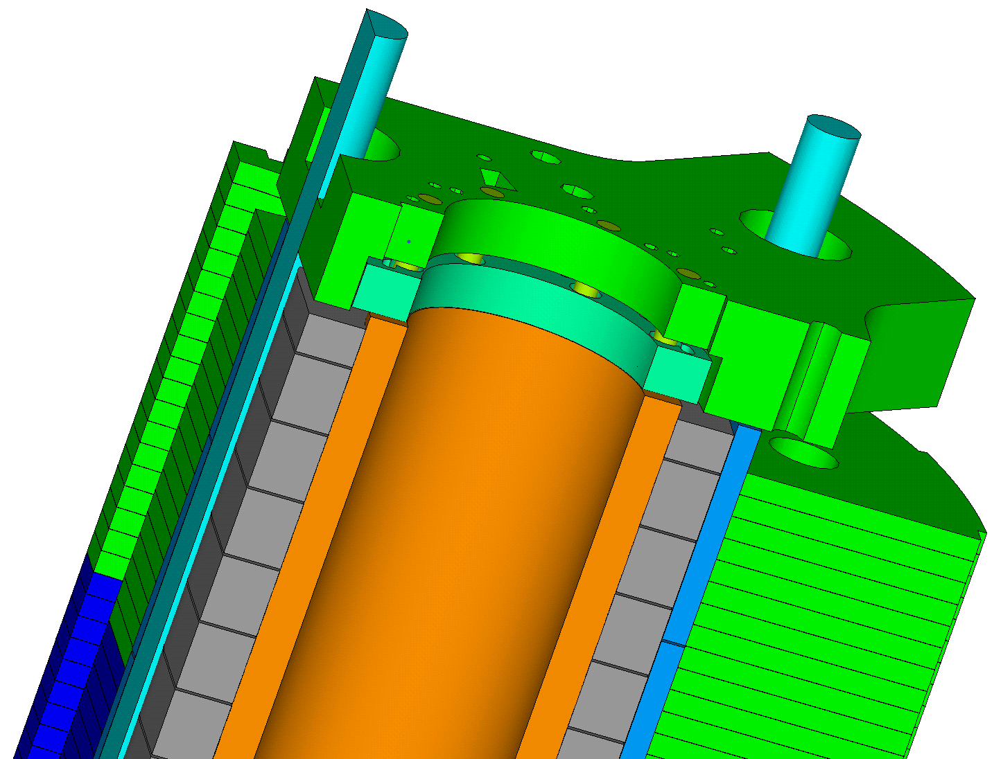
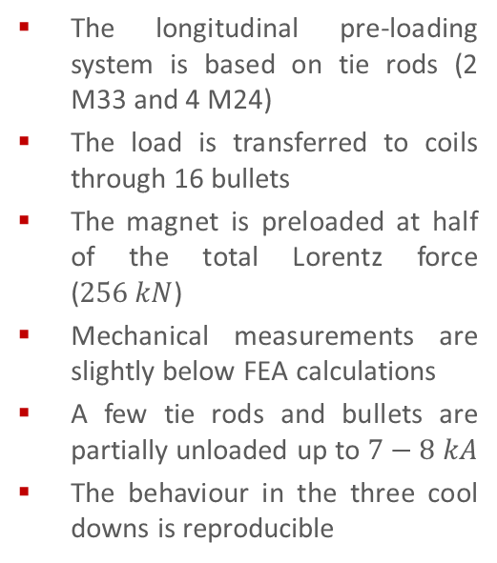
Prototype Test Results: Mechanical Measurements
The longitudinal pre-loading system is based on tie rods (2 M33 and 4 M24)
The load is transferred to coils through 16 bullets
The magnet is preloaded at half of the total Lorentz force ($256 kN$)
Mechanical measurements are slightly below FEA calculations
A few tie rods and bullets are partially unloaded up to $7−8 kA$
The behaviour in the three cool downs is reproducible
tie rods
bullets
  Courtesy of M. Guinchard

Slide 10
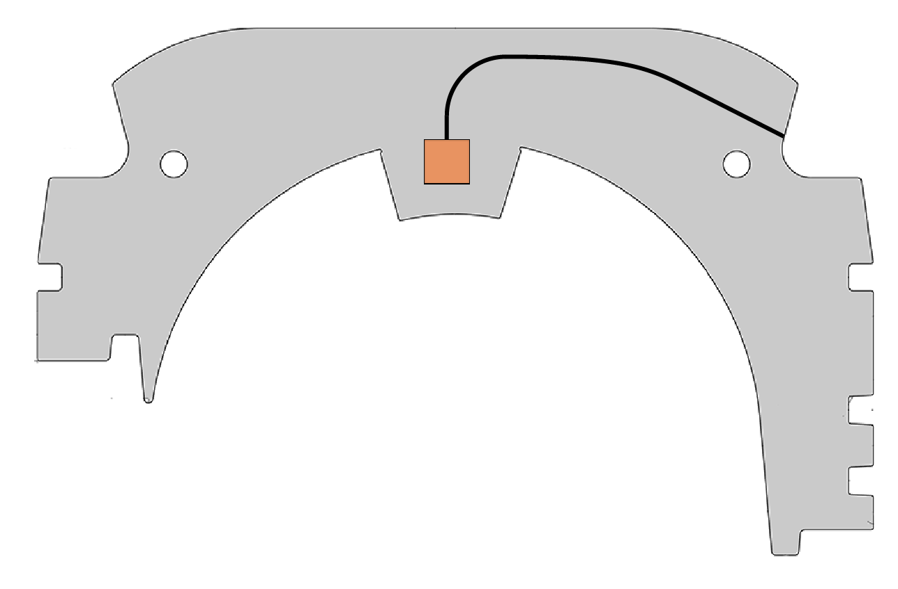
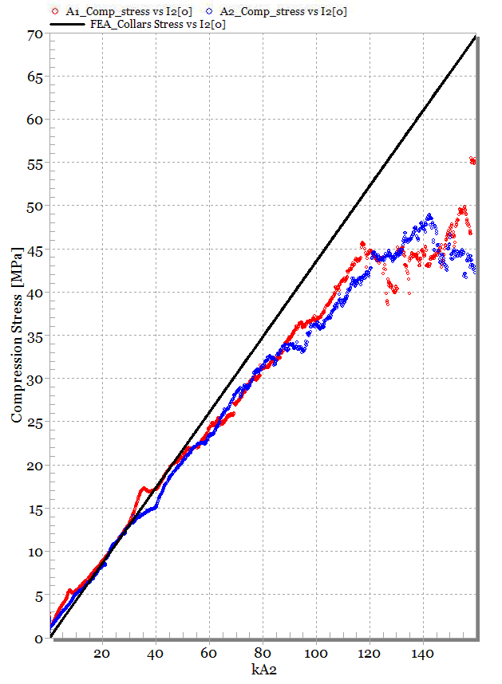
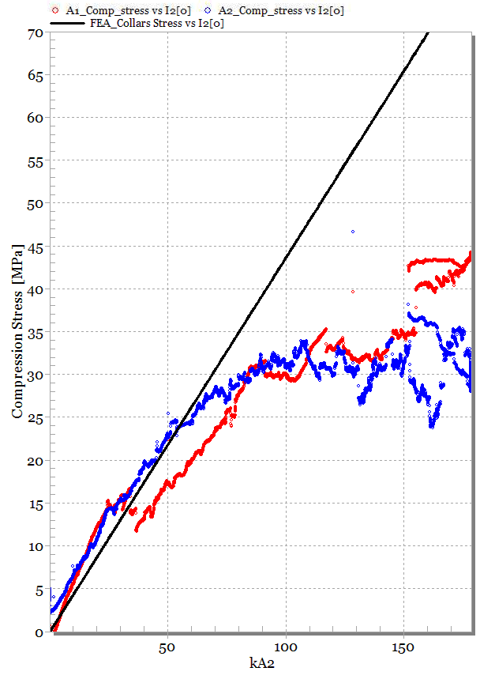
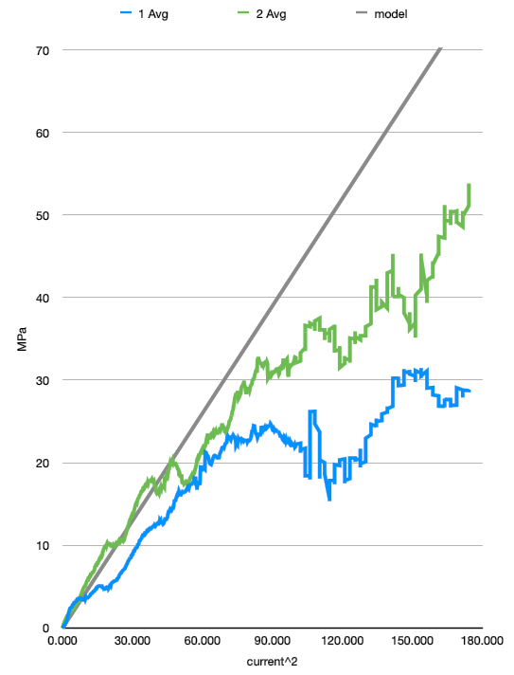
Prototype Test Results: Mechanical Measurements
Several collars were instrumented with strain gauges in the pole
A loss of pre-stress occurred between 1st and 2nd cool down
No further reduction is evident between 2nd and 4th cool down
  Courtesy of M. Guinchard

Slide 11
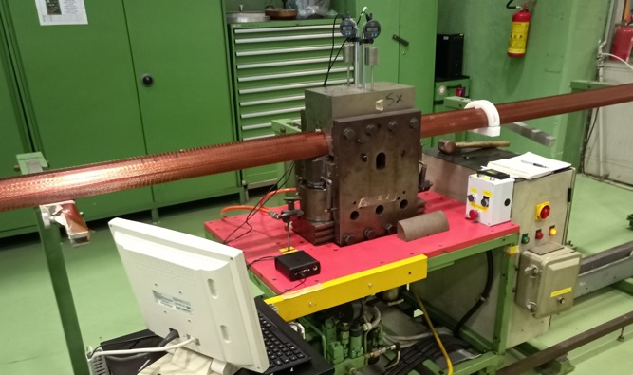
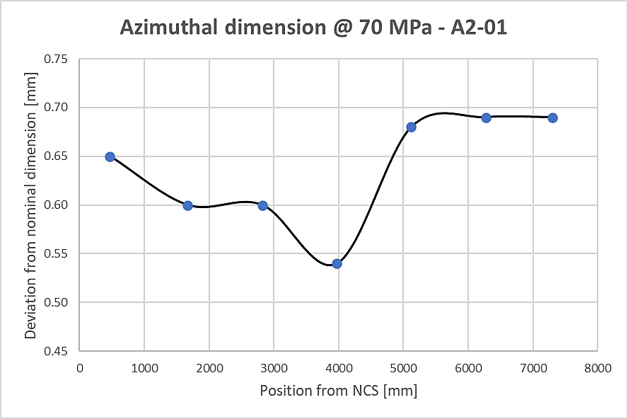
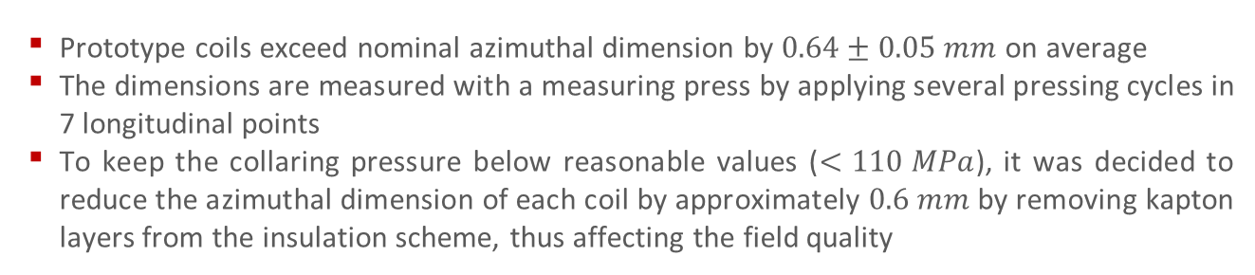
Prototype Coil Azimuthal Size
  Prototype coils exceed nominal azimuthal dimension by $0.64±0.05 mm$ on average
  The dimensions are measured with a measuring press by applying several pressing cycles in 7 longitudinal points
  To keep the collaring pressure below reasonable values ($<110 MPa$), it was decided to reduce the azimuthal dimension of each coil by approximately $0.6 mm$ by removing kapton layers from the insulation scheme, thus affecting the field quality
Coil | Min [mm] | Max [mm] | Avg [mm]
A-01 | 0.36 | 0.62 | 0.54 | Spare coil
A1-02 | 0.55 | 0.80 | 0.70 | Spare aperture
B1-02 | 0.55 | 0.72 | 0.66 | Spare aperture
A1-01 | 0.54 | 0.71 | 0.64 | Aperture V1
B1-01 | 0.47 | 0.77 | 0.63 | Aperture V1
A2-01 | 0.54 | 0.69 | 0.64 | Aperture V2
B2-01 | 0.54 | 0.71 | 0.64 | Aperture V2

Slide 12
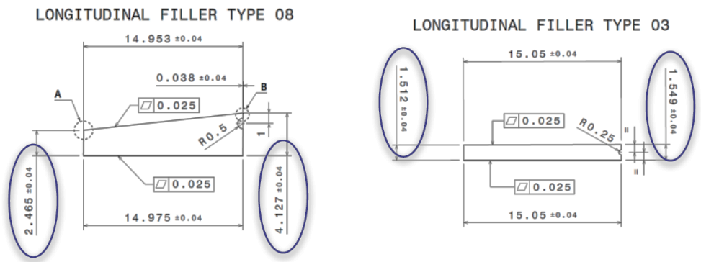
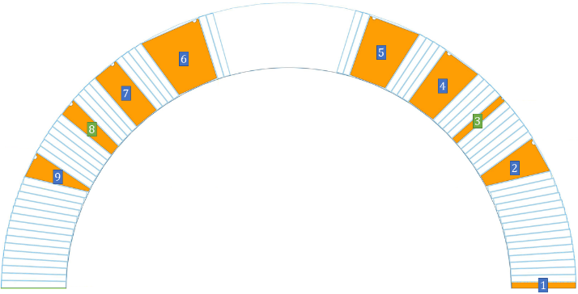
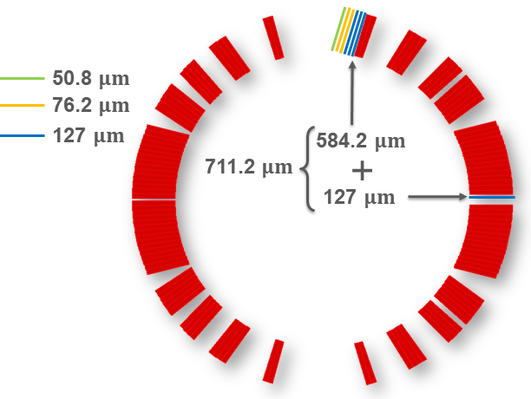
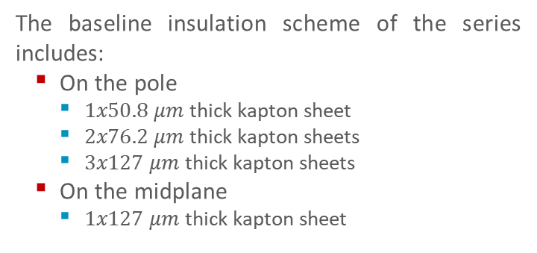
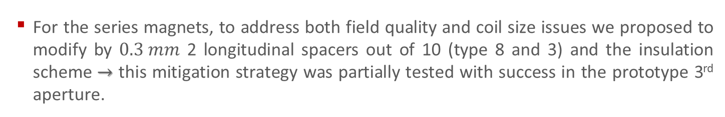
Change of Cross-section
  For the series magnets, to address both field quality and coil size issues we proposed to modify by $0.3 mm$ 2 longitudinal spacers out of 10 (type 8 and 3) and the insulation scheme $→$ this mitigation strategy was partially tested with success in the prototype 3rd aperture.
  The baseline insulation scheme of the series includes:
  On the pole
    $1x50.8 μm$ thick kapton sheet
    $2x76.2 μm$ thick kapton sheets
    $3x127 μm$ thick kapton sheets
  On the midplane
    $1x127 μm$ thick kapton sheet

Slide 13
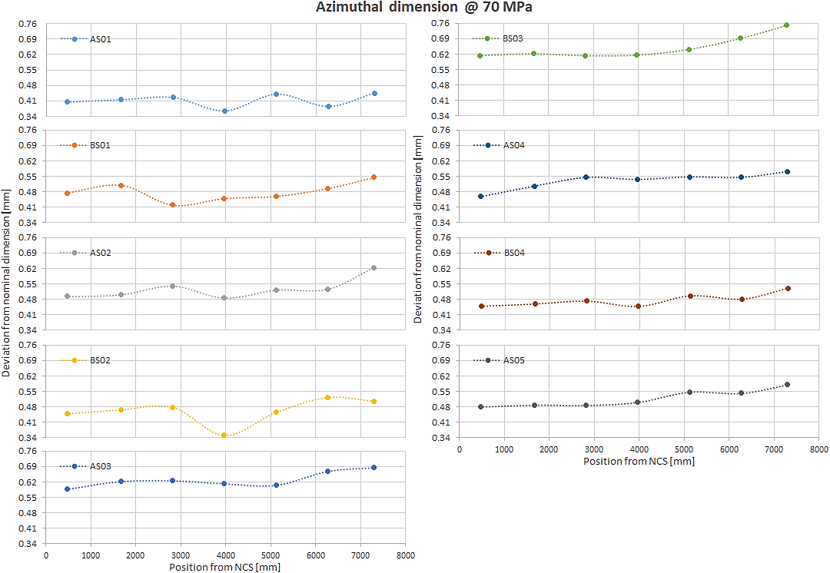
Status of the Series Magnets
  MBRD1 (DIP1) fabrication has been completed at ASG Superconductors and the magnet has been measured at RT
  So far 13 coils have been wound, 9 of which have also been cured and measured (AS01, BS01, AS02 and BS02 were used for the construction of DIP1)
    To address the different coil sizes, we studied a specific shimming plan to fulfil the field quality requirements
Oversize of the coils
Coil type | Min [mm] | Max [mm] | Avg [mm]
AS01 | 0.34 | 0.45 | 0.41
BS01 | 0.39 | 0.60 | 0.48
AS02 | 0.47 | 0.64 | 0.53
BS02 | 0.31 | 0.55 | 0.46
AS03 | 0.56 | 0.70 | 0.63
BS03 | 0.52 | 0.82 | 0.65
AS04 | 0.37 | 0.61 | 0.53
BS04 | 0.42 | 0.60 | 0.48
AS05 | 0.42 | 0.61 | 0.52

Slide 14
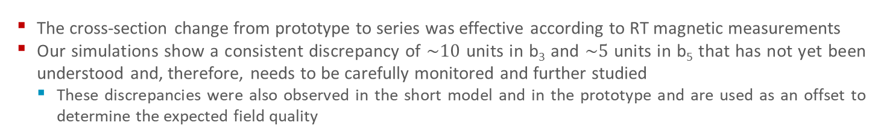

Status of the Series Magnets
  The cross-section change from prototype to series was effective according to RT magnetic measurements
  Our simulations show a consistent discrepancy of $\sim 10$ units in b₃ and $\sim 5$ units in b₅ that has not yet been understood and, therefore, needs to be carefully monitored and further studied
    These discrepancies were also observed in the short model and in the prototype and are used as an offset to determine the expected field quality
Double aperture with iron yoke at room temperature
SIMULATIONS, EXPECTED & MEASUREMENTS
 | CENTER |  |  |  |  |  | INTEGRATED
 | AP01 |  |  | AP02 |  |  | AP01 |  |  | AP02
 | SIMU | EXPE | MEAS | SIMU | EXPE | MEAS | SIMU | EXPE | MEAS | SIMU | EXPE | MEAS
b2 | 3.25 | 1.20 | -1.27 | -3.28 | -1.23 | 1.32 | -3.17 | 3.31 | -5.19 | 3.22 | -3.26 | 5.17
b3 | -11.32 | 1.81 | -1.84 | -14.46 | -1.33 | 1.35 | -11.51 | 1.28 | -3.26 | -14.60 | -1.81 | -0.87
b4 | -1.39 | 0.39 | 0.30 | 1.63 | -0.15 | 2.08 | -0.91 | 0.29 | 0.24 | 1.15 | -0.05 | 1.66
b5 | -0.43 | 4.78 | 4.90 | -0.13 | 5.09 | 4.23 | -1.53 | 3.63 | 4.01 | -1.23 | 3.92 | 3.61
b6 | -0.30 | -2.03 | 1.32 | 0.30 | 2.02 | 0.45 | -0.21 | -2.00 | 1.33 | 0.20 | 1.99 | 0.32
b7 | 1.90 | 1.82 | 1.61 | 1.83 | 1.75 | 0.73 | 1.65 | 1.30 | 0.92 | 1.57 | 1.23 | 0.32
$$∆={Measurements}_{PROTO}^{with iron @ RT}−{Simulations}_{PROTO}^{with iron @ RT}$$
$$EXPE=SIMU+∆$$

Slide 15
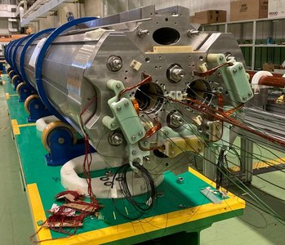

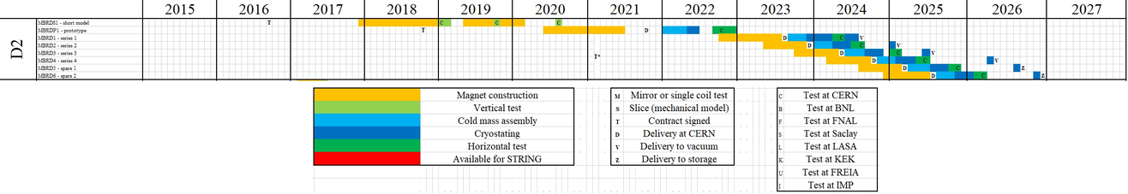
Overall Schedule
  The first series magnet (MBRD1) is completed and will be delivered to CERN in October
  Construction of the 6 series magnets is on schedule and is expected to be completed in mid-2025
  The plan for the series is aligned with the updated schedule
  The D2 series is not on the critical path

Slide 16
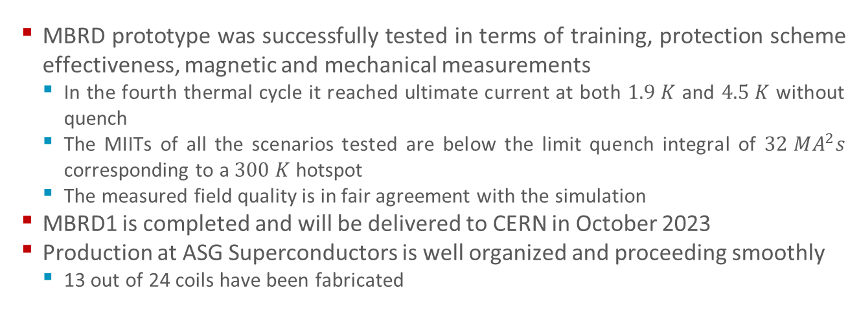
Conclusion
  MBRD prototype was successfully tested in terms of training, protection scheme effectiveness, magnetic and mechanical measurements
    In the fourth thermal cycle it reached ultimate current at both $1.9 K$ and $4.5 K$ without quench
    The MIITs of all the scenarios tested are below the limit quench integral of $32 MA^{2}s$ corresponding to a $300 K$ hotspot
    The measured field quality is in fair agreement with the simulation
  MBRD1 is completed and will be delivered to CERN in October 2023
  Production at ASG Superconductors is well organized and proceeding smoothly
    13 out of 24 coils have been fabricated

Slide 17
THANKS FOR YOUR ATTENTION

Slide 19
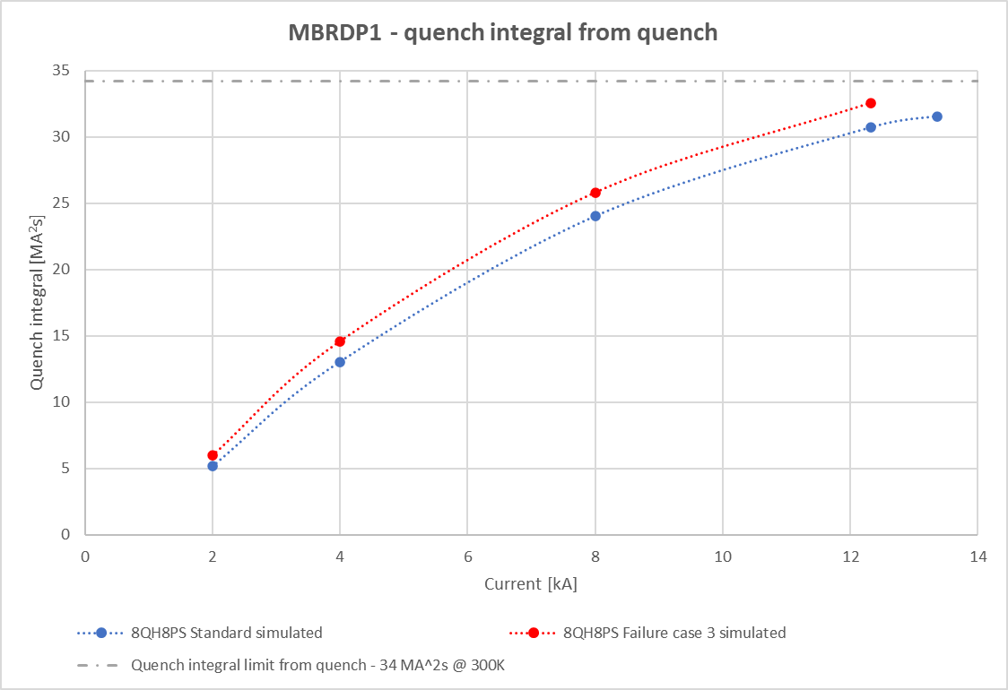

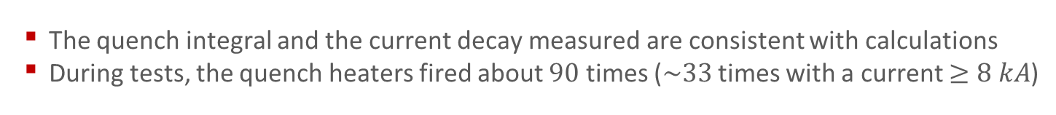
Prototype test results: protection scheme effectiveness
  Note: the quench integral is given from the trigger moment; in a real quench one should add the time from quench start to trigger (e. g. for the quench at $1.9 K$ at $12.63 kA$ this was $23 ms$ or $3.7 MA^{2}s$).
  Note: the quench integral simulated is given from the quench moment.
  The quench integral and the current decay measured are consistent with calculations
  During tests, the quench heaters fired about $90$ times ($\sim 33$ times with a current $≥8 kA$)
  Courtesy of G. Willering

Slide 20
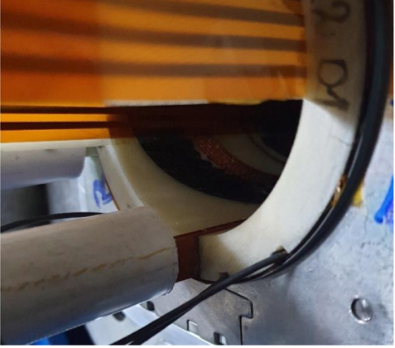
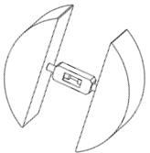
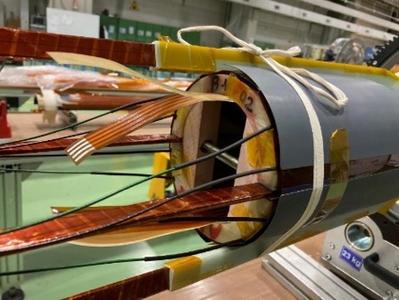
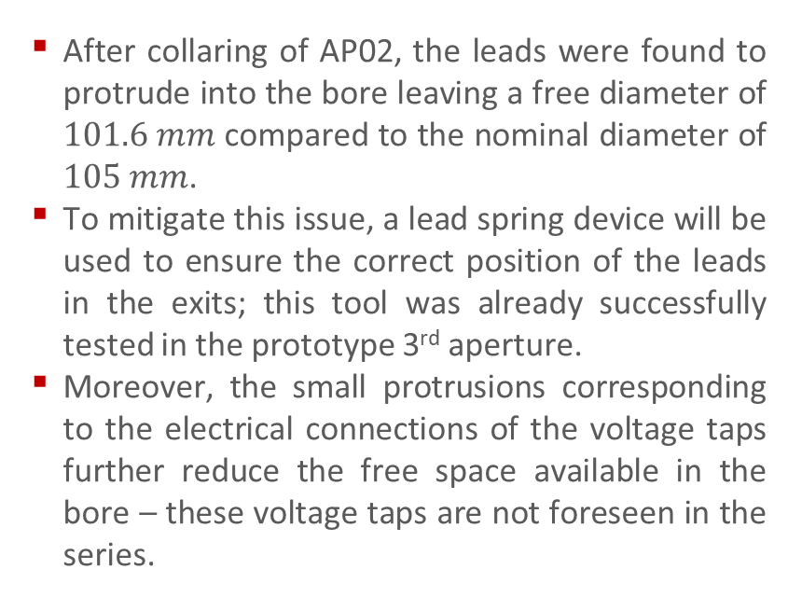
Prototype NCs: AP02 Leads Protrusion
  NC EDMS 2618354 – noncritical, level 3
  After collaring of AP02, the leads were found to protrude into the bore leaving a free diameter of $101.6 mm$ compared to the nominal diameter of $105 mm$.
  To mitigate this issue, a lead spring device will be used to ensure the correct position of the leads in the exits; this tool was already successfully tested in the prototype 3rd aperture.
  Moreover, the small protrusions corresponding to the electrical connections of the voltage taps further reduce the free space available in the bore – these voltage taps are not foreseen in the series.

Slide 21
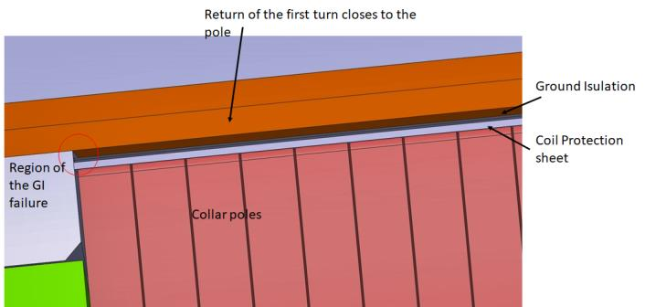
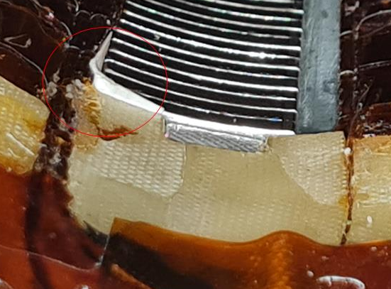
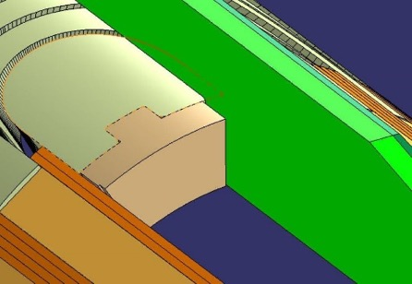
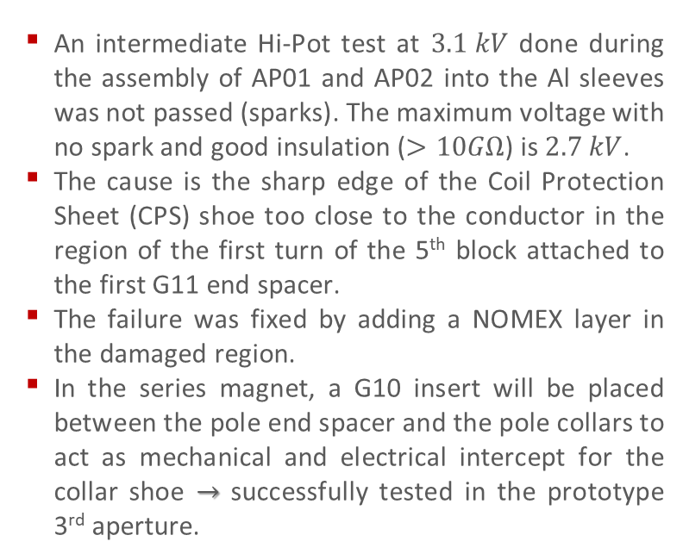
Prototype NCs: Coil B2-01 of AP02 Ground Insulation
NC EDMS 2589433 – noncritical, level 3
  An intermediate Hi-Pot test at $3.1 kV$ done during the assembly of AP01 and AP02 into the Al sleeves was not passed (sparks). The maximum voltage with no spark and good insulation ($>10GΩ$) is $2.7 kV$.
  The cause is the sharp edge of the Coil Protection Sheet (CPS) shoe too close to the conductor in the region of the first turn of the 5th block attached to the first G11 end spacer.
  The failure was fixed by adding a NOMEX layer in the damaged region.
  In the series magnet, a G10 insert will be placed between the pole end spacer and the pole collars to act as mechanical and electrical intercept for the collar shoe $→$ successfully tested in the prototype 3rd aperture.

Slide 22
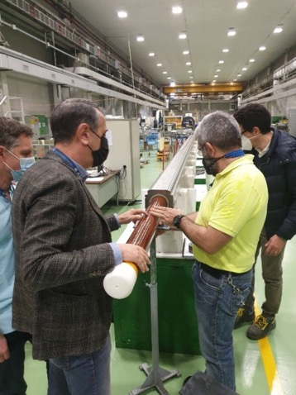
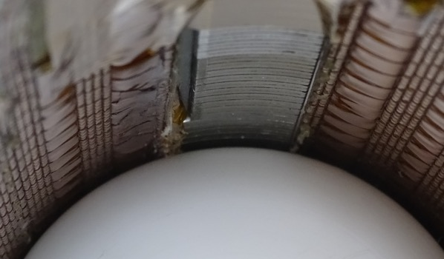
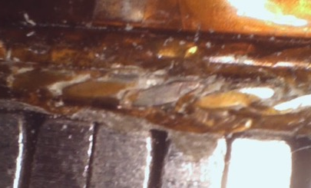




Prototype NCs: Layer Jump Protrusion
EDMS NC 2715620 – critical, level 4
  During the cold bore insertion, it was not possible to proceed because it got stuck on the connection side because both the layer jump and the NOMEX layer were protruding $\sim 2 mm$ in the bore.
  After the insertion trial, the cable insulation was damaged $→$ the insulation was consolidated using the injection of Eccobond epoxy under a controlled applied pressure afterwards successfully passed the electrical tests.
  The root cause analysis was performed by ASG, finding that collars and G11 protection box were marginally in interference $→$ the latter has been modified in the prototype 3rd aperture.
$$∅ 0.825 mm$$

Slide 23



Prototype NCs: Axial Pre-stress Loss
  Longitudinal tie rods are tightened via Nordlock Superbolts to avoid torque.
  After delivery at CERN, a significant decrease of longitudinal pre-stress has been observed.
  A new tightening has been performed at CERN and bolts have been glued $→$ afterwards no significant change has been observed.
  Most probable causes have been identified:
    Internal friction release between coils and collars
    Unscrewing of jackbolts due to vibrations, tie rod bending and low applied torque.
  Several mitigation strategies have been investigated:
    Modification of transport tool
    Measurement of the actual properties of the Superbolts
    Increase of the axial pre-load
    Final tightening at CERN
    Screw blocking either mechanically, via welding or gluing.
  Our suggestion is gluing, with Staycast or equivalent, after tightening to ensure reversibility.

Slide 24

Strategy for the Series Magnets
  Considering the issues on the prototype and the project update for the series
    MBRD1 (DIP1) will be a pre-series magnet, followed by 5 series magnets from MBRD2 to MBRD6 (DIP2 – DIP6)
    MBRD1 will still be compliant with D2 requirements for use in the HL-LHC
    $⇒$ The production of the D2 series magnets cannot be fully parallelized
      Our strategy for the series production:
        Produce two coils and collar the first pre-series aperture (hold point on coil fabrication)
        If the collaring of the first aperture is successfully done, release the hold point on coil fabrication
        Produce and collar the second two coils (hold point on the aperture fabrication)
        Assemble the two pre-series apertures into the iron yoke and perform warm magnetic measurements
        If the warm magnetic measurements are in line with expectations, release the hold point on aperture fabrication
        Start the production of the 5 series magnets

