Slide 1



Status of CCT D2 correctors
E. Todesco, on behalf of Q. Xu (IHEP-CAS)
For the CCT D2 corrector Magnet Team:
Y. Wang, J. Wang (IHEP)
X. Ou, D. Ni (IMP)
and A. Foussat (CERN)
20 September 2023

Slide 2
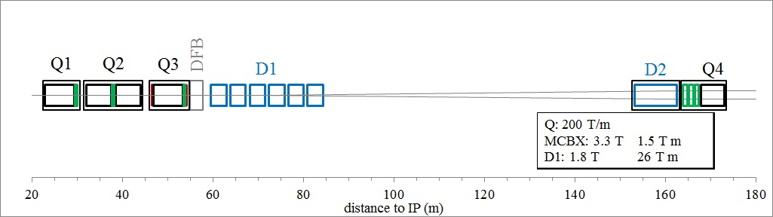
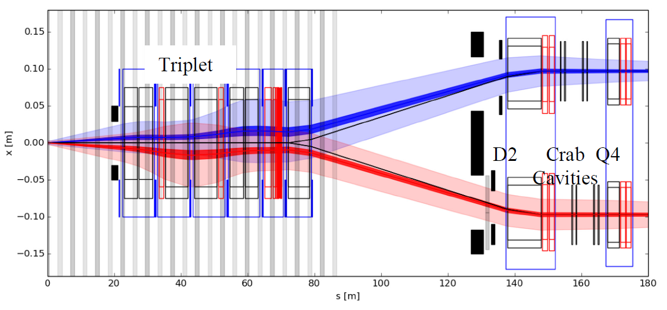
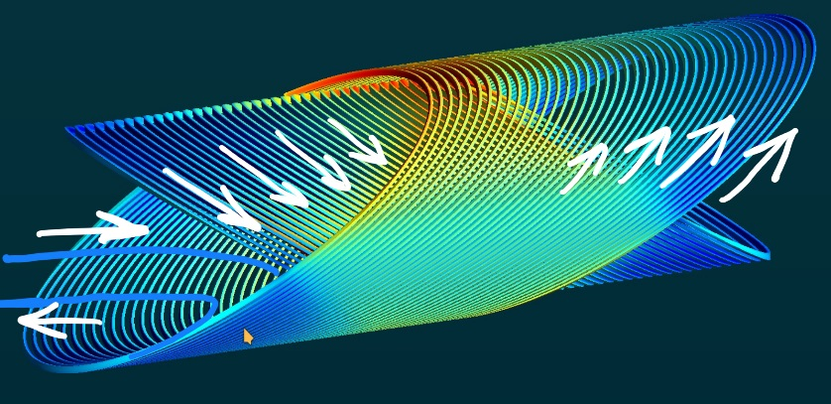
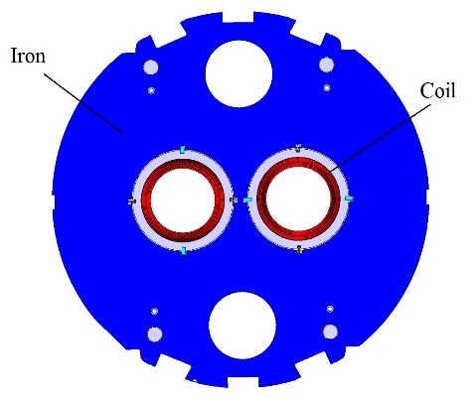
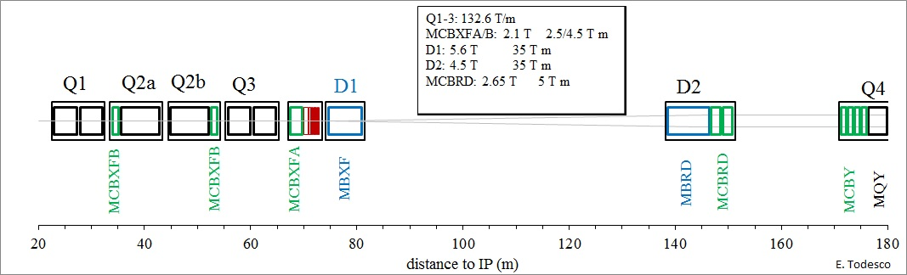
MCBRD: the HL-LHC D2 orbit correctors, 12+1 units, providing a 5 Tm integrated field in two apertures, vertical in one and horizontal in the other
LHC 2008-2022
E. Todesco
HL-LHC 2026-2035

Slide 3



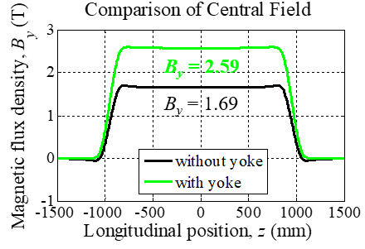
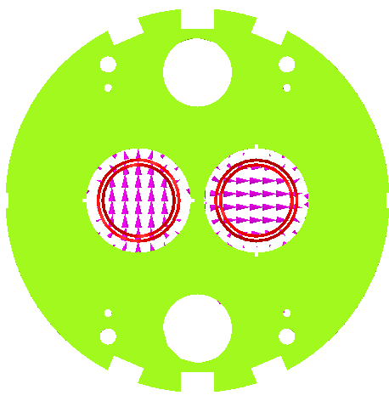

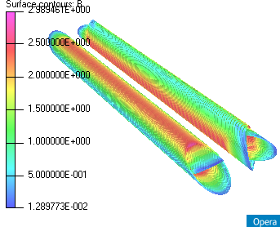
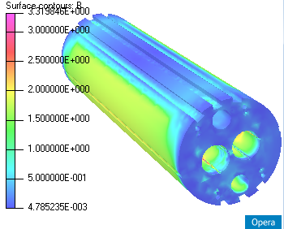
Main design parameters of the magnet
Items | Values
CCT skew angle | 30°
No. of turns per layer | 365
Slot size in former (mm) | 2×5
Spacing per turn | 5.222
Inside/Outside diameter of the former (mm) | Inner former:105.35/119.35 Inner former:120.80/134.85
Inside diameter of the groove/slot(mm) | 1st layer: 109.15/119.15 2nd layer: 124.65/134.65
Reference radius (mm) | 35
Diameter of aperture (mm) | 105
Current (A) | 395
Cooling hole
Hole for tie rod
Hole for fixing pin
Aperture
Yoke alignment
CCT Coils
Ø 614 mm
Items | Values
Diameter of yoke (mm) | 614
Thickness of yoke lamination (mm) | 5.8
Diameter of aperture (mm) | 167
Position of aperture (mm) | 94.19
Yoke key slot(mm) | 8(3.01) ×6
Diameter of cooling hole (mm) | 110
Position of cooling hole (mm) | 205

Slide 4

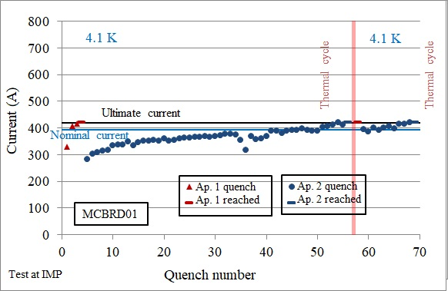
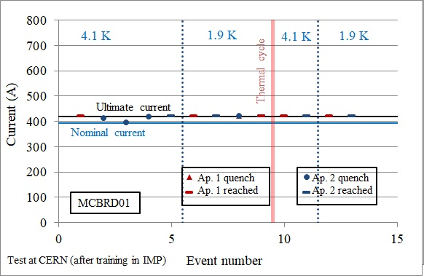
The beginning of the production
Out of the 12 series magnets, 4 have been built in BAMA
MBCRD01 and MCBRD02 coils were built with a variant of the CERN procedure (wet impregnation)
Both magnets reached ultimate current, and had limited retraining after thermal cycle, at the edge of the requirements
  They are now at CERN, where they have also been tested at 1.9 K

Slide 5
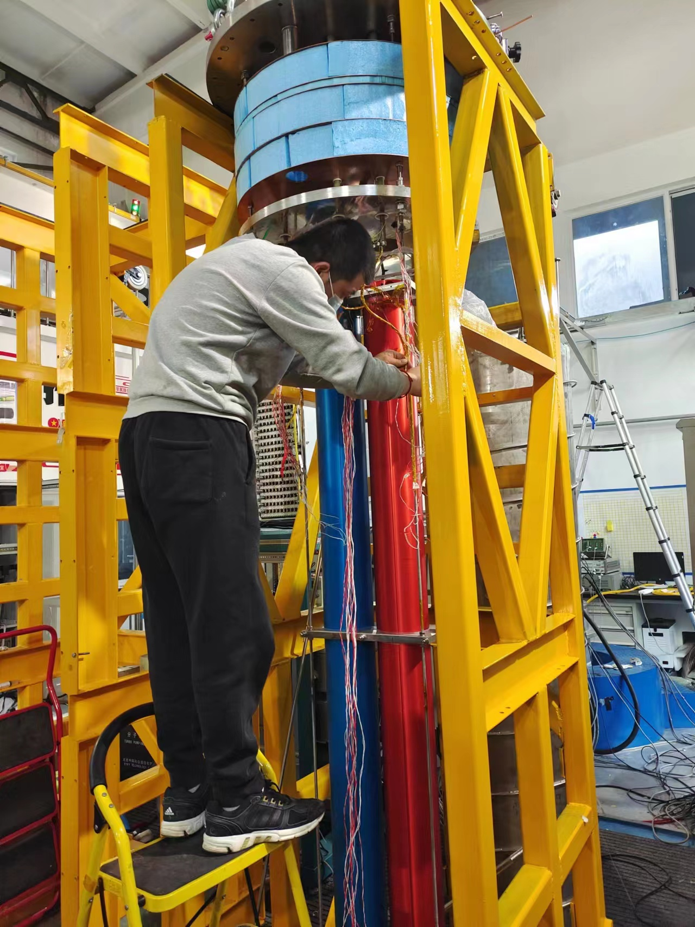
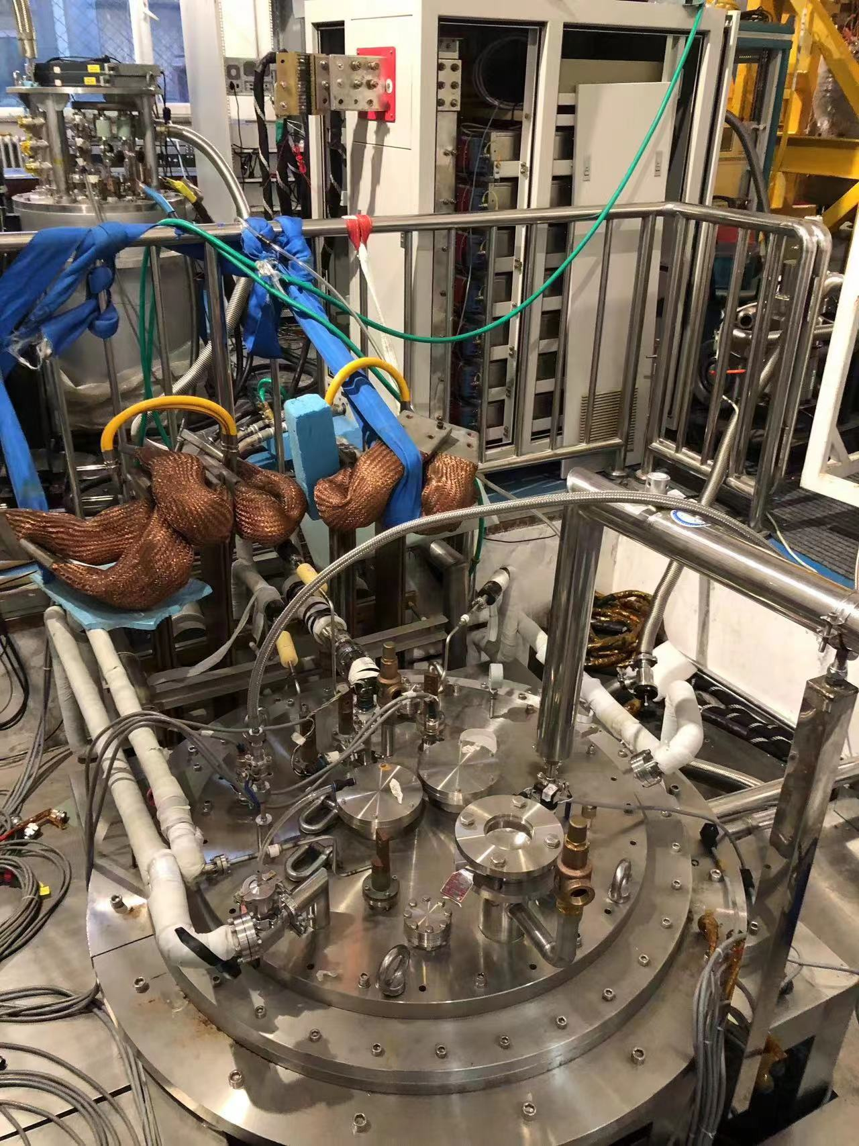
The test strategy
IHEP added to the baseline the test of individual coils in IHEP test station at 4.1 K, to have a fast feedback on production and to cope with the long training
Test of individual coil in IHEP

Slide 6
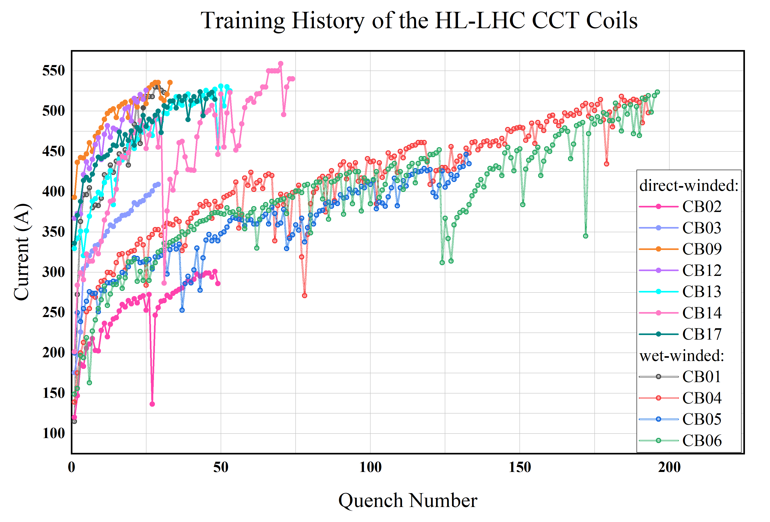
Performance of individual coils
The long training also induced an iteration on the impregnation procedures (VPI) and a fine tuning of the groove size (reduction of the height of the groove from 5.1 to 4.8 mm) to better fit the conductor in the former
The iteration on coil procedures was positive, and more recent coils train faster

Slide 7
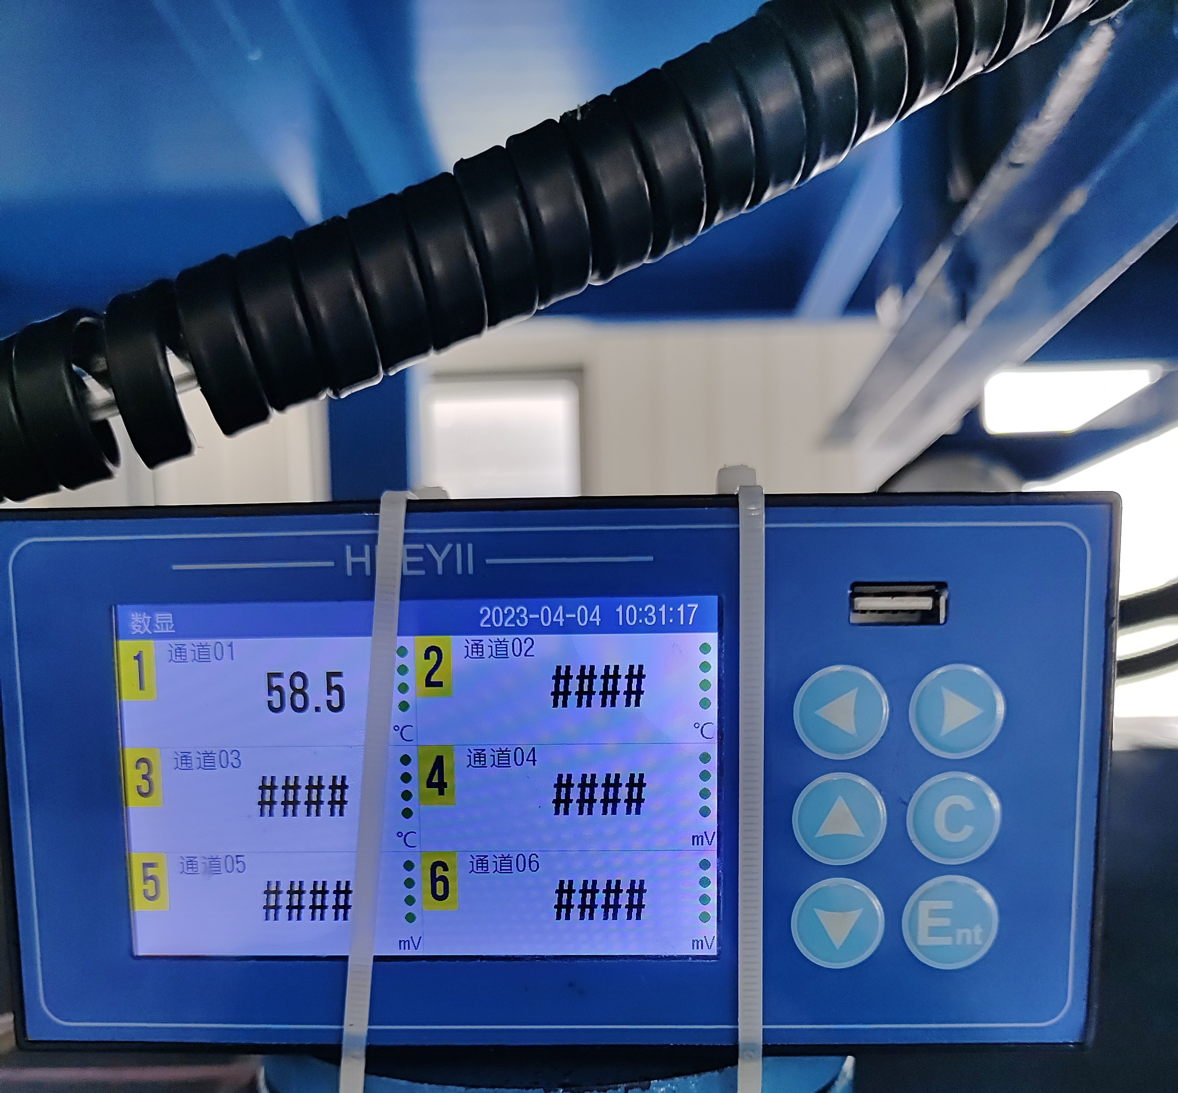
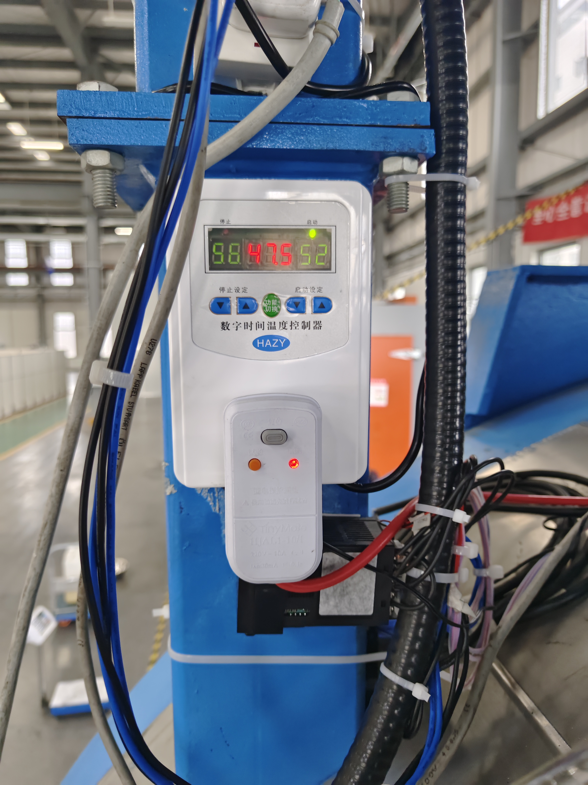
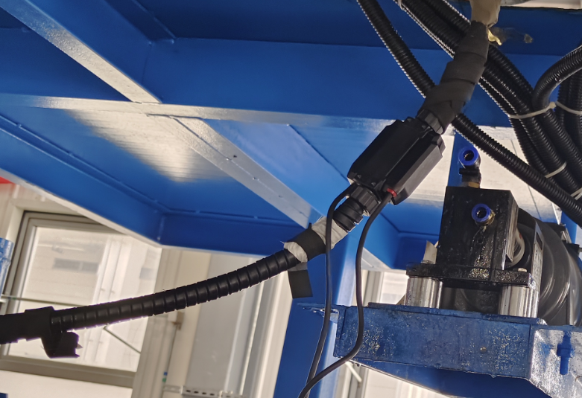
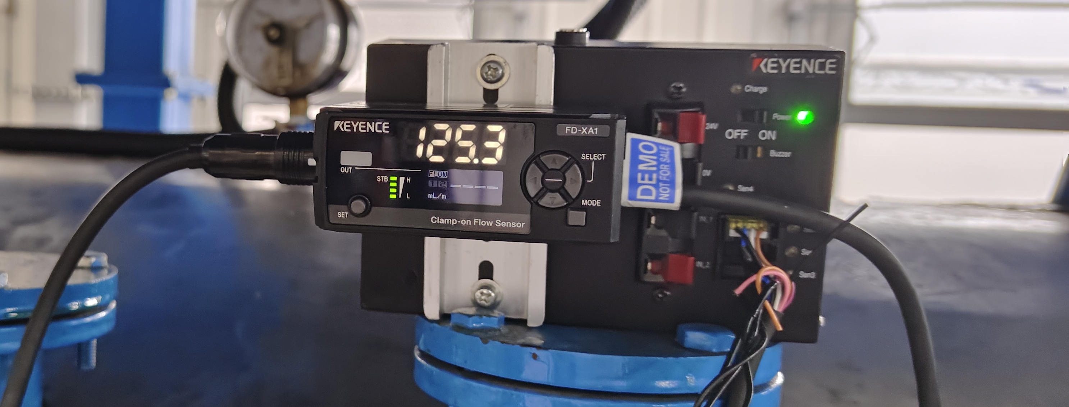
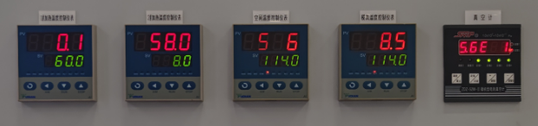
Corrective actions of the VPI station
Inlet pipeline
Thermal insulation
Heating belt
Ultrasonic flow meter
T controller for the inletpipeline:52-58
T controller for the mold
60.1 - 58.0 - 58.6 - 58.5

Slide 8
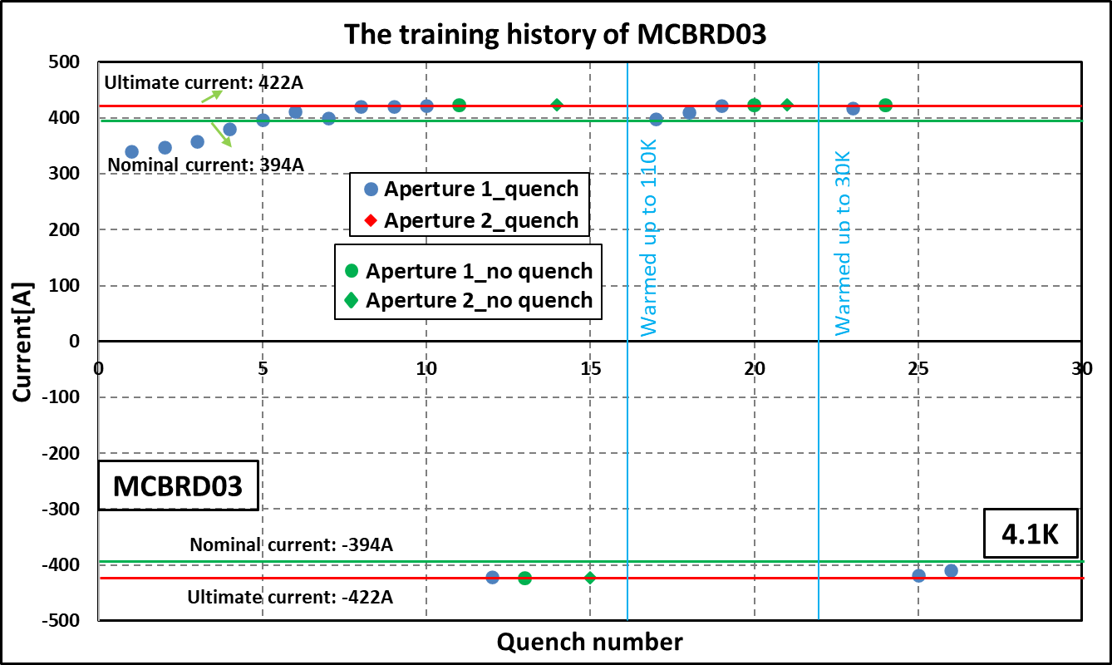
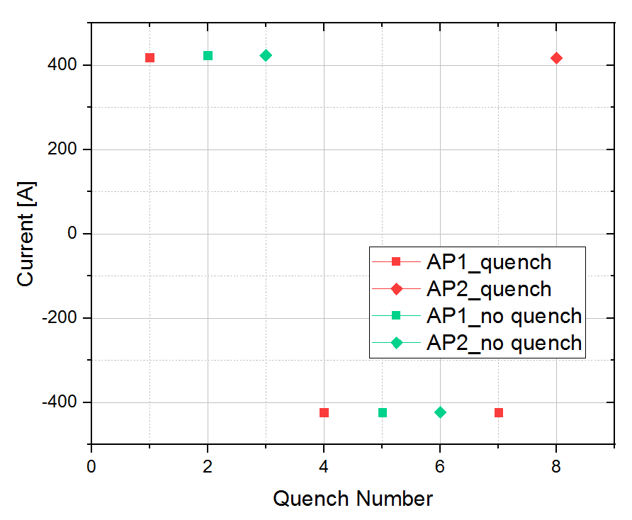
MCBRD03 (third series magnet) performance
MCBRD03 was tested in IMP, reached performance and is now at CERN
  No retraining below nominal current

Slide 9
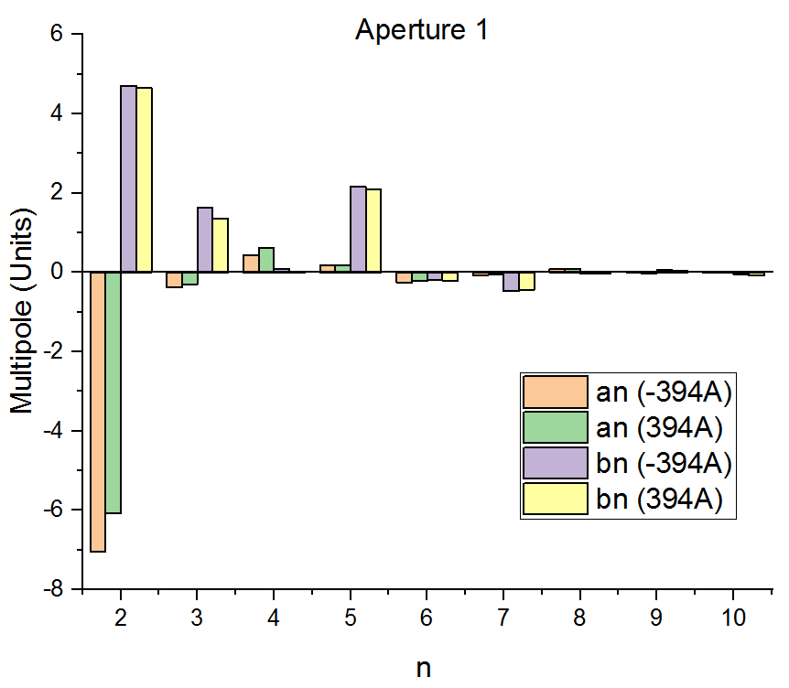
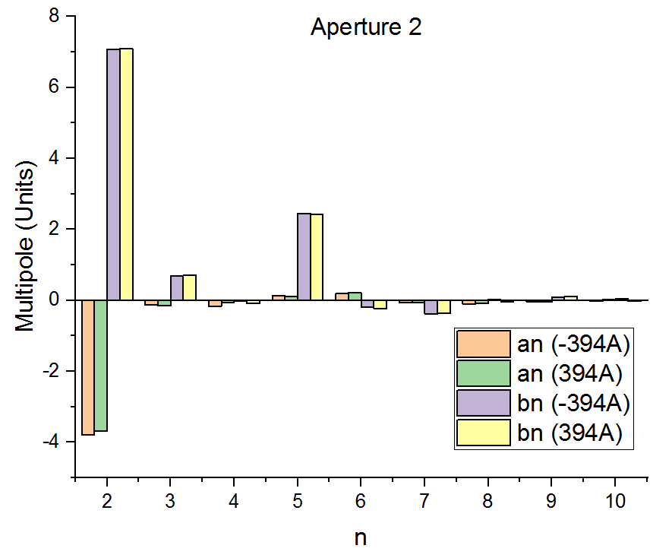
Field Quality of MCBRD03
Field quality is systematically measured in China and is within specifications

Slide 10
MCBRD04 (fourth series magnet) performance
MCBRD04 was tested in IMP, reached performance and thermal cycle will take place in October
  It also reached ultimate current, with short training to nominal current

Slide 11
Schedule and CERN contribution
Iteration on procedures induced some delays with respect to initial schedule – but quality comes before schedule
To mitigate the risk of having limited corrector availability for D2 cold mass, CERN proposed to manufacture two magnets with Chinese components
  Efforts are ongoing in 927 laboratories, dedicated talk of A. Foussat in the parallel session

Slide 12
Summary
4 MCBRD magnets (out of 12 needed) have been fabricated in BAMA
  All of them reached the ultimate current at 4.1 K
Long virgin training issues (not in requirements, but consuming IHEP resources) and retraining (at the margin of HL-LHC requirements) induced an iteration on manufacturing procedure and a fine tuning of design - this iteration took place after MCBRD02
  MCBRD03 confirmed the positive effect of the iteration on performance
  MCBRD04 confirmed reproducibility, thermal cycle is pending
  MCBRD05 shall be assembled at the end of the year
This small series of CCT is giving relevant information on this type of design and technology that is considered for many applications well beyond HL-LHC correctors

