Slide 1

Status of CC cryomodules
Niklas Templeton – STFC Daresbury Laboratory
On behalf of the UK Crab Cavity collaboration
13th HL-LHC Collaboration Meeting – Vancouver (CA) – 26 Sep ‘23

Slide 2
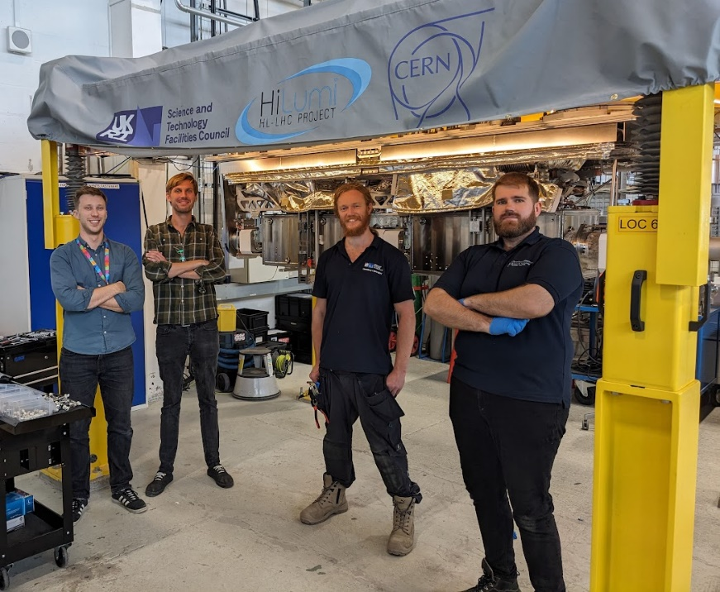
Status of CC cryomodules
UK involvement in HL-LHC Crab Cavities
RFD SPS Cryomodule Build
  Last 12 months
  Challenges & Lessons Learnt
DQW LHC Cryomodules
  Challenges & Continuous Improvement

Slide 3
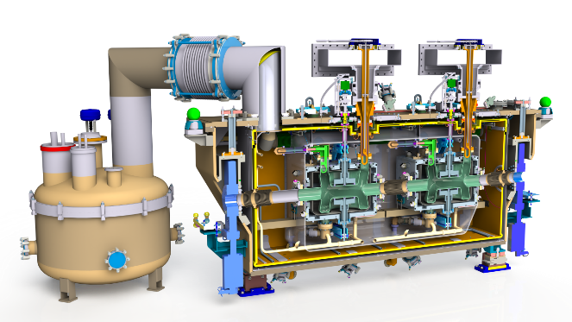
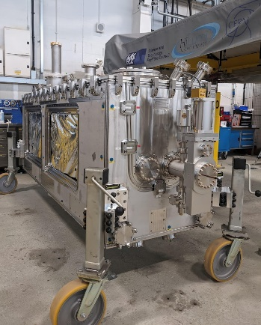
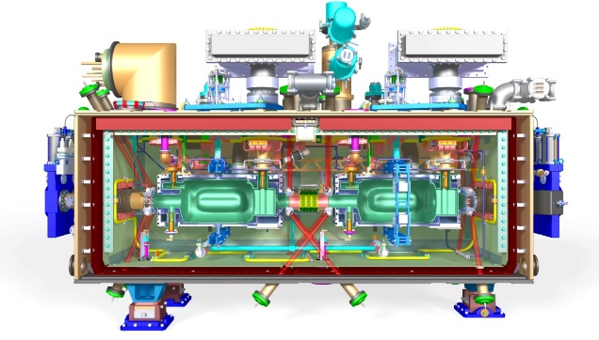
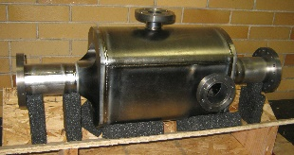
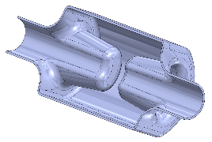
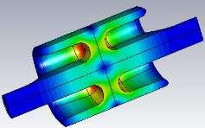
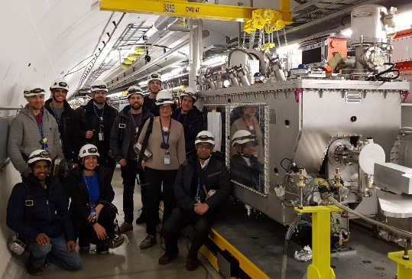
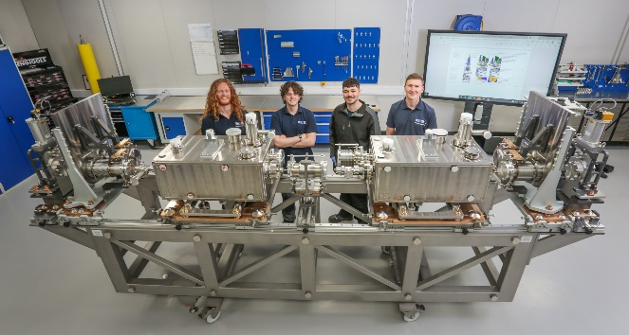
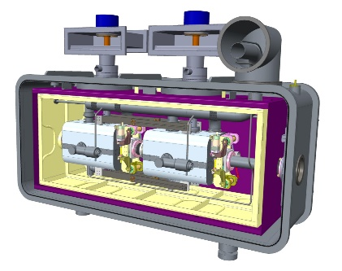
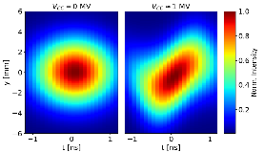
UK involvement in WP4 collaboration
4-Rod
Crab Cavity
DQW Prototype CM
RFD SPS CM
DQW LHC CMs
2011
2025

Slide 4
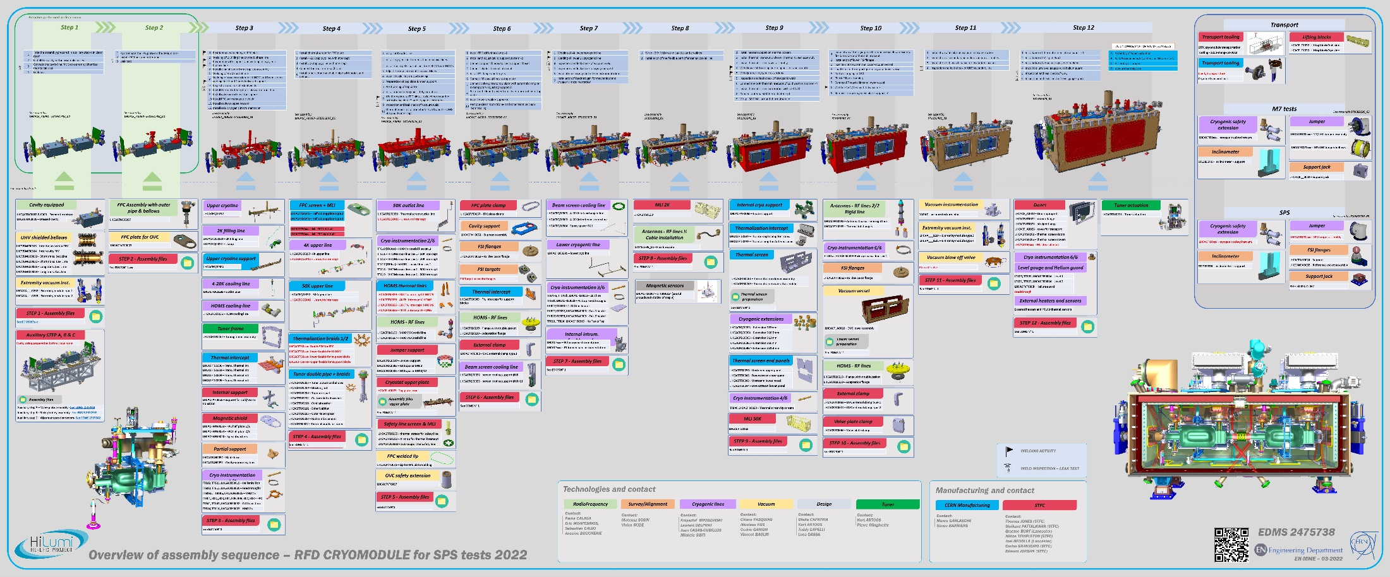
RFD SPS Cryomodule Build
Poster by Teddy Capelli

Slide 5

Status Sep ‘23
DONE ✓
On Tack
NC

Slide 6
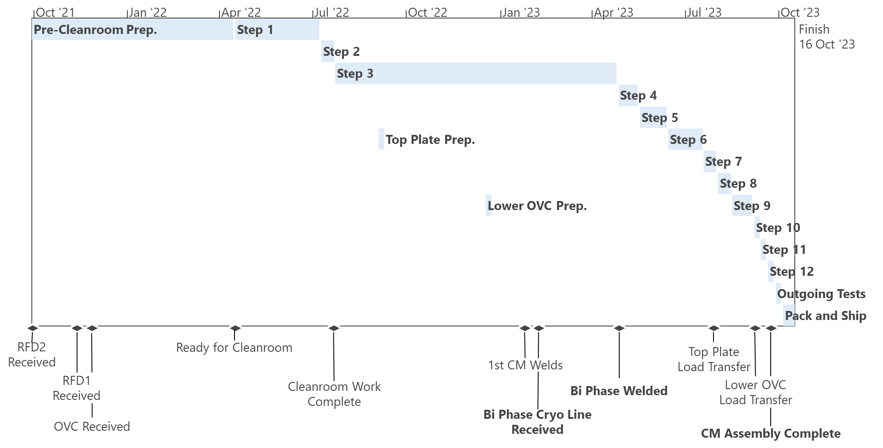
RFD As-Built Timeline (simplified)

Slide 7
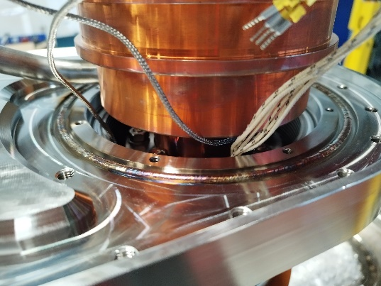
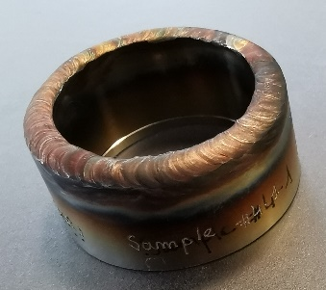
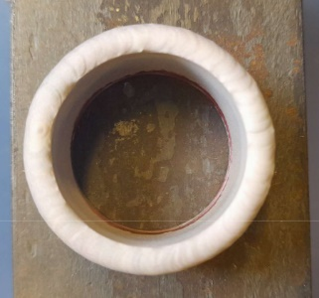
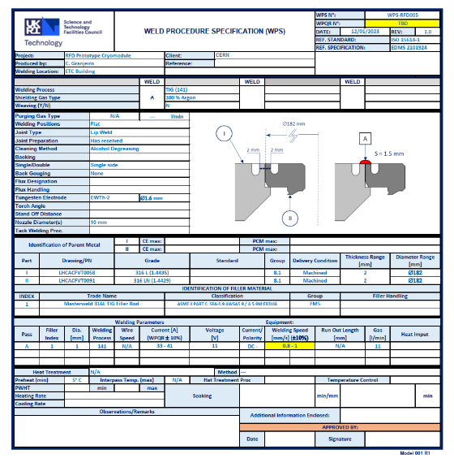
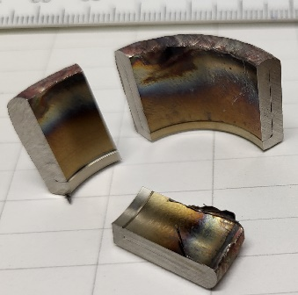
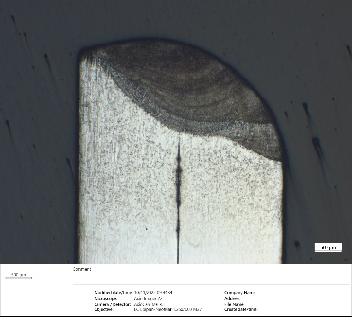
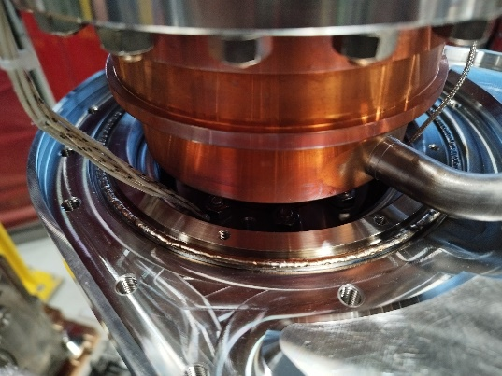
Highlights (last 12 mo.)
Coded welding qualification & 1st CM welds – Jan ‘23

Slide 8
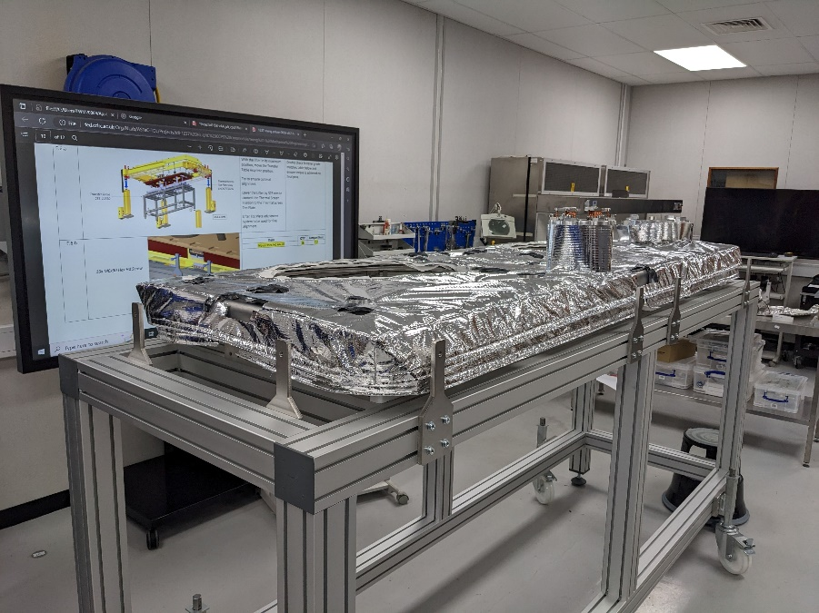
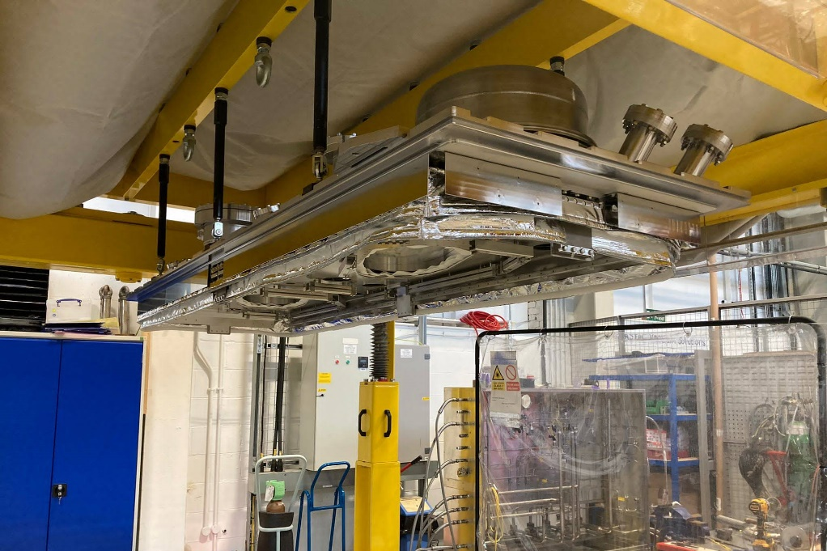
Highlights (last 12 mo.)
Top Plate Equipped - Warm Mag Shield, Thermal Screen, MLI
New MLI skills!

Slide 9
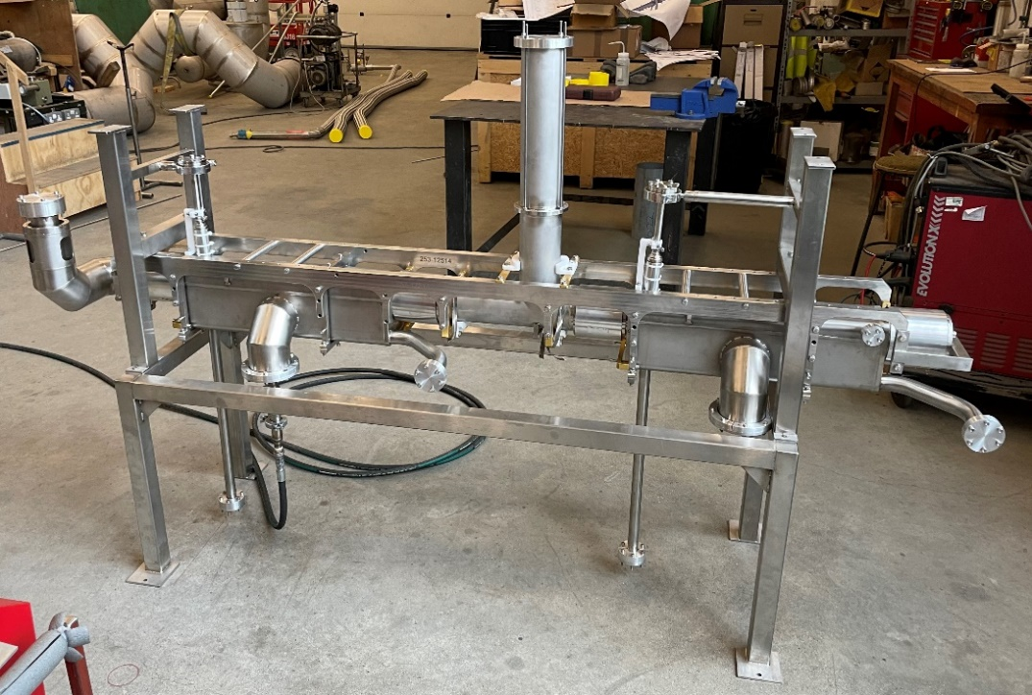
Highlights (last 12 mo.)
Bi Phase Cryoline delivered Feb ’23
18 months late
Several NCs found after delivery – some with major impact
Pressure test failure
  Rig design not fit for purpose

Slide 10
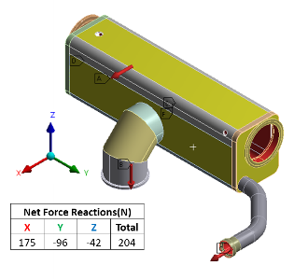
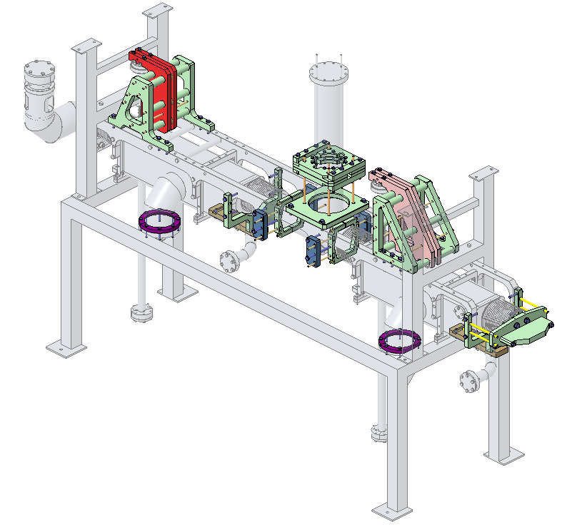
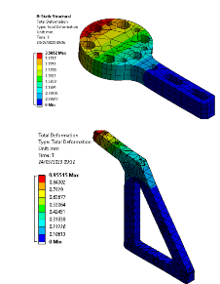
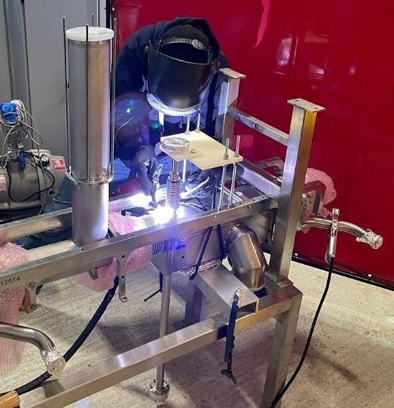
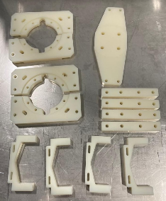
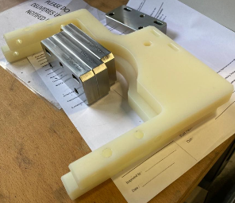
Highlights (last 12 mo.)
Bi Phase line NC resolution
New Pressure Test Rig
  Developed & delivered in-house min timescales
  54 components
  24 unique parts
  FEA verification
He Level Ports replaced in-house
Re-qualification tests passed ✓

Slide 11
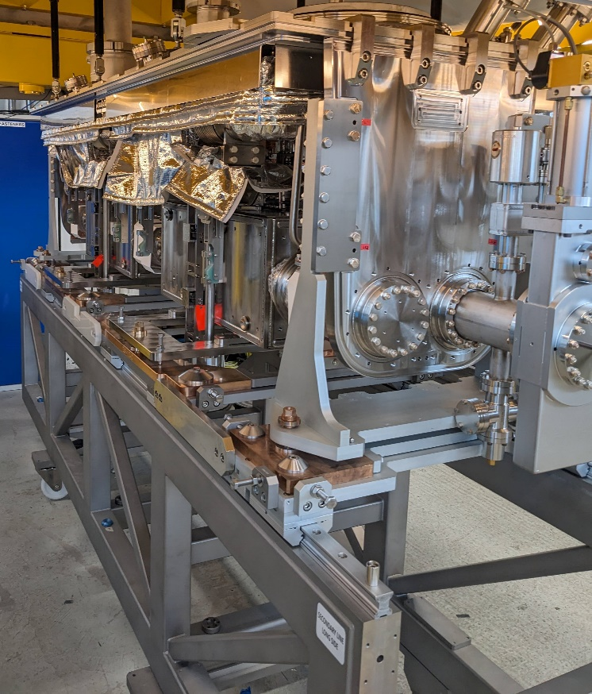
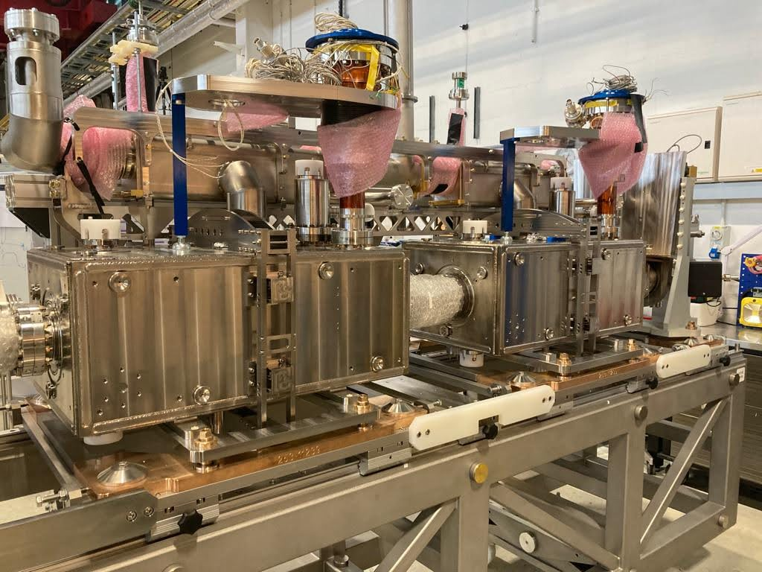
Highlights (last 12 mo.)
Bi Phase, Tuner & Top Plate integration (steps 3-5)

Slide 12
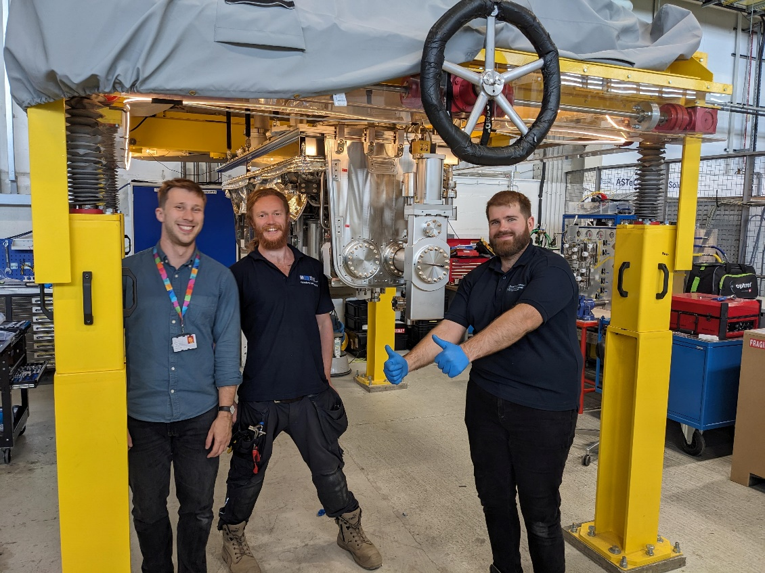
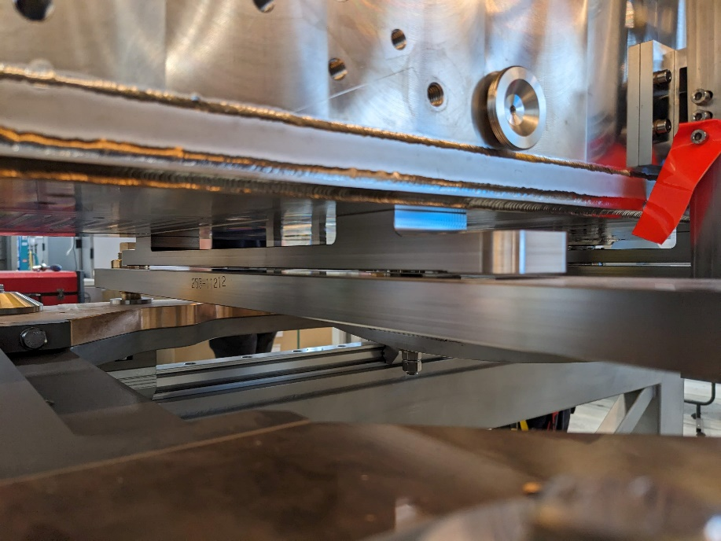
Highlights (last 12 mo.)
Cavitystring to Top Plate load transfer (step 6)

Slide 13
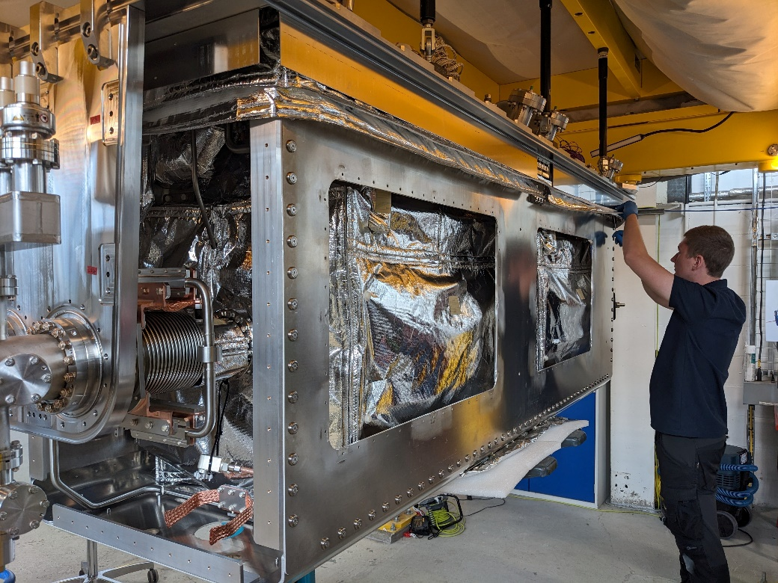
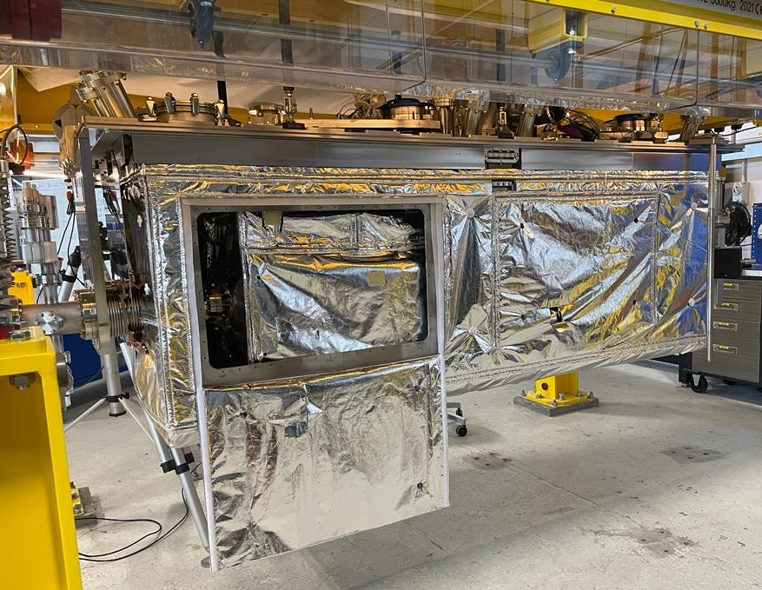
Highlights (last 12 mo.)
Thermal Screen & 50K MLI (step 9)

Slide 14
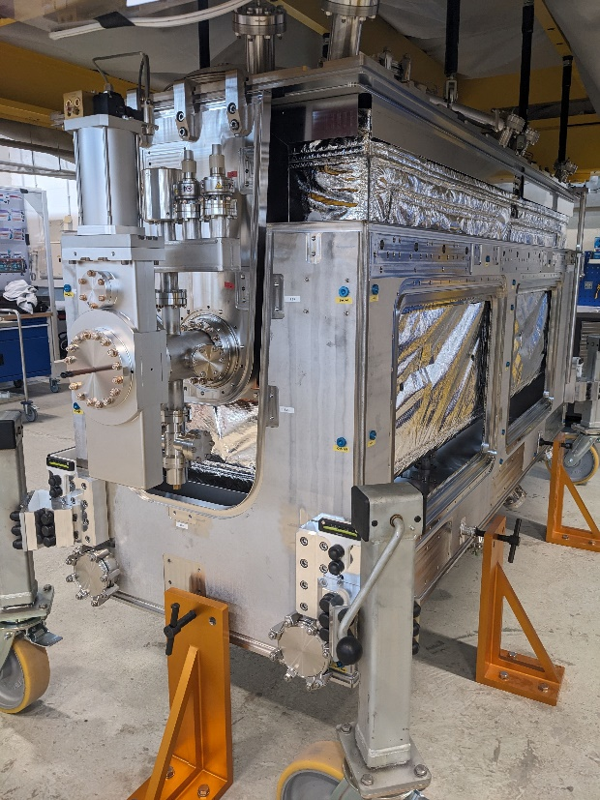
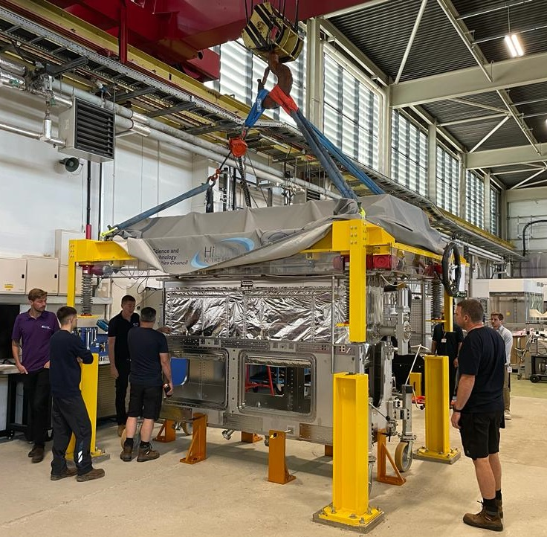
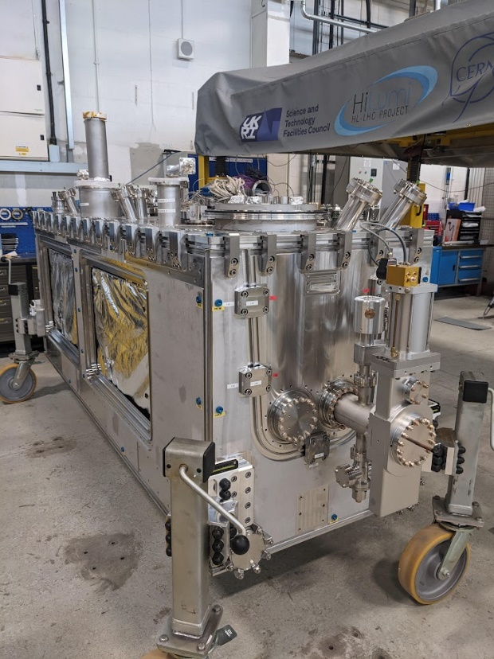
Highlights (last 12 mo.)
Lower OVC integration

Slide 15
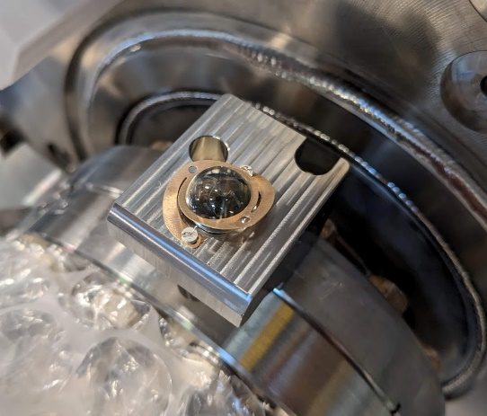
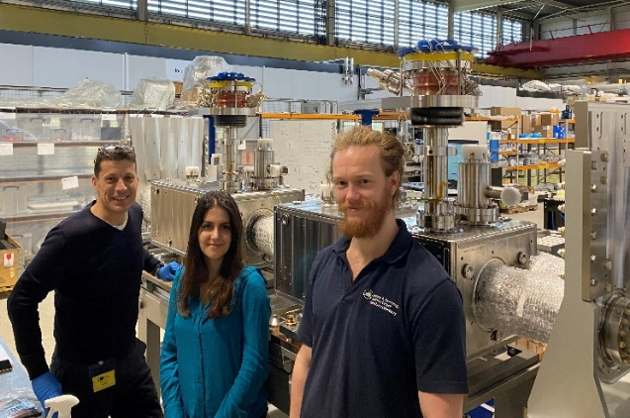
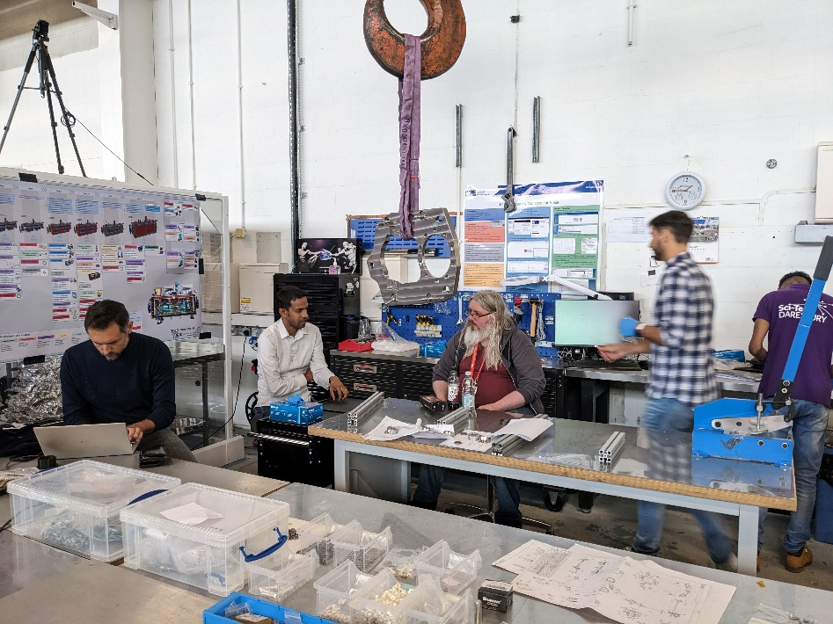
Highlights (last 12 mo.)
Many CERN visitors for knowledge transfer & build support:
RF
Fibre optic strain gauge
Survey & alignment
Cryo instrumentation
TIG & orbital welds
Tuner assembly
Management & load transfer oversight
Transport tooling & logistics

Slide 16
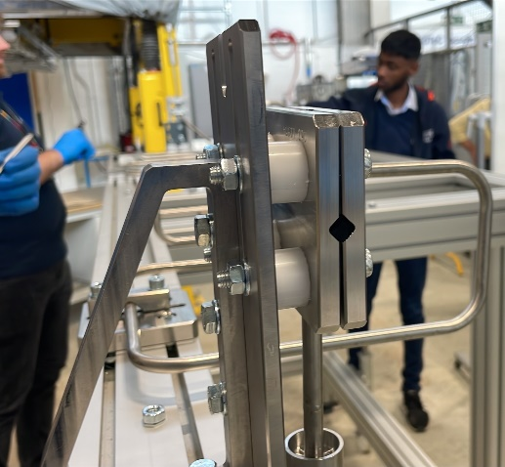
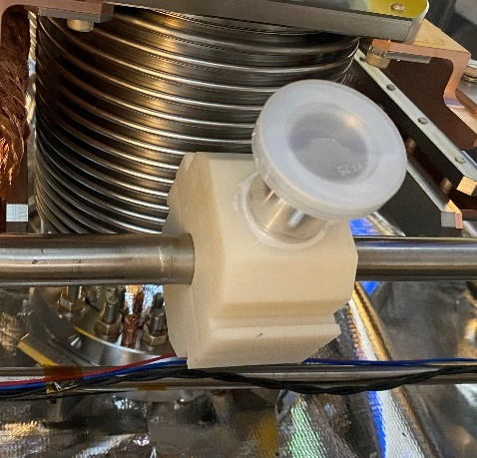
Highlights (last 12 mo.)
Elegant solutions to incidental challenges
Faster in-house manufacturing
Vacuum & pressure test rigs & procedures
3D printed leak test tools (clamshells)
Qualification of assembly tooling & infrastructure
Organisational evolution
Notes:
Cryomodule transport
Torque Calcs
Agile Project Management Principles

Slide 17
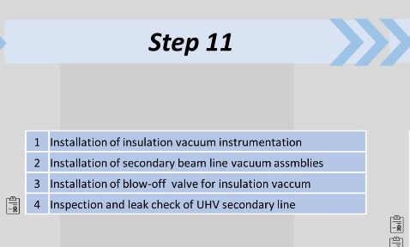
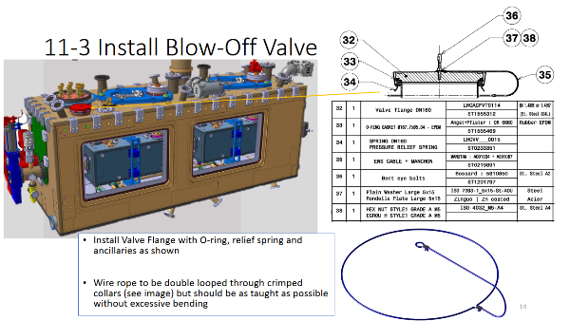
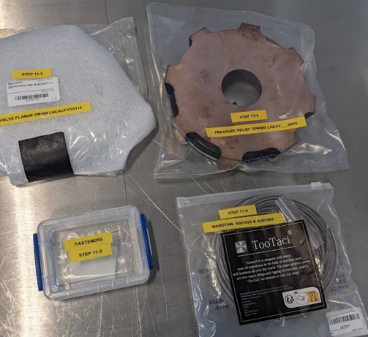
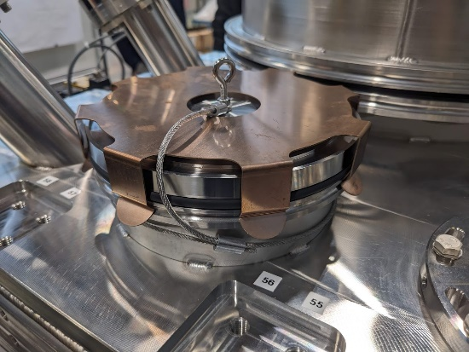
Assembly Procedures
Based on poster logic + tooling & infrastructure
To troubleshoot & de-risk technical tasks
‘BOM kits’ can be prepped by sub-step
Extremely valuable for LHC CC Cryomodules
Includes requirements, torques & sign-off checklists for travellers

Slide 18

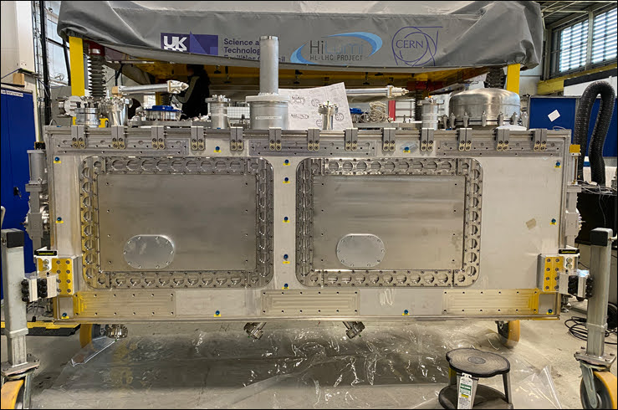
Some RFD Metrics
Total Assembly Procedures = 840 pages!
Cryomodule Components: 10K (>5k unique)
Tooling drawings: 524
28 NCRs Resolved
Total build team effort <9 FTE per year!
  FT engineers & technicians + shared specialist & support staff
  *not including apprentice effort

Slide 19
Challenges & Lessons Learnt
Integration complexity, sensitivity & design ‘teething’
Recruitment & retention
Supplier QA Management
Internal QA & EDMS/MTF management effort
Material specifications, traceability, coating & cleaning
Co-ordinating specialist support & visits

Slide 20
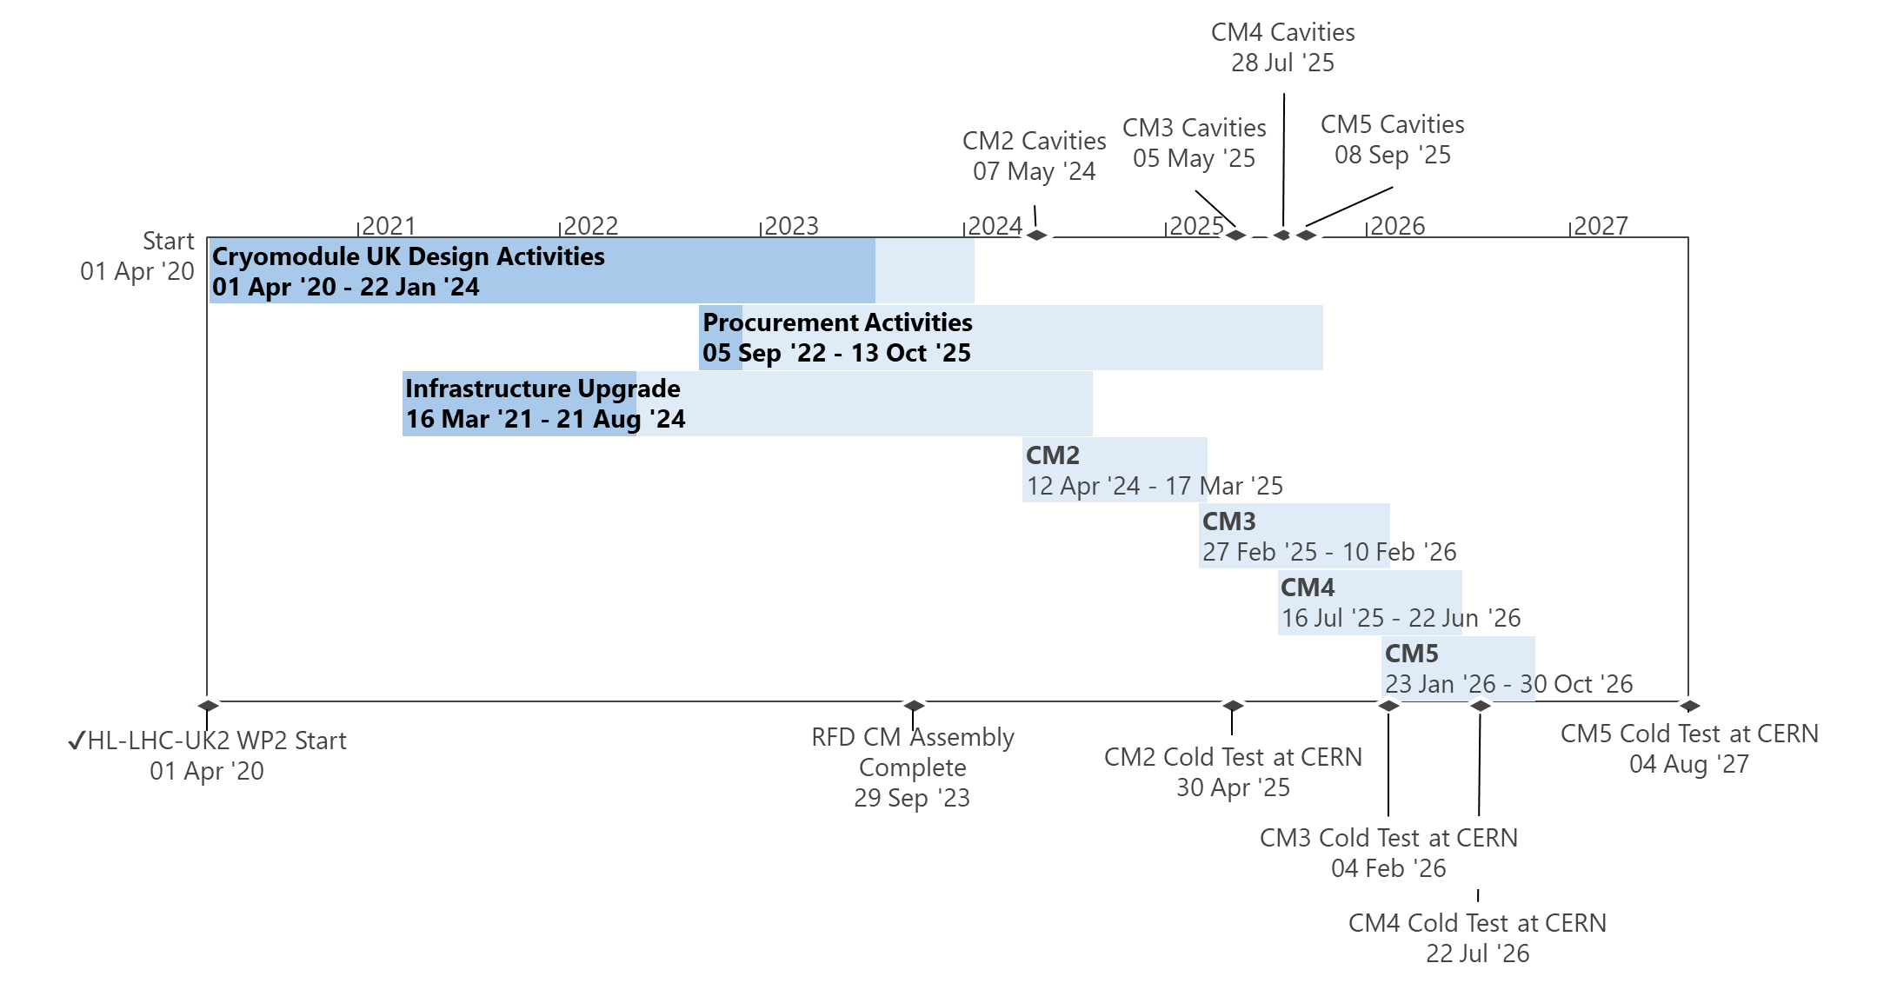
UK DQW Schedule
RFD build delays impacted DQW progress
RI Cavity Delivery delays

Slide 21
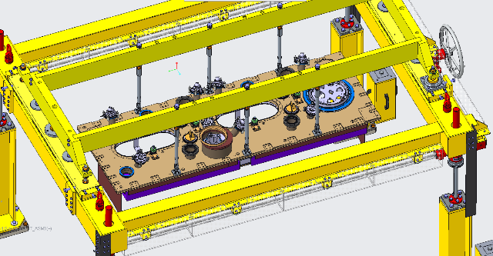


DQW Tooling & Infrastructure
(Re)design work:
Top Plate Lifting Gantry Mods ✓
Transfer Table ✓
Cavitystring tooling – nearly done
Next:
Anti-shock transport frame
Bi Phase Qualification Rig

Slide 22


DQW Cryomodule Procurement
Beamline vac equipment - received or on-order
Cavitystring Trolley II - received
2x common string trolley tooling - on-site
OVC tender - live
Warm Mag Shield tender - live
Cryolines materials & fabrication - on-going (critical)

Slide 23

DQW Improvements
More info in WP4 break-out talks
More staffing & more experience
Infrastructure upgrades
Parts management workstation ✓
Build area flooring
Improved storage, workbenches & layout
Parts management
5S consultancy discussions ✓
ID > QC > Processing > Label + Storage
Technical sub-team
Dimensional control
Mock assembly
Managing cleaning etc.
BOM kit prep.

Slide 24




Slide 25


Shipping
Agreed with CERN to use CERN transport team and truck

Slide 26

Shipping
Documentation is progressing well with tight coordination between AJBM + Ben Lewis (STFC Logistics) + Simon Barriere (CERN)

Slide 27
DQW Series Build Timeline (Sep ‘22)
Apr '20
Apr '20
Apr '20
Apr '20
Apr '20
Apr '20
Apr '20
Apr '20
Apr '20
Apr '20
Apr '20
Apr '20
Apr '20
Apr '20
Apr '20
Apr '20
Apr '20
Apr '20
Apr '20
Apr '20
Jul '20
Jul '20
Jul '20
Jul '20
Jul '20
Jul '20
Jul '20
Jul '20
Jul '20
Jul '20
Jul '20
Jul '20
Jul '20
Jul '20
Jul '20
Jul '20
Jul '20
Jul '20
Jul '20
Jul '20
Oct '20
Oct '20
Oct '20
Oct '20
Oct '20
Oct '20
Oct '20
Oct '20
Oct '20
Oct '20
Oct '20
Oct '20
Oct '20
Oct '20
Oct '20
Oct '20
Oct '20
Oct '20
Oct '20
Oct '20
Jan '21
Jan '21
Jan '21
Jan '21
Jan '21
Jan '21
Jan '21
Jan '21
Jan '21
Jan '21
Jan '21
Jan '21
Jan '21
Jan '21
Jan '21
Jan '21
Jan '21
Jan '21
Jan '21
Jan '21
Apr '21
Apr '21
Apr '21
Apr '21
Apr '21
Apr '21
Apr '21
Apr '21
Apr '21
Apr '21
Apr '21
Apr '21
Apr '21
Apr '21
Apr '21
Apr '21
Apr '21
Apr '21
Apr '21
Apr '21
Jul '21
Jul '21
Jul '21
Jul '21
Jul '21
Jul '21
Jul '21
Jul '21
Jul '21
Jul '21
Jul '21
Jul '21
Jul '21
Jul '21
Jul '21
Jul '21
Jul '21
Jul '21
Jul '21
Jul '21
Oct '21
Oct '21
Oct '21
Oct '21
Oct '21
Oct '21
Oct '21
Oct '21
Oct '21
Oct '21
Oct '21
Oct '21
Oct '21
Oct '21
Oct '21
Oct '21
Oct '21
Oct '21
Oct '21
Oct '21
Jan '22
Jan '22
Jan '22
Jan '22
Jan '22
Jan '22
Jan '22
Jan '22
Jan '22
Jan '22
Jan '22
Jan '22
Jan '22
Jan '22
Jan '22
Jan '22
Jan '22
Jan '22
Jan '22
Jan '22
Apr '22
Apr '22
Apr '22
Apr '22
Apr '22
Apr '22
Apr '22
Apr '22
Apr '22
Apr '22
Apr '22
Apr '22
Apr '22
Apr '22
Apr '22
Apr '22
Apr '22
Apr '22
Apr '22
Apr '22
Jul '22
Jul '22
Jul '22
Jul '22
Jul '22
Jul '22
Jul '22
Jul '22
Jul '22
Jul '22
Jul '22
Jul '22
Jul '22
Jul '22
Jul '22
Jul '22
Jul '22
Jul '22
Jul '22
Jul '22
Oct '22
Oct '22
Oct '22
Oct '22
Oct '22
Oct '22
Oct '22
Oct '22
Oct '22
Oct '22
Oct '22
Oct '22
Oct '22
Oct '22
Oct '22
Oct '22
Oct '22
Oct '22
Oct '22
Oct '22
Jan '23
Jan '23
Jan '23
Jan '23
Jan '23
Jan '23
Jan '23
Jan '23
Jan '23
Jan '23
Jan '23
Jan '23
Jan '23
Jan '23
Jan '23
Jan '23
Jan '23
Jan '23
Jan '23
Jan '23
Apr '23
Apr '23
Apr '23
Apr '23
Apr '23
Apr '23
Apr '23
Apr '23
Apr '23
Apr '23
Apr '23
Apr '23
Apr '23
Apr '23
Apr '23
Apr '23
Apr '23
Apr '23
Apr '23
Apr '23
Jul '23
Jul '23
Jul '23
Jul '23
Jul '23
Jul '23
Jul '23
Jul '23
Jul '23
Jul '23
Jul '23
Jul '23
Jul '23
Jul '23
Jul '23
Jul '23
Jul '23
Jul '23
Jul '23
Jul '23
Oct '23
Oct '23
Oct '23
Oct '23
Oct '23
Oct '23
Oct '23
Oct '23
Oct '23
Oct '23
Oct '23
Oct '23
Oct '23
Oct '23
Oct '23
Oct '23
Oct '23
Oct '23
Oct '23
Oct '23
Jan '24
Jan '24
Jan '24
Jan '24
Jan '24
Jan '24
Jan '24
Jan '24
Jan '24
Jan '24
Jan '24
Jan '24
Jan '24
Jan '24
Jan '24
Jan '24
Jan '24
Jan '24
Jan '24
Jan '24
Apr '24
Apr '24
Apr '24
Apr '24
Apr '24
Apr '24
Apr '24
Apr '24
Apr '24
Apr '24
Apr '24
Apr '24
Apr '24
Apr '24
Apr '24
Apr '24
Apr '24
Apr '24
Apr '24
Apr '24
Jul '24
Jul '24
Jul '24
Jul '24
Jul '24
Jul '24
Jul '24
Jul '24
Jul '24
Jul '24
Jul '24
Jul '24
Jul '24
Jul '24
Jul '24
Jul '24
Jul '24
Jul '24
Jul '24
Jul '24
Oct '24
Oct '24
Oct '24
Oct '24
Oct '24
Oct '24
Oct '24
Oct '24
Oct '24
Oct '24
Oct '24
Oct '24
Oct '24
Oct '24
Oct '24
Oct '24
Oct '24
Oct '24
Oct '24
Oct '24
Jan '25
Jan '25
Jan '25
Jan '25
Jan '25
Jan '25
Jan '25
Jan '25
Jan '25
Jan '25
Jan '25
Jan '25
Jan '25
Jan '25
Jan '25
Jan '25
Jan '25
Jan '25
Jan '25
Jan '25
Apr '25
Apr '25
Apr '25
Apr '25
Apr '25
Apr '25
Apr '25
Apr '25
Apr '25
Apr '25
Apr '25
Apr '25
Apr '25
Apr '25
Apr '25
Apr '25
Apr '25
Apr '25
Apr '25
Apr '25
Jul '25
Jul '25
Jul '25
Jul '25
Jul '25
Jul '25
Jul '25
Jul '25
Jul '25
Jul '25
Jul '25
Jul '25
Jul '25
Jul '25
Jul '25
Jul '25
Jul '25
Jul '25
Jul '25
Jul '25
Oct '25
Oct '25
Oct '25
Oct '25
Oct '25
Oct '25
Oct '25
Oct '25
Oct '25
Oct '25
Oct '25
Oct '25
Oct '25
Oct '25
Oct '25
Oct '25
Oct '25
Oct '25
Oct '25
Oct '25
Jan '26
Jan '26
Jan '26
Jan '26
Jan '26
Jan '26
Jan '26
Jan '26
Jan '26
Jan '26
Jan '26
Jan '26
Jan '26
Jan '26
Jan '26
Jan '26
Jan '26
Jan '26
Jan '26
Jan '26
Apr '26
Apr '26
Apr '26
Apr '26
Apr '26
Apr '26
Apr '26
Apr '26
Apr '26
Apr '26
Apr '26
Apr '26
Apr '26
Apr '26
Apr '26
Apr '26
Apr '26
Apr '26
Apr '26
Apr '26
Jul '26
Jul '26
Jul '26
Jul '26
Jul '26
Jul '26
Jul '26
Jul '26
Jul '26
Jul '26
Jul '26
Jul '26
Jul '26
Jul '26
Jul '26
Jul '26
Jul '26
Jul '26
Jul '26
Jul '26
Oct '26
Oct '26
Oct '26
Oct '26
Oct '26
Oct '26
Oct '26
Oct '26
Oct '26
Oct '26
Oct '26
Oct '26
Oct '26
Oct '26
Oct '26
Oct '26
Oct '26
Oct '26
Oct '26
Oct '26
Jan '27
Jan '27
Jan '27
Jan '27
Jan '27
Jan '27
Jan '27
Jan '27
Jan '27
Jan '27
Jan '27
Jan '27
Jan '27
Jan '27
Jan '27
Jan '27
Jan '27
Jan '27
Jan '27
Jan '27
Start
01/04/20
Cryomodule UK Design Activities
01/04/20 - 14/06/23
Finish
15/04/27
Cryomodule UK Design Activities
01/04/20 - 14/06/23
Procurement Activities
05/09/22 - 07/03/25
Procurement Activities
05/09/22 - 07/03/25
Infrastructure Upgrade
16/03/21 - 03/10/23
Infrastructure Upgrade
16/03/21 - 03/10/23
11/23
CM2 Clean Assy
CM2 General Assembly
17/11/23 - 26/04/24
CM2 General Assy
CM2 Acceptance Tests
RFD Pre-series Cryomodule - SM18 Testing
27/03/23 - 02/10/23
RFD Pre-series Cryomodule - SM18 Testing
27/03/23 - 02/10/23
CM3 Clean Assy
CM3 General Assembly
07/10/24 - 06/02/25
CM3 General Assy
CM3 Acceptance Tests
25
CM4 Clean Assy
CM4 General Assembly
17/01/25 - 03/06/25
CM4 General Assy
CM4 Acceptance Tests
CM5 Clean Assy
CM5 General Assembly
07/05/25 - 26/09/25
CM5 General Assy
CM5 Acceptance Tests
HL-LHC-UK2 WP2 Start
01/04/20
HL-LHC-UK2 WP2 Start
01/04/20
CM2 Cavity Set Received
21/08/23
CM2 Cavity Set Received
21/08/23
CM5 Ready to Transport
24/10/25
CM5 Ready to Transport
24/10/25

