Slide 1



Status of Canadian Contribution to WP4
Bob Laxdal
TRIUMF Hi-Lumi Technical Coordinator
Sept. 25, 2023

Slide 2
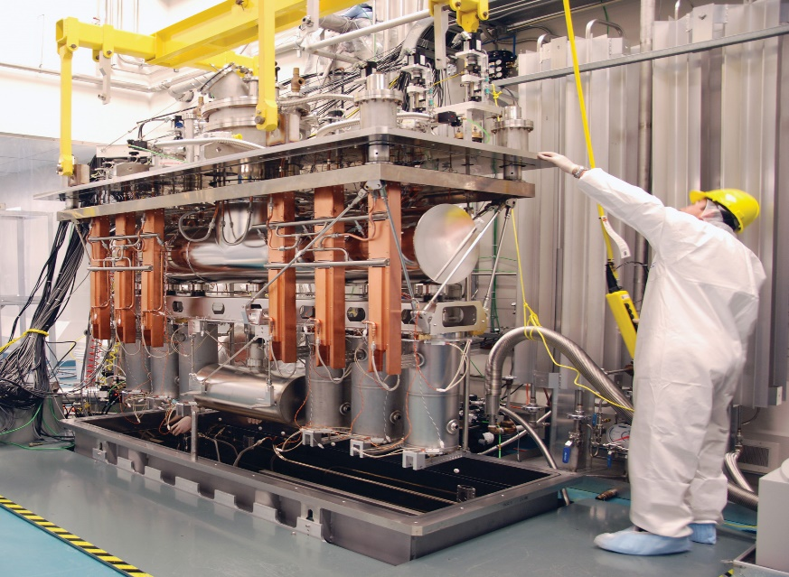
TRIUMF is Canada’s particle accelerator centre

Slide 3


Slide 4
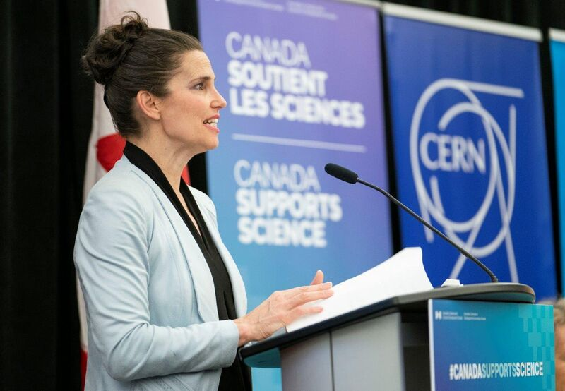
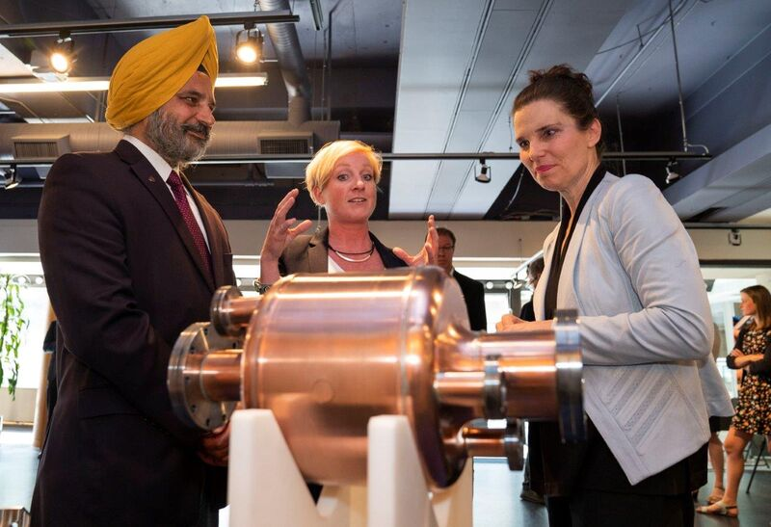
June 25, 2018
“Great science knows no borders.” Minister Kirsty Duncan
Canadian Minister of Science and Sport Kirsty Duncan announces 10M$ support for TRIUMF to build 5 Hi Lumi LHC RFD Crab Cavity Cryomodules
Working with the Canadian research community and industry, TRIUMF will lead the production of the cryomodules with a $2 million in-kind contribution for a total project value of $12 million.

Slide 5
Scope and constraints

Slide 6
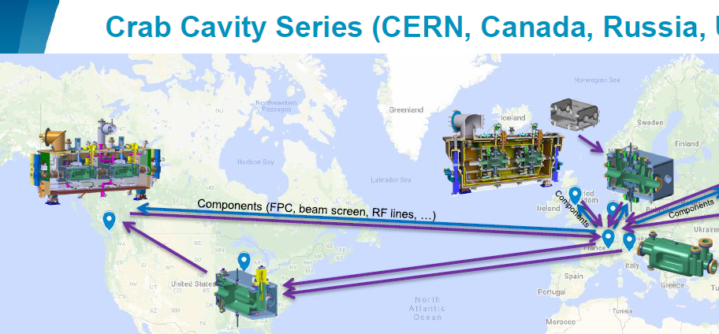
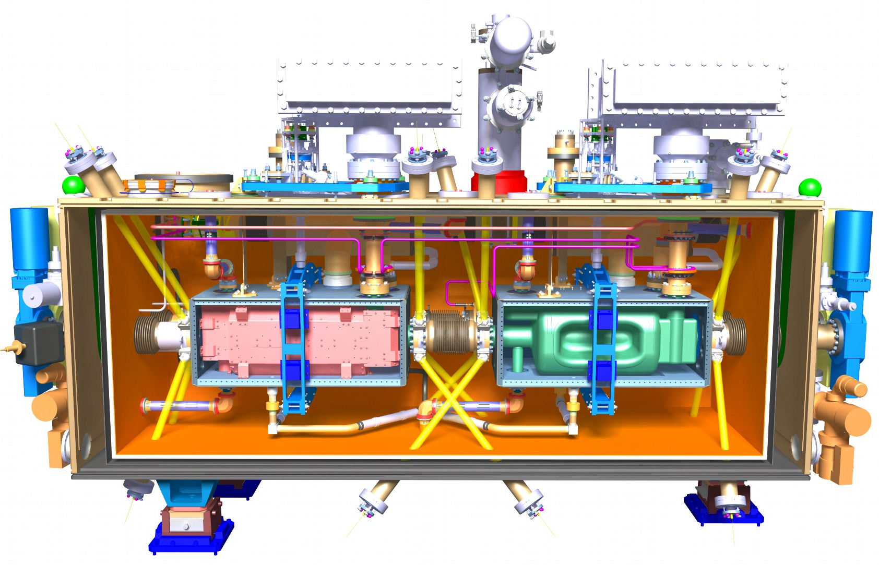
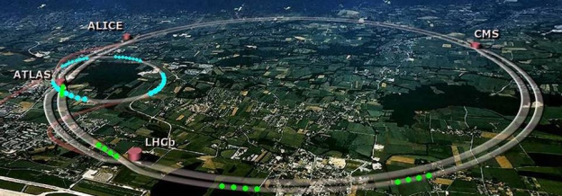
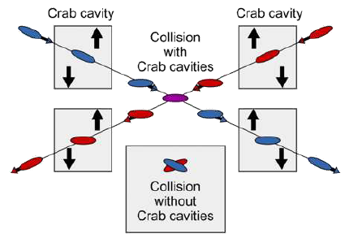
High Luminosity Canada – part of global collaboration (CERN, USA, UK) that will deliver Crab Cavity modules – essential for the luminosity increase at ATLAS and CMS

Slide 7
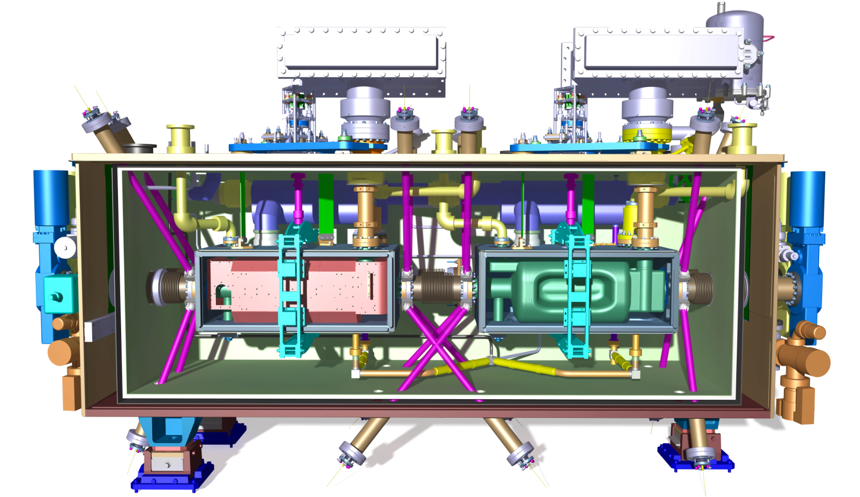
Scope of Canadian Contribution
Scope:
TRIUMF to work with CERN and UK colleagues to develop RFD cryomodule design, assembly tooling and fixtures, assembly procedures
TRIUMF to receive 10 dressed RFD resonators from US-AUP, to re-qualify the cavities, to install the fundamental power coupler and to assemble each pair of RFDs into five hermetic strings
TRIUMF to assemble hermetic strings into five crymodules
TRIUMF to qualify the cryomodules through testing at TRIUMF before packaging and shipping to CERN

Slide 8
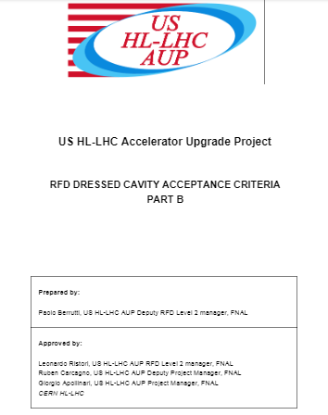
Cavity Re-qualification at TRIUMF
CERN acceptance of AUP cavities will happen at TRIUMF
Acceptance criteria are established in a document from AUP in consultation with TRIUMF
We will receive qualified cavities under vacuum and with test coupler and vacuum diagnostic on board
The acceptance document itemizes a series of warm and cold measurements to confirm that the cavity has not been degraded during transport and is acceptable to be installed in the CM.
A cavity test is expected to take 10 days
8

Slide 9
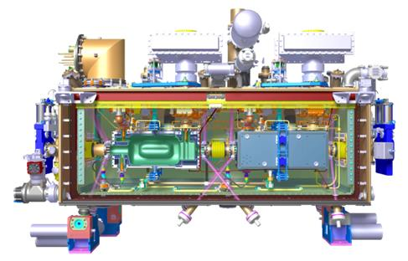
Cryomodule Qualification/Commissioning at TRIUMF
Hardware checks
  Check the operation of diagnostics at room temperature
  Leak check and pressure test – all volumes
  Measure warm rf frequency, alignment
Qualify at 77K
  Cooldown to 77K
  leak check, alignment check
  Check rf frequency
Qualify at 4K
  Cooldown cold mass to 4K
  Check alignment
  Check rf frequency
  Check operation of tuner
  Power each cavity independently to check gradient and Q
  Check static load to 4K based on falling level
The testing will be done in the SRF test area.
A CM test is expect to take 4 weeks with 1 week of preparation, 2 weeks of testing and 1 week of warm-up and removal.
The amplifier will be supplied by CERN
9

Slide 10
Project Strategy
The project strategy calls for procurement of parts for a single cryomodule, TCM0, followed by procurement of parts for the production series TCM1-4
Gate 3A enabled us to launch procurements to support cavity testing, infrastructure upgrades and for parts to prepare prototype cryomodule (CM) as drawing readiness allows
Project slippages due to Covid and other forces vs. boundary conditions on project funds are having an impact on this strategy
  Shifting timelines for
    TCM0 cavities from AUP
    Released drawings and parts from CERN
  Fixed timeline for spending the funds
Project Milestone | Date | Inputs
Gate 1 | Dec 2019 | Conceptual design review, preliminary scope def’n
Gate 2 | Aug. 2020 | Final scope def’n, detailed budget
Gate 3A TCM0 | May 2021 | TCM0 design
10

Slide 11
Funding and priorities
Due to the nature of the funding agreement ALL funds for the project must be spent before April 2025
Project slippage means that now spending is a major risk to the Canadian contribution and strategies are being modified
TRIUMF has presently spent or committed 42% of the funds - TRIUMF will have to spend the remaining 58% in the next 18 months
Risk mitigation requires
  Ordering production quantities as soon as possible (In addition to TCM0 procurements)
  Timely release of drawing packages for long lead items of series
  Prioritization for higher cost items
  Timely arrival of items where CERN is doing a group purchase for UK and Canada so cheques can be written
11

Slide 12
Progress Milestones
Milestone | Application | Achieved
4k-2k Cryo insert qualified | Infrastructure | Nov 2022
OVC Drawings released | TCM0 | Apr 2023
OVC tender released | TCM0 | May 2023
OVC material order issued | TCM1-5 | Jun 2023
Clean room tender released | Infrastructure | Jun 2023
Sector Valves received | TCM0 | Jul 2023
OVC order issued (Axton) | TCM0 | Jul 2023
Mu-metal tender released | TCM1-5 | Jul 2023
Clean room contract issued | Infrastructure | Sep 2023
Mu-metal contract issued | TCM1-5 | Sep 2023
MLI tender issued | TCM1-5 | -

Slide 13
Infrastructure preparations

Slide 14
Progress Milestones - Infrastructure
Milestone | Application | Achieved
4k-2k Cryo insert qualified | Infrastructure | Nov 2022
OVC Drawings released | TCM0 | Apr 2023
OVC tender released | TCM0 | May 2023
OVC material order issued | TCM1-5 | Jun 2023
Clean room tender released | Infrastructure | Jun 2023
Sector Valves received | TCM0 | Jul 2023
OVC order issued (Axton) | TCM0 | Jul 2023
Mu-metal tender released | TCM1-5 | Jul 2023
Clean room contract issued | Infrastructure | Sep 2023
Mu-metal contract issued | TCM1-5 | Sep 2023
MLI tender issued | TCM1-5 | -

Slide 15
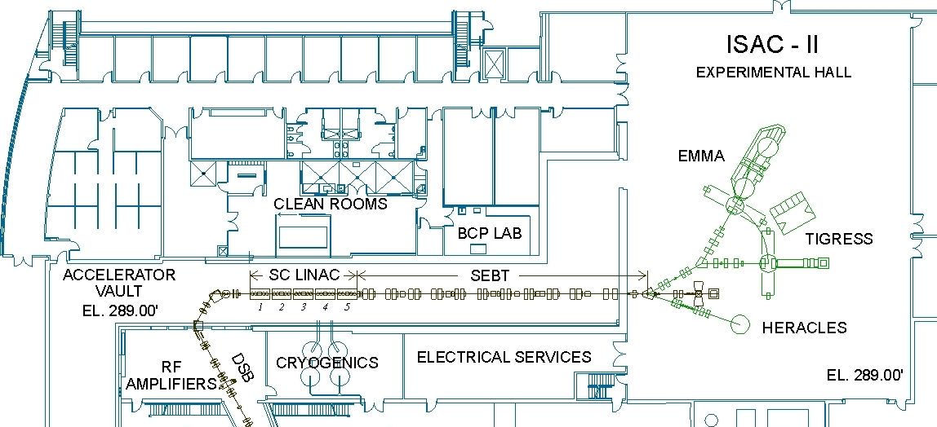
TRIUMF SRF Facilities
The legacy from the development of the TRIUMF superconducting linacs is an SRF facility and know-how, unique in Canada,
The lab supports the in-house accelerator program, external collaborations as well as SRF research and, through NSERC funds, a varied student program in close partnership with U.Victoria
Dirty assembly
RF
HPWR
Prep room
Cavity/CM testing
Clean assembly
BCP

Slide 16
TRIUMF SRF Facilities – Hi-Lumi Upgrade
To improve the throughput of Hi-lumi CMs we are installing a second clean-room in the ISAC-II experimental hall
The clean room will allow dedicated string assembly over the life of the project – ready March 2024
Dirty assembly
Clean assembly
RF
HPWR
Prep room
Cavity/CM testing
Clean assembly
BCP

Slide 17
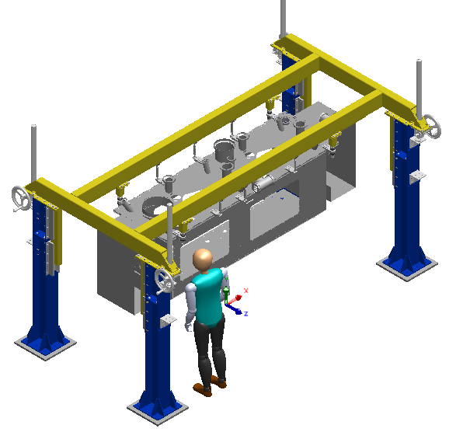
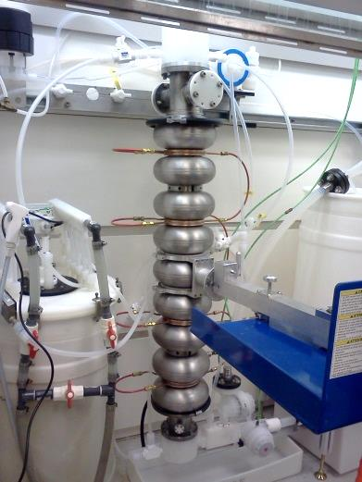
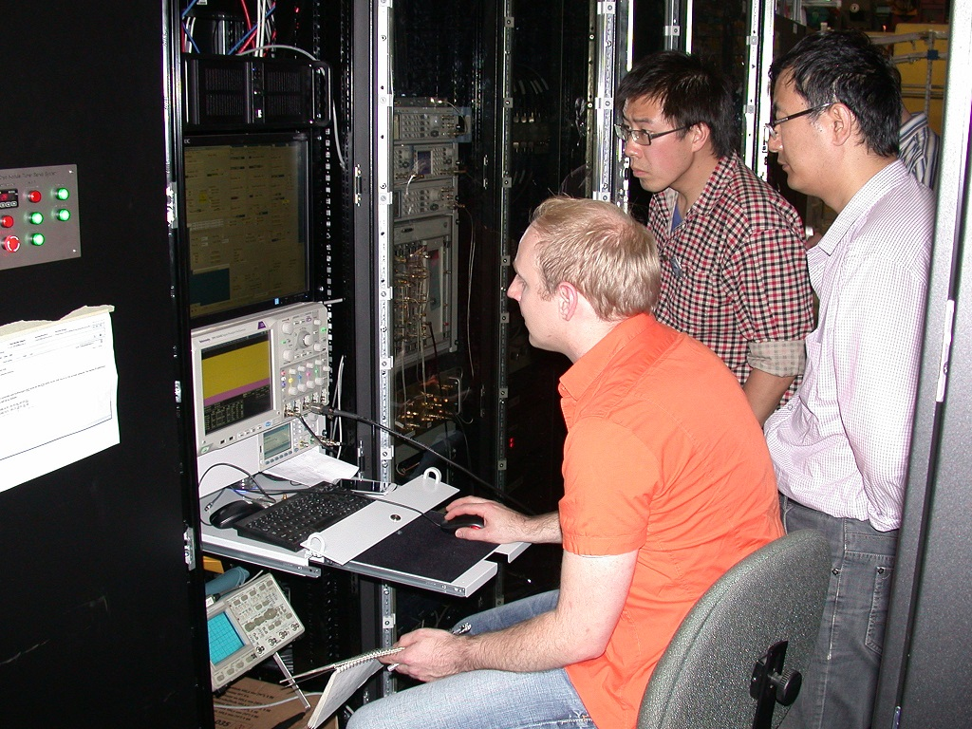
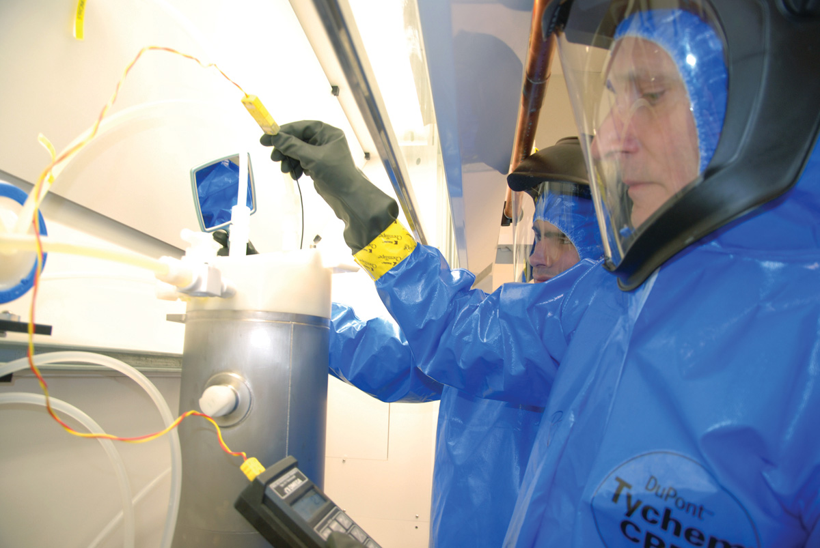
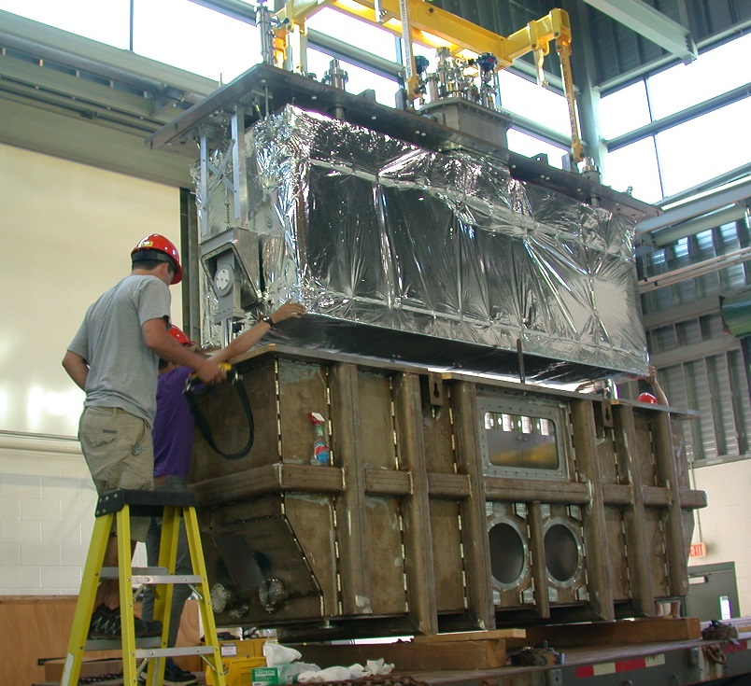
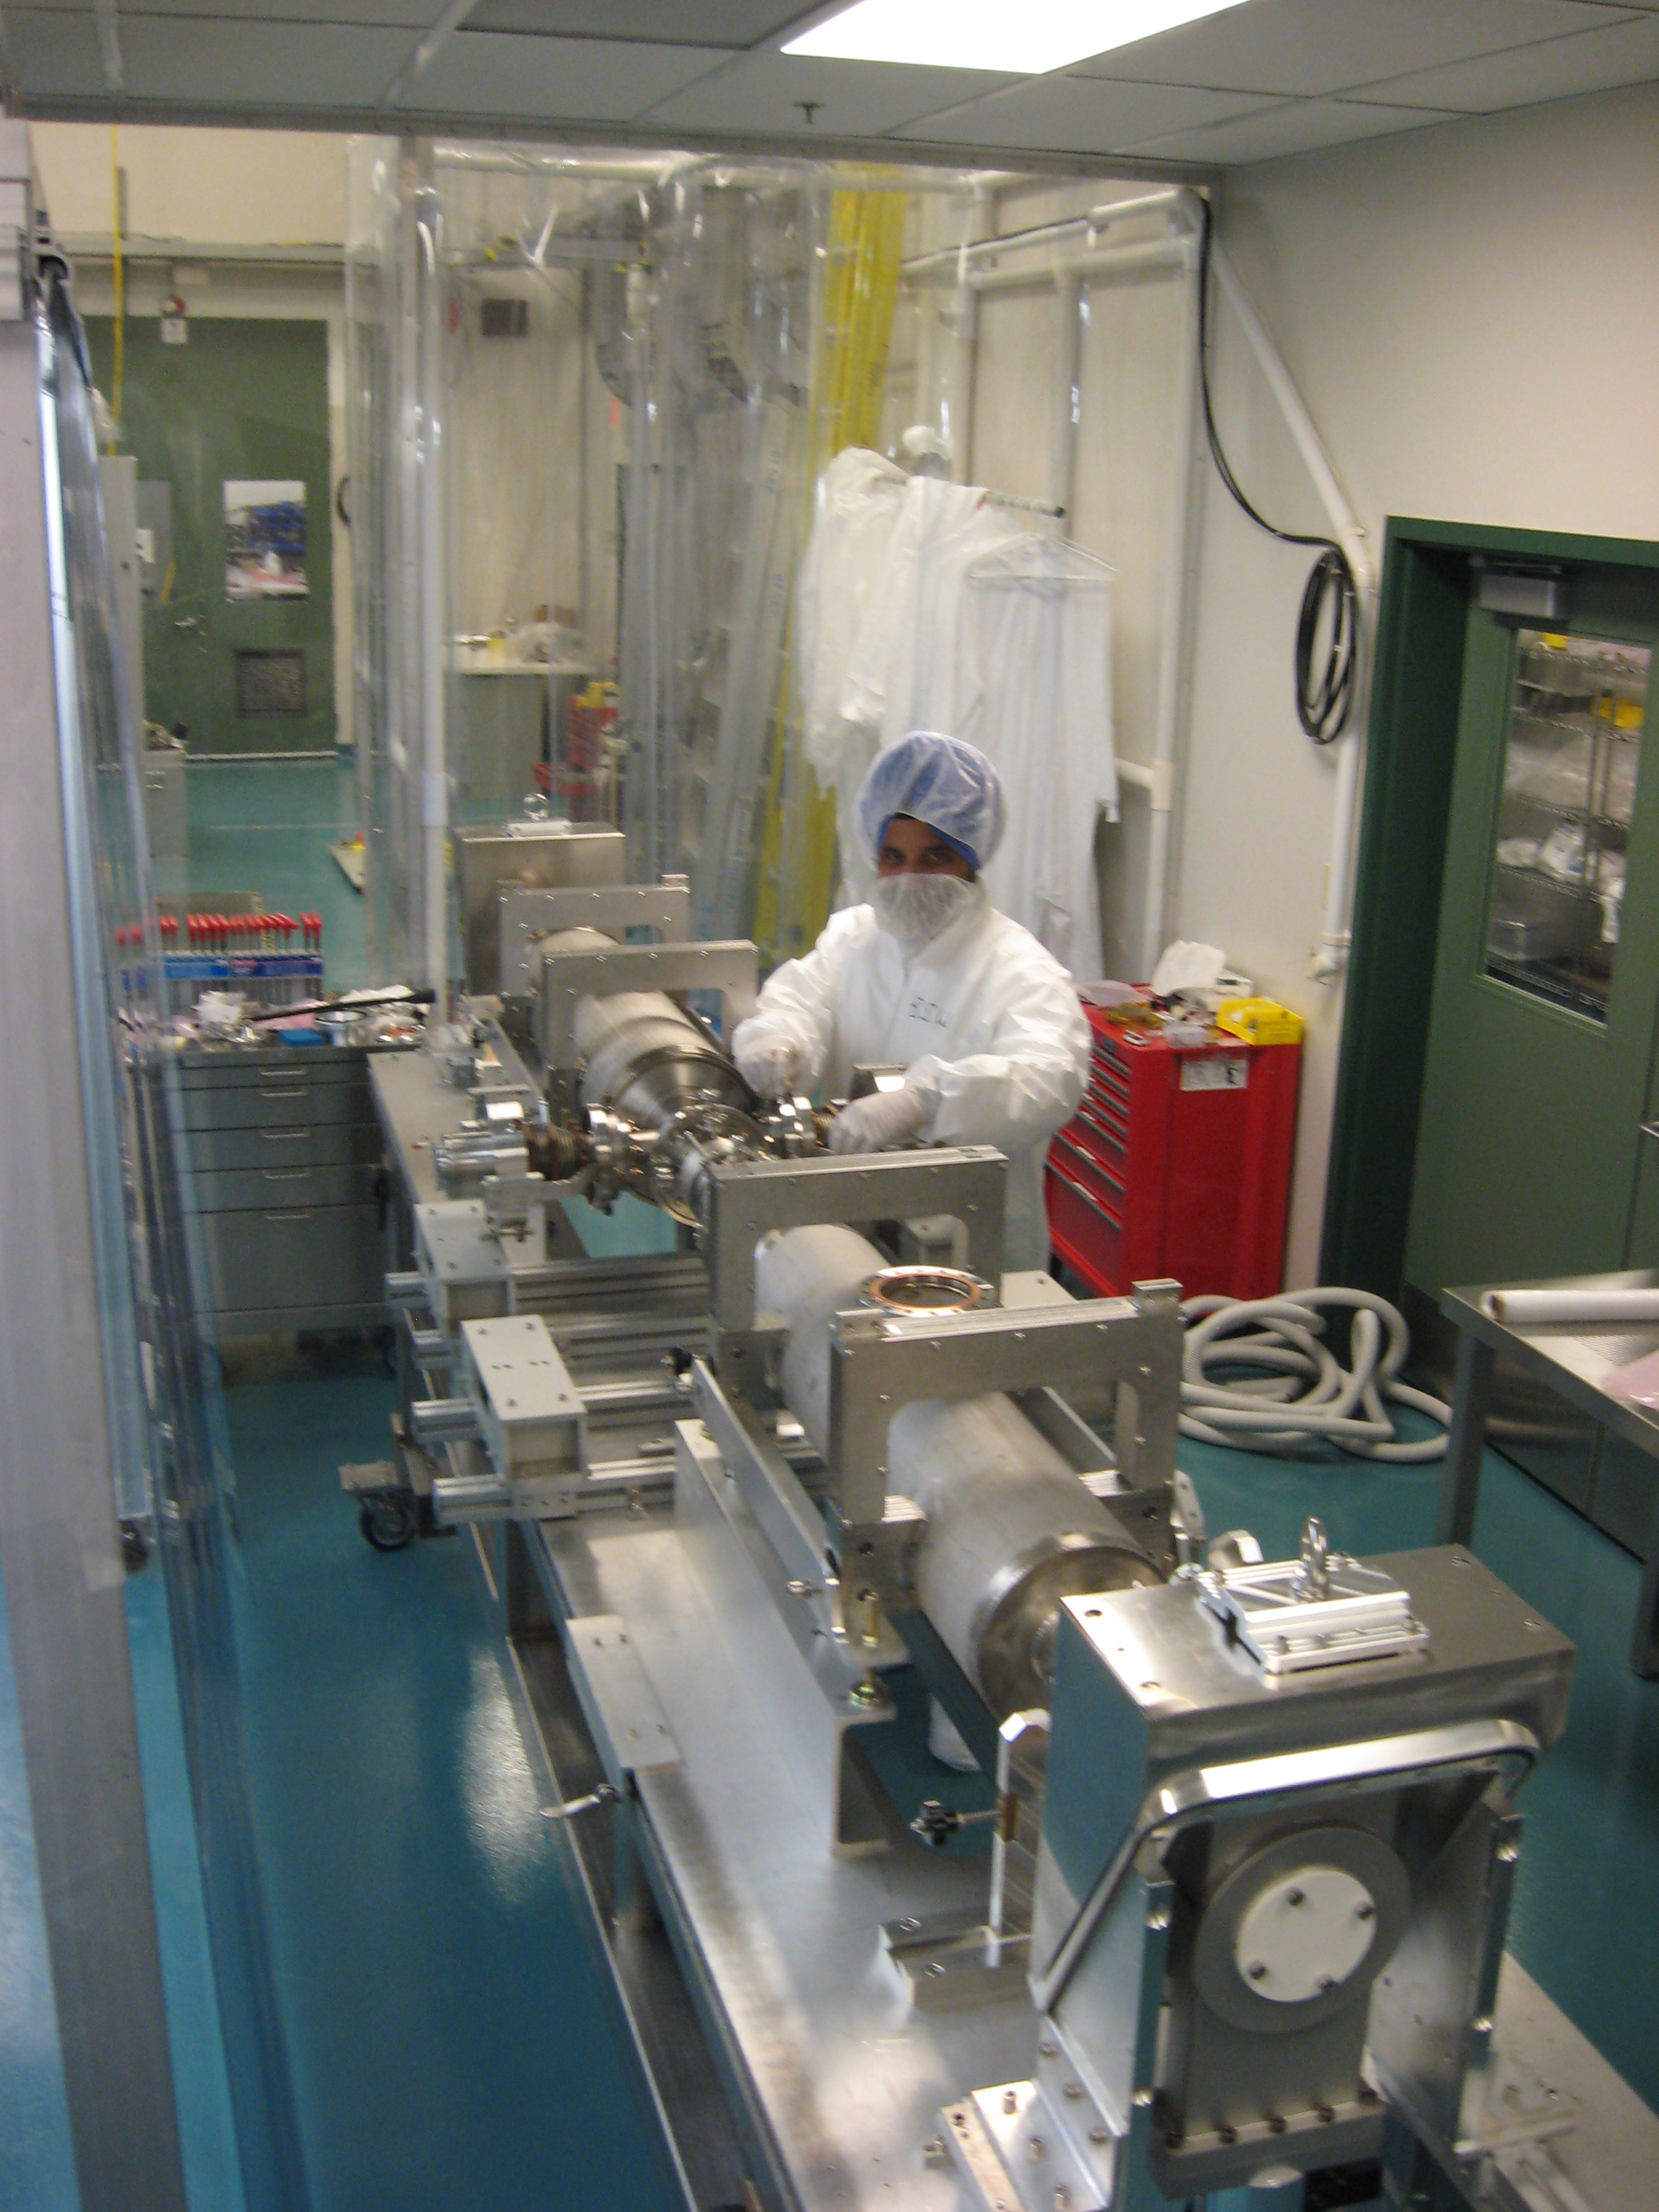
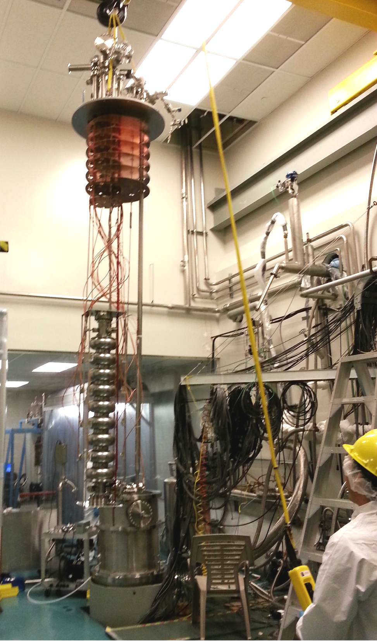

TRIUMF SRF Facilities
New Hi-Lumi Area
Dirty assembly
Clean assembly
RF
HPWR
Prep room
Cavity/CM testing
Clean assembly
BCP

Slide 18
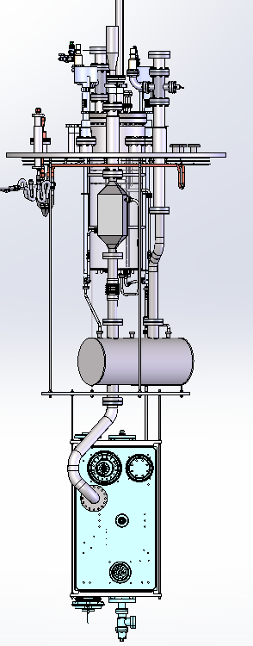
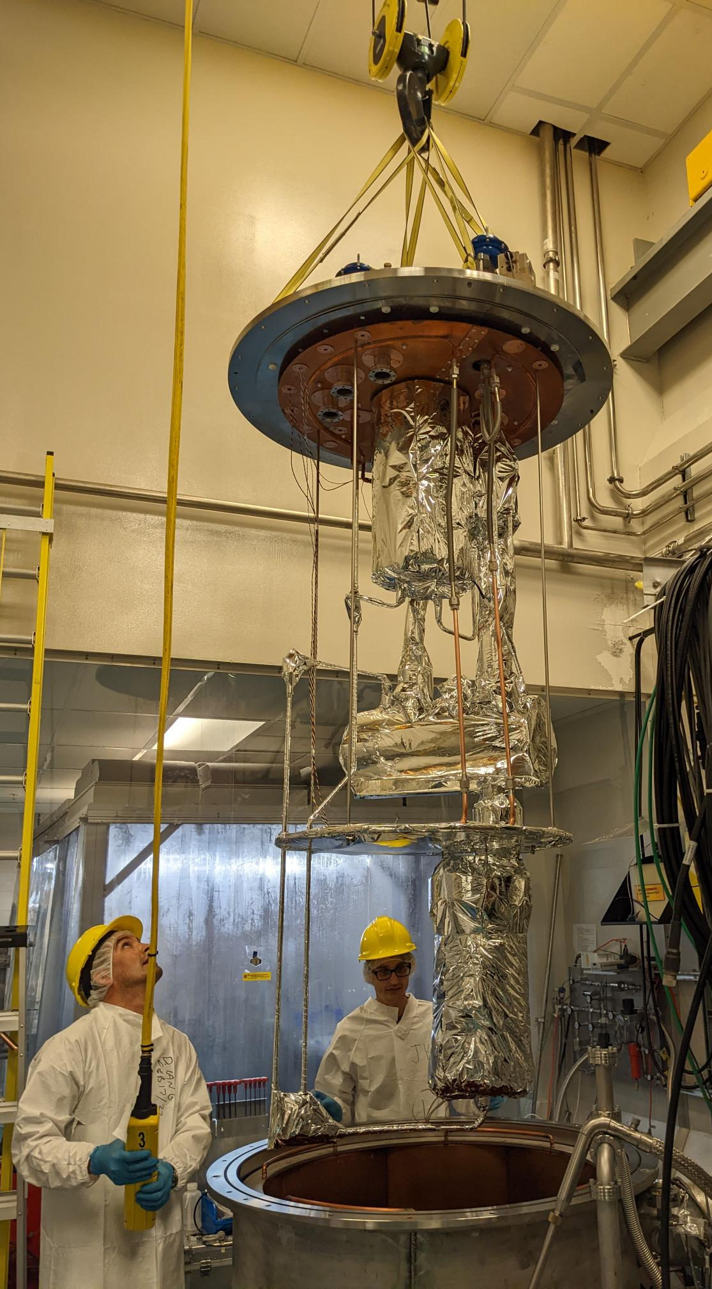
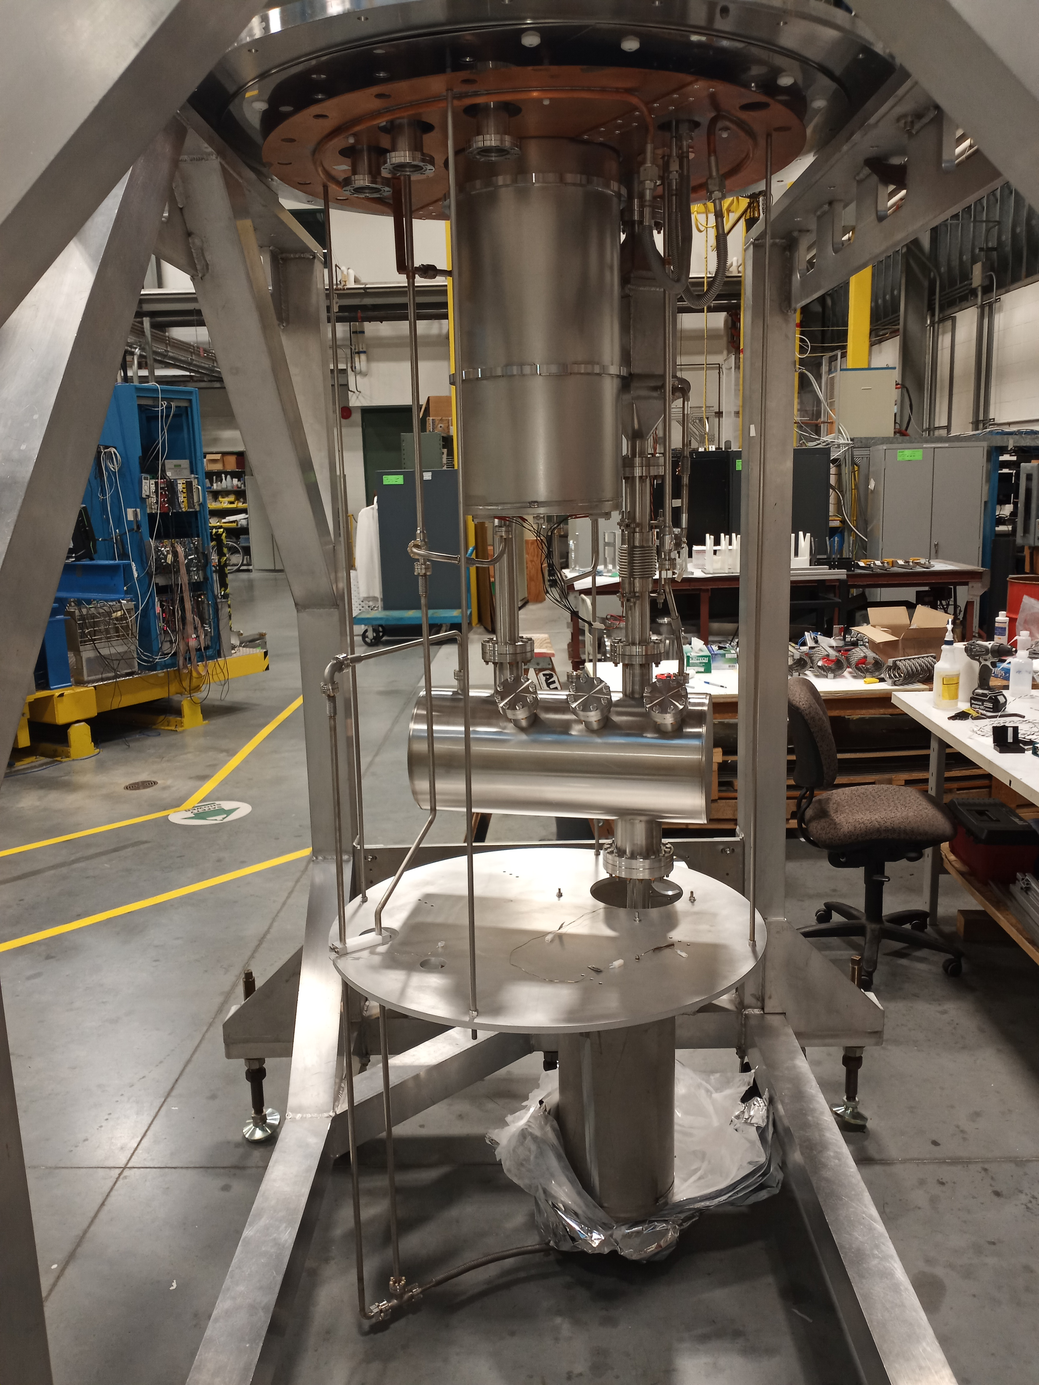
Preparation for cavity testing
TRIUMF will requalify the AUP cavities upon delivery from JLab
TRIUMF has upgraded the cavity test facility in preparation for cavity delivery
  Prepared and qualified cryo-insert for multi-purpose cryostat to test dressed cavities at 2K in jacketed mode
  Upgraded cavity test diagnostics
  Upgraded 2K pumping capacity
Ready for jacketed 2K testing of AUP cavities

Slide 19
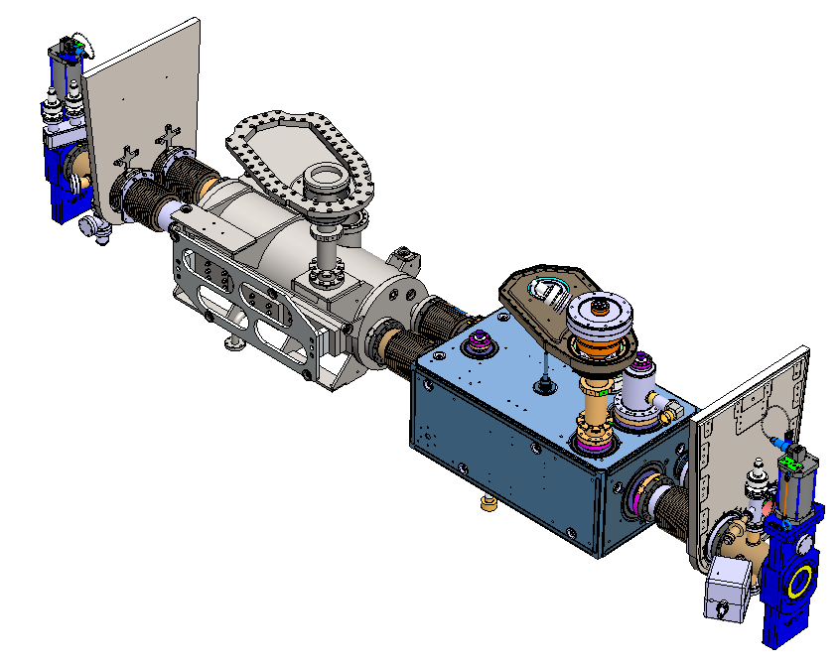
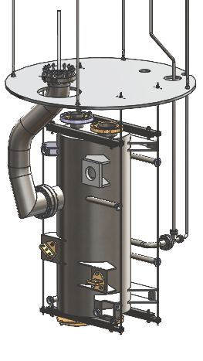
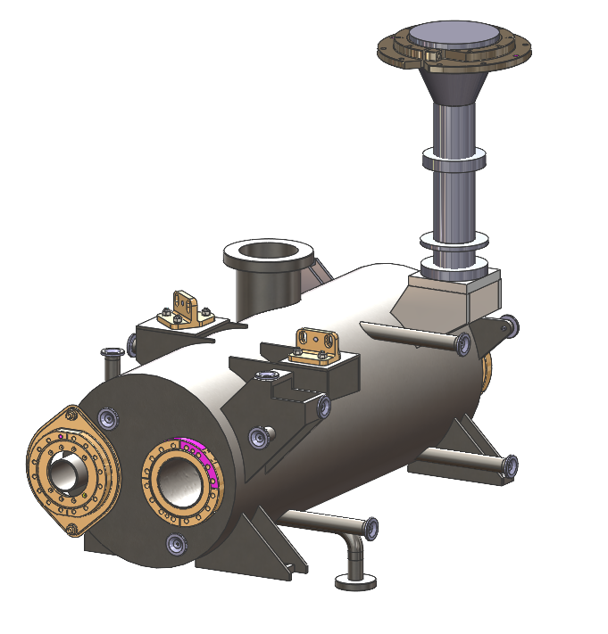
Dummy cavity for TCM0
AUP anticipates only one TCM0 cavity in Spring 2024
TRIUMF is fabricating a Dummy cavity
  Identical LHe volume and mass as the actual cavity
  Identical beam and helium interfaces as the RFD cavity
  Identical support interfaces
Will be used for testing prior to cavity delivery and during assembly of TCM0 cavity string

Slide 20
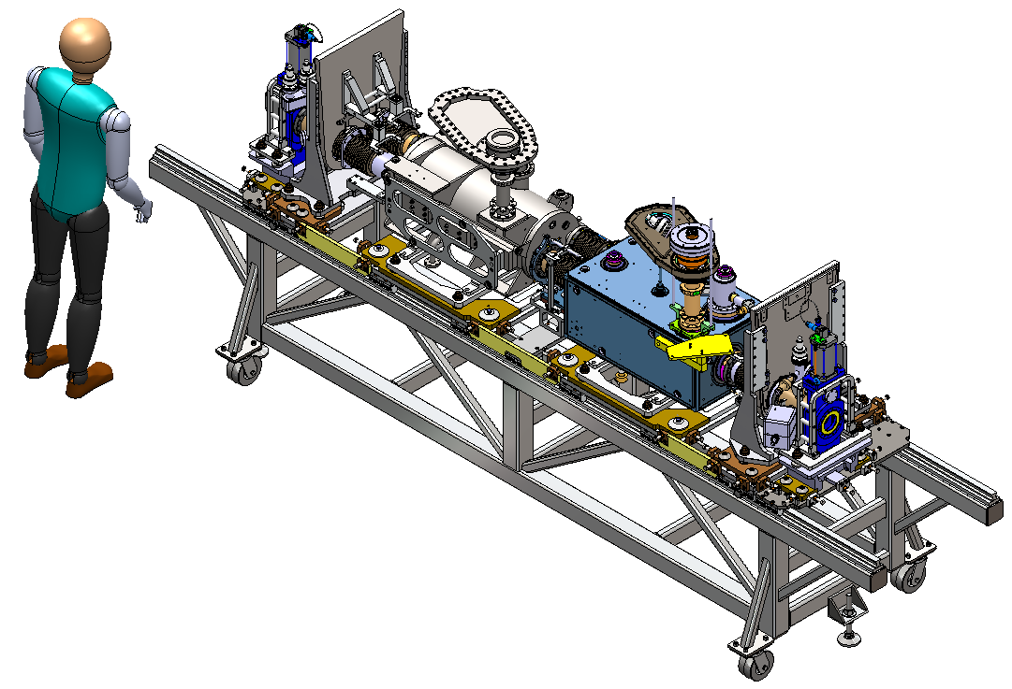
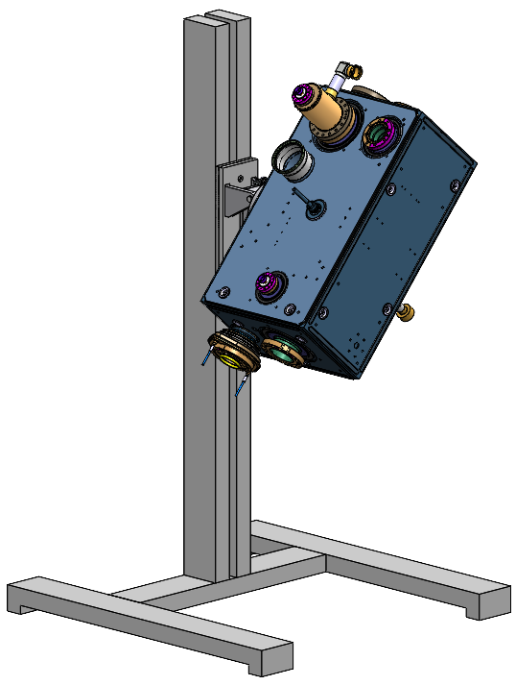
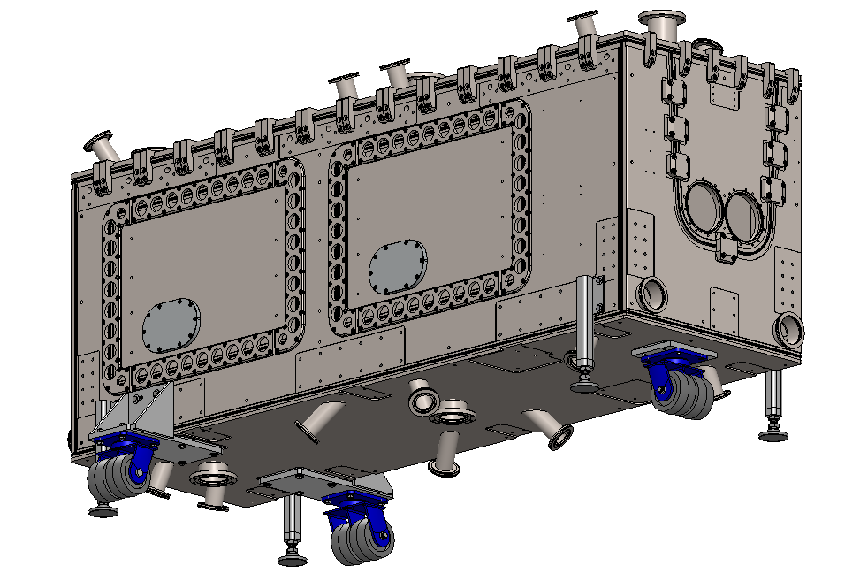
Infrastructure in the queue
String assembly frame
  Based on UK design
  Ready to send for manufacture
  Rails and castors received
Cavity manipulation/rinsing tooling
  In design
Top assembly frame
  Detailed design
Cryomodule trolley
  Detailed design

Slide 21
Infrastructure upgrade status
 |  | specified | designed | ordered | received
Clean room upgrade | Garments
 | Particulate monitoring
 | Vacuum equipment
 | New clean room
Cavity testing | 4k/2k insert
 | Test diagnostics
 | 2k pumping capacity
Assembly fixtures | Hermetic string cart |  |  | parts | parts
 | Dummy cavity
 | Cavity handling tooling |  | 50%
 | Top down assembly stand |  | 90%
 | Cryomodule trolley |  | 50%

Slide 22
Cryomodule Fabrication

Slide 23
Progress Milestones - Cryomodules
Milestone | Application | Achieved
4k-2k Cryo insert qualified | Infrastructure | Nov 2022
OVC Drawings released | TCM0 | Apr 2023
OVC tender released | TCM0 | May 2023
OVC material order issued | TCM1-5 | Jun 2023
Clean room tender released | Infrastructure | Jun 2023
Sector Valves received | TCM0 | Jul 2023
OVC order issued (Axton) | TCM0 | Jul 2023
Mu-metal tender released | TCM1-5 | Jul 2023
Clean room contract issued | Infrastructure | Sep 2023
Mu-metal contract issued | TCM1-5 | Sep 2023
MLI tender issued | TCM1-5 | -

Slide 24
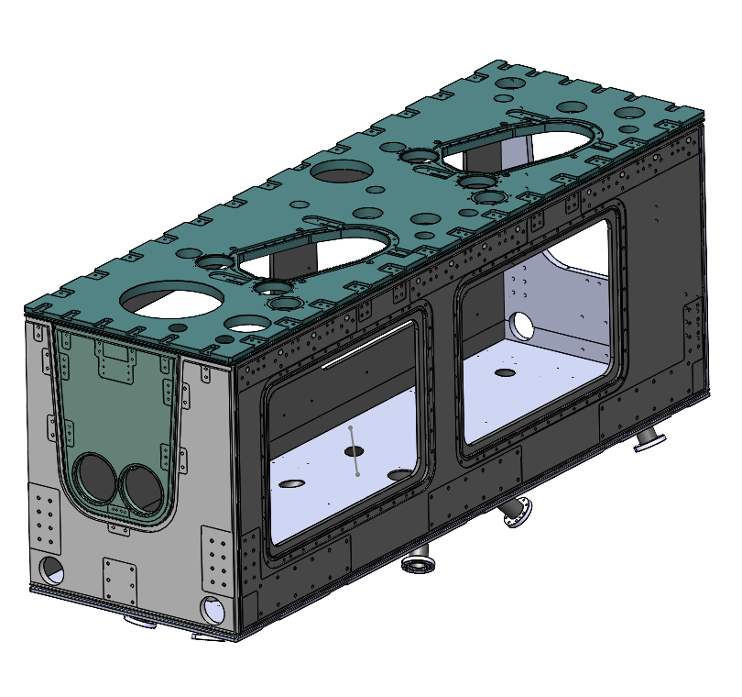
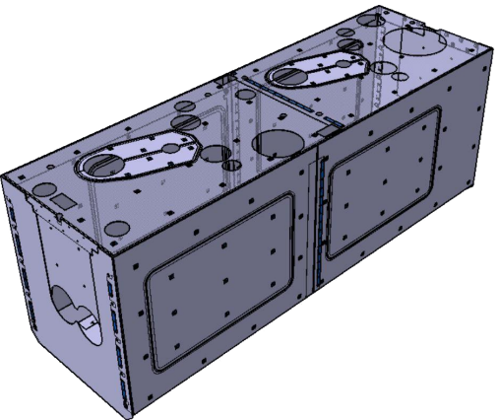
Cryomodule fabrication milestones
Drawings for OVC completed and RFQ issued
  Considerable effort to translate EU/CERN specifications for NA vendors
  Good learning exercise
Contract for one outer vacuum chamber (OVC) issued to Axton (Vancouver)
Material for five OVCs ordered from Outokumpu – delivery in Oct. 2023
Tender complete for 5 mu-metal shields
Successful bidder selected
First article by Feb. 2024 – final article by Dec. 2024

Slide 25
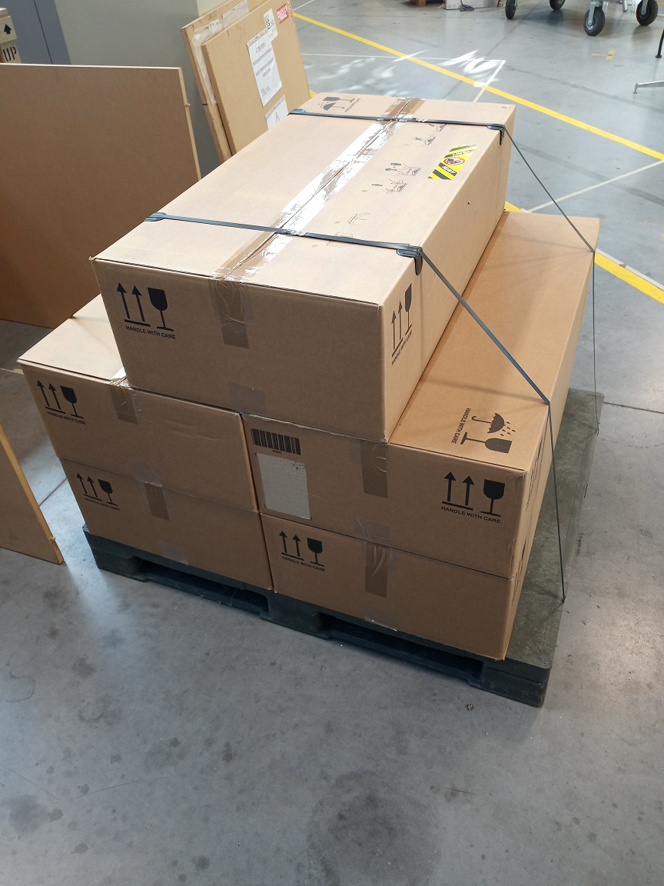
First articles received
First articles shipped from CERN to TRIUMF
5 Sector valves were received by TRIUMF SRF Group on July 21, 2023

Slide 26

Cryomodule fabrication strategy
CM string assembly requires cavities from AUP, FPCs and beamline assemblies from CERN – first articles are required to assemble TCM0.
Next items for series production where TRIUMF requires released drawings
MLI blankets
Thermal shield
Cold tuner frame and warm tuner actuator assembly
Cryogenic internal lines and supports
TRIUMF also requires delivery of CM parts in CERN scope and group purchased parts (at least for first articles):
Cavity testing - rf components – Jan 2024
String assembly – Mar 2024
Cryomodule assembly – Apr 2024
Cryomodule testing – May 2024
AUP, CERN
TRIUMF
AUP Delivery Projection
Cavity Pair | Module | Early dates | Late dates
Pre-series Cavity | TCM0 | Mar 2024 | -
Series 1 and 2 | TCM1 | May 2024 | Apr 2025
Series 3 and 4 | TCM2 | Sep 2024 | Jun 2025
Series 5 and 6 | TCM3 | Nov 2024 | Jul 2025
Series 7 and 8 | TCM4 | Jan 2025 | Sep 2025
Series 9 and 10 | TCM5 | Mar 2025 | Oct 2025

Slide 27
Timeline

Slide 28
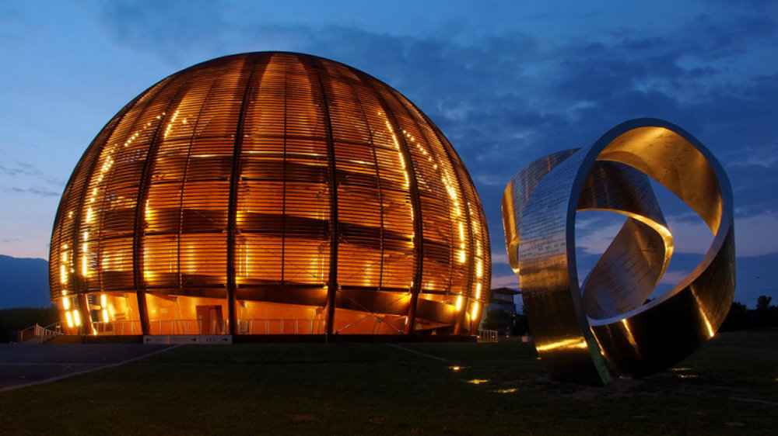
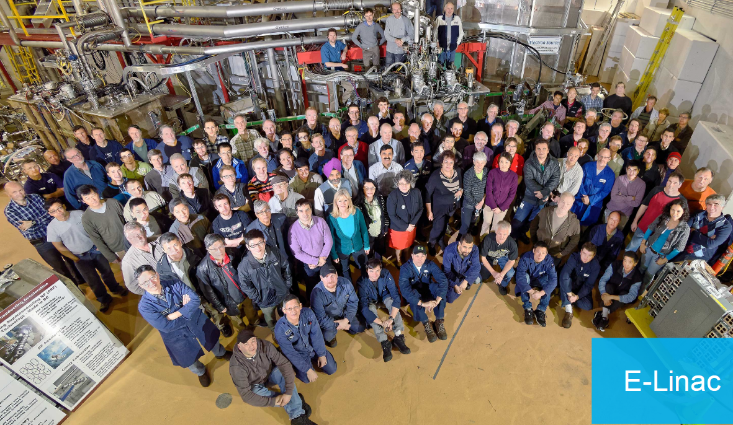

Summary
Revamping strategy to address finite time window for available funds
  Prioritizing with CERN the release of drawings for CM series to launch other long lead items
  Milestone dates for CERN deliverables communicated to CERN
Preparing TCM0 and series production CMs
  OVC production launched – TCM0
  OVC material ordered - series
  Mu-metal vendor selected – series
  Sector valves received from CERN
Cavity testing infrastructure
  4k/2k assembly tested and meets all specs
  Pumping station installed
  Ready for 2k testing
New clean room ordered for March 2024 – tooling in preparation

