Slide 1
Summary and status of HL-LHC Collaborations
Lars K. Jensen
on behalf of the HiLumi collaborations office
13th HL-LHC Collaboration Meeting – TRIUMF – 25->28 September 2023

Slide 2
Collaborations summary
Most of the collaboration agreements are signed and are in full execution
Since last Annual Meeting
  CERN-UK Phase 1 (one signature missing on KE3297 and two invoices)
  CERN-UK Phase 2 – all signed – no invoices yet
  KEK – transfer of ownership for D1 magnets
  INFN – expert support (pending INFN signature)
Agreements that did not materialize
  CERN-Russia agreements: termination letters TBD for two remaining agreements (Hollow Electron Lens and beam dump)

Slide 3
Items previously foreseen as Russian contribution
 | What | Project action
signed not yet funded | TAXS and TAXN | Industrial procurement
 | Current leads matching section and inner triplets | In-house production at CERN with large part of materials purchased via industrial procurement
 | Low impedance collimators (12 units) + IR collimators (28 units) | Industrial procurement
 | RF power amplifiers for crab cavities | Promising news from KEK
 | BPM Mechanics (20+28 units) | Industrial procurement
 | Ionisation chambers for SPS and LHC systems for HL-LHC beams (1000 units) | Prototype in-house, Industrial procurement for series. Actively looking for potential collaborations
 | HF-HOM and HOM Couplers and Filed Antennas | In-house production at CERN
 | LHC Kickers and Dump | Kickers: descoped Dump: In-house production at CERN
 | Hollow e-lens | Descoped (soft landing)
 | ​Crystal collimation for ions | In-house production at CERN

Slide 4
Strategy
Procurement being prepared (see Hector’s presentation)
Options explored in parallel for a few items:
  Discussions took place with KEK/Japan to contribute on:
    Quench Heater Power Supplies
      Commitment letter duly received and archived
      Agreement under preparation awaiting updates from KEK
      CERN visit to Japan planned for mid-Oct 2023
    RF power amplifiers and distribution for crab cavities
      Awaiting news from KEK
Discussions took place with CPNEM-Brazil for possible contributions on some items:
  Negative outcome due to CERN associate membership status not yet granted
Discussions with the Pakistani ILO (manufacturing and assembly)

Slide 5






The Inner Triplet region: collaborations
Addition
Connection to LHC (UL)
Service gallery (UR)
QHPS
DFHM
DFHX
SC Links
Q2a
Q1
TAXS
Q2b
CP
Q3
DFX
D1
DFM

Slide 6


The MS (matching section) region: collaborations
UA gallery
Service cavern
(BBLR)
Q4
Crab cavities
D2
Collimators
CC RF power
TAXN
Likely addition

Slide 7
Meetings
Since the 2022 annual meeting
  7 collaboration steering meetings (INFN, IHEP, KEK, AUP, UNIMAN, CIEMAT, Uppsala)
  First TRIUMF steering meeting right after this meeting (with AUP participation)
Future SC meetings:
  IHEP and AUP steering meetings planned during December 2023
  CIEMAT SC January 2024
  INFN SC February 2024
  KEK SC March 2024 (D1, QHPS, CC RF power)
  UNIMAN SC April 2024
  Uppsala SC June 2024
Many other technical meetings within the work-packages

Slide 8
Summary: TOTAL in-kind ~94 MCHF (Sep 2023)
 |  | COUNTRY | Agreement | Institute | Brief description of the collaboration | in-kind-value |  | Country | in-kind vakue
 | R&D | France | KE2736 | CEA | Thermal Design of Superconducting High Field Magnets at CERN | 118 |  | France | 118
 |  | UK | KE3298 | Manchester | Beam instrumentation | 317 |  | UK | 4368
 |  | UK | KE3299 | Manchester | Cold powering: DFBX for String | 26 |  | Italy | 3945
 |  | UK | KN3362 | ASTeC+Dundee | Laser treatment prototype (LESS) | 0 |  | Spain | 3040
 | Prototypes and BASELINE | Italy | KE3085+KE2291 | INFN | High-order corrector magnets + prototypes | 1045 |  | China | 2225
 |  | Spain | KE2292+3797 | CIEMAT | Nested orbit correctors + prototypes | 3040 |  | Sweden | 750
 |  | China | KN4154 | IHEP | D2 Correctors | 2225 |  | Japan | 9000
 |  | Sweden | KE3082 | Uppsala Univ. | Cold testing of corrector magnets and crab cavities | 0 |  | USA | 66015
 |  | Japan | ICA-JP-010+KN4074 | KEK | D1 magnet model and cold mass | 9000 |  | Canada | 4600
 |  | Italy | KE2291+KE3084+KE4417 | INFN | D2 model + prototype+ Magnet | 2900
 |  | USA | P131 | Several | Crab Cavities | 6065 |  | Total | 94061
 |  | USA | P131 | Several | Triplet magnets | 59950
 |  | Canada | P095 | TRIUMF | RFD Crab-cavities cryomodules | 4600
 |  | Sweden | KE5162 | Uppsala Univ. | Parts for the DFHM and DFHX 8+1 units | 750
 |  | UK | KE5170 | SOTO | DFM and DFX 8+1 units | 1000
 |  | UK | KE5168 | ASTeC+Lancaster | DQW Crab-cavities cryomodules | 1925
 |  | UK | KE5169 | LIV+RHUL | Beam instrumentation EO-BPM | 200
 |  | UK | KE5169 | Liverpool | Beam Instr. for Hollow e-lens | 700
 |  | UK | KR5171 | Dundee | Laser treatment (LESS) | 200
 |  |  |  |  | Total of in-kind | 94061

Slide 9
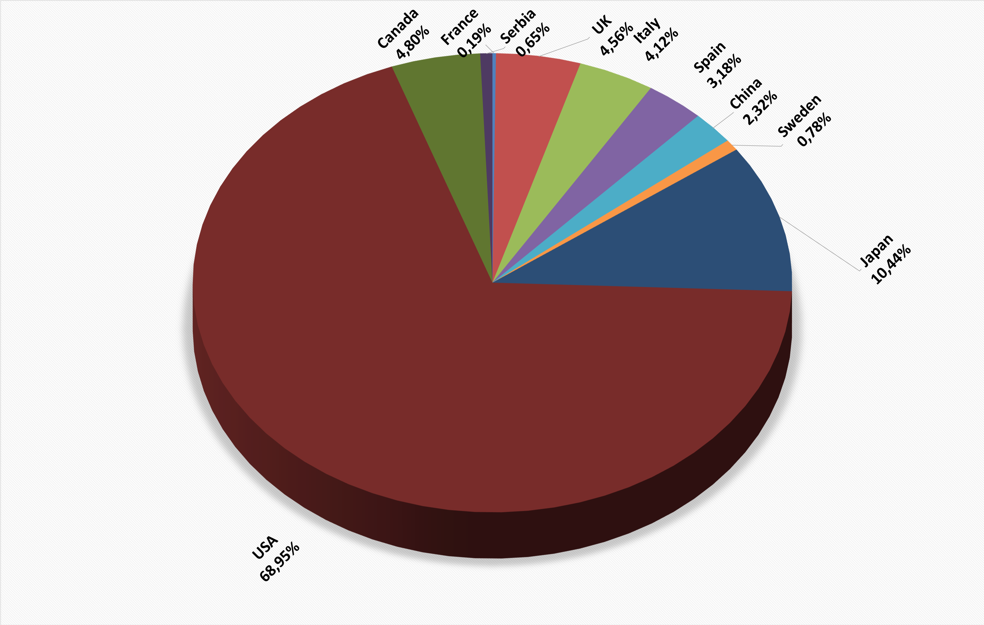
In-kind contribution share (Sep 2023)
KEK/JP will increase to ~20% (2024) with QHPS (2 MCHF) and RF power (12 MCHF) in-kind contributions

Slide 10

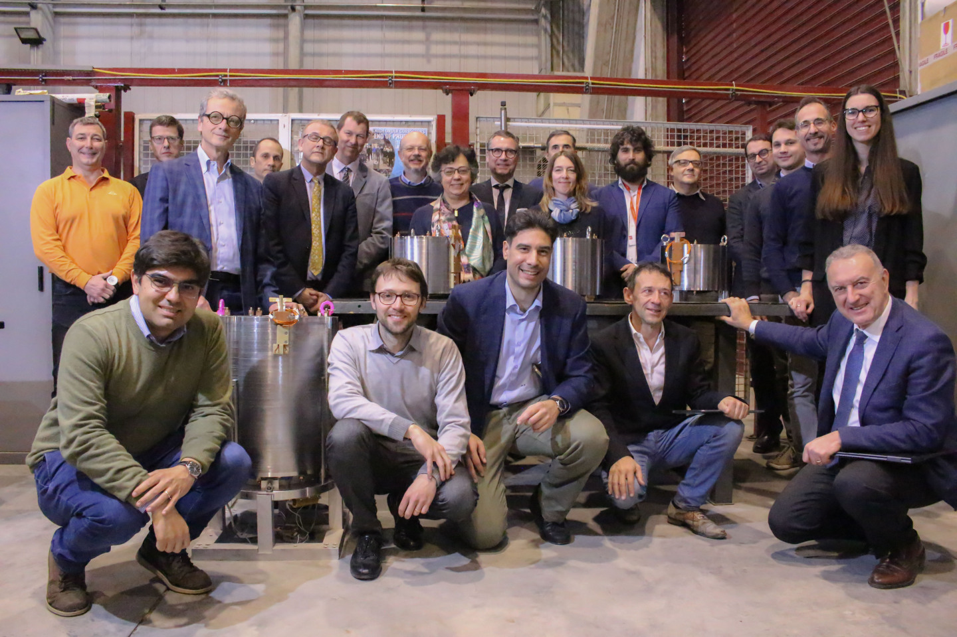
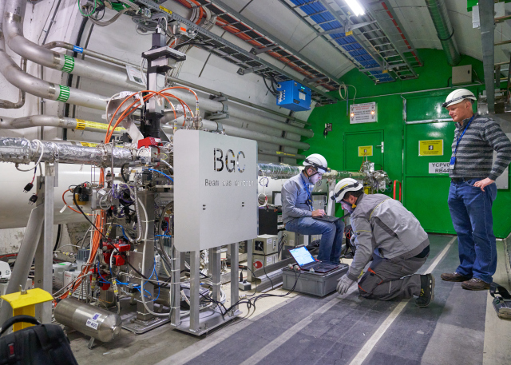
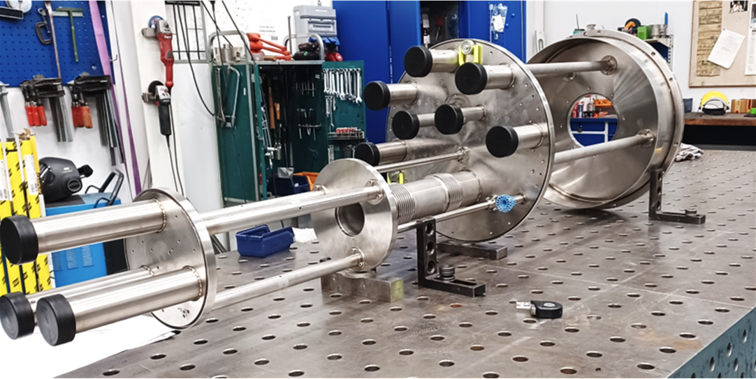
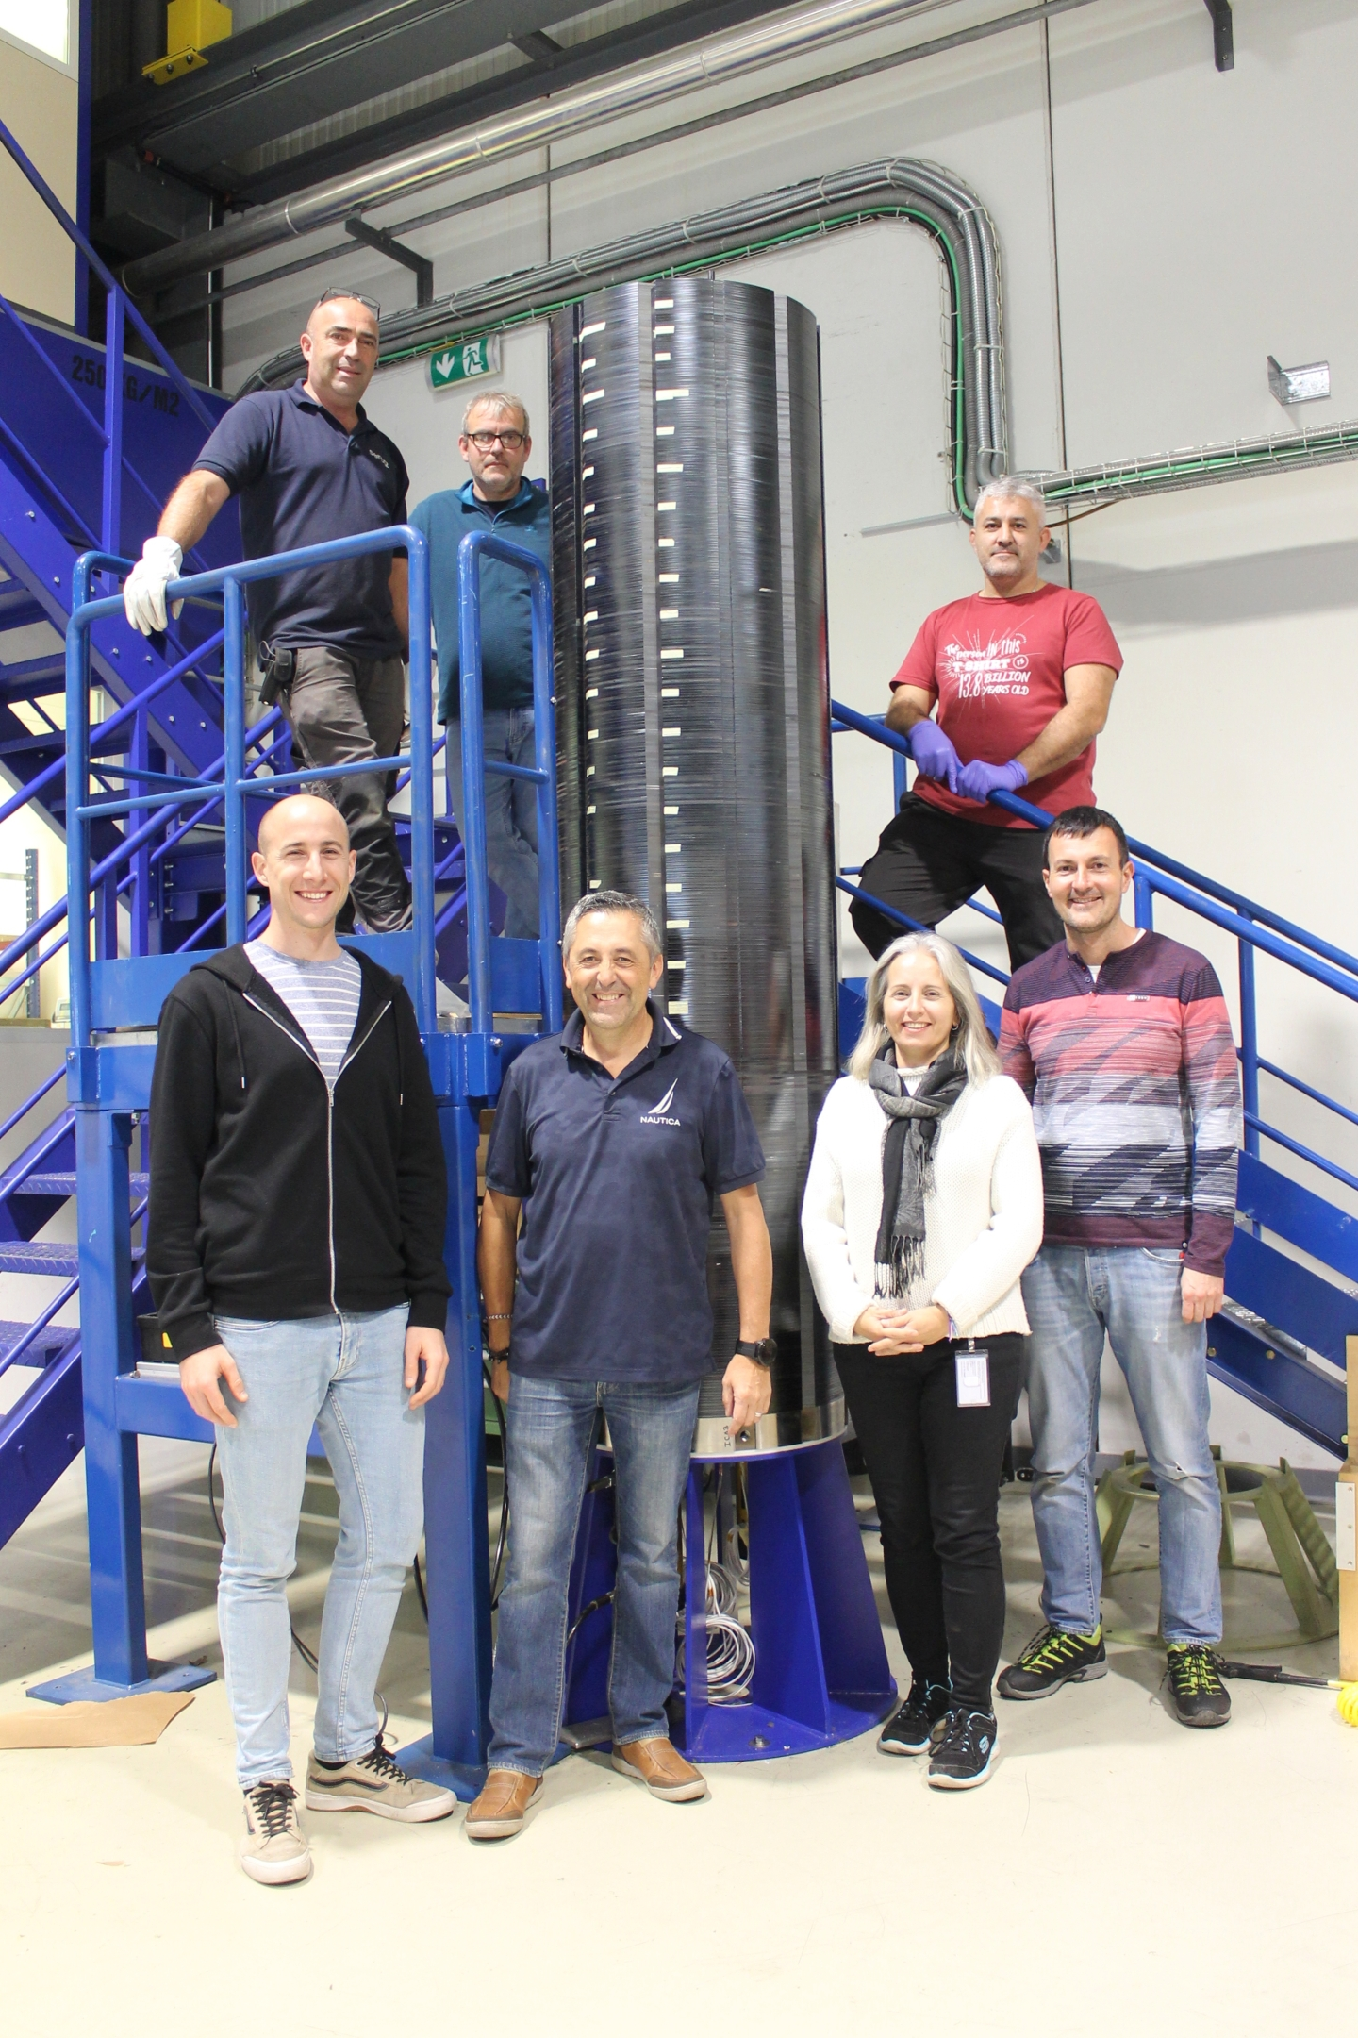
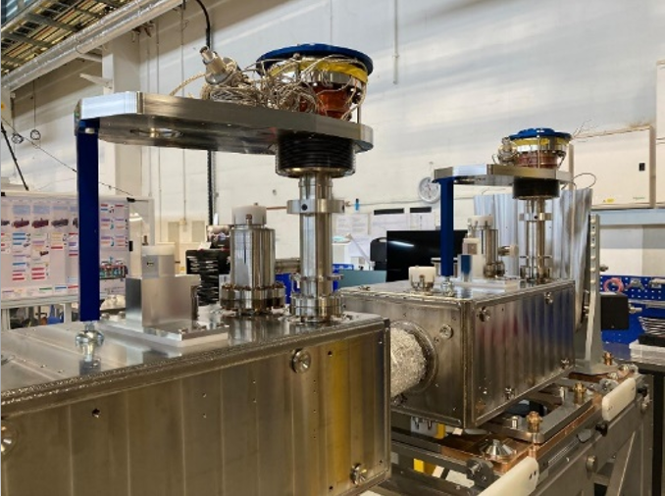
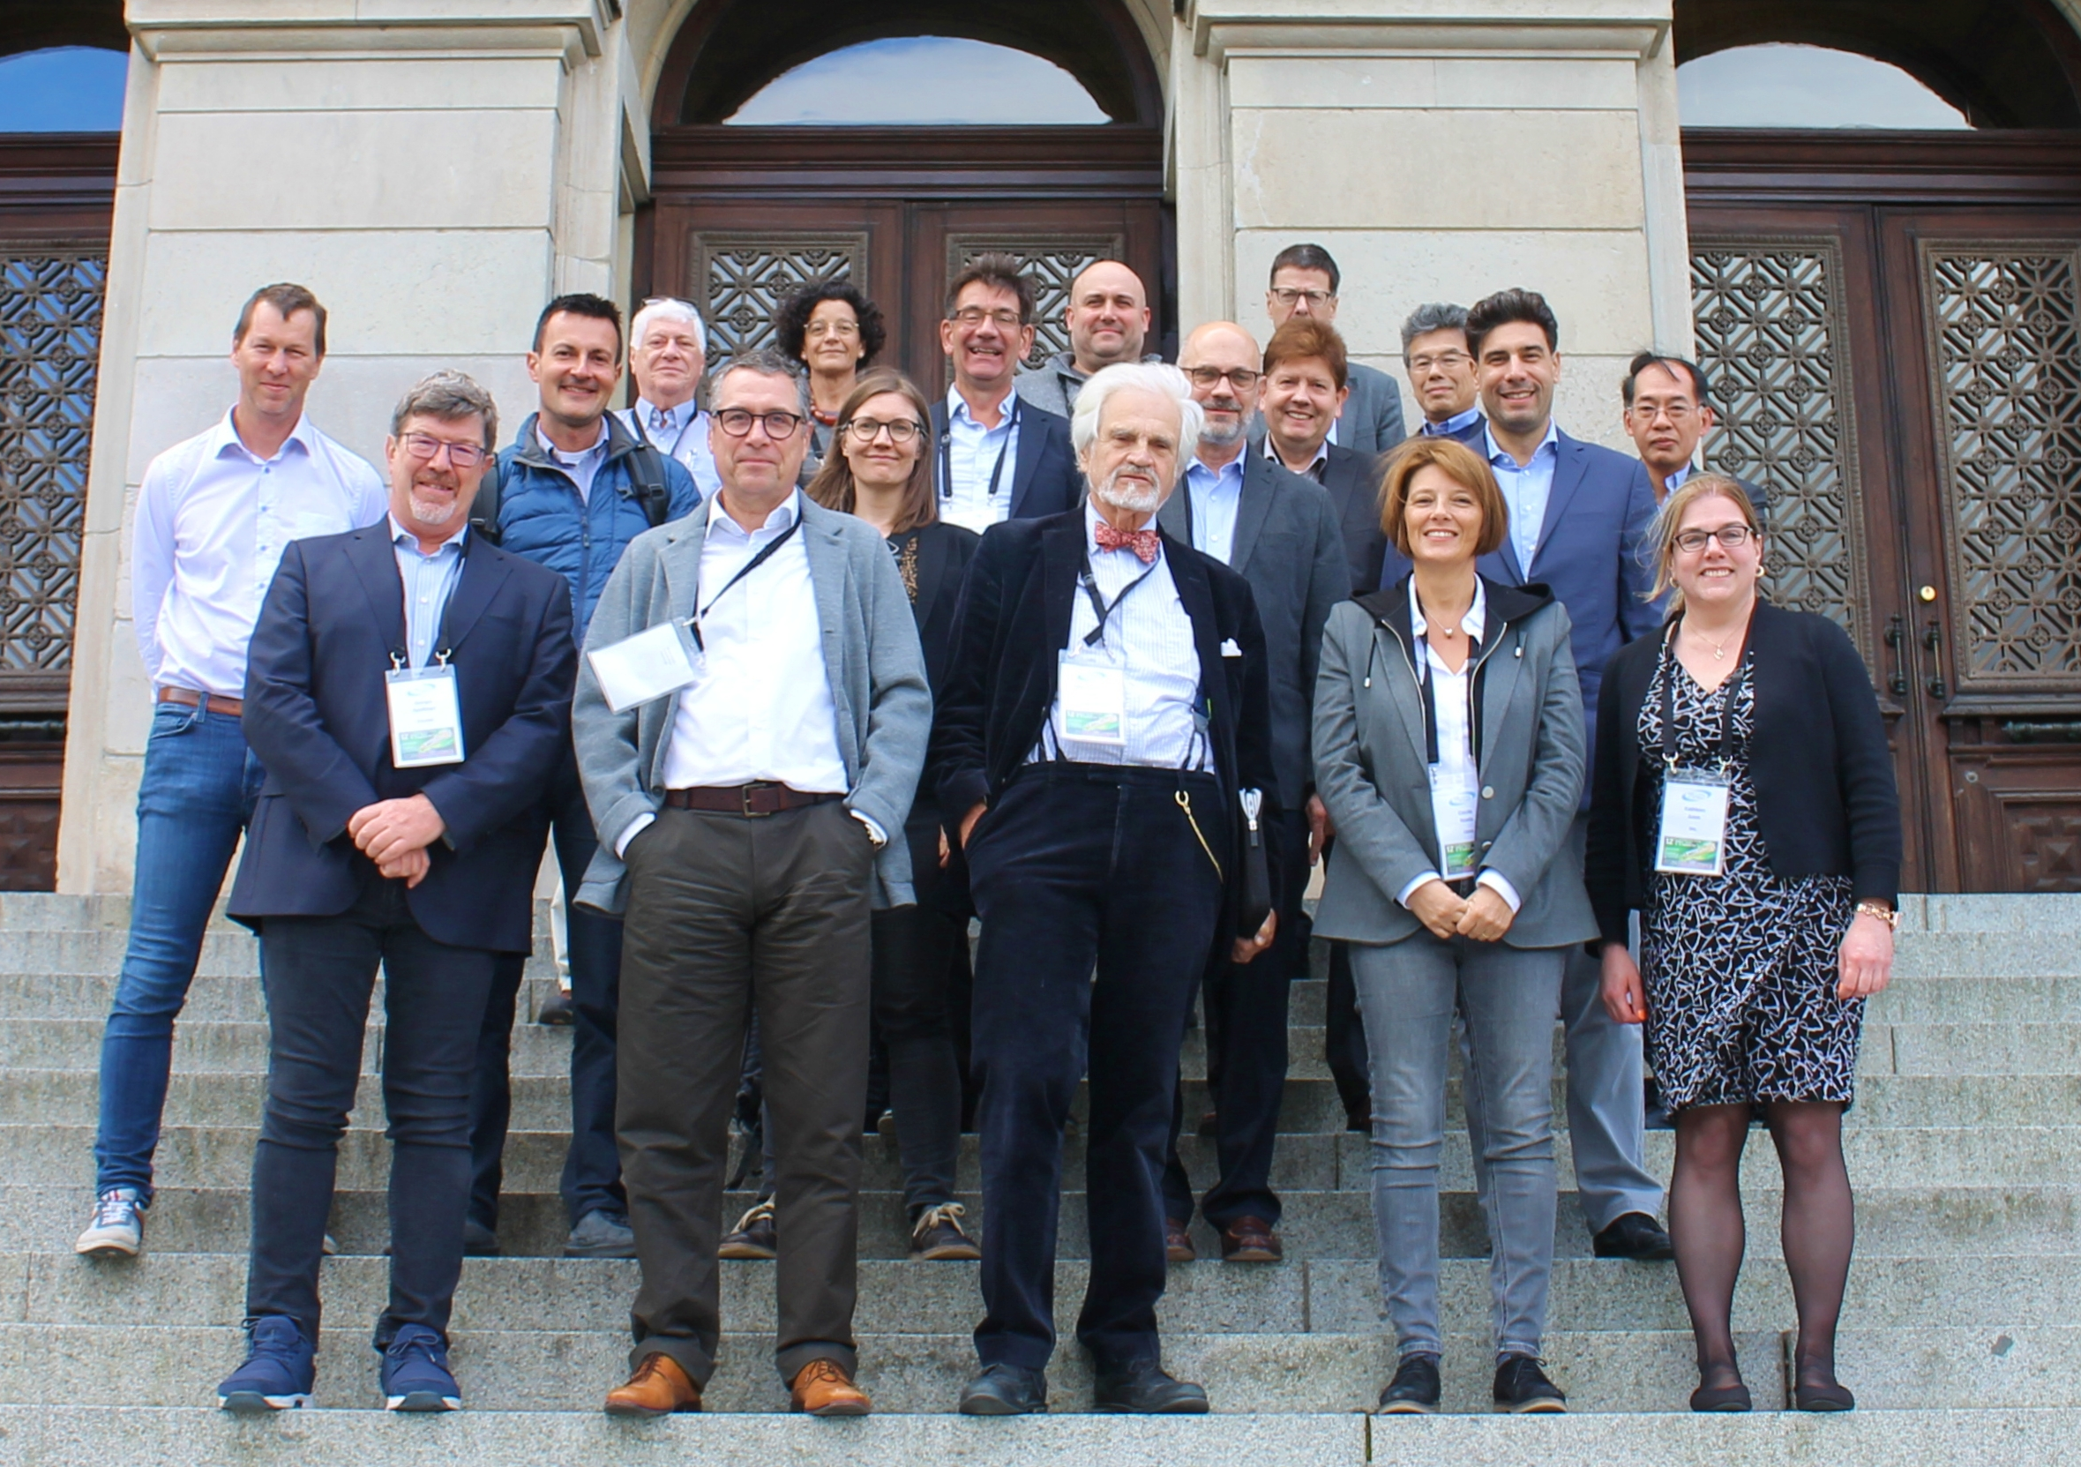
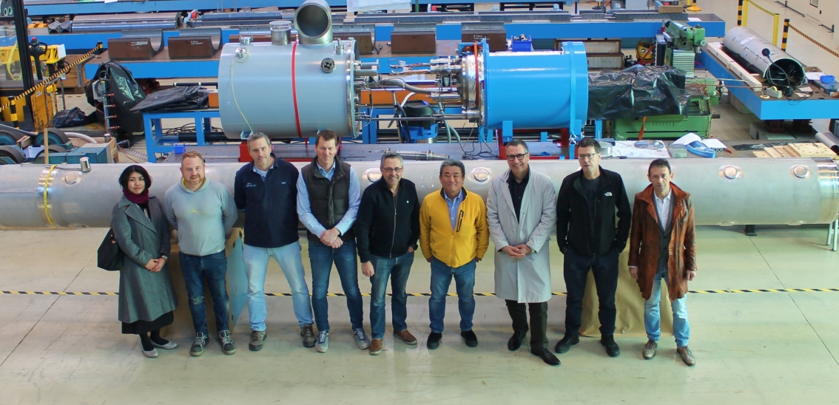
HLCB newsletter highlights
Please let us know about any highlights to be added
https://hlcb-newsletter.web.cern.ch/
HOM Corrector production celebration at LASA/Milan
DFH blank assembly at RFR/SE
Beam Gas Curtain(BGC) installation in the LHC
Assembly operation of the first Orbit Corrector prototype MCBXFA
D1 prototype magnet reception at CERN
Assembly of RFD crab cavity module
HL-LHC Collaboration Board members in Uppsala

Slide 11
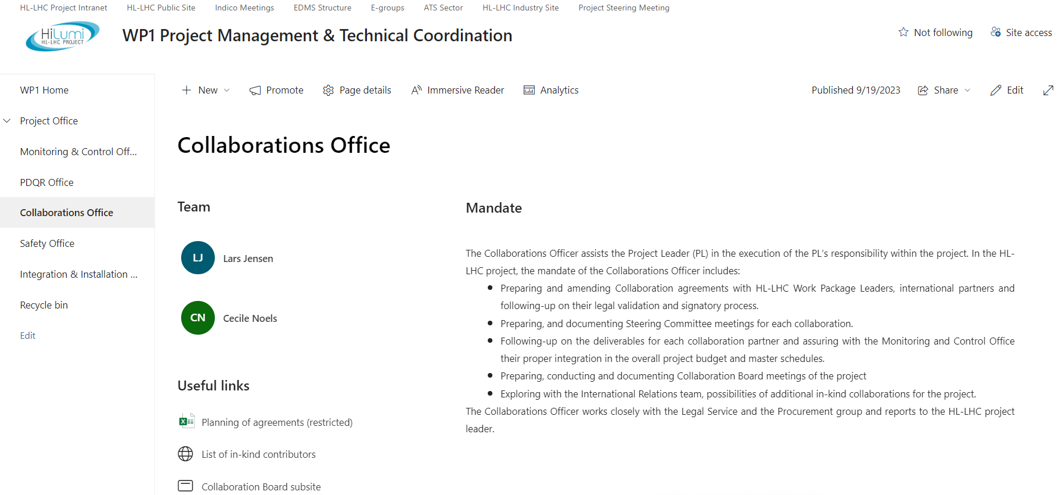
New CB SharePoint web-site
https://cern.sharepoint.com/sites/HL-LHC/CB/
  HLCB members and minutes of HLCB meetings
  Collaboration institutes with links to MoU’s, link-persons, SC meetings and agreements
  Please check the pages and let us know if any changes should be made

Slide 12
Conclusions
Collaborations play an important role for the HL-LHC project
Production started for all existing collaboration agreements
  Status of the various collaborations will be visible in the talks this week
  Happy to document all good news in the HLCB newsletter
Important addenda to be finalised and signed
Amendments for schedule reasons (Covid’19 etc) being signed, more expected
  Contracts involving money are typically very long to materialise
Collaboration office is available to provide support across WPs

