Slide 1
SM18 Test-Facility and Test Plans
Prepared by M. Buzio, S. Russenschuck & F. Savary
on behalf of the SM18 test and magnetic measurement team, and all Groups/Sections involved in the SM18 test bench re-configuration project
Presented by A. Devred
Page 1/20
13th HL-LHC Collaboration Meeting, Vancouver, Canada ‒ 25-28 September 2032

Slide 2
Overview
Advances in the SM18 test-bench reconfiguration project
Recent results in cryomagnet testing
  See also the presentation by G. Willering
Recent results of magnetic measurements and instrumentation
  See also the presentation by L. Fiscarelli
Page 2/20
13th HL-LHC Collaboration Meeting, Vancouver, Canada ‒ 25-28 September 2032

Slide 3
Thanks to a large team from other CERN Groups and Sections
BE-CEM
  uQDS GUI (all benches); DAQ (all benches except F1/2).
BE-ICS
  Interlock PLC for shuffling module and anticryostat (all benches), software and commissioning.
EN-EL
  CFB instrumentation cabling, 2 kA cabling of the new polarity switch, AC connections of new aux powering racks, cabling for additional CP instrumentation and CLIQ.
EN-MME
  Design Office; procurement and/or manufacture of various components for shuffling modules.
EN-ACE
  Relocation of staircase to the platform; installation of new electronics racks.
SY-EPS
  Installation of new 2 kA polarity inverting switch; installation and commissioning of 2 kA power supplies; load/polarity inverting switches.
TE-CRG
  Cryo PLC: complete cabling to DFHX/DFX, I/O test; cold commissioning of the upgraded CFB; modifications of the CFB for the shuffling module; cold commissioning of the shuffling module; modification of the CFB for the new anticryostats.
TE-MPE
  Commissioning of 2 kA Energy Extraction system; commissioning uQDS current sensors; installation and commissioning of Energy Extraction 2k A/600 A (mobile rack); commissioning of uQDS crates and current sensors (dI/dt computation in firmware).
Page 3/20
13th HL-LHC Collaboration Meeting, Vancouver, Canada ‒ 25-28 September 2032

Slide 4
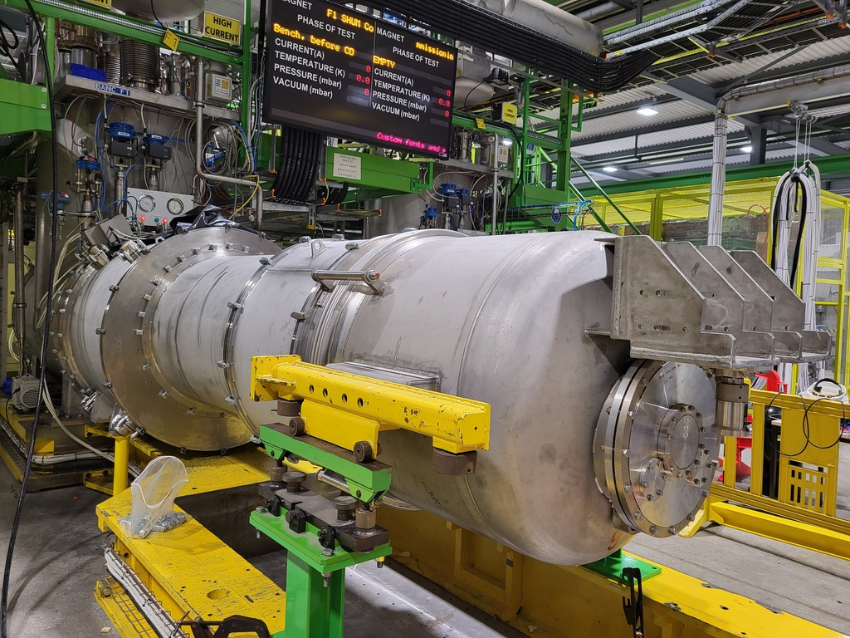
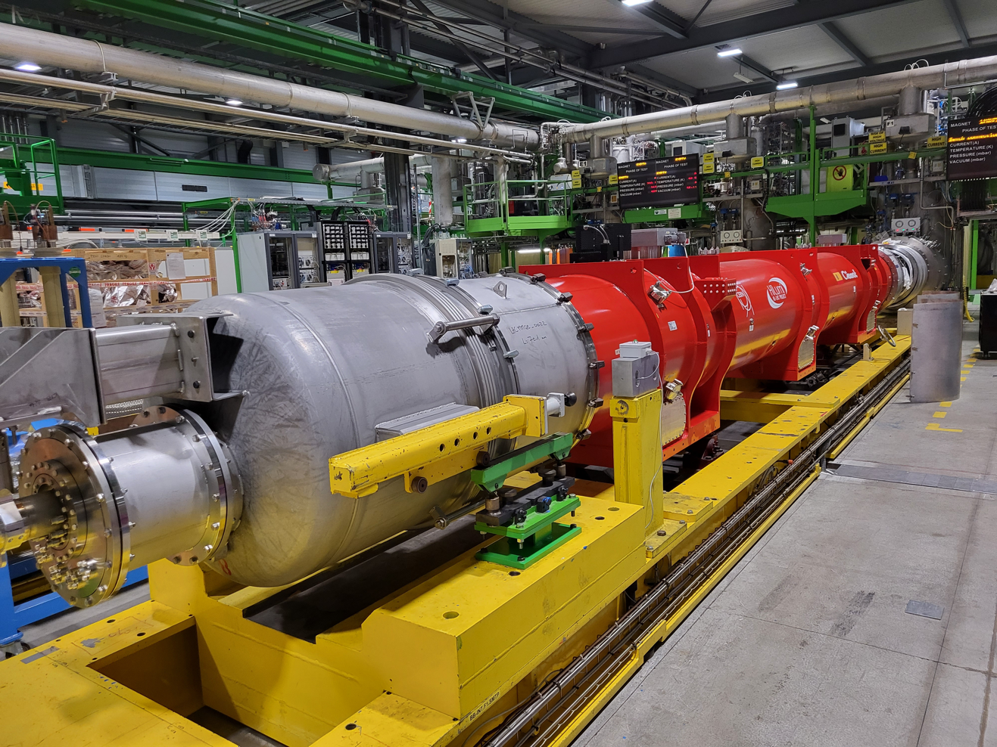
F1: First bench equipped with a shuffling module
Short-circuit commissioning: August 10, 2023
Q2 cryo-magnet connection: September 14, 2023
Page 4/20
13th HL-LHC Collaboration Meeting, Vancouver, Canada ‒ 25-28 September 2032

Slide 5
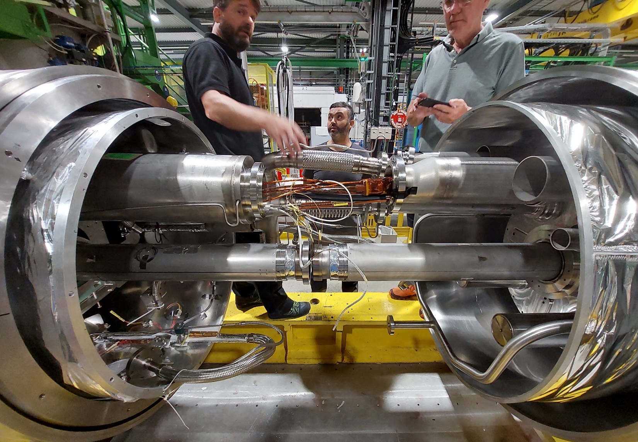
Cryomagnet connection: details
thermal screen with MLI
2×2 18 kA busbars
GHe return
2×2 2 kA busbars
XY 1.9 K LHe line
Ø110 mm anticryostat
MQXF
Q2 P3b
Shuffling Module
Page 5/20
13th HL-LHC Collaboration Meeting, Vancouver, Canada ‒ 25-28 September 2032

Slide 6
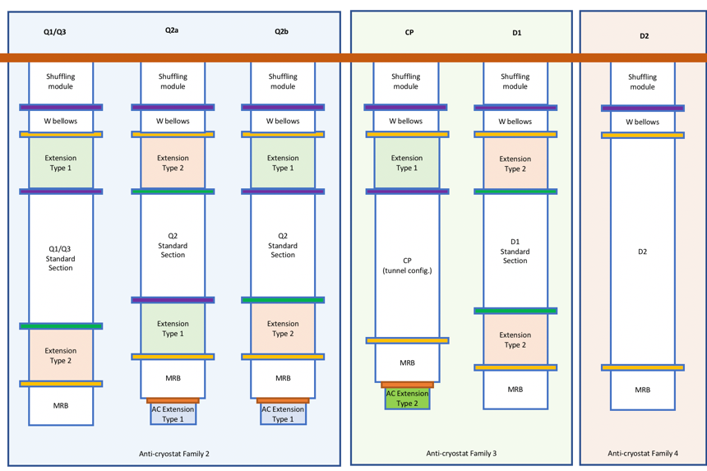
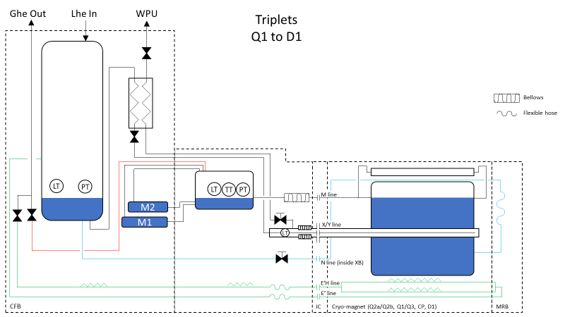
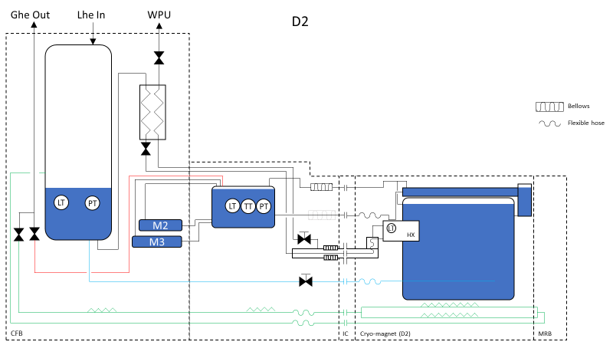
Test-bench compatibility
Standardization
as much as possible, in order to limit types of anti-cryostats, shafts for magnetic measurements, and quench antenna.
Bench A2
Bench F1
Bench A2
Bench B2
Bench C2
The shuffling module can be made compatible with all WP3 magnets including D2; 3 benches are still to be equipped for the SM18 upgrade; baseline: one magnet type per bench (except Q1/Q3 and CP on A2).
Page 6/20
13th HL-LHC Collaboration Meeting, Vancouver, Canada ‒ 25-28 September 2032

Slide 7
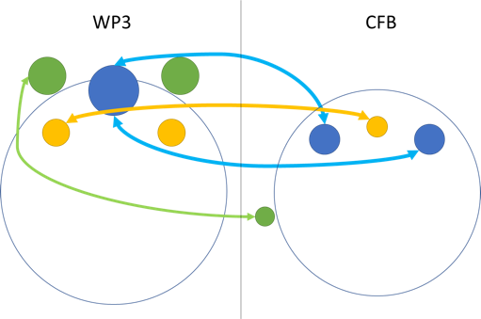
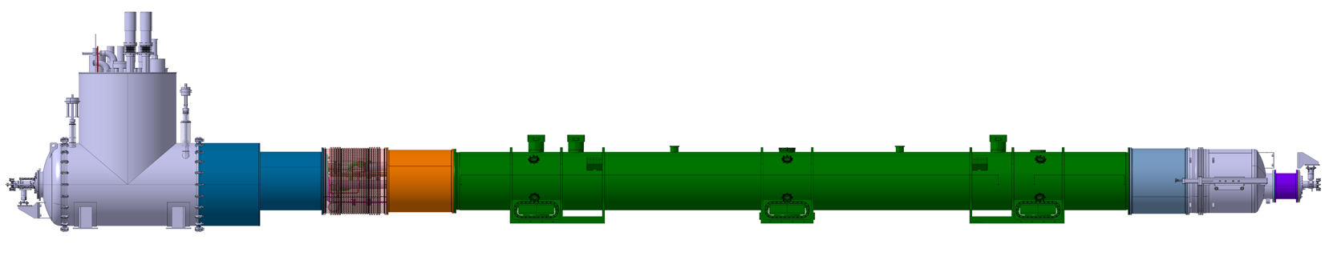
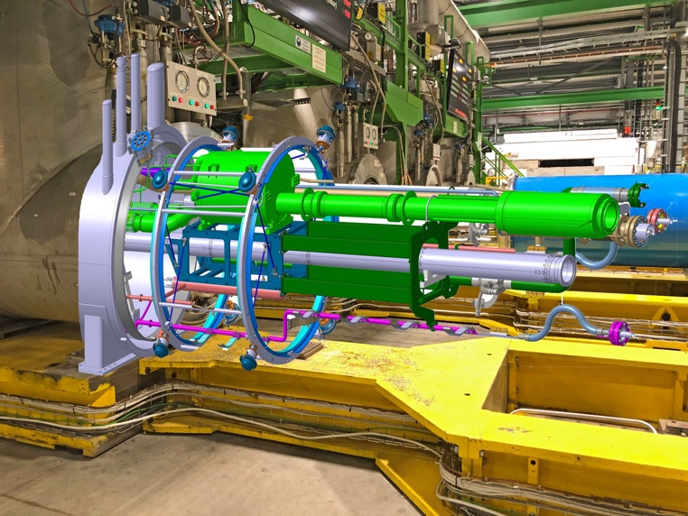
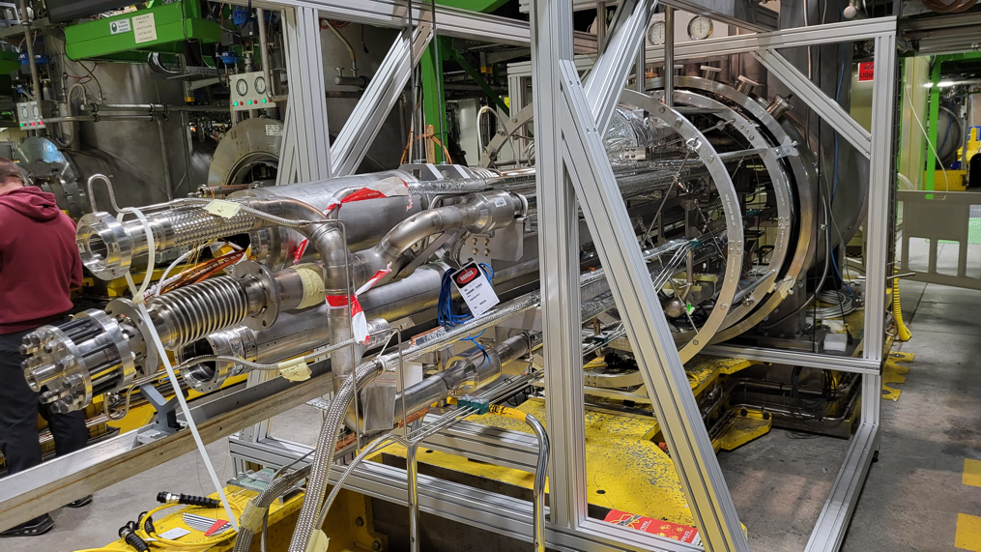
Good level of standardization albeit with variants
CFB
Shuffling
module
WP3 cryo-magnet
MRB
LHC W bellows
VV extension #1
VV extension #2
VV extension #3
(not for all magnets)
Shuffling Module:
Interface between WP3 magnets and CFB.
Compatibility matrix:
Existing equipment
New component
Magnet to be tested
 | A2 | B2 | C2 | F1
Q1 | X
Q2a | OK |  |  | X
Q2b | OK |  |  | X
Q3 | X
D1 | OK | X
CP | X
D2 |  |  | X
Page 7/20
13th HL-LHC Collaboration Meeting, Vancouver, Canada ‒ 25-28 September 2032

Slide 8
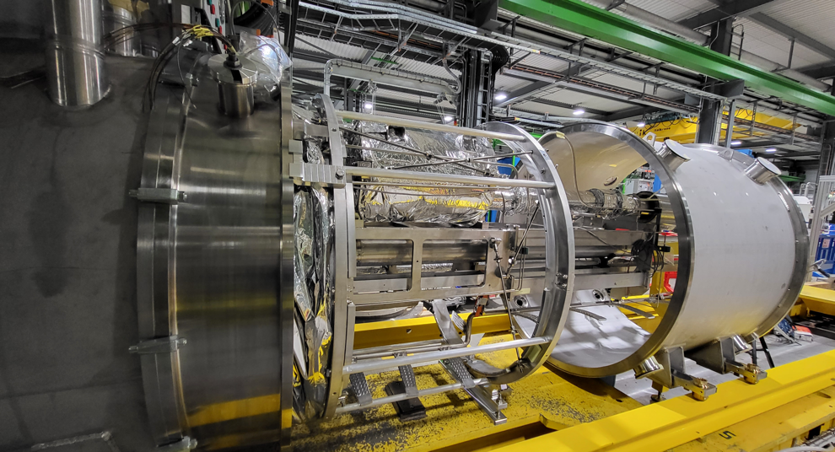
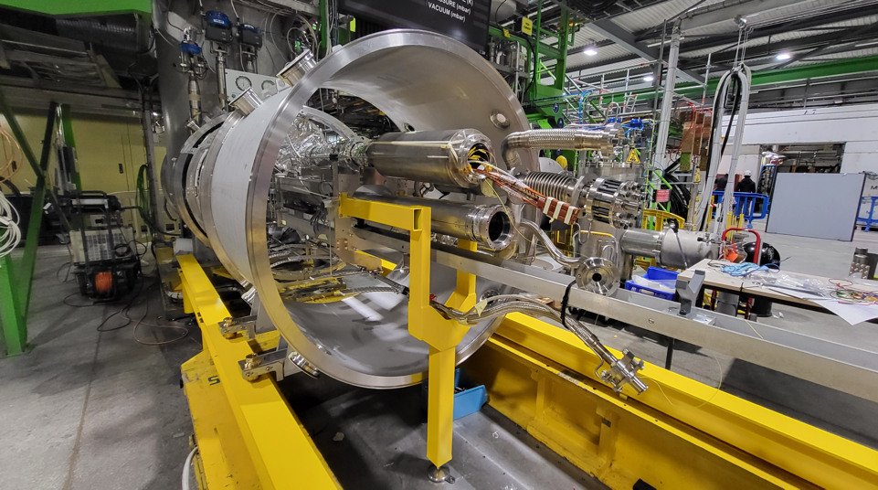
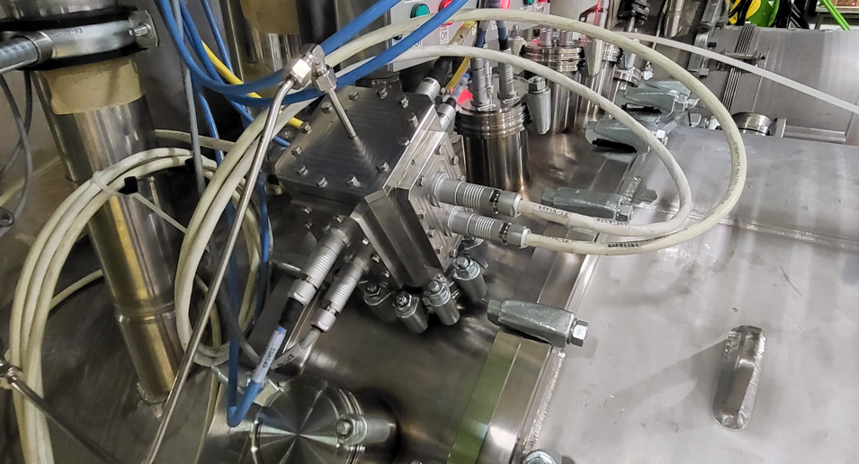
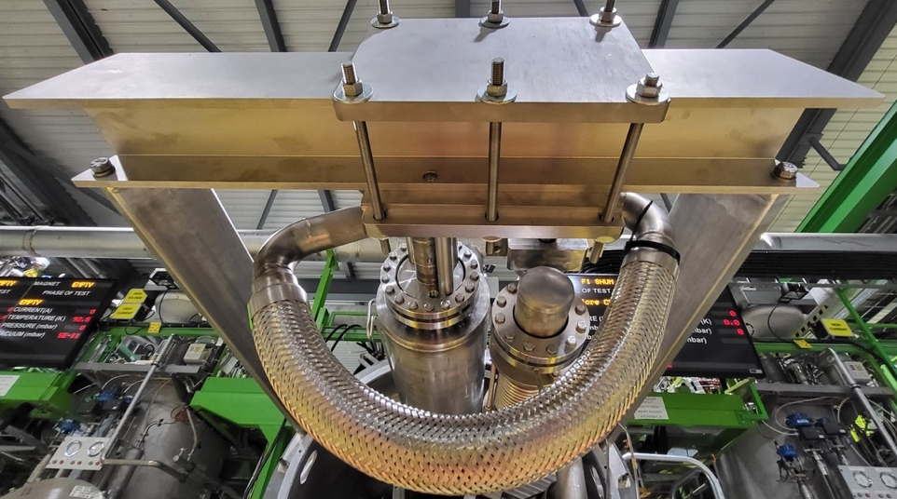
Highlights
Space frame and cantilever beam to support the He lines in the vacuum vessel
Integration of a short anti-cryostat to house the magnetic measurements shaft
Temporary support structure for global pressure and leak test at end of assembly
Connector box on the instrumentation VV, extension of the phase separator via IFS capillary
Page 8/20
13th HL-LHC Collaboration Meeting, Vancouver, Canada ‒ 25-28 September 2032

Slide 9
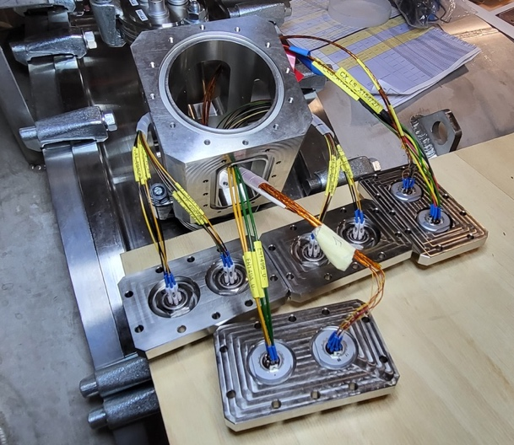
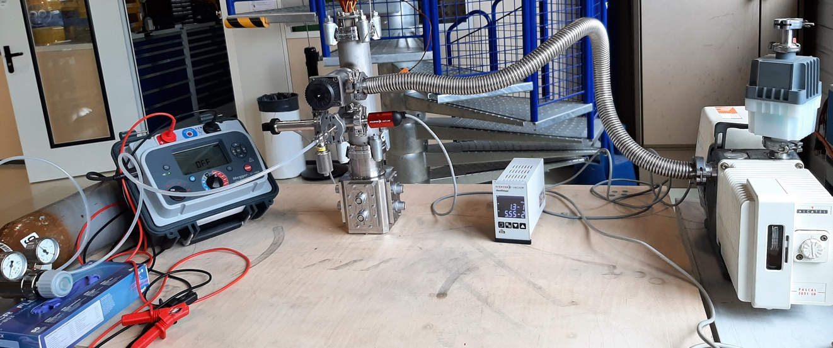
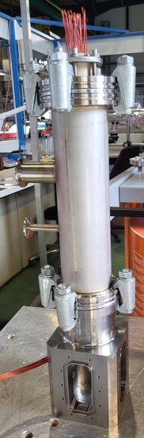
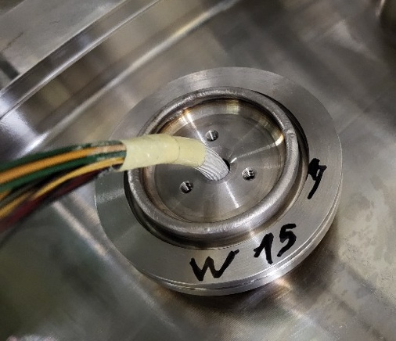
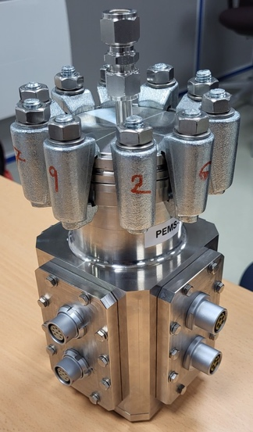
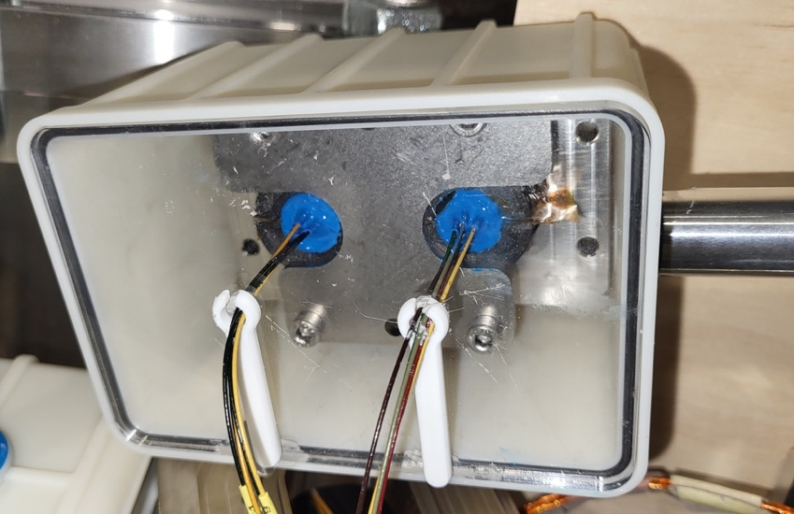
Example of challenges: qualification of the connector box
The connector box has undergone HV insulation tests in air and gaseous He; the insulation of the connectors was reinforced with resin potting:
  Breakdown was observed for 2 of 4 tested connectors @4.2 kV and 4.8 kV in gaseous He, providing adequate margin to test HL-LHC magnets.
Cabling, jointing, and assembly procedures developed during work on F1.
Qualification of the connector box per PED requirements with HSE (pressure tested @5 x 20 bars).
Cabling, jointing and potting on F1 bench
Connector box for high pressure test
HV test set-up at CERN HV laboratory
Page 9/20
13th HL-LHC Collaboration Meeting, Vancouver, Canada ‒ 25-28 September 2032

Slide 10
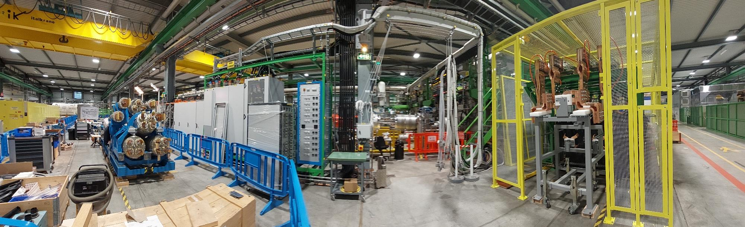
Test bench F2 for SC link: status
Patch Panel Interface (PPI)
− commissioned successfully with new 18 kA and 2kA water- and air-cooled power circuits; − 2kA current lead terminations now in preparation with help of String mock-up (temporary configuration with standard rigid 300 mm² cable).
Instrumentation and cabling
− DFHX/DFX cryo instrumentation cabling: preparations ongoing;
− 20 × new uQDS crates installed and cabled, to be tested.
DFHX
swinging arm
connection mock-up
PPI cage
12.03.23
Page 10/20
13th HL-LHC Collaboration Meeting, Vancouver, Canada ‒ 25-28 September 2032

Slide 11
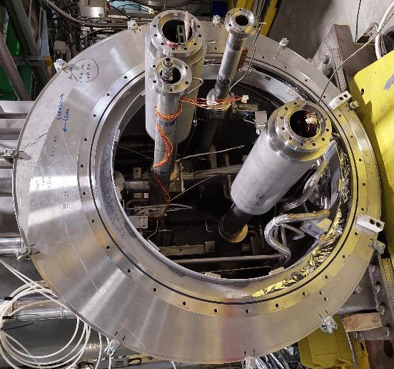
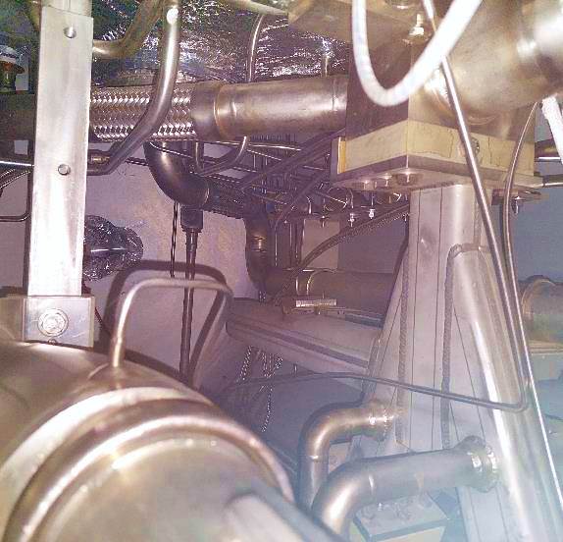
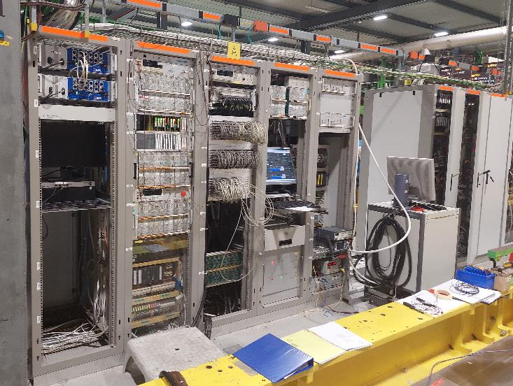
Test bench A2 for Q1/3 & CP – status
Cryo PLC: process updated (~identical to F1);
Aux power circuits: 2 kA load and polarity switches procured and assembled, ultra-flexible cable ordered;
Protections: 2×uQDS crates for MQXF/MCBXF protection installed; 2 kA/600 A Energy Extraction systems available;
Shuffling Module: essentially identical to F1/B2 unit, all components/electrical connectors available, assembly started in SMI2;
Anticryostat: new short unit type 2/3 available.
2 kA/18 kA s/c
ready to install “pieuvre”
raised line N
(to be done on B2/C2)
new 2 kA current
leads/plugs
2× uQDS crates
Interlock PLC HW upgraded
NI DAQ-based instrumentation v.3 (10 kHz)
12.03.23
Page 11/20
13th HL-LHC Collaboration Meeting, Vancouver, Canada ‒ 25-28 September 2032

Slide 12
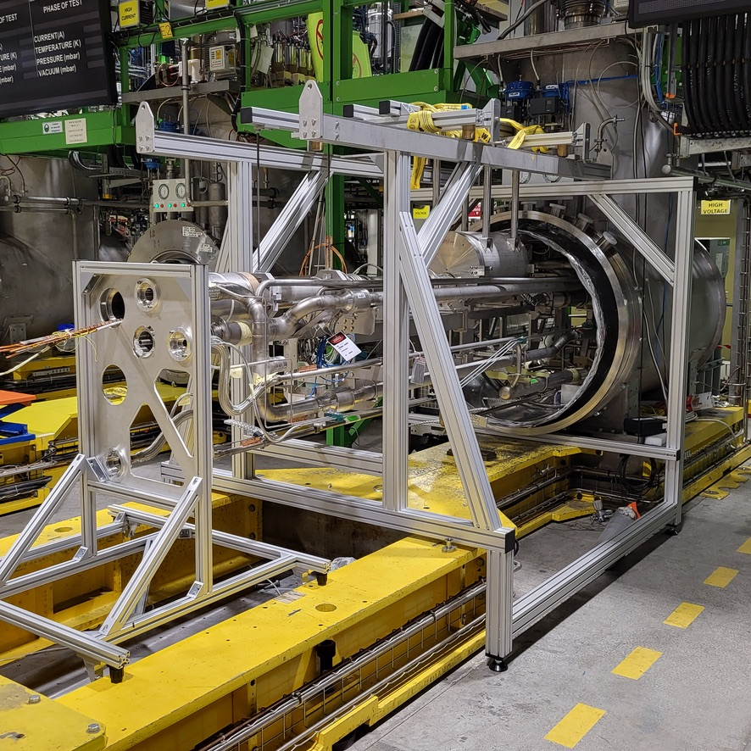
Challenges: scheduling
Schedule requirements for A2 are still a challenge and attention is required for C2.
Following a review by TE Department on 19 September 2023; decision was taken to allocate additional resources
  Fabrication of a second assembly structure to allow work that has to go in parallel on two benches;
  Determine the best moment to install the new N-line equipped with a new submarine valve (for safety reasons, a one-week cryo-stop is required).
Following slide presents baseline schedule agreed by TE-Department and HL-LHC project.
Page 12/20
13th HL-LHC Collaboration Meeting, Vancouver, Canada ‒ 25-28 September 2032

Slide 13
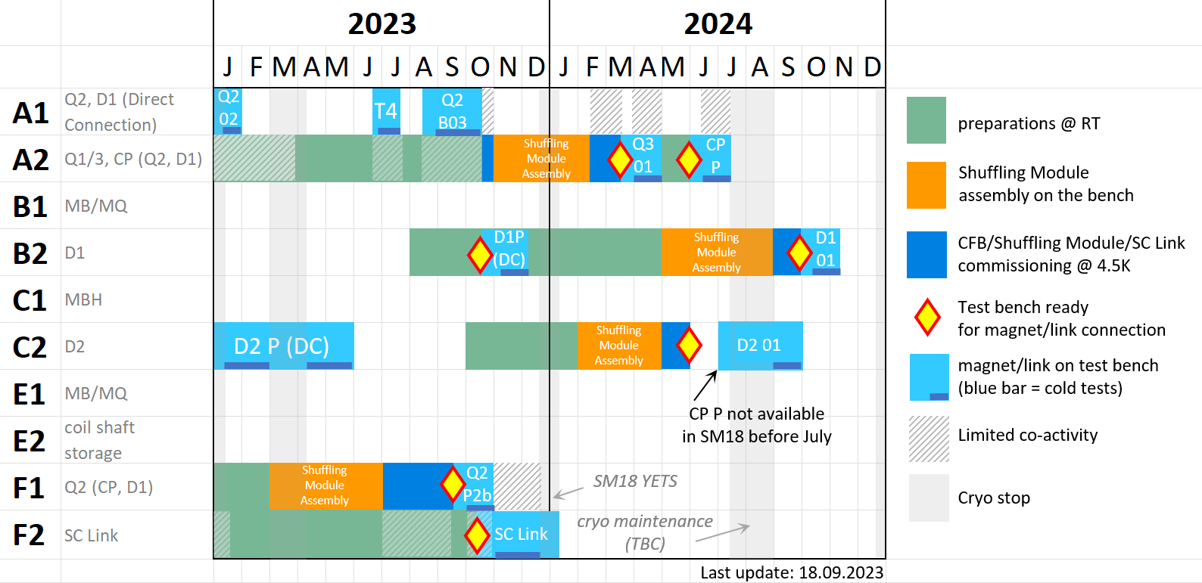
Schedule summary: a consolidated baseline scenario
D2 01
Page 13/20
13th HL-LHC Collaboration Meeting, Vancouver, Canada ‒ 25-28 September 2032

Slide 14
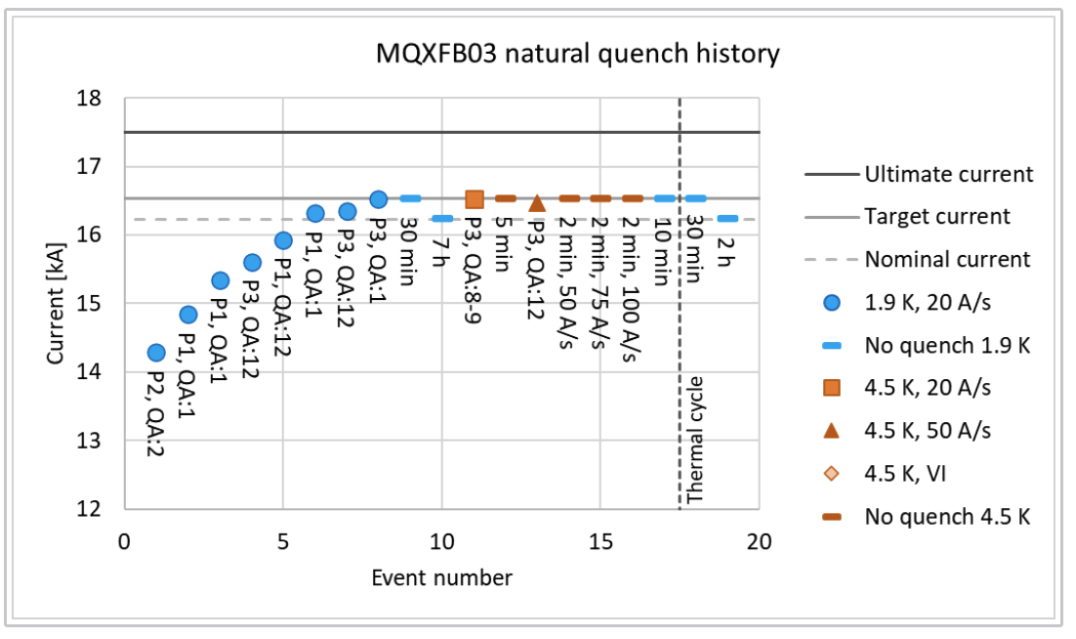
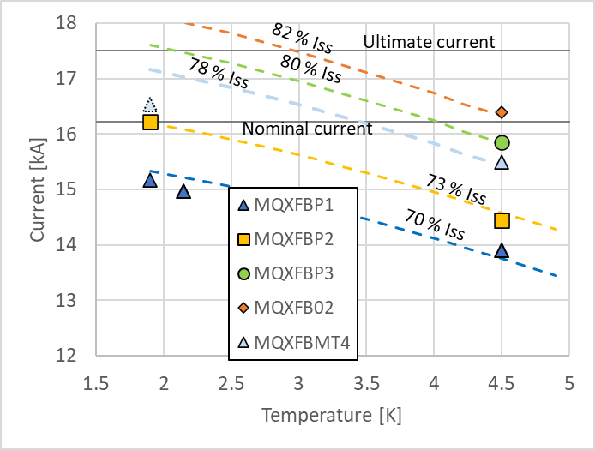
Recent test results: MQXFB03
3rd magnet of 3-stage recovery strategy, integrating: (1) improved cold mass assembly and fixed point, (2) improved magnet loading procedure, (3) improved coil manufacturing procedures to remove hump & belly at coil centre.
Good performance during the first cool down: magnet reached target current of 16.53 kA at both 1.9 K and 4.5 K; first 7.2-m-long MQXFB magnet to do so.
No retraining after warm-up/cooldown cycle; magnet reached target current at 1.9 K; ramp at 4.5 K to be done tomorrow.
Training quenches are all in the ends; performance limitation and phenomenology observed on all previous, full-length, MQXFB magnets in straight section, near magnet centre (at apex of hump & belly) have been overcome.
Page 14/20
13th HL-LHC Collaboration Meeting, Vancouver, Canada ‒ 25-28 September 2032

Slide 15
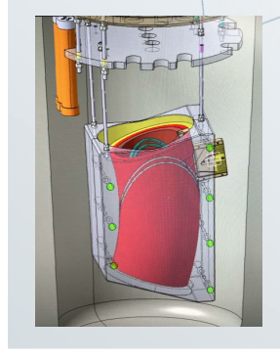
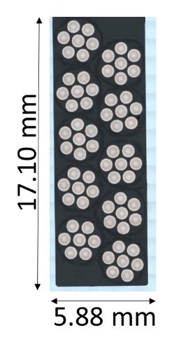
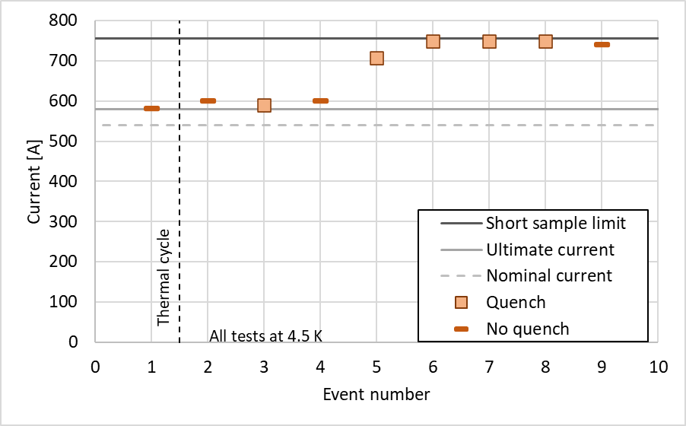
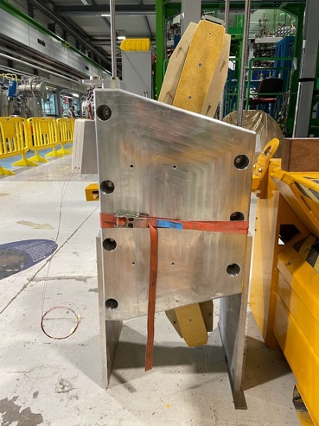
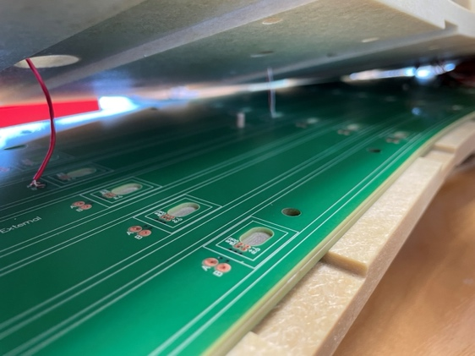
Test and magnetic measurement of FUSILLO sub-scale
FUSILLO is a strongly curved Nb‒Ti CCT magnet design derived from MCBRD program (but relying on 6-around-one cable).
A sub-scale demonstrator was built and tested and reached nominal current without training quench at 4.5 K and achieved near short sample limit with a few training steps.
Magnetic measurements are in good agreement with Roxie simulated data.
X-Sectional View
of Fusillo
Winding
Courtesy of A. Haziot (CERN/TE-MSC)
Page 15/20
13th HL-LHC Collaboration Meeting, Vancouver, Canada ‒ 25-28 September 2032

Slide 16
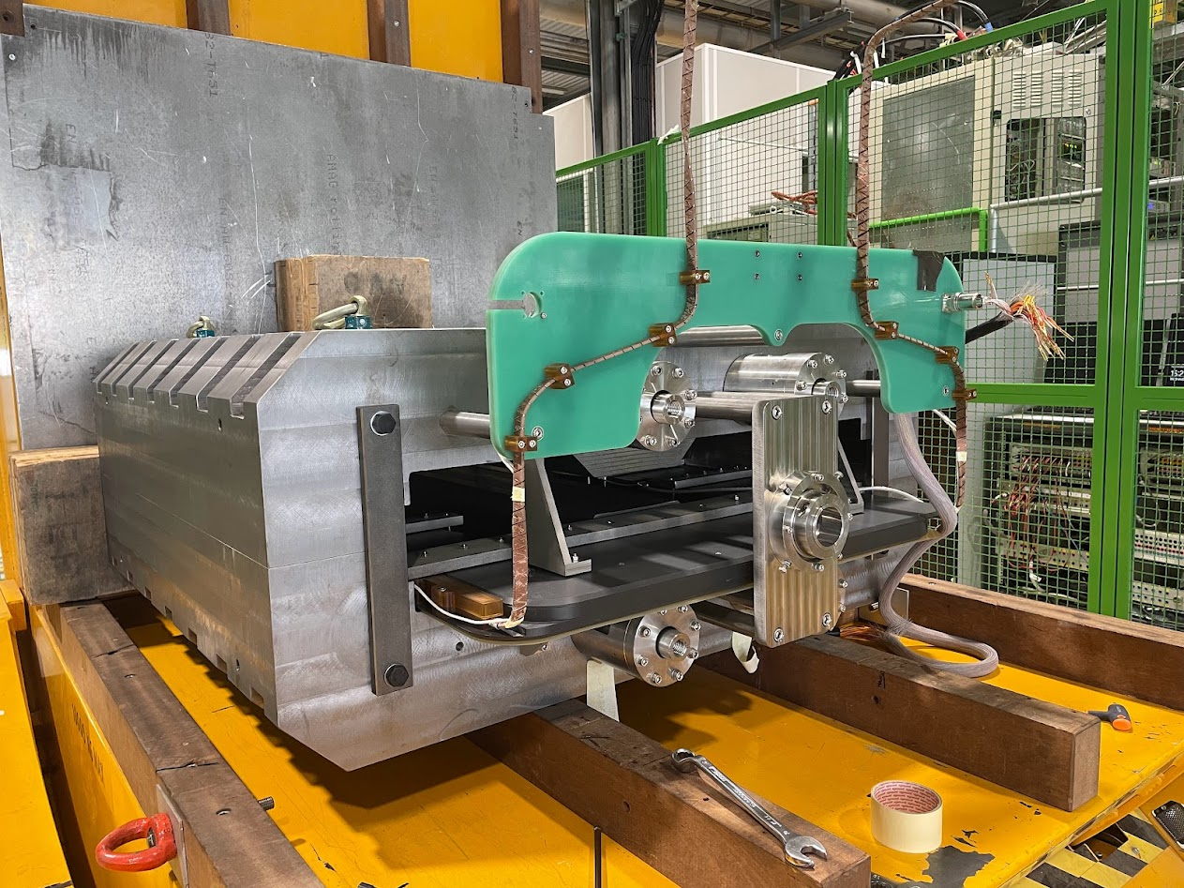
Test and Magnetic measurement of EESD magnet demonstrator
Energy-Efficient Superferic Dipole (EESD) is an innovative iron-dominated magnet design relying on the 3-kA MgB₂ cable developed for sc link in WP6a.
A demonstrator was built and tested, which achieved 5 kA and 1.95 T dipole field at 4.5 K wihtout quench.
MgB₂ Cable (18 Strands Twisted Around Braided Copper Core)
Courtesy of A. Devred,
A. Ballarino, N. Bourcey,
F. Mangiarotti, A. Milanese,
C. Petrone (CERN/TE-MSC)
EESD magnet demonstrator
Magnetic measurement date confromed to expectations.
20 K test under preparation.
Page 16/20
13th HL-LHC Collaboration Meeting, Vancouver, Canada ‒ 25-28 September 2032

Slide 17
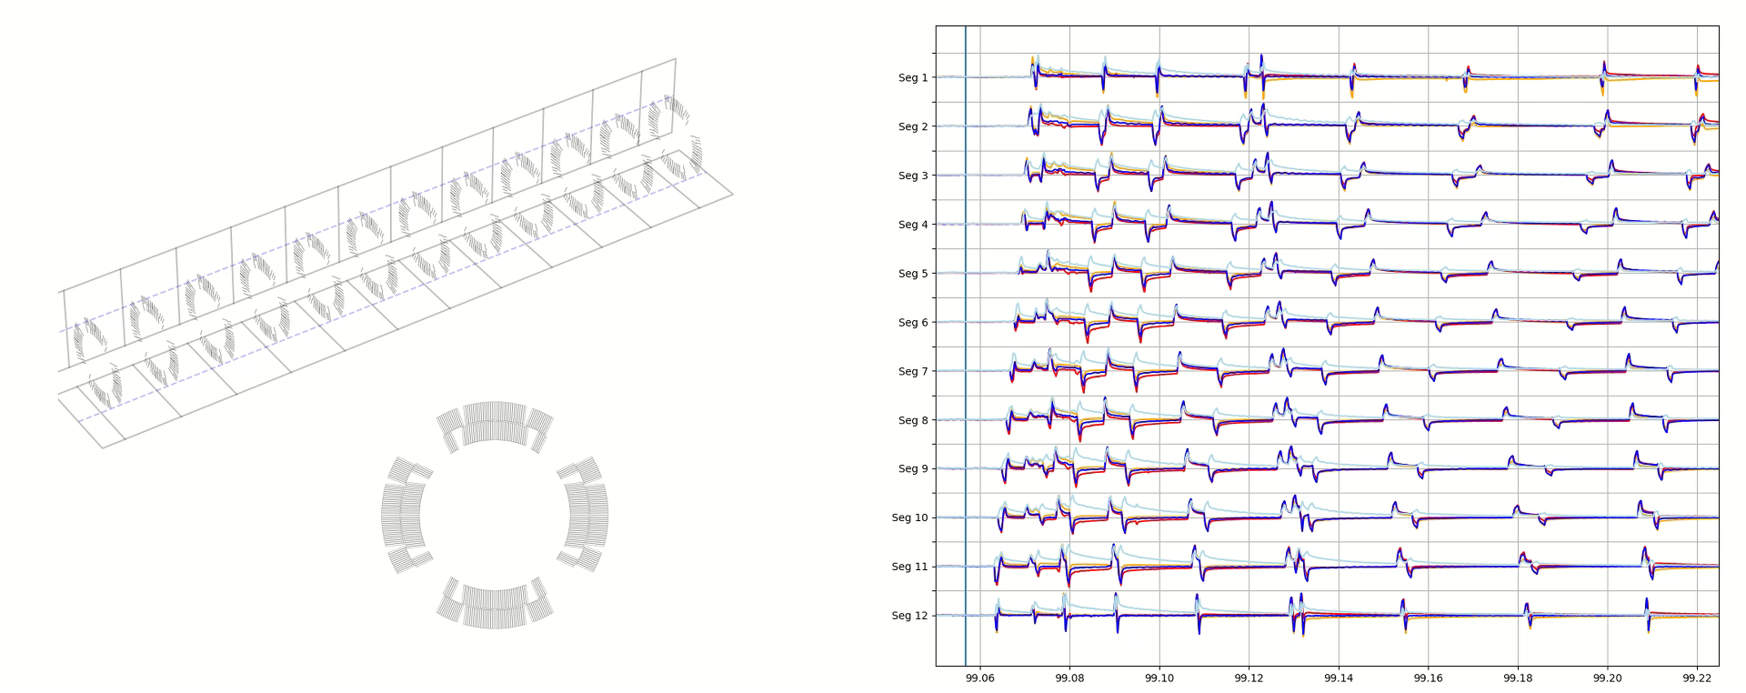
Flux-jump signals in new quench antenna
Propagation speed of the order of ~700->350 m/s at 1.9 K, ~900->500 m/s at 4.5 K.
Page 17/20
13th HL-LHC Collaboration Meeting, Vancouver, Canada ‒ 25-28 September 2032

Slide 18
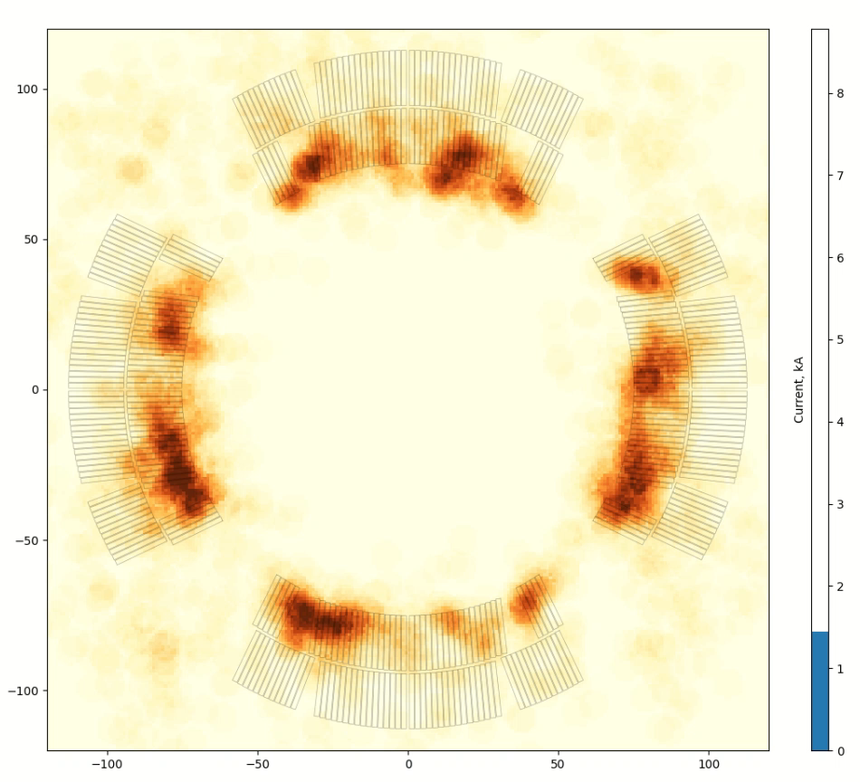
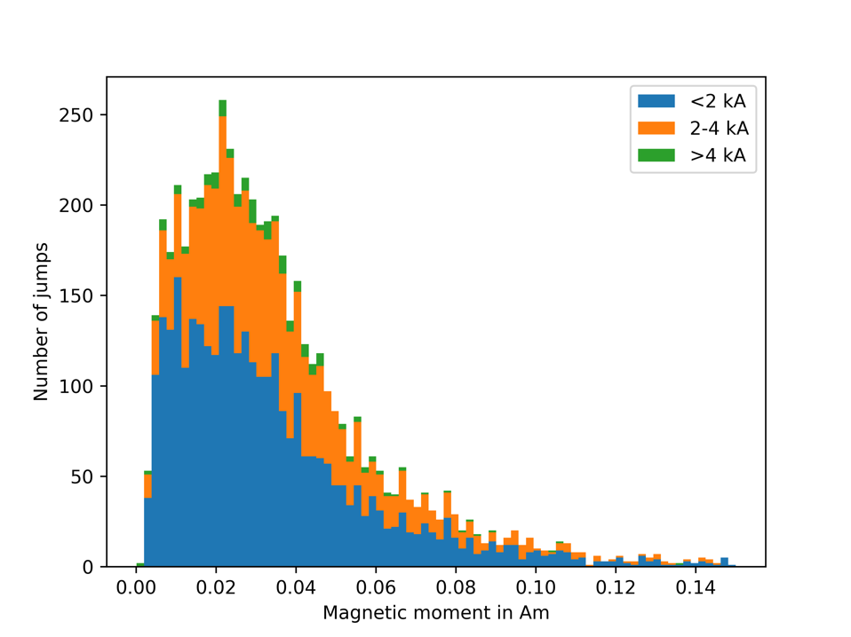
Automatic parameter extraction for flux-jump signals
4.5 K
4.5 K
Page 18/20
13th HL-LHC Collaboration Meeting, Vancouver, Canada ‒ 25-28 September 2032

Slide 19
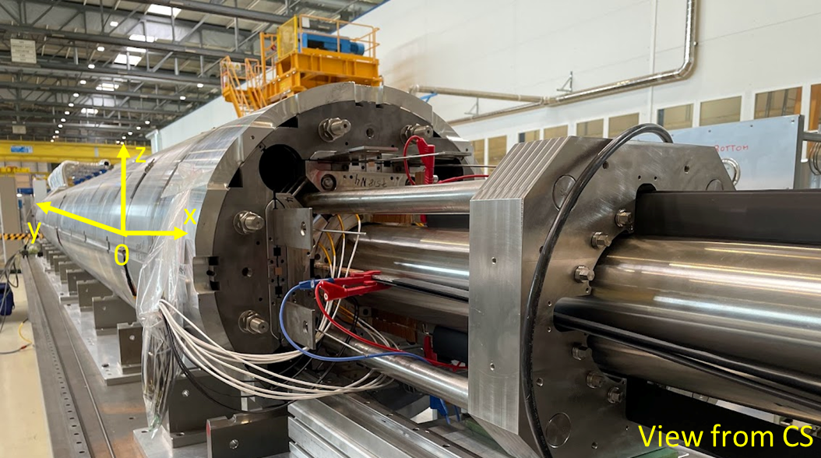
Magnetic measurement of LMQXFB03 after coil-pack insertion
Magnetic measurement of new series MQXFB magnet, performed by rotating coil scanner (RCS)
Measurements performed after coil pack insertion (before loading).
New rotating-coil scanner commissioned
Page 19/20
13th HL-LHC Collaboration Meeting, Vancouver, Canada ‒ 25-28 September 2032

Slide 20
Conclusions
Important milestones reached in benches F1/F2.
Result of the hard and dedicated work of many staff in TE-MSC and other CERN Groups and Sections, showing skill and adaptability
Commissioning tests serve their purpose and point out necessary improvements;
issues found cause delays but should be considered natural steps in the development of such a unique and complex test station.
The schedule consolidated with the experience acquired shows that bench A2 is on the critical path; additional resources committed by TE Department to ensure timely readiness.
MQXB03 is first 7.2-m-long to achieve achieve target currents at both 1.9 and 4.5 K.
Good test results on diversification programs spun off from HL-LHC (e.g., FUSILLO and EESD), preparing the path for after HL-LHC activities.
Page 20/20
13th HL-LHC Collaboration Meeting, Vancouver, Canada ‒ 25-28 September 2032

Slide 21
Additional Slides
13th HL-LHC Collaboration Meeting, Vancouver, Canada ‒ 25-28 September 2032

Slide 22
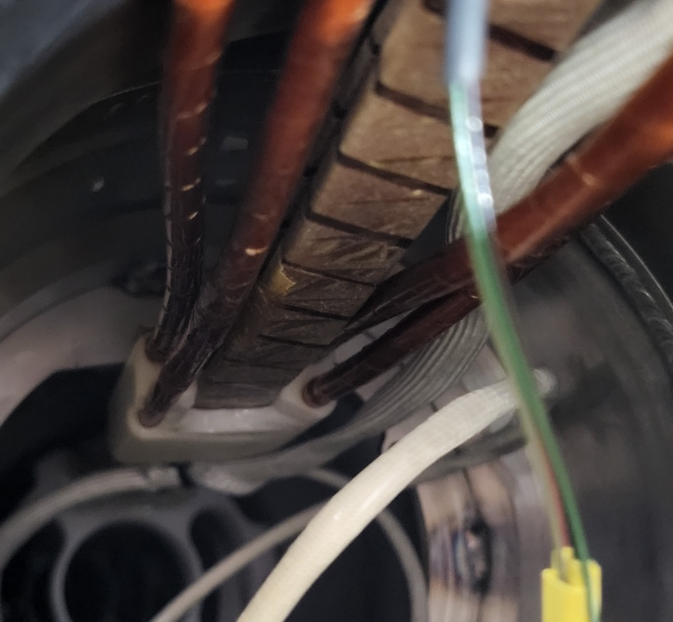
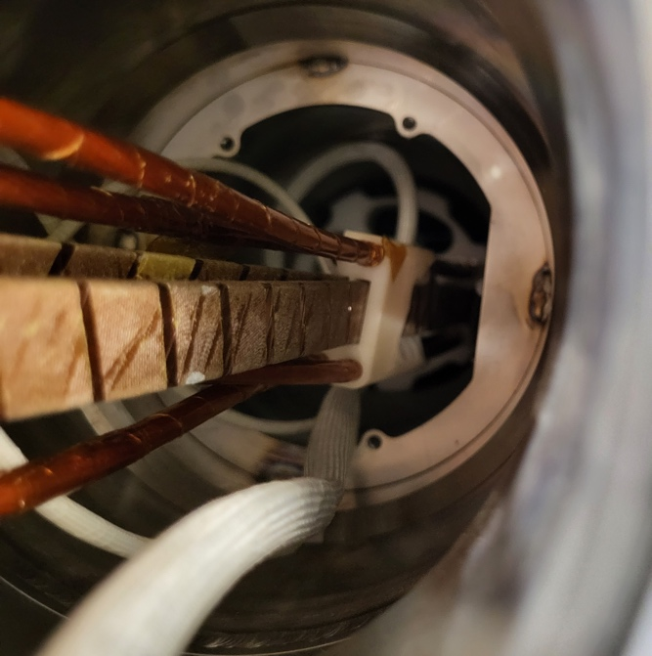
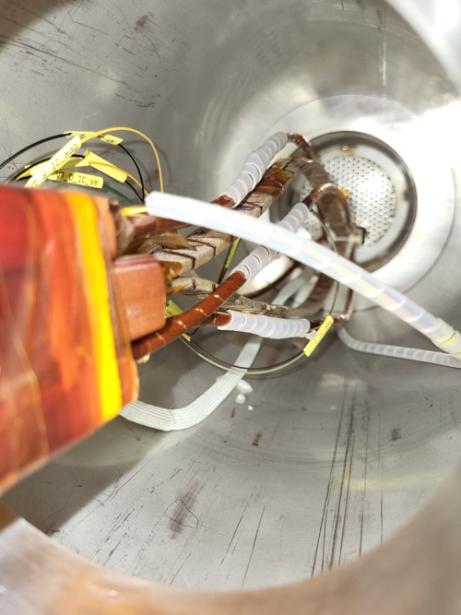
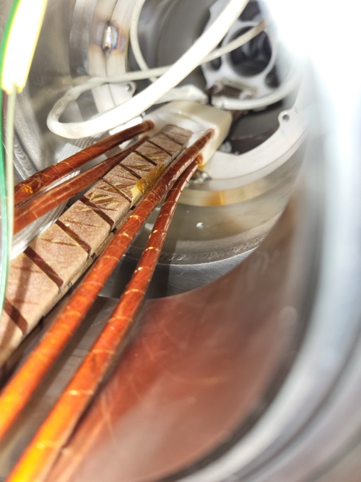
Challenges (2/2): busbar routing and support
Both 18 kA and 2 kA busbars were found deformed between the electrical joints (at the very end of the bus bars) and the position of the helium filter where all the bus bars are put together in a non-metallic flange/support.
The bus bars have repelled each other when powered leading to ”training” quenches; additional supports have been added.
Original shape of all cables before powering tests
Support (at He filter position) broken at top by bus bar pushing outwards when powered and deformed
Support (at He filter position) broken at bottom likely during assembly and adjustment of its position
Here after powering tests
13th HL-LHC Collaboration Meeting, Vancouver, Canada ‒ 25-28 September 2032

Slide 23


Lessons learned from F1
Missing components: some required to be designed, and some required simple modifications.
  Octopus parts for the global pressure and leak test, including thermal screen segments.
  Various additional supports for the helium lines.
Additional components:
  Cold pressure sensor on the N-line, which necessitated modifying the N-line.
  Mechanical shielding for the connector box.
Tooling to be designed and manufactured:
  Set of clamshells for local leak tests of welded joints.
  Qualification of the connector box at both RT and cold conditions @ 5x20 bar.
  Global pressure and leak test not successful
  XY-line, M-line and N-line found deformed.
  Octopus parts and supports had to be modified.
  Busbar support:
  Insufficient support at some locations to take up repelling e.m. force when current circulating
  Modifications will be put in place for the shuffling modules of the other 3 benches A2, B2 and C2, and also for the bench F1 at the extremity of the bus bars that is accessible (magnet side).
13th HL-LHC Collaboration Meeting, Vancouver, Canada ‒ 25-28 September 2032

Slide 24
Test bench F1 - coming next
Components to be commissioned with first magnet
− Dedicated part of the PLC interlock system
− Protection equipment: new PDSU
− uQDS: new GUI still to be tested, incl. file saving in TDMS format to be completed.
Challenges | Risk | Mitigation
Shuffling Module-related challenges
Missing redundant Phase Separator LHe level gage | Operation not possible in case of fault of the remaining gage | Repair at the level of the Instrumentation Box can be carried out with magnet @ RT in about ~1 week
R_{GND} = 70 MΩ in the 2kA CL heaters (vs ~ 80 GΩ expct.) Applies also to bench A2. | The heaters must be disconnected during HV tests | Installation of insulation transformers upstream (space in the Cryo cabinet TBC).
V≤1.5 kV @4.5 K in 2kA circuits Applies also to bench A2. | Non-standard operational procedure. No impact on magnet testing | Follow detailed HV test procedure with checklist Improved leads/plugs might be considered for long-term consolidation after HL-LHC campaign
2kA EE incompatible with PC in absence of inductive load Applies also to bench A2. | In case of a quench, a 530 V surge will destroy PC diodes | Follow detailed procedure including manual s/c the EE switch in case of future s/c tests
uQDS firmware updates closely coupled to software/operation Applies to all benches. | Update/debug cycle may engender delays | Tight coordination between teams (normally the case !) Provide test crates to BE-CEM
Co-activity with F2 | Tower structure to lower the link onto DFX + scaffolding for operators represent a risk of falling objects on the magnet (esp. fragile IFS boxes). Electrical interference/operator safety | Prevent simultaneous cold operation of F1/DFX installation (impossible to complete commissioning of F1 and F2 in 2023) and/or install additional protections No concurrent powering/HV tests (TBD)
12.03.23
13th HL-LHC Collaboration Meeting, Vancouver, Canada ‒ 25-28 September 2032
Notes:
Add EE in series ?

Slide 25
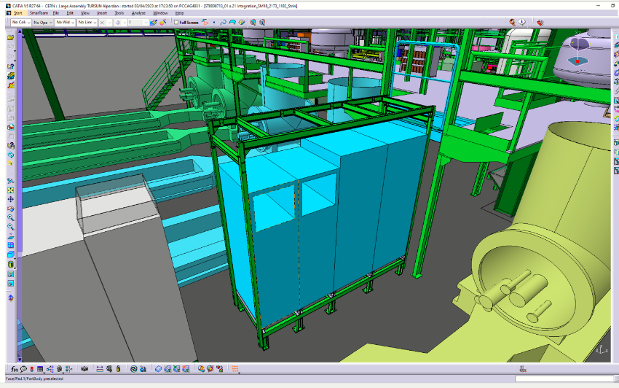
Test bench A2 - coming next
Aux power circuits
− preparation ongoing for CFB commissioning
− installation of final electronics in place of the existing staircase
(2× 2 kA load switches, 2×2 kA polarity switches)
− final 2 kA circuit to be partially made with Class 6 cablr
Cryogenic equipment
− Refurbishment of main busbar end plates with SnAg
− Shuffling module: assembly on test bench
Instrumentation and Protection
− Finalization of signal cabling for CP, cabling for CLIQ
− Interlock PLC I/O commissioning in the different bench configurations
− 2 kA/600 A Energy Extraction systems installation and commissioning − uQDS systems: doubling up the number of crates to simplify reconfiguration CP ↔ Q2
− Cryo PLC: commissioning of the CL instrumentation (heater, splitting box)
2×2 kA load switches
2×2 kA Energy Extraction
12.03.23
13th HL-LHC Collaboration Meeting, Vancouver, Canada ‒ 25-28 September 2032

Slide 26
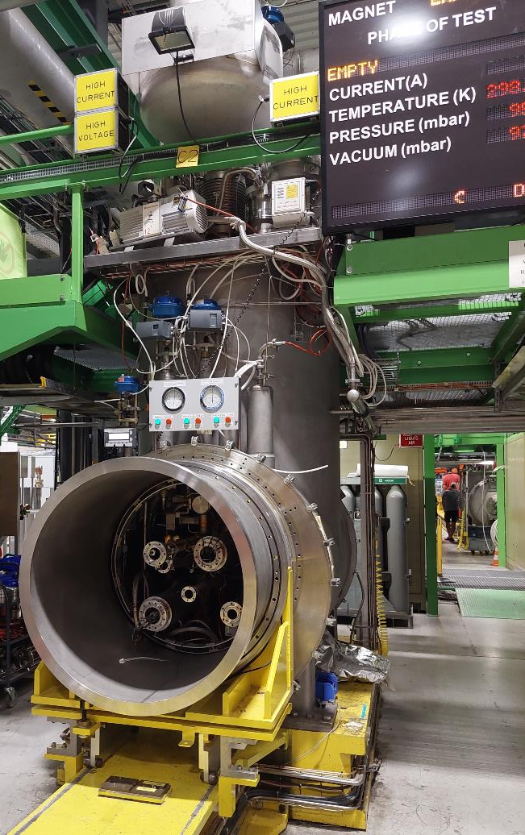
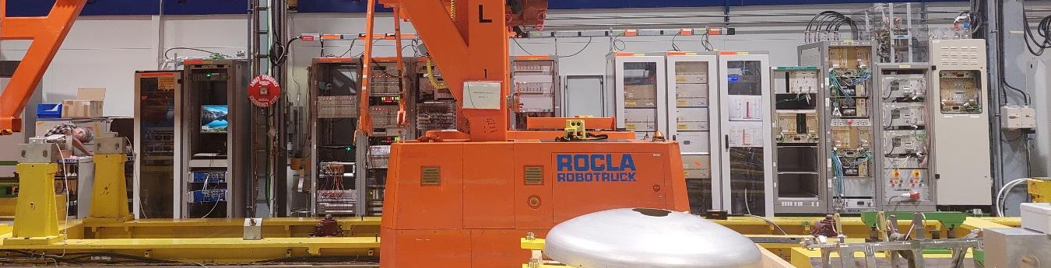
Test bench C2 for D2 – status
Bench already configured and used to test D2 prototype in Direct Connection
Power circuits
− Main 15kA/aux 600A ready (except. SnAg refurbishment of main leads)
Shuffling module
− Significatively different than F1, A2, B2 units due to double aperture magnet
− Design completed, all components in common with others are procured. Fabrication of differing ones is being launched.
Instrumentation and Protections
− 2 × uQDS crates installed to protect MCBRD correctors
− Protection of D2 main dipole with legacy PotAim cards
2× uQDS crates
Safety Matrix
NI DAQ v3
Quench Heaters
Aux Power Converters/Switches
13th HL-LHC Collaboration Meeting, Vancouver, Canada ‒ 25-28 September 2032

Slide 27
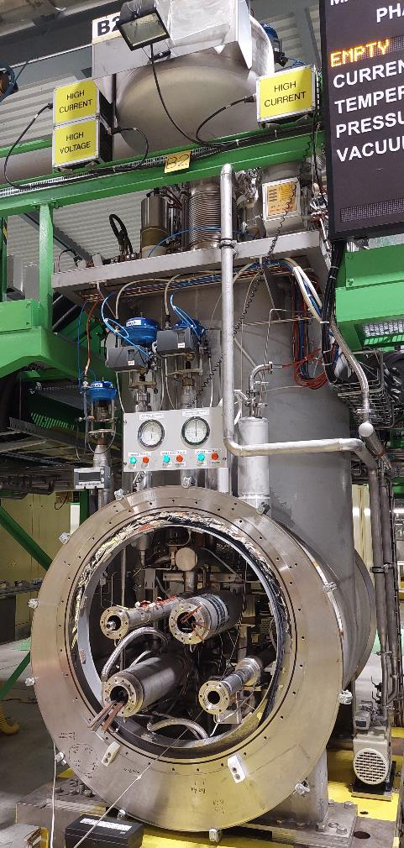
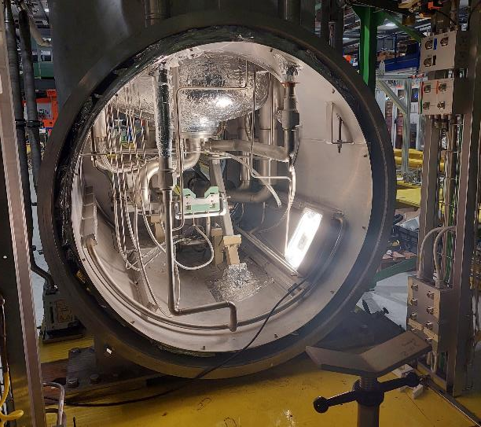
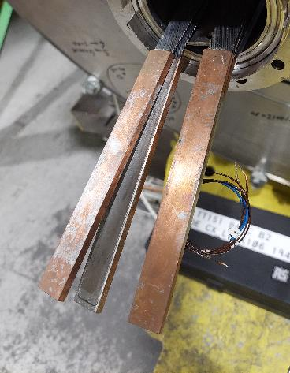
Test bench B2 for D1 – status
Bench configured for D1 Prototype (Direct Connection)
− Main 15 kA/600 Auxiliary power circuits [not needed] operational
− Main magnet protection with legacy PotAim cards
− Acquisition with improved PXI NI-based DAQ v. 3 (10 kHz)
− New ∅109 mm short and long antivryostats Type 2/3 ready
Shuffling module for D1 Series
− All components are procured (identical to F1/A2 units)
Main busbar terminations
to be refurbished with SnAg
New ∅110 mm
anticryostat support
Ready now to connect D1 Prototype
Anticryostat installation ongoing
12.03.23
13th HL-LHC Collaboration Meeting, Vancouver, Canada ‒ 25-28 September 2032

Slide 28
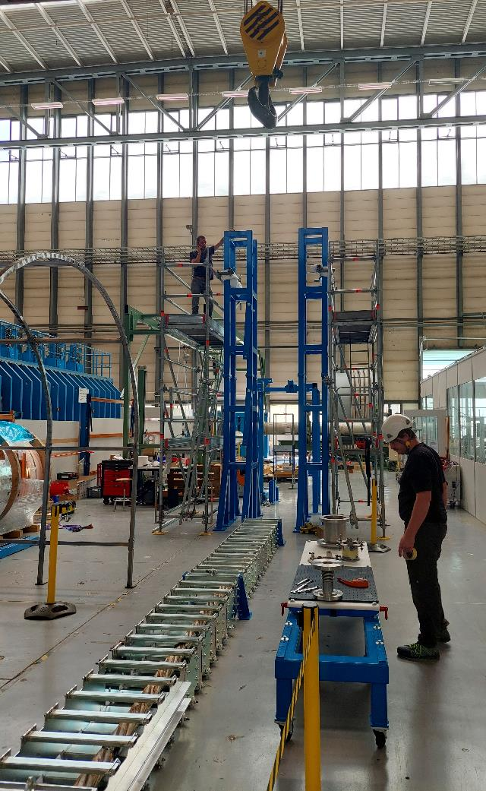
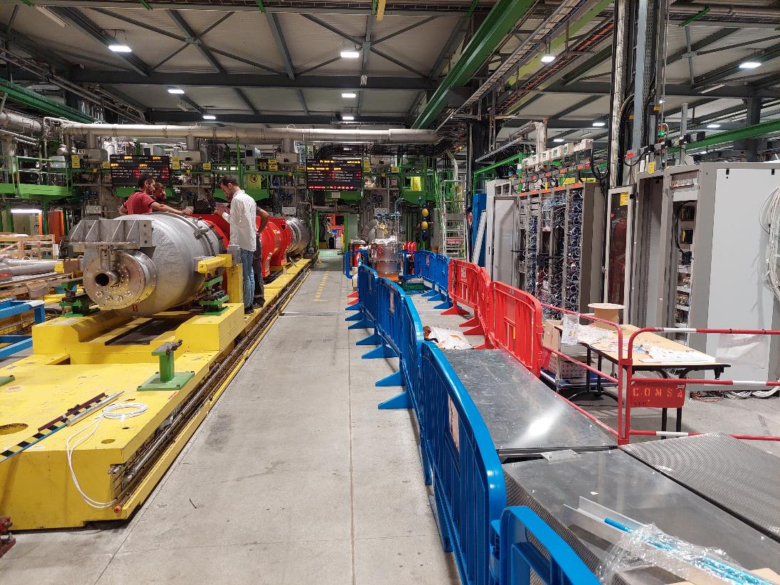
Challenges: co-activity
Risk Analysis of co-activity ongoing
12.03.23
13th HL-LHC Collaboration Meeting, Vancouver, Canada ‒ 25-28 September 2032

Slide 29
Availability of magnets for test benches
Negative margin: magnet ready before test bench
(Critical path)
Magnet to be tested | Bench | Availability for cold test | Test bench readiness | Margins on test bench readiness
Q3 01 | A2 | 26/02/2024 | 15/03/2024 | -3 weeks
Q1 02 | No Cold test foreseen | / | / | /
Q2 P2b | Currently on F1 | / | / | /
Q2 P3a | F1 | 11/10/2023 | 24/11/2023 | -2 weeks
CP P | A2 | 30/01/2024 | 22/05/2024 | -4 months
D1 P | Done. Tested on B2 | / | / | /
D2 01 | C2 | 10/07/2024 | 30/05/2024 | 6 weeks
D1 01 | B2 | 20/12/2024 | 30/09/2024 | 6 weeks
Margin for first serie D2 and D1
Cold tested in the US
Q2P2b before Q2 P3a
Q3 01 tests before + 1 month work for CP P on A2 bench
13th HL-LHC Collaboration Meeting, Vancouver, Canada ‒ 25-28 September 2032

Slide 30

Recent test results: D2 prototype
4th cooldown, 3rd cooldown without powering.
Zero quenches of the main magnet at 1.9 K and 4.5 K up to ultimate current.
Combined powering 1st corrector magnet (MCBRDP1b)+main magnet (MBRDP1) OK up to ultimate current.
Magnetic measurements ongoing for coupling between the corrector and main magnet
13th HL-LHC Collaboration Meeting, Vancouver, Canada ‒ 25-28 September 2032

Slide 31




D2 prototype stray field
High stray field in D2 magnets because field in both apertures in same direction.
The new 3 mT limit for ferromagnetic tiool manipulation (implemented in summer) asks for derogation with Risk Assessment document.
Signaling and blinking lights o.k.
13th HL-LHC Collaboration Meeting, Vancouver, Canada ‒ 25-28 September 2032

Slide 32

MCBXFB02
In the 4 cool downs (two before reassembly, two after), there were only 2 quenches in the nominal operating space (one in CD1 and one in CD4), 2 quenches in the ultimate operating space (both in CD1) and 3 beyond the ultimate operating space (two in CD1 and one in CD3).
13th HL-LHC Collaboration Meeting, Vancouver, Canada ‒ 25-28 September 2032

Slide 33



MBHDP301 – 11T model with end cage
The aperture with end cage reached above nominal current but showed a reduction of coil limit by about 500 A compared to the previous test of this coil in a different assembly. The V-I measurements showed a significant voltage build-up
The aperture without end cage had a quench heater failure and could not be powered.
13th HL-LHC Collaboration Meeting, Vancouver, Canada ‒ 25-28 September 2032

