Slide 1

“HL and LS3 Installation Plans”
(what is planned? what is going on?)
by:
HL-WP15&17: P. Fessia, M. Modena, L.Tavian
EN/ACE-OSS: M. Barberan, M. Bernardini, H. De Maynard, E. Vergara
13th HL-LHC Collaboration Meeting – Vancouver - CA, 25-28 Sept 2023

Slide 2
Content
Context
Installation Planning for new surface buildings
Installation Planning for new underground galleries
Installation Planning for LS3 : LHC Tunnel
Status analysis, open points and main issues
Conclusion
13th HL-LHC Collaboration Meeting – Vancouver, CA 25-28 Sept 2023; M. Modena on HL and LS3 Schedule Plans

Slide 3
Context
Following the completion of new HL buildings & galleries construction, the HL Installation phase has started!
  New buildings: Installation advancing at IP1 and IP5 as planned: → general services installation, (HL equipment will follow); installation expected to be completed before LS3
  New underground galleries installation: swapped order of priority of IP1 and IP5 due to a CE issue (lift cage): → general services installation started; HL equipment installation will follow without interruption through RUN3-EYETS-LS3
  LHC Tunnel installation schedule (LS3): several iterations with all main Teams & WPs in order to endorse a LS3 Planning Vers-2 in Oct. 2023 (Note: HL Cost & Schedule Reviews are our natural milestones to approve new planning baselines; Ver-2 will be presented to CSR23 in November).
Major milestones to come:
  Completion of general services installation (Jan2025 for the new bldgs.; mid2025 for the underground)
  Cryogenic installation (compressors, cold boxes, lines, QXL installation in SHM-PM-US-UR,...): will be the first main HL equipment to be routed along the “new HL bldgs. & galleries path”
  EYETS 23/24 and 24/25: prepare (and advance if/what possible) the installation in the LHC Tunnel and galleries (tagging for de-cabling, TI2/UJ22 modification, cores pre-excavation(?), etc.)
  LS3 START: End of LHC RUN3 expected in November 2025; TO BE READY! very intense and packed sequence of activities! ... (so: planning, resources smoothing, alternative scenario (were possible) are critical and must be analysed and tackled!)
13th HL-LHC Collaboration Meeting – Vancouver, CA 25-28 Sept 2023; M. Modena on HL and LS3 Schedule Plans

Slide 4
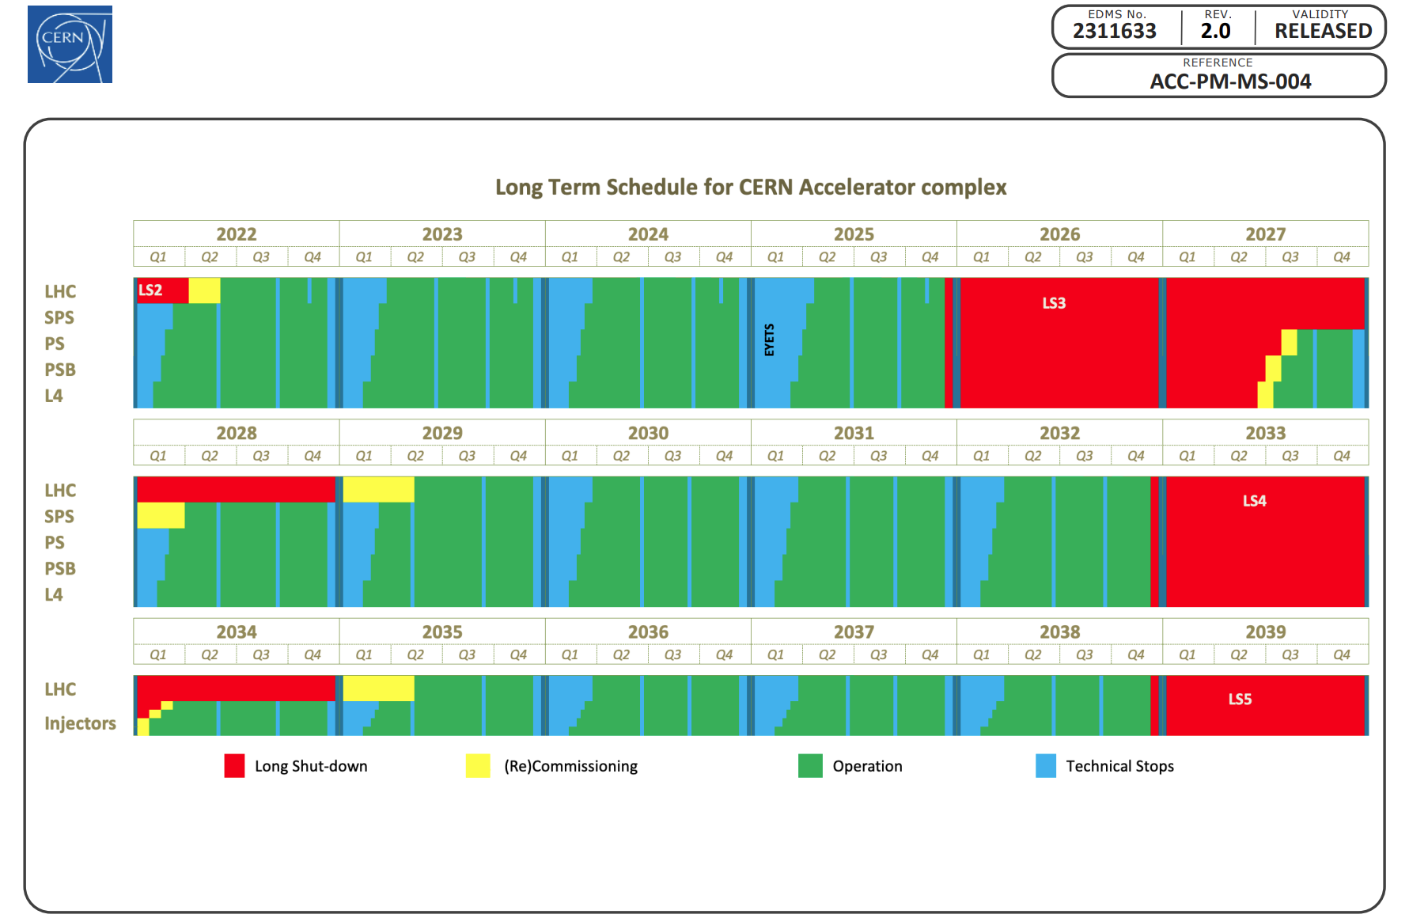
Long Term Schedule for the CERN Accelerator Complex
ACC-PM-MS-0004 V.2.0
Long Shutdown 3 starting on
17th November 2025
4
13th HL-LHC Collaboration Meeting – Vancouver, CA 25-28 Sept 2023; M. Modena on HL and LS3 Schedule Plans

Slide 5
Content
Context
Installation Planning for new surface bldgs.
Installation Planning for new underground galleries
Installation Planning for LS3 : LHC Tunnel
Analysis status, open points and main issues
Conclusion
13th HL-LHC Collaboration Meeting – Vancouver, CA 25-28 Sept 2023; M. Modena on HL and LS3 Schedule Plans

Slide 6
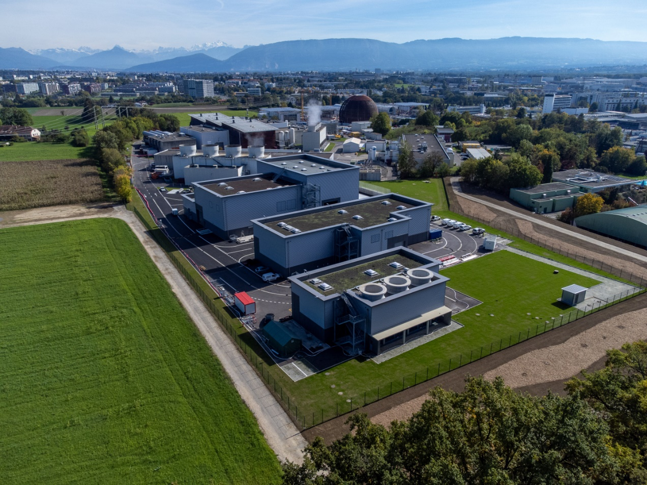
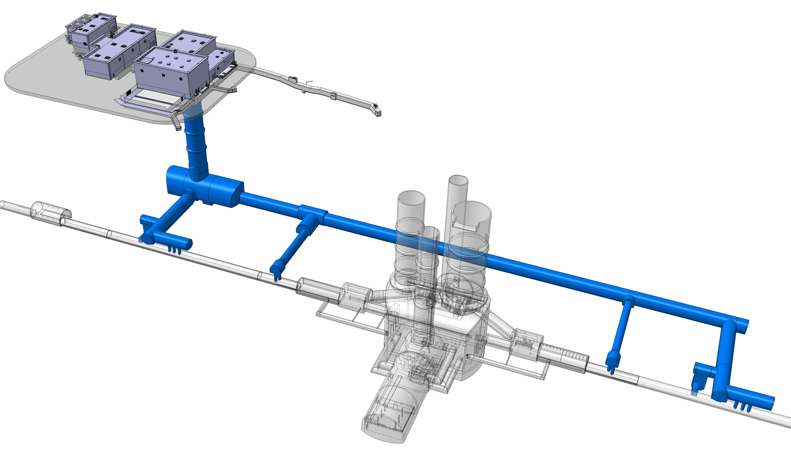
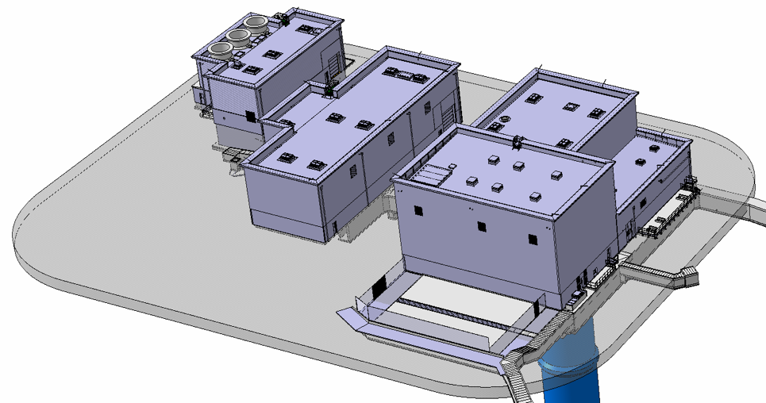
Installation Planning for new surface bldgs. IP1
SD17
SE17
SHM17
SU17
SF17
SF 17
SHM 17
SU 17
SE 17
SD 17
13th HL-LHC Collaboration Meeting – Vancouver, CA 25-28 Sept 2023; M. Modena on HL and LS3 Schedule Plans

Slide 7
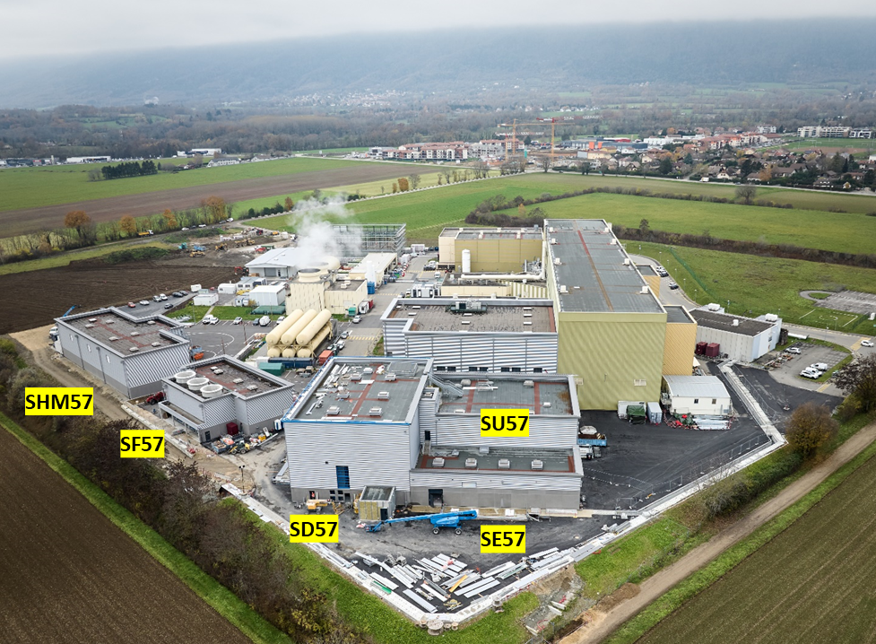
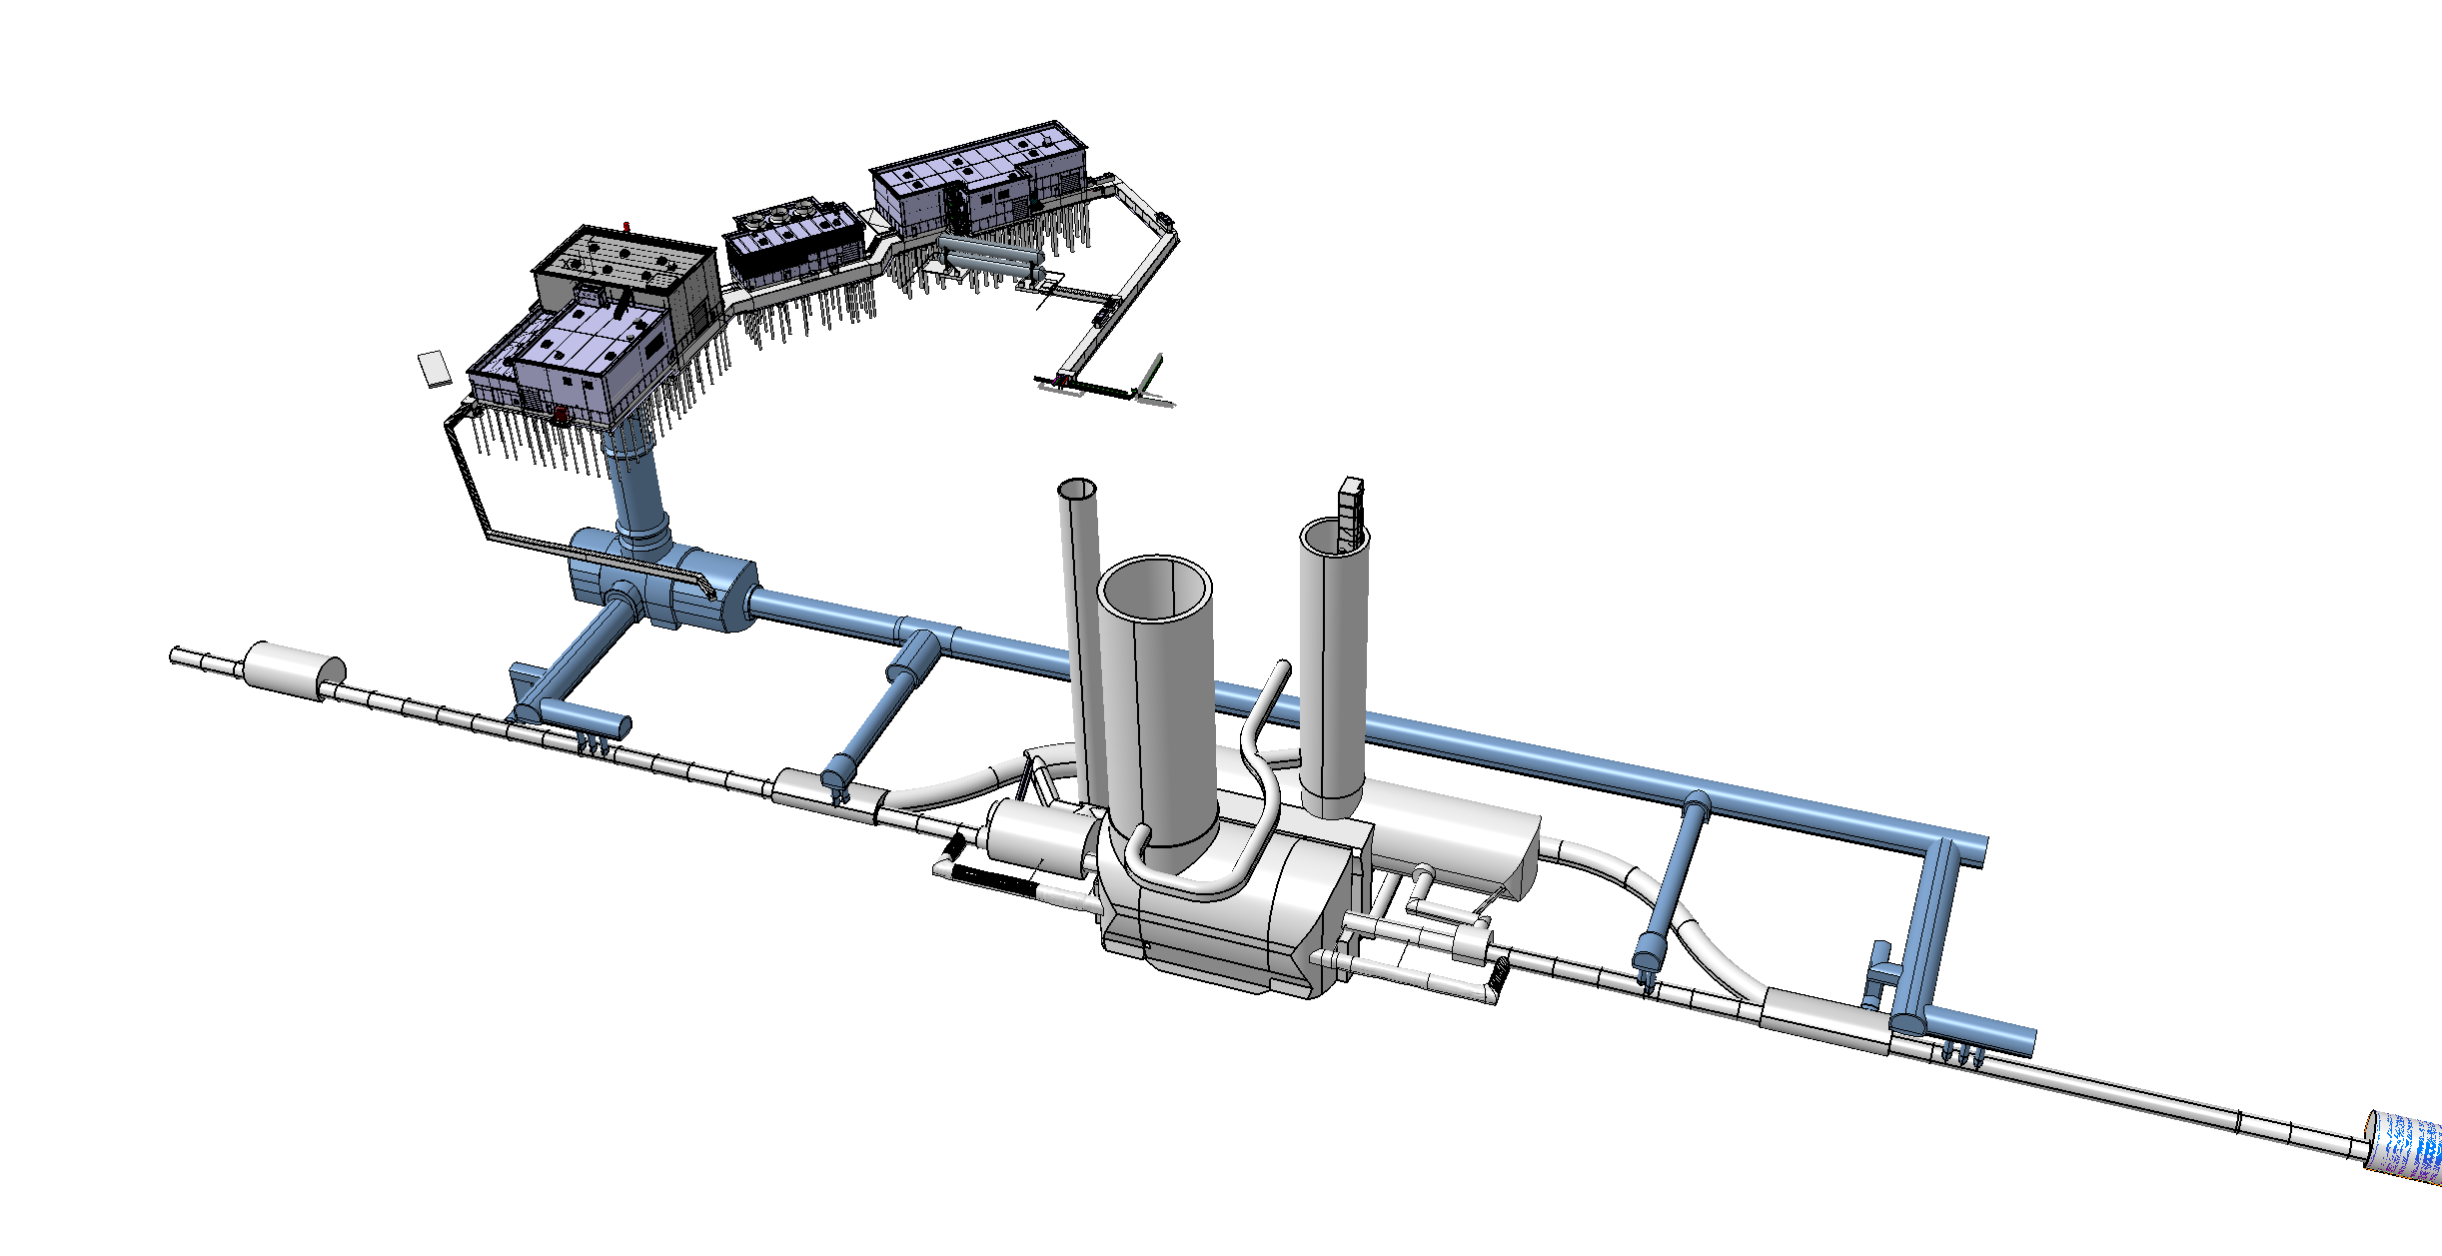
Installation Planning for new surface bldgs. IP5
SHM 57
SF 57
SD 57
SL 57
SE 57
SU 57
13th HL-LHC Collaboration Meeting – Vancouver, CA 25-28 Sept 2023; M. Modena on HL and LS3 Schedule Plans

Slide 8
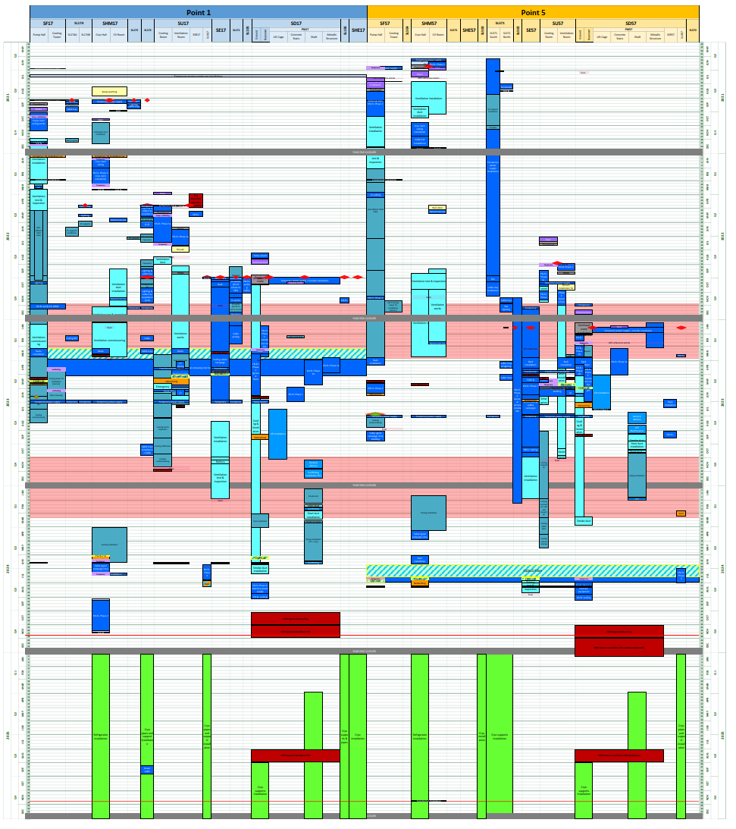
Installation Planning for new surface bldgs. LHC-PM-MS-0020 v.3.0
Point 1
Point 5
2021
2021
2022
2022
2023
2023
2024
2024
Legend:
EN-EL: electrical infrastructure & cabling
EN-CV Ventilation
EN-CV Cooling
Cryo
ODH
2025
2025
13th HL-LHC Collaboration Meeting – Vancouver, CA 25-28 Sept 2023; M. Modena on HL and LS3 Schedule Plans

Slide 9
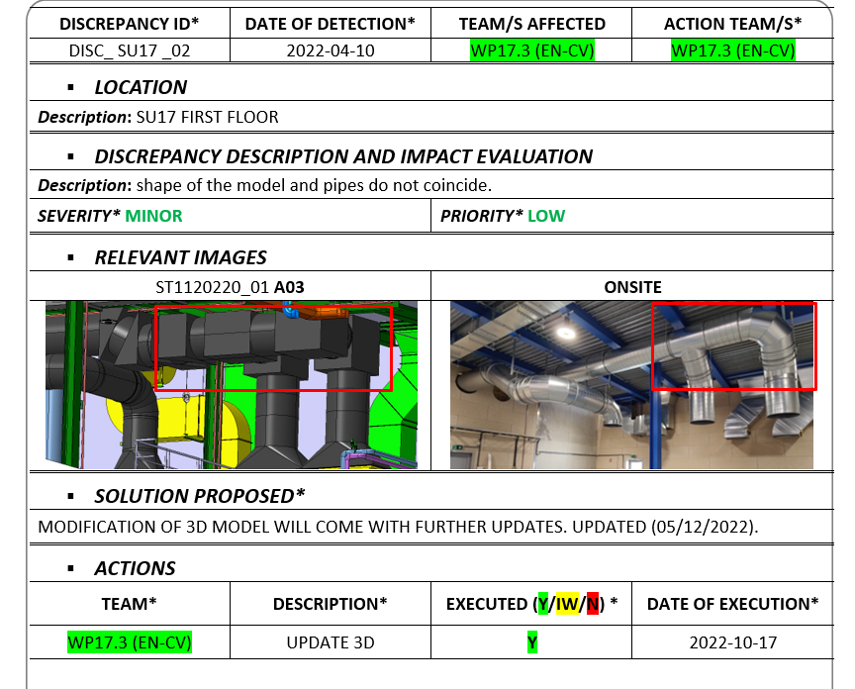
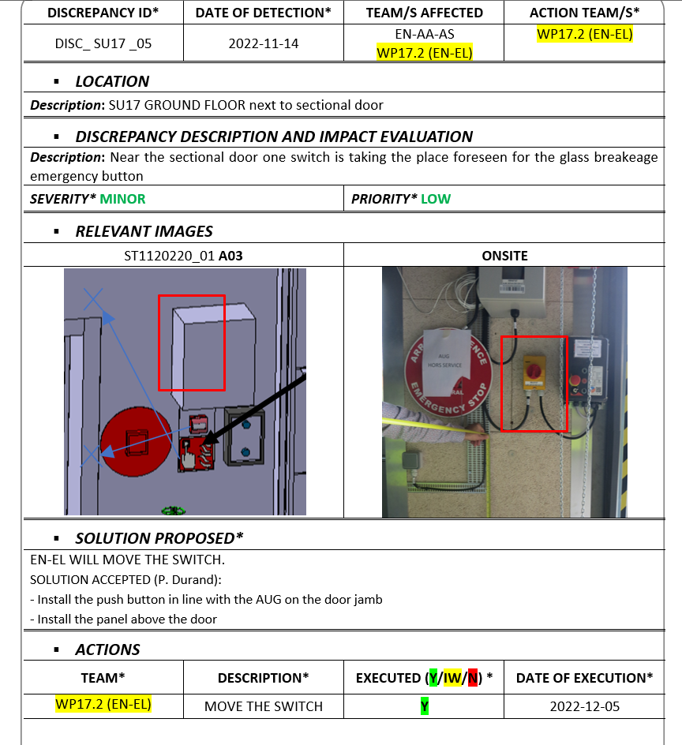
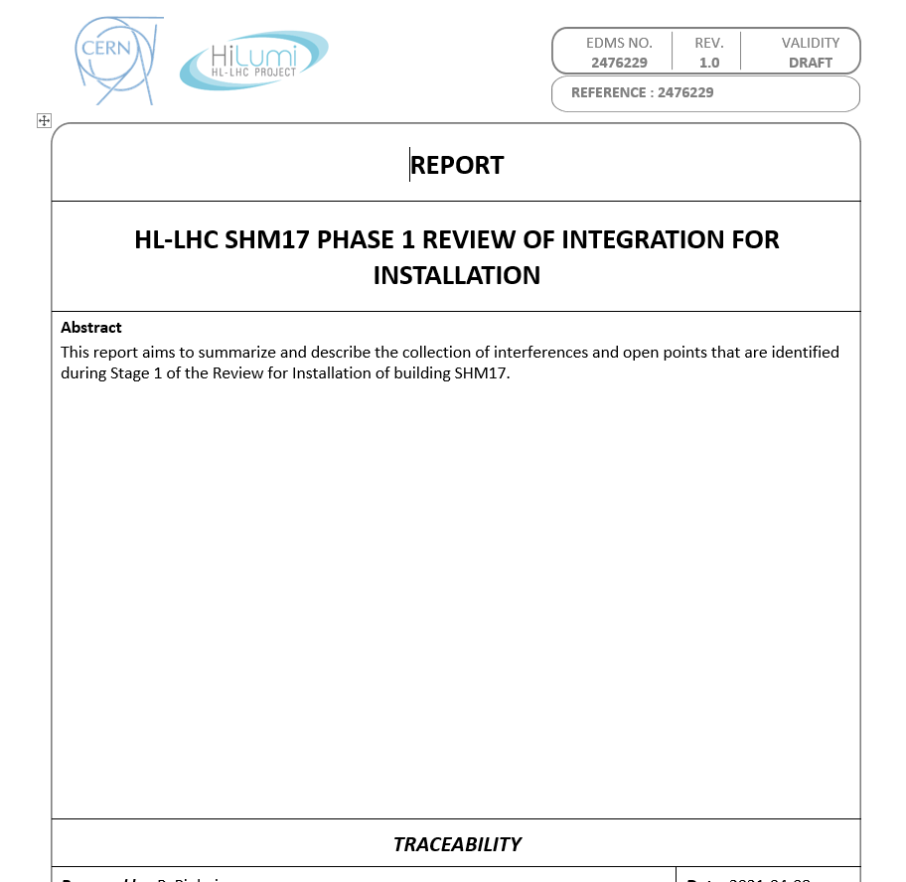
Installation Planning for new surface bldgs.
General services installation started as soon as bldgs. were made available. Installation advancing as planned.
WP15 put in place follow-up meetings (weekly) and documentation to monitor advancement, NC resolution (many!) and validation:
Installation phase will be completed with the release of a 3D-Model “AS BUILT”!
13th HL-LHC Collaboration Meeting – Vancouver, CA 25-28 Sept 2023; M. Modena on HL and LS3 Schedule Plans

Slide 10
Content
Context
Installation Planning for new surface bldgs.
Installation Planning for new underground galleries
Installation Planning for LS3 : LHC Tunnel
Analysis status, open points and main issues
Conclusion
13th HL-LHC Collaboration Meeting – Vancouver, CA 25-28 Sept 2023; M. Modena on HL and LS3 Schedule Plans

Slide 11
Installation Planning for new underground galleries
A first version “in work” for the new underground galleries planning (1st phase) was presented by WP17 at 181st TCC (20/7/23)
Formally, the supervision of the installation will pass from WP17 to WP15 as soon as installation of general services is completed.
A 1st finalized version will be circulated (TCC etc.) in October 2023
As for the surface buildings, installation phase will be completed with the release of a 3D-Model “AS BUILT”!
13th HL-LHC Collaboration Meeting – Vancouver, CA 25-28 Sept 2023; M. Modena on HL and LS3 Schedule Plans

Slide 12
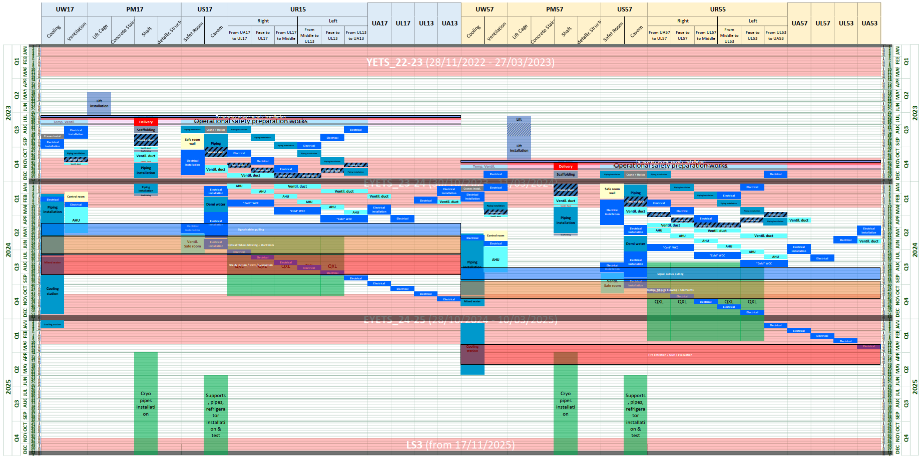
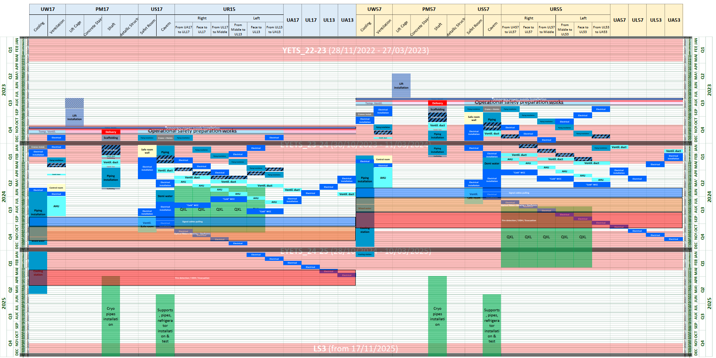
WP17 Underground installation planning
    New strategy adopted
        It was decided to permute lift installation from Point 1 to Point 5 (Plan B)
          Lift installation in PM57 started 8th of May 2023, and commissioning 21st of July 2023
          Lift installation in PM17 restarted 17th of July 2023, and commissioning 3rd of November 2023
Plan A: Point 1 then Point 5
Plan B: Point 5 then Point 1
12
13th HL-LHC Collaboration Meeting – Vancouver, CA 25-28 Sept 2023; M. Modena on HL and LS3 Schedule Plans

Slide 13
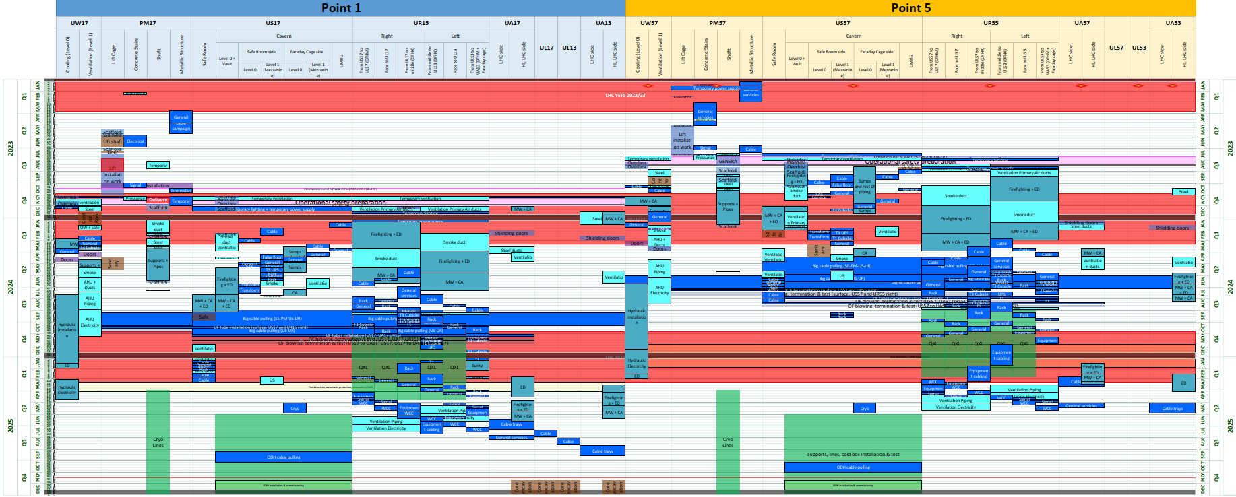
WP17 Underground installation planning LHC-PM-MS-0020 v.3.0
    Updated the installation scenario (swapped Points)
13
13th HL-LHC Collaboration Meeting – Vancouver, CA 25-28 Sept 2023; M. Modena on HL and LS3 Schedule Plans

Slide 14
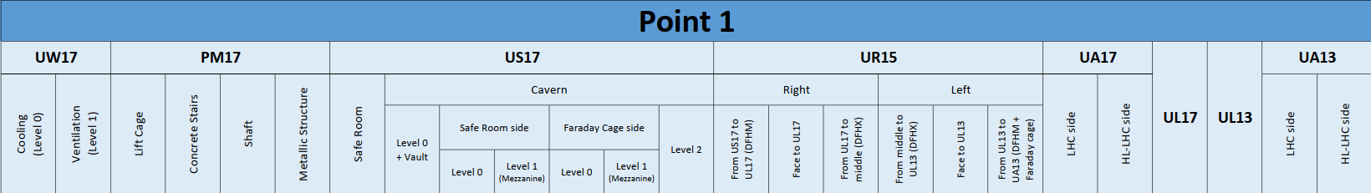
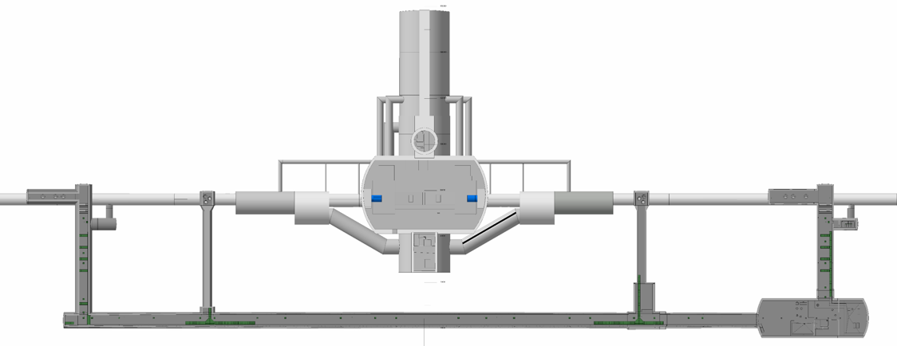
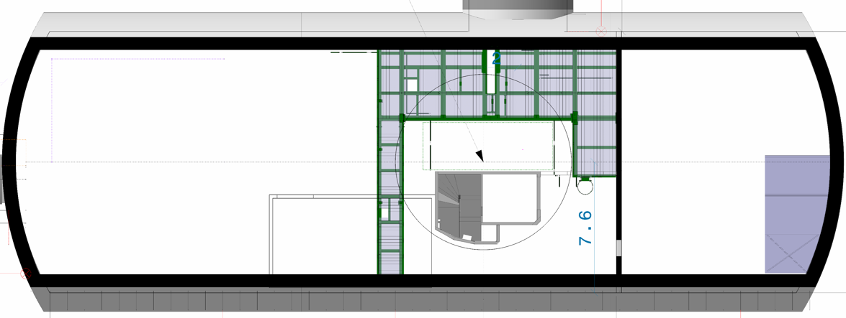

Installation Planning for new underground galleries
13th HL-LHC Collaboration Meeting – Vancouver, CA 25-28 Sept 2023; M. Modena on HL and LS3 Schedule Plans

Slide 15
Content
Context
Installation Planning for new surface bldgs.
Installation Planning for new underground galleries
Installation Planning for LS3 : LHC Tunnel
Analysis status, open points and main issues
Conclusion
13th HL-LHC Collaboration Meeting – Vancouver, CA 25-28 Sept 2023; M. Modena on HL and LS3 Schedule Plans

Slide 16
LS3 Installation planning: status & evolution
We are today at Version-2.0 (EDMS 2400939) to be endorsed with WPs, Groups and mgmt. as new “In-work Baseline” (EDMS doc. will remain “IN WORK”). Pure installation duration estimated in ~3y plus ~6m for commissioning (not including the training quench phase of the last sector)
This Vers-2.0 is the consolidation of Vers-1.3 presented at this 178th TCC (8 June 2023)
(NOTE : in Nov 2022: Vers-1.2 presented at 166th TCC and sent out “for revision”. Received comments analysed and discussed with teams through more than 15 dedicated meetings/discussions)
(NOTE: on Feb 2021: started conjoint studies with EN/ACE-OSS*)
Vers-1.0 was released in Nov 2020 (CSR2020): duration of ~3y (34.5 months) (validated with all Groups → “success oriented” approach)
Vers-0 was released Nov 2019 (CSR2019): HL Schedule : ~4y duration, (“initial estimations” discussed with WPs/Groups)
(NOTE: at the start of the Project, duration of HL-LHC installation was fixed “a priori” to 2.5y)
LS3 planning will continuously evolve, mainly due to the inclusion of all other activities and projects planned for LS3 (Injectors upgrades, standard LHC maintenance, exceptional LHC maintenance (e.g. Beam Screen treatments), resource smoothing with NACONS, etc...)
*ACE-OSS in charge of coordinating and scheduling of consolidation, upgrade, installation, maintenance and repair activities for the LHC and its injectors during programmed stops (long shutdowns and technical stops), as well as for providing planning support for projects.
13th HL-LHC Collaboration Meeting – Vancouver, CA 25-28 Sept 2023; M. Modena on HL and LS3 Schedule Plans

Slide 17
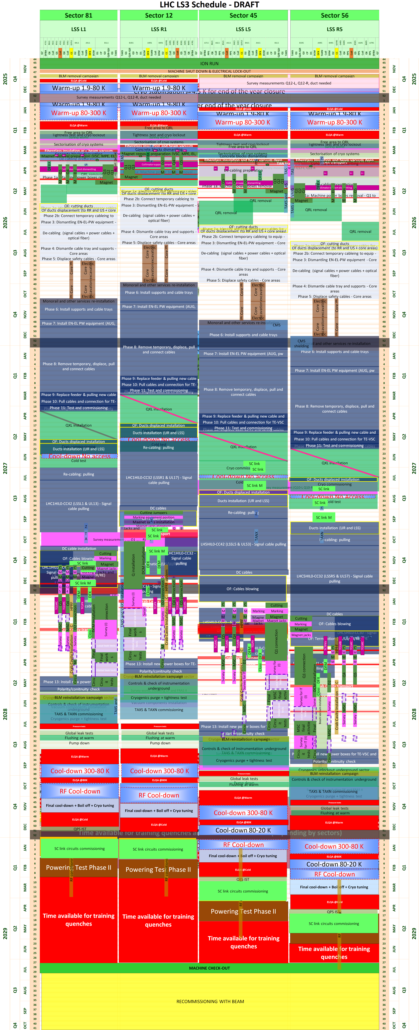
LS3 Planning for LHC Tunnel EDMS 2400939
LS3 Schedule – September 2023, Ver.-2.0
Sector 81
Sector 12
Sector 45
Sector 56
LSS L1
LSS R1
LSS L5
LSS R5
Warm-up and related tests (Nov’25 to Mar’26)
25
25
2026
2026
LSS dismantling after cryo lockout (Mar’26 to Jul’26)
Cabling dismantling
(May’26 to Oct’26)
Core excavation (LHC side)
(Aug’26 to Dec’26)
2027
2027
Cabling installation
(Oct’26 to Feb’28)
2028
2028
LSS installation (Mar’27 to Sep’28)
Note: a presentation of the LS3 Planning Vers-2 is scheduled at the TCC of 5th October!
Cool-down, related test and HWC (from Aug’28)
2029
2029
13th HL-LHC Collaboration Meeting – Vancouver, CA 25-28 Sept 2023; M. Modena on HL and LS3 Schedule Plans

Slide 18
Content
Context
Installation Planning for new surface bldgs.
Installation Planning for new underground galleries
Installation Planning for LS3 : LHC Tunnel
Analysis status, open points and main issues
Conclusion
13th HL-LHC Collaboration Meeting – Vancouver, CA 25-28 Sept 2023; M. Modena on HL and LS3 Schedule Plans

Slide 19
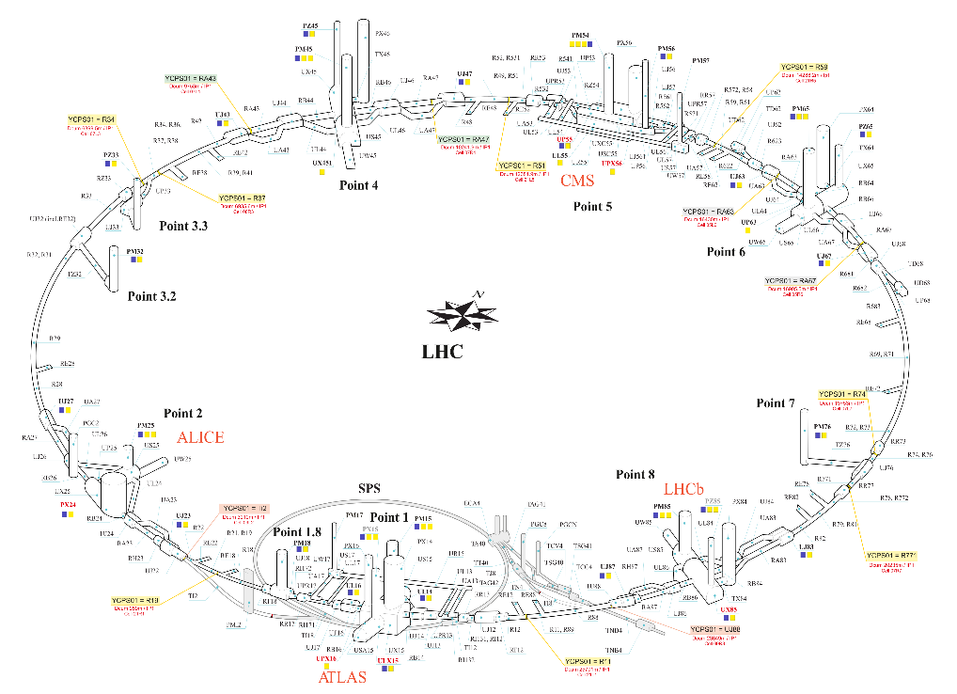
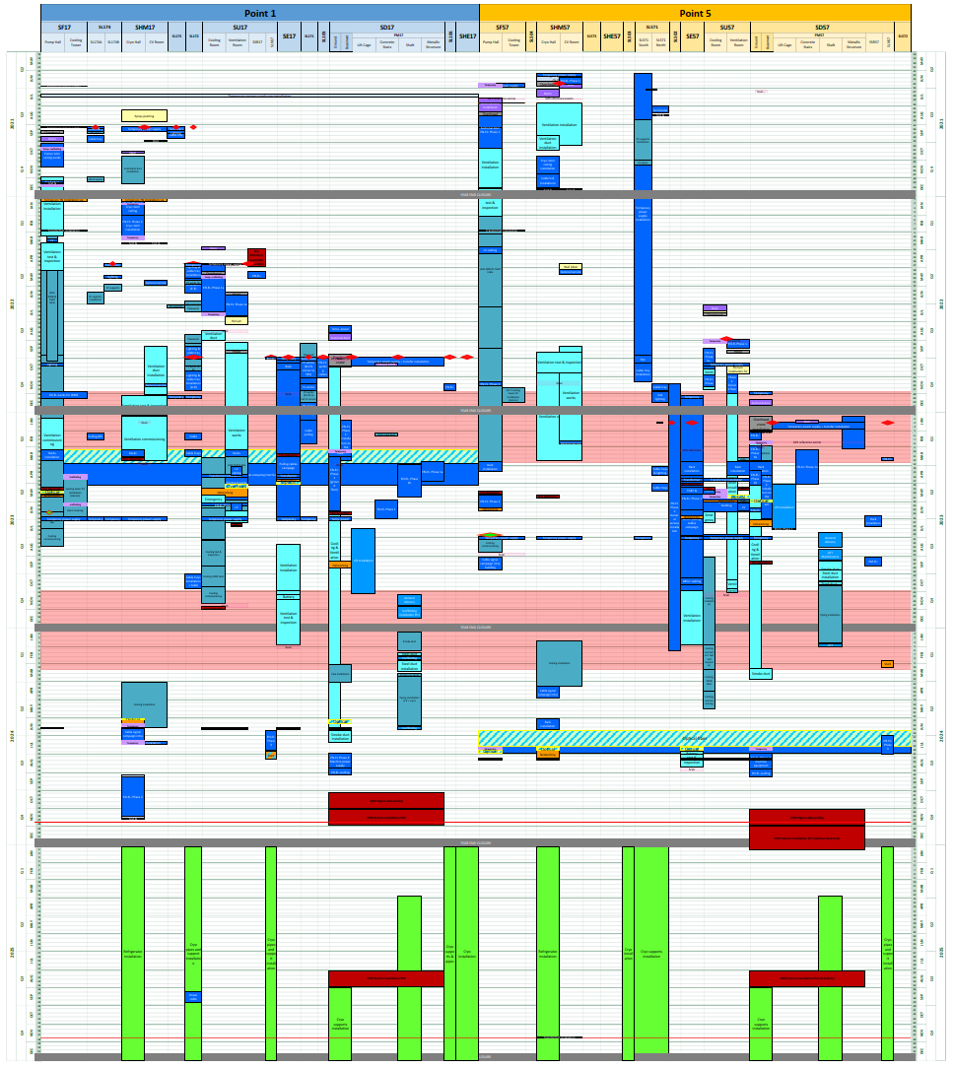
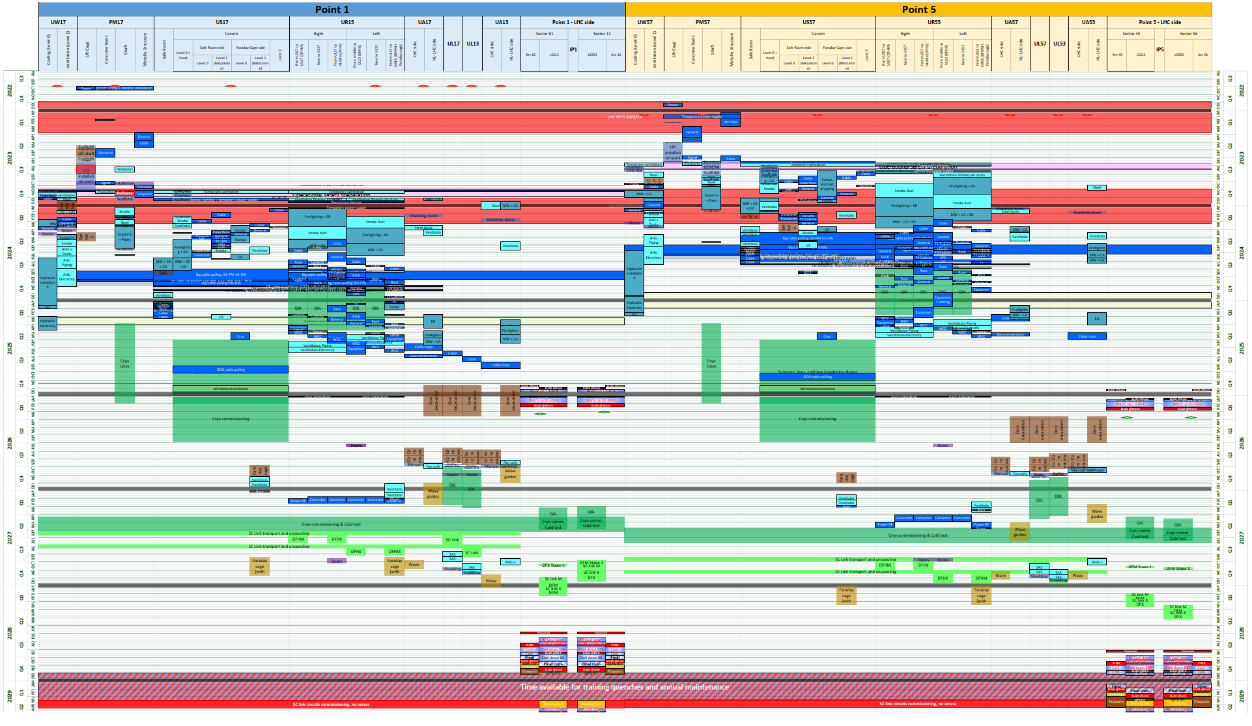
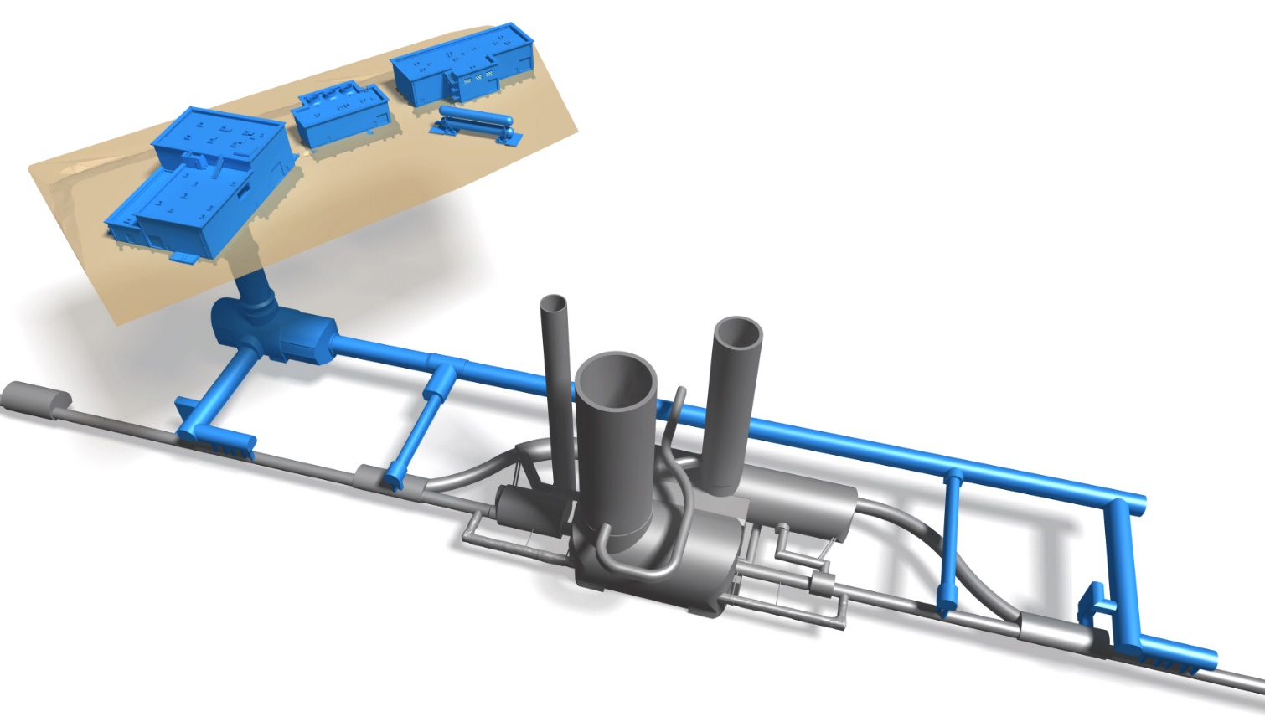
HL-LHC Run3+LS3 schedule
HL-LHC surface facilities
Point 1
Point 5
HL-LHC underground galleries
2021
2021
2022
2022
22
22
2023
2023
2023
2023
2024
2024
2024
2024
LHC LS3 schedule
2025
2025
2025
2025
s12
s23
s45
s56
s81
s34
s67
s78
25
25
2026
2026
2026
2026
LS3 start
2027
2027
2027
2027
2028
2028
2028
2028
29
29
2029
2029
13th HL-LHC Collaboration Meeting – Vancouver, CA 25-28 Sept 2023; M. Modena on HL and LS3 Schedule Plans

Slide 20
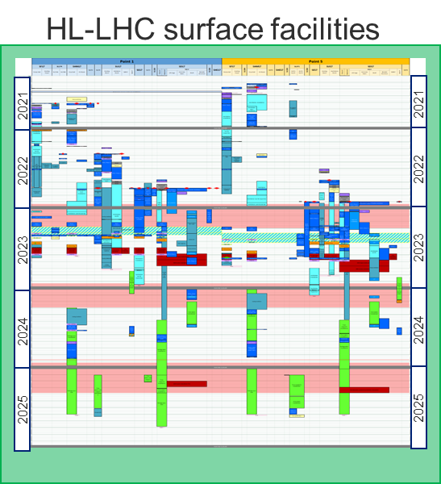
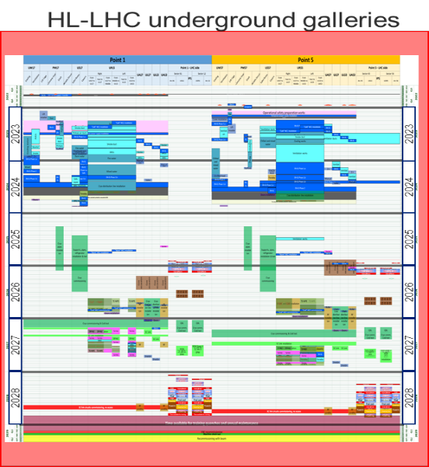
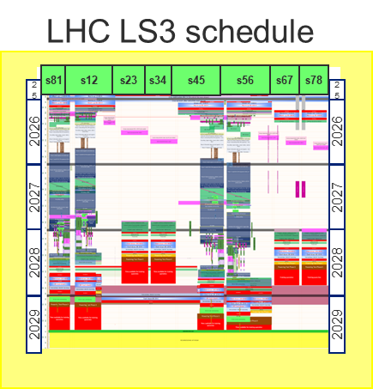
LHC Run3+LS3 preliminary draft schedule
HL-LHC/LHC Master Schedule
Teams will alternate between P1 & P5,
to optimise resources and manage co-activities
2022
2023
2024
2025
2026
2027
2028
2029
RUN4 (starting w/ machine check-out)
Cooling and ventilation systems for HL facilities
HL LHC surface facilities
Electrical distribution & power for HL facilities
Cryogenics
HL-LHC underground galleries
Technical infrastructure
Cores?
Cores?
Cryogenics, power converters, SC links, machine protection...
RUN 3
Warm-up
Cores
Deinstallation and installation
HL-LHC in the LHC tunnel
(De-)cabling
Cool-down
Commissioning
Training Quench & Annual Maintenance
13th HL-LHC Collaboration Meeting – Vancouver, CA 25-28 Sept 2023; M. Modena on HL and LS3 Schedule Plans

Slide 21
LS3 schedule analysis and open points
Some comments on Version 2.0:
The study advanced further (with >30 meetings hold since Nov2022) in order to explore further optimisations.
To be remarked in particular:
  EN-EL: considering the global presence on the field during LS3, they are the primary actors:
    De-cabling and cabling (including cables trays, lightening, electrical boards, etc.) is the largest activity in terms of equipment volume treated and areas covered.
    Upon request of the Project, EN-EL has confirmed the possibility to widely utilize double-shift for its activities during LS3
  TE-VSC: is intervening everywhere in all HL regions for:
    the (present) beam Vacuum Sectors de-/installation and installation of the new ones,
    plus all the interventions in support of other teams (e.g. insulation vacuum of magnets, CC, DFHX/M, TDE, etc.),
    plus in standard LHC and other projects (e.g. Beam Screen treatments)
  With these 2 Groups we have now a more solid and agreed evaluation of the duration of activities.
  Consolidated as well the magnets/SClinks transport and installation (with TE-MSC and EN-HE). The SClinks installation is the most difficult to be evaluated (→ but we should soon profit from the STRING experience)
  A key point of further improvement: agreement on activities cohabitation (e.g. during the EN-EL installation phases, during the magnets interconnection activities, etc.)
13th HL-LHC Collaboration Meeting – Vancouver, CA 25-28 Sept 2023; M. Modena on HL and LS3 Schedule Plans

Slide 22
LS3 schedule analysis and open points
Some comments on Version 2.0:
Version-2.0 now includes the mandatory “End-of-LS LHC maintenance” needs:
  Maintenance mandatory as for any other standard LHC LS and shut-down (it will cover: CV, CRYO, EL installations – AUG tests - and many other subsystem checks/maintenance)
  End-of-LS3 LHC maintenance has to adapt due to the presence of new HL Plants (with pro&contra)
  The analysis and planning of the “End-of-LS LHC maintenance” phases is in mandate of EN/ACE-OSS.
  HL-LHC will contribute with the analysis of required maintenance for the new HL installations (CRYO, EN-CV, EN-EL)
  The analysis has started and is ongoing! Since this maintenance phase for 4 Sectors is deeply embedded with the installation and (re)commissioning phases, it is essential to optimize these 3 phases together!
The impact of the cores excavation is still to be analysed and consolidated, since we are at the moment missing technical information (MS for cores excavation just completed; IT will be sent out in Oct 2023)
The “homework” asked now to WPs and Groups is to perform a resource evaluation & resource-smoothing based on Vers-2.0 and bring to the Project and to the CERN Management which mitigation actions (and at which cost) could be studied and put in place on those aspects.
As mentioned, Version-2.0 shows an overall HL duration slightly longer with respect to previous version and to nominal LS3+commissioning duration→ keep-on pursuing the LS3 phases optimization with all HL-WPs and CERN Groups and Services in order to optimize the duration!
13th HL-LHC Collaboration Meeting – Vancouver, CA 25-28 Sept 2023; M. Modena on HL and LS3 Schedule Plans

Slide 23
Content
Context
Installation Planning for new surface bldgs.
Installation Planning for new underground galleries
Installation Planning for LS3 : LHC Tunnel
Analysis status, open points and main issues
Conclusion
13th HL-LHC Collaboration Meeting – Vancouver, CA 25-28 Sept 2023; M. Modena on HL and LS3 Schedule Plans

Slide 24
CONCLUSION:
HL Installation has started and is advancing as planned!
  → new surface bldgs. → new underground galleries …then→ LHC Tunnel
  This will be a continuous process through RUN3, EYETS and finally LS3
LS3 Planning studies are on-going with the release of a new Version-2.0
  Consolidating duration estimation of all phases with Groups/WPs
  Starting to add LHC consolidations, other projects, resource allocation analysis, etc.
  Still “light” on some technical evaluation/impact (i.e. cores excavation)
  Global duration vs. LS3 expected length is still critical point under analysis: we still miss some important information (e.g. other consolidation projects in LHC and others).
A key point will now be the resources evaluation & smoothing to be done with/by the WPs and Groups.
THANKS for the ATTENTION!
13th HL-LHC Collaboration Meeting – Vancouver, CA 25-28 Sept 2023; M. Modena on HL and LS3 Schedule Plans

Slide 25
Extra slides
13th HL-LHC Collaboration Meeting – Vancouver, CA 25-28 Sept 2023; M. Modena on HL and LS3 Schedule Plans

Slide 26
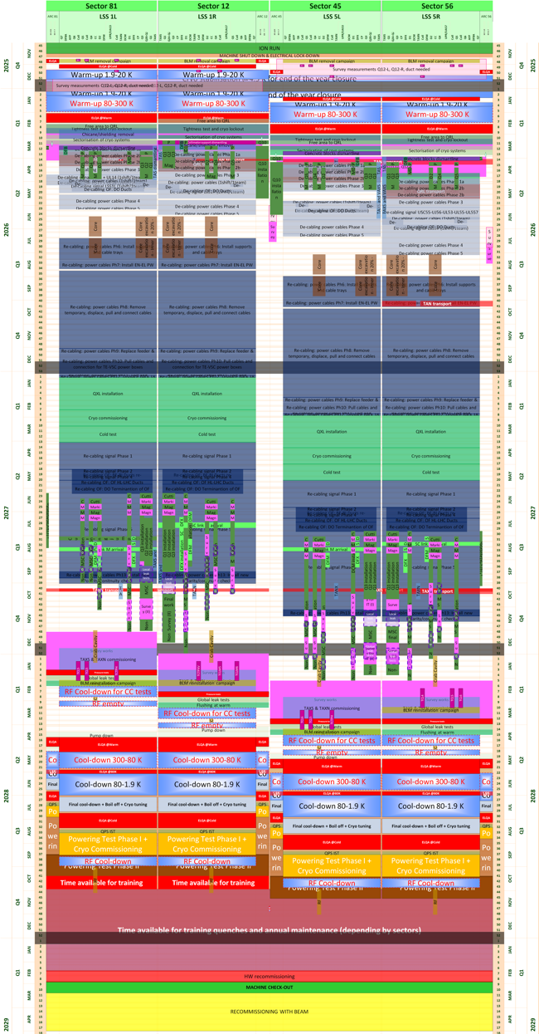
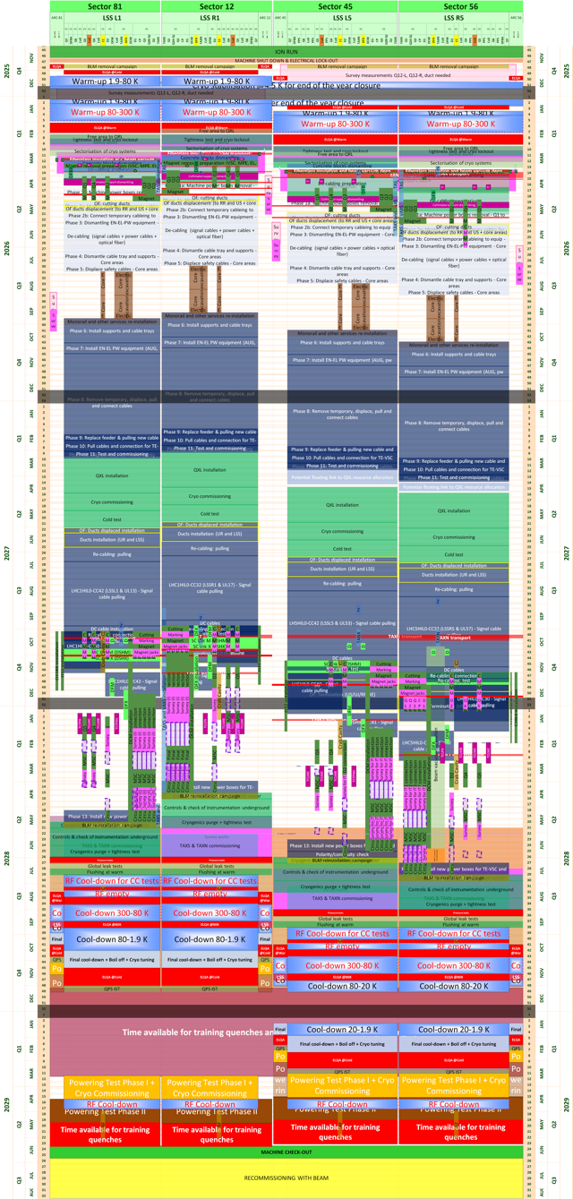
LS3 Planning for LHC Tunnel EVOLUTION EDMS 2400939
LS3 Schedule – TCC Nov 2022, Ver.-1.2
LS3 Schedule – TCC June 2023, Ver.-1.3
LS3 Schedule – September 2023, Ver.-2.0
Sector 81
Sector 12
Sector 45
Sector 56
Sector 81
Sector 12
Sector 45
Sector 56
Sector 81
Sector 12
Sector 45
Sector 56
LSS L1
LSS R1
LSS L5
LSS R5
LSS L1
LSS R1
LSS L5
LSS R5
LSS L1
LSS R1
LSS L5
LSS R5
25
25
25
25
2026
2026
2026
2026
2027
2027
2027
2027
2028
2028
2028
2028
Note: a presentation of the LS3 Planning Vers-2 is scheduled at the TCC of 5th October!
2029
2029
2029
2029
13th HL-LHC Collaboration Meeting – Vancouver, CA 25-28 Sept 2023; M. Modena on HL and LS3 Schedule Plans

Slide 27
LS3 Planning for LHC Tunnel EVOLUTION EDMS 2400939
Sector 81
Sector 12
Sector 45
Sector 56
LSS L1
LSS R1
LSS L5
LSS R5
Sector 12
Sector 81
Sector 12
Sector 45
Sector 56
Sector 81
Sector 45
Sector 56
LSS L1
LSS R1
LSS L5
LSS R5
LSS L1
LSS R1
LSS L5
LSS R5
2028
2028
2028
2028
2029
2029
2029
2029
Powering Tests Phase II end Nov’28
Powering Tests Phase II end May’29
Powering Tests Phase II end in Jun’29
Note: a presentation of the LS3 Planning Vers-2 is scheduled at the TCC of 5th October!
13th HL-LHC Collaboration Meeting – Vancouver, CA 25-28 Sept 2023; M. Modena on HL and LS3 Schedule Plans

Slide 28
Sector 12
Sector 45
Sector 56
Sector 81
Sector 23
Sector 34
Sector 67
Sector 78
LHC LS3 Schedule
Critical path
25
25
2026
2026
Warm-up & test
de-cabling
core excavation
cabling
LSS reinstallation
→ Cool-down &
test & recommissioning
2027
2027
2028
2028
2029
2029
13th HL-LHC Collaboration Meeting – Vancouver, CA 25-28 Sept 2023; M. Modena on HL and LS3 Schedule Plans

