Slide 1
First Year of Operation of the MKI-Cool
M.J. Barnes
Acknowledgements:
C. Bracco, W. Bartmann, O. Bjorkqvist, M. Diaz, L. Ducimetière, Y. Dutheil, G. Favia, B. Goddard,
T. Kramer, T. Maurin, V. Namora, A. Porret, D. Standen, T. Stadlbauer, P. Trubacova, L. Vega Cid,
V. Vlachodimitropoulos, W. Weterings

Slide 2
Outline
Context
  MKI purpose and design
  Cr₂O₃ coating
  Damping element and MKI cool
First year of operation
  Vacuum
  Temperature
Looking forward
  RF damper
  Alumina tubes
Provisional planning for future MKI Cool installations in the LHC
Conclusions

Slide 3
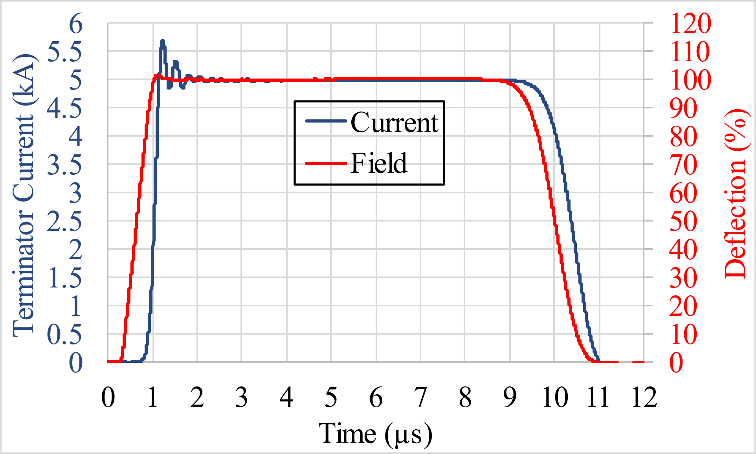
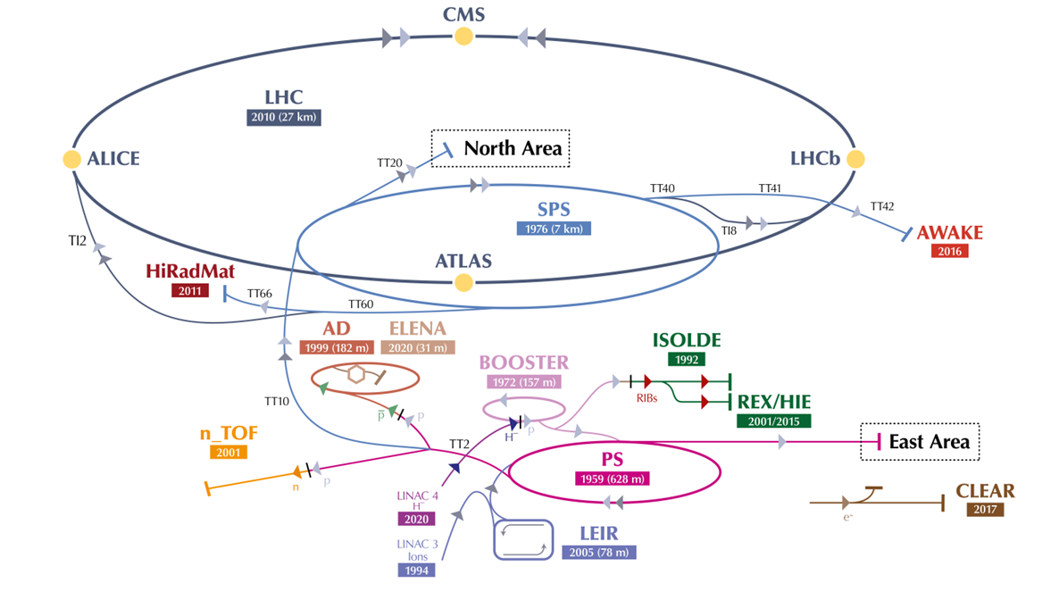
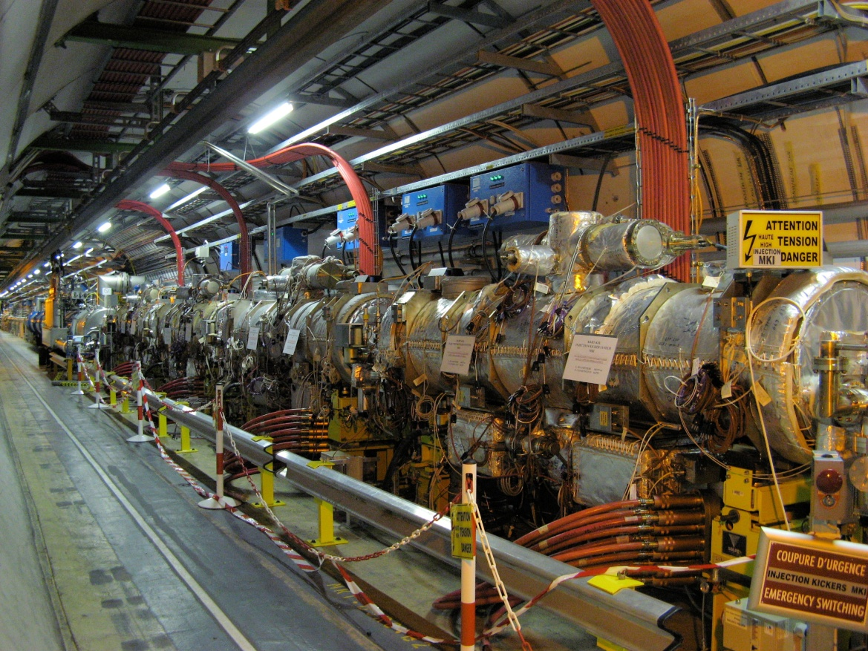
Context
MKI: Injector kicker magnets for the LHC
Typical MKI pulse:
LHC anti-clockwise injection (4 MKI magnets)
Point 2
Point 8
Vacuum Interconnect to Quadrupole Q5
Point 8
LHC clockwise injection (4 MKI magnets)
MKI8A
MKI8B
MKI8C
MKI8D
Beam 2 direction

Slide 4
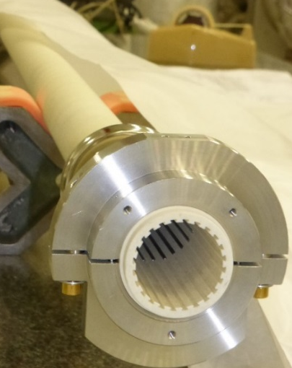
Context
Screen conductors inside MKI
Alumina tube
(installed in MKI)
Screen conductors carry image current of circulating beam
        ⇓
Reduce beam induced heating
Conductors are supported and electrically insulated by alumina tube (high SEY)
2017-18 YETS upgrade of MKI8D: alumina tube coated on the inside with Cr₂O₃:
  has a low Secondary Electron Yield (SEY)
  does not produce dust in the vacuum system
  is beneficial for high voltage issues
Alumina tube
Slots on the tube, to insert screen conductors
Injected/
circulating beam
MKI magnet
Vacuum tank
Injected/
circulating beam
24 screen conductors
(one each 15 degrees, since LS1)

Slide 5
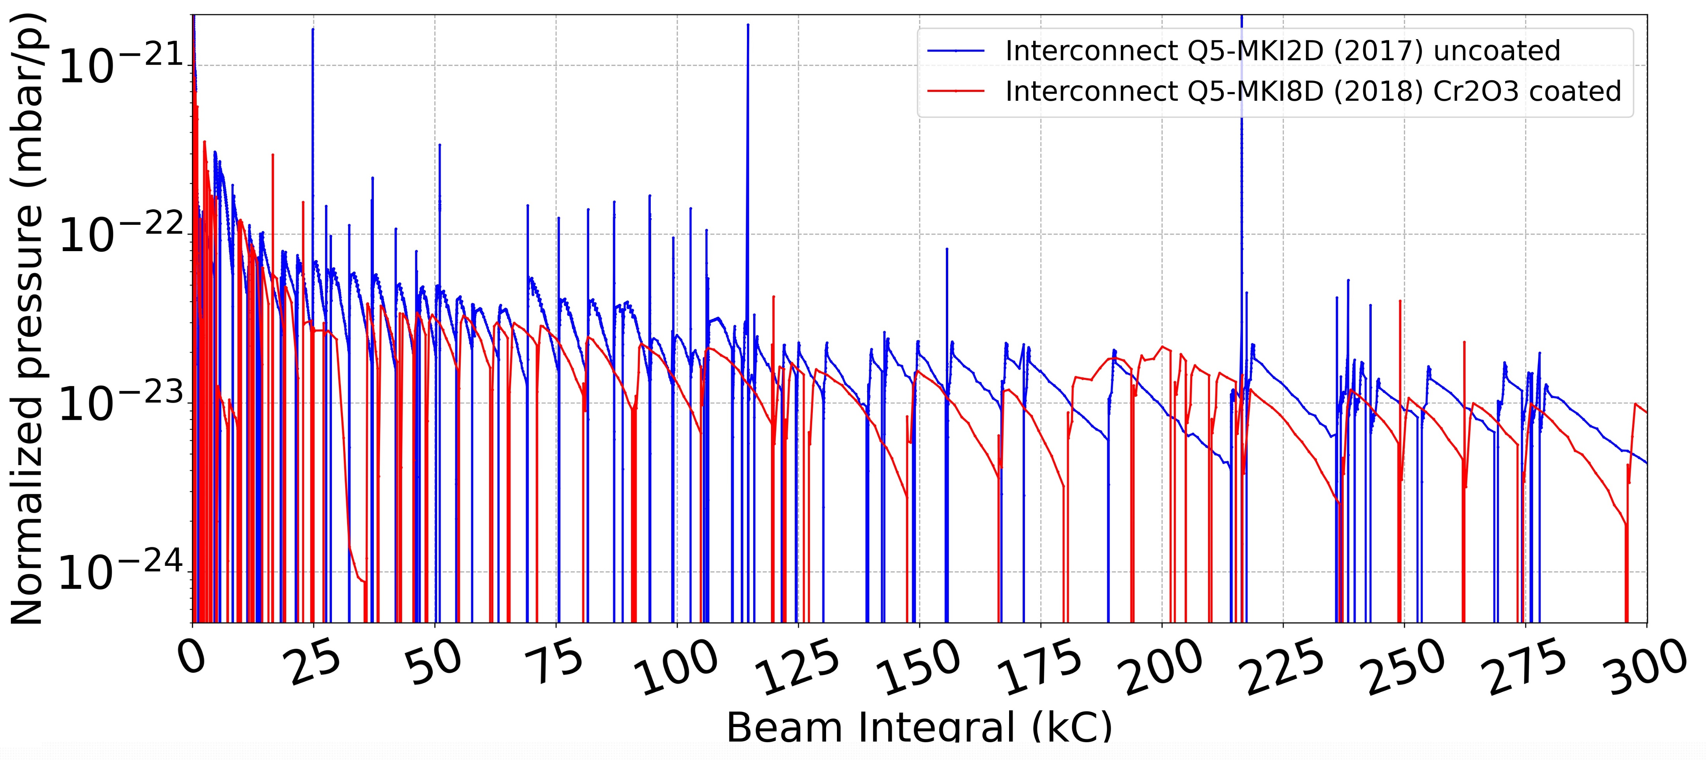
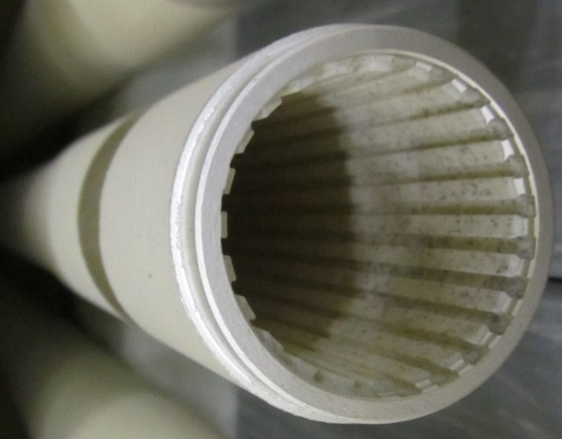
Context
Cr₂O₃ coating of MKI8D alumina tube, installed during YETS 2017/18
Before installation:
Pressure in Q5-MKI8D vacuum interconnect was a factor of ∼3 (2012, 2015 and 2017) to ∼12 (2016) higher than that of Q5-MKI2D [first MKI2 to see beam]
After installation:
The factor of 3-12 is not observed anymore in Q5-MKI8D.
No other vacuum modifications were done: pressure reduction is attributed to Cr₂O₃ coating 👍
Alumina tube with Cr₂O₃ coating on the inside

Slide 6
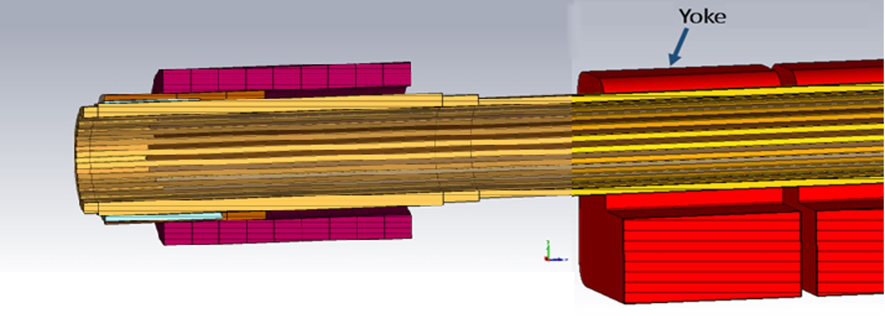
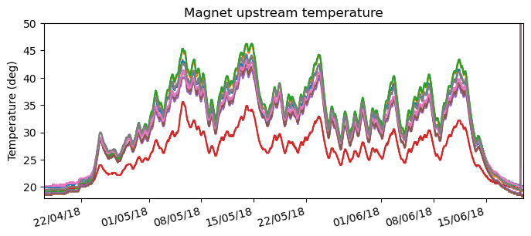
Context
Damping element of upgraded MKI8D: the origin of MKI-Cool
Screen conductors
Redesigned metallization and ferrite rings (damper), on the alumina tube outside of the magnet aperture
  Reduces beam induced power deposition and re-locates it from the ferrite yoke to the damper
Damper is not at pulsed high voltage
  Easier to cool !
Conductive sleeve
Injected/circulating beam
Metallization
Alumina tube
(ΔT_{MKI8D})/(ΔT_{MKI8_Post-LS1}) ≈ 0.6
Damper
(ferrite rings exposed to beam)
Magnet
Post-LS1 design
Upgraded MKI8D: lower heating of ferrite yoke

Slide 7
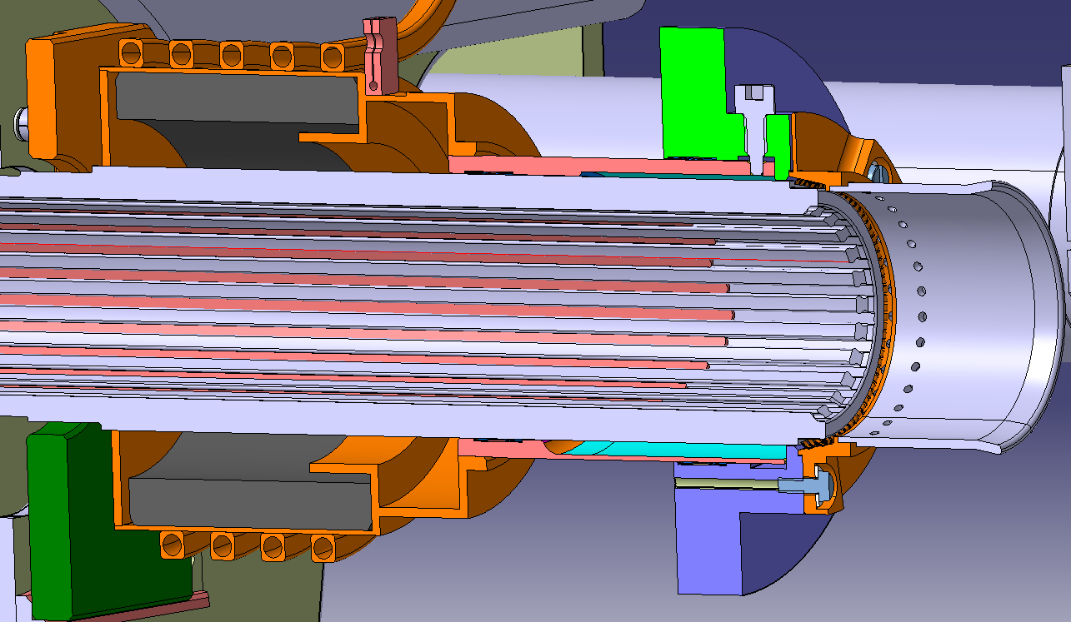
Context
MKI-Cool = damping element + water cooling
Pipes for water cooling
Redesigned metallization and ferrite rings (damper) reduces beam induced power and re-locates it from ferrite yoke to damper
BUT, with HL-LHC beam, an uncooled RF damper would reach its Curie temperature, and thus would no longer re-locate losses from the ferrite yoke → yoke temperature would increase
MKI-Cool: water cooling of the RF damper to remove heat
Metallization
Beam
Screen conductors
Alumina tube
Damper
(ferrite ring)
Magnet

Slide 8
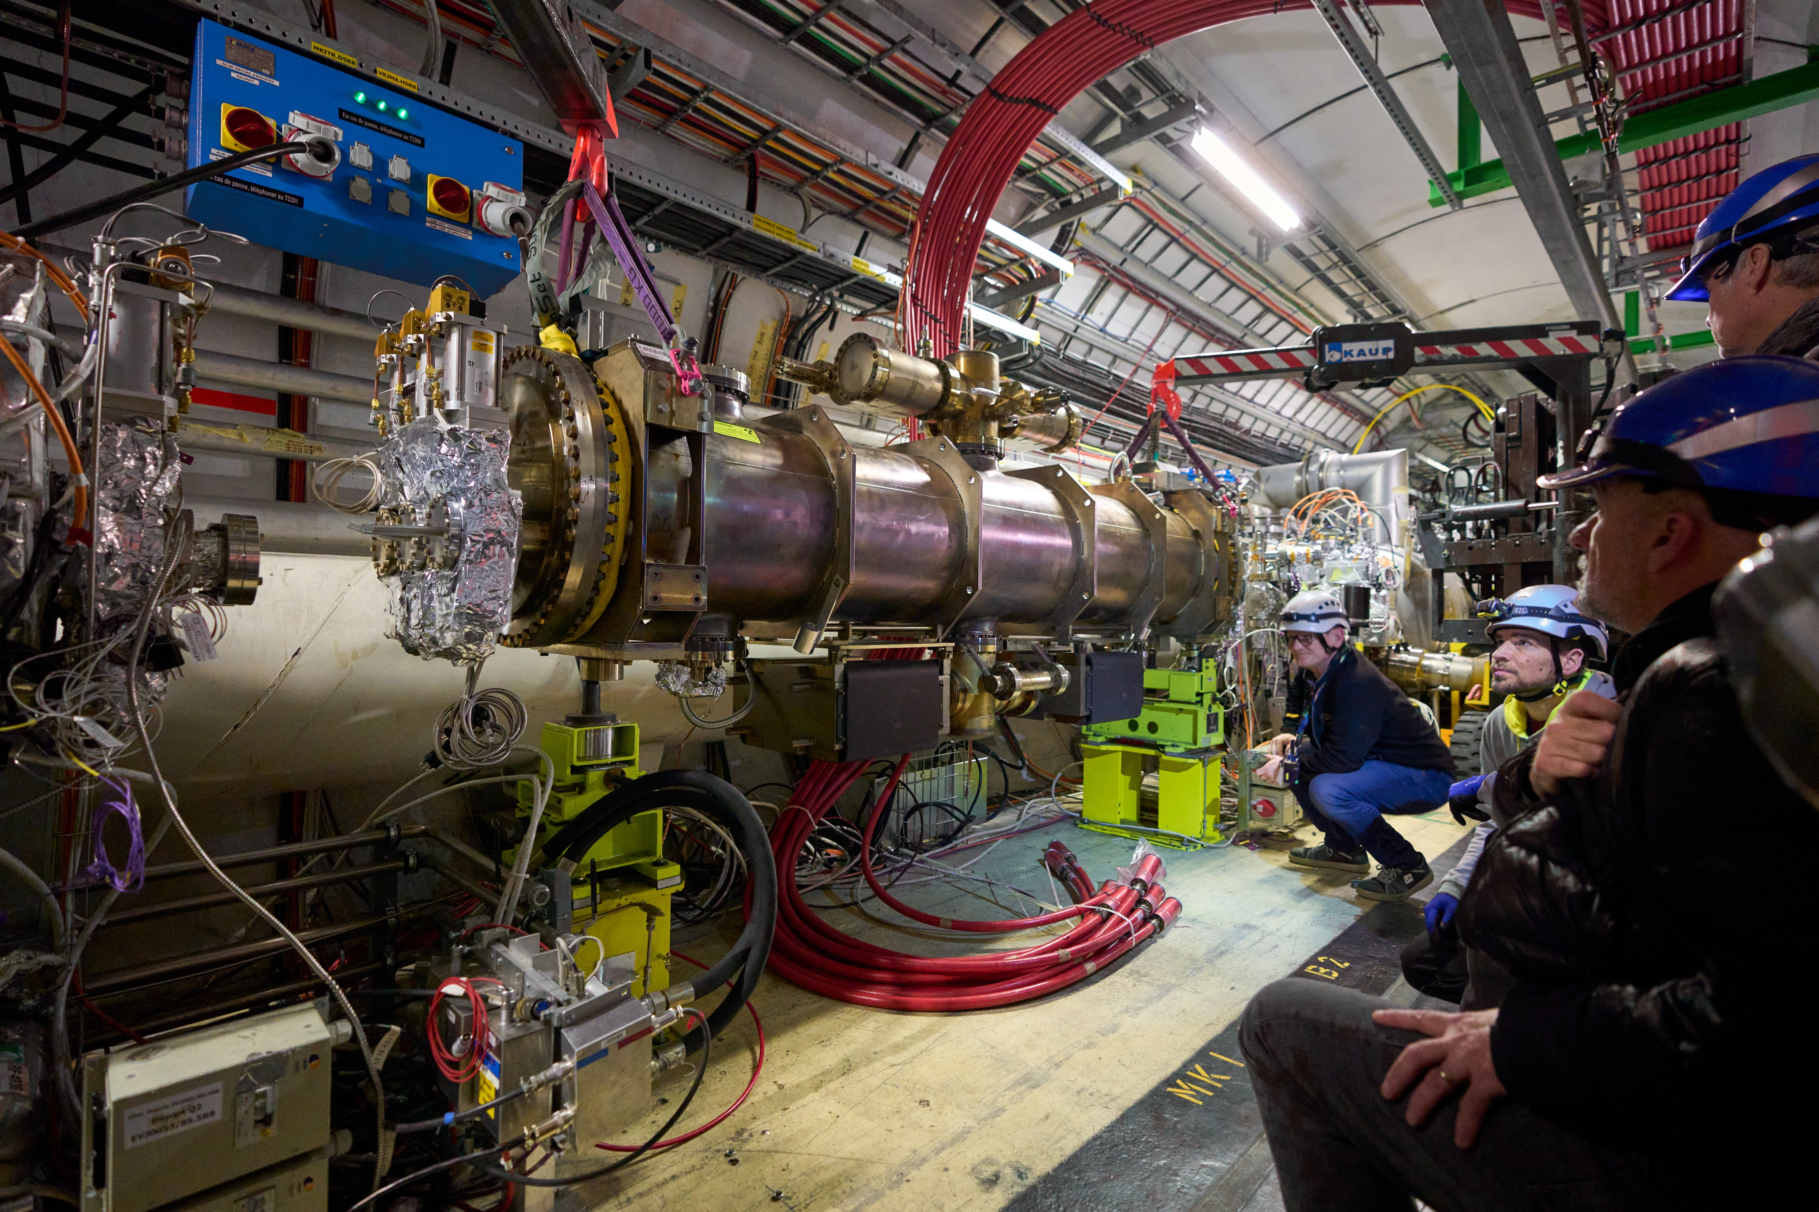
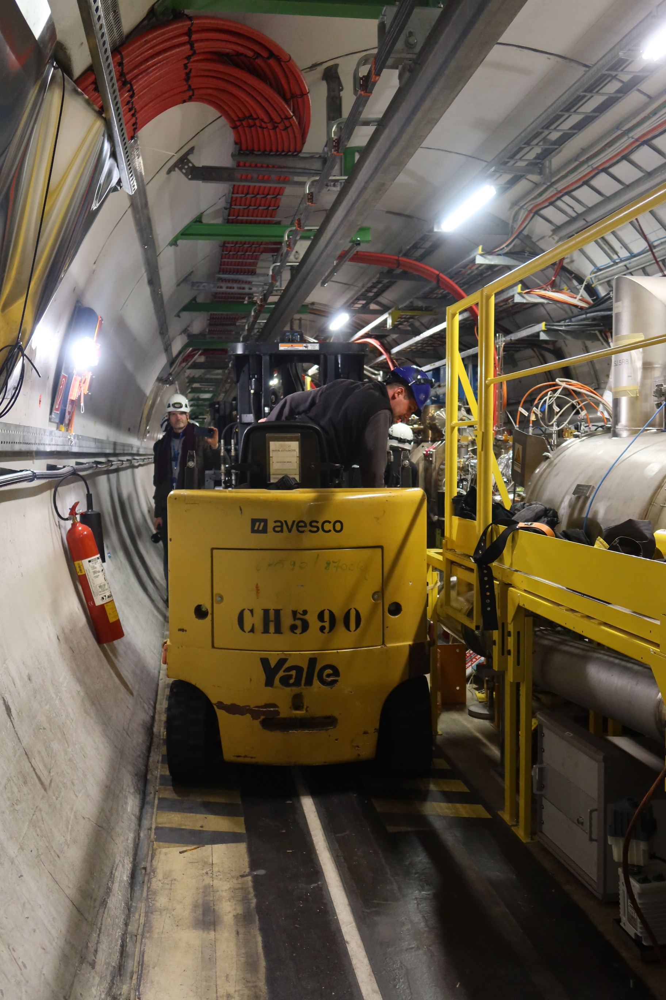
First MKI-Cool: installed in LHC during YETS 2022/23
MKI cool in test cage
MKI-Cool installed at location MKI8D (exchanged for, prototype, upgraded MKI8D)

Slide 9
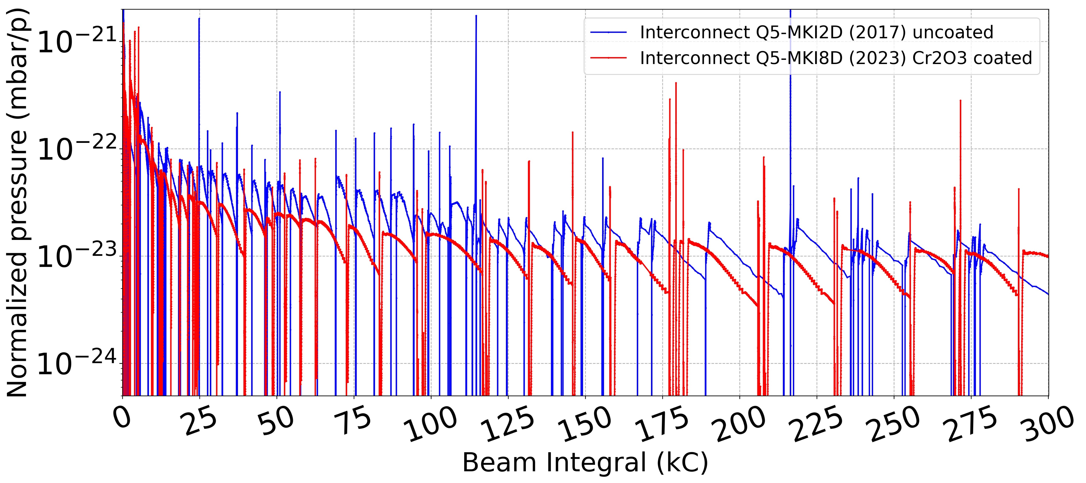
MKI-Cool operation in LHC during 2023 - Vacuum
Dynamic pressure:
Cr₂O₃ coated tube of MKI-Cool exhibited rapid conditioning with beam 👍
Q5-MKI2D
MKI-Cool
As per upgraded MKI8D installed during YETS 2017/18:
pressure reduction attributed to Cr₂O₃ coating, of alumina tube, also seen for MKI-Cool 👍

Slide 10
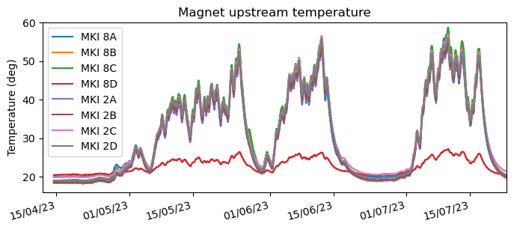
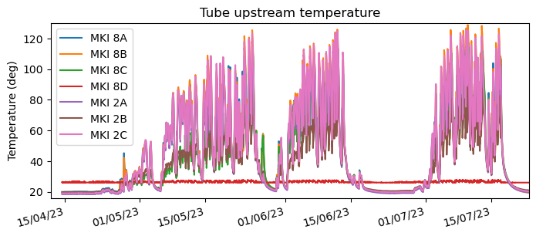
MKI-Cool operation in LHC during 2023 - Temperature
(ΔT_{MKI-Cool})/(ΔT_{MKI8_Post-LS1}) ≈ 0.17
(ΔT_{MKI-Cool})/(ΔT_{MKI8_Post-LS1}) ≈ 0.02
ΔT=40˚C
Post-LS1 design
Post-LS1 design
MKI Cool
ΔT<7˚C
MKI Cool
MKI-Cool shows significant reduction in measured temperatures 👍
Magnet upstream measured temperature rise of MKI-Cool < 20% of post-LS1 designs
Tube upstream measured temperature rise of MKI-Cool < 2% of post-LS1 designs
For HL-LHC ultimate beam parameters, expected beam induced power will be a factor of <5 greater than for above: no heating issues expected for the MKI-Cool.

Slide 11
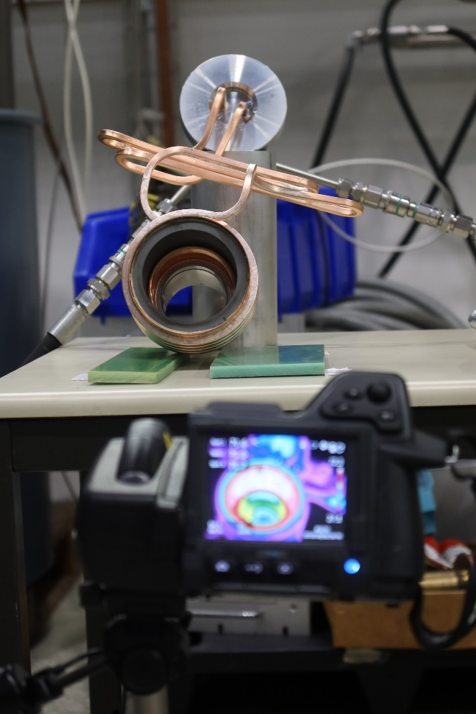
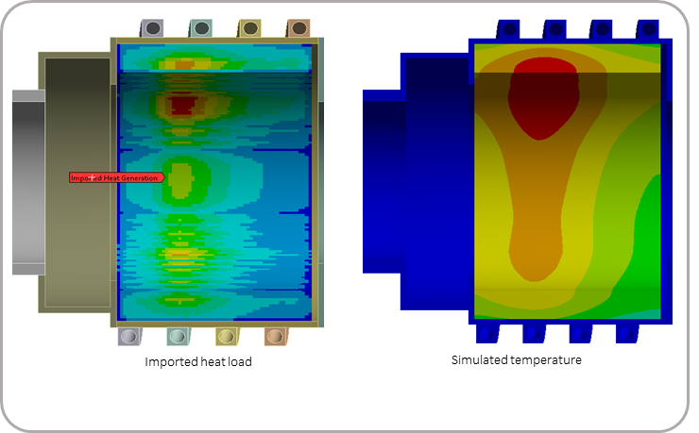
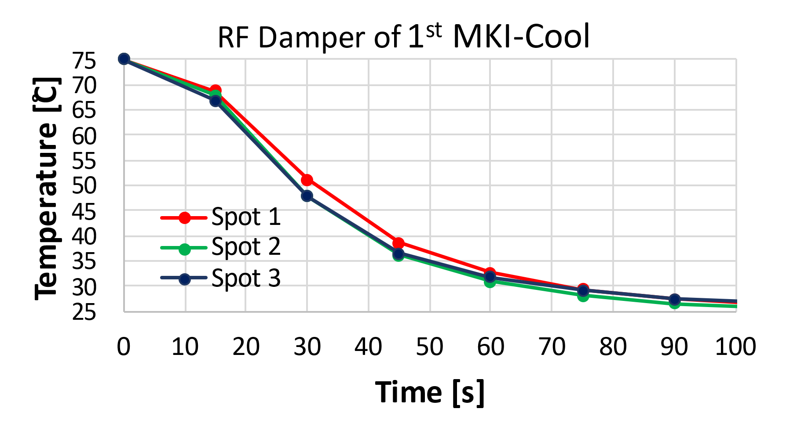
MKI-Cool RF Damper
Good thermal contact of interface between ferrite and copper cylinder & cooling circuits is essential to:
Limit maximum temperature of ferrite
Limit mechanical stress in ferrite
Hence, ferrite and copper cylinder are vacuum brazed.
Transient thermal measurements carried out to determine Thermal Contact Conductance (TCC) of brazing [TCC required: ≥ 1000 W/(m²⋅K)]:
ANSYS: imported head load
ANSYS: predicted temperature
Thermal contact measurement
1st MKI-Cool RF damper: Tcc ~3000 👍
Original prototype RF damper: Tcc ~1100 (to be used in 2nd MKI-Cool) 👍
Recent production of RF dampers: Tcc ~400 👎
Studies ongoing to rectify brazing issues @ CERN. Also, discussions with industry

Slide 12
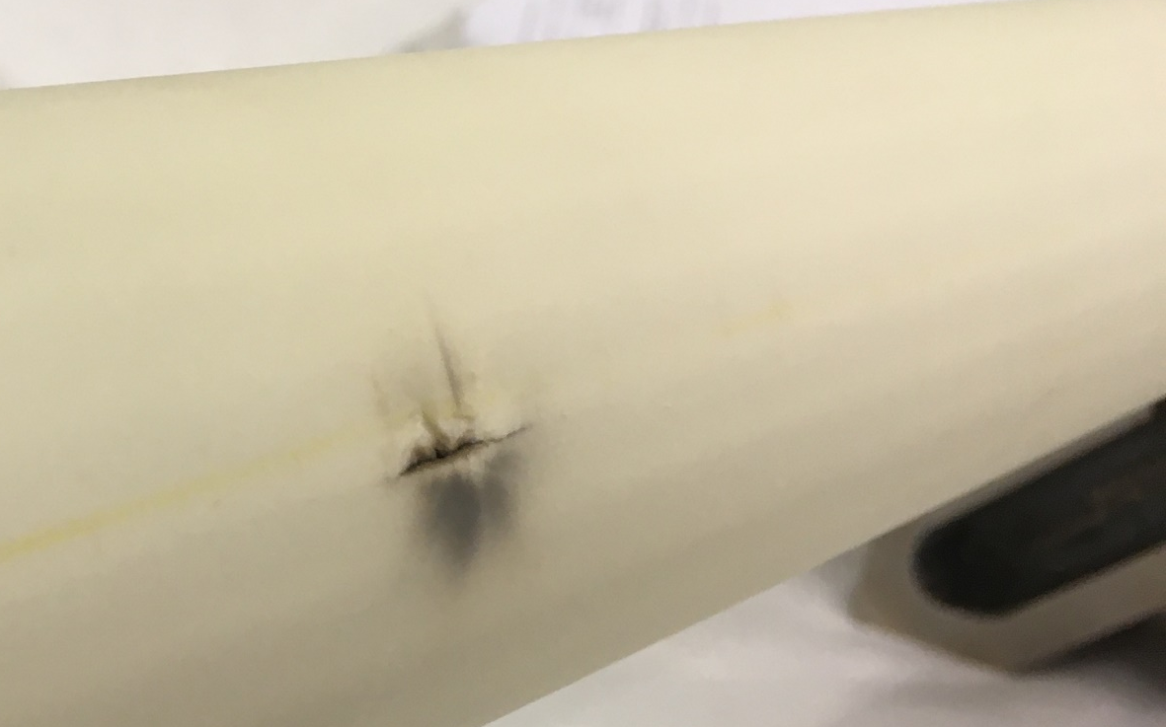
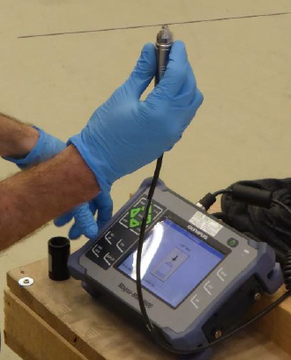
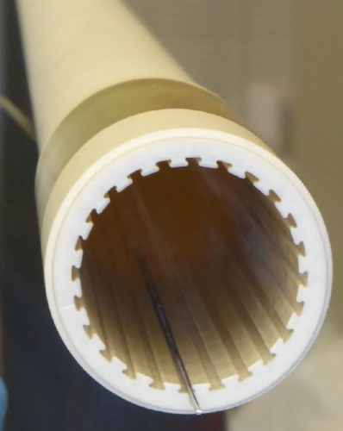
MKI-Cool Alumina Tubes
One of the batch of alumina tubes, ordered during 2017, punctured during HV pulse condition of MKI, due to a thin wall 👎.
Also, an issue with slots being too wide 👎.
Puncture
Tomography of punctured tube.
Courtesy: B. Bulat
1.2mm thick
Magnetic wire
Technique developed to measure the wall thickness of alumina tubes
Complete batch of 2017 tubes measured, using a magnetic gauge:
  Discussions with tube manufacturer re increasing minimum wall thickness, while staying within specified geometric envelope (i.e. ensuring better concentricity of tubes)
Probe connected to device
Measured thickness

Slide 13
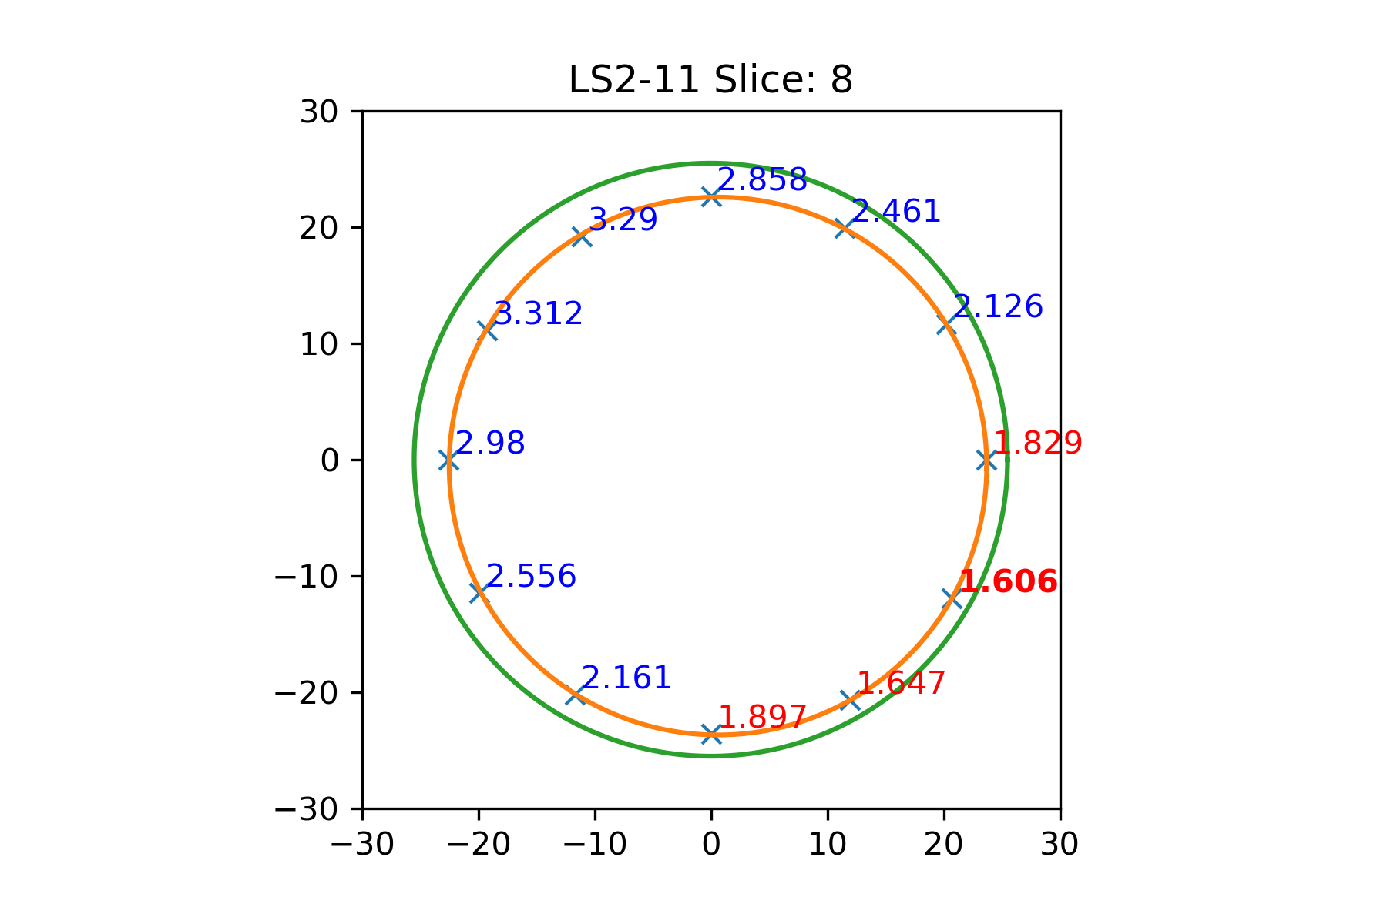
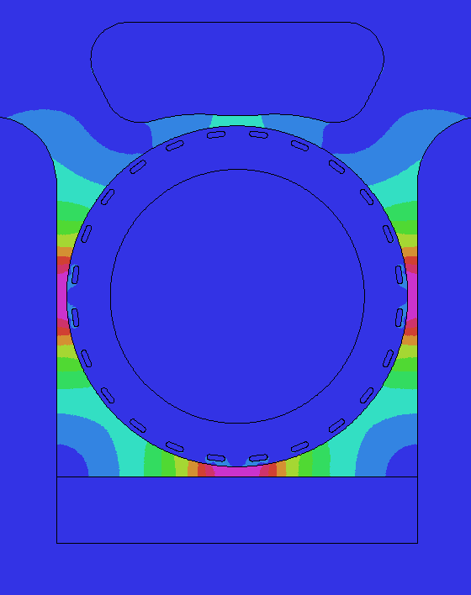
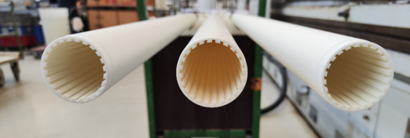
MKI-Cool Alumina Tubes
Thickness values
(<2mm in red)
Electric field predictions
Python programme developed, to display the wall thickness of the alumina tubes and optimize the angular orientation of the tube in the MKI Cool (to minimize electric stress):
Interpolated profile
Goal: Maximize thickness at positions of high electric field
R&D has been carried out, by the manufacturer of the alumina tubes, to understand and overcome the previous production issues:
Three tubes successfully manufactured 👍 are being shipped to CERN
Detailed QA, including wall thickness measurements, to be performed at CERN prior to acceptance of tubes
If R&D tubes are of good quality, order for series of tubes to be placed

Slide 14
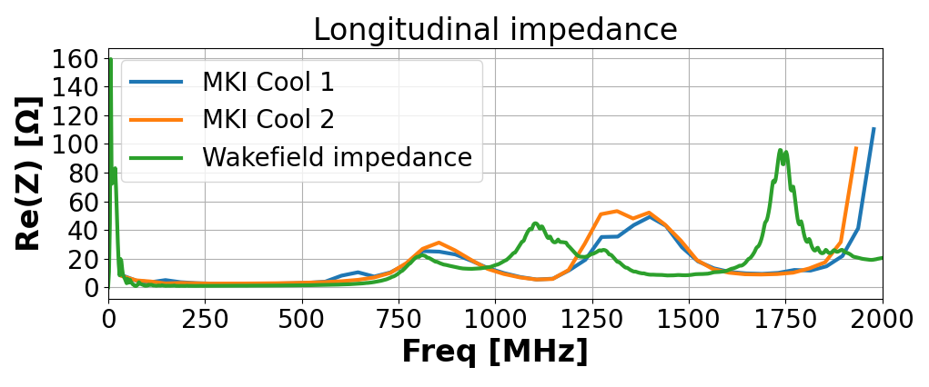
MKI-Cool Provisional Planning
1 MKI cool (#1) ✓ | 1 MKI cool (#2) | 2 MKI cools | 2 MKI cools | 2 MKI Cools | 4 Spare MKI Cools
YETS 22/23 | YETS 23/24 | YETS 24/25 | Start of LS3 | During LS3 | During LS3
Point 8 | Point 8 | Point 8 | Point 2 | Point 2
Note: planning could be constrained by available resources (HR and cleanroom).
MKI Cool #2:
Prototype MKI Cool RF damper used
Cr₂O₃ coated tube recovered from upgraded MKI8D (removed from LHC during YETS 22/23)
Longitudinal impedance measurements carried out:
  Very similar impedance to MKI-Cool #1 👍
MKI-Cool #2 presently undergoing oven bakeout
Installation of MKI Cool, at position MKI8C, scheduled from 24/1/2024

Slide 15
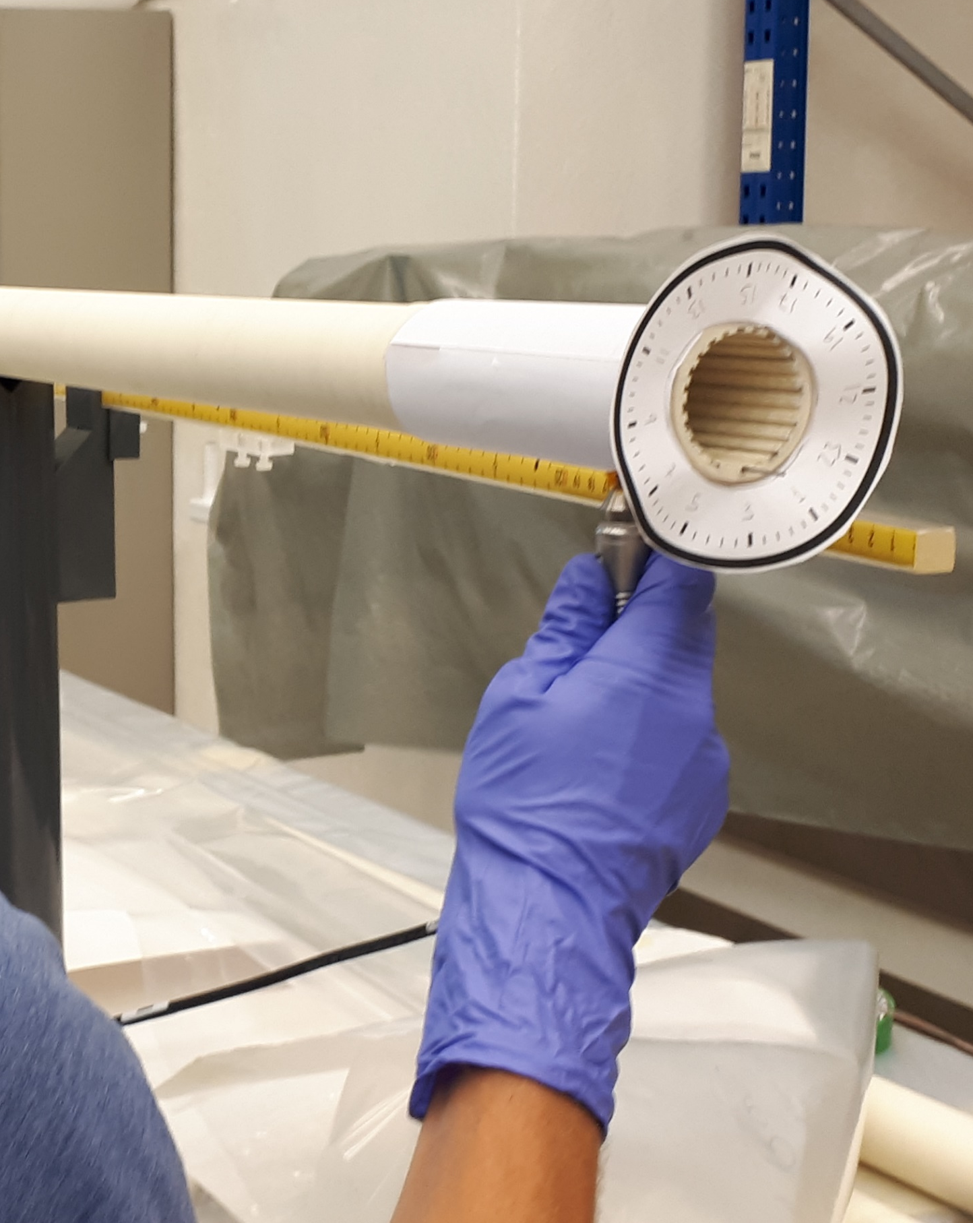

Conclusions
First MKI-Cool, with water cooled RF damper, installed during YETS 2022/23:
  Cr2O3 coating of alumina tube conditioned rapidly with beam 👍
  Temperature rise, due to beam induced heating of yoke, is < 20% of other MKIs 👍
  For HL-LHC ultimate beam parameters, no heating issues expected for the MKI-Cool 👍
Issues with brazing ferrite to copper cylinder (bad thermal contact), for series of RF dampers:
  Under investigation with CERN MME
  Possibilities under discussion with industry
R&D carried out, by the manufacturer of the alumina tubes, to understand and overcome the production issues:
  Three tubes successfully manufactured and are being shipped to CERN 👍
  Detailed QA, including wall thickness measurements, to be performed at CERN prior to acceptance of tubes
Based on excellent results of MKI-Cool operation 👍, MKIs to be upgraded to MKI-Cools – provisional planning shown
$$E_{θ,d}=f(θ,d)$$

Slide 16
Questions ?

Slide 17
Spare slides

Slide 18
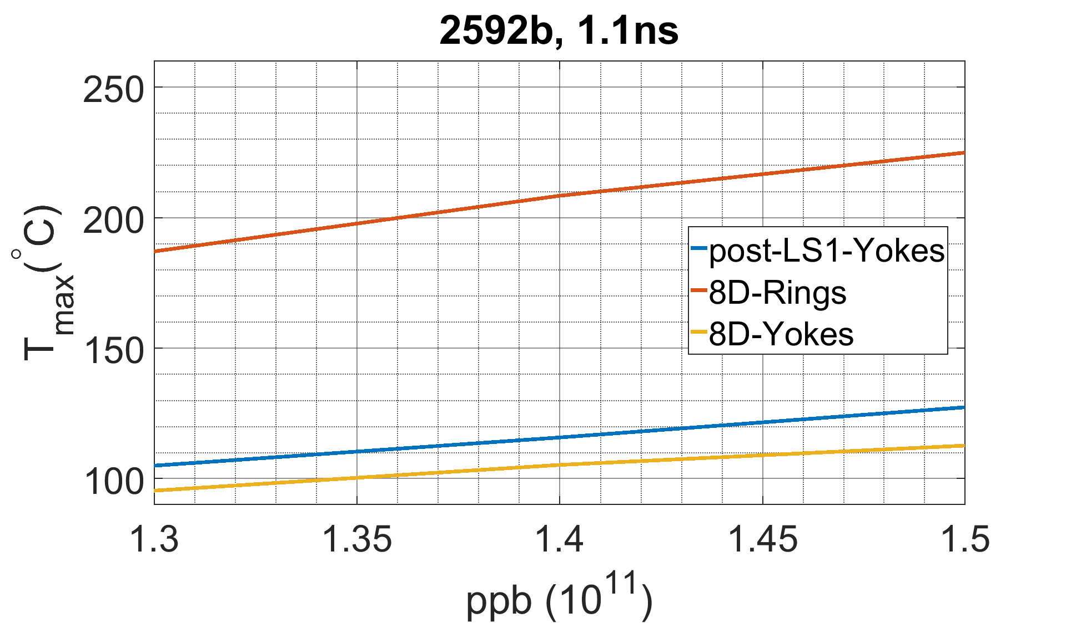
Beam Induced Heating Limitations (1)
MKI limits for max number of circulating bunches are given by post-LS1 magnets installed
  Details in: V. Vlachodimitropoulos, “Hardware limitations at injection” (https://indico.cern.ch/event/663598/) and “Update on MKI impedance studies” (https://indico.cern.ch/event/734086/)
Can consider these as ‘soft’ limits: exceeding them by a small amount will not damage the MKIs nor cause a beam dump. However, cooling with existing MKIs is very poor (predicted thermal time constant for cool-down of yoke is several hours): hence, these operational limits will avoid heavy efficiency penalties.
Curie Temp. (T_{C}) of Rings = 250°C
T_{C} of Yokes = 125°C
Notes:
Up to 7.8 us pulse length operated so far - OK for 240 bunches per train (8.2 us might be in reach, if needed, but to be evaluated in MD ﬁrst) ***check***

Slide 19
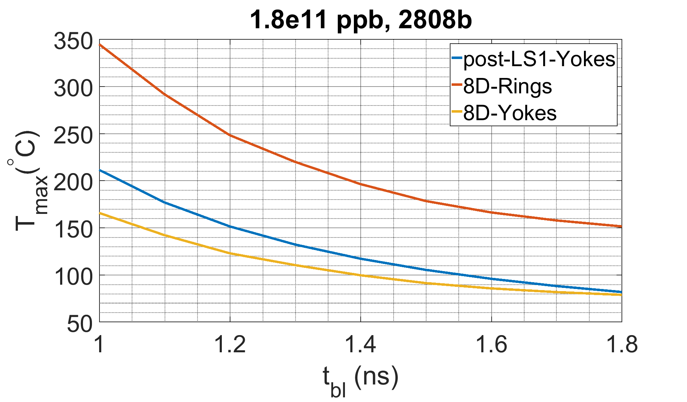
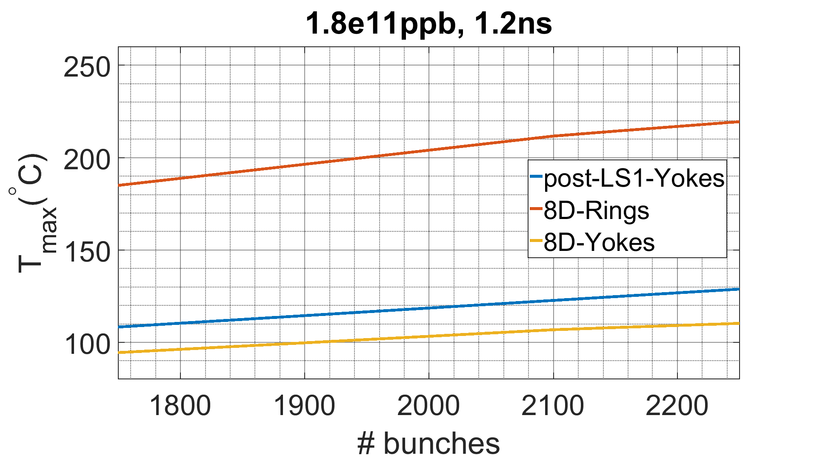
Beam Induced Heating Limitations (2)
Steady state approach used for thermal simulations for post-LS1 MKIs and upgraded MKI8D (YETS 2017/18)
Gaussian longitudinal proﬁle with equi-populated bunches for beam
The following limits are intended for normal operation
In case of usage for speciﬁc tests, depending on the operational conditions foreseen (previous cool down, time at ﬂat top, etc.), allowed parameters (number of bunches and bunch length) to be evaluated
1.35ns
T_{C} of Rings = 250°C
2160b
T_{C} of Rings = 250°C
T_{C} of Yokes = 125°C
T_{C} of Yokes = 125°C

Slide 20
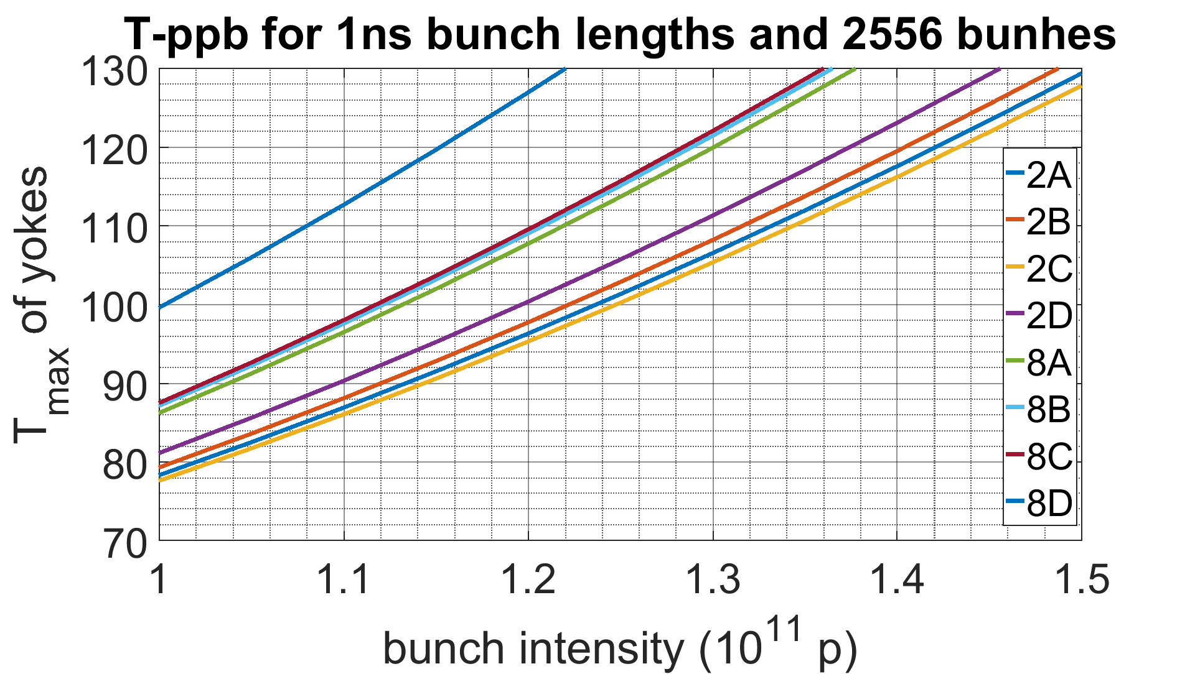
Expected heating for post-LS1 design
Approach to modify the scaling factor for the other magnets (see Lorena’s presentation for a more detailed analysis)
  Get maximum reached temperatures (of MagnetUp sensors during 2017 operation)
  Correct for differences in initial temperatures between the different sensors (data from March 2017) and equalize with ambient temperatures (i.e. no beam/dissipated power) used in thermal simulations (22°C)
  Use P_loss-T graph to estimate the differences in total dissipated power within each magnet
  Modify the scaling factor accordingly
Example below to make things more clear (hopefully!)
Current limitation (after MKI8D upgrade) is MKI8C: ~1.32e11 p
MKI8A-C have very close intensity margins
Margins shown for MKI8D, are the ones before the replacement with the upgraded MKI during YETS 2017/18
X
X
 | MKI 8C | MKI 8D*
Measured max T (°C) | 55.5 | 62.6
Initial T (°C) | 20 | 23
“Corrected” max T (°C) | 57.5 | 61.6
Estimated dissipated power (W) | 57 | 71
Power ratio | 0.8 | 1
X
*Before it was upgraded in YETS 17/18

Slide 21
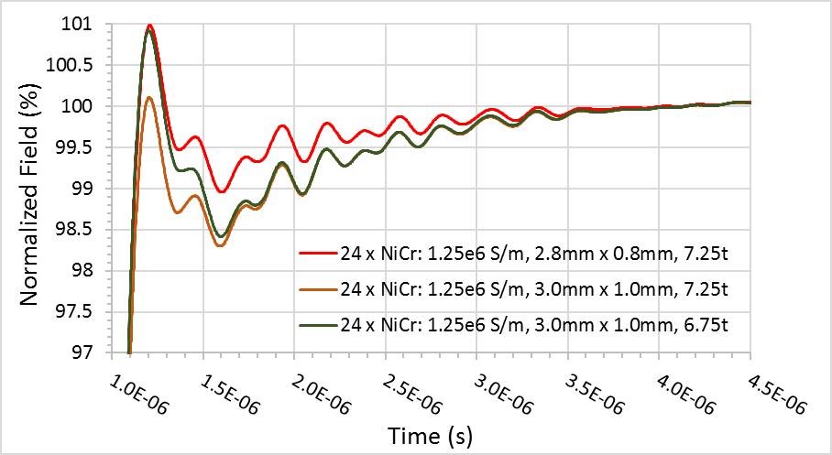
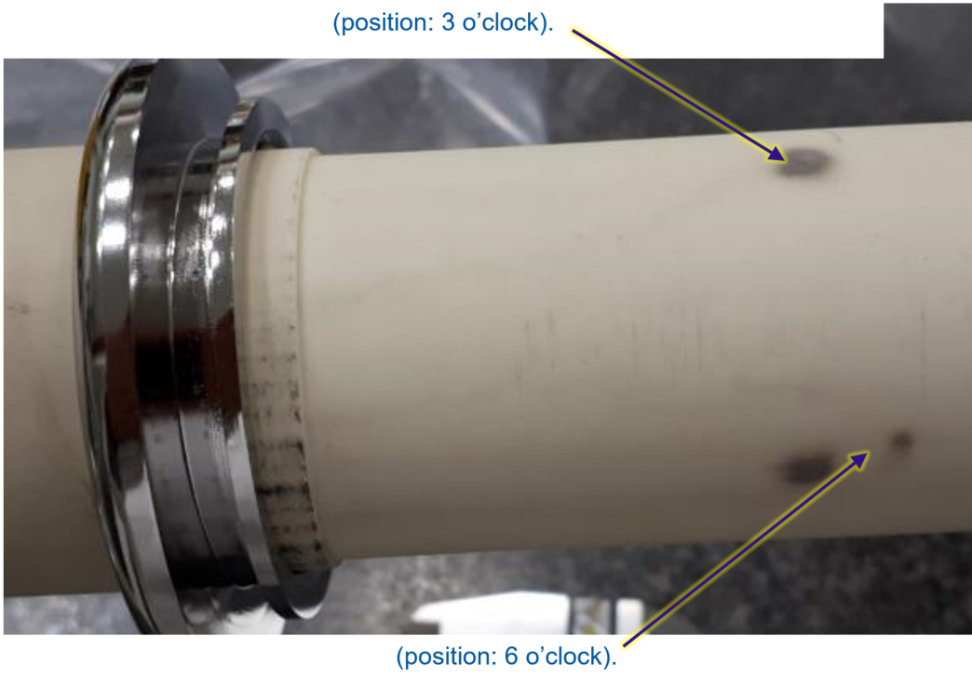
Historical issues – now solved
During 2019
Non-conformity of slots in alumina tubes purchased during 2017: slots were too wide. Thus, it was necessary to use screen conductors with a small zig-zag
[HL-NCR: https://edms.cern.ch/document/2440015/1.0]
HV pre-conditioning of MKI cool failed:
[HL-NCR: https://edms.cern.ch/document/2440015/1.0]
18 strong sparks occurred over two weeks
Conditioning plateaued at ~45kV (goal=56.1kV)
Three black marks from HV breakdowns to alumina tube
Wider screen conductors
Using wider screen conductors was discarded due to influence on magnetic field (eddy currents)

Slide 22
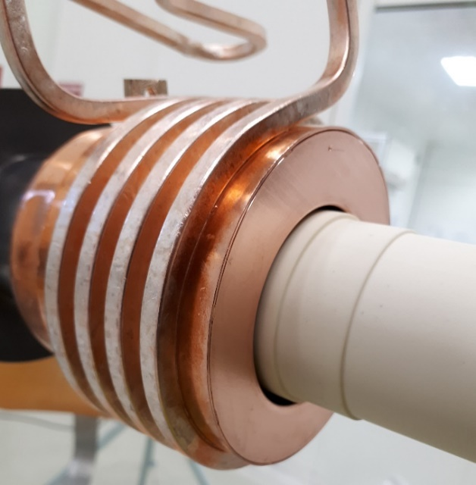
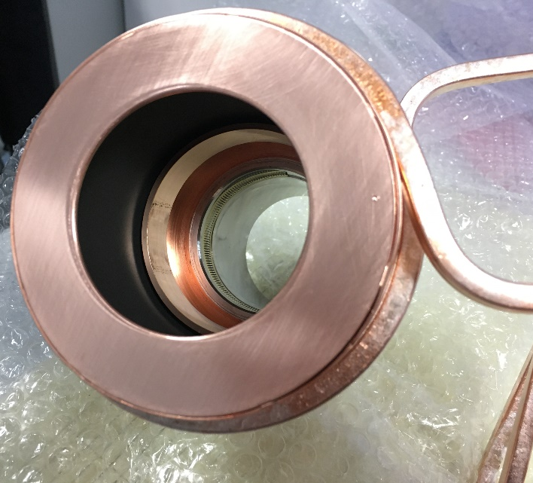
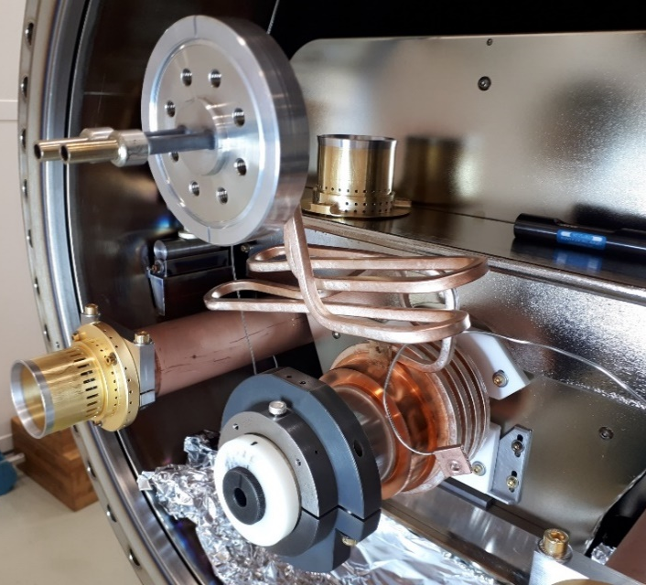
2. Issues – now solved
During 2019. Actions carried out
RF damper structure was modified to mitigate HV breakdowns:
Metal supports for tube replaced by macor
RF damper end cap inside diameter enlarged (from 56mm to 60mm), to increase distance to alumina tube
Sharp edge on stainless steel short eccentric tube removed (manufacturing error)
Cooling pipes for RF damper
RF damper
60mm & 1mm offset downwards
Macor supports
End-cap
1 mm radius
Sharp edge chamfered

Slide 23
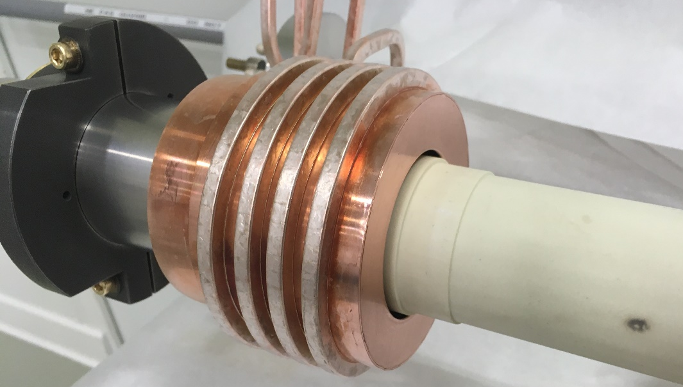
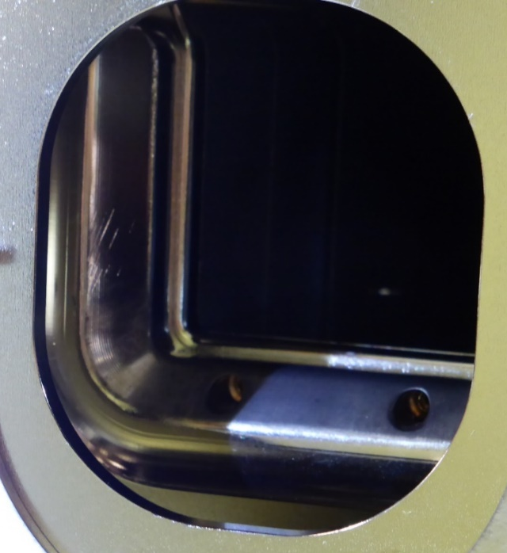

2. Issue – now solved
Inspection after conditioning (November 2020)
First observation: Still one black mark seen on the tube, at the end (3 marks in 2019)
The reason was a sharp edge due to mis-alignment of HV busbar of the magnet
Solved with correct alignment
Alumina tube
Field: ~16.3 kV/mm
1.2 mm
1.5 mm
Field: ~19.3 kV/mm
HV end plate
HV busbar
Alumina tube outside of magnet
Peak field ~34 kV/mm
Enhanced electric field (~doubled) due to dealignment of HV busbar
End of magnet, without tube

Slide 24
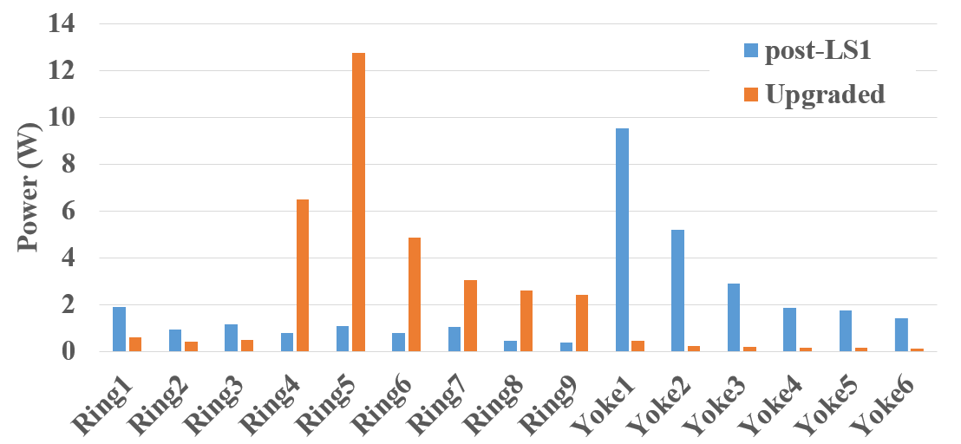
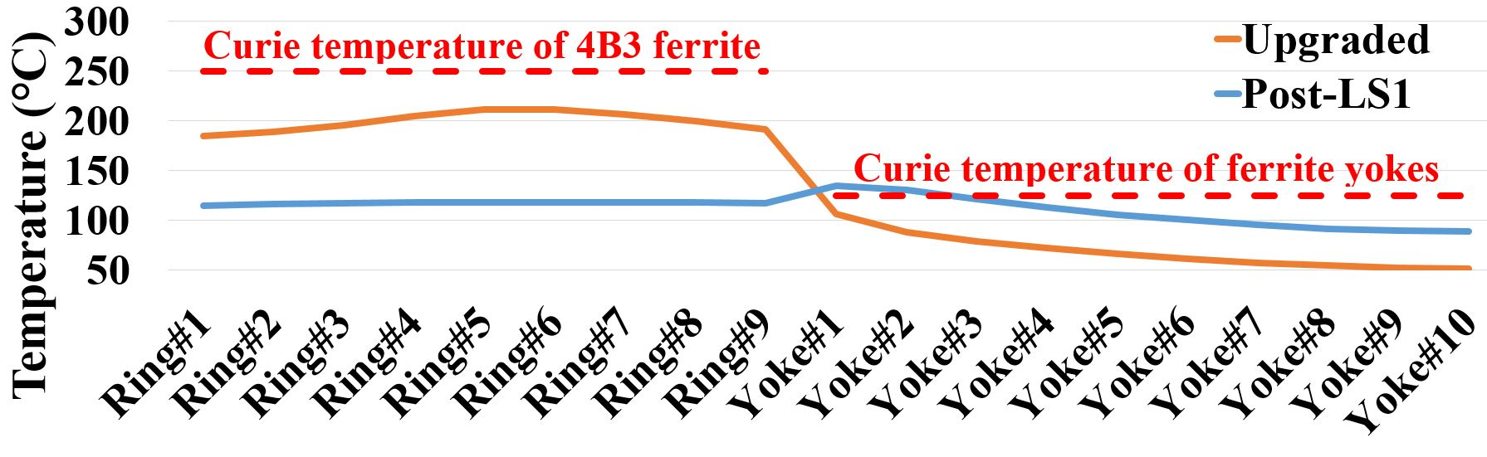
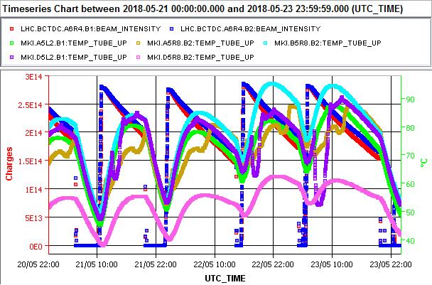
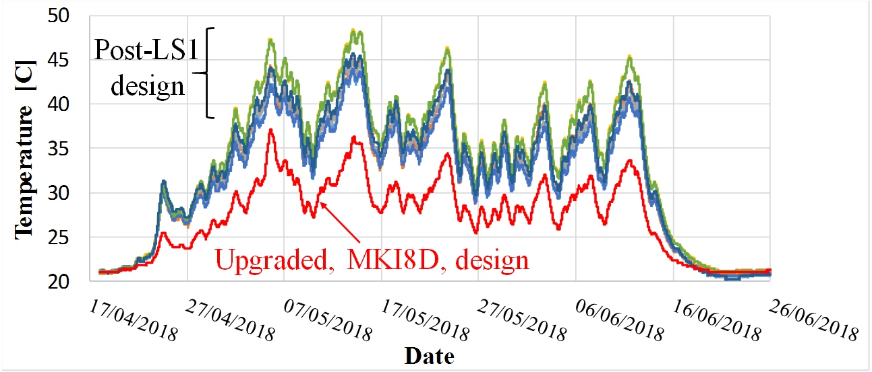
MKI Beam Screens – Predictions & Measurements
Prediction: IPAC2018 (WEPMK001) – Run 2 (1.15e11 ppb, 2808b, 1ns Gaussian bunches)
Prediction: IPAC2018 (WEPMK005)
Vasilis: presentation to 21st IWG, 26/6/2018
Discontinuities on some Tube_Ups during cool down
Measurement: IPAC2019 (THPRB072)
MKI8D Tube_Up
No discontinuities, but cooler than expected !
Notes:
Note: Run 2 (1.15e11 ppb, 2808b, 1ns Gaussian bunches) are taken from Vasilis’s presentation to 21st IWG, 26/6/2018

