Slide 1
Machine Protection Status and Plans
Daniel Wollmann
13th HL-LHC Collaboration Meeting, Vancouver (Canada), 25.-28. September 2023

Slide 2
Outline
Status and plans for the machine protection hardware for HL-LHC
  Energy Extraction systems
  Coupling Loss Induced Quench systems (CLIQ)
  Quench Heater Power Supplies & DQLIMs
  Powering Interlock Controller
  Instrumentation Feedthrough Systems
  Cold & Warm diode stacks
  ElQA patch panel racks
  Current Lead Heater Regulator Systems
  Quench Detection System
  Ethernet enabled Data Acquisition (EDAQ)
Critical failure cases for HL-LHC & Damage studies
  Spurious firing of CLIQ
  Crab cavity failures
  Damage studies with sc. sample coils
Conclusions

Slide 3
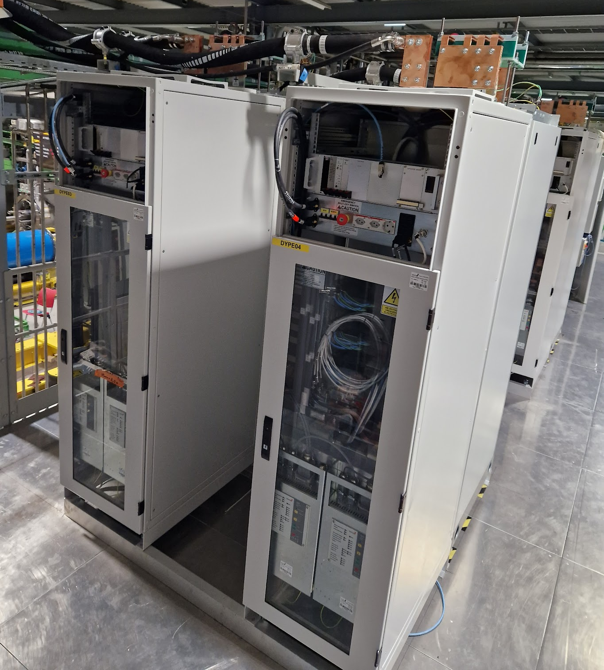
Energy Extraction Systems
All Energy Extraction systems for the IT String (6+1 x 2 kA & 1+1 x 600 A) have been installed in the IT String following their delivery and successful testing.
Call for tender for 24 x 2 kA and 20 x 600 A finished.
Approval for contract negotiation requested to CERN’s October 2023 Finance committee.
Delivery of series units expected between end 2025 and mid 2026.
2 kA EE systems
See also M. Pojer’s talk in the joint session of WP3/WP6a/WP7/WP16 Tue PM

Slide 4
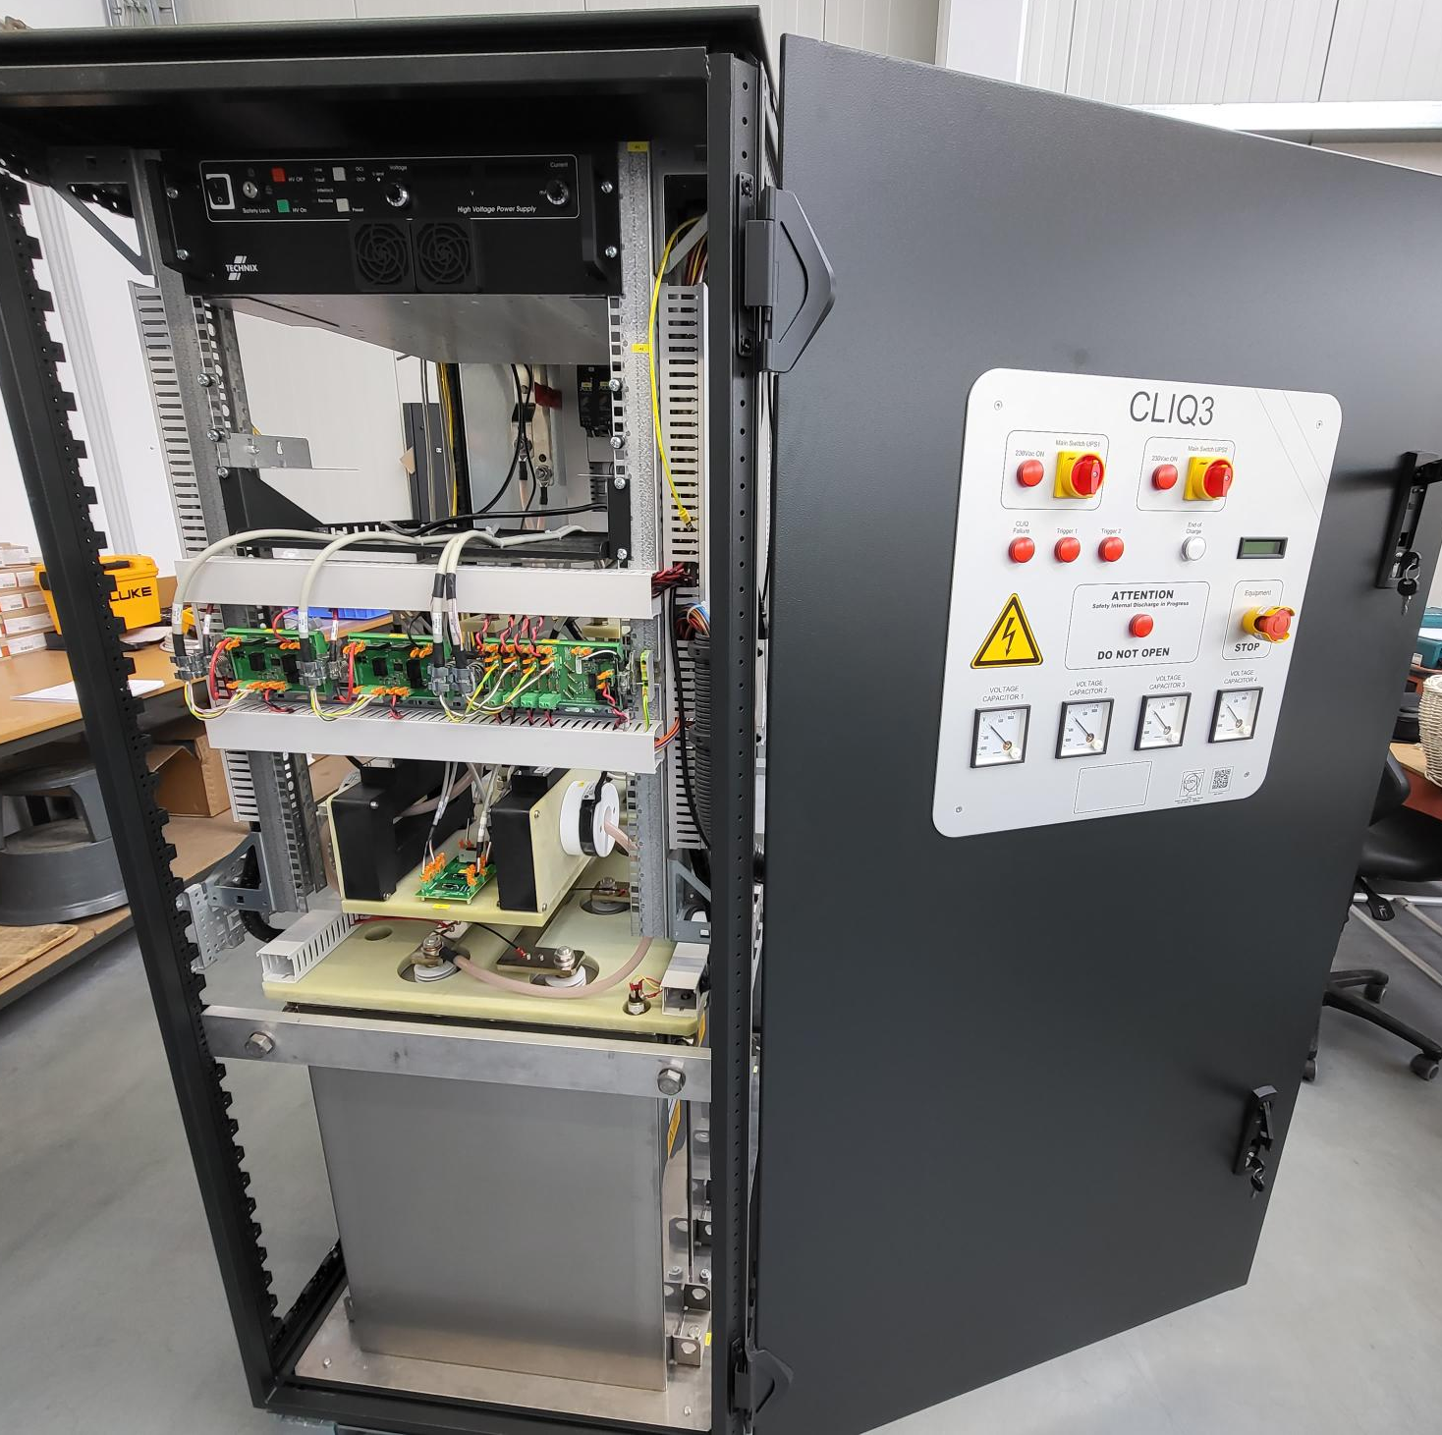
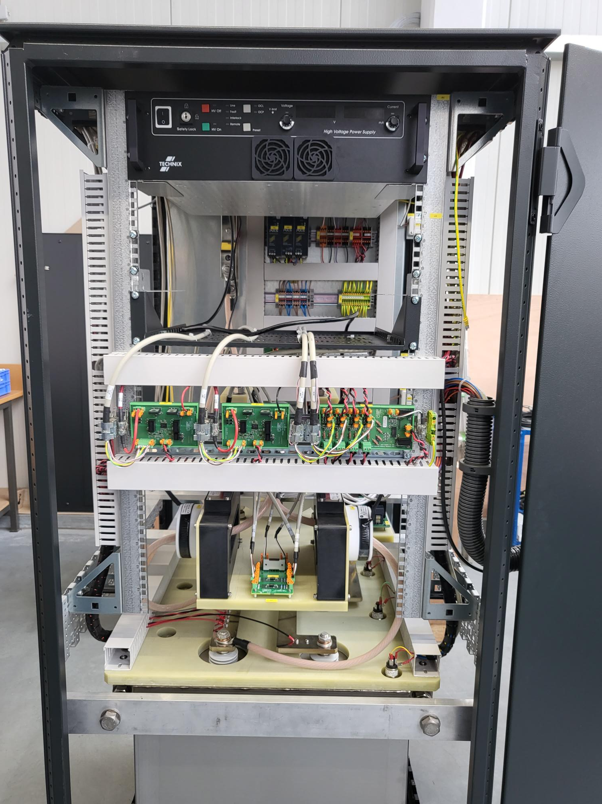
Coupling Loss Induced Quench (CLIQ)
Capacitors for IT String units & tunnel series have been produced and delivered to CERN.
The first of the series CLIQ unit has been delivered to CERN in March 2023 and was successfully validated.
Safety assessment, vibration and EMC studies have been successfully performed (Safety report).
The production of the 6 + 2 CLIQ units for the IT String is ongoing and they are expected to be ready for the installation in the IT String in December 2023.
The production of the 24 units for the tunnel will start in 2024 and should be finished early 2025.
Charger Disconnection Unit
Capacitor Balance resistor Unit
Burden Resistor Unit
Main capacitors
See also M. Pojer’s talk in the joint session of WP3/WP6a/WP7/WP16 Tue PM

Slide 5
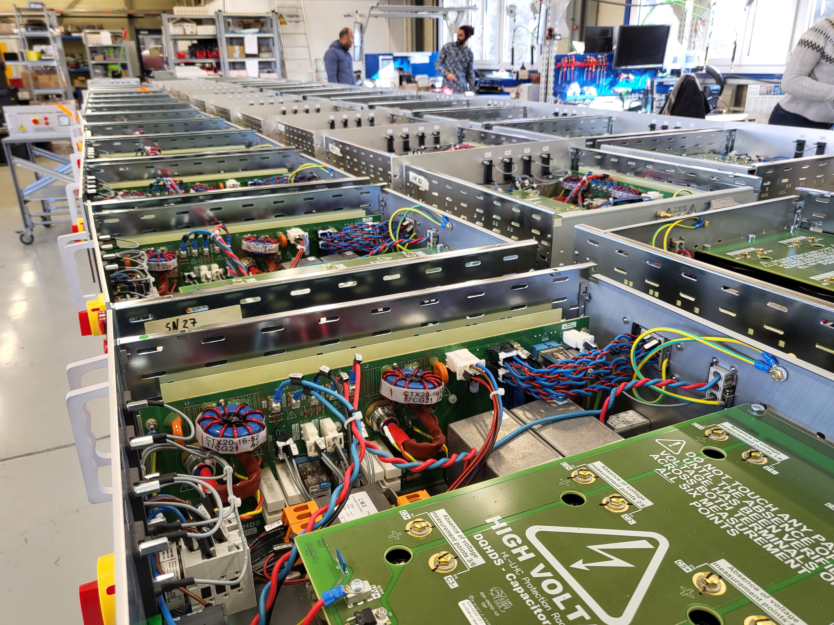
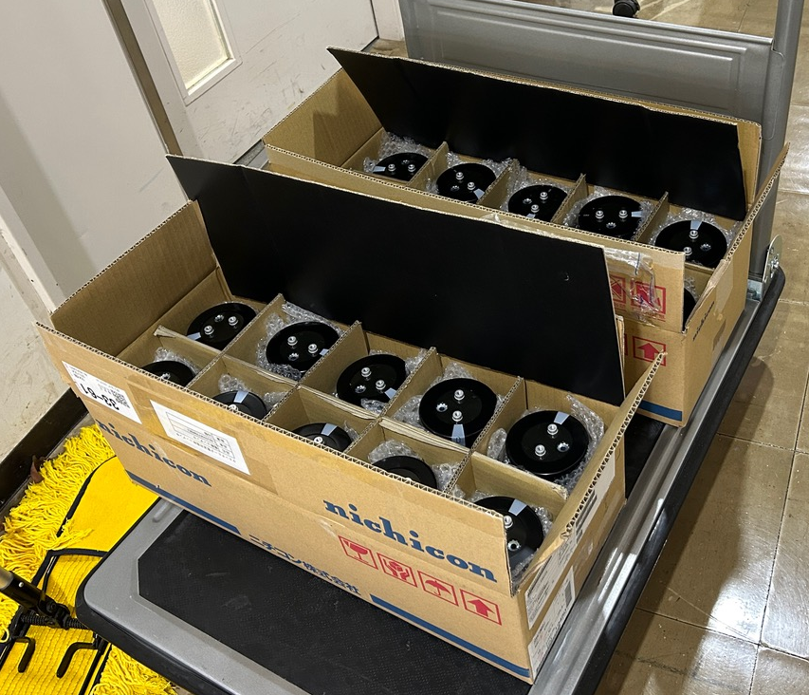
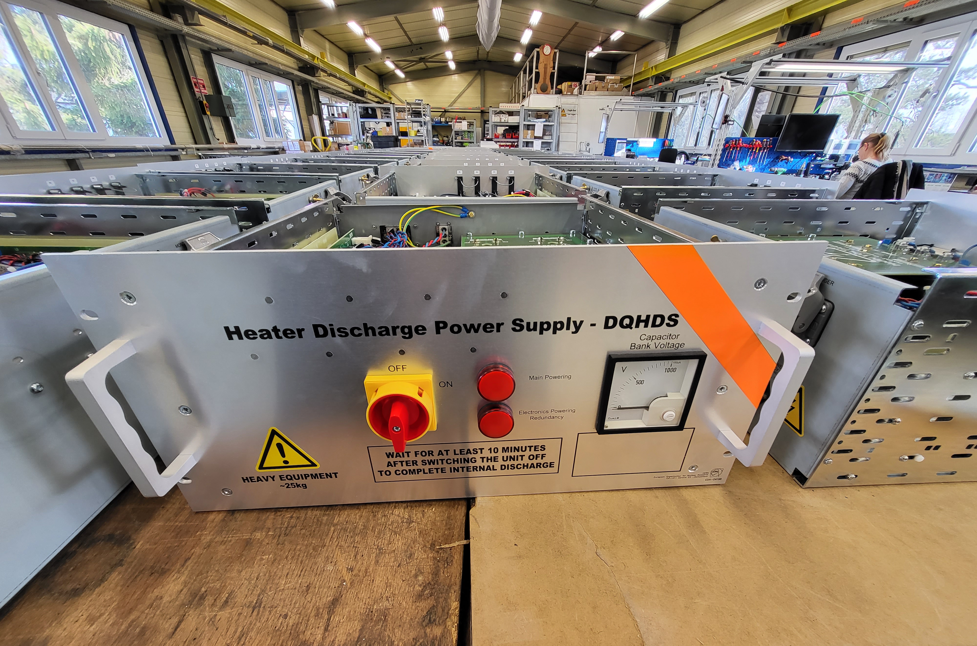
Quench Heater Power Supplies (DQHDS) for the IT String
All 60 units (52 + 8) for the IT String have been manufactured.
Testing of the units is ongoing.
They will be delivered to the IT String in October 2023.
Seven DQLIM units have been produced at CERN and will be installed into the IT String in October 2023
Series production:
The units for the tunnel will be provided as in-kind contribution from Japan under the lead of KEK.
Nichicon has introduced (small) modifications in the capacitor model (new base-plate, reduced variation of capacitance [4.7 mF +20% -5 %])
20 prototype capacitors have been delivered to CERN from KEK and have been successfully validated.
See also M. Pojer’s talk in the joint session of WP3/WP6a/WP7/WP16 Tue PM

Slide 6
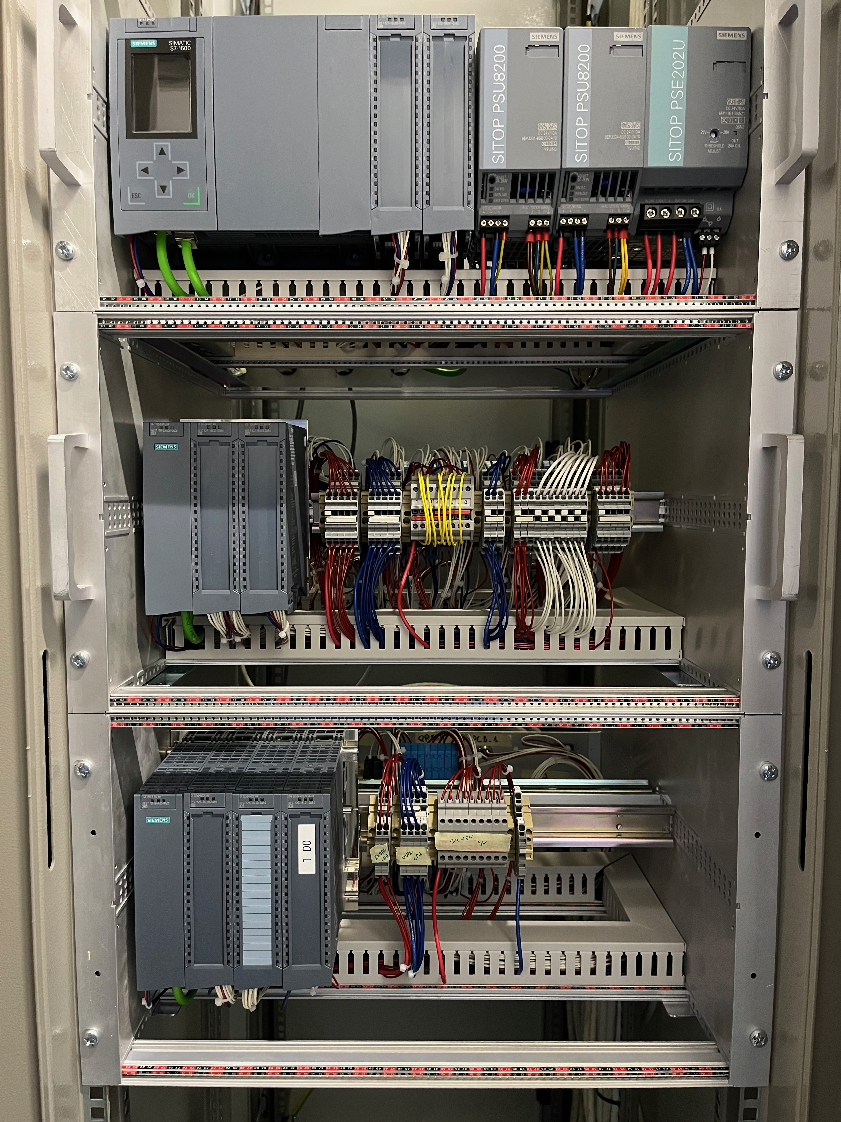
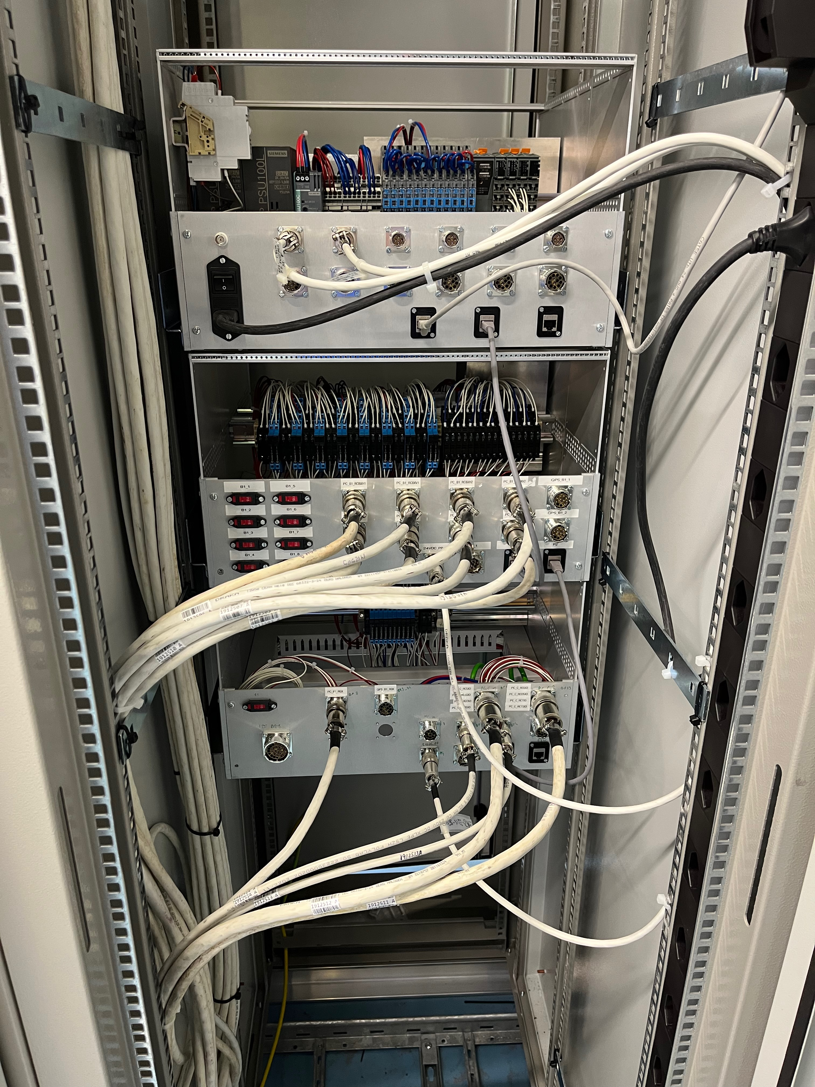
Powering Interlock Controller
The first prototype of the new Powering Interlock Controller (PICv2) has been installed in the IT String following successful testing in the lab
The final layout of the PICv2 for the LHC tunnel is currently still under study and should be available in December 2023.

Slide 7
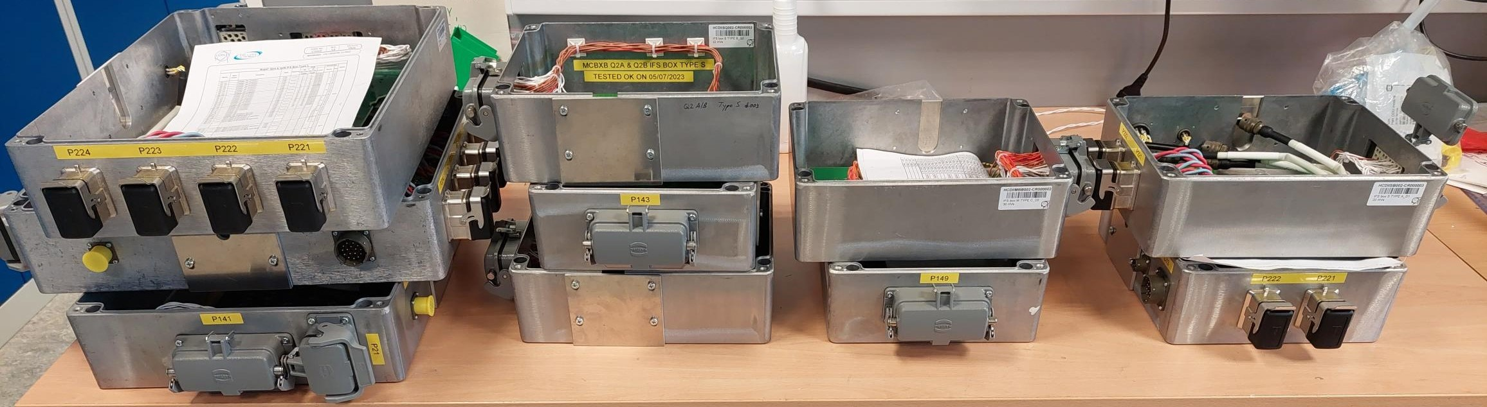
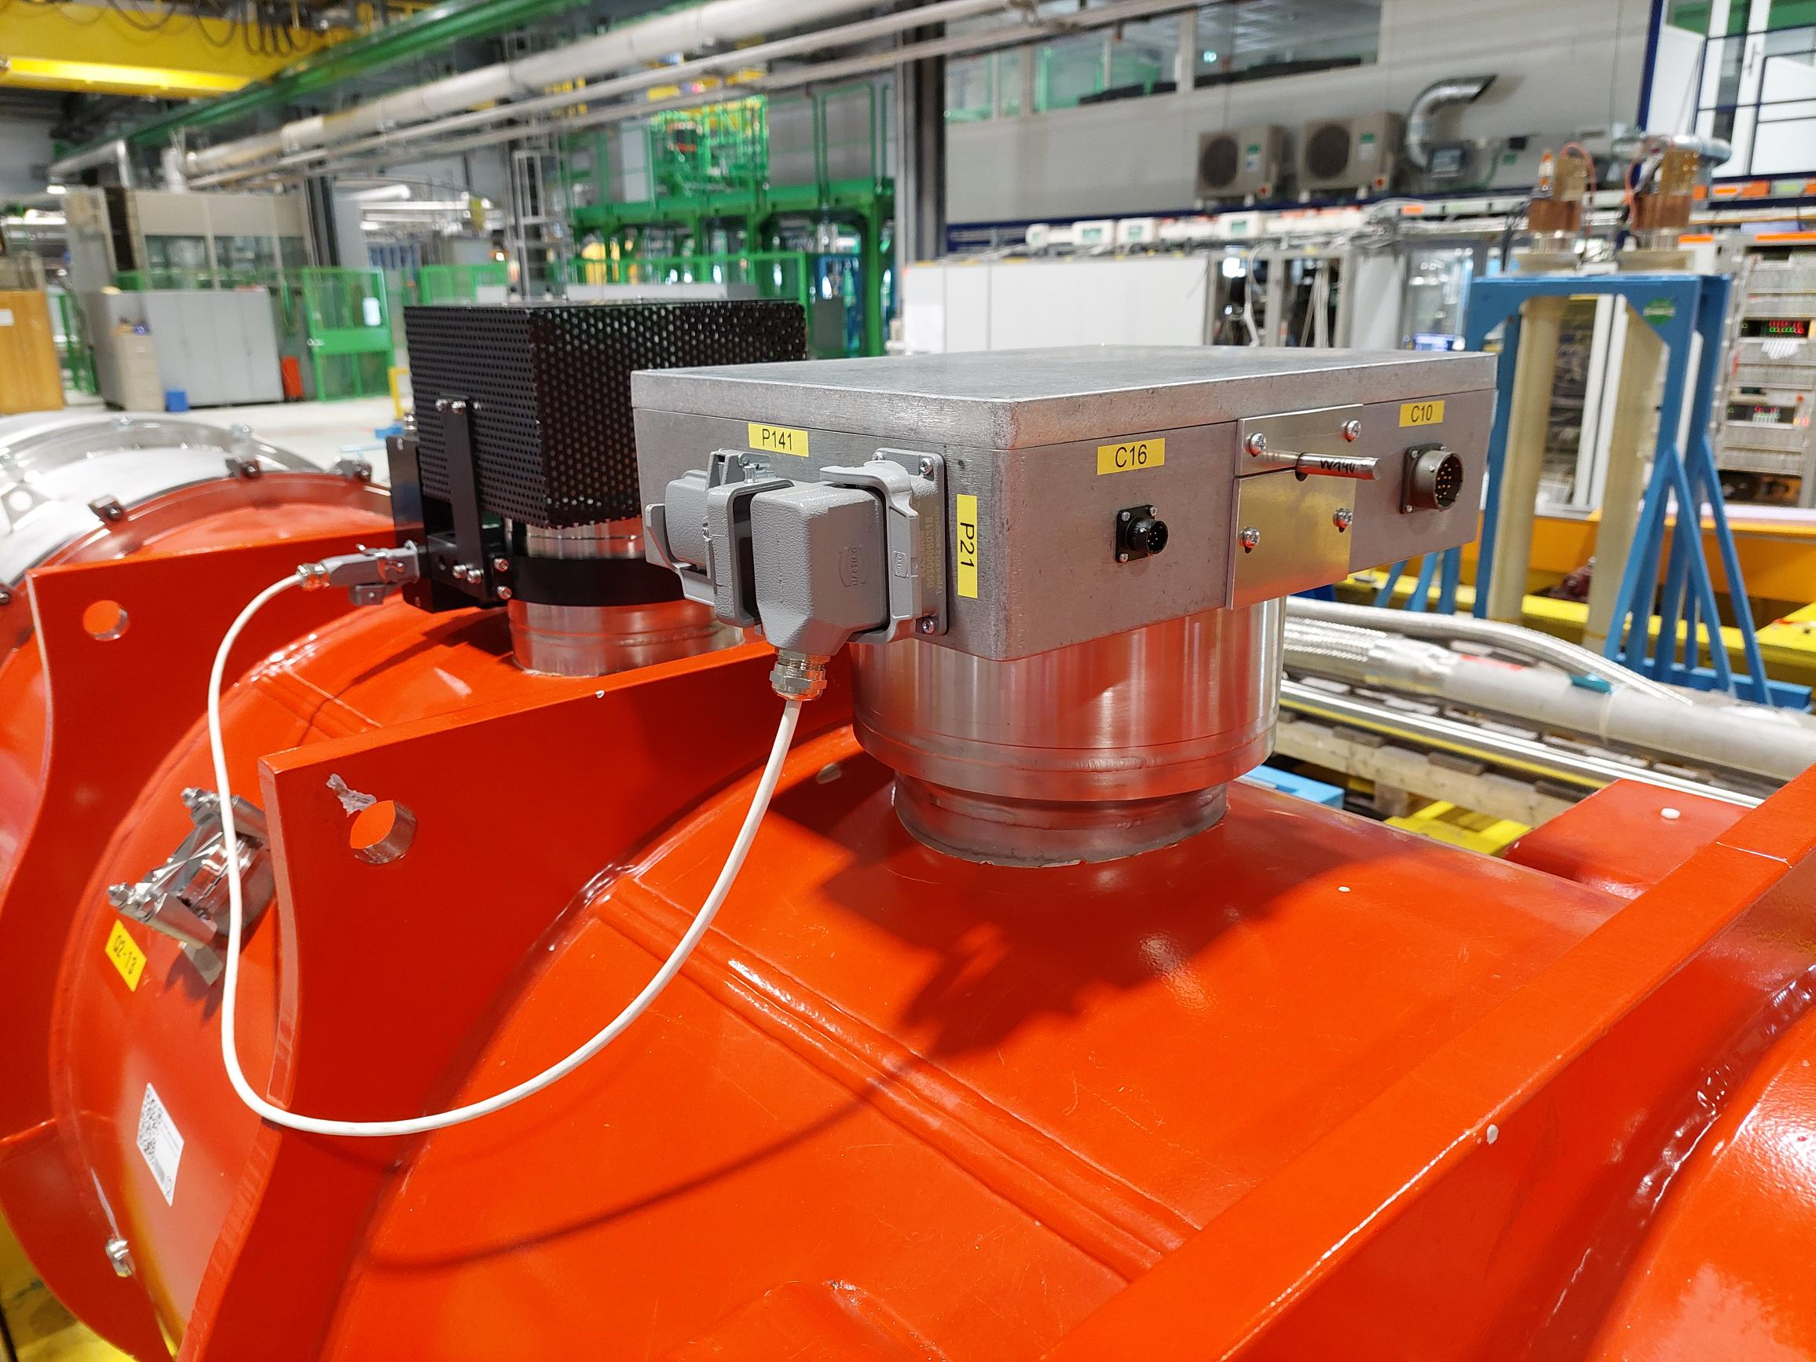
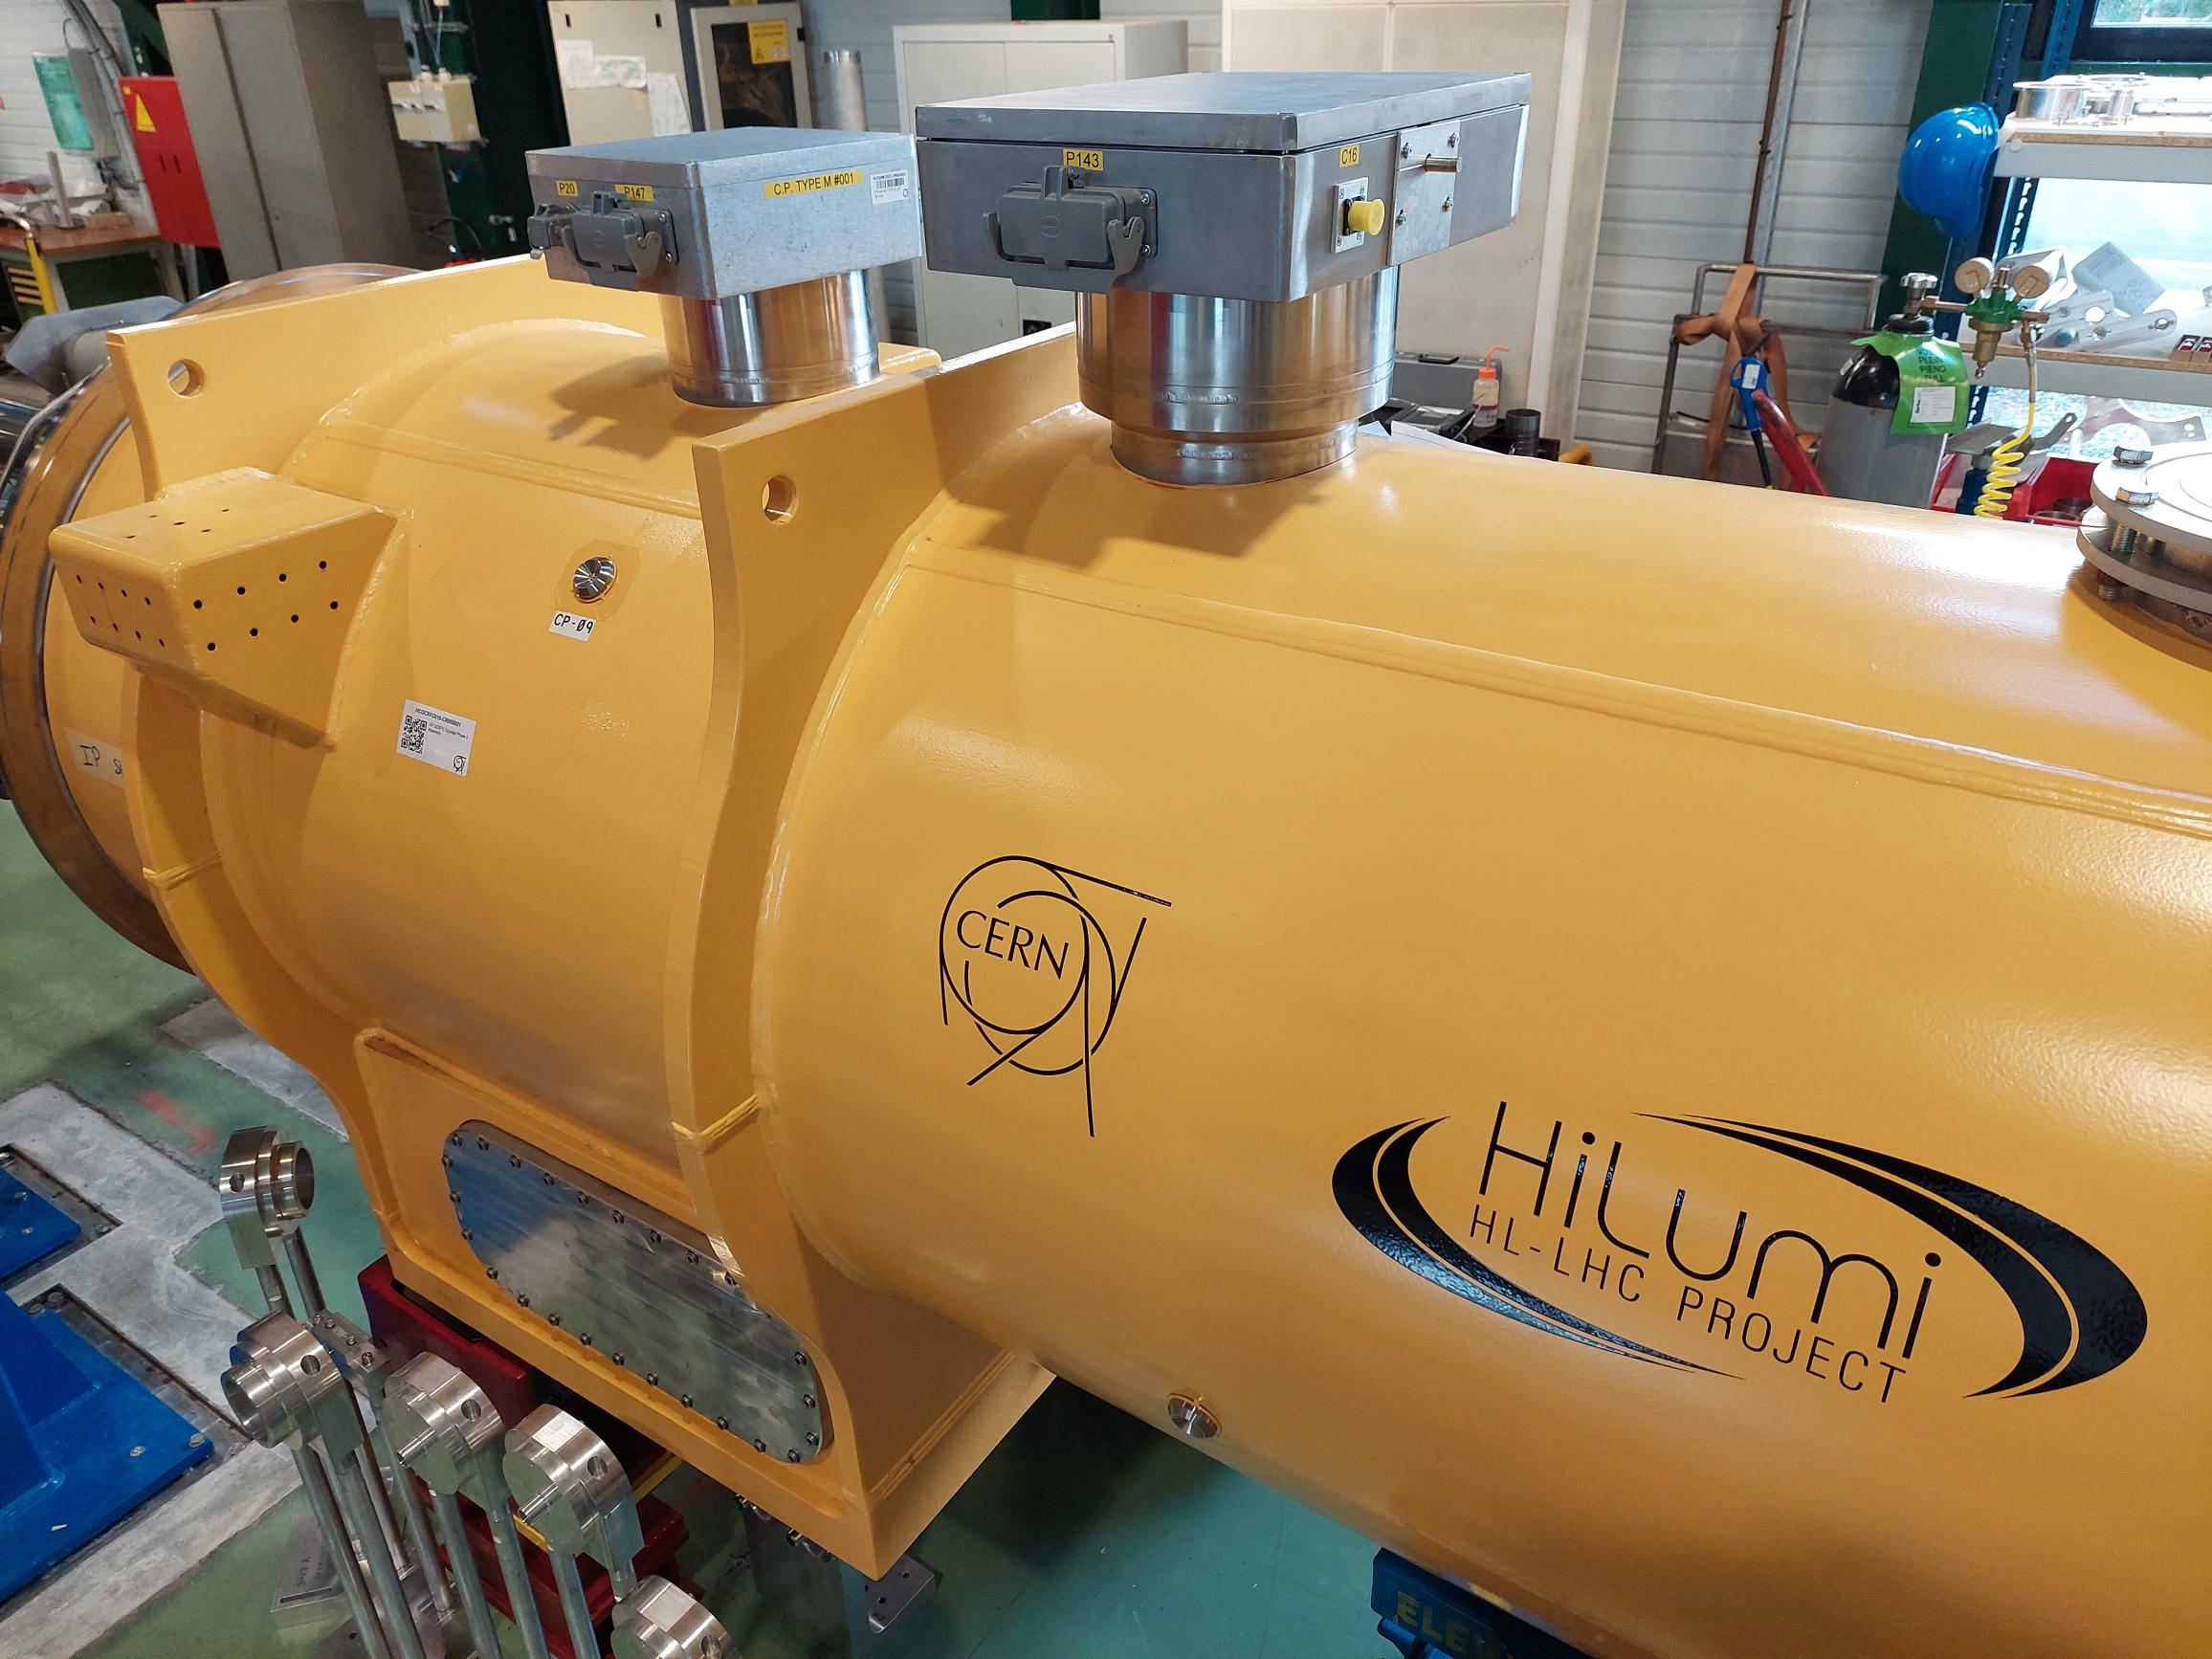
Instrumentation Feedthrough System (IFS)
Three different types/sizes of IFS boxes have been designed to cover the needs of the HL-LHC cryo-assemblies (L, M, S).
44 out of a total of a total of 144 have been assembled and tested.
IFSs are provided to WP3 as needed for the equipment of the cryo-assemblies
IFS boxes after assembly and electrical tests
IFS boxes installed on first Corrector Package cryostat being prepared in SMI2
IFS boxes installed on first Q2A magnet being prepared in SM18 test bench (F1).

Slide 8
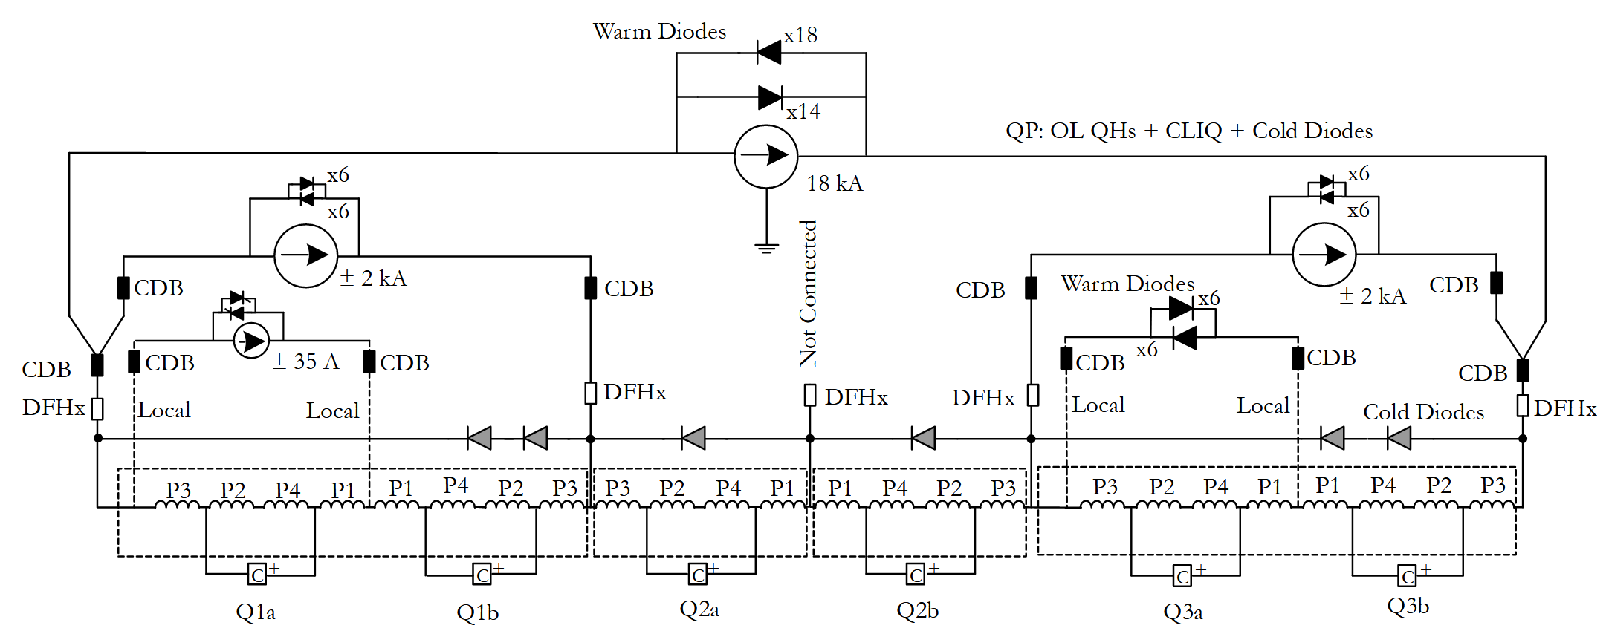
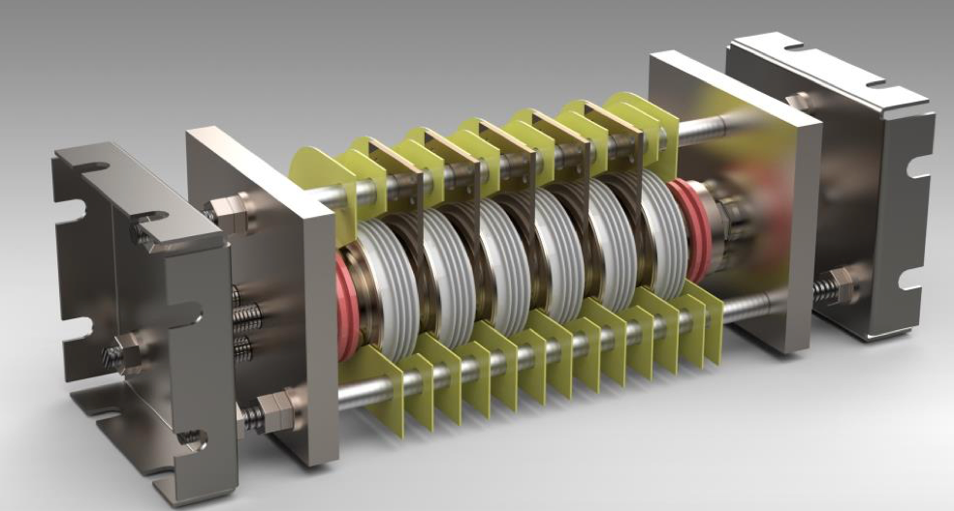
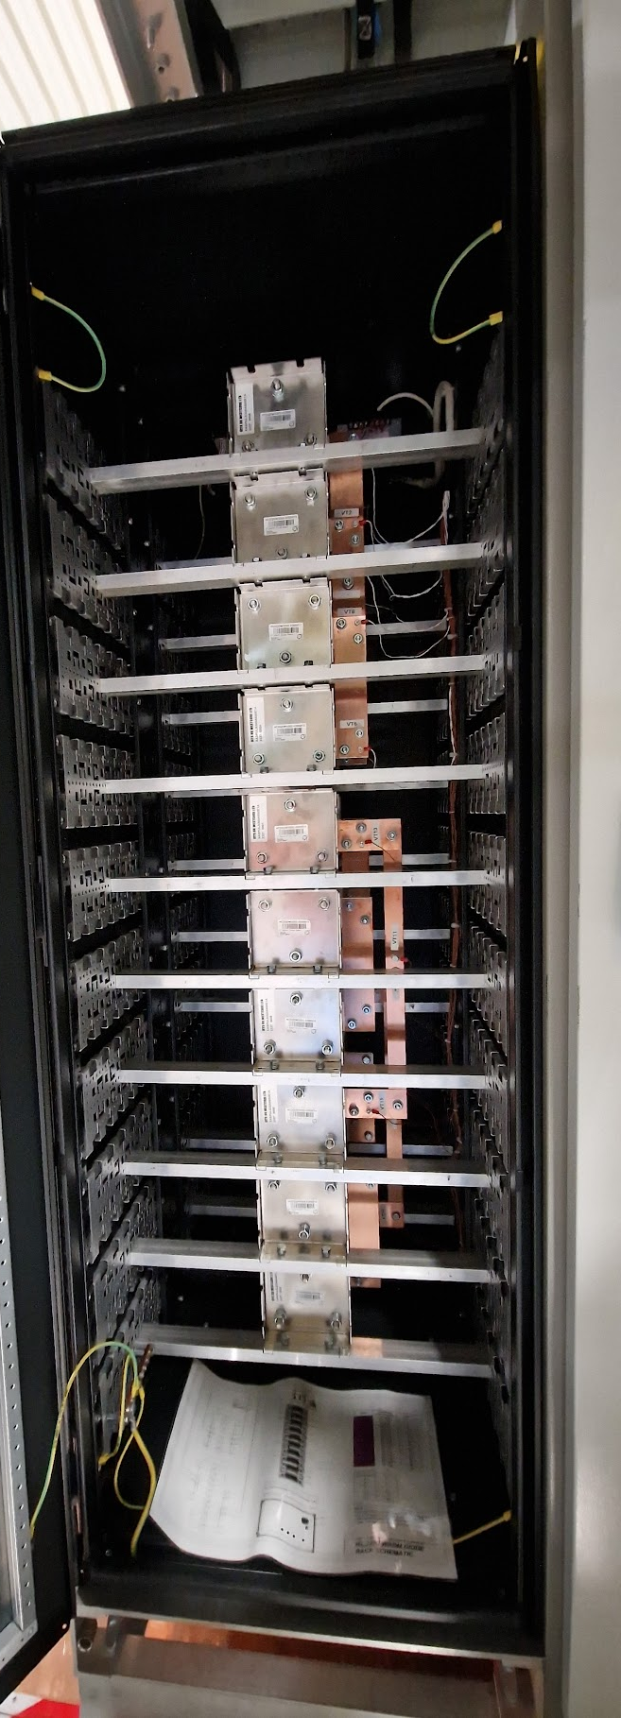
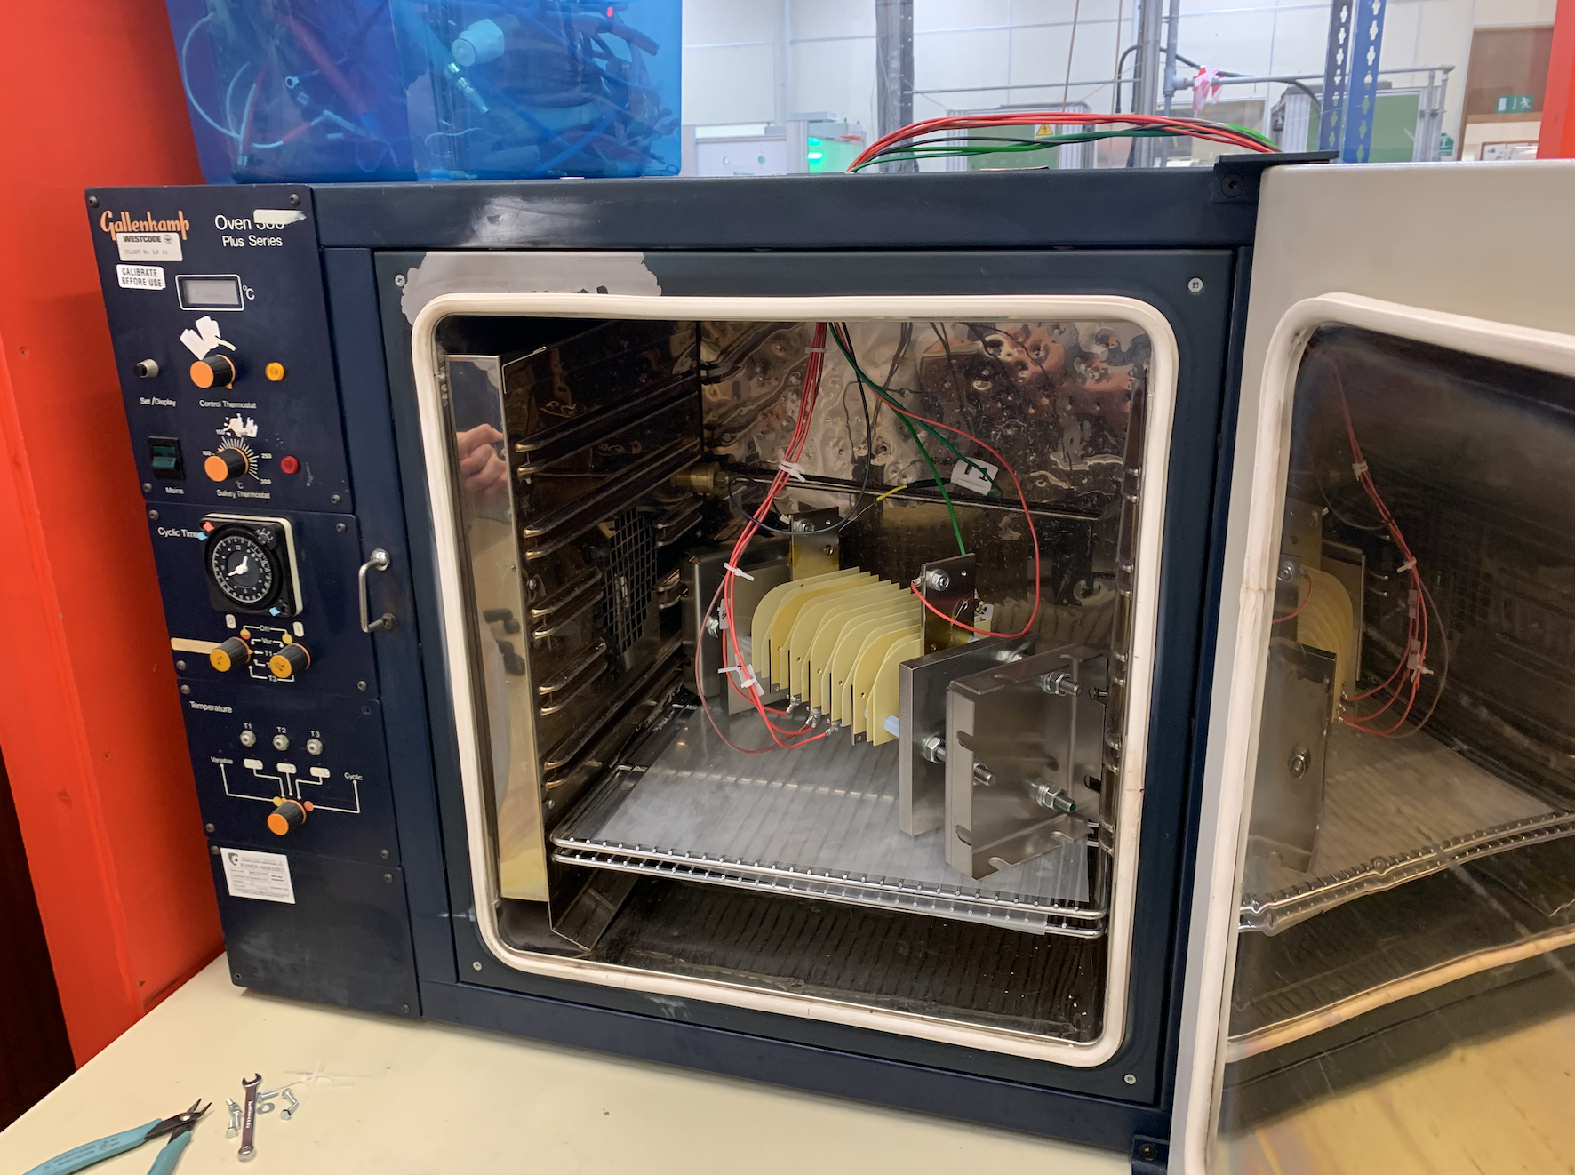
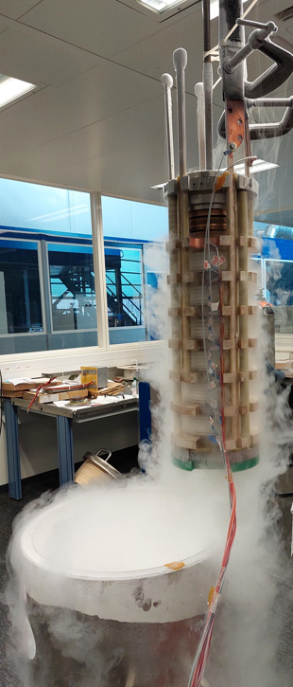
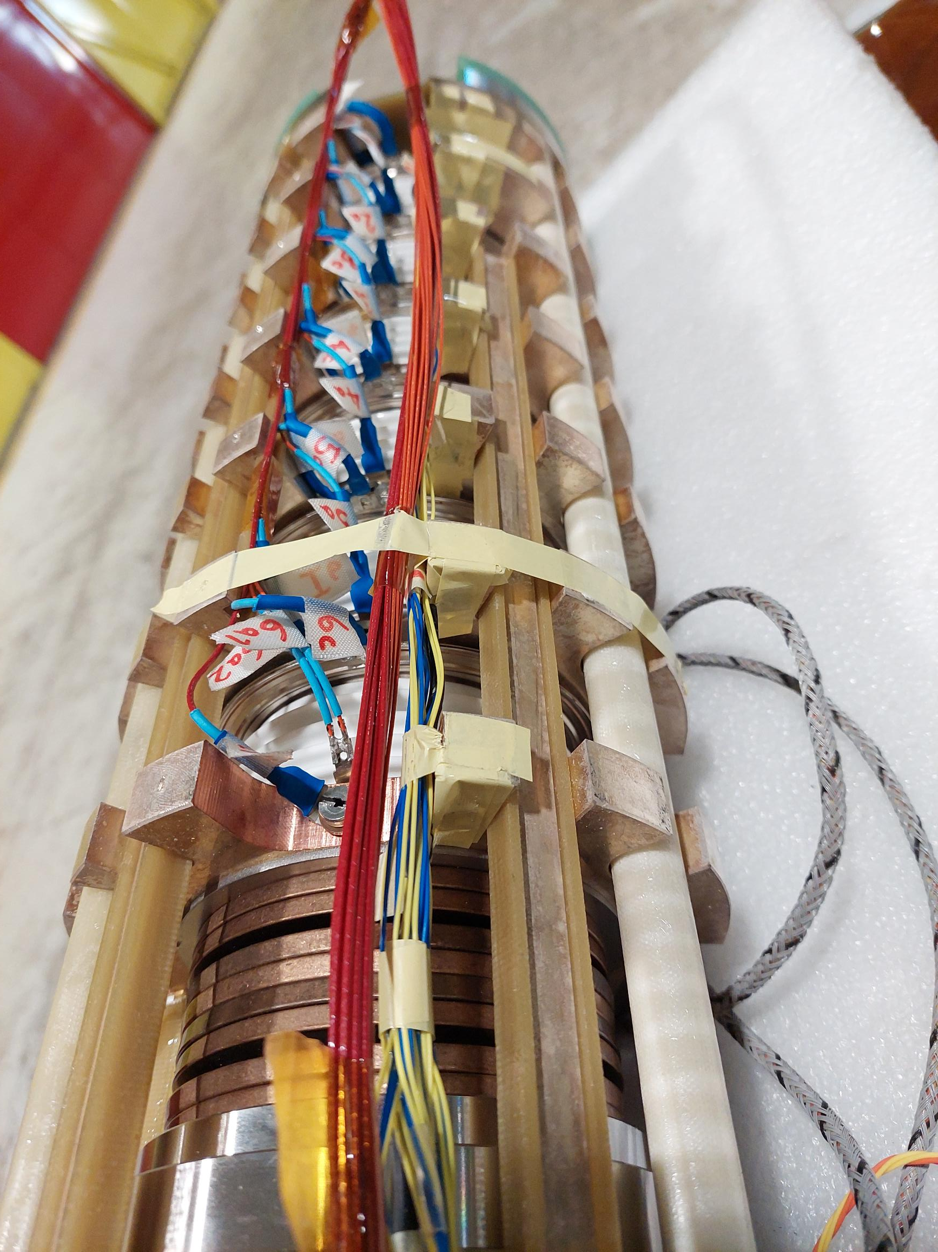
Diodes
Cold diode stack for DCM
First prototype assembled and fully qualified (RT, 77 K and 4 K) → ready for the installation in the DCM.
Endorsed for use in IT String by MCF #123
Test report EDMS 2956417
Warm diode rack
Warm diode stacks with six diodes manufactured and validated in industry.
Diode rack with ten redundant diode stacks assembled, tested and installed in the IT String:
  three redundant stacks for the main IT power converter
  two antiparallel redundant stacks for the Q3a branch
Test report EDMS 2895231

Slide 9
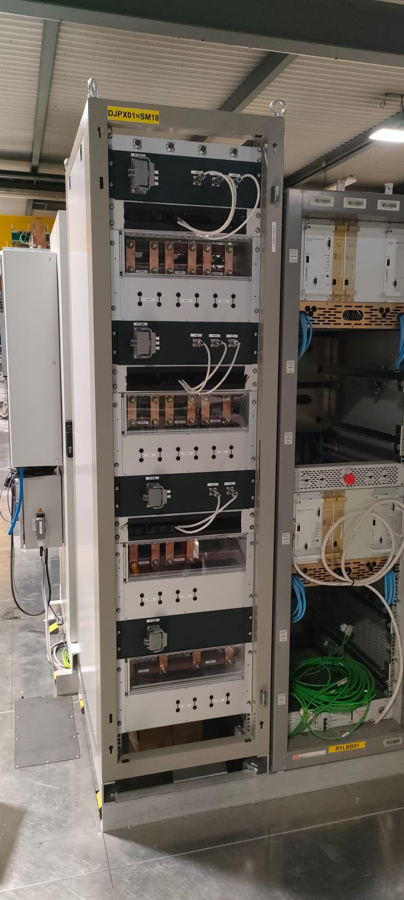
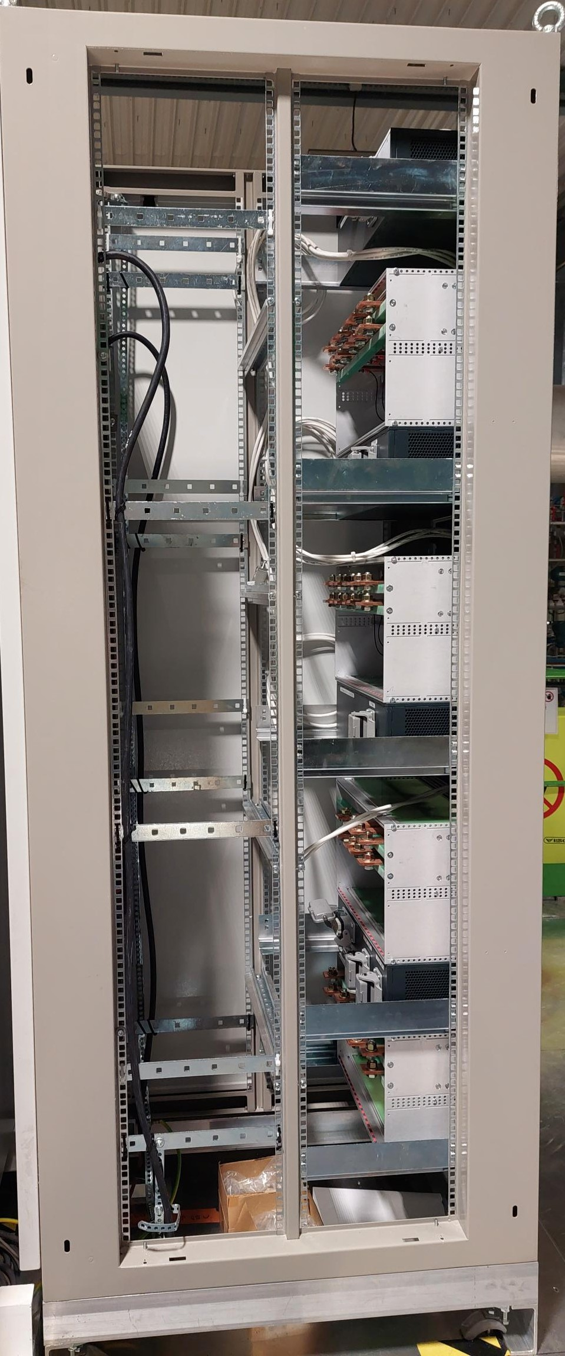
ElQA patch panel racks
ElQA patch panel racks have been introduced for the 120 A and 200 A HL-LHC circuits to
  Allow for safe disconnection and reconnection of the DC warm cables,
  Group the V-tap wires of these circuits in a common place to dispatch only the V-taps needed for the protection of the 120A circuits to power converters,
  Perform ElQA and diagnostics in low radiation area.
The ElQA rack has been installed in the IT String.
Specification in EDMS 2598227
ElQA patch panel rack in the IT String

Slide 10
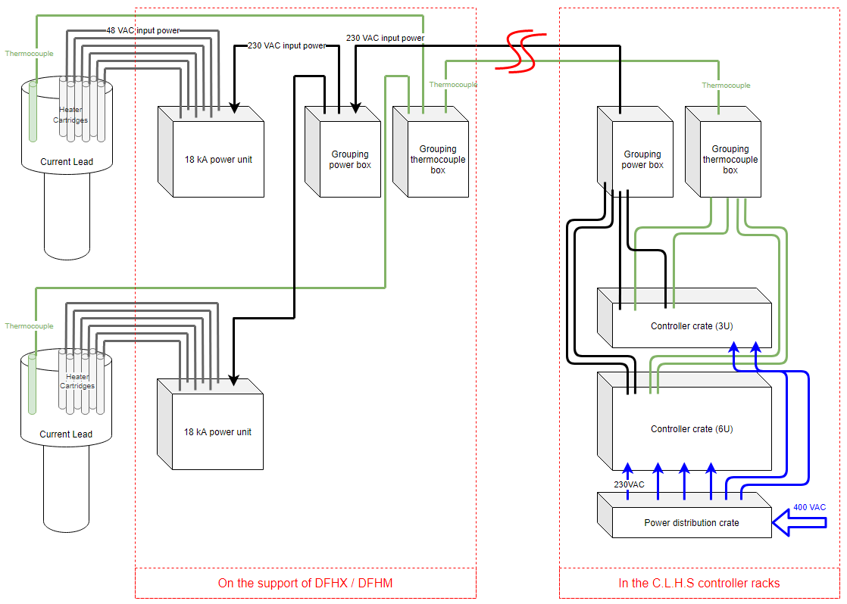
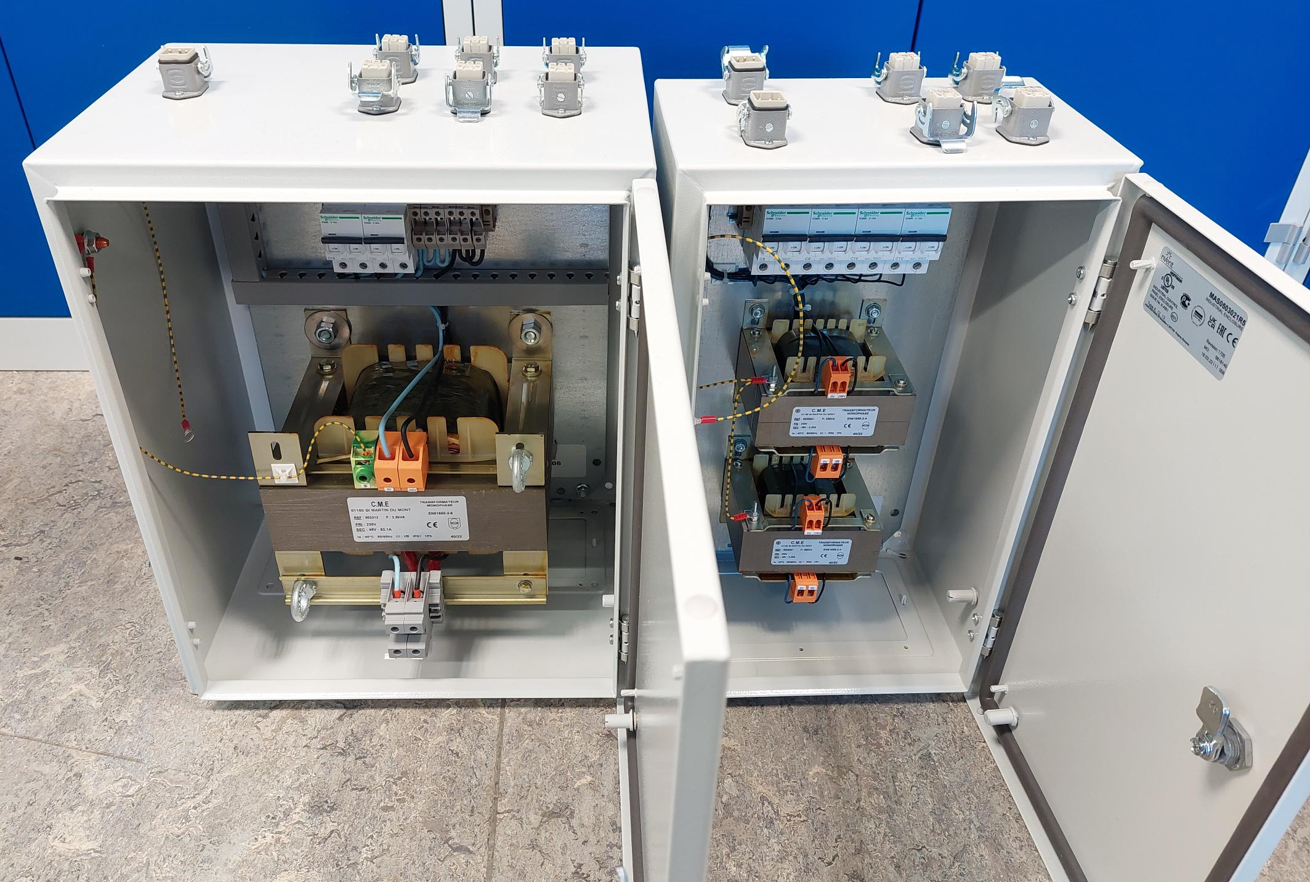
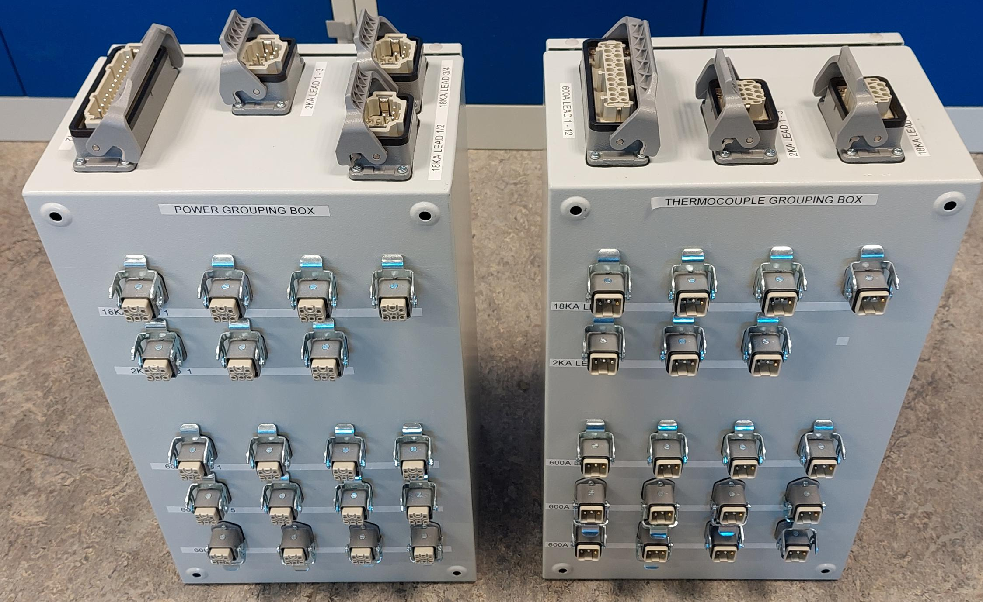
Current Lead Heater Regulator System
WP7 is providing the powering and the regulation of the current lead heaters for the DFHX and the DFHM:
  Power units (AC transformers, breakers, cabling)
  Power and Thermocouple grouping box on DFHX/M
  Power and Thermocouple (JX) cables from DFHX/M to control rack
  Dispatching box for Power and Thermocouple in the control rack
  Control crates for DFHX/M
  Power distribution crate
The assembly of the equipment for the IT String has started.
Specification in EDMS 2786821
Power boxes
Grouping boxes

Slide 11
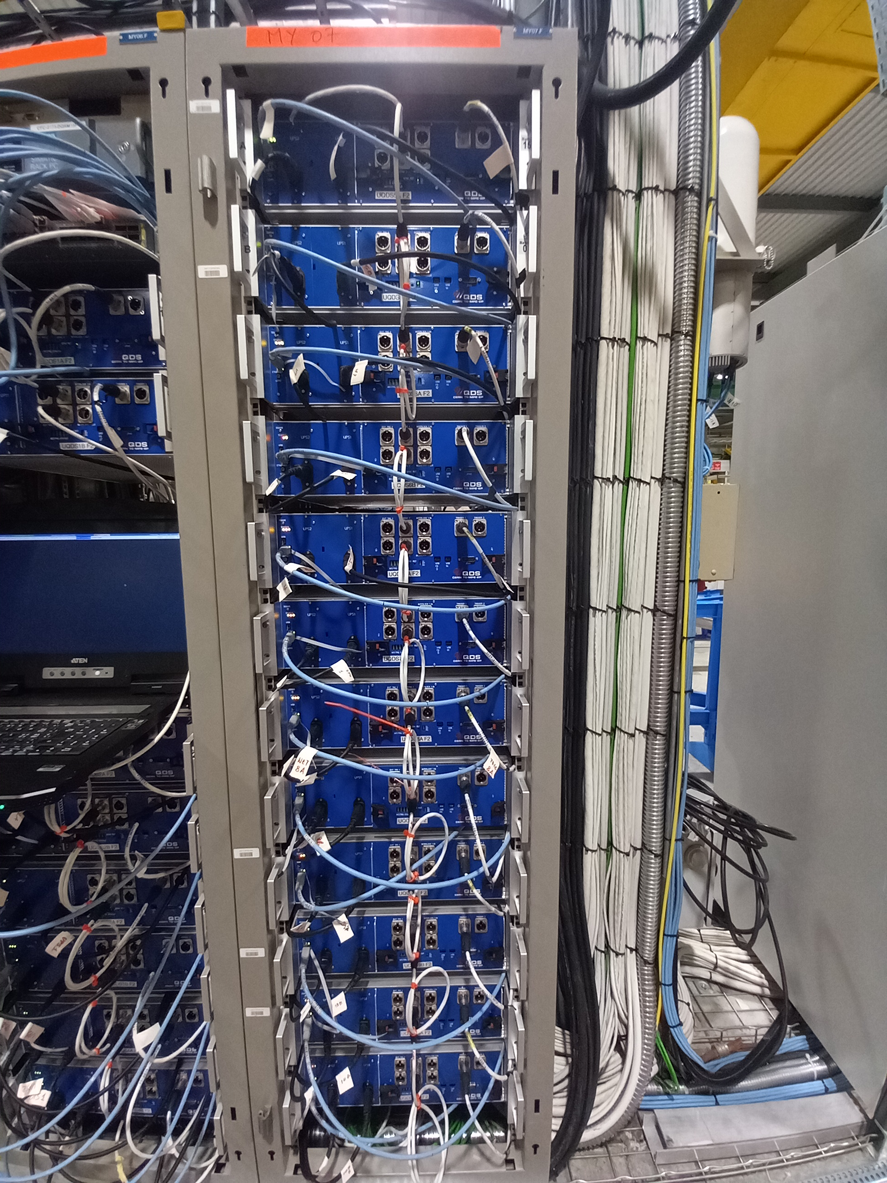
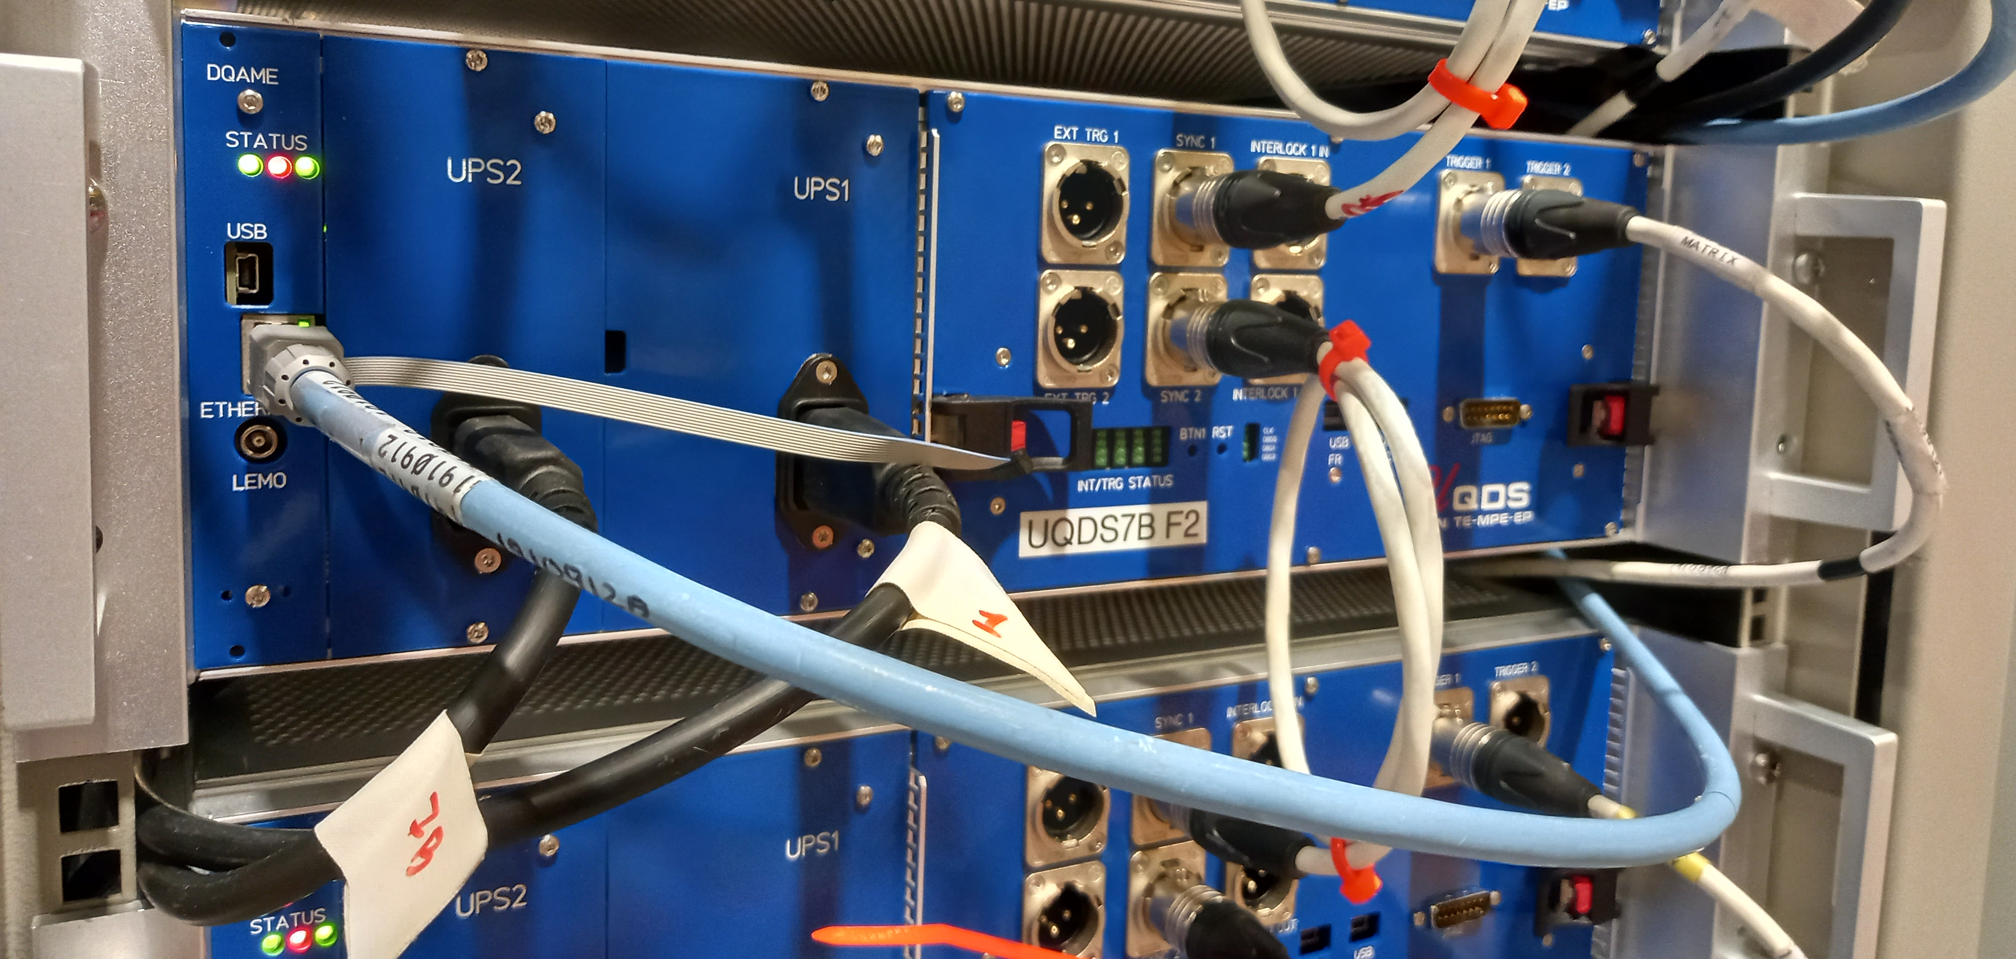
Quench Detection System
The Quench Detection System with the new ethernet based data acquisition system (EDAQ) for the HL-LHC circuits has been successfully deployed and commissioned in the SM18 test bench F1 @ CERN.
Assembly of the Quench Detection System and the Protection device supervision units (PDSU) for quench heater power supplies & CLIQ for the IT String is ongoing.
The IT String units will be supplied by June 2024.
EDAQ
UQDS in SM18
See also J. Steckert’s talk in the joint session of WP3/WP6a/WP7/WP16 Tue PM

Slide 12
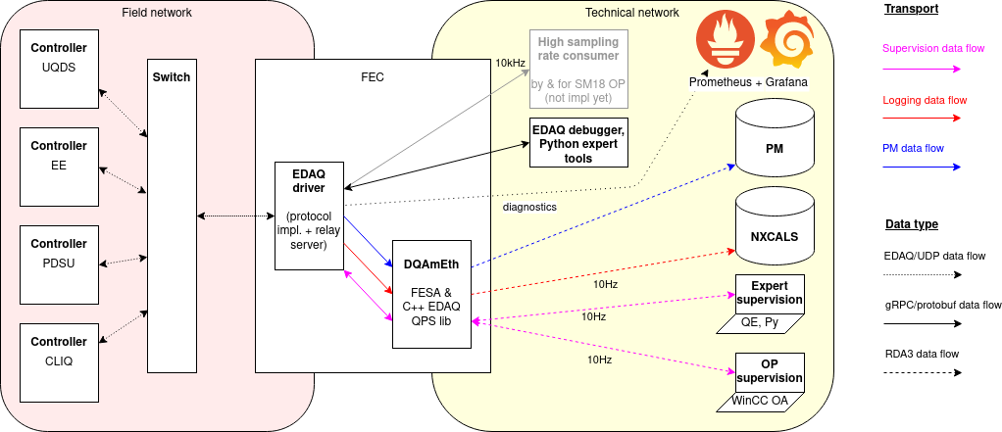
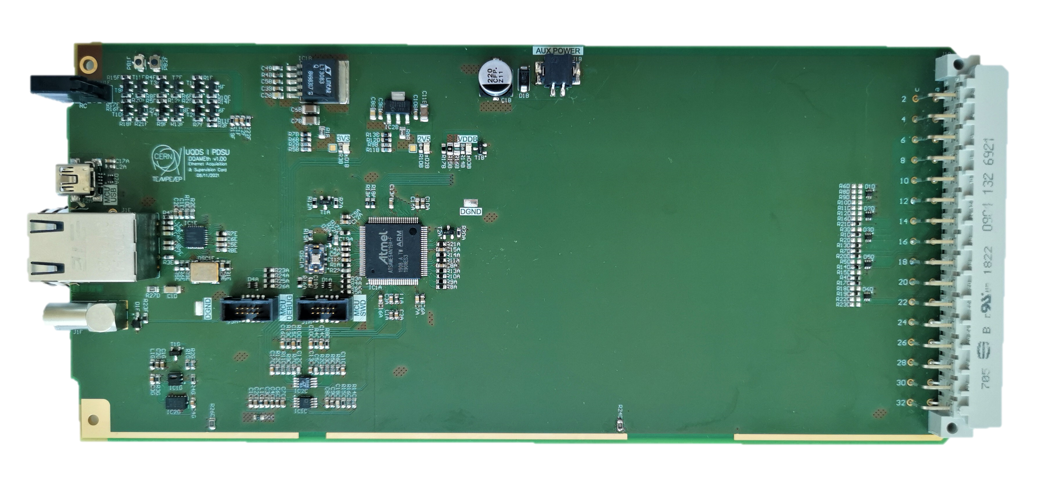
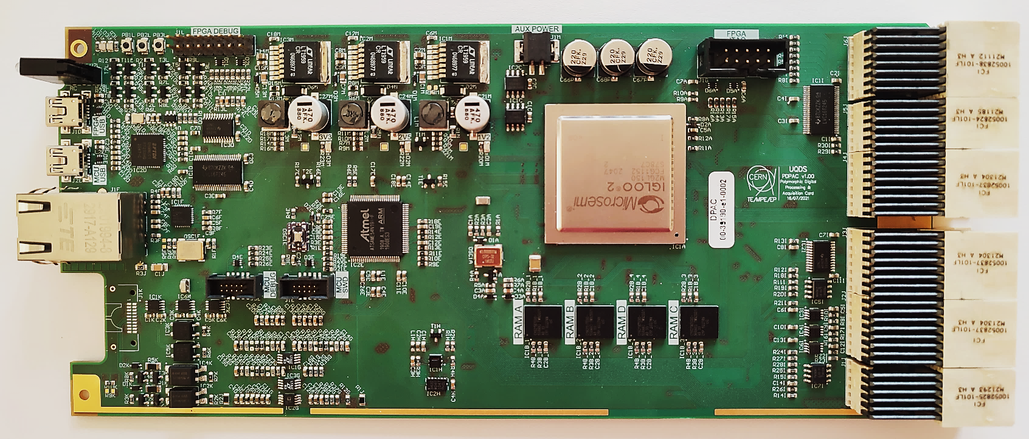
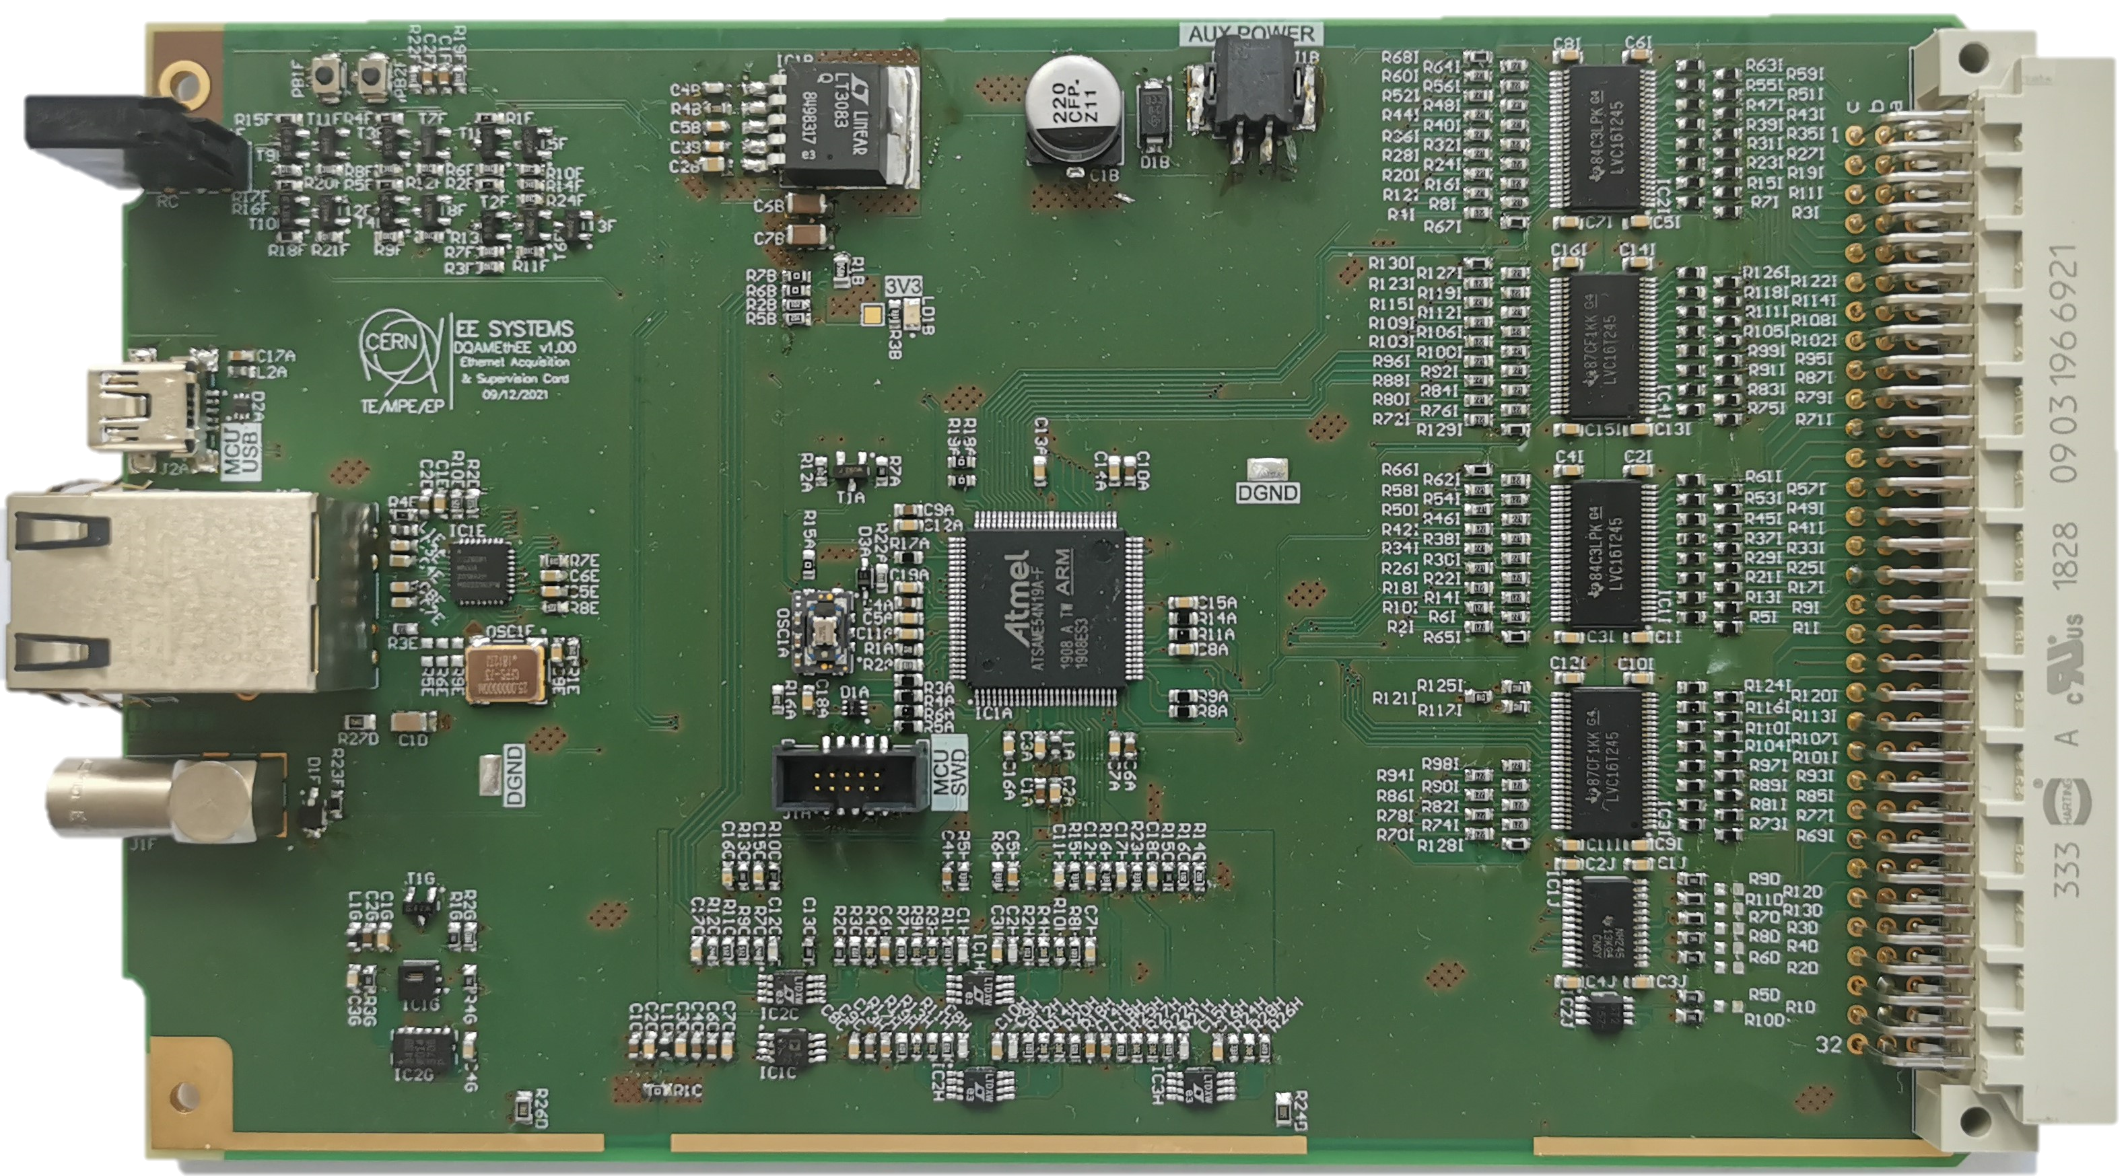
Ethernet enabled data acquisition (EDAQ)
The Quench protection systems (QDS, PDSU, CLIQ, EE) for the HL-LHC will use a novel ethernet based data acquisition system
Deployed for the first time in the SM18 testbenches @ CERN
EDAQ specifications in EDMS 2616562
EDAQ controller
Microcontroller based (Cortex M4F architecture & 100 Mbps Ethernet)
Synchronization accuracy < 1us
Data throughput > 20 Mbps
Continuous logging rate up to 10 kHz

Slide 13
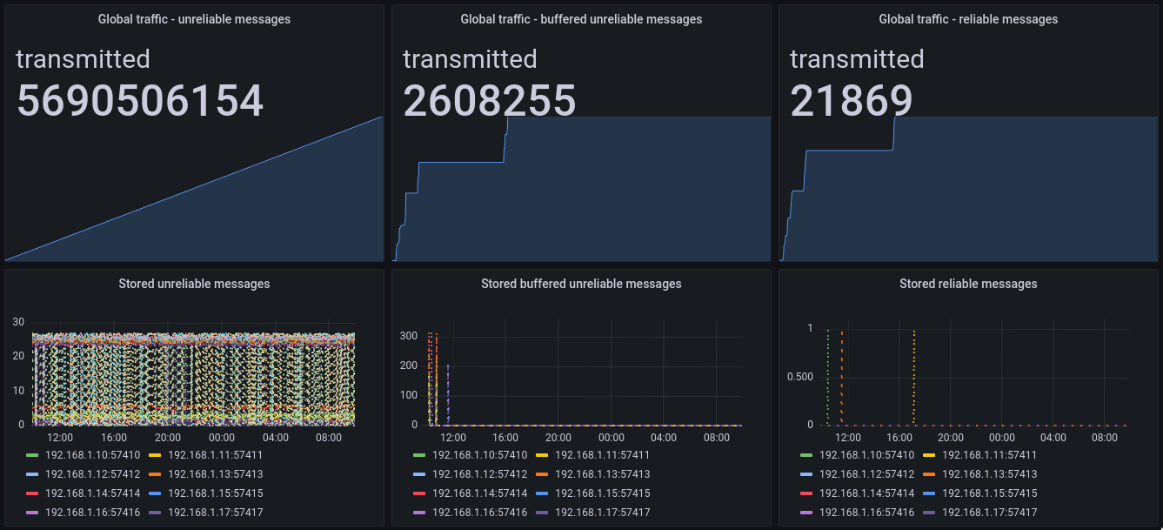
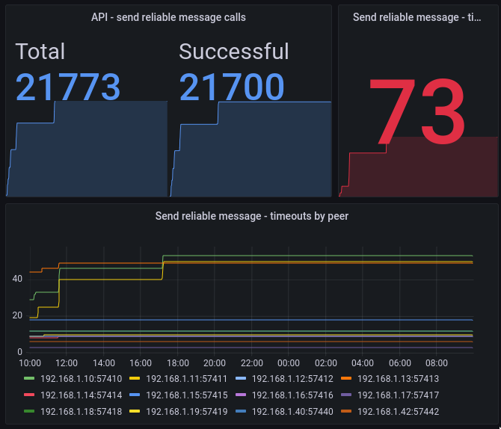
EDAQ monitoring
Logging data
Post Mortem data
Commands
Logging data queue
PM data queue
Commands queue
Overview of EDAQ traffic in the SM18 facility (24h)
Fine monitoring of commands: 73 packets lost of 21773 transmission attempts (< 0.5%)
Extensive monitoring of the EDAQ performance has been implemented in preparation for the EDAQ deployment in the IT String.
https://mpe-grafana.cern.ch/d/Skz58ImSk/edaq-sm18?orgId=1&refresh=5s

Slide 14
Outline
Status and plans for the machine protection hardware for HL-LHC
  Energy Extraction systems
  Coupling Loss Induced Quench systems (CLIQ)
  Quench Heater Power Supplies & DQLIMs
  Powering Interlock Controller
  Instrumentation Feedthrough Systems
  Cold & Warm diode stacks
  ElQA patch panel racks
  Current Lead Heater Regulator Systems
  Quench Detection System
  Ethernet enabled Data Acquisition (EDAQ)
Critical failure cases for HL-LHC & Damage studies
  Spurious firing of CLIQ
  Crab cavity failures
  Damage studies with sc. sample coils
Conclusions

Slide 15
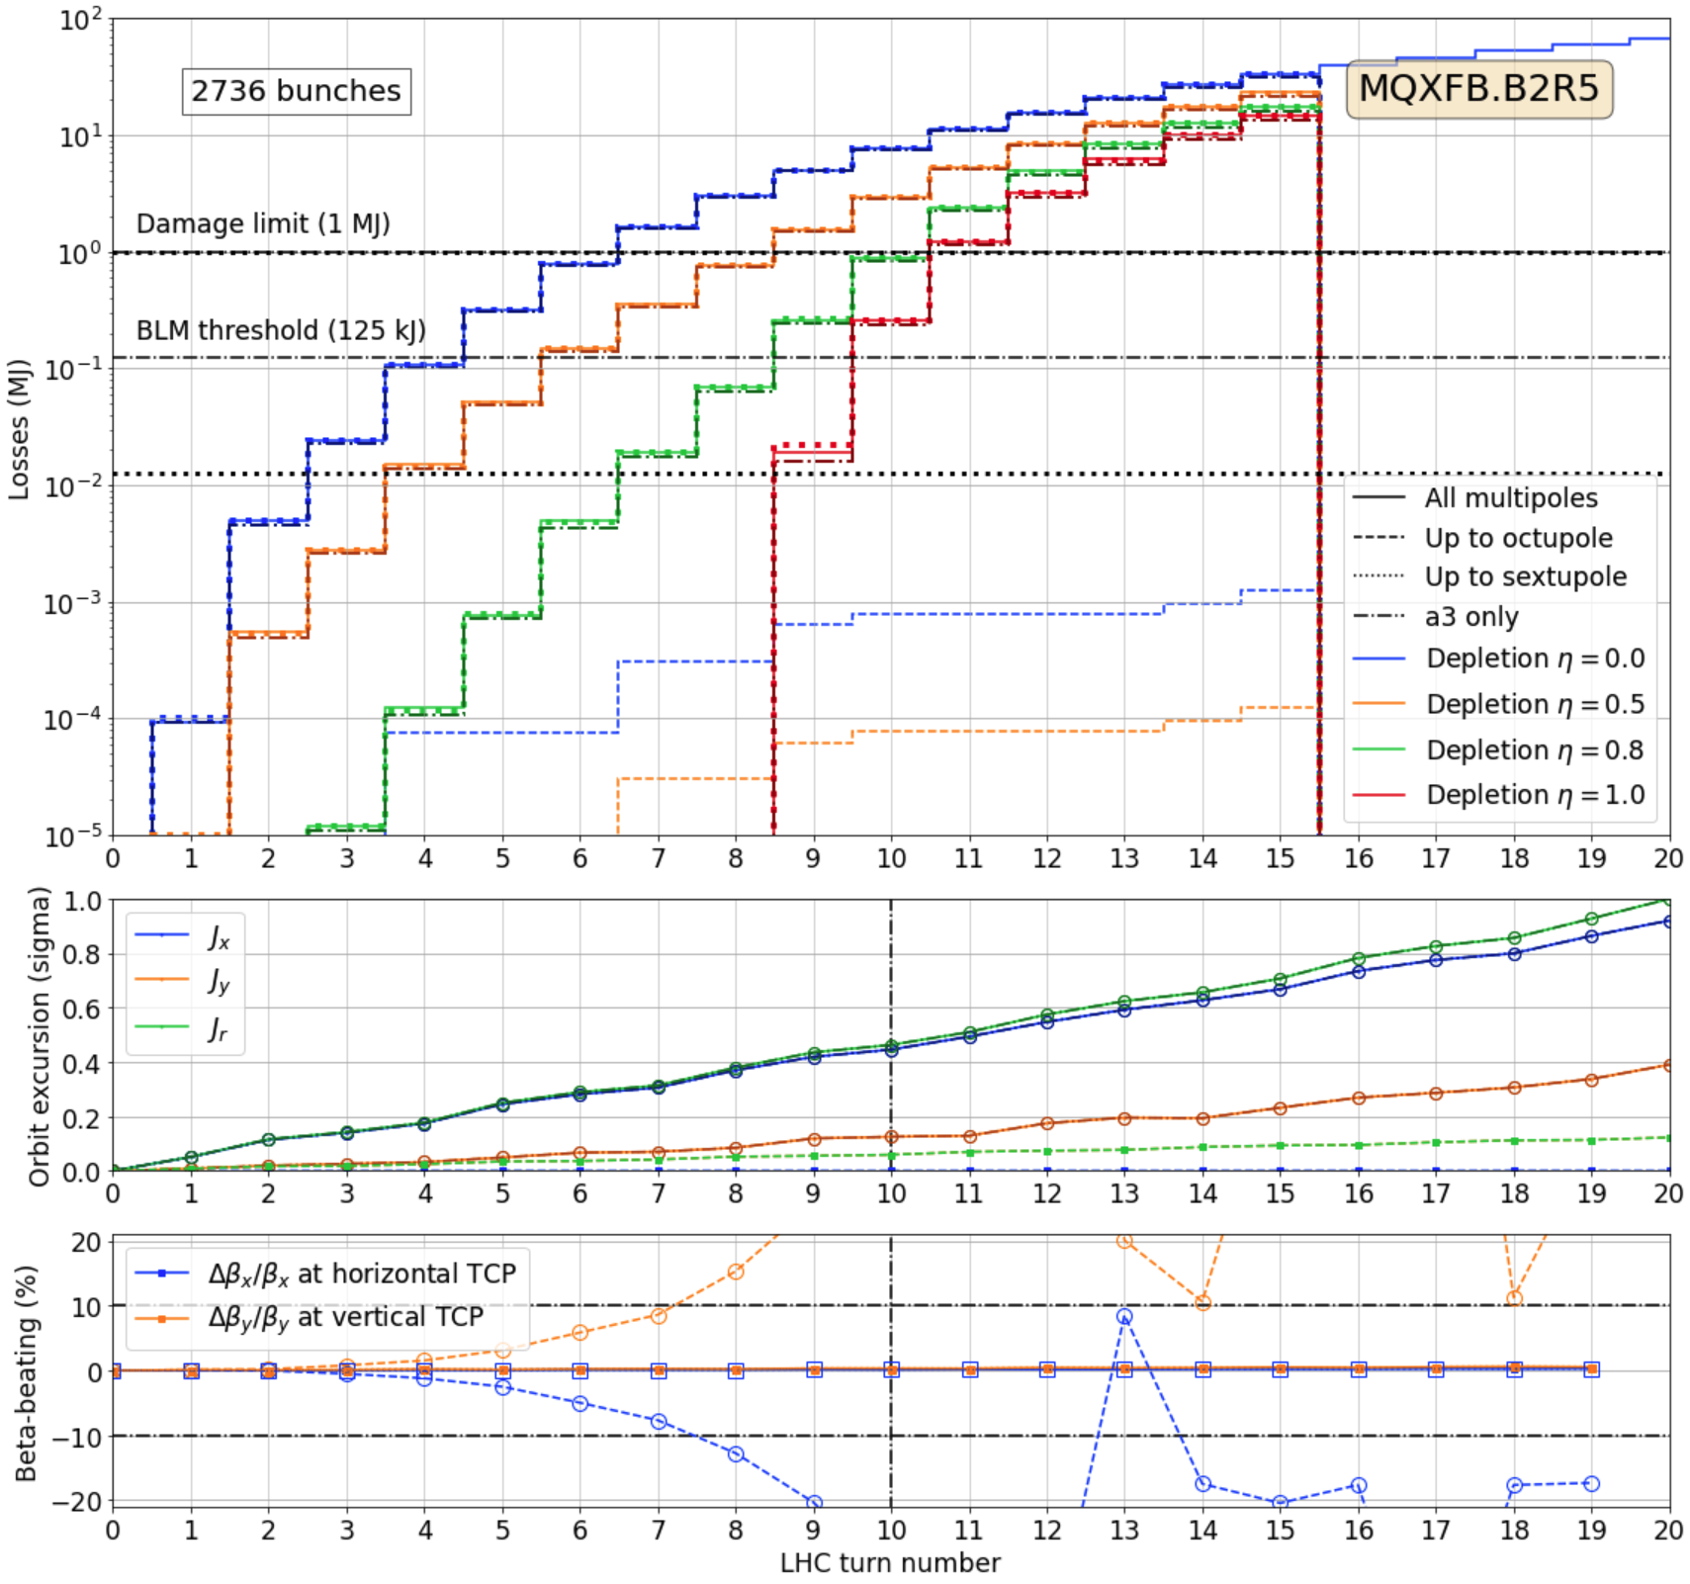
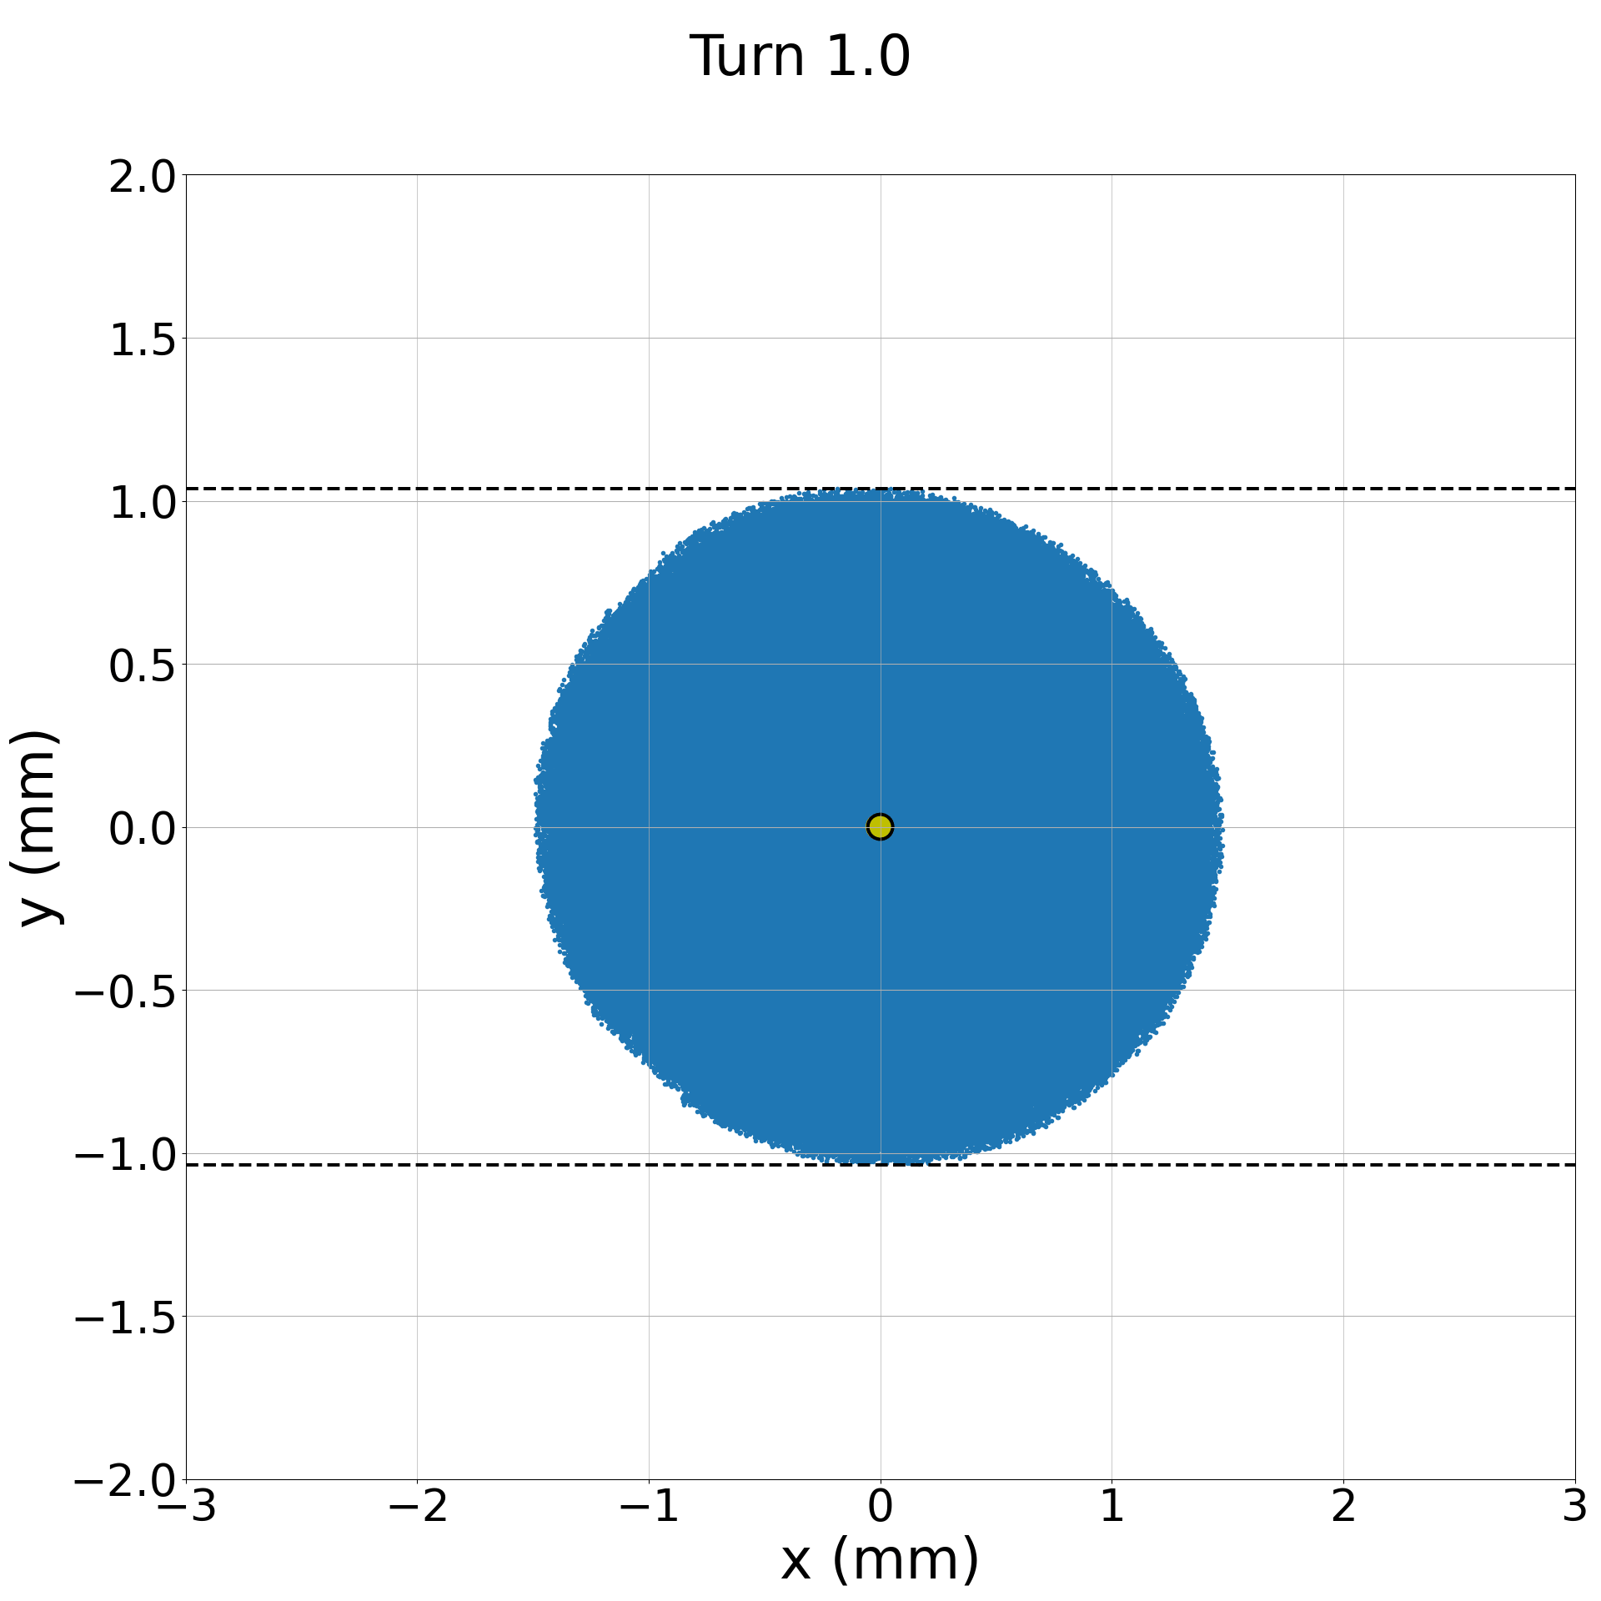
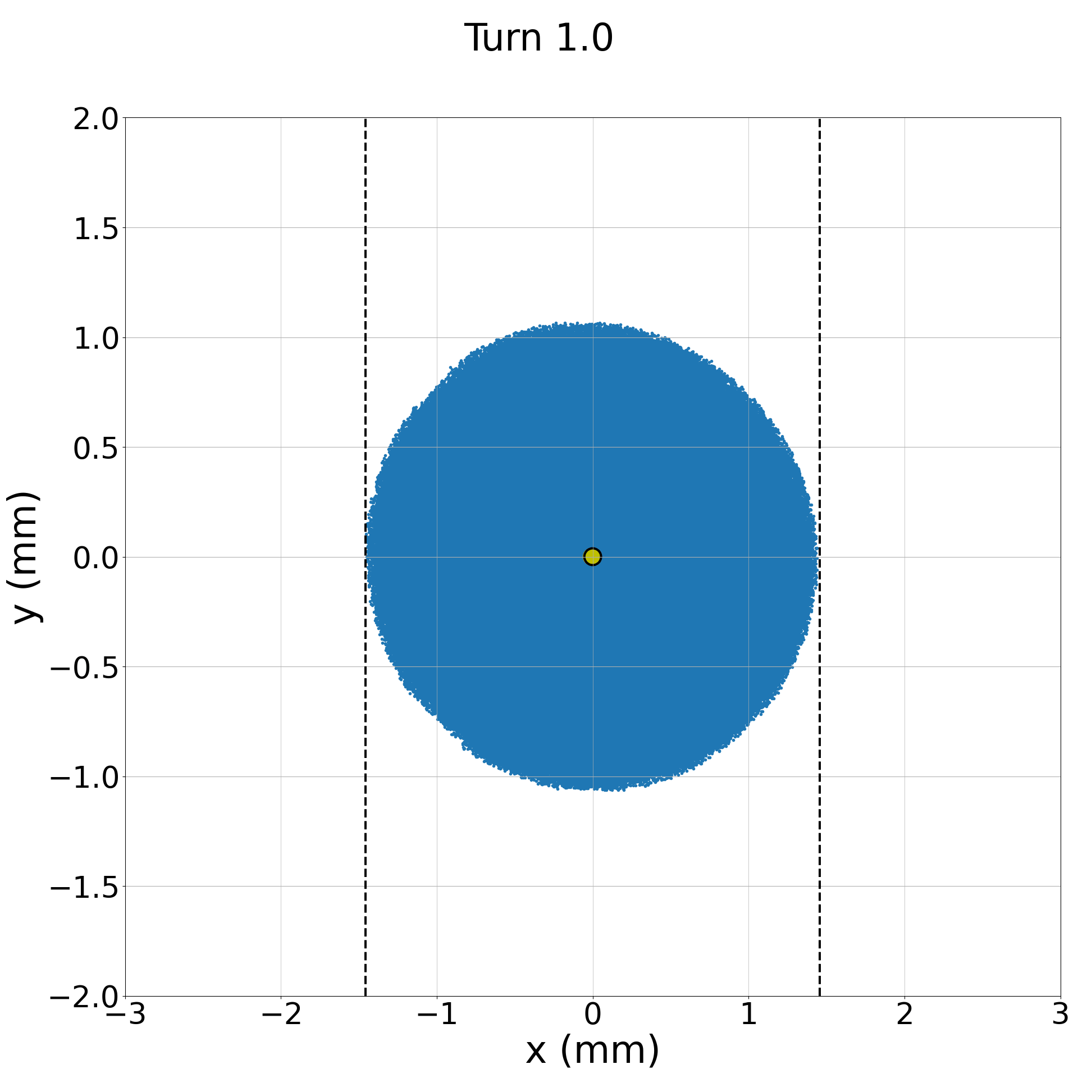
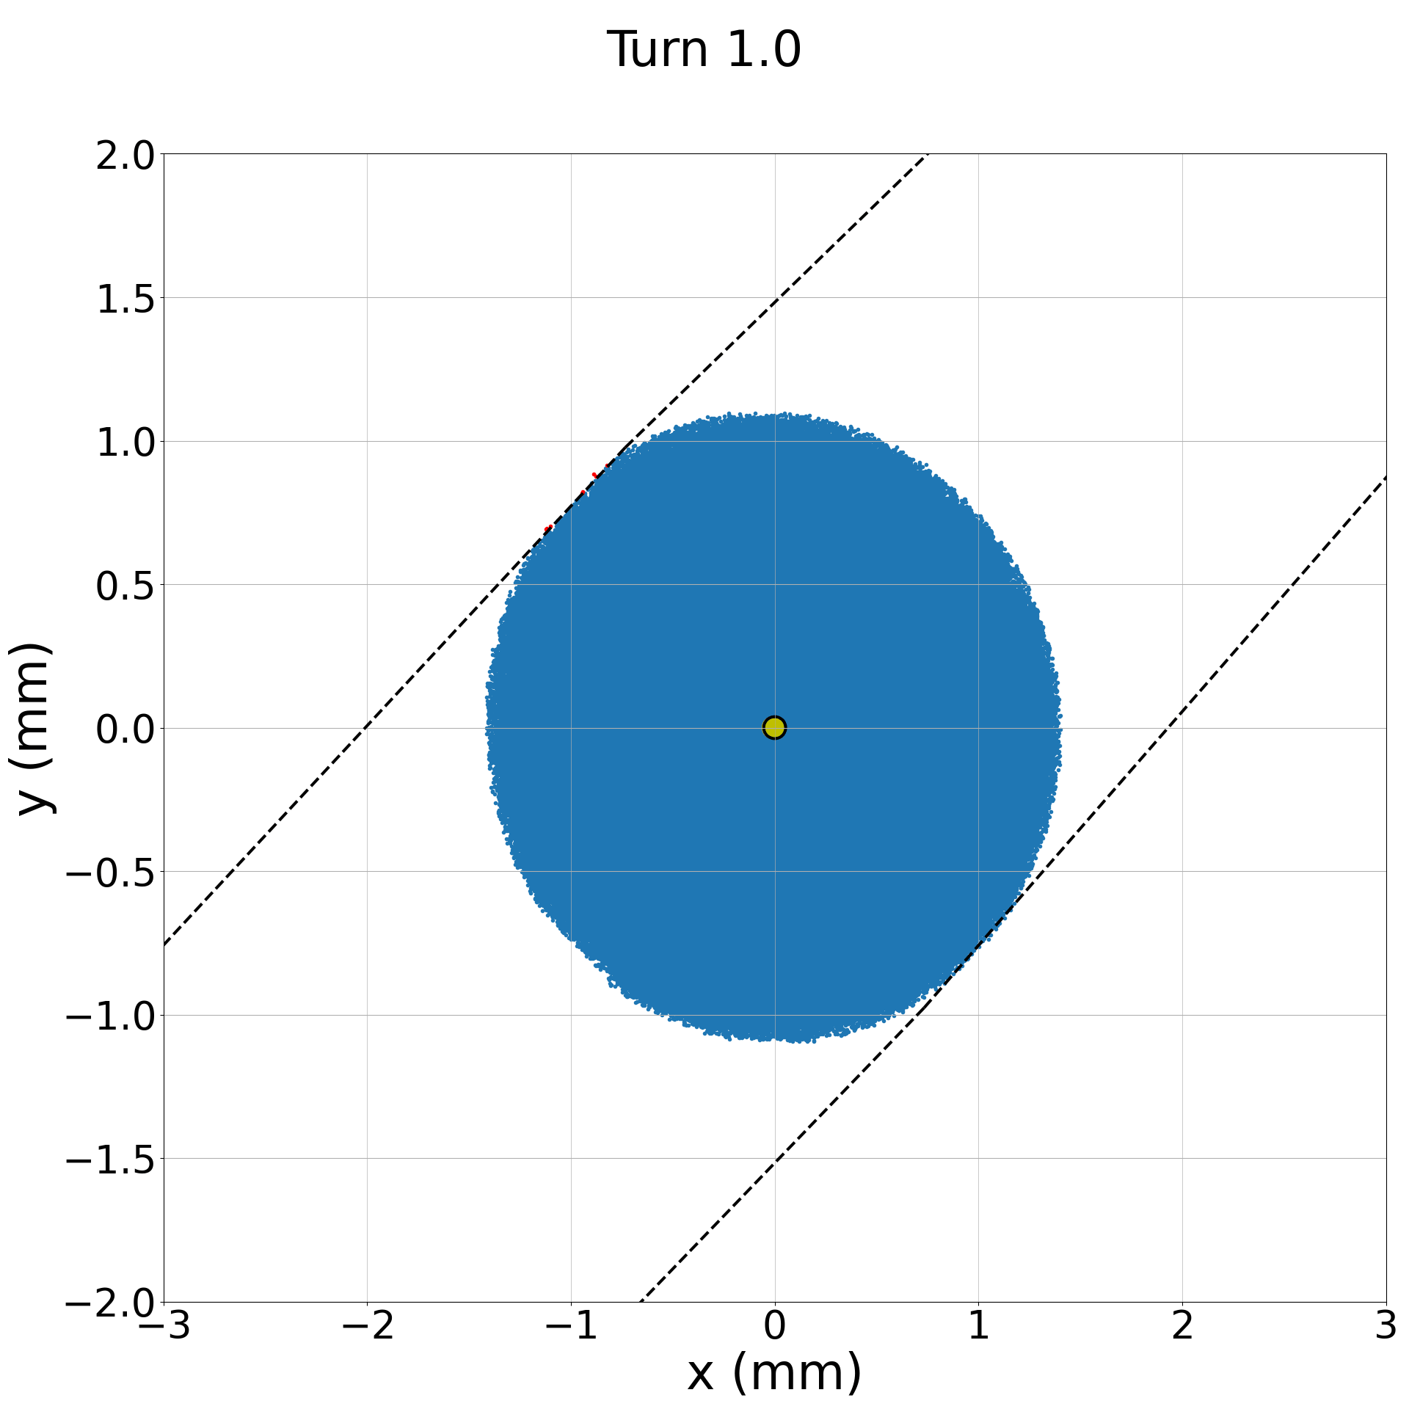
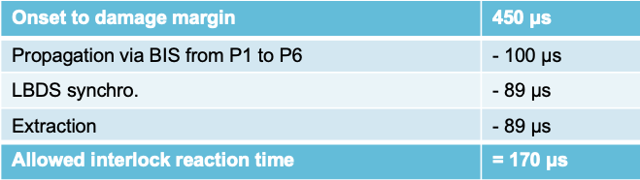
Impact of spurious CLIQ discharge on beam
The use of Coupling Loss induced Quench systems (CLIQ) for the protection of the HL-LHC triplets will introduce a new fast failure for the beam in the LHC in case of a spurious discharge of one unit
CLIQ discharge creates strong skew octupole component (same level as sum of lattice octupoles) causing a distortion of the particle distribution leading to fast losses in the collimation systems → critical loss levels reached after 5 turns.
Fast interlock will be implemented via the protection device supervision units (PDSU) directly linking to the BIS.
TCP.D6L7 (vertical)
TCP.C6L7 (horizontal)
TCP.B6L7 (skew)

Slide 16
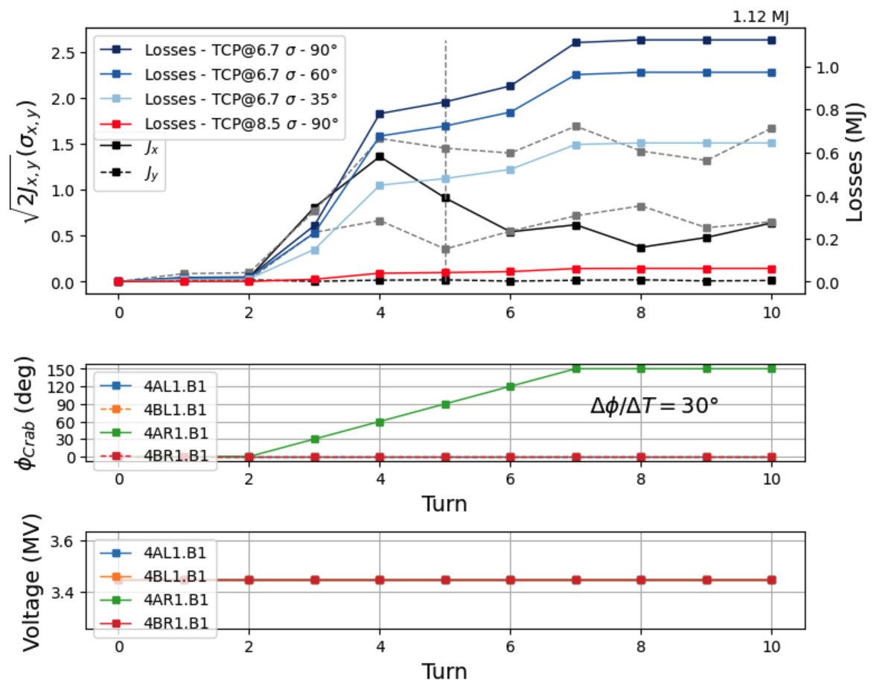
Crab Cavity failures - simulations
Phase slip
  Phase change in one crab cavity over 5 turns by 30 degree per turn
  Shift of centre of bunch by 1.4 sigma within two turns after the start of the failure
  Up to 1.12 MJ lost after 10 turns (0.8 MJ after 3 turns)
  60-degree phase advance between CC and TCP would limit losses below 1 MJ.
Fast interlocks for phase and voltage are required for machine protection.
Phase advance between crab cavities and primary collimators smaller than 60 degree will reduce their criticality.
Phase slip
Worst case 4AR1.B1

Slide 17
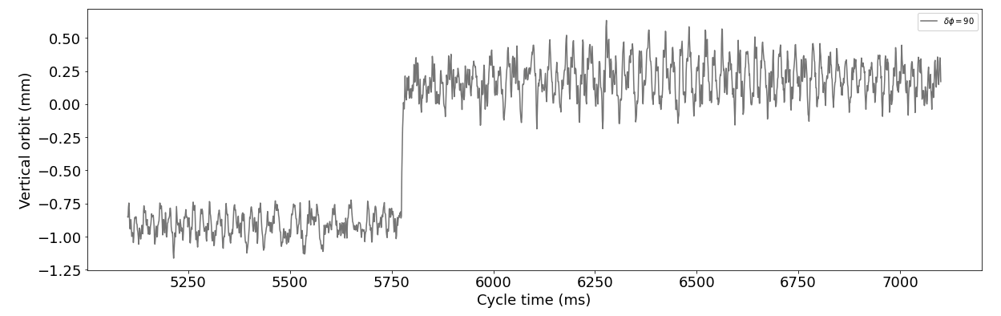
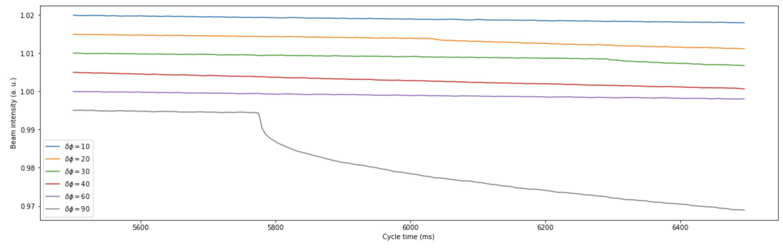
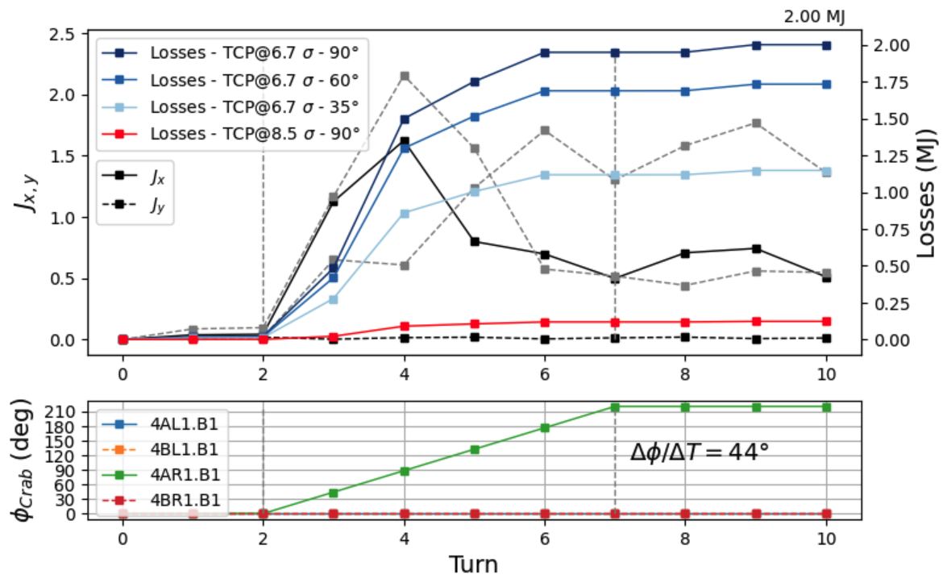
Crab cavity failures – experiments
Beam losses were observed for the 20, 30 and 90 degrees jump.
(Beam loss data could not be retrieved for the 40- and 60-degree cases)
Corresponding closed-orbit jump of
~ 1 mm followed a 90 degree phase jump in the CC in the SPS
Recently experiments to measure the impact of CC phase jump have been performed in the SPS (thanks to the RF team):
  10, 30, 40, 60, 90 degrees phase jump at constant CC voltage ➔ orbit changes have been observed for all cases and beam losses were observed (beam loss data missing for 40- and 60-degree cases).
  Measurements do not provide additional input on the dynamics of the failure case due to the limited time resolution of the BPMs (1 ms) and BLMs (5 ms) in the SPS → Simulations remain the best way to predict the criticality of the failure cases.
  The maximum achievable phase change per turn must be reviewed: theoretical limit 44-degree versus 30-degree limit observed experimentally in 2022. In case of 44 degrees the losses would increase to 2 MJ within 10 turns.
Future experimental studies on crab cavity failure cases (phase slip, quench) in the SPS require improved turn-by-turn diagnostics of the orbit and beam losses.
See also talk in the joint session of WP2/WP4/WP13 Thu AM

Slide 18
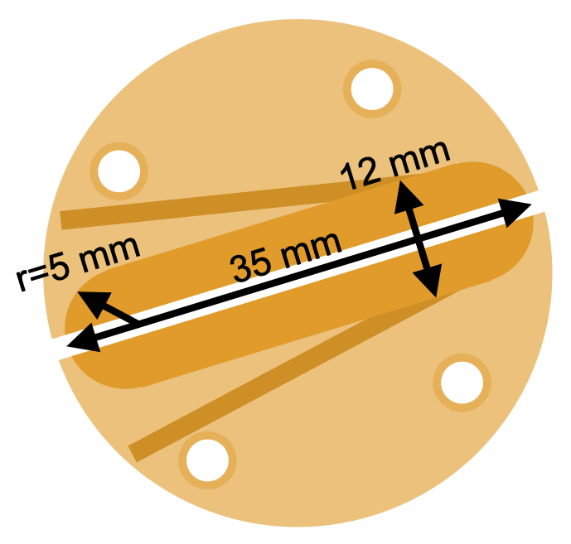
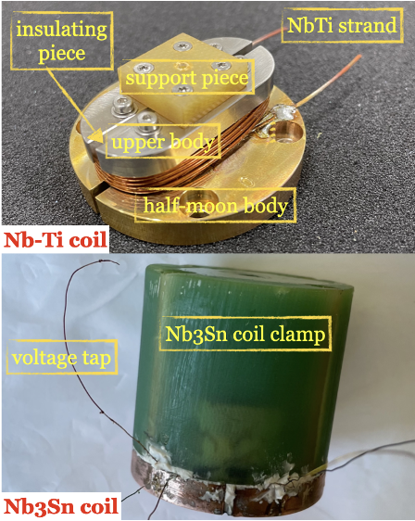
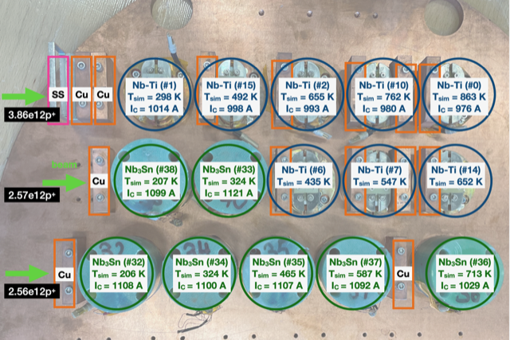
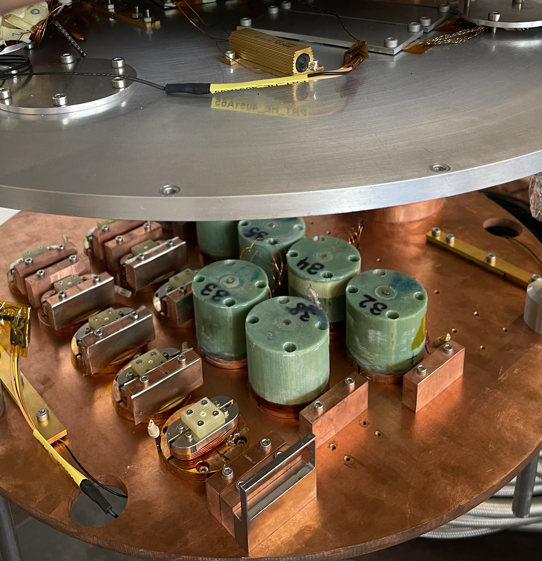
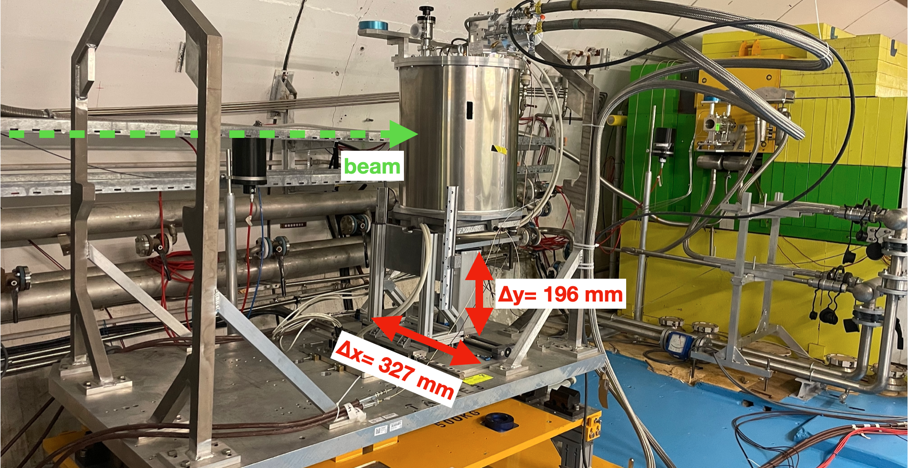
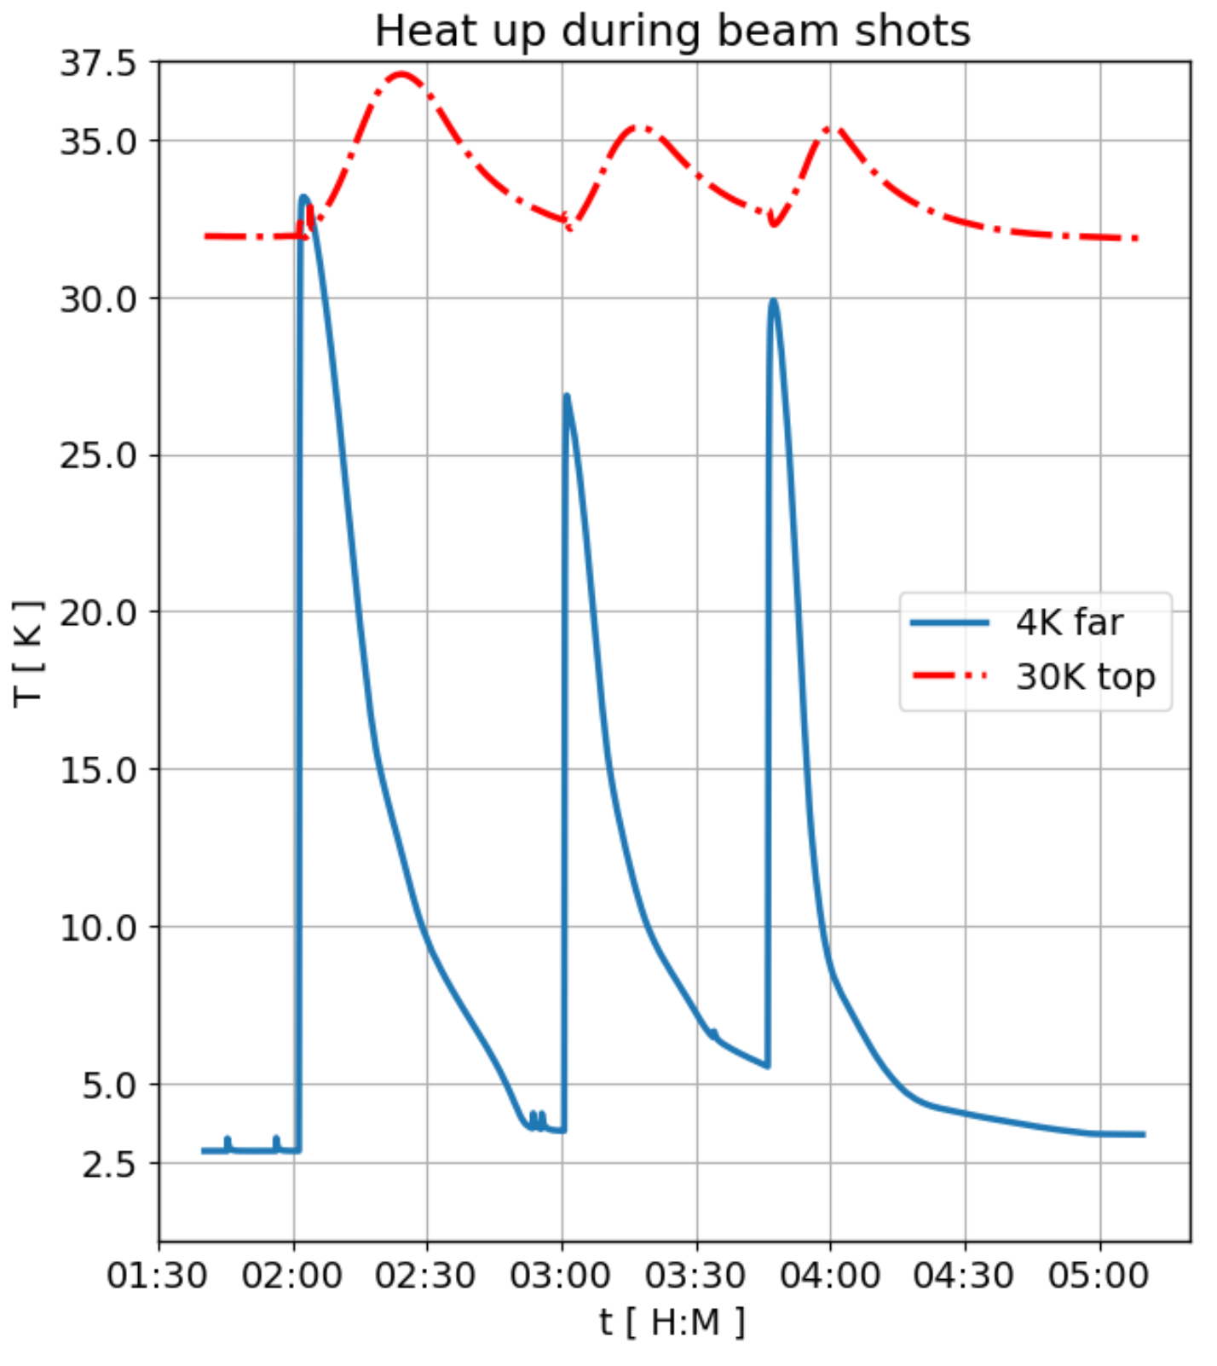
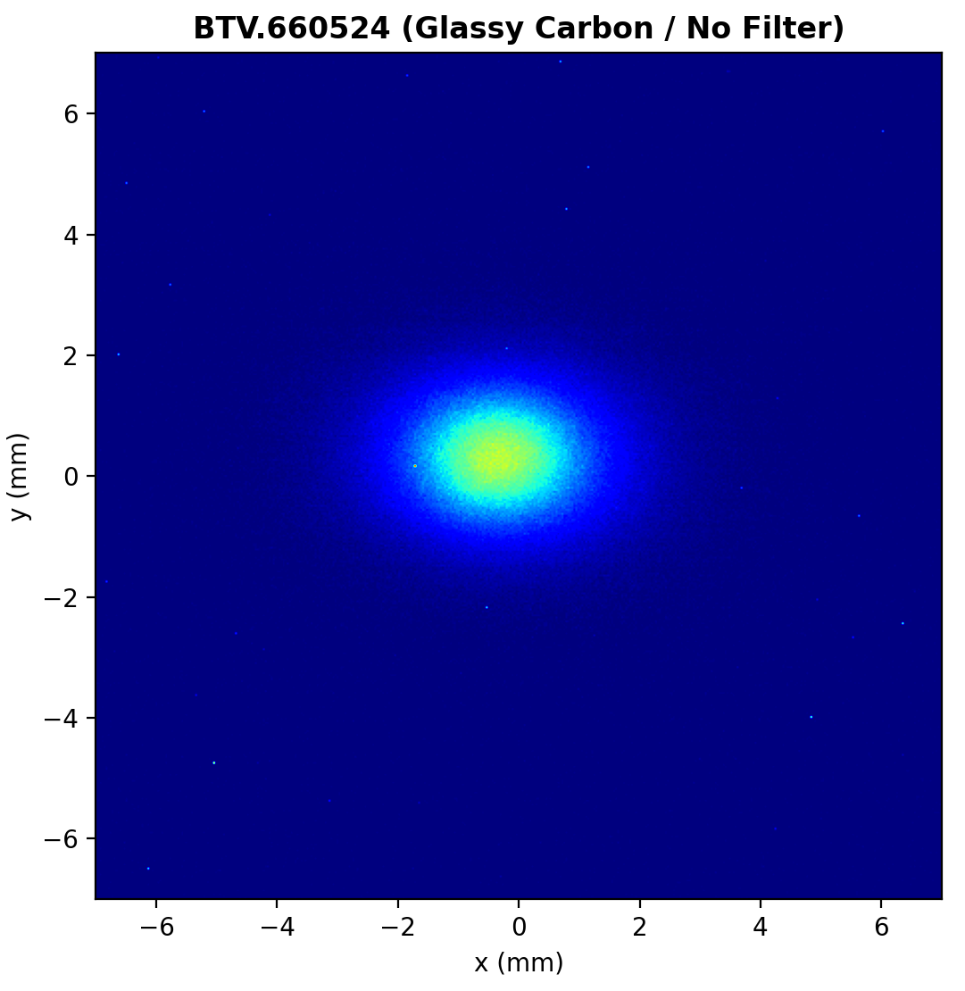
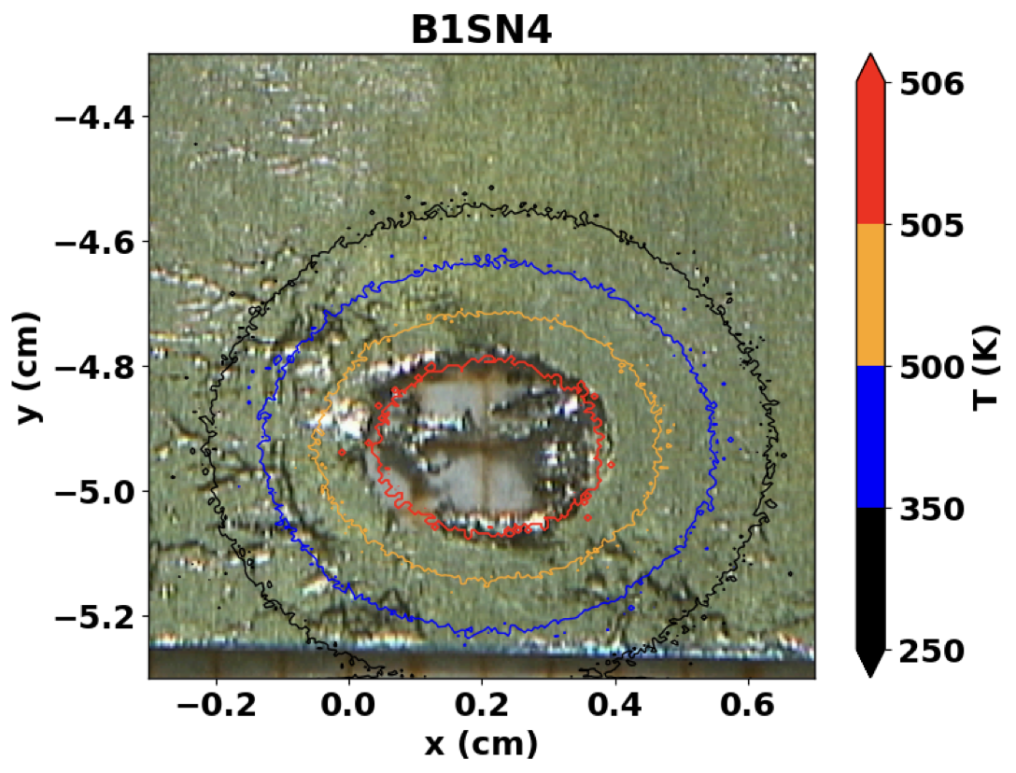
HiRadMat Damage experiment Oct 2022
Successful experiment performed in HiRadMat with Nb-Ti and Nb₃Sn sample coils at 5 K.
Hotspots reached:
  Nb-Ti: 298 K – 863 K
  Nb₃Sn: 206 K – 713 K
Coils will be qualified @ University of Geneva from October 2023

Slide 19
Conclusions
WP7 has delivered and installed a significant part of its protection equipment for the IT String – the missing parts will be added in the coming months.
The HL-LHC quench detection and new ethernet based data acquisition system have been deployed and commissioned in the SM18 test benches → important step before going into the IT String.
CLIQ and crab cavity failures will be the most critical failure cases in HL-LHC.
Future machine protection tests with crab cavities in the SPS require turn-by-turn diagnostics.
WP7 has performed a damage experiment with beam sc. sample coils at 5 K in CERN’s HiRadMat facility → impatiently waiting for the critical current measurements.

Slide 20
Thanks a lot for your attention!

Slide 21
Backup slides

Slide 22
Machine conditions and parameters assumed in the following
HL-LHC layout v1.4/v1.5 with round optics (β* 15 cm)
Collimator settings:
  Preference from machine protection and collimation to use tight collimator settings for the restart after LS3: Primary cut (TCP) @ 6.7 sigma;
  Settings of TCPs in mm similar to current Run3 settings & similar bunch intensities at the start of Run4;
  Provide maximum protection of LHC aperture and margin in the collimation hierarchy for the re-start after a long shutdown;
  Based on available aperture and operational experience (reproducibility, unexpected failure cases etc.) go to relaxed collimator settings (primary cut @ 8.5 sigma);
  Hollow e-lens (not anymore baseline), target for studied failures:
  4.7 sigma – 6.7 sigma / 6.5 sigma – 8.5 sigma
 | Assumed parameters
Beam energy | 7 TeV
Beam stored energy | 674 MJ
Bunch intensity | 2.2 x 10¹¹ p⁺/bunch (2736 bunches)
Beam emittance | 2.5 μm
Primary cut (TCP) tight / relaxed | 6.7 sigma / 8.5 sigma
Crossing angle at IP1-5 | 500 μrad
BLM threshold | 125 kJ
BCCM threshold | 340 kJ
Critical loss level (IP7) | 1 MJ
Time required to safely extract beams after detection of a failure | 270 μs (3 turns)

Slide 23
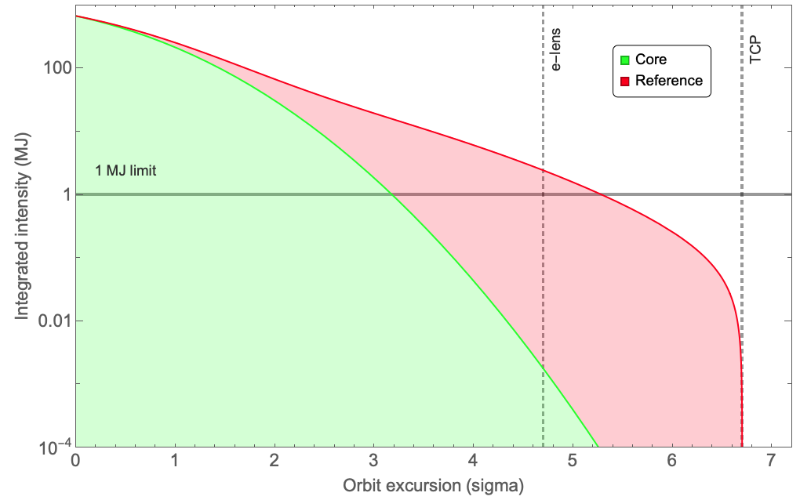
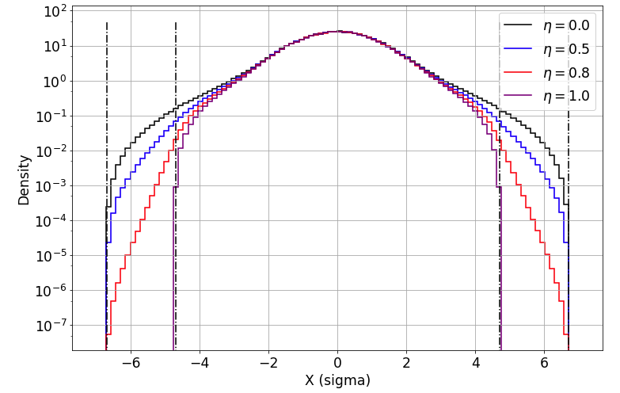
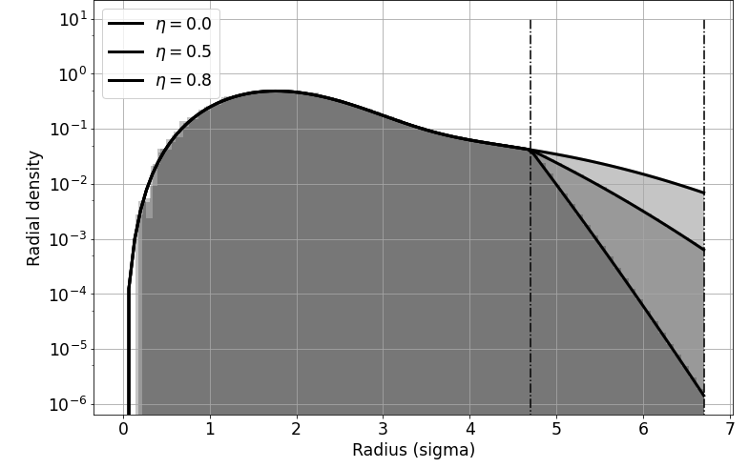
Assumed beam distribution
Double gaussian distribution derived from halo scrapings with the collimators (2.4 MJ above 4.7 sigma).
Translated into a 4 D beam distribution (sum of two modified radial χ -distributions).
For relaxed settings, halo model is extrapolated to 8.5 sigma. No re-population of halo is taken into account.
Halo depletion (e.g. by hollow e-lens) is modelled by multiplying the distribution with a modified probability density function deriving an exponential decrease in the halo between 4.7 sigma and the primary collimator cut → η := depletion factor (η= 1 for fully depleted halo).
Depleted halo
Projection

Slide 24
Crab cavity failures - Introduction
Crab cavity failures have been studied for more than 10 years:
  T. Baer, Very Fast Losses of the Circulating LHC Beam, their Mitigation and Machine Protection, CERN-THESIS-2013-233
  B. Yee-Rendon et al., Fast crab cavity failures in HL-LHC, CERN-ACC-2014-0107
  A. Santamaria Garcia, Experiment and Machine Protection from Fast Losses caused by Crab Cavities in the High Luminosity LHC, CERN-THESIS-2018-142
  B. Lindstrom, Criticality of fast failures in the High Luminosity Large Hadron Collider, CERN-THESIS-2020-318
Failure cases:
  Voltage drop: Change of voltage in one crab cavity causing unclosed crabbing
  Phase jump: Change of phase in one crab cavity within one turn
  Phase slip: Change of phase in one crab cavity over multiple turns → most critical case
As the crab cavity configuration and optics etc. have changed since the very detailed study by
A. Santamaria Garcia, we have recently revisited the cases with the following assumptions:
  Crab cavity voltage: 3.4 MV
  Bunch length (4 sigma): 1 ns
  Phase advance (90 degrees) between CC and TCP - results rescaled to other phase advances in post-processing
  Complete collimation phase space coverage

Slide 25


Crab Cavity failure: worst cases 4AR1.B1
Phase slip
  Phase change in one crab cavity over 5 turns by 30 degree per turn
  Shift of centre of bunch by 1.4 sigma within two turns after the start of the failure
  Up to 1.12 MJ lost after 10 turns (0.8 MJ after 3 turns)
Phase jump
  Phase change of 30 degree in one turn
  Shift of centre of bunch by 1.0 sigma within two turns after the start of the failure
  Up to 0.38 MJ lost within 10 turns (0.35 MJ after 3 turns)
Voltage drop
  Drop of voltage to zero within one turn
  Up to 0.59 MJ lost within 10 turns (0.5 MJ after 3 turns)
Phase slip
Phase jump
Voltage drop

