Slide 1

Beam Instrumentation: Status and plans
Vancouver, September 2023
Ray Veness on behalf of WP13
Thanks for material from:
E.Bravin, D.Gudkov, M.Krupa, T.Lefevre, T.Levens, S.Mazzoni, F.Roncarolo, G.Schneider, O.Selacek, J.Storey, C.Zamantzas

Slide 2
Scope of the talk
Task | Description | Equipment code
WP 13.1 | Beam loss monitors | BLM
WP 13.2 | Beam-gas curtain monitor | BGC
WP 13.3 | Beam position monitors | BPM
WP 13.4 | Luminosity monitors | BRANQ
WP 13.5 | High-bandwidth BPM in IP4 | BPW
WP 13.6 | Synchrotron light diagnostics | BSR
WP 13.7 | Beam-gas ionisation monitor [new technology baseline] | BGI
WP 13.8 | Long-range beam-beam compensator [not covered here]* | BBLR
WP 13.9 | Electron beam test stand [moved → WP 5.3.2.9] | -
WP 13.10 | Transport and installation [not covered here]
*Covered in a dedicated WP2/WP13 meeting on Wednesday afternoon

Slide 3
Introduction
Wide range of instrument types required for HL
  ‘Workhorse’ operation monitors such as BPMs and BLMs with strict requirements for availability and integration with other systems
  Diagnostics for beam monitoring and optimisation such as BSRT and BGI with challenging new performance specifications requiring extensive development and beam tests
‘External’ factors
  End of Russian collaborations
    BPM monitor in-kind production
    BLM ionization chamber in-kind production
    Secondary effect of HEL collaboration on BGC and EBTS
  Availability of accelerators at CERN
    Prototype testing in the SPS and LHC
    Unplanned reduction in LHC physics run
More information from
  Papers from IPAC-23, journals and the International Beam Instrumentation Conference (IBIC-23), last week
  Parallel session talks at this HL-LHC meeting

Slide 4
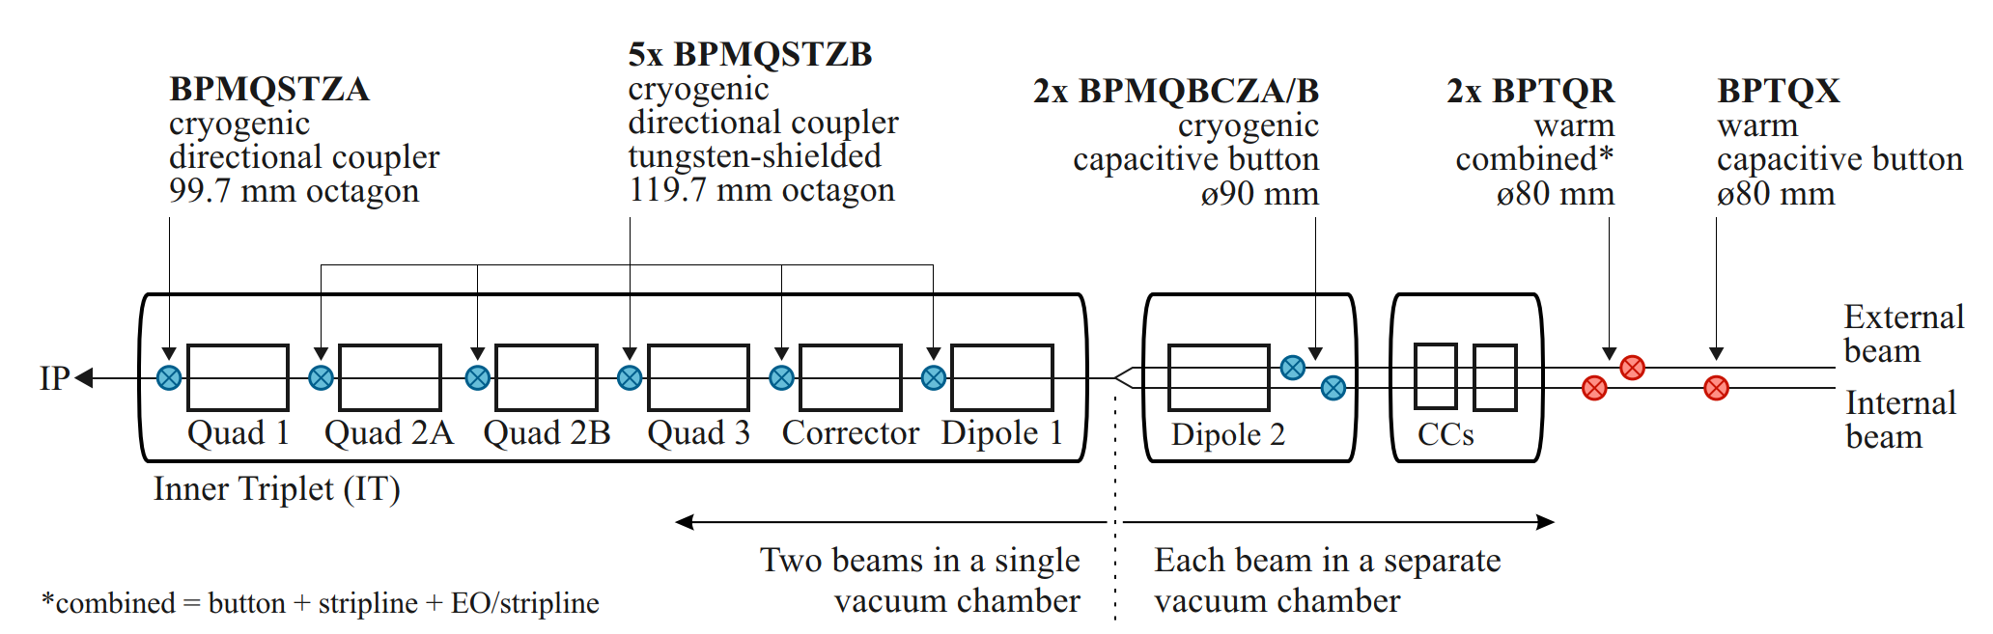
Task 13.3 New Beam Position Monitors (BPMs) - Overview
44 new BPMs to be built and installed for HL-LHC baseline
  Cryogenic ‘directional’ couplers (with 2 variants) in the triplets
    Stripline pickups sensitive to beam direction for the cryogenic combined beam sections
  Cryogenic capacitive button BPMs
    In the dual aperture separation dipole cryostats
  Room temperature BPMs for crab cavity (CC) diagnostics and experiments
    Capacitive buttons for phasing with beam and filtering of the antenna signal
    Stripline antenna for amplitude and noise feedback
    (Electro-optical) pickups for wideband measurement of beam instabilities from the CC
Crab Cavity Pick-up (M.Krupa, Thursday)

Slide 5
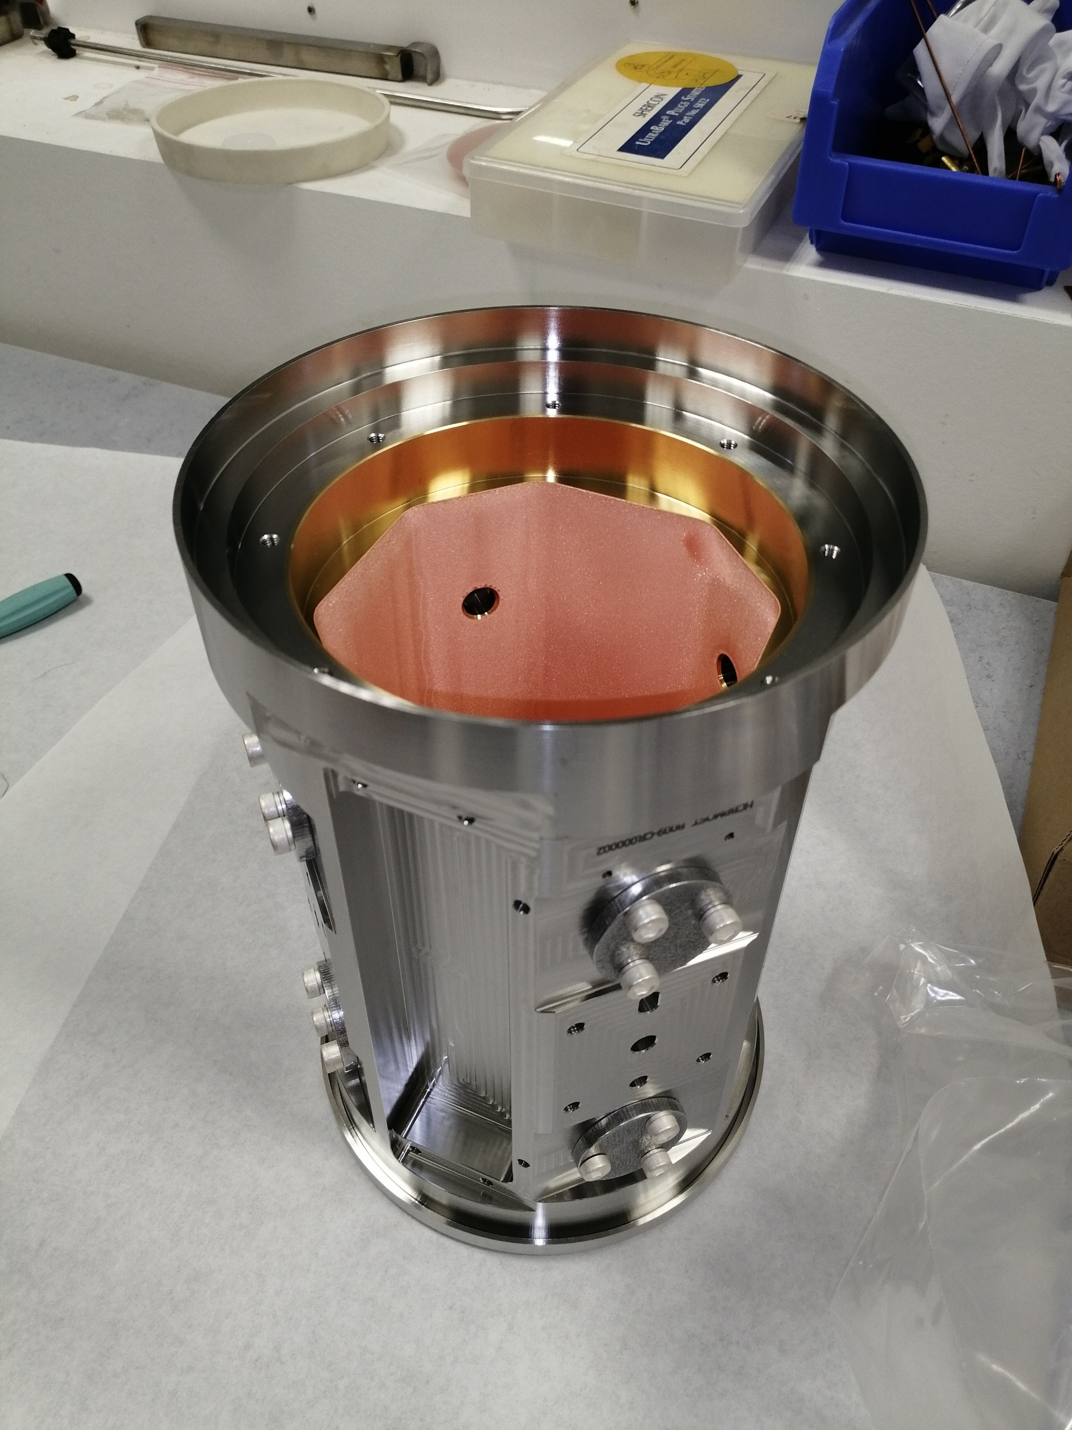
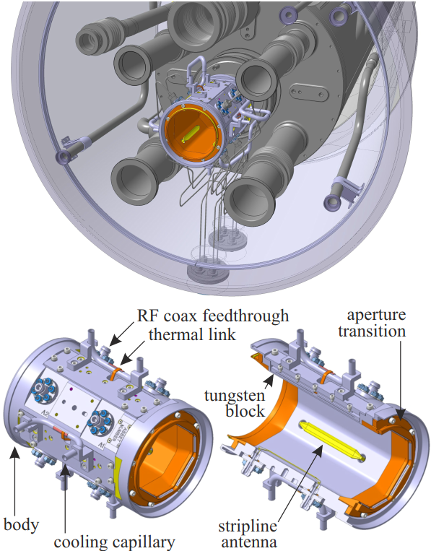
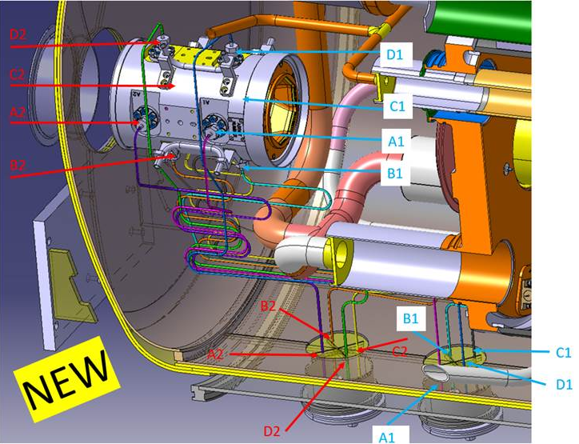
Task 13.3 New BPMs in Q1 to Q5
Design
  Octagonal body with copper transitions
  Gold, copper and aCarbon coated
  Integrated tungsten absorbers with active cooling
  Memo update released defining responsibilities for integration, including BPM-beamscreen assembly
    WP3, WP12, WP13, WP15.4
Status of cryo-BPM body production
  Production moved in-house (MME/VSC) following termination of Russian collaboration
    Design frozen following Production Readiness Review in October 2022
    5 pre-series bodies have been successfully produced
    Coatings and cooling tube integration ongoing
    Series of 33 plus spares in production
    Cryo-cable integration and installation access in progress
  Market survey launched for 558 cryogenic SiO2 RF cables (WP13 + WP5.2)
Coated pre-series body at CERN

Slide 6
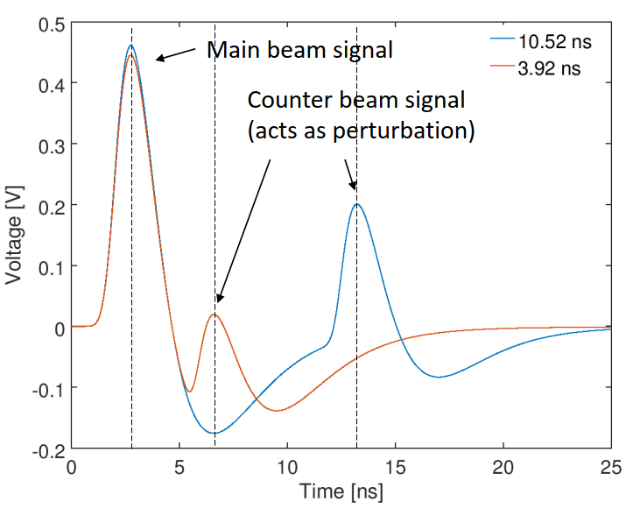
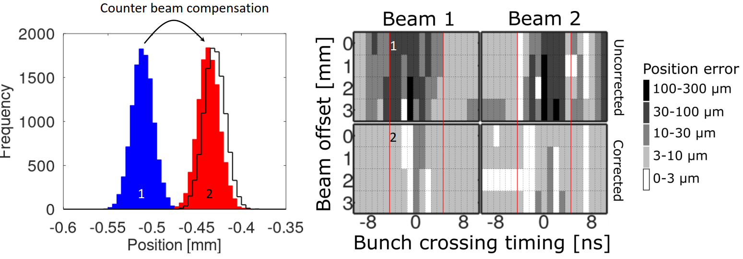
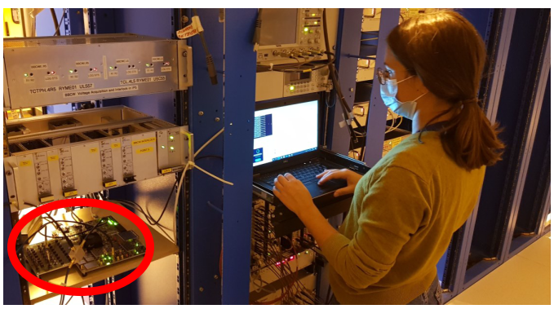
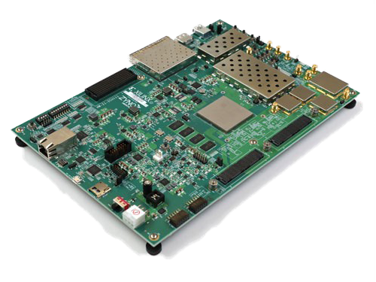
Task 13.3: New BPM acquisition electronics in Q1 to Q5
Good progress with development of proof-of-principle data acquisition system
  Based on a commercial evaluation board with a state-of-the-art RFSoC chip
  Integration into CERN controls infrastructure (Linux, FESA, timing etc.) has been demonstrated
  CTTB decisions on SoC strategy at CERN are key to the project timeline
  In-contact with potential vendors with the CERN procurement team
Testing in CERN accelerators in-progress
  Large amount of beam data acquired during a dedicated MD in 2022; fully analyzed with main results published at IPAC
  Electronics recently installed in SPS to develop integration with timing and controls infrastructure
Custom analogue and digital front-end extension boards under design
https://www.ipac23.org/preproc/doi/jacow-ipac2023-thpl089/index.html
https://www.ipac23.org/preproc/doi/jacow-ipac2023-thpl119/index.html

Slide 7
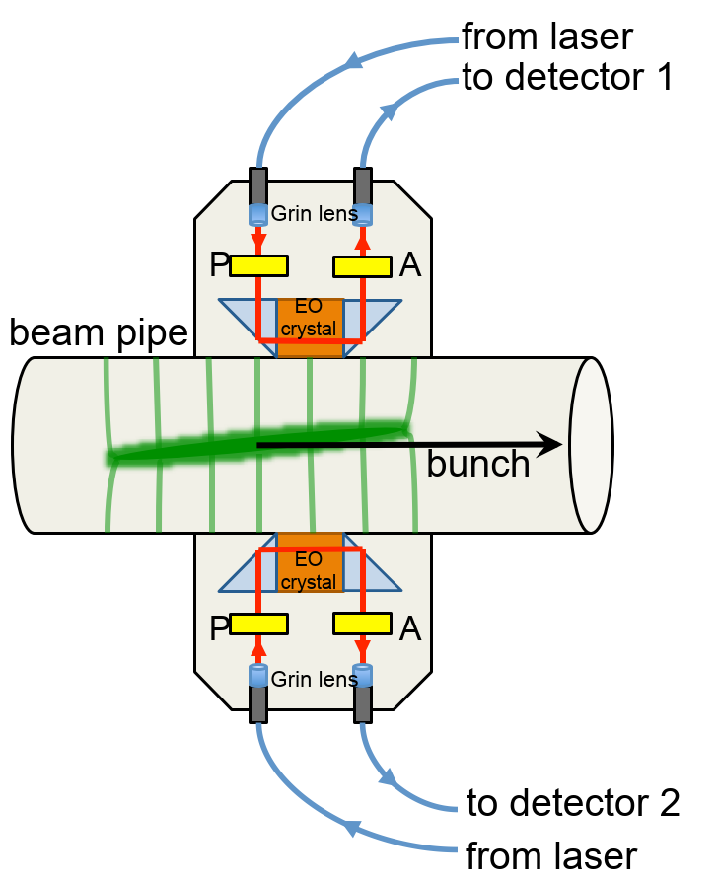
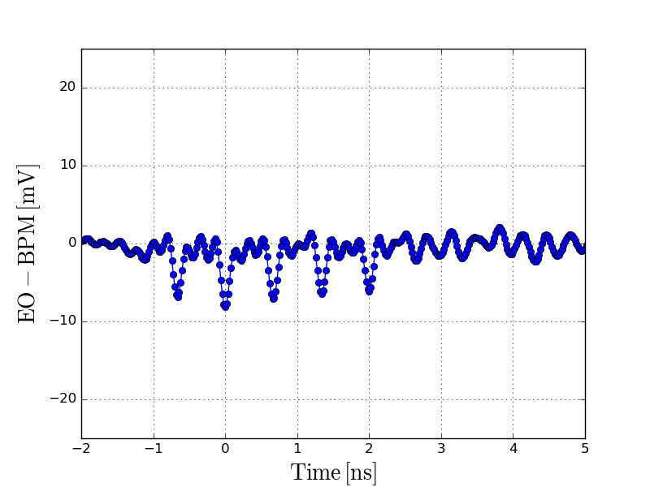
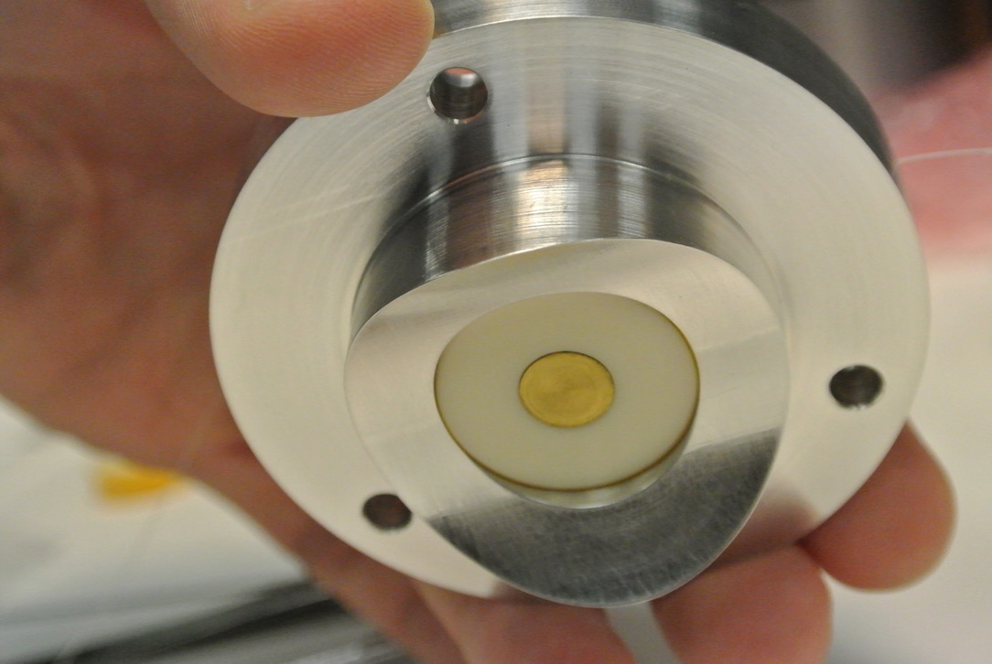
Task 13.5: Electro-Optical BPM
Upgrade to existing head-tail directional pickup
  Higher bandwidth (>6 GHz) for transverse resolution along a crabbed HL-LHC bunch
  Developed with Royal Holloway University of London as part of HL-UK
Status and plans
  SPS tests 2016-2018 followed by new device development
  HiRadMat tests in 2021 for single shot bunch resolution
    171 mV/mm gradient measured
  Bandwidth tests in CLEAR 2022
    Time resolution well within the <50 ps required for HL-LHC
  New SPS device being constructed
    Planned installation in SPS YETS 23-4
    Some pickup brazing issues recently found
Measurements in CLEAR: Train of 5 bunches spaced by 666ps (above) and Single bunch (2ps bunch length) measurement (below)
Electro-optical BPM principle (above) and new e-o pickup (below)
  EO BPM studies & PU for CC diagnostics (T.Levens)

Slide 8
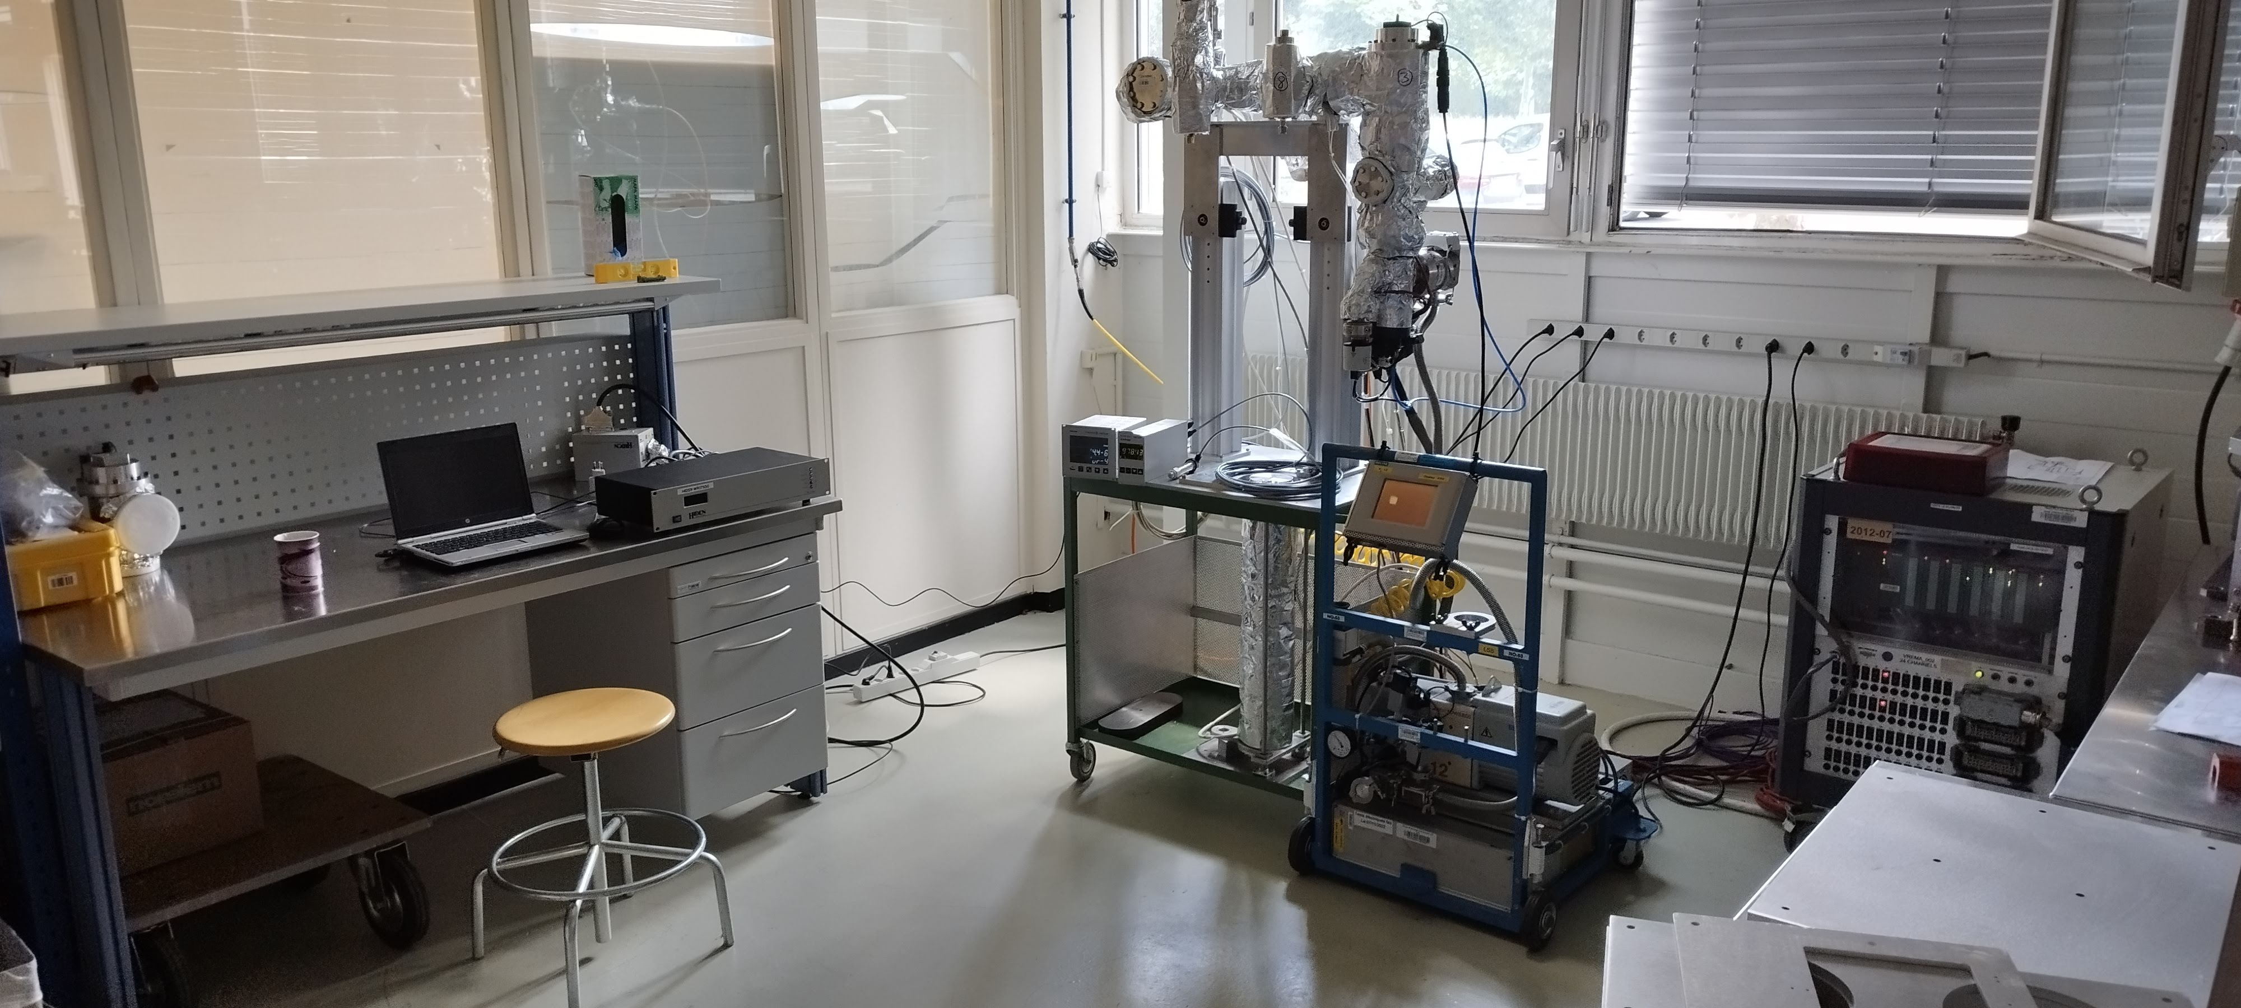
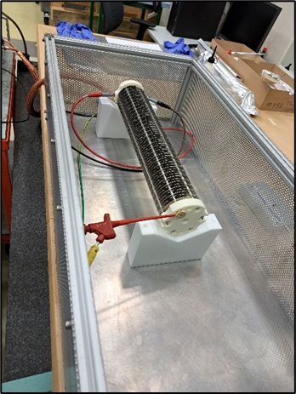
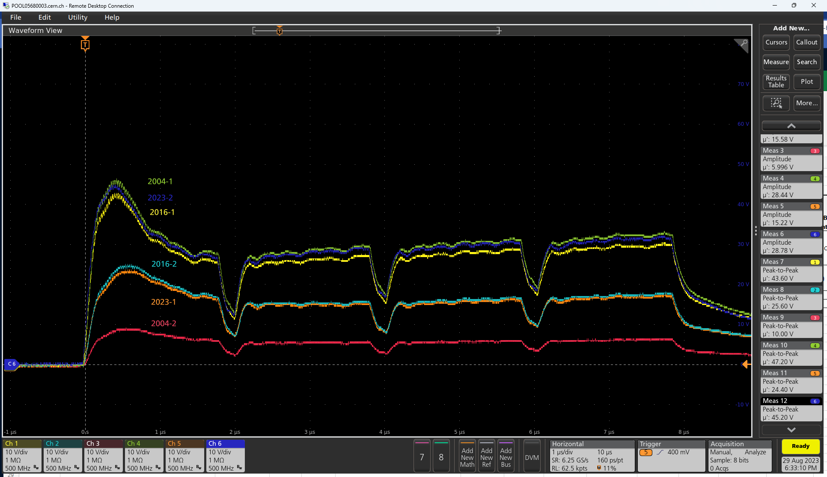
Task 13.1: Beam Loss Monitor (BLM) New Ionisation Chamber (IC) Production
HL-LHC requires extension of existing BLM coverage with many new ICs
Large-scale IC production following end of Russian Collaboration
  1000 to produce for LS3, of which 200 for HL-LHC.
  Reverse engineering of design and production process with much help from EN-MME and TE-VSC
  Accelerated production of protoypes in 2022-3 along with the assembly stand needed for bakeout and gas filling
Recent successful preliminary tests in HiRadMat
  Two CERN-produced prototypes installed next to beam dump
  Comparison of beam loss signals for the three different production lots (2008, 2016, 2023) show acceptable dispersion
  Dedicated beam time planned for 2024
Strategy and resources being assembled for series production
  In-house vs. outsource, but materials and production quality are critical to ensure performance in this key instrument
BLM electrical resistance test stand
BLM filling and bakeout stand
4x42 high intensity bunches on a BLM cluster in HiRadMat (August 2023)

Slide 9
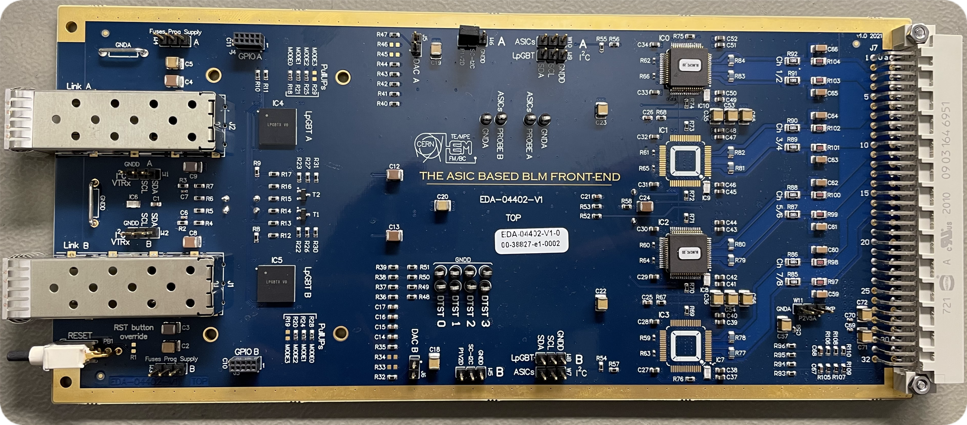
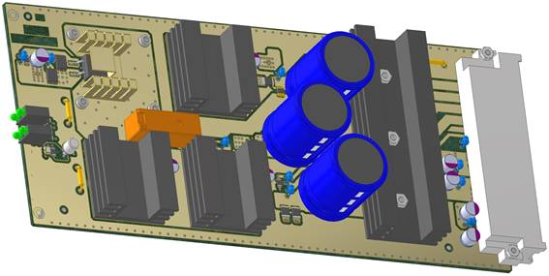
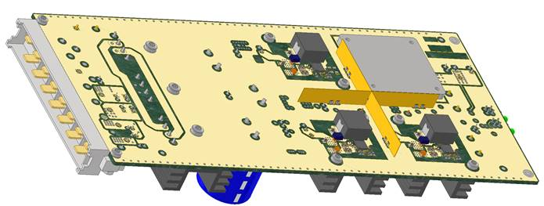
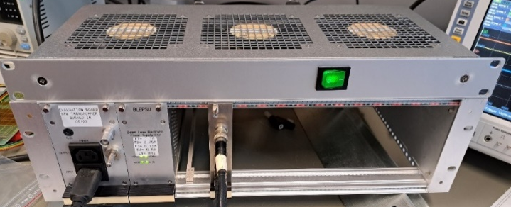
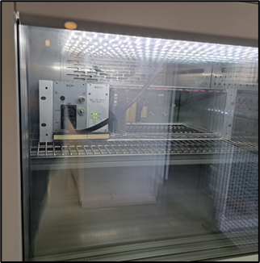
Task 13.1: BLM electronics
New Rad-Hard card (BLEIC) to allow reduced cable lengths and improve S/N ratio
  First deployment at strategic locations during LS3 to complete and validate development in parallel to the current electronics
  Full electronics deployment during LS4 as part of the Consolidation project,
New rad-hard power supplies (BLEPSU)
  Necessary for radiation resistance and replacing obsolete systems
  Developed in common for BLMs and BPMs, in collaboration with EP-ESE and BE-CEM with likely CERN-wide usage
  v3 based on bPOL (rad-hard ASIC)
  Recent v4 prototype validation completed*, optimised for tunnel environment
  All tests and validations completed, e.g.
    CHARM (reached ~ 1500 Gy accumulated)
    Climatic chamber (150h stress-test up to 100°C)
2 x SM-VTRx
2 x LpGBT
4 x BLMASIC
New BLEIC card with application-specific IC (ASIC) so fewer componants
3D models of BLEPSU v4
3-D models of BLEPSU v4
Setup for CHARM & Climatic chamber
Set-up for CHARM and climatic test-chamber
*https://edms.cern.ch/item/EDA-03919-V4-0/0

Slide 10
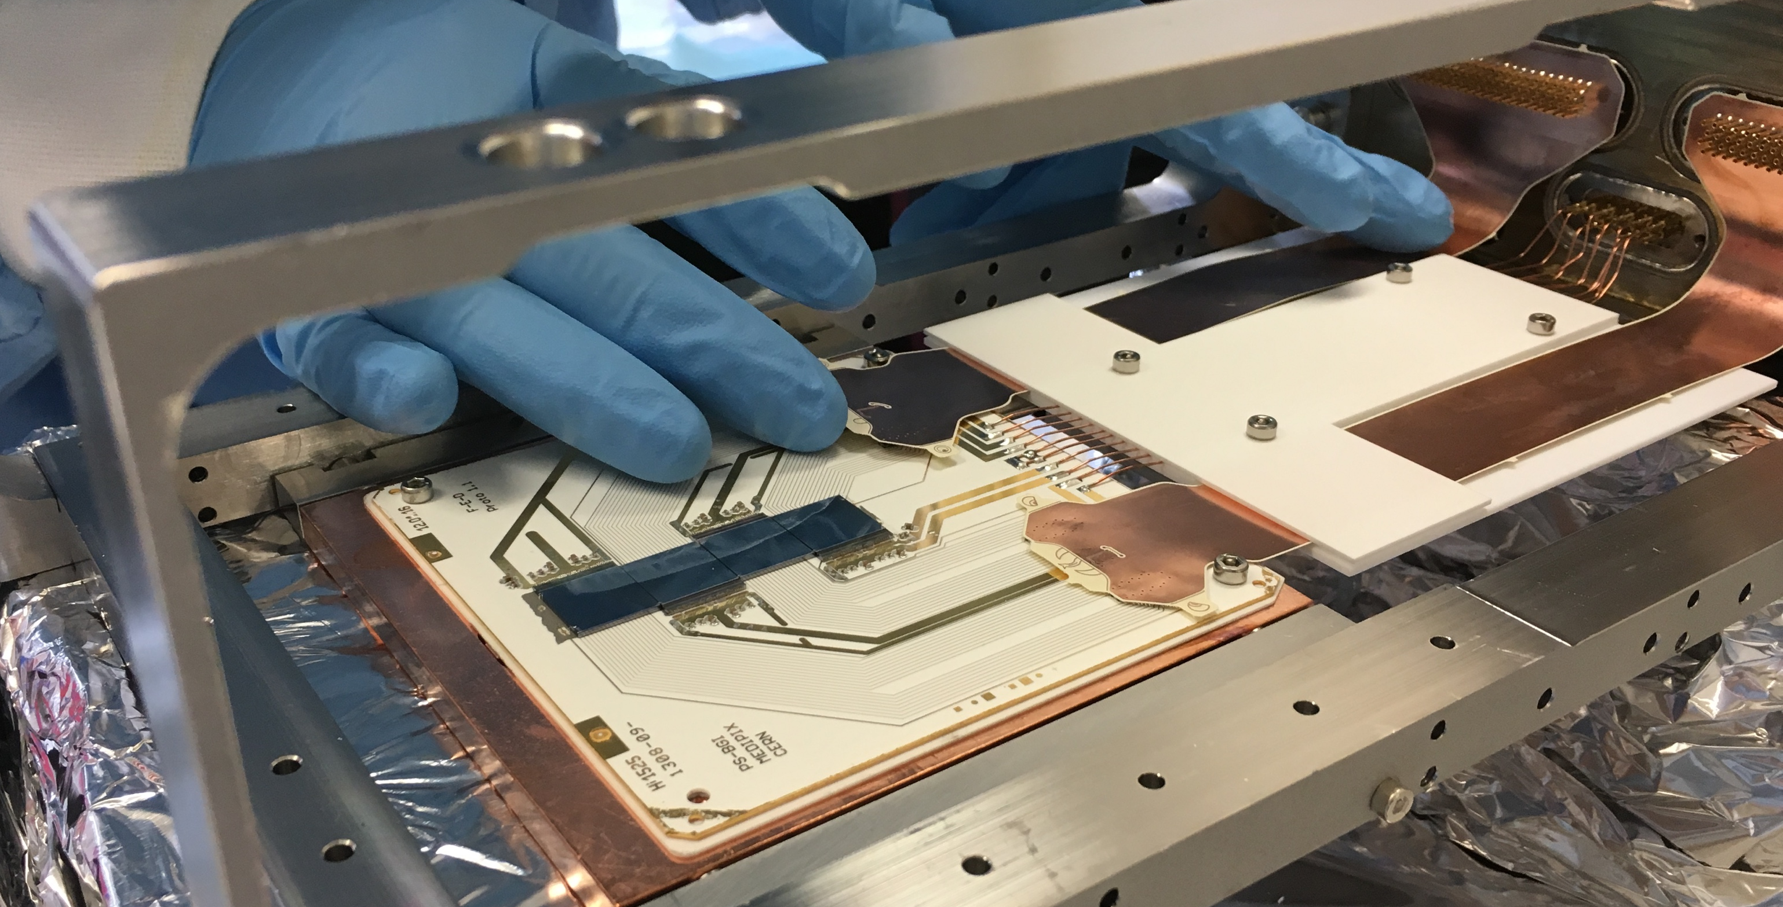
Task 13.7: Beam gas ionisation (BGI) monitor
Non-destructive transverse beam profiles with continuous bunch-by-bunch measurements throughout the accleration cycle.
  Following the BGV/BGI review in Oct. ’22 the BGI became the HL-LHC baseline
  HL-LHC device is developing from the instrument built for LIU-PS, installed in LS2 and the SPS-CONS instrument in production for YETS23-4
BGI detects ionization electrons produced by beam-gas interactions
  Individual ionisation electrons detected with Timepix3 Hybrid Pixel Detectors (HPD’s) installed directly in the beam pipe.
Timepix3 boards assembled onto the detector structure
Beam profile is measured by counting the number of detector ionisation electrons.

Slide 11
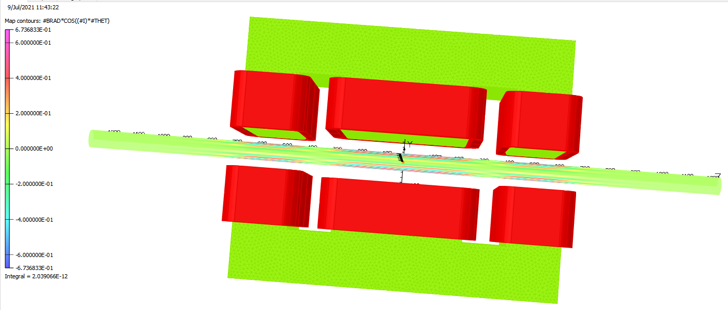
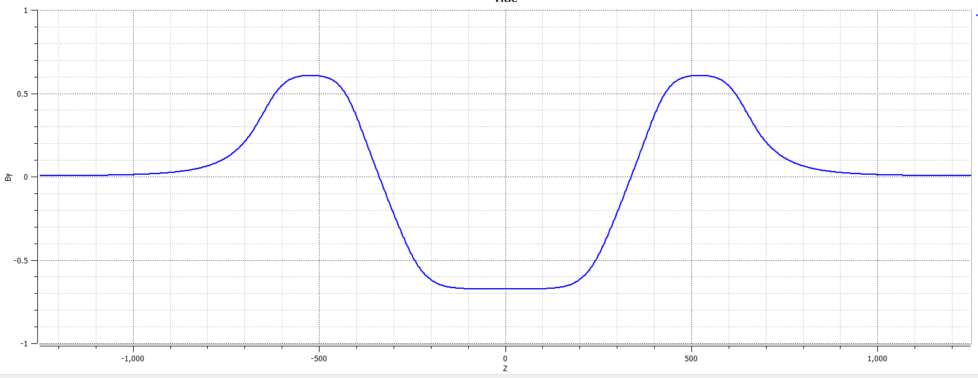
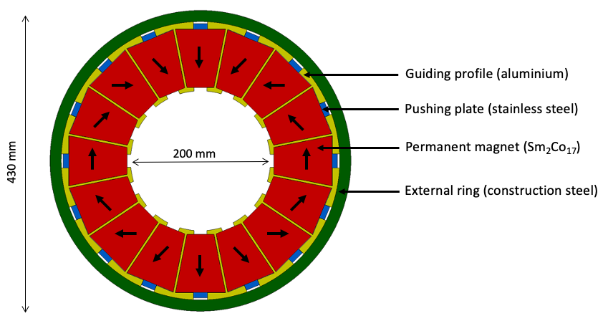
Task 13.7: BGI Magnet
BGI requires a dipole magnet to guide ionization electrons to the detector plane
  Equipment Integration Note released for IR4*
Two options for BGI magnet
  Baseline from the 2022 review is a 0.6 T electro-magnet, using conventional technology
  Reviewers also recommended investigating permanent magnet designs
  TE-MSC investigating permanent magnet concepts based on ‘Halbach’ or ‘C’ shaped designs.
Preliminary electromagnet design - 0.6T self-compensating dipole magnet [D.Bodart (MSC)]
D.Bodart (TE-MSC)
B-field strength (T)
Beam axis (mm)
*https://edms.cern.ch/document/2932261/0.1 (M. Navarro Baeza, J. Oliveria)
‘Halbach’ permanent magnet concept [P-A. Thonet (MSC)]

Slide 12
Task 13.7: BGI Tests and Plans
PS-BGI [LIU-funded project]
  Installed during LS2 and operating with beam for Run 3
SPS-BGI [CONS-funded project]
  Learning from the PS-BGI, in preparation for installation in EYETS23-4 [Critical path construction with EN-MME]
Plan to install prototype instrument (w/o magnet) in LHC during YETS24-5
  Learning from both the PS and SPS designs
  Qualify the instrument for the LHC beampipe environment (vacuum & impedance tests);
  Verify operation of the Timepix4 HPDs with the LHC electro-magnetic environment
  Measure backgrounds due to beam loss & syncrotron light;
  No plans to measure beam profiles as it requires the dipole magnet
(transverse) Image of a single PSB bunch in the PS
(Time domain) Continuous & non-destructive measurement of beam size and position throughout the PS cycle (1.2s)

Slide 13
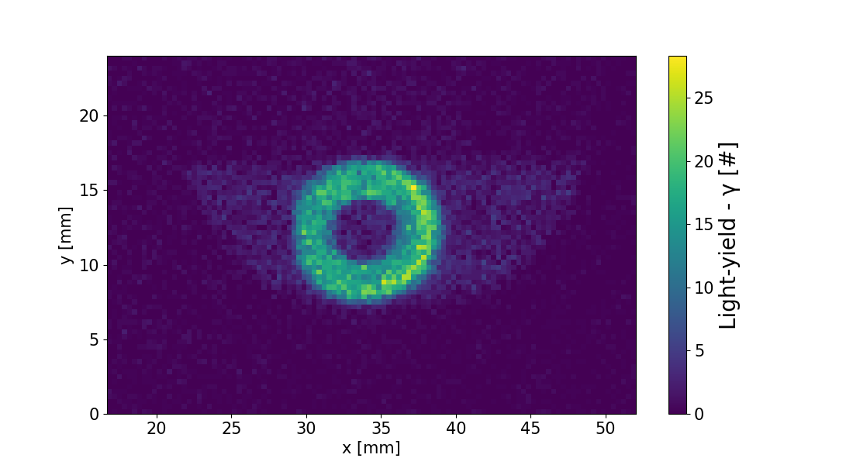
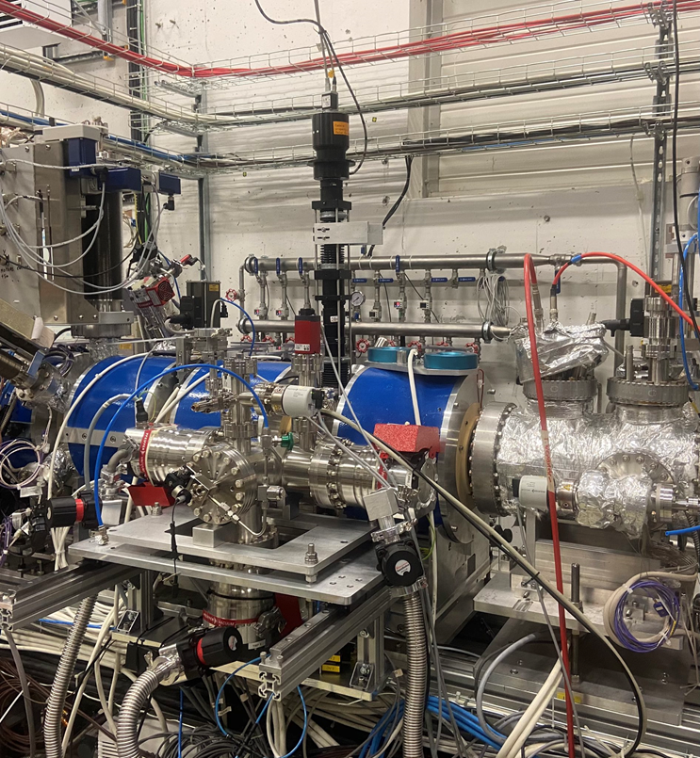
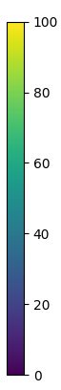
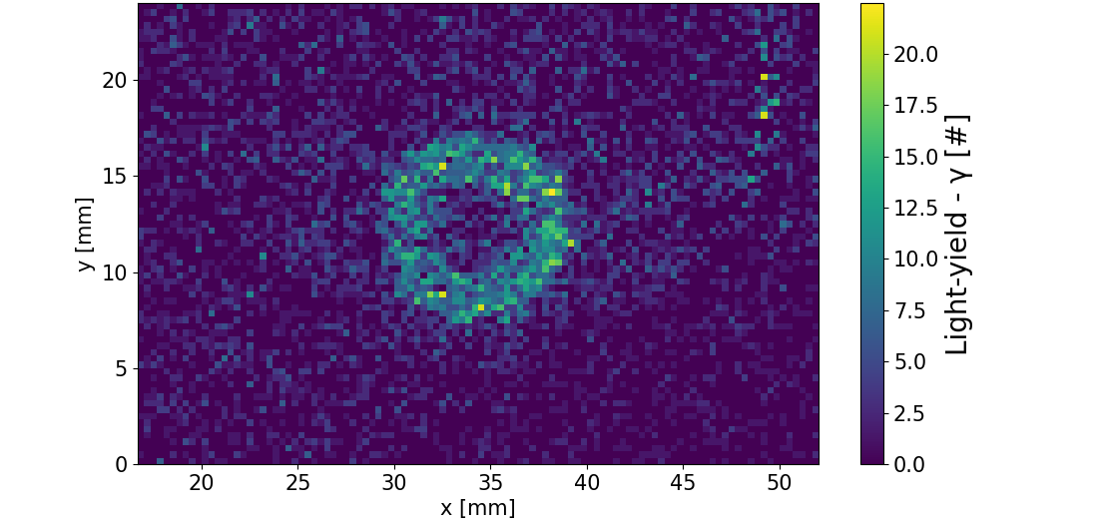
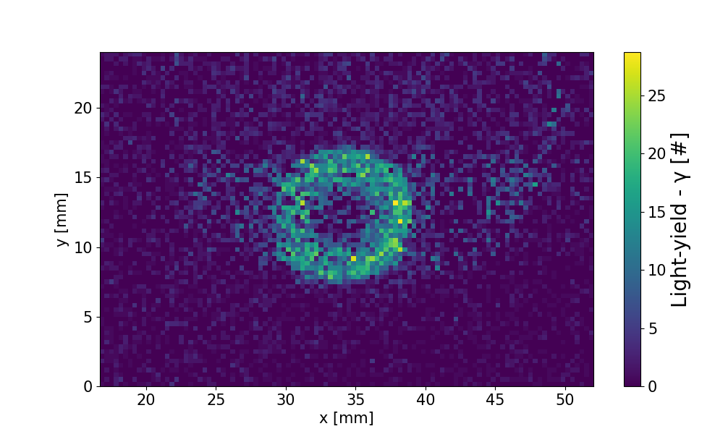
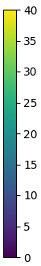
Task 13.2: Beam Gas Curtain (BGC)
7 keV, 1.1 A
Beam int. time: 2 s
A 2D gas ‘screen’ generates a direct optical image of the beam via beam-induced fluorescence
  Non-invasive ‘on-line’ monitor
  Sensitive to both electrons and protons
  Operates in strong magnetic fields
  Developed as ‘overlap’ instrument for the HEL
Full prototype instrument delivered and tested at CERN from HL-UK
  In-kind contribution from the UK (Cockcroft Institute) with support from GSI
  Tested with hollow electron beam on the Electron Beam Test Stand (EBTS) in November 2022 (shown right), then installed in the LHC (next slide)
N2
Ne
BGC installed on the EBTS (November 2022- above) with non-destructive images of the hollow electron beam taken with different curtain gases (right)
Ar
O.Sedlacek et al. Gas Jet based Fluorescence Profile Monitor for Low Energy Electrons and High Energy Protons at LHC [IBIC 2023]
The International Beam Instrumentation Conference, 2023 Saskatoon, Canada

Slide 14
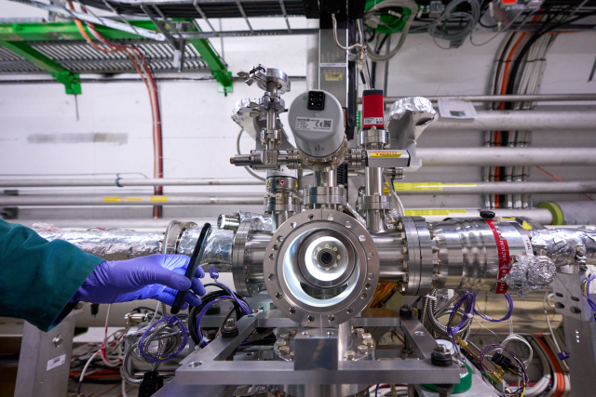
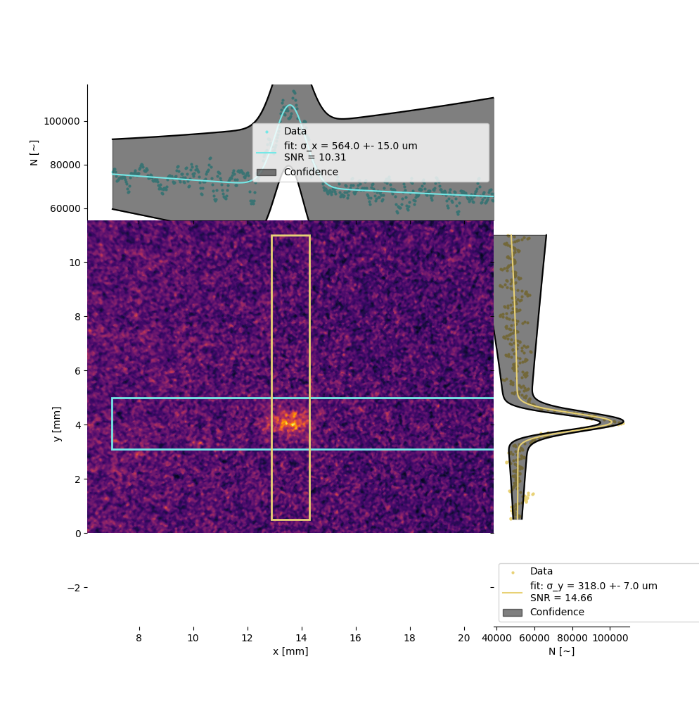
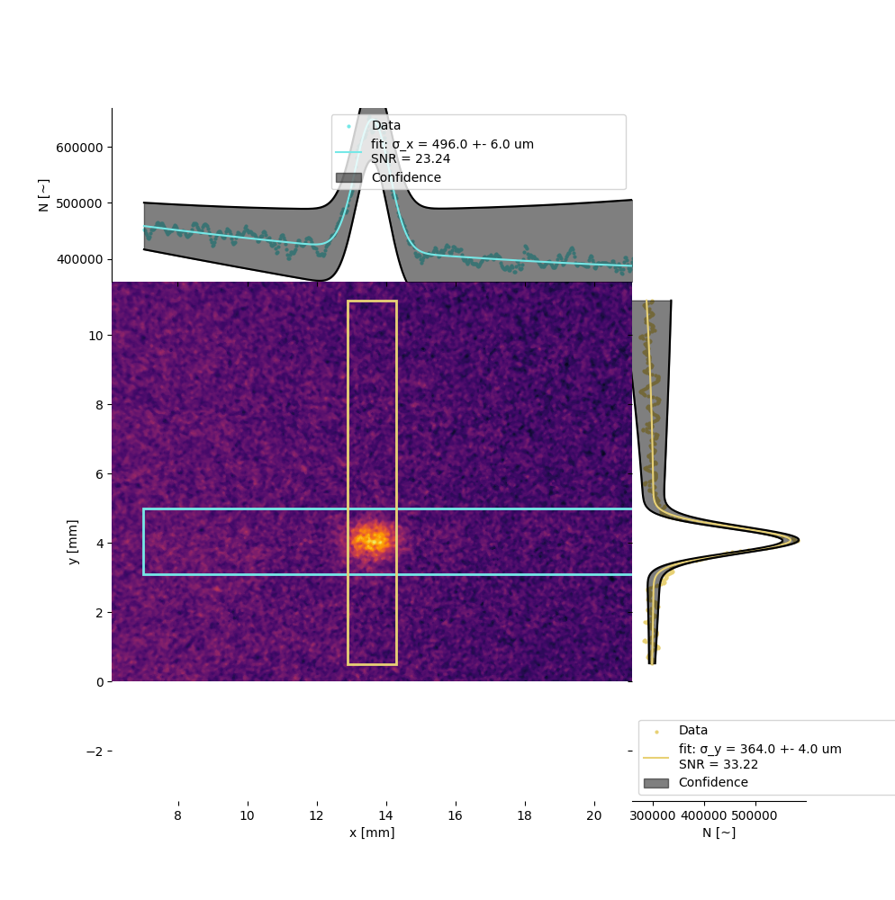
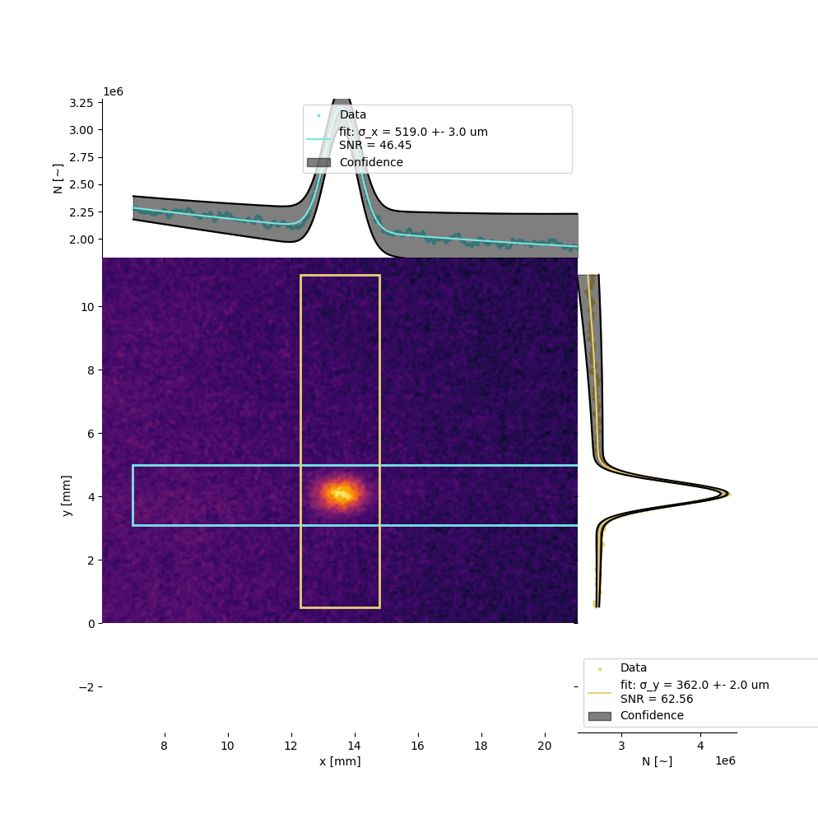
Task 13.2: BGC in the LHC
Installed in the LHC, p4 during YETS22-3
  Commissioned, then very successful (but preliminary) non-invasive tests measuring LHC proton beams during run 2023
  Plans for future tests with ions then protons in 2024
BGC installed in the LHC during YETS22-3
Centroid measurements
Profile measurements
10s
1min
5min
SNR ≈ 14.7
SNR ≈ 33.2
SNR ≈ 62.6
https://videos.cern.ch/record/2297523

Slide 15
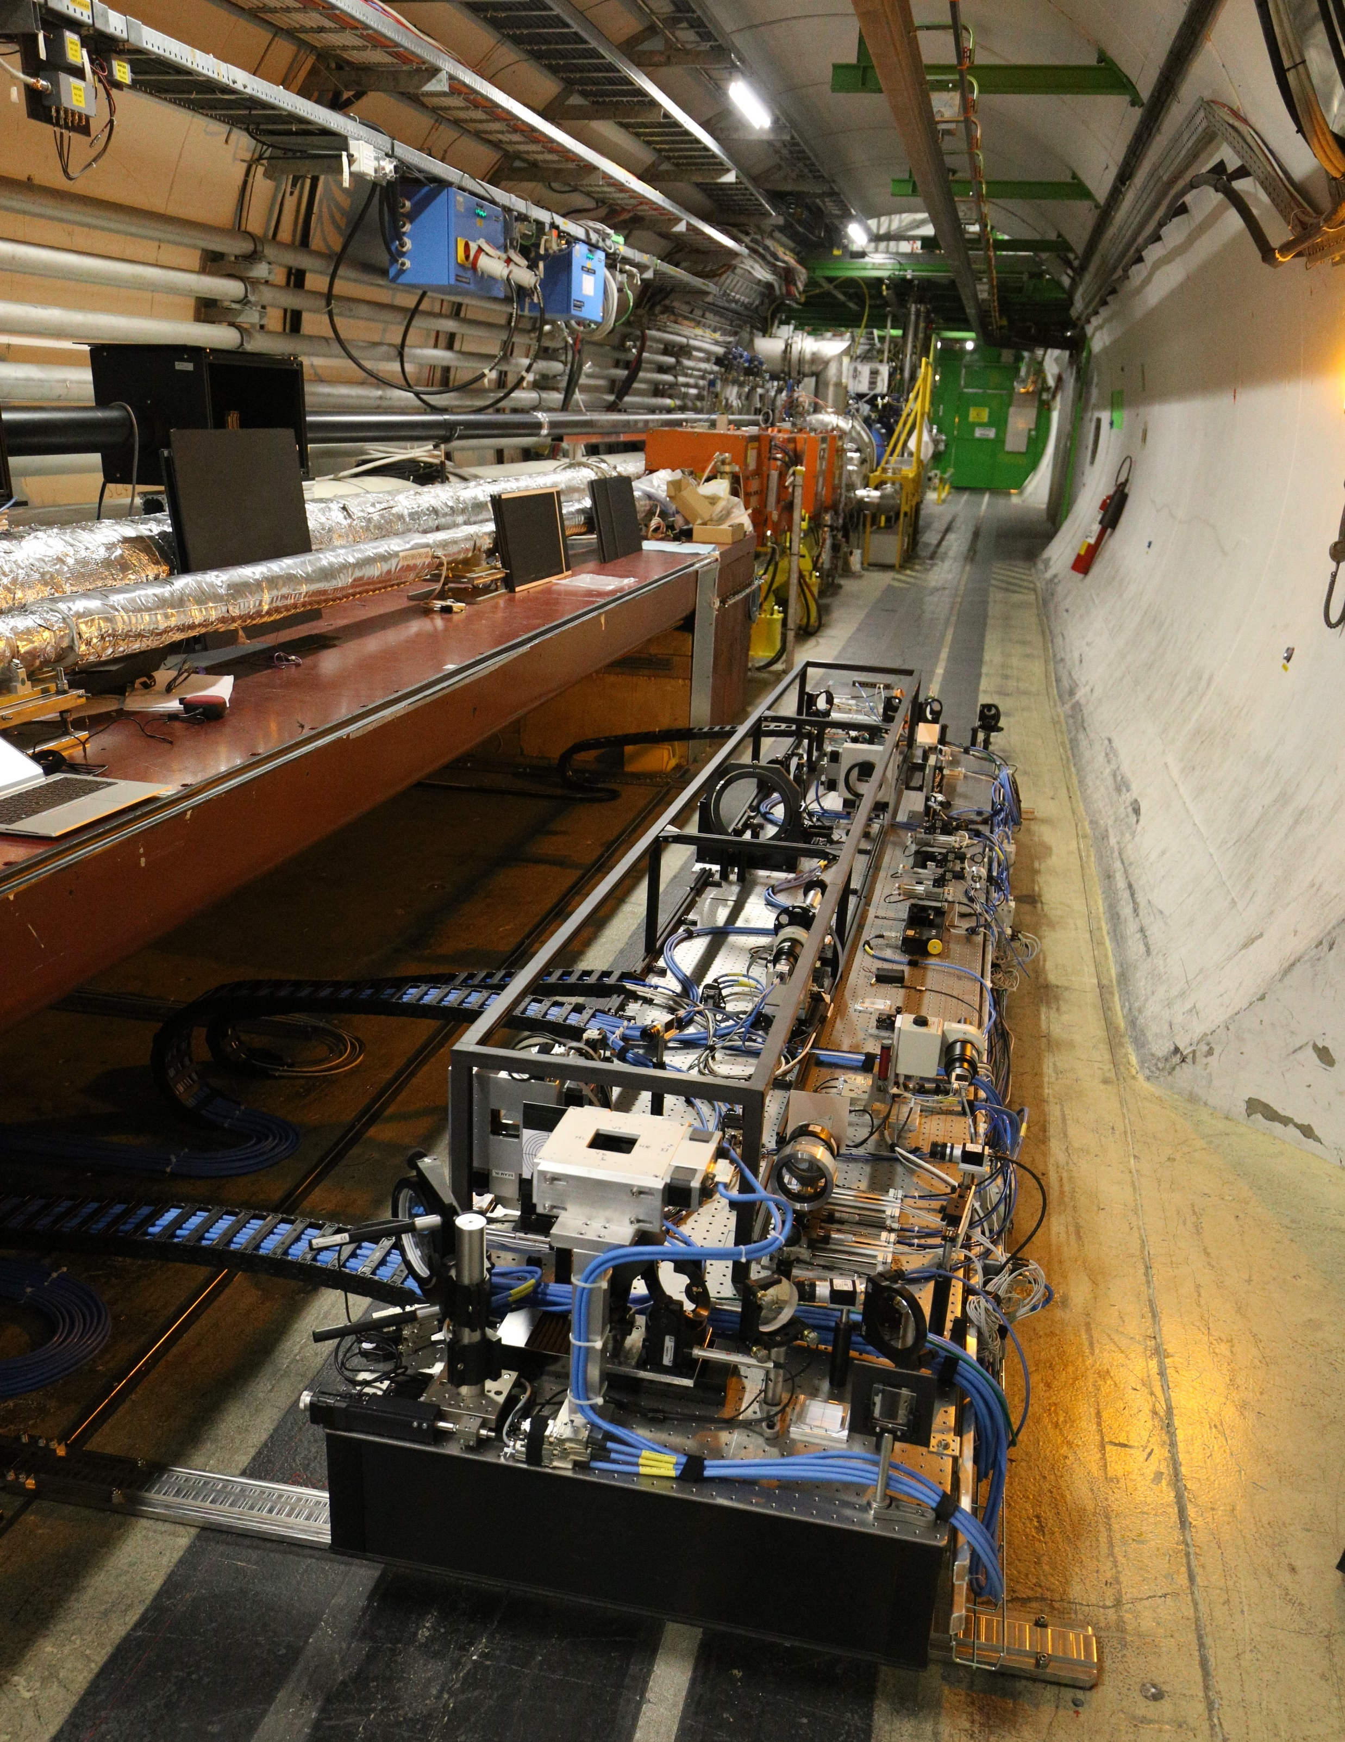
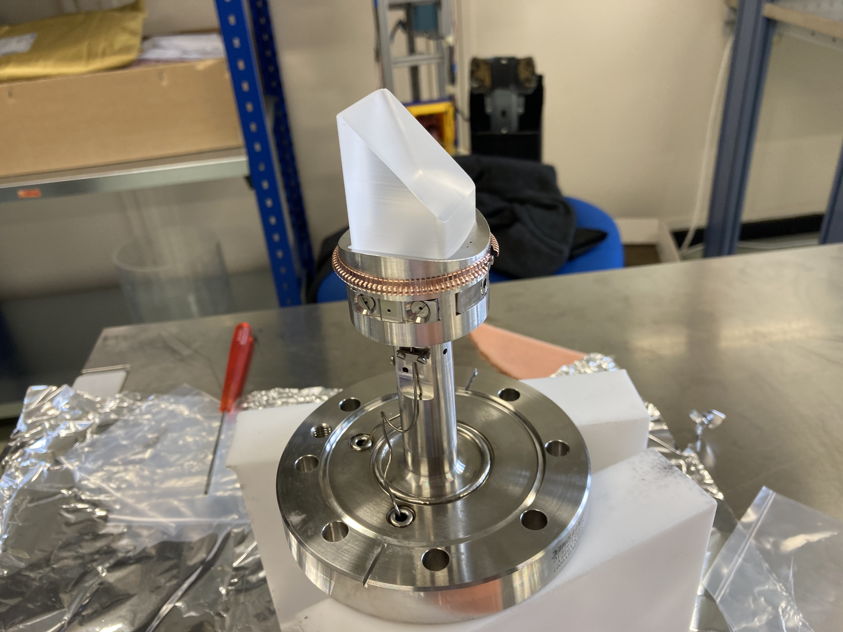
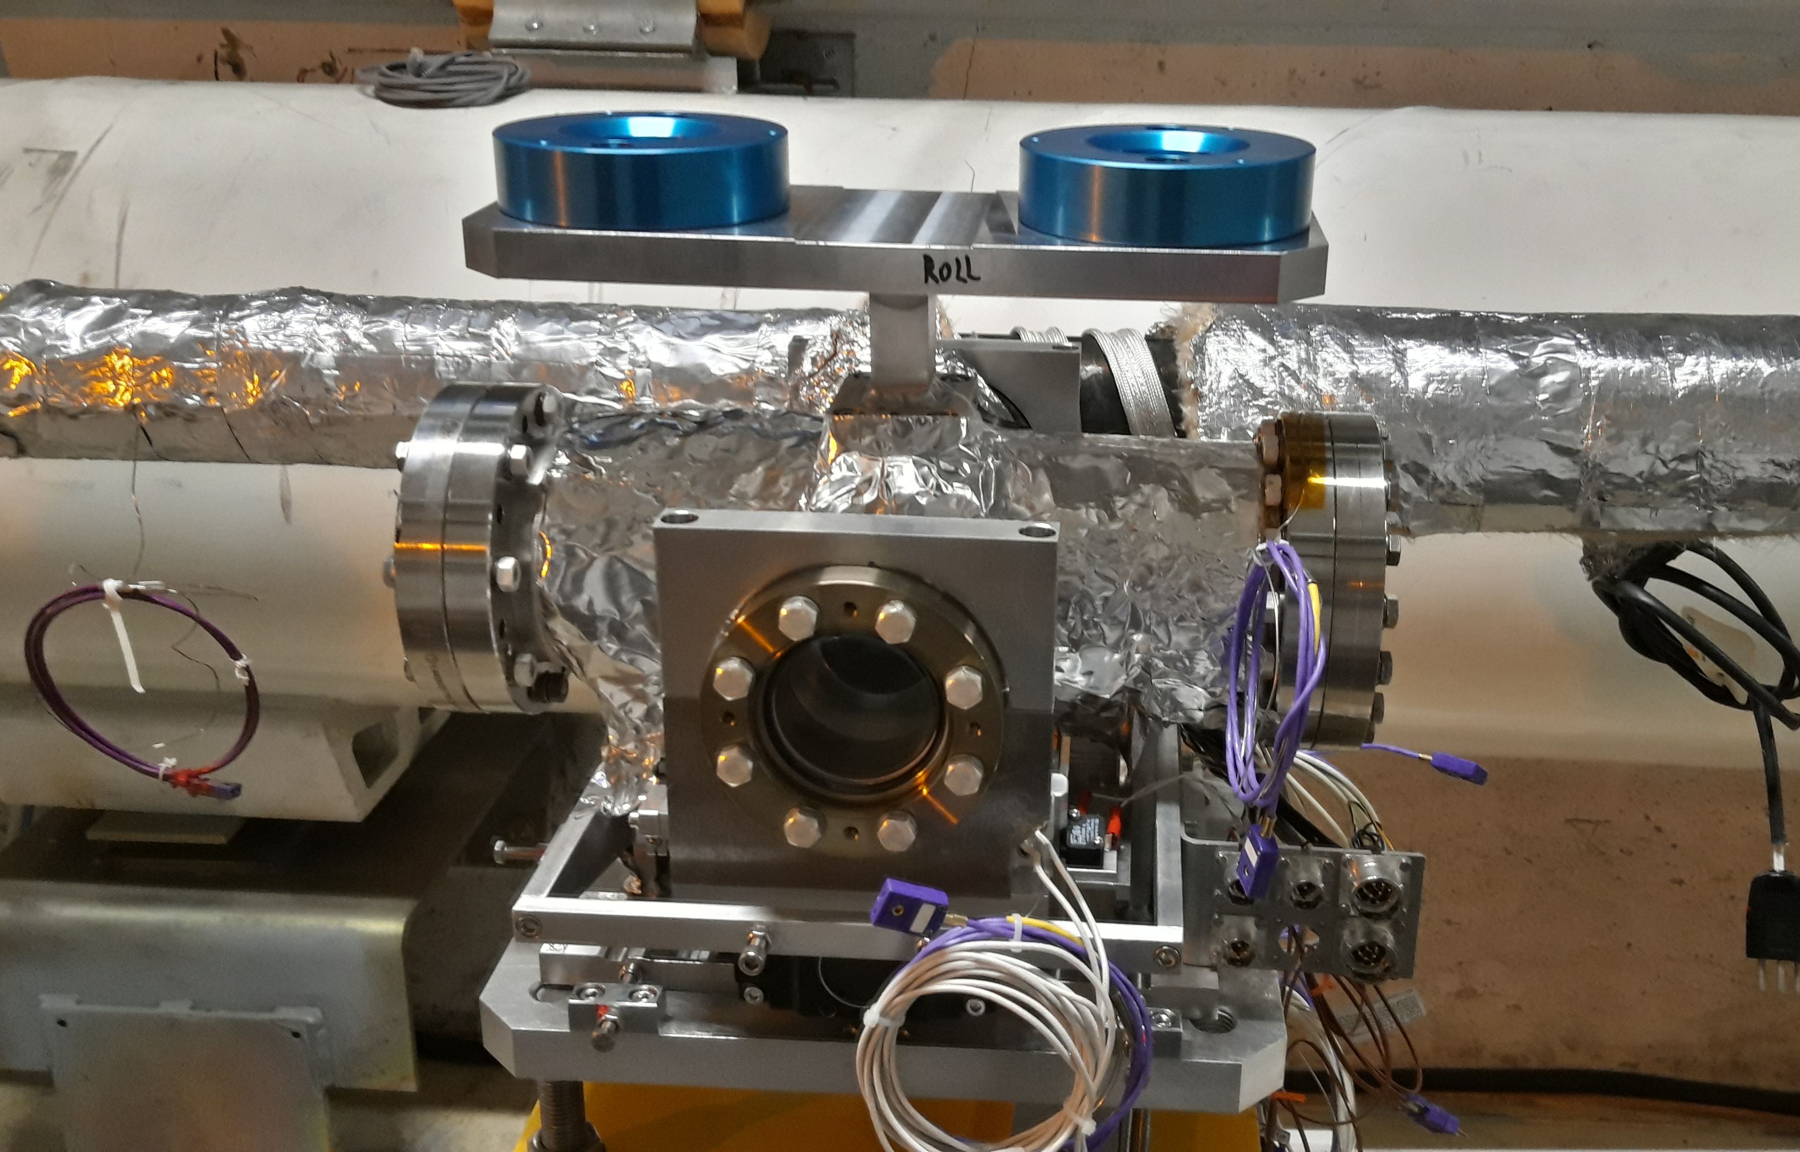
Task 13.6: Synchrotron light diagnostics (BSR)
New SR light extraction tank with mirror (BSRTM)
  Installed in LHC 4L, equipped with new mirror design, proved to be ok w.r.t. to impedance in 2022-2023.
Beam Halo monitoring with a SR Coronagraph
  Built in collaboration with KEK and installed on BSR
  Commissioning and tests were planned during LHC machine development (MD) time in Aug 2023 (now postponed to Oct)
  Detailed simulations using SRW software show fundamental limitation with source diffraction
    Suggesting HL specification (10e-5 contrast) not achievable with this instrument, ultimate reach to be confirmed by experiment
Options for Beam Halo measurement
  Performing the characterization of Coronagraph with beam asap.
  Studying feasibility of alternative halo measurement instruments
  Will review situation as soon as data available, along with an update of the HL-LHC halo measurement needs
New SR extraction mirror
New extraction tank in IR4L

Slide 16
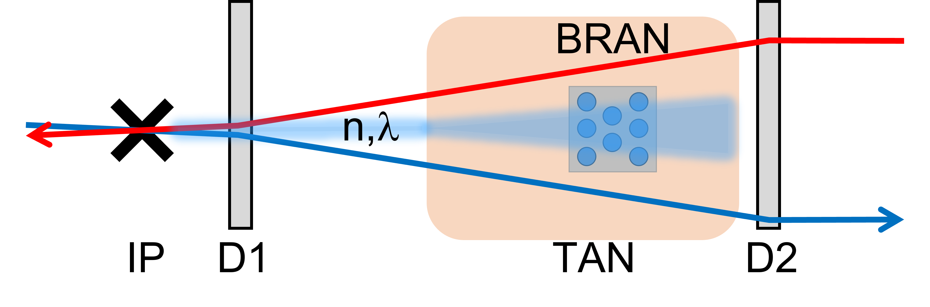
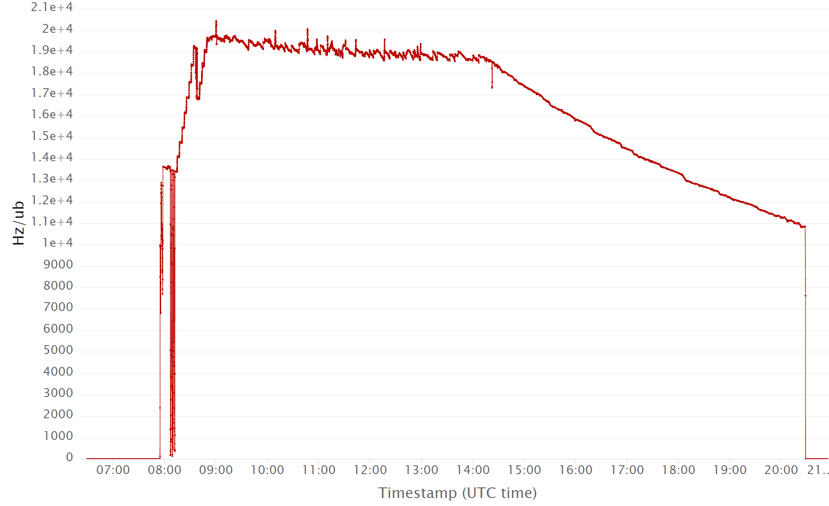
Task 13.4: Luminosity Monitors (BRANQ)
Provides a relative luminosity measurement for LHC experiments
  Used for optimising collision rates and
  Cross-checking the absolute monitors in each experiment
  Detects the electro-magnetic showers in the TAXN
New design for HL
  Based on Cherenkov radiation produced in fused silica rods
  Four prototypes installed in IR1/5. New firmware and data acquisition system
  Recent tests with beam in the LHC confirm wide luminosity range to 2x10¹⁴ µb/Hz and very good resolution
Future plans for the final HL version
  Based on the same SiO₂ bars, adapted to the new TAXN absorber and optimised for full HL intensity
Luminosity monitor concept and schematic
  Yang et al. ‘Optical transmission characterization of fused silica materials irradiated at the CERN Large Hadron Collider’, NIM A 1055, 168523 (2023)
BRAN-D 1R, Fill 9072, 16/7/2023, full 2.1e04 lumi range.

Slide 17
Summary
Excellent progress made in the development, tests with beams and production for all tasks
  Critical cold BPM manufacture is back on-schedule despite the end of the Russian in-kind contribution
  BLM ionization chamber also back under control following urgent reverse-engineering and prototyping
  Design review on full-cycle transverse beam size measurement resulted in new baseline for BGI instrument
    Benefitting from convergent development and instrument installations in PS and SPS
  Early successful tests made with the BGC, both for hollow electron beams and as a profile monitor in the LHC are being continued
Some decisions to be taken:
  Beam halo monitoring baseline and requirements
  Production strategy for series BLM ionization chambers
  High-bandwidth pickup technology

Slide 18





Collaboration partners

Slide 19

First Gas Jet fluorescence measurements at LHC at 6.8 TeV
Parameters
Beam Energy [TeV] | 6.8
Beam intensity [p] | 2.2e14
Gas jet | Ne
Integration time [s] | 1659
Background
Background gas interaction
Proton beam
Gas jet interaction
Gas curtain

Slide 20
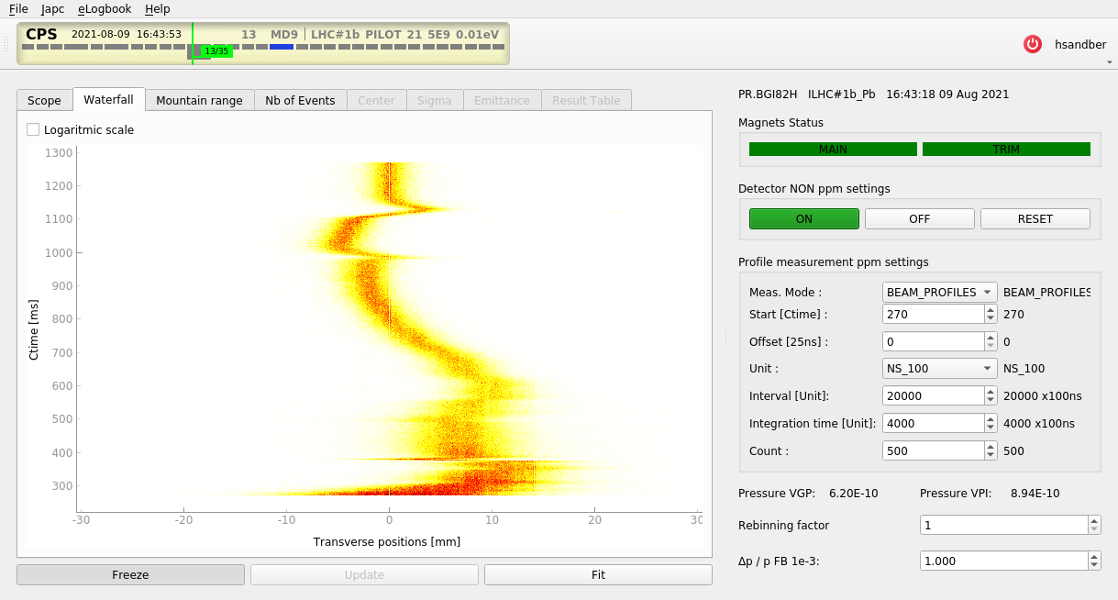
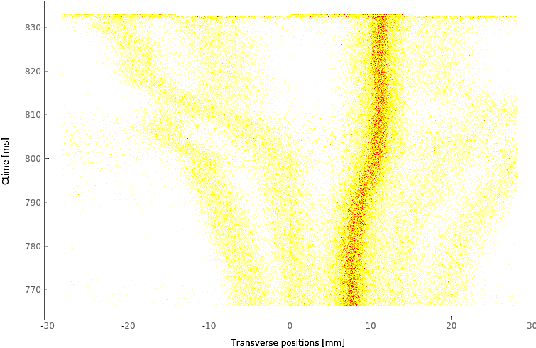
PS BGI – Example operational measurement
Evolution of Pb54+ beam from injection to extraction
Evolutions of beamlets in Multi-Turn Extraction (MTE) beam (for fixed target experiments)

Slide 21
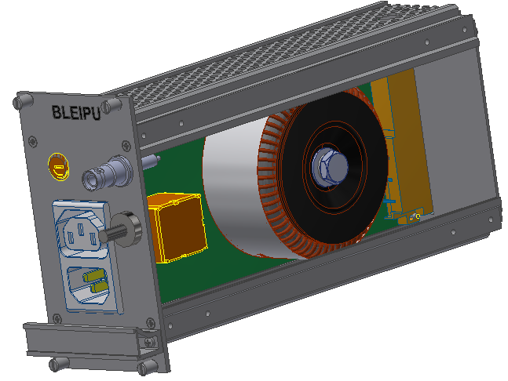
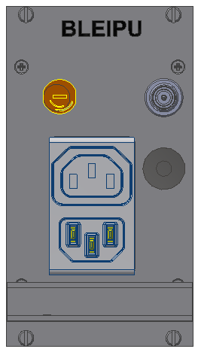
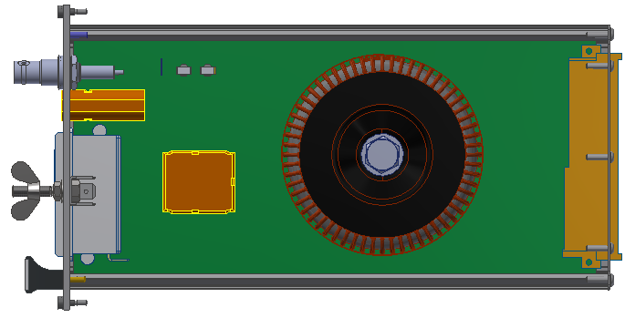
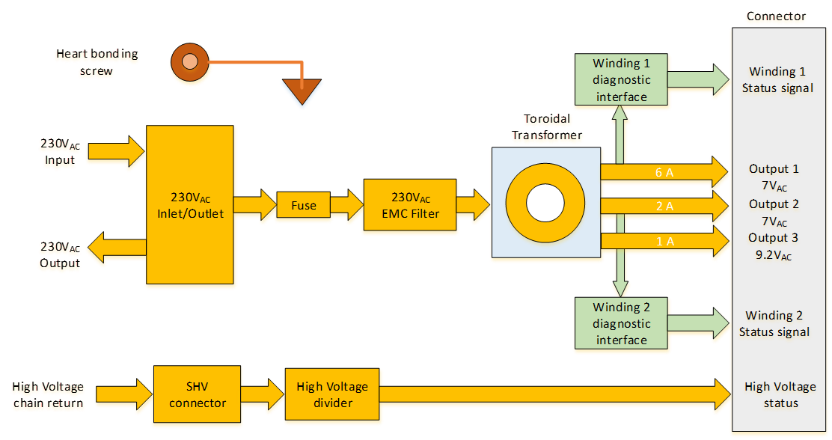
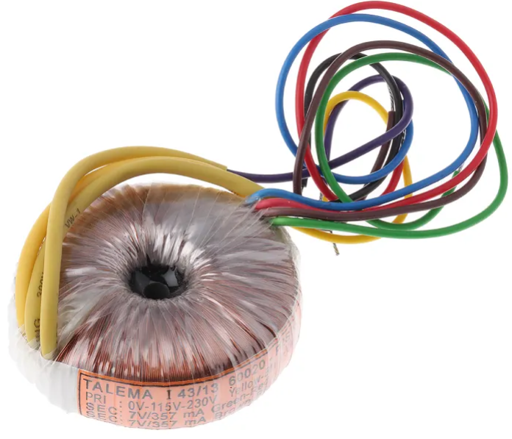
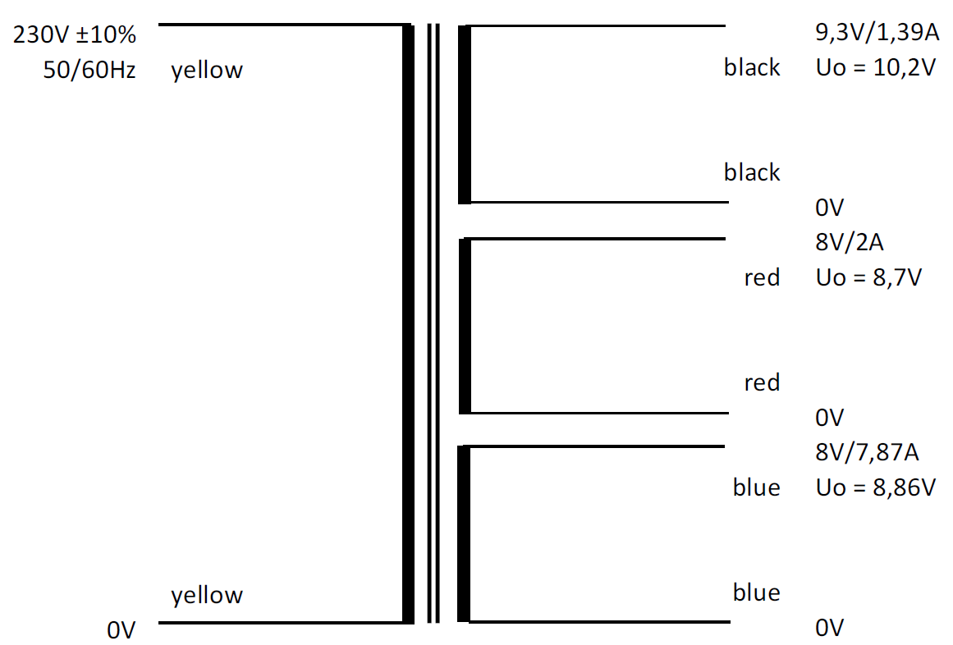
Task 13.1 Radiation hard beam loss monitor electronics
BLEIPU : BLM/BPM Rad-tol Input Power Unit
The Input Power Unit (BLEIPU) converts the 230 V_{AC} power input in the AC output voltages delivered to the Power Supply Unit
  EDA-03918
Provides also
  transformer diagnostic and
  the detector bias chain return with voltage conversion
HV input connector
230 V_{AC} Inlet/Outlet
Main Fuse
Earth bonding
Radiation tolerant power transformer (custom design)
HV divider
New custom-made toroidal transformer with radiation compliant material
Input filter
3D model of BLEIPU
Transformer & output voltages

Slide 22
Task 13.5: Electro-Optical BPM tests at CLEAR
Tested with 200MeV, ps long electron bunch @ CLEAR, measured using 33GHz oscilloscope
Train of 5 bunches spaced by 666ps
Single bunch (2ps bunch length) measurement
Measured time response of the EO BPM ~30ps FWHM
Well within the expected EO-BPM design and our specifications

