Slide 1

13th HL-LHC Collaboration Meeting
Closeout

Slide 2
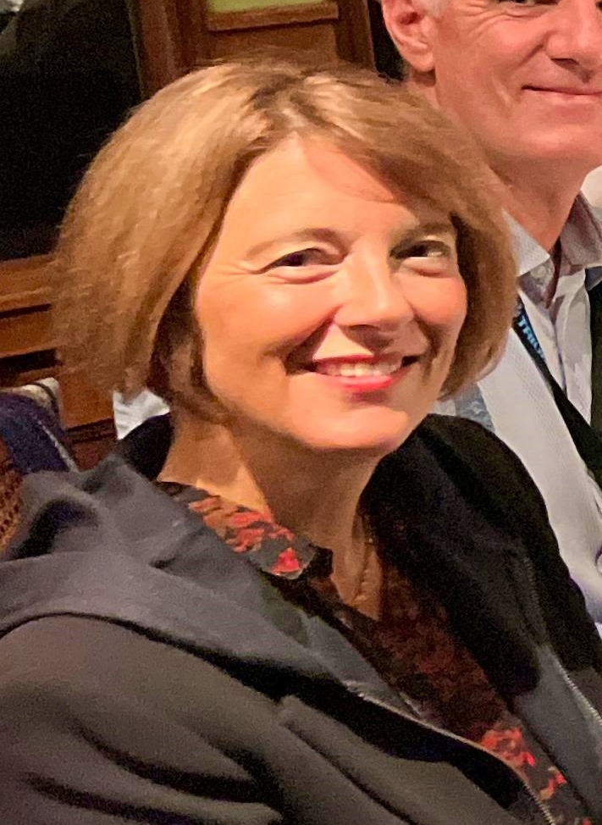
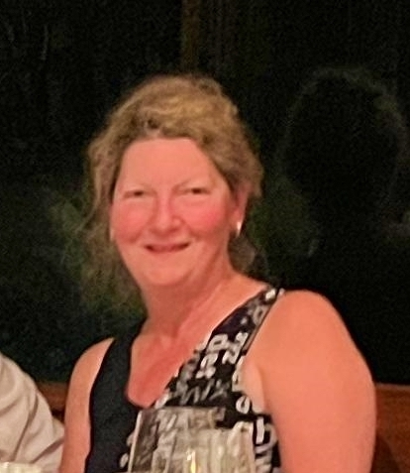
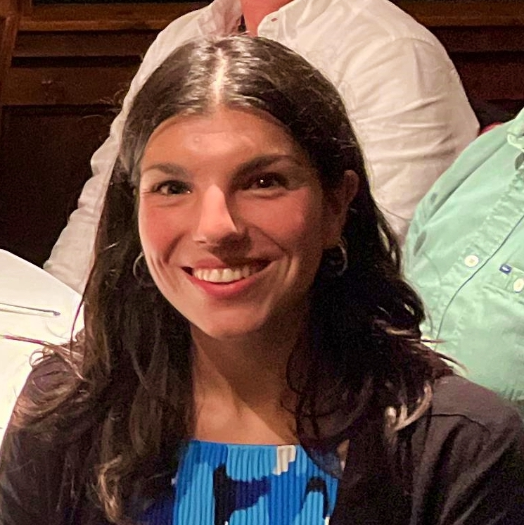
2nd Post-Covid Workshop Organization
Many thanks to Oliver Kester for volunteering
to host this meeting!
Many thanks to ALL of YOU for making
the trip!
Many thanks to Cecile, Irene and Jana for all the
preparation work and organization!

Slide 3
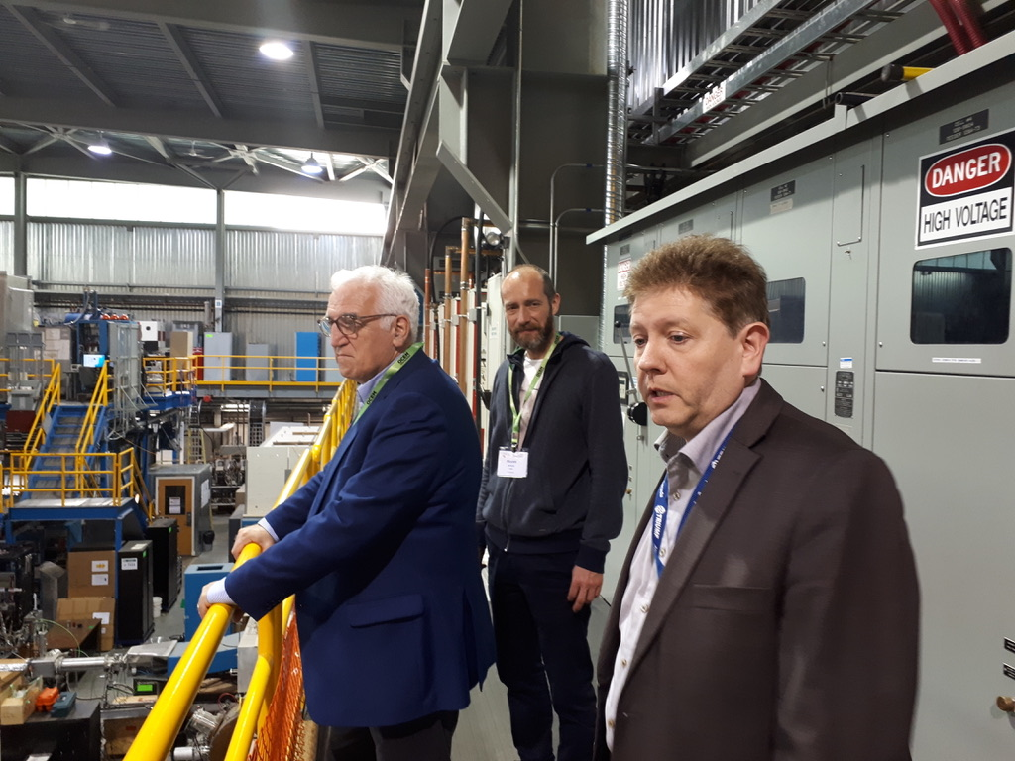
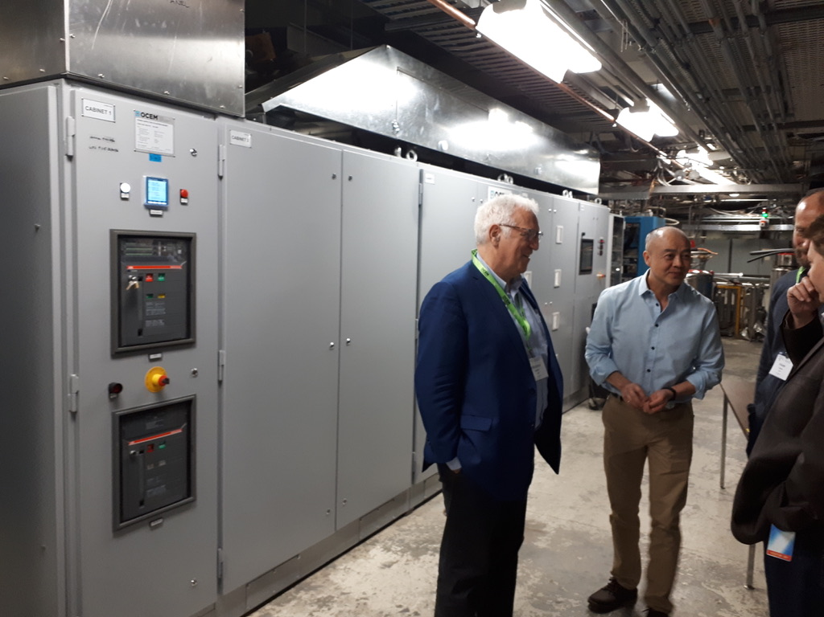
This CM represents the closure of a 5 Year Journey with TRIUMF
2018 visit with Frederick Bordry and Frank Gerigk
Exploring the idea of a collaboration in May 2018
during IPAC 2018

Slide 4

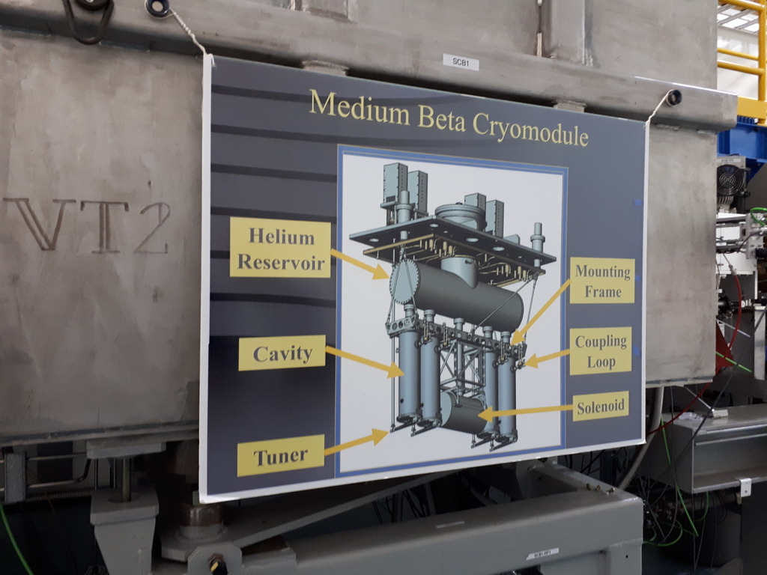
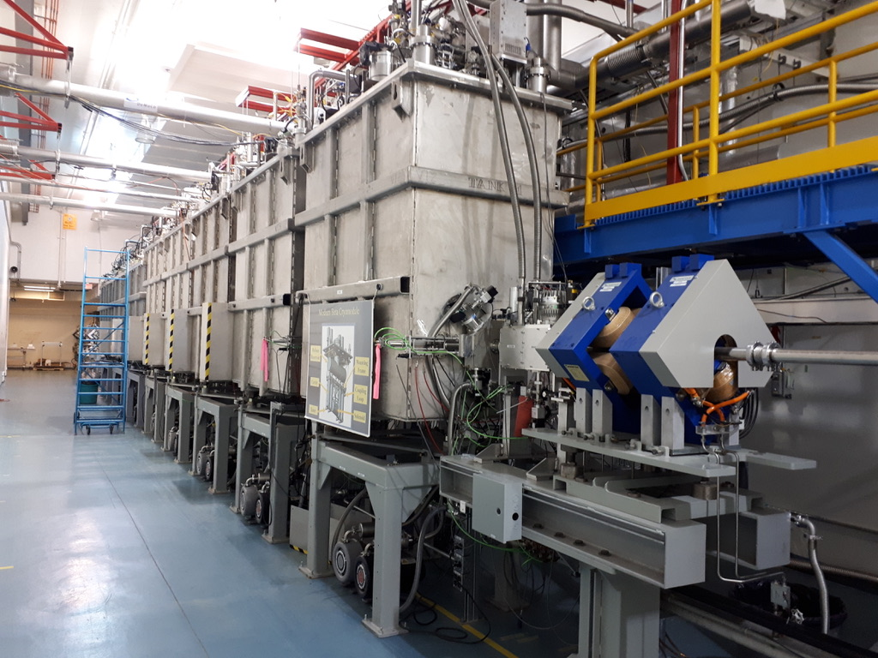
Closure of a 5 Year Journey with TRIUMF
This CM represents the closure of a 5 Year Journey with TRIUMF
Top Loaded Cryo-Modules
Matching expertise!
With corresponding Clean Room Facilities and SRF Expertise!

Slide 5
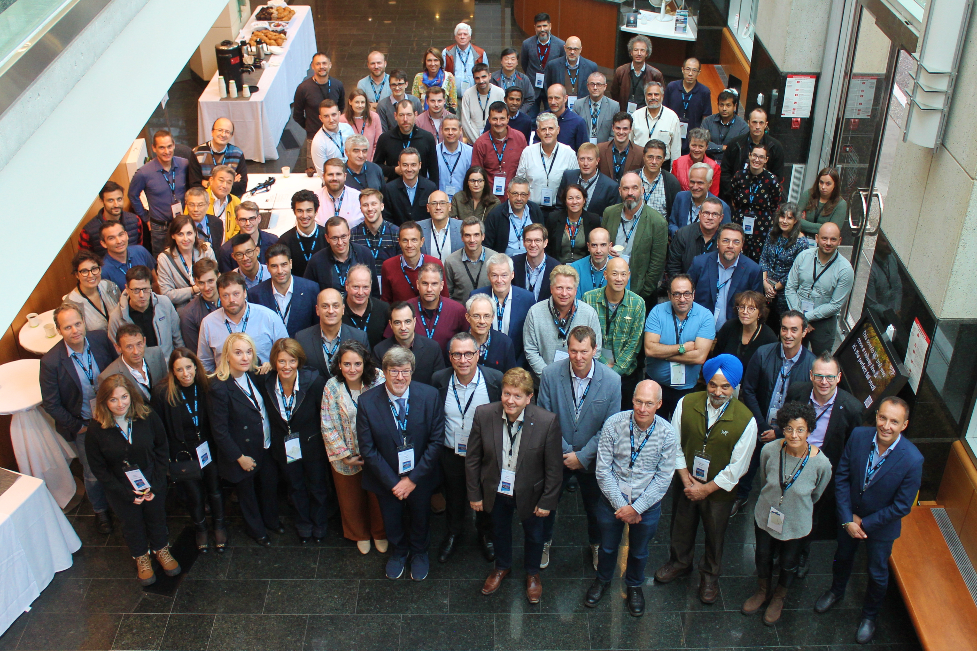
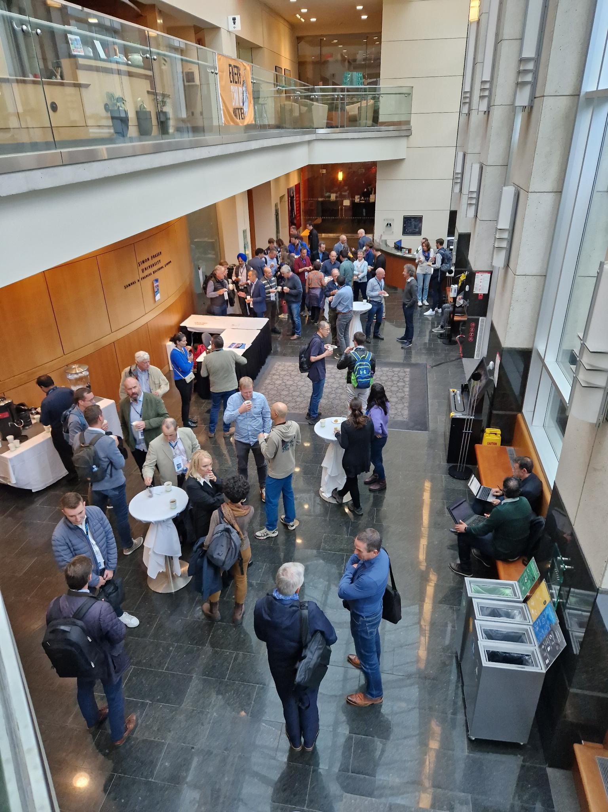
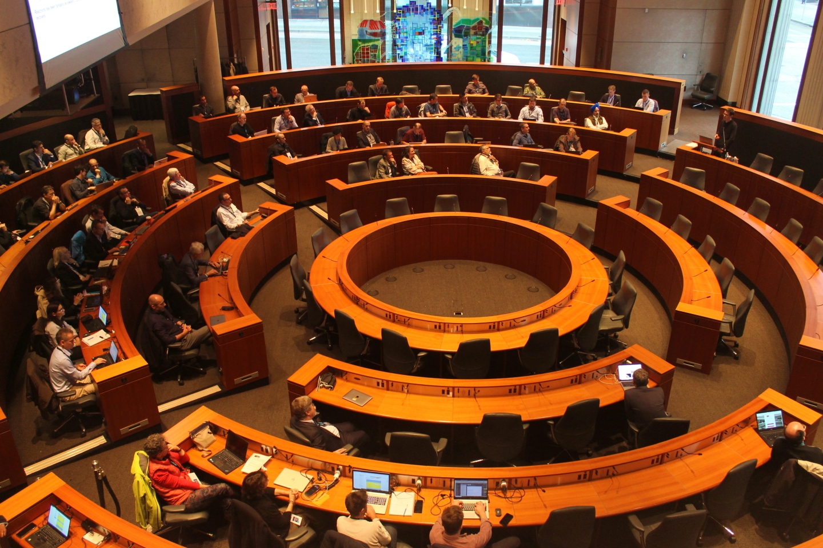
2nd In-Person Conference since COVID – with over 100 participants!

Slide 6
UBC campus

Slide 7
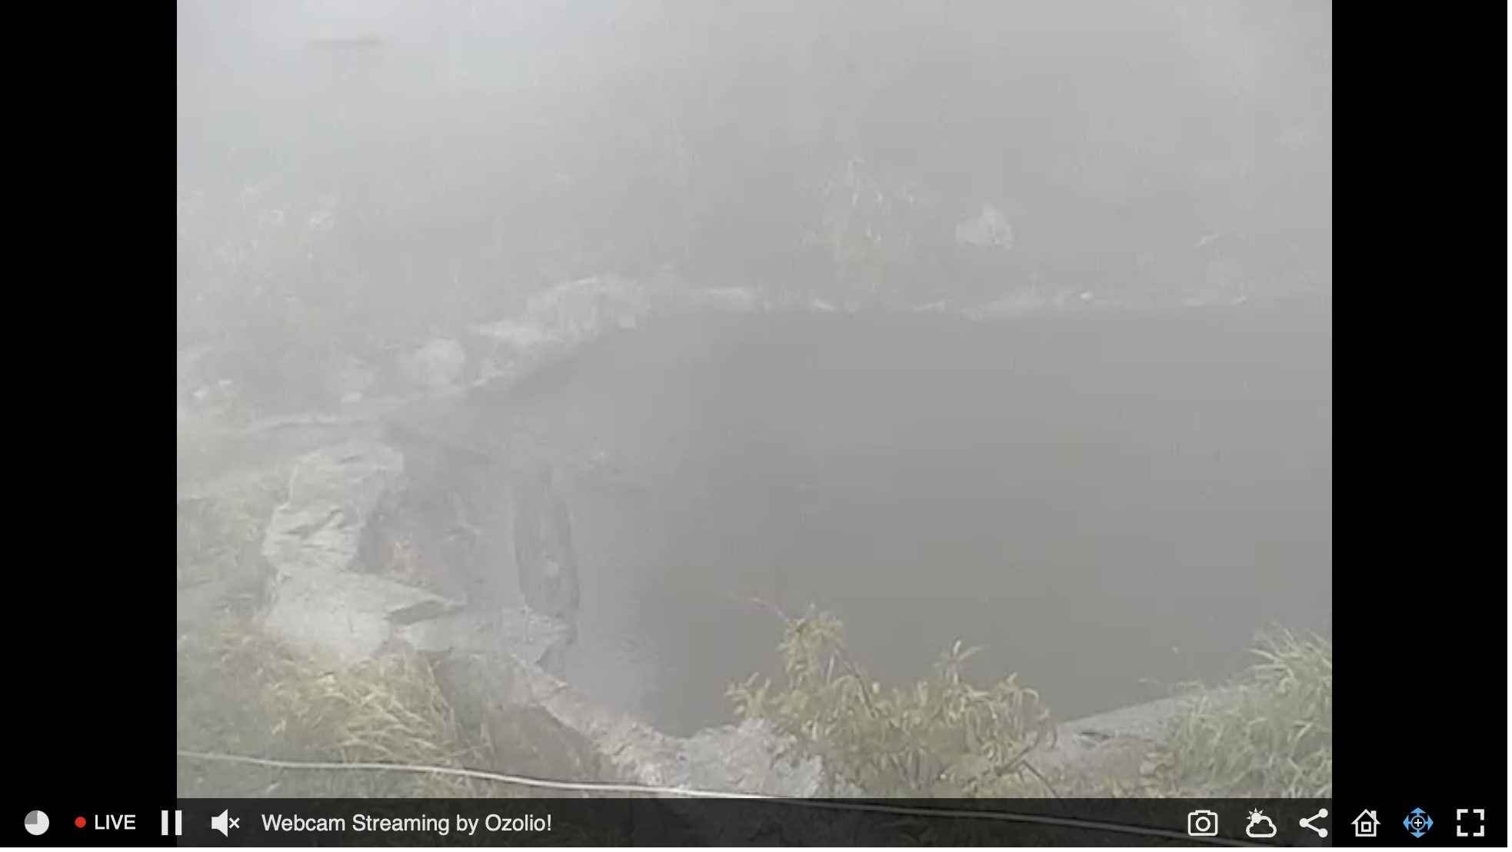
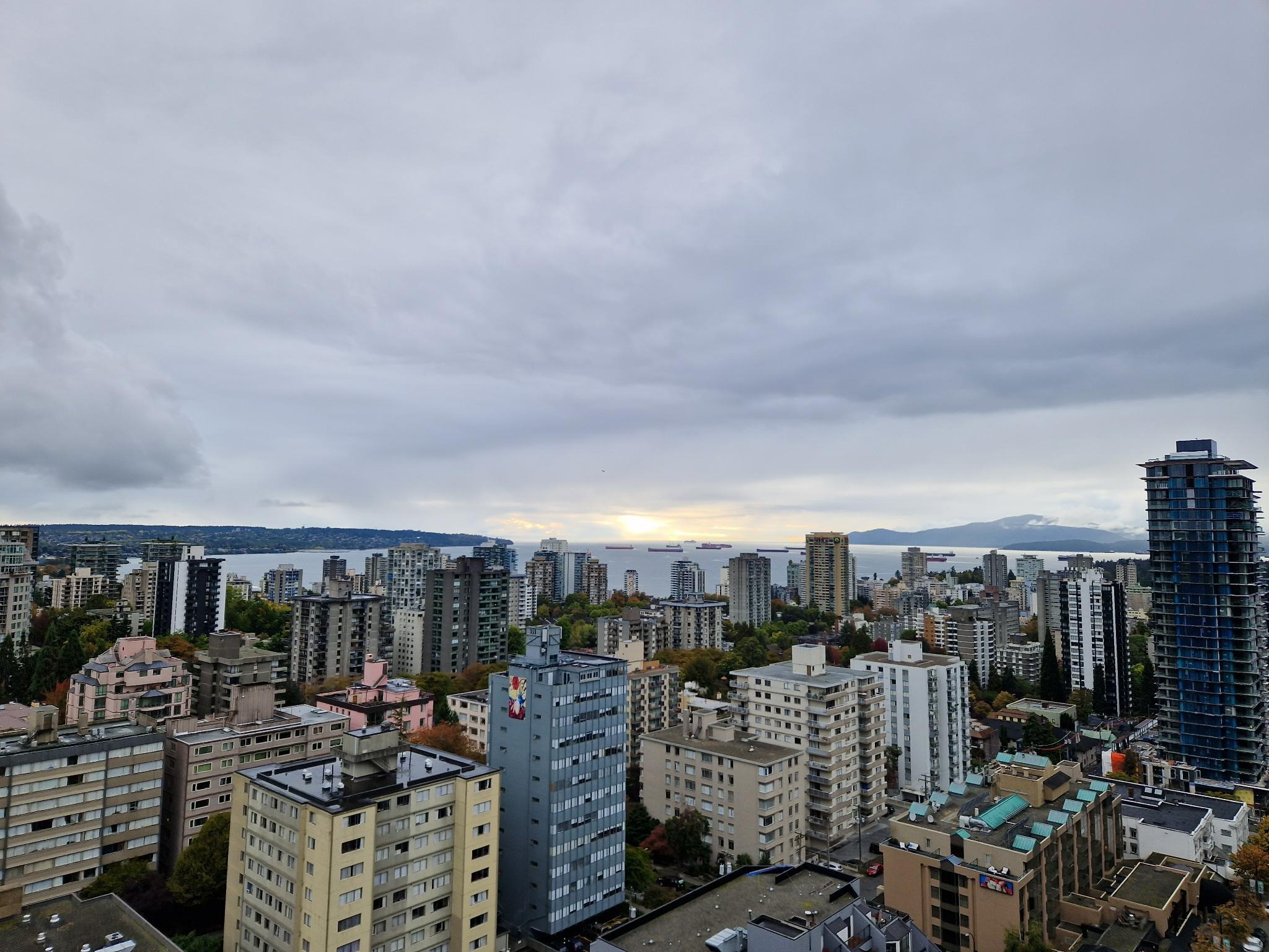
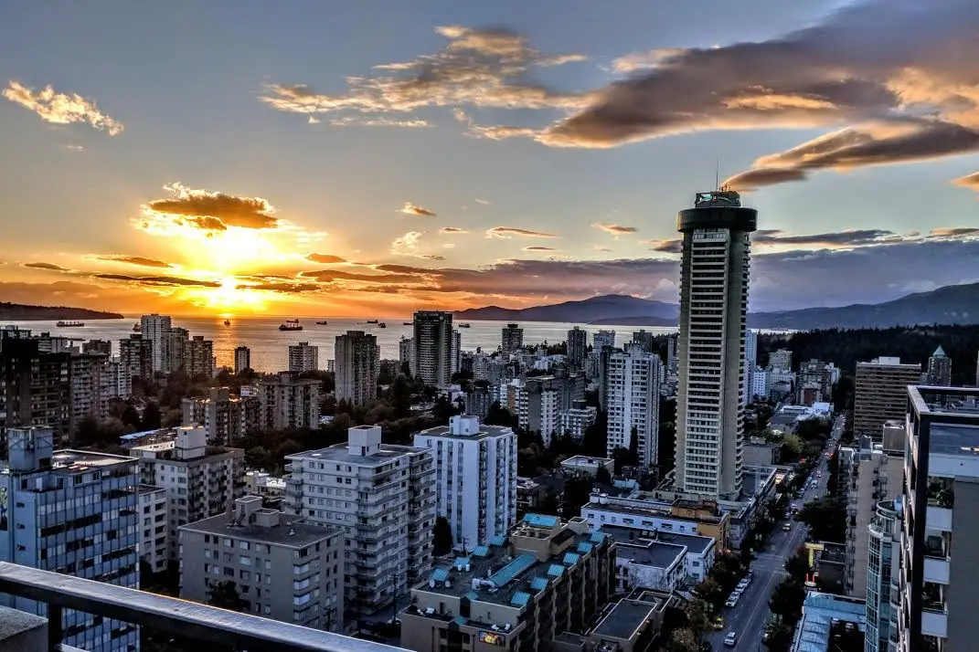
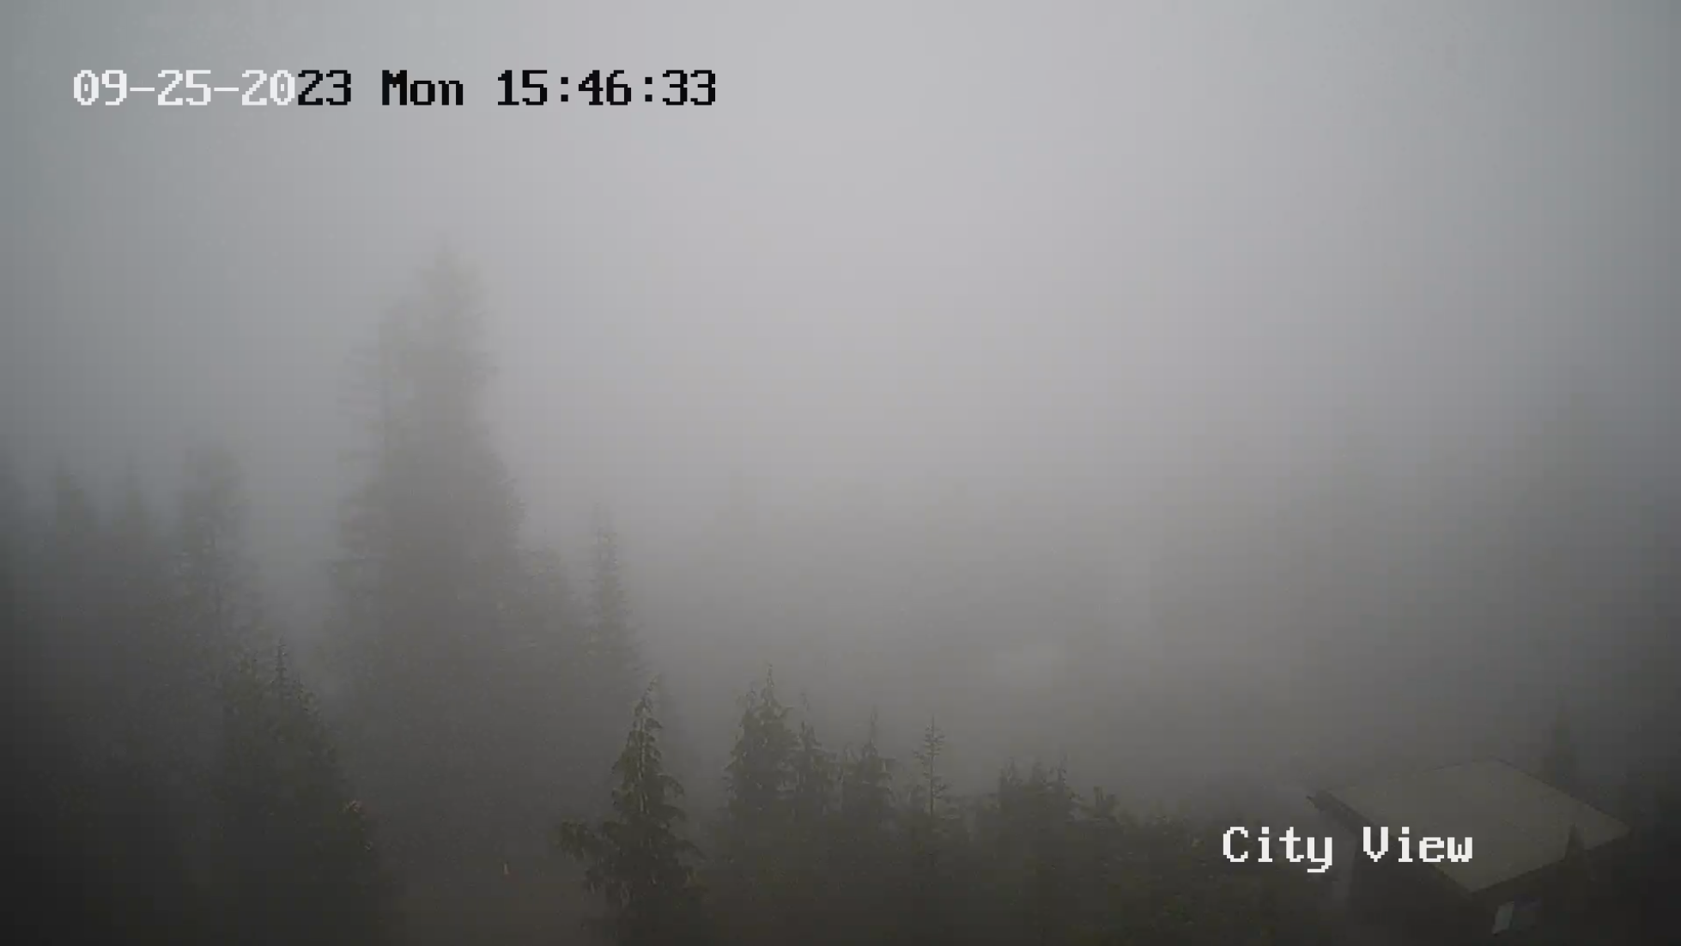
Wonderful location at the heart of Vancouver!!
Grouse Mountain Webcam
on Monday
From there it went unfortunately worse

Slide 8
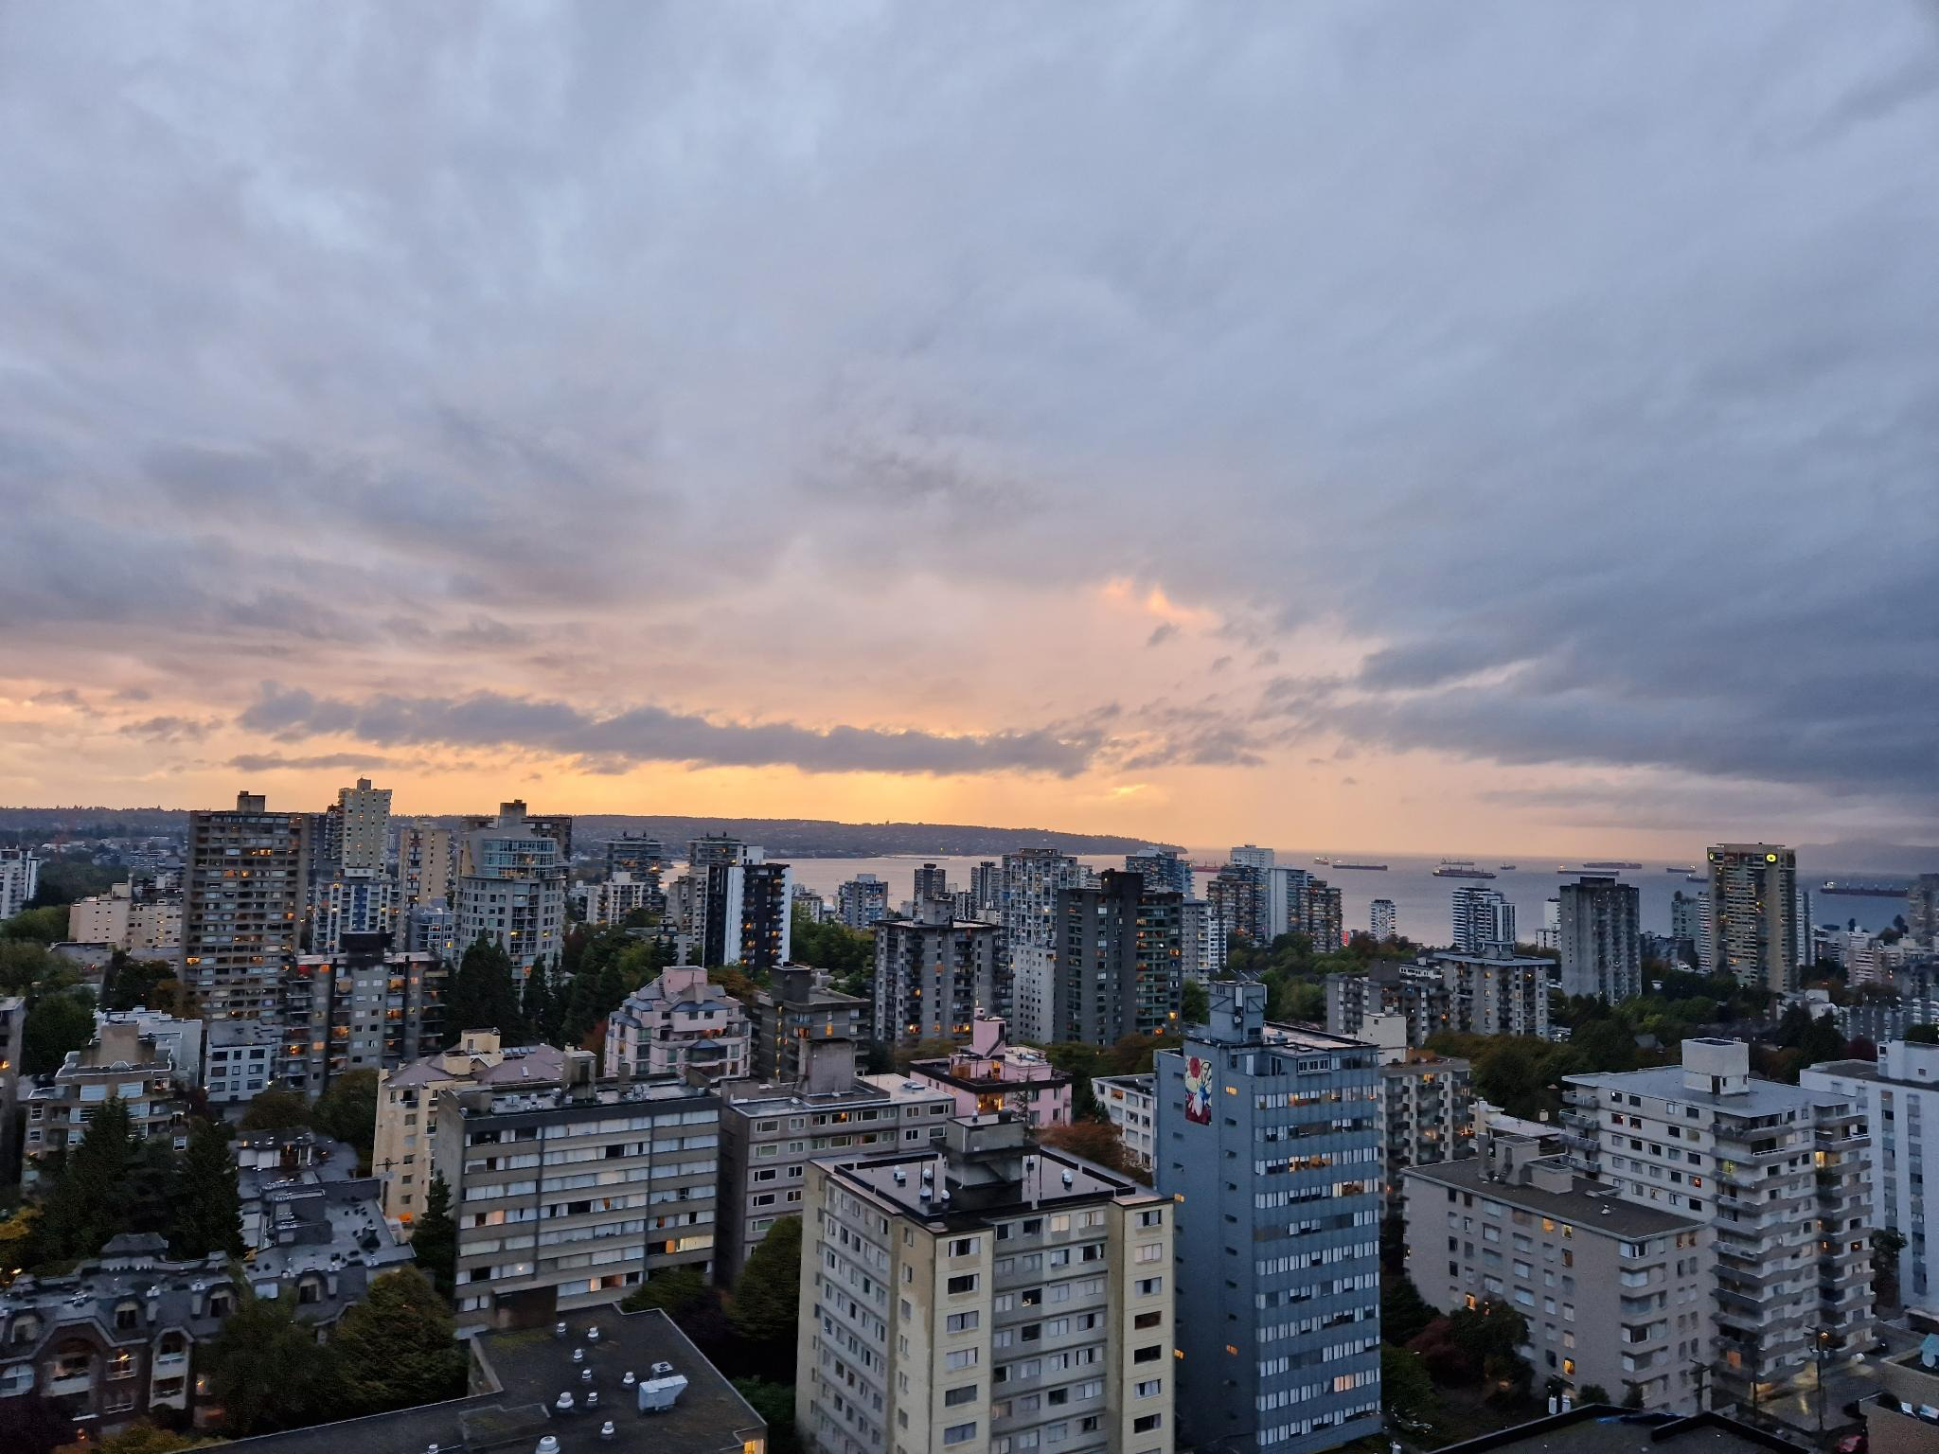
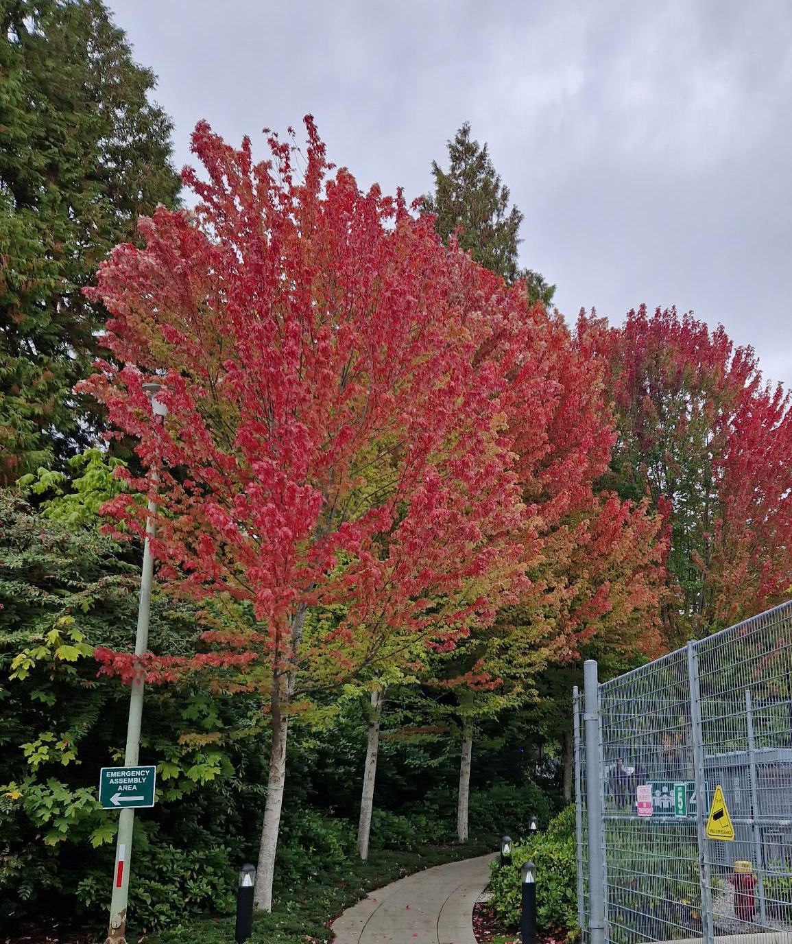
But you just have to find the right timing

Slide 9
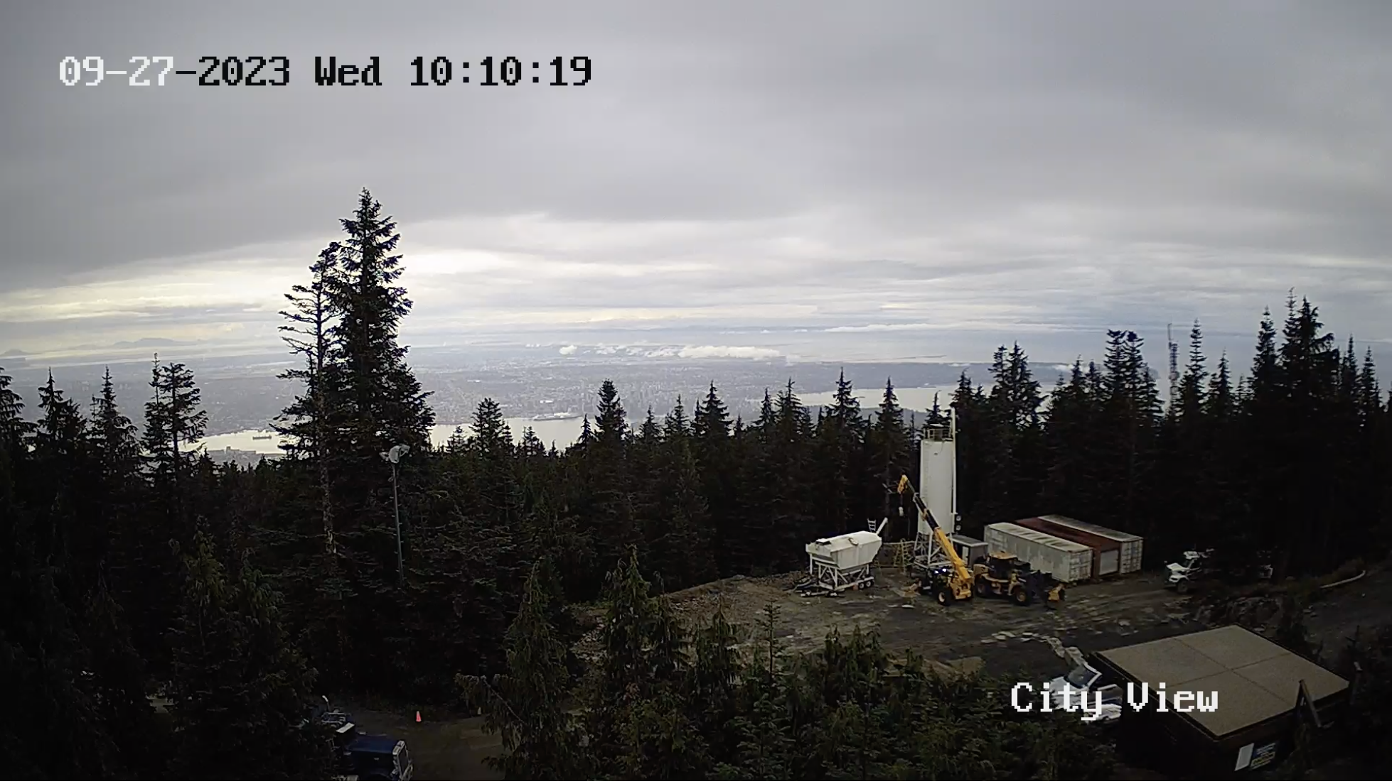
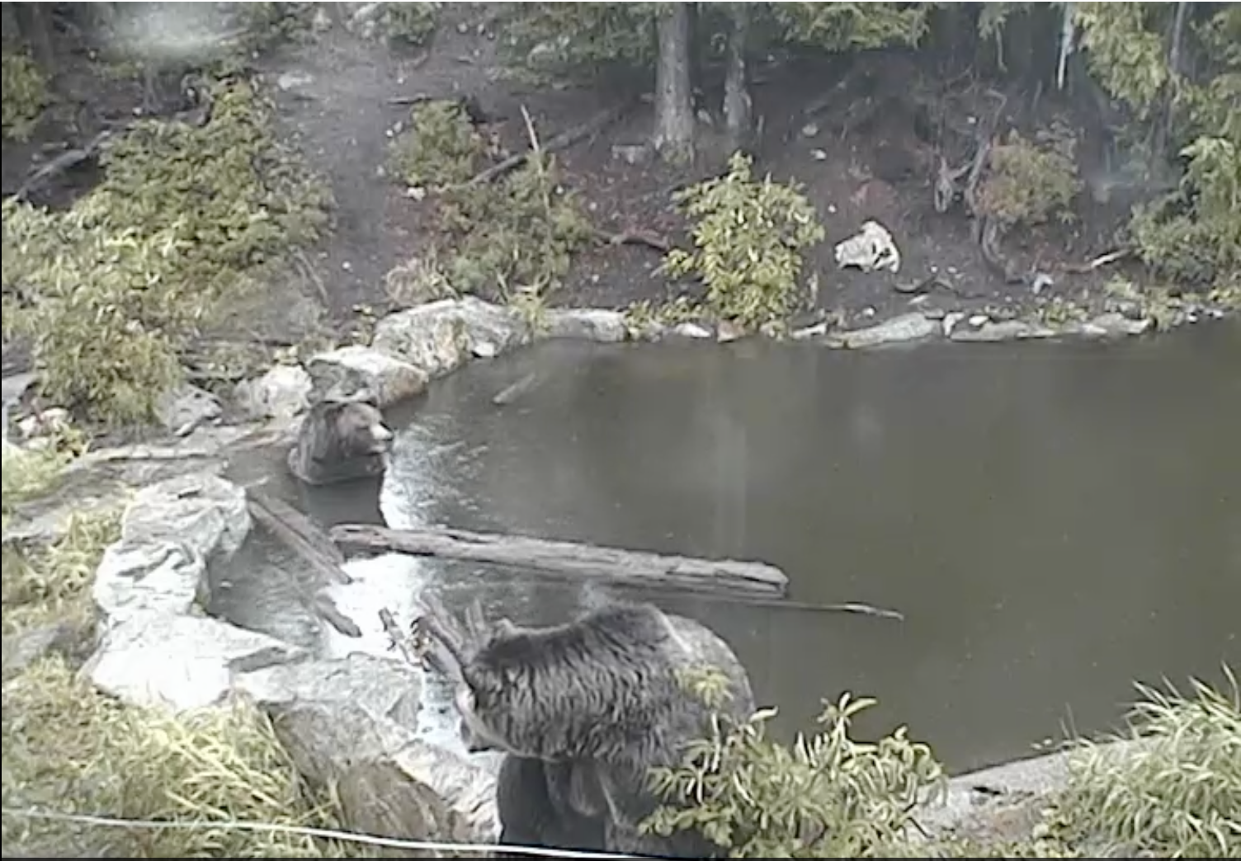
Conference Dinner on Wednesday!
Grouse Mountain

Slide 10
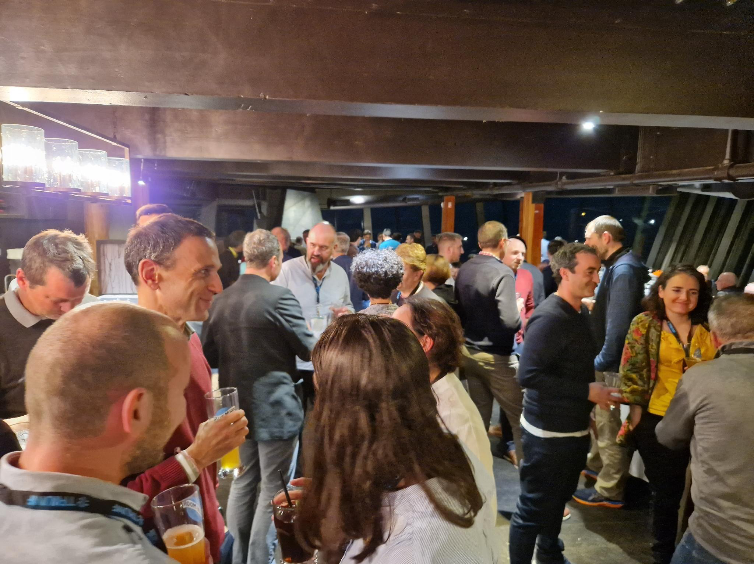
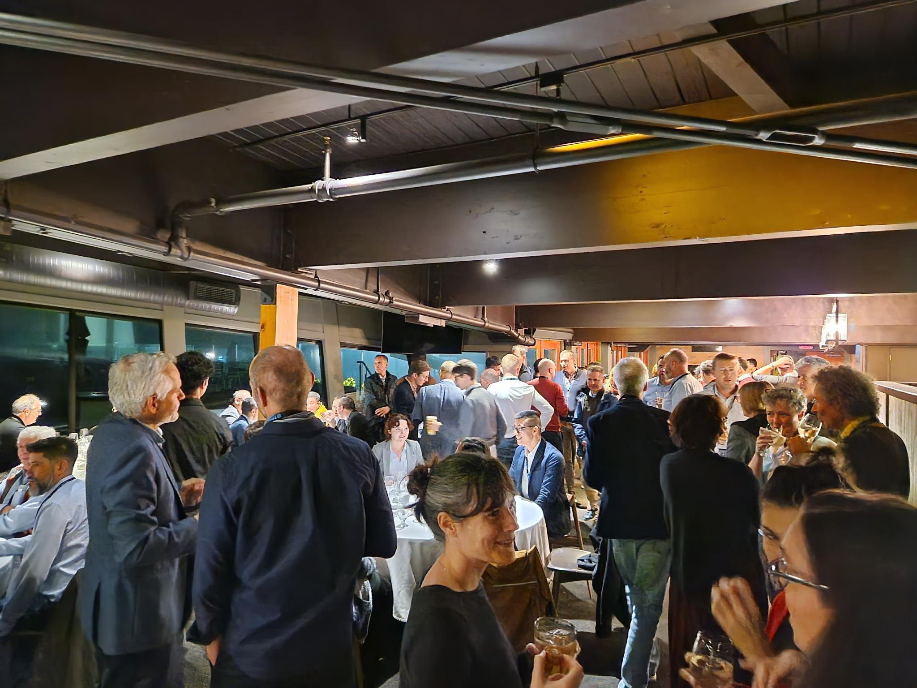
Conference Dinner on Wednesday!
Big Thank You to Cecile and Jana
for the rebooking and the last minute
arrangements of the logistics!

Slide 11
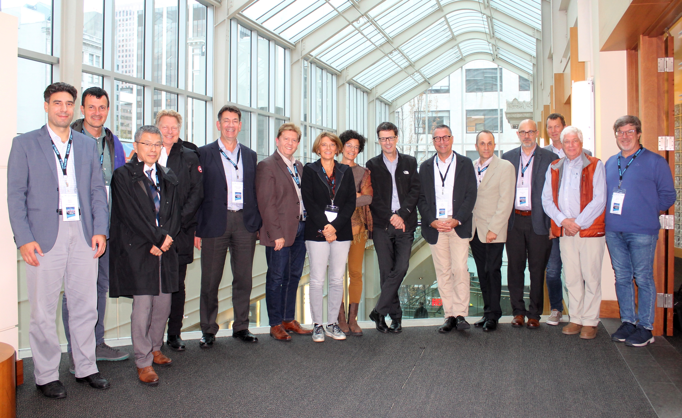
HL-LHC Collaboration Board
13th HL-LHC
Collaboration
Board meeting
Plus participants
connected
via Zoom
Plus the 1st
TRIUMF – CERN
Steering Committee
meeting

Slide 12
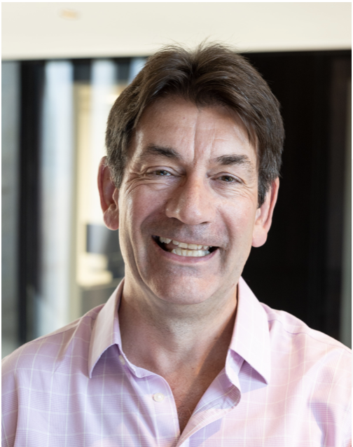
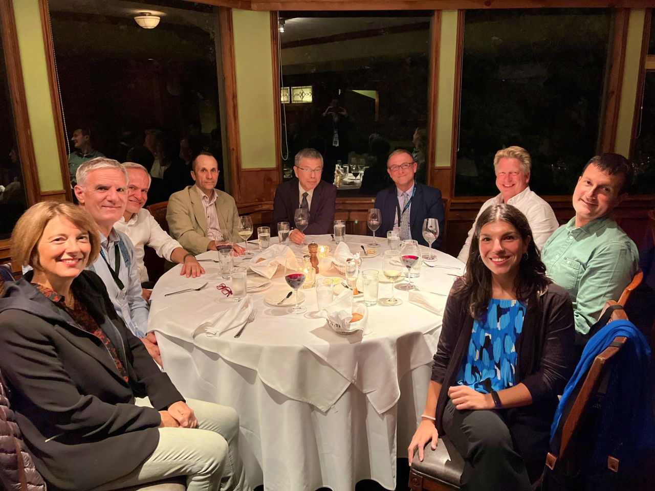
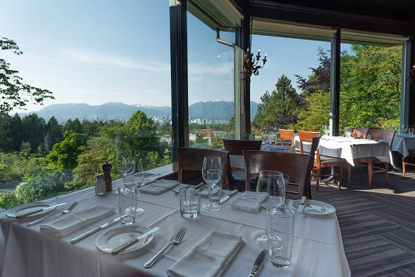
HL-LHC Collaboration Board on Tuesday
13th HL-LHC
Collaboration
CB Dinner
Thanks to Phill Borrows for chairing
that meeting!
Seasons in the Park

Slide 13
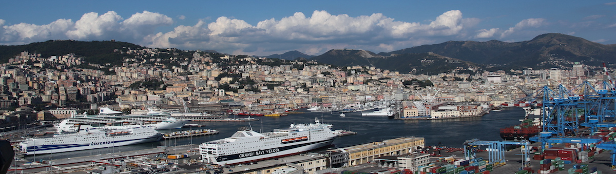
2024 Collaboration Meeting in Genoa
ASG Superconductors (where MBRD is born)
Wide range of hotels and restaurants
Almost anything at walking distance in city centre
Many possible side attractions
Marco Statera

Slide 14
2024 Collaboration Meeting in Genoa
Several location under evaluation
Aquarium
Hotel Bristol
Palazzi dei Rolli
Magazzini del Cotone
. . .
Marco Statera

Slide 15
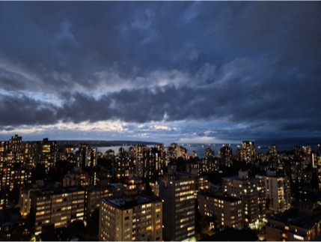
Time to Close the Meeting
Wishing you all a safe trip home!

Slide 17
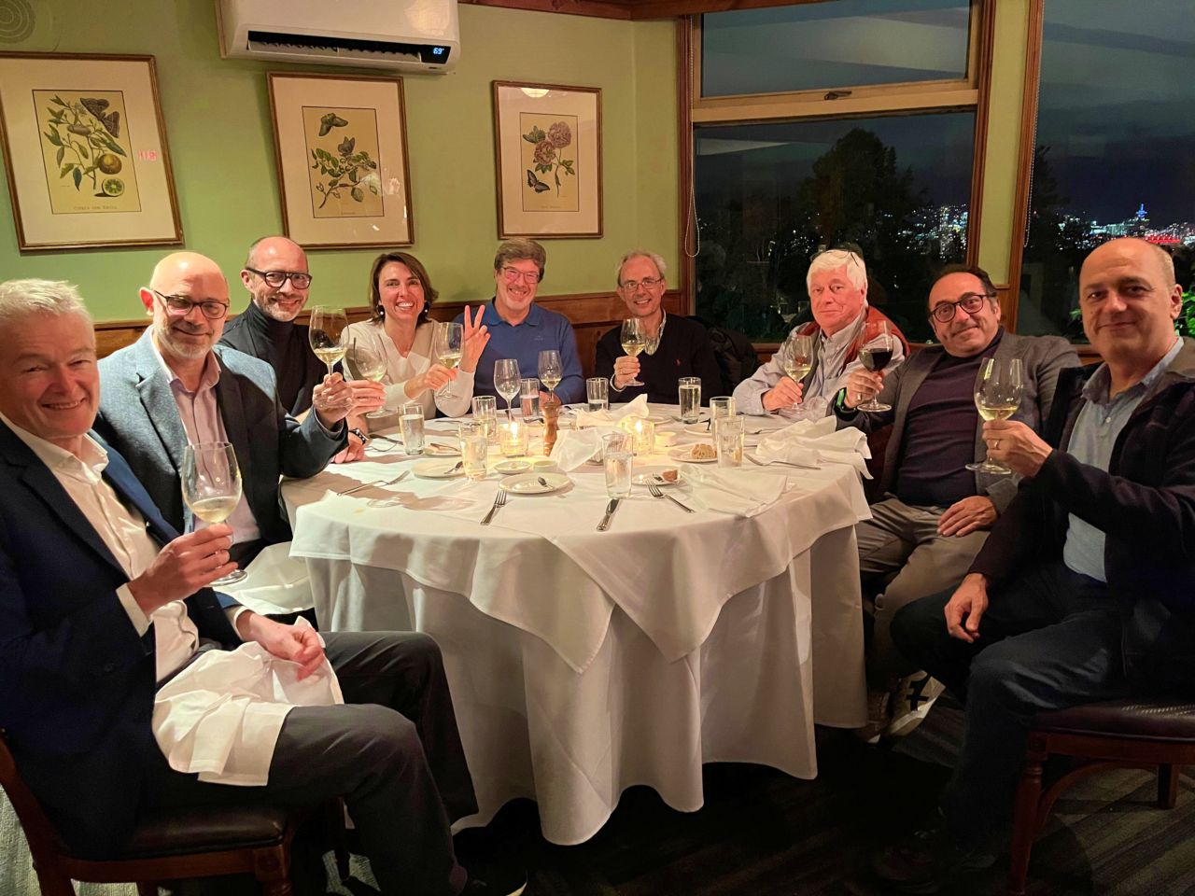
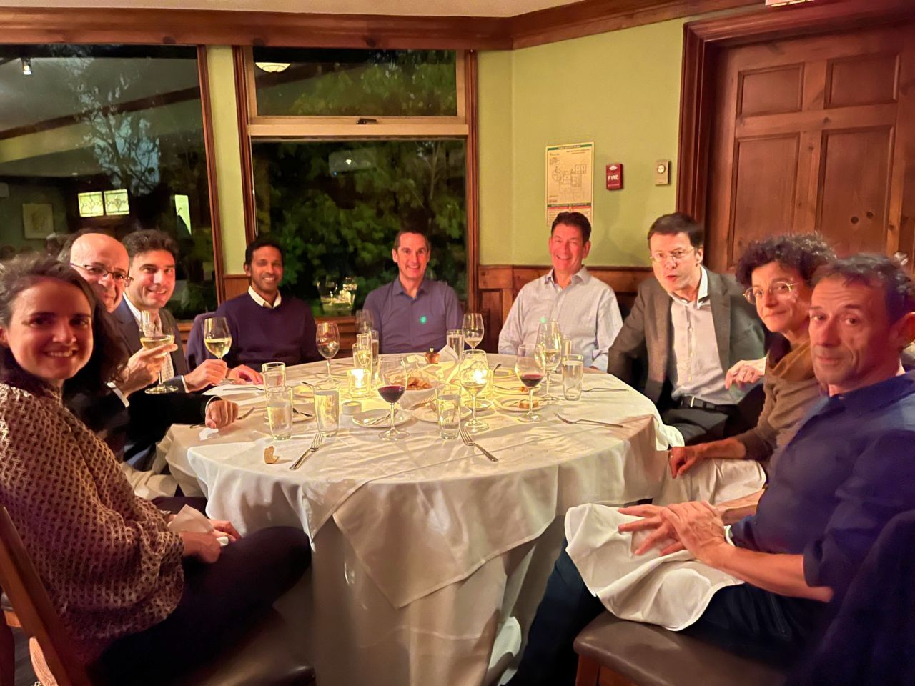
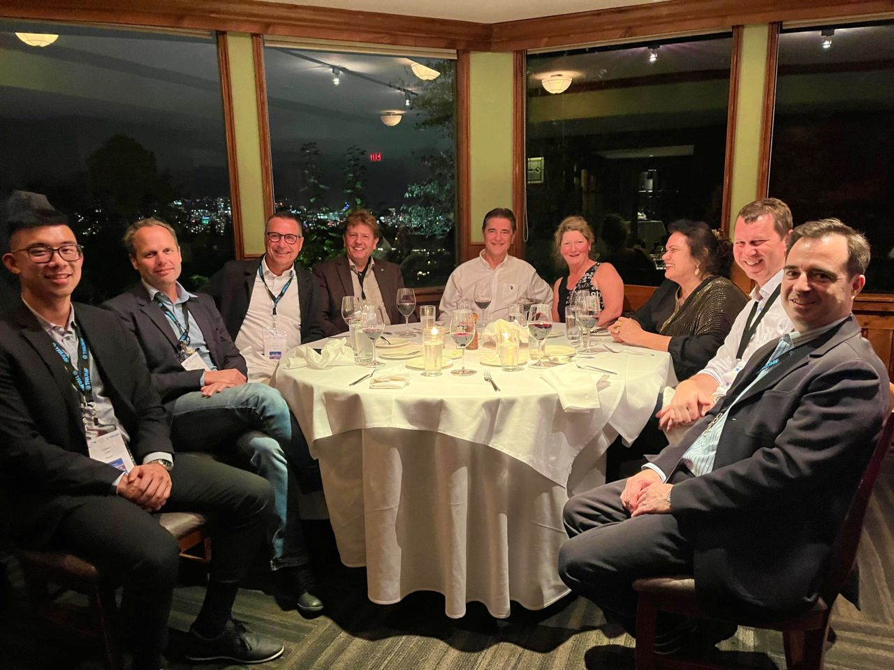
HL-LHC Collaboration Board on Tuesday
13th HL-LHC
Collaboration
CB Dinner
Gardens by the Park

Slide 18
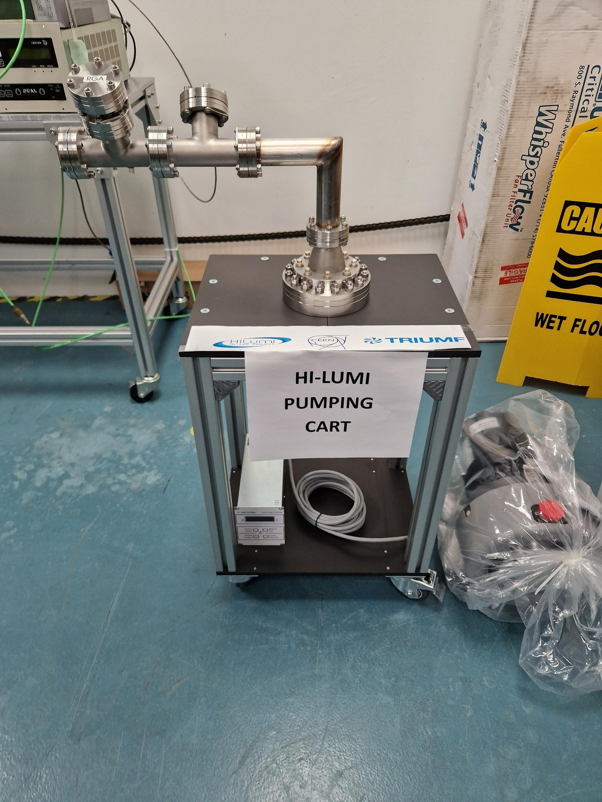
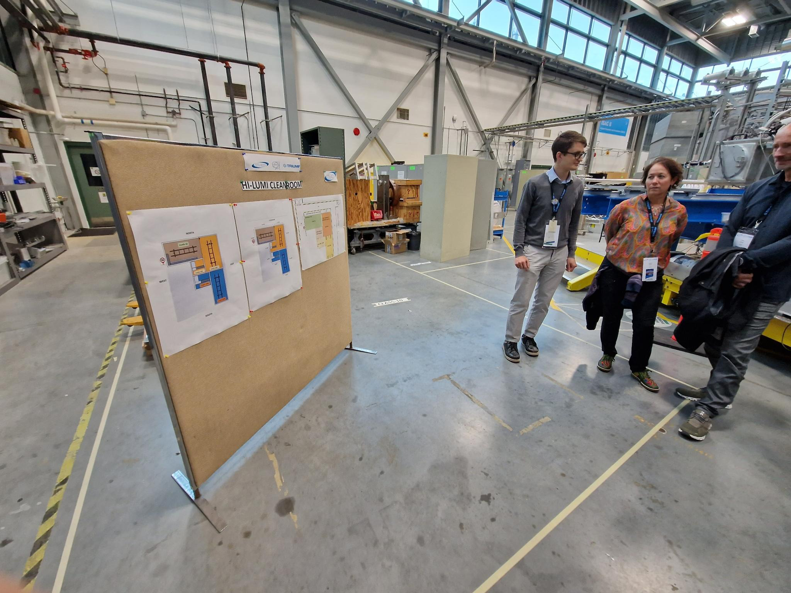
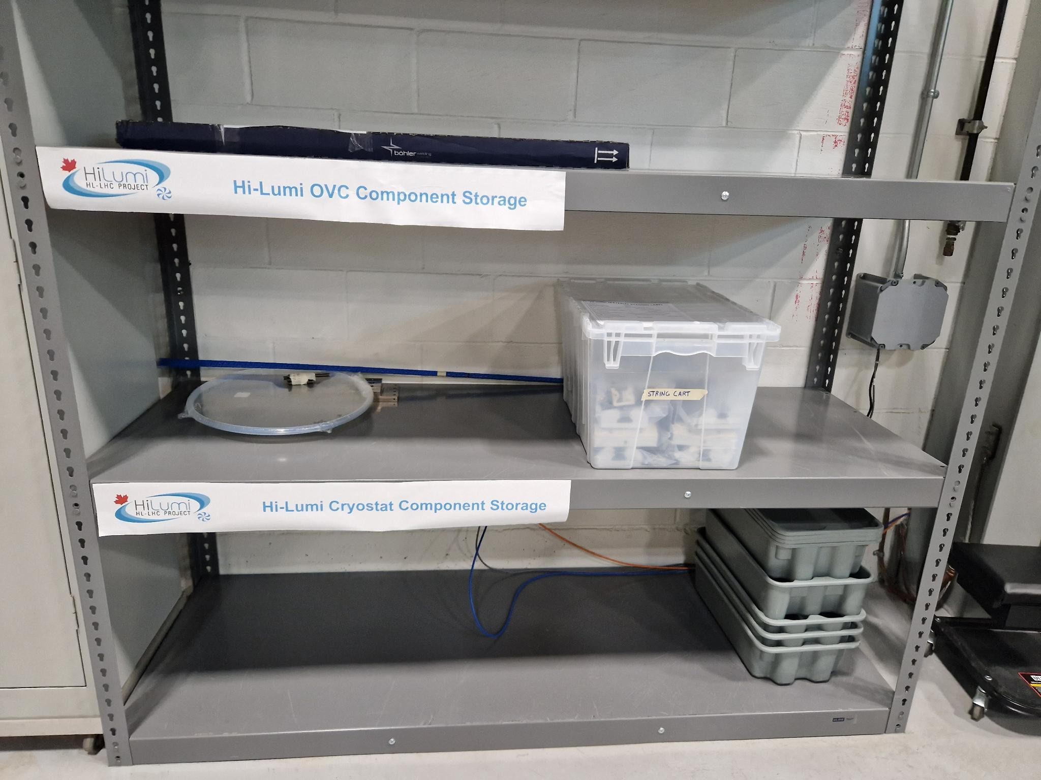
Closure of a 5 Year Journey with TRIUMF
HL-LHC Cleanroom
HL-LHC Vacuum
Equipment
➔Good to see Facilities are shaping up!
HL-LHC Storage Area
2023 visit during HL-LHC Annual Meeting

Slide 19
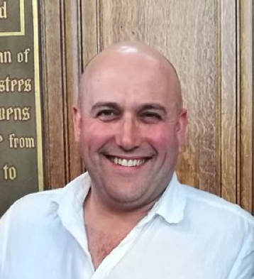
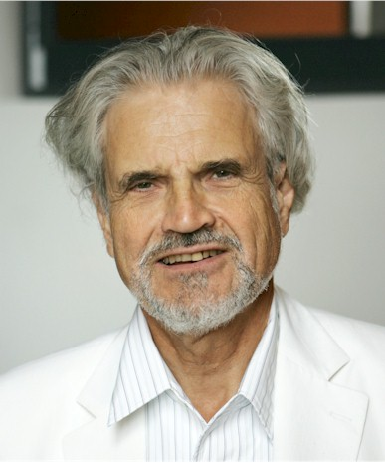
HL-LHC Collaboration Board
HL-LHC CB Chairs
2011 to 2015 (FP7-HiLumi)
2015 to 2018
2018 to 2022
Elected 2022
Andy Wolski (UNILIV)
Rob Appleby (UNIMAN)
Tord Ekeloff (Uppsala U.)
Philip Borrows (Oxford U.)

