Slide 1
Experience with UQDS and EDAQ in the SM18 test benches and plans
Jens Steckert, Jelena Spasic, Tomasz Podzorny, Guzman Martin, Reiner Denz & colleagues – TE-MPE-EP
Marc-Antoine Galilee – TE-MPE-CB
Thanks to Piotr Koziol, Stian Juberg and the SM18 Teams

Slide 2
Outline
UQDS overview
EDAQ overview
Cluster F1 & Cluster F2
  System Layout F1
  UQDS firmware for F1 overview
Operational experience
  Experience in F1
  Experience with UQDS in SM18
Summary

Slide 3
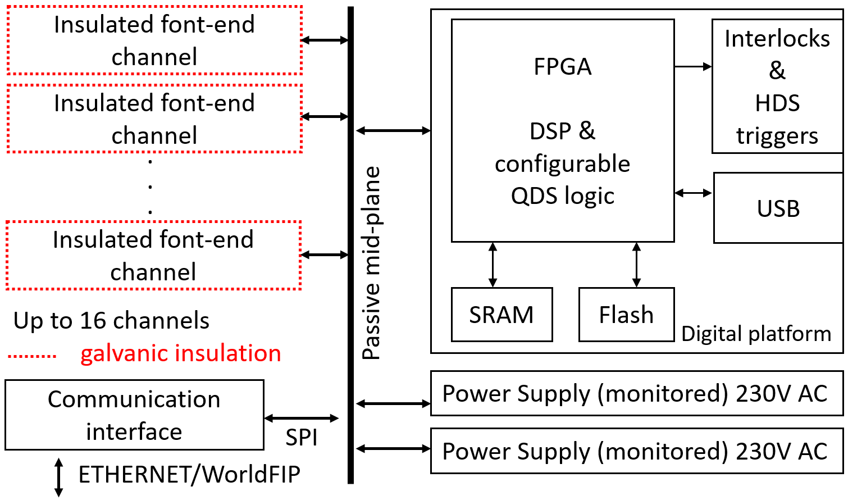
Universal Quench Detection System – UQDS
Modular, generic system
Central FPGA performing
all logic based on IGLOO2
  Advanced signal filtering
  Dynamic setting of quench detection parameters for efficient operation
Analog front ends digitize signals and provide galvanic isolation
Redundant power supplies,
diode coupled and monitored
Passive mid-plane
Controls interface
– WorldFIP or EDAQ
UQDS is the baseline for HL-LHC – the first full deployment will be the IT-string project

Slide 4
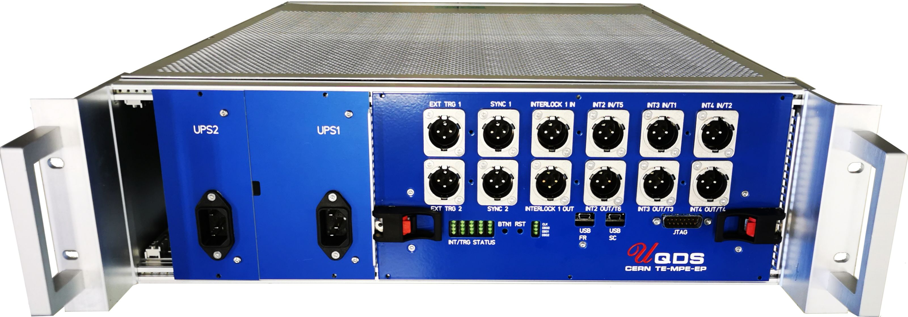
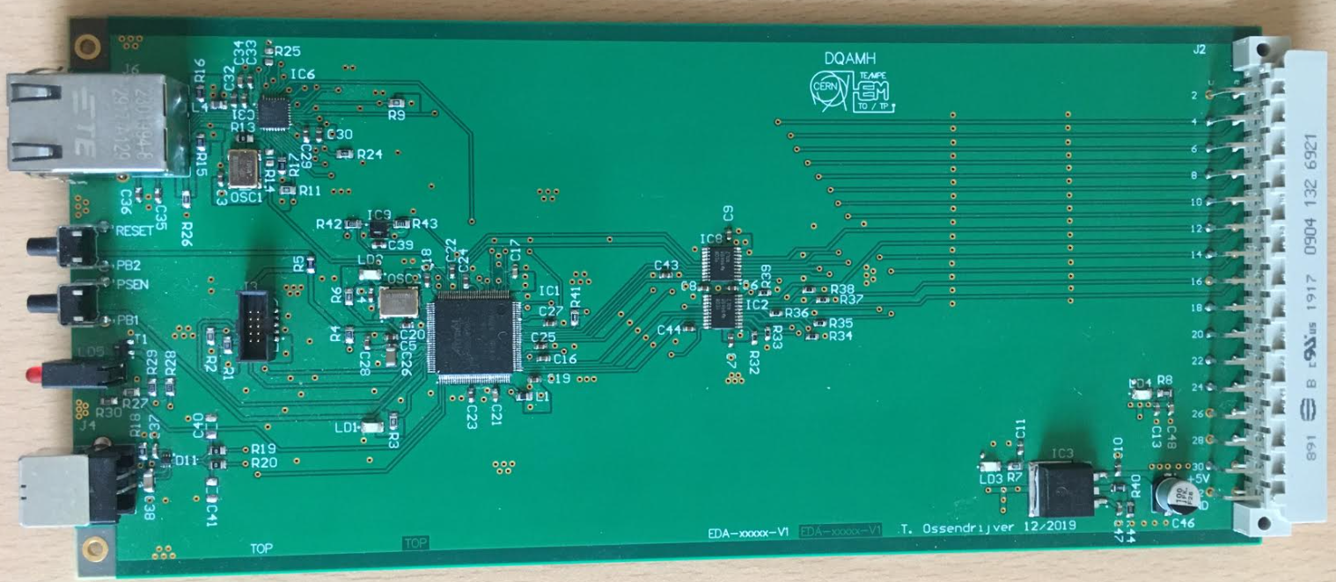
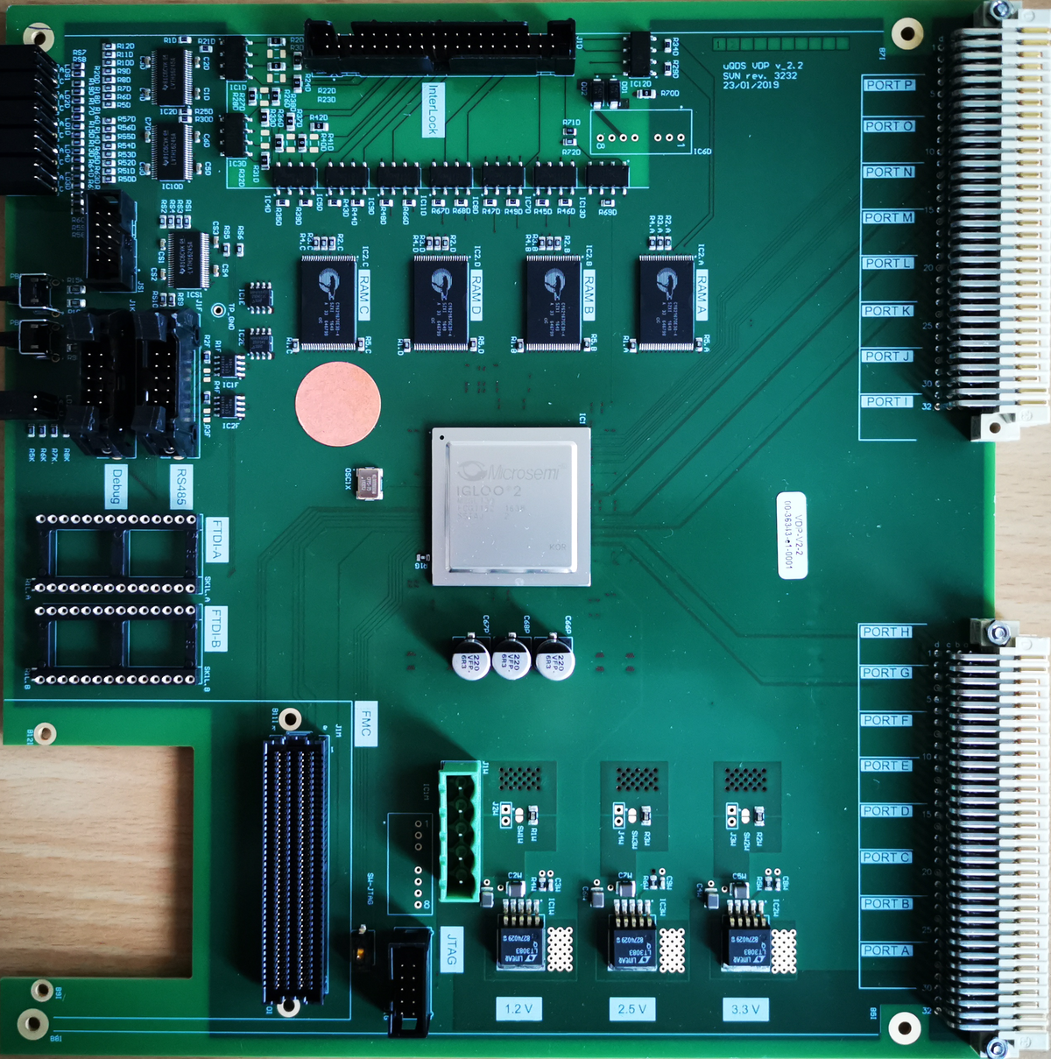
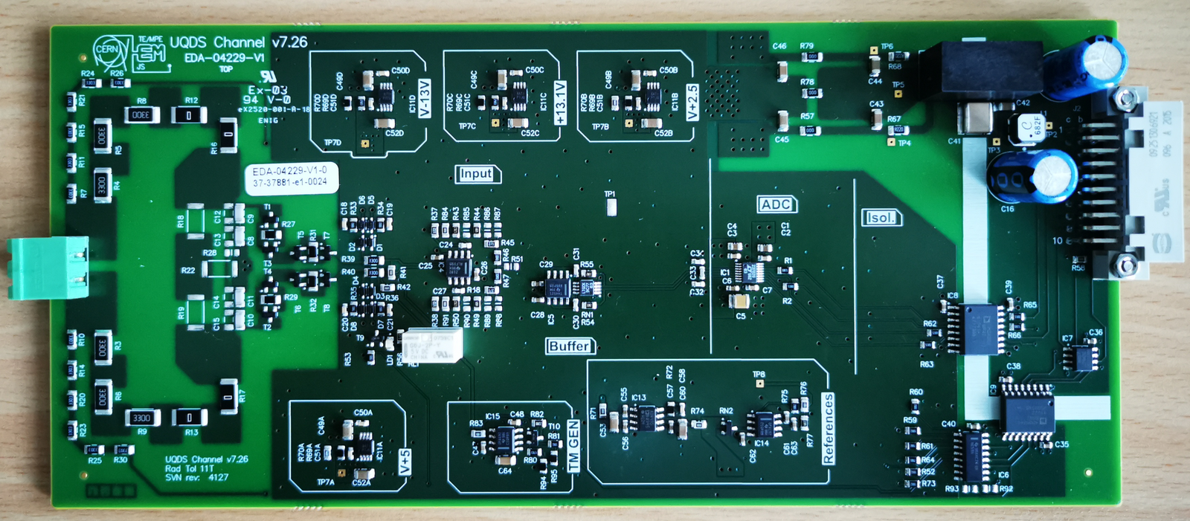
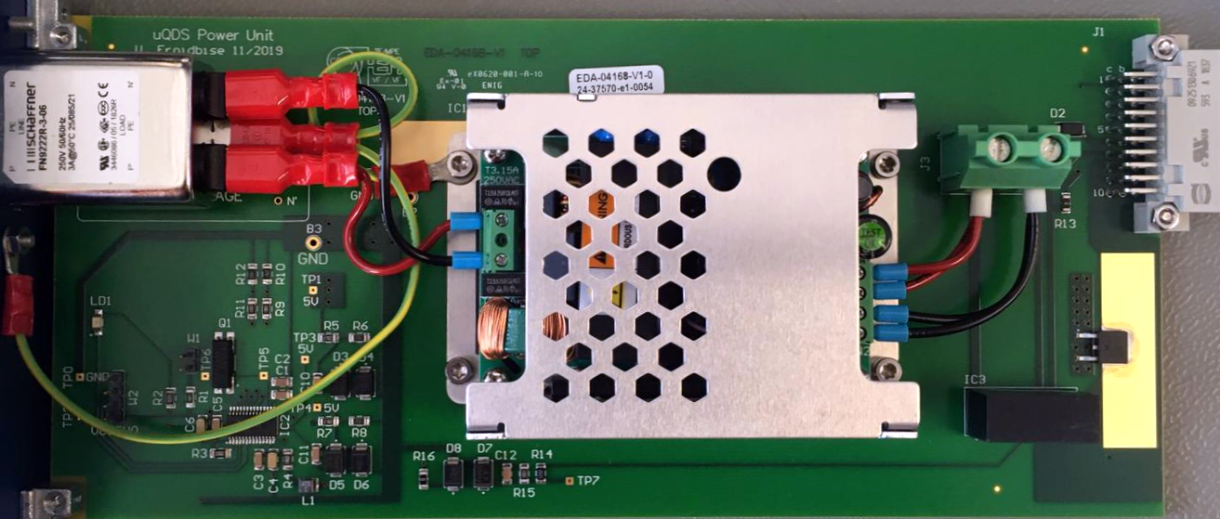
UQDS
Parameter | Value
Resolution (20-bit ADC) | 105 nV/LSB .. 48 uV/LSB
ADC speed | Up to 1 MS/s
Analogue bandwidth @ gain | 120 kHz @ G=1 100 kHz @ G=9 50 kHz @ G=45 7 kHz @ G=450
Active input voltage range | +/-50 mV (G=450) .. +/-22.5 V (G=1)
Max differential input voltage | 1 kV/1 s
Galvanic insulation | 2.5 kV/20 min, 5kV/1min

Slide 5
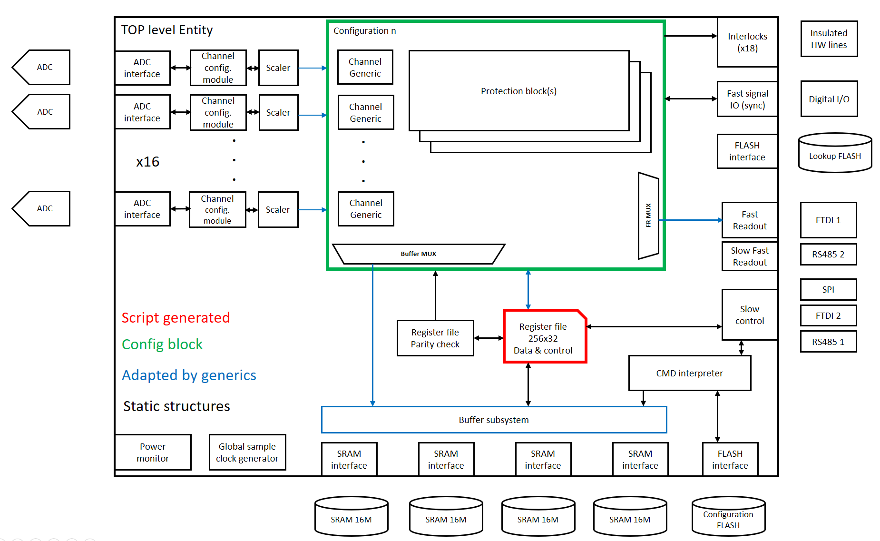
FPGA Gateware
Application specific part
(C22, C23...)
Modular approach:
Basic infrastructure is static
Application specific parts adapted to each case
Some code is generated by scripts to avoid errors and speed up generation of new blocks

Slide 6
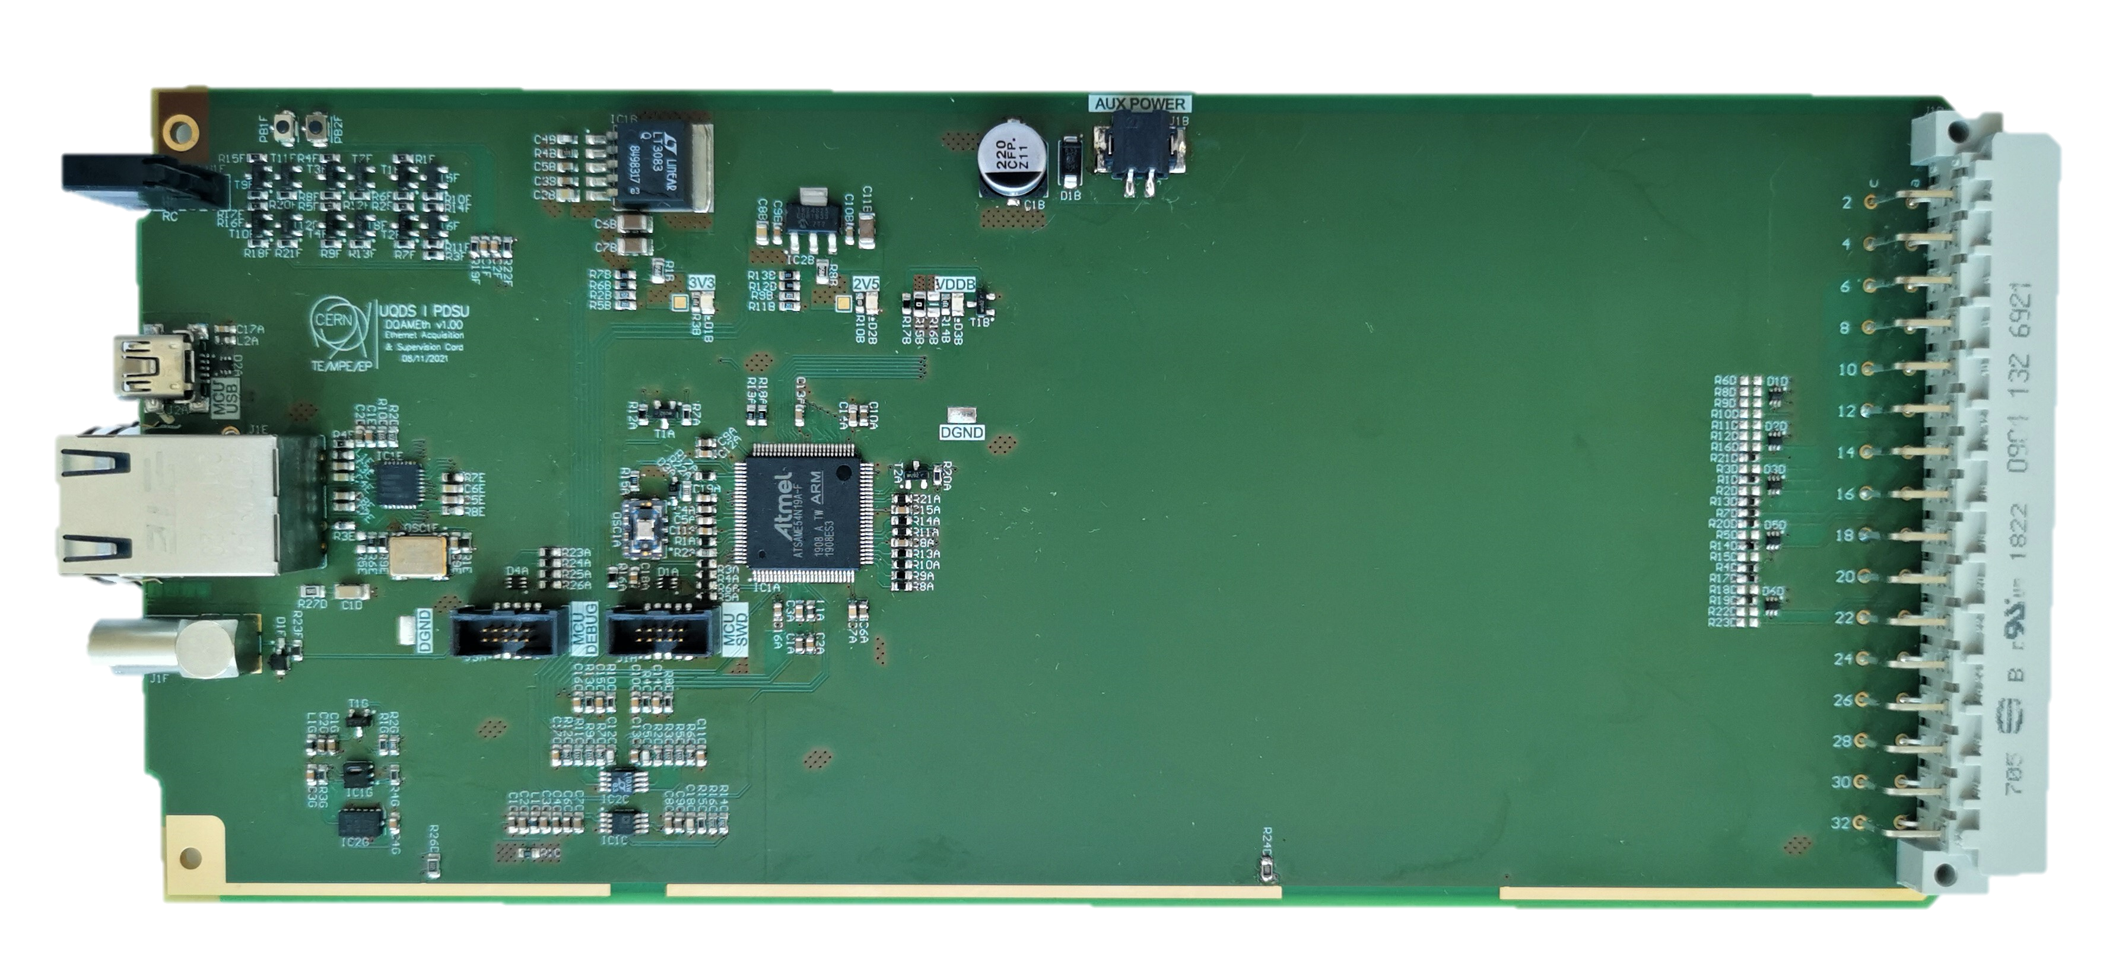
EDAQ
Communication and time synchronization system developed by MPE-EP to replace the outdated WorldFIP field bus by a modern ETHERNET based system
Key features:
  Data transmission rate of 10Mbit/client (WorldFIP was limited to ~960 bytes/s )
  Timing synchronization << 1ms (~1us)
  Full integration into FESA (Front End Server Architecture)
  Full integration to CERN controls system:
    NxCALS (Logging) → 10Hz continuous
    Post Mortem (transmission of high resolution data after system had triggered)
    FESA API (get and set commands allow controls by third party applications
  Fast logging: up to 10kHz continuous logging NEW
  Possibility of fast readout with ~300kHz
EDAQ controller for UQDS

Slide 7
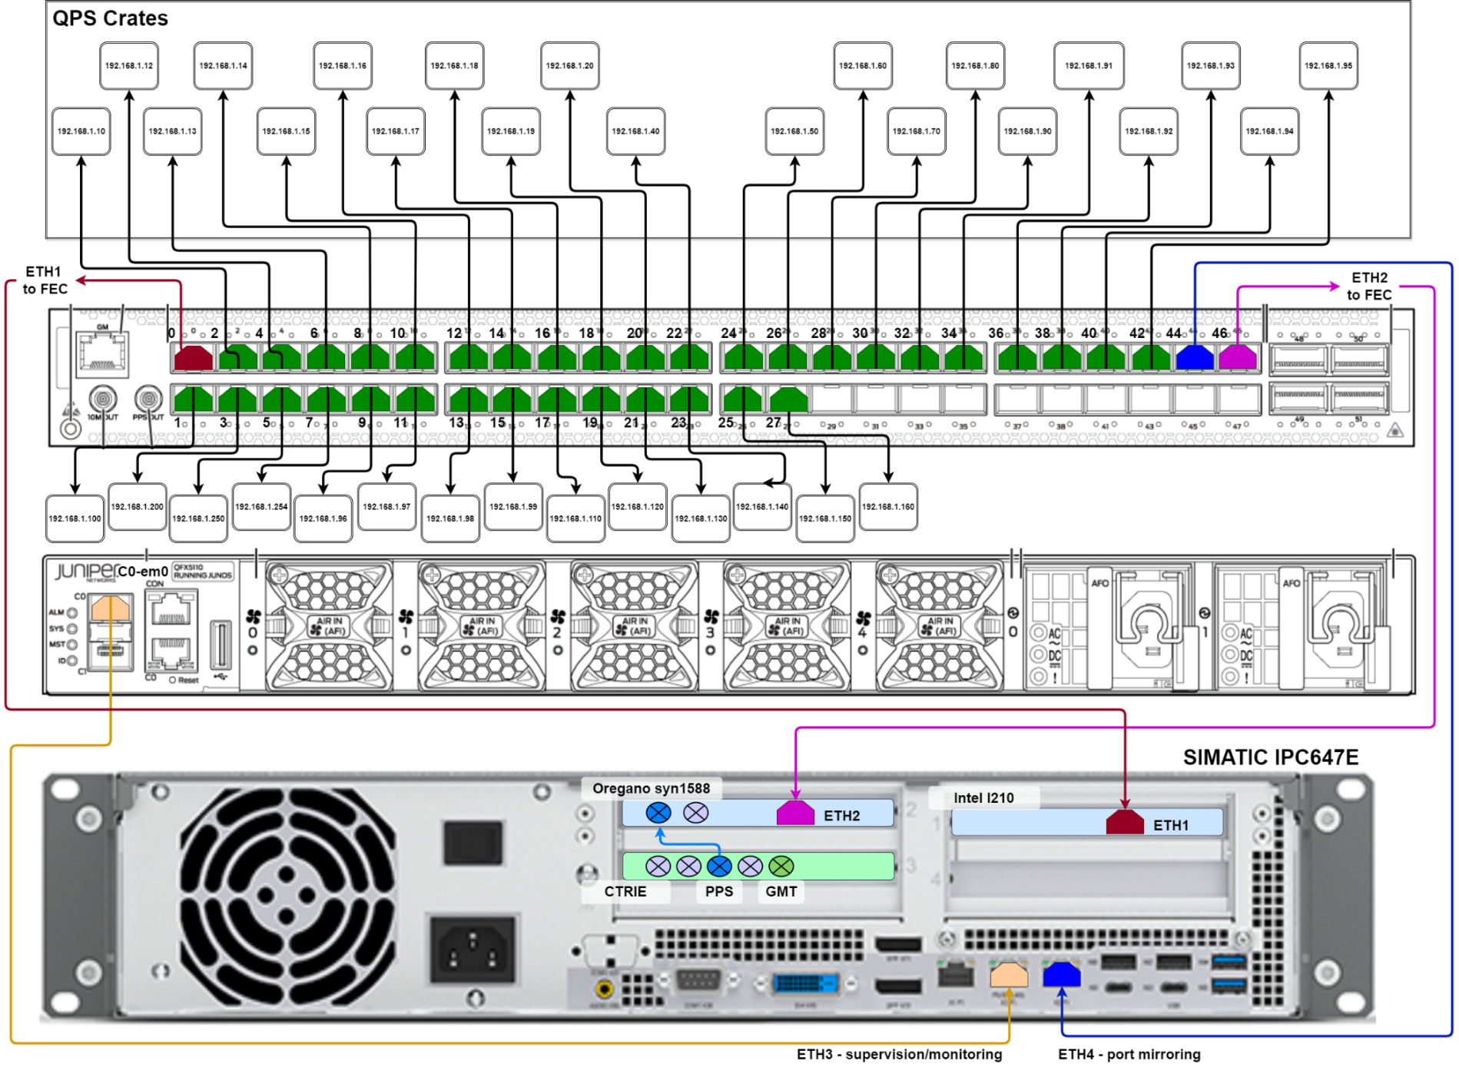
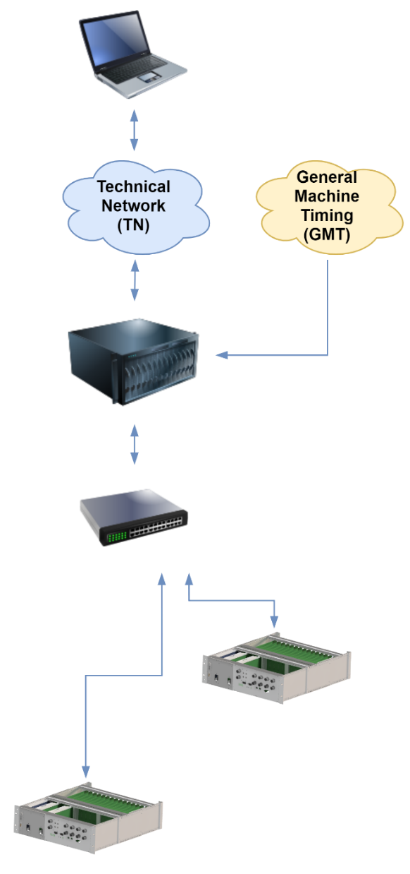
EDAQ infrastructure and configuration
Clients (UQDS)
Switch
Front end server
Credit: M. Murillo Moya

Slide 8
SM18 Cluster F1 & F2
Cluster F in SM18 was upgraded to provide a modernized test bench for HiLumi magnets and the superconducting link
Quench detection, test bench protection and data acquisition is provided by UQDS + EDAQ
F1 system size: 10x UQDS & 1x PDSUv1
F2 system size: 20x UQDS
Cluster F1 is commissioned and waiting for the first MQXF magnet
Cluster F2 will be commissioned after F1 and will be used to test the super conducting link.

Slide 9
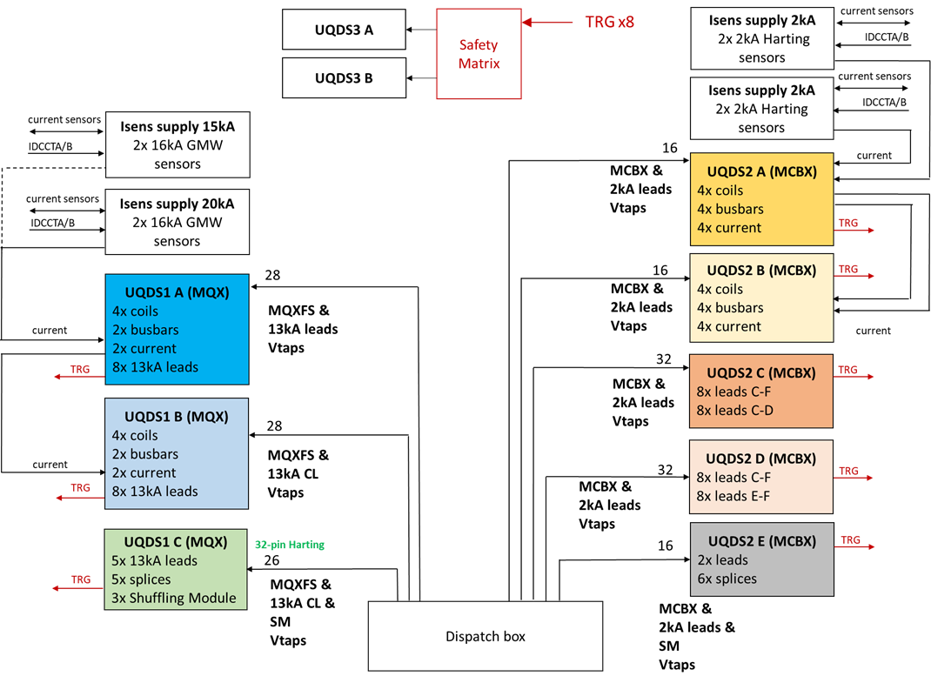
Cluster F1 QDS block diagram
UQDS is used for:
  Magnet protection
  Testbench protection
  (Current leads, bus-bars etc.)
  Monitoring (additional signals)
Magnet protection systems are redundant and interlocking, monitoring systems are not
Monitoring crates will record post mortem when protection crates trigger
Current sensors are connected via dedicated powering and connection boxes
Mon
Mon

Slide 10
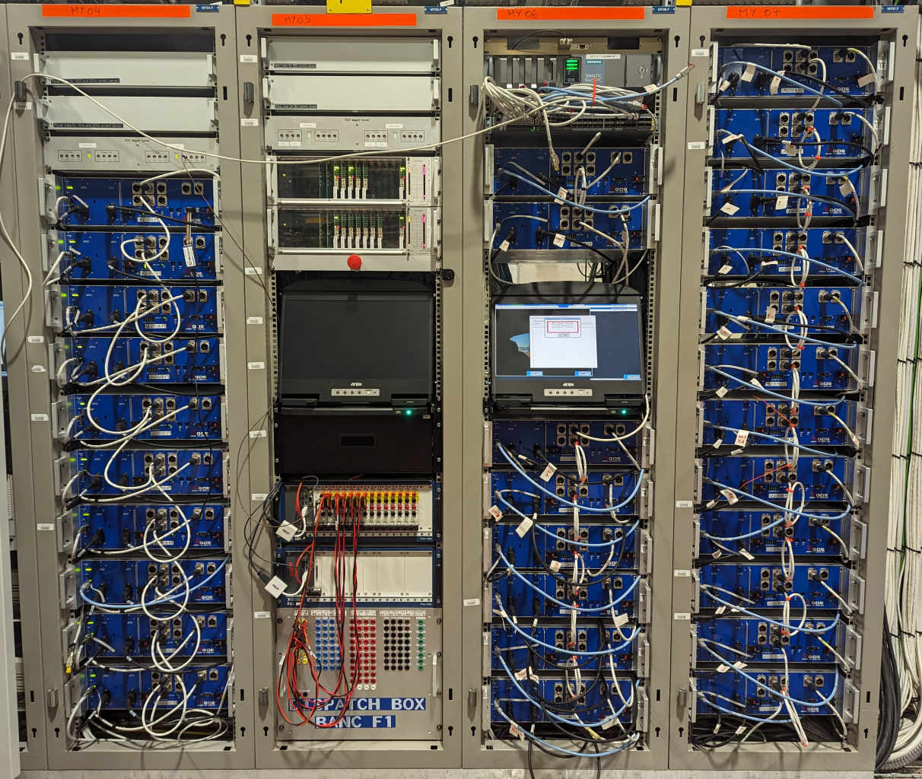
Cluster F1 & F2
UQDS installation
10 systems for F1
20 systems for F2
Current sensor boxes

Slide 11
UQDS firmware for F1
C22
  Protection of MQX magnet and test bench
  Implements protection algorithm for MQXF magnets already used in SM18 earlier
  Additional Test bench protection channels for current leads
  27 signals at ~20kHz in Post Mortem (75k points)
C23
  Protection of MCBX corrector magnets and test bench
  Implements hybrid (comparison and L*di/dt) algorithm used in SM18 in cluster D earlier.
  31 signals at 9.6kHz in Post Mortem (65k points)
C24
  Generic firmware with 16 channels implementing 16 absolute thresholds
  Used for test bench protection and additional monitoring

Slide 12
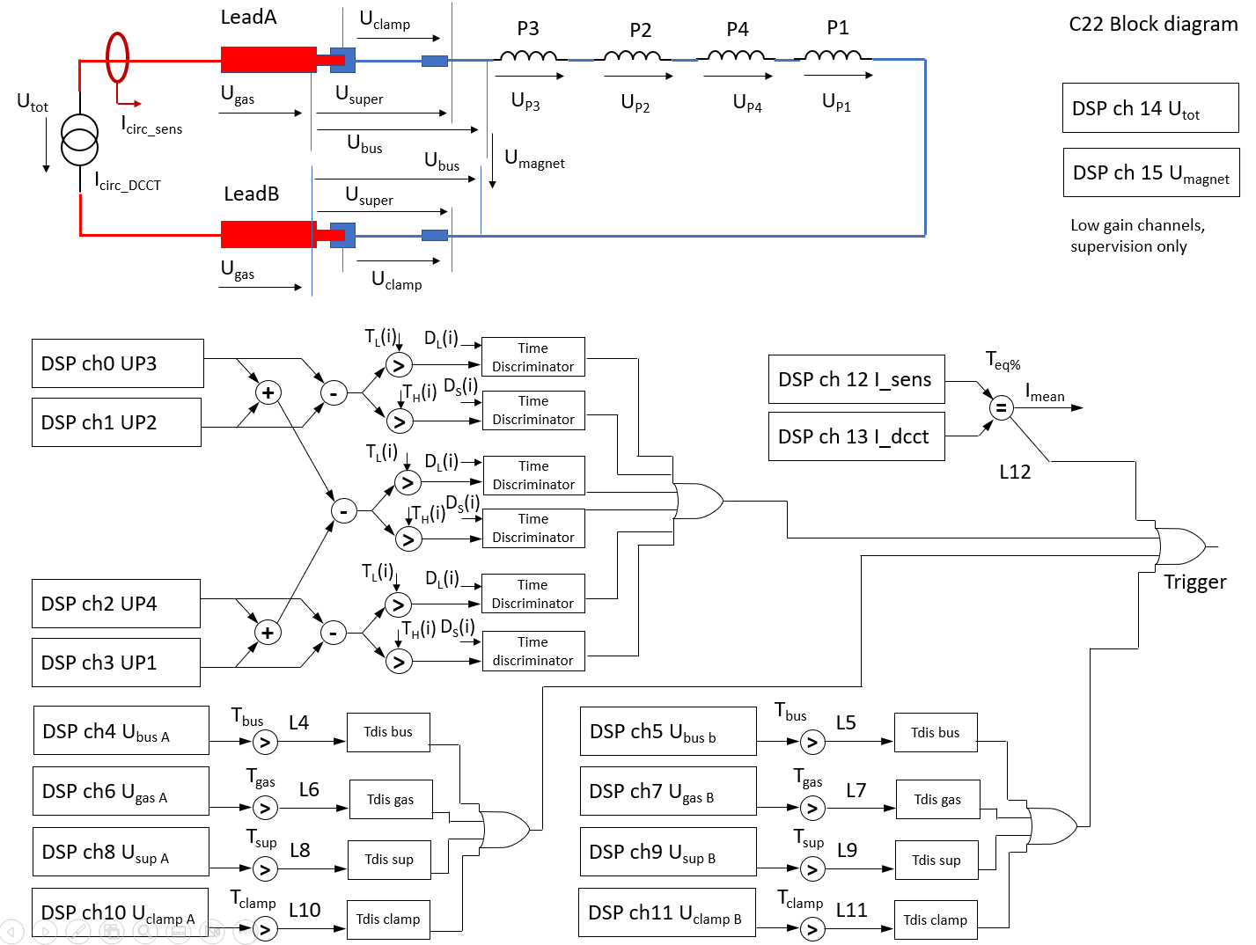
Firmware architecture
(example C22)

Slide 13
Cluster F1 controls GUI
Developed by BE-CEM-MTA
Allows the basic control of the UQDS crates via the EDAQ stack and FESA
Gives the test bench operators a graphic user interface
Thresholds and discrimination times can be changed by the TB operators
Tested during cluster F1 commissioning

Slide 14
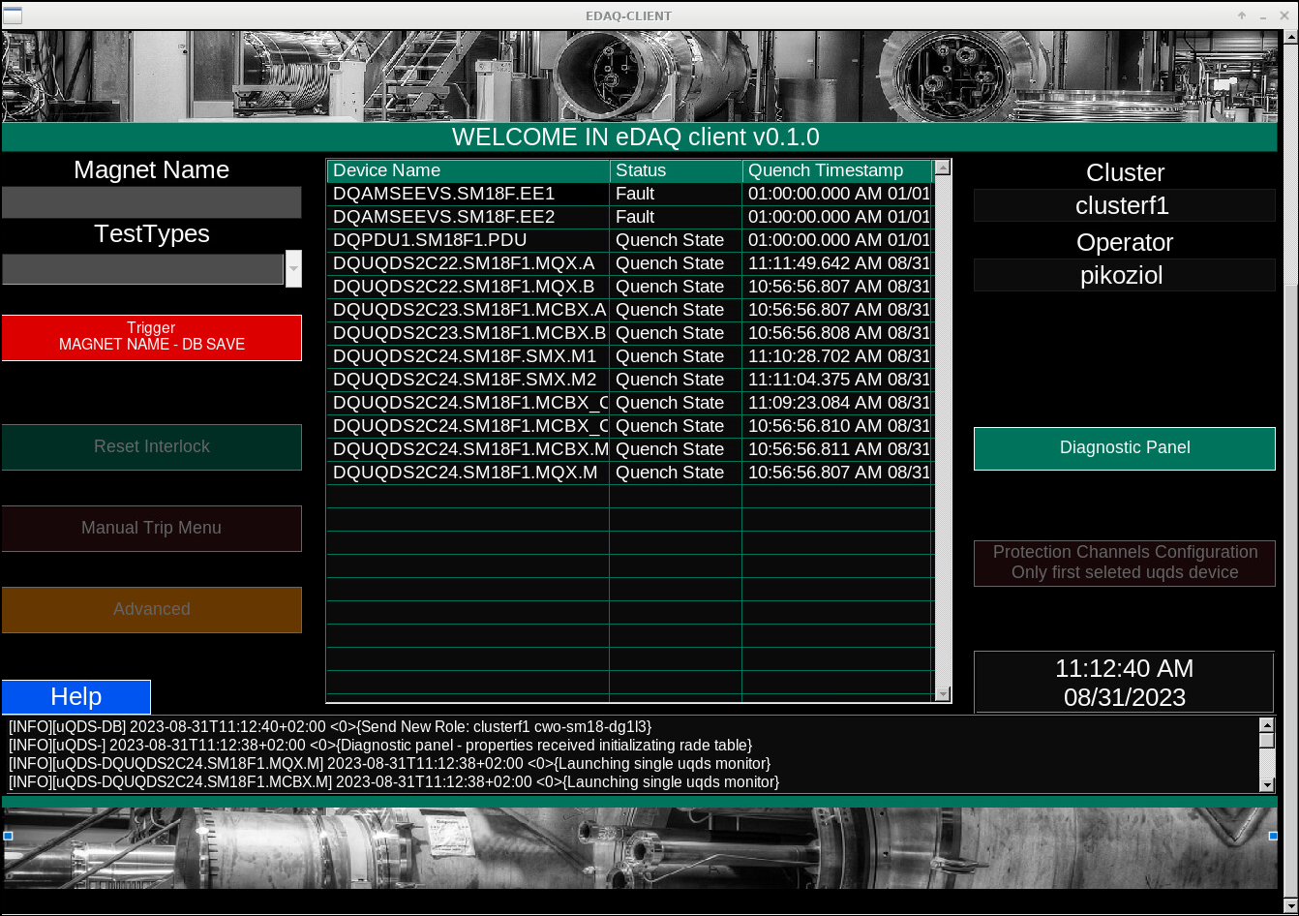
Cluster F1 controls GUI
Screenshot: Piotr Koziol

Slide 15
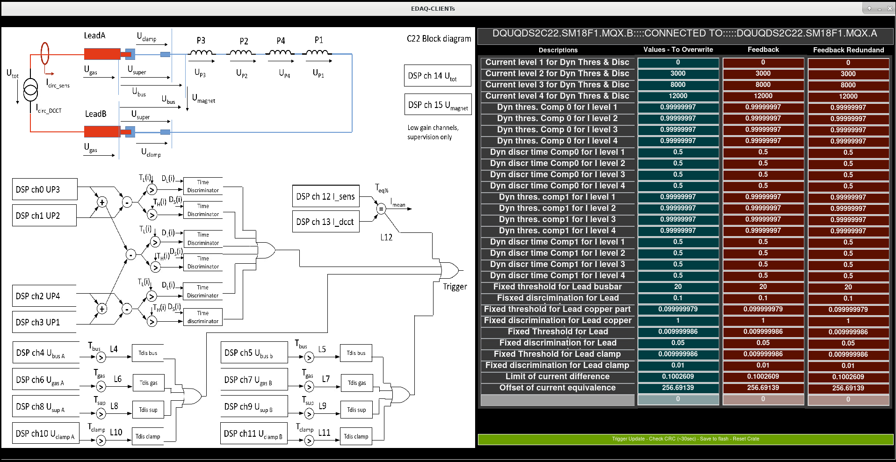
Cluster F1 controls GUI
Screenshot: Piotr Koziol
Screenshots of Piotr go here

Slide 16
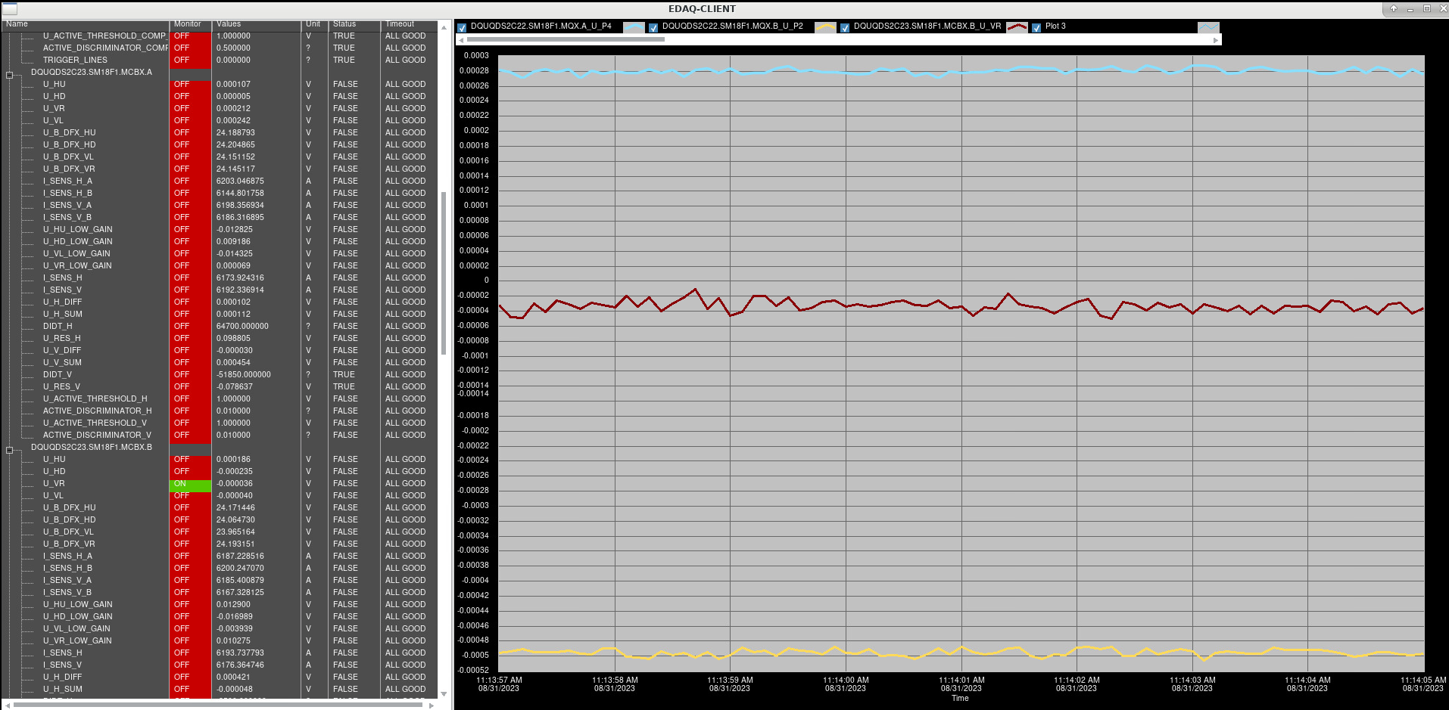
Cluster F1 controls GUI
Screenshot: Piotr Koziol

Slide 17
Experience with UQDS & F1
So far, UQDS was active during cluster F1 commissioning
Shuffling module issues, delayed the production phase of F1
Integration of EDAQ and UQDS took some time but is solved
Fast logging option to be implemented in second phase
Parameter configuration of UQDS needs some attention to ensure integrity of the system
  We have to make sure that each UQDS crate is properly configured and “locked” by internal checksum
  Configuration management needs still action from experts and TB crew to be able to keep a record of settings → Room for automation !
In general experience is very good and we look forward to see the first magnet being tested !

Slide 18
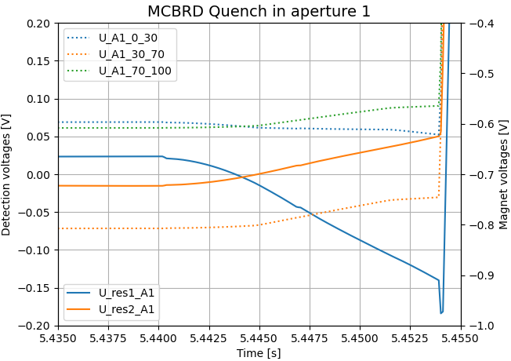
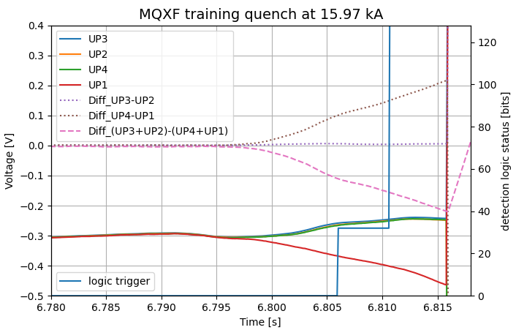
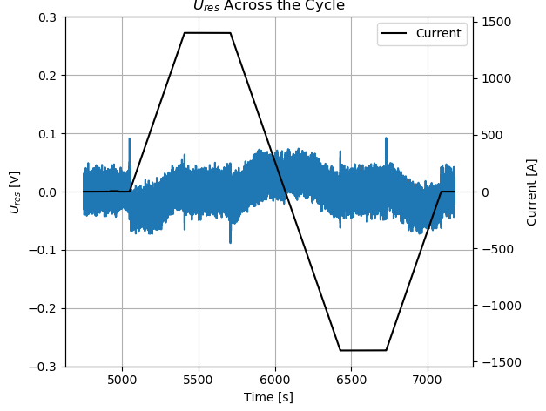
Other installations of UQDS in SM18 (no EDAQ)
UQDS is in use in SM18 since many years
Table on the left shows the currently installed systems
QDS specialist required for setup and (remote) operation
By following the development of the magnets we learn about their specifics and we are able to test the QD algorithms in “real world”
So far UQDS has “seen” representatives of all HiLumi magnet families
Cluster | Installed UQDS
A | 2x UQDS for MQXF/MCBX magnets
B | 2x UQDS for D1 (MBRD)
C | 2x UQDS for MCBRD test
D | 3x UQDS for MCBX or MCBRD test (2 for protection, one monitoring crate)
- | System to measure acoustic sensors (Used wherever required)

Slide 19
Experience with other installations in SM18
Except cluster F the UQDS installations are not included in CERN controls infrastructure (no EDAQ)
This requires relatively intensive expert coverage to operate as there is no official GUI available (only development GUI for experts)
Biggest challenge for more sensitive algorithms (L* di/dt) is the noise coming from power converters as well as low current operation (necessitating I dependent settings)
Another (yet unknown) noise source is also coupling in a lot of measurement systems in SM18. EMC user forum is informed and we’ll launch a campaign with D. Valuch to identify the source of that noise.
Using UQDS on (prototype) magnets in SM18 is an extremely valuable test bed for the final LHC units. → STRING will be final test for algorithms and systems

Slide 20
Summary/Plans
Hardware installation and commissioning of cluster F1 system completed
Hardware installation of F2 systems completed (still commissioning pending)
EDAQ integration completed
User GUI delivered by BE-CEM and working
Configuration management to be more automated
Possibility to extend EDAQ + GUI integration on other UQDS installations in SM18
F1 & F2 UQDS+EDAQ installations are the blueprint for STRING QDS installation

