Slide 1

Experience with new Energy Extraction Systems and CLIQ in the SM18 test benches and plans
Mirko Pojer
CERN TE-MPE-MP
with contributions from
David Carrillo – CLIQ & HL-DQHDS Project Leader
Bozhidar Panev – Vacuum-switch-based EES Project Leader
Spyridon Georgakakis – Electronics design Leader
and
Gerard Willering, Franco Mangiarotti from SM18

Slide 2
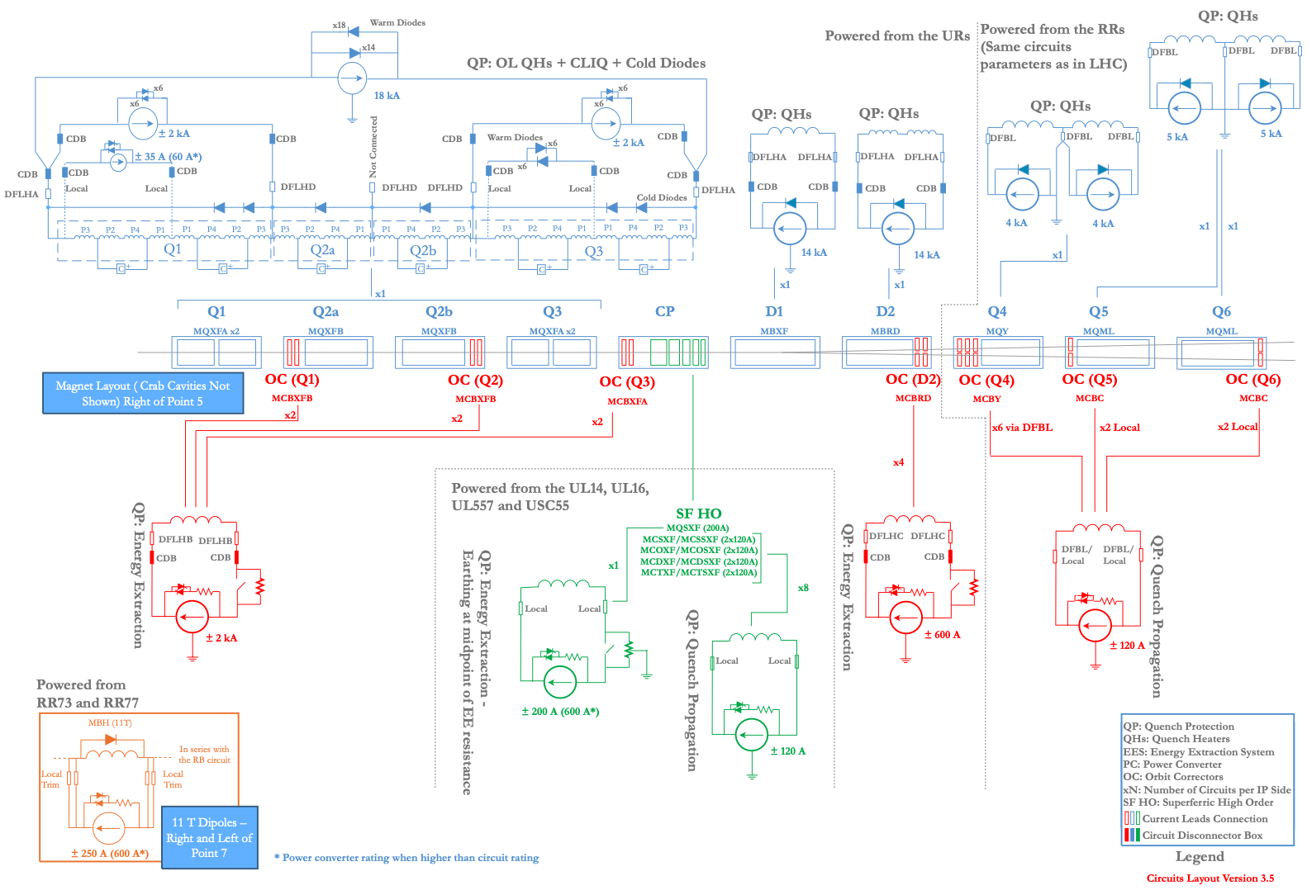
HL-LHC baseline for magnet protection systems
Protection hardware per IP side:
6 CLIQ units
11 Energy Extraction Systems (EES)
- 6 x 2 kA
- 1 x 600 A - single config
- 2 x 600 A - double config
60 Quench Heaters PS (DQHDS)
- 16 for Q1
- 8+8 for Q2a/b
- 16 for Q3
- 4 for D1
- 8 for D2
8 DQLIMs

Slide 3
Outline
Distribution of HL protection devices in SM18
CLIQ
  Project recap and milestones
  Experience in bldg. 272 and in SM18
  CLIQ v3
Vacuum-switches-based Energy Extraction System (EES)
  Project milestones
  Overview of the system
  Experience in bldg. 272 and in SM18
  New control electronics
  Safety remarks
Extra: DQHDS procurement and testing status

Slide 4
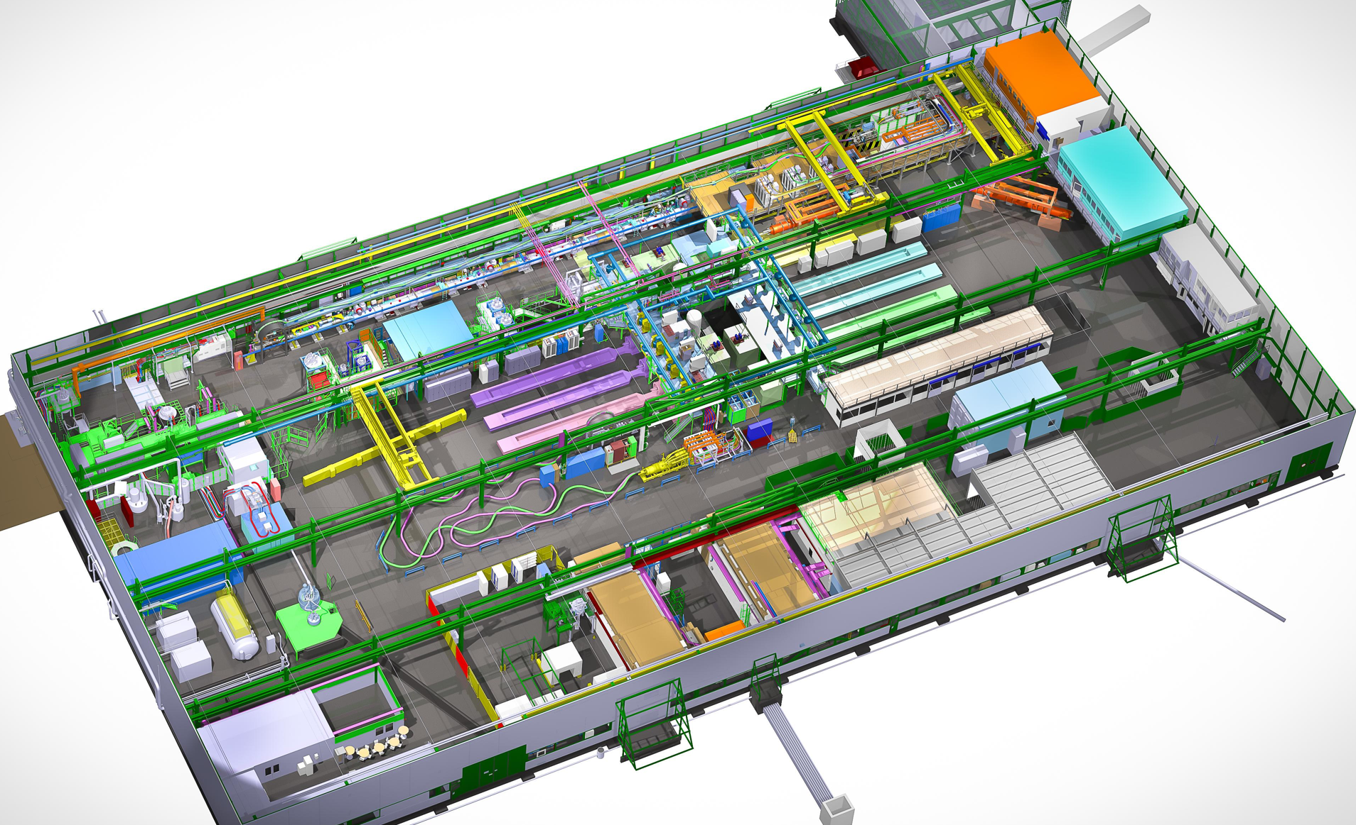
EES and CLIQ(v2) in SM18
30 kA IGBT EES
1 CLIQ unit
2 CLIQ units
6 x 2 kA vacuum-based
1 x 600 A vacuum-based
2 x 2 kA IGBT EES
LHC-type
600 A EES
6 CLIQ units
*To be installed
15 kA IGBT EES
2 x 2 kA vacuum-based
2 x 600 A (LHC-type)
*To be installed
2 x 600 A vacuum-based
20 kA thyristor switch (hybrid version)
2 x 2 kA vacuum-based

Slide 5
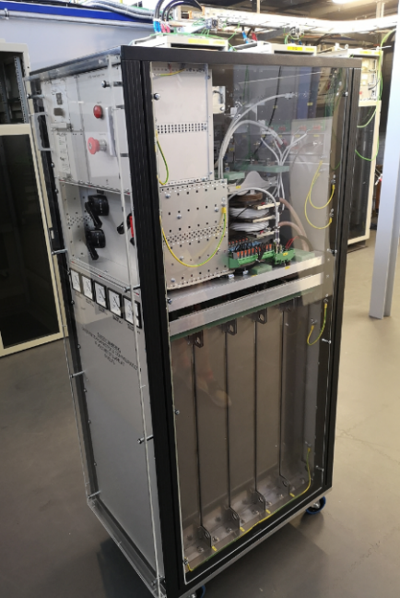
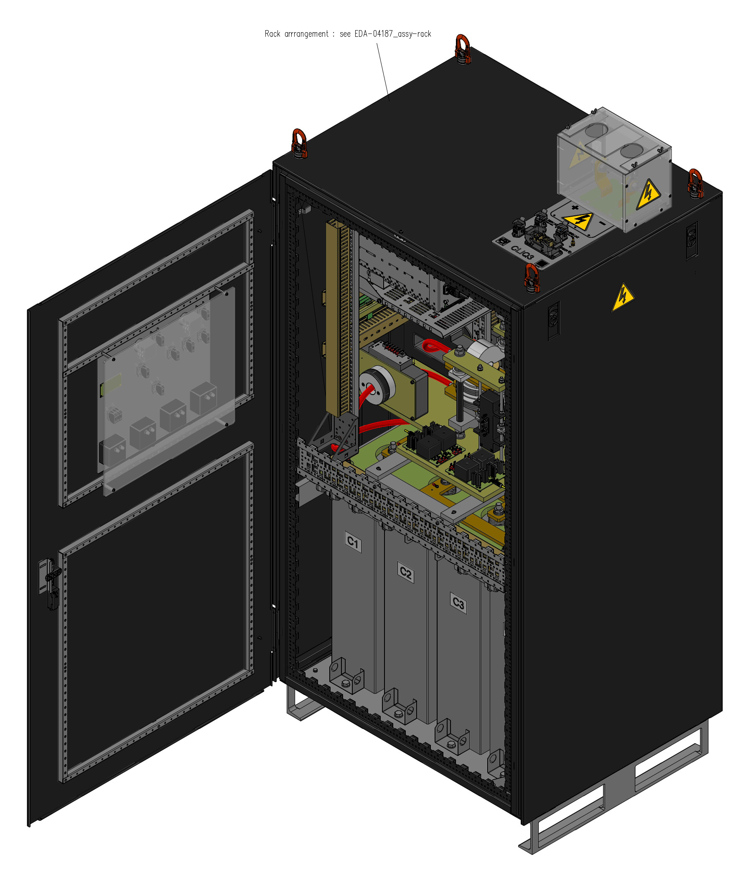
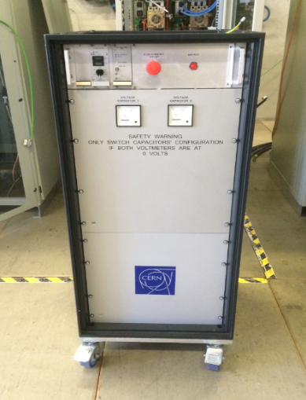
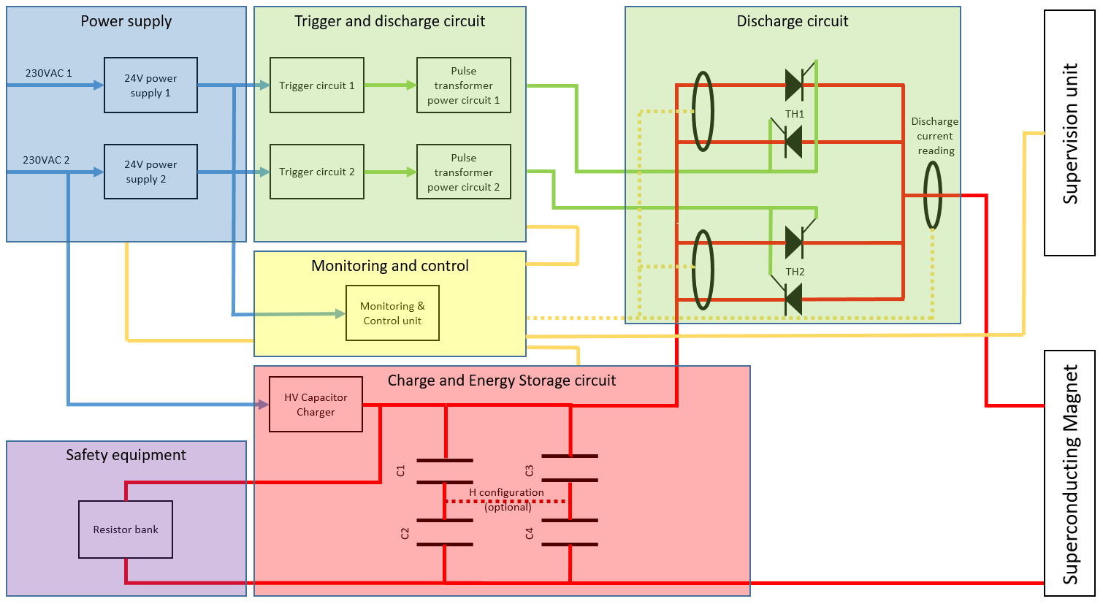
CLIQ system – Project recap
Coupling-Loss Induced Quench (CLIQ) is a quench protection method based on a capacitor discharge resulting in high inter-filament and inter-strand coupling losses.
The core system of CLIQv1, v2 and v3 is the same, so previous prototypes (already used in SM18 and Fermilab) implement the same protection strategy and reliability.
V1
V2
V3
CLIQ prototypes timeline
2015 2017 2021
CLIQ v3 main parameters
Redundant 230 VAC power supply
Redundant trigger
Capacitor bank in square configuration (4x40 mF, 1000 V DC)
Monitoring and control unit
Q1 and Q3: 2 CLIQ units each, with V=600 V, 40 mF
Q2a and Q2b: 1 CLIQ unit each, with V=1000 V, 40 mF
I peak ~ 2- 3 kA / f = 10-20 Hz

Slide 6
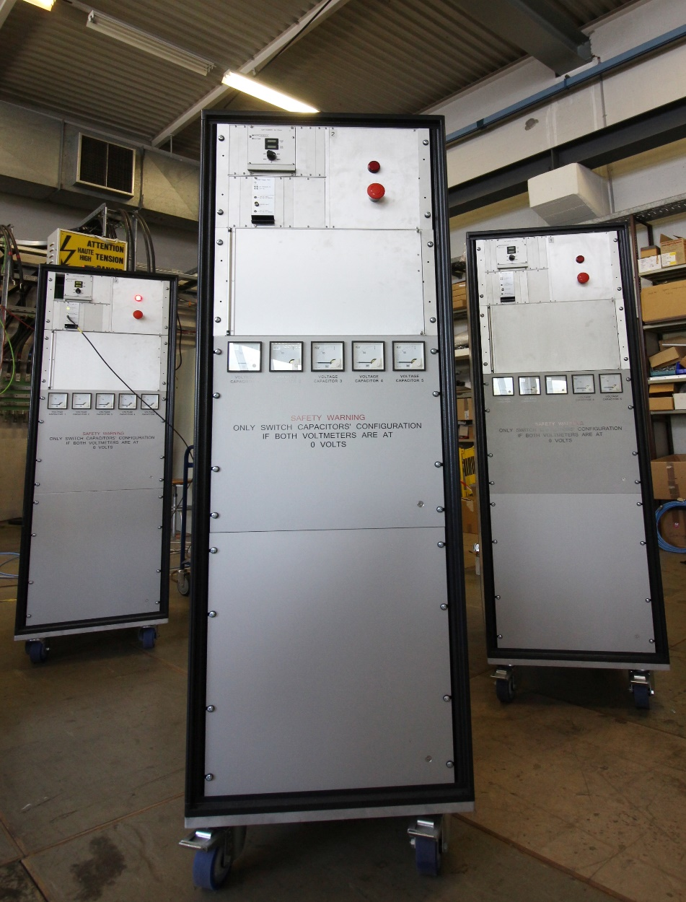
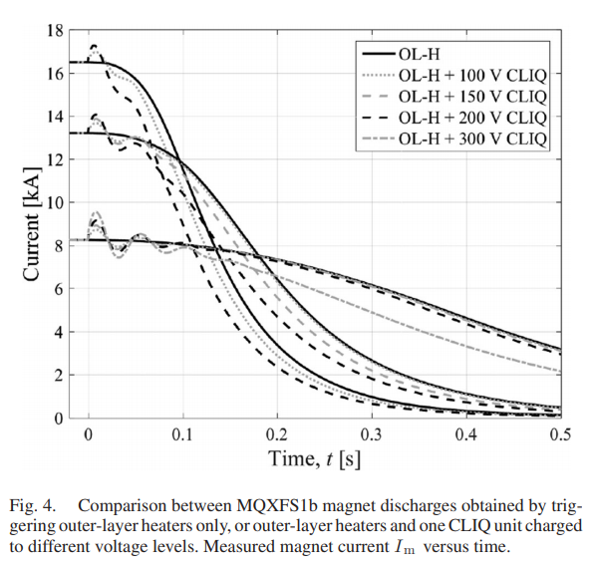
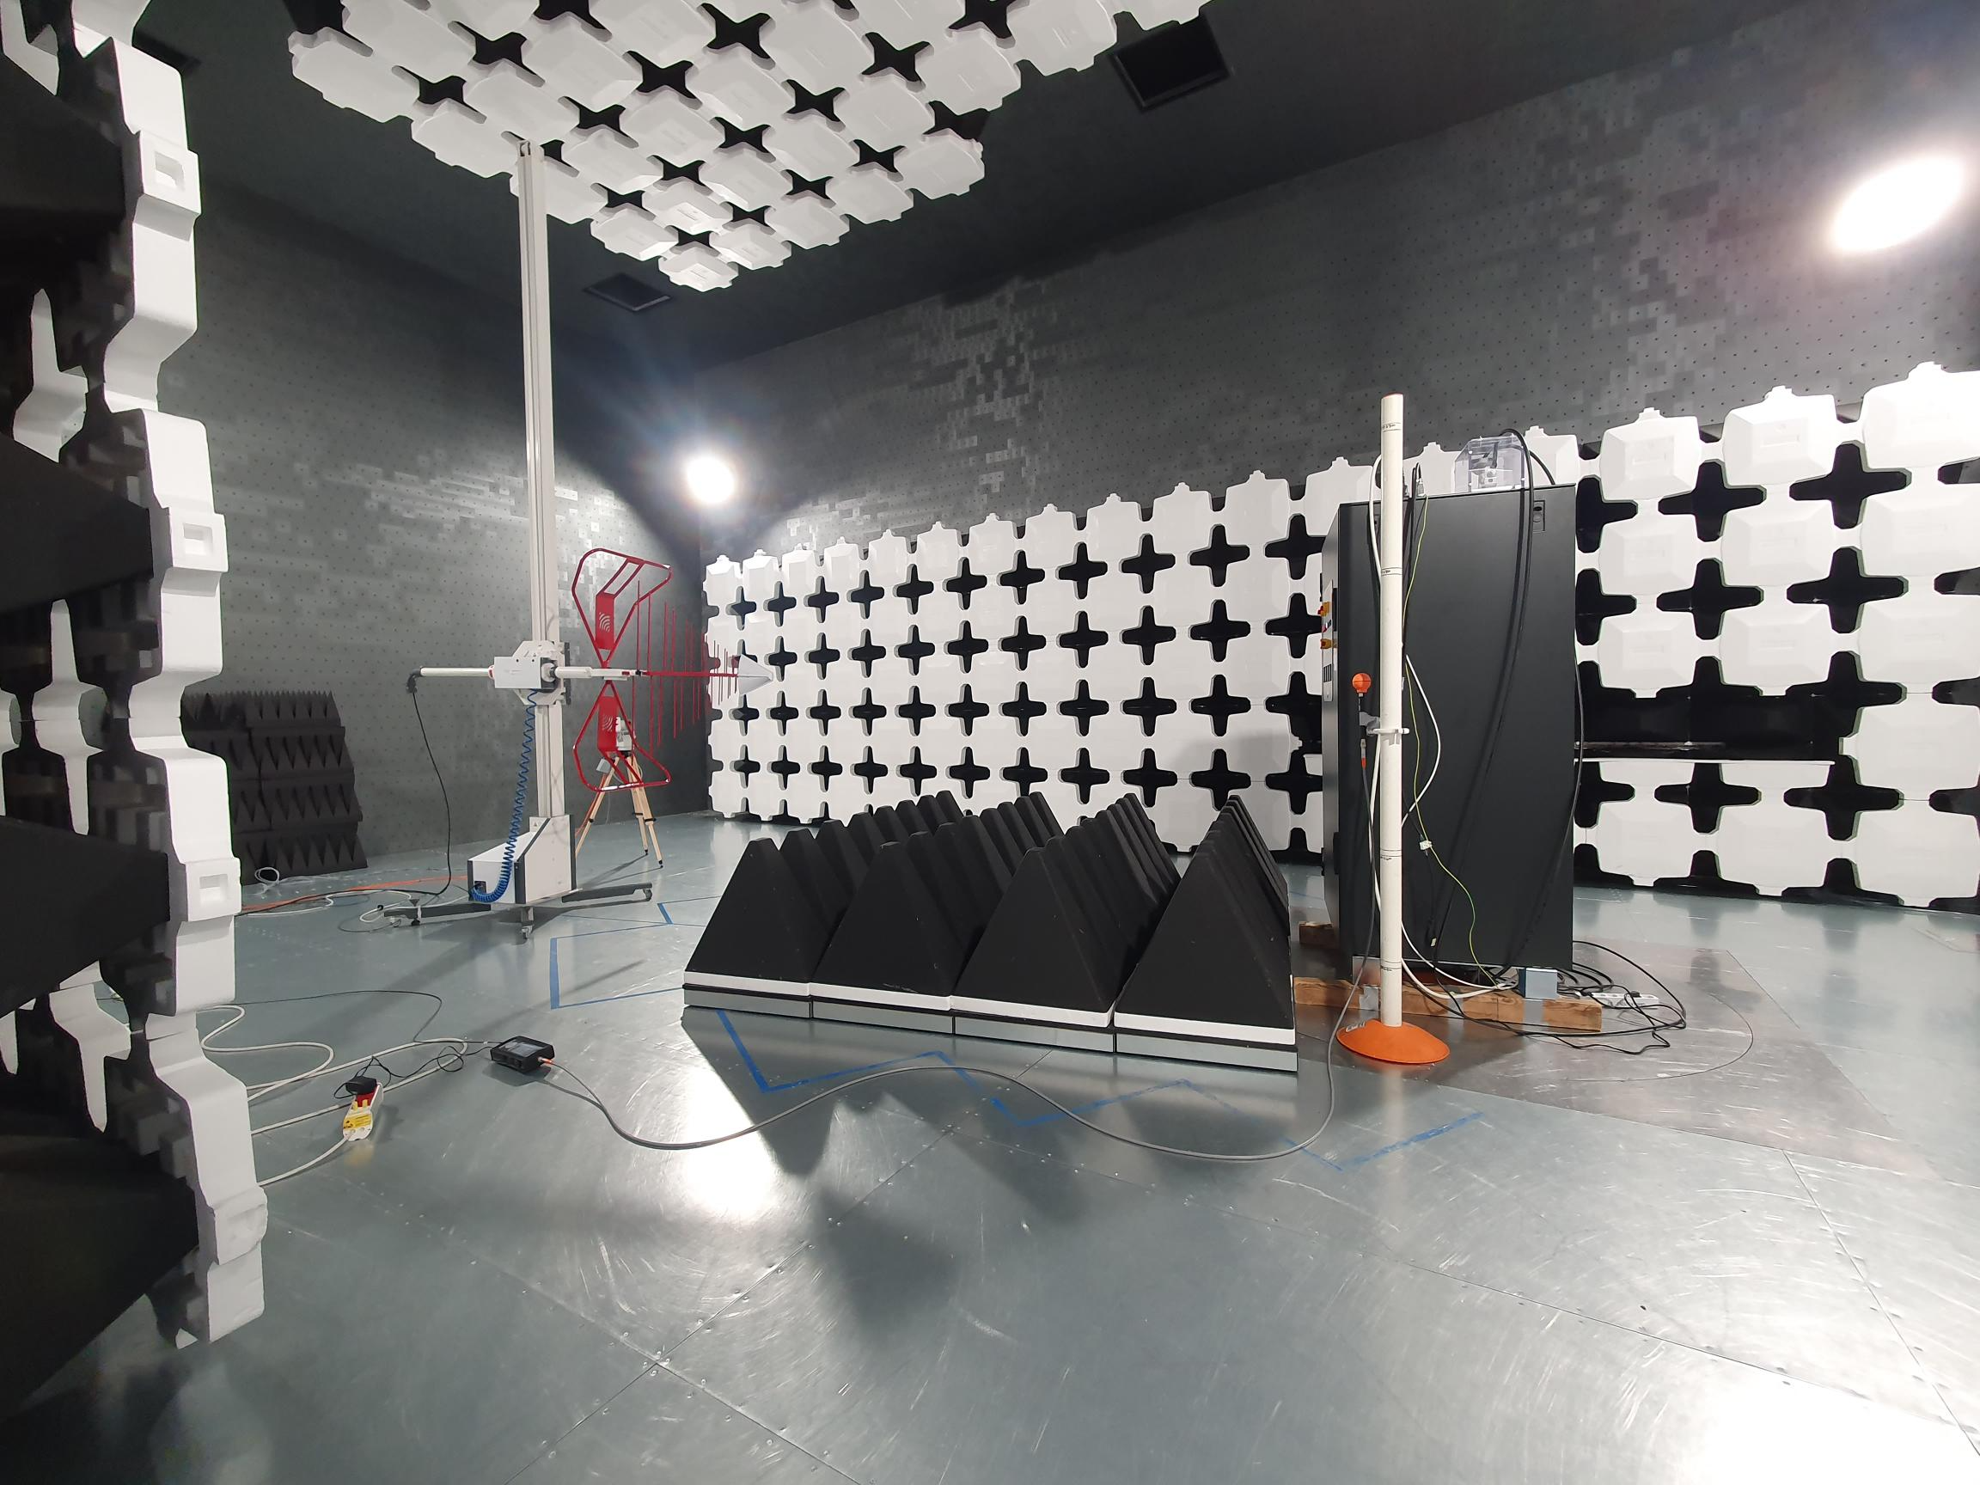
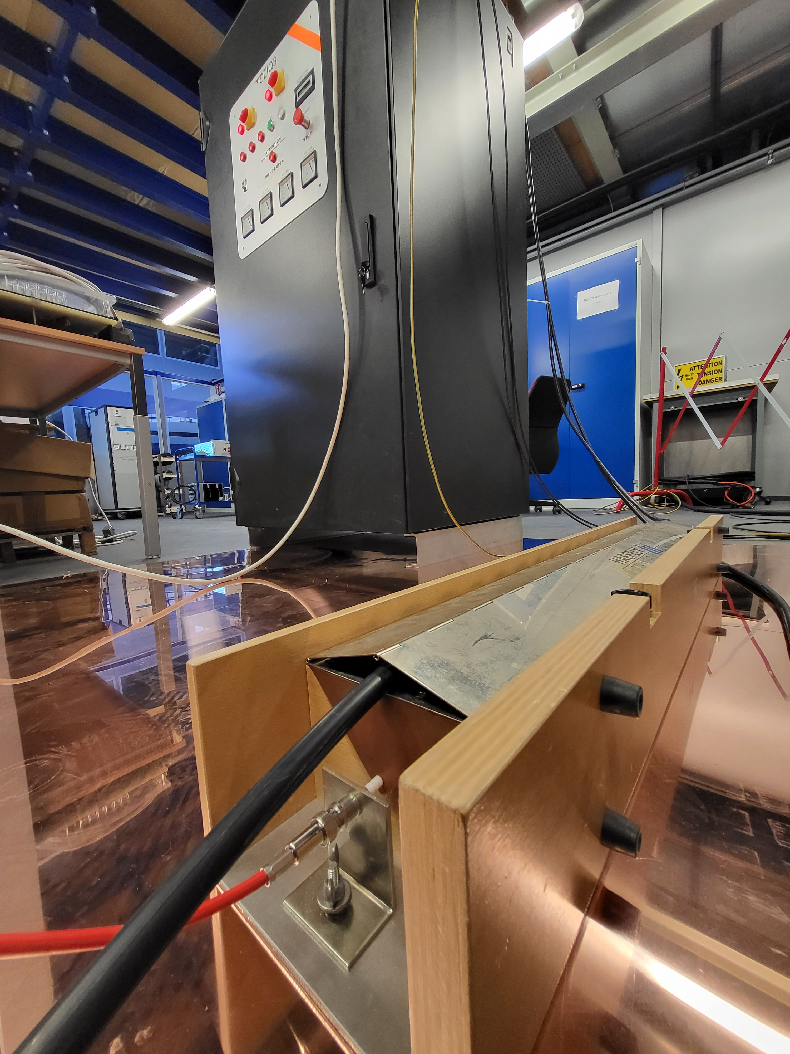
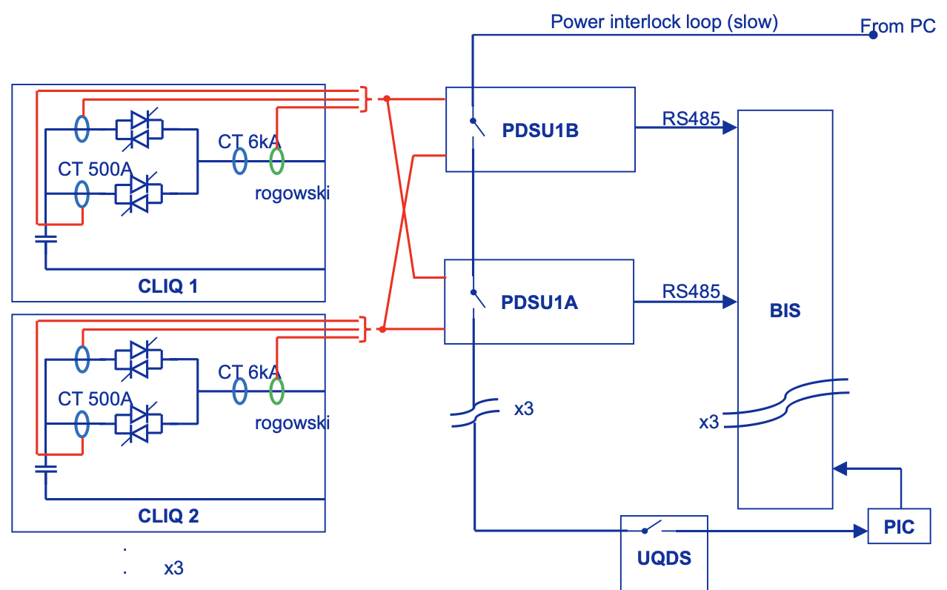
Project milestones
Extensive R&D program in SM18 and at Fermilab
Initial two CLIQ versions fully validated
Industrialization of CLIQv2 units (11 units manufactured)
Conceptual Design Review – Apr 2020
CE marking studies of CLIQv2 – Q4/20
Market Survey for series production – Q4/20
Reliability Run with CLIQv2
  8000 discharges done on a 2.1 mH/85 mΩ coil – Q2/21
Invitation to Tender for series production – Q2/21
Production Readiness Review – Dec 2021
Immunity campaign on current sensors for spurious triggering detection – Q2/22
  Improvement of current measurement scheme and direct connection to BIS
Qualification of CLIQv3 pre-series – Mar 2023
World-wide shortage of electronic components obliged to redesign most boards
CE and environmental studies with pre-series unit – Apr 2023
Green light for production of the String units – Q3/23

Slide 7
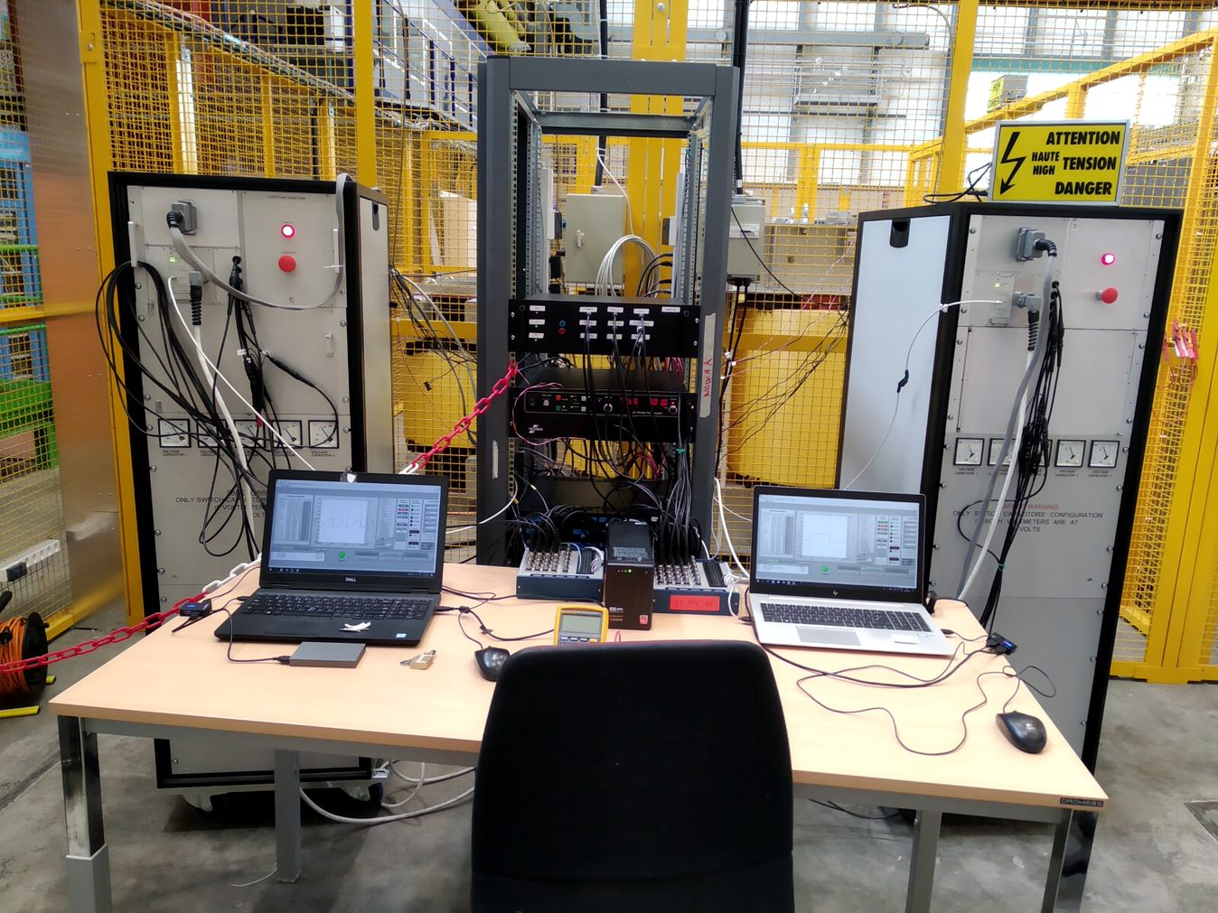
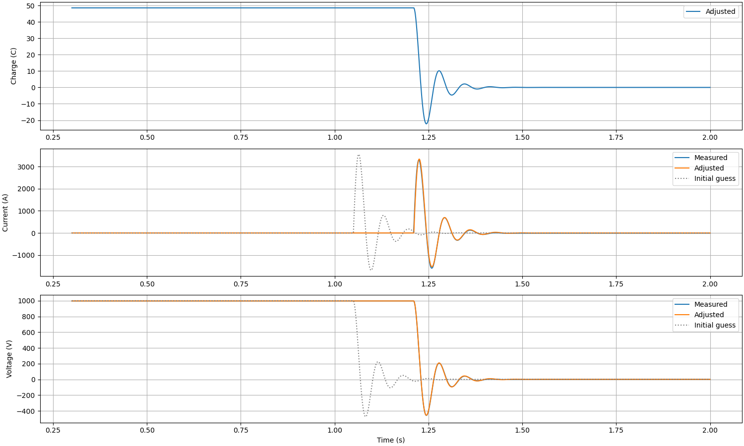
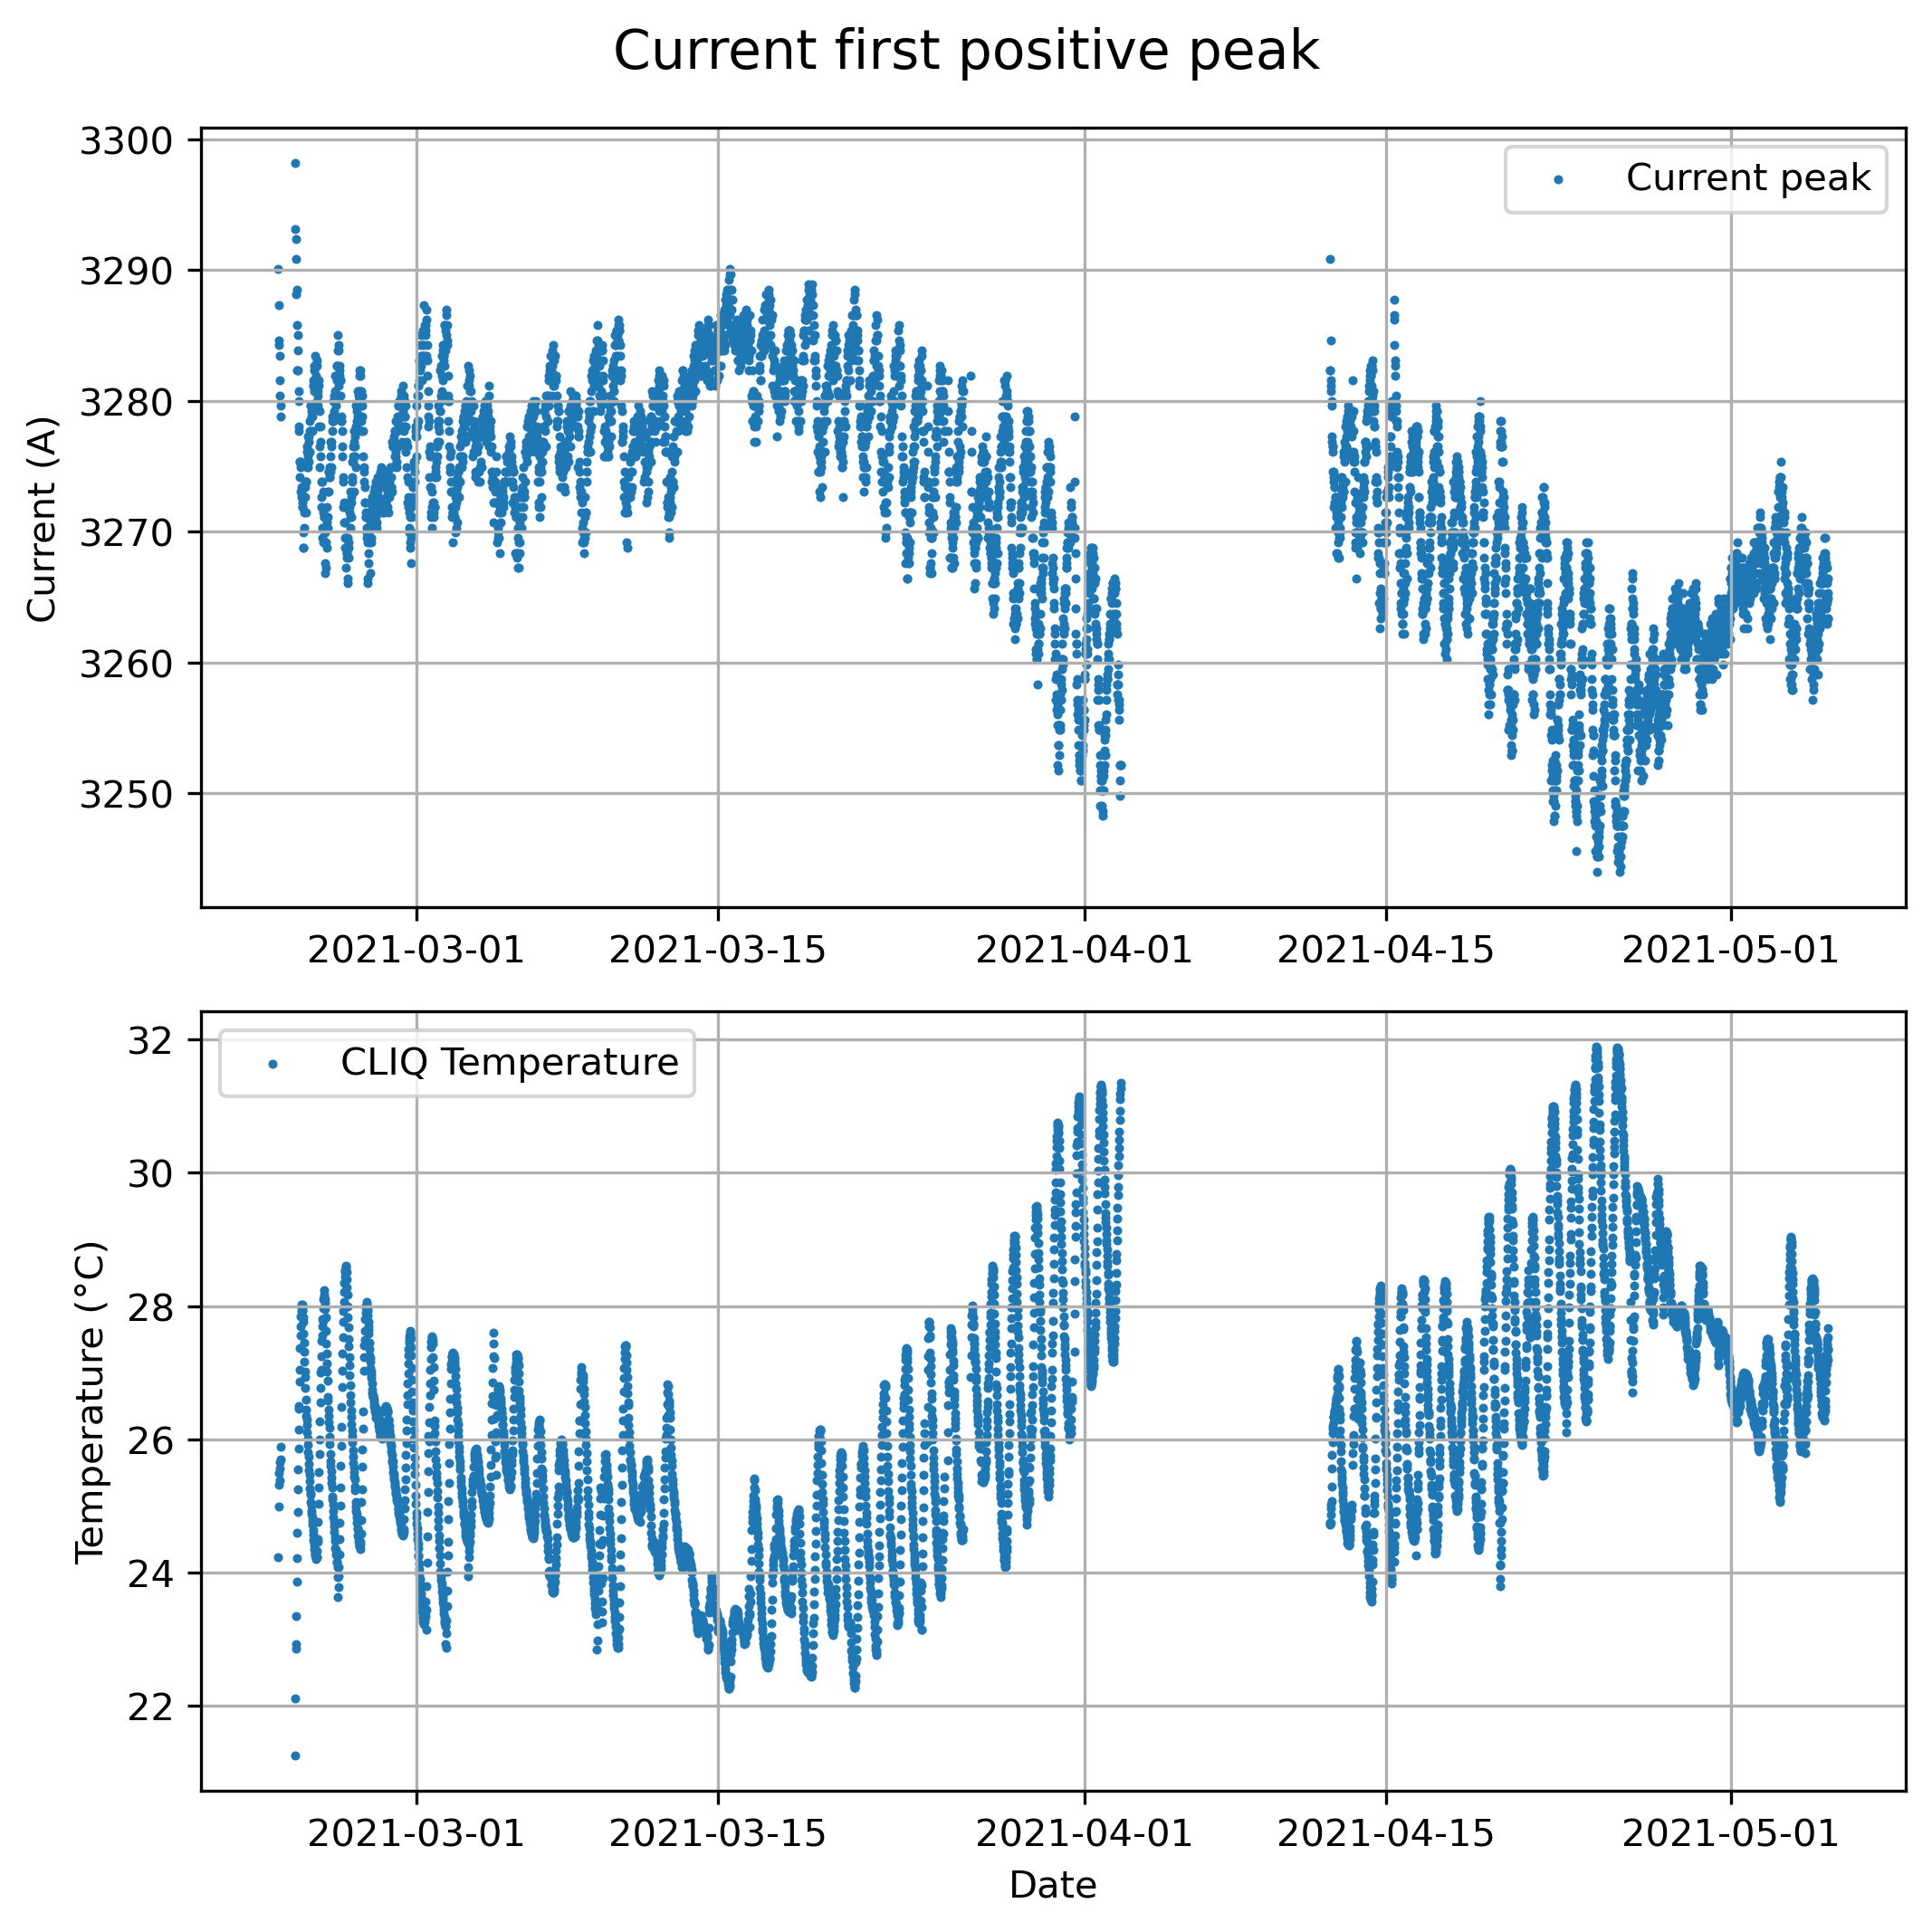
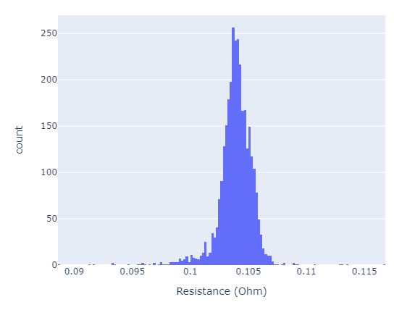
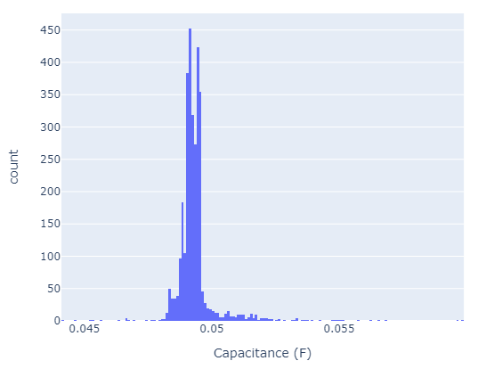
CLIQ reliability run
Recommended by the panel of the Conceptual Design Review held in April 2020
8000 discharges between 2 units were done, to prove the lifetime of the system of 20 years (number of expected CLIQ activations in 20 years is below 200)
No failure was detected on both units in either the power stage nor the control and processing stage
No meaningful variation in resistance and capacitance values
Current and voltage amplitude variations are merely due to ambient temperature
Current first positive peak
High reliability and no noticeable variations due to aging
Numerical fitting of RLC components to each discharge
Resistance and capacitance values during the tests

Slide 8
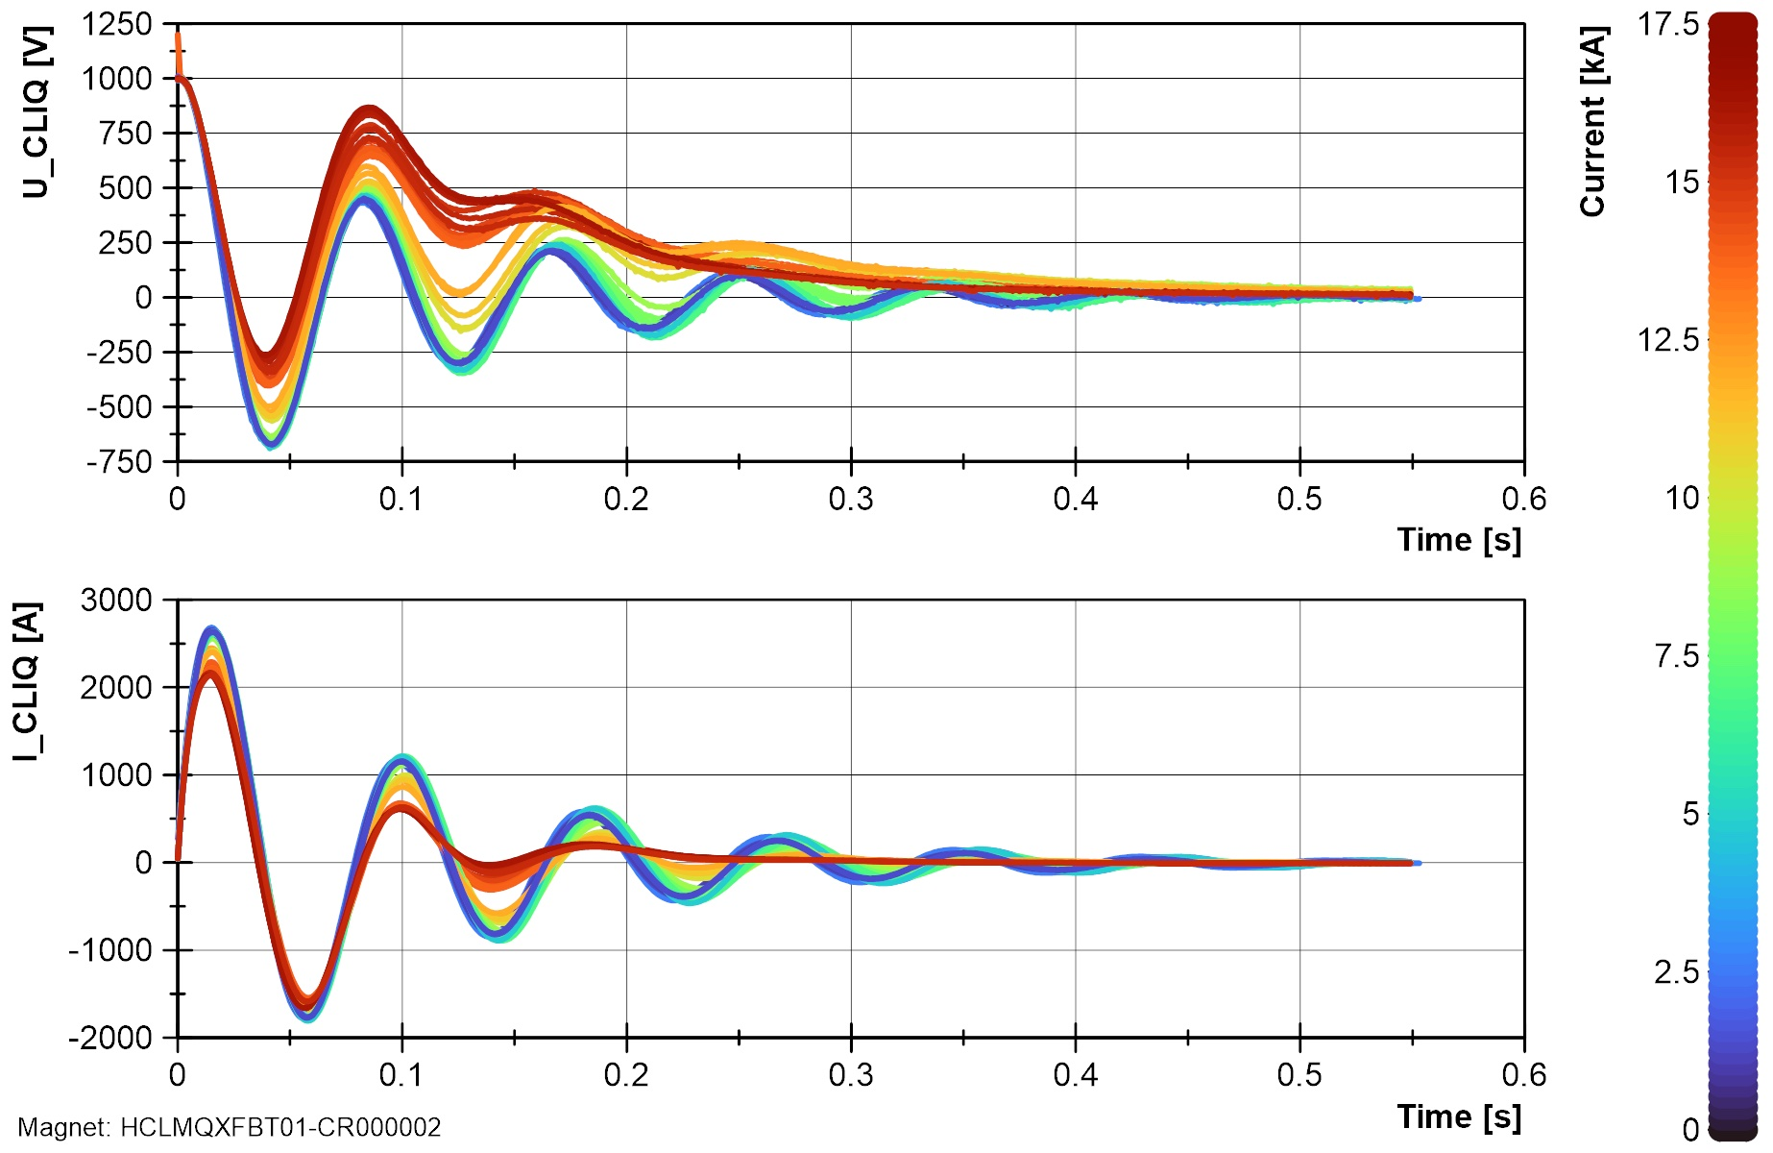
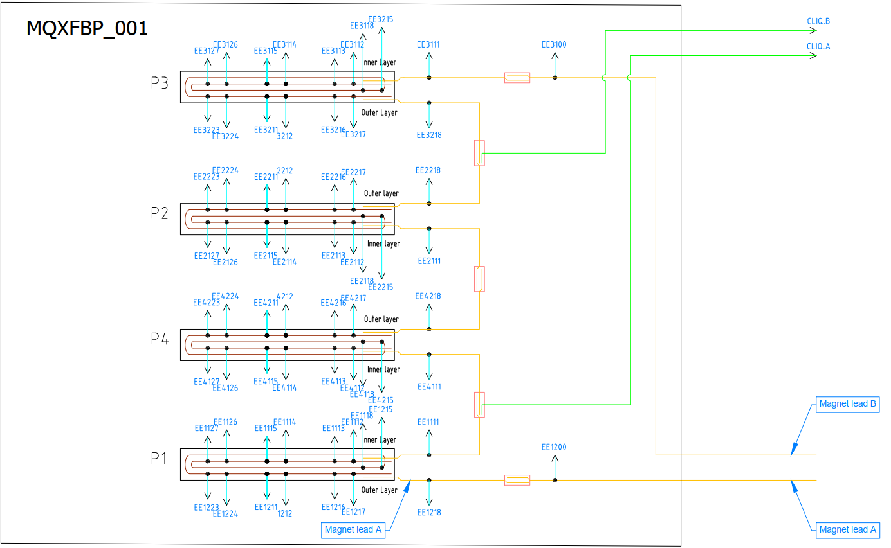
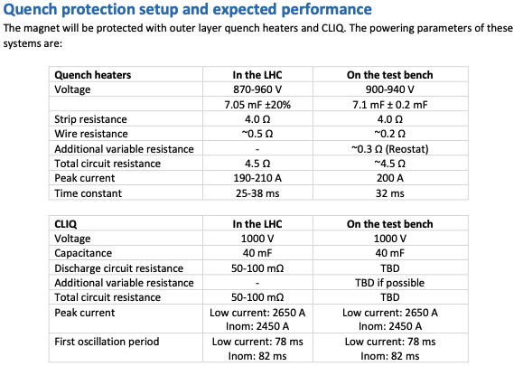
Experience in SM18
The return of experience from SM18 (and from Fermilab) shows that CLIQ is a reliable system for the protection of superconducting magnets. Three units were used in more than 300 tests without problems in SM18:
  MQXFBP1: 56
  MQXFBP2: 98
  MQXFBP3: 31
  MQXFB02: 61
  MQXFBMT4: ~25
  MQXFB03 (ongoing): ~25
Example of voltage and current measurements for all CLIQ discharges on MQXFBP2.
(courtesy of SM18 team)
The failure of 2 chargers was reported along the years (the second one related to a wrong manipulation), but this is not safety critical as only impacts the availability and not the protection. The charger was changed with a more robust model!
Quench protection setup (CLIQ and outer layer quench heaters).
(courtesy of SM18 team)

Slide 9
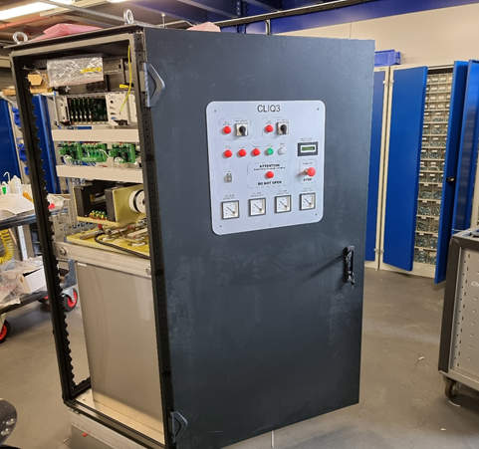
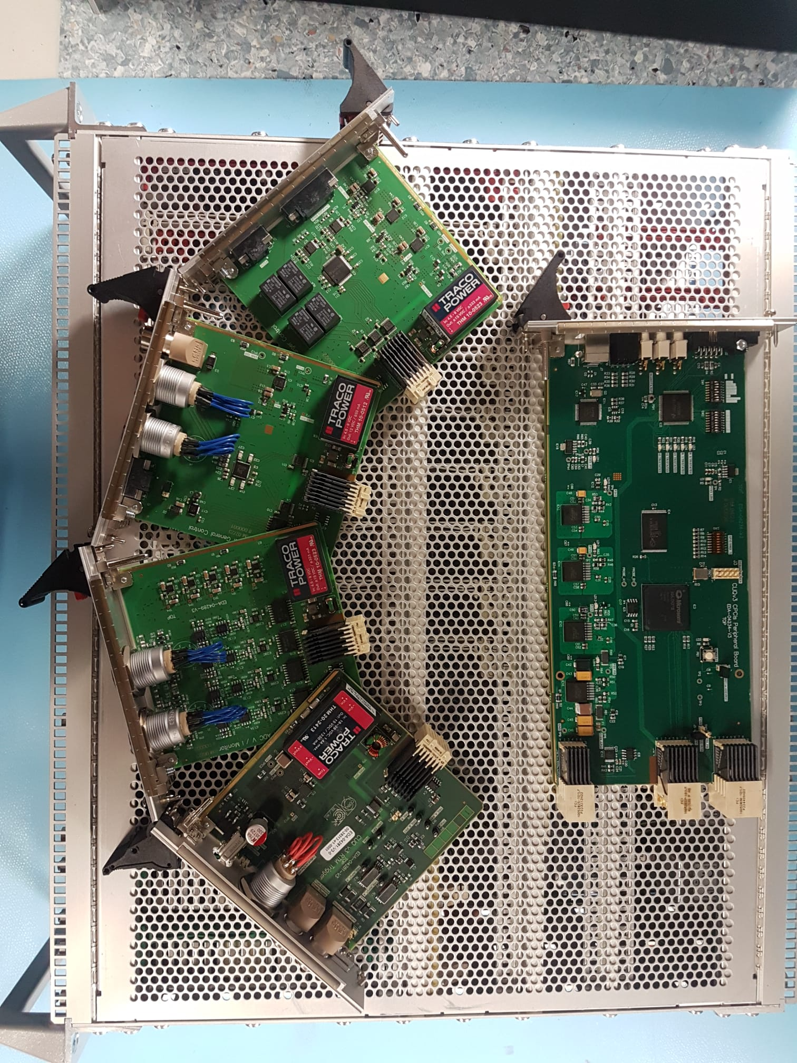
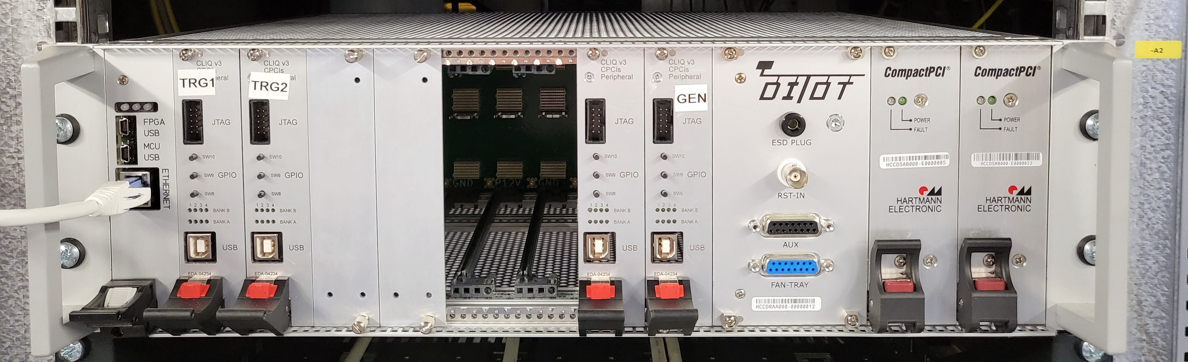
CLIQ v3 – machine version
CLIQ v3 incorporates several improvements vs to v2
  The core of the discharge system is the same
  v3 has 4 capacitors vs 5 of v2, connected in a more reliable configuration (square configuration instead of parallel connection)
  Different charger, providing increased robustness
  Redundant powering and triggering
  More current sensors for fast spurious triggering detection
  DI/OT was implemented for an extended diagnostic of the unit and improved reliability
Despite the electronic components crisis, the objective is to deliver the units to the String by the end of this year.

Slide 10
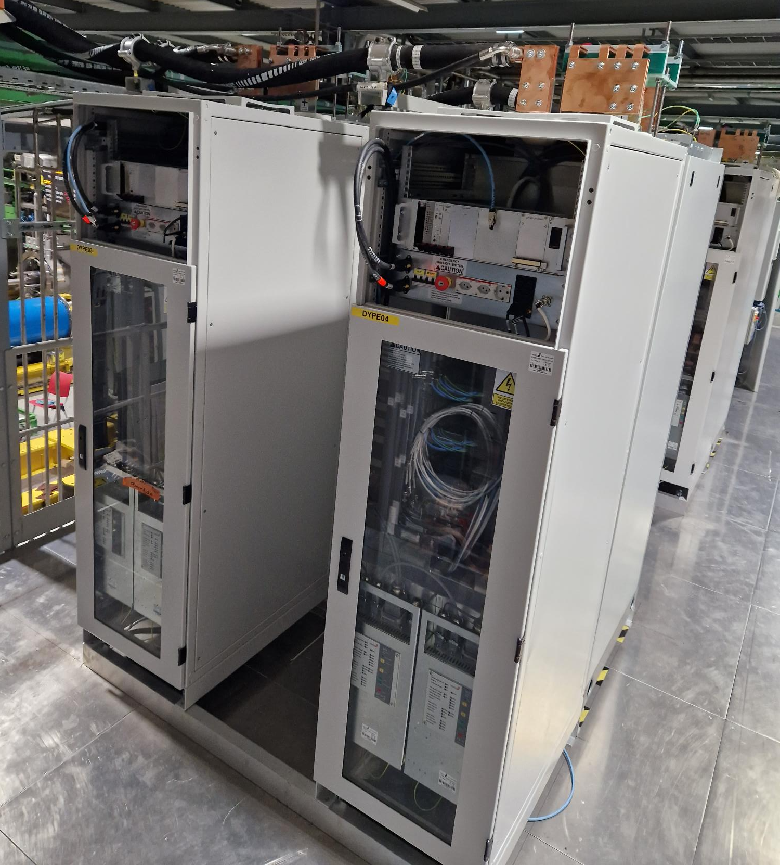
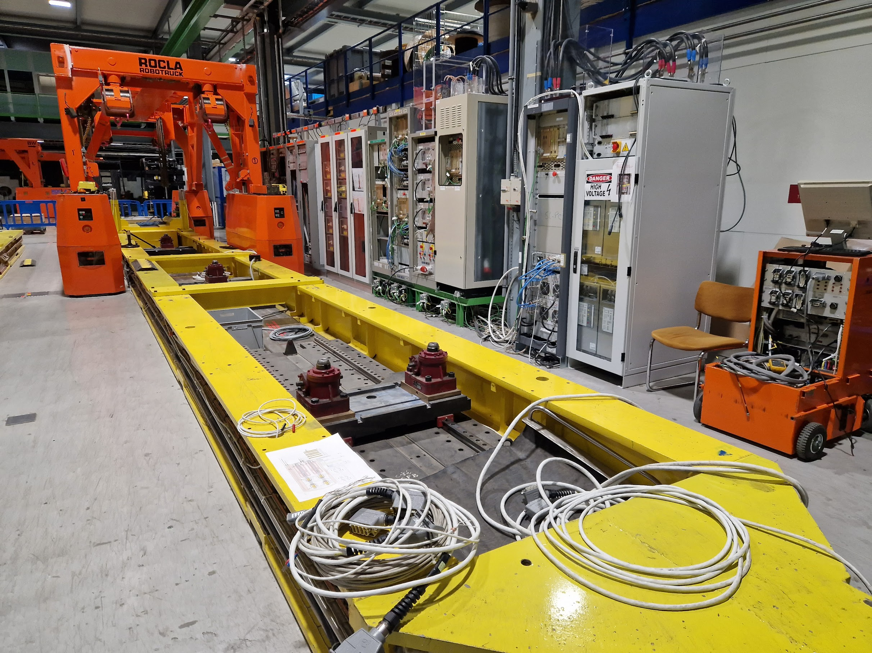
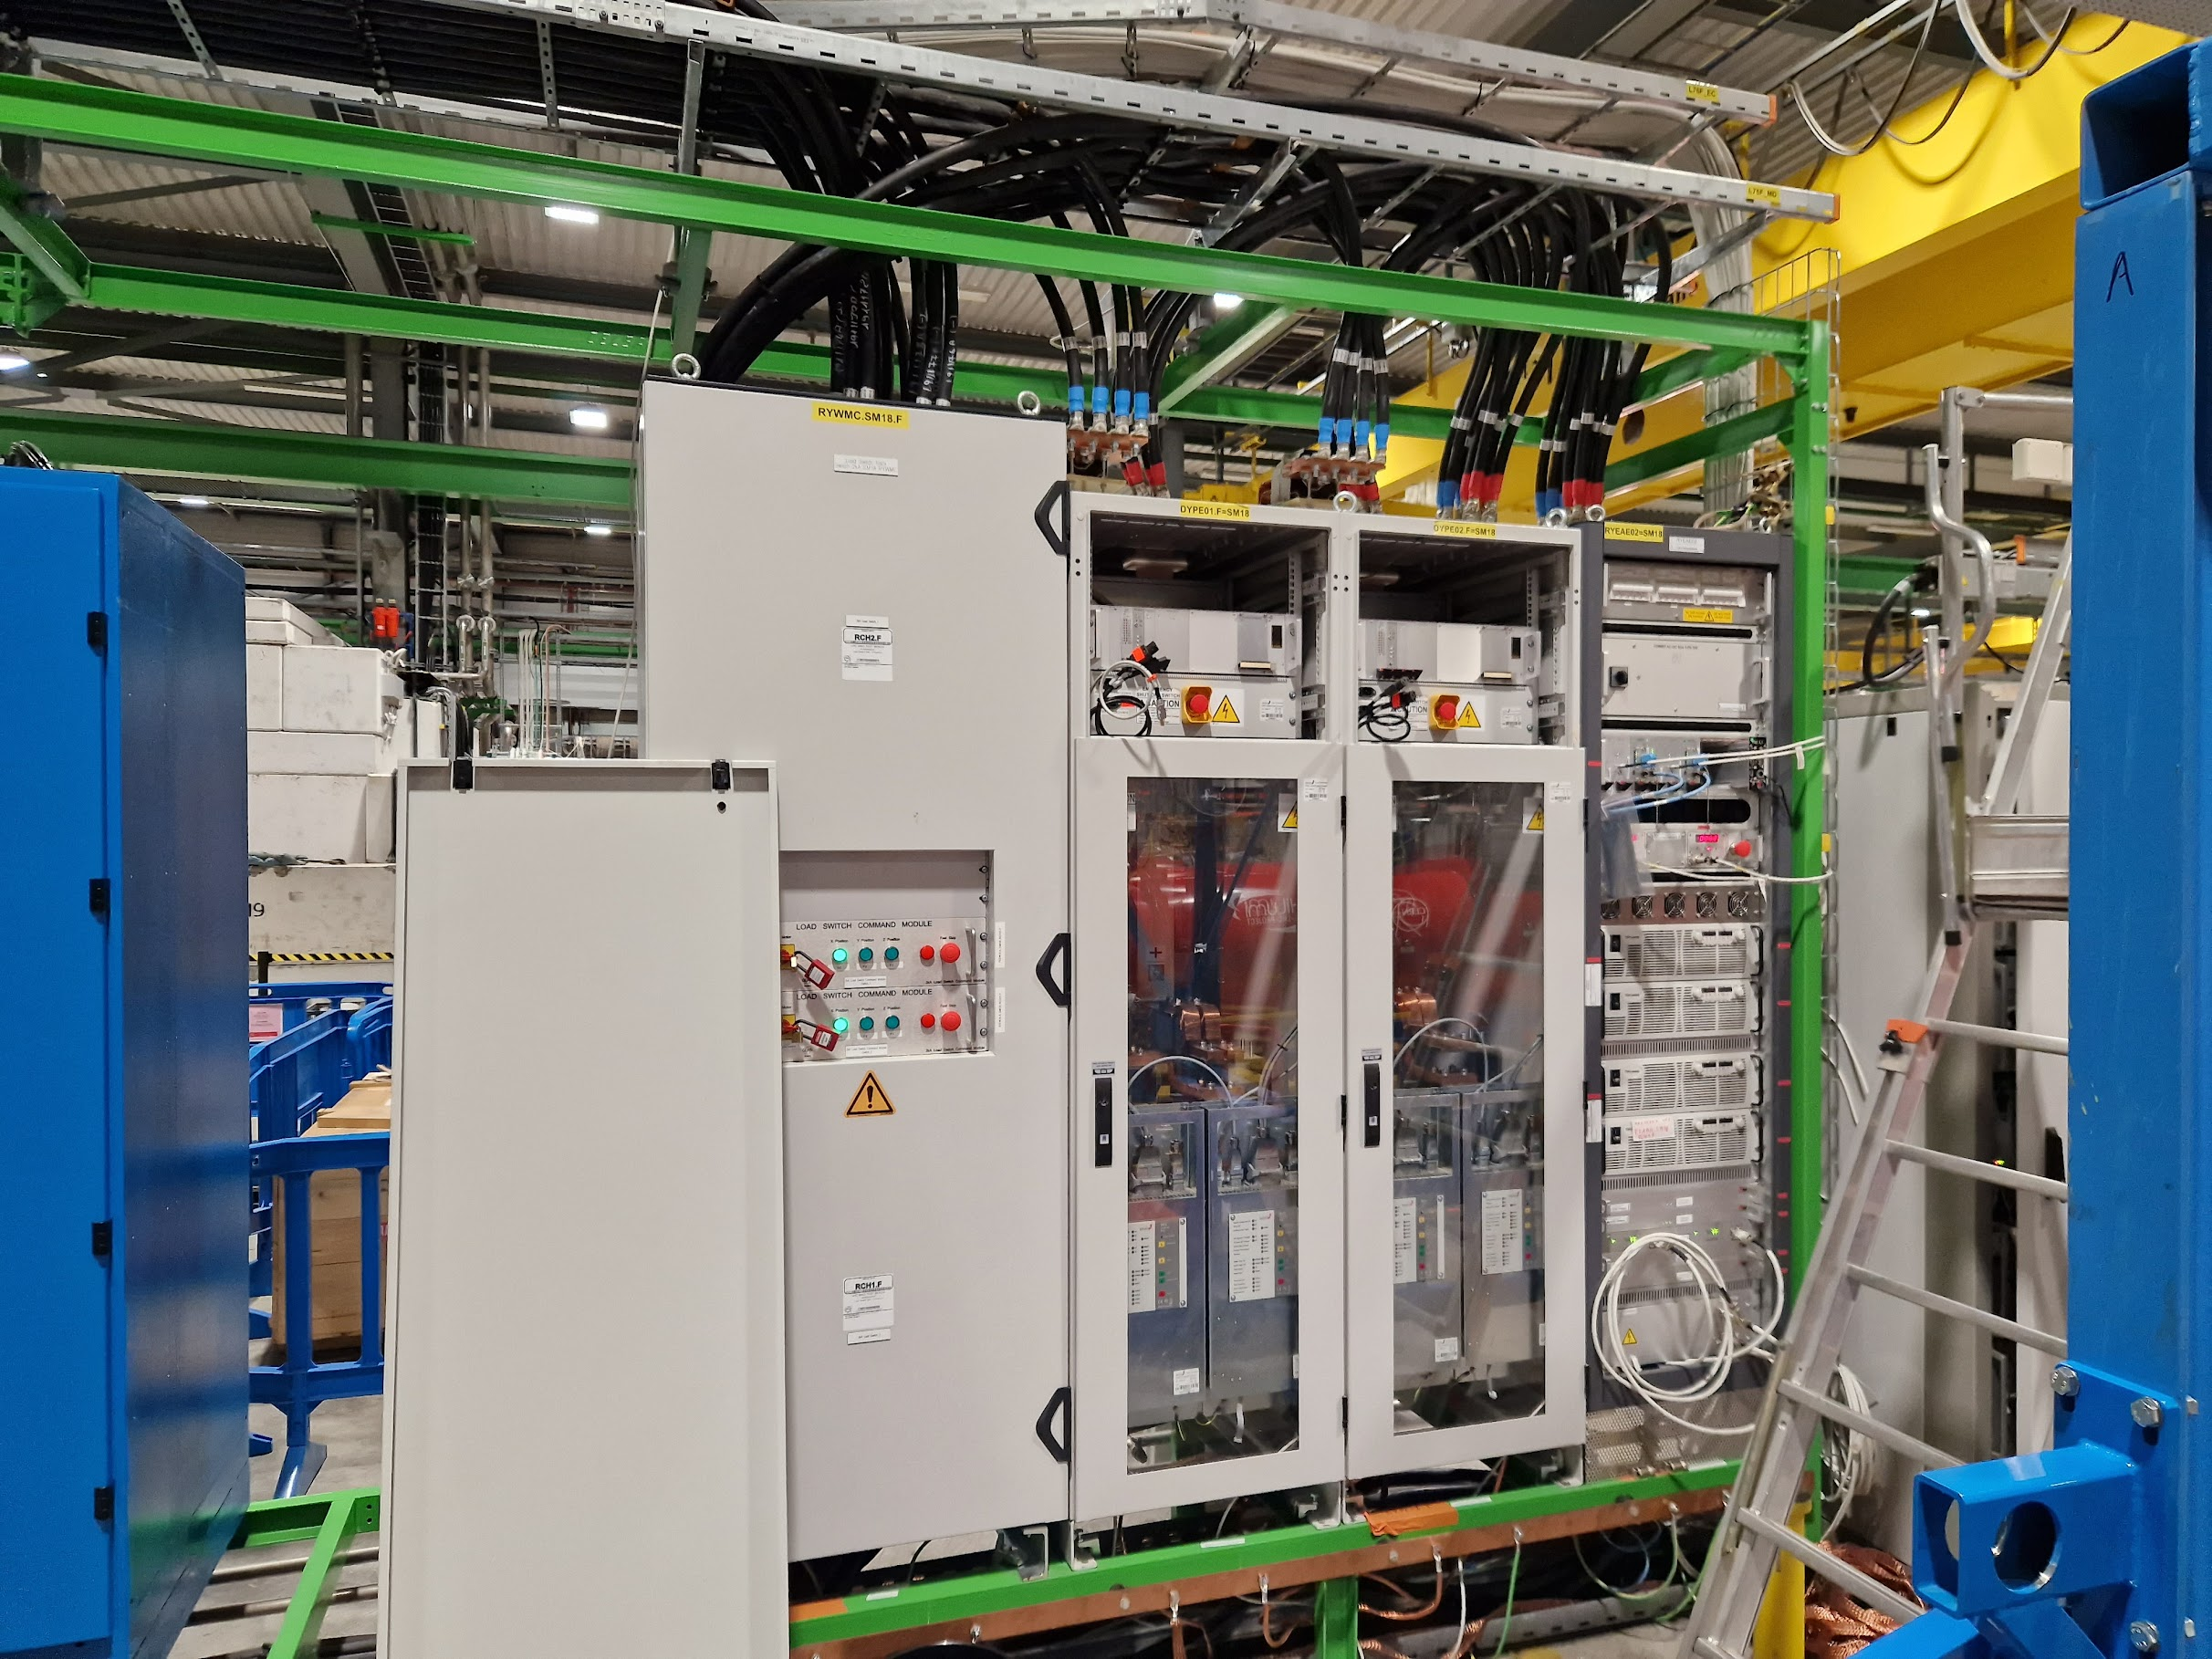
HL-LHC EES in SM18
2 x 600 A systems in cluster C2
6 x 2 kA systems in String
+ 1 x 600 A system
In addition:
2 x 2 kA EES will be installed in cluster A2 by Feb 2024
2 x 2 kA systems in cluster F1

Slide 11
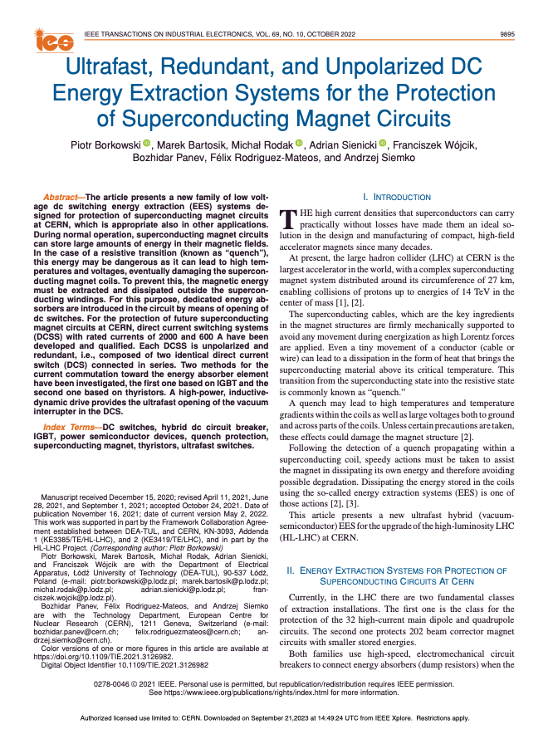
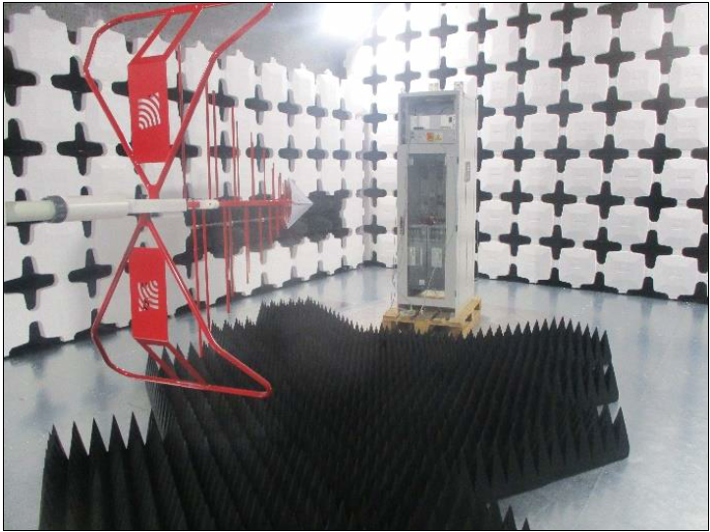
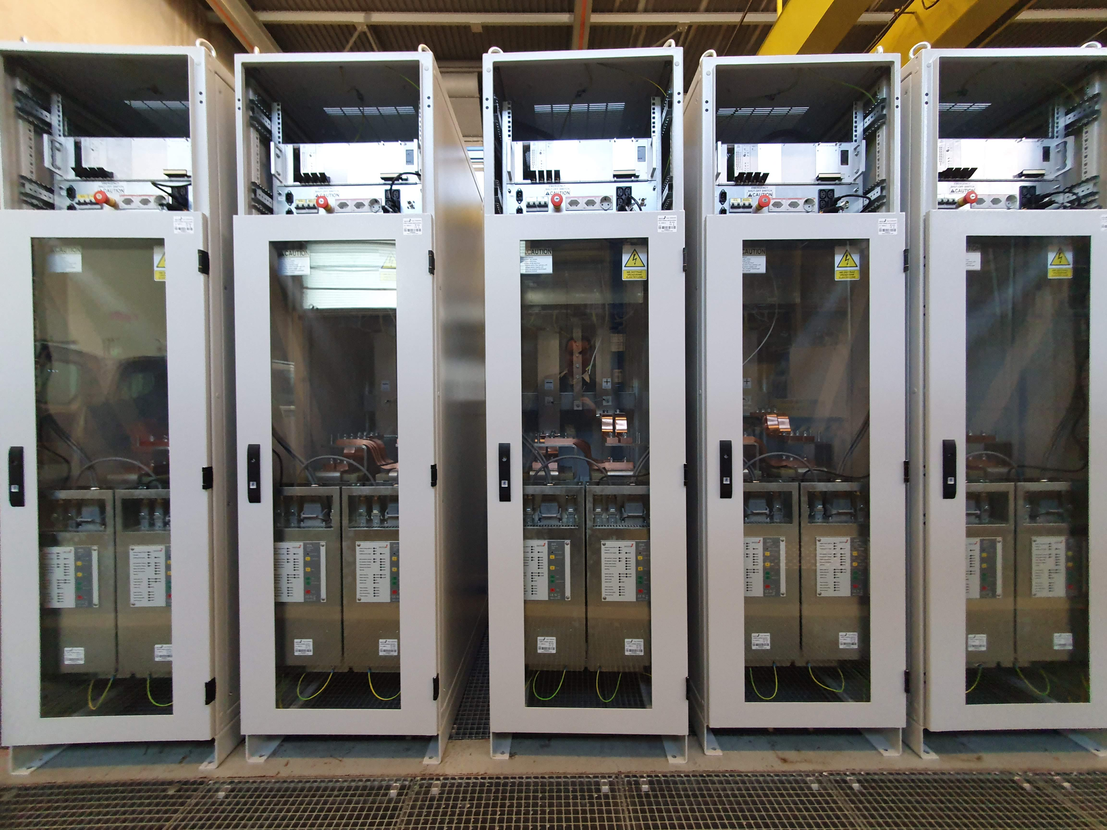
Project milestones
Start of development of the vacuum-switch-based EES in collaboration with the Lodz University of Technology (Poland) – 2017
2 prototypes (2 kA and 600 A) built and successfully tested – 2018
8 systems produced and tested in SM18 – 2019
Implementation of redundancy on the power electronics – 2020
CE marking studies of the improved version – Q4/20
Market Survey for the production of the String units – Apr 2021
Invitation to Tender for the production of the String units – Aug 2021
Delivery of the first two units for the String – Nov 2022
Delivery of all units for the String – Jan 2023
Installation of 6+1 units in the String – Q2/23
Market Survey for series production re-issued – Mar 2023
Invitation to Tender for series production – Jul 2023
Proposal for the attribution of the contract for the series to be presented at the CERN FC on October 4

Slide 12
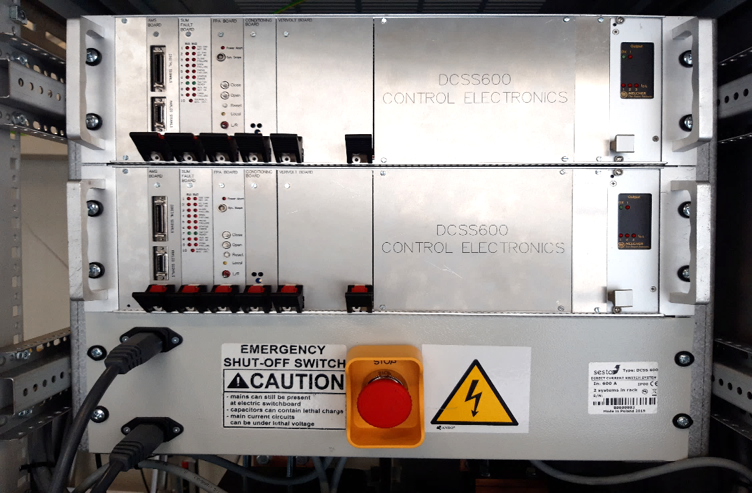
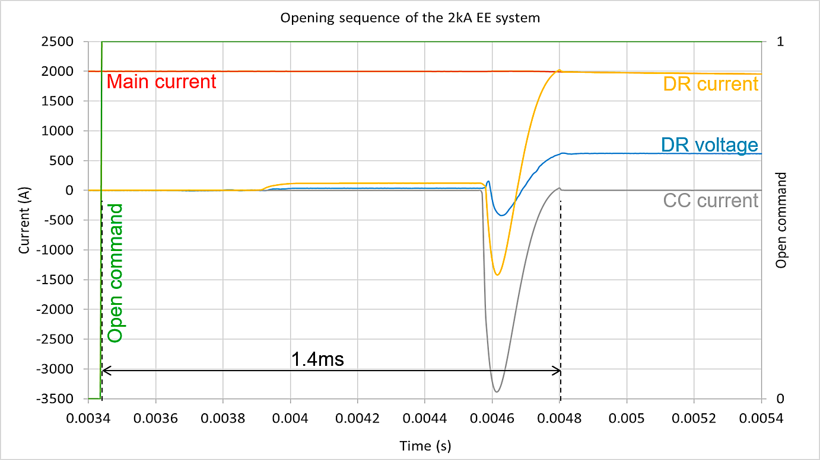
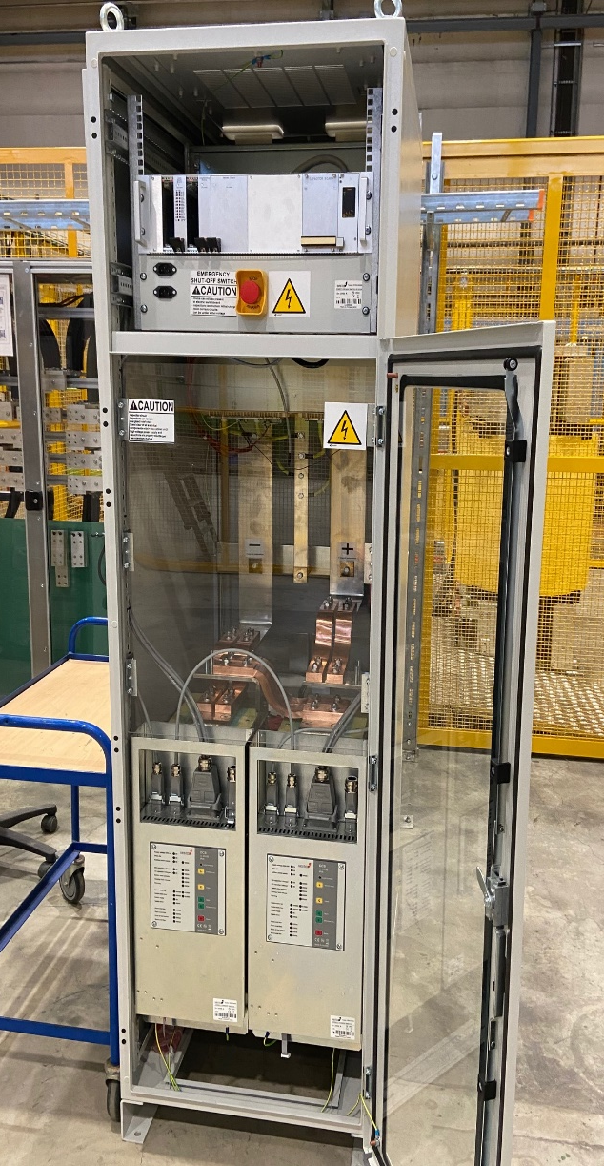
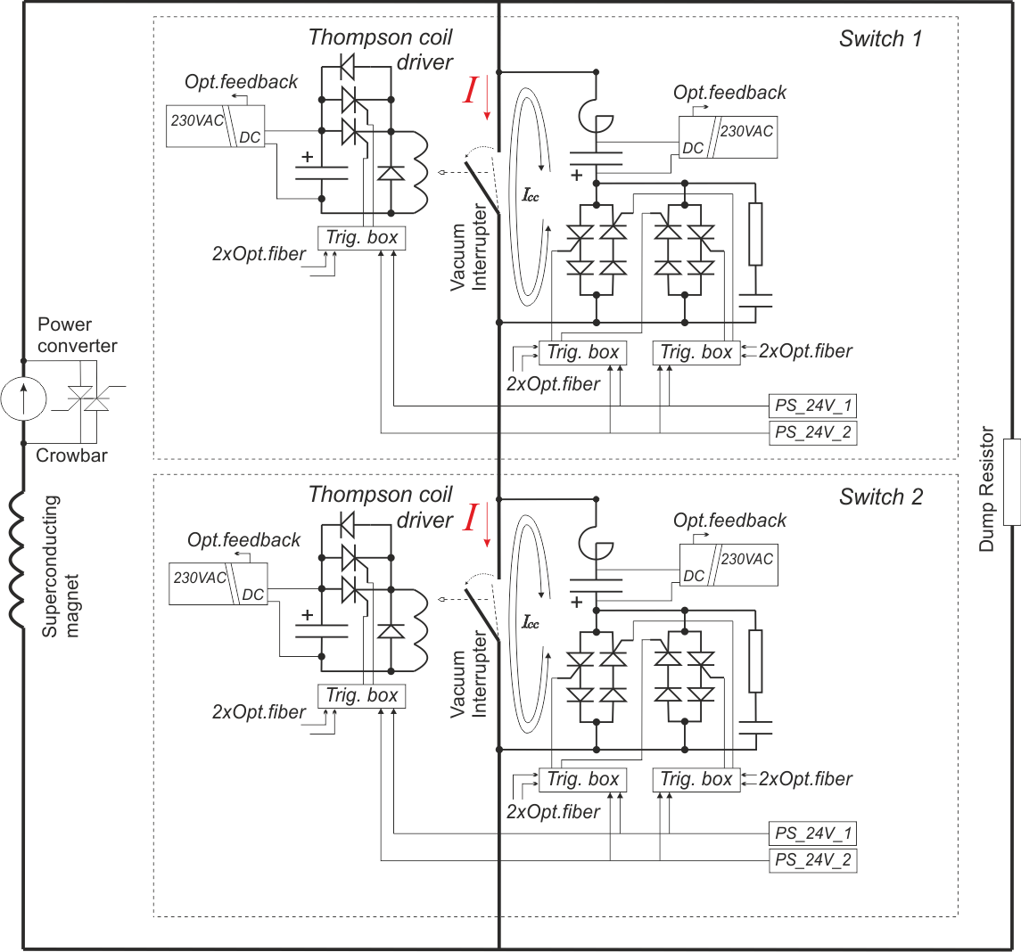
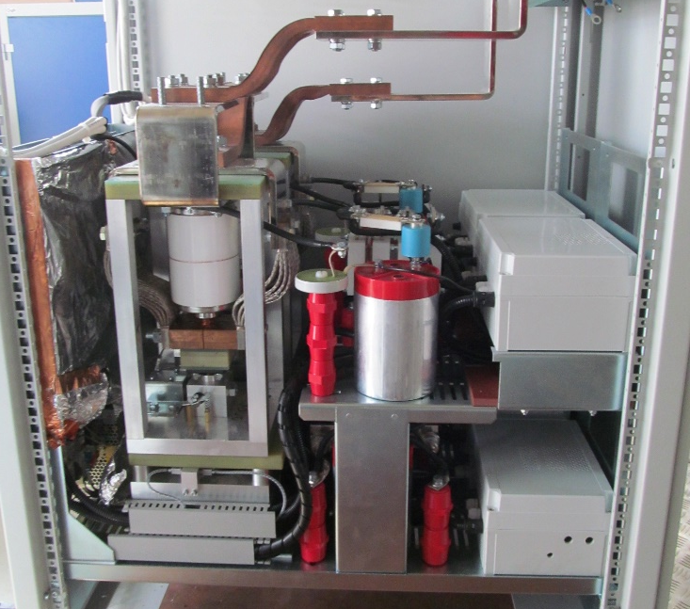
HL-LHC EE systems - overview
Opening sequence of the 2 kA EES
New development ongoing
(see later)
Power IO terminals
Exponential decay
Dump resistors
Open command
Switch cassette
IDD opens
vacuum contact
450 us
Arc ignition
700 us
Trigger CC1
250 us
Trigger CC2
Standard EURO rack (60x90x200)
Vacuum interrupter
Auxiliary circuits
200 us
Full redundancy
Exp decay
* IDD = Inductive dynamic driver CC = Counter-current

Slide 13
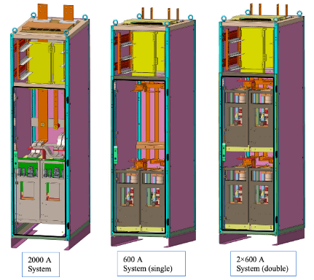
HL-LHC EE systems – main parameters
Two industrial bipolar vacuum switches for 2 kA / 600 A connected in series
The opening sequence can be initiated by
    sending an open command (locally or remotely)
    by rupturing the FPA loop
Max. rated voltage: 1 kV
Dump resistors
  0.15 Ω for 2 kA systems
  1.4 Ω for 600 A systems
Switch opening time: < 2 ms
Mechanical cycles: > 20 000 cycles
Opening at nominal current: > 10 000 cycles
Maintenance-free operation
Standard Euro rack (900/600/2000) mm
Full redundancy ensured at power and control parts

Slide 14
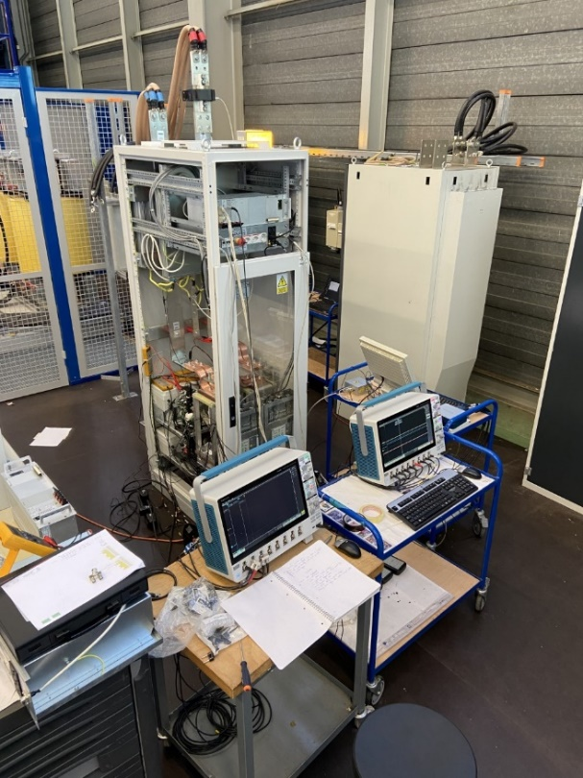
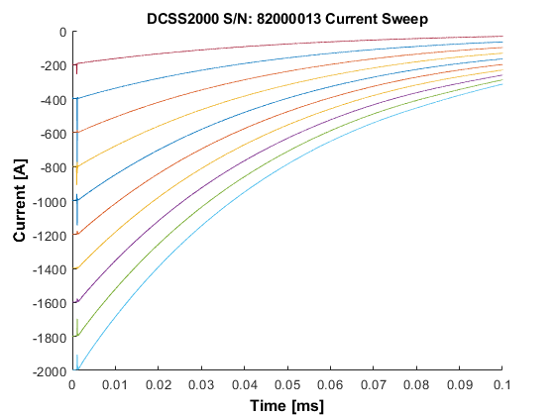
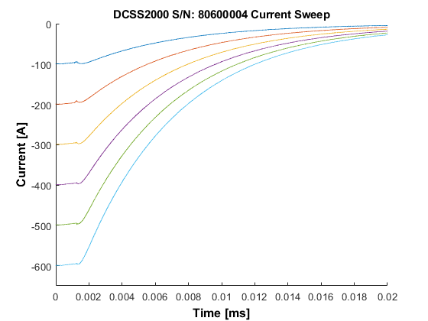
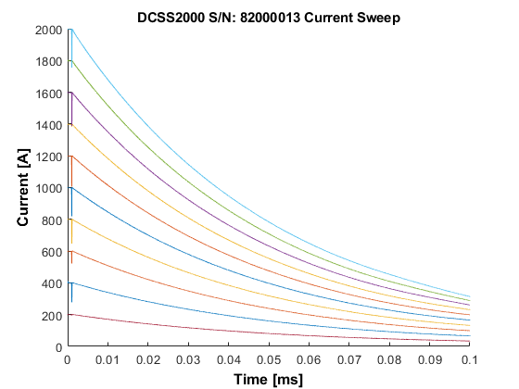
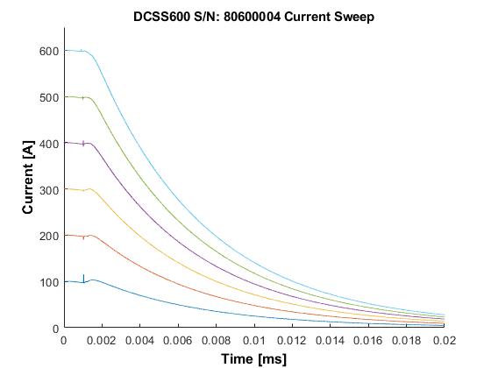
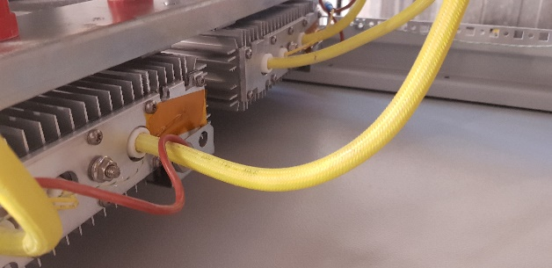
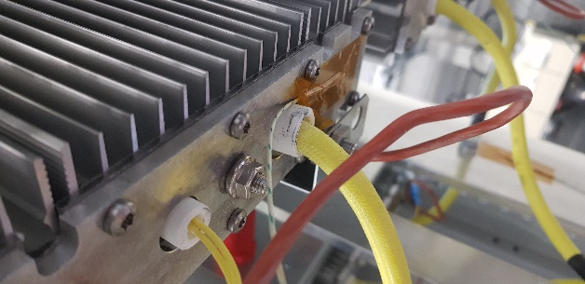
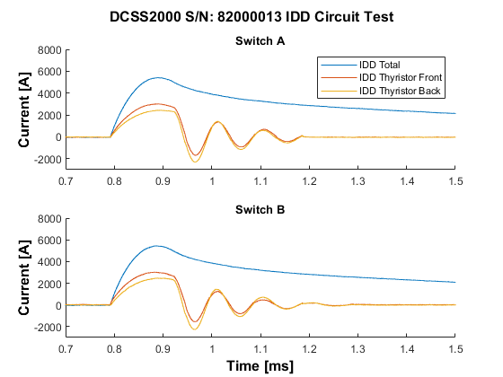
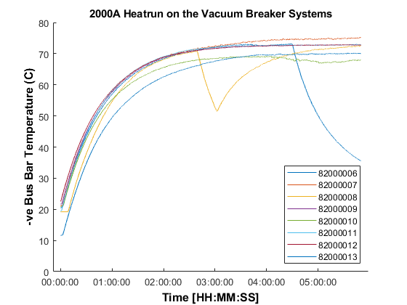
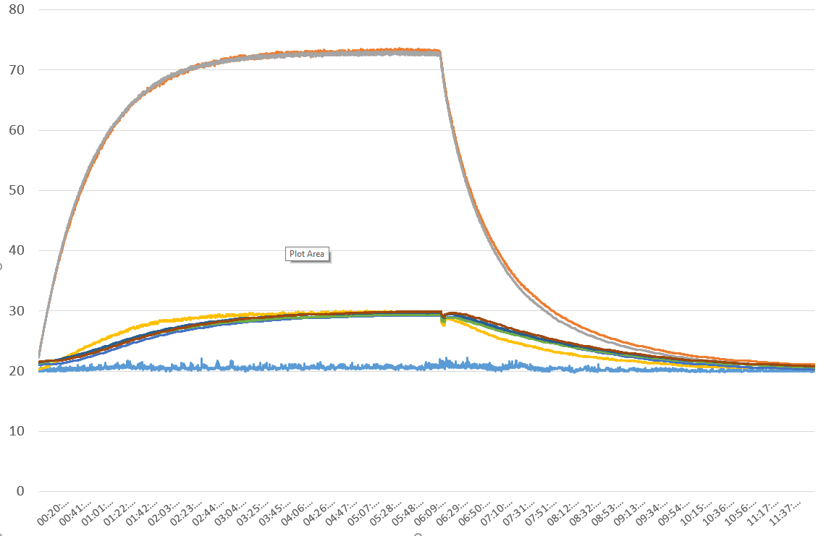
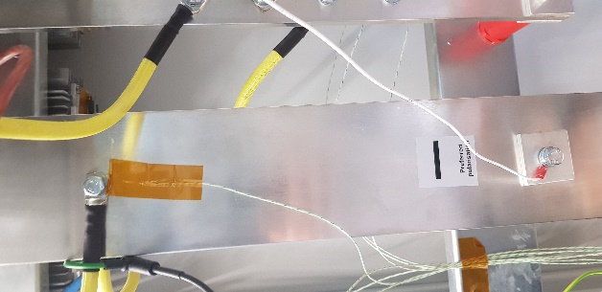
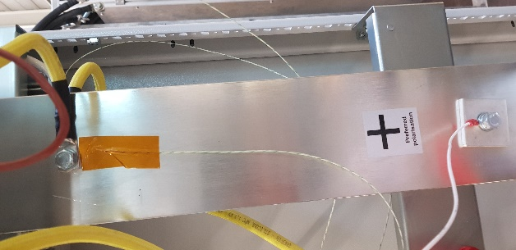
Bld.272 validation tests
Before their installation in SM18, all units are thoroughly tested in the test area in bldg 272 with plenty of discharges on a 10 mH load. Heat runs to validate the thermal performance are also done.
Test setup
Thermocouples installation
8 hours heat run
All EE systems max. temperatures

Slide 15
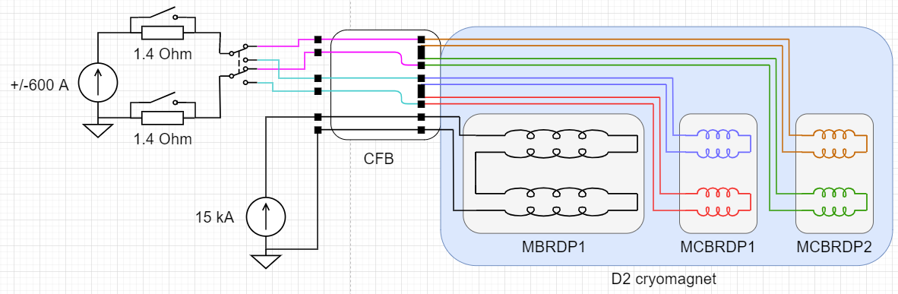
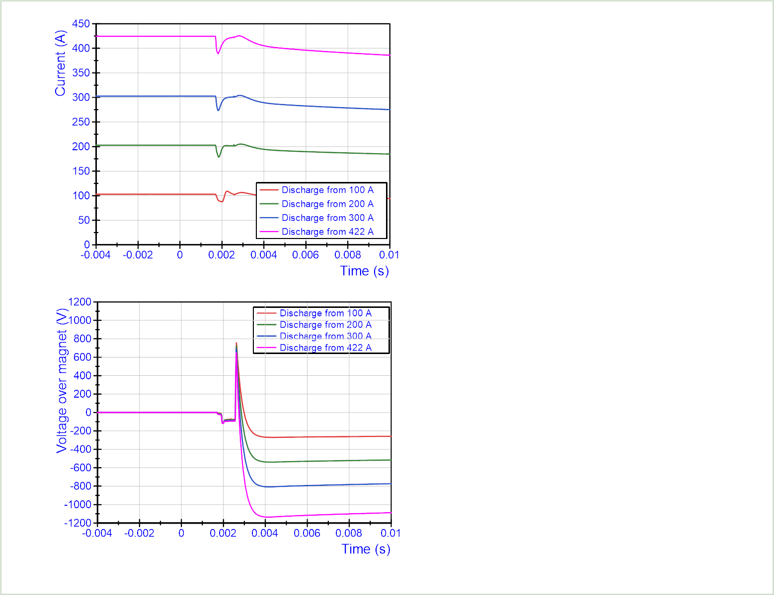
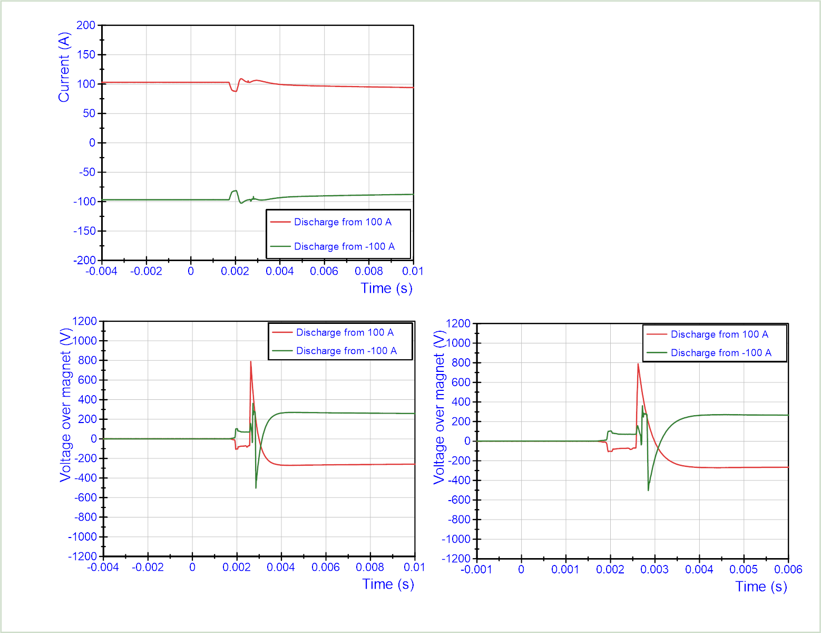
Experience with the test in SM18
This new technology was tested on a small number of magnets in SM18. Nonetheless, it is based on a conventional protection mechanisms, industrial breakers and an improved redundancy that guarantee a solid and reliable operation.
Extensive tests, with few hundred openings at 2 kA, were done in SM18 in 2019 with a prototype system on the vertical test bench with an MCBXF magnet. Up to 20 000 cycles were also done in LUT-Poland. The test results showed the excellent performance of this system with no failure.
Recently, the new vacuum switch system with the 600 A circuit was used in the D2 prototype to protect the MCBRD magnets on test bench C2 and the system is still installed for the series magnets (between 20 and 100 discharges done up to now).
Current and voltage on the magnet during extractions at different current levels (courtesy of G. Willering).
Comparison of current and voltage on the magnet during extractions at 2 different polarities (courtesy of G. Willering).
Tests will start soon on test bench F1, where two 2 kA EES are installed and ready for operation.

Slide 16
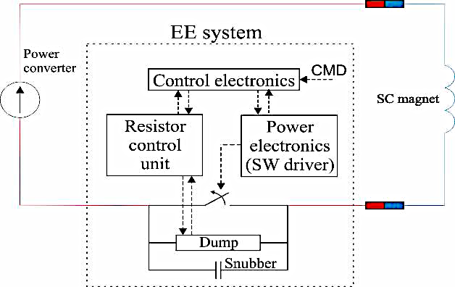

New control electronics for EES
An additional improvement on the vacuum-switch-based EES is under development and it is planned to be tested and validated by the end of the year.
It foresees the complete separation of control an power electronics, with the implementation of a design developed by B. Panev and S. Georgakakis.
All boards are ordered (part of them already tested) and two cassettes of an EES system are being modified to comply with this new electronics.
The String is ready to use the old electronics, but the new one could be retrofitted as soon as the qualifications tests are completed.
2 analogue signals boards (already produced)
FPA interlock board
General interlock board
Commercial PS, to be replaced with a rad-hard version
2 control boards
(being produced)
Capacitor board
System board
(to be delivered by TE/MPE-EP)
2 driver boards

Slide 17



Safety remark
HL will be the first case in the LHC when an active source of high voltage/current (other than the power converter) will be connected to the main magnet circuits.
  For CLIQ: 40 mH, 1000 V capacitors (20 kJ stored)
  For EES: 530 V, 57J pulse stored energy
Therefore, the consequences at the level of personnel and equipment safety are important.
Personnel
  Both equipment types must be locked-out before any intervention on the live parts of the circuit!
Equipment
  2kA EE incompatible with PC in absence of inductive load: in case of a trigger, a 530 V surge could destroy the PC diodes.
In addition, for CLIQv2, differently from the machine unit, the capacitance value of can be changed by using the mechanical switches behind the front panel. Opening the door to the capacitance selector will automatically disconnect the power supply and activate the internal discharge of the unit.
The internal discharge of the unit takes nevertheless approximately 100 s.
Detailed procedure were written to illustrate these risks.
Following the CE marking studies and subsequent fixing of minor recommendations, CLIQv2 and v3 and the vacuum-switch-based EES are compliant with the CE standards of safety!

Slide 18






DQHDS procurement and testing status
52 units + 8 spare for the String were produced at CERN and are ready to be tested.
  Automatic tester almost operational.
The series production has been secured with an in-kind contribution from Japan, through KEK
  Issues of yearly budget activation
  Extremely good collaboration with KEK.
Irradiation tests in CHARM proved that the units could operate up to an integrated dose of 350 Gy:
  In the two irradiated crates, the failing component was the thyristor
  The expected total maximum dose will be around 100 Gy for HL units.
The 7 + 2 spare DQLIM units for the String are produced and ready to test as well.
DQHDS production at CERN
Tests in CHARM
DQLIM units
Automatic tester

Slide 19
Concluding remarks
CLIQ and the vacuum-switch-based EES have demonstrated to be reliable elements of the protection system.
  CLIQ units are systematically used in SM18 and a big statistics has already been cumulated
  The EES have proven their performance, but a big step will be done with the test of the magnets in test benches F1 and A2 in the coming months.
After many problems related to the global market, the production of the CLIQ units for the String is assured and they should soon be at CERN for validation.
The EE systems are already installed in the String and ready for commissioning.
The String will be the most important verification of all protection system in a real machine configuration.
New safety requirements will be needed in the LHC when the systems are operated.

Slide 20
Thanks for the attention!
Questions?

