Slide 1
SM18 validation of RFD CM Prototype for SPS tests
Katarzyna Turaj on behalf of WP4 and SY-RF-SRF
13th HL-LHC Collaboration Meeting, Vancouver, 25-28.09.2023

Slide 2
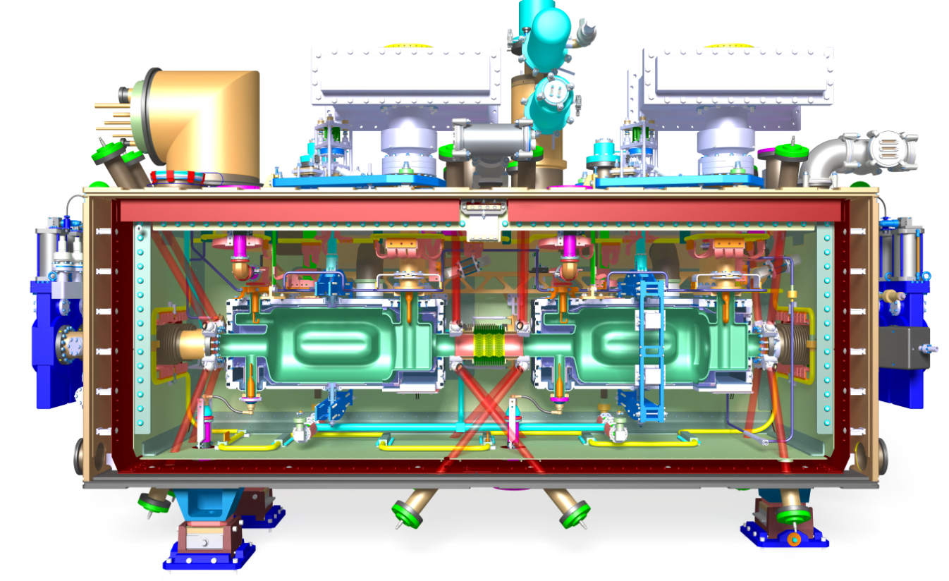
RFD CM parameters
Voltage 3.4 MV/cavity
Epeak 40 MV/m
Bpeak 70 mT
Frequency 400.79 MHz
Q0 10^10
Qext 5 x 10^5
Cavity tuning ±100 kHz
Temperature 2.0 K
RF power 40 kW
Courtesy: T. Capelli
Eng spec. 2043014

Slide 3
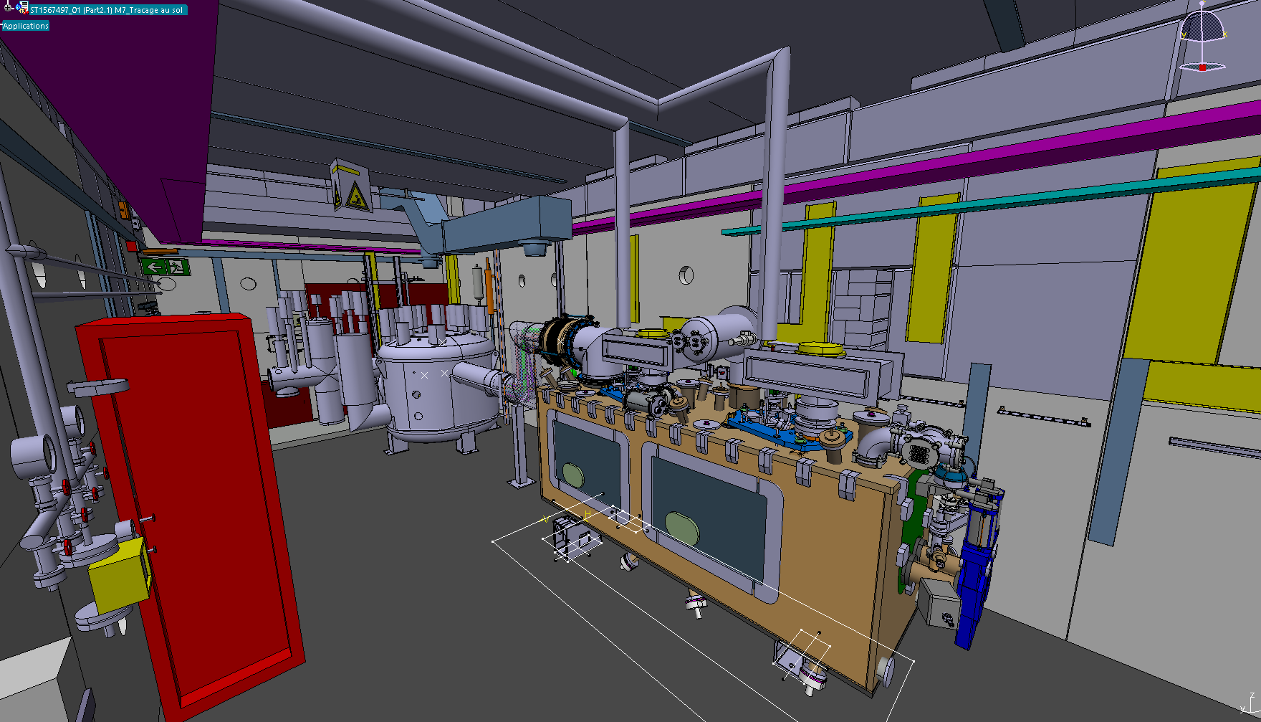
Goals of RFD CM cold test in SM18
Testing of RFD CM is a crucial validation step of the cryomodule assembly process.
Validation of the cryomodule at 2K is required before RFD CM installation in the SPS.
Courtesy: A. Kosmicki

Slide 4
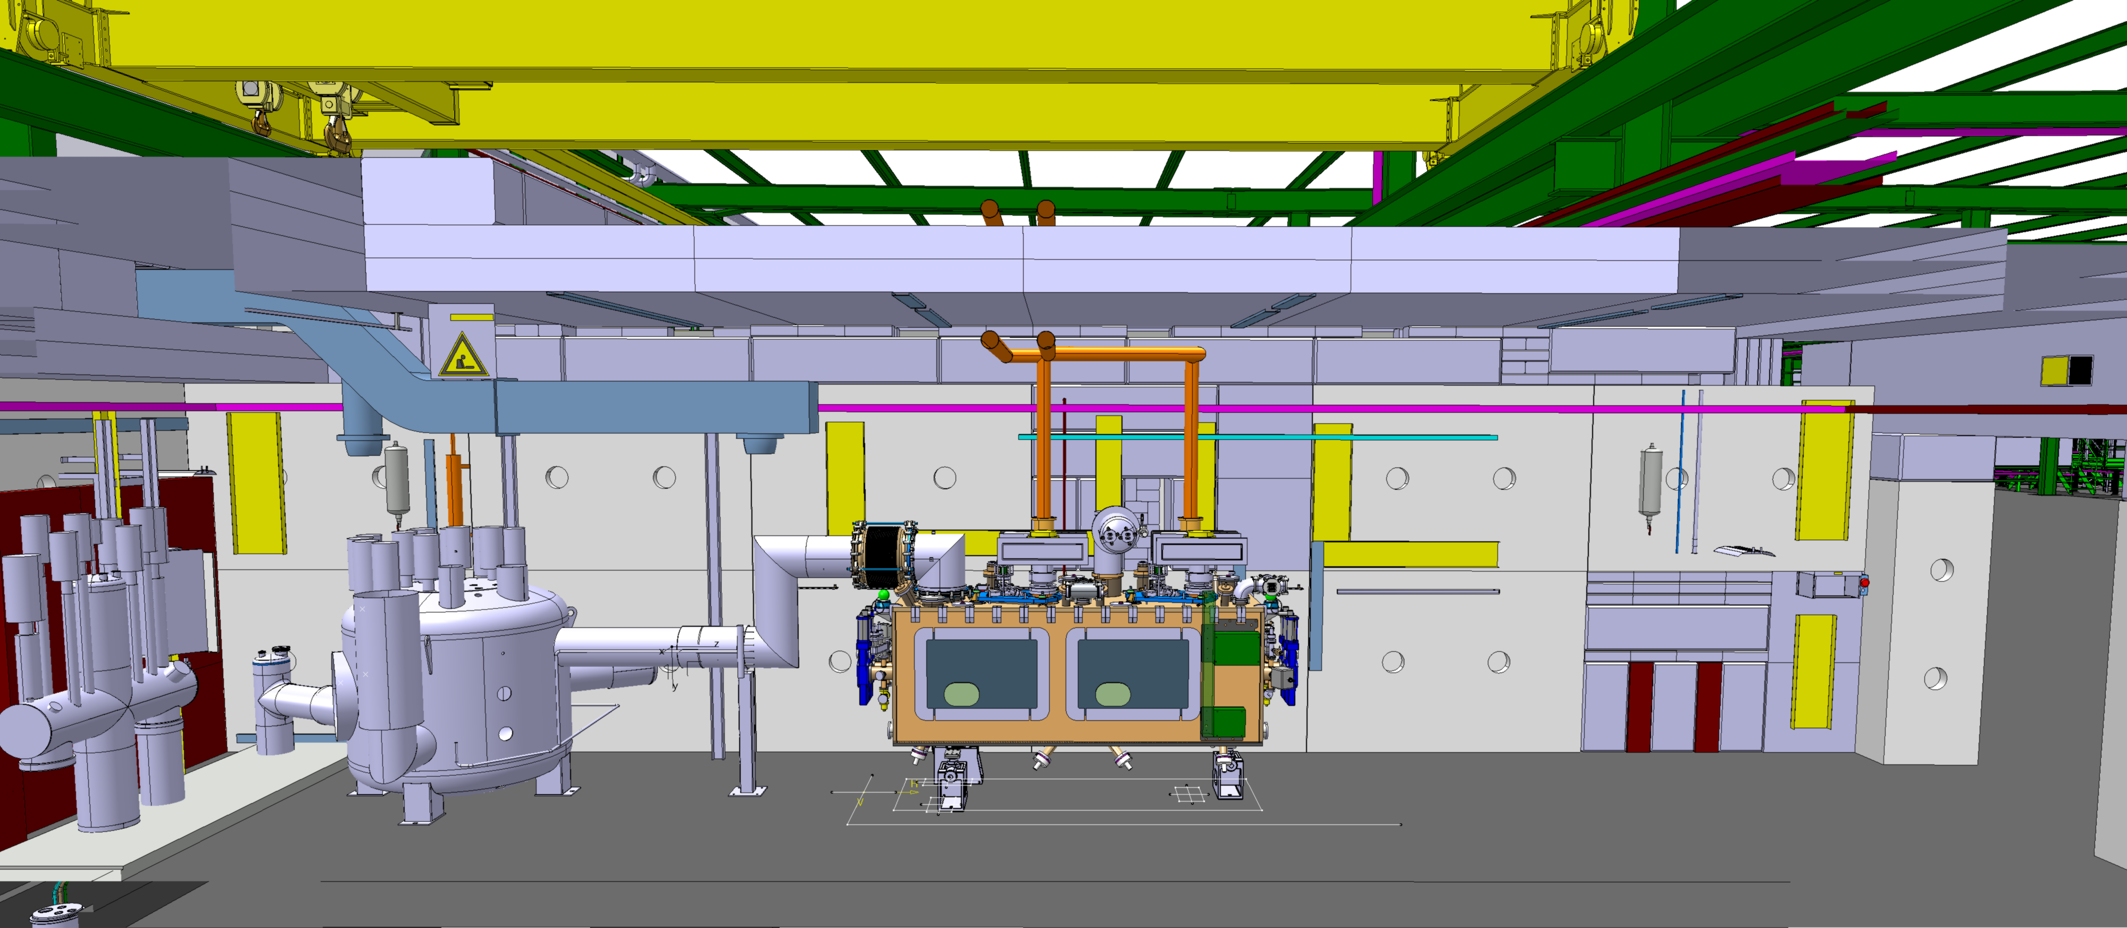
Infrastructure: M7 test stand
Dedicated bunker M7 to allow full validation of CC CM.
The test infrastructure will be compatible with both RFD and DQW cryomodules.
  This test stand will be used to qualify all HL-LHC CM (11).
Manufacturing and Inspection Plan : CRAB RFD CM TESTING SM18 → EDMS 2756481
Courtesy: A. Kosmicki

Slide 5
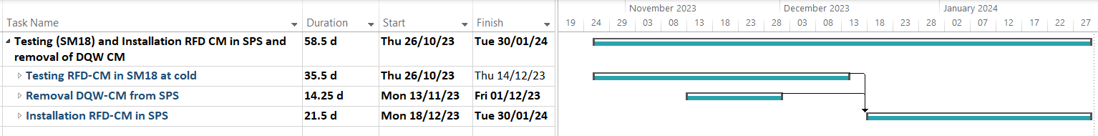
SM18 planning changes
Due to delays in production and a short window for installation in the SPS during EYETS 2023-24 the testing program in SM18 was significantly reduced (*).
  Test flow and steps were adjusted.
  Duration reduced from original 4 months to 1.5 month.
The main goal is to perform Vacuum/Cryo-System leak tests at 2K.
All measurements and tests at 2K were reduced to minimum.
  No conditioning of the RF power couplers.
  No single cavities performance tests.
  RF tests only include measurements of the fundamental frequency, HOM spectrum and tuner response.
Testing in SM18
Removal of DQW
Installation of RFD CM in SPS
No works during the Christmas break
(*) 12th HL-LHC Collaboration Meeting, : RFD-CM reception at CERN & acceptance tests

Slide 6
Workflow of RFD CM in SM18
CM Reception
Low Power Measurement
RF Conditioning
Ready to Transport
Transfer to M7
Pump & purge
Cool Down
RF Measurement
Disconnection
Alignment
Leak Test
RGA
LLRF Test
RGA
RF Warm Measurement
Connection
(VAC/CRG/RF)
Heat Loads
Thermal cycle and final
Warm-up
cancel

Slide 7
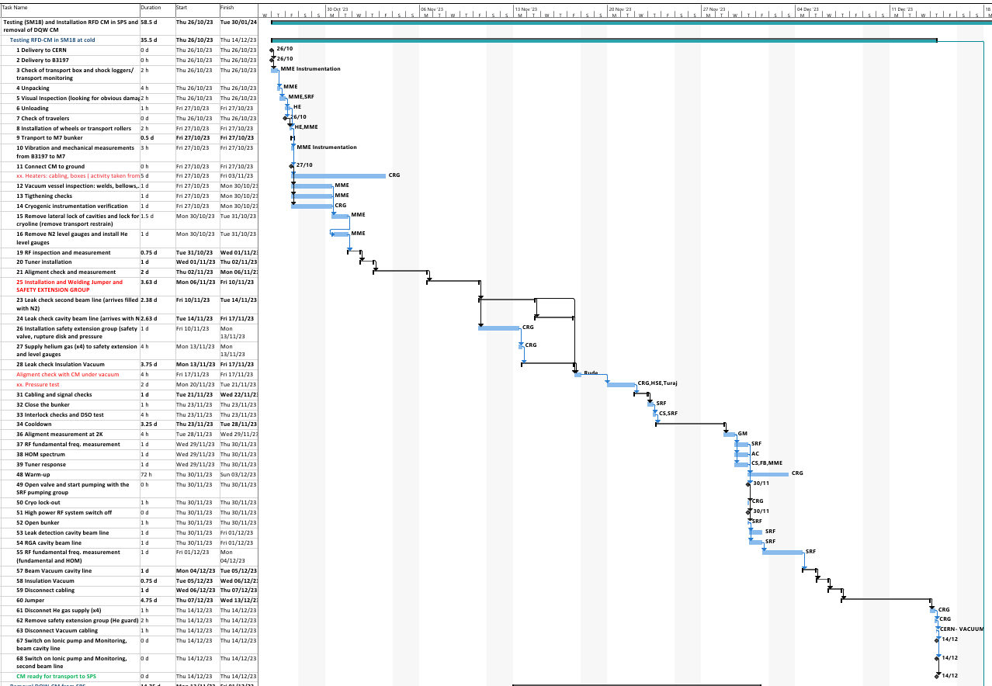
SM18 planning
Delivery and inspections
Jumper and safety group extension welding
Leak checks
Alignment
Pressure test
Final checks
Cool-down
2K
Warm-up
Leak checks
Disconnection

Slide 8
Conclusions
The test infrastructure is ready to enable validation of the RFD CM.
A validation and testing program is being developed. Includes procedures, reports and full data logging.
Due to delays in production, the test program was reduced.
The main goal of the SM18 test is to verify Vacuum/Cryo-System leak tightness at 2K.
Only low power RF measurements are intended.
Courtesy: T. Capelli
Notes:
LLRF installation on going
RF Power: Reserved space ready for installation
Cryogenics: Infrastructure in place.

Slide 9
Thank you very much!

Slide 10
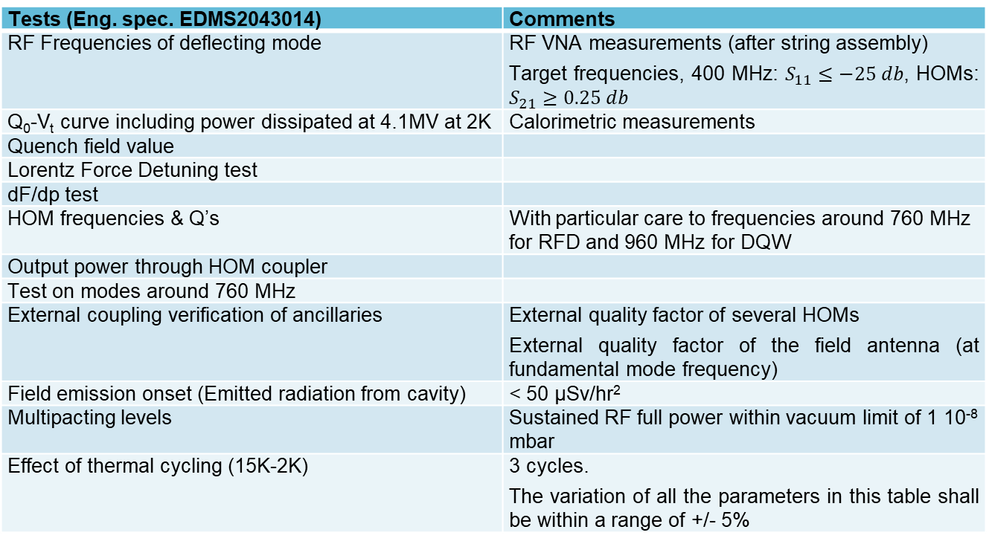
RFD CM Test Program
Manufacturing and Inspection Plan: CRAB RFD CM TESTING SM18 → EDMS 2756481
Tests (Eng. spec. EDMS2043014) | Comments
RF Frequencies of deflecting mode | RF VNA measurements (after string assembly) Target frequencies, 400 MHz: $S_{11}≤−25 db$, HOMs: $S_{21}≥0.25 db$
Q₀-V_{t} curve including power dissipated at 4.1MV at 2K | Calorimetric measurements
Quench field value
Lorentz Force Detuning test
dF/dp test
HOM frequencies & Q’s | With particular care to frequencies around 760 MHz for RFD and 960 MHz for DQW
Output power through HOM coupler
Test on modes around 760 MHz
External coupling verification of ancillaries | External quality factor of several HOMs External quality factor of the field antenna (at fundamental mode frequency)
Field emission onset (Emitted radiation from cavity) | < 50 µSv/hr²
Multipacting levels | Sustained RF full power within vacuum limit of 1 10⁻⁸ mbar
Effect of thermal cycling (15K-2K) | 3 cycles. The variation of all the parameters in this table shall be within a range of +/- 5%
Notes:
RF frequencies of deflecting mode
Q₀-V_{t} curve including power dissipated at 4.1 MV for 2 K operation and quench field
Lorentz Force Detuning
dF/dp test
HOM frequencies & Q’s values
Output power through HOM couplers
External coupling verification of ancillaries
Field emission onset ( <50uSv/h2)
Multipacting levels
Effect of thermal cycling (up to 80K)

Slide 11
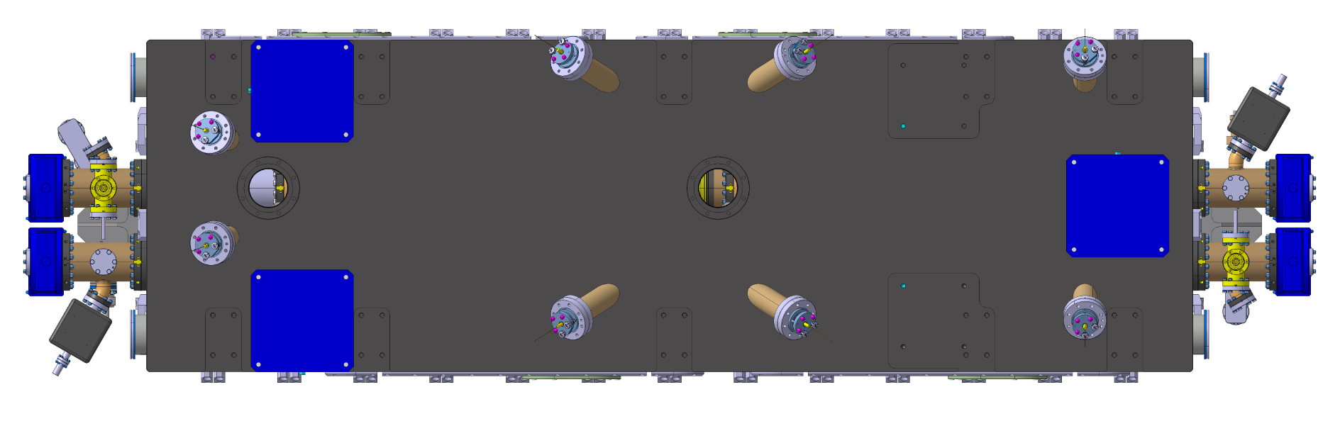
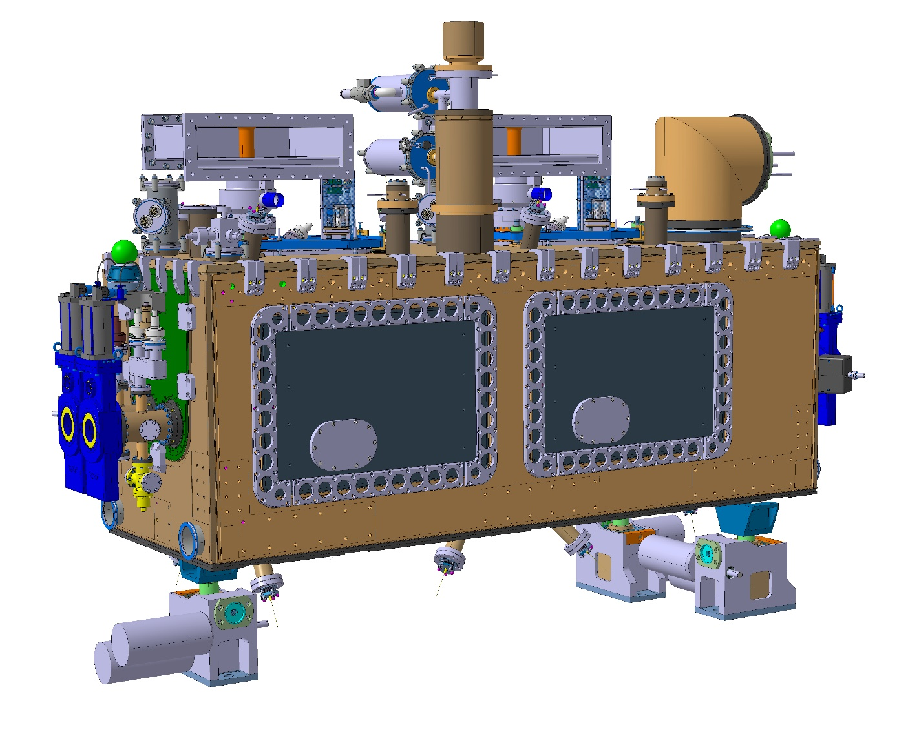
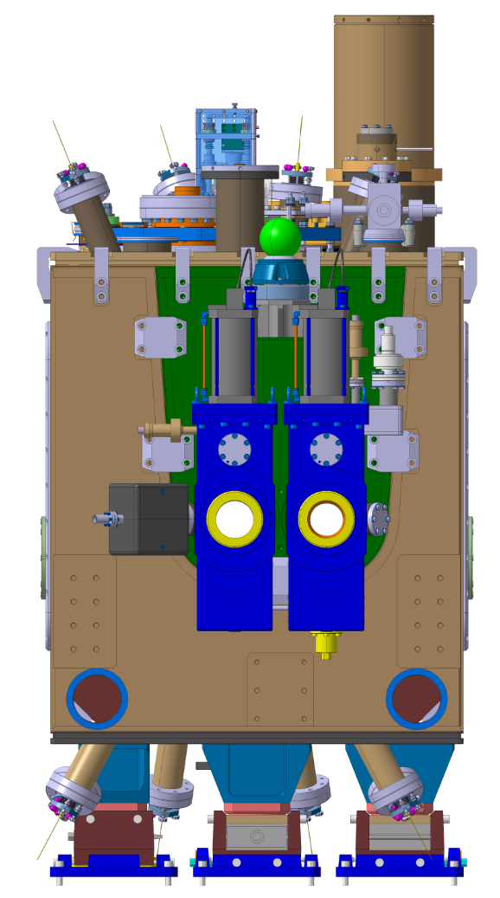
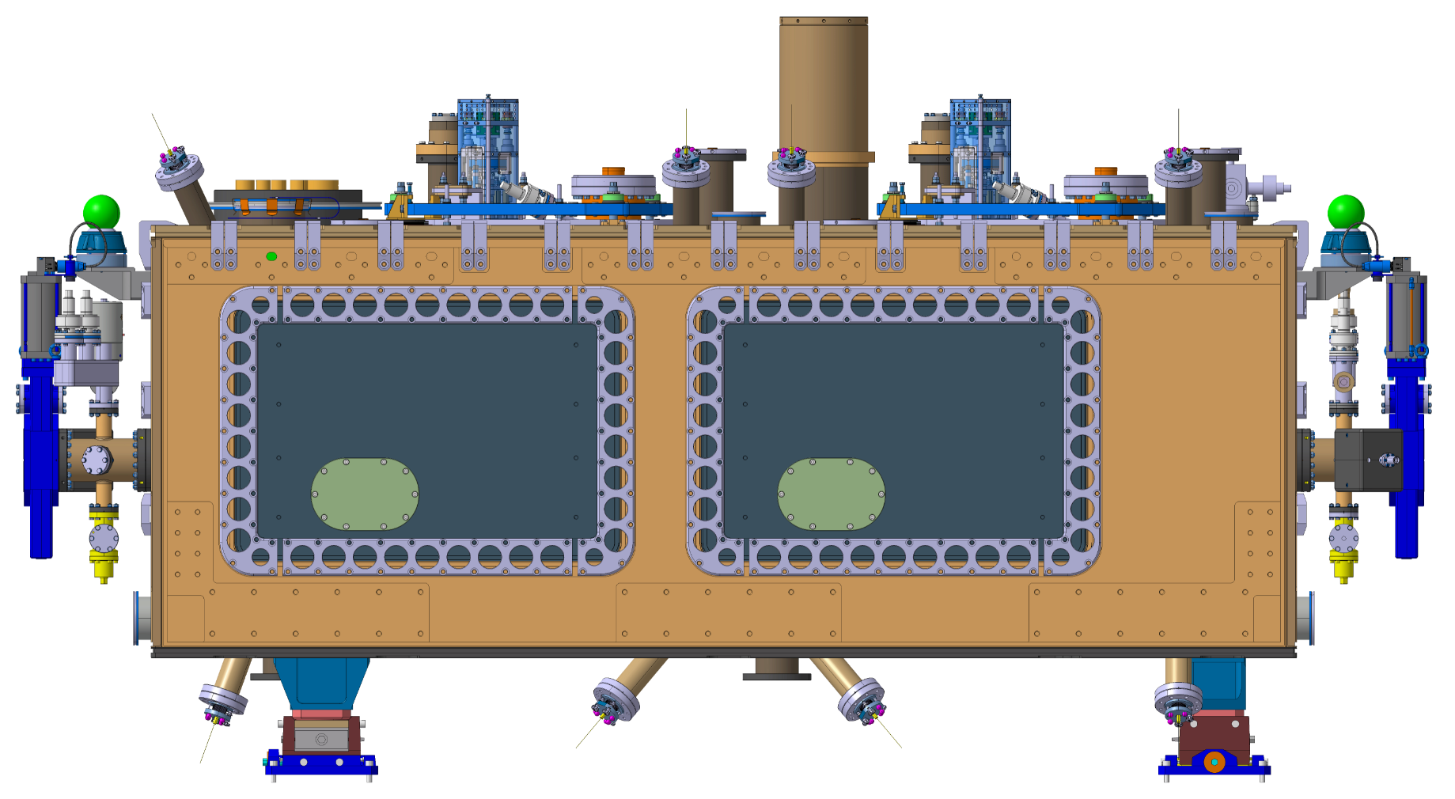
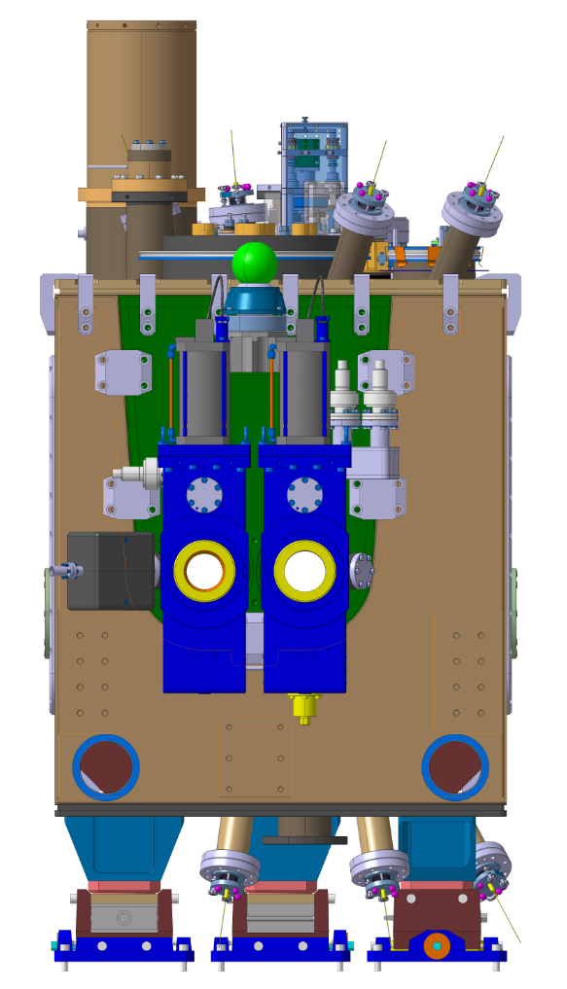
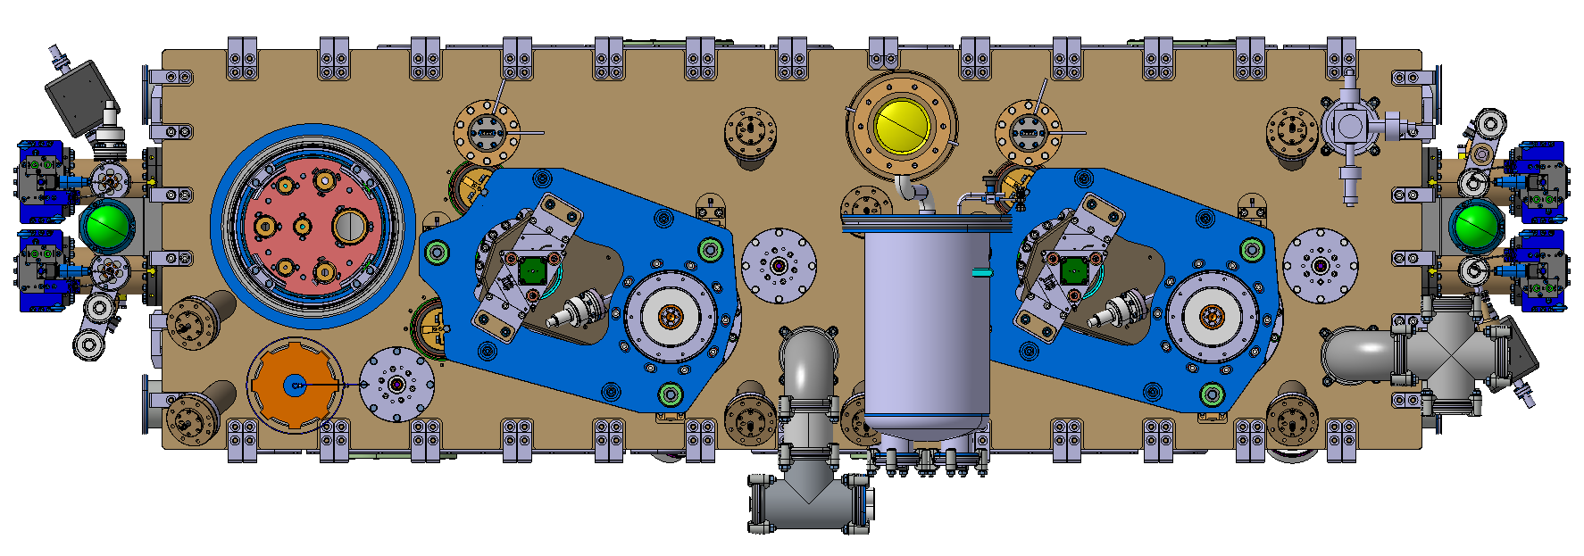
RFD cryomodule ports/interfaces
FSI – DN63 CF flange
Total Qty : 16
RF connexions
SY/RF
Alignment and position monitoring
BE/GM
Insulation vacuum
TE/VSC
1040
Beam vacuum
TE/VSC
2750
Cryogenic
TE/CRG
Pick up antenna feedthrough
Total Qty : 2
875
Insulation vacuum pumping port 1/2
Total Qty : 4– iso K DN100
Insulation vacuum pumping port 2/2
Total Qty : 4– iso K DN100
Level gauges feedthrough
2x / 2x ConFlat (CF) DN40
FSI – DN63 CF flange
Total Qty : 16
Cryogenic jumper
Iso K DN400
Total Qty : 1
Insulation vacuum instrumentation – Iso K DN100
Total Qty : 1
Beam vacuum instrumentation 2/2
Total Qty : 4
See drawings XXXXX
Beam vacuum instrumentation 1/2
Total Qty : 4
Drawing under preparation
Instrumentation port
3 Flanges ISO K DN100
Insulation vacuum pressure relief – Iso K DN160
Total Qty : 1
HOMS feedthrough
Total Qty : 4
Cryogenic safety port for pressure measurement
1 Flanges ISO K DN63
Instrumentation port
1 Flange ISO K DN100

