Slide 1


RFD Industrial Cavity Production
Manuele Narduzzi - FNAL
13th HL-LHC Collaboration Meeting – Sep 25th – 28th, 2023

Slide 2
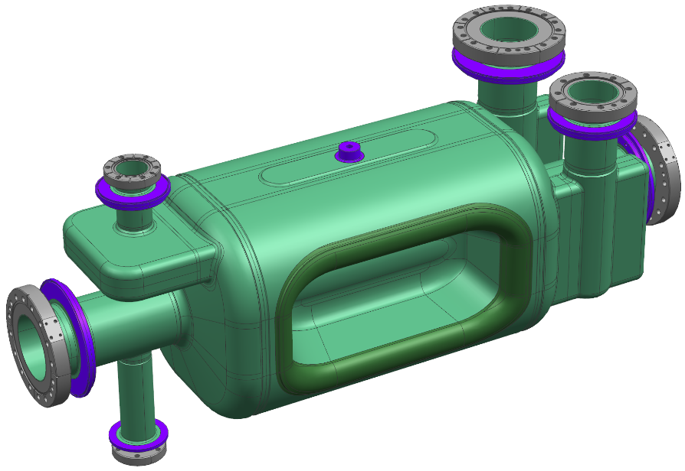
Outline
Series Niobium: status and issues
Pre-series & Series RFD fabrication at ZRI
He Tanks for Prototypes & Processing at ZRI
Summary & Upcoming plans

Slide 3
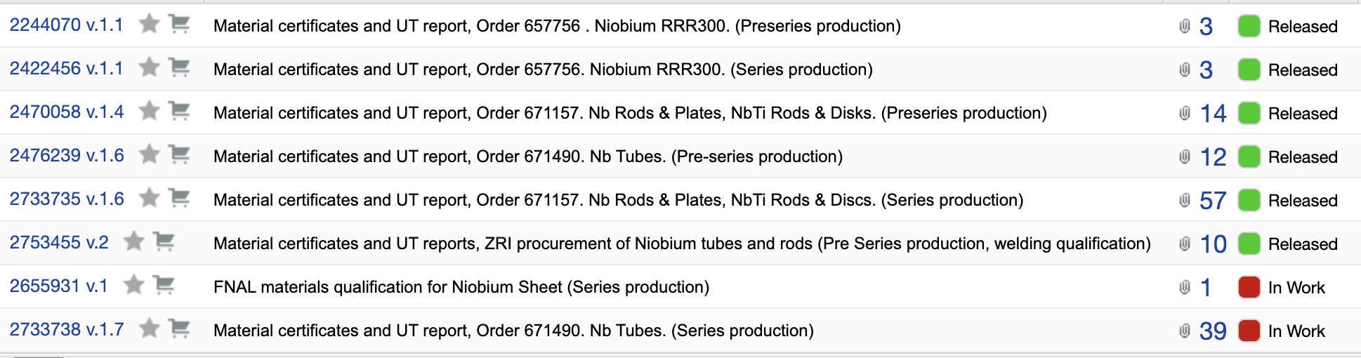
Series Niobium: status & issues (1)
  The material certificates and UT QCs are available on EDMS
    Additional NDTs performed by AUP on Nb sheets
  The last batch of Nb tubes has been recently delivered to ZRI*
    Delivery from Ningxia was delayed several months than expected
      Postponed the Series Brazing Qualification!
    CERN will carry out further NDTs on 2 of 8 unqualified tubes UTs
*ZRI is the acronym for “Zanon Research and Innovation”

Slide 4
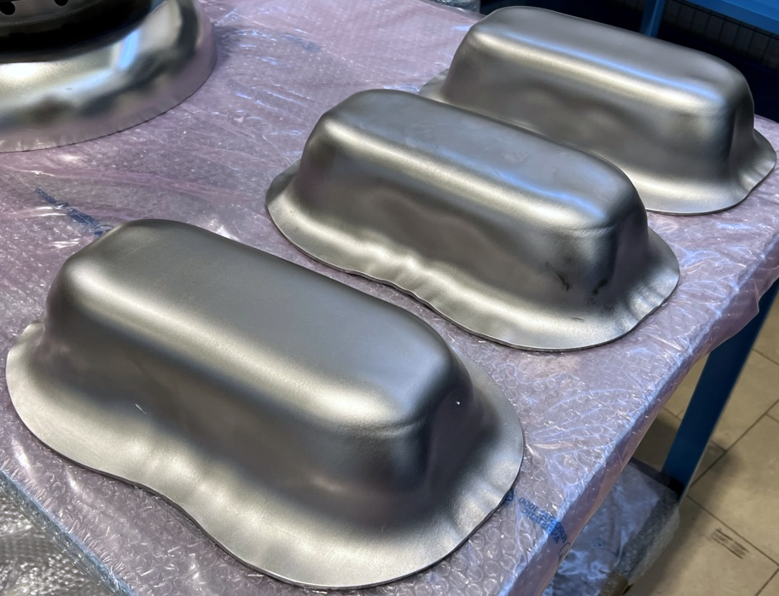
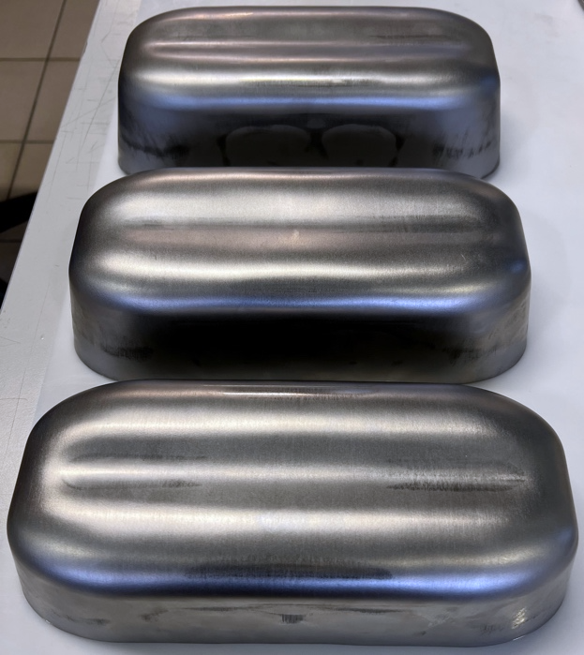
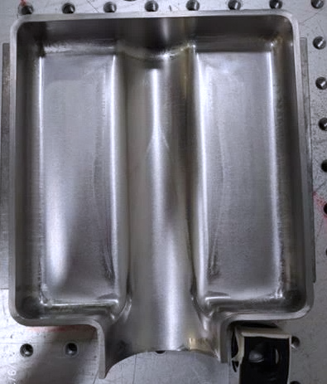
Series Niobium: status & issues (2)
  Poles and WGs formed from series Nb shows non-repeatable results:
    Some Poles showed less than desirable results even if formed from the same sheets used for acceptable components.
    Waveguides require many coining steps to get close to the required shape accuracy, unlike pre-series ones.
    AUP stock materials are enough for the manufacturing of 14 RFDs
Unacceptable Poles (left) and Acceptable Poles (middle) from the same Niobium sheet. Difficult stamping of Waveguides (right)

Slide 5
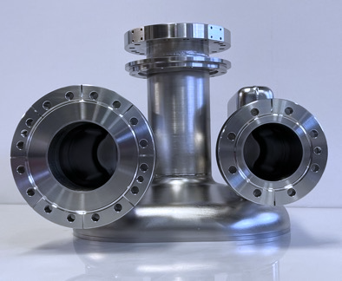
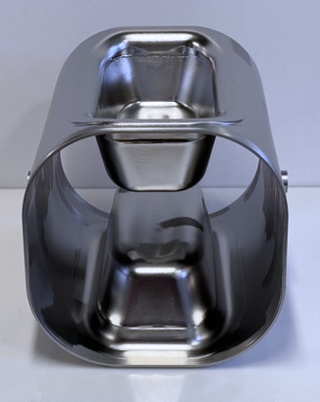
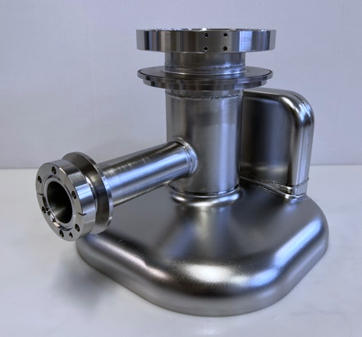
AUP Pre-series & Series Fabrication at ZRI
  Adopted CERN Eng. Spec. & Dwg for pre-series
  Approved Fab. Dwgs, MIP & QA/QC Procedures
  Approved Weld Test Plan
  Approved Welding book
  Finalizing Brazing Test Plan (Series only)
  Addressed all the reviews’ recommendations
  Adopted the HL-LHC quality system (MTF/EDMS)
  Enhanced QCs and VTS tests at FNAL & JLab
Documentation Prior
to Manufacturing
QA/QCs during
production
98% of first 2x Pre-Series RFDs completed (delivery expected late 2023)
11% of 10x Series RFDs manufacturing has been completed

Slide 6
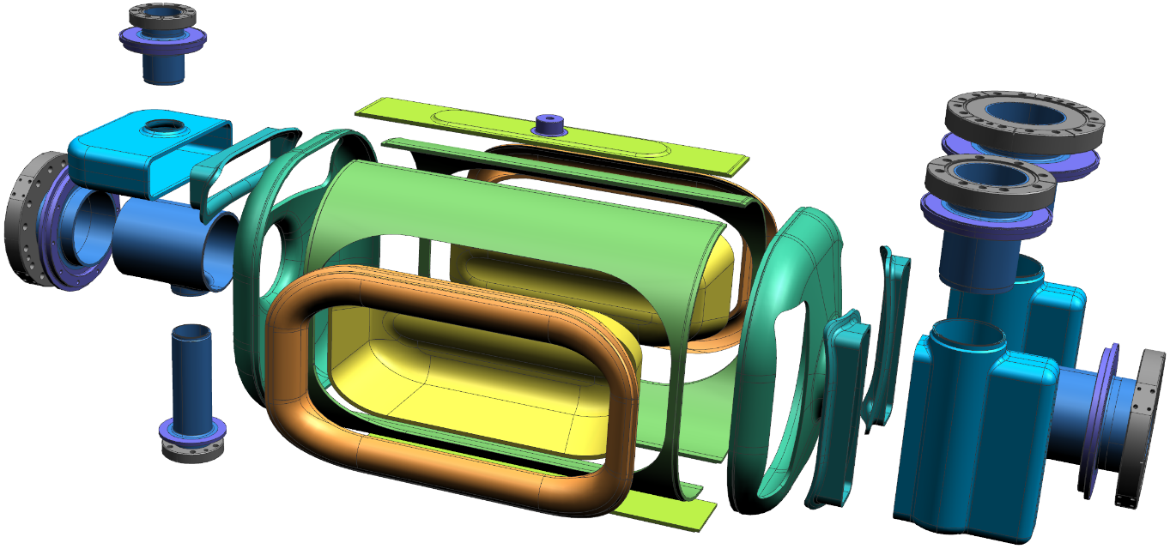
Documentation Prior To Manufacturing:
Pre-series & Series RFD Fabrication Strategy at ZRI
Transition
V-HOM
Racetrack
V-HOM
Waveguide
Transition
H-HOM
H-HOM
Waveguide
Beam Axis Extr.
Antenna
Extr.
Corner
Pole
FPC
Waveguide
Half Main Body
End Cap
Transition
FPC
  Extremities tubes machined from Nb seamless pipes (no roll-forming)
  Single design for all the Transitions (machined from a block)
  Subcomponents interfaces and EBW joints handled as ZRI know-how
  Strategy validated with 2x Prototypes and 2x Pre-series bare cavities

Slide 7
Documentation Prior To Manufacturing:
Technical Documentation Status
Fabrication drawings approved by CERN
Welding Test Plan PQR approved by CERN
Welding Book approved by CERN
Brazing Test Plan PQR (series only) to be approved

Slide 8
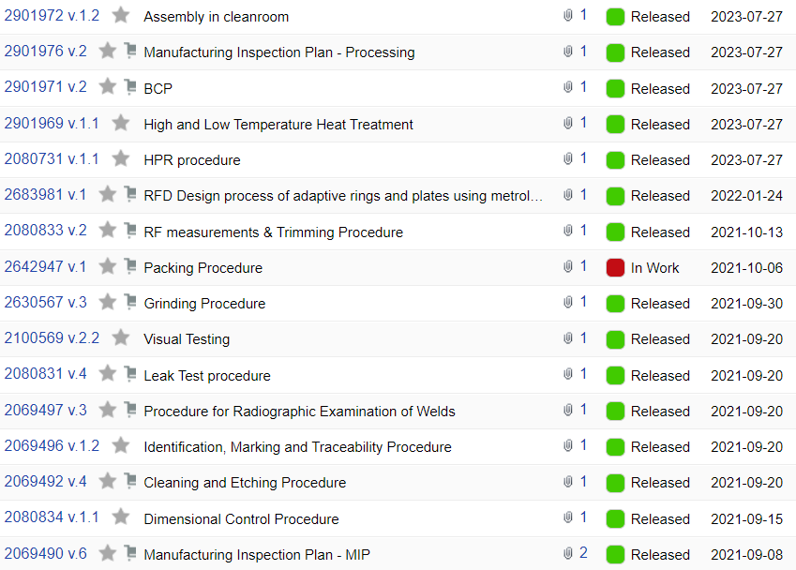
Documentation Prior To Manufacturing:
MIP and Procedures Status
QA & QC Procedures: 15 of 17 approved by CERN
Processing at ZRI
Being finalized
Being finalized

Slide 9
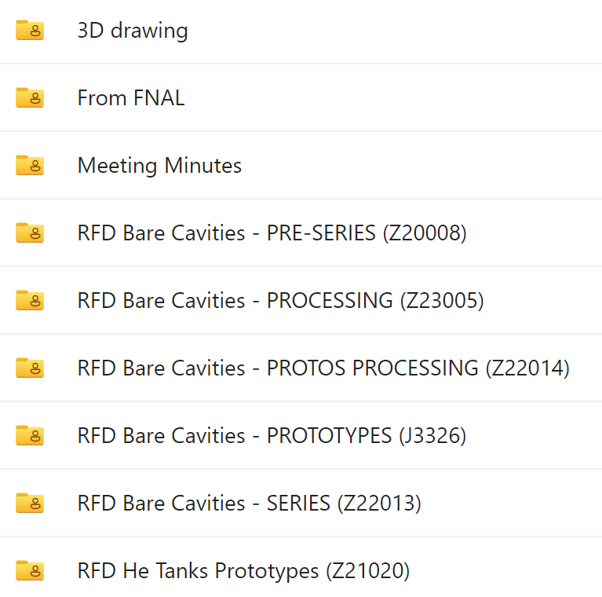
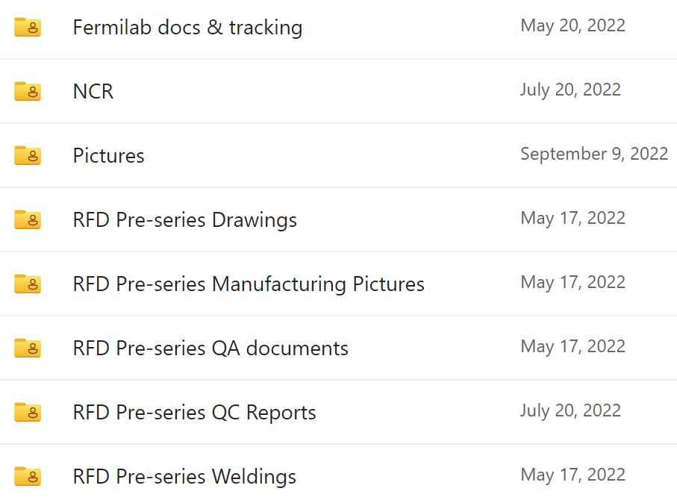
QA/QC During Fabrication:
Quality Approval Process between ZRI & AUP
All QC reports are uploaded on FermiCloud by ZRI
ZRI and AUP track QCRs approvals via signatures of completed production steps on MIP.
The QCRs are checked and approved by FNAL (189 per Bare Cavity)
AUP shares all the reports on EDMS / MTF

Slide 10
QA/QC During Fabrication:
Quality Approval Process between AUP & CERN (1)
“Approval Process MTF-EDMS for AUP RFD Crab Cavities” (EDMS 2896383)
CERN approves:
  Fabrication drawings and Manufacturing Procedures: MIP, Welding & Brazing QA
  NDT, welders and brazing operators' certificates
  Raw material certificates and UT reports
AUP uploads and releases all manufacturing reports to EDMS / MTF
CERN reviews and releases:
  Bare Cavities final frequency and metrology, UT thickness (after BCP) + Cold RF test
  Dressed Cavities:
    Pressure test + LT of He Tanks and 2nd Beam Pipe for Jacketed Cavities
    Cold RF tests + Frequency at 2K+ for Dressed Cavities
CERN reviews and closes all the NCRs
Notes:
Prendi I bullet dale slide di Hector solo per bullet

Slide 11
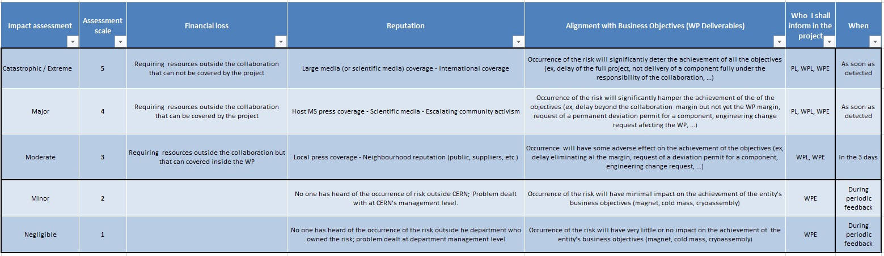
QA/QC During Fabrication:
Quality Approval Process between AUP & CERN (2)
“Handling, Sharing and approval of NCRs AUP-CERN” (EDMS 2384617)
The NC Impact is assessed by AUP based on:
  “AUP Quality Plan for vendors and FNAL Incoming Inspections NCs”
  Technical, Schedule, Financial and Reputational impact
Collaborations Impact Matrix used for assessment or escalate to CERN
Non-critical NCs are managed internally
  Shared with CERN via MTF
  NCRs use vendor’s templates
  Special attention to Welding
Critical NCs are managed as to HL-LHC NC Policy:
    Shared with CERN within days via MTF
    HL-LHC NC template is used
    5 Ws (What, Where, When, Who, Why)
Notes:
Prendi I bullet dale slide di Hector solo per bullet

Slide 12
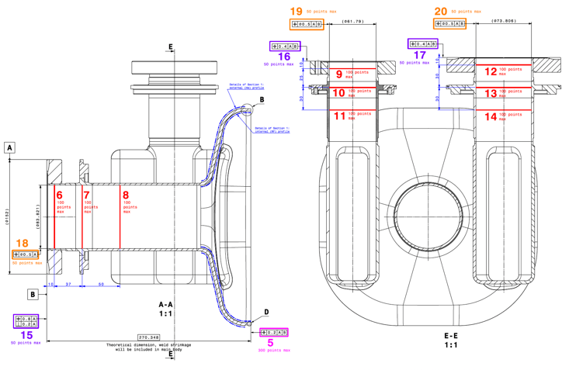
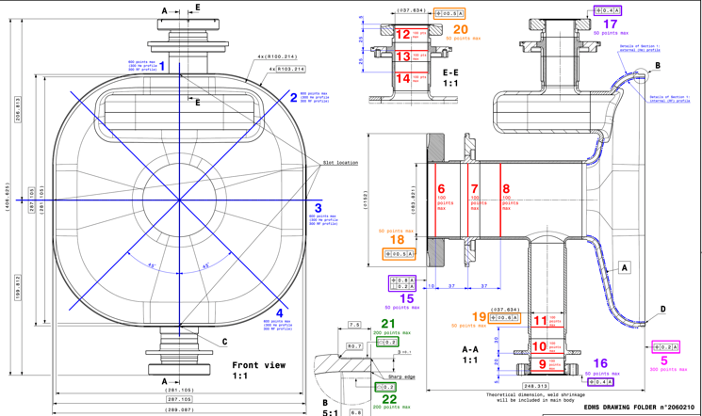
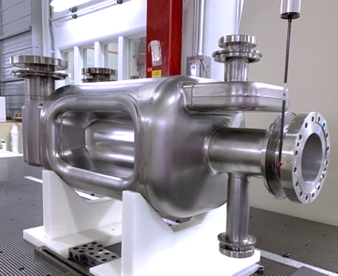
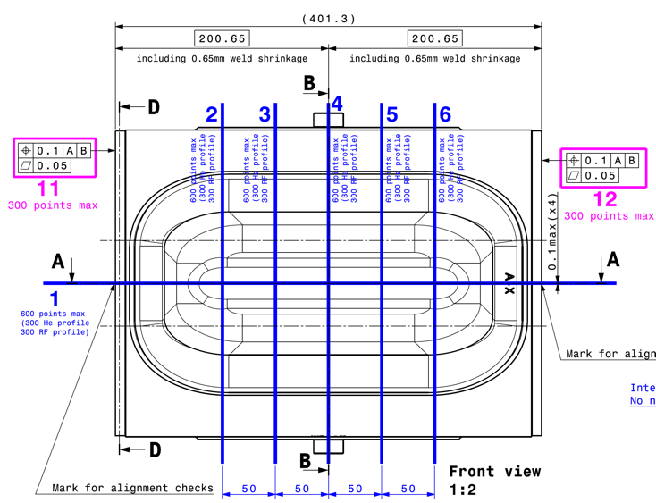
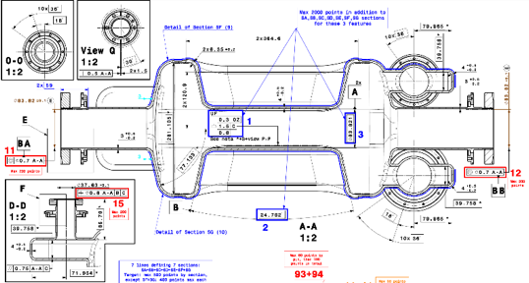
QA/QC During Fabrication:
Final Inspections of Bare Cavities at ZRI
VT (Visual Testing) + RT (Radiographic Testing) + RF (Frequency) check after EBW
He LT (Leak Testing) → Final RF → Final CMM and Ultrasonic Thickness inspection
  CMM as Inspection dwg LHCACFCA0565 and sub-assembly as (EDMS 2734588)
VT of external surfaces + Traceability Report (of subcomponents)
Approval of Manufacturing Dossier and Shipping to FNAL for VTS
Notes:
Aggiungi disegno ispezione

Slide 13
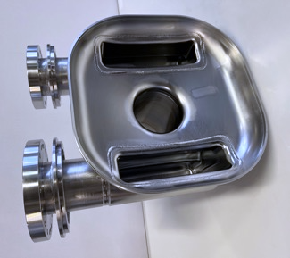
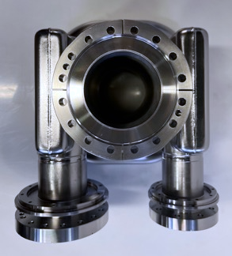
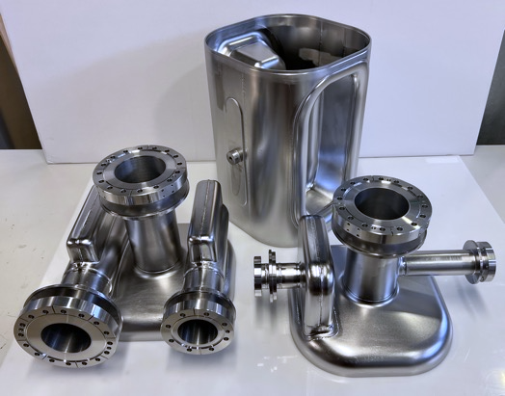
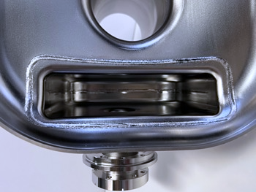
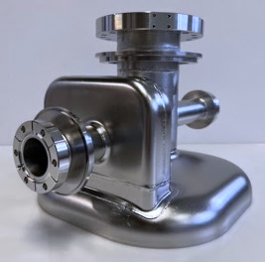
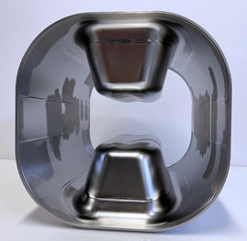
Pre-series subcomponents before final EBW

Slide 14
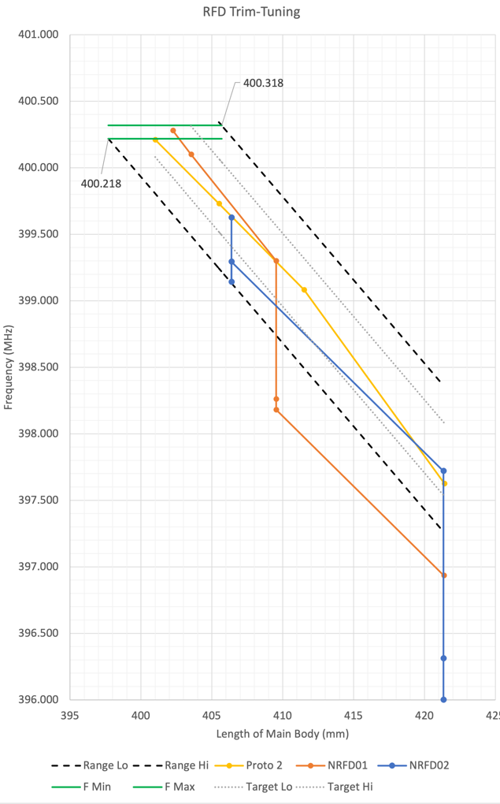
Pre-series RFDs: Trim Tuning Journey
NRFD01:
First RF check: frequency lower than expected caused by geometric non-idealities
First cut to check the dF/dL: lower than ideal
Two steps of reshaping for both Pole distance and Main Body interface with End Caps
Second cut: showed ideal dF/dL
Last cut provided results on target!
NRFD02:
First RF check: frequency lower than NRFD01
Poles and Bodies reshaping: RF on target
First cut: dF/dL lower than expected
Added a second two-step reshape to bring the cavity to the ideal frequency
Second cut: waiting for the results
5
4
Acceptable Frequency range
4
3
3
2
2
1
1

Slide 15
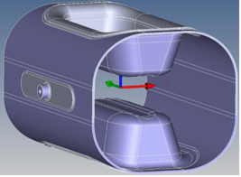
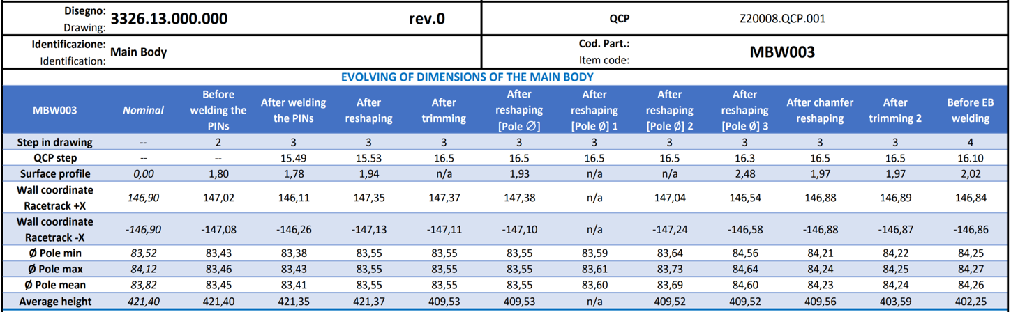
Pre-series RFDs: Trim Tuning Journey
NRFD01 (Pre-series #1) Trim Tuning details

Slide 16
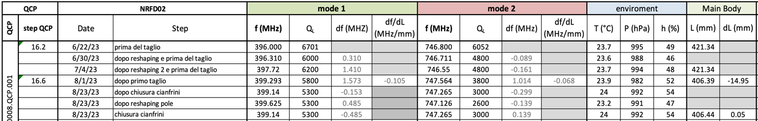
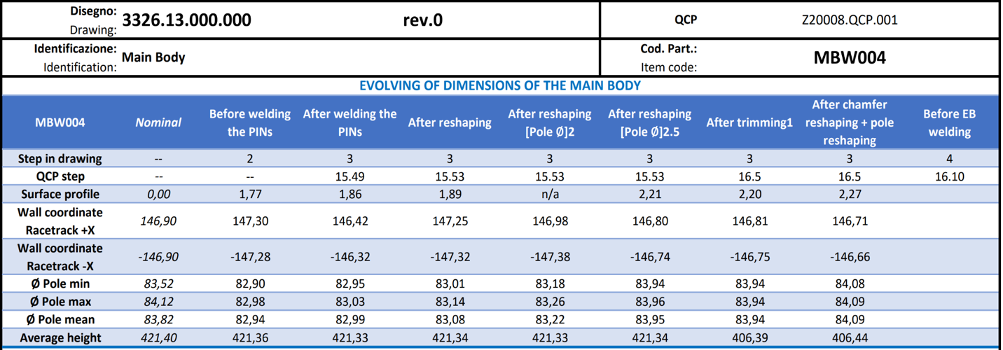
Pre-series RFDs: Trim Tuning Journey
NRFD02 (Pre-series #2) Trim Tuning details

Slide 17
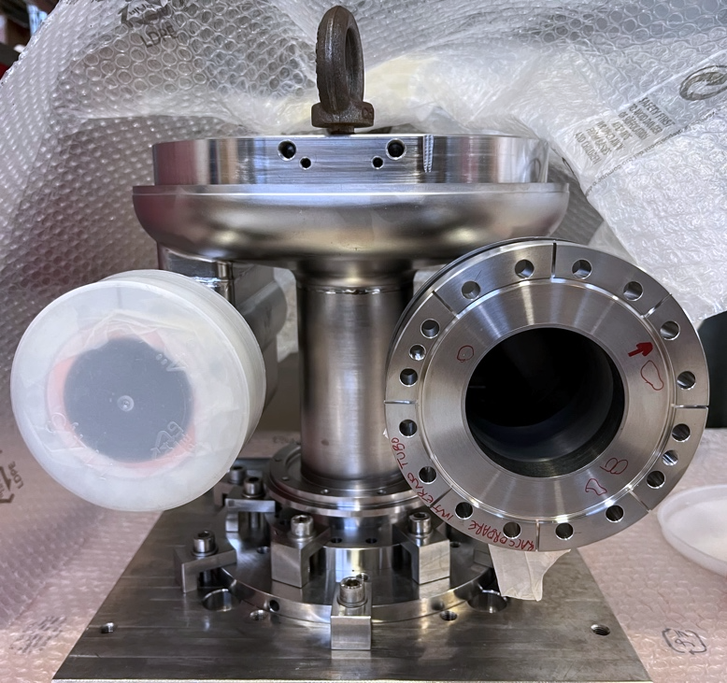
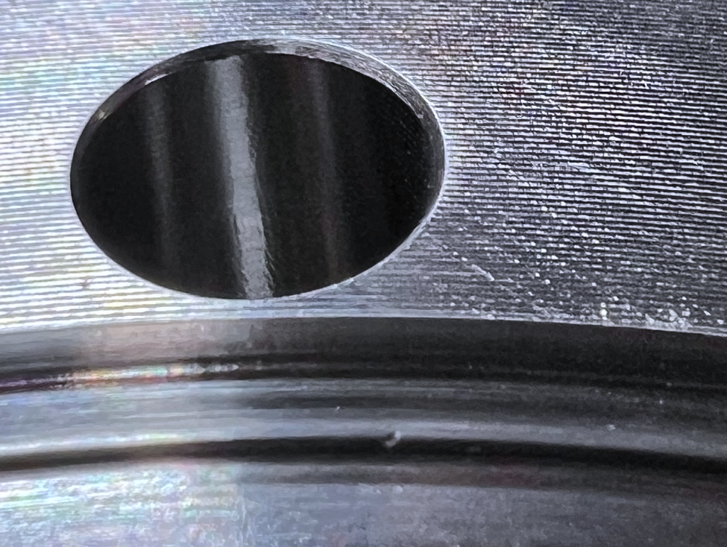
Pre-series NCRs: H-HOM knife edge case
Unacceptable defect on Knife Edge (depth > 0.2mm)
Attempts at adjustment provided unsatisfactory results
A custom-made cutting tool will be used for rework
  Entire flange plane will be reworked (keep the thickness acceptable)
  3+ weeks ETA for procurement of the cutting tool (for vertical lathe)
  1 week ETA for CNC machining

Slide 18
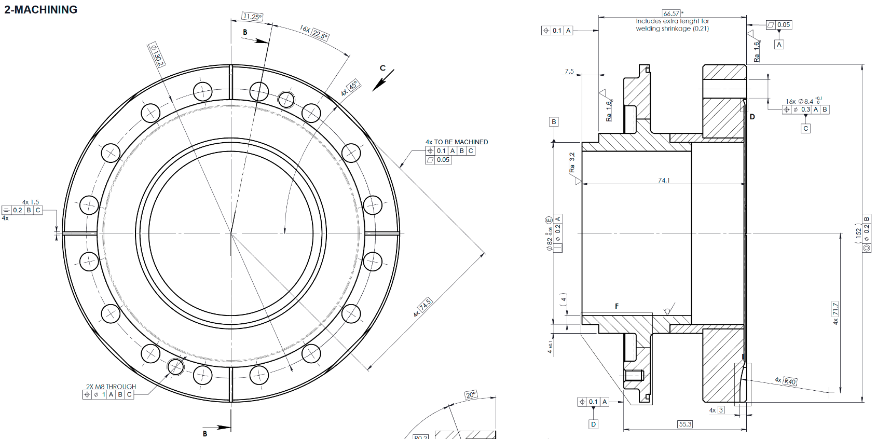
Pre-series NCRs: Beam Axis case
Machining issue on one of the Beam Axis brazed extremity.
Holes pattern and alignment planes shifted by 0.3mm.
AUP decided to reject the part. ZRI machined a new one.
+0.3 ∼
+0.3 ∼
+0.3 ∼
-0.3 ∼
-0.3 ∼
It slowed down production of pre-series cavities for several weeks

Slide 19
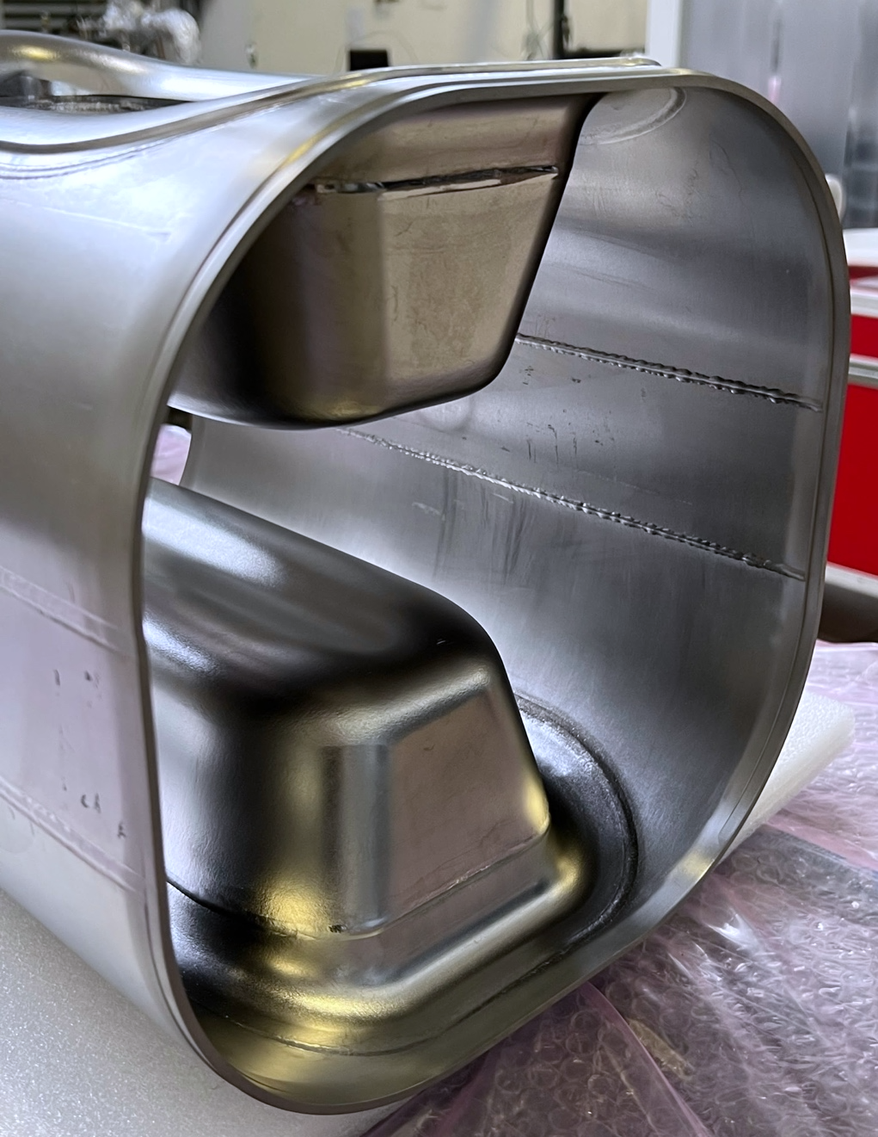
Pre-series NCRs: Main Body case
After Main Bodies EBW some scratches have been noticed during VT:
  The root cause was the EBW fixture removal
  Racetrack RF surfaces was the most affected
  Minor defects on Poles
Countermeasures
  Re-machining the fixture to avoid future problems
  Local grinding of the affected RF surfaces (according to the CERN’s approved ZRI procedure)

Slide 20
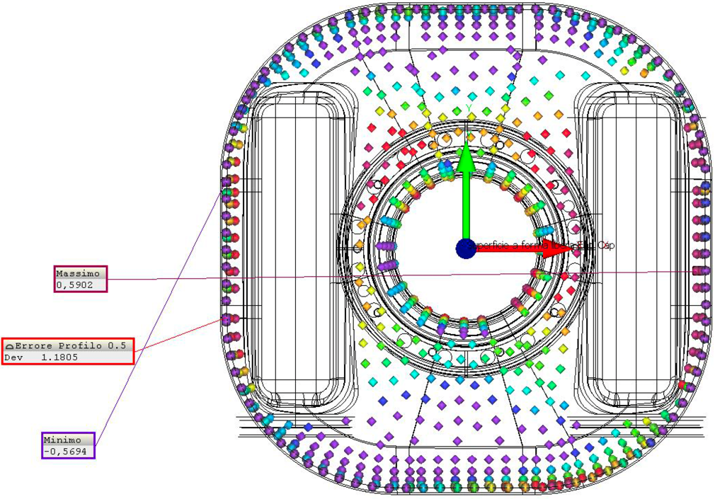
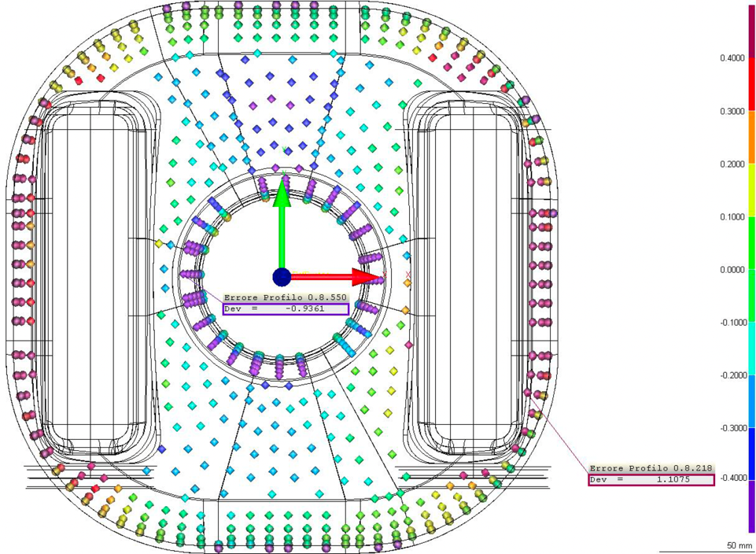
Pre-series vs Prototypes Metrology:
V-HOM End Group
Pre-series V-HOM End Group
{+/-0.25mm scale}
Prototype V-HOM End Group
{+/-0.4mm scale}
Several improvements in manufacturing have been implemented by ZRI:
  Forming tooling slightly reworked.
  EBW and CNC fixtures updated.
Significant improvement in shape accuracy from 2.22mm to +1.18mm.
Procedures deriving prototypes have been validated.

Slide 21
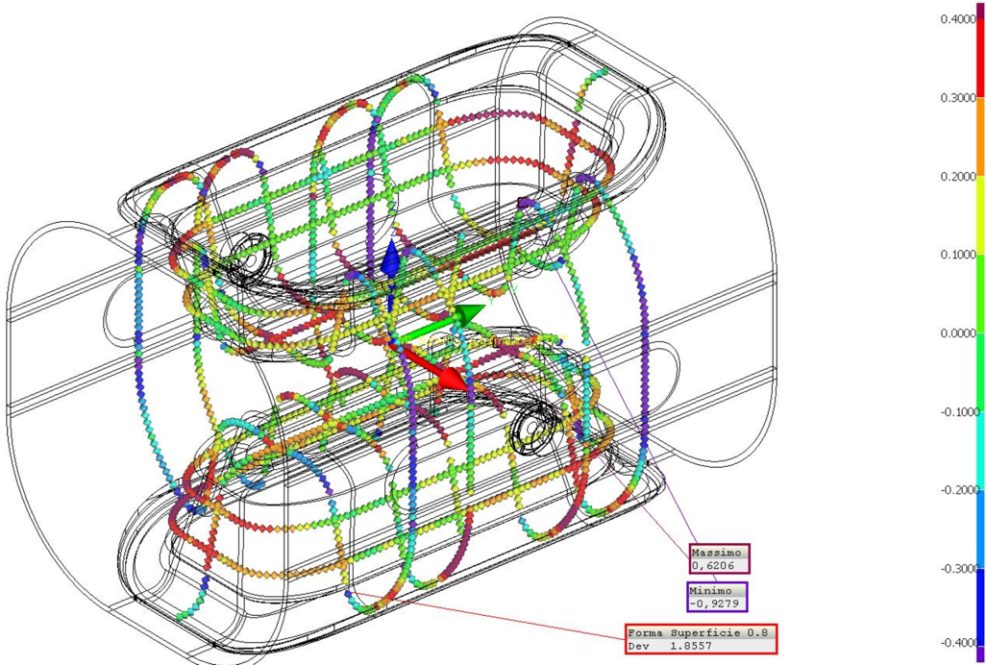
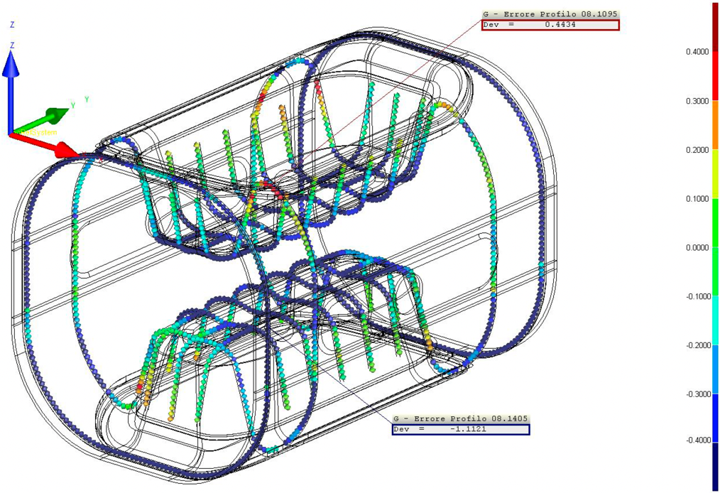
Pre-series vs Prototypes Metrology:
Main Body
Pre-series Main Body
Prototype Main Body
Effective reshaping of Main Body have been performed by ZRI:
  Poles and extremity of main body can be reshaped with sub-mm accuracy to enhance the cavity Frequency before final EBW
Noticeable improvement in shape accuracy from 2.22mm to +1.86mm.
Procedures deriving prototypes have been revised to improve results

Slide 22
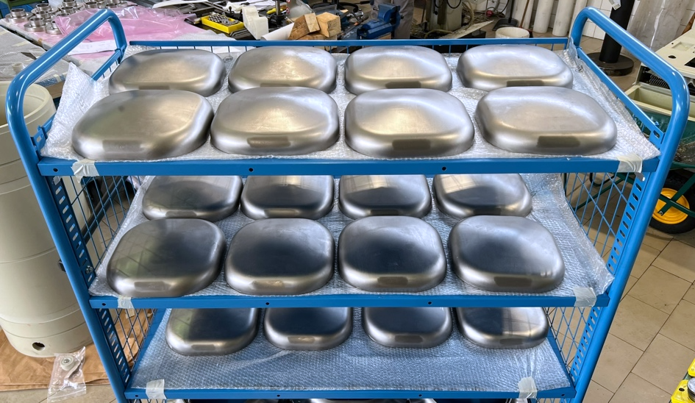
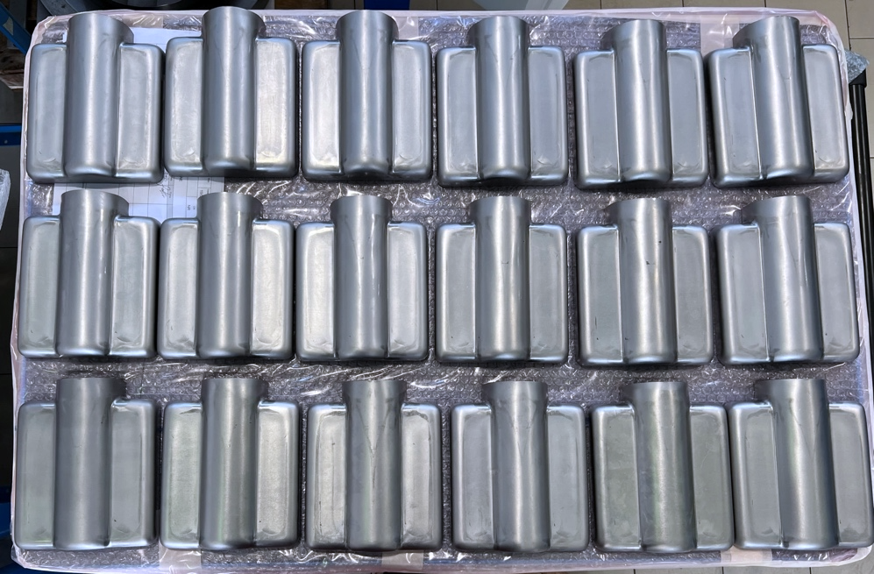
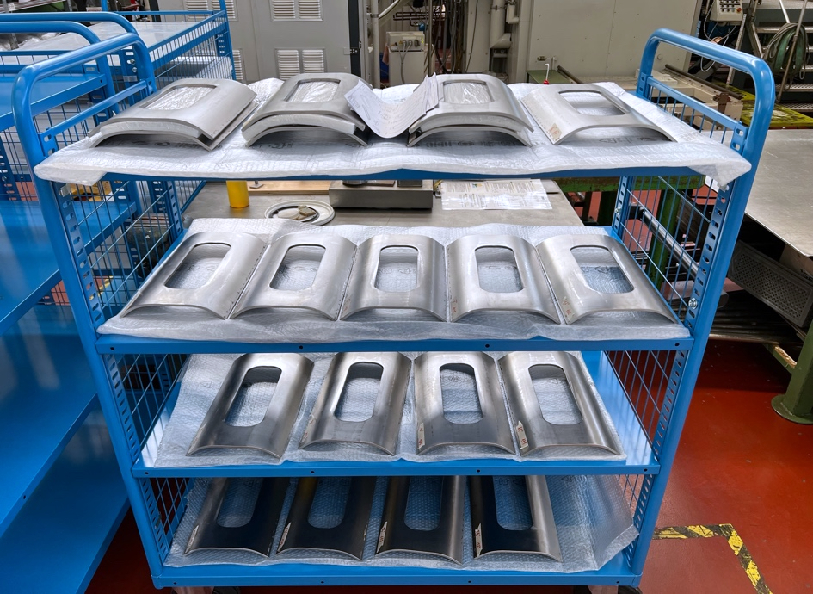
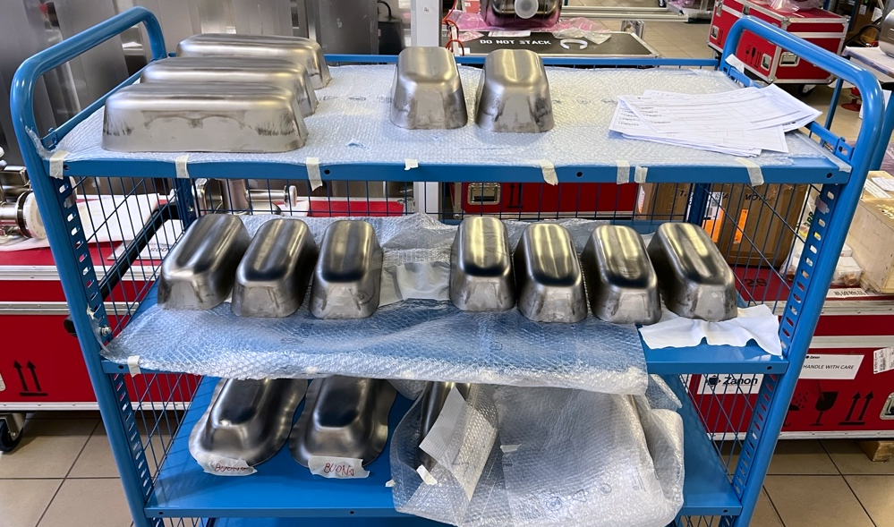
RFD Series manufacturing at ZRI

Slide 23
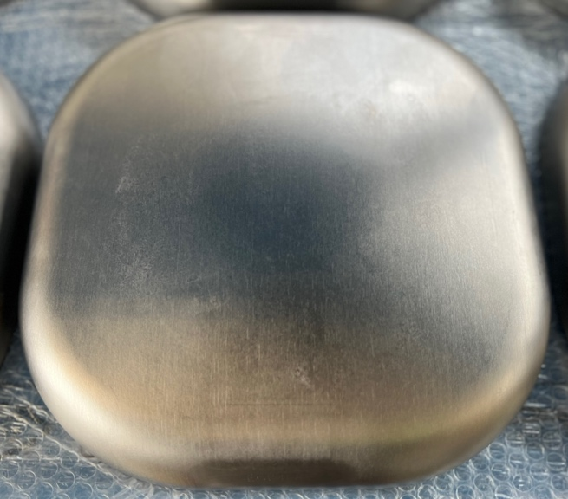
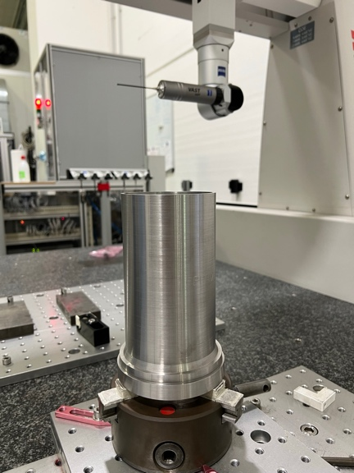
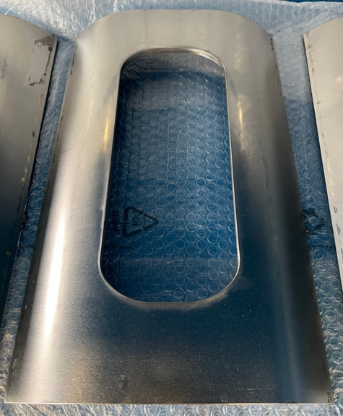
RFD Series manufacturing at ZRI
Order placed for 10 x Bare RFDs cavities fabrication.
Full processing for 2 Pre-series + 10 Series Bare Cavities at ZRI.
  ZRI will perform bulk rotational BCP, HPR, 600ºC + 120ºC bake as EDMS 2901976.
  AUP increases bulk BCP up to 150µm after prototypes experience
All the QA/QC & manufacturing procedures have been already validated.
FNAL provided all the raw materials.
Brazed Joints for Series & testing materials have been procured by ZRI
  Ningxia delayed tubes delivery for months. Brazing qualification will start soon.
  Brazing Test Plan for Nb/SS extremities is available on EDMS 2910273
ZRI QCP/ MIP global advancement: 11% completed

Slide 24
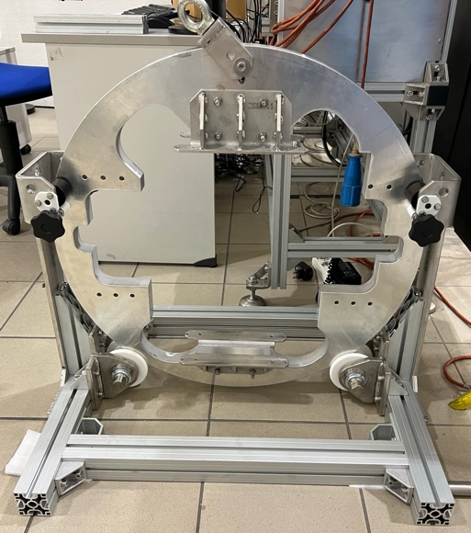
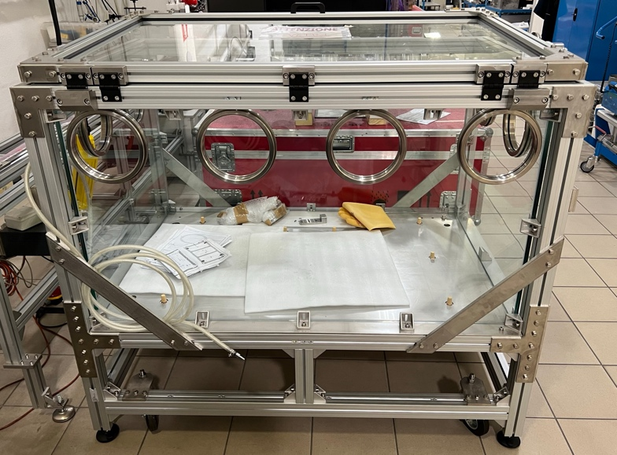
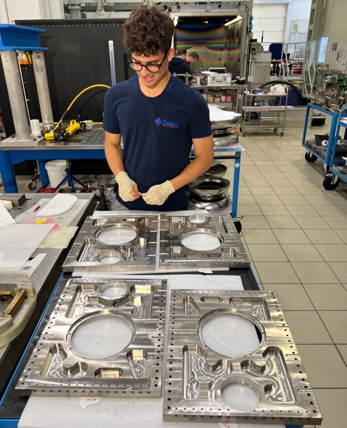
RFD He Tank Prototypes Fabrication at ZRI
ZRI is ready to install He Tank onto NRFDP002
  PO for 11x Series He Tanks will be placed in weeks
ZRI Dwgs, MIP, Welding Book, Test Plan PQR, LT available on EDMS
  Ti/SS brazed samples have been qualified EDMS 2917474
  CERN approval required only for Series fabrication.
All materials and accessories are available at ZRI.
NRFDP002 and Magnetic Shields available at ZRI for integration.
Glove box and internal rotating tool ready to be tested
Integration is started. ETA first weeks of Nov 2023.
Notes:
PO for 11 Series He Tank: low risk, so the Hold Points will lead the production

Slide 25
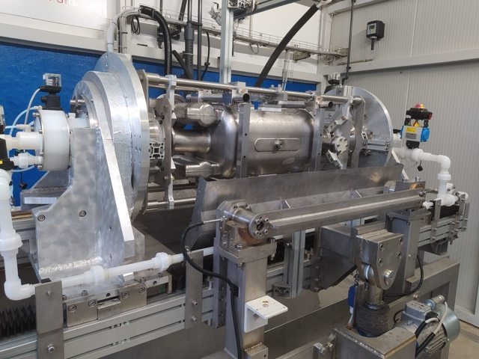
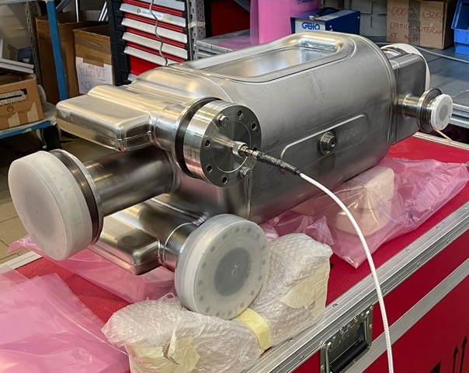
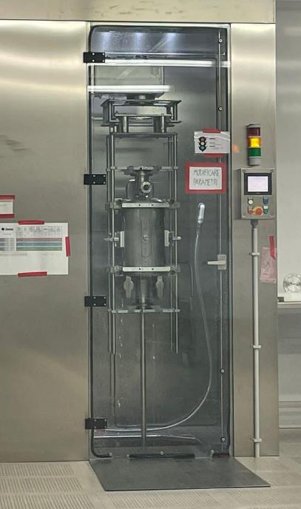


Prototypes Processing at ZRI
NRFDP001 was clean room assembled
Totally processed at ZRI (rotating BCP, HPR, 600C, 120C)
Processing validation still ongoing
Courtesy of ZRI (confidential)
Notes:
Aggiungi dettagli processing

Slide 26

Prototype NRFDP001:
Clean Room assembly issues at ZRI
First Cold Test at FNAL: Cold leak at 2K
VT showed some assembly issues
  Concentricity cavity flanges/caps
  up to 230µm of gap (V-HOM side)
Shipped back to ZRI for a new HPR + updated assembly (witness by FNAL)
Second VTS at FNAL:
  Leak problems: solved
  Very good Q₀ at low field but FE limited cavity performances
Next steps: retesting at JLab + some extra NDTs on internal surfaces
Notes:
Overall goal

Slide 27
Summary & Plans
Raw materials:
All materials are available at ZRI.
Experiencing some issues in Poles and WGs forming with Series mats.
Nb Tubes shipped with months of retards, two required additional NDTs.
RFD Bare Cavities:
2x Prototypes qualified w/wo ancillaries. Exceeded requirements. Processing at ZRI still not completely validated for cold leak issues.
2x Pre-series RFD are being finalized (ETA end 2023). Appreciable improvements compared to the prototypes. QA very close to full approval.
10 x Series RFD manufacturing at ZRI ongoing (11%). Brazing qualification will start in the next weeks.
RFD Jacketed Cavities
2x He Tank Prototypes integration in the next months.
PO for 11x Series He Tanks will be placed in the next weeks.
QA need CERN approval for series production.
Notes:
reduce

Slide 28
Thanks for the attention!
Notes:
Add Slide transition to production.

Slide 29


AUP RFD Prototypes Testing
  2 x RFD Prototypes manufactured at ZRI to HL-LHC specifications
  Both cavities (NRFDP001/2) exceeded functional requirements
  ZRI QA docs, QCRs and Procedures exercised on EDMS/ MTF
  AUP qualified the cavities via VTS w/wo HOMs (A. Castilla presentation)
VTS @2K of NRFDP002 with ancillaries
Courtesy of A. Castilla (JLab)
RF check of NRFDP002 without ancillaries
(FNAL)

Slide 30
































































ZRI Fabrication Strategy
FPC Waveguide
End Cap
H-HOM Waveguide
Beam Axis
Pole
Corner
Half Main Body
Racetrack
& Tuning Pin
Pick Up
Beam Axis
V-HOM Waveguide

Slide 31



Raw Materials Procurement
Dressed RFD mat. specs agreed between CERN - AUP
  RRR300 Niobium
    Sheets – CERN spec. 3300 ed.4 (EDMS 1095252)
    Bars & Plates – CERN spec. 3301 ed.4 (EDMS 1476934)
    Seamless Tubes (EDMS 2367297)
    Ultrasonic Inspection Procedure (EDMS 1971779)
  Nb-55Ti
    Bars & Plates - CERN spec. 4055 ed.4 (EDMS 1485727)
    Ultrasonic Inspection Procedure (EDMS 2116737)
  Stainless Steel 1.4429 (316LN)
    Forged Blanks - CERN spec. 1001 ed.5 (EDMS 790775)
  Other materials for Dressed Cavity
    (Ti, Cu, SS, Cryophy, Alumina & Gapasil)
Sizes & quantities optimized by ZRI* after protos experience
Purchased according to the HL-LHC requirements
(Pre-series & Series production)
  PO 657756 (Ningxia) Nb Sheets
  PO 671157 (Ningxia) Nb Rods & Plates, NbTi Rods & Discs
  PO 671490 (Ningxia) Nb Tubes
  ZRI* PO (Ningxia) additional Nb for welding tests
  PO 686821 (ANL) extra brazed joints for pre-series
* ”Ettore Zanon spa” has changed its name in ZRI: “Zanon Research & Innovation srl”
Notes:
All specs released. Size & Quantities optimized for production. PO placed.

