Slide 1

DQW industrial production & cavity assembly challenges
N. Valverde, P. Kohler on behalf of HL-LHC WP4, EN-MME & SY-RF-SRF
13th HL-LHC Collaboration Meeting, Vancouver, 27.09.2023

Slide 2
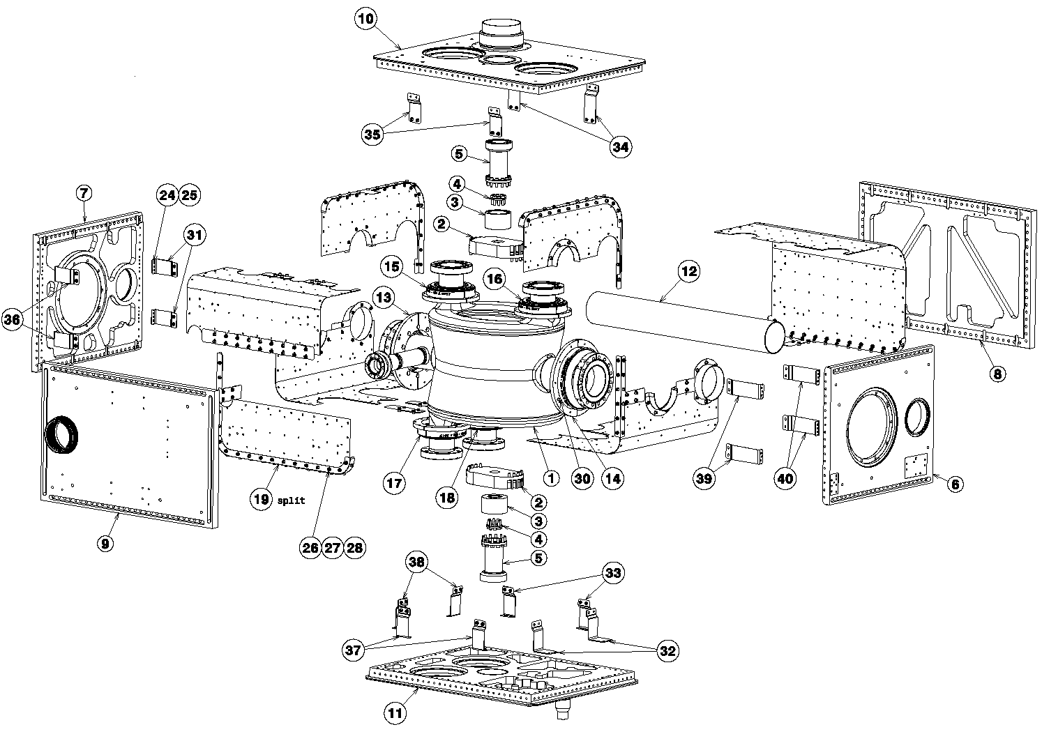
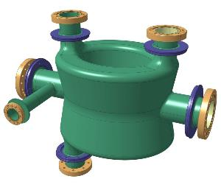
DQW Jacketed Cavities Contract
Contract signed on March 2018 with the company Research Instruments (RI) to provide:
    1 preseries Jacketed cavity
  After qualification of preseries Jacketed cavity by CERN (cold RF test):
    10 series Jacketed cavities
DQW Bare cavity
DQW Jacketed cavity

Slide 3
RI Contract Timeline
1 preseries + option of 10 series JC
From last annual meeting
2 preseries + option of 9 series JC
Reception Preseries RI-BC-1
Reception Preseries RI-BC-2
Green light RI series bare cavity production and preseries jacketing
Contract Mar. 18
ADD1
ADD2
ADD3
ADD4
ADD5
ADD6
Completion CERN-BC-2
Completion CERN-BC-1
Sept.18
Oct.18
Jun.19
Feb.20
Feb.21
May.21
Sept.21
Jul.21
Mar.22
Jul.21
Jul.21
2 preseries + option of 6 series JC
Fabrication at CERN of 2 JC
Main milestones since the last annual meeting:
Completion CERN-JC-2
Completion CERN-JC-1
Reception
Preseries
RI-JC-2
Reception
Preseries
RI-JC-1
ADD8
Oct.22
March.23
July.23
August.23
August.23
ADD: Addendum to the contract

Slide 4
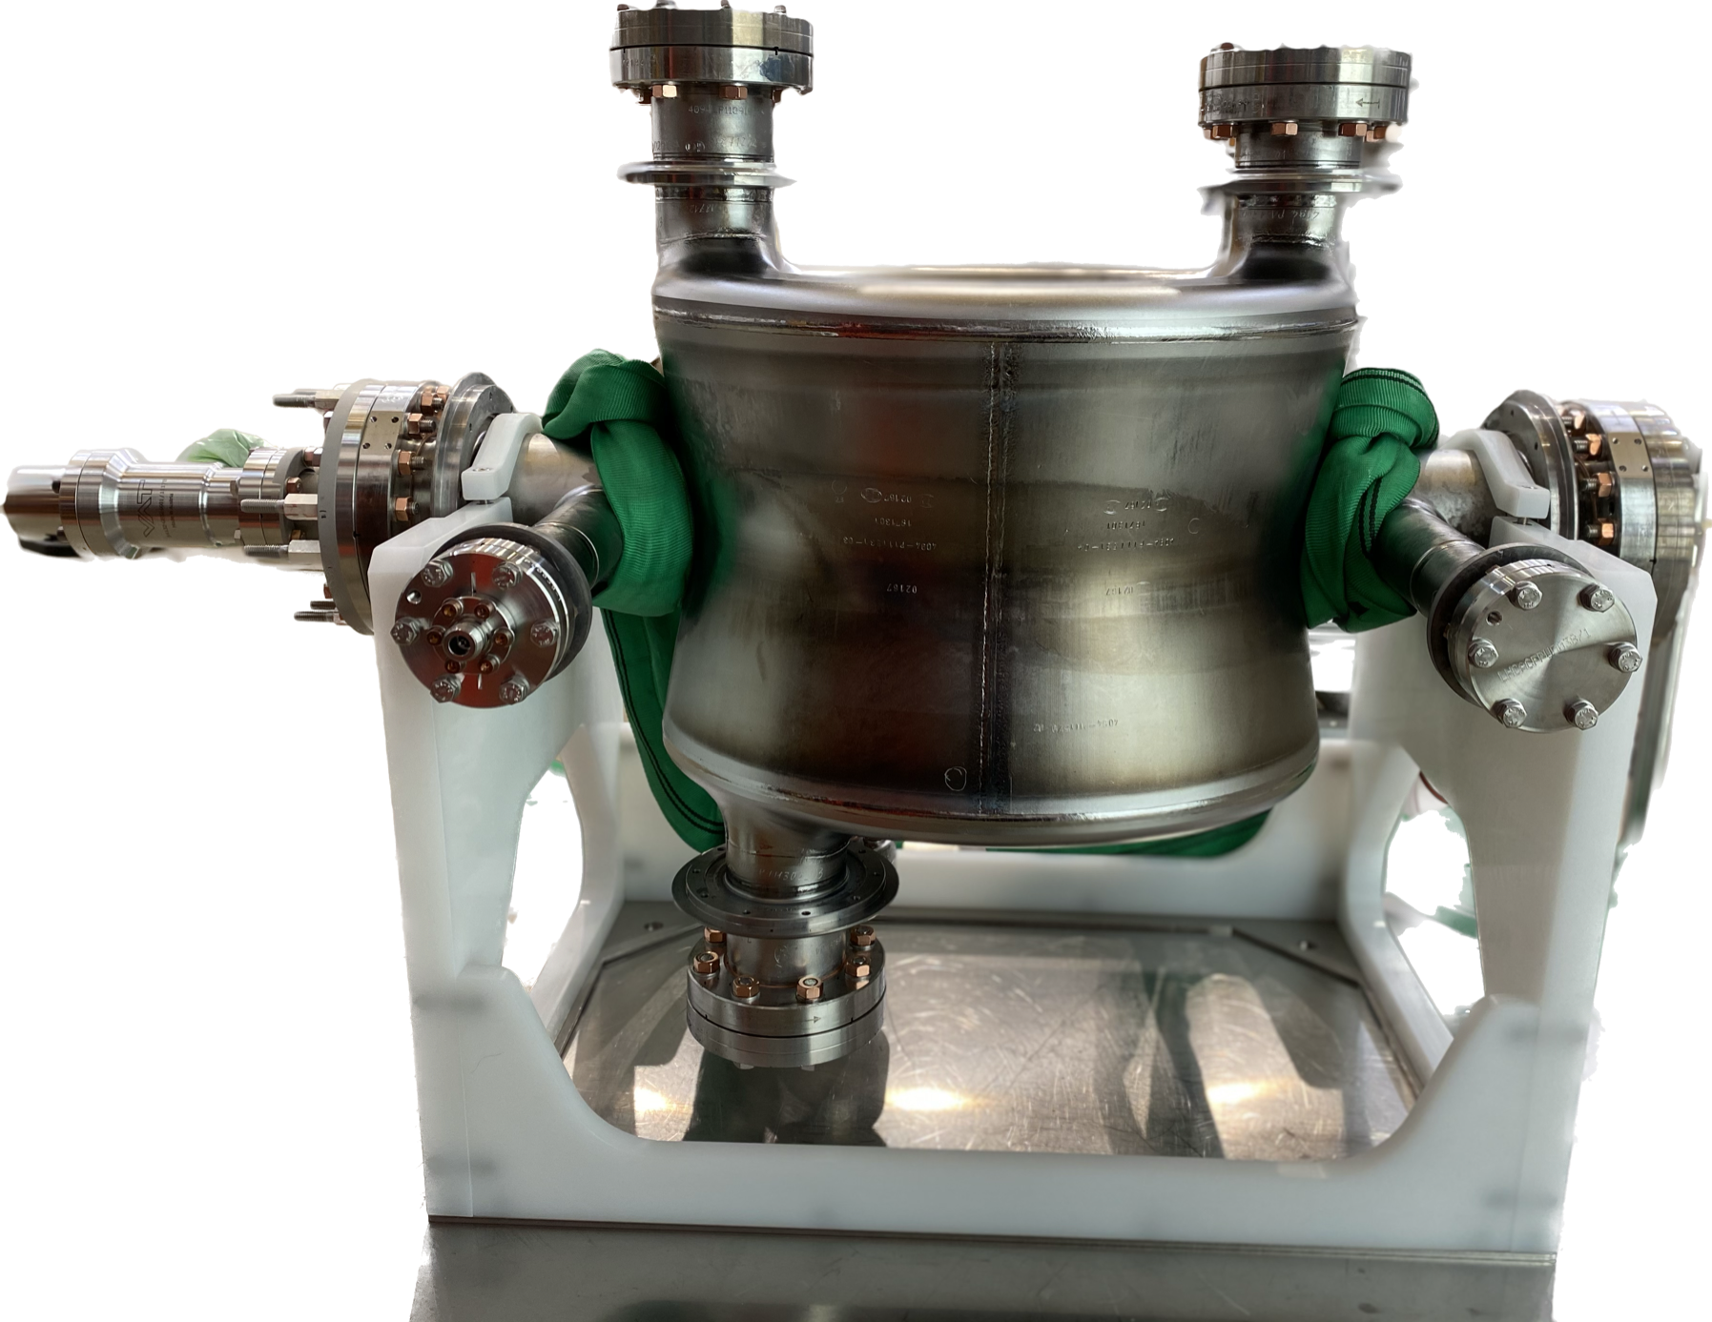
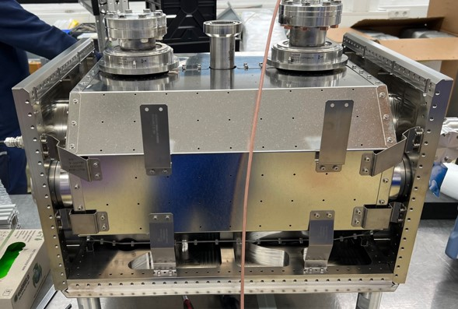
Preseries Jacketed cavities RI
05.2021
Reception at CERN Preseries Bare cavity RI-DQW-BC1
07.2021
Reception at CERN Preseries Bare cavity RI-DQW-BC2
Acceptance Preseries bare cavities
10 months
See talk K.Turaj
03.2022
  RI-BC-1
  1st cold test didn't reach specification
  HPR+ clean room assembly at CERN
  2nd cold test didn't reach specification
  Light BCP, HPR and clean room assembly at CERN
  3rd cold test with successful results : 5.8 MV
  RI-BC-2: 1st cold test reached 5MV
03.2022
Cavities back to RI for jacketing
08.2022
Approval drawings and MIP helium tank
08-12/2022
Manufacturing helium tank parts
08/2022-01/2023
Procurement special parts (TI Bellows, Ti fasteners)
Welding qualifications
9 months
  08-12/2022 Procurement Ti material
  12/2022-02/2023 Finalisation welding samples
  02-05/2023 Sample testing by notified body
08/2022-05/2023
04.2023
Assembly helium tank and CMS
06.2023
Welding helium tank
06.2023
Leak test, pressure test, metrology, RF measurements
07.2023
Reception Preseries Jacketed cavity RI-JC-2
08.2023
Reception Preseries Jacketed cavity RI-JC-1
Notes:
3rd test: 15.02.2022-18.02.2022
2nd test: 29.11.2021- 03.12.2021
1st test: 01.08.2021

Slide 5
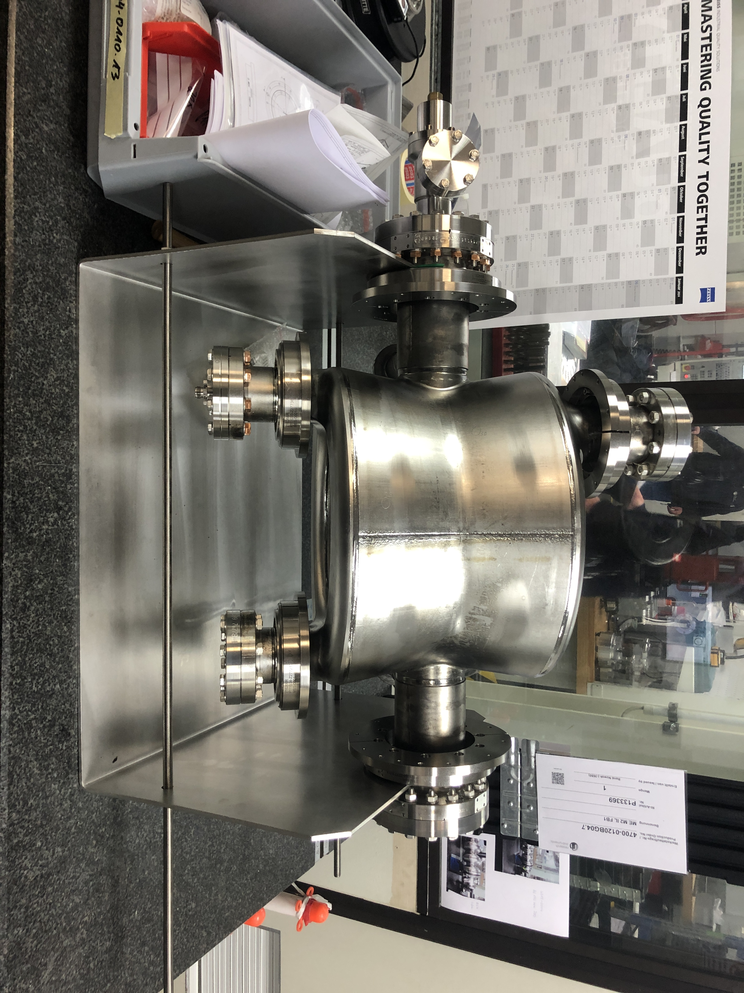
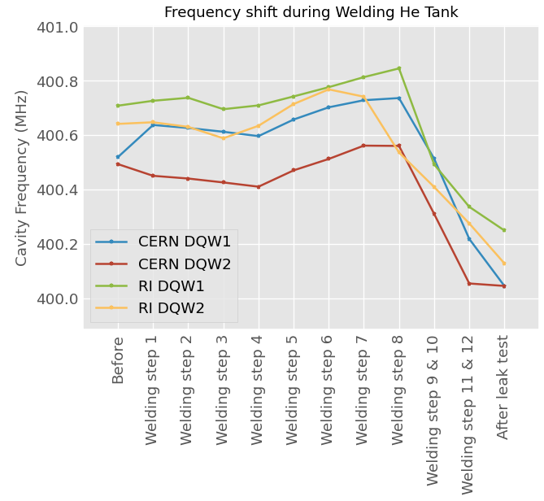
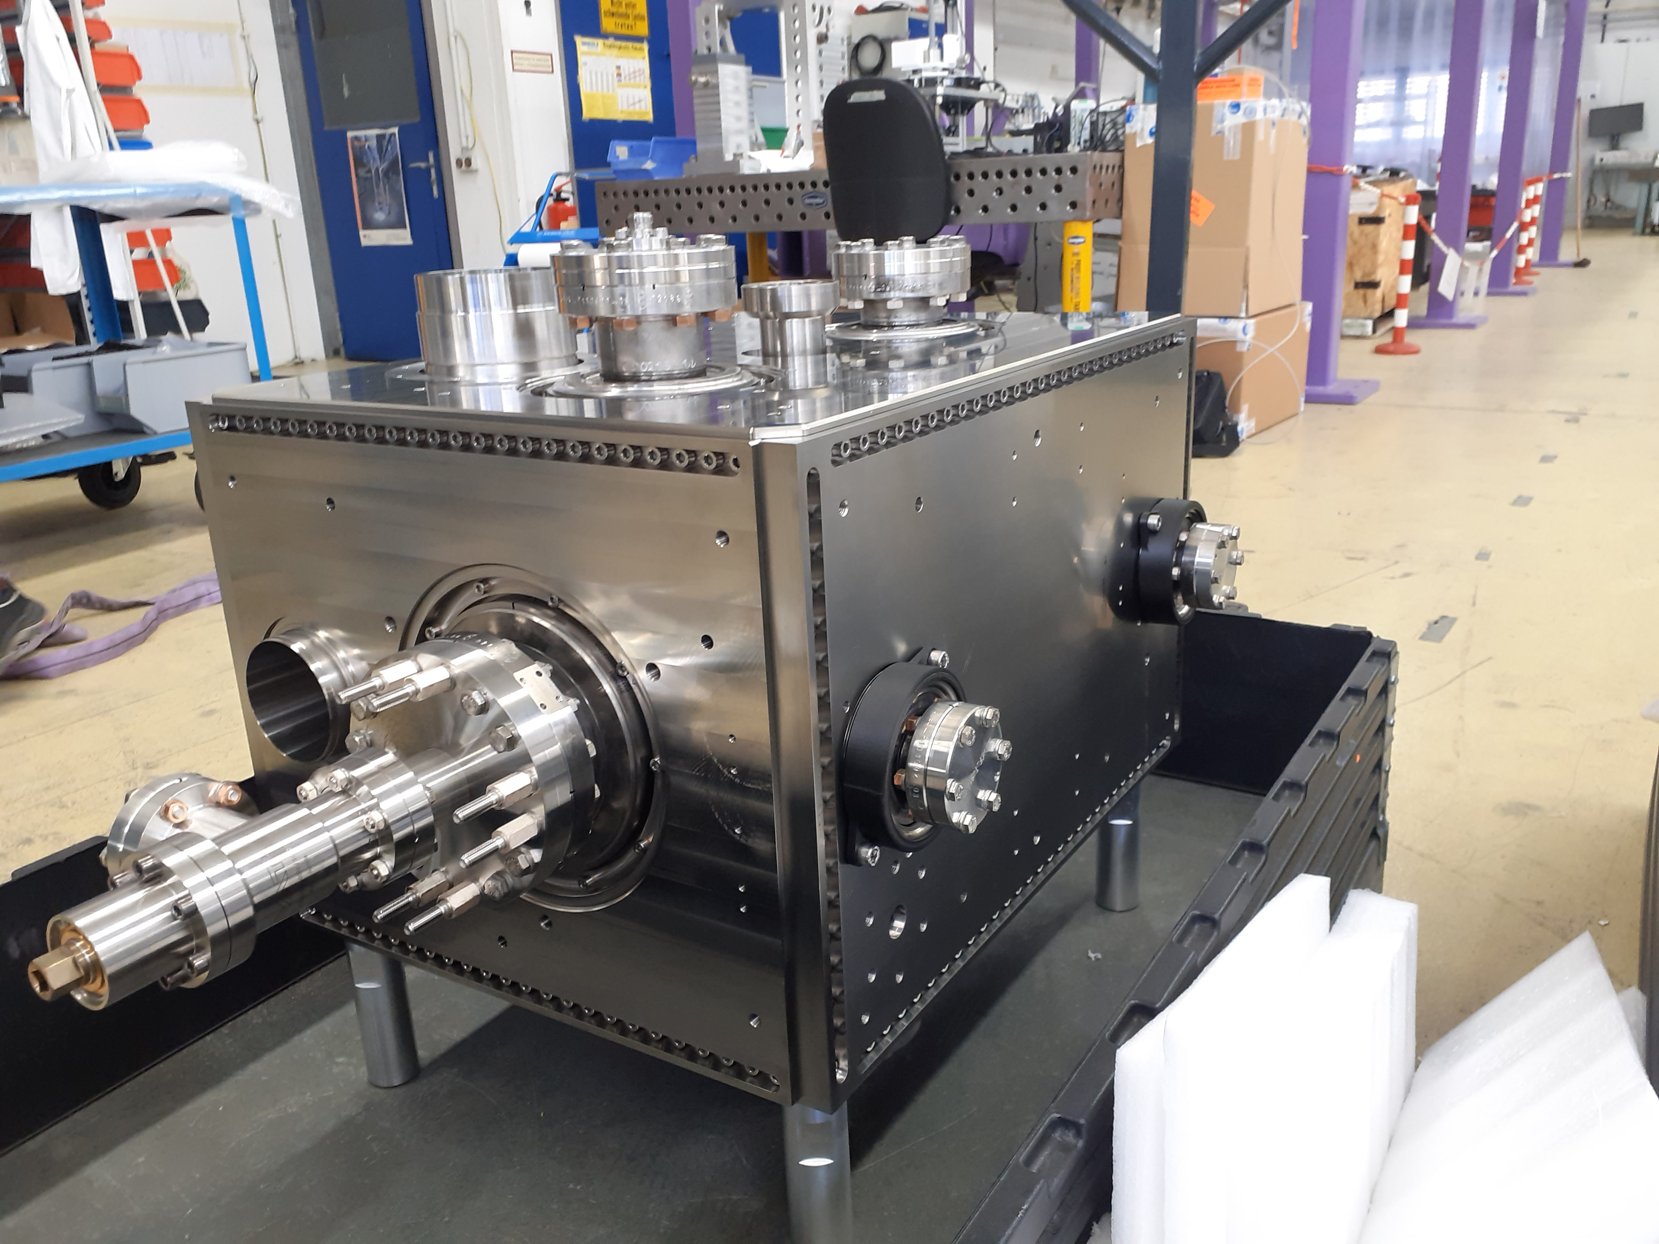
Preseries JC RI – Freq. during He tank welding
Fundamental frequency tracking during He tank welding and comparison with CERN cavities
Jacketing of 4 DQW cavities completed (x2 at CERN, x2 at RI)
Consistent results
Frequency drops during the final welds as expected from SPS- DQW experience
 | RI-DQW-JC1 | RI-DQW-JC2 | CERN-DQW-JC1 | CERN-DQW-JC2
Freq. Shift (MHz) | -0.459 | -0.454 | -0.464 | -0.459

Slide 6
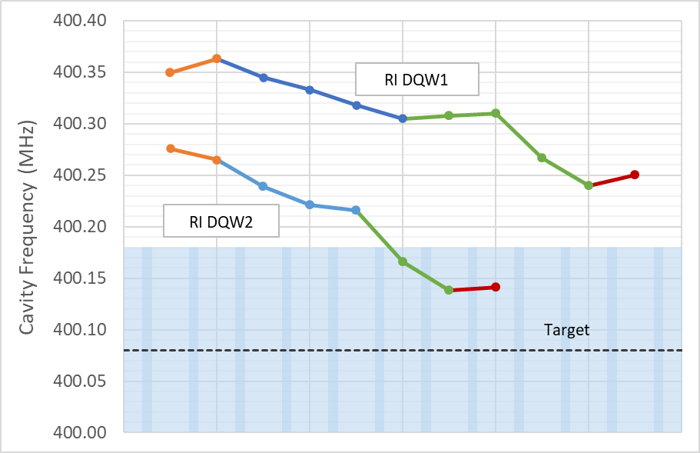
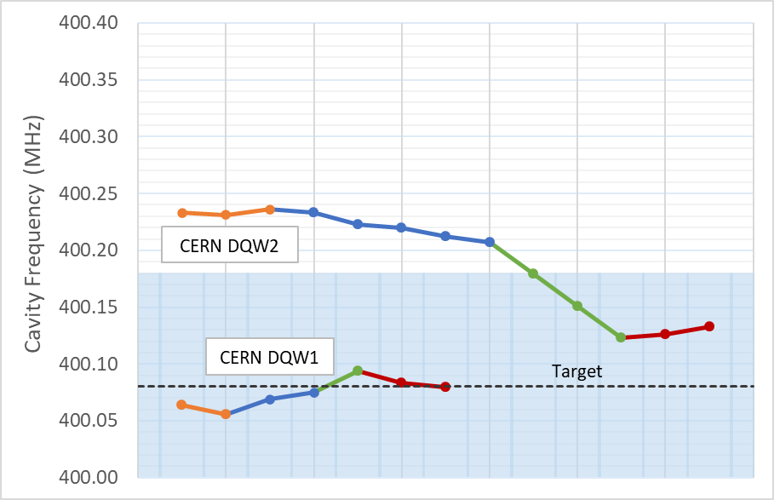
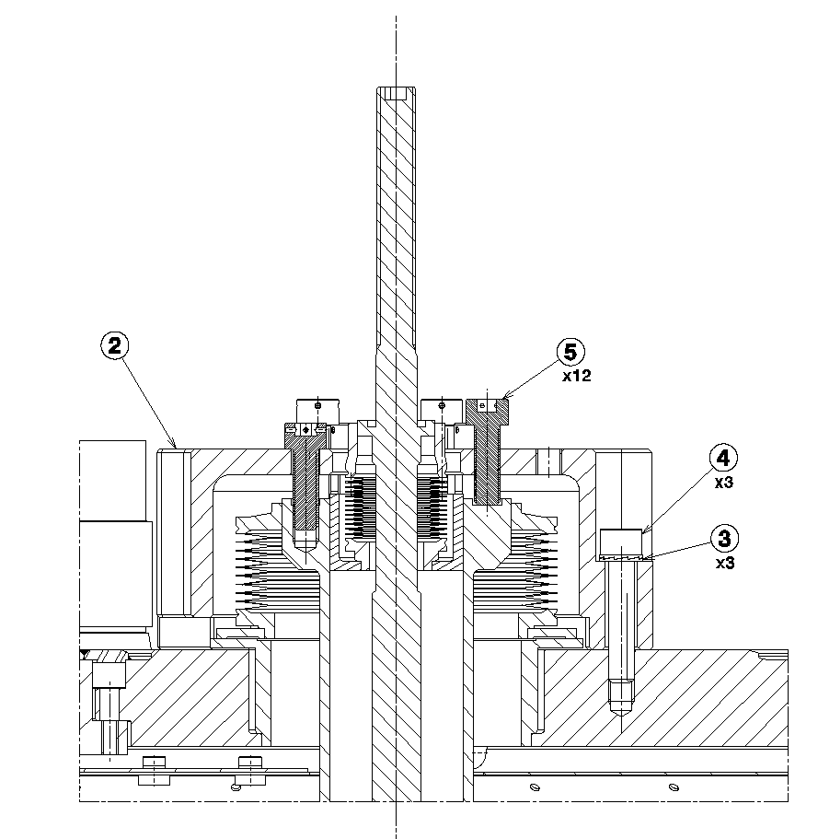
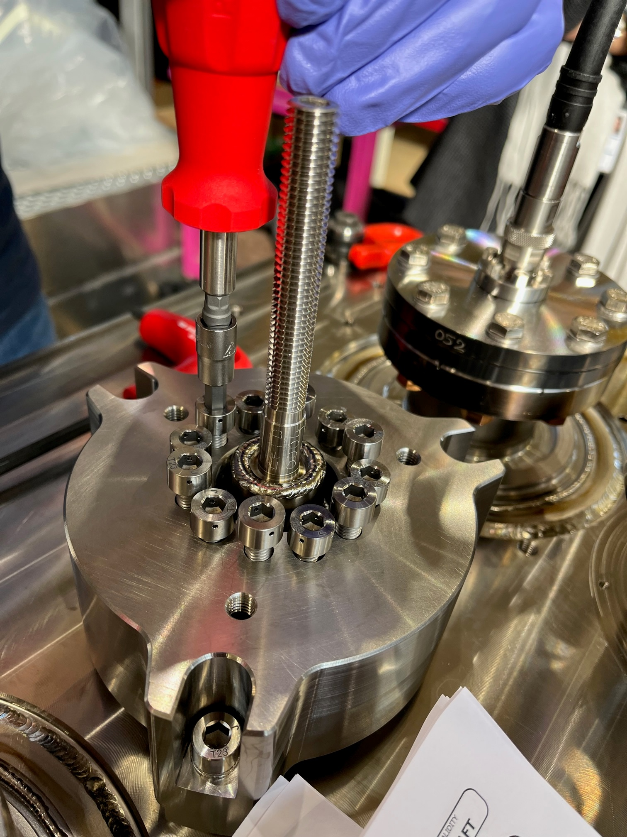
Preseries JC RI – Pre-tuning
The freq. can be modified after welding He tank (pre-tuning).
The cavity can be deformed by applying forces to the pull and push screws and change the RF freq.
 | RI-JC-DQW1 | RI-JC-DQW2 | RI-JC-DQW2 | CERN-JC-DQW1 |  | CERN-JC-DQW2
Target Frequency (MHz) | 400.08 ± 0.1
Frequency Before (MHz) | 400.360 |  | 400.276 | 400.064 | 400.064 | 400.233
Frequency After Tuning (MHz) | 400.250 |  | 400.141 | 400.079 | 400.079 | 400.133
Tuning Torque Top (Nm) | 2.5 Pushing |  | 2.0 Pushing | 3.0 Pulling | 3.0 Pulling | 2.0 Pushing
Tuning Torque Bottom (Nm) | 1.5 Pushing |  | 1.5 Pushing | 3.0 Pulling | 3.0 Pulling | 2.0 Pushing
X6 PULL
Increase Freq.
X6 PUSH
Decrease Freq.
Notes:
Max pretuner range is 326 kHz for the pushing configuration and 272 when pulling. Pre-tuner sensitivity 1046 KHz/mm

Slide 7
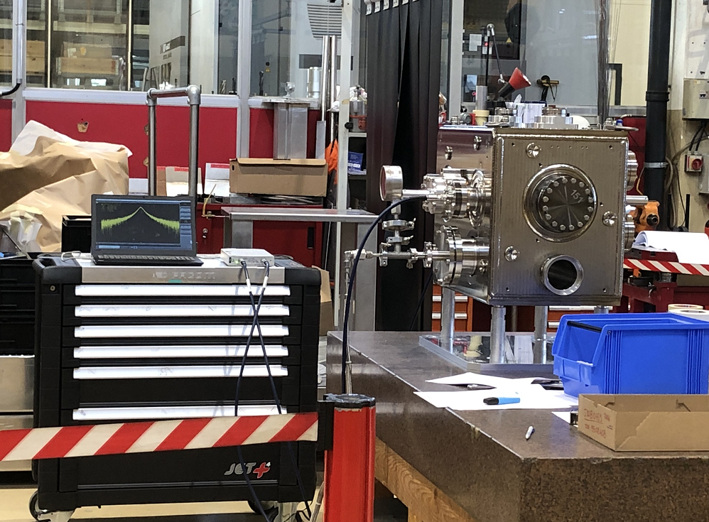
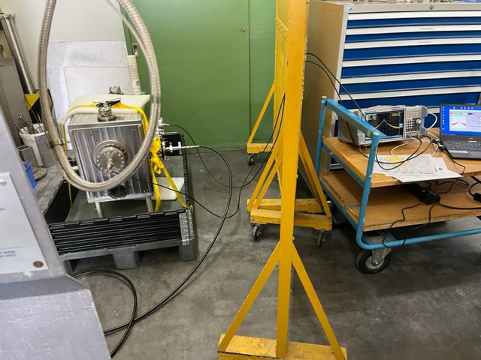
Preseries JC RI – Pressure test
Differential pressure of 2.7 bar across vessel walls and across cavity walls.
The required test pressure is maintained for minimum 30 min.
Fundamental Frequency tracked throughout.
 | RI-JC-DQW1 | RI-JC-DQW2 | CERN-JC-DQW1 | CERN-JC-DQW2
Target Frequency (MHz) | 400.08 ± 0.1
Frequency Before (MHz) | 400.138 | 400.248 | 400.064 | 400.125
Frequency After Pressure Test (MHz) | 400.123 | 400.277 | 400.045 | 400.092
Pressure Sensitivity (Hz/mBar) | -110.85 | -104.62 | -82.033 | -103.85
Maximum Frequency Shift @2.7bar (kHz) | -267 | -281 | -210 | -240
Residual Frequency Shift (kHz) | -15 | -21 | -19 | -33
  CERN
  RI

Slide 8
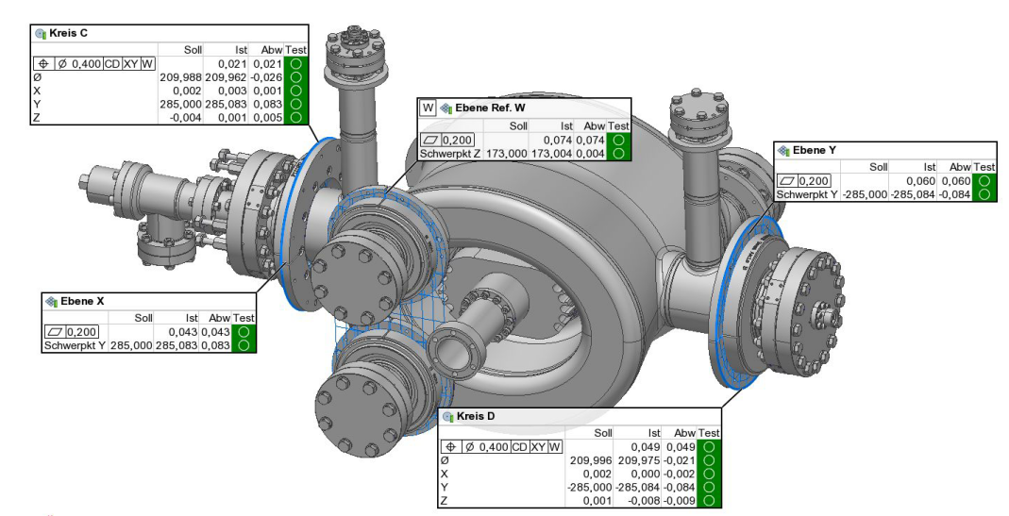
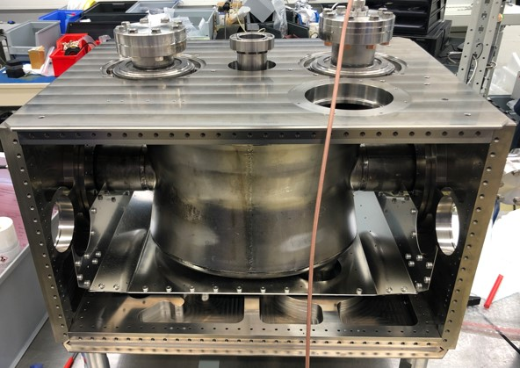
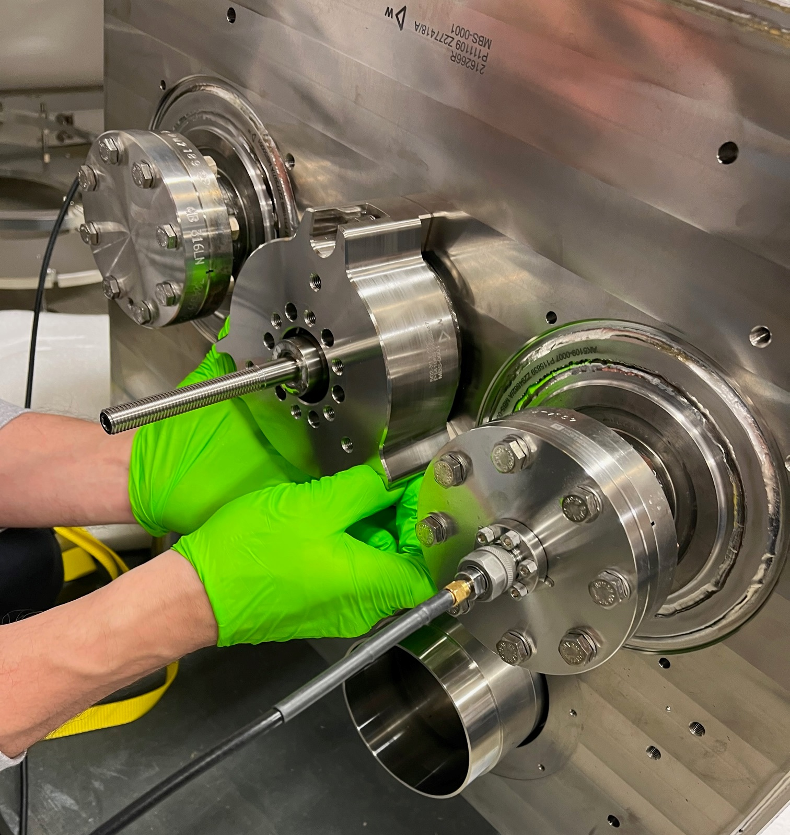
Preseries JC RI
BC with transition rings
Metrology : BC with transition rings
Assembly test with RF measurements
Assembly He tank and CMS
Assembly He tank
Installation pretuner
Pressure test with RF follow up
Assembly pretuning system

Slide 9
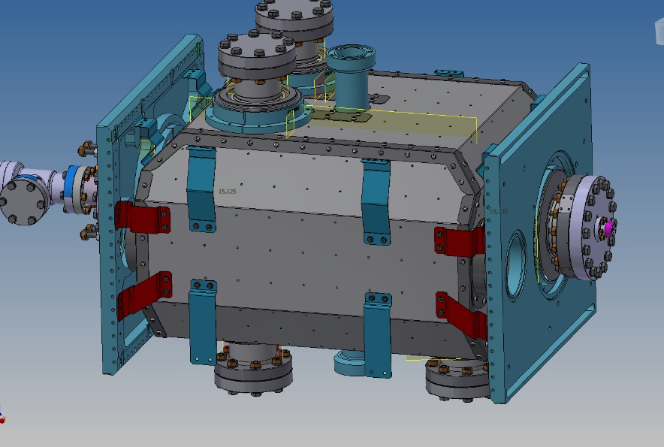
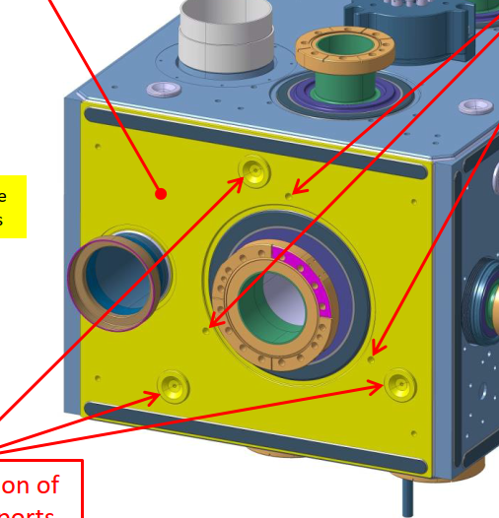
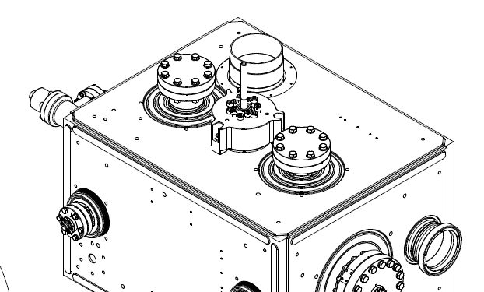
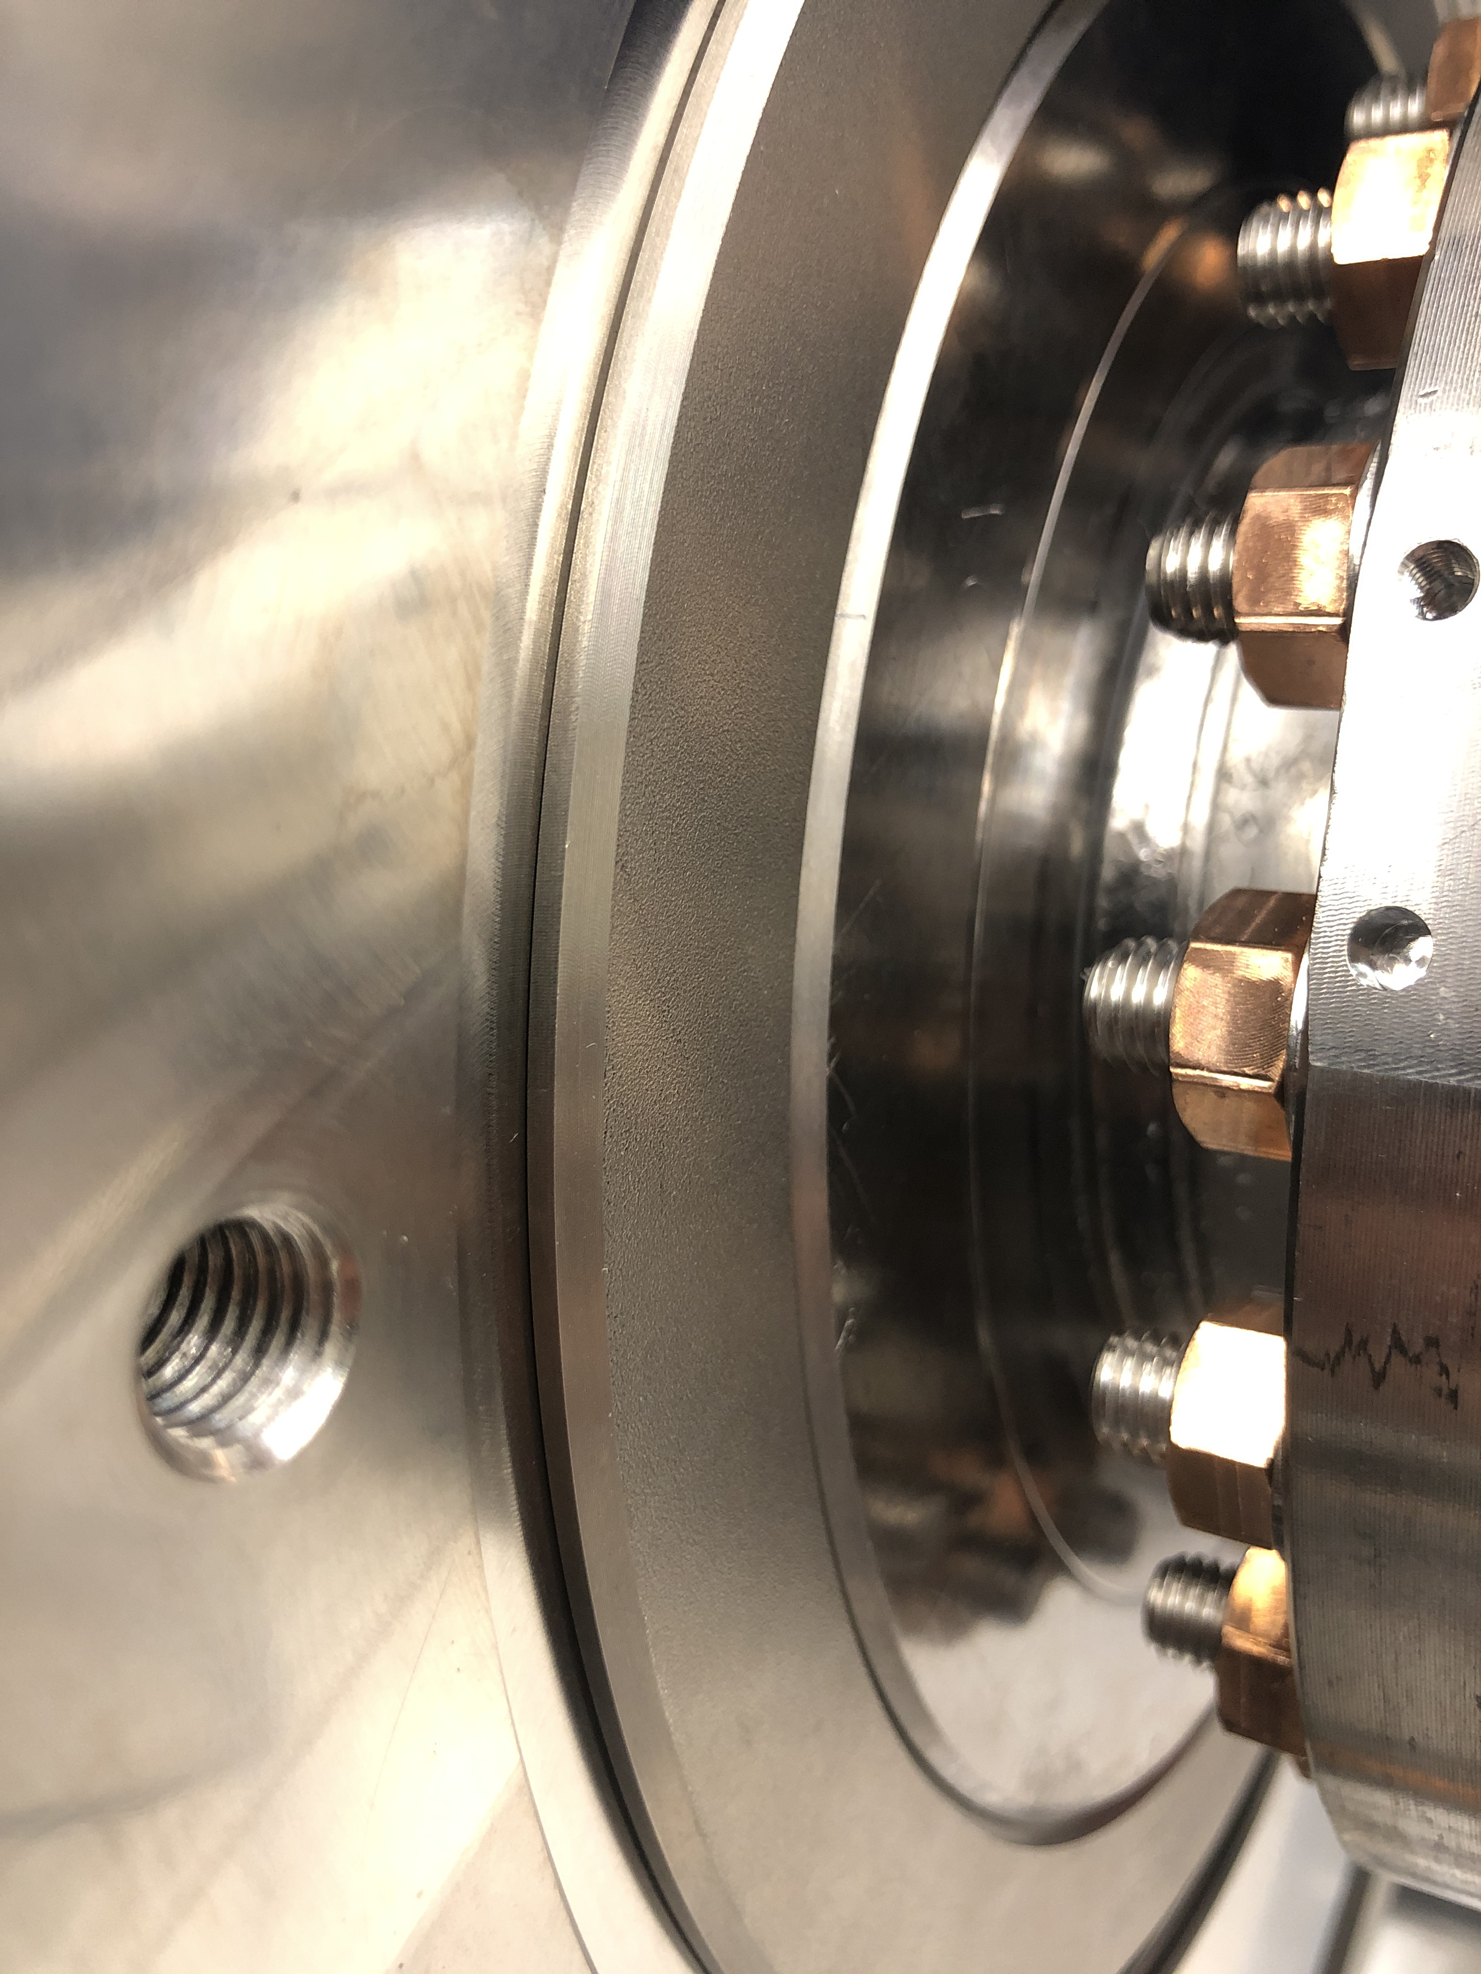
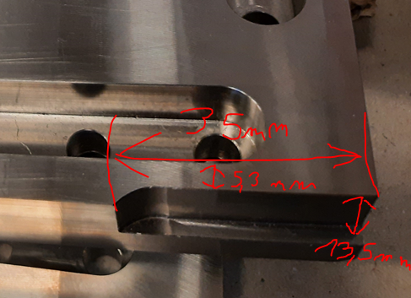
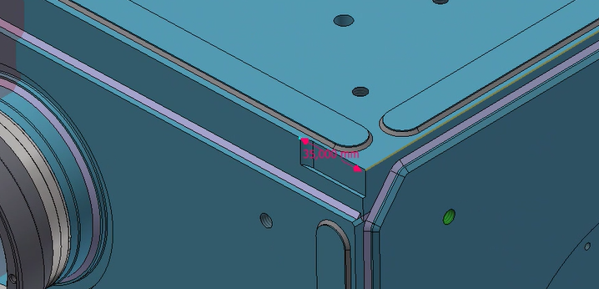
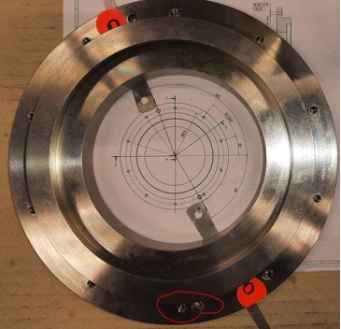
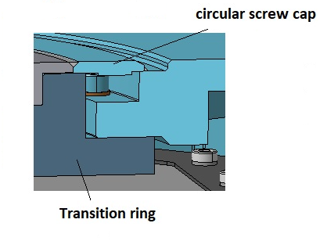
Preseries JC RI- NCRs
Several NCRs (non-critical), which require deep analysis from several colleagues to understand the implications leading to delays in the planning
#1 Inverted transversal plates (RI-DQW-JC2): Transversal Helium tank plates were swapped.
Affecting the position of fiducial supports and holes used for tooling. Concession
#2 Deviations on the ports, tuner-rod position and beam aperture. Concession
  #3 Tuning coarse adjuster : Mounting trouble on both cavities
  Repair (enlarging hole diameter)
  #4 Beam tube cover plates (RI-DQW-JC2) : Circular screw caps on beam pipes were not in contact with Helium vessel plate making the welding impossible. Repair
  Lesson learnt: customized circular screw caps will be done for each cavity for all ports to avoid gaps or misalignment.
#5 Milling error on Longitudinal plate helium vessel (RI-DQW-JC2). Concession
#6 Pick-up plate cavity RI-DQW-JC1: Helium tank plate Pick-up side machined acc. to the theoretical position of the PU ports instead of the real position. Concession, the bellow will accommodate the deviation.
  #7 Wrong borehole position on beam axis transitions (RI-DQW-JC2) : Milling error- Repair

Slide 10

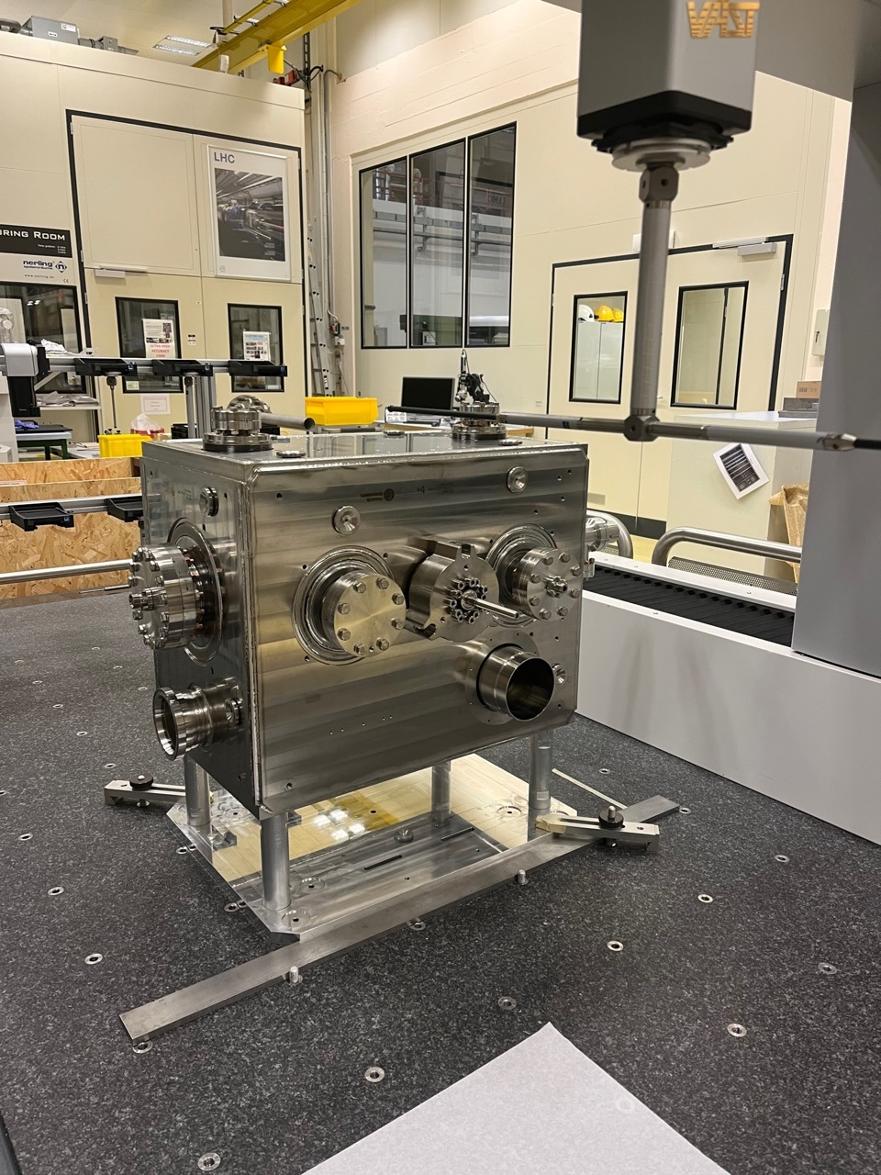
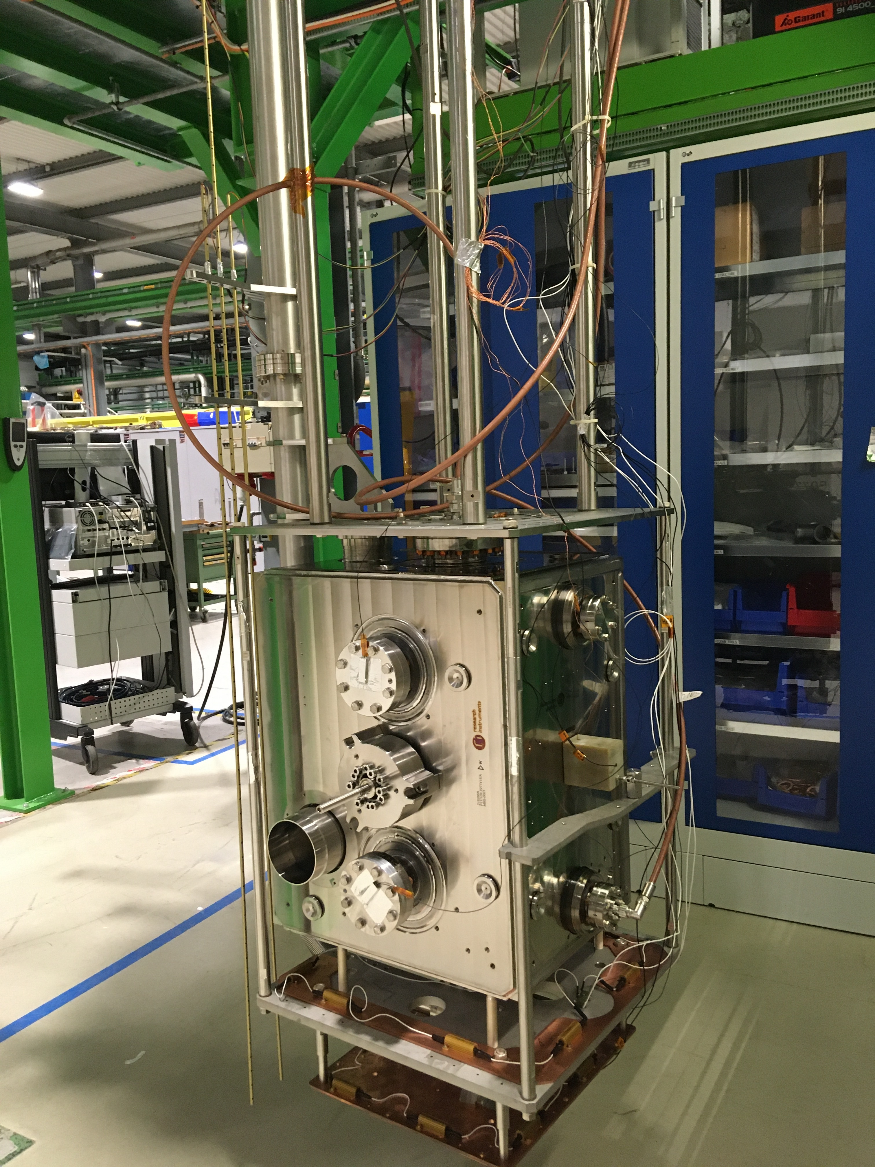
Reception Preseries JC RI
Visual inspection
 | RI-DQW-JC1 | RI-DQW-JC2 | Target JC
Freq. (warm, atm. press) | 400.23 | 400.180 | 400.08 ± 0.1 MHz
Freq. (2K, vacuum) | Cold RF test in Oct. | 400.93 * | 400.79 MHz
Freq. meas. warm
Metrology
* Pre-tuning of JC to reach 400.79 MHz to be done before installation of HOMs
Clean room assembly at CERN
Cold RF test
  Metrology at CERN of RI-DQW-JC2
  Cold RF test at CERN
  RI-DQW-JC2
See talk K.Turaj
Metrology done. Data being analyzed
RI-DQW-JC2
Cold RF test: Successful results 5.9 MV
Metrology done. Data being analyzed.
RI-DQW-JC1
Cold RF test expected Oct.23

Slide 11
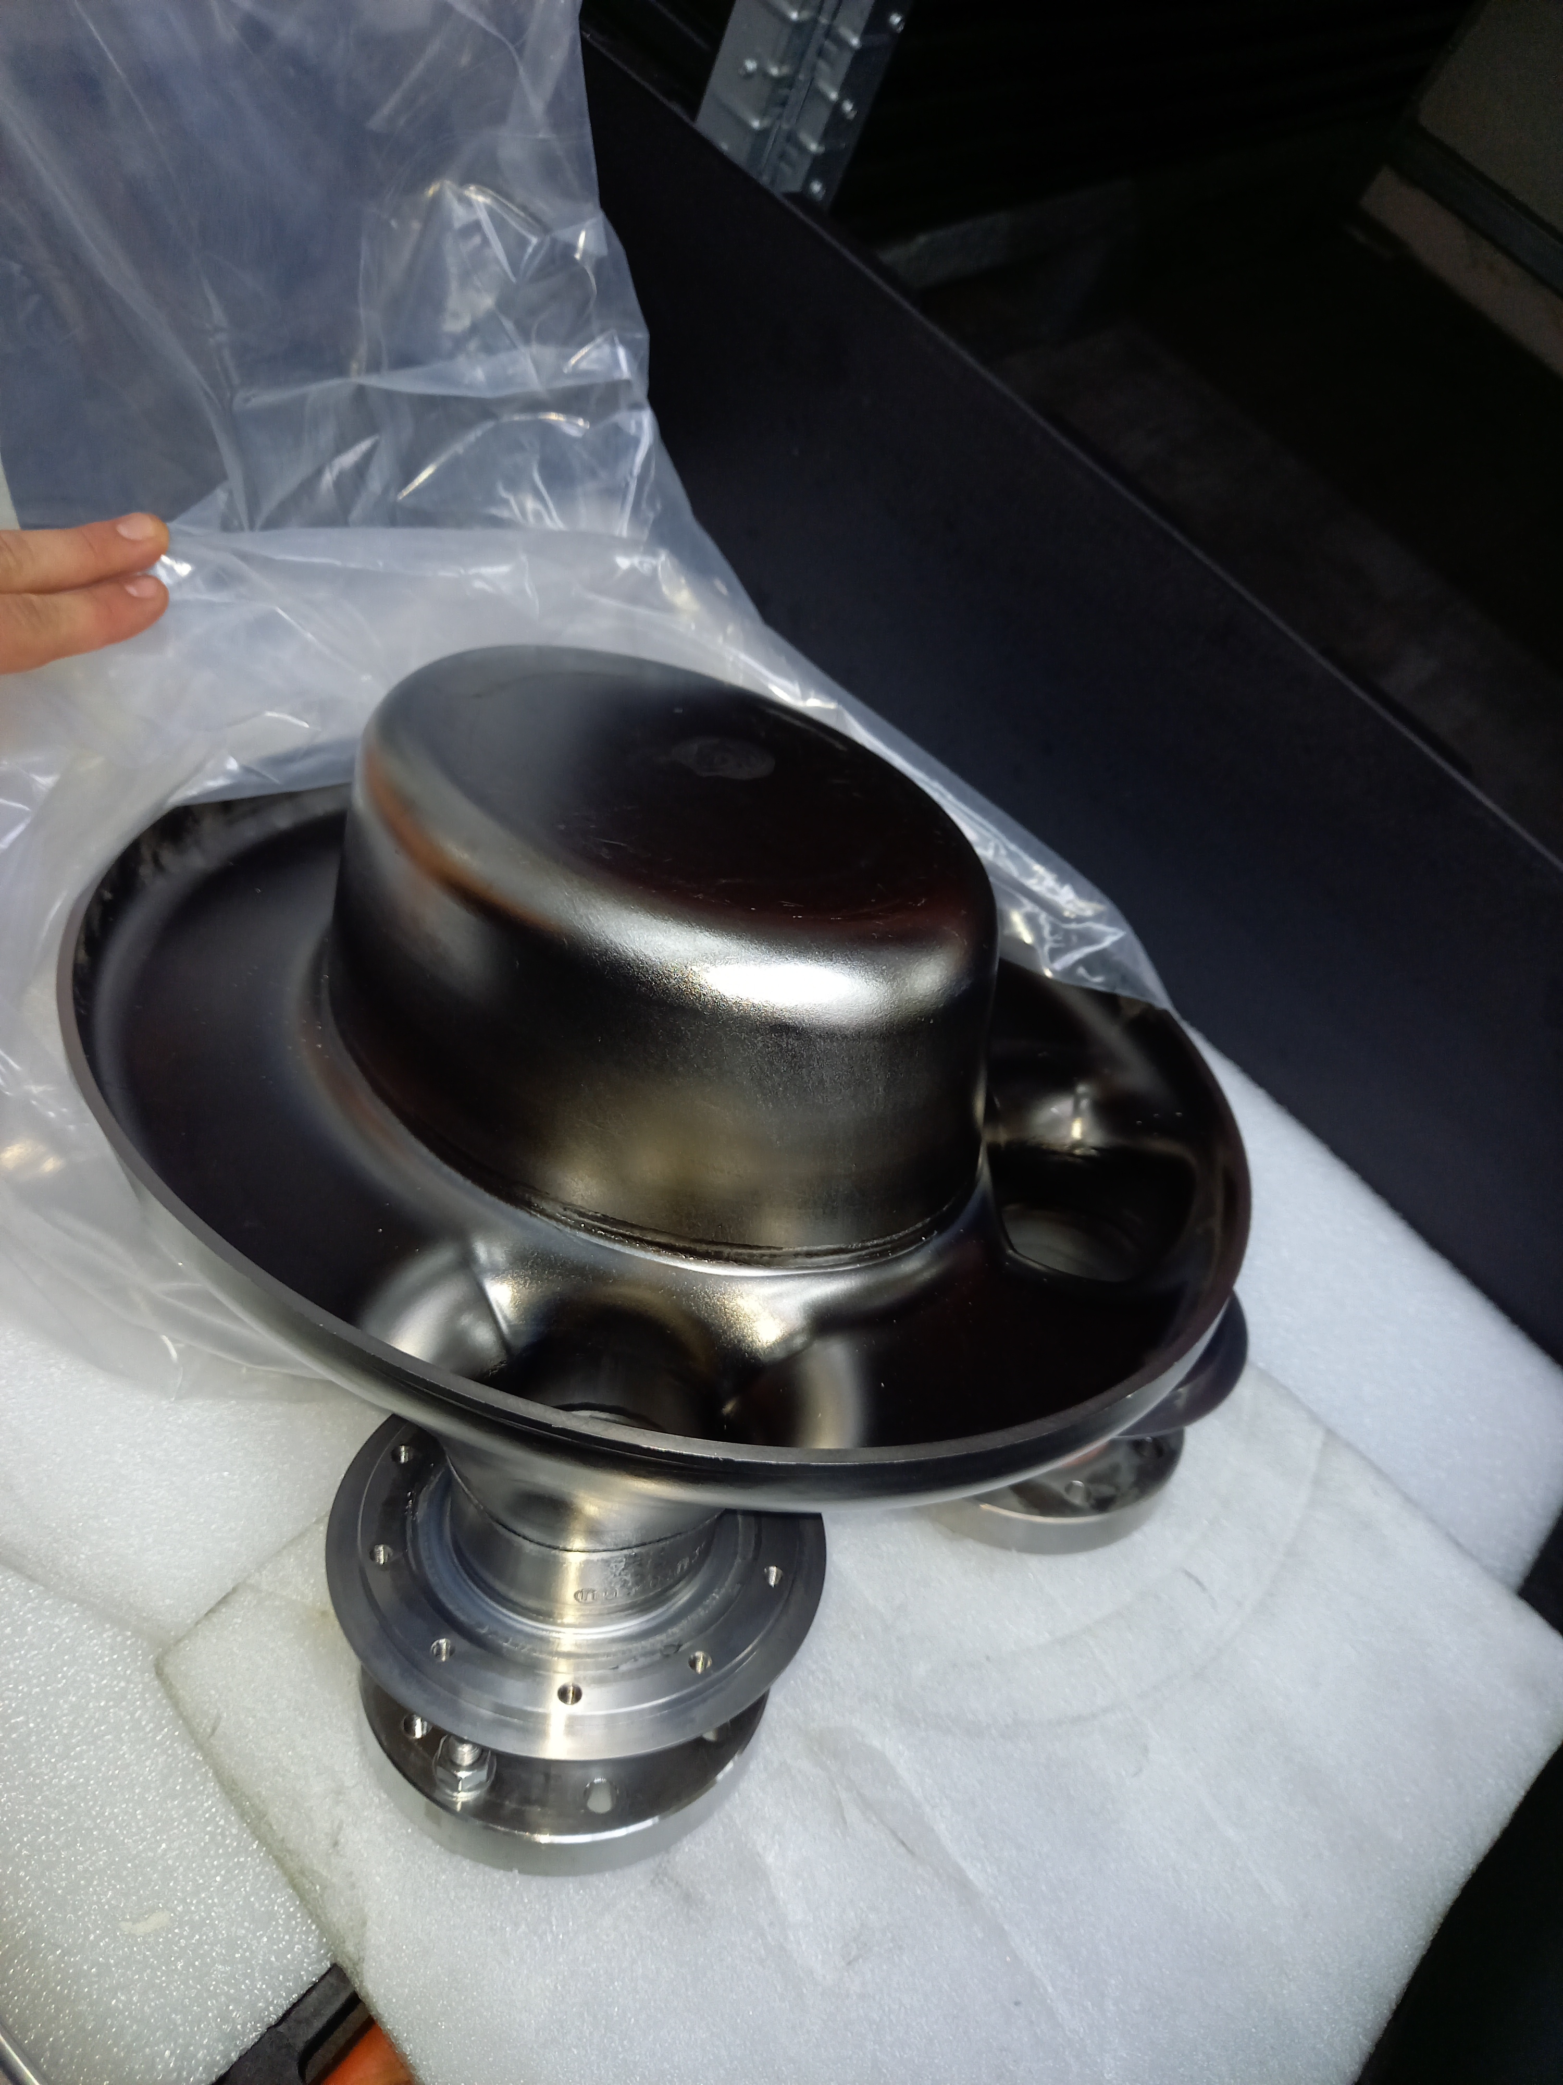
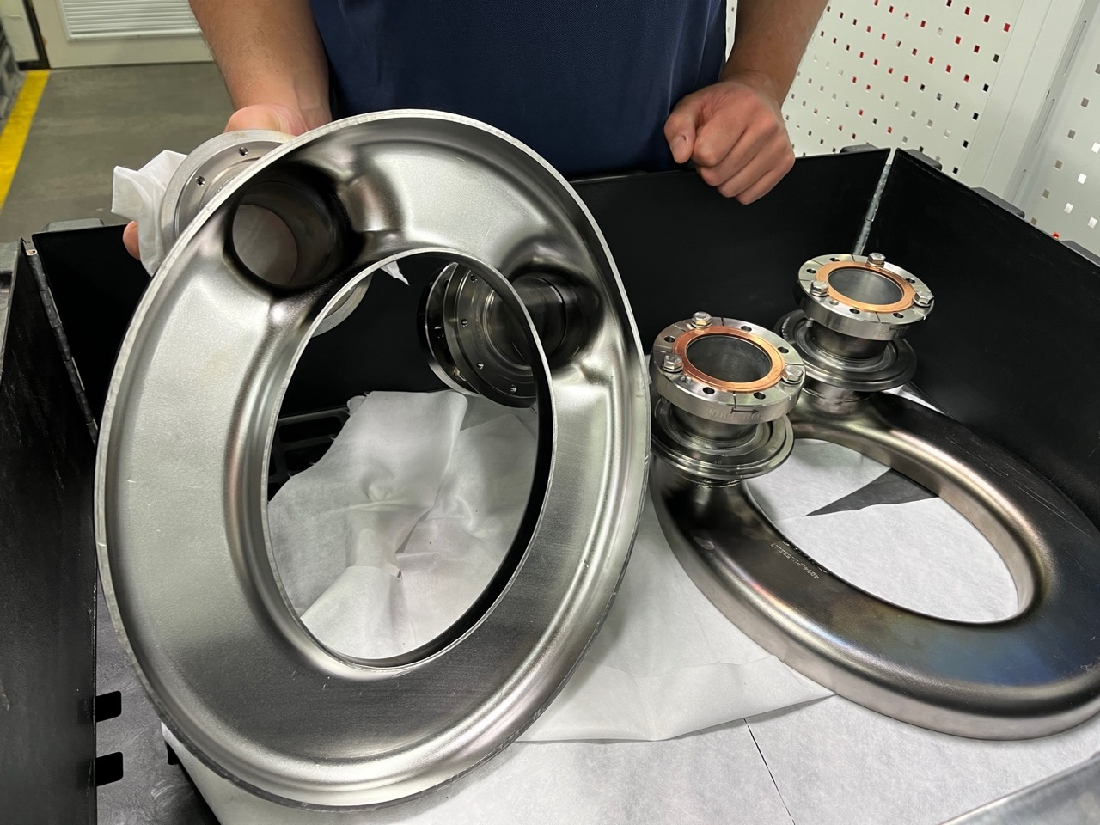
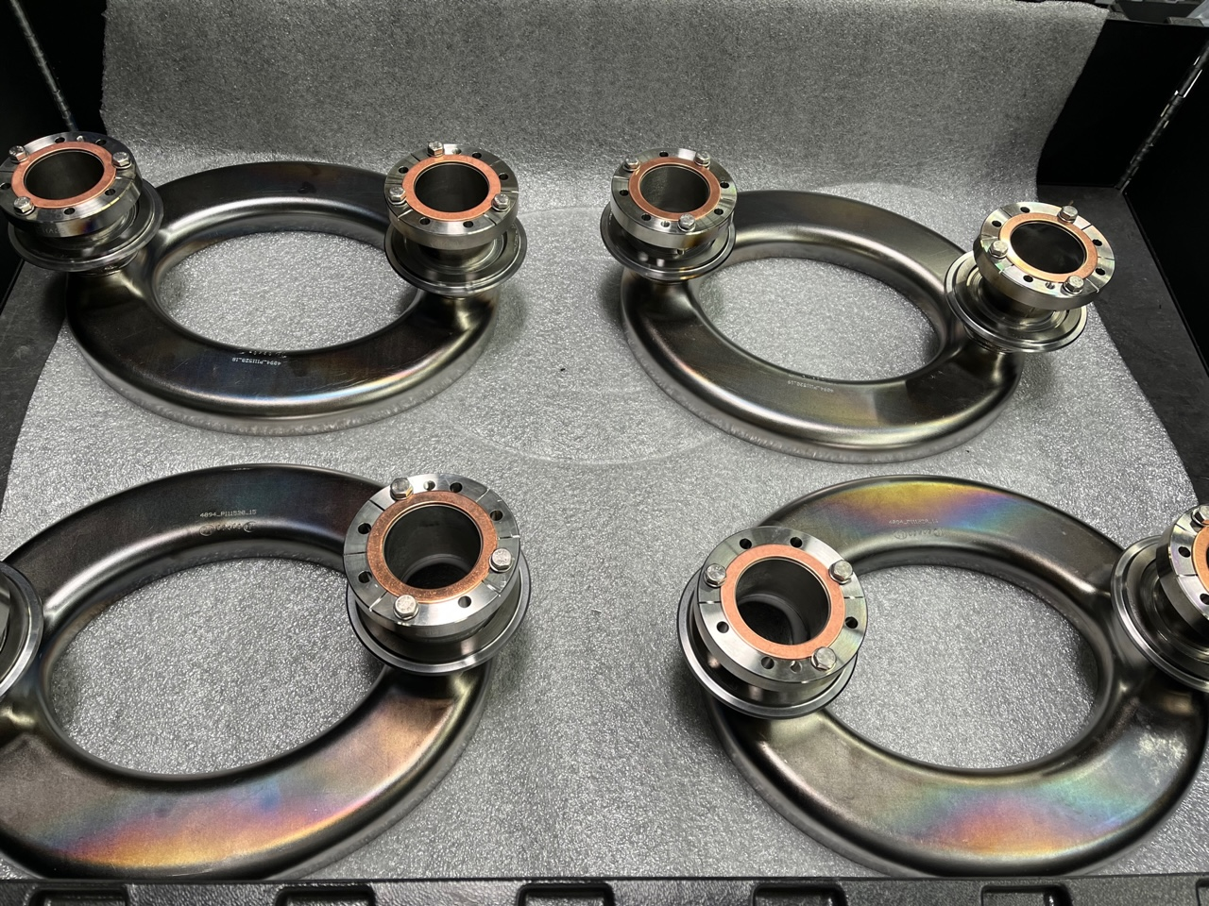
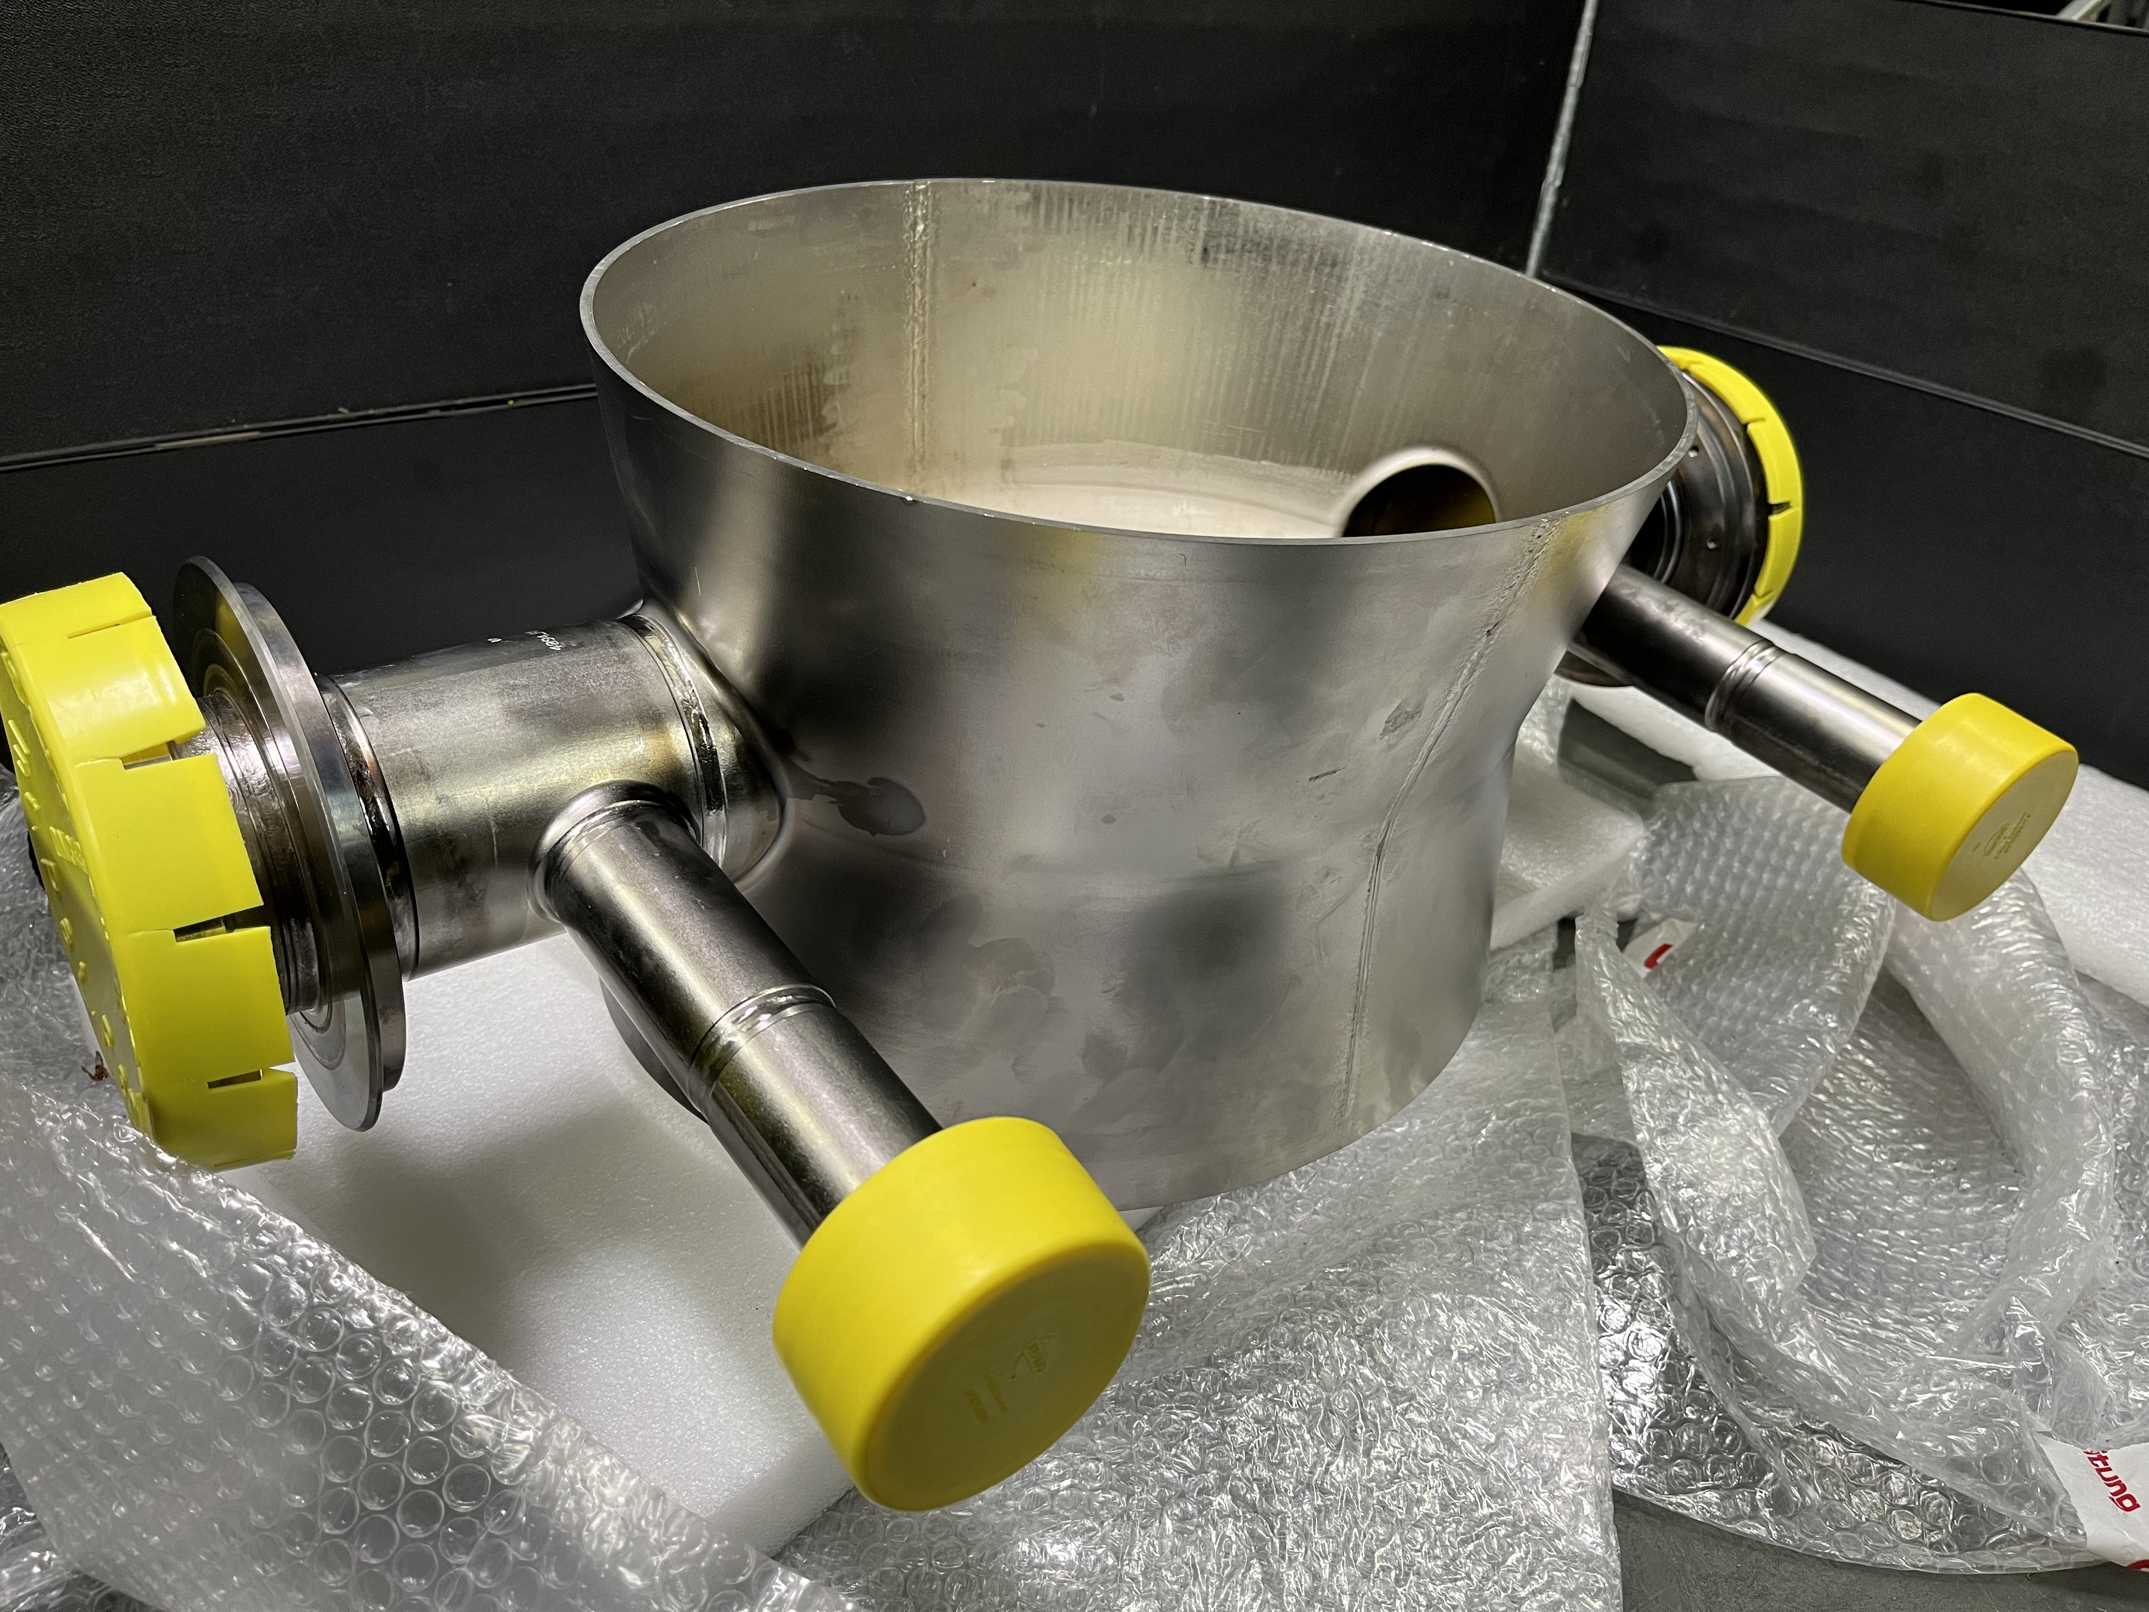
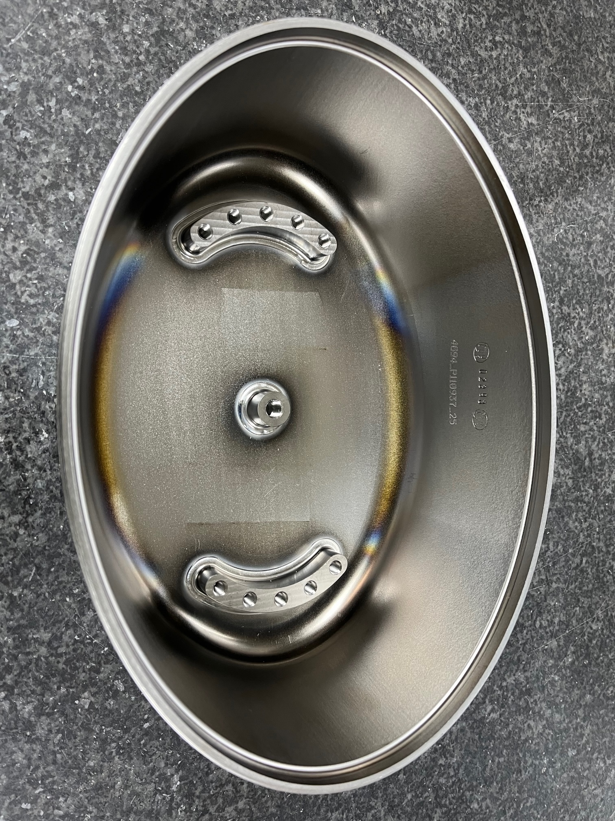
Series Bare Cavities RI
Delivery x6 series bare cavities from Dec. 2023 until April 2024
03.2022
Acceptance Preseries bare cavities
Green light series bare cavities
05.2023
Start series bare cavities fabrication
08.2023
Final Approval drawings and MIP
11.2023
Delivery to CERN RI-DQW-BC 3
12.2023
Delivery to CERN RI-DQW-BC 4
02.2024
Delivery to CERN RI-DQW-BC 5
02.2024
Delivery to CERN RI-DQW-BC 6
03.2024
Delivery to CERN RI-DQW-BC 7
03.2024
Delivery to CERN RI-DQW-BC 8

Slide 12
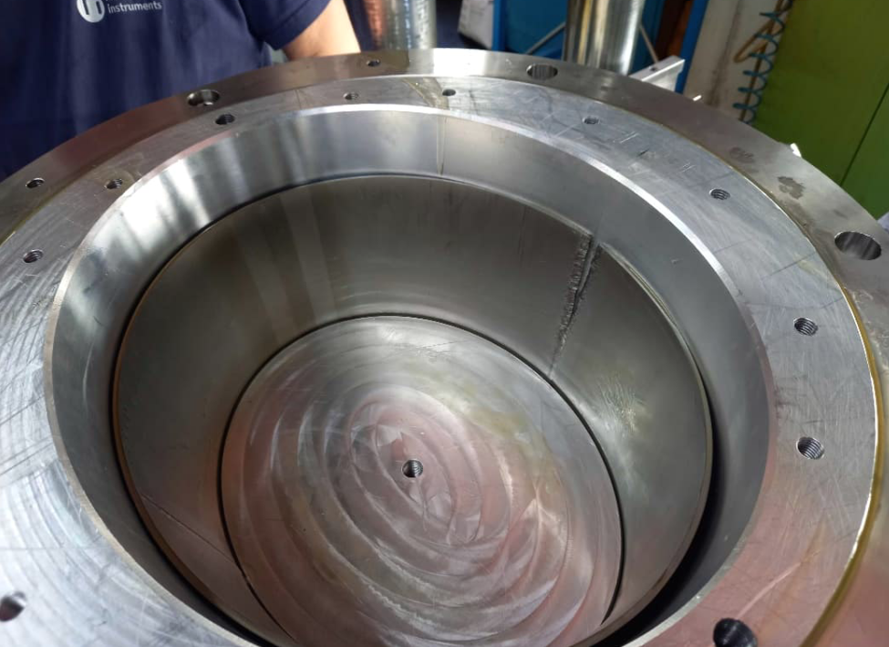
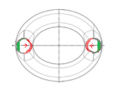
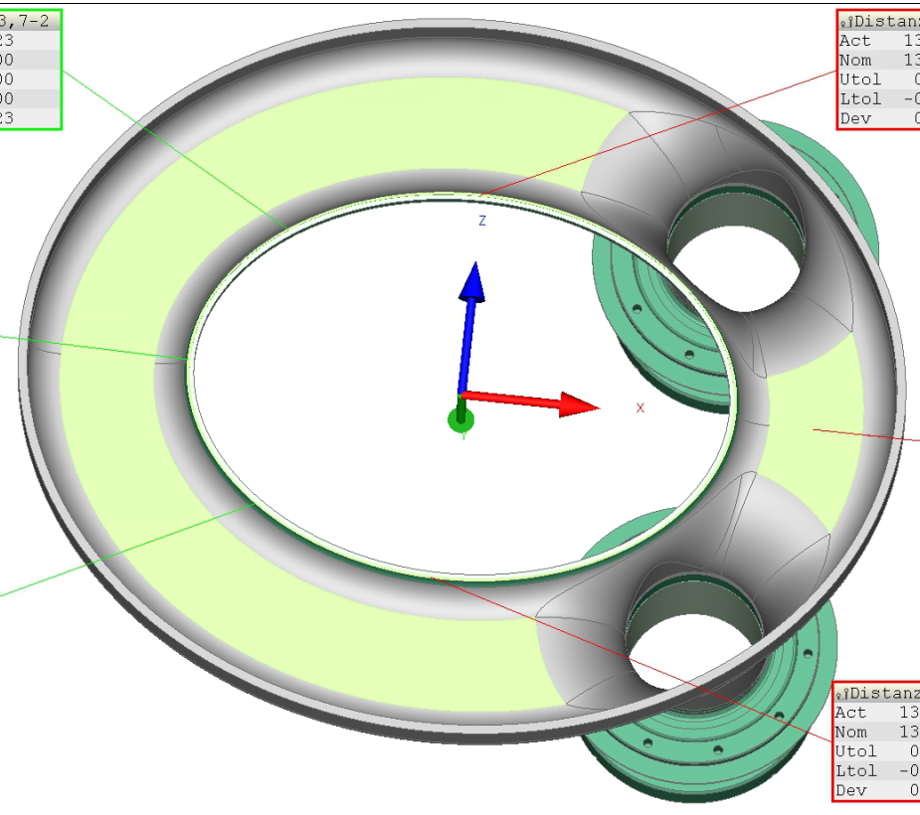
Series BC RI- NCRs
Several NCRs which require deep analysis from several colleagues to understand the implications. Some NCR can´t be assessed until cavity cold RF test is done.
  #1 Wrong position M5 holes on NbTi flange: Milling error- Accepted- Modification of adaptative rings accordingly.
  #2 Low thickness after necking out for pick-up port : Concession
  #3 Brazing pick-up port, lack of filler metal on the front side. Scrap
  #9 Crack on the longitudinal weld of main body during forming : Scrap
  #4 Error on the Brazing cycle: Scrap (x27 pieces)
  #5 Low thickness necking elliptical cap: Concession
  #6 Brazing- wrong alignment during assembly- Scrap
  #7 Depth of pockets for welding beans and pin on bowl was smaller than requested – Milling error- Concession
  #8 Necking out of elliptical done with wrong tooling- Scrap
  #10 Deviations on bowls- Concession
  #13 Deviation position HOM and FPC ports
  #11 Milling of beam tubes for necking out done in the wrong direction: Scrap
  #12 Pin out of tolerances (x1). Scrap
  #14 Deviation distance between RF surface elliptical cap to the bowl weld joint- under review

Slide 13
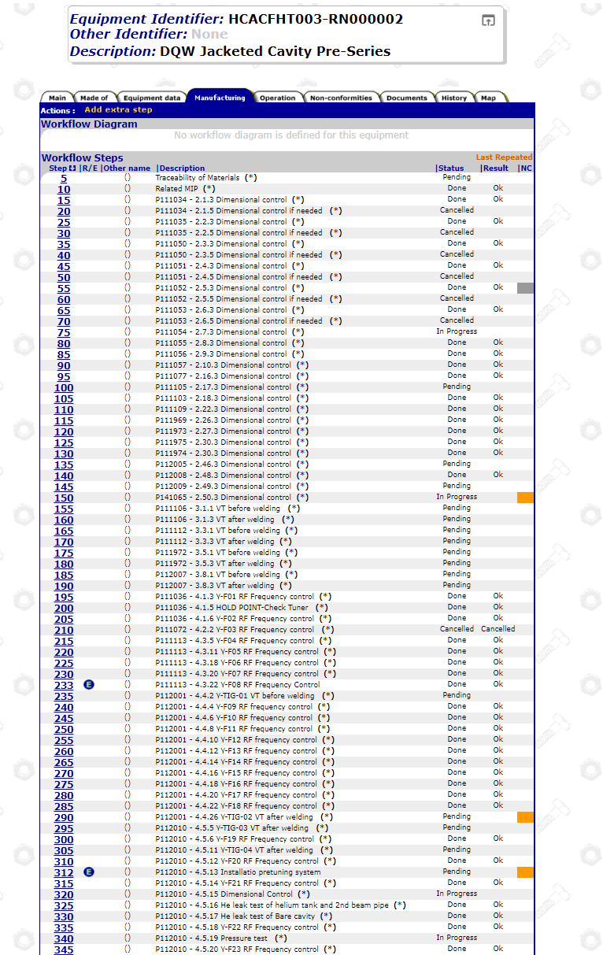
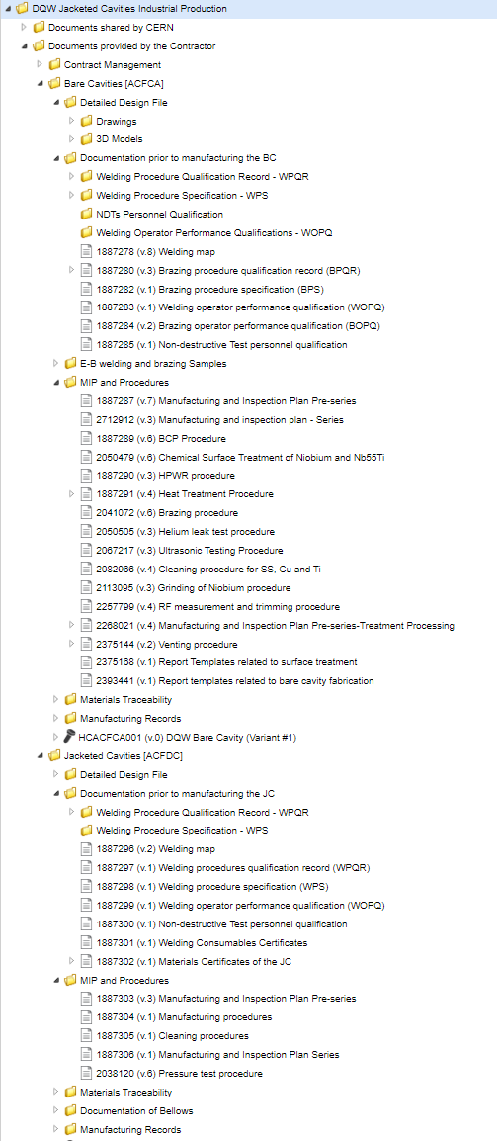
Documentary structure RI
Documentary structure of the contract (EDMS) in place and actively used by the supplier. Full traceability of documents and versions.
Many interactions with the supplier to achieve the quality level requested by the technical specification (EDMS 1803555).

Slide 14
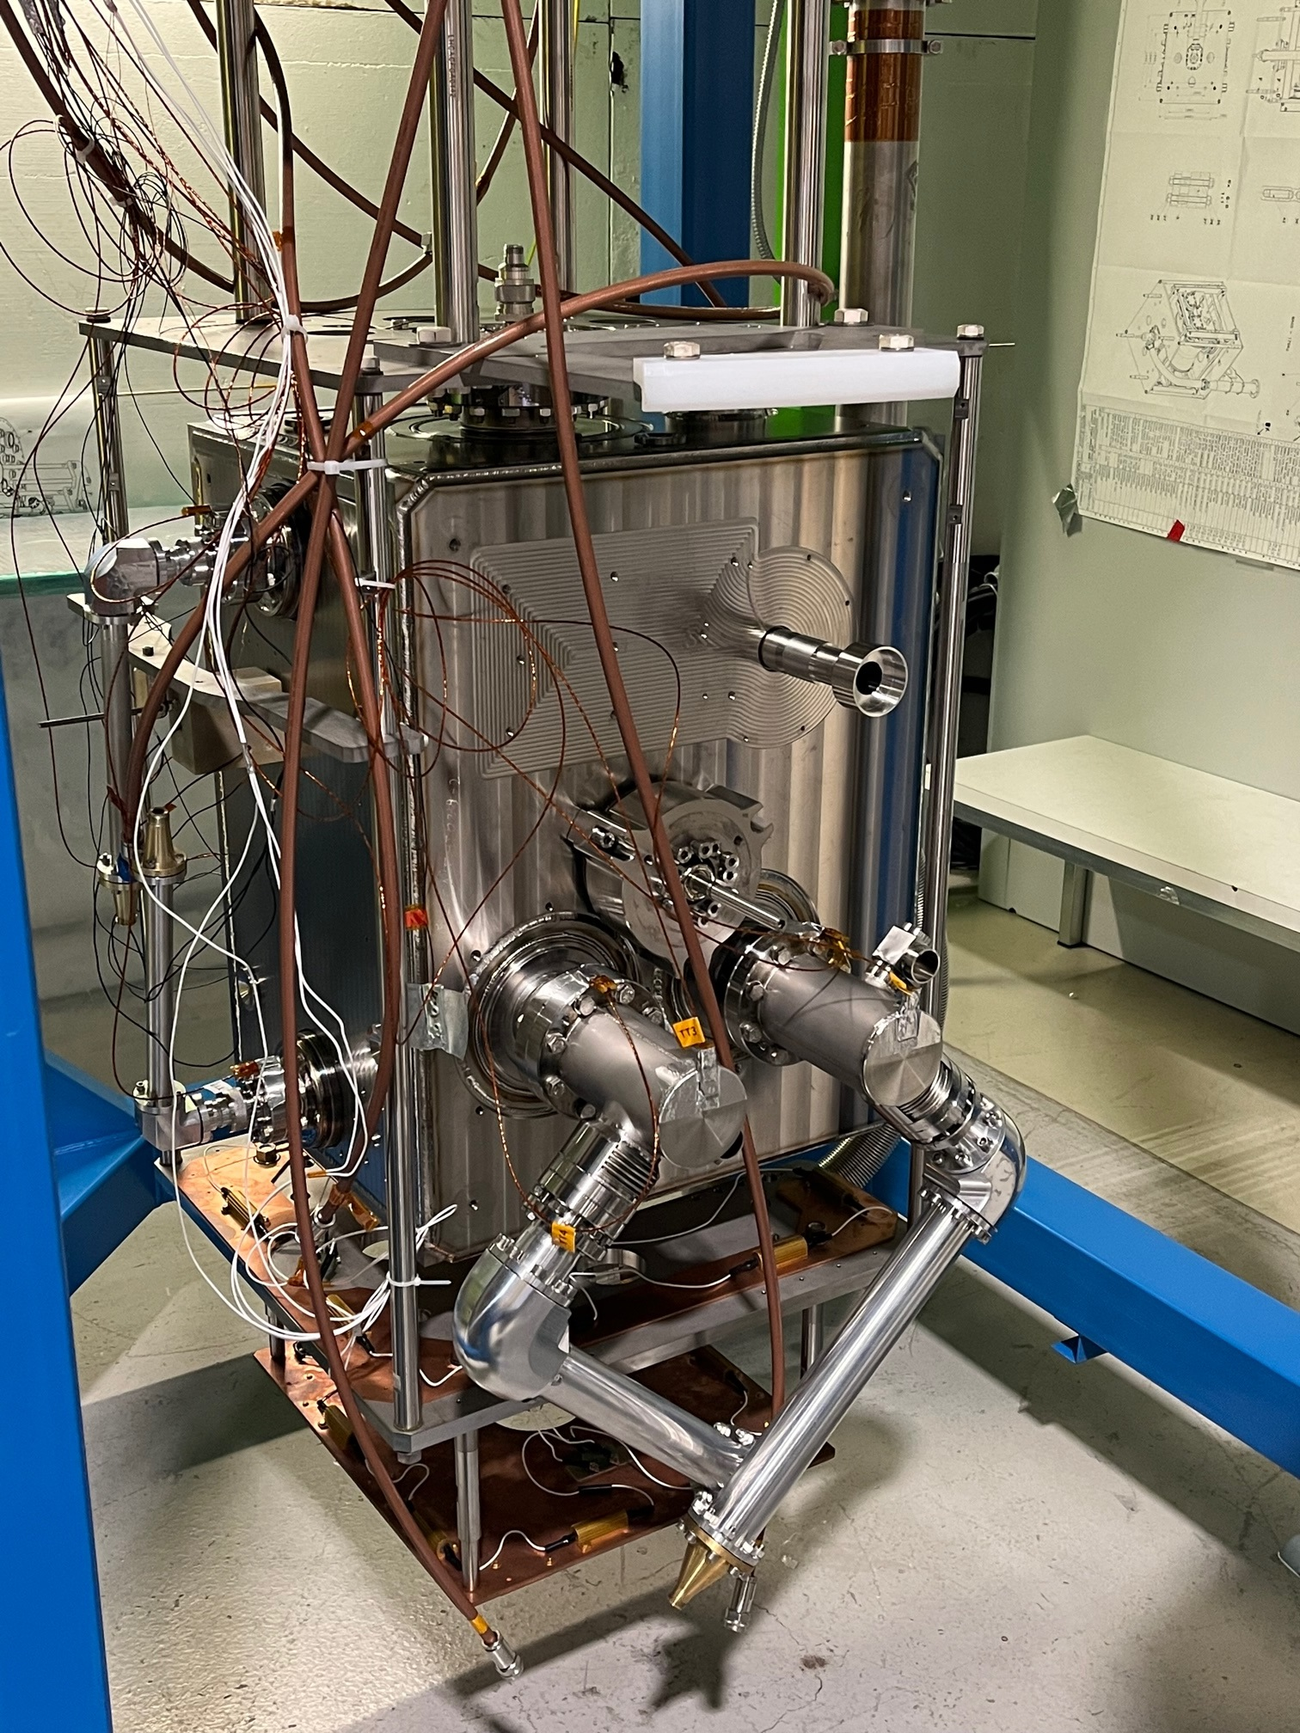
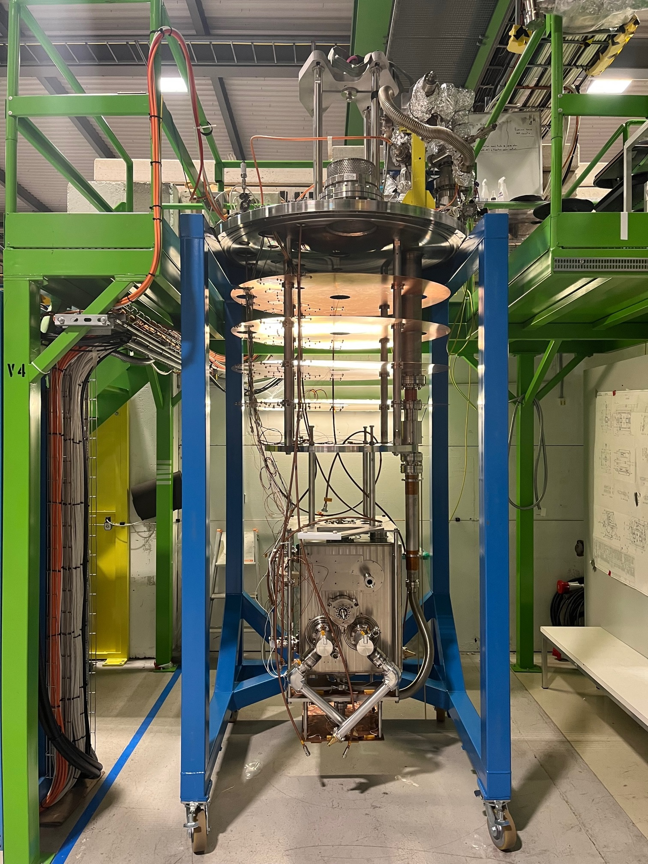
Cavity and CM testing in SM18
See talk K.Turaj
Number of cavity cold tests increased from 2022 to 2023.
New insert in preparation to ease the planning
Dressed cavities are more challenging and require more clean room resources.
Bottlenecks for 2024: clean room resources with cavity preparation and string assembly.
helium availability in SM18
2022
4 Bare cavities
3 successful
6 Cold RF test CC:
2 Jacketed cavities
1 successful
2023
3 Jacketed cavities
3 successful
10 Cold RF test CC:
1 CM cold test
7 Dressed cavities
1 successful, 3 not successful
2024
6 Bare cavities
10 Cold RF test CC:
3 Jacketed cavities
1 Dressed cavity
1 CM string assembly
1 CM cold test
2025
3 Jacketed cavities
8 Cold RF test CC:
2 CM cold test
5 Dressed cavities

Slide 15
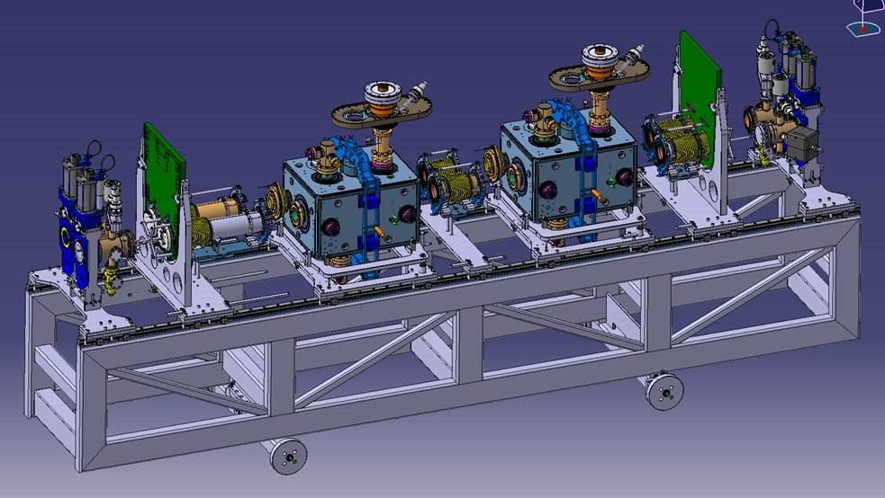
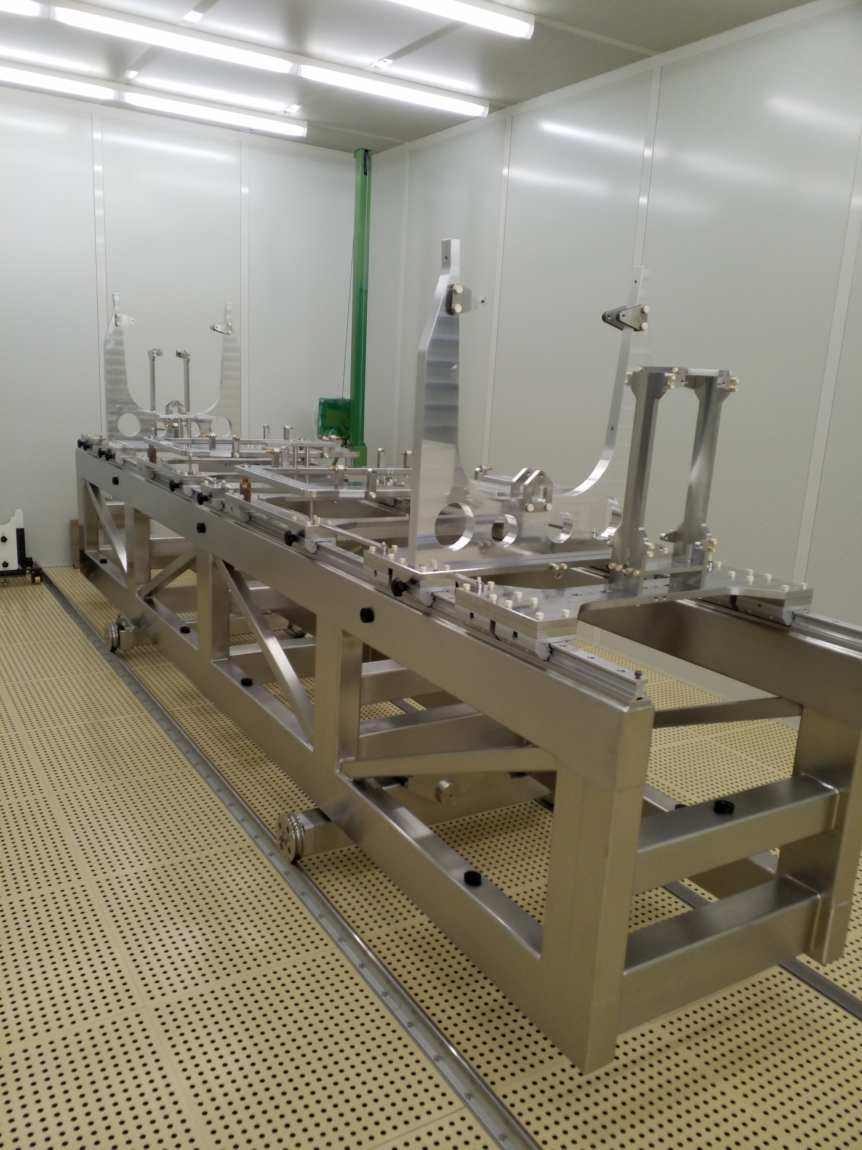
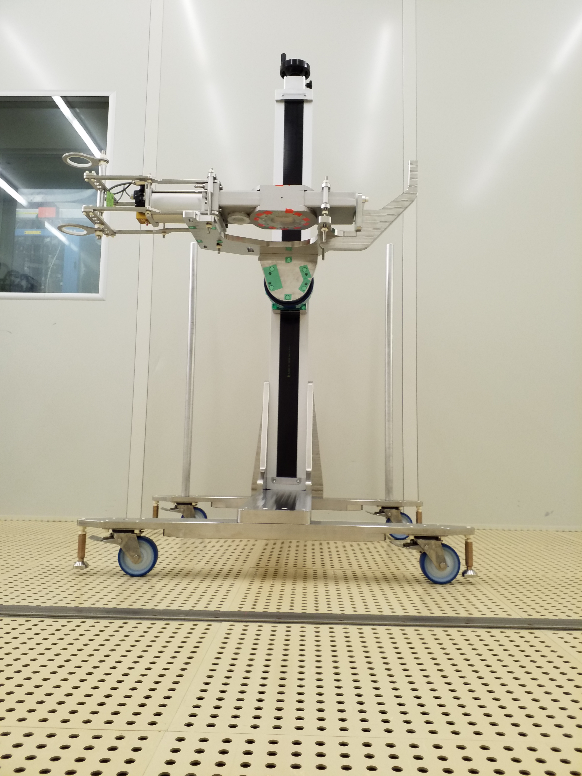
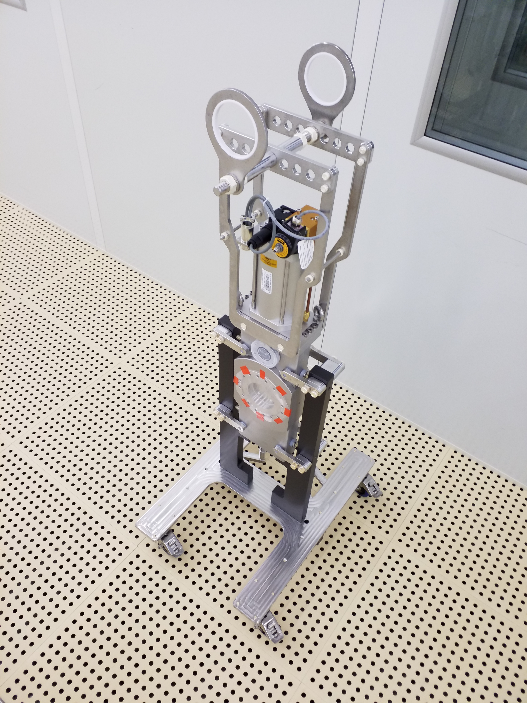
CERN Cleanroom tooling for cavities string assembly
Goal : design & produce tools to interconnect & align easily the full cavities string, aiming at keeping the cavity line ISO 4 (ISO 14644 cleanroom norm)
Result : complete tooling set for cavities string handling, and extremity vacuum chambers subassembly, anti-dust prepared in less than 4 weeks
Interconnection & alignment tooling for complete string
Rotating system:
Cleaner assembly of the Extremity Vacuum Chambers with the various valves and gauges
Sector valve handling frame and cleanroom intermediate storage trolley

Slide 16
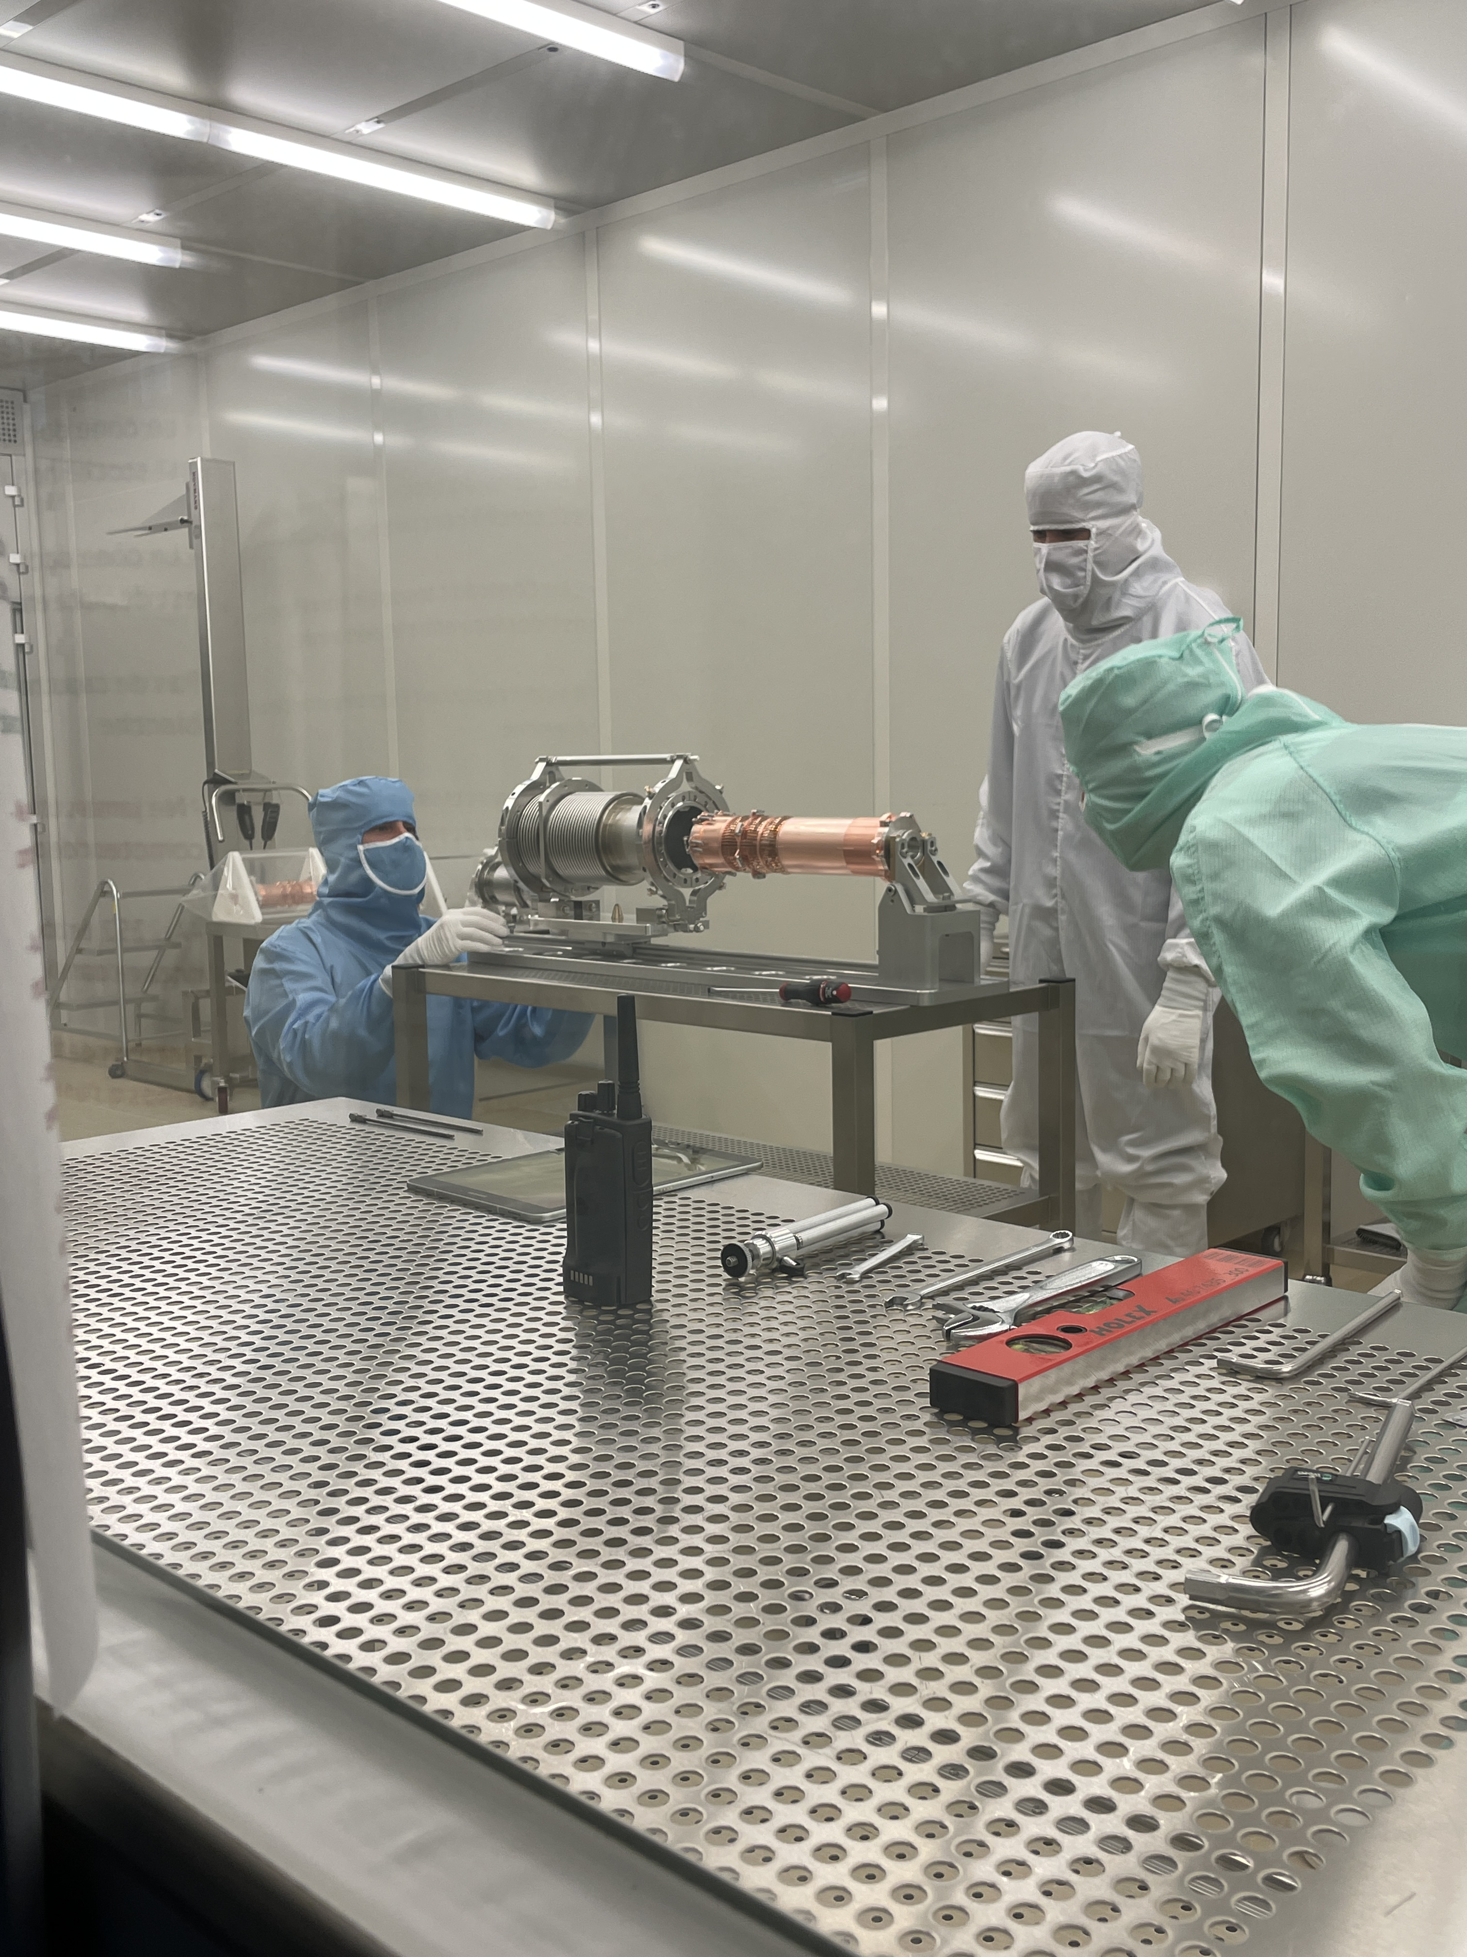
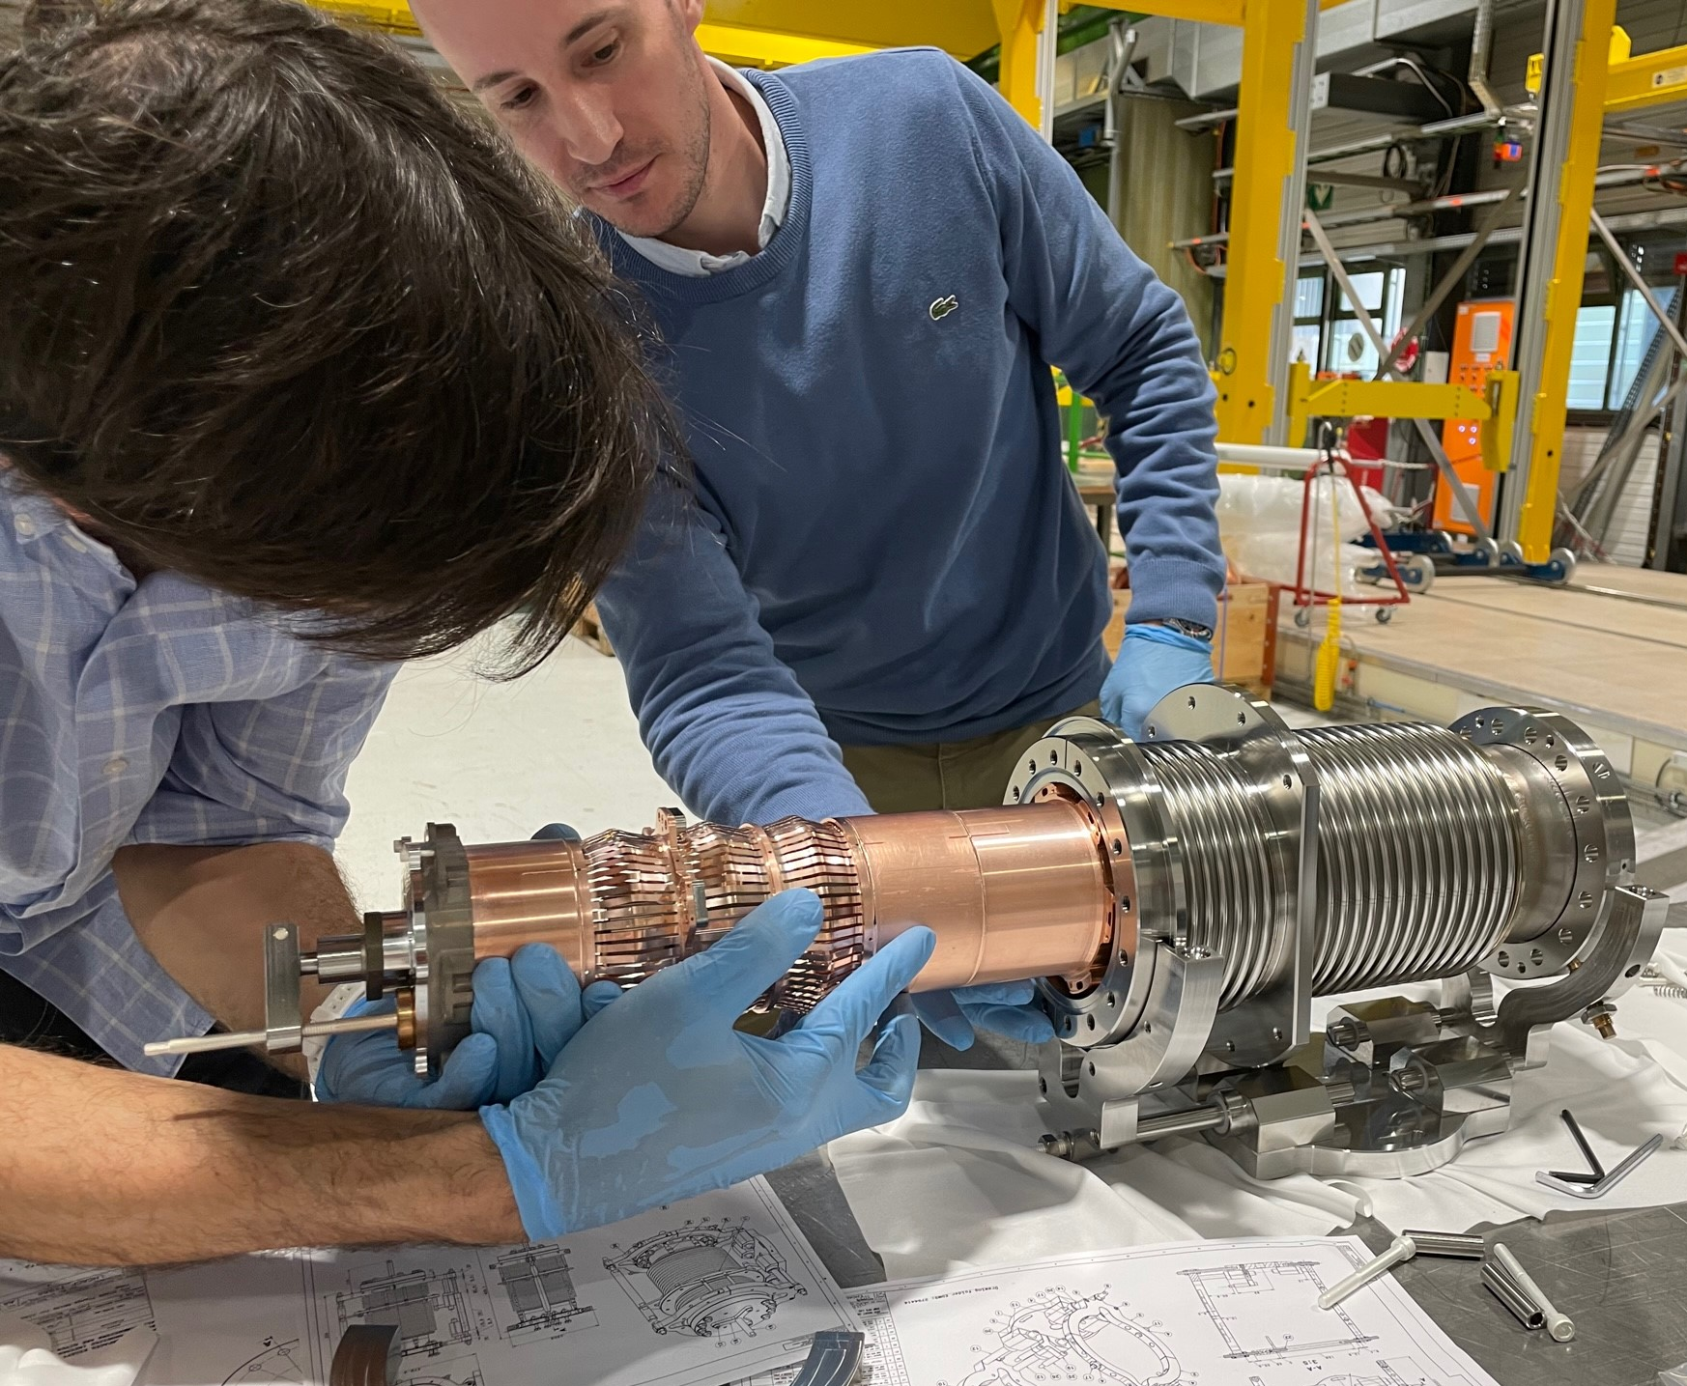
Process development for Plug In Modules subassembly
Goal : would it be possible to assemble PIMs outside cleanroom and perform anti-dust conditioning afterward, in order to save resources and improve cleanliness ?
RFD 2021 summary :
*Parts degreased and manually cleaned outside cleanroom ; rinsed ; then assembled inside cleanroom
Status after rinsing, before assembly :
Inside RF fingers and inside bellow convolutions : ISO 2-3
Outside bellow’s surface and flanges : ISO 6
Status after assembly in cleanroom :
Inside RF fingers and inside bellow convolutions : ISO 6
Fixing area with Ag coated screws & springs : ISO 5, it was ISO 8 before a huge effort of wiping and blowing inside cleanroom
Maintaining sub-ISO 4 is not possible due to complex assembly sequence and need of tightening coated fasteners inside the assembly (between the bellow and the RF finger)
Should not have been accepted for string assembly, but we could not do better with this procedure
DQW 2023 summary :
*Parts degreased, manually cleaned and assembled outside cleanroom ; whole subassembly rinsed inside cleanroom
After rinsing of the whole subassembly :
Outside surface : ISO 4
Inside surface : ISO 4
Fixing area with springs : ISO 5 without extra wiping nor blowing
Accepted for string assembly
NB: Requested a strong care in order to dry the subassembly correctly
A factor 3 in time saving !
A factor 100 in cleanliness level improvement !
Versus

Slide 17
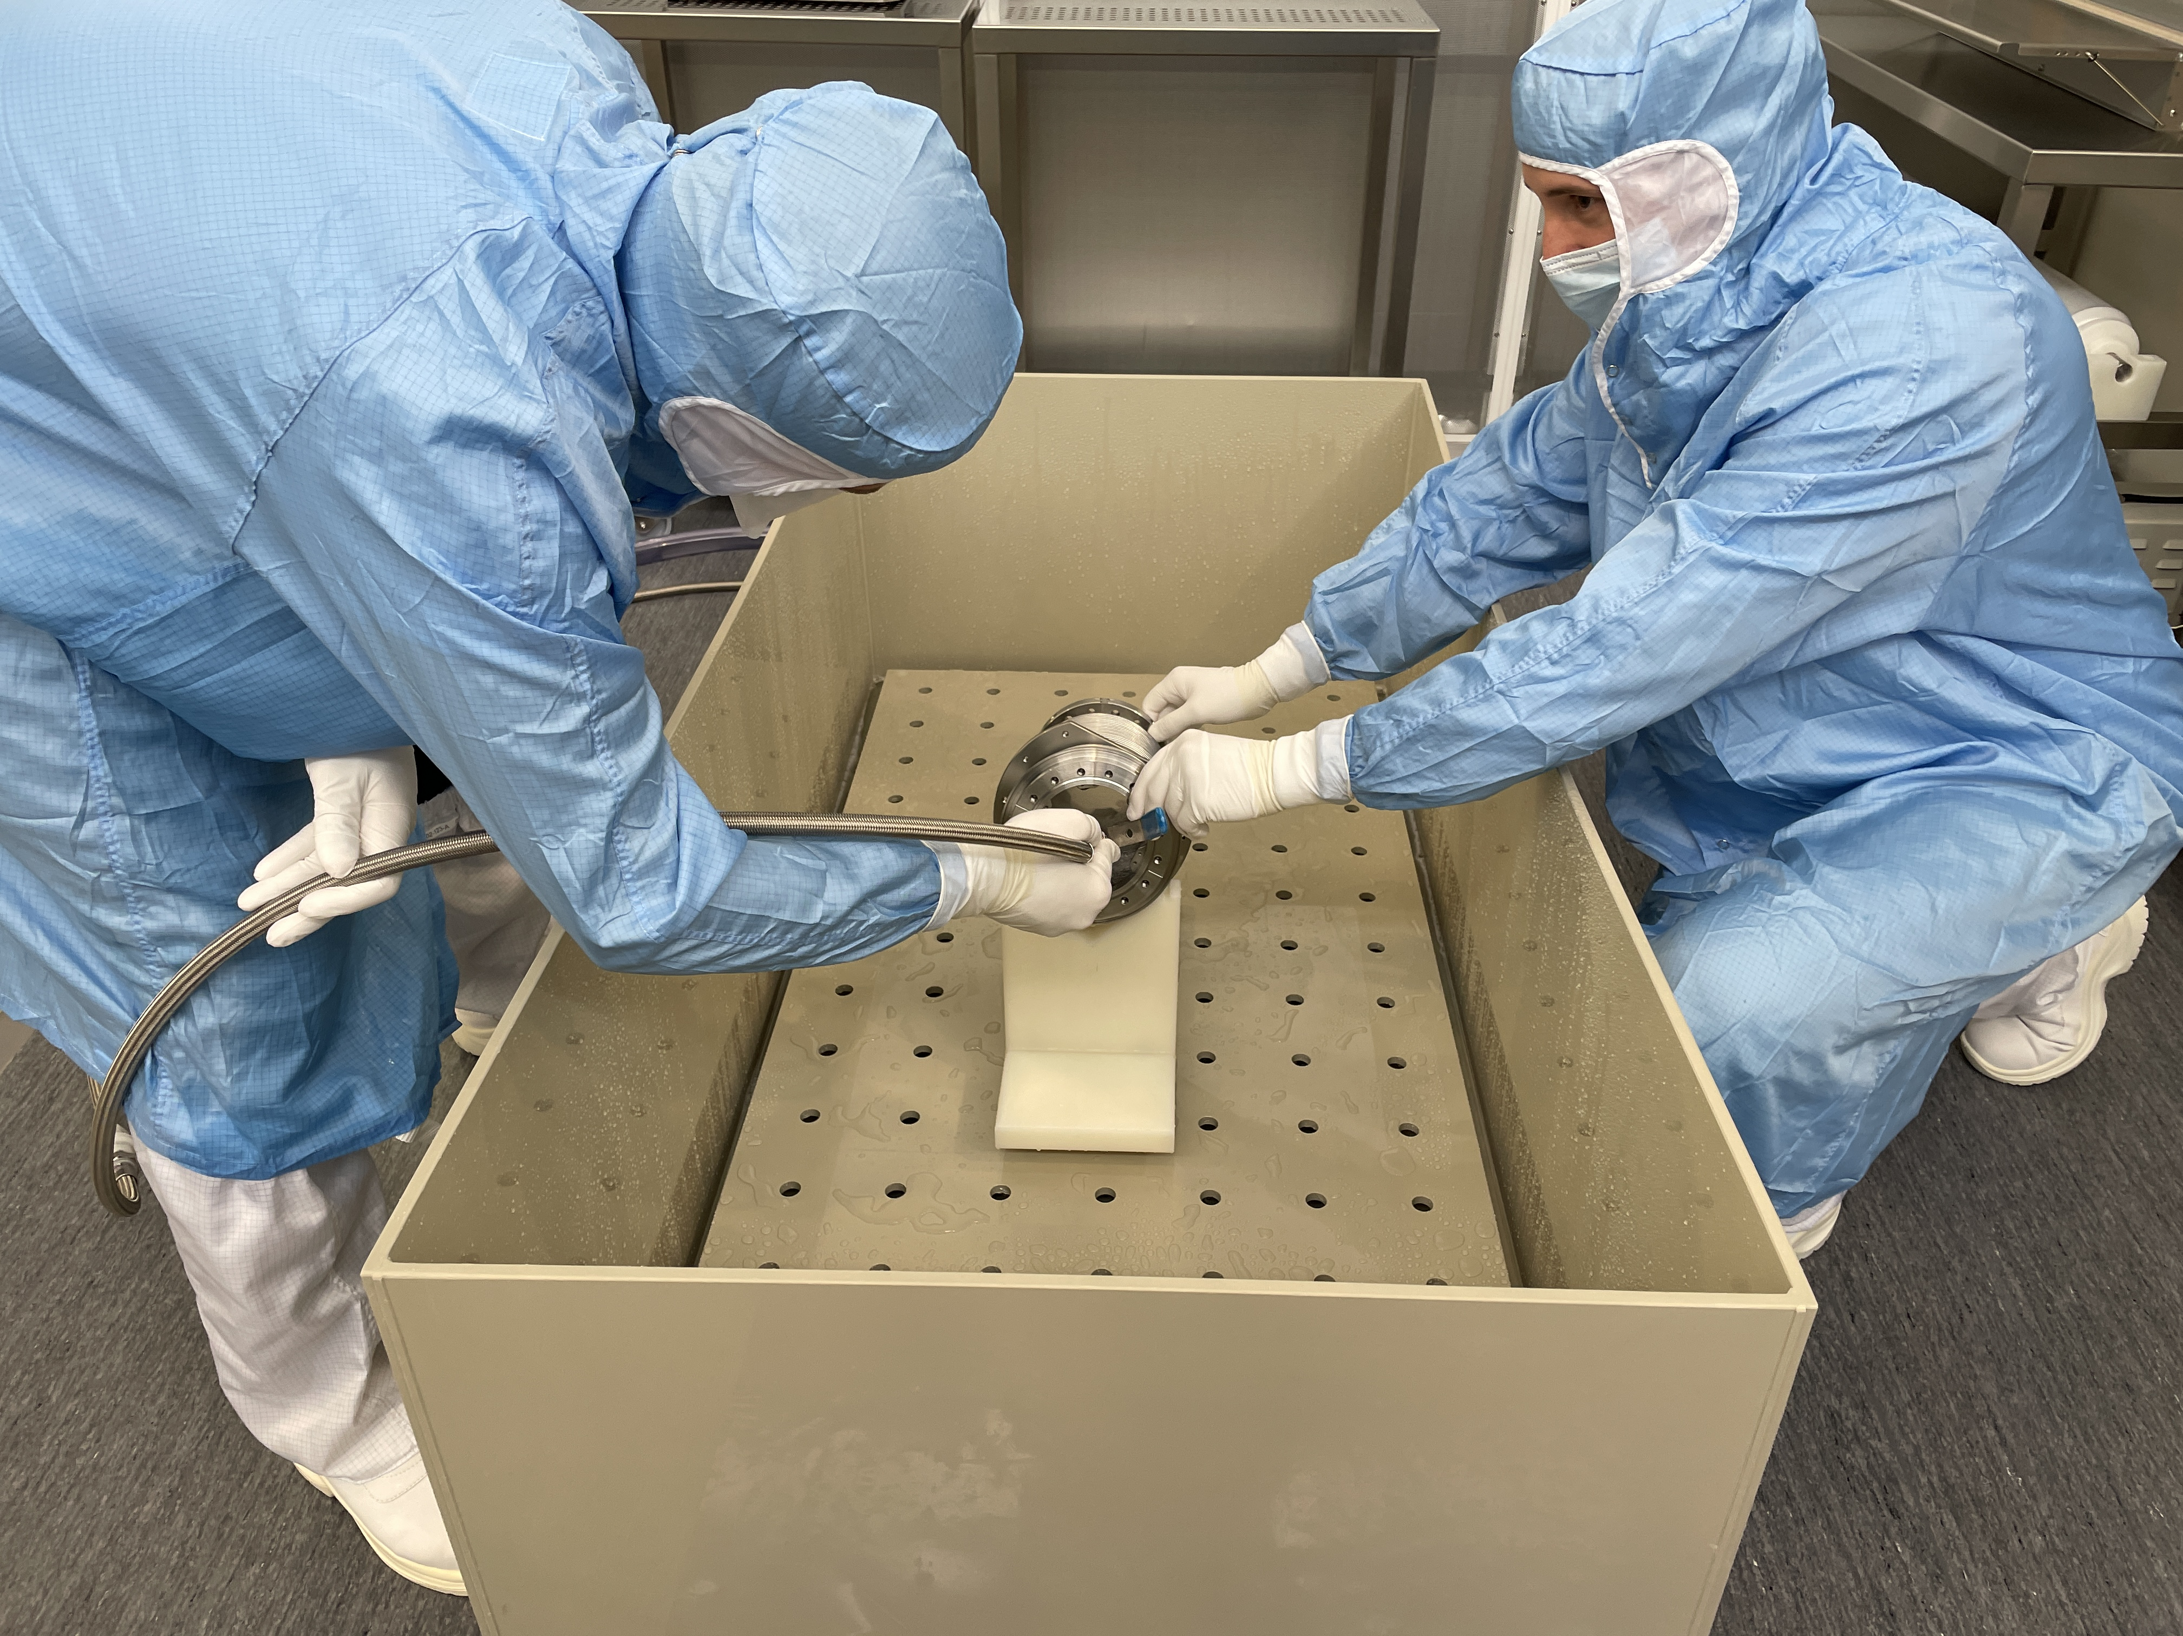
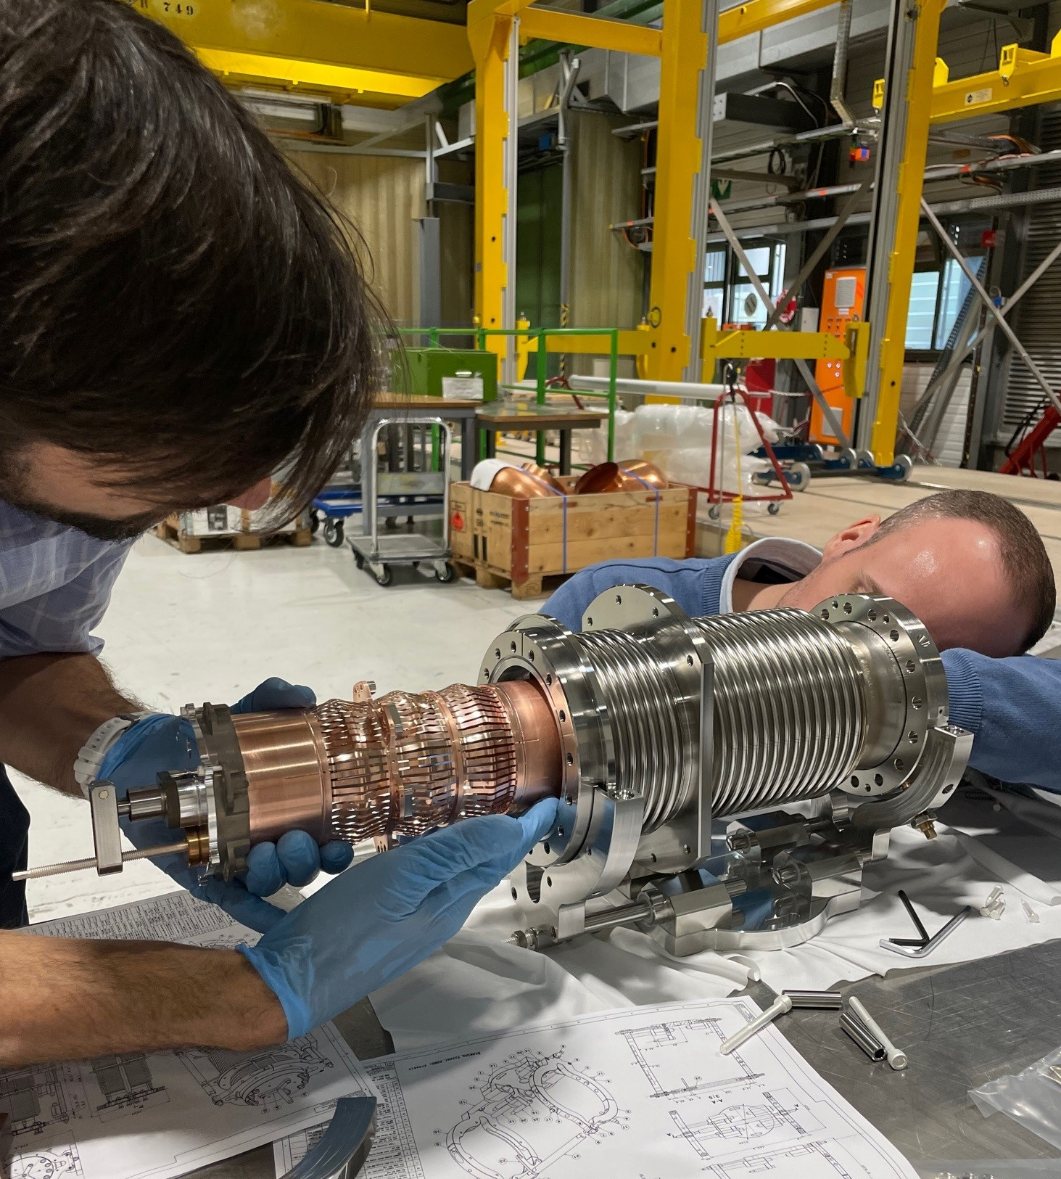

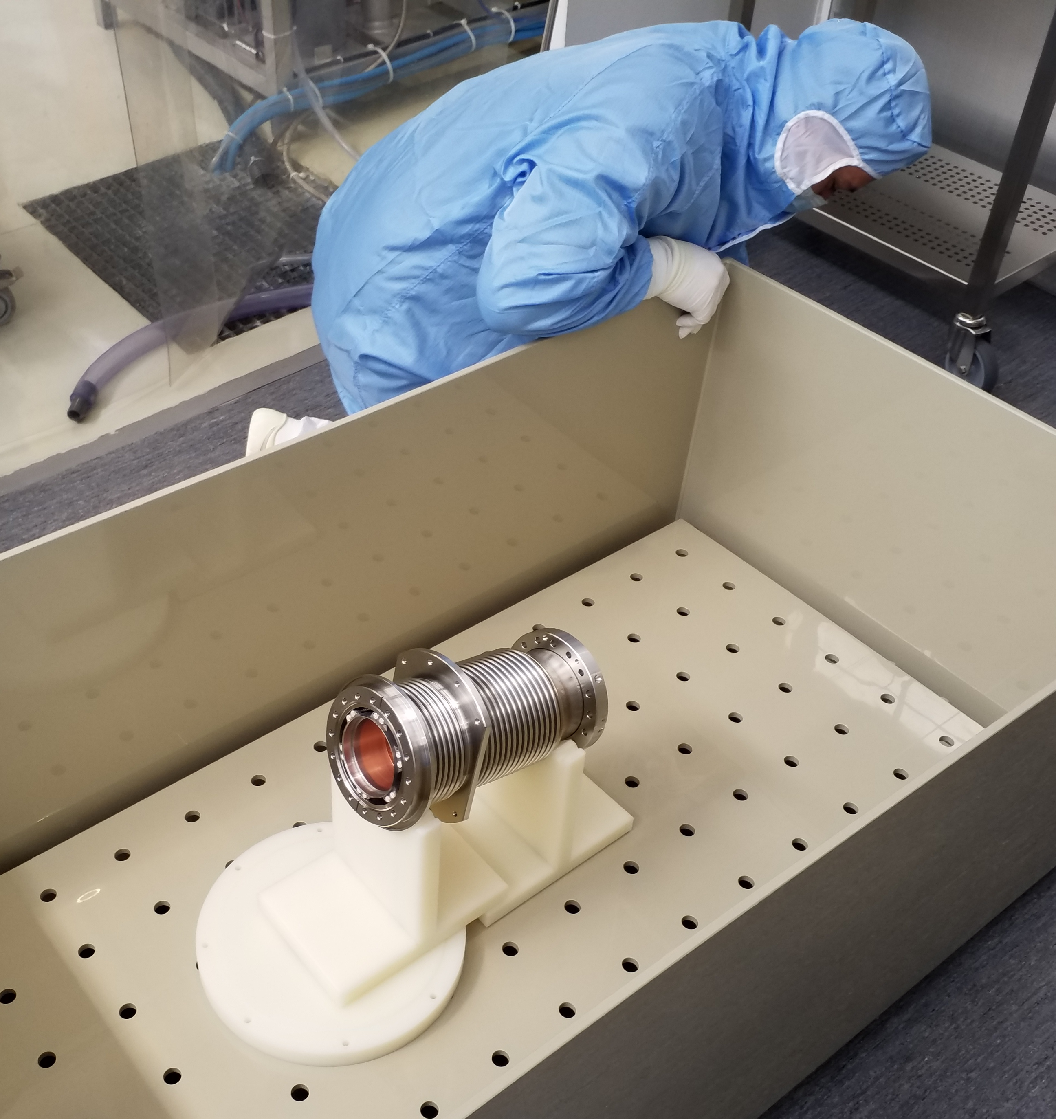
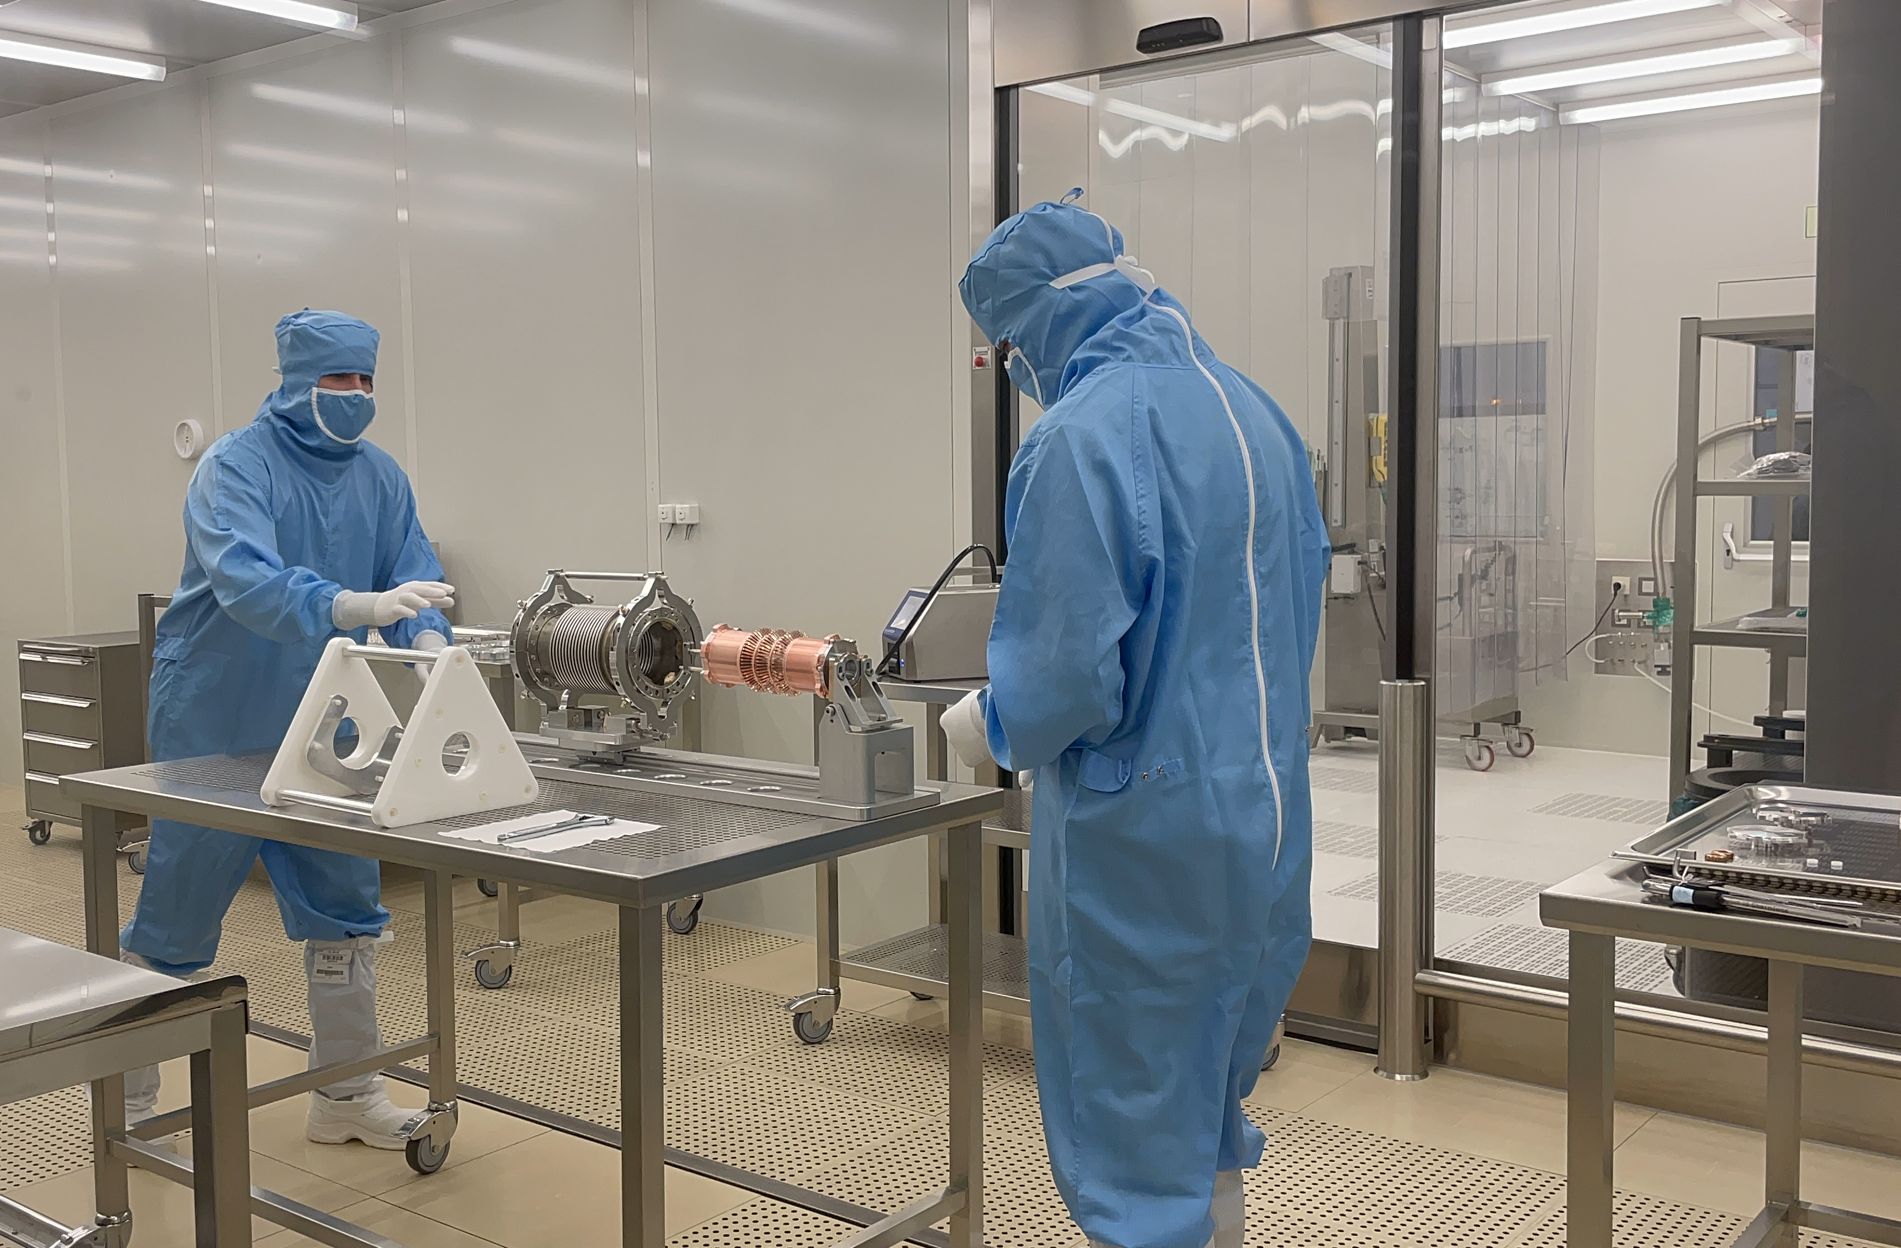
Process development for Plug In Modules subassembly
Result :
It has been proven it is possible to dry the subassembly after rinsing.
It requires a lot of care, but it is feasible without baking out.
The inside of the subassembly went from ISO 6 for RFD, to ISO 4 for DQW.

Slide 18
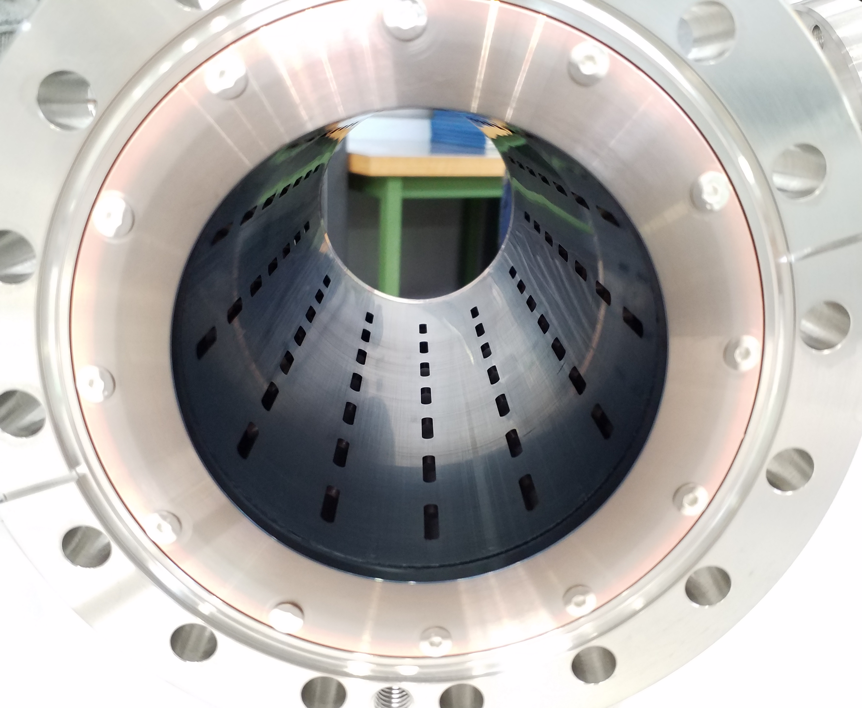
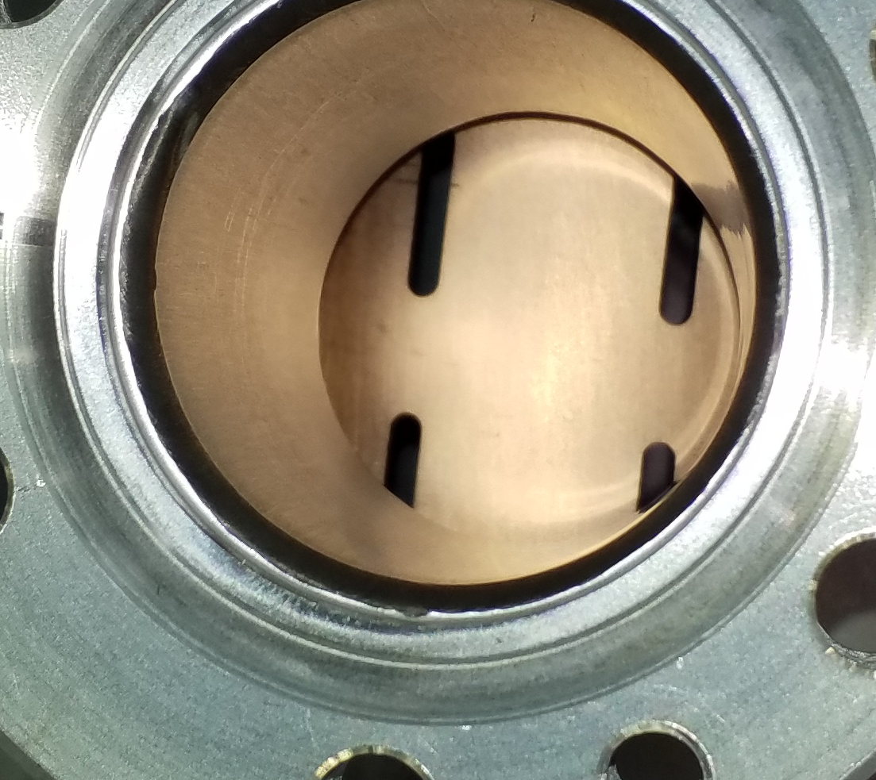


Cleanliness study of Extremity Vacuum Chamber
Goal : cleanroom conditioning comparison of DQW Extremity Vacuum Chamber Before vs. After carbon thin film coating
aC coating
No coating inside the DN40 pipes, no significant backward coating of the grid through the holes (only observed by eye)
EVC 5 BC
Outside : ISO 5
Inside : ISO 3
Cu RF fingers area : ISO 3
EVC 5 AC
ISO 6
ISO 5
ISO 4
EVC 6 BC
ISO 5
ISO 4
ISO 3
EVC 6 AC
ISO 6
ISO 4
ISO 4
Before coating = BC // After coating = AC

Slide 19
Cleanliness study for Extremity Vacuum Chamber
Result :
-Chemical etching of the chambers removed all the oxides and brought the inside cleanliness level from ISO 5 to ISO 4.
-The outer surface gets dirtier each time we prepare these subassemblies. It is necessary to assess where the pollution comes from, and how can we keep the outer surface in the ISO 5 range at maximum.
-Even if the two EVCs are rejected for string assembly in the actual state, the rinsing test showed very promising results :
*Observation is similar to the PIM experience and it is validated it is possible to assemble the grids inside the chambers outside cleanroom, operate cleanroom conditioning, and dry the subassemblies successfully.
*It showed the Cu grid did not oxidized during the cleanroom conditioning in air.
*The coating is closer to be accepted than expected (reminder: the coated Beam Screens for secondary line were ISO 7), but this study is missing an understanding of the reproducibility, since only two EVCs were tested and showed different outcomes.
Decisions are being discussed regarding the coating process and goal in regard with the context of length and position of these subassemblies.

Slide 20
Conclusions
RI preseries jacketed cavities delivered to CERN. First cavity reached 5.9MV at 2K and second cavity will be tested soon. Metrology data under review.
Expected delivery for RI series bare cavities (x6): from Q4 2023 to Q1 2024.
Several NCRs leading to planning delays. Planning evolving.
Frequency measurements during cavity fabrication (welding, trimming, pressure test, pre-tuning) consistent with results at CERN.
Cavity testing in SM18 is ramping up. Bottle neck for 2024: clean room resources to cope with cavity preparation and string assembly.
Tooling for string assembly of CERN DQW CM is ready.
Cleanliness studies for PIMs proved it is possible to assembly PIMs outside cleanroom and perform anti-dust conditioning afterward.

Slide 21



Thank you!

