Slide 1
DQW CERN cavity tests
Katarzyna Turaj on behalf of WP4 and SY-RF-SRF
13th HL-LHC Collaboration Meeting Vancouver, 25-28 September 2023

Slide 2

Status
DQW cavities
CERN
DQW1
DQW2
RI
DQW1
JC
1 CT
BC
3 CT
JC
1 CT
BC
1 CT
JC
1 CT
BC
3 CT
JC
DQW2
BC
1 CT
DC
1 CT
DC
3 CT
DC
DC
...
6 more coming
10 RF cold test since last year
1 cavity ready for a string assembly
  DQW2 CERN
    1 CT in JC
    3 CT in DC
2 more ready for testing in dressed configuration
  DQW1 CERN
    2 (3) CT in BC
    1 CT in JC
    1 CT in DC → retest in October 2023
  DQW2 RI
    1 cold RF test in JC
1 cavity ready for testing in jacketed configuration
  DQW1 RI
Discussed last year
DQW industrial cavity production Nuria Valverde (CERN)
Completed
Ongoing
Coming

Slide 3

Simplified process flow of DQW cavities
Similar preparation and testing process.
RF tests performed in V3 and V4 cryostat in SM18.
Inspection and frequency measurement between each step.
Cavity Reception
Leak Test +RGA
Transfer to the cryostat
Dressing
HPR
Bake out
(120ºC 48h)
Cool down
ΔT < 50K
Jacketing
Cleanroom Assembly
Pumping
Leak Test +RGA
Cold Test
Removal from Insert
Leak Test, RGA
Mount on the insert
Removal from Cryostat
RGA
Slow venting
N2 to 1bara
Starting point of bare cavities produced by RI

Slide 4
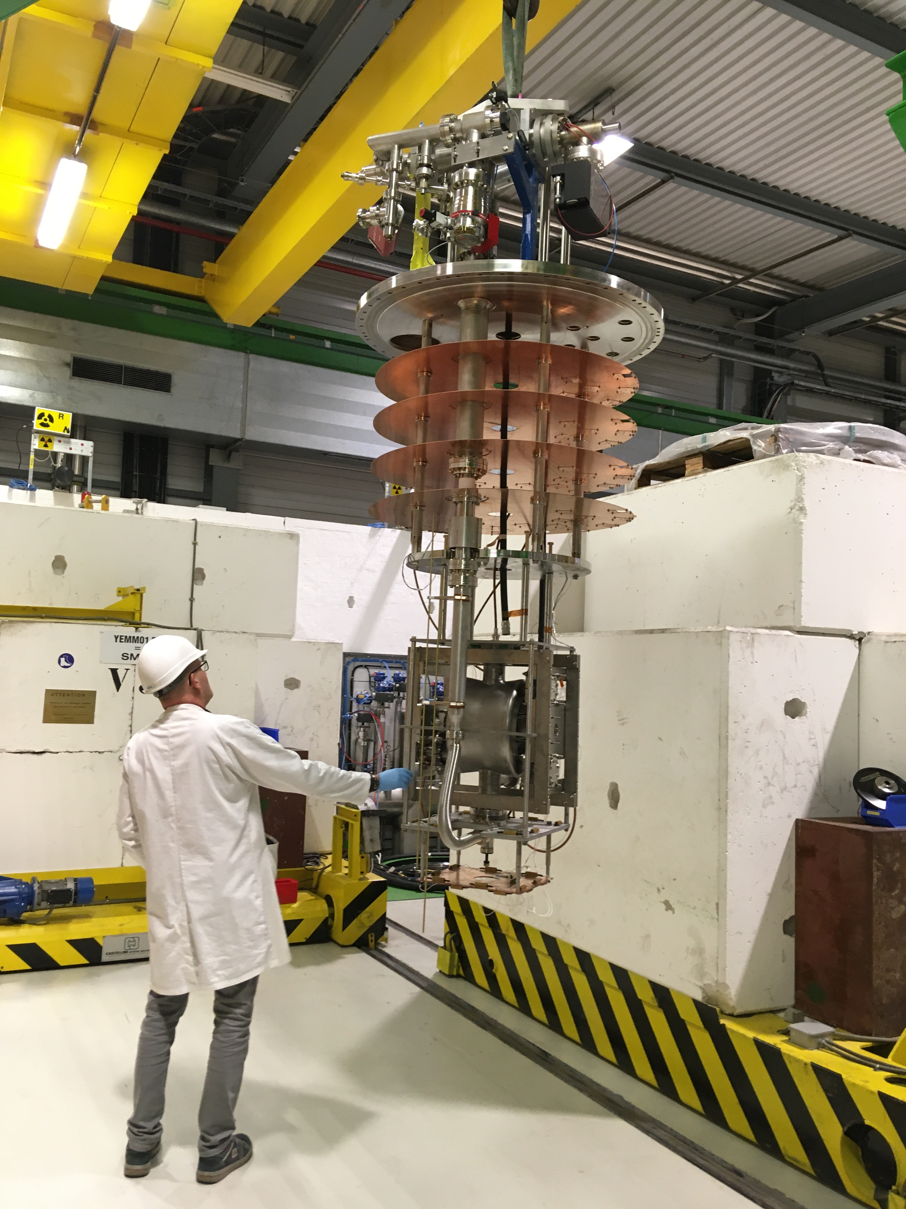
Cold test set-up
Test temperature: 2K
Sensors used during the tests:
  Temperature sensors: CERNOX.
  3 single-axis magnetic flux probes.
  Radiation monitors (different position depends on the cryostat).
Cryostats equipped with magnetic field compensation coils - set at ~0.5µT (BC).
Stiffening frame for bare cavities.
JC and DC tested fully immersed in the LHe bath.
Cavity vacuum actively pumped by turbo and ion pump, then only cryopumping.

Slide 5
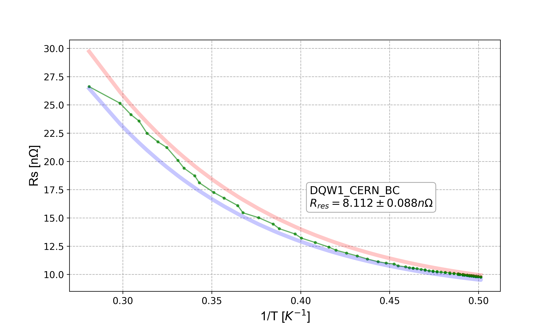
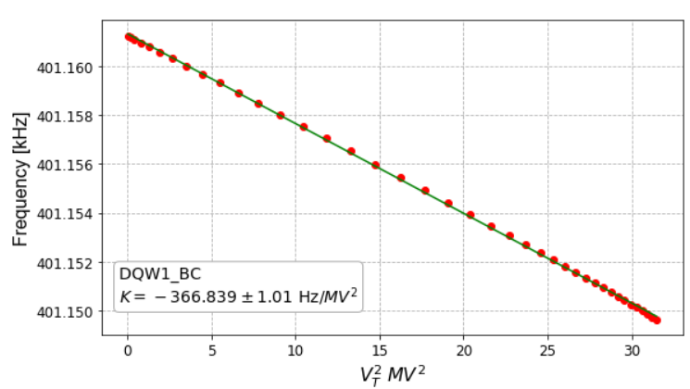
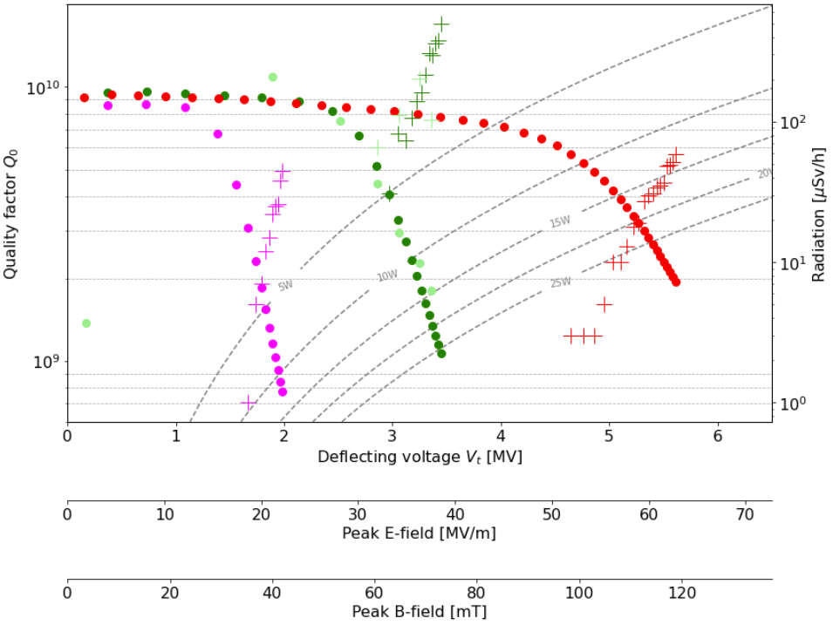
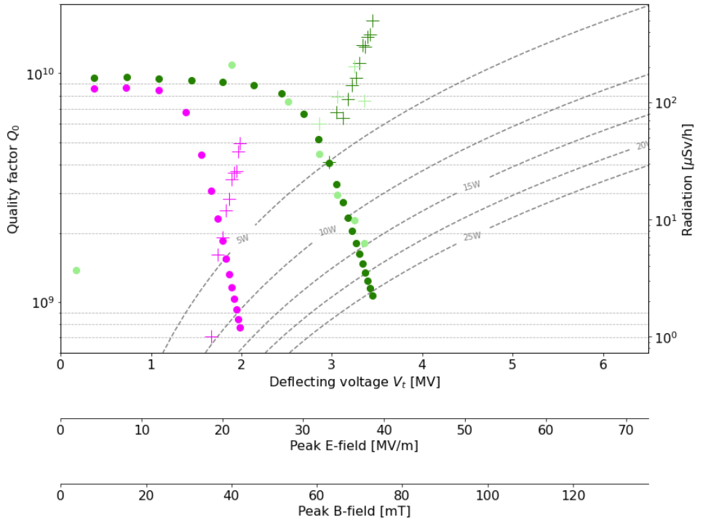
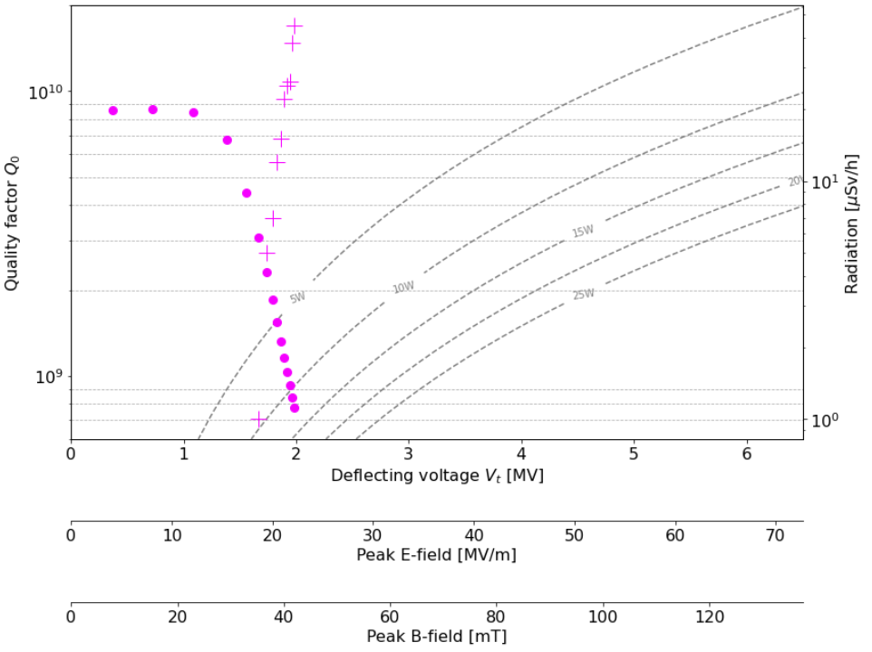
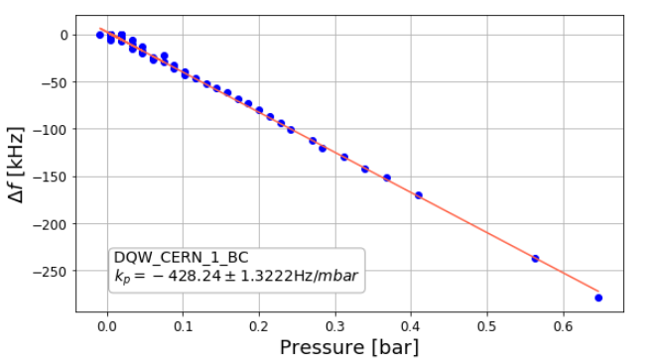
Bare Cavity Test Results – DQW1-CERN-BC
Tested three times:
  1st CT poor RF performance test stopped (*)
  2nd CT after light BCP (~30µm): poor RF performance test stopped.
    Before He processing
    After He processing
  3rd CT after additional light BCP (~30µm): met specification
    5.6MV (𝑄₀=2e9), Epeak~63MV/m and Bpeak~119mT
Residual resistance: ~8.1nΩ
Lorentz Force Detuning
(*) reported last year
Pressure sensitivity

Slide 6
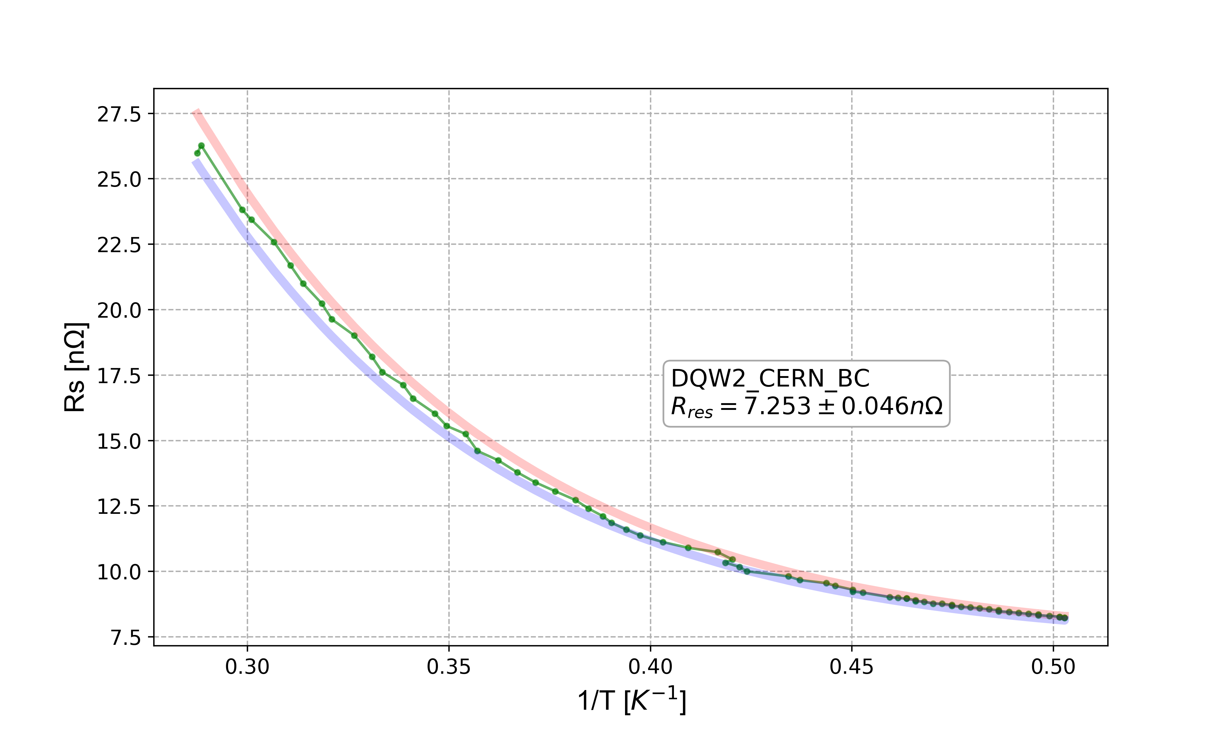
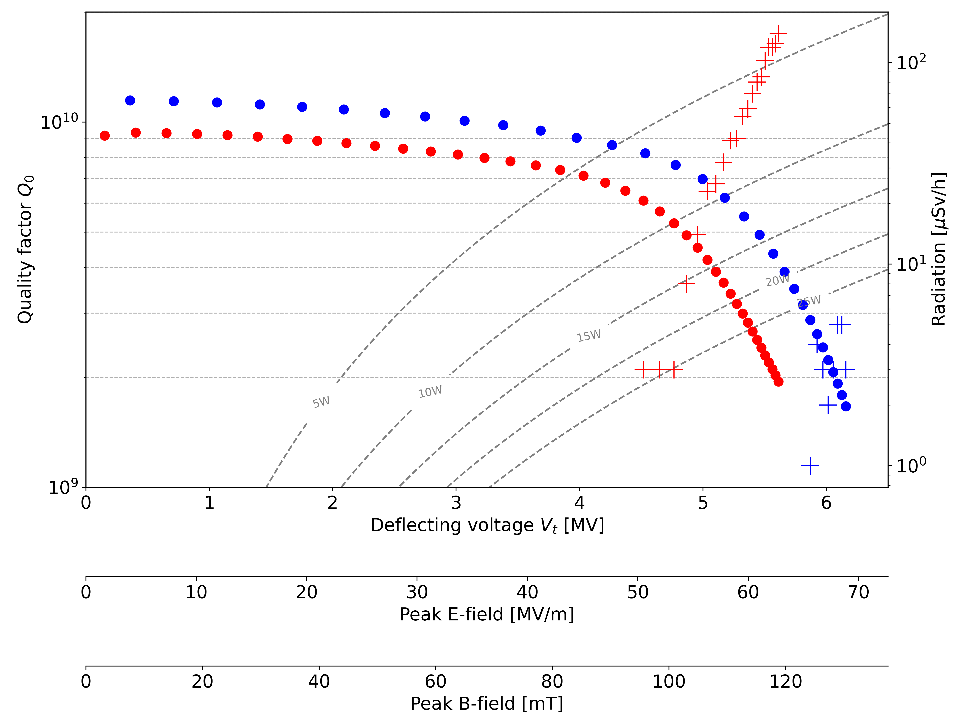
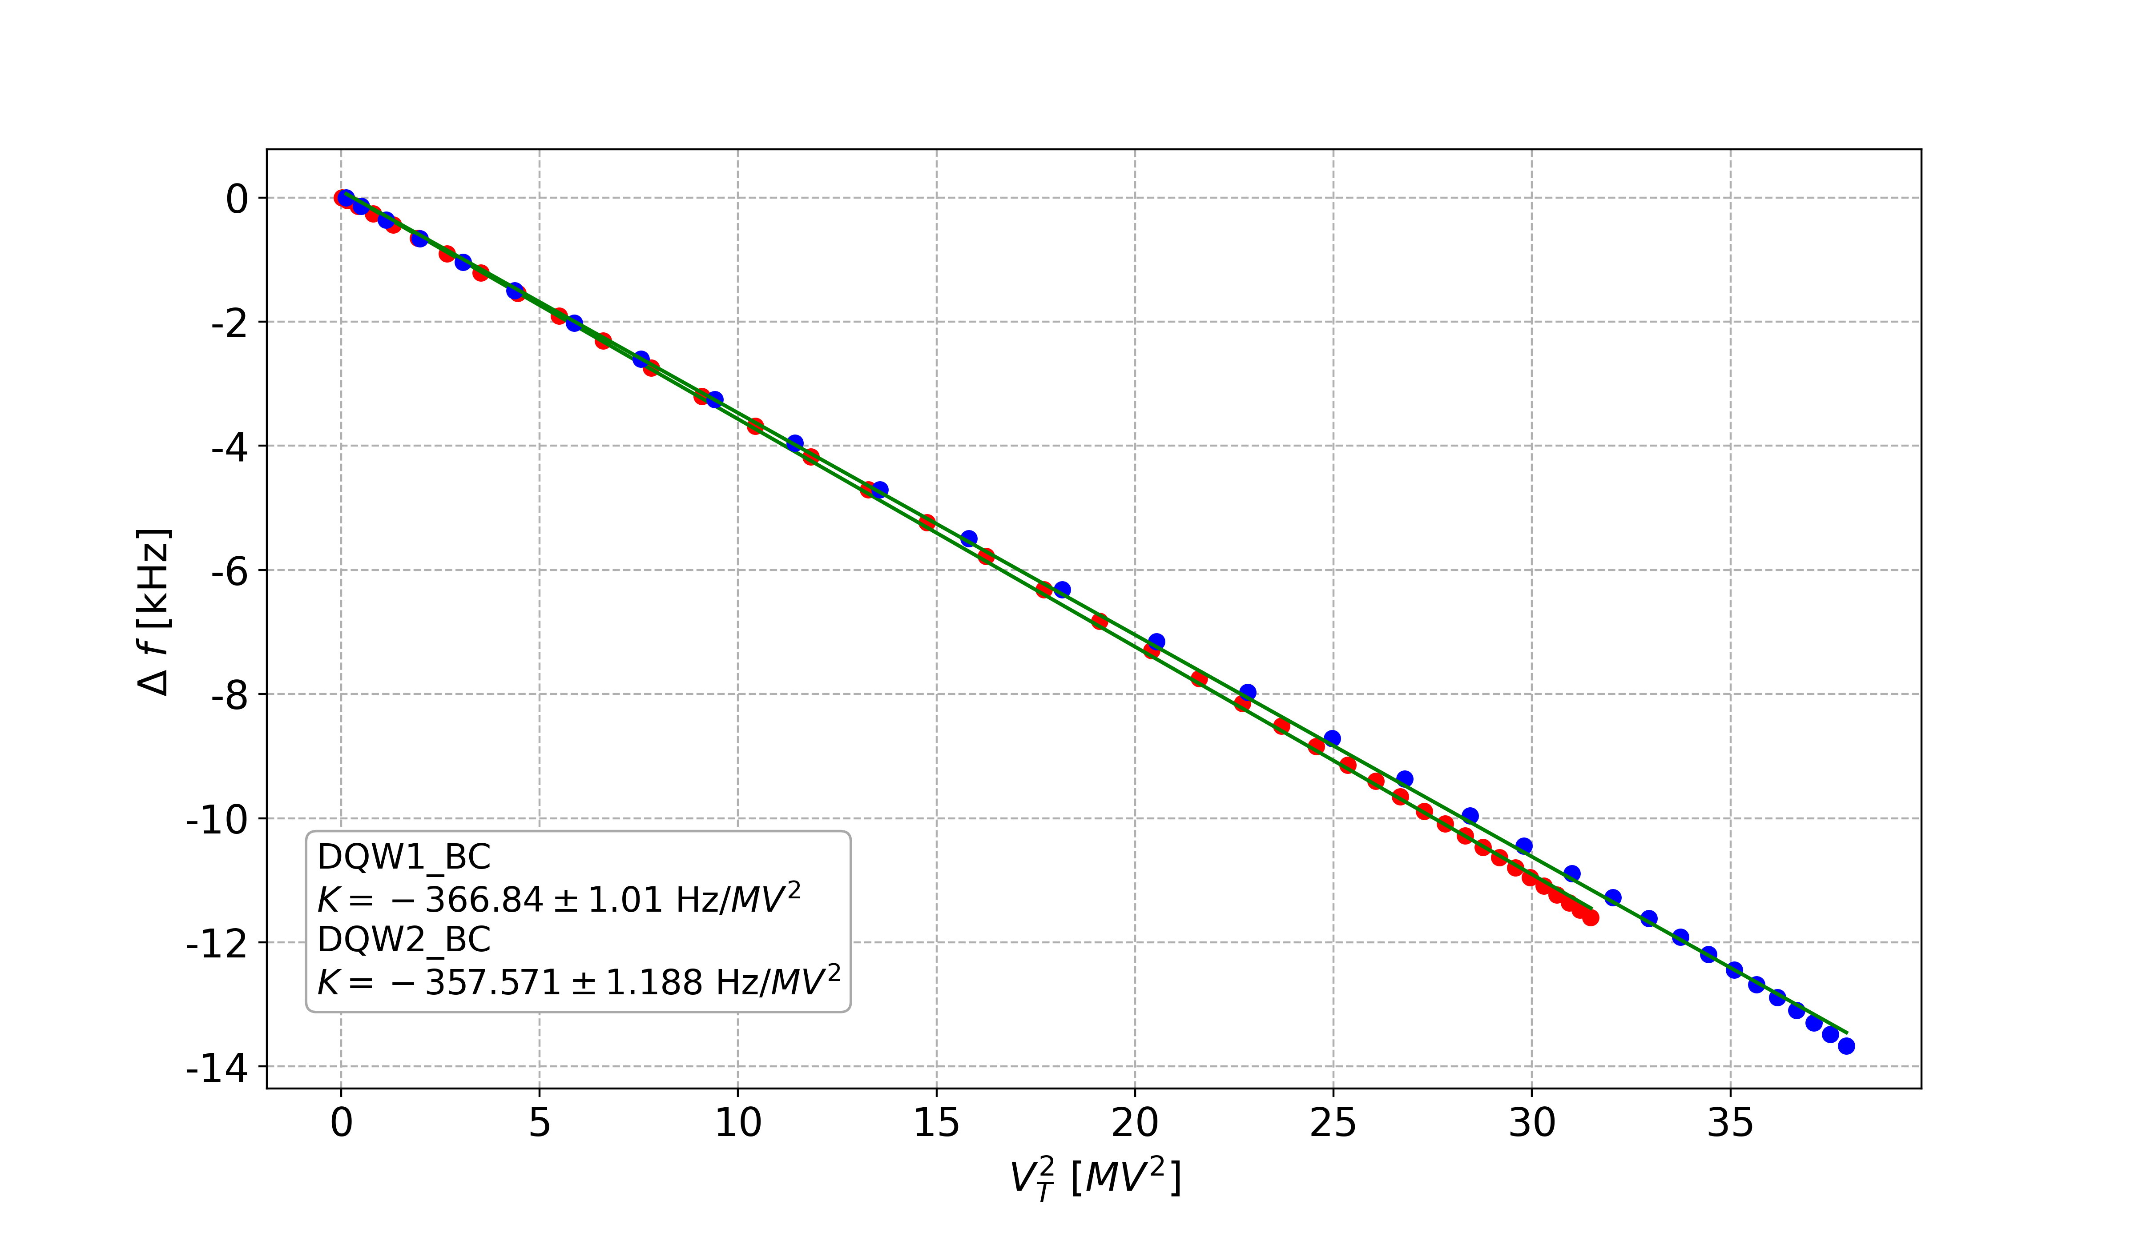
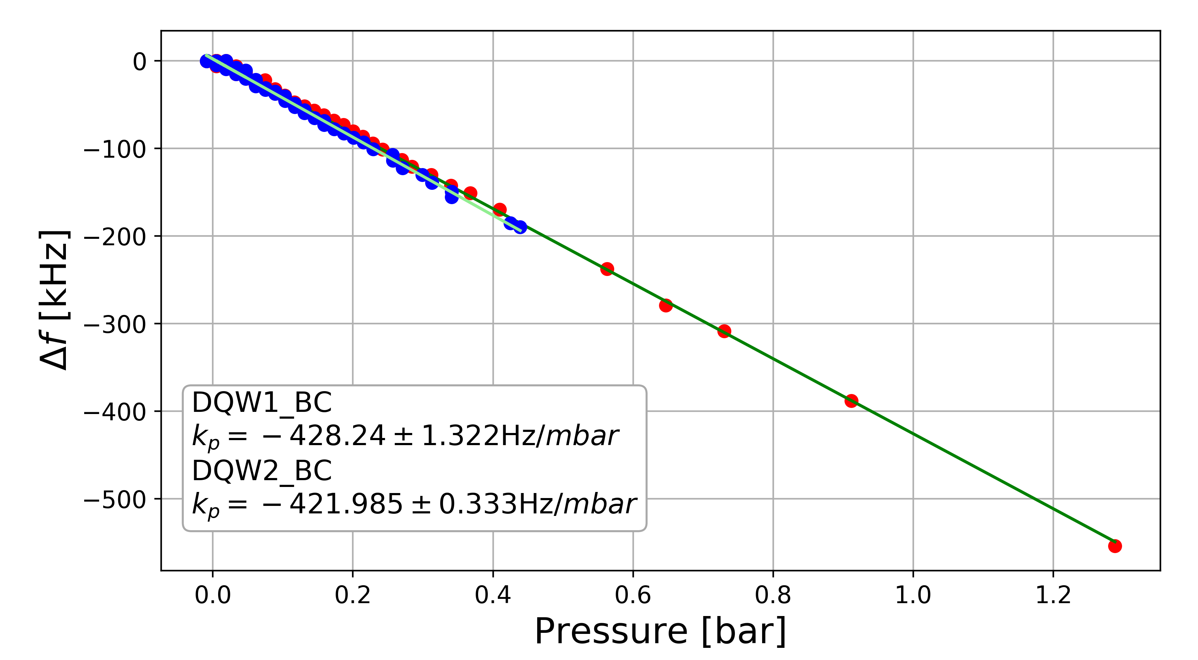
Bare Cavity Test Results – DQW1-C-BC & DQW2-C-BC
DQW1: 5.6MV (Q0=2e9), Epeak~63MV/m and Bpeak~119mT
  Tested 3 times: 2x light BCP at CERN (~30μm) to recover the RF performance
DQW2: 6.17MV (Q0=1.7e9), Epeak~69MV/m and Bpeak~130mT
Residual resistance: ~7.3nΩ
Lorentz Force Detuning
Pressure sensitivity

Slide 7
Jacketing
Cold Magnetic Shield + Helium tank assembly (bolted) and TIG welding

Slide 8
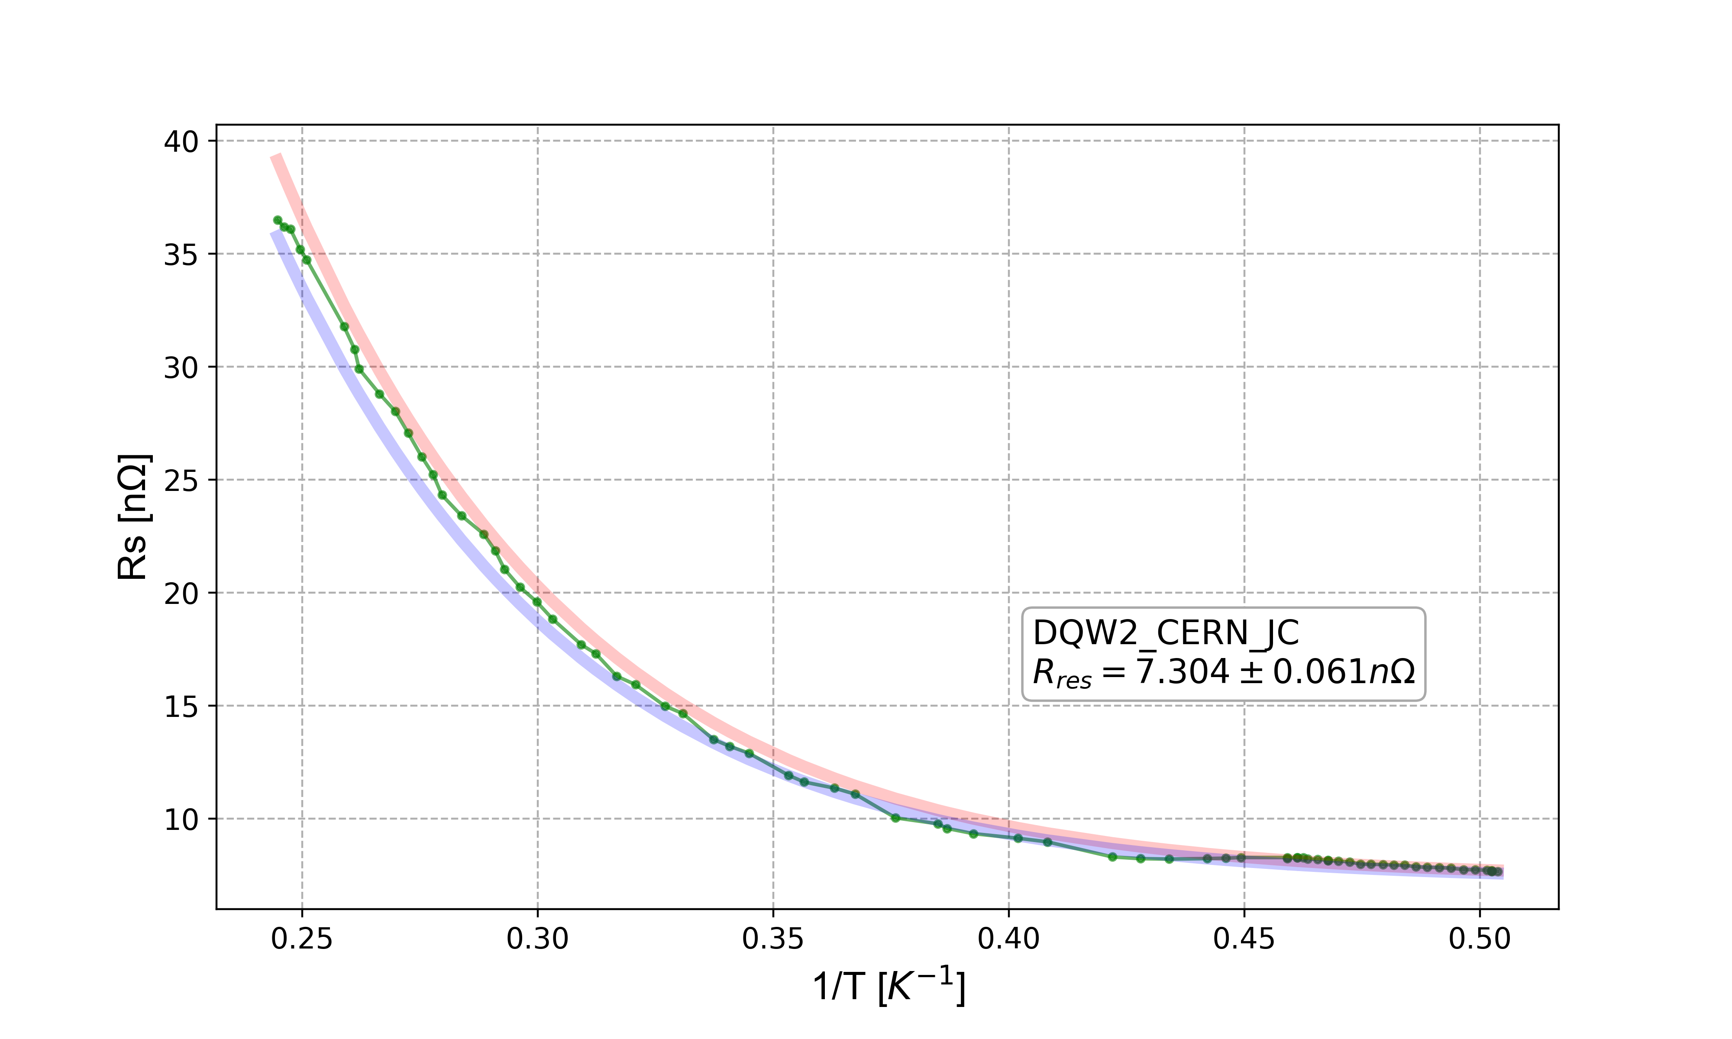
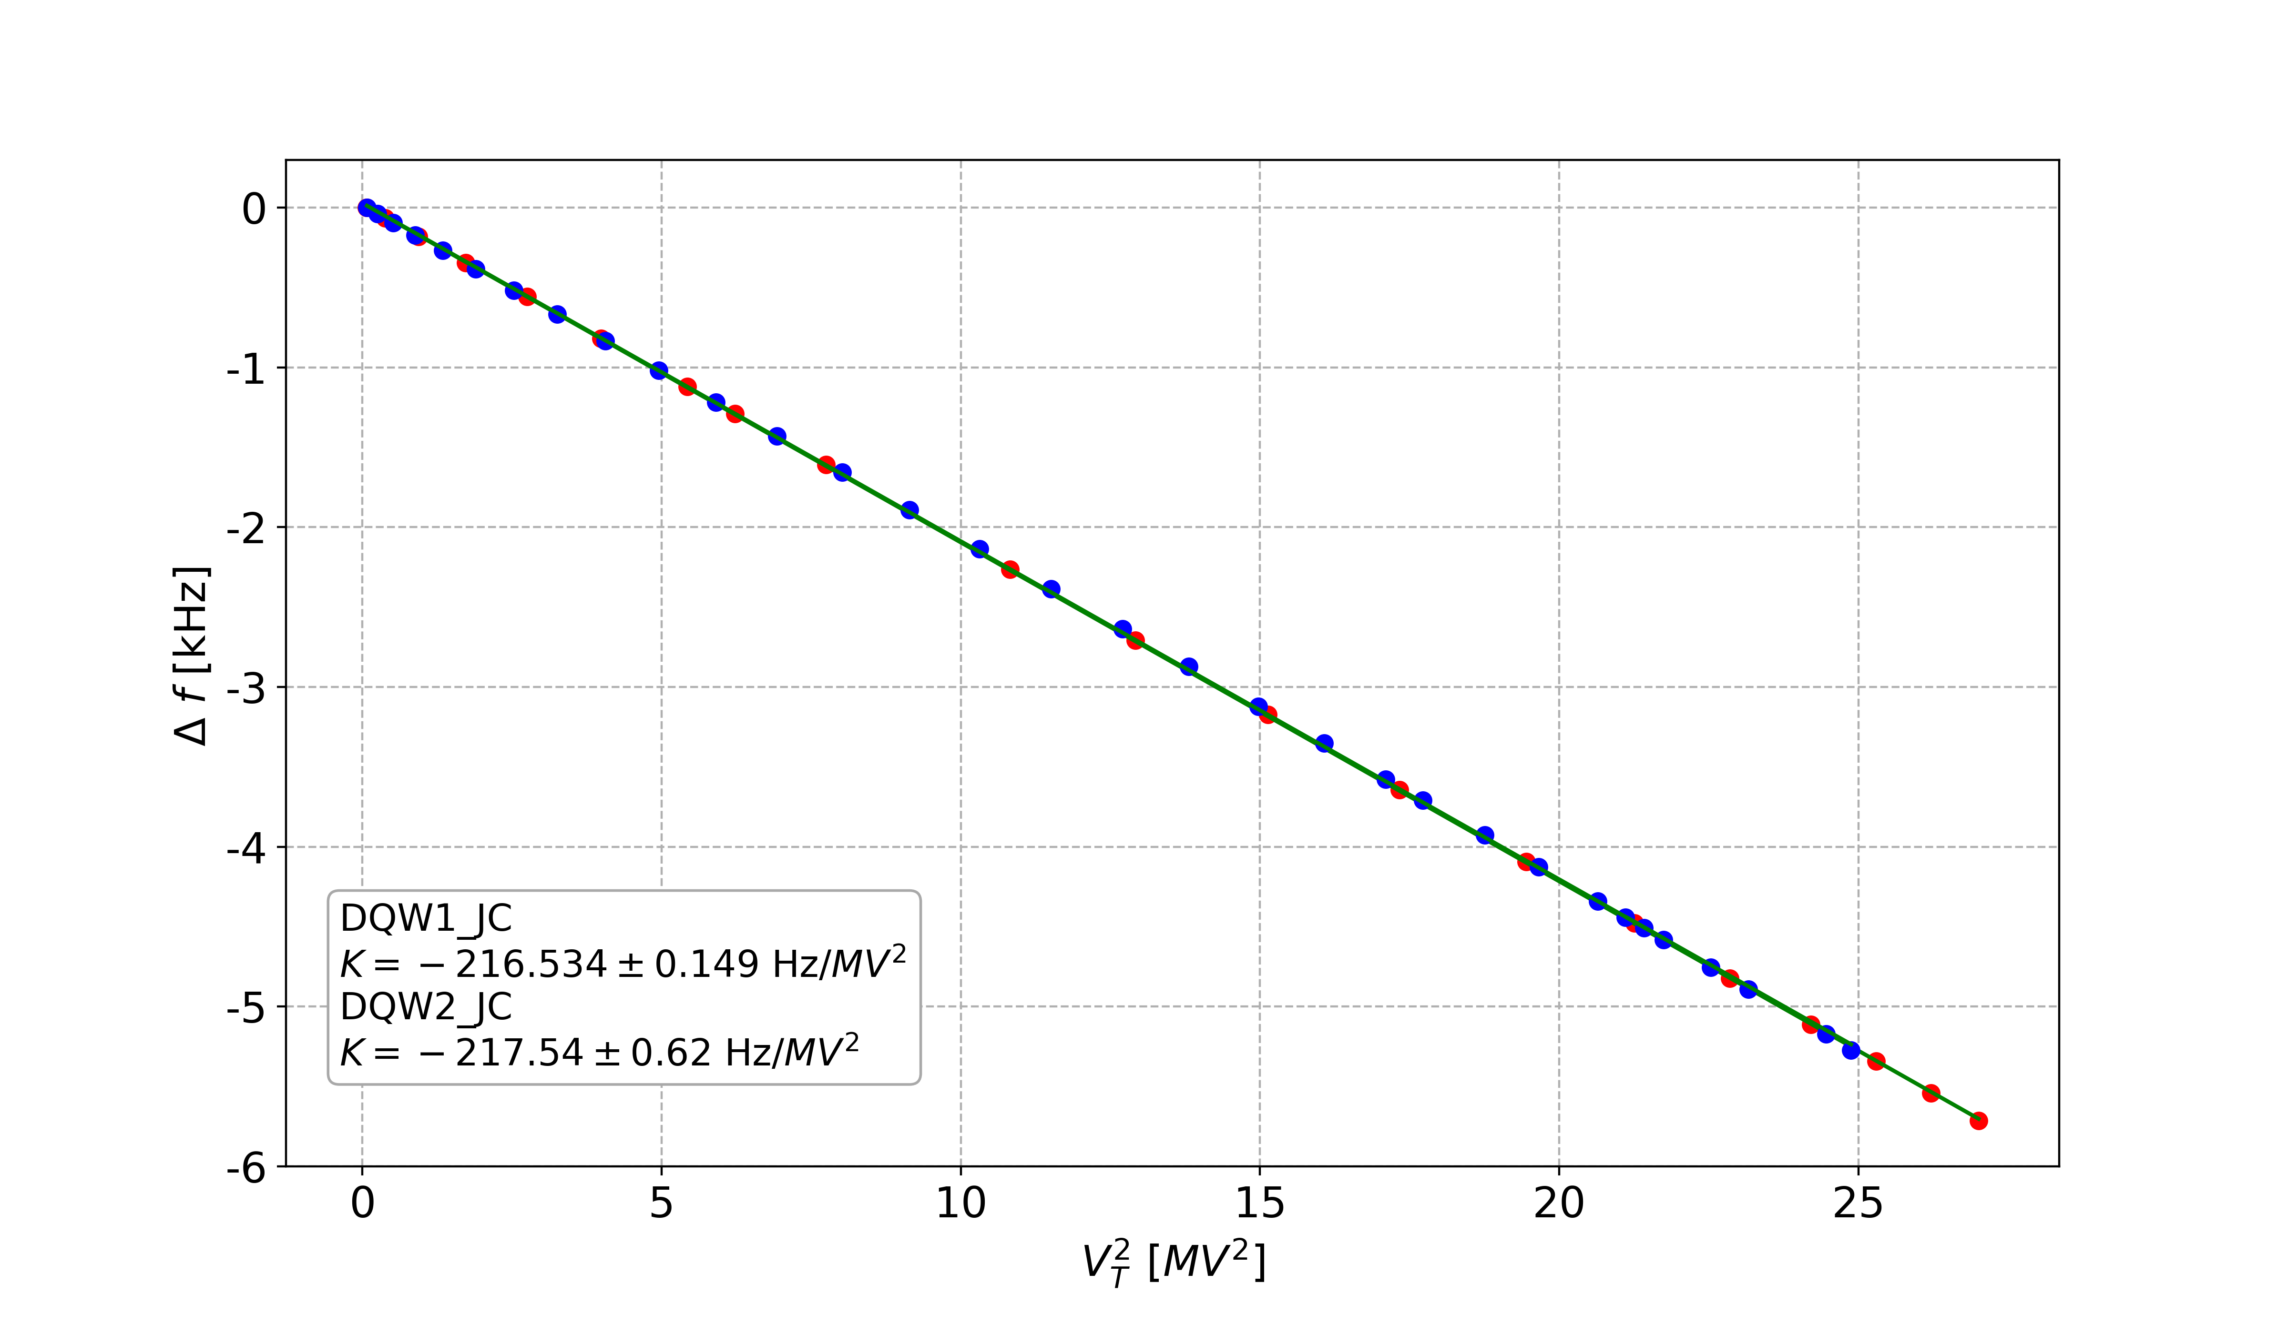
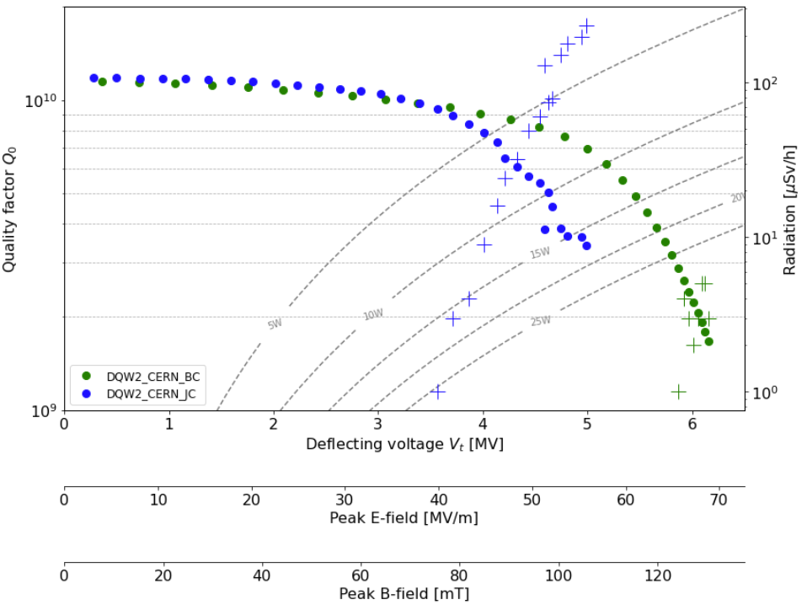
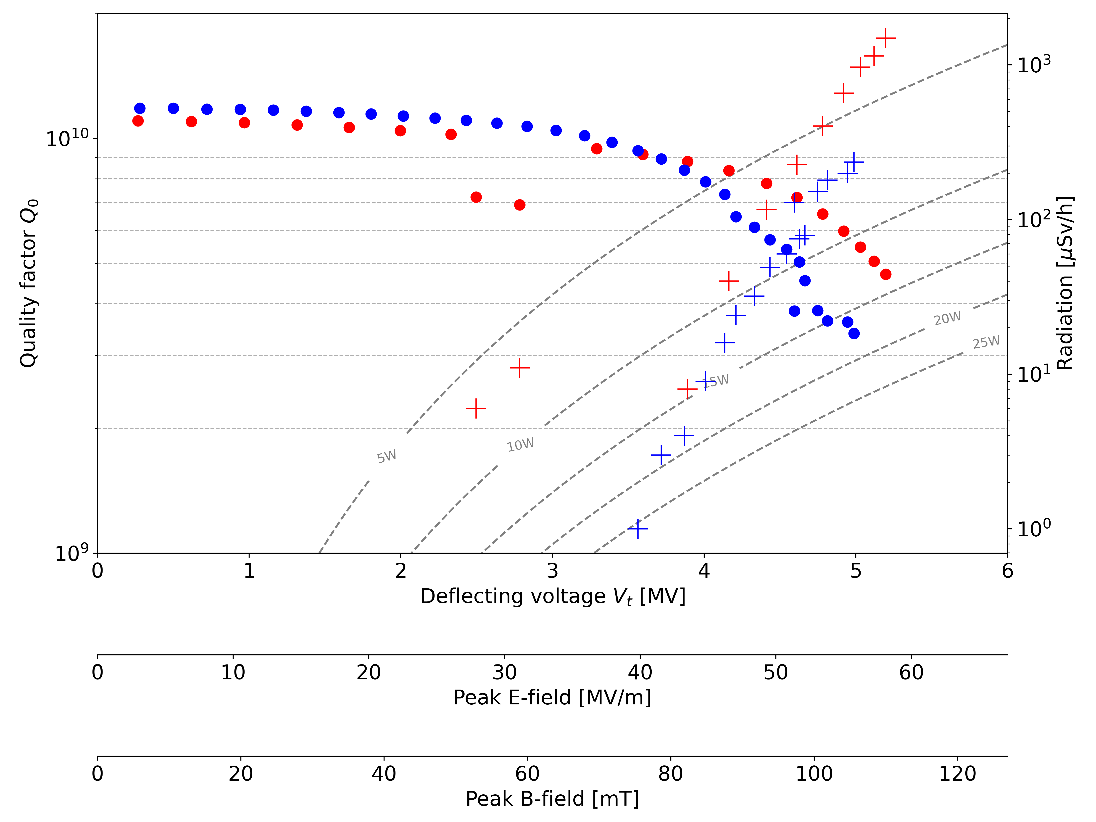
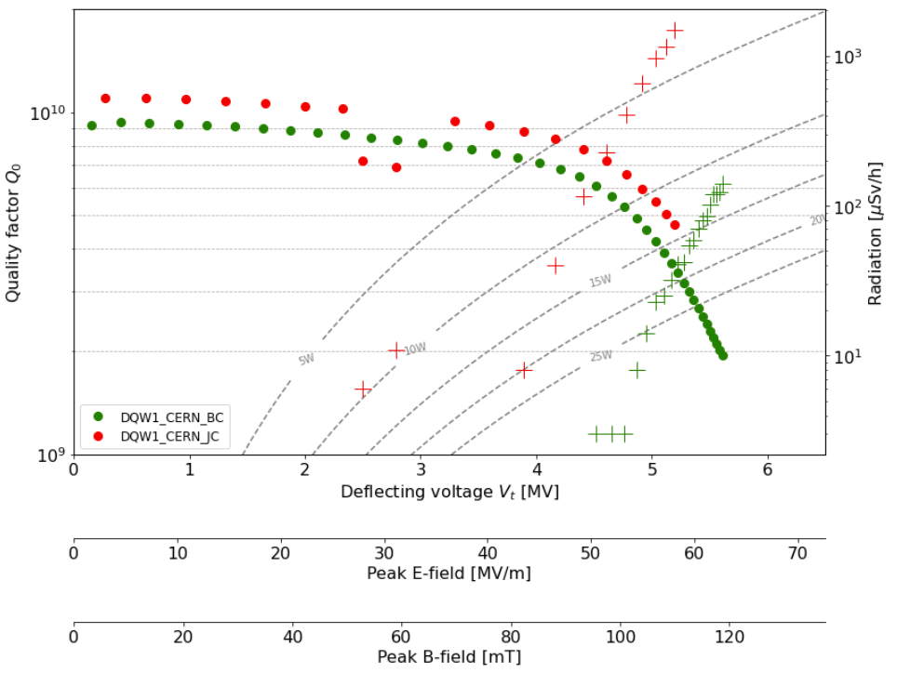
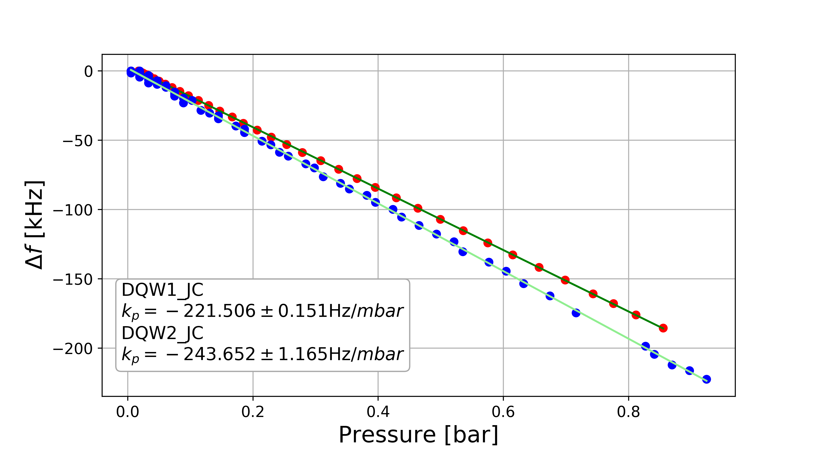
Jacketed Cavity Test Results – DQW1-CERN & DQW2-CERN
DQW1: 5.1MV (𝑄₀=5e9), Epeak~57MV/m and Bpeak~108mT
  Better 𝑄 but higher radiation compared to the bare cavity but tested in a different cryostat.
DQW2: 5 MV (𝑄₀=3.4e9), Epeak~56MV/m and Bpeak~106mT
  Higher radiation (degradation of 𝑄₀ at high field) compared to the bare cavity but tested in a different cryostat.
Tests stopped purposely at ~5MV.
The cavities were sent for dressing at CERN.
Residual resistance: ~7.3nΩ
Lorentz Force Detuning
Pressure sensitivity

Slide 9
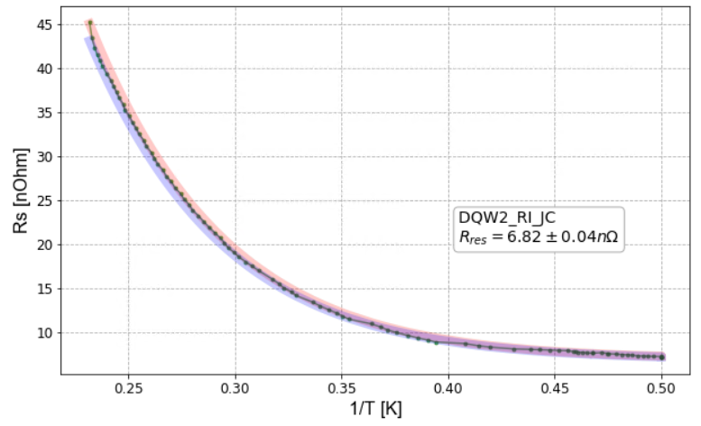
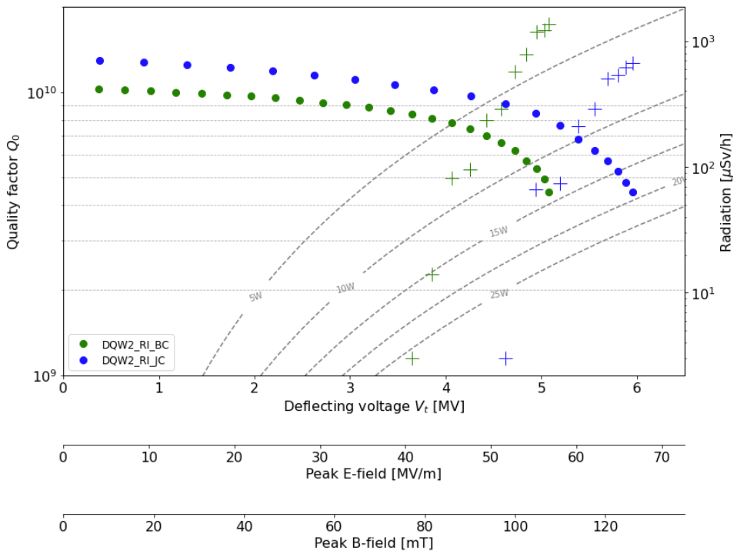
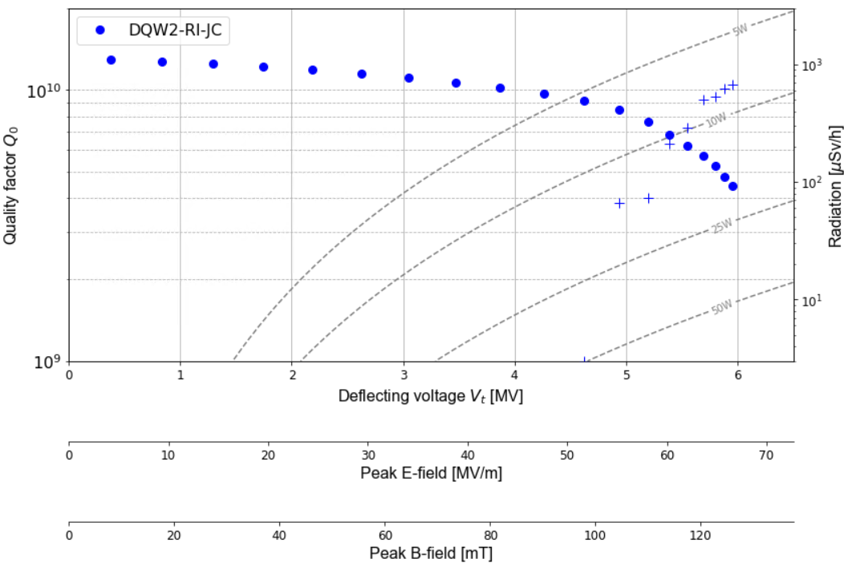
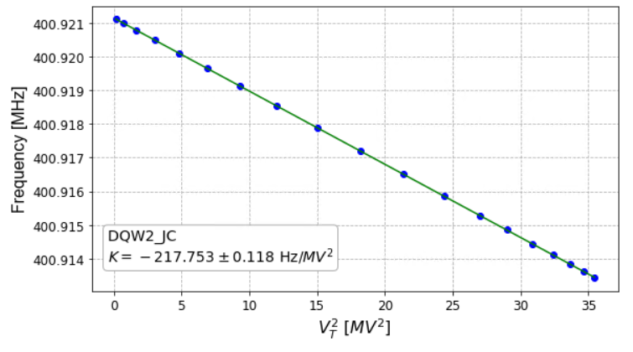
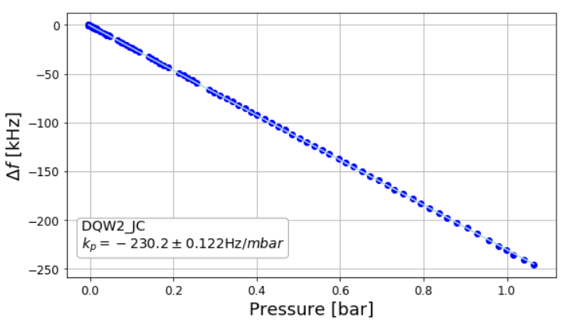
Jacketed Cavity Test Results – DQW2-RI
DQW2: 5.9 MV (𝑄₀=4.4e9), Epeak~67MV/m and Bpeak~126mT
Test stopped at 5.9MV due to the radiation.
Significant improvement (𝑄₀ and radiation) compared to bare cavity tests done in the same cryostat.
The cavity was sent for dressing at CERN.
Residual resistance: ~6.8nΩ!
Lorentz Force Detuning
Pressure sensitivity
Notes:
Tested in the

Slide 10

Dressing
JC equipped with RF couplers (3 HOMs, 1 HF HOM, 1 FA + VT input antenna)

Slide 11
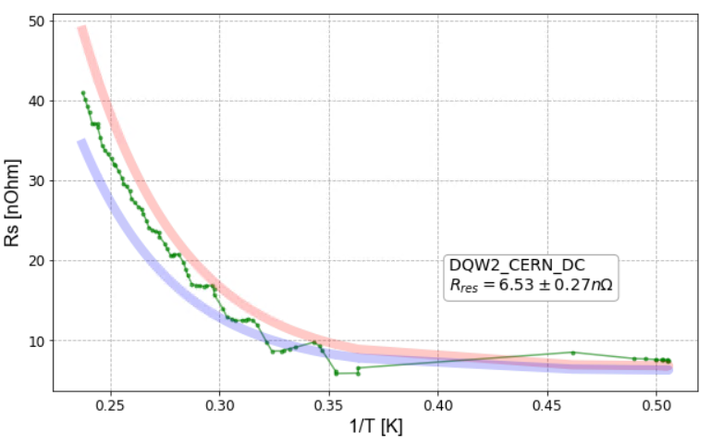
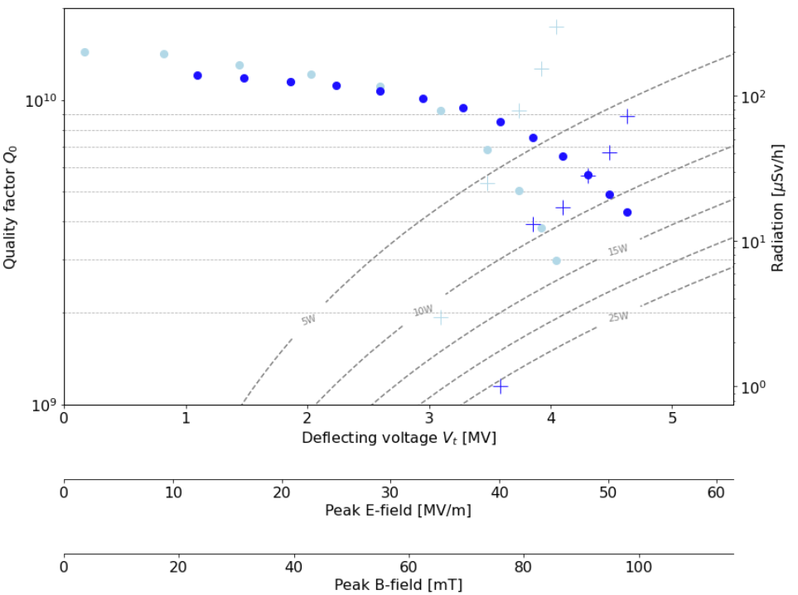
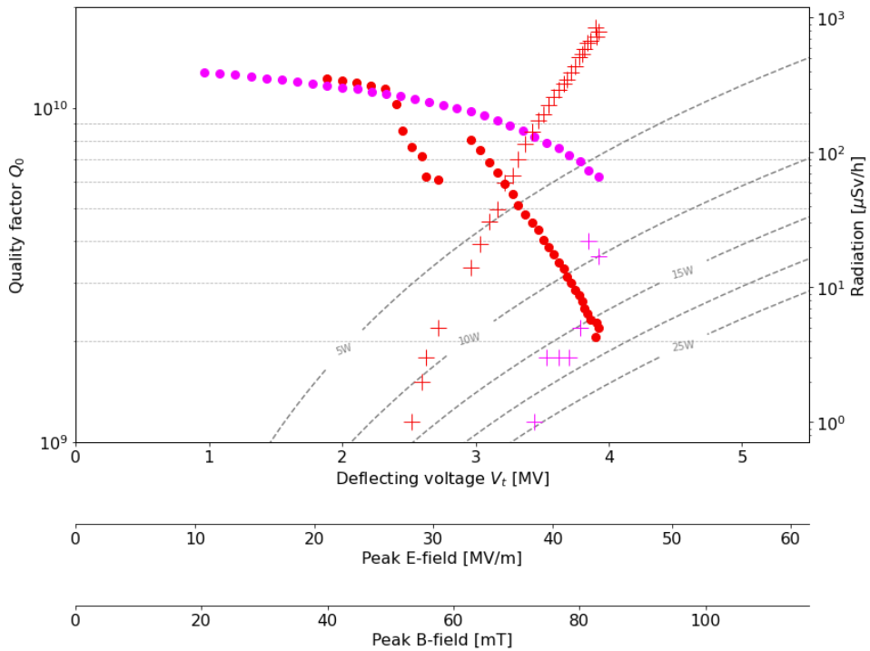
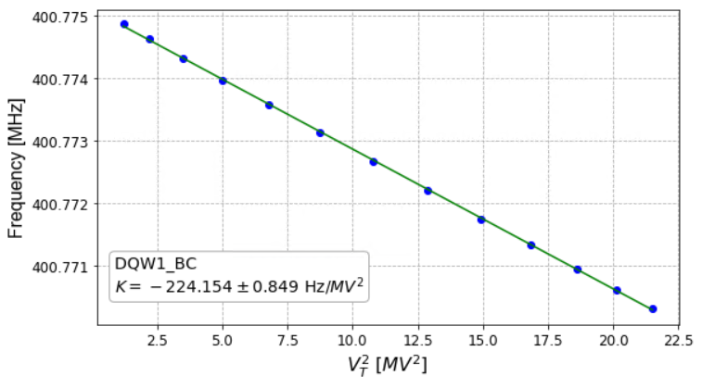
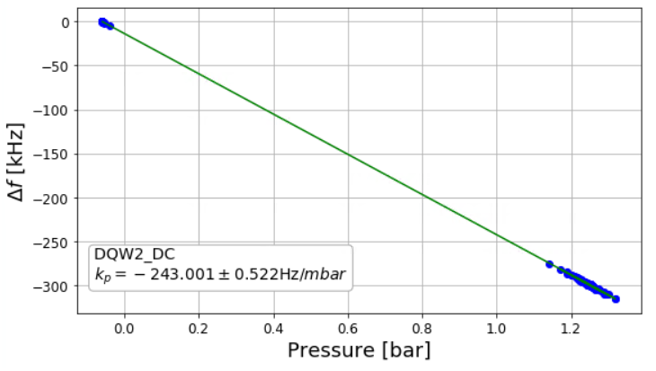
Dressed Cavity Test Results – DQW1-CERN & DQW2-CERN
DQW1: 3.9MV (𝑄₀=2e9) , Epeak~45MV/m and Bpeak~86mT
  Degradation observed after the high-power RF conditioning.
  2nd CT foreseen in October 2023
DQW2: 4.63MV (𝑄₀=3e9), Epeak~52MV/m and Bpeak~99mT
  1 CT stopped due to wrong antennas and 2 CT cavity reach 4MV (*)
  120̊C bakeout + 100µm oh HOMs introduced before 3rd CT
Residual resistance: ~6.5nΩ!
Lorentz Force Detuning
DQW CC frequency & HOM evolution during manufacture and cold testing – Amelia Edwards (Lancaster Uni)
(*) Eng spec: Vt ≥4.1MV,Q0 ≥3.9×10⁹
Pressure sensitivity
Notes:
beam port antenna (Qext 1.9e9): input
field antenna (Qt1.6e10): pickup
HOM1 (HOM coupler below FPC port) Qext 1.82e+13
HOM2 (HOM next to the field antenna) Qext 8.66e+13
HOM3 (HOM next to the HOM2) Qext=1.68e+11,
HF-HOM: Qext= 1e+11

Slide 12
Challenges and lessons learnt
The max fields reached are mostly dominated by the presence of field emission.
Thermal cycle, up to ≈20 K, consistently improved 𝑄₀ of both the jacketed and dressed cavities by ≈400%.
As a precaution, dressed cavities are tested at 2.5K and only final measurements are made at 2K.
120̊C bakeout was implemented for the dressed cavity configuration.
25Ω feed-throughs + adapters were used and posed no issue.
HOMs coupler treatment required several iterations.
DQW HOM couplers challenges & FPC – Simon Barrière (CERN)
Notes:
For CERN cavities, an increase in radiation was observed from the bare to jacketed configuration.
The DQW2 RI cavity showed the opposite behaviour: prepared at CERN.

Slide 13
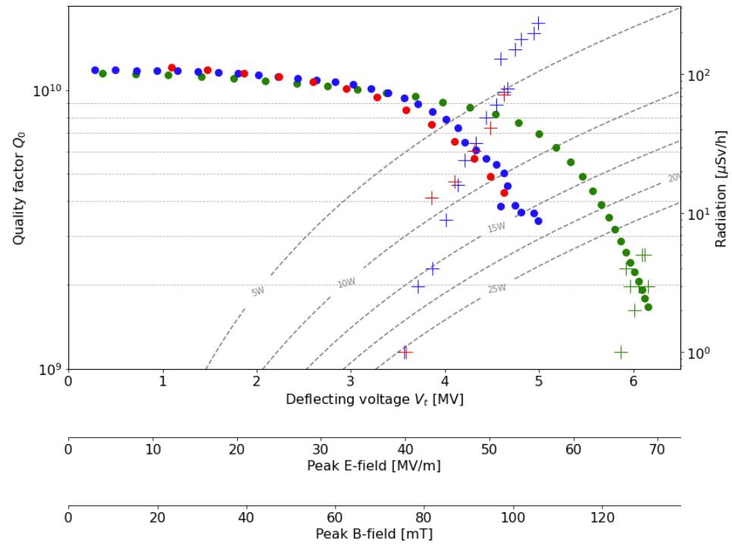

Conclusions
DQW2-CERN dressed cavity exceeded the specification target: 4.6MV.
  2 more cavities (DQW1-CERN, DQW2-RI) ready for the cold test in dressed configuration: Oct ’23.
1st jacketed cavity (DQW2) from RI met required specification: 5.9MV.
Several important lessons were learned during the testing of the DQW cavities.
DQW2: BC, JC, DC
1st cavity ready for a string assembly

Slide 14
Summary table
3rd CT after light BCP
 | Specification (*) | DQW1-RI-BC | DQW2-RI-BC | DQW2-RI-JC | DQW1-CERN-BC | DQW2-CERN-BC | DQW1-CERN-JC | DQW2-CERN-JC | DQW2-CERN-DC
Resonant frequency at 2K [MHz] | 400.79±0.15 | 401.22 | 401.17 | 400.92 | 401.16 | 401.35 | 400.7 | 400.8 | 400.776
Max V_{t} [MV] | ≥4.1 | 5.8 | 5.1 | 5.9 | 5.6 | 6.2 | 5.1 | 5 | 4.63
Q₀ at 4.1 MV | ≥3.9×10⁹ | 4.7e9 | 7.8e9 | 1e10 | 7e9 | 9e9 | 8e9 | 7e9 | 7e9
Lorentz Force Detuning Coefficient [Hz/MV^2] | <400 | 365 | 408 | 218 | 367 | 358 | 217 | 218 | 224
Sensitivity to LHe pressure fluctuation dF/dp [Hz/mbar] | ≤300 | 436 | 484 | 230 | 428 | 422 | 221 | 244 | 243
P_{diss} at 4.1 MV [W] | ≤10 | 8 | 4.9 | 3.9 | 5.5 | 4 | 4.8 | 5.4 | 6
(*) EDMS1389669

Slide 15
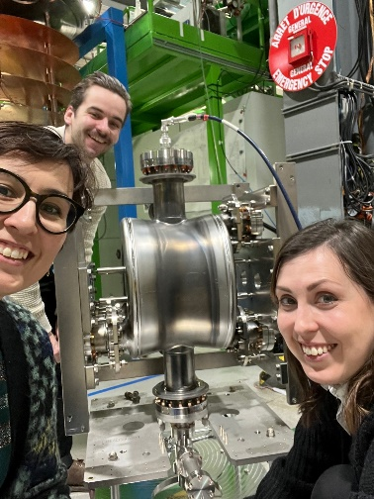
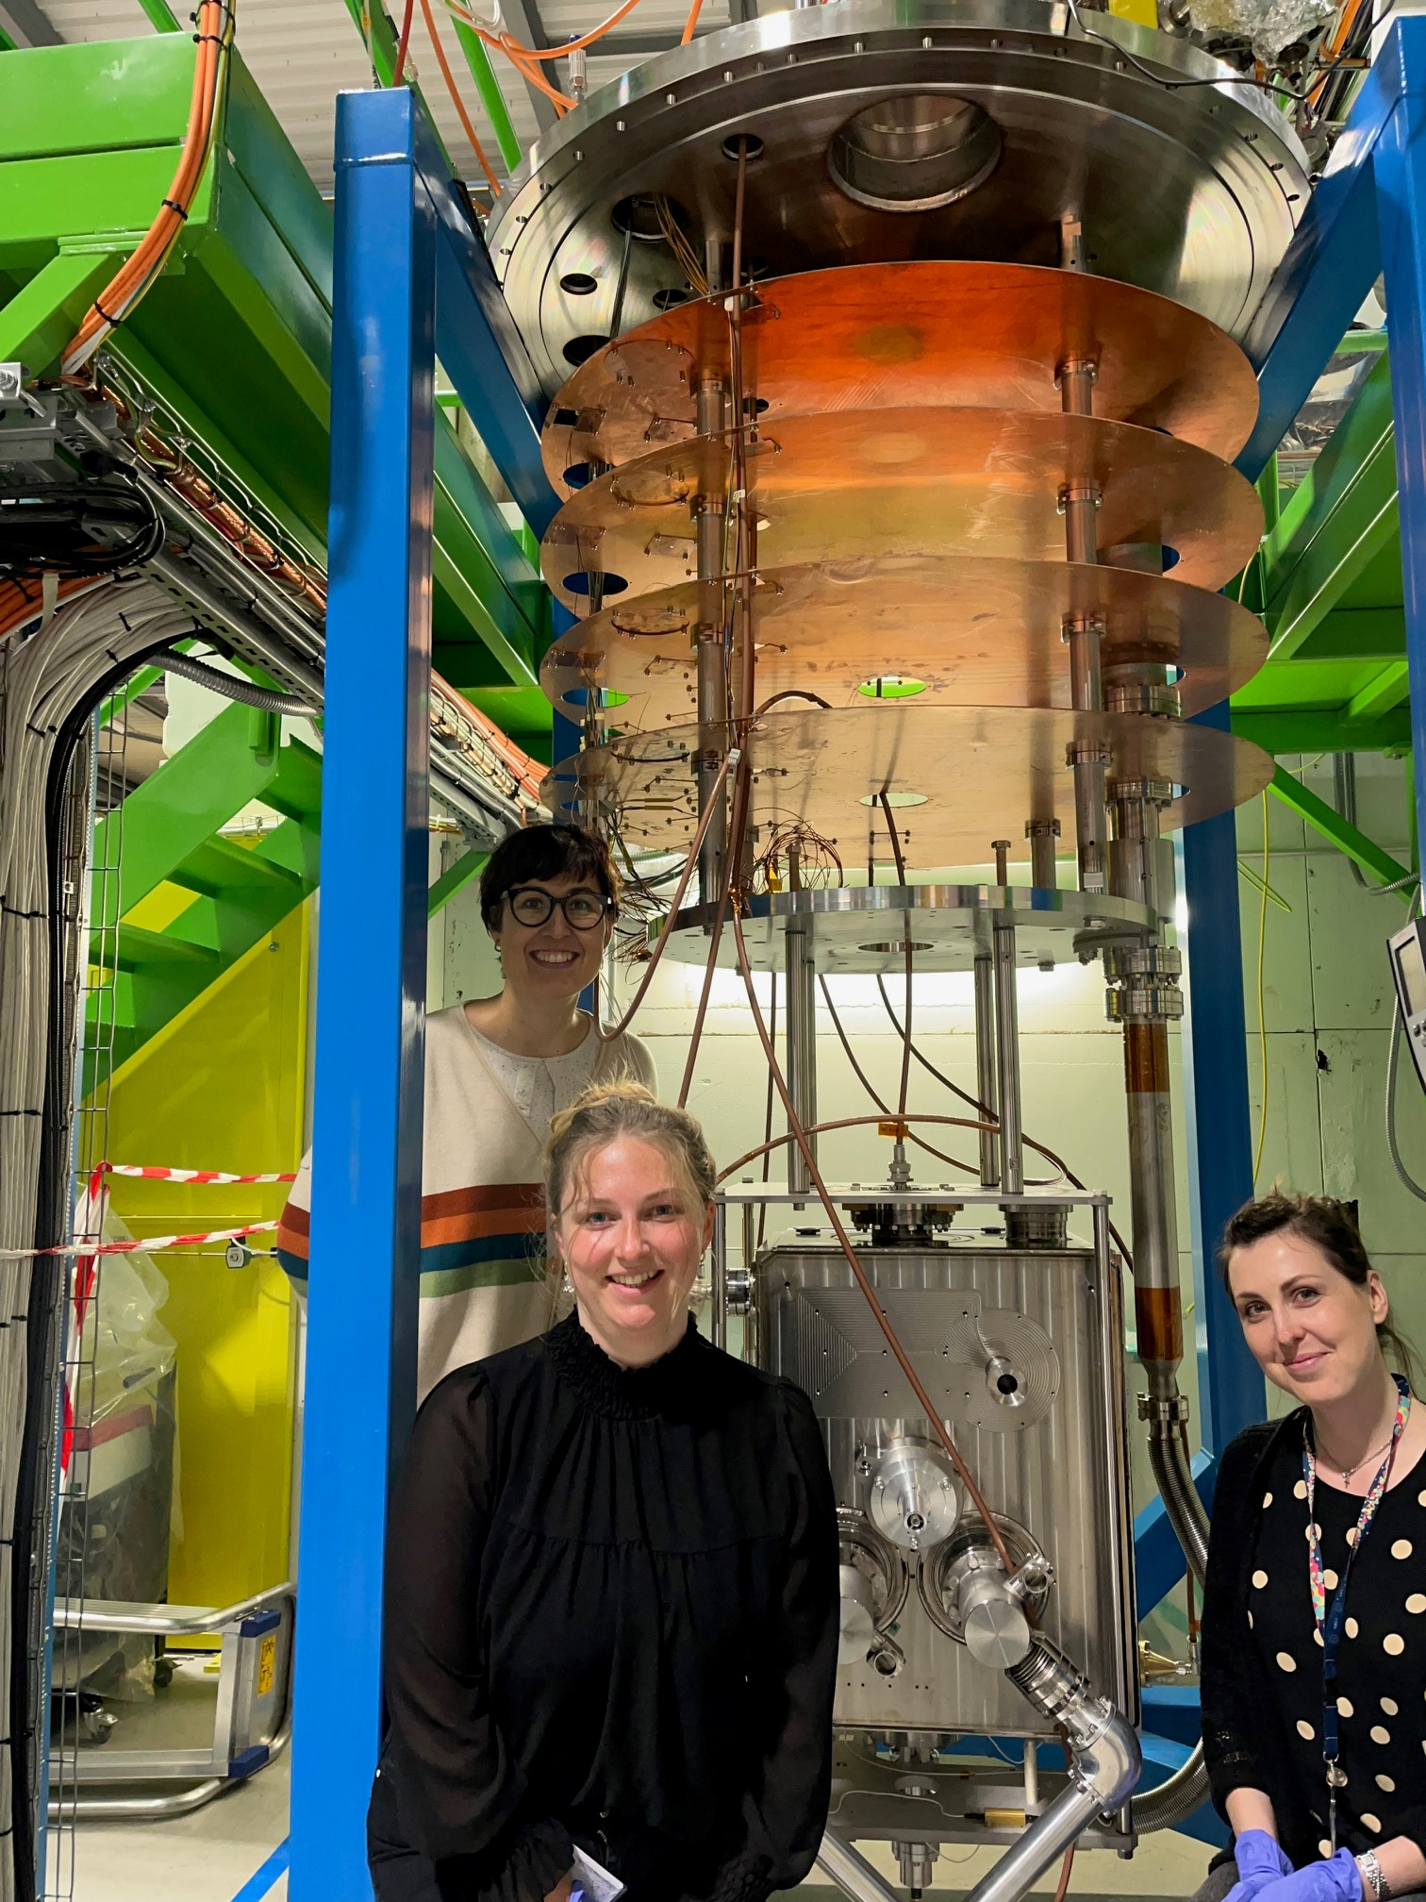
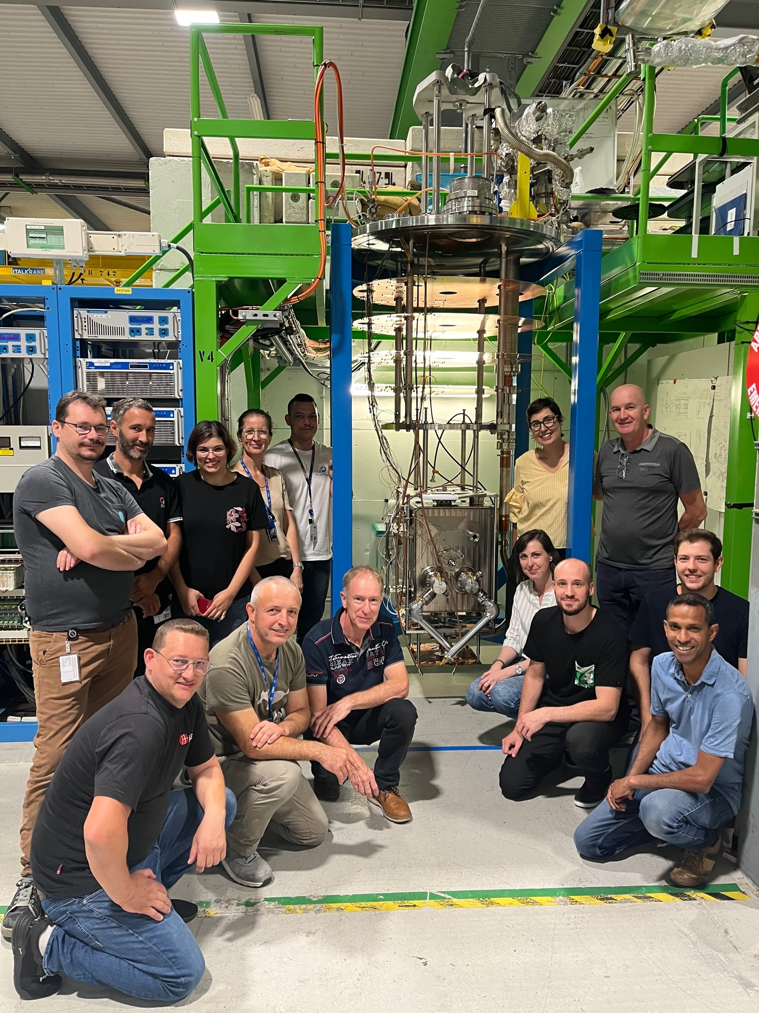
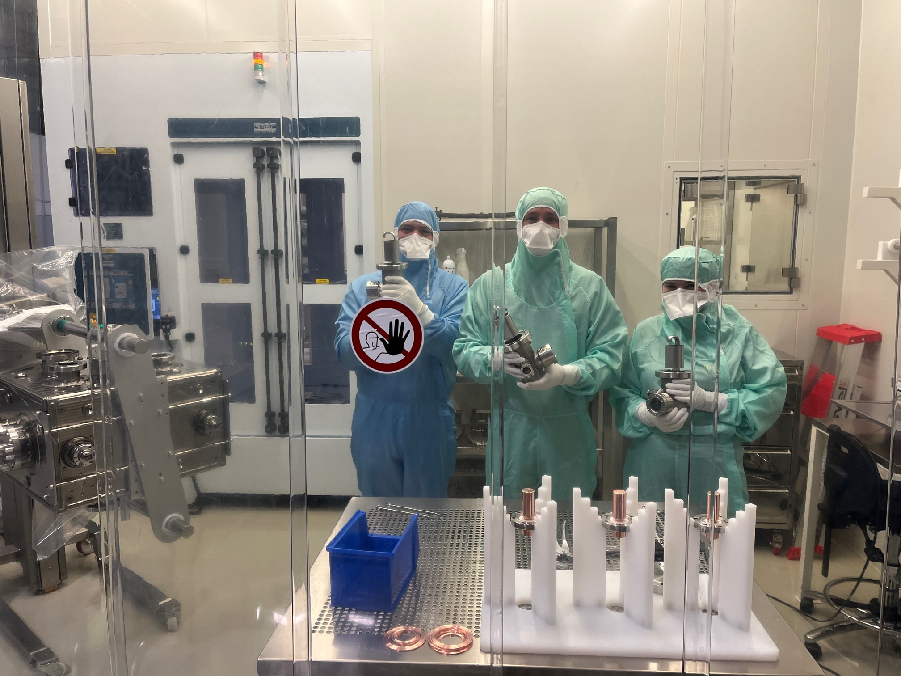
Thank you very much!

